Slide 1

High beta, MHD, and non-resonant magnetic braking by NTV in KSTAR
S.A. Sabbagh¹, Y.-S. Park¹, Y.M. Jeon², S.H. Hahn², J. W. Berkery¹, J.M. Bialek¹, Y.S. Bae², J.G. Bak², R. Budny³, J. Chung², S.C. Jardin³, J.H. Kim², J.Y. Kim², J. Ko², W. Ko², E. Kolemen³, S.G. Lee², D. Mueller³, Y.K. Oh², H.K. Park⁴, J.K. Park³, J.C. Seol⁵, K.C. Shaing⁵, H.L. Yang², S.W. Yoon², K.-I. You², G. Yun⁴, and the KSTAR Team
¹Department of Applied Physics, Columbia University, New York, NY, USA
²National Fusion Research Institute, Daejeon, Korea
³Princeton Plasma Physics Laboratory, Princeton, NJ, USA
⁴POSTECH, Pohang, Korea
⁵National Cheng Kung University, Tainan, Taiwan
PPPL-NFRI NSTX-U-KSTAR Collaboration Meeting
October 21st, 2013
Princeton, NJ
Work supported by the U.S. Department of Energy
under grant DE-FG02-99ER54524.
In collaboration with
National Fusion
Research Institute
V1.2

Slide 2
US-Korea collaboration on KSTAR:
High beta and 3D plasma stability research
Addresses key KSTAR Milestones (including)
  High-performance, long-pulse, steady-state device operation
  Instability/disruption avoidance and associated physics research
  Application of results to ITER
Supportive Partnerships
  NFRI, PPPL, Columbia U., POSTECH, et al.
Successful Collaboration Approach
  Synergistic tokamak physics research utilizing the KSTAR (Korea) and NSTX-U (USA) devices – consistent with 5 year plans
  Columbia U. group publications
    3 IAEA FEC presentations and papers
    3 refereed-journal articles, +1 paper just submitted, +1 in process

Slide 3
First plasmas exceeding the ideal no-wall MHD stability limit mark initial KSTAR advanced tokamak operation
Motivation
  Understanding and maintenance of MHD stability at high β_{N}, over long pulse duration are key KSTAR, ITER goals
  Altering plasma rotation to study MHD stability, and to operate in most ITER relevant low rotation regime are key
Outline
  High β_{N} results exceeding the n = 1 ideal no-wall limit
  Open loop control of plasma rotation using 3D fields
  ELM mitigation using n = 2 field via midplane IVCC
  Plasma control improvements
  Global mode stabilization performance calculations

Slide 4
Plasmas have reached and exceeded the predicted “closest approach” to the n = 1 ideal no-wall stability limit
I_{p} scan performed to determine “optimal” β_{N} vs. I_{p}
  B_{T} in range 1.3 - 1.5T
  β_{N} up to 3.0
β_{N}/l_{i} = 3.8 (75% increase from 2011)
  a high value for advanced tokamaks, e.g. for DIII-D
Mode stability
  Target plasma is at published computed ideal n = 1 no-wall stability limit (DCON)
  Plasma is subject to RWM instability, depending on plasma rotation profile
  Rotating n = 1, 2 mode activity observed in core during H-mode
KSTAR design operating space
n = 1 with-wall limit
(DCON)
β_{N}
n = 1 no-wall limit (DCON)
(experiment MP2012-04-23-021)
2012
2011
Up to 2010
Plasma internal inductance (l_{i})
TRANSP for these plasmas (R. Budny (PPPL))

Slide 5
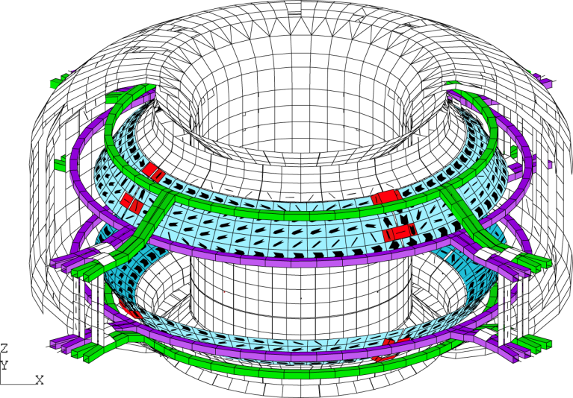
Pre-programmed n = 2 field used to alter V_{φ}(R) non-resonantly in using in-vessel control coil (IVCC)
Test plasma characteristics vs. toroidal rotation by slowing plasma with non resonant n = 2 NTV using IVCC
3
Ip (MA)
2
NBI
1
4
t(s)
NBI dropouts for CES (~ 1 Hz)
Simplified expression of NTV force (“1/ν regime”)
K.C. Shaing, et al.,
PPCF 51 (2009) 035004
T_{i}^{5/2}
Steady-state velocity
Inverse aspect ratio
Pre-requisite for study of NTV physics in KSTAR – comparison to NSTX (low A)

Slide 6
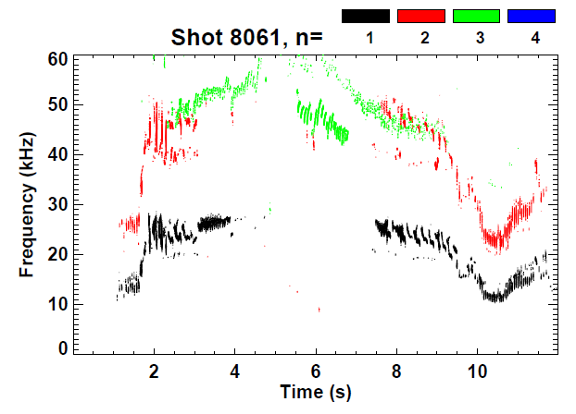
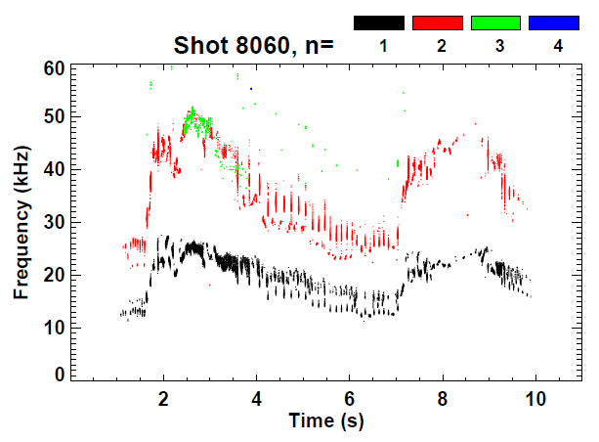
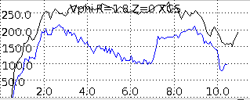
Effect of step increases in n = 2 IVCC current observed in mode frequency, XCS rotation data
No IVCC n > 0 field
With IVCC n = 2 field
Spin down
Spin up
n = 2 field on
n = 2 field off
XCS (Z=0)
Low frequency MHD mode rotation frequency decreased by 40 - 50% without mode locking
Measureable energy confinement time change with n = 2 field applied
no n = 2
Vφ
with n = 2
t (s)

Slide 7
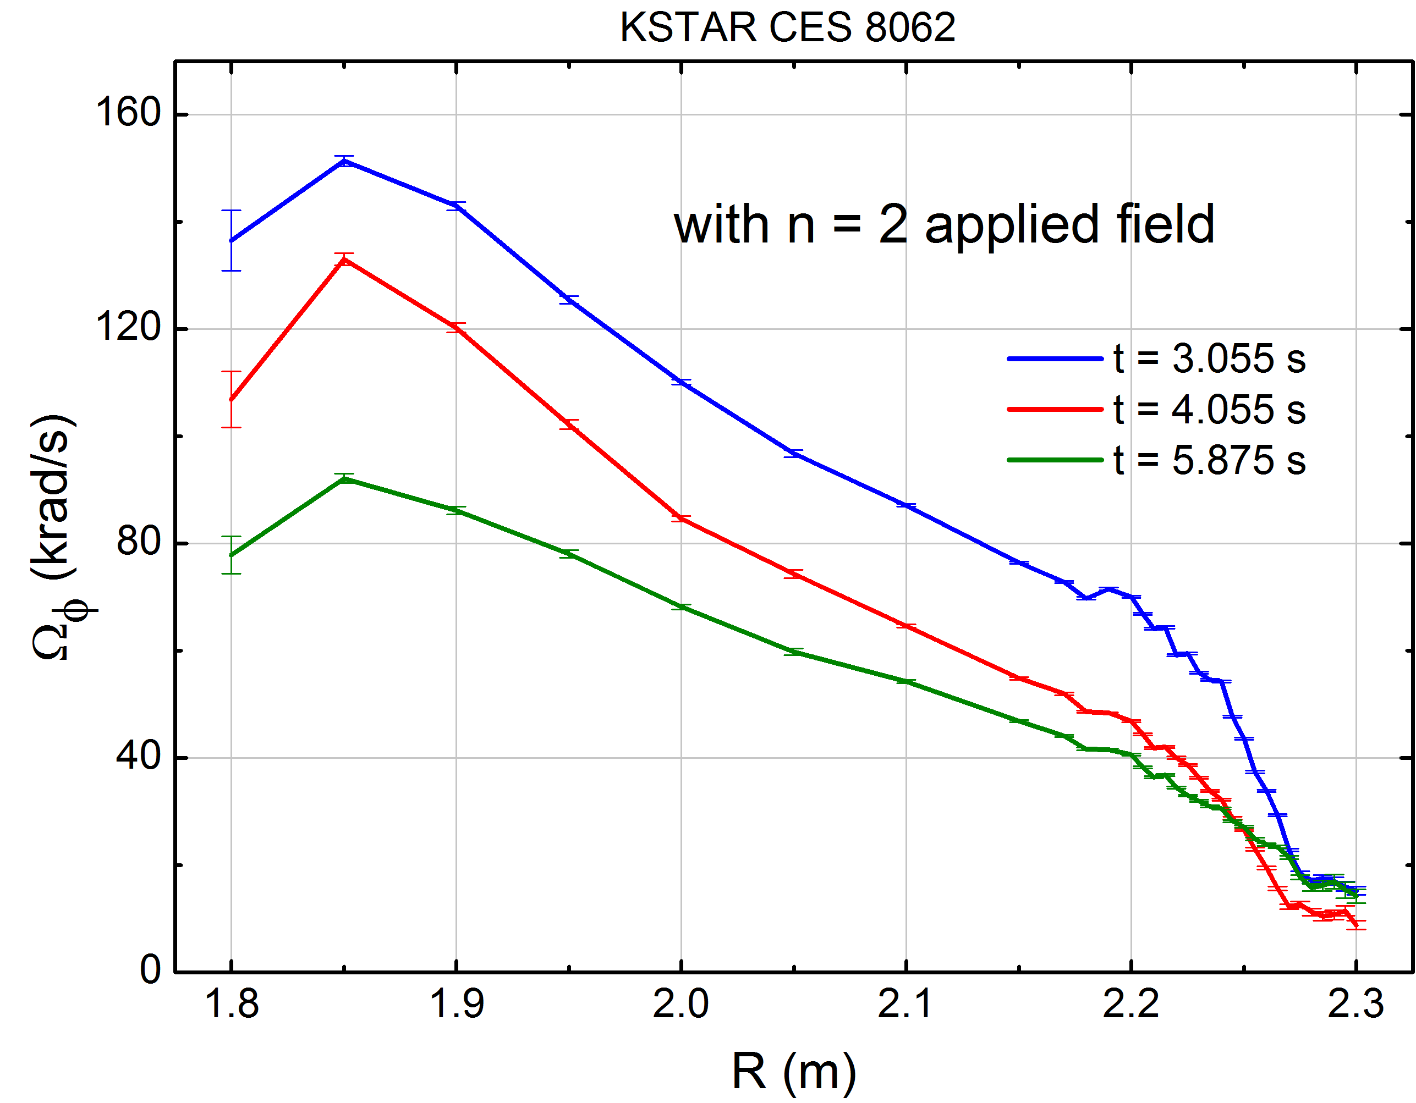
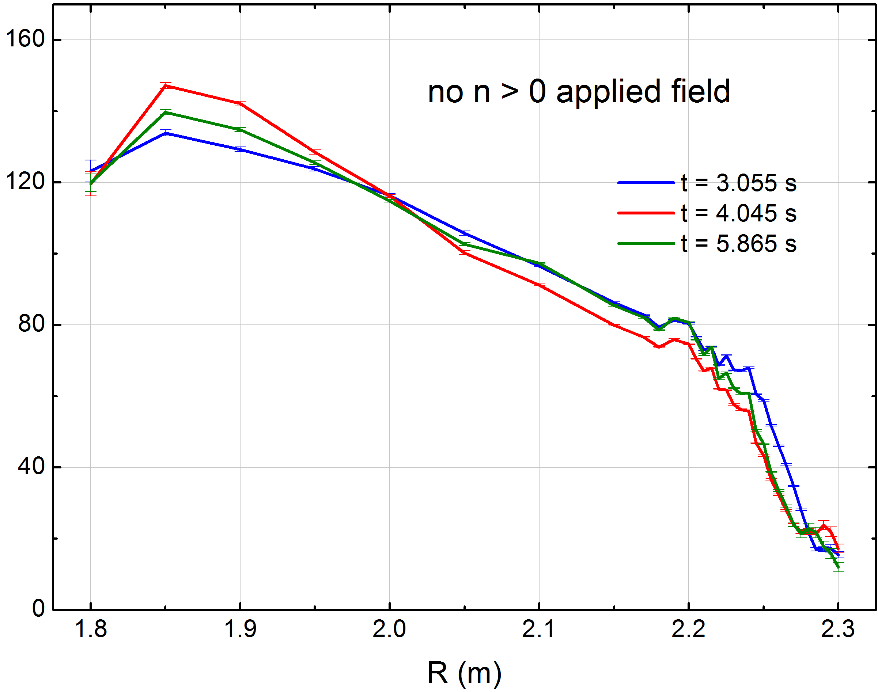
Clear reduction in CES measured toroidal plasma rotation profile with applied n = 2 field
With IVCC n = 2 field
No IVCC n > 0 field
Note: The rotation slows further at later times (shown in XCS data)
8062
8061
Significant reduction of rotation speed using “middle” IVCC coil alone
Significant alteration in rotation pedestal at the edge during braking
  Slowed rotation profile resembles an L-mode profile (H-mode is maintained)
W. Ko (CES)

Slide 8
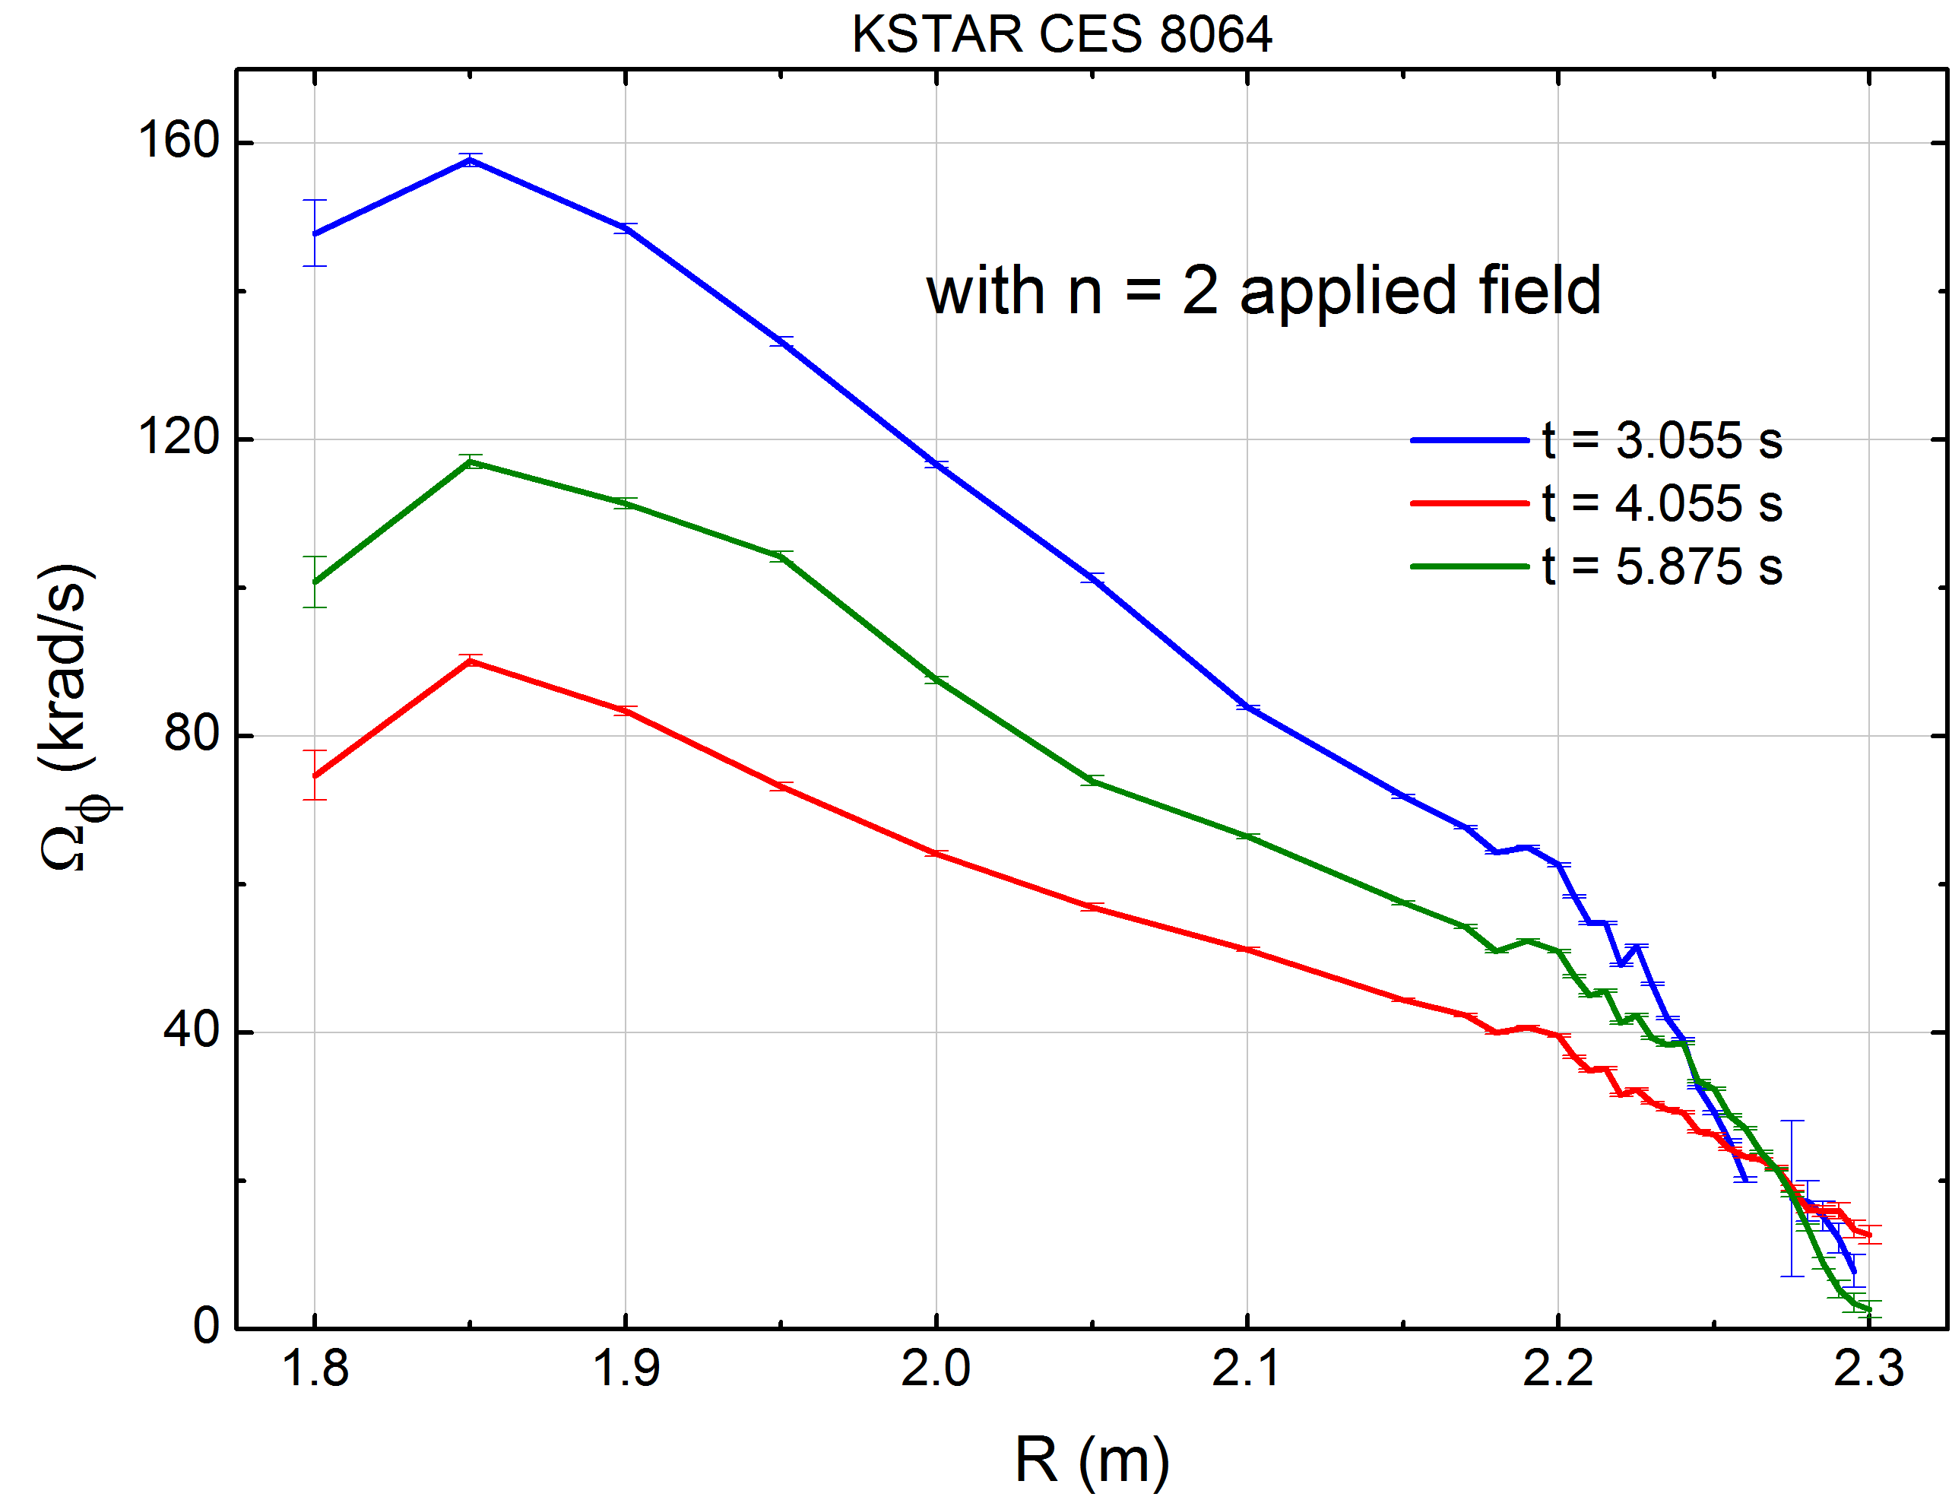
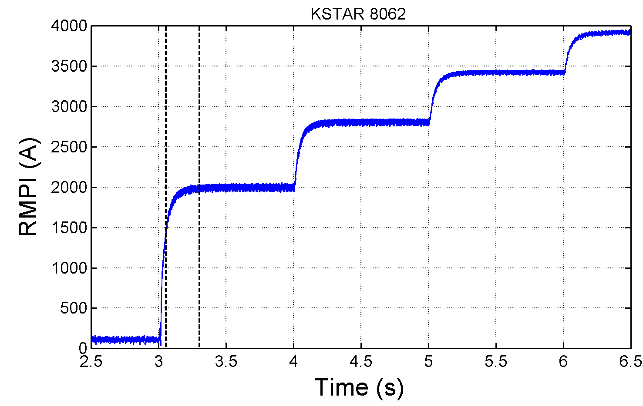
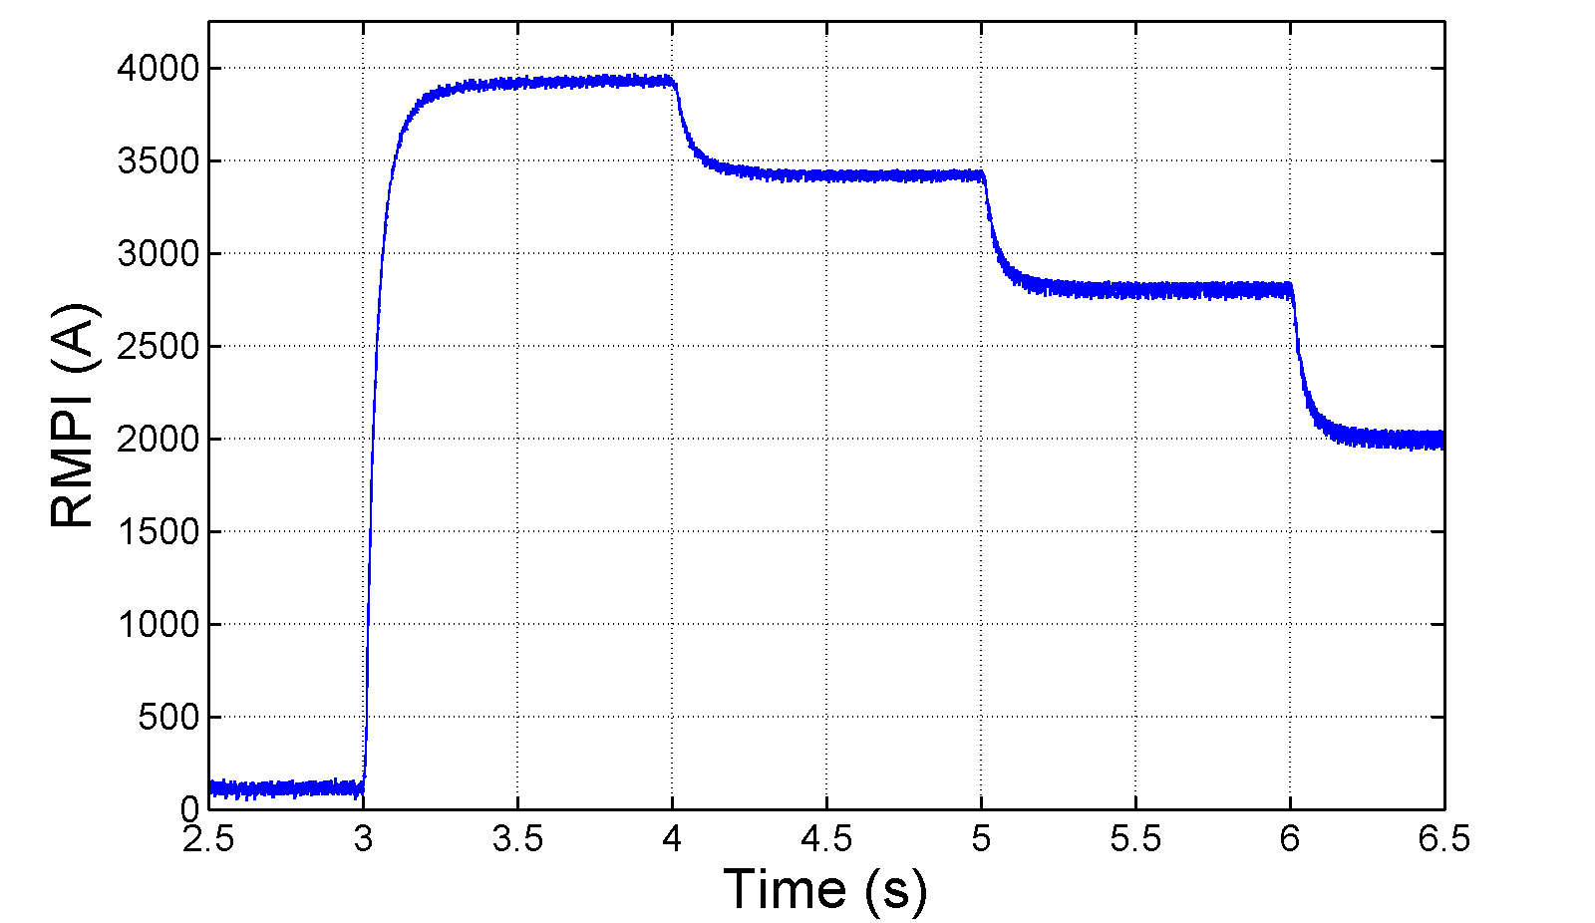
Measured toroidal plasma rotation profile shows plasma spin-up when n = 2 field is decreased
1
With n = 2 field
(step current up)
With n = 2 field
(step current down)
1
2
3
3
2
8062
8064
IVCC n = 2 current
At same IVCC
current, rotation
profile shows no hysteresis – important for control
1
2
3
1
2
3
W. Ko (CES)

Slide 9
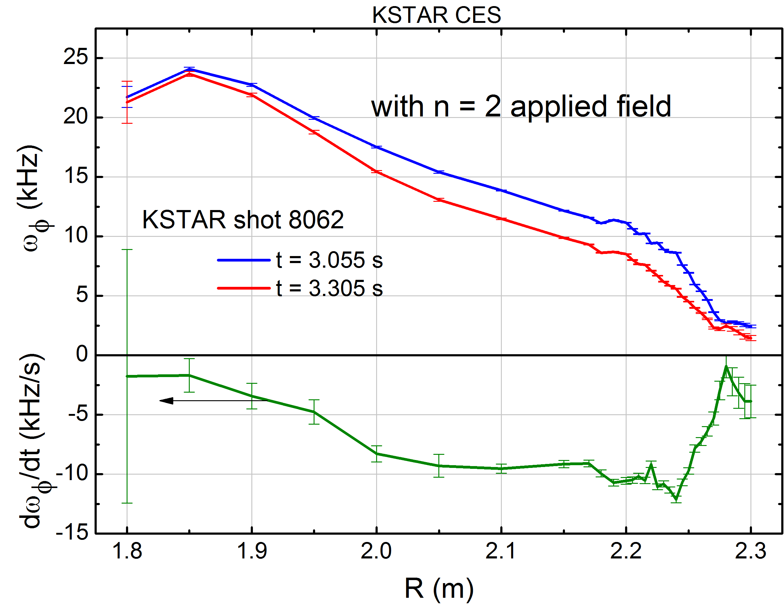
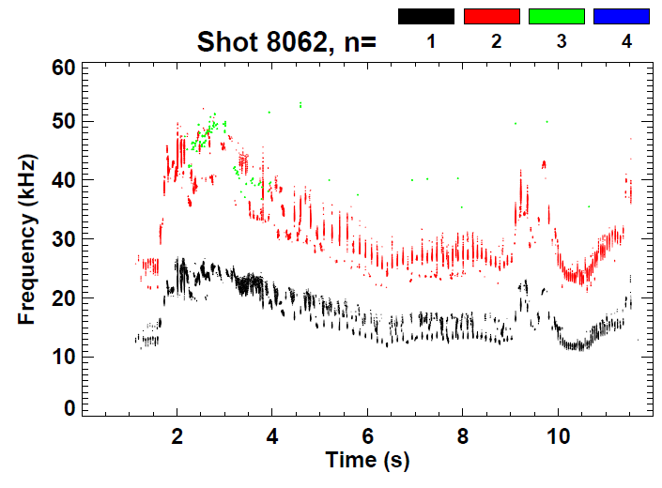
Rotation reduction by n = 2 applied field is global and appears non-resonant; no mode locking
t = 3.305s
t = 3.055s
IVCC n = 2 current
(“midplane coil”)
Damping rate
profile
magnetic spectrum
Rotating n = 1, 2 modes observed in core
  would not produce the observed rotation profile change (no change in core)

Slide 10
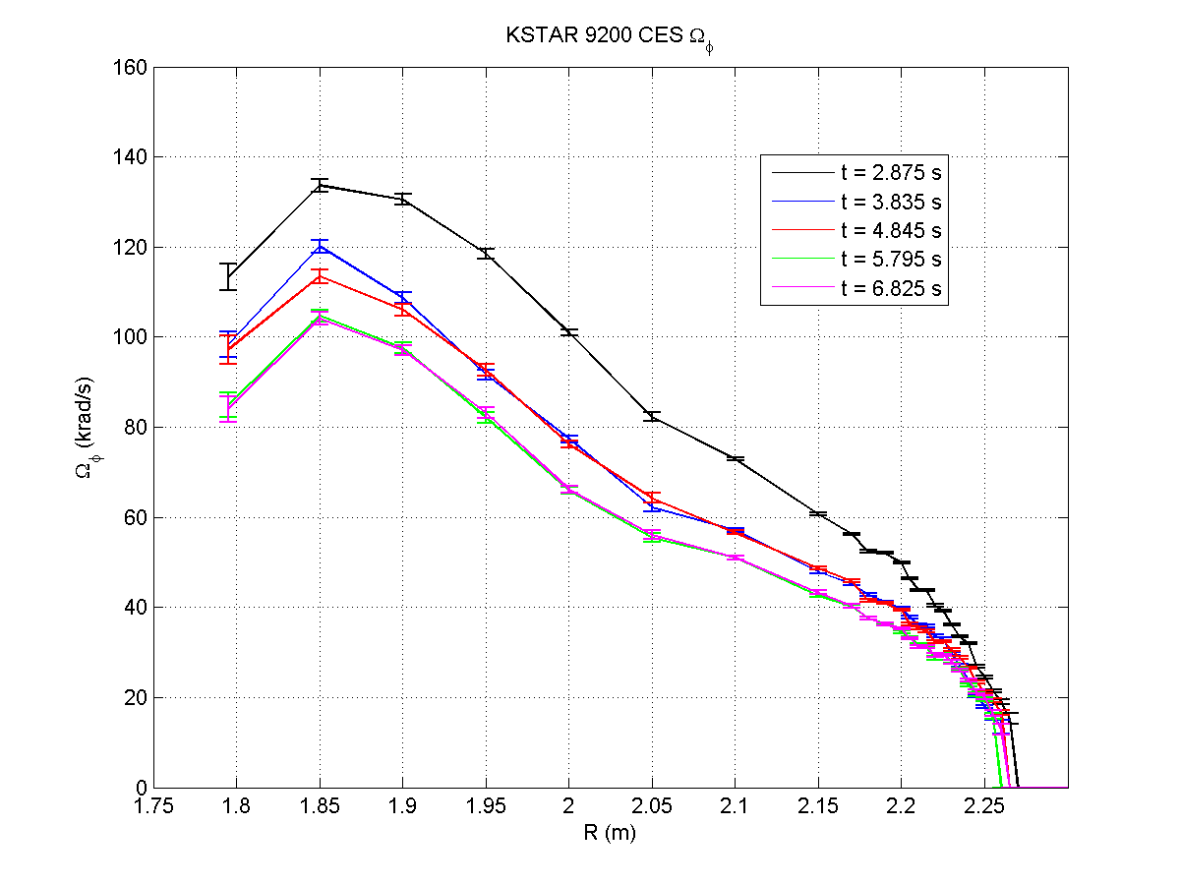
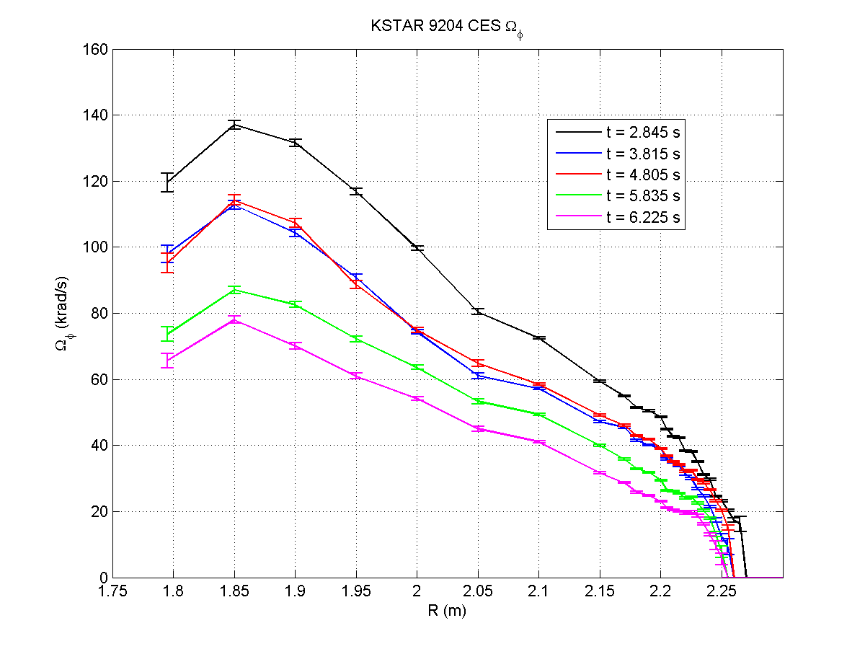
New δB spectra applied in 2013 experiment
Toroidal rotation profile evolution
(top/bottom IVCC (n = 2))
Toroidal rotation profile evolution
(top/middle/bottom IVCC (n = 2))
Before n = 2
current
Before n = 2
current
I_{IVCC} steps
1) 2.00 kA/turn
2) 2.83 kA/turn
3) 3.46 kA/turn
4) 4.00 kA/turn
I_{IVCC} steps
1) 2.00 kA/turn
2) 2.83 kA/turn
3) 3.46 kA/turn
4) 4.00 kA/turn
9200
9204
n = 2 top/bottom IVCC configurations used for first time
  Knowledge of NTV braking from top/bottom coils alone important for combined use with future n = 1 RWM active stabilization
  Stronger braking using top/middle/bottom IVCC
Experiment MP2013-05-03-003

Slide 11
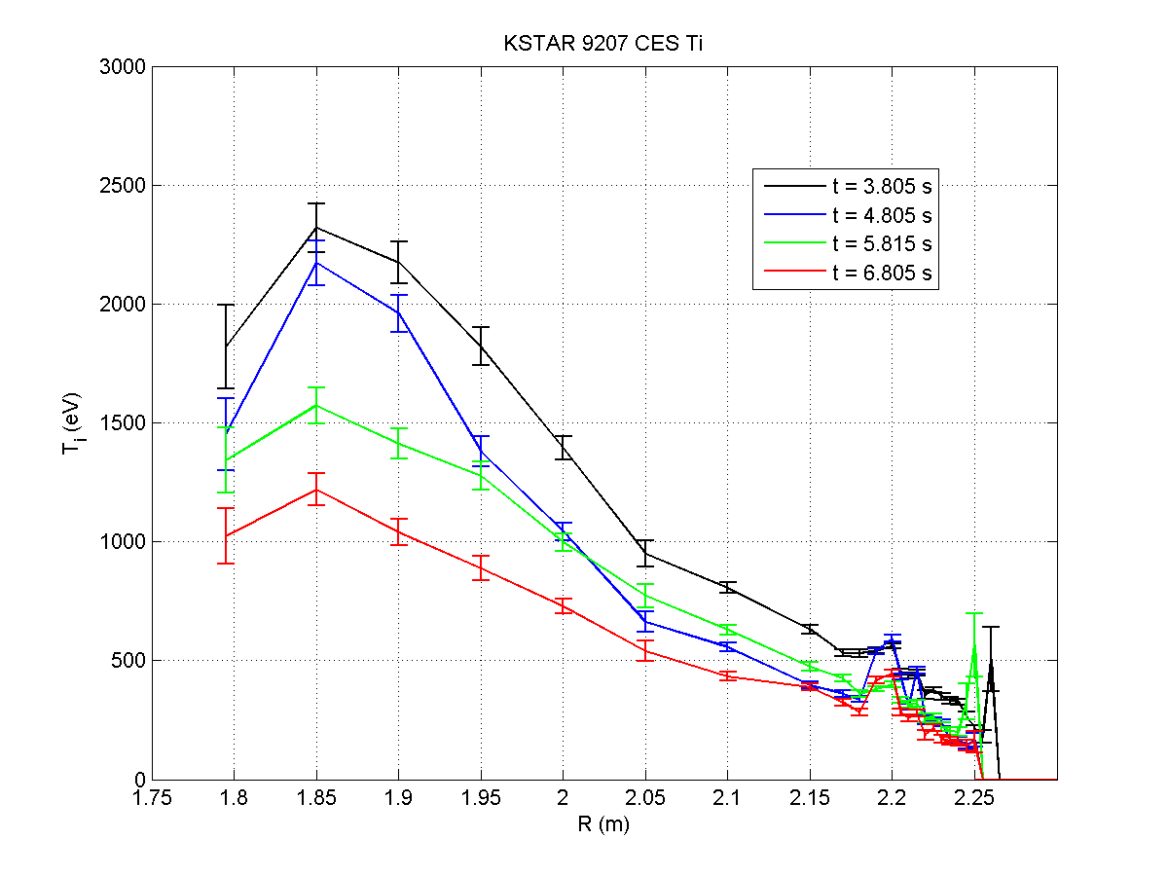
SMBI used to alter T_{i} during n = 2 NTV braking (2013)
2) SMBI: Examine dependence of NTV on collisionality
SMBI (change number / duration)
(up to 16ms duration)
Exact Ip waveform and level to be
determined from earlier shots in MP
Choose IVCC current levels based on earlier steps. Vary level, or use a new shot
Ip (MA)
t = 3s
2
1
NBI
2 seconds
2 seconds
t(s)
Traces
1) 1st IVCC, before SMBI
2) 1st IVCC, after SBMI
3) 2nd IVCC, before SMBI
4) 2nd IVCC, after SMBI
1)
T_{i} (eV)
2)
3)
4)
Clear change in T_{i} profile from SMBI
9207
R (m)
Experiment MP2013-05-03-003
V1.1

Slide 12
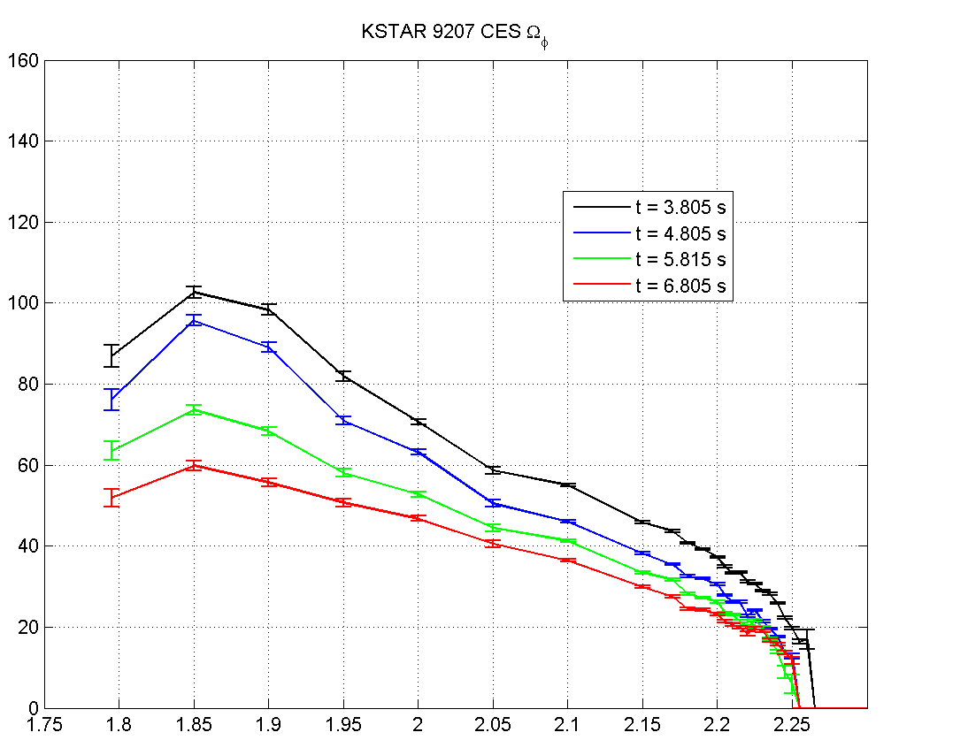
Toroidal rotation was clearly changed due to n = 2 NTV and SMBI
Traces
1) 1st IVCC, before SMBI
2) 1st IVCC, after SBMI
3) 2nd IVCC, before SMBI
4) 2nd IVCC, after SMBI
1)
Ω_{φ} (krad/s)
2)
3)
4)
9207
R (m)
Further shot comparison, analysis is needed to determine effect of SMBI on n = 2 NTV braking strength
Experiment MP2013-05-03-003

Slide 13
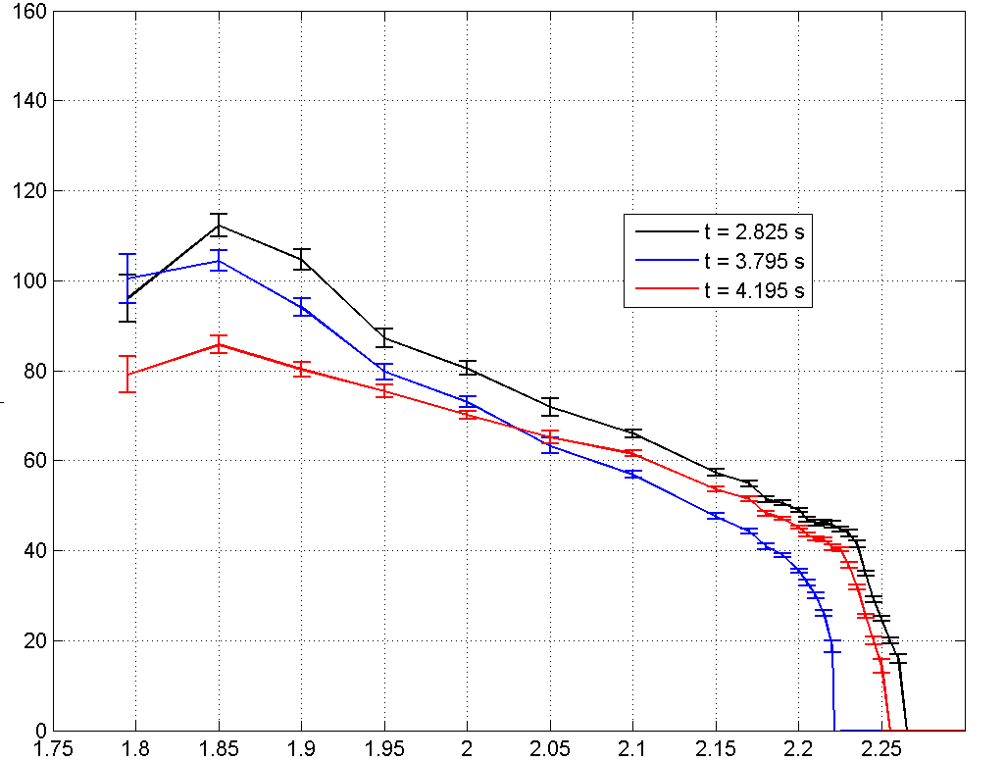
Rotation profile alteration observed with combined IVCC n = 2 NTV + ECH (110 + 170 GHz)
Only time for two shots
  Original shot plan had several more ECH shots
  These shots show combined technique works (not optimized)
Combination of effects / timing can change Ω_{φ} shear
  Note: n = 2 NTV current was run at only ½ maximum (not max. effect)
  n = 2 NTV shows global rotation damping
  Addition of ECH drops core rotation, increases edge Ω_{φ}, decreases shear
    Outward momentum transfer
Rotation profile before n = 2 and ECH
Ω_{φ} (krad/s)
n = 2 NTV + ECH
n = 2 NTV alone
9281
R (m)
Experiment MP2013-05-03-003

Slide 14
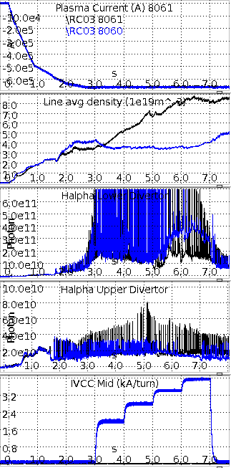
ELM mitigation found when using n = 2 field via middle IVCC only
I_{p} (MA)
Mitigation observed when sufficiently high n = 2 field is applied
  I_{Ivcc} > 3 kA/turn
    Note: didn’t observe this in 2011 due to 1.8 kA/turn limit
  Reduction in density observed at start of n = 2 applied field
    Need to verify validity of density evolution
t(s)
<n_{e}> (10¹⁹m⁻³)
t(s)
H_{α} (arb)
t(s)
H_{α} (arb)
t(s)
I_{n=2} (kA/turn)
n = 2 field
t(s)

Slide 15
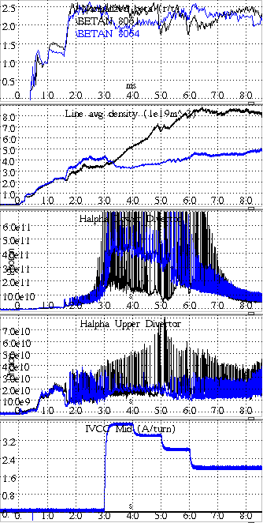
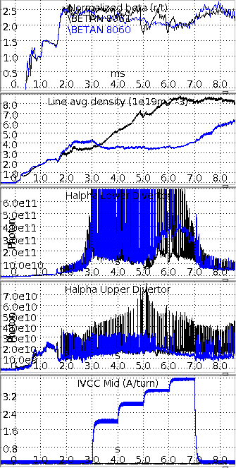
ELM mitigation found using n = 2 field, via middle IVCC only, correlates with field strength
β_{N}
Mitigation observed when sufficiently high n = 2 field is applied
  Stored energy, β_{N} varies
  However, shot that has continuous ELMing with no n = 2 field has same β_{N} variation
t(s)
<n_{e}> (10¹⁹m⁻³)
mitigated
mitigated
t(s)
H_{α} (arb)
t(s)
H_{α} (arb)
t(s)
n = 2
field (high EARLY)
n = 2
field (high LATE)
I_{n=2} (kA/turn)
t(s)

Slide 16
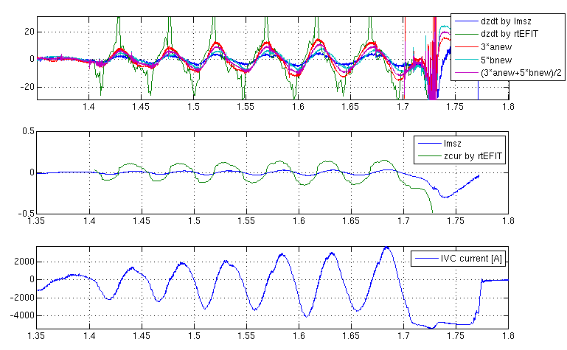
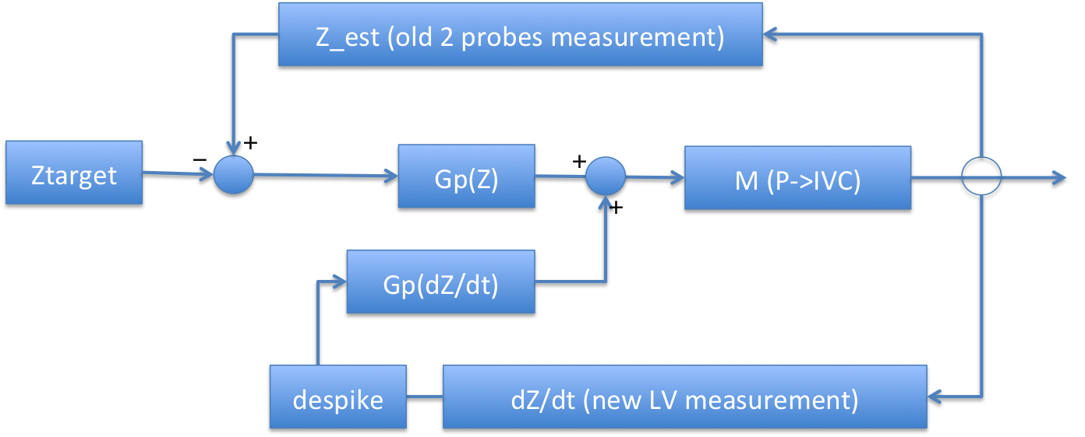
Vertical control design modifications made in PCS
New dZ/dt estimator was verified against 2012 real-time EFIT Z_{cur} measurement
  Sensitivity of LMSZ, the old estimator, is poor for high triangularity shots
  2013 version compensates IVC current pickups only
“Limited” algorithm now has new dZ/dt feedback loop, tested at the dedicated experiment (Aug. 7th)
  Gain’s determined by “relay feedback control technique 2 tries
  G_{p} = 3.48, G_{d} = 0.05
Caveats :
  Compensation on spikes sync’ed with ELMs
#7904
System
D. Mueller (PPPL), S.H. Hahn (NFRI)

Slide 17
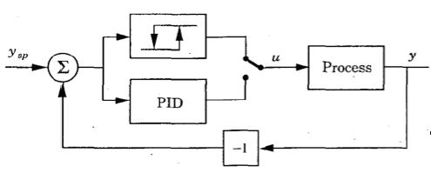
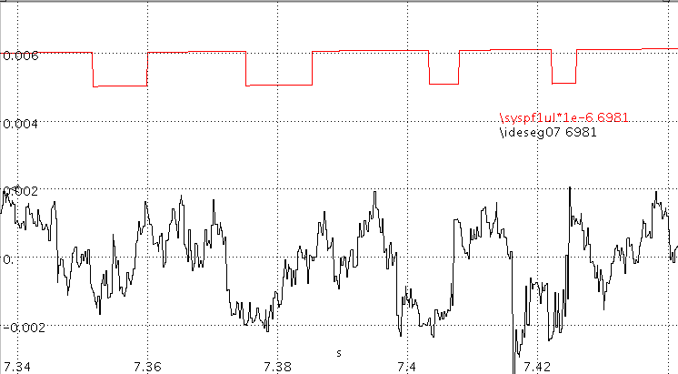

Relay feedback algorithm helped determine gains set
Sysmain category: if relay feedback’s turned on for a coil, the coil current demands will oscillate like the picture, invoking responses on the PID loop
  The method gave a direct, optimized set of gains for Ip & segment PID
  Gives also the Rule of Thumb for ratio of Gp / Gi
#6981: PF1UL → SEG07 (inboard gap)
2h
2A
Pu
E. Kolemen (PPPL)

Slide 18
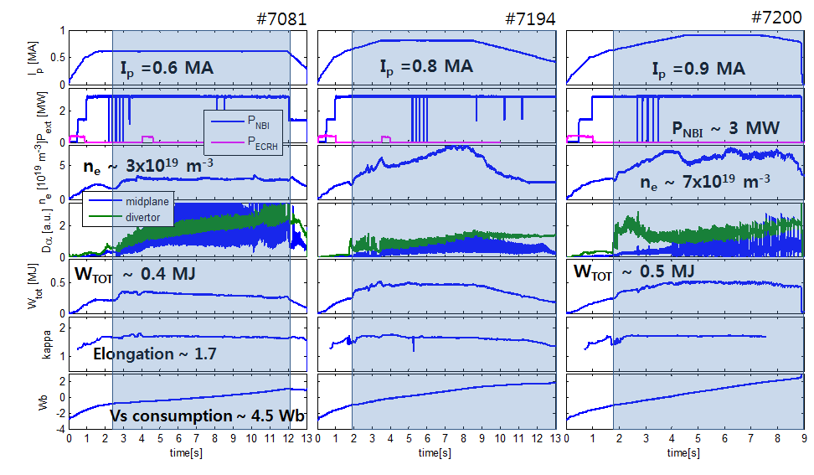
The new improved control development helped enable increase of plasma current and duration of H-mode (11 seconds)
Expanded the operation regime of the plasmas
- I_{p} up to 0.9 MA with 3 MW beams
- Stored energy (W_{tot}) ~ 0.4 MJ
E. Kolemen (PPPL)
~9.4s H-mode
~11.0s H-mode
~7.2s H-mode

Slide 19
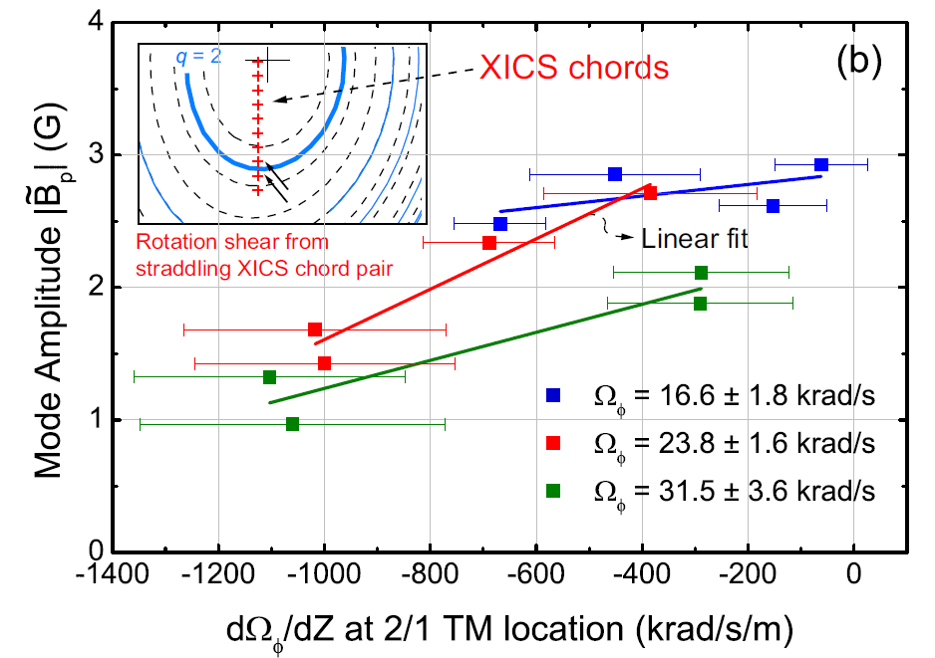
Correlation between plasma velocity shear and 2/1 TM amplitude found
Mode identification from ECE, ECEI systems
Observed increase of TM amplitude vs. Ω_{φ} shear decreases at reduced Ω_{φ}
Y.S. Park, S.A. Sabbagh, J.M. Bialek, et al. Nucl. Fusion 53 (2013) 083029

Slide 20
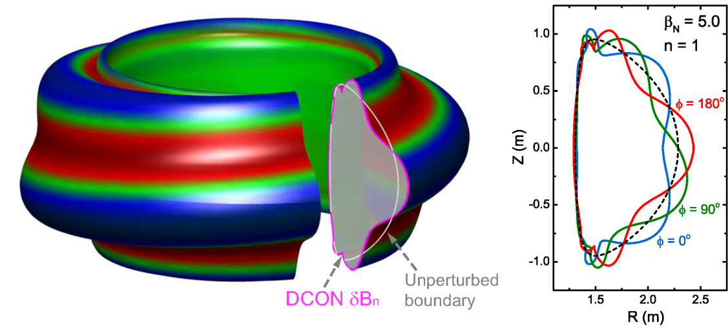
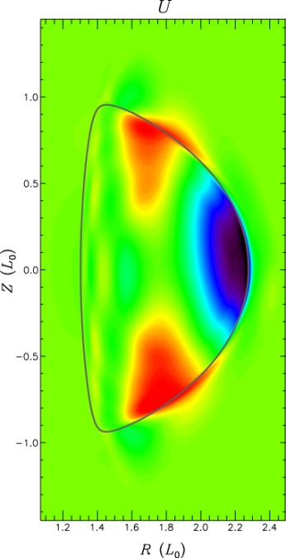
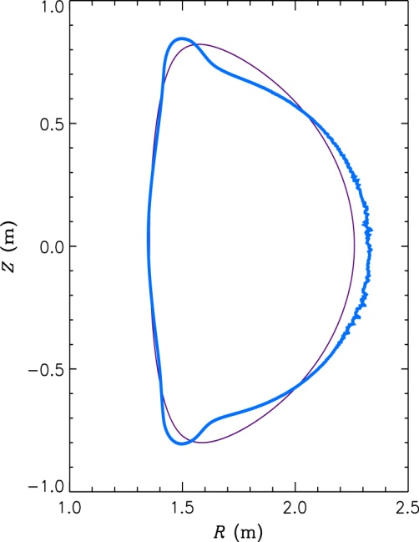
M3D-C¹ MHD code being run for KSTAR, compared to DCON
KSTAR DCON n = 1 unstable mode eigenfunction
Linear stability analysis using M3D-C¹ code (collaboration S. Jardin)
  Extended MHD code solving full two-fluid MHD equations in 3D geometry
  Non-linear code, presently being used in linear mode for initial runs
Ideal n = 1 stability limit from DCON and M3D-C¹ compare well
  For the same input equilibria, “equivalent” wall configurations compared
  With-wall n = 1 stability limit computed as β_{N} ~ 5.0 in both calculations
  Further M3D-C¹ calculations for KSTAR will include improved wall configurations (3D, resistive wall) and analysis for resistive instabilities
M3D-C¹ unstable mode velocity stream function and δB_{n}
δB_{n}
(q = 4)
Y.S. Park, et al.

Slide 21
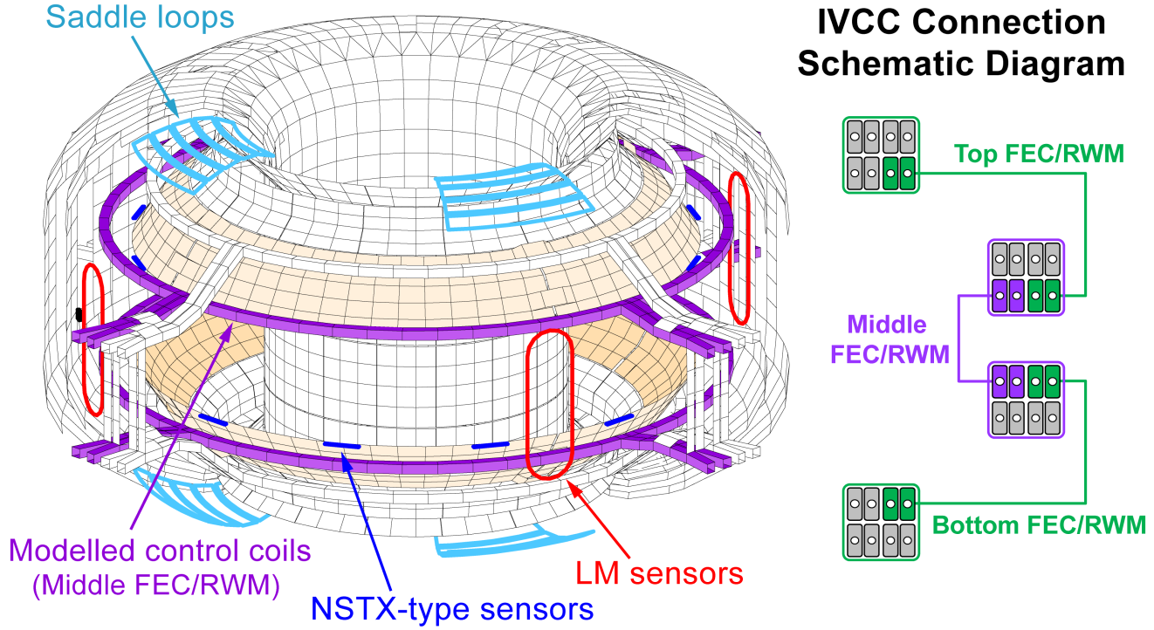
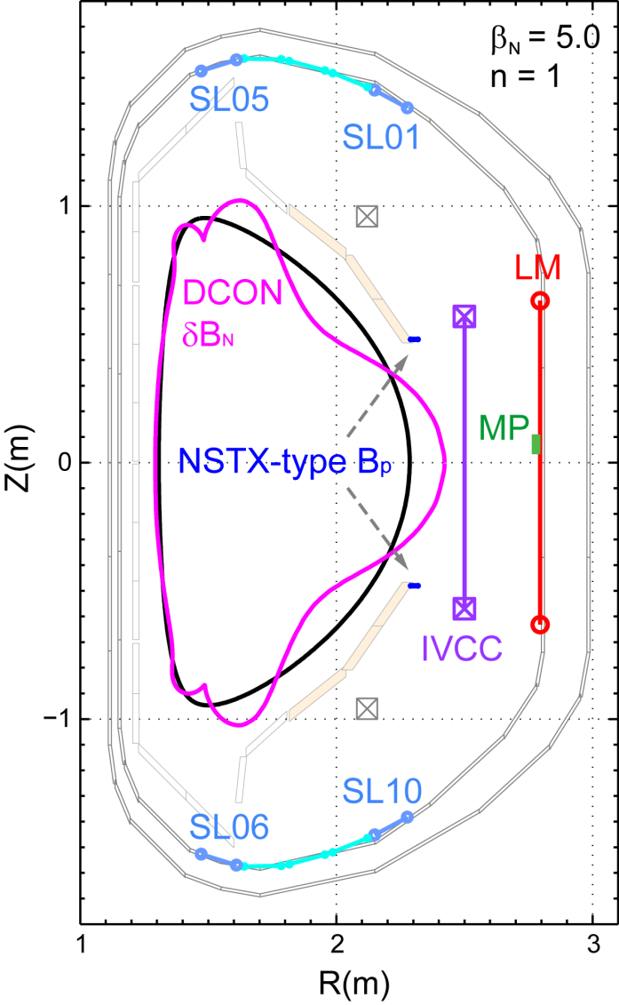
Active n = 1 RWM control performance determined with 3D sensors
Sensor location and
n = 1 DCON eigenmode
Study considered different sensors
  Sensors presently available: (i) LM, (ii) SL, (iii) MP,
  Possible new sensors: (iv) “NSTX-type B_{P}” sensors
  (NOTE): Need more toroidal sensor positions to track n = 1 mode rotation
Y.S. Park, et al. (submitted to Phys. Plasmas 2013)

Slide 22
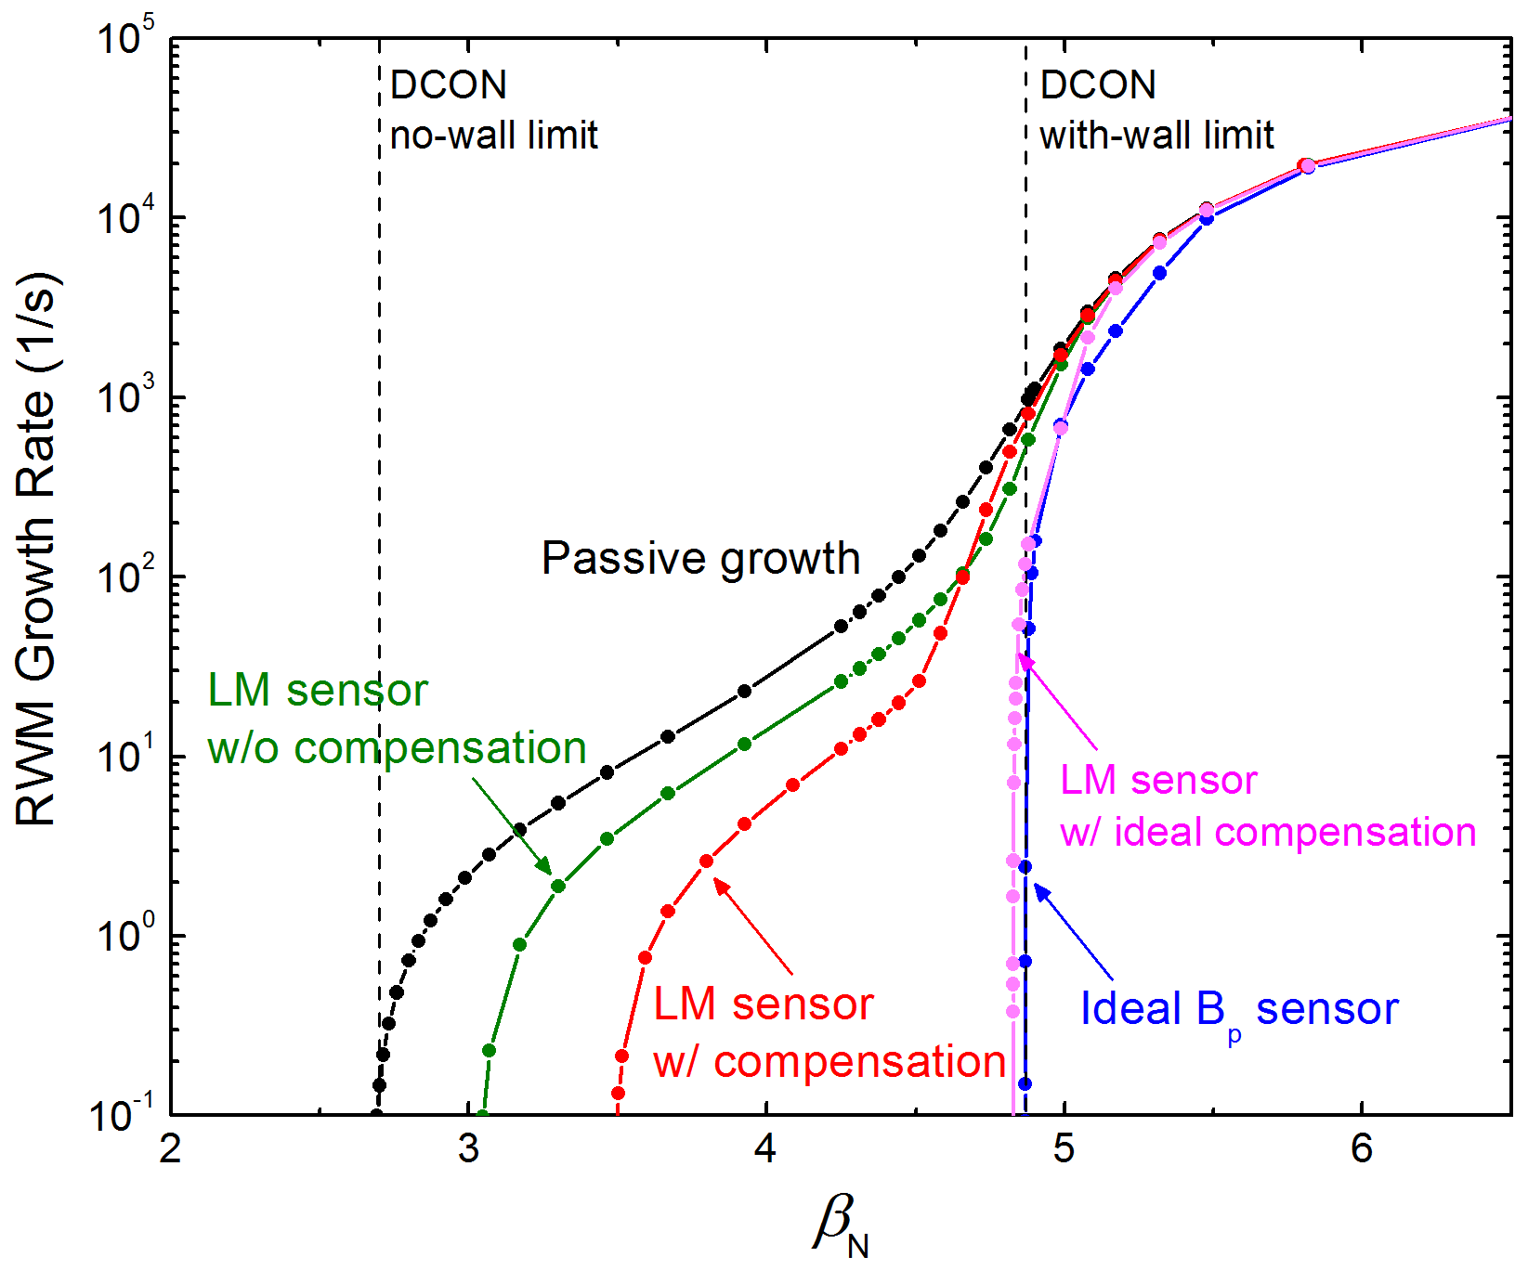
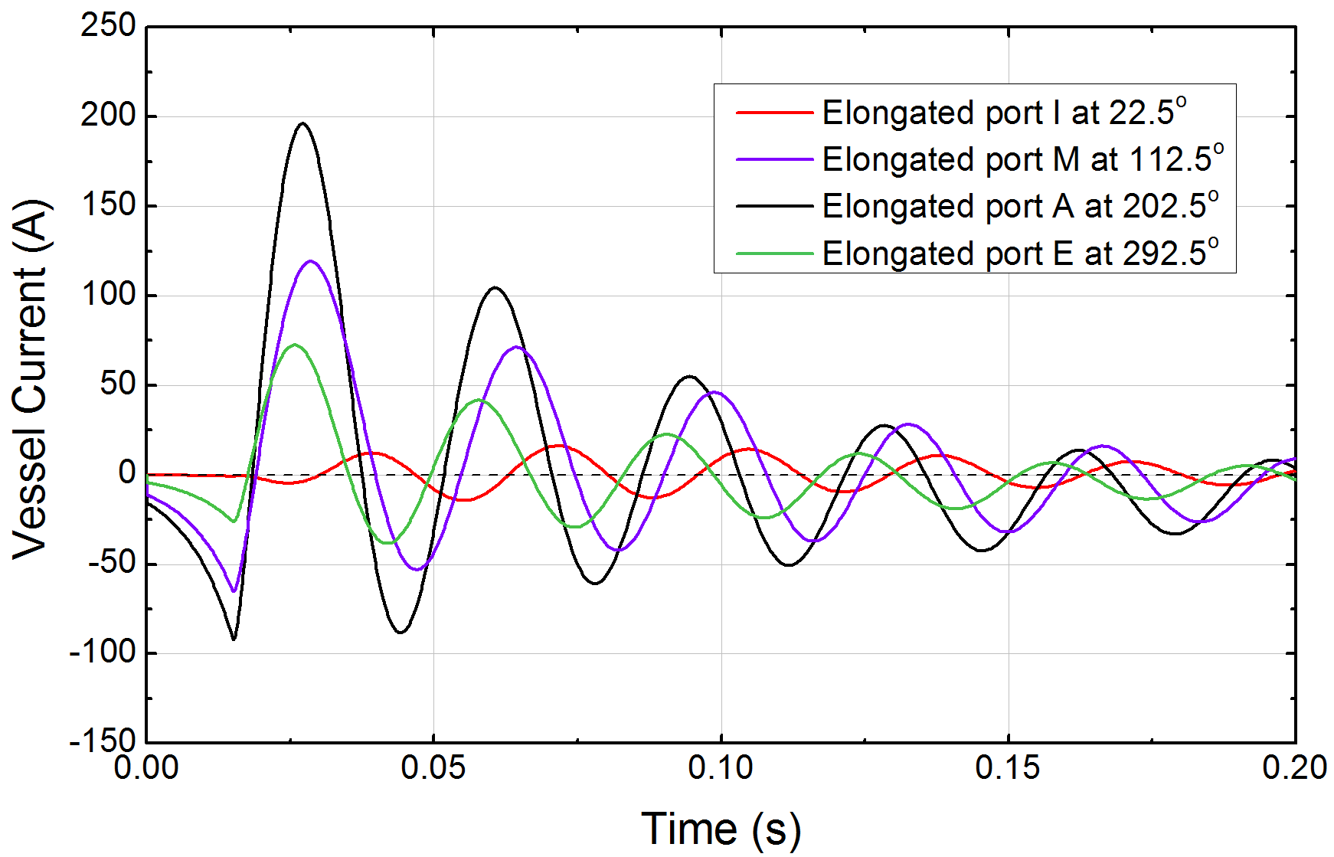
Active n = 1 RWM control performance determined for present “LM” 3D sensors
RWM growth rate vs. β_{N}
(no kinetic stabilization)
Vessel currents around ports
LM sensors
MP sensor
Performance strongly affected by vessel currents around ports

Slide 23
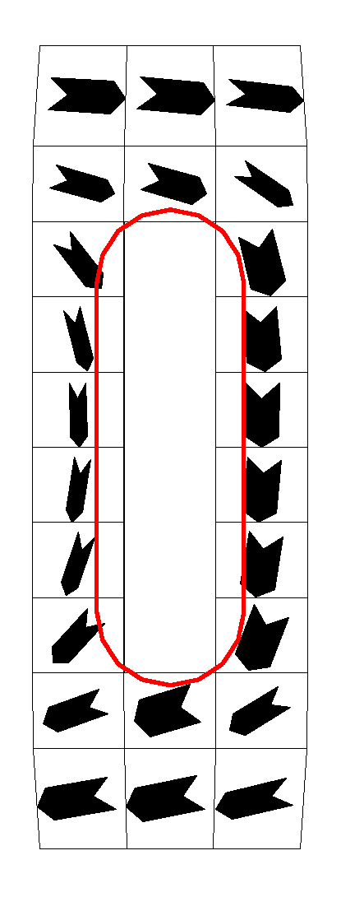
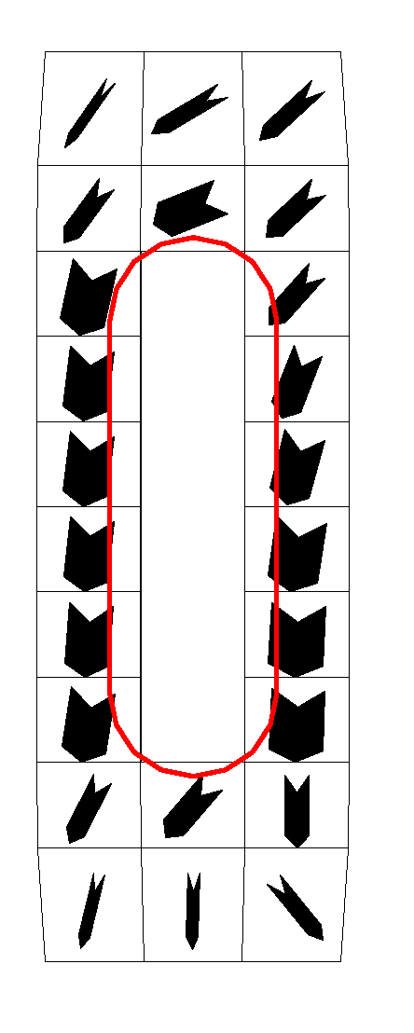
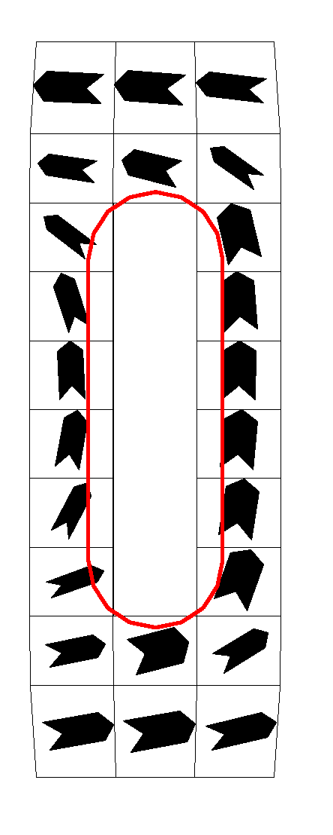
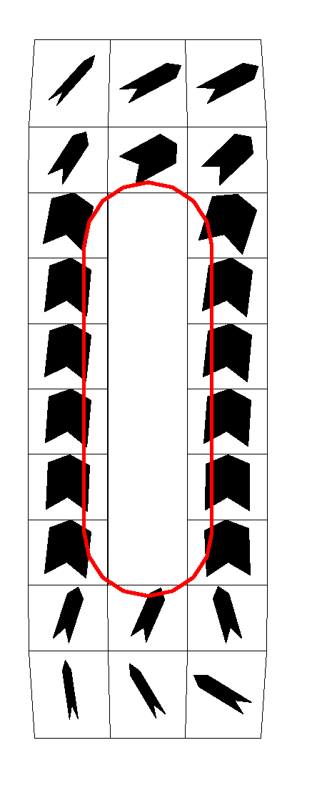
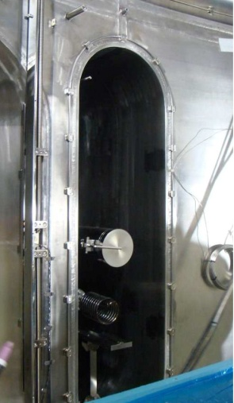
Control coil-induced vessel current significantly limits
performance of the LM sensors
LM01 @ 22.5º
LM04 @ 112.5º
LM03 @ 202.5º
LM02 @ 292.5º
VALEN3D computation of induced vessel current during successful n = 1 feedback
I
M
A
E
X
Induced current in vessel around ports
LM sensors
*
Control performance with LM sensors
  limited by control coil-induced vessel currents circulating around the elongated port
  Induced vessel currents significantly alters the measured mode phase
LM
*CCW angle from the H-port

Slide 24
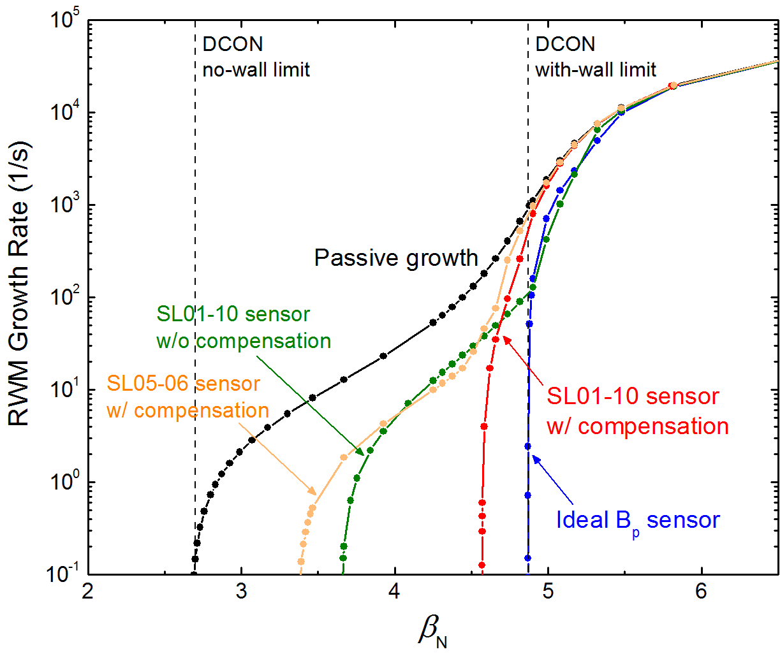

Active n = 1 RWM control performance improved when present “SL” 3D sensors are used
SL sensors
MP sensor
Y.S. Park, et al.
Physics leading to control performance results
  SL sensor performance mostly set by interference due to passive plates (SL01-10 with applied field compensated perform best)
  MP sensors have lowest coupling to vessel/plates: but only 3 toroidal positions, small effective area

Slide 25
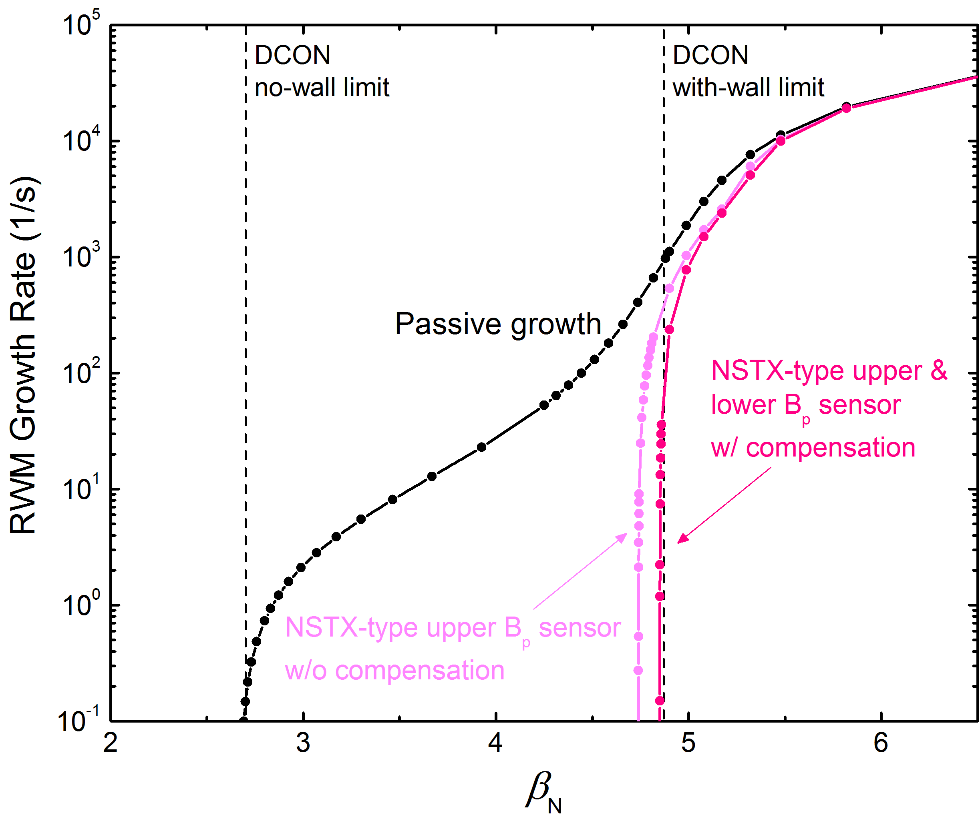
Active n = 1 RWM control performance determined for “optimized”, realistic 3D sensors
NSTX-type sensor
Y.S. Park, et al.
Physics leading to control performance results
  “NSTX-type B_{p}” sensor performance only weakly affected by vessel and passive plate currents

Slide 26
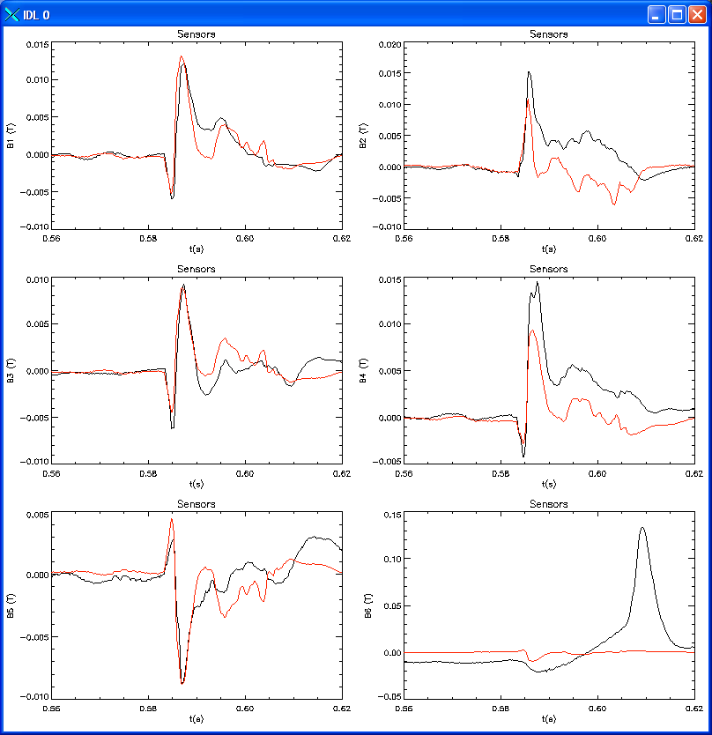
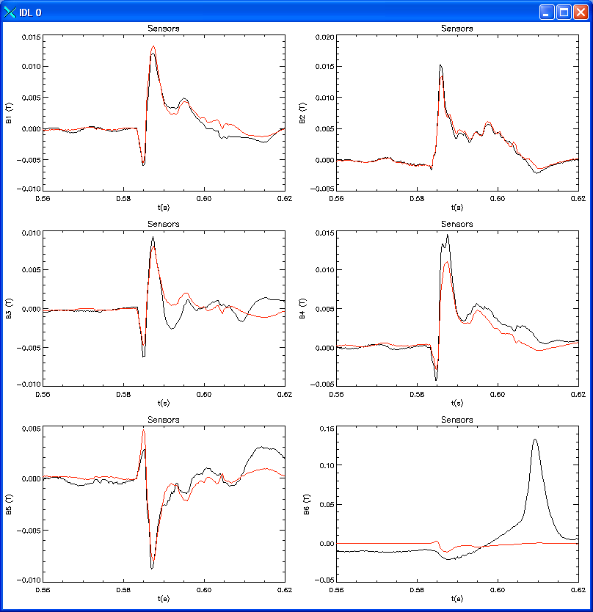
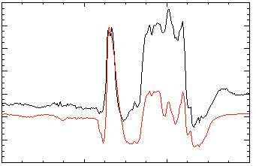
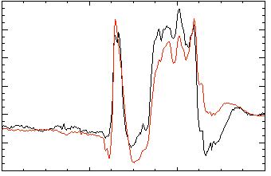
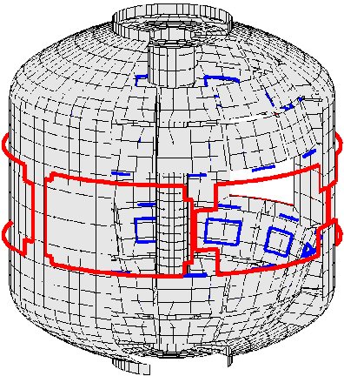
Model-based RWM state-space controller used on NSTX improves standard PID control
NSTX: RWM Upper B_{p} Sensor Differences (G)
Control approach proposed for ITER
Can describe n > 1, varied poloidal mode spectrum in model
3D mode and conducting hardware features described in real-time
  Greater detail measured by upgraded sensor coverage is better utilized than with PID
2 States (similar to PID)
7 States
200
δB_{p}¹⁸⁰
δB_{p}¹⁸⁰
(a)
(b)
100
0
-100
150
δB_{p}⁹⁰
δB_{p}⁹⁰
100
Sensor Differences (G)
50
0
-50
80
δB_{p}⁹⁰
(c)
δB_{p}⁹⁰
(d)
NSTX software written to be transportable, e.g. to KSTAR
  Discussed implementation on KSTAR
40
0
137722
137722
0.56
0.58
0.60
0.56
0.58
0.60
0.62
t (s)
t (s)
No NBI Port (c)
With NBI Port (d)
S.A. Sabbagh, et al., Nuclear Fusion 53 (2013) 104007

Slide 27
US-Korea collaboration on KSTAR on high beta and 3D plasma stability research having continued success
Plasmas have reached and exceeded the n = 1 ideal no-wall limit for H-mode profiles for first time in KSTAR
Open-loop rotation profile control has been demonstrated via n = 2 field application, and +ECH without mode locking
  Aim toward future closed loop control, active research on NSTX-U
ELM mitigation shown with n = 2 field using “middle” coil alone
RWM control calculations indicate reasonable performance with compensated SL sensors
  Improvements by using new sensor positions / state space controller
Analysis continues, is expanding (e.g. TRANSP, M3D-C¹)
Research plan includes higher β_{N}, lower V_{φ} (for ITER), stability and NTV understanding at long pulse in 2014 experiment

Slide 28
Supporting slides follow

Slide 29
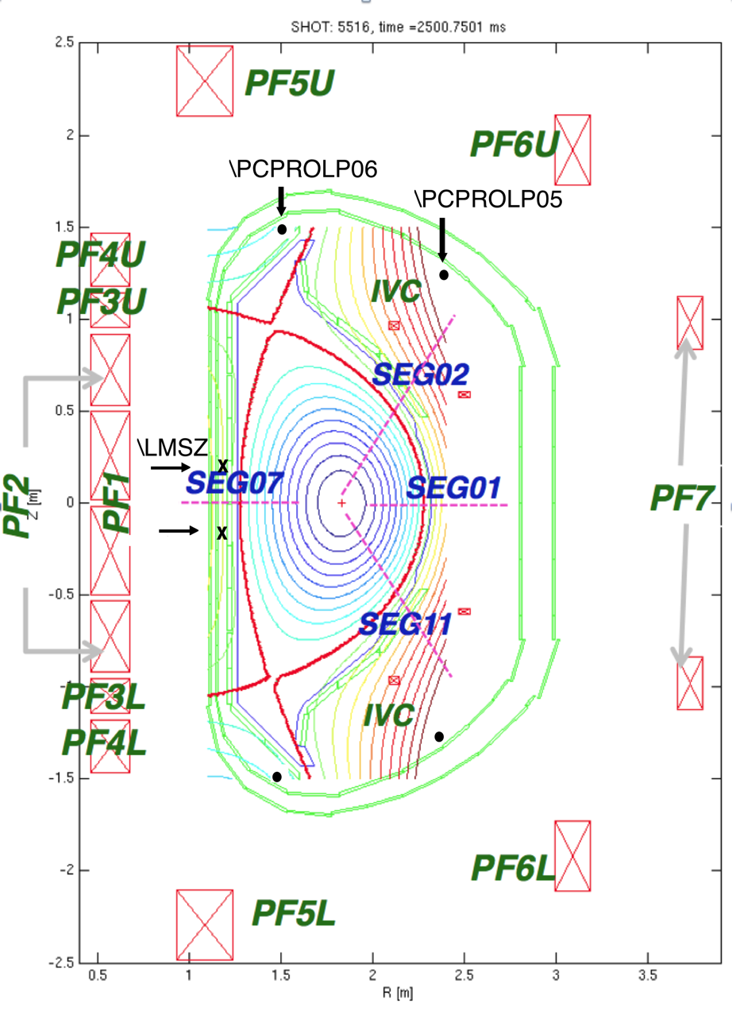
Loop voltage differences - better, faster dz/dt signal
The In-vessel Vertical Control (IVC) coil is used for fast control (~20 ms)
Presently the fast z estimate (\LMSZ) is based on 2 magnetic probe sensors
  On centerstack, near midplane
  Shielded from plasma by passive plates
  Integrated signals, similar in size, small difference
Loop voltage differences provides reasonable dz/dt signals
  Large in size, better signal to noise
  May allow use of derivative-only term for IVC, reducing DC-offsets
  Caveat: picks up poloidal fields and/or IVC itself
    \PCPROLP05 must be compensated for IVC, for -06 it is not so important
    pickup of SC coils is present, but is small compared to plasma motion for each pair
    Noise spikes on some shots, must be resolved
D. Mueller (PPPL), S.H. Hahn (NFRI)

Slide 30
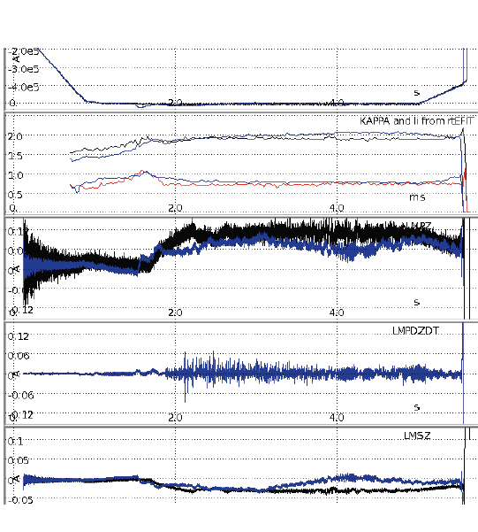
New dZ/dt control increased available kappa with suitable Z₀ target
Black = accomplishment in 2013
Blue = future work suggested
Kappa increase up to 2.1
Made a dZ/dt signal estimator with reasonable corrections
  Need to validate against 2013 EFIT / SXR core information
Implemented an experimental algorithm for using both Z and dZ/dt at the PCS
  Need to deal with spike pickups, which origin is not clarified
  Baseline noise (~20mVpp) needs to be removed
Application of the algorithm enhanced available kappa
  Z position control at faster CPU is inconsistent with isoflux (slower)
  Need to modify PCS next year
κ
l_{i}
IVC current
dZ/dt PID
Increase Z₀ target
by + 2 cm
t (s)
D. Mueller (PPPL), S.H. Hahn (NFRI)

Slide 31
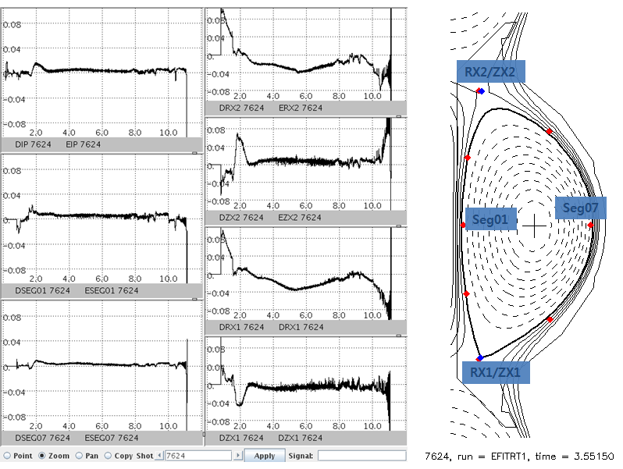
Double-null shape is controlled only with control points
8-s of successful steady controls by the tuned control set:
Gains for plasma current (DIP), in- & out- board gaps (seg07, seg01) are tuned by relay feedback algorithm
SEG01
SEG07
E. Kolemen (PPPL)

Slide 32
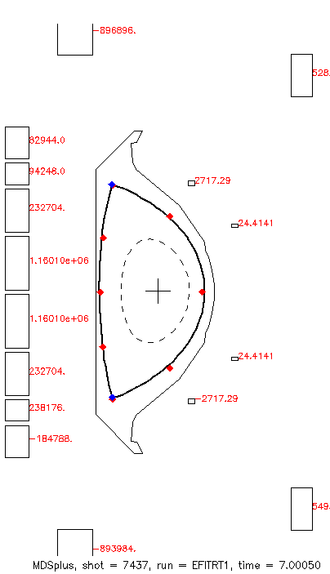
SISO configurations used for double-null shape [isodnull]
ISODNULL
Basic set:
all -> Plasma current (all coils)
PF3/4 or 3-4/4-5 -> RX/ZX for X-point positions
PF1/2 -> SEG07 (inboard gap)
PF6/7 -> SEG01 (outboard gap)
Optional: for drSep
PF6 -> Seg03/10 (75/285 deg)
PF3 -> Seg04-09
RX2
ZX2
Seg03
Seg04
Seg07
Seg01
Seg09
Seg10
RX1
ZX1
E. Kolemen (PPPL)

Slide 33
Vertical Control Summary
Voltage loop differences successfully used in the fast vertical control loop (IVC)
  Some evidence that higher Kappa was achieved
  Run time limited ability to quantify the improvement
Inconsistency in Z₀ between fast data and rtEFIT
  Probable cause of vertical control oscillations below the stability limit
  Resolving discrepancy reduces demand on IVC (and likely the control induced oscillations)
Did not have time to attempt using only dz/dt feedback control for IVC
Noise spikes are too short to be due to plasma motion, suspect noise from crates with ground shared with filter scopes
D. Mueller (PPPL), S.H. Hahn (NFRI)

Slide 34
Experiment MP2012-04-23-021 accomplished three key results
Results Summary
  Plasmas have reached and surpassed the n = 1 ideal no-wall limit computed and published for KSTAR with H-mode profiles
    High values of β_{N} up to 3, β_{N}/l_{i} > 3.8
    Published n = 1 no-wall limit is β_{N} = 2.5 at l_{i} = 0.7 (β_{N}/l_{i} = 3.57)
  Plasma rotation has been significantly altered in a controlled manner with n = 2 applied 3D field
    Key for mode stability studies, and access to ITER-relevant rotation
    Utilized middle IVCC only (so far); ~ 50% reduction in core rotation
    H-mode rotation profile shape is altered by n = 2 field
  ELM mitigation found using n = 2 fields with midplane IVCC alone
    Challenges ELM stabilization hypotheses that require applied field that aligns with field line pitch (e.g. off-midplane coils)

Slide 35
Experiment to reach and surpass n = 1 no-wall limit in KSTAR planned since (at least ) 2010
2010 run
2010 run
Profiles used in ideal MHD
no-wall limit study
Y.S. Park, et al., Nucl. Fusion 51 (2011) 053001
Projected n = 1 ideal stability for KSTAR H-mode plasmas (O. Katsuro-Hopkins, et al., NF 50 (2010) 025019
2010 run

Slide 36
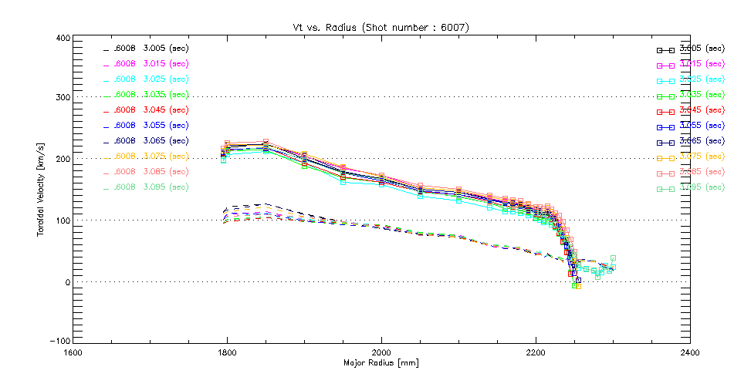
H-mode / L-mode rotation profiles considerably different in KSTAR – a positive characteristic for physics studies
Slide from 2012 KSTAR Conference (Muju)
400
KSTAR 6007 6008
— 6007 3.005 s
— 6008 3.005 s
— 6007 3.015 s
— 6008 3.015 s
300
— 6007 3.025 s
— 6008 3.025 s
— 6007 3.035 s
H-mode
— 6008 3.035 s
— 6007 3.045 s
— 6008 3.045 s
— 6007 3.055 s
Goal of rotation control by IVCC
— 6008 3.055 s
200
— 6007 3.065 s
— 6008 3.065 s
ω_{φ} (kHz)
— 6007 3.075 s
— 6008 3.075 s
— 6007 3.085 s
— 6008 3.085 s
— 6007 3.095 s
— 6008 3.095 s
100
0
L-mode
S.A. Sabbagh, et al., KSTAR MP2011-03-09-001
CES courtesy of W.H. Ko (NFRI)
H-mode
separatrix
from EFIT
L-mode
separatrix
from EFIT
-100
1.6
1.8
2.0
2.2
2.4
R(m)
Develop a method to change rotation profile from H-mode to L-mode like shape (NTV type non-resonant braking) by applied field from IVC

Slide 37
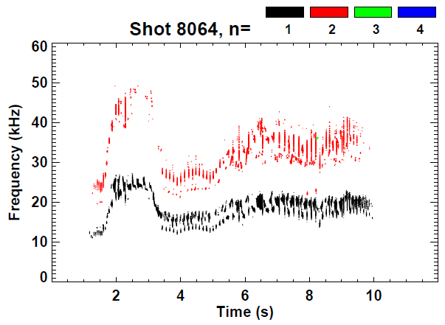

Open-loop rotation control with n = 2 IVCC current produced: V_{φ} decreased, then increased
No IVCC n > 0 field
With IVCC n = 2 field – large step first
Spin down
Spin up as field reduced
n = 2 field on
n = 2 field off
XCS (Z=0)
no n = 2
Low frequency MHD mode rotation frequency decreased by 40 - 50% without mode locking
Vφ
with n = 2
t (s)

Slide 38

Percentage reduction on V_{φ} apparently larger in 2012 experiment
Toroidal rotation profile evolution
(middle IVCC (n = 2)): 2013
Toroidal rotation profile evolution
(middle IVCC (n = 2)): 2012
1
With n = 2 field
(step current up)
2
Before n = 2
current
I_{IVCC} steps
1) 2.00 kA/turn
2) 2.83 kA/turn
3) 3.46 kA/turn
4) 4.00 kA/turn
3
9199
8062
Might be explained by a lower stored energy (lower Ti) in present experiments
  This is one of the experimental objectives, further analysis will determine this
Experiments MP2013-05-03-003; MP2012-04-23-021

