Slide 1
Dataset Citation: From Pilot to Production
Mark Martin
Assistant Director, Office of Scientific and Technical Information
U.S. Department of Energy

Slide 2
What This Presentation Is About
What is OSTI
History of OSTI’s data citation program
ARM Data Archive
Our role in the AIP project

Slide 3
Office of Scientific and Technical Information (OSTI)
Mission:
Advance science and sustain technological creativity by making R&D findings available and useful to the Department of Energy researchers and the public.
Premise:
Science advances only if knowledge is shared.
Corollary:
Accelerating the sharing of knowledge speeds the advancement of science (discovery).

Slide 4
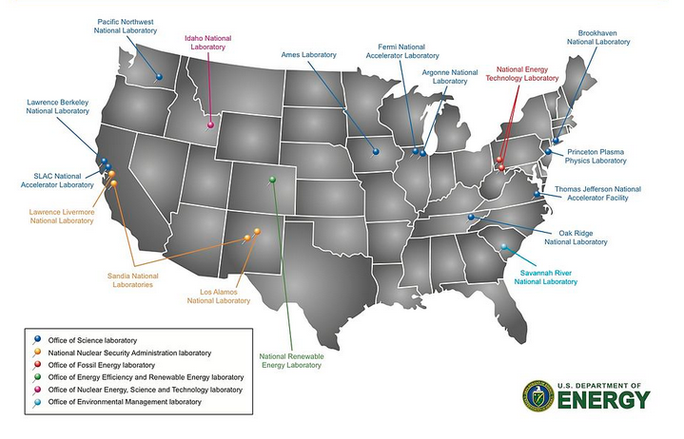
DOE STI Program
OSTI manages agency-wide program to ensure access and delivery of research results.
DOE R&D results are:
collected from DOE offices, labs, and facilities;
preserved for re-use; and
made accessible via multiple web outlets.

Slide 5
Importance of Data
Research output = technical reports and journal articles, but also commonly includes large amounts of associated data.
DOE Order 241.1B
Updated and released December of 2010.
The first time this directive officially stated that data from funded research could be identified/announced to OSTI.

Slide 6
Why Cite Data?
We believe that you should cite data in just the same way that you can cite other sources of information, such as articles and books.
Data citation is important because:
enables easy reuse and verification of data,
allows the impact of data to be tracked, and
creates a scholarly structure that recognizes and rewards data producers.

Slide 7
Citing Datasets Noted in Technical Reports – A Pilot Project
Initial Research
(2008/2009)
Used data from the Atmospheric Radiation Measurement (ARM) Archive, maintained at the Oak Ridge National Laboratory.
Selected Digital Object Identifiers (DOIs) as the preferred persistent locator.
Acquired an account with the German National Library of Science and Technology (TIB) as the DOI Registration Agency (RA) for this initial pilot.

Slide 8
Citing Datasets Noted in Technical Reports – A Pilot Project
Demonstrated the ability to locate the digital objects associated with a sample of DOE reports.
Created the associated metadata for the digital objects.
Assigned a DOI to the objects, and successfully registered the DOIs with the TIB.
Updated reports with live links to newly registered data DOIs.

Slide 9
Meanwhile…DataCite
TIB teamed with an international consortium in December of 2009 to create the DataCite DOI Registration Agency.
Created services to support assignment of Digital Object Identifiers (DOIs) to datasets.
Validates, maintains, and resolves DOIs and the associated metadata.
Consortium was composed of 11 institutions focused on improving the scholarly infrastructure around datasets and other non-textual information.

Slide 10
OSTI and DataCite
OSTI joined DataCite in January of 2011.
There were two other U.S. members, the California Digital Library and Purdue University Libraries.
DOE OSTI was and still is the only U.S. federal agency.
OSTI minted first DOI and registered it with DataCite on August 10, 2011.

Slide 11
OSTI’s Data ID Service
Announcement Notice 241.6 Collects the metadata needed to identify/announce datasets resulting from work funded by DOE.
Two options:
An individual may manually submit metadata via E-Link using Announcement Notice 241.6.
Organizations may use OSTI’s automated 241.6 web service for volume submissions.
Information submitted via AN 241.6 allows OSTI to assign DOIs to datasets.
OSTI then registers these DOIs with DataCite as a service to researchers.

Slide 12
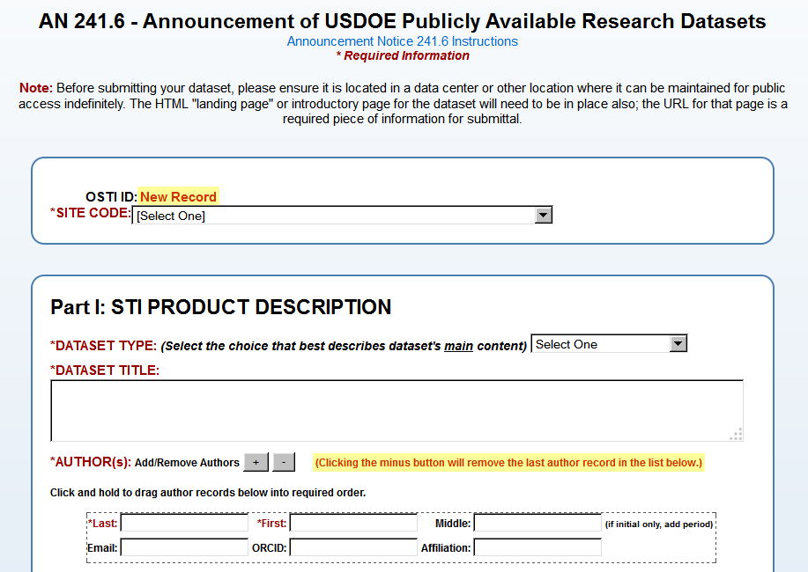
Required Metadata
Dataset Type
Dataset Title
Creator(s)/Principal Investigator(s)
Dataset Product Number(s)
DOE Contract Number(s)
Originating Research Organization
Publication/Issue Date
Language
Country of Origin/Publication
Sponsoring Organization(s)
Site URL (landing page for dataset)
Contact Information (will not be displayed publicly)

Slide 13
Dissemination of Data-Related Information to DOE/OSTI Databases
To SciTech Connect: Semantically searchable database containing all DOE records, including technical reports, journal articles, conference literature, multimedia, and datasets.
To DOE Data Explorer: Inventory of DOE data collections wherever they reside. It also provides access to individual dataset records as they are submitted via the Data ID Service.
Currently over 1050 data collections
and datasets/datastreams in DDE.

Slide 14
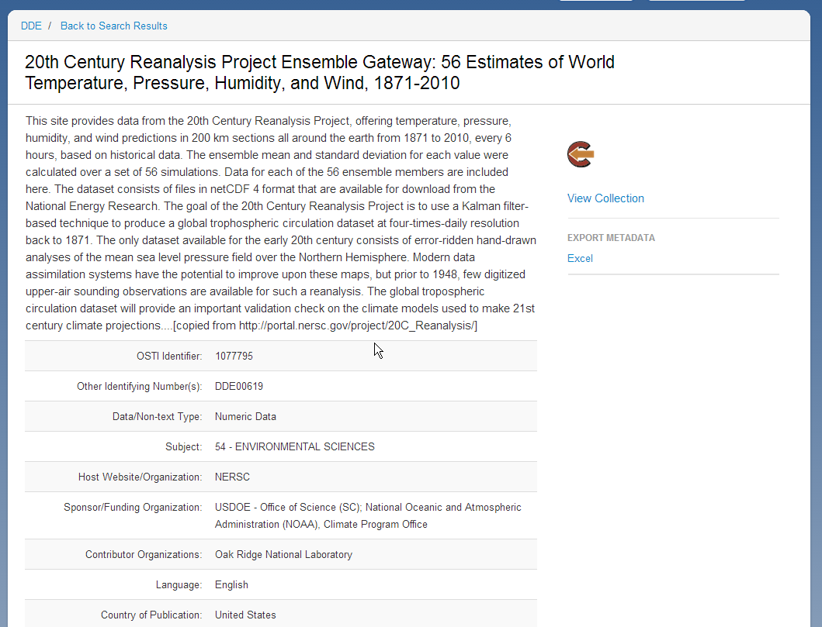
DDE Data Collection Citation
Numeric Data
Figures/Data Plots
Specialized Mix
Genome/Genetics Data
Interactive Data Maps
Animations/Simulations
Multimedia

Slide 15
Dissemination… to Major Search Engines and Beyond
SciTech Connect records, including dataset citations, are picked up and indexed by Google.
Dataset citations also flow to major interagency resource, Science.gov.

Slide 16
OSTI’s Data ID Service Customers
The ARM Data Archive graduated from a pilot project to OSTI’s first data customer.
First DOI for a dataset was assigned by OSTI and registered with DataCite on 8/10/2011.
580 ARM datasets are now registered.

Slide 17
ARM Data Archive
The Challenges:
There are millions of data files from over 3,000 data products.
Many continuous datastreams are created from around-the-clock monitoring of environment by multiple instruments. Temporal and geographic information becomes very important.
There is a large user community (climate change model community).
Data are also published via other portals.

Slide 18
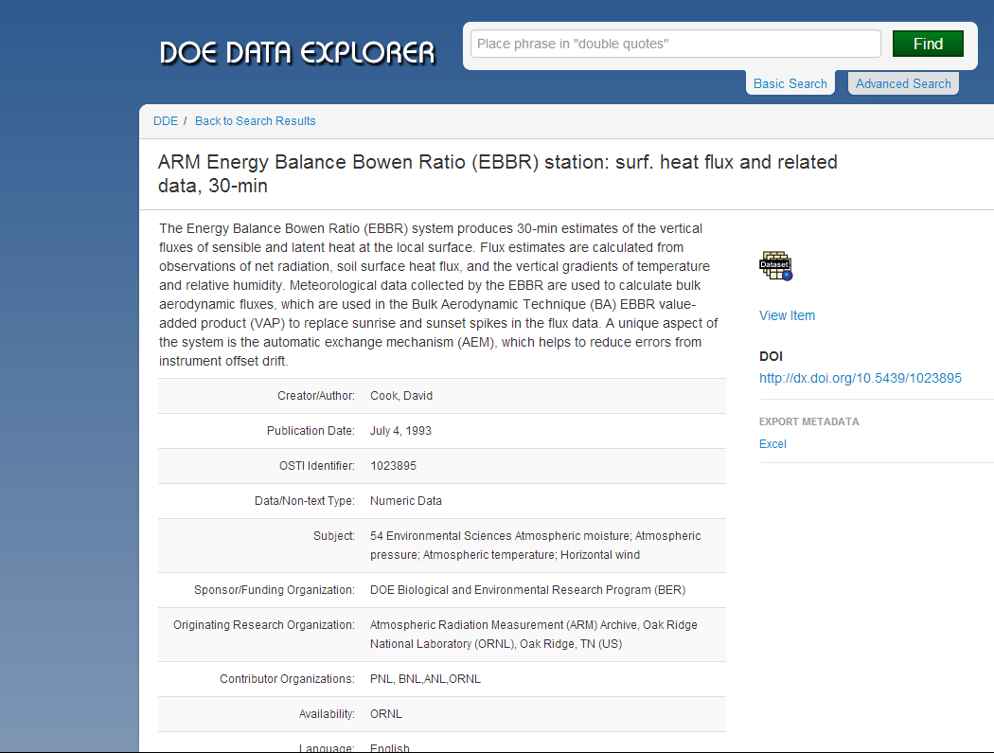
DDE Citation for ARM Datastream

Slide 19
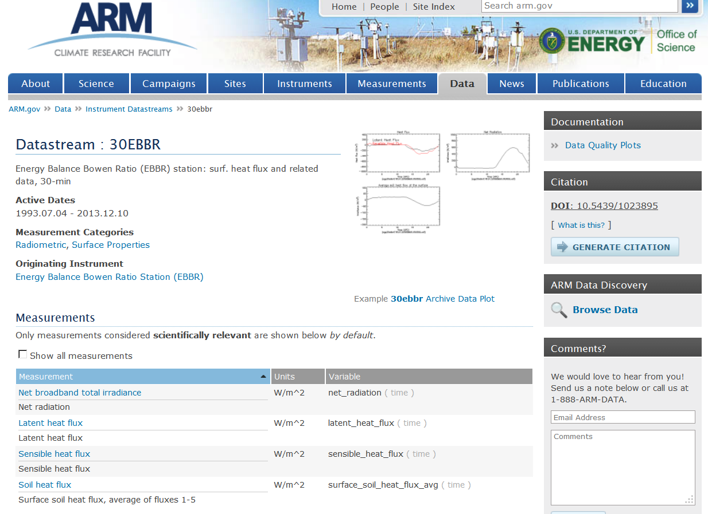
“Landing Page” for the DOI (10.5439/1023895) assigned to this ARM datastream

Slide 20
OSTI’s Data ID Service Current Status
Data Clients in Production
Atmospheric Radiation Management Program (ARM Archive at ORNL)
Irradiance and Meteorological Data, Renewable Resource Data Center (RReDC at NREL)
Coherent X-ray Imaging Data Bank (CXIDB at LBNL)
Next Generation Ecosystems Experiment – Arctic (NGEE-Arctic at ORNL)
Data Clients in Testing
Oak Ridge Leadership Computing Facility (OLCF at the National Center for Computational Sciences, ORNL)
Data Clients Committed and Planning
National Nuclear Data Center (NNDC at BNL)
DOE Geothermal Data Repository

Slide 21
AIP Pilot – Physics of Plasmas
History of collaboration between AIP and OSTI
Experience with dataset citation
Allocating agent for DOIs – i.e. DataCite membership

Slide 22
Questions?
Mark Martin
martinm@osti.gov
www.osti.gov

