Slide 1
Data Accessibility:
The Role of the Publisher
Alison Waldron
Princeton Plasma Physics Lab Meeting
December 16, 2013

Slide 2
Data Accessibility: Why?
US National Science Board’s (NSB) Task Force on Data Policies issued its report
on Digital Research Data Sharing and Management (NSB 2011) requiring “…grantees to make both the data and the methods and techniques used in the creation and analysis of the data accessible for the purposes of building upon or verifying figures, tables, findings, and conclusions in peer reviewed publications.”
But Beyond Govt. Mandates:
Researchers should get credit – data should be citable
Help authors comply with funding agency accessibility requirements
Make data accessible, and usable – need industry standards
Reduce barriers to furthering research

Slide 3
Data Accessibility: What?
The aim of this project is to
Develop methods for acquiring the digital data that underlie figures and tables
Provide access to the actual data objects that underlie the figures and tables in the published literature
Educate scientists about the importance of making such data sets available

Slide 4
Data Accessibility: How?
Develop methods for incorporating data in published articles for: The Astronomical Journal and The Astrophysical Journal (AAS) and Physics of Plasmas (AIPP).
Author Surveys
Workshops: data, metadata, data peer-review
Develop methods for production, delivery, discovery, & linking
Make functionality available to authors
Assessment: look for areas of improvement

Slide 5
Open questions
How should the data be presented
Do we have the right metadata? What other metadata does plasma physics require?
What are popular repositories or repository traits?
Are we missing common data formats?
What unique features would make this useful to the global community?

Slide 6
How it Could Look

Slide 7
First: A Special Thanks!
David Smith and co-authors volunteered their Physics of Plasmas article
and two datasets (two tables and two figures) THANKS!
DOE-OSTI created and registered two separate records with DataCite,
each provided with its own OSTI ID (links not yet live)

Slide 8
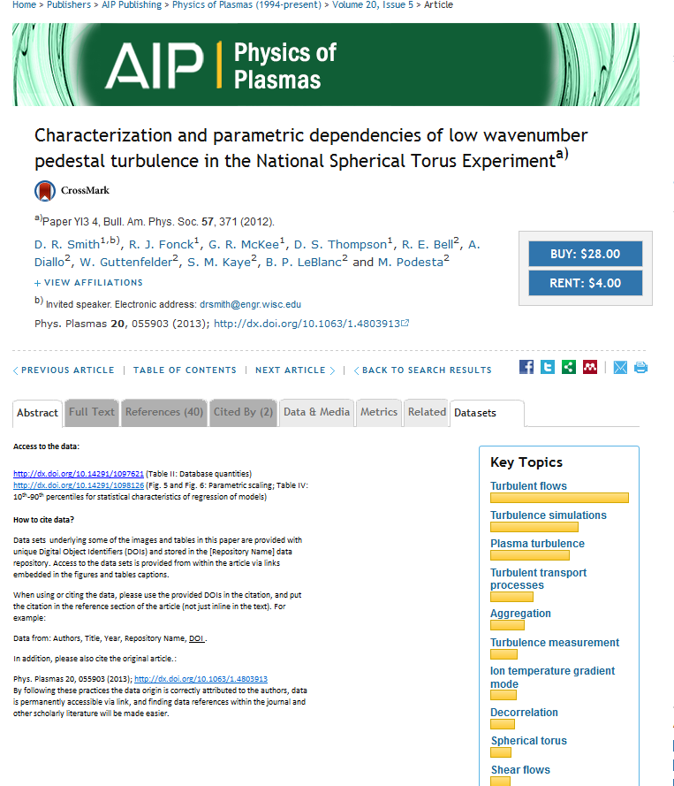
How will it work?
Datasets must be openly accessible
From abstract page and table/figure view (not just from the body of the article)
Without a subscription

Slide 9
Access to the data: Each dataset will have it’s own doi
http://dx.doi.org/10.14291/1097621 (Table II: Database quantities)
http://dx.doi.org/10.14291/1098126 (Fig. 5 and Fig. 6: Parametric scaling; Table IV: 10th-90th percentiles for statistical characteristics of regression of models)
How to cite data?
Data sets underlying some of the images and tables in this paper are provided with unique Digital Object Identifiers (DOIs) and stored in the [Repository Name] data repository. Access to the data sets is provided from within the article via links embedded in the figures and tables captions.
When using or citing the data, please use the provided DOIs in the citation, and put the citation in the reference section of the article (not just inline in the text). For example:
Data from: Authors, Title, Year, Repository Name, DOI .
In addition, please also cite the original article.:
Phys. Plasmas 20, 055903 (2013); http://dx.doi.org/10.1063/1.4803913
By following these practices the data origin is correctly attributed to the authors, data is permanently accessible via link, and finding data references within the journal and other scholarly literature will be made easier.

Slide 10
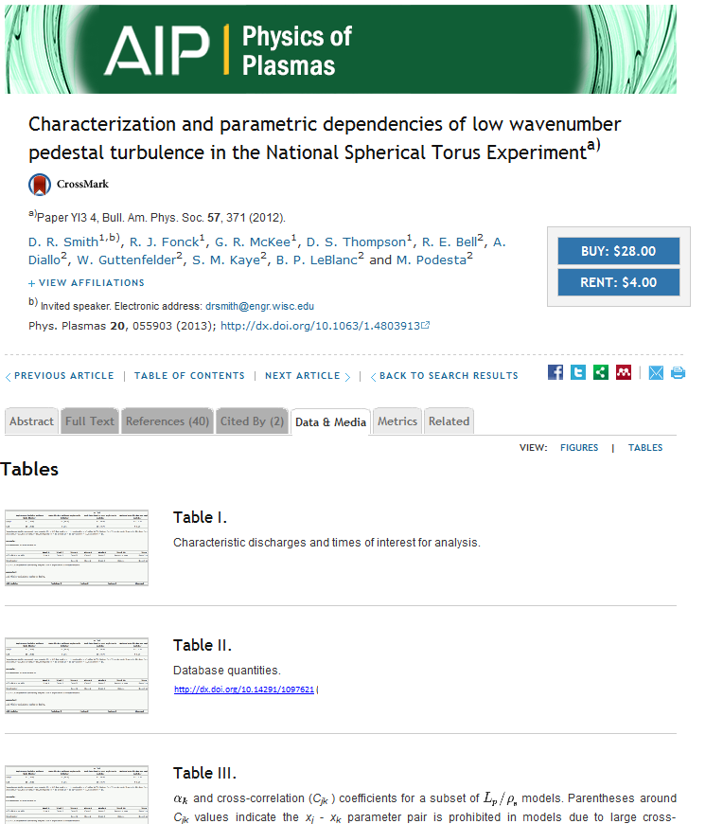
From the Abstract View

Slide 11
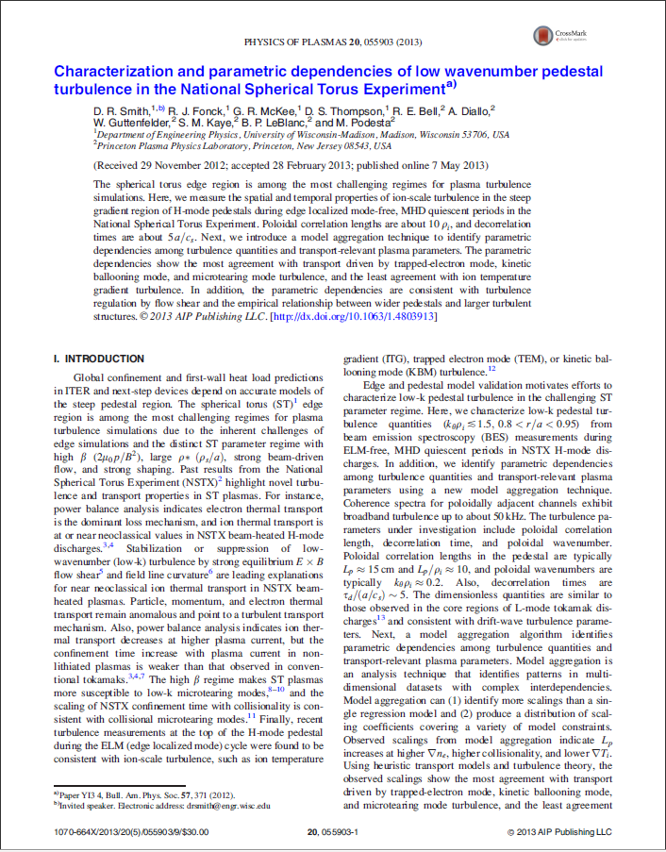
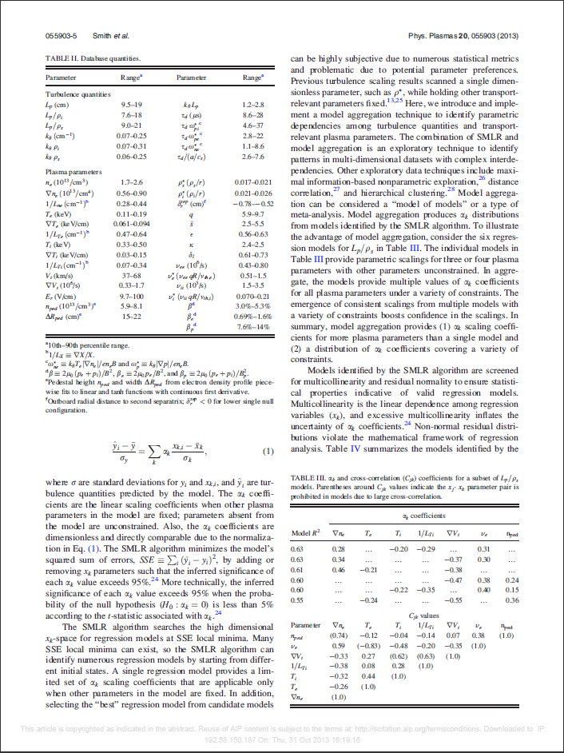
Published Article with Data
http://dx.doi.org/10.14291/1097621

Slide 12
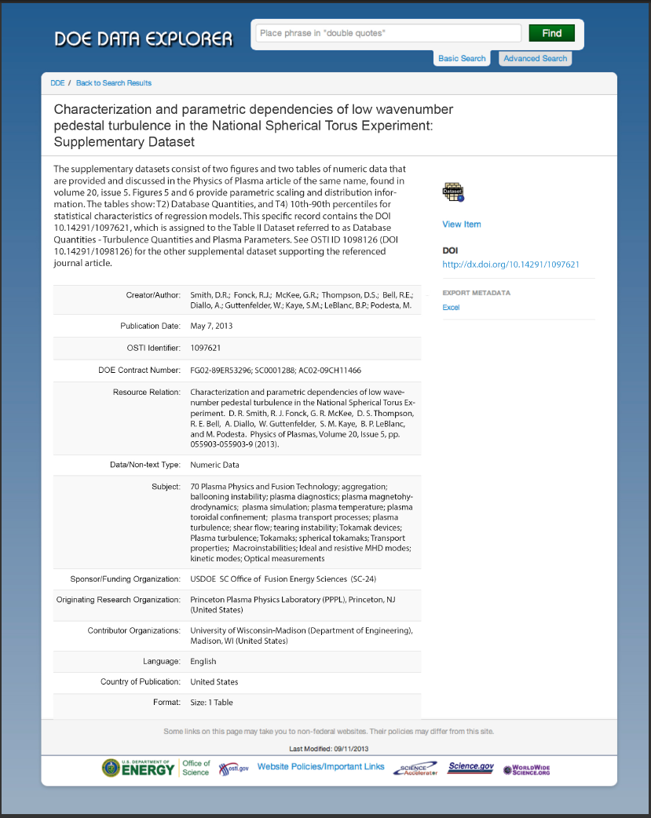
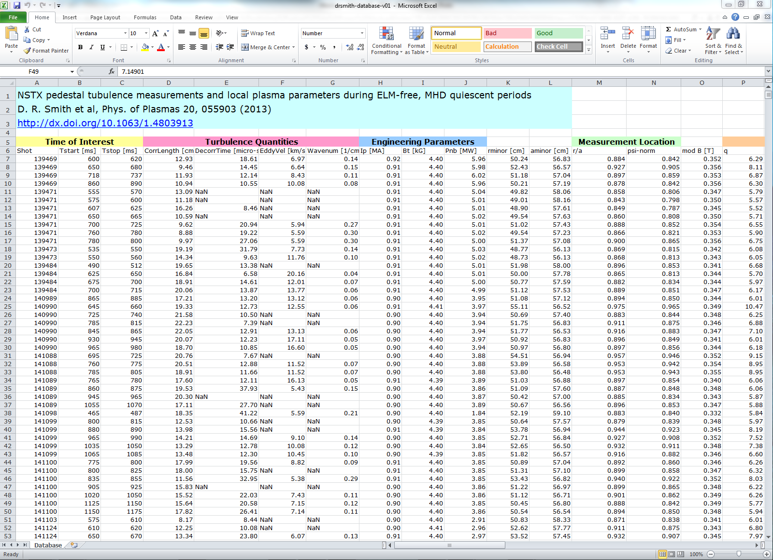
Data Landing Page

Slide 13
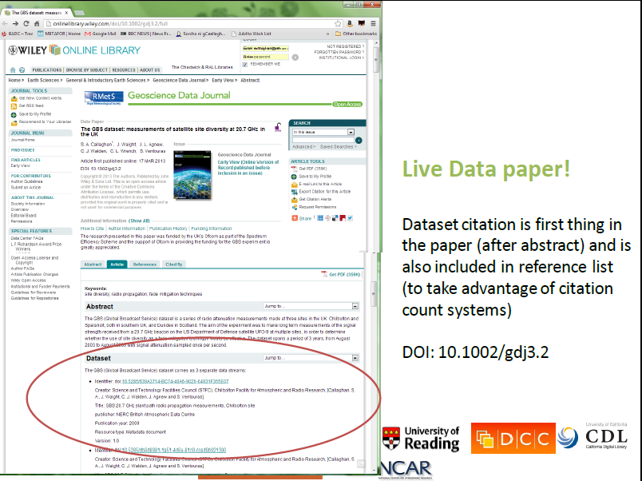
Other Examples: GDJ abstract view

Slide 14
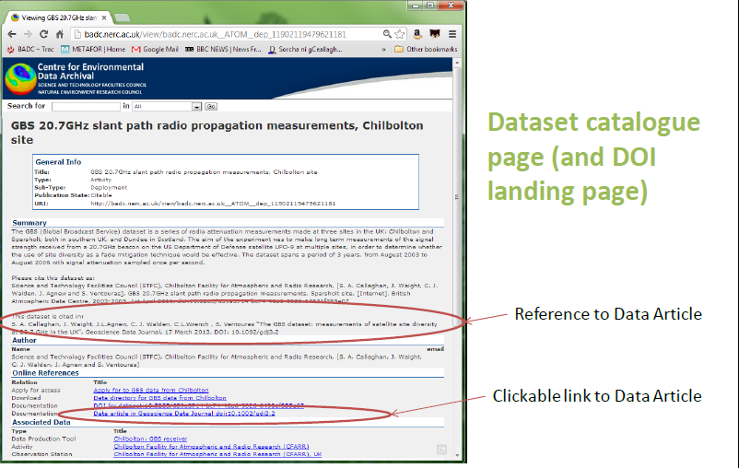
Other Examples: DOI Landing Page

Slide 15
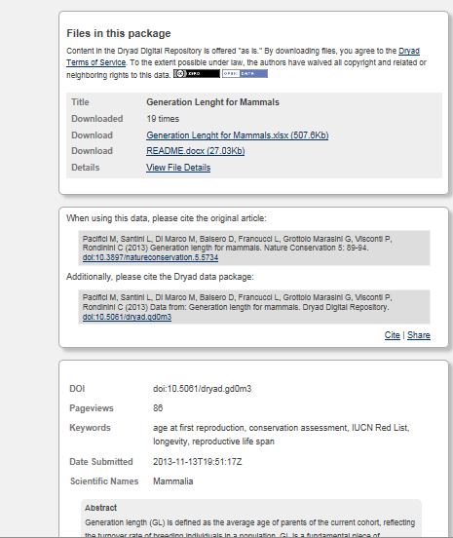
Other Examples: Dryad Landing Page
Possibility for README files
Bi-directional links
Data submission time stamp!!

Slide 16

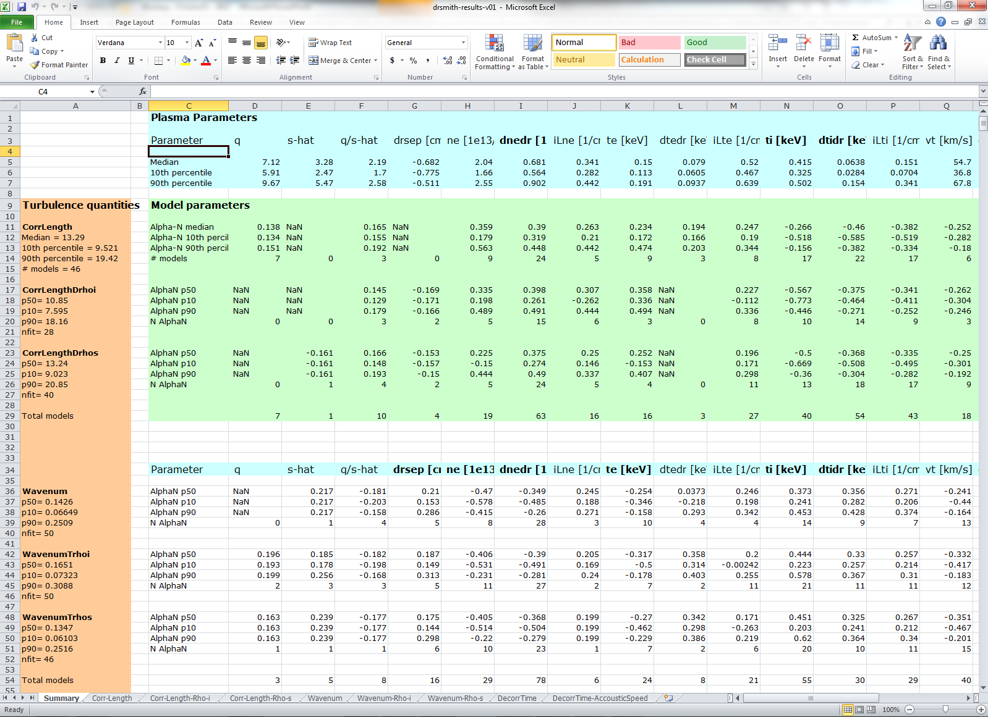
Cross-linking

Slide 17
Data Repositories

Slide 18
Data Repositories: Standard Practices
Enable access to the dataset
Ensure dataset persistence
Clear responsibility of preserving data long term
Quality control measures in place
Unique/persistent id resolving to open landing page
Enable searching and retrieval of datasets
Collect information about repository statistics
For peer-review and post-publication

Slide 19
Wiley’s Acceptable Repositories
For Geoscience Data Journal, acceptable repositories are:
3TU.Datacentrum
British Atmospheric Data Centre (BADC)
British Oceanographic Data Centre (BODC)
CISL Research Data Archive
CSIRO Data Access Portal
Environmental Information Data Centre (EIDC)
Figshare
IEDA:EarthChem
IEDA:MGDS
National Geoscience Data Centre (NGDC)
NCAR Earth Observing Lab data archive
NERC Earth Observation Data Centre (NEODC)
NOAA National Climatic Data Center (NCDC)
NOAA National Oceanographic Data Center (NODC)
NOAA National Geophysical Data Center (NGDC)
PANGAEA
Polar Data Centre (PDC)
Zenodo

Slide 20
Other Repositories: Key Questions
Dryad now charges a fee to authors for depositing data – Is this something you would be willing to pay a fee for?
Are institutional/large lab/funding agency repositories viewed more favorably?
What will you consider when selecting a data repository?

Slide 21
Community Needs

Slide 22
Differences across the community
Data management plans vary
Repository Preferences
Other differences across the plasma physics community?
Data accessibility concerns at the moment are regional

Slide 23
Next Steps

Slide 24
Next Steps
Clarify internal implementation and workflow
Launch pilot
Gather final input

