Slide 1
Synthetic Aperture Microwave Imaging on MAST and NSTX-U
S. J. Freethy¹, K. J. Brunner^{1,2} , J Chorley^{1,2} D. Thomas^{1,3}, V. F. Shevchenko¹, J. Urban⁴ and R. G. L. Vann³
1 EURATOM/CCFE Fusion Association, Abingdon, Oxfordshire, OX14 3DB, UK
2 Centre for Advanced Instrumentation, Department of Physics, Durham University, Durham, UK
3 York Plasma Institute Department of physics, University of York, York, YO10 5DD, UK
4 Institute of Plasma Physics, Academy of Sciences of the Czech Republic, Prague

Slide 2
Outline
Introduction and motivations – S. J. Freethy
  Introduction to SAMI
  Introduction to EBW emission
  Results from MAST
Reflectometry and backscattering – D. Thomas
  Multiple reflectometers
  Backscattering and Doppler shifts
Technical developments and upgrade – J. Brunner
  FPGAs
  The SAMI digitiser
  FPGA/GPU data “real-time” data processing

Slide 3
Outline
Introduction and motivations – S. J. Freethy
  Introduction to SAMI
  Introduction to EBW emission
  Results from MAST
Reflectometry and backscattering – D. Thomas
  Multiple reflectometers
  Backscattering and Doppler shifts
Technical developments and upgrade – J. Brunner
  FPGAs
  The SAMI digitiser
  FPGA/GPU data “real-time” data processing

Slide 4
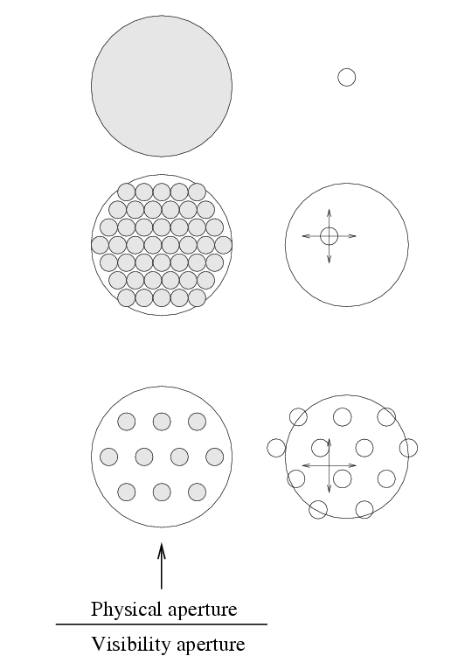
SAMI is a thinned array
For imaging microwaves you can use…
A lens or mirror element steered by moving the element,
or used to focus image onto an array of detectors.
A traditional phased array is a filled aperture of phase sensitive antennas.
Beam is steered through phase control of elements
High signal to noise, but high redundancy
A thinned array makes use of the spatial incoherence of the source to remove redundancies, making images of the same fidelity with much fewer elements
Beam is steered through phase control of elements
Beam steering replaced by Fourier Transform

Slide 5
SAMI is a thinned array
For imaging microwaves you can use…
A lens or mirror element steered by moving the element,
or used to focus image onto an array of detectors.
A traditional phased array is a filled aperture of phase sensitive antennas.
Beam is steered through phase control of elements
High signal to noise, but high redundancy
A thinned array makes use of the spatial incoherence of the source to remove redundancies, making images of the same fidelity with much fewer elements
Beam is steered through phase control of elements
Beam steering replaced by Fourier Transform

Slide 6
SAMI is a thinned array
For imaging microwaves you can use…
A lens or mirror element steered by moving the element,
or used to focus image onto an array of detectors.
A traditional phased array is a filled aperture of phase sensitive antennas.
Beam is steered through phase control of elements
High signal to noise, but high redundancy
A thinned array makes use of the spatial incoherence of the source to remove redundancies, making images of the same fidelity with much fewer elements
Beam is steered through phase control of elements
Beam steering replaced by Fourier Transform

Slide 7
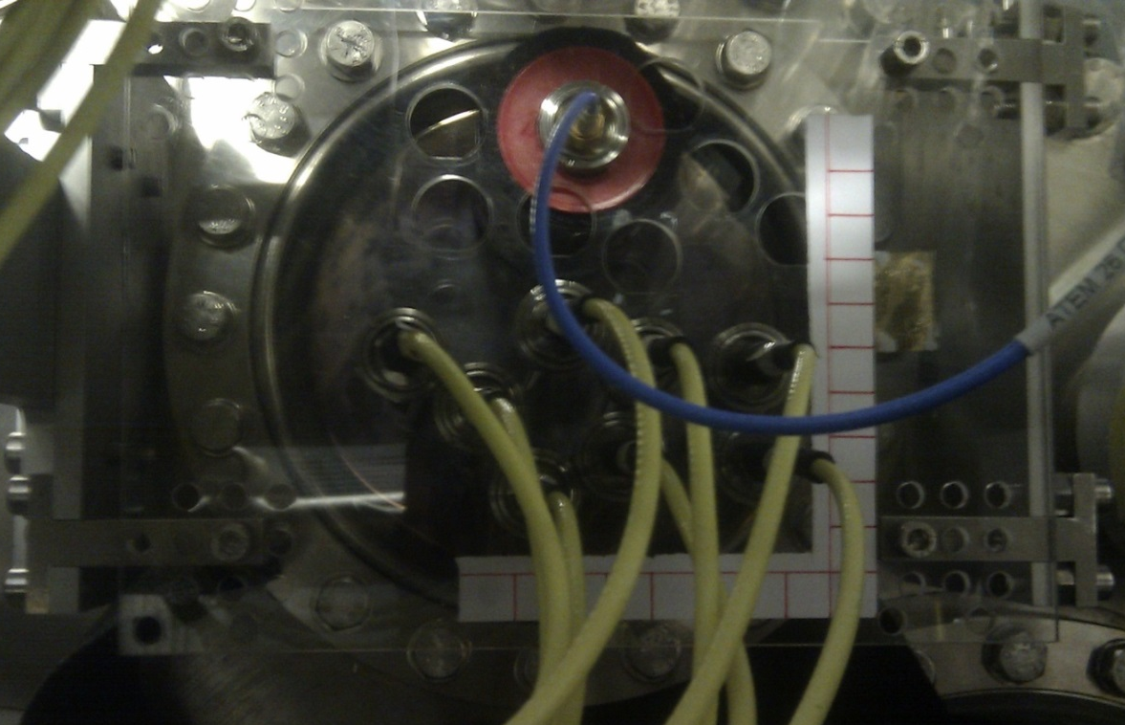
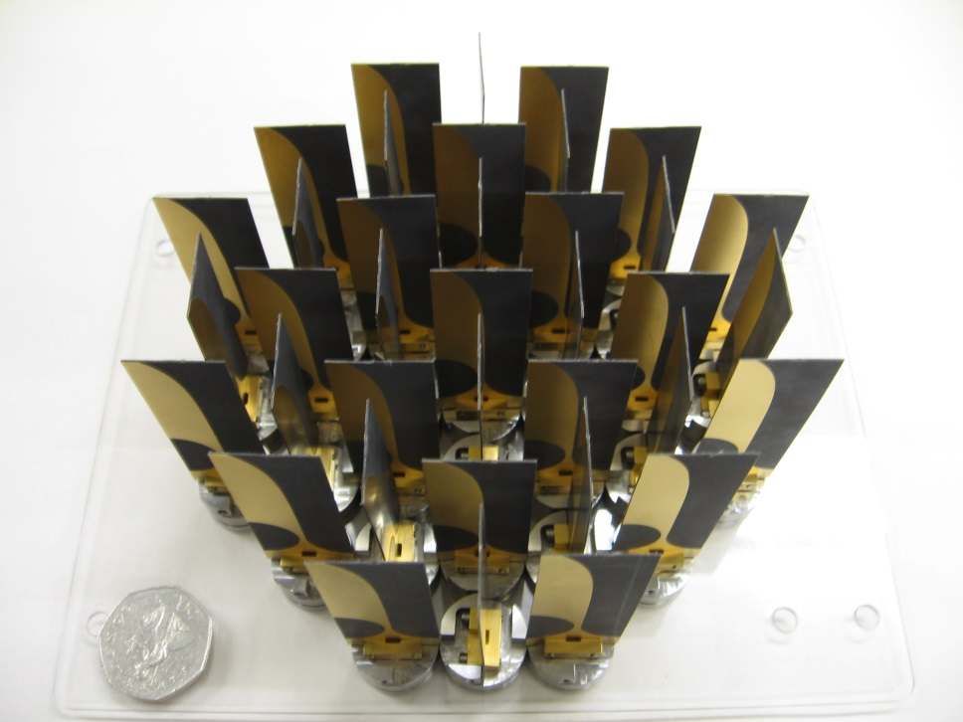
SAMI array
8 Antenna array installed on MAST
36 Antenna array for illustration
Linear polarised, very broadband PCB based antenna
Array has wide field of view -> small antenna spacings

Slide 8
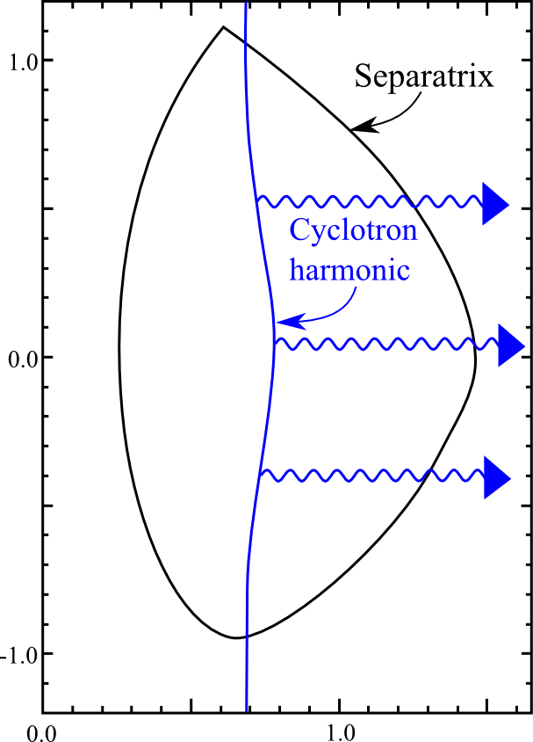
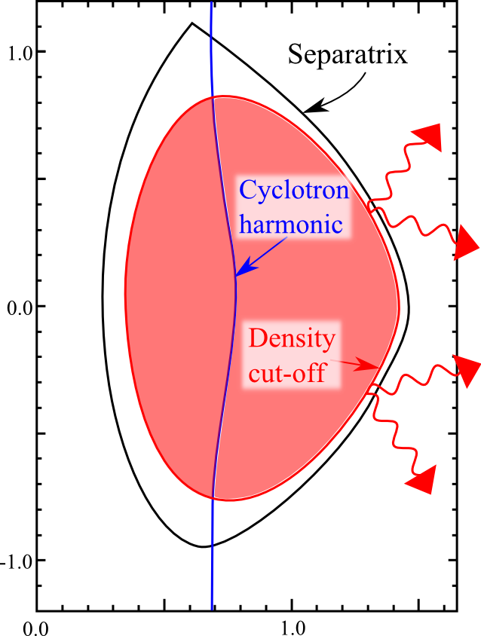
Emission from over-dense machines
Most conventional tokamaks emit thermal radiation from Cyclotron harmonics
High beta machines tend to have their harmonics covered by cut-offs
EBE
Under-dense -> Normal ECE
Over-dense -> mode converted emission

Slide 9
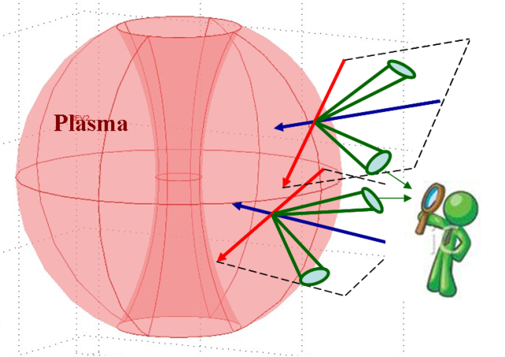
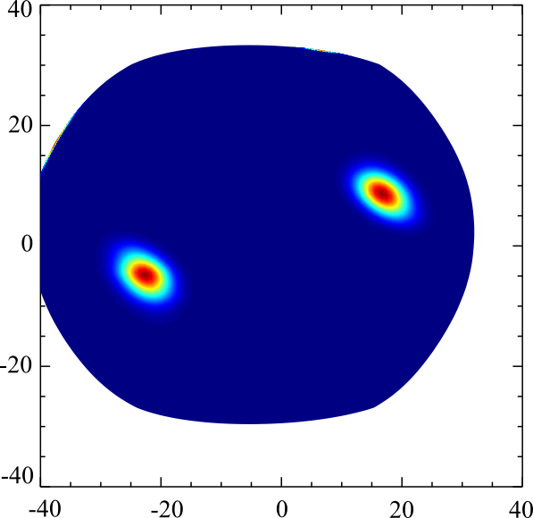
Mode converted emission
The dependence of the Mode Conversion (MC) on the incident angle to the field means the emission is anisotropic.
The MC’d emission takes the form of narrow angular cones.
When all emission is considered, it appears as two spots on the plasma density surface along the magnetic field line.
Mode conversion happens at different layers in the plasma for different frequencies, so we may diagnose different radii

Slide 10
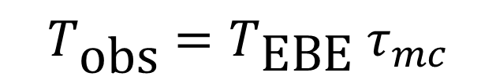
Mode Converted Emission
The brightness-temperature of the emission is the product of the brightness-temperature of the EBW at source and the mode conversion coefficient.
$$T_{\text{obs}}=T_{\text{EBE}} τ_{mc}$$

Slide 11
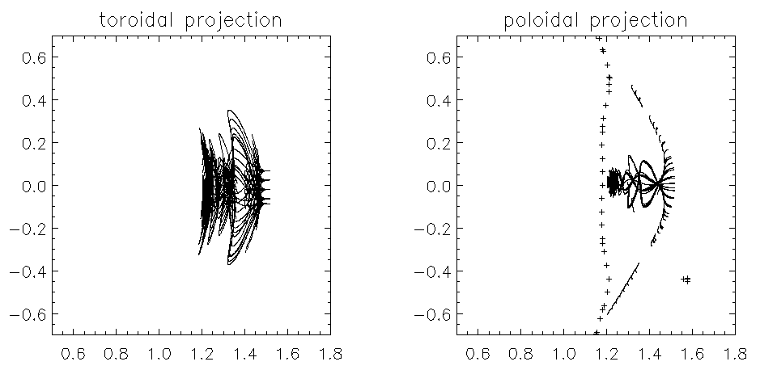


Ray tracing shows strong off-midplane Doppler broadening
11GHz example – Only rays on the midplane originate at the cyclotron harmonic
$$ω_{\text{c}}$$
$$ω_{\text{UHR}}$$
Off midplane, the rays originate from the colder outer regions

Slide 12
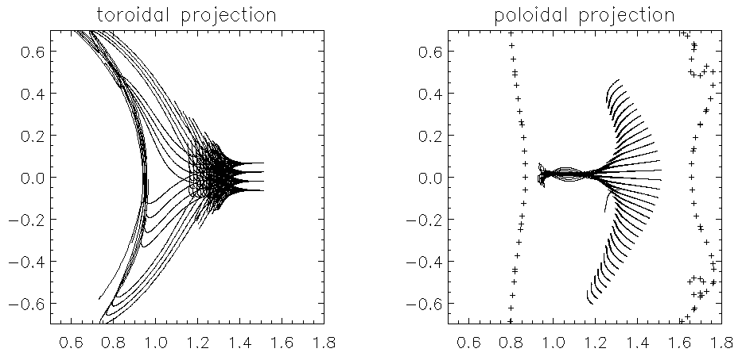


Maximum penetration between harmonics
15GHz example – Maximum penetration of off midplane rays happens between harmonics
$$ω_{\text{c}}$$
$$ω_{\text{UHR}}$$
$${2ω}_{\text{c}}$$

Slide 13
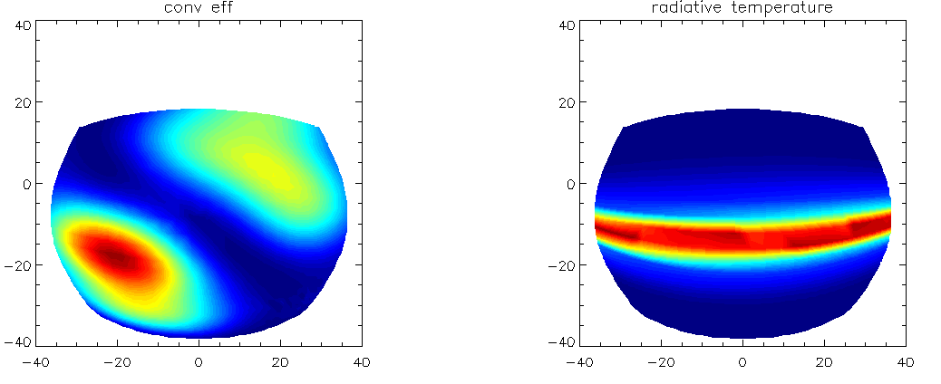
Radiative temperature effect
Performing AMR simulations we can see that, for low frequencies, the wave refraction dominates the observable emission profile.
11GHz
11GHz
X
Cold periphery
Harmonic emission

Slide 14
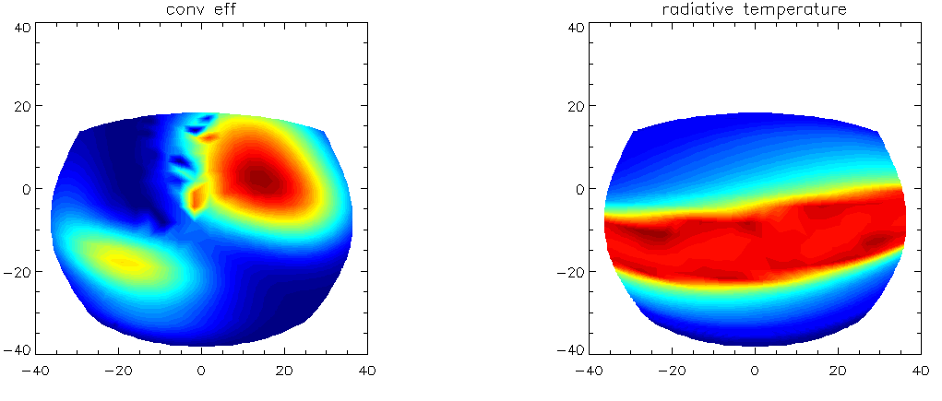
Radiative temperature effect
In between the harmonics, the effect is less pronounced, but still present.
15GHz
15GHz
X
transition
Core emission

Slide 15
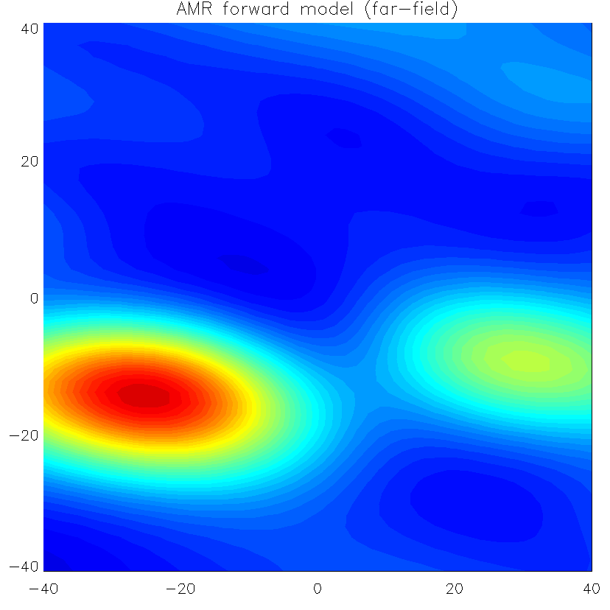
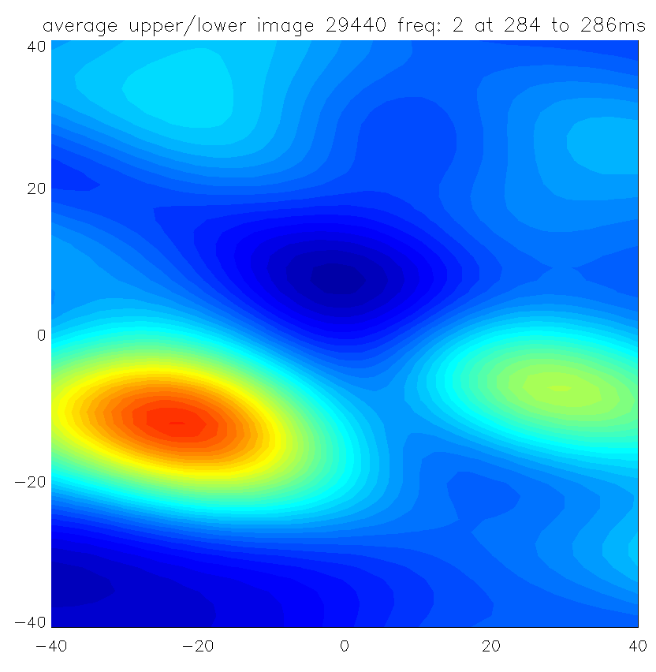
Forward model 11GHz
Excellent agreement between convolved AMR emission and observed emission

Slide 16
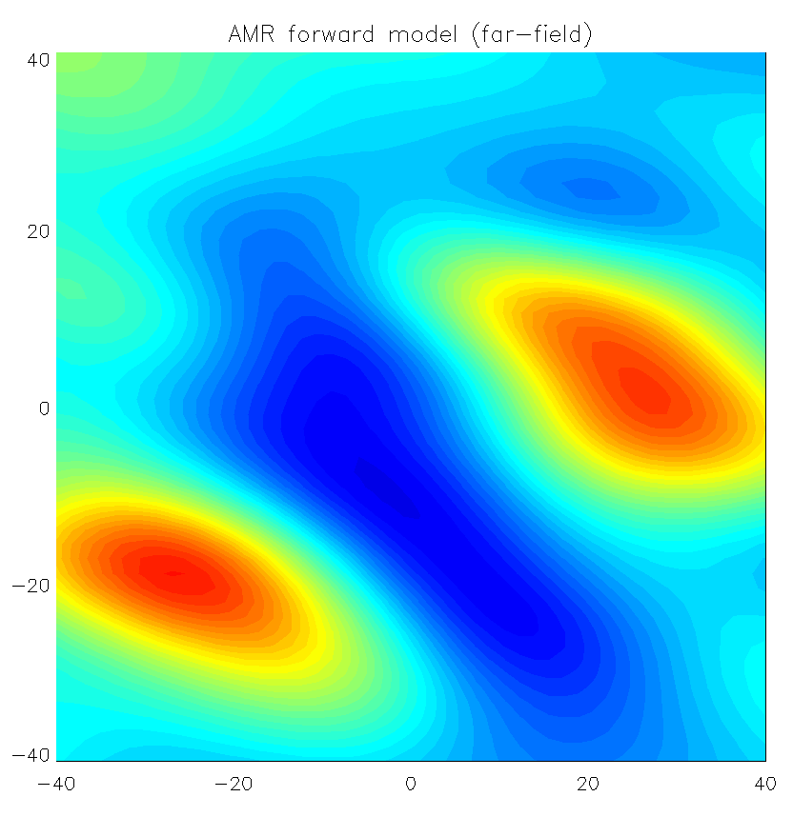
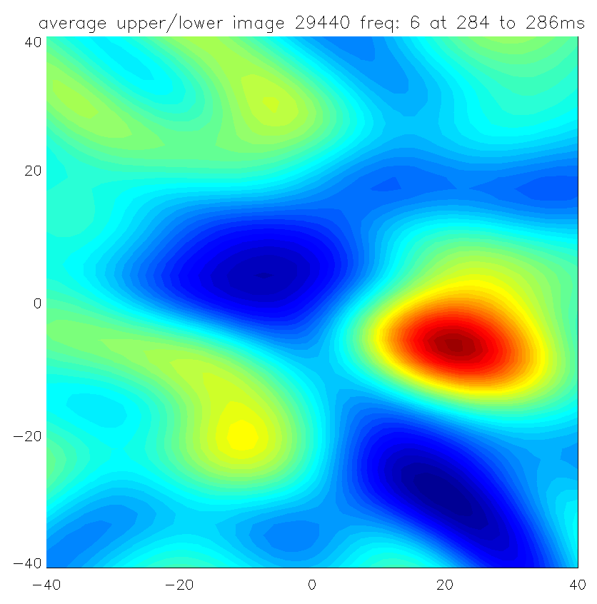
Forward model 15GHz
Less good agreement at higher frequencies.
“Pitch” is consistently flatter than predicted

Slide 17
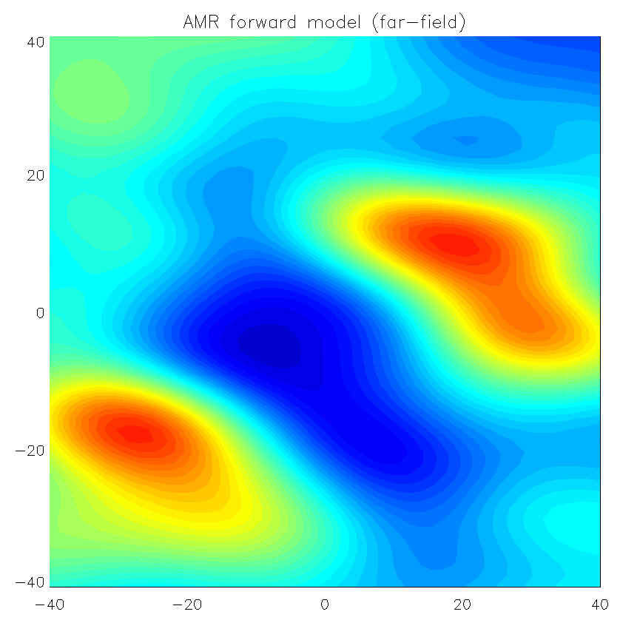
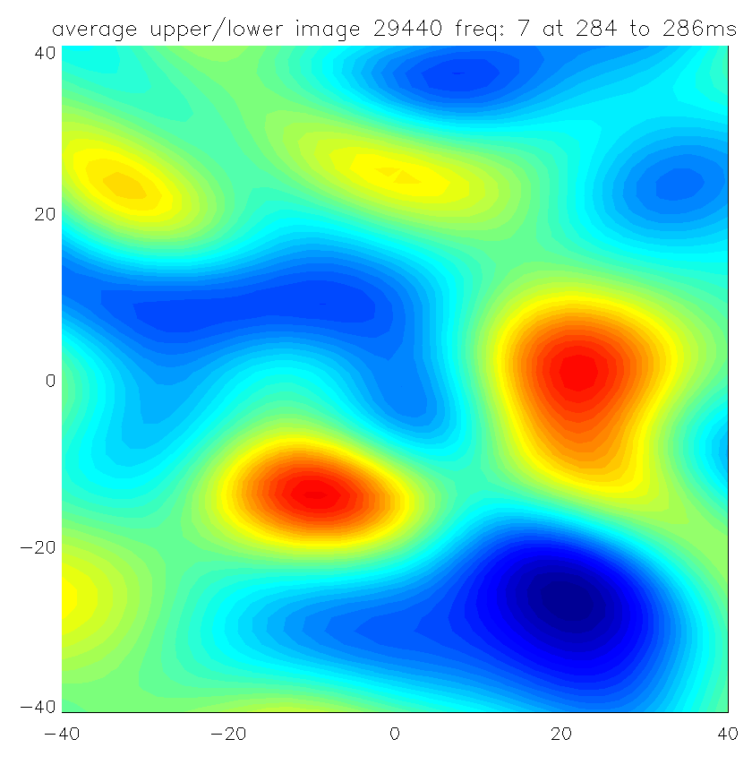
Forward model 16GHz
Elongation of observed upper window, due to emission window splitting in two

Slide 18
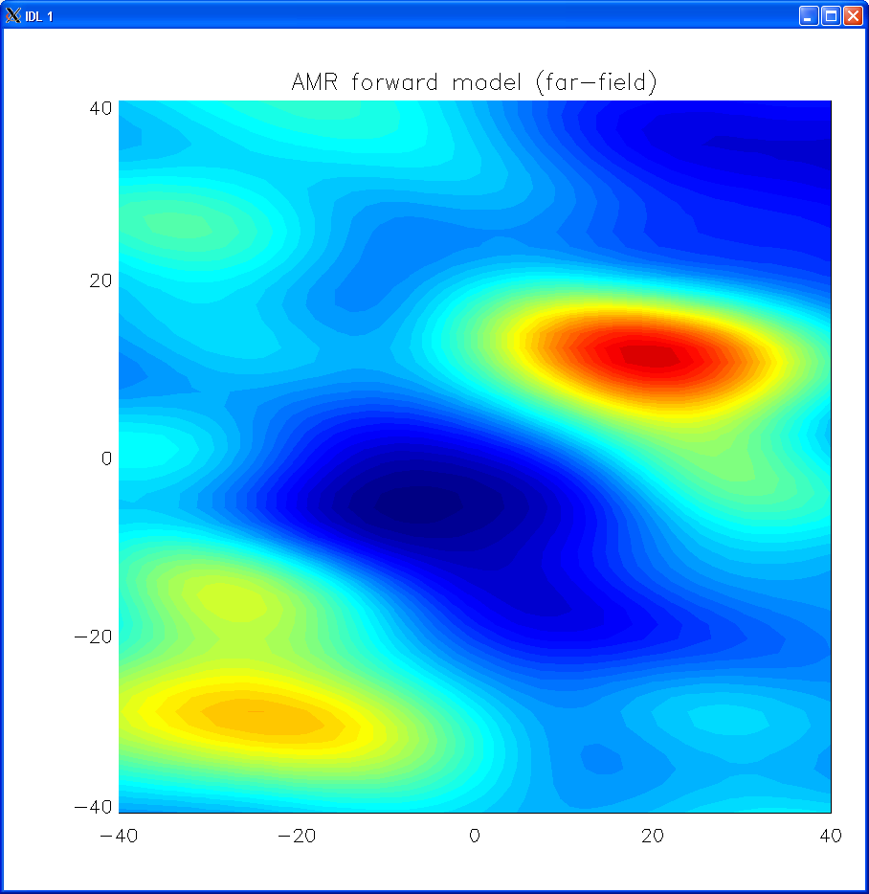
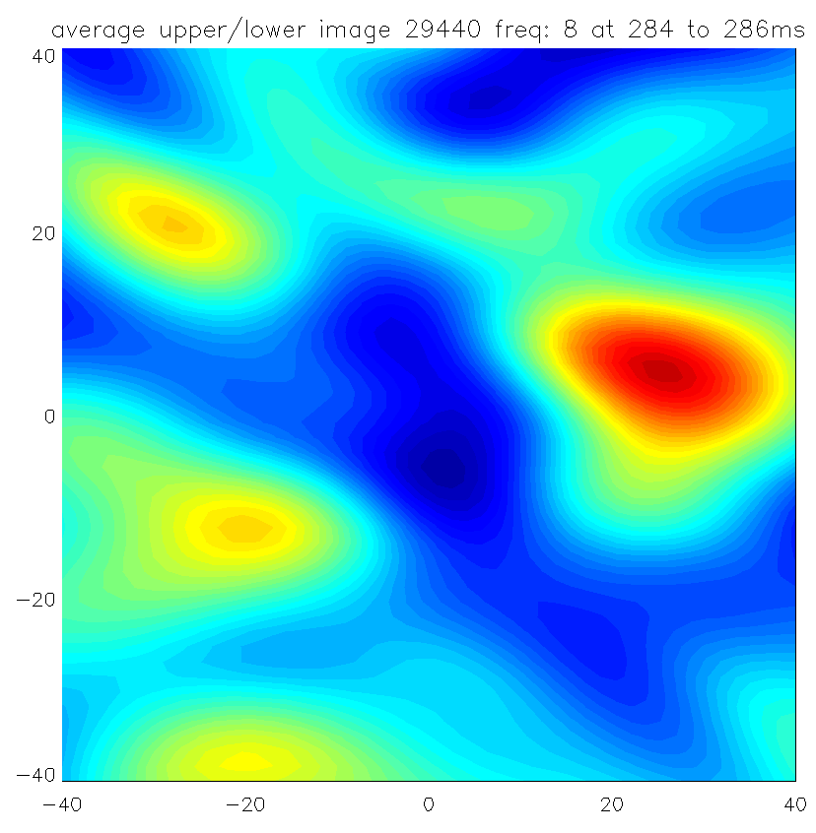
Forward model 17GHz
Right hand window moves up off the midplane signalling 2nd harmonic emission beginning to take over. Hotter, fundamental emission is seen only off midplane.

Slide 19
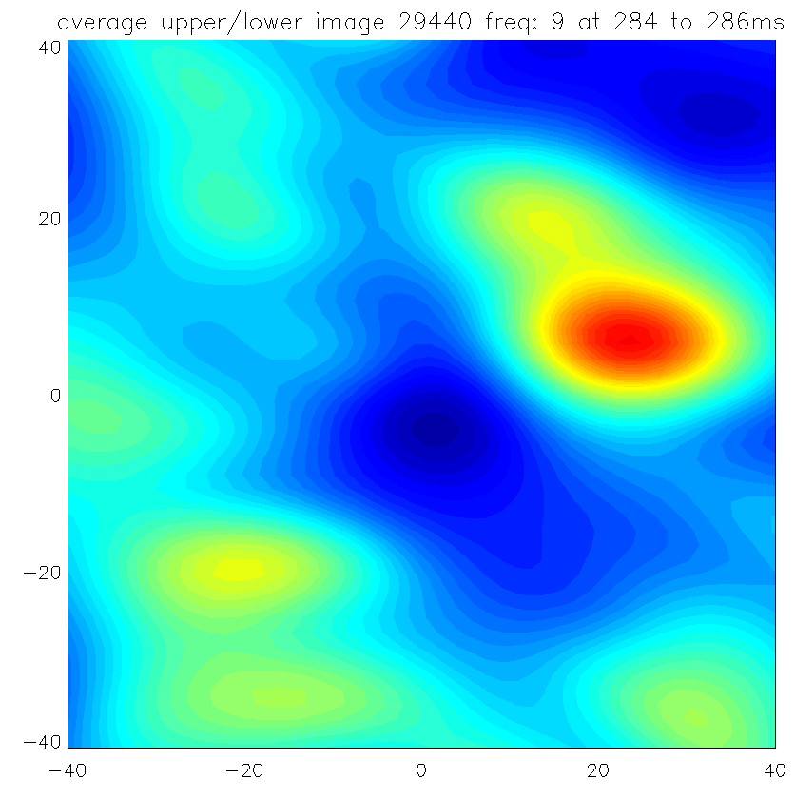
Forward model 18GHz
Continuing to higher frequencies, the midplane emission shuts down entirely as the 2nd harmonic begins to overlap with the UHR

Slide 20
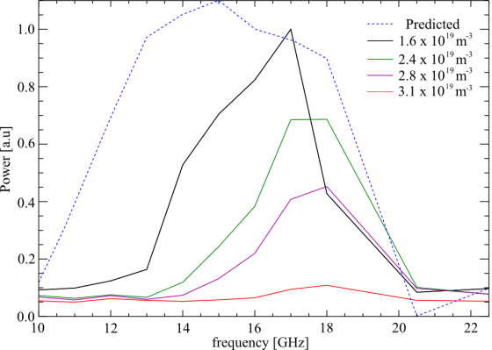
Density dependence of emission
Peak emission moves to higher frequency
Scooped lower frequencies

Slide 21
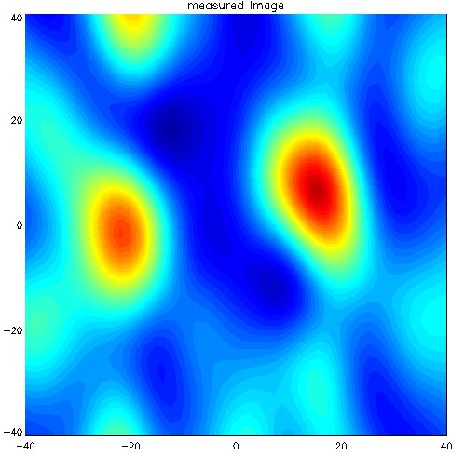
Array on midplane ne = 1.6e19 m⁻¹
Clear trend of decreasing apparent pitch with increasing ne.

Slide 22
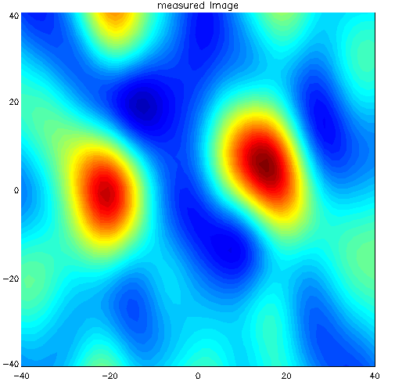
Array on midplane ne = 2.4e19 m⁻¹
Clear trend of decreasing apparent pitch with increasing ne.

Slide 23
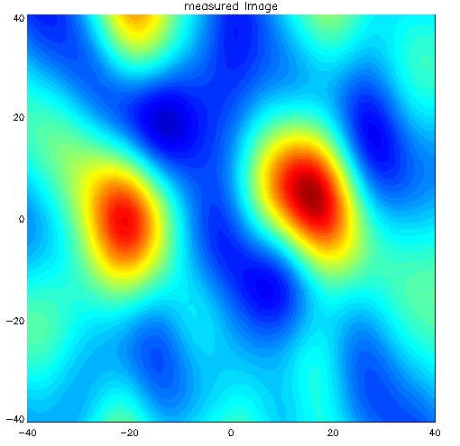
Array on midplane ne = 2.8e19 m⁻¹
Clear trend of decreasing apparent pitch with increasing ne.

Slide 24
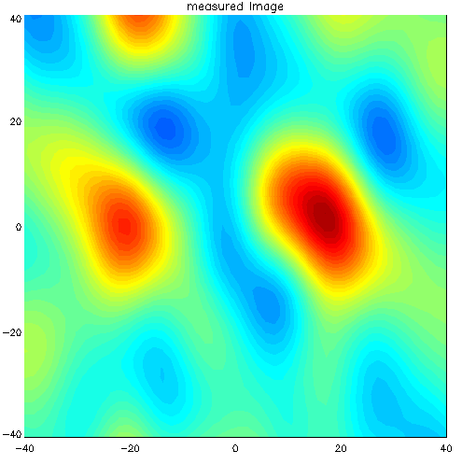
Array on midplane ne = 3.1e19 m⁻¹
Clear trend of decreasing apparent pitch with increasing ne.

Slide 25
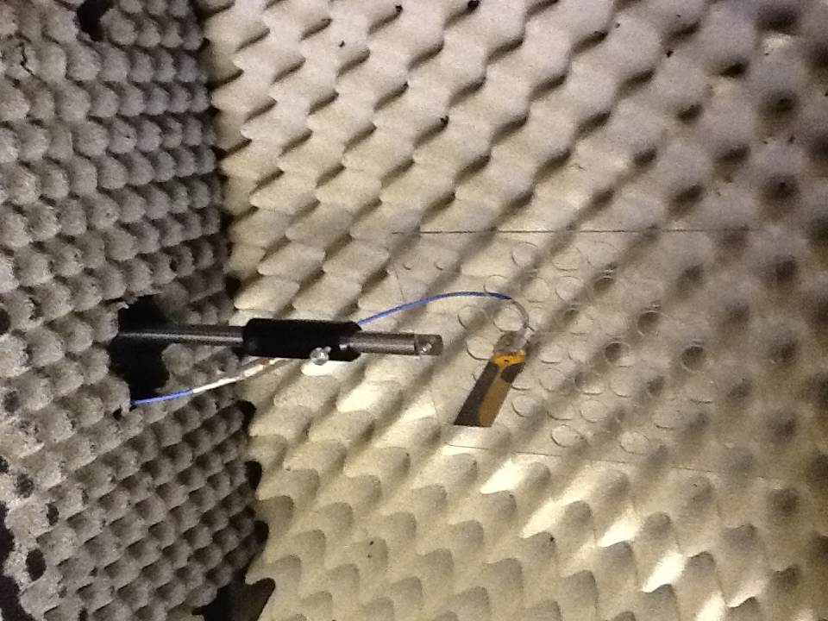
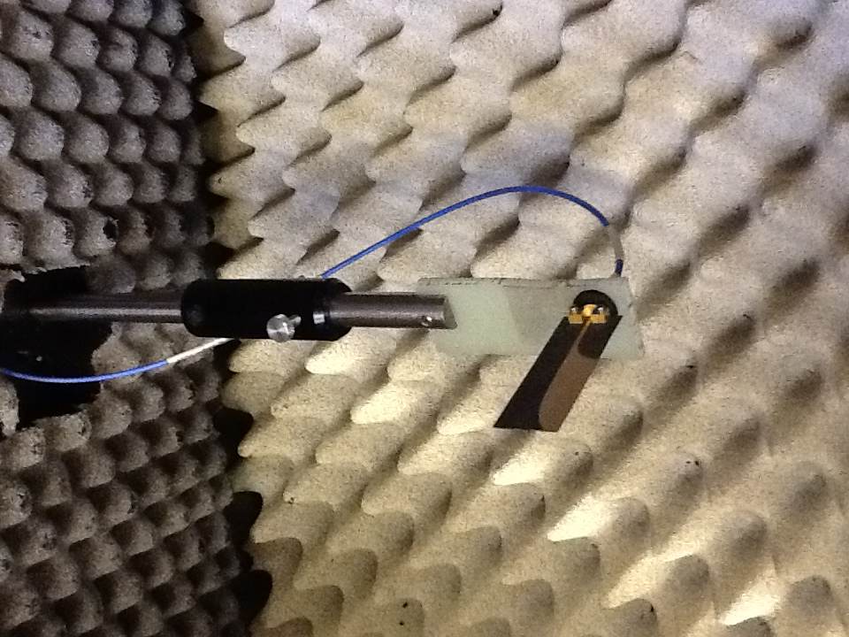
Single antenna setups

Slide 26
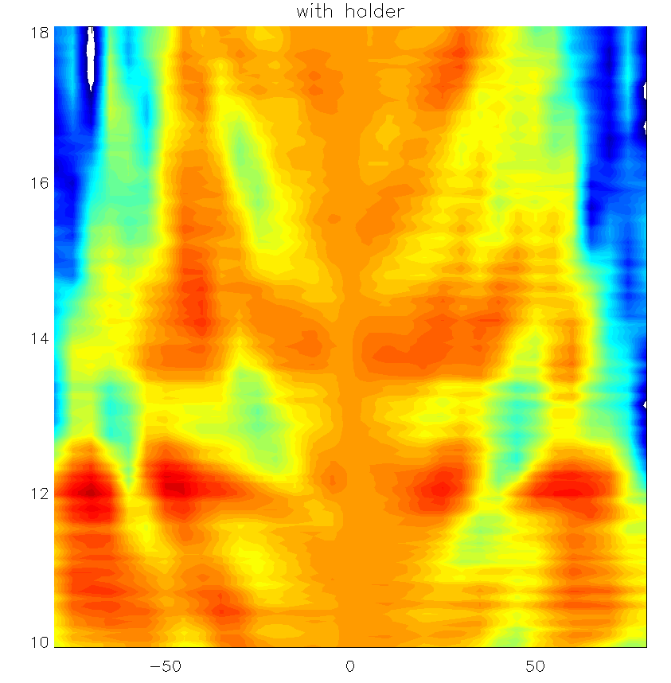
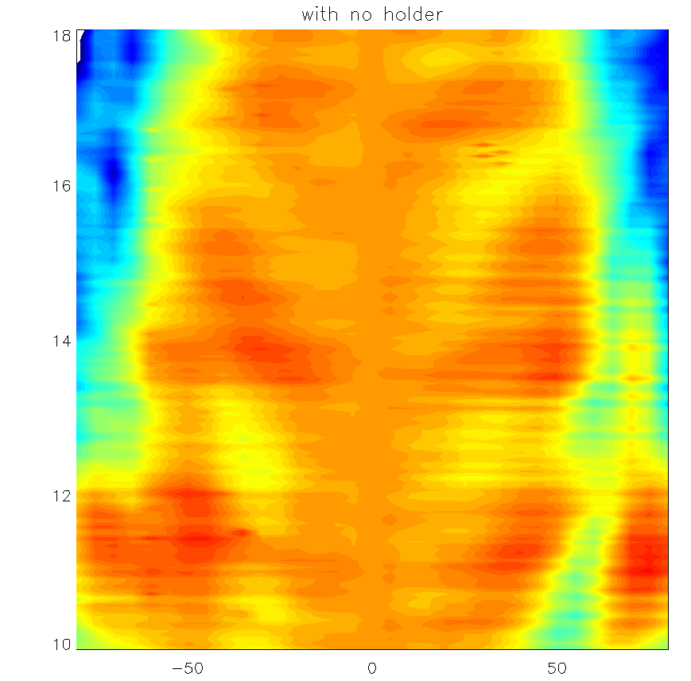
Normalised straight ahead and power in dB
Colour range = -15dB – >5 dB
With holder
No holder
Frequency [GHz]
Frequency [GHz]
Angle [deg]
Angle [deg]

Slide 27
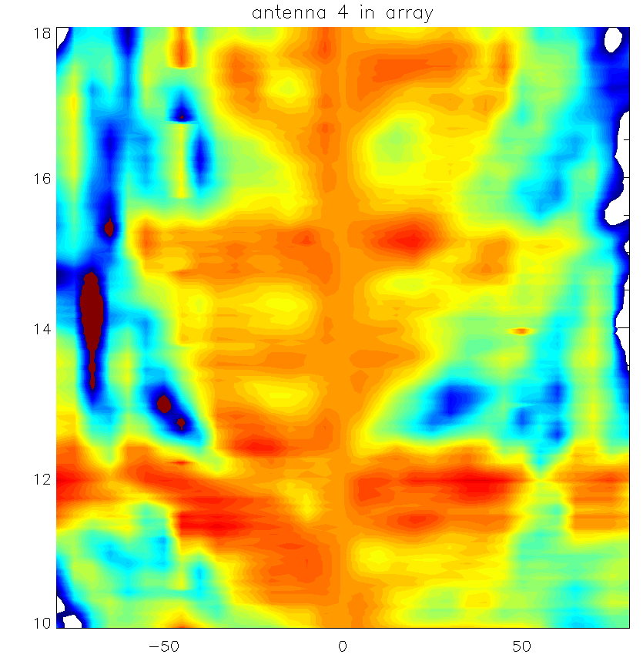
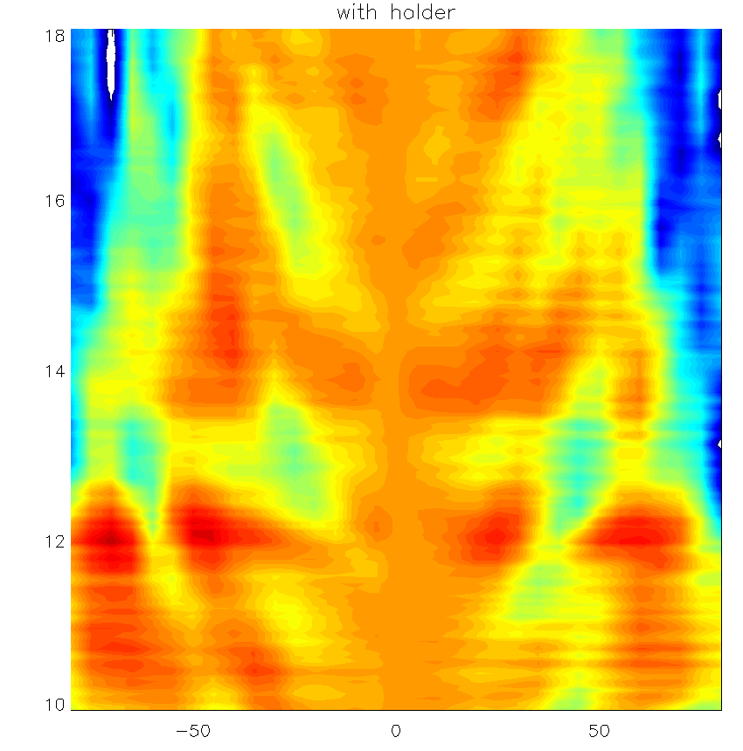
Antenna comparisons
Colour range = -15dB – >5 dB
Antenna 4 in array
Single antenna
Frequency [GHz]
Frequency [GHz]
Angle [deg]
Angle [deg]

Slide 28
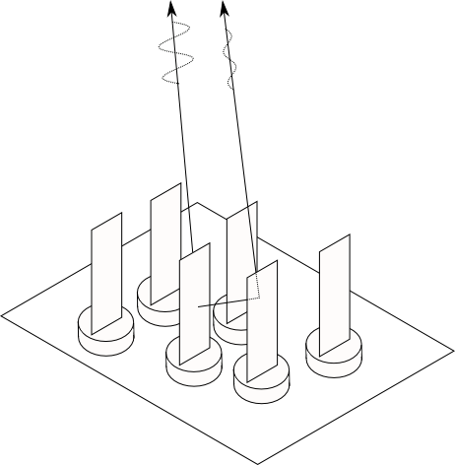
3D array effects distort antenna beam patterns
The presence of other antennas distorts the beam pattern.
The antenna cross talk is too low to be causing the issue.
A full wave model of the array is required to diagnose and correct the problem.
We perform modelling using a commercial package called COMSOL.
Interference from radiation scattered within the array

Slide 29
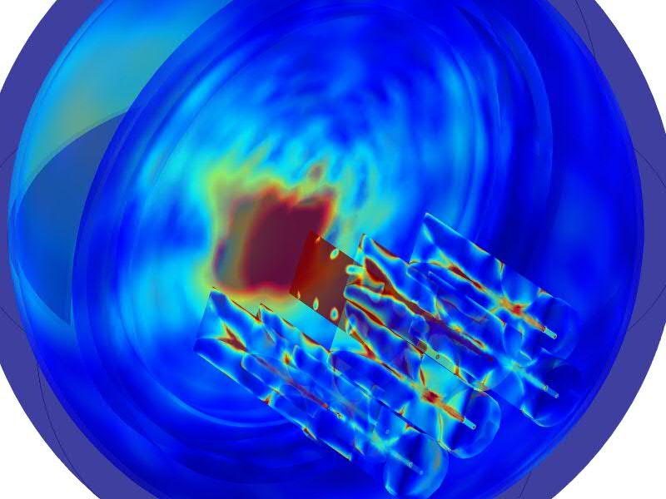
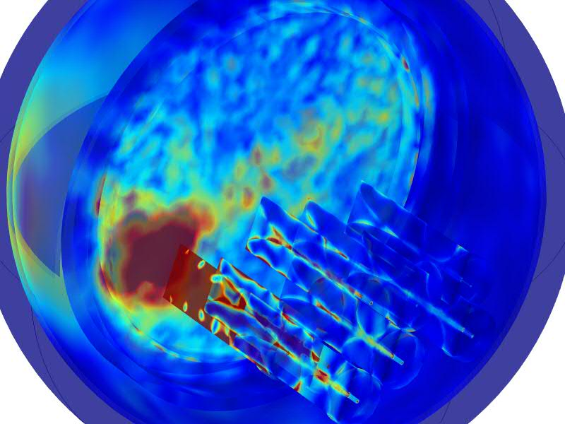
Array modelling
Vacuum window
Antenna array

Slide 30
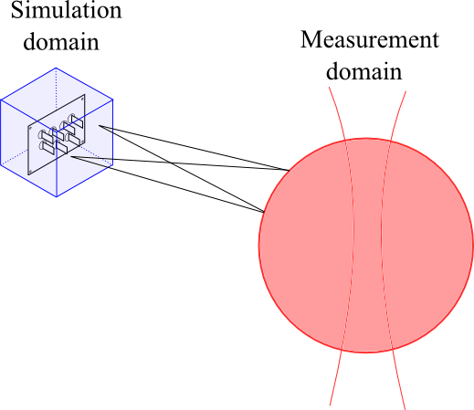
Full wave extrapolation to measurement domain
Using the Schelkunoff principle combined with Huygens‘ principle, the vector potentials are extrapolated to an arbitrary location
Detailed full wave simulation of the array over a small domain
MAST density cut off, or array measurement location

Slide 31
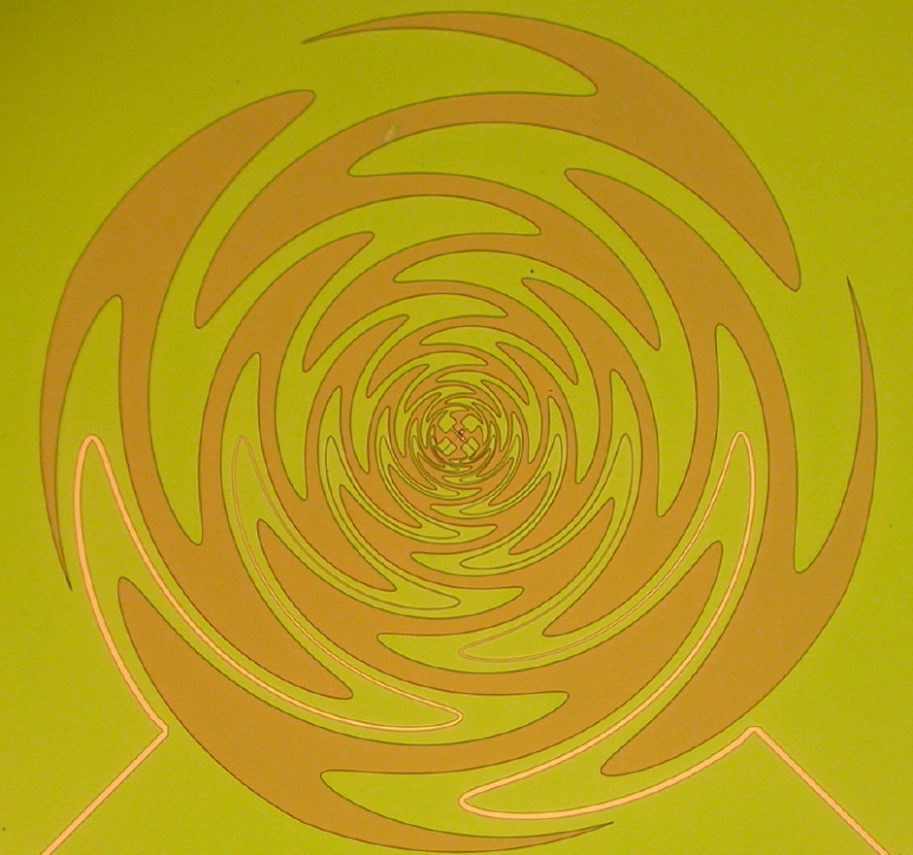
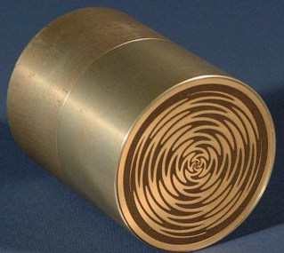
Future developments for SAMI
Dual polarisation planar “sinuous” antennas
Very stable phase centre
Planar PCB antenna, avoids 3D field scattering effects.
Cavity backed to control backwards pointing lobes

Slide 32
Outline
Introduction and motivations – S. J. Freethy
  Introduction to SAMI
  Introduction to EBW emission
  Results from MAST
Reflectometry and backscattering – D. Thomas
  Multiple refelctometers
  Backscattering and doppler shifts
Technical developments and upgrade – J. Brunner
  FPGAs
  The SAMI digitiser
  FPGA/GPU data “real-time” data processing

Slide 33
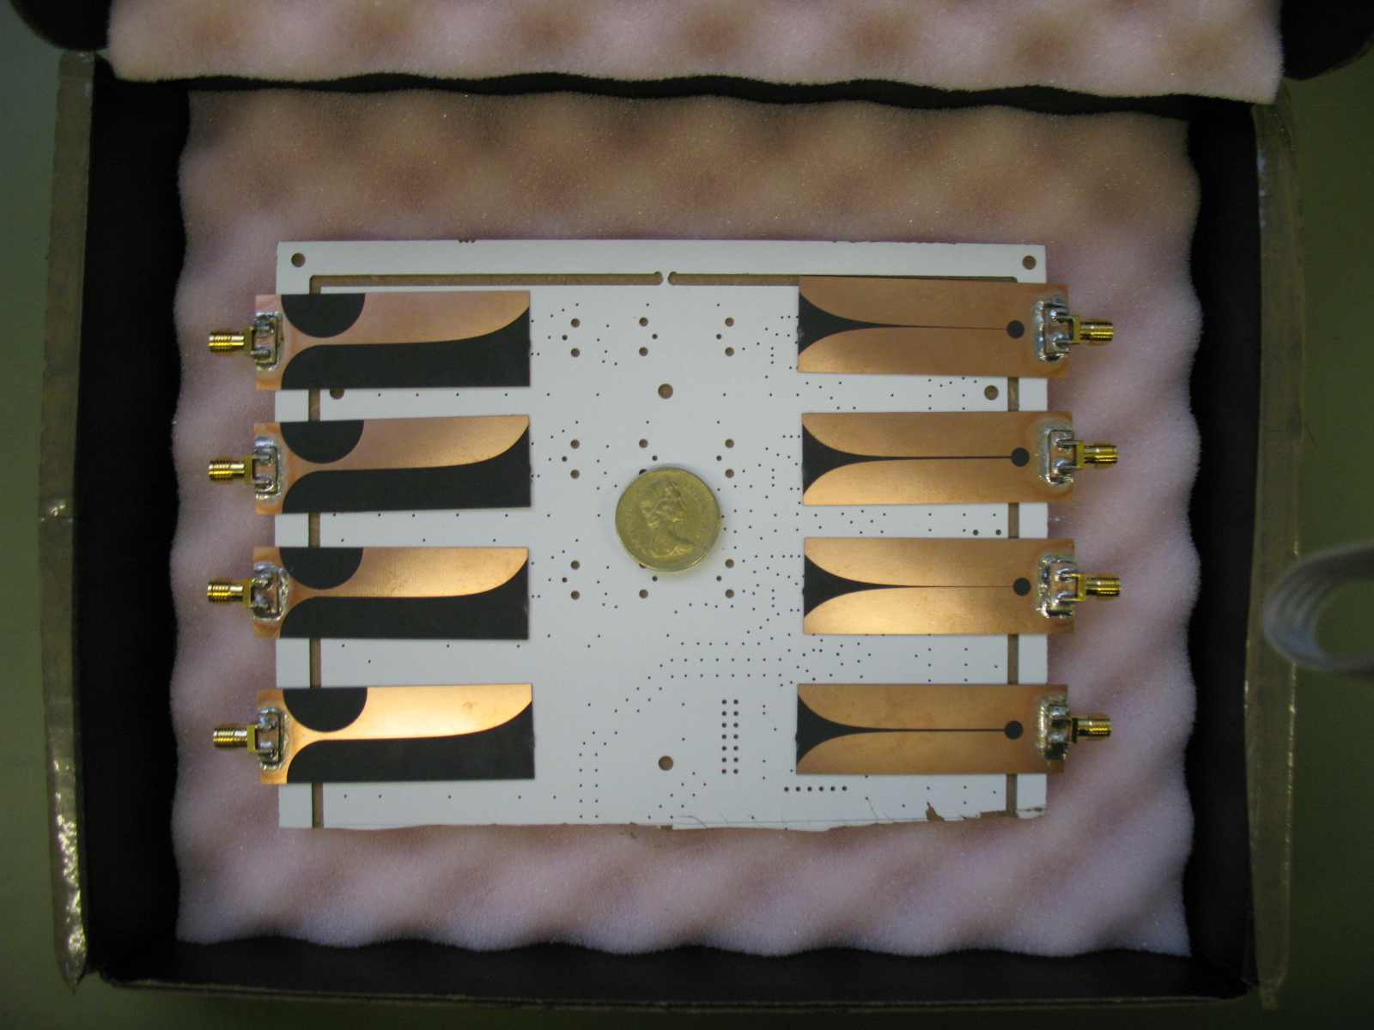
Active Probing on SAMI
2 Active Probing Antennas
8 Receiving Antennas
SAMI can actively probe the plasma with two different IF frequencies (10,12 MHz) simultaneously
The back scattered signals are then received by the 8 receiving antennas
This can be done for 16 different frequencies 10-35GHz
2cm
6cm

Slide 34
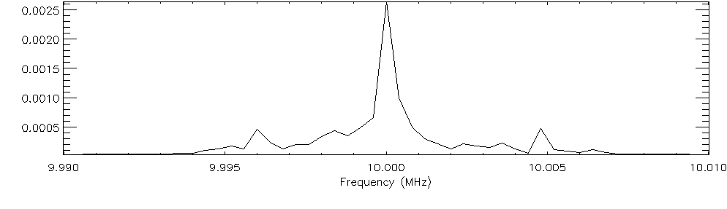
Reflectometry using SAMI
Use a very small part of the IF frequency spectrum for reflectometry
This is how it is possible to carry out passive and active imaging at the same time

Slide 35
Reflectometry using SAMI (cont’d)
Having 2 active probing antennas and 8 receiving antennas means that we measure 16 different phases

Slide 36
Reflectometry fitting proceedure
Using the differences in the phases we numerically minimize a function until we have a best fit
This fitting proceedure has been tested on synthetic data
Applying this fitting proceedure to SAMI data is ongoing
x = [R − b + (a + b cos θ) cos(θ + δ sin θ)] cos φ
y = [R − b + (a + b cos θ) cos(θ + δ sin θ)] sin φ
z=z₀ +κasinθ
Notes:
Go through the slide first and then go on to explain the image better. 3cm error on EFIT data. It does a global fit where as this is right in the edge region. Thomson scattering has an spatial resolution of about ~2cm.

Slide 37
L-mode 98ms into MAST shot #27246
The black dotted line represents the LCFS as calculated by EFIT
The plasma density data is generated by Thomson Scattering along the mid-plane coupled to flux surfaces calculated by EFIT
The red and blue dots represent the emitting and receiving antennas respectively.
The purple surfaces represent contours where the plasma frequency is equal to one of the SAMI imaging frequencies.
Notes:
The active probing signal will reflect off one of these density surfaces

Slide 38
H-mode 359ms into MAST shot #27246
We see that in H-mode all of the reflection surfaces are bunched up in the edge region
This means we could get density measurements with a spatial resolution of ~3mm in the pedestal during H-mode.
The accuracy at which we will be able to make these measurements is yet to be determined.
Notes:
The same information is displayed as before but later in the shot

Slide 39
Accuracy of fitting
A 2nd Active probing antenna has already been added to SAMI and a third could potentially be added in the future
Very accurate pedestal density measurements could potentially be made

Slide 40
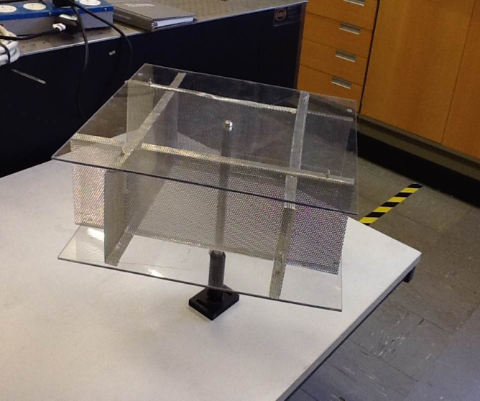
Doppler Reflectometry test setup
Rotating multiple
corner reflector
Probing signal
Imaging phased
array of antennas
Back-reflected signal
Rotating corner reflector
was used in calibration

Slide 41
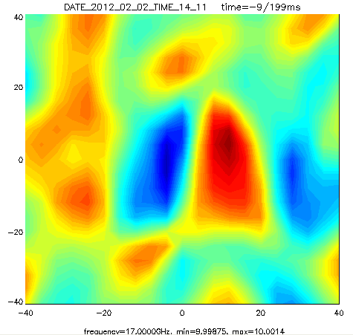
Doppler test setup results
Here we show a beam formed image of the rotating mesh at 17GHz time integrated over 200ms
Red and blue shifted signals are apparent in the spatial locations we would expect.
The amount of Doppler shift observed is ±250Hz which corresponds to a rotation rate of 3 rotations/sec consistent with the rotation speed used.

Slide 42
Plasma results
13GHz
16GHz
Images averaged over 10ms at 13 and 16GHz respectively.
The spatial structure in the Doppler shift as the observed radiation is predominantly Bragg backscattered radiation from plasma turbulent structures aligned along the magnetic field.
Notes:
Here are the results from Doppler reflectometry. On the right is a Doppler map at 13GHz and on the right is a Doppler map at 16GHz. Red shows positive Doppler shit and blue negative. Their orientation of the observed Doppler shifts is thought to be due to the plasma density surface being corrugated due to turbulent elongated along the field lines. So though the plasma may be rotating this way this corrugation means you get a Doppler shift orientated at the angle observed.

Slide 43
L-mode spontaneous rotation
Doppler shift as a function of time for 13 and 16 GHz.
16GHz is reflected from a deeper layer in the plasma.
The 16 GHz layer is accelerated to a higher rotation velocity.
Notes:
We have also looked at how the Doppler shift varies as a function of time. We see that the Doppler shift form the 16GHz surface appears to spin up to a higher velocity. This could potentially be due to plasma dragging on neutral gas in the edge region.

Slide 44
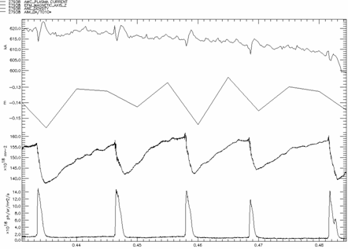
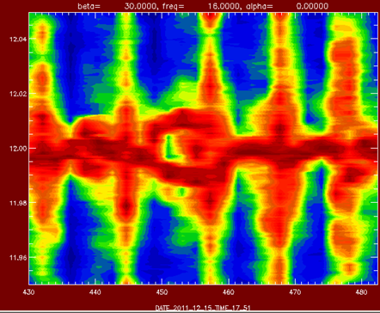
Coherent structures in Doppler Spectrum
I_{p}
Doppler back scattered (DBS) spectra plotted against time illustrate dynamics during and in between ELMs
Coherent structures visible during ELMS
Z_{axis}
n_{e}
D_{α}
Coherent structure destroyed by ELM
Coherent structure collapsed itself
44/34

Slide 45
Aims on NSTX-U using active probing
Make high resolution density measurements in the edge region of NSTX-U plasma. Plasma ~70cm away on MAST, ~15cm away -NSTX-U relative phase difference larger. This will aid reflectometry.
Obtain Doppler maps of NSTX-U plasma
Resolve coherent MHD structures using the spectrum of Doppler back scattered signals

Slide 46
Outline
Introduction and motivations – S. J. Freethy
  Introduction to SAMI
  Introduction to EBW emission
  Results from MAST
Reflectometry and backscattering – D. Thomas
  Multiple reflectometers
  Backscattering and Doppler shifts
Technical developments and upgrade – J. Brunner
  FPGAs
  The SAMI digitiser
  FPGA/GPU data “real-time” data processing

Slide 47
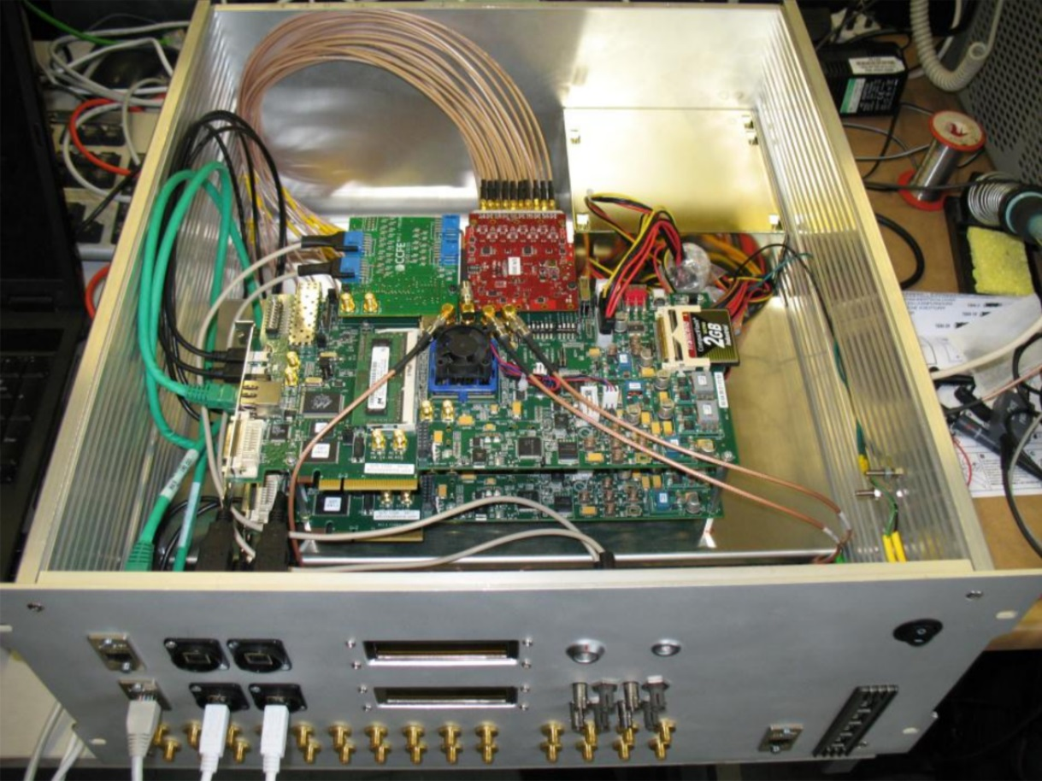
Fast digitization for SAMI
SAMI strongly dependent on synchronized high speed data acquisition across multiple channels
At the same time variable configurations, i.e. active probing & passive imaging
FPGAs enable high speed data acquisition for high bandwidth whilst allowing reconfiguration
[1]
[1] Shevchenko, V. F.; Vann, R. G. L.; Freethy, S. J. & Huang, B. K.
“Synthetic aperture microwave imaging with active probing for fusion plasma diagnostics”
Journal of Instrumentation, 2012, 7, P10016

Slide 48
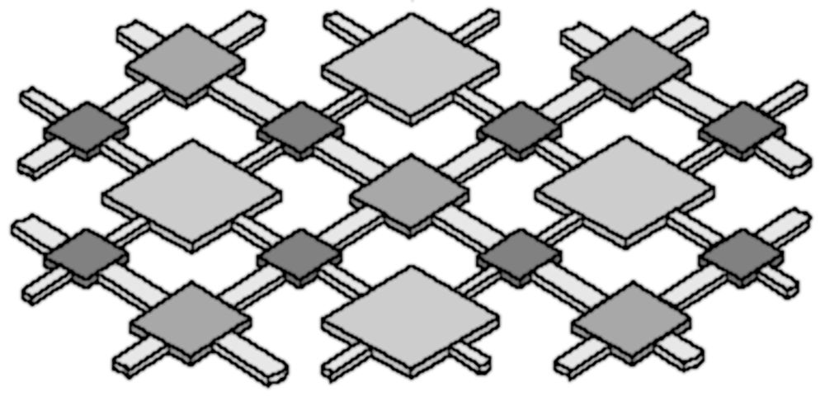
FPGA basics – the fabric
Configurable
switch matrix
Configurable
interconnect
Local data routes
[2]
Global transmission lines
Configurable Logic Block
input
output
[3]
[2] "Introduction to Programmable Logic”; J. Coughlan.; RAL Technology Department, Lecture series 2007
[3] “Computer Architecture I – Laboratory Exercises Background and Introduction to FPGAs”; Konstantinos Tatas; Lecture series

Slide 49
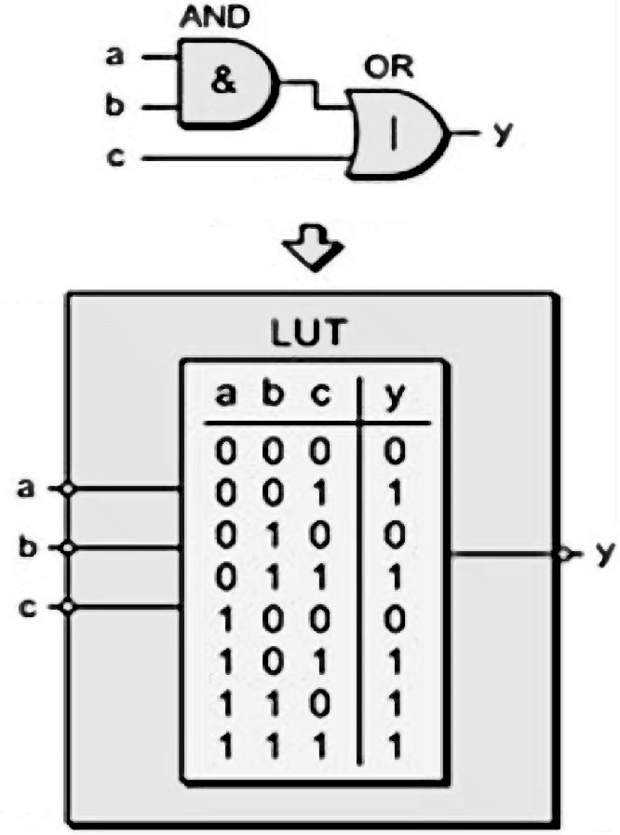
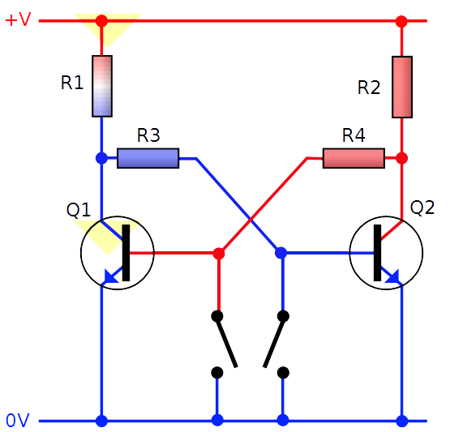
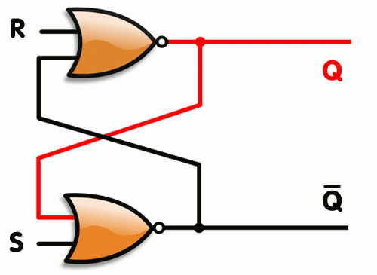
FPGA basics – the CLB
output
Multiplexer is controlled and decides whether the output is registered
input
[2]
Register or Flip Flop
[3]
Wikipedia
[4] "Computing Performance Benchmarks among CPU, GPU, and FPGA"; Cullinan, C. and Wyant, C. and Frattesi, T. and Huang, X.; MathWorks; Apr 2012; E-project-030212-123508

Slide 50
FPGA basics – features
In modern FPGAs the fabric has additional specialized blocks to enhance performance, i.e.
    Block-RAM elements(BRAM)
    Fast general purpose DSPs for multiplication etc.
    Fast transceiver pins for high speed data transmission
    Specialized delay blocks for timing
    Dedicated Clock generation blocks

Slide 51
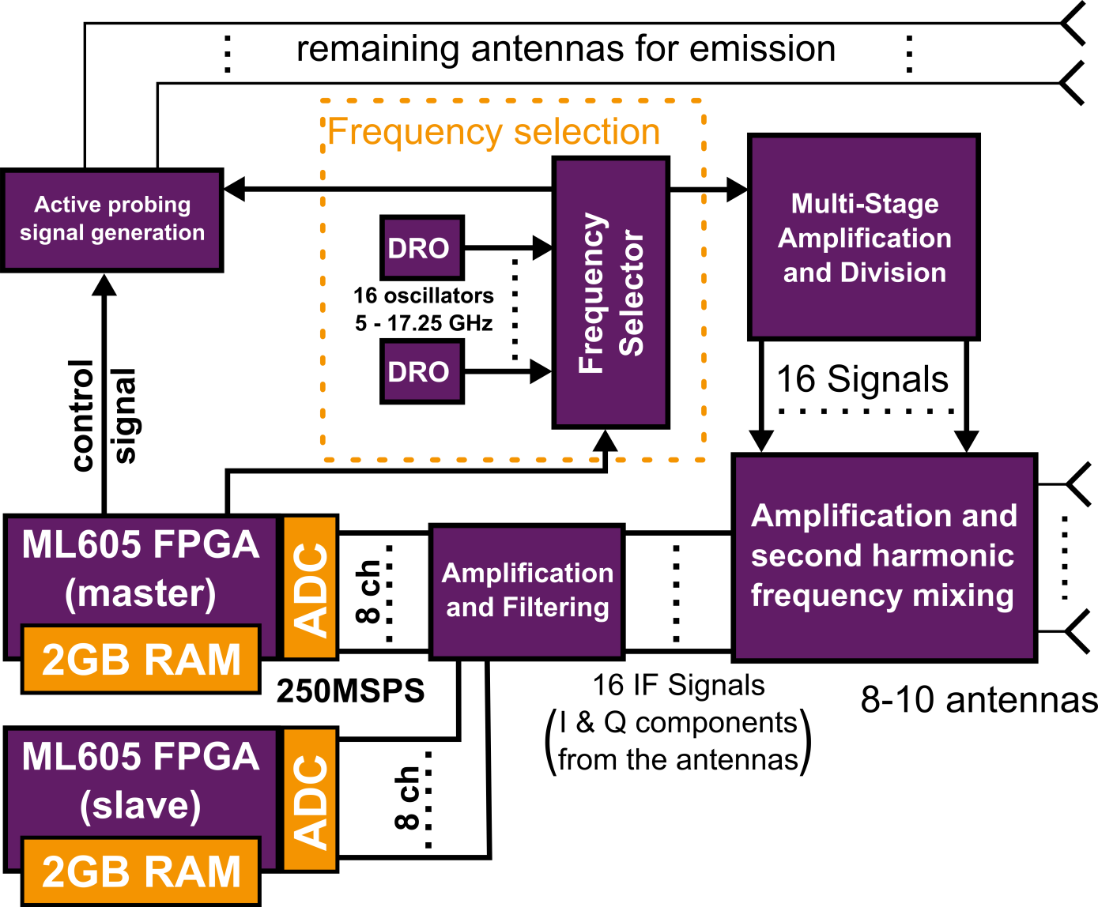
FPGA integration in SAMI
FPGAs select frequencies from Local Oscillators (set before shot)
FPGAs provide upconversion signal for active probing
Currently FPGAs sample at 250MSPS with 14bit
  4GB of raw data on 500ms MAST shots
running Linux on the FPGAs allows us to change the operation mode between shots

Slide 52

FPGA clock synchronization
Clock synchronization across boards is absolutely crucial for SAMI to work
Firmware switches between an external and internal clock reference
Identical firmware on both boards eases development
Due to insufficiencies in reference clocks a board currently supplies the reference

Slide 53


FPGA setup on NSTX
Antenna rack with mixers for down conversion are placed directly on the rack

Slide 54
FPGA setup on NSTX
Antenna rack with mixers for down conversion are placed directly on the rack
Local oscillators have to stay close to the mixers
FPGAs have a private fibre optic 100Mbit network with acquisition PC to download data and upload firmware
The FPGA system is controlled via a webpage based on the acquisition PC

Slide 55
Moving SAMI forward: new challenges
Currently SAMI collects 4GB of data per 500ms shot, which barely fits onto the FPGAs without the capability of upgrading the memory capacity
Bypassing all security measures transfer of data from the FPGAs currently takes 2-3min, however the transmission is not fully reliable
Processing of that data currently takes about 15-20min: more than the avg. time between MAST shots
Both NSTX-U and MAST-U plan on operating multiple seconds and hence will require semi-continuous acquisition and thus data streaming with faster processing
Limits in the currently employed system force us to completely redesign data transfer and processing

Slide 56

The future of SAMI
Utilizing on board PCIe connectors transfer time could be reduced to seconds
Streaming data into CPU host RAM directly and processing it after each shot would significantly increase SAMI operation limits
Using GPUs to process data on the fly would reduce storage requirements

Slide 57
GPU based processing
(work done by Joanne Chorley)
Serial IDL based data evaluation takes longer than the time between shots on MAST
Evaluation algorithm using beam forming is highly parallelizable and thus fit for GPUs
Main problem for the GPU is memory and transfer time as the data amount doubles on read in and temporarily grows up to triple the size during processing
Parallelizing the code and “outsourcing it to a GPU brought significant speed up
 | Total Algorithm Time[s] | Reading data from Memory [s] | Compute Time(s)
IDL | 1038.378 | 128.32 * | 910.058 *
C (serial code) | 464.55 | 88.160 * | 376.39 *
CUDA (NVIDIA K40) | 17.4238 | 11.65 | 5.7748

Slide 58

An FPGA-GPU tandem
To achieve maximum data transmission between GPU and FPGAs direct streaming of data between the devices is beneficial
Treating FPGA memory as an extension to the GPU memory can bypass the CPU host and utilize the maximum speed of the PCIe bridge
Saving only a fraction of the RAW data plus the processed data should decrease the amount of data by a factor of 2000

