Slide 1
Measuring multicusp particle confinement in the Madison plasma dynamo experiment
Chris Cooper
University of Wisconsin, Madison
PPPL, Princeton, NJ, December 16, 2014
Mike Clark, Cami Collins, Ken Flanagan, Ivan Khalzov, Jason Milhone, Mark Nornberg, Blair Seidlitz, John Wallace, David Weisberg, Ellen Zweibel & Cary Forest
Notes:
I’d like to thank Wayne Solomon for inviting me out and Devon Battaglia for hosting me and giving me the opportunity to present my postdoc research at UW Madison working on confinement in the MPDX. I’d like to acknowledge my collaborators and PI Cary Forest.
MPDX is a novel versatile plasma research device designed to investigate flow driven MDH instabilities such as the dynamo in regimes important to the current research in astrophysical and simulation-based dynamos

Slide 2
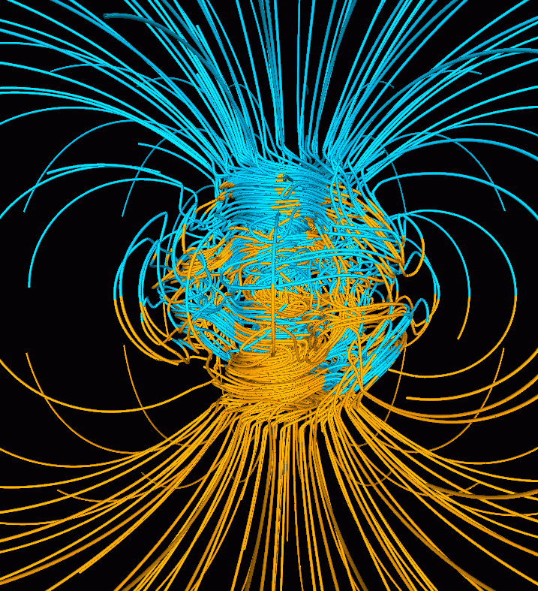
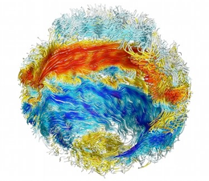
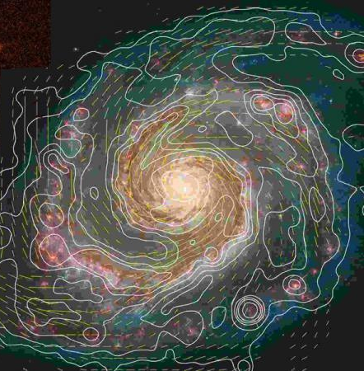
Dynamos create magnetic fields throughout universe
Simulation of
Earth’s magnetic field
Simulation of
Sun’s magnetic field
Measurements of
M51 magnetic field
?
Notes:
What is a dynamo? The dynamo is a process whereby a flowing, conducting fluid interacts with a magnetic field, amplifying it with sustained growth through a feedback process. It describes the enhanced concentration of magnetic fields seen in stars, planets, galaxies and most celestial bodies, including our Earth and Sun. There are 3 requisites for successful dynamo 1) a source of free energy to drive flows such as rotation, 2) a sufficiently conducting fluid which can advect magnetic field faster than resistive diffusion, and 3) a seed field which, when acted upon by the flows, is amplified. Despite their prevalence, there remain many unanswered questions about dynamos such as the growth rates, saturation mechanisms, system size, and the details of the interactions between the flows and the fields.

Slide 3
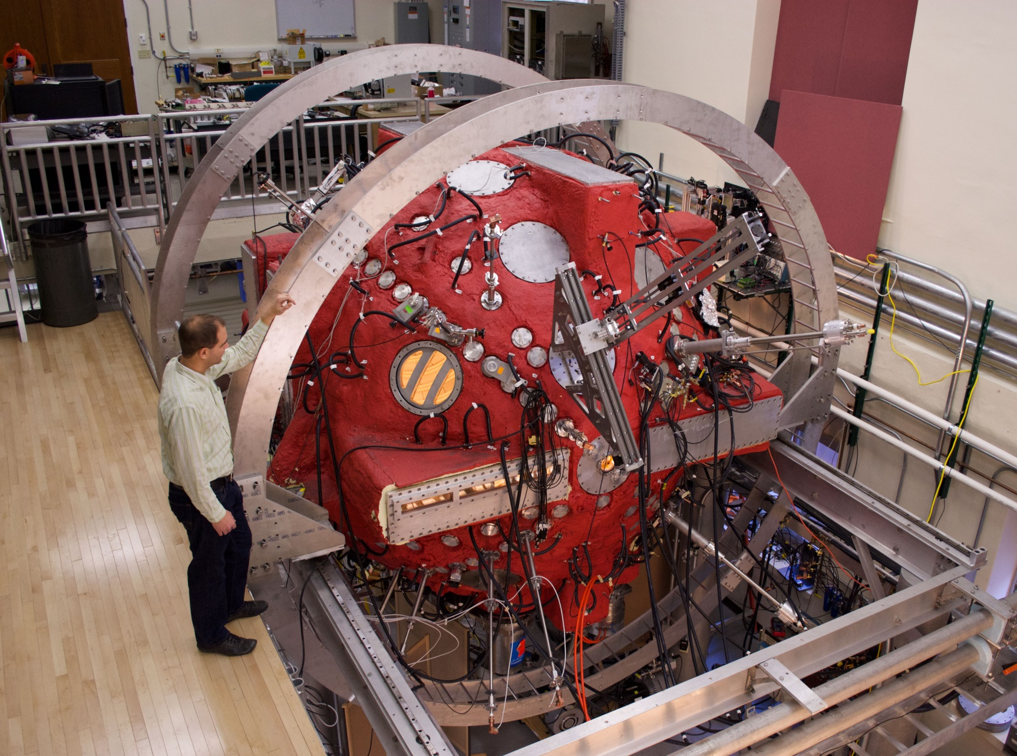
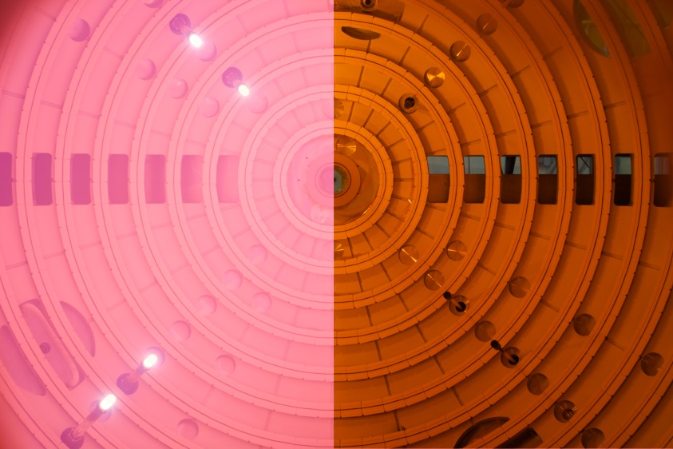
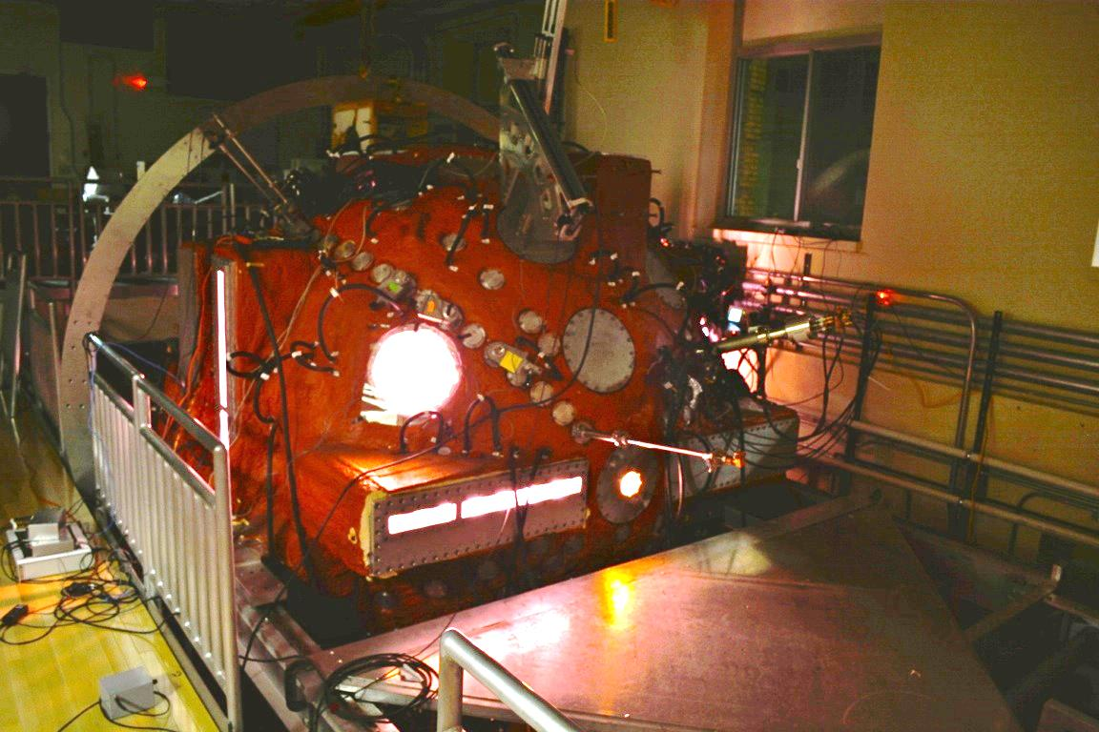
MPDX successfully creates repeatable, highly conducting plasmas suitable for dynamo research
Notes:
We hope to study many of these questions in the Madison plasma dynamo experiment. In MPDX, we have developed a method to confine and stir a highly conducting 3 m diameter laboratory plasma in a regime where the kinetic energy of the flows exceeds the magnetic energy in the plasma. This will allow us to investigate creating a laboratory dynamo for studying using plasma as the conducting fluid.
However, work must be done to understand the plasma production and confinement to determine if we can produce plasma suitable for dynamo research. Bottom up method for creating a dynamo in a laboratory
Plasma on/off, night shot

Slide 4
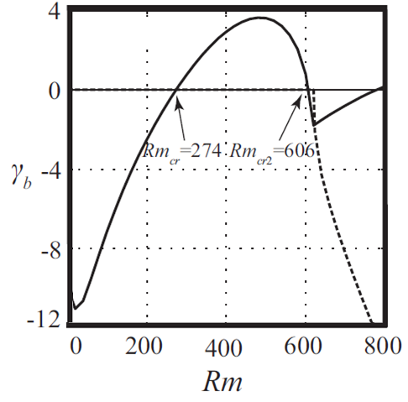
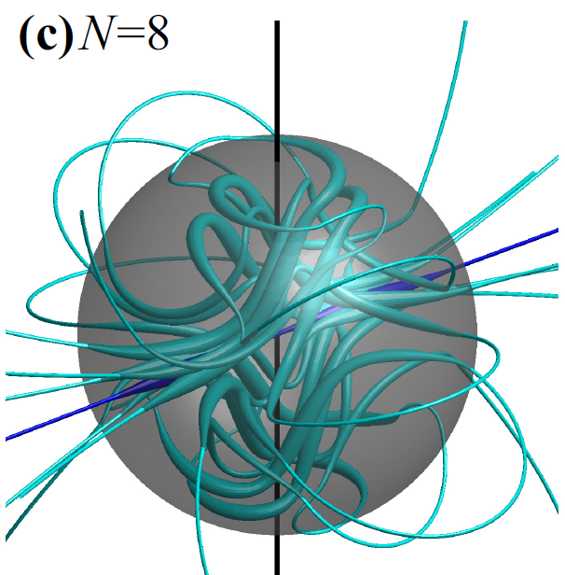
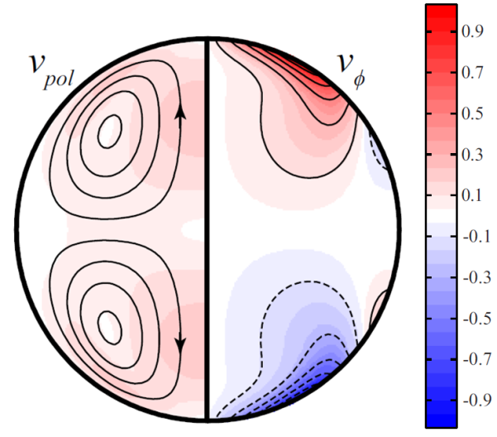
Simulations predict dynamo for a class of two vortex, laminar, boundary-driven flows
Spence et al, Astro. J. 700:470-478 (2009)
Khalzov et al, Phys of Plasmas 19 112106 (2012)
Dynamo growth rate
1) Select v_{φ}(θ)
(r=r_{o})
3) Select
Rm=Lv/η
Modified Von-
Karman flow
Rm_{crit}=274
$$∇^{2}v=Re[\left(v∙∇\right)v+∇p]$$
$$γ_{b}B=∇^{2}B+Rm(∇×(v×B))$$
2) Select
Re=Lv/ν
HD stability?
Notes:
The majority of previous dynamo experiments have been numerical simulations. In fact, the first experiments we are going to perform are motivated by recent numerical simulations of dynamos in spherical geometry. Flows in MPDX are generated by torques applied to the edge of the plasma, so we will be investigating the special class of dynamo created by two counter-rotating vortices generated by boundary driven flows

Slide 5
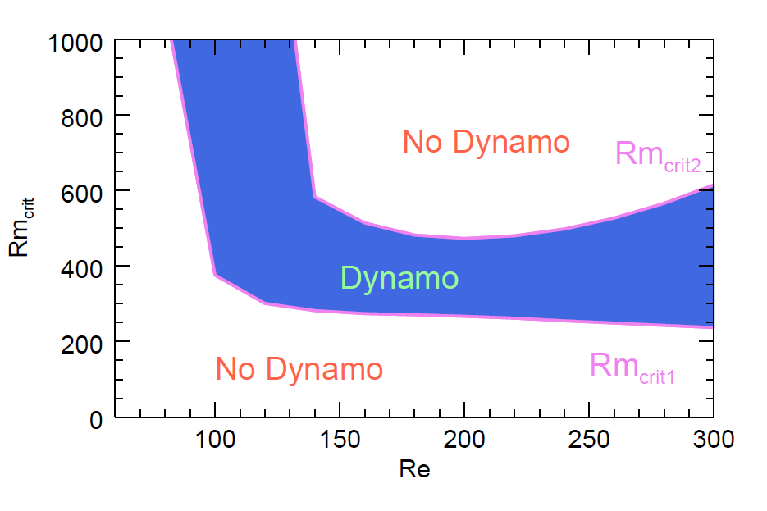
v_{φ}(θ), Re, and Rm uniquely predict kinematic dynamo in simulation
Spence et al, Astro. J. 700:470-478 (2009)
Khalzov et al, Phys of Plasmas 19 112106 (2012)
HD unstable
Dynamo very sensitive to Re, Rm AND details of flow
Notes:
-exhaustive search of parameter space for this class of dynamo, limited by resolution Rm and HD stability (Re)
-1) no dynamo below Re=80 (zero suppressed) we suspect this is related to critical level of poloidal flow
-2) majority of the time, no dynamo. Taking off reversal is no dynamo

Slide 6
Liquid sodium, with fixed Pm = ν/η =10⁻⁵, cannot be used to investigate this class of dynamo
To achieve:
requires:
which results in turbulent flows which can suppress dynamo
$$Rm=\frac{Lv_{p}}{η}>{Rm}_{crit}\sim 300$$
$$Re=\frac{Lv_{p}}{υ}\sim 3×{10}^{7}$$
Notes:
Previous attempts at laboratory dynamos have used liquid Na, with an inconveniently fixed conductivity and resistivity

Slide 7
Viscosity and conductivity (Re, Rm and Pm) are independently adjustable in plasma
Braginskii, transport processes in plasma 1965
$$Re=\frac{Lv_{p}}{υ}$$
$$=7.8 L_{m}v_{km/s}\left(\frac{Z^{4}n_{i,{10}^{18}m^{−3}}\sqrt{μ_{i}}}{{T_{i,eV}}_{}^{5/2}}\right)>100$$
$$Rm=\frac{Lv_{p}}{η}$$
$$=1.6 L_{m}v_{km/s}\left(\frac{{T_{e,eV}}_{}^{3/2}}{Z}\right)>100$$
Difficulties in using laboratory plasma:
$$M_{A}\sim v_{p}\left(\frac{\sqrt{n_{i}μ_{i}}}{B}\right)>1$$
How to confine plasma and maintain
How to stir plasma with boundary driven flows
Knowledge of T_{i} is very important for determining Re
Avoid modifications of ν and η due to collisions with neutral particles
Notes:
In plasma, these can vary, sub in classical values, get formulas.
-individually adjustable

Slide 8
Viscosity and conductivity (Re, Rm and Pm) are independently adjustable in plasma
Braginskii, transport processes in plasma 1965
$$Re=\frac{Lv_{p}}{υ}$$
$$=7.8 L_{m}v_{km/s}\left(\frac{Z^{4}n_{i,{10}^{18}m^{−3}}\sqrt{μ_{i}}}{{T_{i,eV}}_{}^{5/2}}\right)>100$$
$$Rm=\frac{Lv_{p}}{η}$$
$$=1.6 L_{m}v_{km/s}\left(\frac{{T_{e,eV}}_{}^{3/2}}{Z}\right)>100$$
Does not come for free:
$$M_{A}\sim v_{p}\left(\frac{\sqrt{n_{i}μ_{i}}}{B}\right)>1$$
The first step in creating a laboratory plasma dynamo in MPDX is to characterize the confinement in order to predict plasma parameters.
How to confine plasma and maintain
How to stir plasma with boundary driven flows
Knowledge of T_{i} is very important for determining Re
Avoid modifications of ν and η from collisions with neutral particles
Notes:
This is my jam

Slide 9
Outline of Talk
Investigate the properties of magnetic cusps in MPDX
Overview of cusps and first confinement model
Discuss measured cusp features and loss width
Characterize particle balance and confinement
Directly measure particle loss rates, confinement time
Compare ion heating and neutral burnout
Modifications to the sheath for the cusp geometry
Conclusions and Future work
Notes:
What determines plasma parameters throughout cusp, what sets footprint?
What determines loss rates through sheath (particle balance)

Slide 10
MPDX successfully creates repeatable, highly conducting plasmas suitable for dynamo research
Helmholtz coil (seed B)
2D Auto. probe drive
Complete probe access
9 x LaB₆ Cathodes
Axis of
rotation
Probes measure local v, B, and plasma parameters (ν,η)
Passive optical diagnostics measure
T_{i} and n_{e}

Slide 11
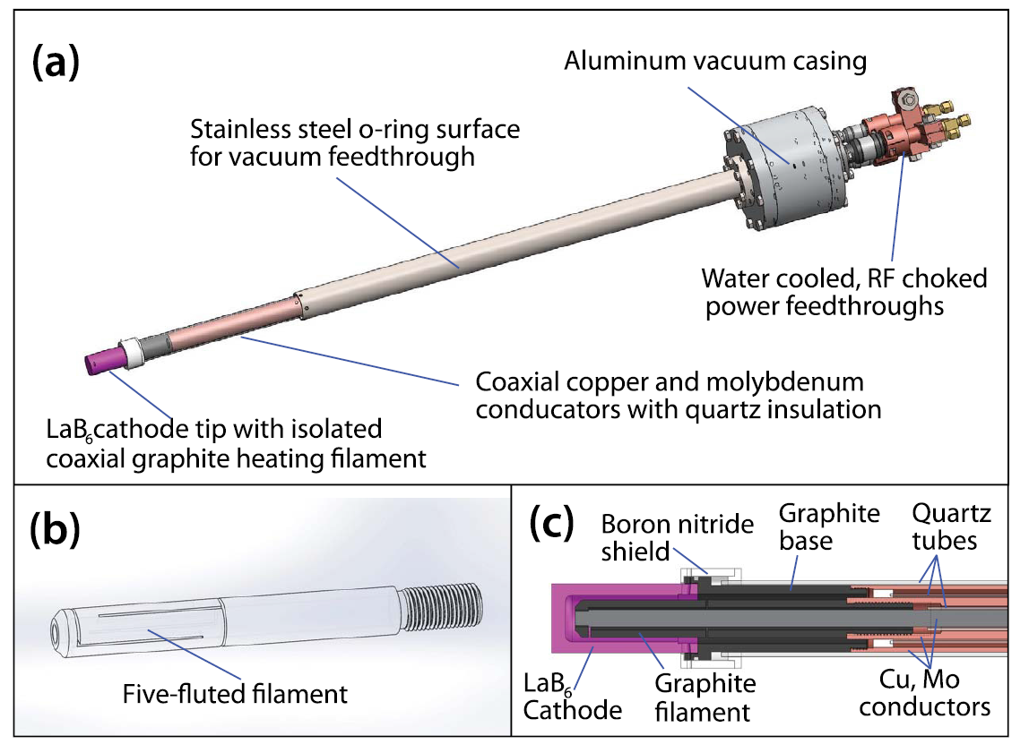
High energy electron beams from LaB₆ Cathodes creates and heats plasma
$$V_{d}<400 V I_{d}<50 A$$
9 cathodes capable of 4-160 kW of plasma heating
Notes:
Plasma is generated using LaB6 stirring rods inserted radially into the device. The LaB6 is heated until thermally emissive, then individually biased 400 volts wrt moly anodes also inserted radially. The initial current drawn ionizes a fill gas selected by the experimenter such as H He or Ar. After a few hundred microseconds, a sufficient amount of plasma is produced and it takes over ionization. The beam of primary electrons at 400 eV merely heats the plasma. As soon as the bias is removed, the plasma recombines back into the gas
Tradeoff between depth and loss area

Slide 12
MPDX is cylindrically symmetric, spherical multicusp confinement device
S
Unmagnetized
Core Plasma
N
N
S
S
N
Notes:
The plasma is confined using cylindrically symmetric multicusp magnetic field around the outside of MPDX. 3000 4 kG SaCo permanent magnets are screwed into the device wall with alternating polarity

Slide 13
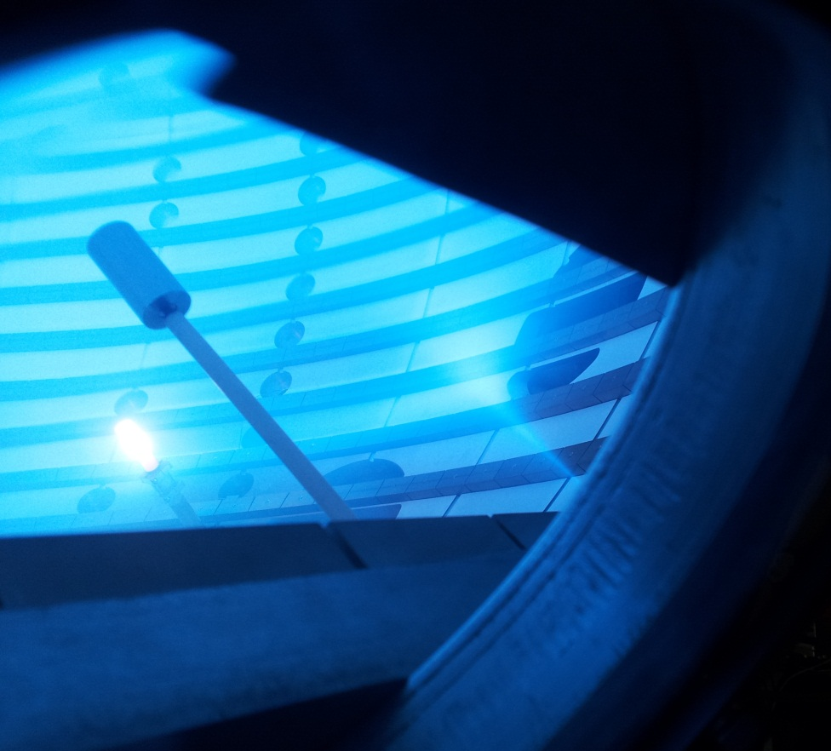
MPDX is cylindrically symmetric, spherical multicusp confinement device
Anode
Plasma Cusp
S
Unmagnetized
Core Plasma
N
S
Emissive LaB6 cathode
N
Notes:
Recognize this as spherical makenzie bucket

Slide 14
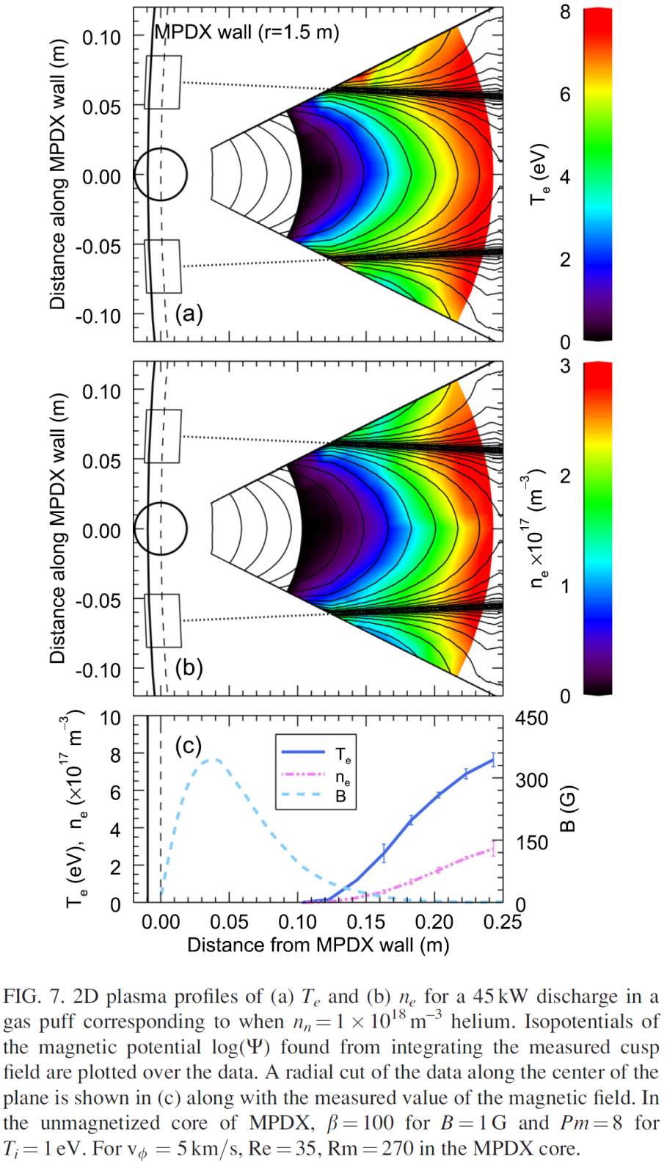
Magnetic field confines a large, unmagnetized plasma
45 kW discharge in 3x10⁻⁵ Torr He
C. M. Cooper et al, Phys. Plas 21, 013505 (2014)
Notes:
Start with nn gas puff, bias applied, nn drops seen in radiated power, heating

Slide 15
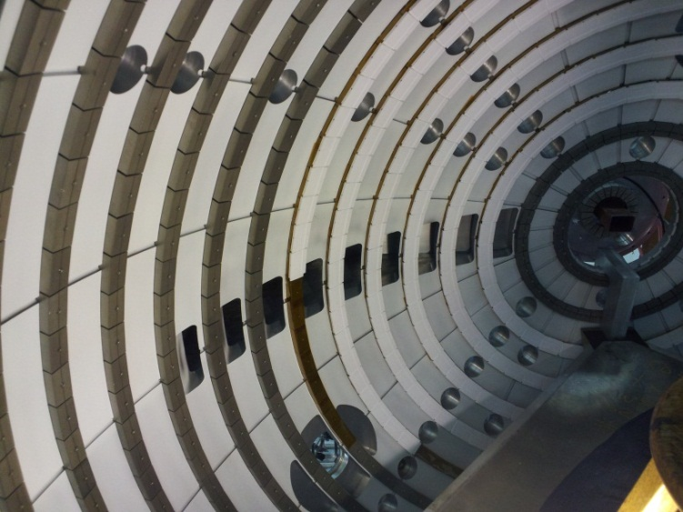
Multicusp magnetic field reduces losses to wall and greatly improves confinement
Wall losses greatly reduced
$$\frac{A_{mag}}{A_{sph}}\sim \frac{{LW}_{cusp}}{{LW}_{mag}}\sim \frac{1 mm}{125 mm}\sim 0.8\%$$
Compare to previous work¹
$$w_{cusp}=4\sqrt{ρ_{e}ρ_{i}}\sim 1 mm$$
¹Hershkowitz N. et al, Phys. Rev. Let. 35 5 (1979)

Slide 16
Plasma parameter scaling well described by particle and power balance model
Pow, n_{n}
<->
T_{e}, T_{i}, n_{e}
<->
ν, η
<->
Re, Rm
Particle and energy confinement
$$Vn_{e}n_{n}<σ_{iz}v_{e}>=(A_{c}+A_{p})Γ_{w}$$
Volumetric Ionization
Cusp losses
$$P=\left(Q_{ionz}+Q_{rad}+Q_{n}\right)V +γ_{e}T_{e}(A_{c}+A_{p})Γ_{w}$$
LaB₆ and
Magnetron
Ionization
Radiation
Collisions
Convection
Edge flow
Notes:
Using measured Te, ne, can predict the radiated power well, and most of input power

Slide 17
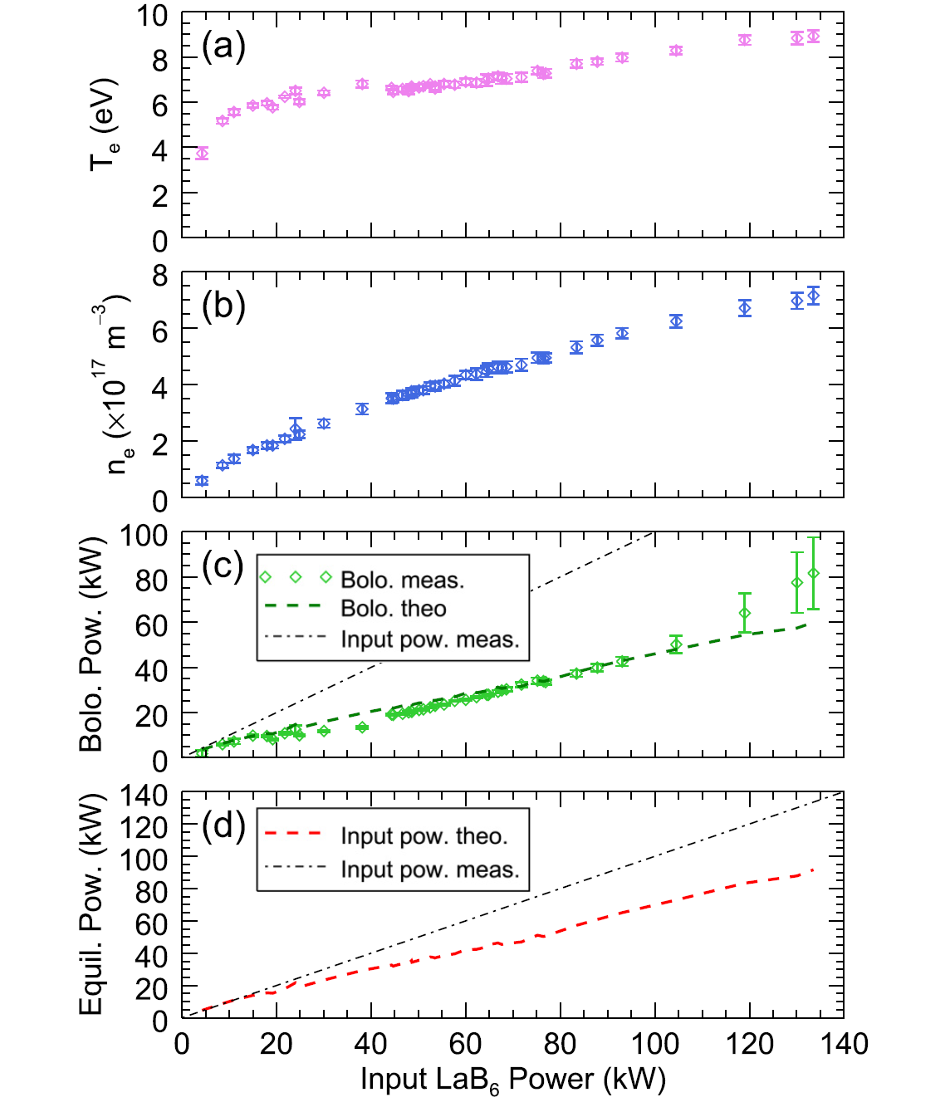
Plasma parameter scaling well described by particle and power balance model
Pow, n_{n}
<->
T_{e}, T_{i}, n_{e}
<->
ν, η
<->
Re, Rm
Input power 250 kW
Re, Rm tradeoff
T_{i} predicted, but not measured
Must add additional loss area to match experiment
Z_{eff} >1?
What are sheath boundary conditions
6.5x10⁻⁵ Torr He, (n_{fill}=2x10¹² cm⁻³)
Notes:
Using measured Te, ne, can predict the radiated power well, and most of input power, miss losses to wall, ion current to cathode

Slide 18
Fabry-Perot Interferometer uses etalon to create $λ$ dependent interference pattern
etalon
Phase difference between two wave fronts is wavelength dependent
$$d$$
$$θ$$
$$T_{0}$$
$$δ=\left(\frac{2π}{λ}\right)2dn\cos{θ}$$
$$T_{1}$$
$$T_{2}$$
$$T_{3}$$
$$T_{4}$$
Notes:
To measure Ti, I developed a FPI which produces high resolution images of spectral lines in order to determine the energy distribution function of the species. The FPI contains collection optics, focusing optics, and an etalon. An etalon consists of two flat, parallel, highly reflecting plates. Light that enters the gap is reflected back and forth, each time leaking a small transmitting beam with a phase shift
This is similar to a thin film interference pattern but for the transmitted light

Slide 19
Fabry-Perot Interferometer uses etalon to create $λ$ dependent interference pattern
etalon
$$d$$
$$θ$$
Light is focused at infinity, add a converging lens images a ring pattern
Notes:
By imaging the light onto a screen, light and dark fringes which correspond to constructive and destructive interference of the transmitted light.

Slide 20
Fabry-Perot Interferometer creates a high resolution image of ion spectral lines
Interference pattern separates light by wavelength into a series of Lorentzian broadened rings according to
$$mλ=2dcos(θ)$$
etalon
Continuous source
$$d$$
Ring width
(Instrumental broadening)
$$δλ$$
$$θ$$
$$Δλ$$
Ring spacing
Add filter to isolate interested lines
System characterized by Finesse which determines instrumental broadening
$$F=\frac{4R}{{\left(1−R\right)}^{2}}=\frac{Δλ}{δλ}$$

Slide 21
Fabry-Perot Interferometer images chord of plasma in region of no flow
All lengths in mm
Notes:
Set out to characterize Ti, with Fred Wroestler

Slide 22
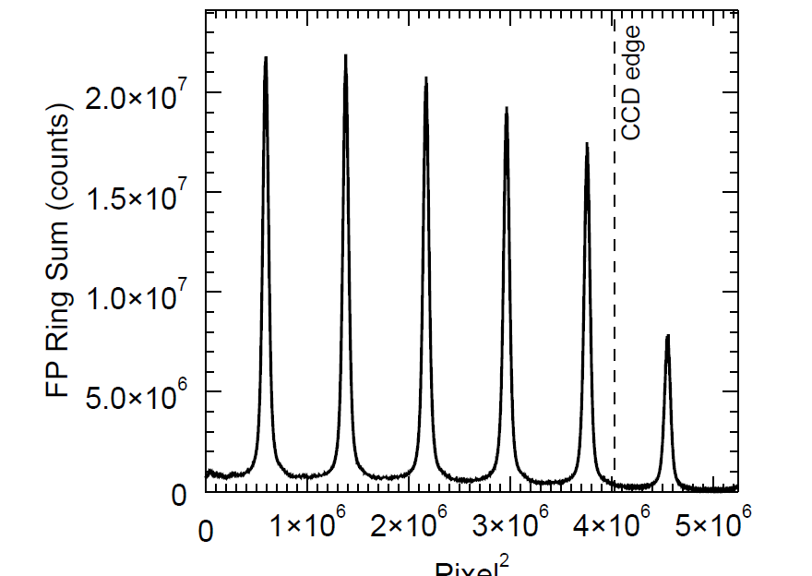
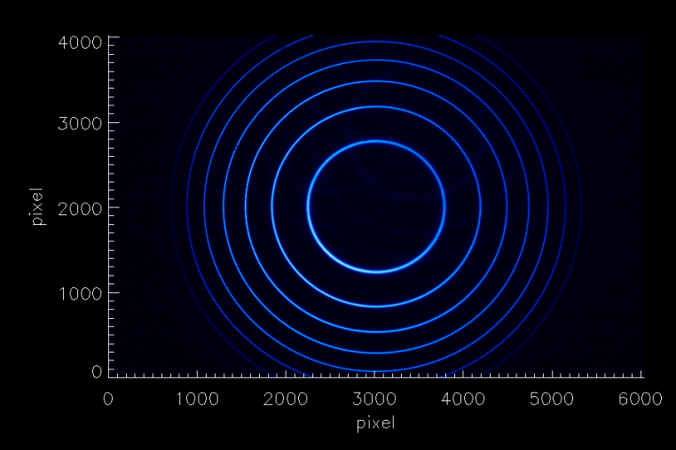
Sub pixel binning, image processing yields high resolution ion diagnostic
Argon II 488.0 nm
Entire Ion Energy Distribution Function can be measured from each peak, yielding
v_{i}, T_{i}
I
II
Ring sum
IV
III
Pixel²
$$mλ=2d\frac{L}{\sqrt{L^{2}+r^{2}}}$$
$$\sim 2d\left(1−\frac{r^{2}}{2L^{2}}\right) , Ο\left(\frac{r^{4}}{L^{4}}\right)$$
$$Δv\sim 1×{10}^{−6}c\sim$$
300 m/s, 0.05 eV,
1 pixel (in Argon)
Perform quadrant chip sums, $S_{II}\left(r\right),S_{IV}\left(r\right)$,
- find, $r′$ that minimizes chisq ${(S}_{II}\left(r\right)−S_{IV}\left(r−r^{′}\right))$
Use adaptive binning for sums which maintain constant
$$Δr\left(r\right)|_{Δλ}=\sqrt{{\left(\frac{1}{\frac{1}{\sqrt{L^{2}+r^{2}}}−\frac{mΔλ}{2dL}}\right)}^{2}−L^{2}}−r$$
0.2 pixel, 60 m/s, 0.01 eV (in Argon)
Notes:
Interference pattern is imaged, ring summed. Traditionally use small angle approximation and binned pixels to get coarse EDF. I had to develop novel techniques to incorperate sub pixel binning and retain the full interference equation.

Slide 23
Calibration with Thorium lamp provides Point Spread Function and $λ(r)$
A calibration lamp converts pixel radius to wavelength by finding $d,L,m$ solving over several orders $r_{m}$ and lines $λ_{o}$
$$mλ=2d\frac{L}{\sqrt{L^{2}+r^{2}}}$$
$$r_{m+3}$$
$$r_{m+2}$$
$$r_{m+1}$$
$$r_{m}$$
Ion Line
Ar II 488.0 nm
He II 468.6 nm
Calibration Line
Thorium 487.8733 nm
Thorium 468.6195 nm
Peaks fit to a Lorentzian and used as PSF
Pixel²
Notes:
Everything needs to be known to 1 part in 10^7, the only thing that accurate is the lines themselves.

Slide 24
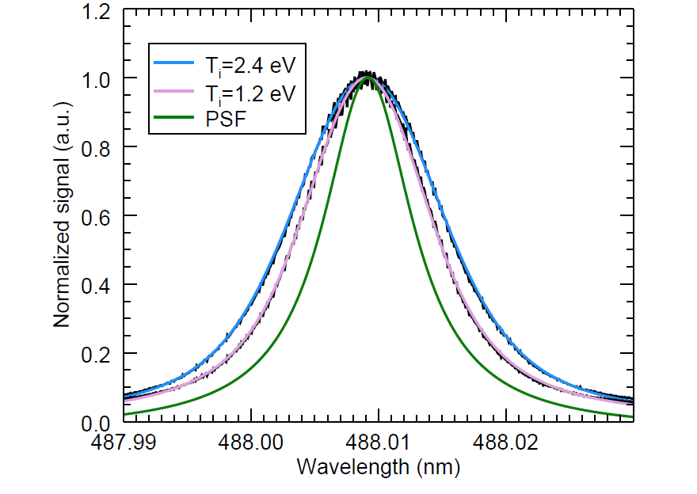
Fabry-Perot Interferometer accurately resolves ion temperature to high precision
Doppler broadening of
Ar 488 nm line
Levenberg-Marquardt
least squares fit
Guess $T_{i},v_{i}$, calculate Doppler broadened Gaussian with constant $Δλ$ PSF spacing
Convolve with PSF (Voigt)
Calculate $χ^{2}$
Refine $T_{i},v_{i}$ guess
Notes:
Each measurement is hundreds of points wide with a peak of 1,000,000 counts so an error less than 1%. These are Voigt functions

Slide 25
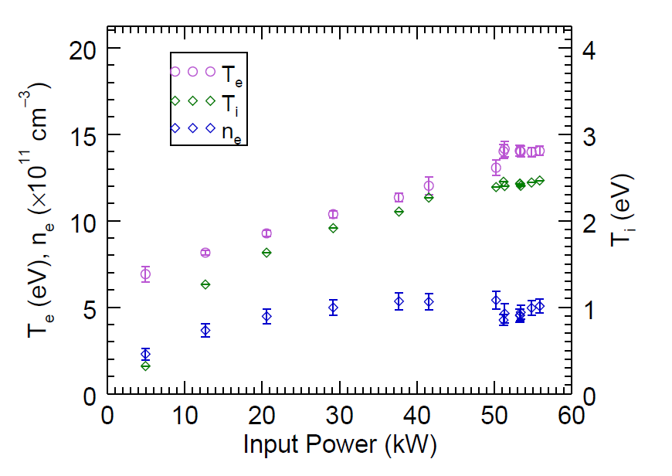
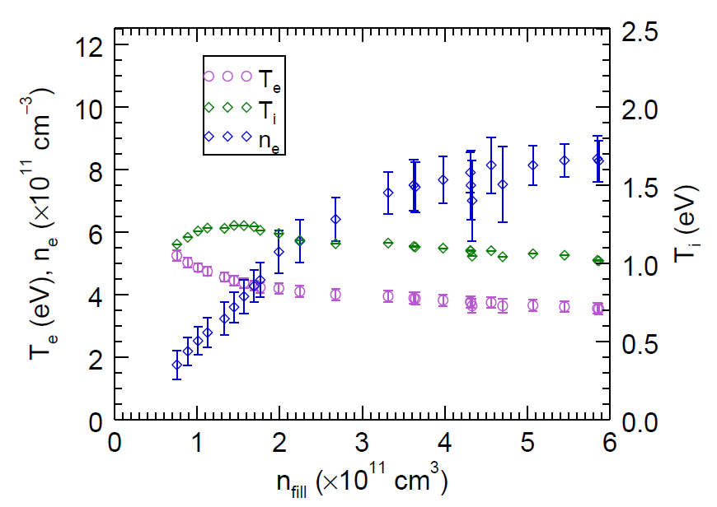
Fabry-Perot Interferometer accurately resolves ion temperature to high precision
Doppler broadening of
Ar 488 nm line
Ar power scan 2.3x10⁻⁶ Torr
Ar nn scan 30 kW

Slide 26
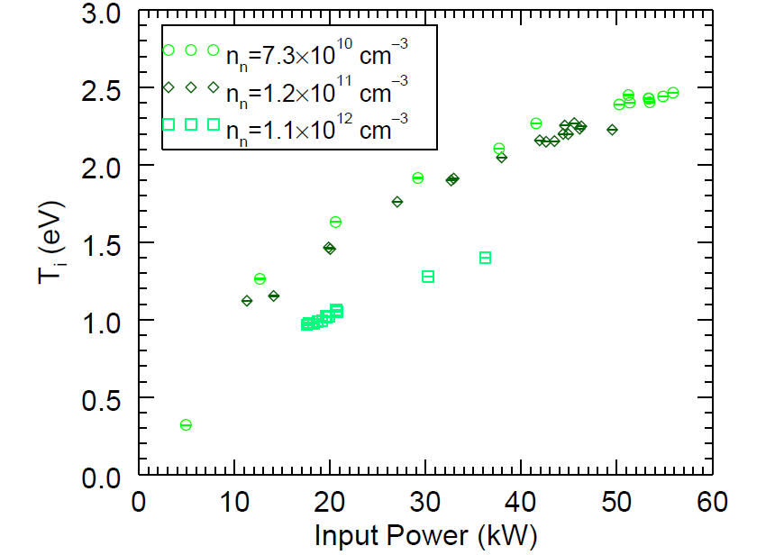
Fabry-Perot Interferometer accurately resolves ion temperature to high precision
Doppler broadening of
Ar 488 nm line
Ar power scans
Ar nn scan 30 kW

Slide 27
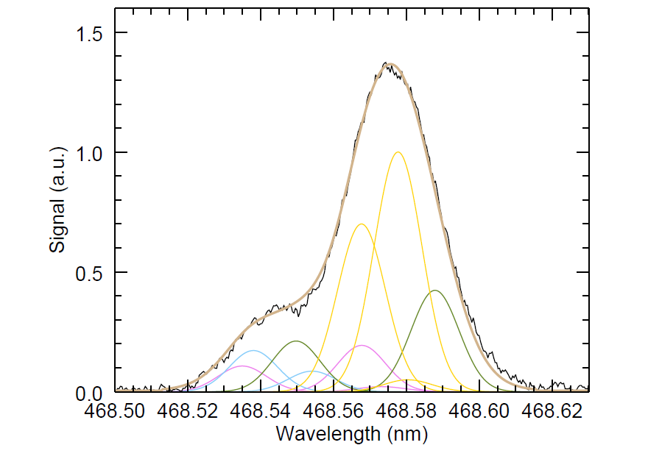
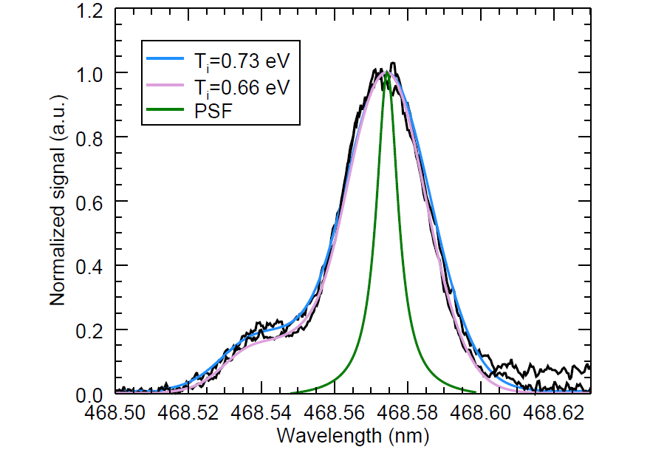
Fabry-Perot Interferometer accurately resolves ion temperature to high precision
Doppler broadening of He 468 nm lines
He 468.6 complex is 13 lines divided into 5 groups shown by color
Levenberg-Marquardt least squares fit to single normalization, v_{i}, T_{i}, and 5 relative amplitude coefficients

Slide 28
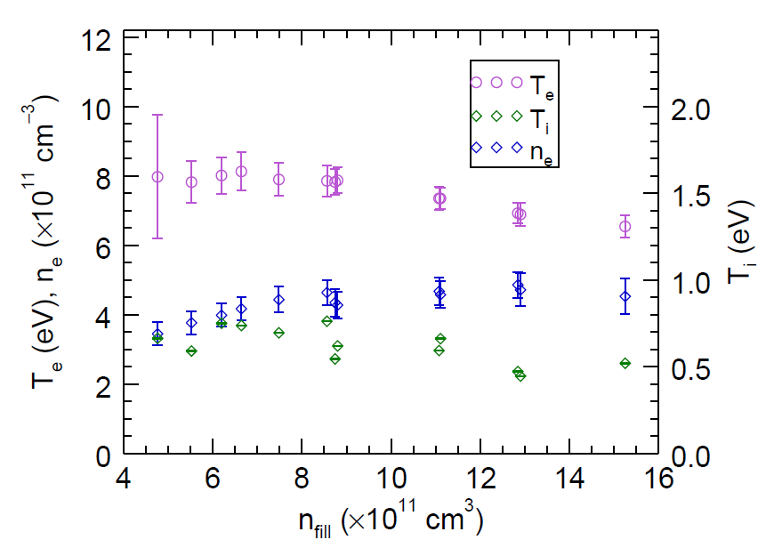
Fabry-Perot Interferometer accurately resolves ion temperature to high precision
Doppler broadening of He 468 nm lines
55 kW input power
He 468.6 complex is 13 lines divided into 5 ratios shown by color
Levenberg-Marquardt least squares fit to single normalization, v_{i}, T_{i}, and 5 relative amplitude coefficients

Slide 29
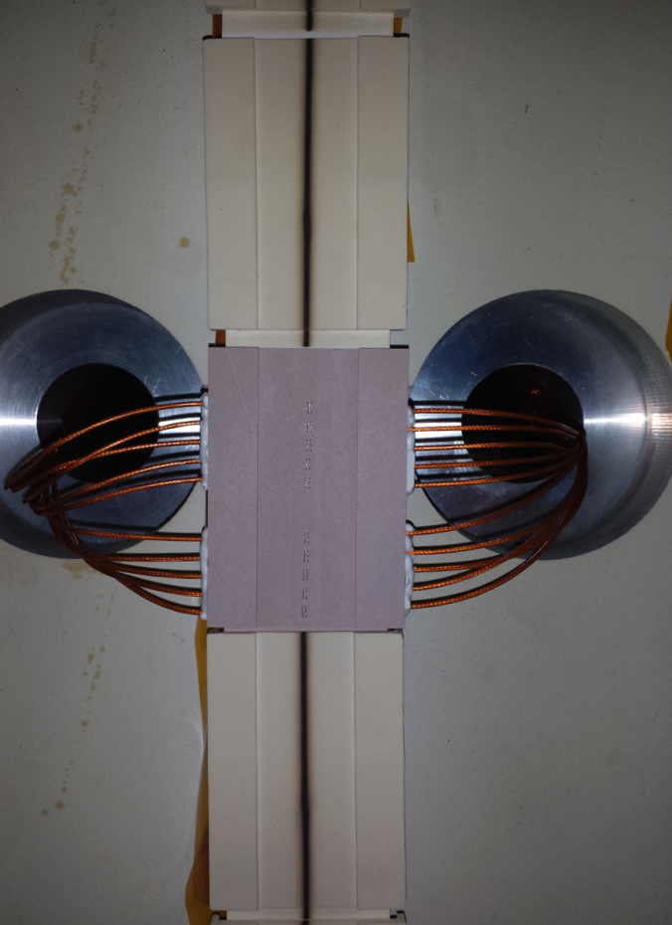
Langmuir probes embedded in tile directly measure plasma parameters, losses at wall
Notes:
Armed with the information about Ti, we are able to study the scaling of the cusp losses and compare to the previous predictions. Replaced limiter tile with…

Slide 30
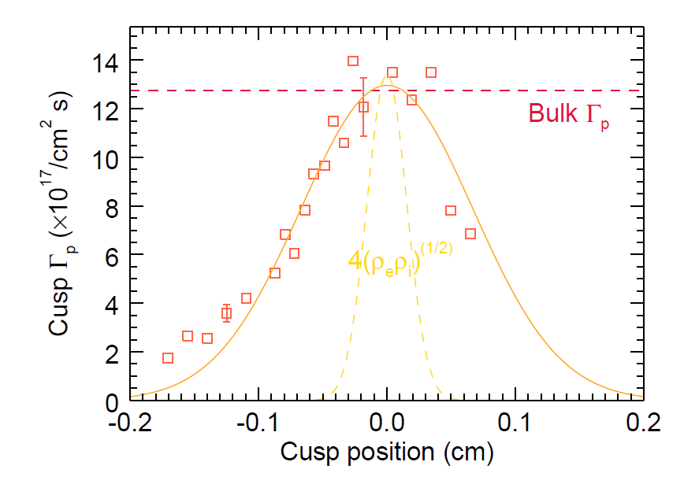
Loss width in new regime deviates from previous experimental measurements
Plasma loss in center of cusp is same as core unmagnetized plasma
Langmuir Probe
Tile
75 kW He plasma with 1.3x10-5 Torr fill pressure
Notes:
Finally a scientifically relevant measurement of Isat

Slide 31
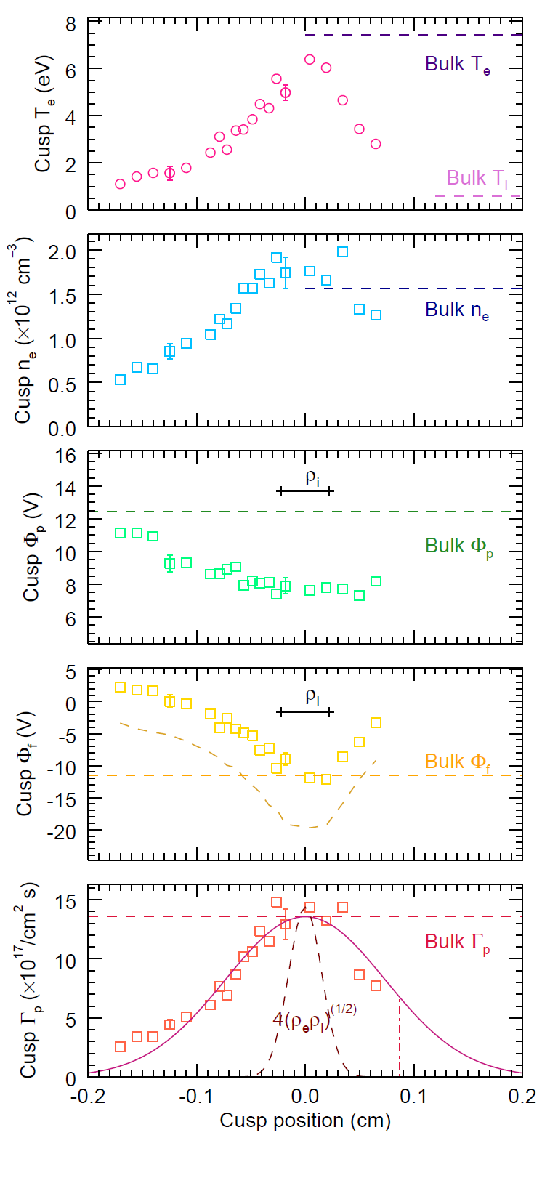
Directly measure plasma parameters and losses at cusp to characterize confinement
Use swept voltage on each tile Langmuir probe to measure plasma parameters
Langmuir Probe
Tile
Flux at wall
75 kW He plasma with 1.3x10-5 Torr fill pressure

Slide 32
Directly measure plasma parameters and losses at cusp to characterize confinement
Use swept voltage on each tile Langmuir probe to measure plasma parameters
T_{e} and n_{e} at cusp center indicate free streaming losses.
This makes ρ_{e} ~ λ_{D} ~ 1x10⁻³ cm
Langmuir Probe
Tile
75 kW He plasma with 1.3x10-5 Torr fill pressure

Slide 33
Directly measure plasma parameters and losses at cusp to characterize confinement
Use swept voltage on each tile Langmuir probe to measure plasma parameters
Langmuir Probe
Φ_{f} offset indicates sheath physics for $Z_{eff}≠1, c_{s}→{c_{s}}^{∗}$
Tile
75 kW He plasma with 1.3x10-5 Torr fill pressure

Slide 34
Directly measure plasma parameters and losses at cusp to characterize confinement
Use swept voltage on each tile Langmuir probe to measure plasma parameters
Φ_{p} shows large scale 2D electric field that pulls ions into cusp.
Langmuir Probe
Tile
75 kW He plasma with 1.3x10-5 Torr fill pressure

Slide 35
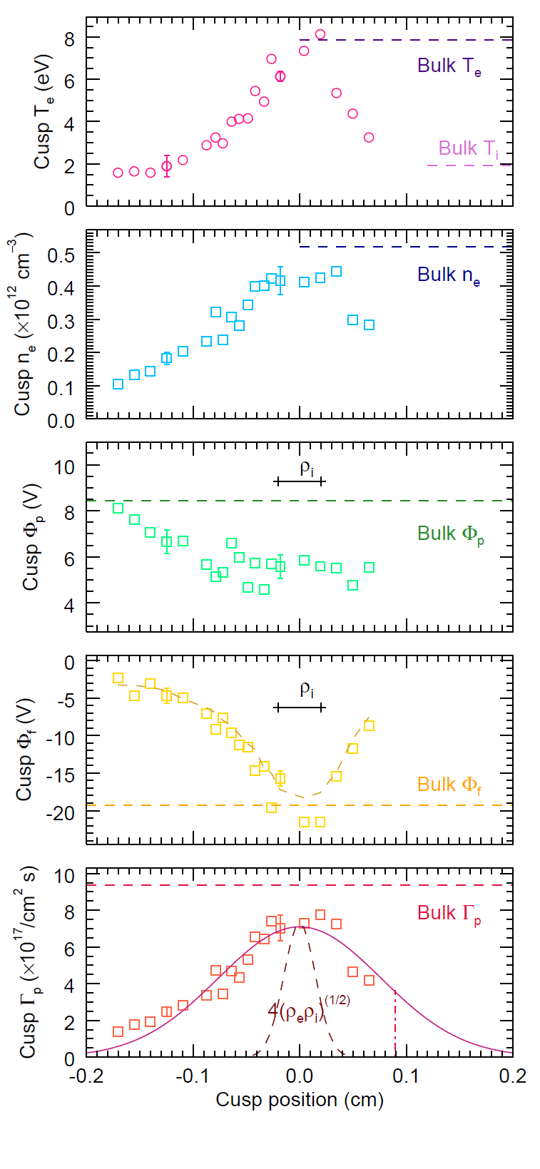
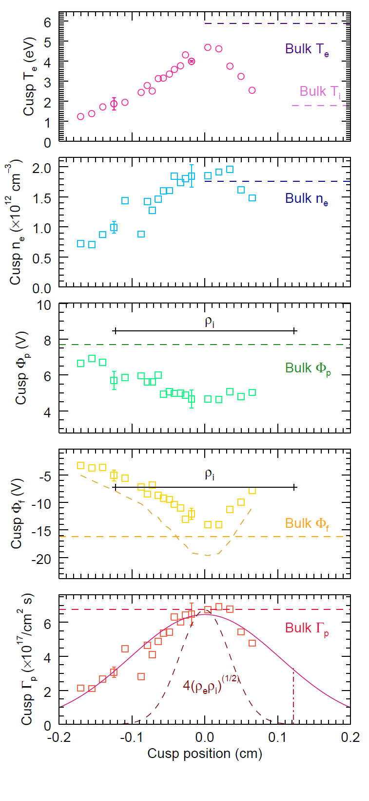
Measurements consistent over a mass scaling
50 kW H + 5% Ar
3.6x10⁻⁶ Torr
75 kW He
1.3x10⁻⁵ Torr
40 kW Ar
8.0x10⁻⁶ Torr

Slide 36
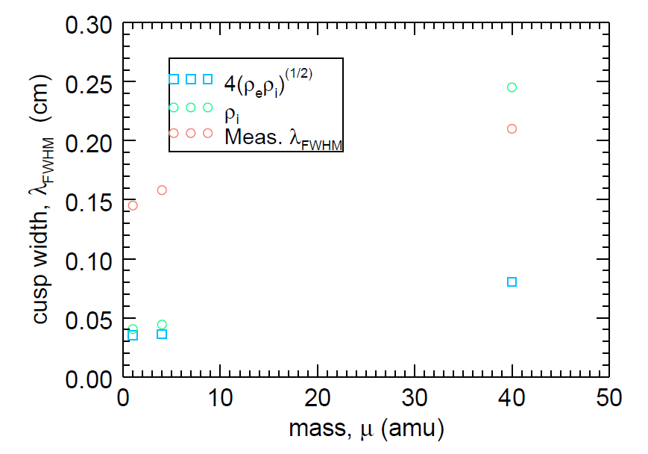
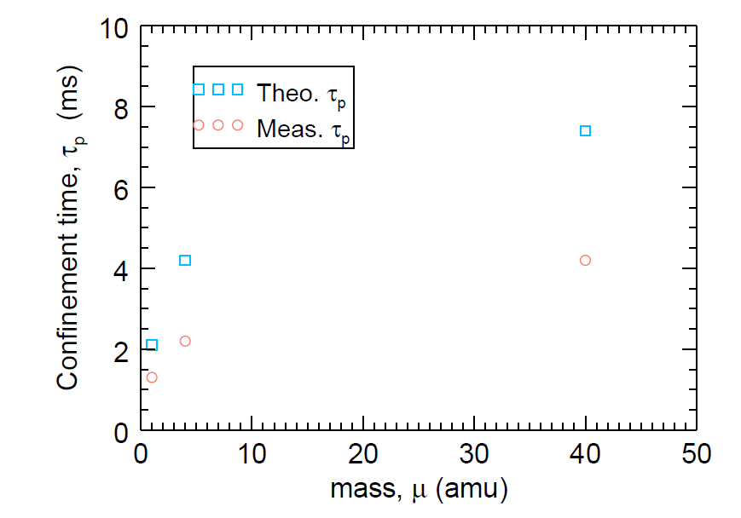
Measured cusp width wider than predicted, does not scale with previous formulas
MPDX operates in a new regime where
$$T_{i}\sim T_{e}$$
$$\frac{B}{∇B}>>λ_{D}$$
$$\frac{B}{∇B}\sim λ_{i}<λ_{e}$$
$$Z_{eff}>1$$
Termination on insulating wall
$$τ_{p}≡\frac{n_{e}V}{\int{dA_{c}Γ_{e,c}}+A_{p}Γ_{e,p}}$$
Directly measure particle confinement time, critical for modelling plasma parameters, viscosity, and conductivity
Characterize over Te, Ti, ne scaling
What sets width?

Slide 37
Cusp width set by balance between passing particles and trapped particle diffusion
In collisionless isothermal limit, $n_{α}(x,y)$ determined by $n_{α,∞}, T_{α,∞}, ΔΨ\left(x,y\right),ΔΦ\left(x,y\right)$ using conservation of energy and canonical momentum
$$+Ψ$$
$Ψ$=0
$$−Ψ$$
Using $Ψ_{∞}≡0$, there is a maximum$|Ψ|$ that can be reached

Slide 38
Cusp width set by balance between passing particles and trapped particle diffusion
In collisional limit, $n_{α}(x,y)$ determined by $n_{α,∞}, D_{⊥,α}$ by comparing the cross field diffusion time to the scattering time into loss cone
$$Γ_{⊥,α}=−D_{⊥,α}\frac{∂n_{α}}{∂⊥}±μ_{⊥,α}\frac{∂φ_{p}}{∂⊥}$$
$$Γ_{||}(Ψ)$$
$$Γ_{⊥}$$
$$Γ_{⊥}$$
$$Γ_{⊥}$$
$$A_{c}∆Γ_{⊥,c}\left(Ψ\right)={A_{w}Γ}_{||,w}(Ψ)$$
$$D_{⊥,α}=μ_{⊥,α}\frac{T_{α}}{e}=\frac{T_{α}}{m_{α}ν_{α}}\frac{{ν_{α}}_{}^{2}}{\left({ν_{α}}_{}^{2}+{ω_{cα}}_{}^{2}\right)}$$
Notes:
Compare Te, ne (psi) wall with middle of cusp field lines equipotential?
For recomb,ionz=0, gamma|| wall is direct measurement of Delta Gamma_perp. How does this compare to theory from diffusion
Like westbound traffic on the 10. By counting the cars that leave on Bundy, Cloverfield, 4th street, ad eventually the PCH, we can reconstruct the traffic profile for the whole length.

Slide 39
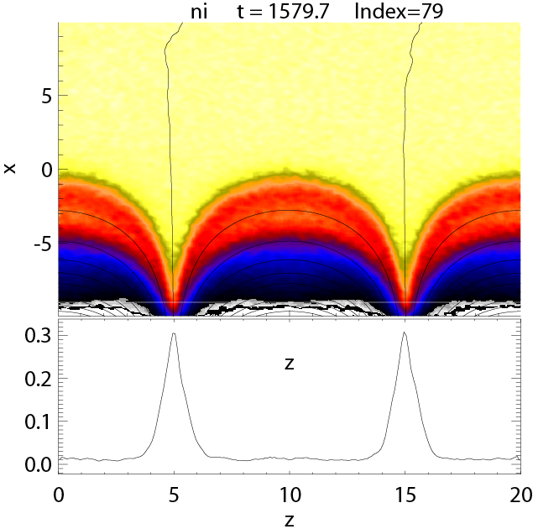
PIC modelling of cusp recreates structure in experiment, has unique scaling
For $c_{s}\sqrt{ρ_{e}ρ_{i}}$:
$$\frac{d}{dt}\ln\left(n_{i}\right)\sim −{\left(\frac{m_{i}}{m_{e}}\right)}^{\left(\frac{3}{4}\right)}{β_{e}}^{\left(\frac{3}{4}\right)}{β_{i}}^{\left(\frac{1}{4}\right)}$$
Simulation:
$$\frac{d}{dt}\ln\left(n_{i}\right)\sim −{\left(\frac{m_{i}}{m_{e}}\right)}^{\left(0.5\right)}{β_{e}}^{\left(0.25\right)}{β_{i}}^{\left(0.15\right)}$$
The PIC species are isotropic, fluid approach sufficient
Also gain information about the potential drop across the magnetic cusp, the floating potential, etc.
$$n_{i}$$
Notes:
Collisionless PIC simulation of multicusp device. Computationally intensive, but overkill, even without collisions, plasma is nearly isotropic.
can’t reach MPDX parameters, but can do more calculations of fluid approach.
Useful comparisons to experiment. Establish a FWHM scaling, look at 2D ne profile, mostly stays on B lines. Can diagnose presence of large scale 2D electric field. Boundaries occur at low beta, don’t effect vacuum field much (extra slide).

Slide 40
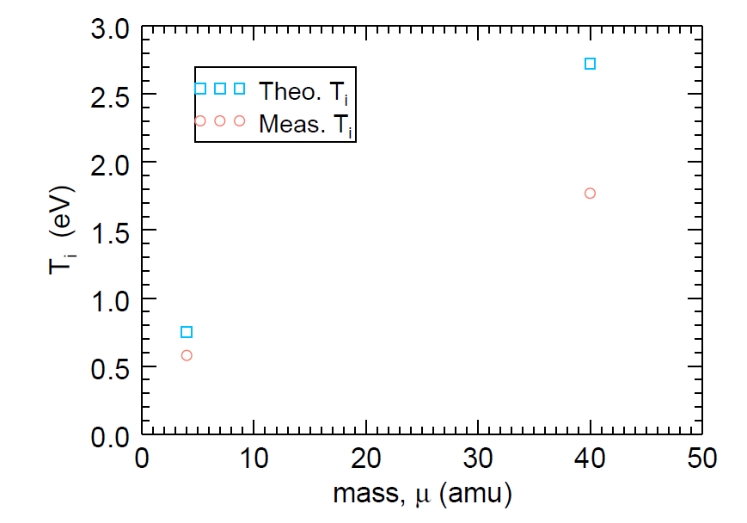
T_{i} predicted by confinement time is less than predicted by classical heating
$$\frac{3m_{e}}{m_{i}}Z_{eff}υ_{ei}n_{e}\left(T_{e}−T_{i}\right)=\left(\frac{3}{2}υ_{in}\sum{n_{i}}+υ_{cx}n_{1}+\sum{n_{i}}\frac{2}{τ_{p}}\right)\left(T_{i}−T_{n}\right)$$
Electron heating
Neutral collisions
Wall losses
Details of sheath can determine individual loss rates, Z_{eff}
Must understand details of neutral gas profile:
production rate matches loss rate
Notes:
Energy confinement time stuff?

Slide 41
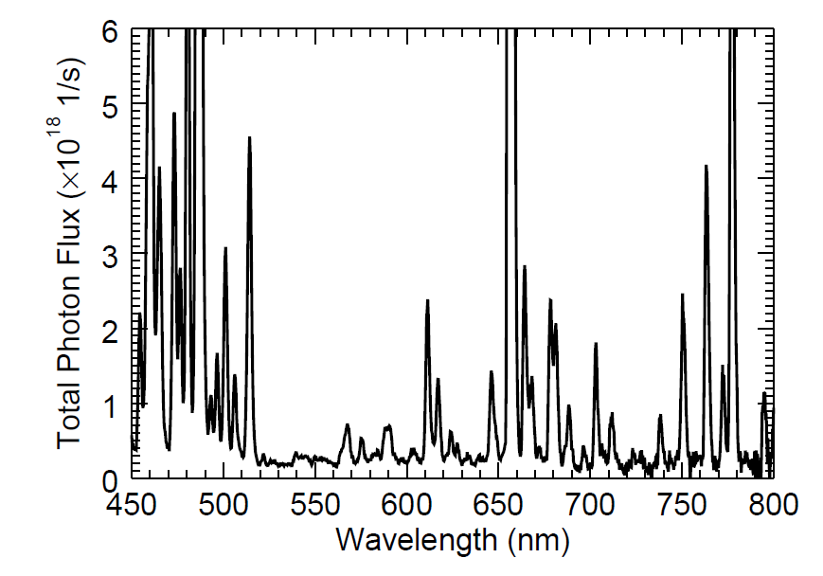
Spectroscopy indicates neutral burnout
Collimator
images
chords
70 kW Ar plasma
T_{e}=6.1 eV, n_{e}=1.7x10¹² cm⁻³
26º
MPDX
Plasma
Spectrometer

Slide 42
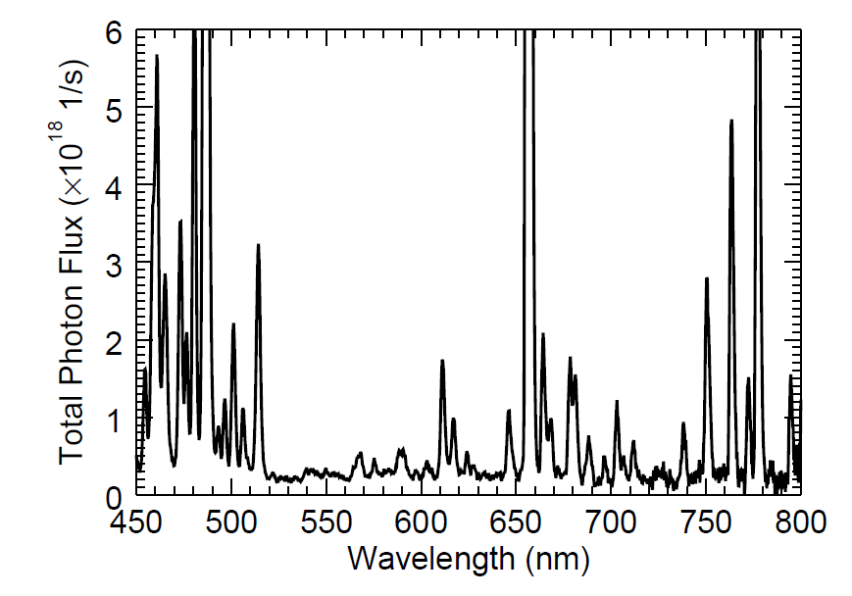
Spectroscopy indicates neutral burnout
Collimator
images
chords
70 kW Ar plasma
T_{e}=6.1 eV, n_{e}=1.7x10¹² cm⁻³
26º
MPDX
Plasma
Spectrometer

Slide 43
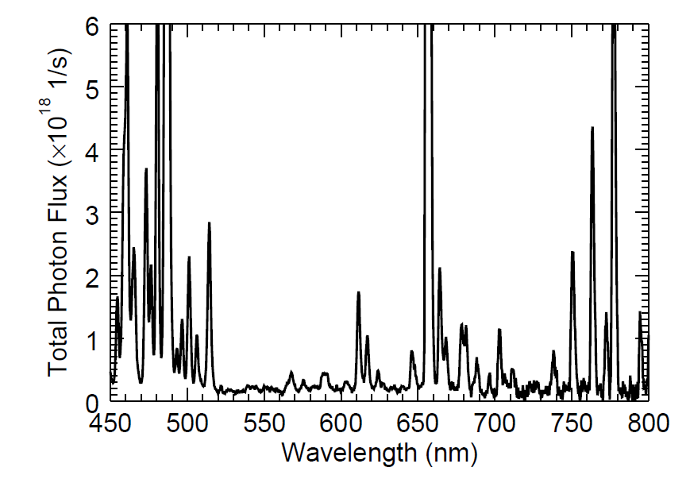
Spectroscopy indicates neutral burnout
Collimator
images
chords
70 kW Ar plasma
T_{e}=6.1 eV, n_{e}=1.7x10¹² cm⁻³
26º
ArII 480
ArI 763
MPDX
Plasma
Spectrometer

Slide 44
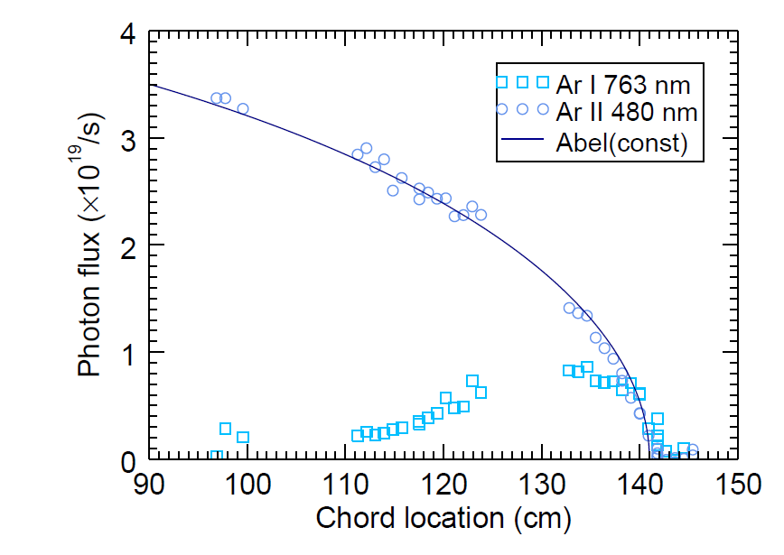
Spectroscopy indicates neutral burnout
Collimator
images
chords
70 kW Ar plasma
T_{e}=6.1 eV, n_{e}=1.7x10¹² cm⁻³
26º
MPDX
Plasma
Spectrometer

Slide 45
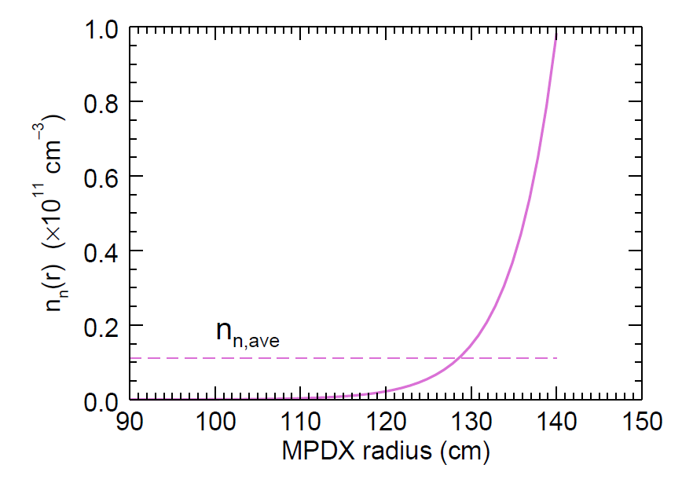
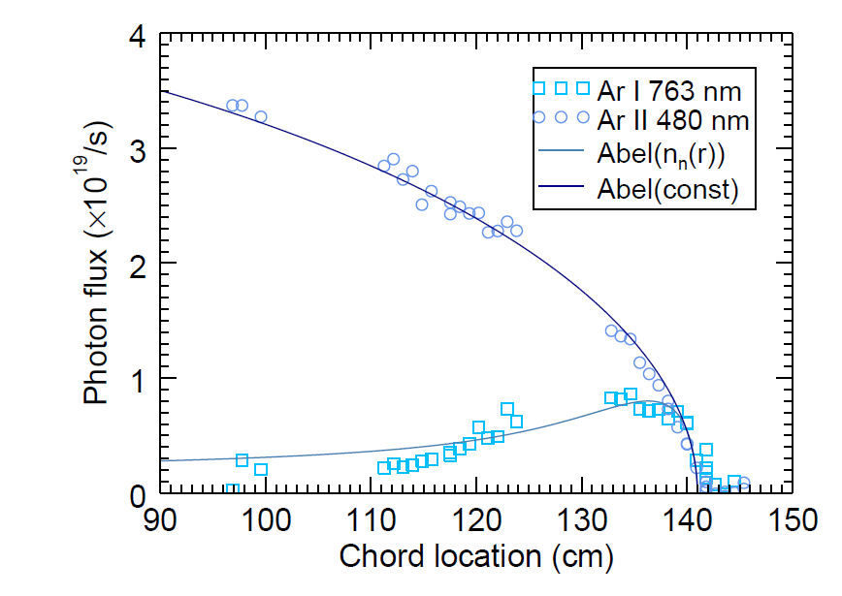
Abel transform of neutral fluid burnout model captures some details of data
Solve particle and momentum continuity equations to predict $n_{n}\left(r\right)$
70 kW Ar plasma
T_{e}=6.1 eV, n_{e}=1.7x10¹² cm⁻³
$${\left[∇∙Γ_{n}\right]}_{r}=−\left\langle σ_{iz}v_{e}\right\rangle n_{e}n_{n}$$
$$∇_{r}p={−m}_{i}ν_{n}Γ_{n,r}$$
$n_{n}$ edge =
0.7$n_{n}$ gauge

Slide 46
Measure Z_{eff}, sheath properties
For all ions leaving at single velocity c_{s}*,
$${c_{s}}^{∗}=\sqrt{\sum{\frac{n_{i}{c_{s,i}}^{2}}{n_{e}}}}$$
$$c_{s,i}=\sqrt{\frac{k_{b}\left(Z_{i}T_{e}+3T_{i}\right)}{m_{i}}}$$
$$Φ_{f}=−\frac{k_{B}T_{e}}{e}ln\left(\frac{c_{s}}{v_{th,e}}\right)$$
H
$Z_{eff}$=1
Optically thin plasma with constant $T_{e}, S\sim n_{e}n_{i}$
Compare to ${n_{e}}^{2}$ to find “missing” $n_{i}, Z_{eff}$
Monitor for Ar III 348.0 nm line
He
$Z_{eff}$=1.1
Ar
$Z_{eff}$=2.1
S. D. Baalrud and C. C. Hegna, Plas Sour. Sci. Tech 20, 025013 (2011)

Slide 47
LaB₆ currents drive flows when retracted into magnetized cusp
Unmagnetized
Core Plasma
JxB force in magnetized cusp field produces torque on plasma
2D calculation of magnetic field strength from magnets using MAXWELL.

Slide 48
Edge flows viscously couple into unmagnetized core
Spinning cathodes
Notes:
note that the profiles are flat and that the viscosity changes due to changing nn, nu_in is 1/10,000 of nu_ei, nu_ii

Slide 49
Close to laboratory simulation of dynamo flow
Khalzov et al, Phys of Plasmas 19 112106 (2012)
Able to test MHD simulation parameters in MPDX
Notes:
-In MPDX, we have developed a way to stirring a confined, unmagnetized plasma.
-Of course too diffuse to use impellers, we drive flow at the plasma edge.
-This plot shows such a flow - set Tor. vel. at the boundary as a funct. of theta, and the internal flows are a solution of the NS eqn. in 2D.
-Describe plot. As you can see, this is a two-vortex flow. Faster the boundary drive, the faster the poloidal flow, and the more we would twist up a frozen-in field line.
-PKE/TKE increases with Re. For this specific edge rotation boundary condition, we’ve volume averaged the kinetic energy in both flow components for different values of Re...
-This makes sense: we’re effectively injecting helicity, and a larger Re allows more velocity shear in our vortices.
-Ideally we’d have a plasma with very low viscosity, and the poloidal cells would have a large percentage of the total kinetic energy in the flow.

Slide 50
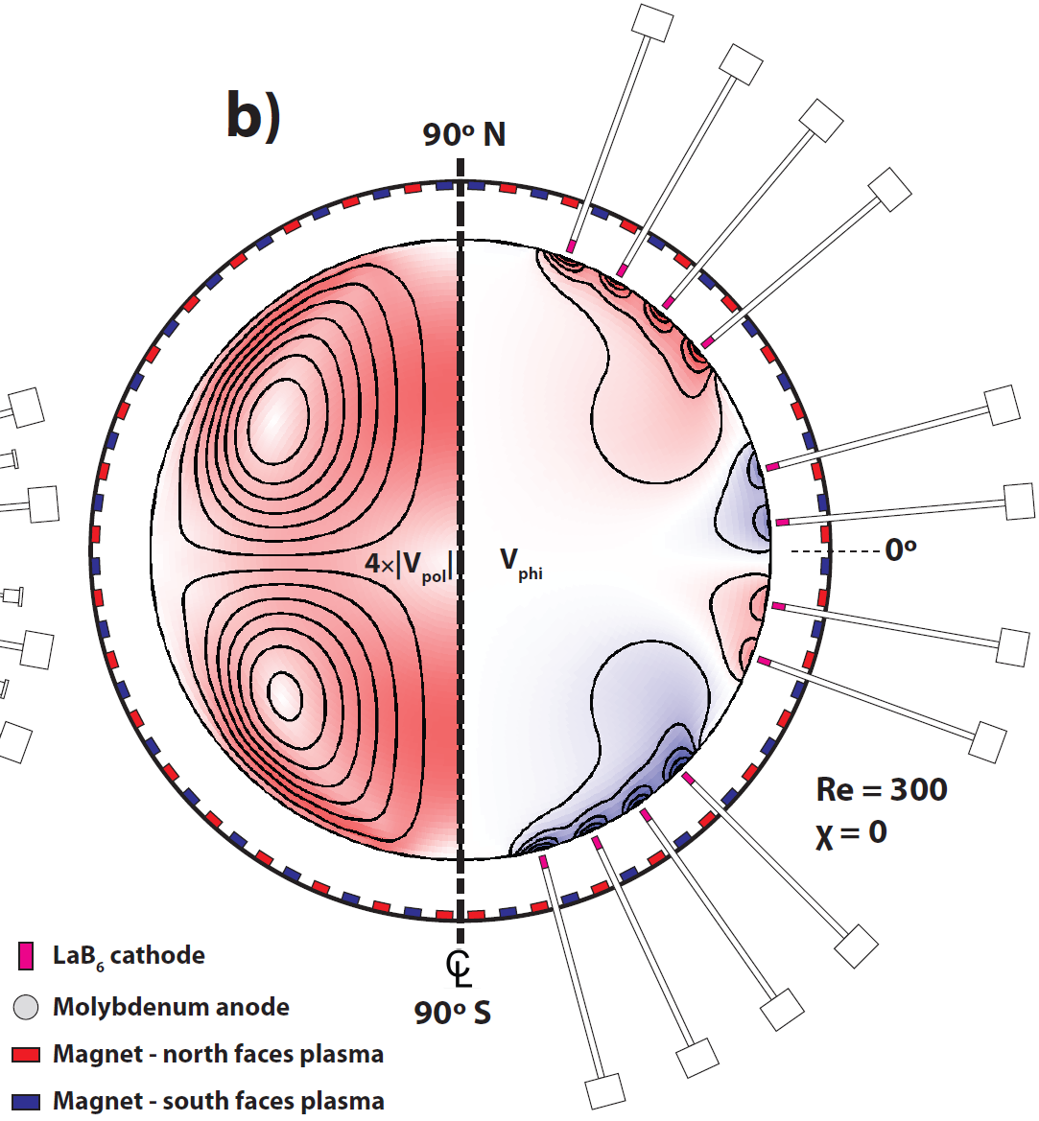
Modified Von Karmàn flow dynamo optimized for dynamo at low Rm
10-12 cathodes required to match details of flow
Notes:
Toroidal velocity given at all poloidal locations and optimized. Re and 2D steady state navier stokes self consistently determine poloidal flows. The eigenvalues of navier stokes are analyzed to find if they are stable, HD unstable flows are thrown out since they are not axisymmetric. Kinematic dynamo problem solved
Using steady state prescribed flow, the induction equation is solved for the kinematic dynamo, and the growth rate is determined. This is 50 radial by 25 poloidal resolution (60 by 30 for other rates)
Very sensitive to flow bc’s most other flows had no dynamo,

Slide 51
MHD modeling predicts measureable saturated field
B=1 G for He plasma, 10¹² cm⁻³, v=10 km/s
Provides experimentalist locality and sensitivity of magnetic measurements for dynamo
Notes:
Movie of Modified Von Karman type dynamo growing. 3D incompressable MHD nonlinear lorentz force term kept (back reaction term), R/V timestep, slow dynamo

Slide 52
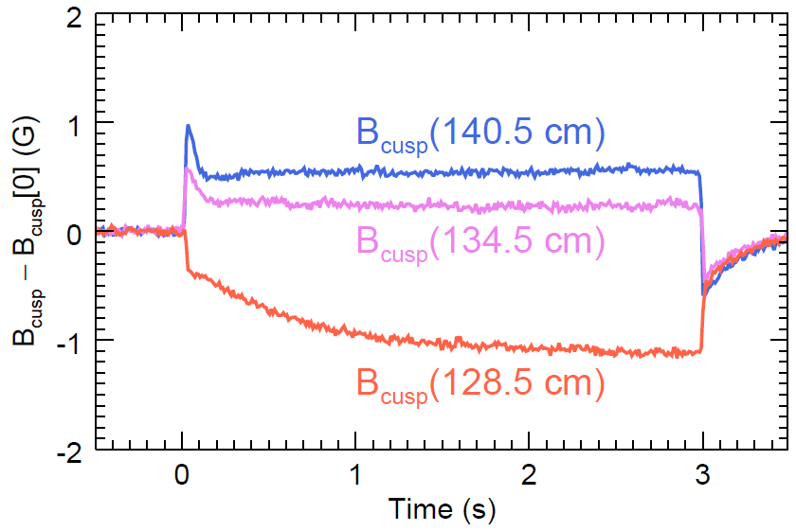
Magnetic Hall probes measure magnetic field with < 0.1 G sensitivity
Successfully measured magnetic field expulsion in stationary plasma due to diamagnetic currents
Notes:
Hall probes can measure 3D magnetic field as a function of time
Prone to temperature effects, must be properly cooled

Slide 53
Conclusions
Exhibit control of plasma parameters (viscosity and resistivity) based on experimental setup
Routinely and accurately measure T_{i} on MPDX for many species using novel FP interferometer
Cusp loss widths in new MPDX regime are wider than predicted, indicating additional physics
Observed neutral burnout consistent with 1D fluid model
MPDX can repeatedly create plasma with dynamo relevant viscosity and conductivity
(T_{e}=13 eV, T_{i}=0.5 eV, n_{e} = 3x10¹¹ cm⁻³
He: Re=250, Rm=500)
Notes:
Expanded parameter regime could be relevant to astrophysical plasmas

Slide 54
Future Work
Characterize cusp loss widths over greater scaling of parameters, compare to simulations
Measure neutral burnout and reconstruct radial profiles to compare source and loss rates
Investigate sheath physics in multi Z species regime in cusp

Slide 55
Other science projects
Thesis work in transport in magnetized plasma/neutral boundary layer [C. M. Cooper and W. Gekelman, Phys. Rev. Let. 110 265001 (2013)]
Metastable quenching and ionization excitation in PCX for LIF
OES measurements to predict plasma parameters
Hall probe measurements of magnetic field expulsion/advection
Measurements of viscosity from velocity profiles, resistivity from magnetic profiles

Slide 56
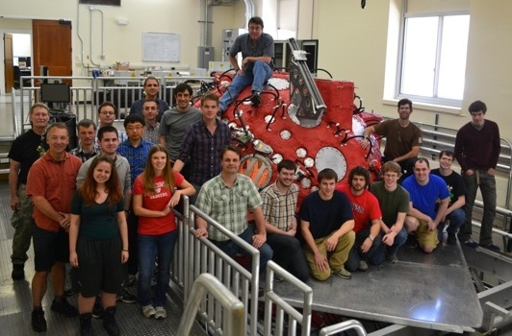
Thanks!

Slide 58
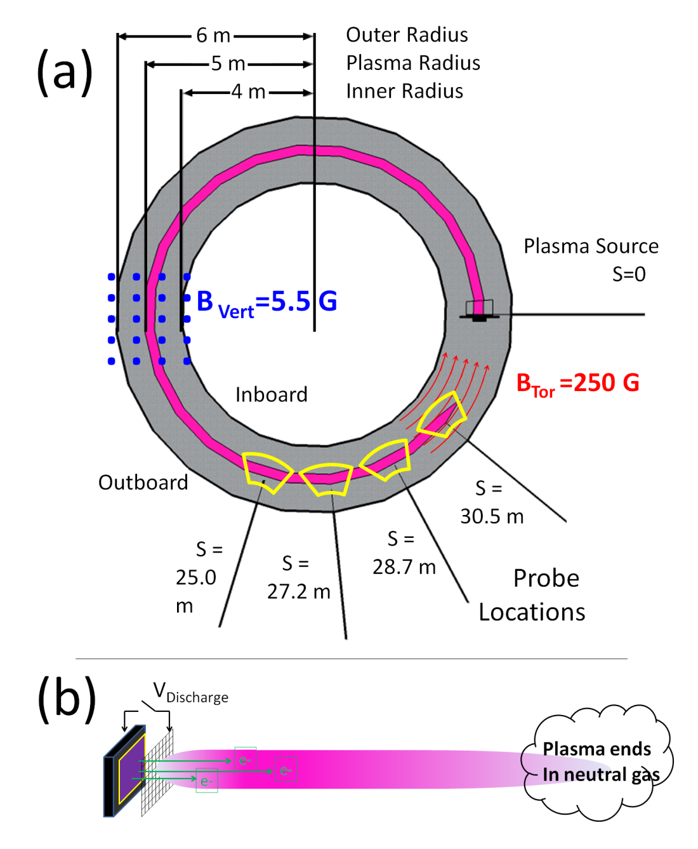
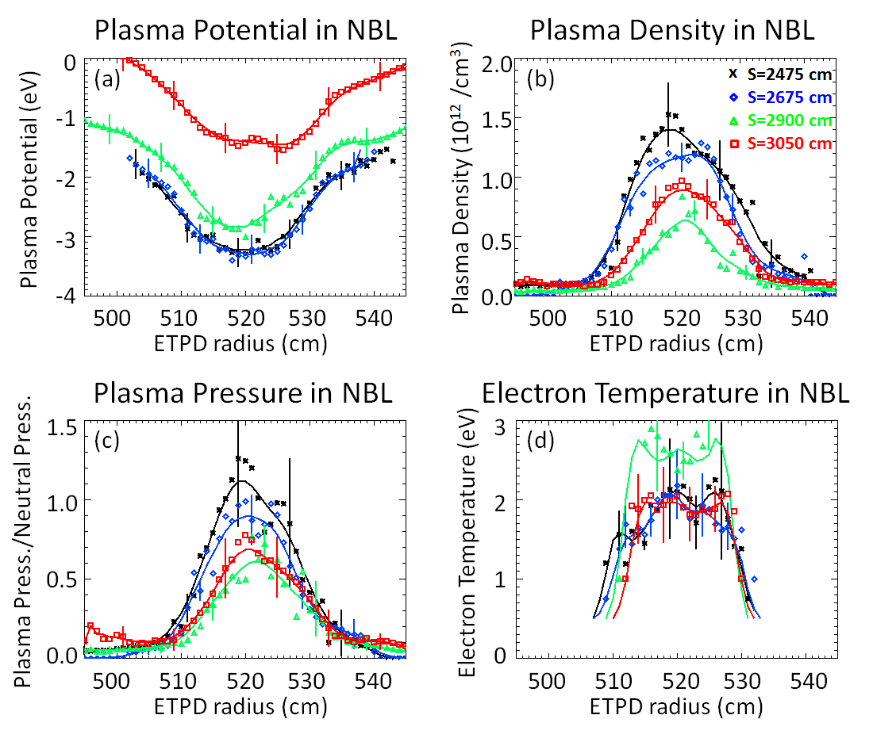
LaB6 plasma terminates on neutral gas losing particles, momentum, and heat

Slide 59
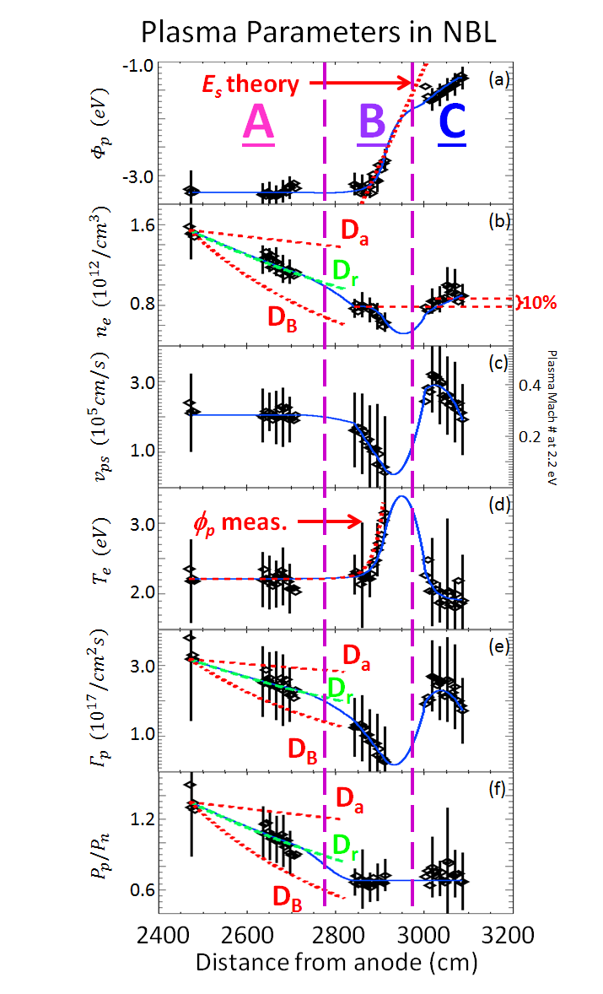
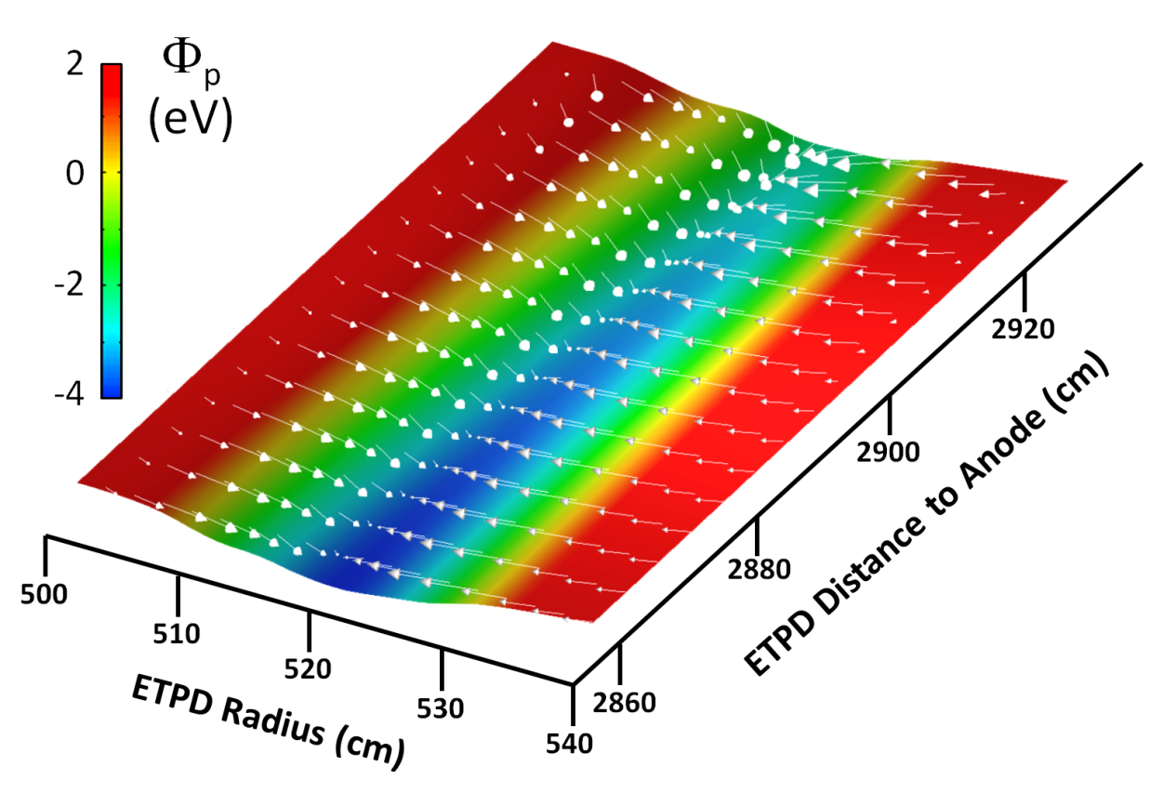
Electric field maintains quasi neutrality during deceleration, heats plasma
Termination electric field in region B

Slide 60
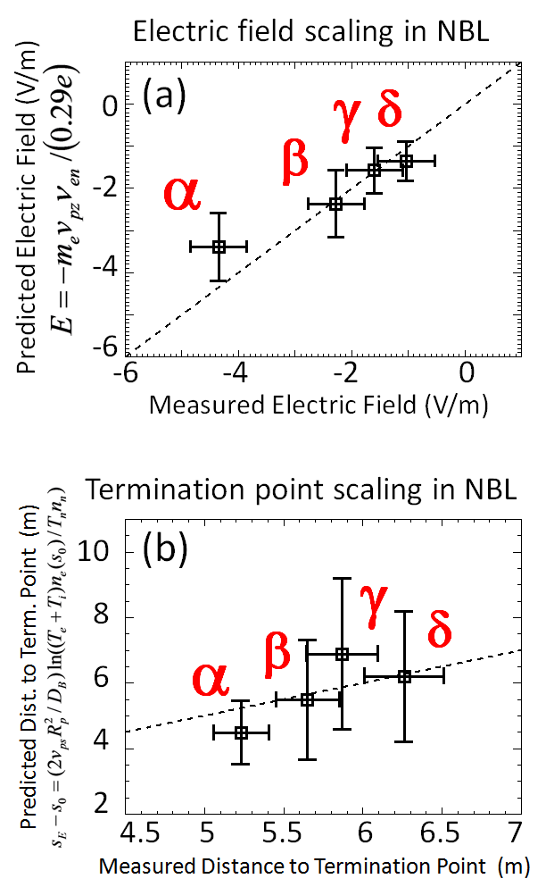
Electric field and pressure balance confirmed over scaling of parameters
Higher flow speed = bigger electric field to pull electrons
Lower density counteracts higher flow

Slide 64
Recent advances in fabrication of strong, custom, magnets make MPDX possible

Slide 65
Cusp width set by balance between passing particles and trapped particle diffusion
In collisionless isothermal limit, $n_{α}(x,y)$ determined by $n_{α,∞}, T_{α,∞}, ΔΨ\left(x,y\right),ΔΦ\left(x,y\right)$ using conservation of energy and canonical momentum
$$n\left(x,y\right)=\frac{n_{∞}}{2}\left\{\begin{aligned}1−erf\left[\left(\frac{\left|qΔΨ\right|}{2mc}+\frac{qcΔΦ}{\left|qΔΨ\right|}\right)\sqrt{\frac{m}{2T_{∞}}}\right] + \\ { e}^{−\frac{qΔΦ}{T_{∞}}}\left(1−erf\left[\left(\frac{\left|qΔΨ\right|}{2mc}−\frac{qcΔΦ}{\left|qΔΨ\right|}\right)\sqrt{\frac{m}{2T_{∞}}}\right]\right)\end{aligned}\right\}$$
Knowledge of $Ψ$ at the magnet surface is needed

Slide 66
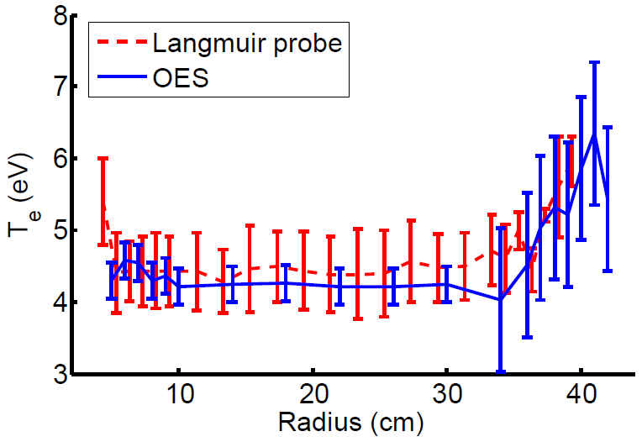
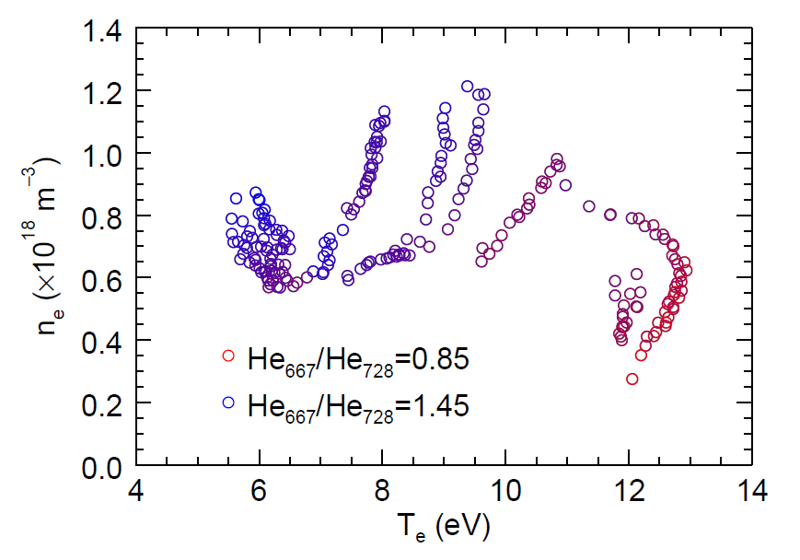
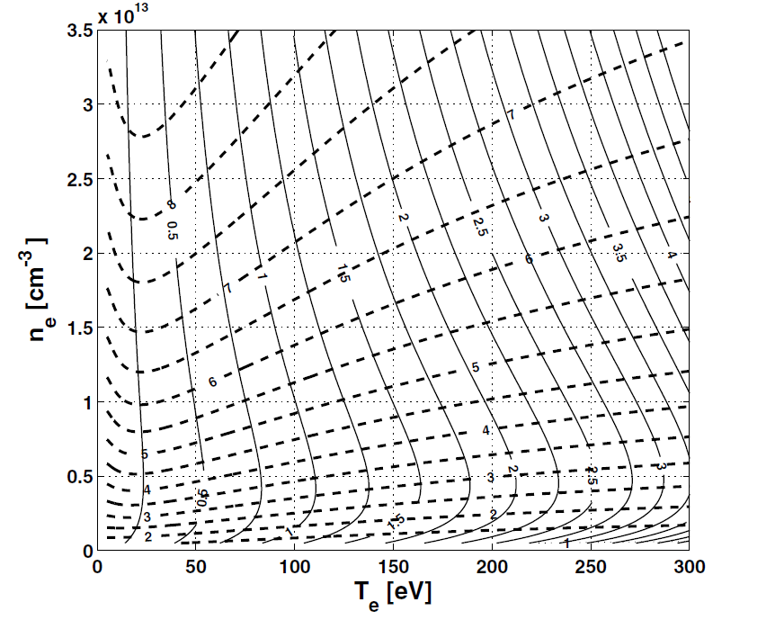
Optical Emission Spectroscopy provides additional non-intrusive diagnostics
OES in Argon can predict T_{e}, n_{m}, and T_{b} in PCX
OES in Helium to benchmark T_{e}, n_{e} predictions in MPDX regime
J. B. Boffard et al, Plas. Sour. Tech 19, 1 (2010)
S. Wang et al, J. Vac. Sci. Tech. 31, 735 (2013)
B. Seidlitz et al, in process of submission Rev. Sci. Instr.
O Schmitz et al, Plas. Phys. Cont. Fus. 50, 115004 (2008)
Notes:
Developing new high resolution (0.1-0.3 nm) broadband (200-850 nm) system using 5 overlapping spectrometers
Oliver data differs because Zeff ne 1

Slide 67
v_{φ}(θ), Re, and Rm uniquely predict kinematic dynamo in simulation
Spence et al, Astro. J. 700:470-478 (2009)
Khalzov et al, Phys of Plasmas 19 112106 (2012)
Poloidal/Toroidal
Energy Balance
HD unstable
Dynamo very sensitive to Re, Rm AND details of flow
Notes:
-exhaustive search of parameter space for this class of dynamo, limited by resolution Rm and HD stability (Re)
-1) no dynamo below Re=80 (zero suppressed) we suspect this is related to critical level of poloidal flow
-2) majority of the time, no dynamo. Taking off reversal is no dynamo

Slide 68
Cathode stirring experiments
Cathode position in cusp determines flow
Notes:
-This data is from our first attempts at controlling the plasma flow by stirring from the edge.
-The electrodes on the southern hemisphere are still fully inserted, and are for heating purposes only.
-These two cathodes on the northern hemisphere have been retracted into the magnetized edge region.
-This plot shows our first attempts at optimizing this cathode position, as measured by a mach probe located in the unmagnetized core.

Slide 69
Six cathodes successfully drive counter-rotating plasmas
6 cathodes driving flow in cusp, 2 cathodes only heating in unmagnetized plasma
T_{e}=13 eV, n_{e}=3x10¹¹ cm⁻³
Re=250, Rm=500
Notes:
Mention that its unbalanced!

Slide 70
Conclusions
MPDX can repeatedly create plasma with dynamo relevant viscosity and conductivity (T_{e}=13 eV, n_{e} = 3x10¹¹ cm⁻³)
Successfully model particle and energy transport in MPDX to predict plasma parameters, confirmed by measurement
Generation of flows in MPDX that locally correspond to Re=250, Rm=500 (v_{edge}=5 km/s)
Direct comparison possible with MHD model parameters in same regime
Notes:
Expanded parameter regime could be relevant to astrophysical plasmas

Slide 71
Goals for measuring successful dynamo action
Compare dynamo parameters to simulations (Re, Rm, saturated B, growth rates)
Turn off “seed field” to confirm dynamo persists.
Confirm saturated magnetic field strength independent of seed field strength.
Investigate dynamo orientation with respect to flow orientation and seed field orientation
Perform volumetric measurements of magnetic field as a function of time to investigate magnetic field generation locations (advection vs growth)
Evidence of magnetic self organization i.e. inverse cascade (turbulent dynamo)

Slide 72
Laboratory plasma dynamo experiments can play an important role in astrophysics research
Possibility of achieving high Rm
Ability to change Pm
Validate dynamo codes
in Pm=Rm/Re~1 regime
Notes:
- Plasma confinement, holding and manipulating plasma, is very important in laboratory plasma physics, research we perform is applicable to many devices
Plasmas are uniquely well suited to build on existing laboratory dynamo experiments b/c of scaling of viscosity and conductivity
The plasmas we create in laboratories are very amenable to modeling, Re, Rm are below 1000 and Pm is order 1
Not trying to replicate geodynamo or Sun’s dynamo in lab

