Slide 1

Multiscale simulations of transport with turbulence and magnetic island
Olivier Izacard
Lawrence Livermore National Laboratory
(University of California - San Diego)
Collaborators:
C. Holland (UCSD)
S.D. James (U. Tulsa)
D.P. Brennan (Princeton U.)
Seminar
April 20, 2015 @ PPPL, Princeton, NJ

Slide 2
OUTLINE
Transport with turbulence & magnetic island
Motivations
Used tools: BOUT++ & OMFIT
Overview of the 5-field model
Verification of 2D electromagnetic 2-field tearing modes
Verification & results of 2D electrostatic 4-field microturbulence with a static magnetic island
First steps toward the self-consistent interactions between Tearing Modes and microturbulence

Slide 3
Motivations & Procedure
Motivations:
MHD and microturbulence (i.e. on ion gyroradius scales or smaller) both important determinants of plasma confinement and device performance
Historically, MHD and microturbulence considered separately
  No tractable rigorous theory capable of handling both, especially for relevant reactor geometry and parameters
However, clear that MHD and microturbulence coexist in many experiments, so potential couplings need to be investigated
Procedure:
In order to make progress on this challenging problem, start by investigating nonlinear couplings between tearing mode and ITG turbulence in a minimal fluid model
Use BOUT++ simulations via OMFIT framework
Endgoals:
  Quantifying “zone of influence” of tearing mode on turbulence – How far from rational surface/island separatrix does turbulence feel impact of island
  Incorporation of turbulence effects into Rutherford equation

Slide 4
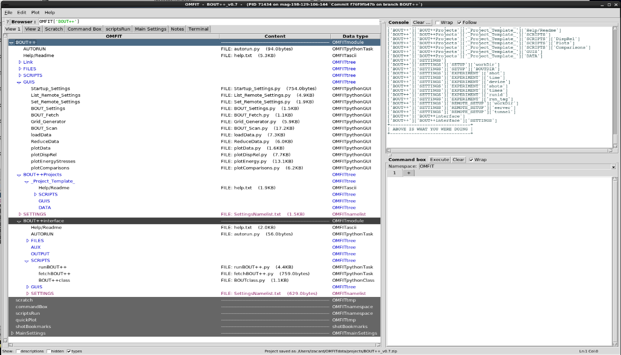
OMFIT: a unique powerful tool for integrated studies
All results here done using OMFIT and its BOUT++ module
OMFIT = One Modeling Framework for Integrated Tasks
“Software” (Graphical User Interface) for integrated studies which can quickly connect many codes (common files) & experimental data (MDS+)
After 2 years: > 60 users; > 30 modules; AToM ($12 M for 3 years, > 15 people): GA, UCSD, LLNL…; > 10³ executions in last 4 months
Bottom-up approach
Collaboration-friendly
Daily assistance (GitHub)
Common files: NetCDF, IDL,
eqdsk, Matlab, ascii…
Remote connections
BOUT++ available
with BOUT++class
  SUMMARY:
  - GUIs: ideal for new users & complex/repetitive tasks
  - Bottom-Up approach (incremental work)
  - Ideal for collaborations
  - Intrinsically modular & Universal:
  Many codes & servers, many applications
  - Theoretical modeling & experimental data analysis

Slide 5
Overview of the 5-field model describing microturbulence and tearing modes
One of the possible fluid model which allow self-consistent interactions between the ITG-driven microturbulence and the tearing modes is:
Gradient-driven turbulence, FLR effects, magnetic shear, possible static magnetic island and current sheet equilibrium…
Notes:
LatexIt:
d_{ t }\tilde { n } &=\frac { a }{ L_{ B } } \frac { \partial }{ \partial y } \left( \tilde { \phi } -\tilde { n } \right) +\nabla _{ \parallel }\left( \tilde { J } _{ \parallel }-\tilde { V } _{ \parallel } \right) +\tilde { B } \cdot \nabla J_{ I }+D\nabla _{ \perp }^{ 2 }\tilde { n } -\nu _{ source }\left< \tilde { n } \right> _{ y,z }\\
d_{ t }\tilde { \Omega } &=\frac { a }{ L_{ B } } \frac { \partial }{ \partial y } \left( (1+\tau )\tilde { n } +\tau \tilde { T } _{ i } \right) +\nabla _{ \parallel }\tilde { J } _{ \parallel }+\tilde { B } \cdot \nabla J_{ I }+\tau \frac { a }{ L_{ T_{ i } } } \frac { \partial \tilde { \Omega } }{ \partial y } +\tau \nabla \cdot \left[ \nabla \tilde { \phi } ,\tilde { n } +\tilde { T } _{ i } \right] +D\nabla _{ \perp }^{ 2 }\tilde { \Omega } \\
d_{ t }\tilde { V } _{ \parallel } &=-\nabla _{ \parallel }\left( (1+\tau )\tilde { n } +\tau \tilde { T } _{ i } \right) +D\nabla _{ \perp }^{ 2 }\tilde { V } _{ \parallel }-\nu _{ source }\left< \tilde { V } _{ \parallel } \right> _{ y,z }\\
d_{ t }\tilde { T } _{ i }&=\tau \frac { a }{ L_{ T_{ i } } } \frac { \partial \tilde { \phi } }{ \partial y } -\left( \Gamma -1 \right) \left( \tau \nabla _{ \parallel }\tilde { V } _{ \parallel }-\lambda \frac { a }{ L_{ B } } \frac { \partial }{ \partial y } \left( \tilde { \phi } +\tau \tilde { n } +\tau \tilde { T } _{ i } \right) \right) +\tau D\nabla _{ \perp }^{ 2 }\tilde { T } _{ i }-\nu _{ source }\left< \tilde { T } _{ i } \right> _{ y,z }\\
\beta d_{ t }\tilde { \psi } &=-\nabla _{ \parallel }\left( \tilde { \phi } -\tilde { n } \right) -\eta \tilde { J } _{ \parallel }\\
\tilde { J } _{ \parallel } &=-\nabla _{ \perp }^{ 2 }\tilde { \psi } ,\qquad d_{ t }=\partial _{ t }+\left[ \tilde { \phi } ,. \right] ,\qquad \nabla _{ \parallel }=\partial _{ z }+B_{ y0 }(x)\partial _{ y }+B_{ I }(y)\cdot \nabla
%%%%%%%
d_{ t }\tilde { n } =\frac { a }{ L_{ B } } \frac { \partial }{ \partial y } \left( \tilde { \phi } -\tilde { n } \right) +\nabla _{ \parallel }\left( \tilde { J } _{ \parallel }-\tilde { V } _{ \parallel } \right) +\tilde { B } \cdot \nabla J_{ I }+D\nabla _{ \perp }^{ 2 }\tilde { n } -\nu _{ source }\left< \tilde { n } \right> _{ y,z }\\ d_{ t }\tilde { \Omega } =\frac { a }{ L_{ B } } \frac { \partial }{ \partial y } \left( (1+\tau )\tilde { n } +\tau \tilde { T } _{ i } \right) +\nabla _{ \parallel }\tilde { J } _{ \parallel }+\tilde { B } \cdot \nabla J_{ I }+\tau \frac { a }{ L_{ T_{ i } } } \frac { \partial \tilde { \Omega } }{ \partial y } +\tau \nabla \cdot \left[ \nabla \tilde { \phi } ,\tilde { n } +\tilde { T } _{ i } \right] +D\nabla _{ \perp }^{ 2 }\tilde { \Omega } \\ d_{ t }\tilde { V } _{ \parallel }=-\nabla _{ \parallel }\left( (1+\tau )\tilde { n } +\tau \tilde { T } _{ i } \right) +D\nabla _{ \perp }^{ 2 }\tilde { V } _{ \parallel }-\nu _{ source }\left< \tilde { V } _{ \parallel } \right> _{ y,z }\\ d_{ t }\tilde { T } _{ i }=\tau \frac { a }{ L_{ T_{ i } } } \frac { \partial \tilde { \phi } }{ \partial y } -\left( \Gamma -1 \right) \left( \tau \nabla _{ \parallel }\tilde { V } _{ \parallel }-\lambda \frac { a }{ L_{ B } } \frac { \partial }{ \partial y } \left( \tilde { \phi } +\tau \tilde { n } +\tau \tilde { T } _{ i } \right) \right) +\tau D\nabla _{ \perp }^{ 2 }\tilde { T } _{ i }-\nu _{ source }\left< \tilde { T } _{ i } \right> _{ y,z }\\ \beta d_{ t }\tilde { \psi } =-\nabla _{ \parallel }\left( \tilde { \phi } -\tilde { n } \right) -\eta \tilde { J } _{ \parallel }\\ \tilde { J } _{ \parallel }=-\nabla _{ \perp }^{ 2 }\tilde { \psi } ,\qquad d_{ t }=\partial _{ t }+\left[ \tilde { \phi } ,. \right] ,\qquad \nabla _{ \parallel }=\partial _{ z }+B_{ y0 }(x)\partial _{ y }+B_{ I }(y)\cdot \nabla

Slide 6
Verification of the 2D 2-field tearing modes
Tearing mode is included in our model: Well known results
Notes:
LatexIt:
d_{ t }\tilde { n } &= d_{ t }\tilde { V } _{ \parallel } = d_{ t }\tilde { T } _{ i } = 0 \\
d_{ t }\tilde { \Omega } &= \nabla _{ \parallel }\tilde { J } _{ \parallel }+\tilde { B } \cdot \nabla J_{ I }+D\nabla _{ \perp }^{ 2 }\tilde { \Omega } \\
\beta d_t \tilde{\psi} &= -\nabla _{ \parallel } \tilde { \phi } - \eta \tilde { J } _{ \parallel } \\
\tilde { J } _{ \parallel } &=-\nabla _{ \perp }^{ 2 }\tilde { \psi } ,\qquad d_{ t }=\partial _{ t }+\left[ \tilde { \phi } ,. \right] ,\qquad \nabla _{ \parallel }=\partial _{ z }+B_{ y0 }(x)\partial _{ y }+B_{ I }(y)\cdot \nabla
%%%%%%%%
d_{ t }\tilde { n } = d_{ t }\tilde { V } _{ \parallel } = d_{ t }\tilde { T } _{ i } = 0 \\ d_{ t }\tilde { \Omega } = \frac { a }{ L_{ B } } \frac { \partial }{ \partial y } \left( (1+\tau )\tilde { n } +\tau \tilde { T } _{ i } \right) +\nabla _{ \parallel }\tilde { J } _{ \parallel }+\tilde { B } \cdot \nabla J_{ I }+\tau \frac { a }{ L_{ T_{ i } } } \frac { \partial \tilde { \Omega } }{ \partial y } +\tau \nabla \cdot \left[ \nabla \tilde { \phi } ,\tilde { n } +\tilde { T } _{ i } \right] +D\nabla _{ \perp }^{ 2 }\tilde { \Omega } \\ \beta d_t \tilde{\psi} = -\nabla _{ \parallel }\left( \tilde { \phi } -\tilde { n } \right) - \eta \tilde { J } _{ \parallel } \\ \tilde { J } _{ \parallel }=-\nabla _{ \perp }^{ 2 }\tilde { \psi } ,\qquad d_{ t }=\partial _{ t }+\left[ \tilde { \phi } ,. \right] ,\qquad \nabla _{ \parallel }=\partial _{ z }+B_{ y0 }(x)\partial _{ y }+B_{ I }(y)\cdot \nabla

Slide 7
Verification of electrostatic 4-field microturbulence driven by gradients with a static magnetic island
Set dψ/dt = 0, turbulent flutter nonlinearities to zero (β -> 0)
Allow separate n, φ fluctuations to allow self-consistent zonal flow response and quantify Ohm’s law nonlinearity in presence of small but finite η
Notes:
LatexIt:
d_{ t }\tilde { n } &=\frac { a }{ L_{ B } } \frac { \partial }{ \partial y } \left( \tilde { \phi } -\tilde { n } \right) +\nabla _{ \parallel }\left( \tilde { J } _{ \parallel }-\tilde { V } _{ \parallel } \right) +\tilde { B } \cdot \nabla J_{ I }+D\nabla _{ \perp }^{ 2 }\tilde { n } -\nu _{ source }\left< \tilde { n } \right> _{ y,z }\\
d_{ t }\tilde { \Omega } &=\frac { a }{ L_{ B } } \frac { \partial }{ \partial y } \left( (1+\tau )\tilde { n } +\tau \tilde { T } _{ i } \right) +\nabla _{ \parallel }\tilde { J } _{ \parallel }+\tilde { B } \cdot \nabla J_{ I }+\tau \frac { a }{ L_{ T_{ i } } } \frac { \partial \tilde { \Omega } }{ \partial y } +\tau \nabla \cdot \left[ \nabla \tilde { \phi } ,\tilde { n } +\tilde { T } _{ i } \right] +D\nabla _{ \perp }^{ 2 }\tilde { \Omega } \\
d_{ t }\tilde { V } _{ \parallel } &=-\nabla _{ \parallel }\left( (1+\tau )\tilde { n } +\tau \tilde { T } _{ i } \right) +D\nabla _{ \perp }^{ 2 }\tilde { V } _{ \parallel }-\nu _{ source }\left< \tilde { V } _{ \parallel } \right> _{ y,z }\\
d_{ t }\tilde { T } _{ i }&=\tau \frac { a }{ L_{ T_{ i } } } \frac { \partial \tilde { \phi } }{ \partial y } -\left( \Gamma -1 \right) \left( \tau \nabla _{ \parallel }\tilde { V } _{ \parallel }-\lambda \frac { a }{ L_{ B } } \frac { \partial }{ \partial y } \left( \tilde { \phi } +\tau \tilde { n } +\tau \tilde { T } _{ i } \right) \right) +\tau D\nabla _{ \perp }^{ 2 }\tilde { T } _{ i }-\nu _{ source }\left< \tilde { T } _{ i } \right> _{ y,z }\\
\beta d_{ t }\tilde { \psi } &=-\nabla _{ \parallel }\left( \tilde { \phi } -\tilde { n } \right) -\eta \tilde { J } _{ \parallel }\\
\tilde { J } _{ \parallel } &=-\nabla _{ \perp }^{ 2 }\tilde { \psi } ,\qquad d_{ t }=\partial _{ t }+\left[ \tilde { \phi } ,. \right] ,\qquad \nabla _{ \parallel }=\partial _{ z }+B_{ y0 }(x)\partial _{ y }+B_{ I }(y)\cdot \nabla
%%%%%%%
d_{ t }\tilde { n } =\frac { a }{ L_{ B } } \frac { \partial }{ \partial y } \left( \tilde { \phi } -\tilde { n } \right) +\nabla _{ \parallel }\left( \tilde { J } _{ \parallel }-\tilde { V } _{ \parallel } \right) +\tilde { B } \cdot \nabla J_{ I }+D\nabla _{ \perp }^{ 2 }\tilde { n } -\nu _{ source }\left< \tilde { n } \right> _{ y,z }\\ d_{ t }\tilde { \Omega } =\frac { a }{ L_{ B } } \frac { \partial }{ \partial y } \left( (1+\tau )\tilde { n } +\tau \tilde { T } _{ i } \right) +\nabla _{ \parallel }\tilde { J } _{ \parallel }+\tilde { B } \cdot \nabla J_{ I }+\tau \frac { a }{ L_{ T_{ i } } } \frac { \partial \tilde { \Omega } }{ \partial y } +\tau \nabla \cdot \left[ \nabla \tilde { \phi } ,\tilde { n } +\tilde { T } _{ i } \right] +D\nabla _{ \perp }^{ 2 }\tilde { \Omega } \\ d_{ t }\tilde { V } _{ \parallel }=-\nabla _{ \parallel }\left( (1+\tau )\tilde { n } +\tau \tilde { T } _{ i } \right) +D\nabla _{ \perp }^{ 2 }\tilde { V } _{ \parallel }-\nu _{ source }\left< \tilde { V } _{ \parallel } \right> _{ y,z }\\ d_{ t }\tilde { T } _{ i }=\tau \frac { a }{ L_{ T_{ i } } } \frac { \partial \tilde { \phi } }{ \partial y } -\left( \Gamma -1 \right) \left( \tau \nabla _{ \parallel }\tilde { V } _{ \parallel }-\lambda \frac { a }{ L_{ B } } \frac { \partial }{ \partial y } \left( \tilde { \phi } +\tau \tilde { n } +\tau \tilde { T } _{ i } \right) \right) +\tau D\nabla _{ \perp }^{ 2 }\tilde { T } _{ i }-\nu _{ source }\left< \tilde { T } _{ i } \right> _{ y,z }\\ \beta d_{ t }\tilde { \psi } =-\nabla _{ \parallel }\left( \tilde { \phi } -\tilde { n } \right) -\eta \tilde { J } _{ \parallel }\\ \tilde { J } _{ \parallel }=-\nabla _{ \perp }^{ 2 }\tilde { \psi } ,\qquad d_{ t }=\partial _{ t }+\left[ \tilde { \phi } ,. \right] ,\qquad \nabla _{ \parallel }=\partial _{ z }+B_{ y0 }(x)\partial _{ y }+B_{ I }(y)\cdot \nabla

Slide 8
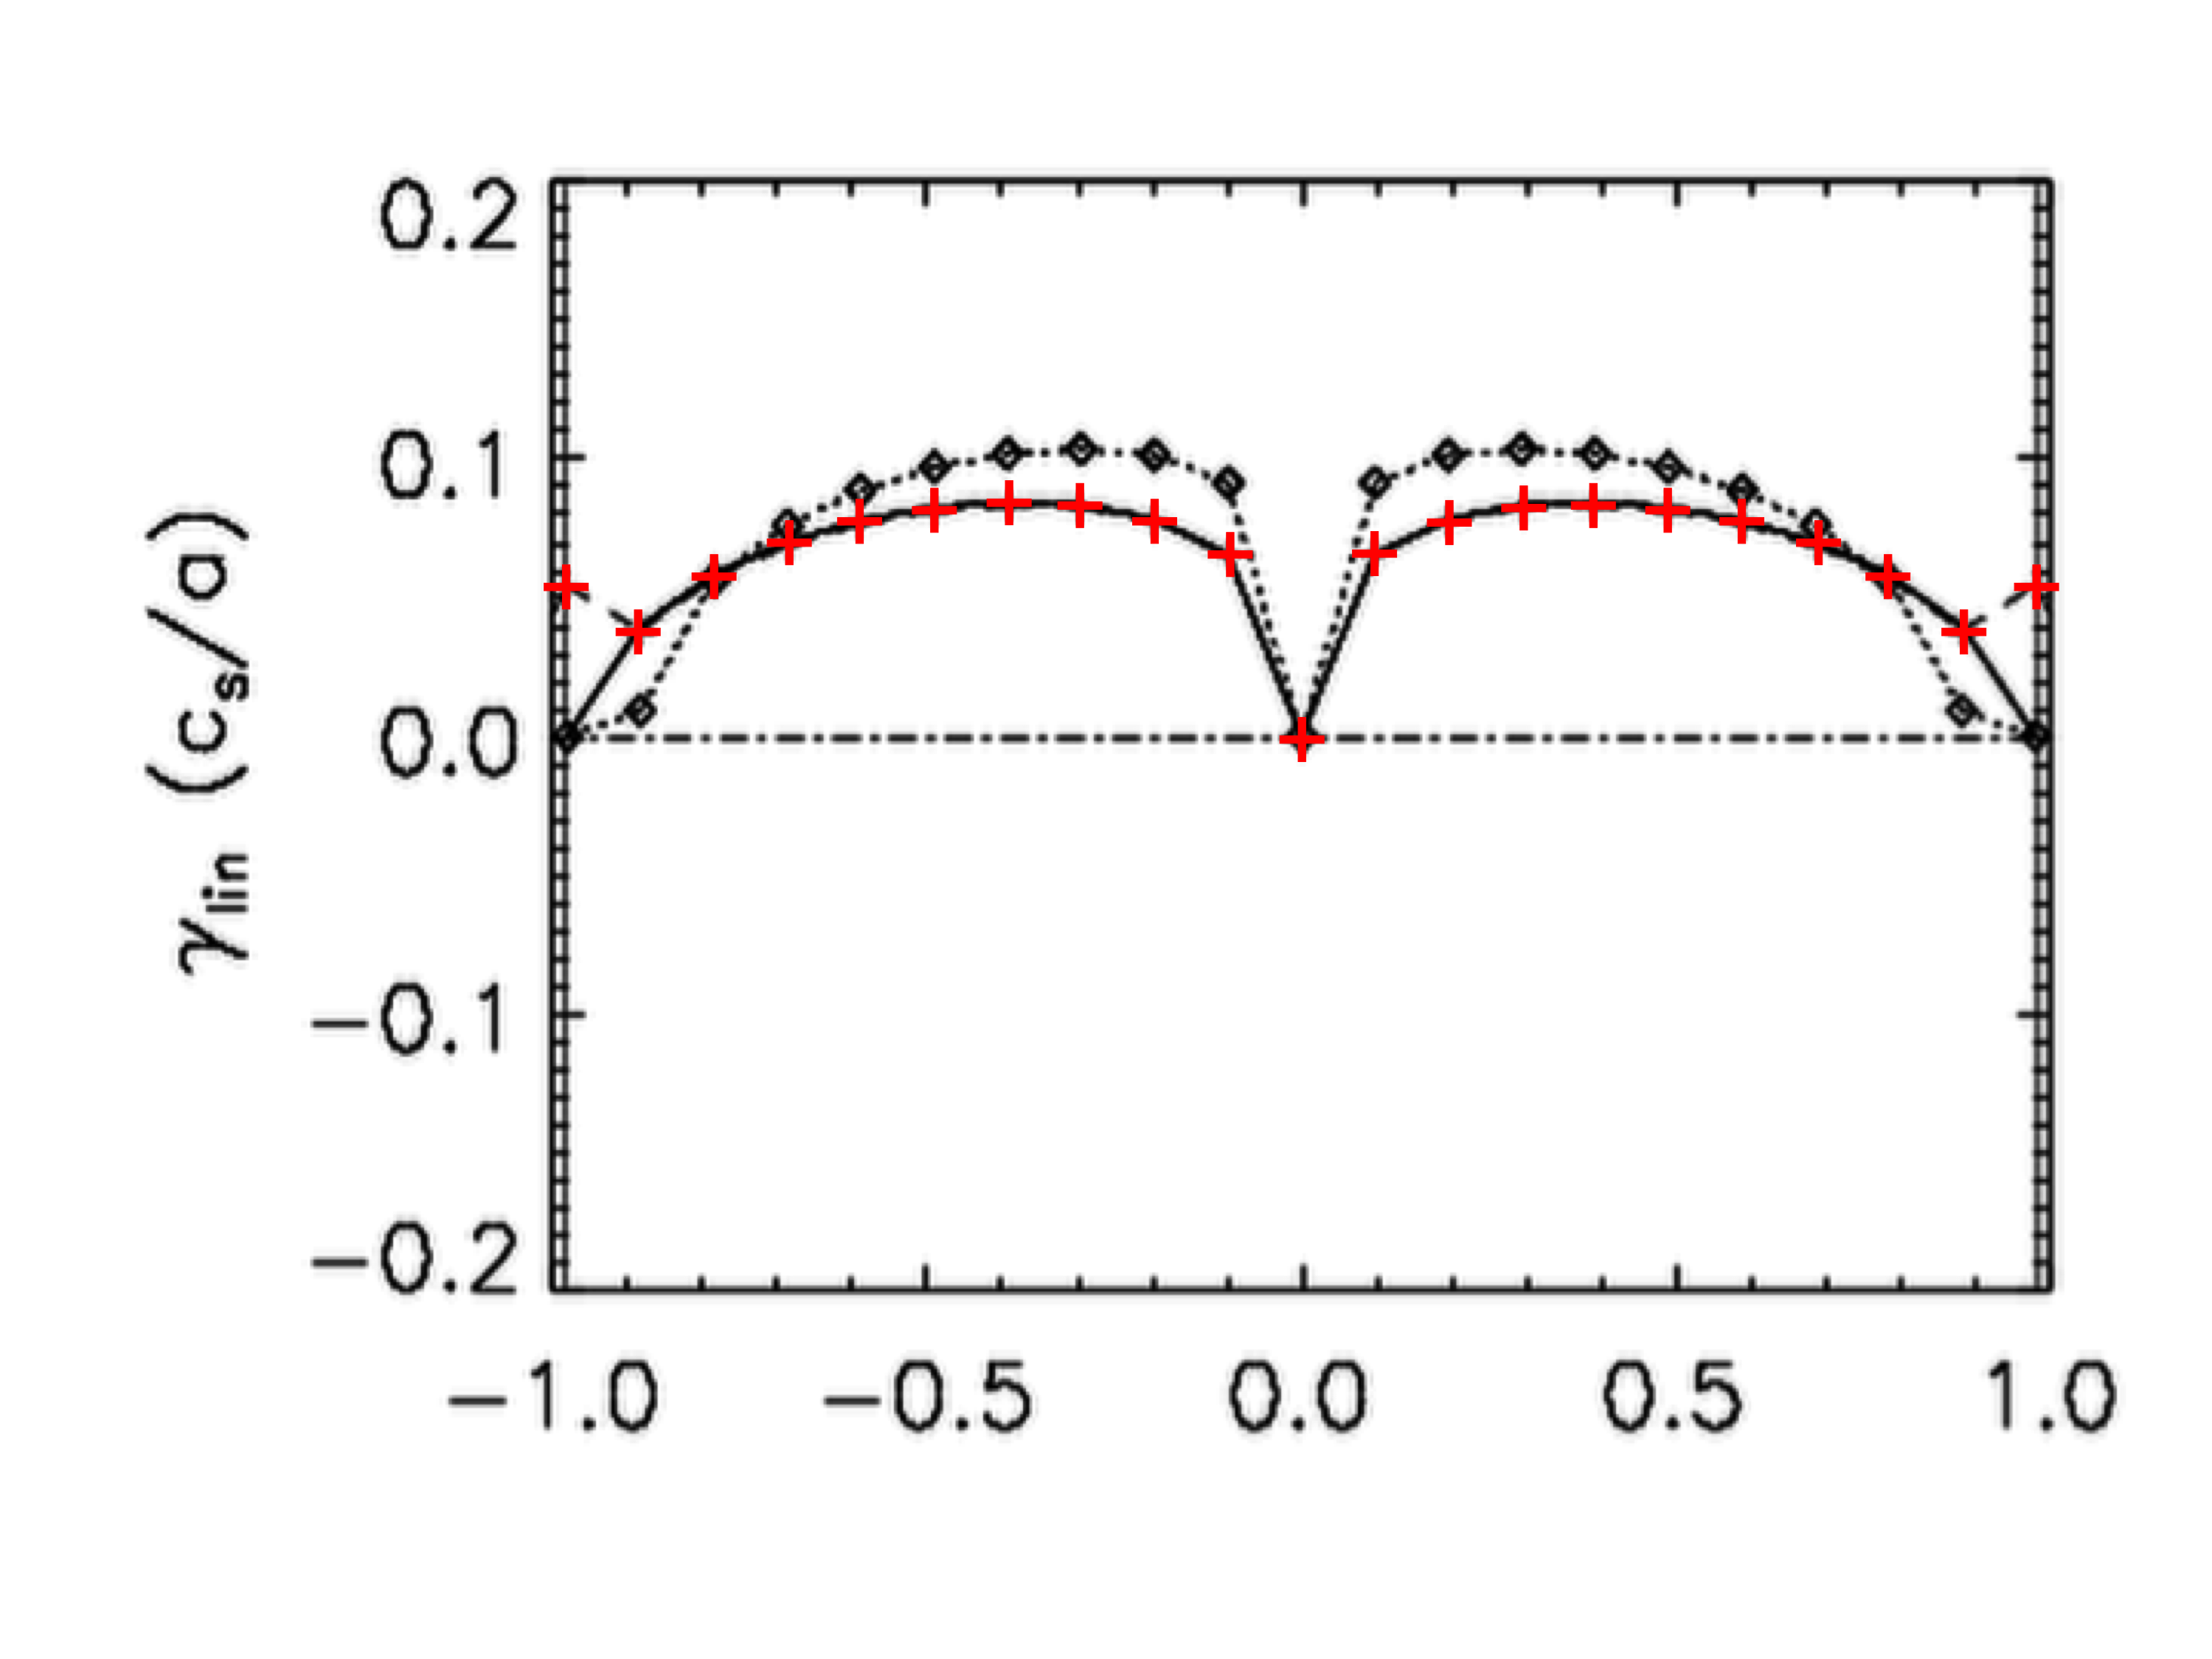
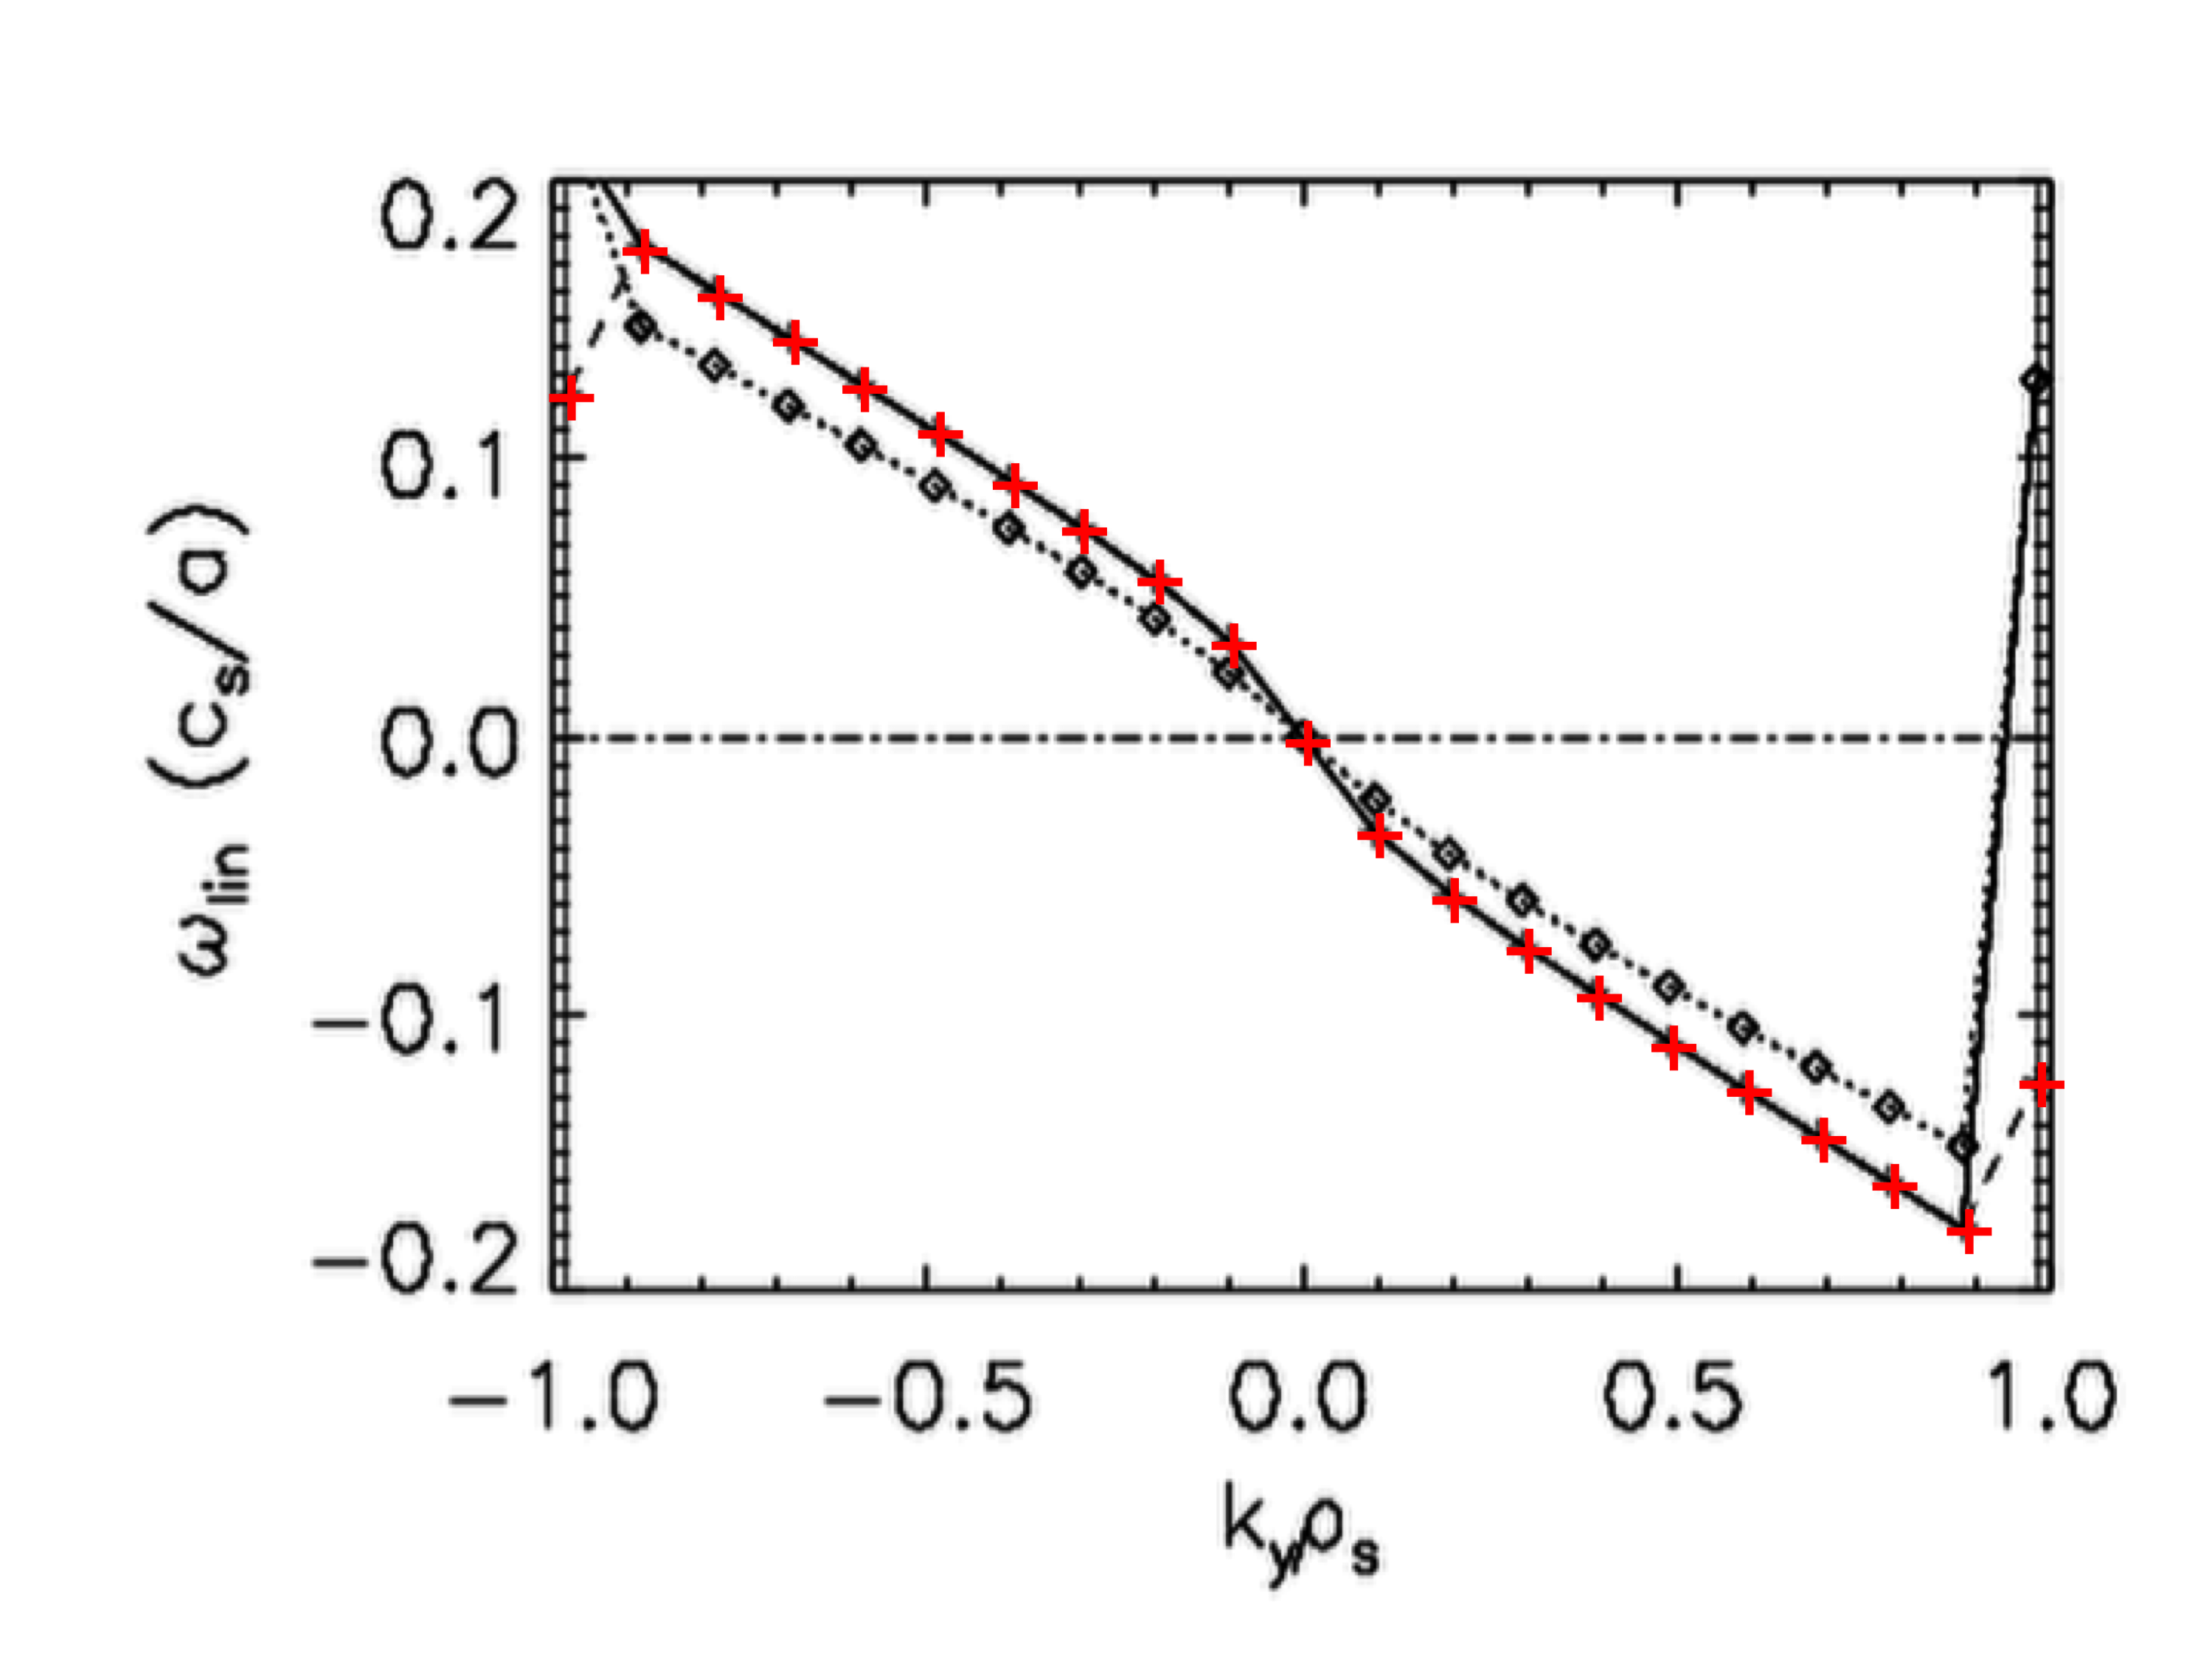
Verification of “four-field” ITG linear dispersion
For the 2D-limit w/o island: the dispersion relation is well validated
Consider limiting case: n₀(x) = 1, a/L_{B} = 0.1, a/L_{Ti} = 0.3, η = 0
Theory λ=0
Theory λ=1
BOUT++ λ=0
+ +
Linear ITG well verified

Slide 9
Solve 2D nonlinear system using BOUT++
SLAB 64 x 64 ρ_{s} box (a = 32, b=64), NX=151, NY=129
ψ_{eq}= -x²/(2L_{s}) + ψ_{island}cos(2πy/b)
Base parameters:
a/L_{B}=0.1, a/L_{Ti}=0.3, η=1e-4, D=1e-2, =0.05
Apply damping (with ) of to prevent quasilinear relaxation and maintain input background profiles

Slide 10
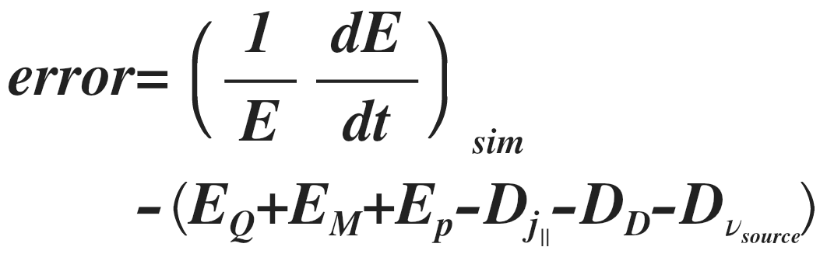
Energy balance: numerical accuracy
Saturation of the turbulence confirmed
Numerical accuracy verified
Energy balance:
E_{f}: Source of energy, drive of instabilities
D_{f}: Sink of energy, dissipation
W_{island} = 0
Nonlinear ITG well verified
Notes:
error=\left. \left( \frac { 1 }{ E } \frac { dE }{ dt } \right) \right. _{ sim }\\
\qquad\quad-\left( E_{ Q }+E_{ M }+E_{ p }-D_{ j_{ \parallel } }-D_{ D }-D_{ \nu _{ source } } \right)
%%%
%E_Q = \left((\tau (1+\tau)-\lambda) \Omega_B^{\star} + \frac{\tau}{\Gamma-1} \Omega_{Ti}^{\star} \right)\ \left< \tilde{v}_x \tilde{T}_i \right>_{y,z,t}
%E_M = \tau (1+\tau) \Omega_B^{\star} \left< \tilde{n} \tilde{v}_x \right>_{y,z,t}
%E_P = \lambda \tau \Omega_B^{\star} \left< \tilde{T}_i \partial_y \tilde{n} \right>_{y,z,t}
%D_j = (1+\tau) \eta \left< \tilde{j}_{\parallel}^2 \right>_{y,z,t}
D_D = D_{\perp} \left[ (1+\tau) \left(\left< \vert\nabla_{\perp}\tilde{n}\vert^2 \right>_{y,z,t}+\left< \vert\nabla_{\perp}^2\tilde{\phi}\vert^2 \right>_{y,z,t}\right) \right.\\
\left.+ \frac{\tau}{\Gamma-1} \left< \vert\nabla_{\perp}\tilde{T}_i\vert^2 \right>_{y,z,t} + \left< \vert\nabla_{\perp}\tilde{v}_{\parallel}\vert^2 \right>_{y,z,t} \right]

Slide 11
Effects of the island on the turbulence
Observation of the flattening of the Ti-profile by the island?
Ti
W_{island} = 0
W_{island} = 15

Slide 12
Effects of the island on the turbulence
Observation of the flattening of the Ti-profile by the island?
Ti0+Ti
W_{island} = 0
W_{island} = 15
At O-point
At X-point

Slide 13
Effects of the island on the turbulence
Observation of the flattening of the Ti-profile by the island?
- On average, no mean
flattening due to forcing
of the background Ti0
- Approximated flattening
of Ti-profile at poloidal
position y=y(O-point)
- Sign inversion of ion
temperature gradient
around separatrix
2 W_{island}

Slide 14

Effects of the island on the turbulence
Turbulent fluctuations of Ti are convected by the island
Ti0+Ti
W_{island} = 0
W_{island} = 15

Slide 15
Island size increases turbulent energy of the system
Energy saturation of the turbulence increases with the island size beyond a threshold of the island size

Slide 16
Island increases & concentrates heat flux near X-point
- Heat flux concentrates inside the island, at the top
Question: Why is there a shift relative to the X-point?
λ=1
W_{island} = 0
W_{island} = 20

Slide 17
Island increases & concentrates heat flux near X-point
- Heat flux concentrates inside the island, at the top
Question: Why is there a shift relative to the X-point?
λ=1
W_{island} = 5
W_{island} = 10

Slide 18
How to quantify the effects of the island
on transport & turbulence?
Parameterization of radial profiles with a set of parameters:
Radial profile fitting of f(x): heat flux or electric potential
W_{island} = 0
f₀: value outside the island
f₁: modification inside the island
2w: width of the profile f(x)
f₁
w
f₀

Slide 19
Quantifying the effects of the island
on transport & turbulence
Parameterization of radial profiles:
heat flux
electric potential
W_{island} ≈ 20 is the limit of the profile fitting consistency

Slide 20
Significant effects of the island on the transport & turbulence beyond a threshold island size
Effect of island on parameters of profiles:
heat flux
electric potential
Conclusion 1:
- The threshold ~ 5-10
correspond to the characteristic eddies length

Slide 21
Island can increase the transport even far away
Flux surface average of the heat flux:
Conclusion:
- same dissymetry of heat flux
- island increases transport
Next question:
- How does turbulence affect the island?
Inside the island
Outside the island

Slide 22
Quantifying effects of turbulence on the island
through an effective turbulent resistivity
Feedback of turbulence on the island from:
Effective turbulent resistivity from Ohm’s law stress
with
Notes:
LatexIt:
%\frac{\partial \nabla_{\perp}^2 \phi_I}{\partial t} &= \bar{B}_{y0} \frac{\partial J_{z,I}}{\partial y} - \tilde{B}_{x} \frac{\partial J_{z,0}}{\partial x} - \frac{1}{\rho^*} \left< \left[ \tilde{\phi} , \nabla_{\perp}^2 \tilde{\phi} \right] \right>_z + \frac{\beta}{\rho^*} \left< \left[ \tilde{\psi} , \nabla_{\perp}^2 \tilde{\psi} \right] \right>_z\\
%\beta \frac{\partial \psi_I}{\partial t} &= -\underbrace{\bar{B}_{y0} \frac{\partial \phi_I}{\partial y}}_{\nabla_{\parallel}^0 \phi_I} - \eta_{\rm{cl}} J_{z,I} + \underbrace{\frac{\beta}{\rho^*} \left< \left[ \tilde{\psi} , \tilde{\phi}-\tilde{n} \right] \right>_z}_{-\eta_{\rm{turb}} J_{z,I} - N_{\rm{nc}}}
\beta \frac{\partial \psi}{\partial t} &= -\nabla_{\parallel} \left( \phi-n \right) - \eta J_{z}

Slide 23
Turbulent resistivity affects more the island dynamics
than classical resistivity
W_{island} {0,1,2,5,10,15,20,25}
Ohm’s Law stress
Effective turbulent resistivity
W_{island}=0
W_{island}=1
W_{island}=2
W_{island}=5
W_{island}=10
W_{island}=15
W_{island}=20
W_{island}=25
Conclusion 2: Quantification of: Effective turbulent resistivity will affect much more the island dynamics than classic resistivity (few orders of magnitude)

Slide 24
Ongoing/future directions
Work presented here represents (our) first steps into nonlinear modeling of the interaction between turbulence and an island, many future directions to pursue
Goals for future work:
  Self-consistent evolution of an island
  Transition to source driven system, 3D (needs BOUT preconditioners)
  More nonlinear simulations to map out couplings of ITG and tearing mode as function of drives dT_{i0}/dx and dJ_{z0}/dx. What is net direction of energy transfer (when summed over all couplings)?
  Additional physics: density gradient, geometry, improved gyrofluid closures
Endgoals:
  quantifying “zone of influence” of tearing mode on turbulence- how far from rational surface/island separatrix does turbulence feel impact of island
  incorporation of turbulence effects into Rutherford equation

Slide 25
THE END
Thank you for your attention!
Do you have questions?

Slide 26
Additional slides for questions

Slide 27
5.1. Verification of “four-field” ITG linear dispersion
The linear dispersion relation is
Turbulence
driven by

Slide 28
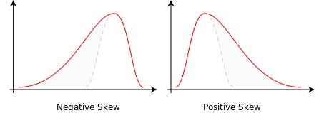
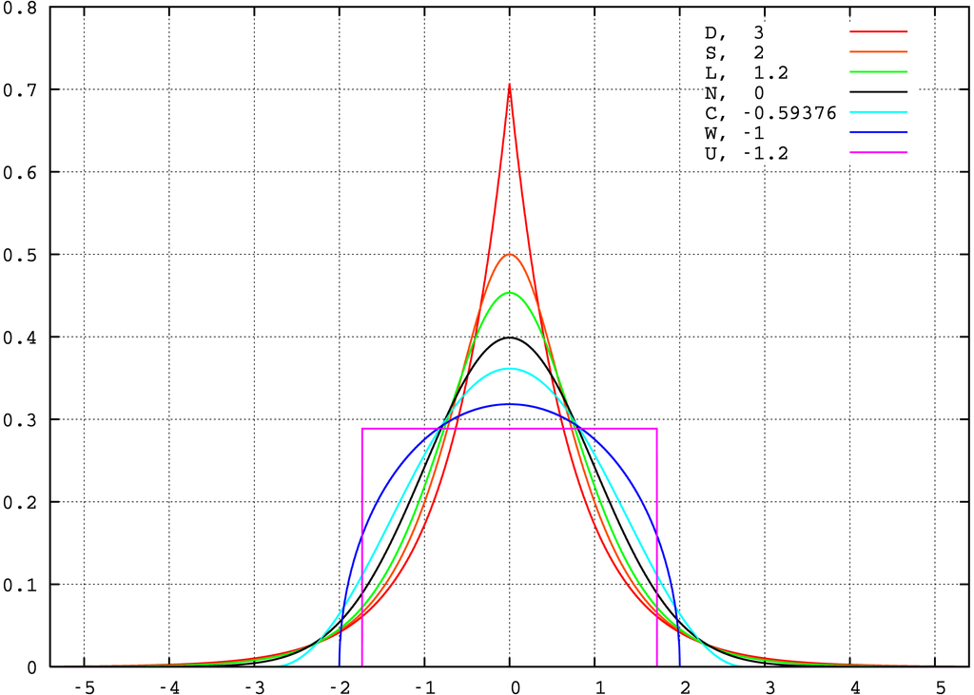
3b. Dynamical statistics: Probability Density Function (PDF)
Effect of island on turbulence statistics:
PDF = probability to observe a specific value of the fluctuation part of the density
Addimensioning:
Skewness and Kurtosis:

Slide 29
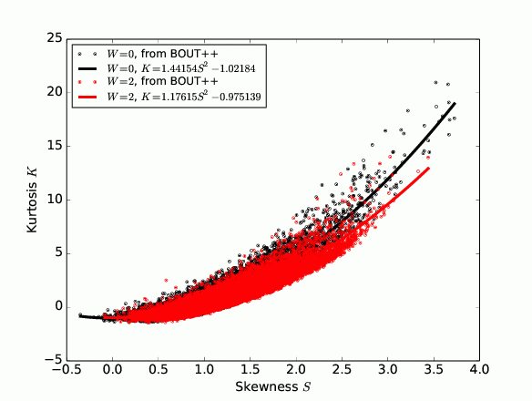
Dynamical statistics: PDF
Effect of island on turbulence statistics:
- Kurtosis decreases
for higher Skewness
- Skewness range
of values decreases
What is the
conclusion?
Quadratic relation similar to experimental measurements
B. Labit, et al., PRL 98 (2007) 255002 result reproduced here:

Slide 30
Dynamical statistics: PDF
Effect of island on turbulence statistics:
Focus on 3 zones:
- close to the O-point
- close to the X-point
- long range effect
X-point
O-point
Long range

Slide 31
Dynamical statistics: PDF
Effect of island on turbulence statistics:
O-point
Barely observe an effect of the island close to the O-point

Slide 32
Dynamical statistics: PDF
Effect of island on turbulence statistics:
X-point
Exclusion of highly fluctuation values

Slide 33
Dynamical statistics: PDF
Effect of island on turbulence statistics:
Long range
Add highly negative fluctuation values
Conclusion:
- Increase of the long range turbulence
- Decrease of the turbulence close to the X-point

Slide 34
5. On going directions
Current equilibria: Shear (TM stable) vs Jensen (TM (un)stable) vs Harris (TM (un)stable)
Magnetic shear:
Jensen equilibrium:
Harris current sheet:

Slide 35
On going directions
Tearing mode instability increases with current sharpness (Δ’ a versus k_{eq}/k_{y})
k₀ = 0
B_{eq}=0.0075
Use of the Harris current sheet
The magnetic shear k₀ control the (un)stability of TM
The amplitude and width of the current sheet control the (un)stability of TM (not shown here)
These results are obtained from a shooting algorithm with a magnetic shear k₀ ≠ 0 since there is no known analytic solution for Δ’ a
Ready for dynamical evolution of the magnetic island
k_{eq}/k_{y}=2
B_{eq}=0.0075
k₀ = 0
k_{eq}/k_{y}=2
B_{eq}=0.0075
k₀ = 0.05

Slide 36
4b. Example Future Research Direction:
Improving Fluid Model to Retain Hamiltonian Structure
Fluid equations are “mutilated”[1] if we add the common used ballooning (with Ti=0) and FLR (with B=const.) terms:
  ballooning/shearing/island (with Ti=0): or
  FLR (with B=const.):
Gyroviscous effects must be taken into account
Ordering:
[1]: P.J. Morrison, Phys. Plasmas 12, 058102 (2005)

Slide 37
Example Future Research Direction:
Improving Fluid Model to Retain Hamiltonian Structure
Shifted vorticity and new stream function :
              The stream function contains the gyroreduction operator[2] due to the gyroviscous tensor
Laplace inversion:
=> extraction of the stream function
=> extraction of the electric potential
[2]: B. Scott, Phys. Plasmas 7, 1845 (2000)

Slide 38
Example Future Research Direction:
Improving Fluid Model to Retain Hamiltonian Structure
Three-field self-consistent model
No magnetic shear, no ballooning

Slide 39
Example Future Research Direction:
Improving Fluid Model to Retain Hamiltonian Structure
The linear dispersion relation of the new four-field self-consistent model without gradient-driven terms is close to the initial model:
- a neutral mode
- a pair of acoustic waves
What are the differences with
the results of the previous four-field model?
Future steps:
- importance of these gyroviscous effects w/o island
- self-consistent static magnetic shear and island
- self-consistent dynamic magnetic shear and island

