Slide 1
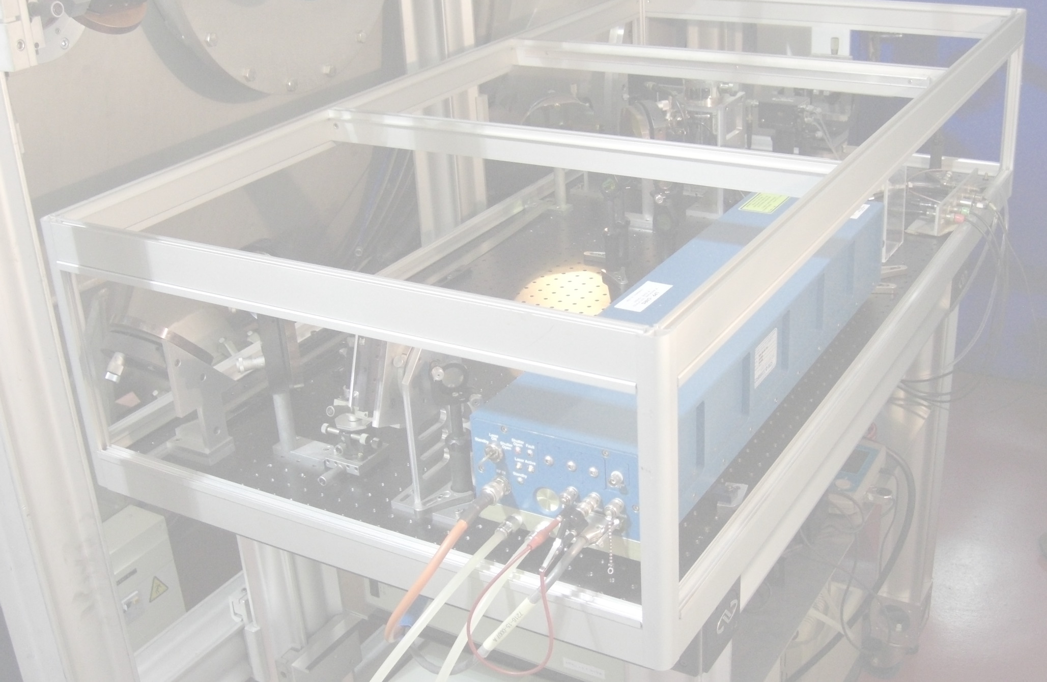
Laser scattering studies of microturbulence
in low-temperature plasmas
Sedina Tsikata
ICARE, CNRS – Orléans, France

Slide 2
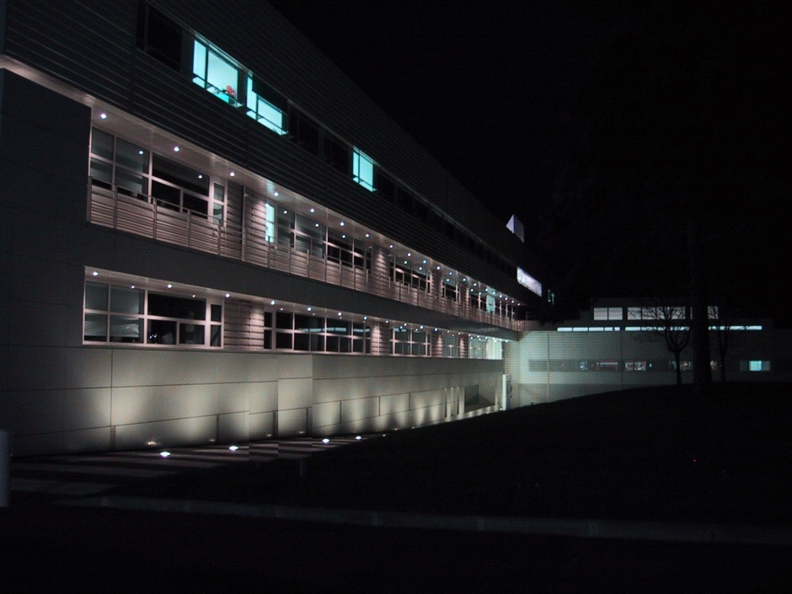
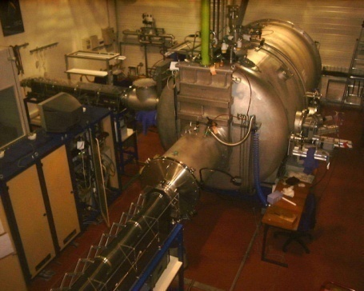
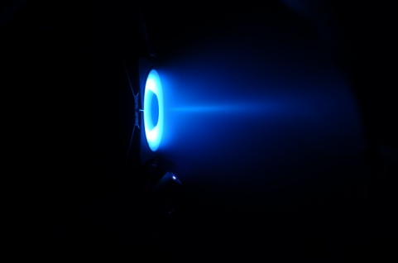
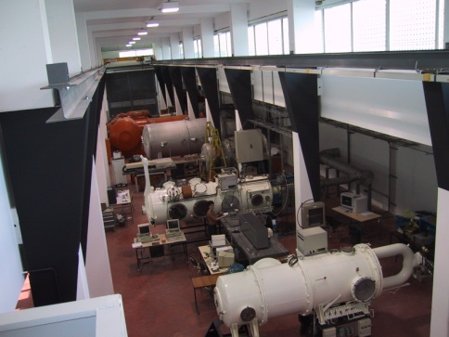
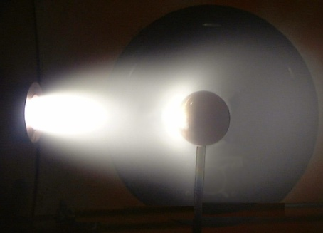
A bit about ICARE
ICARE (Institut de Combustion, Aérothermique, Réactivité et Environnement), Orléans
- a research laboratory of the French National Research Center (CNRS)
research in combustion, atmospheric chemistry, plasma propulsion and high speed flows
site of national EP thruster test facility, PIVOINE-2G: academic and industrial research
ST recruited in 2011: research focus = plasma laser diagnostics
S. Tsikata PPPL, May 9, 2016

Slide 3
Today’s talk
Collective Thomson scattering for low-temperature plasma studies
 Hall thruster research context
 PRAXIS diagnostic development and features
 some insights
 planar magnetron research context
 new diagnostic implementation
 recent insights
Incoherent Thomson scattering diagnostic development
 planned implementations and investigations: thruster, magnetron and ECR sources
Concluding remarks on upcoming and in-progress studies
S. Tsikata PPPL, May 9, 2016

Slide 4
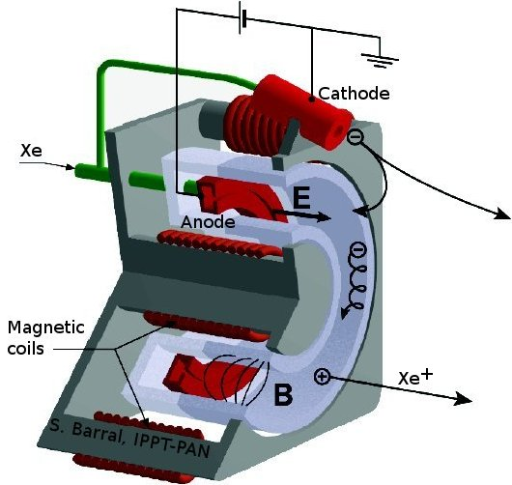
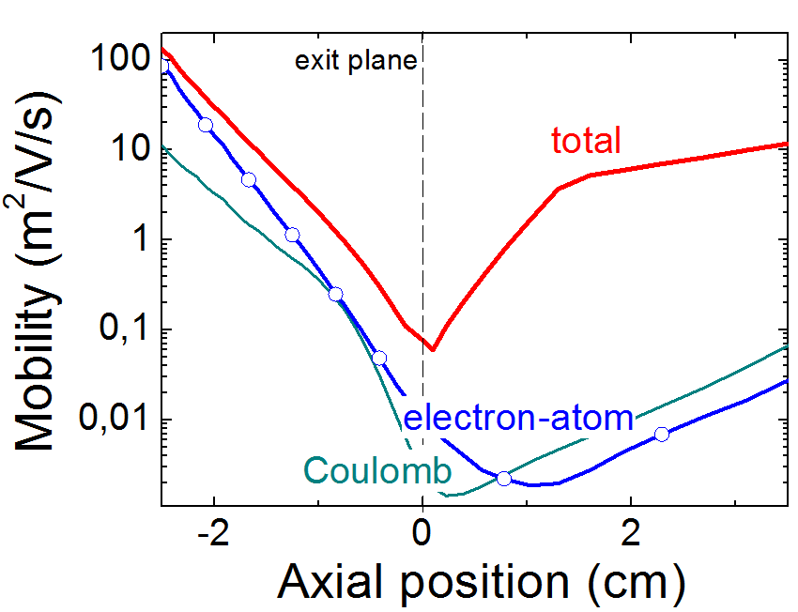
The Hall thruster
current applications: satellite attitude control and positioning; space missions
(SMART-1, ESA)
more ambitious missions planned: ARM (Asteroid Recovery Mission, NASA)
L. Garrigues, LAPLACE (Toulouse)
radial B, axial E
magnetized electrons with azimuthal drift; unmagnetized ions
n_{e}: 10¹⁶ – 10¹⁸ m⁻³; T_{e} = 1 eV to 80 eV
Anomalously high electron mobility at exit plane, in the absence of collisions – why?
S. Tsikata PPPL, May 9, 2016

Slide 5
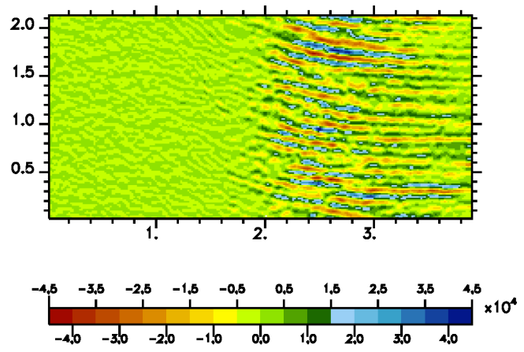
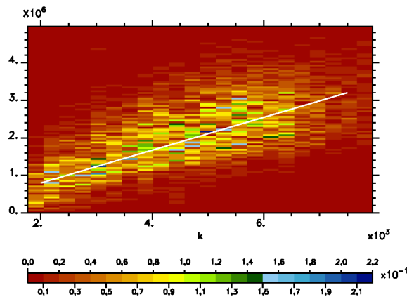
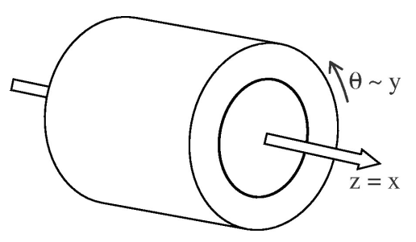
Hall thruster research
Plasma instabilities¹ likely a factor
2D self-consistent particle-in-cell simulations², azimuthal-axial geometry:
Adam, Héron and Laval
exit plane
Θ (cm)
f
k
x (cm)
electric field
potential
appearance of mm-scale and sub mm-scale azimuthal electric field
linear, discrete dispersion relation
mode associated with high level of electron transport
1. Yoshikawa and Rose, Phys. Fluids 5, 334 (1962)
2. Adam, Héron and Laval, Phys. Plasmas 11, 295 (2004)
S. Tsikata PPPL, May 9, 2016

Slide 6
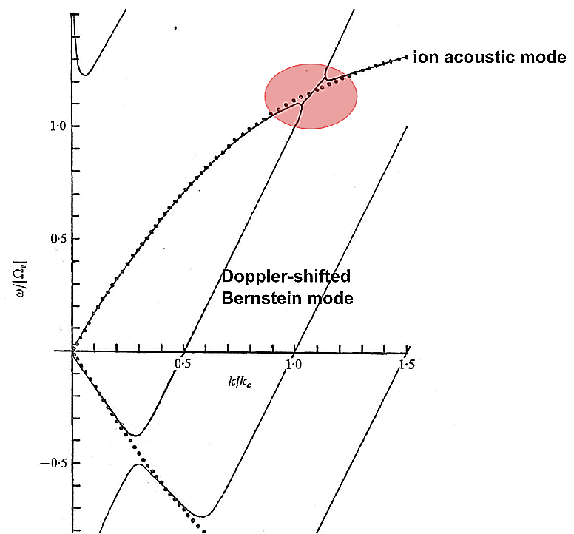
Hall thruster research
Electron cyclotron drift instability (ECDI)
excited when Bernstein electron cyclotron
mode couples to the ion acoustic mode¹
early appearances as first major instability
explaining cross-field transport
numerous early numerical and theoretical studies concerning this instability:
Gary and Sanderson (1970); Gary (1970)
Forslund et al., (1970, 1971, 1972)
Wong (1970)
Lampe et al., (1971, 1972)
Lashmore-Davies (1970)
1. Gary and Sanderson, J. Plasma Physics, 4, 739 (1970)
S. Tsikata PPPL, May 9, 2016

Slide 7
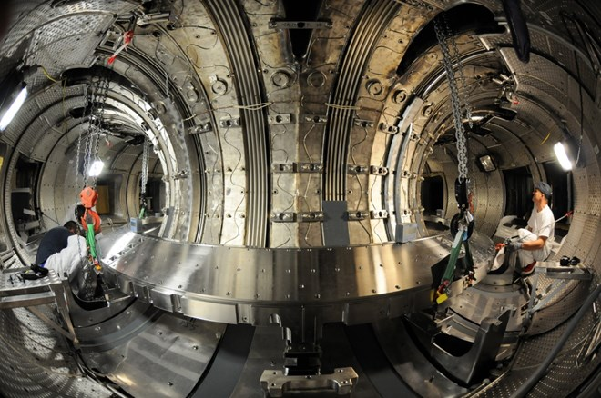
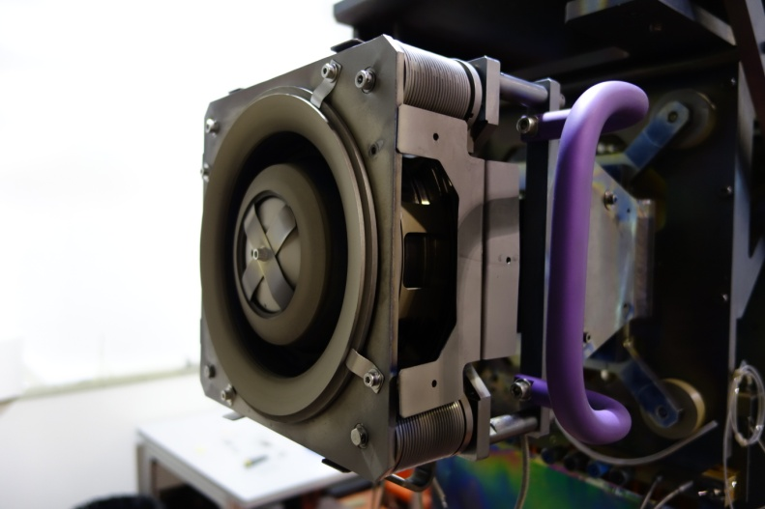
Collective Thomson scattering
Questions posed
is the ECDI a factor in thruster plasmas?
can numerical code results regarding microturbulence be validated?
ST PhD thesis (2009): Instabilities, Transport and Turbulence in Tokamaks team
Plasma Physics Laboratory
Ecole Polytechnique, Palaiseau
 Design and development of a new collective Thomson scattering tool for Hall thruster microturbulence investigations
S. Tsikata PPPL, May 9, 2016

Slide 8
Collective Thomson scattering: principle
length scales scanned > Debye length
 correlated fluctuations become visible
the diagnostic measures electron density fluctuations associated with the instability
the observation wave vector k properties can be varied for sophisticated studies of mode properties
S. Tsikata PPPL, May 9, 2016

Slide 9
PRAXIS features
PRAXIS: PRopulsion Analysis eXperiments via Infrared Scattering
access to Larmor radius-scale electron density fluctuations: 0.4 – 2 mm
variable wave vector orientation
signal maximization (factor 10³ compared to similar diagnostic used for toroidal plasma studies)
- high incident laser power (> 40 W) + beam quality
low-loss optics
standard heterodyne detection scheme
- mixing of plasma-scattered signal with reference ‘local oscillator’
high acquisition quality
very large sample depth: several million points per channel
high sample rate: 100 MHz
12-bit vertical resolution
S. Tsikata PPPL, May 9, 2016

Slide 10
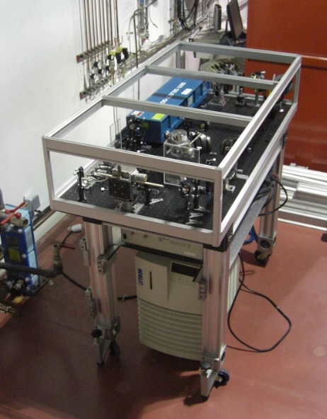
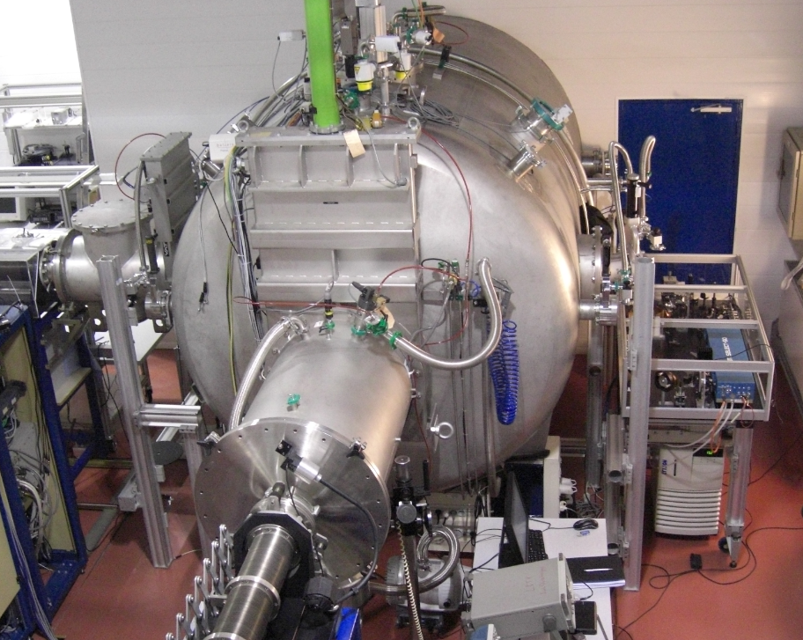
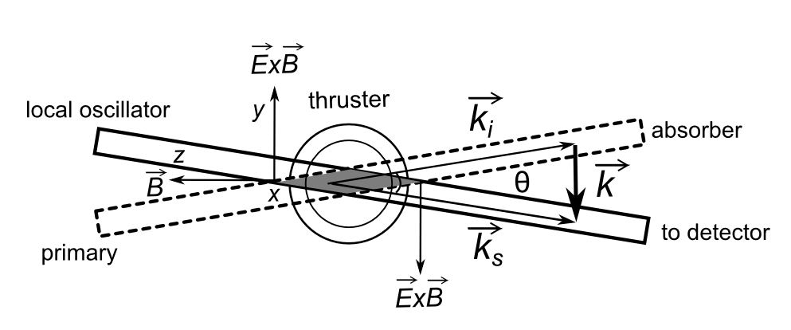
PRAXIS thruster implementation
beam trajectories
vessel axis
PRAXIS optical bench (Orléans)
test campaign at the national thruster
facility PIVOINE-2G (Orléans)
S. Tsikata PPPL, May 9, 2016

Slide 11
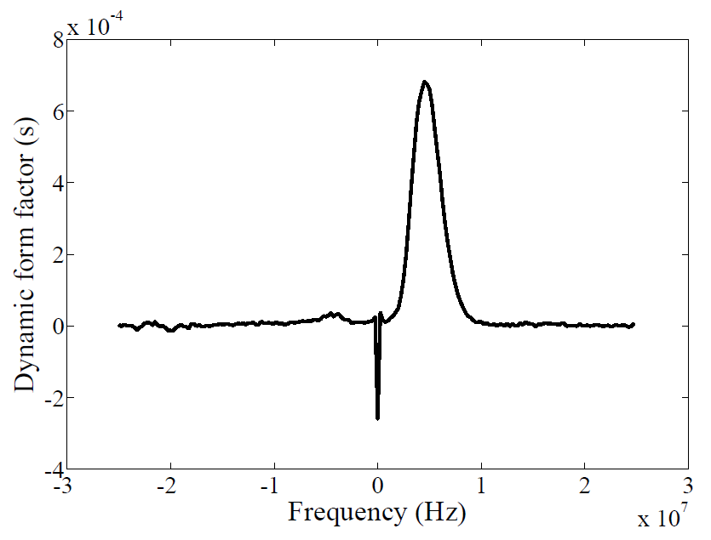
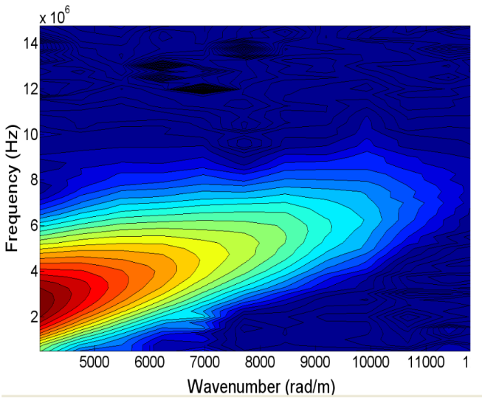
PRAXIS thruster implementation: some key results
First successful experimental identification of predicted mm-scale azimuthal electron density fluctuations¹
symmetric mode peaks for azimuthal k
experimental dispersion relation: linear and continuous
exponential variation of energy with wavenumber
axial variation: fluctuation amplitude increasing beyond exit plane
1. S. Tsikata, N. Lemoine, V. Pisarev and D. Grésillon. Phys. Plasmas 16, 033506 (2009)
S. Tsikata PPPL, May 9, 2016

Slide 12
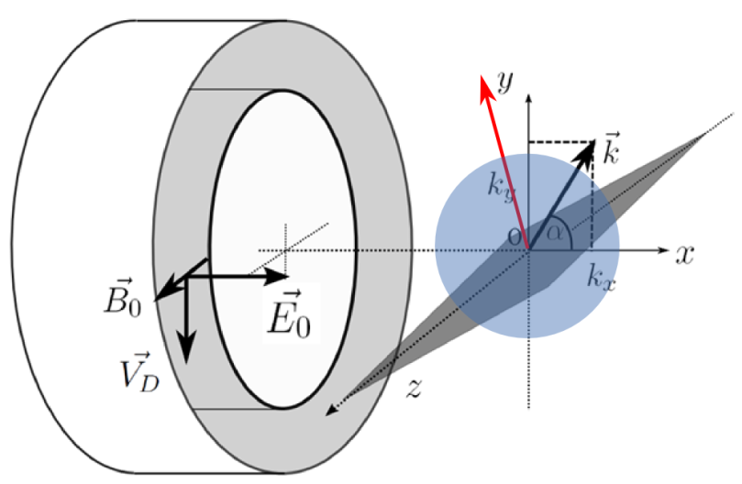
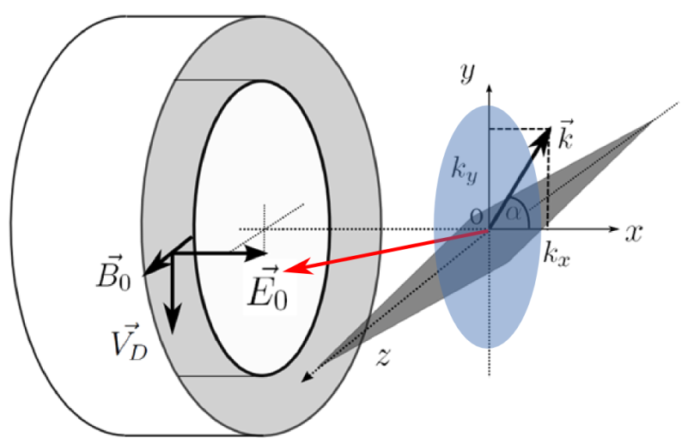
PRAXIS thruster implementation: some key results
Determination of mode directivity¹
(ExB, E) plane: 10° inclination; axial component
(ExB, B) plane: 5° inclination; radial component
1. S. Tsikata, C. Honoré, N. Lemoine, D. Grésillon, Phys. Plasmas 17, 112110 (2010)
S. Tsikata PPPL, May 9, 2016

Slide 13
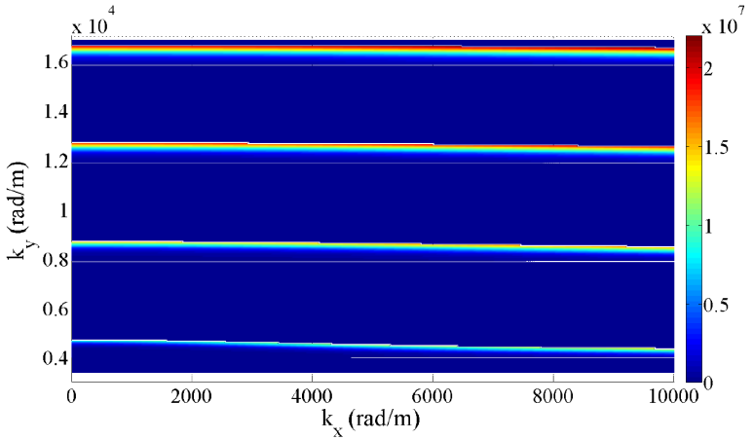
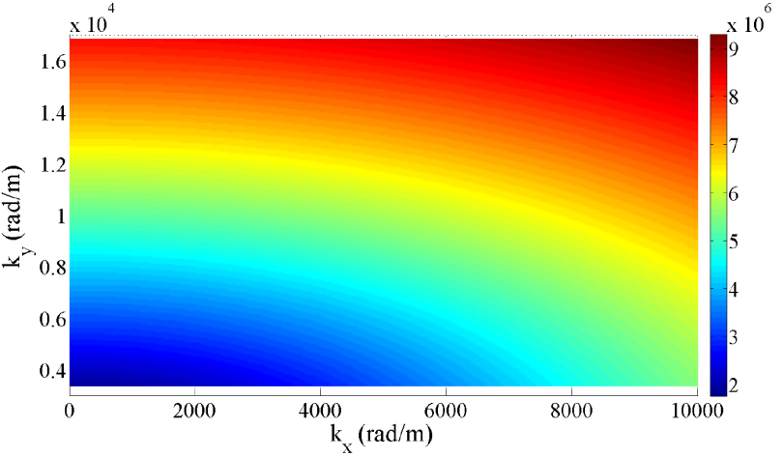
PRAXIS thruster implementation: some key results
Refinement of theoretical models using experimental results on 3D mode propagation^{1,2}
2D: frequency
3D: frequency
1. S. Tsikata, PhD thesis, Ecole Polytechnique (2009)
2. Cavalier et al. Phys. Plasmas 20, 082107 (2013)
S. Tsikata PPPL, May 9, 2016

Slide 14
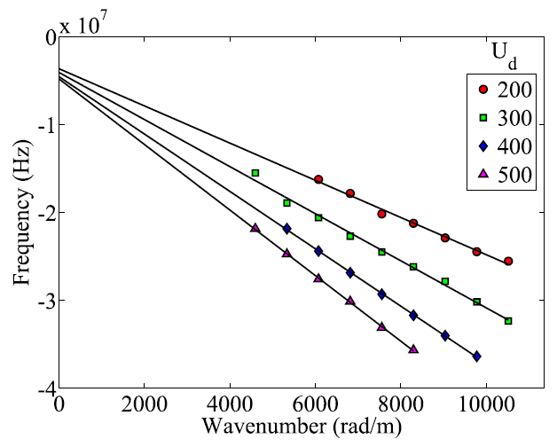
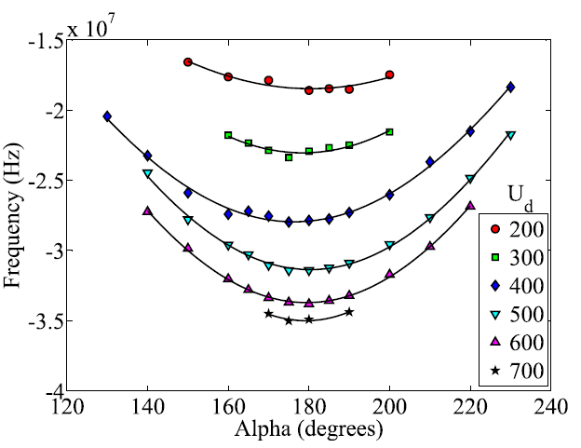
PRAXIS thruster implementation: some key results
Explanation for the presence of an additional axially-propagating two-stream instability¹
a separate axially-propagating mode is present at mm-scales
this mode is influenced by presence of both Xe⁺ and Xe²⁺ ions
1. S. Tsikata, J. Cavalier, A. Héron, C. Honoré, N. Lemoine, D. Grésillon and D. Coulette, Phys. Plasmas 21, 072116 (2014)
S. Tsikata PPPL, May 9, 2016

Slide 15
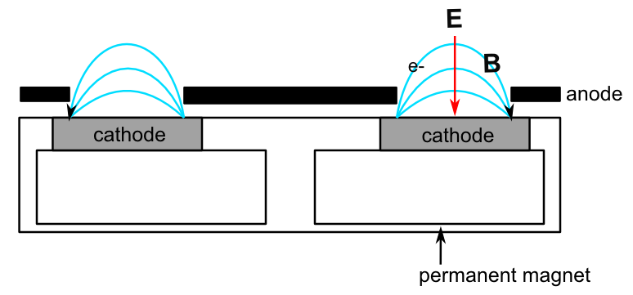
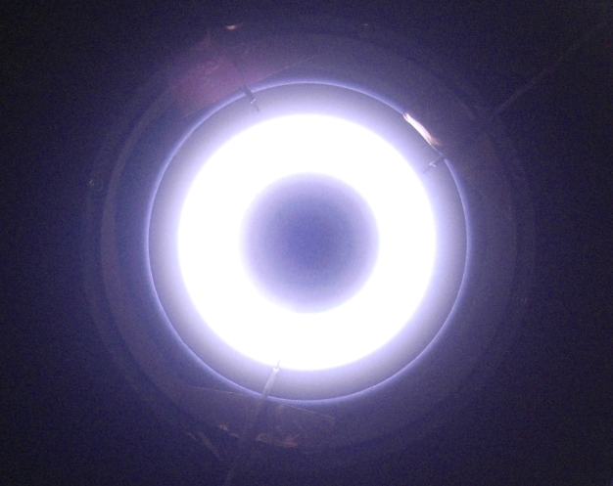
The planar magnetron
recognized in the 1970s as an important potential sputtering devices
advantages: low pressure, low voltage operation, high plasma density
applications: tool coatings, optical devices, medical implants, microelectronics
bombardment of cathode by ions with energies of several hundred eV
DC operation: n_{e}: 10¹⁶ – 10¹⁸ m⁻³; T_{e} = 1 eV to several tens of eV
S. Tsikata PPPL, May 9, 2016

Slide 16
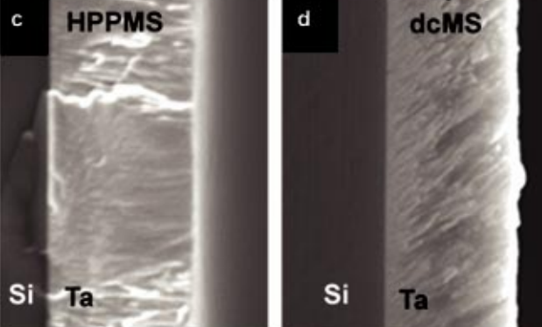
The planar magnetron: new motivations for study
recent emergence of new HiPIMS¹ regime (High Impulse Pulsed Magnetron Sputtering)
advantages over DC operation: improved film properties, plasma densities 10¹⁸ – 10²⁰ m⁻³
from Alami et al., J. Vac. Sci.Technol. A 23, 278 (2005)
Can we link plasma dynamics to deposition processes in a predictive way?
anomalous electron transport
electron properties
ionization processes
plasma organization
improved understanding/
measurements needed:
1. Kouznetsov et al., Surf. Coat. Technol. 122, 290 (1999)
S. Tsikata PPPL, May 9, 2016

Slide 17
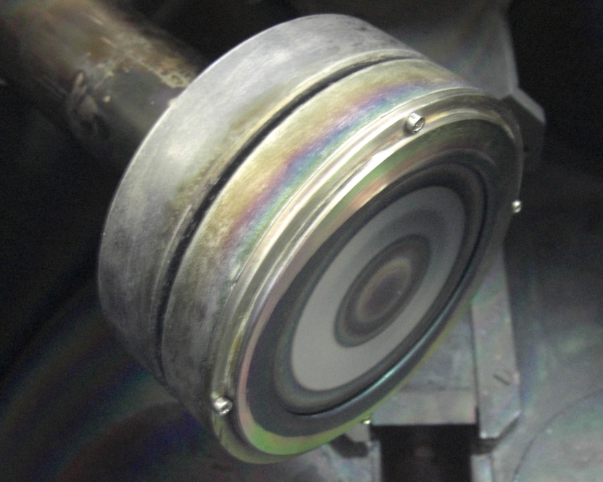
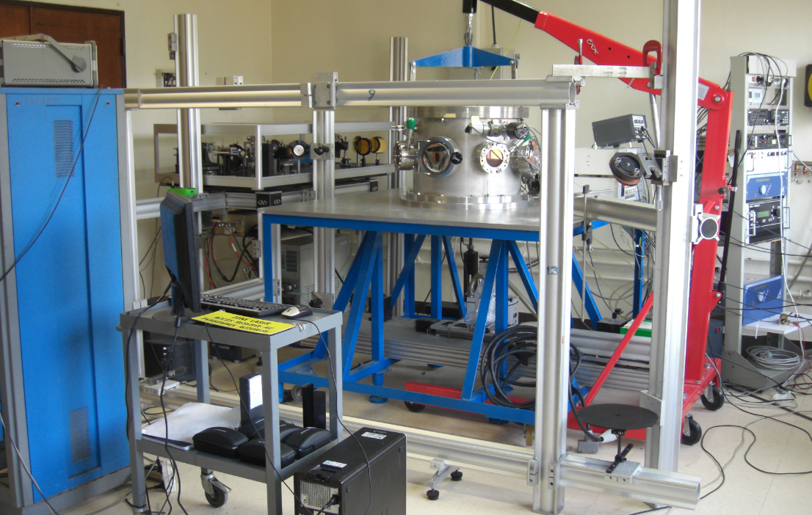
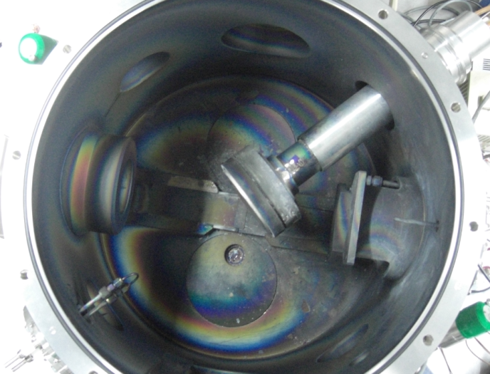
PRAXIS magnetron implementation
Installation of diagnostic at the LPGP plasma physics laboratory, Orsay
first collective scattering campaign in 2014 on DIVA planar magnetron, Ti target
new experiments in 2015 with focus on HiPIMS regime
S. Tsikata PPPL, May 9, 2016

Slide 18
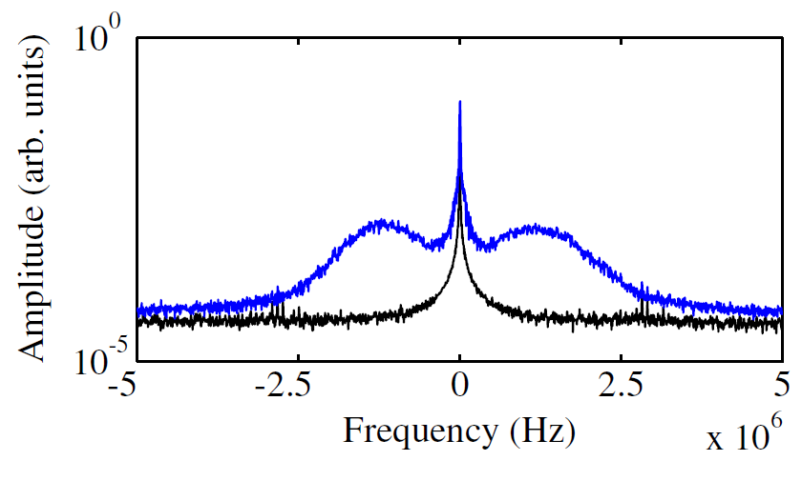
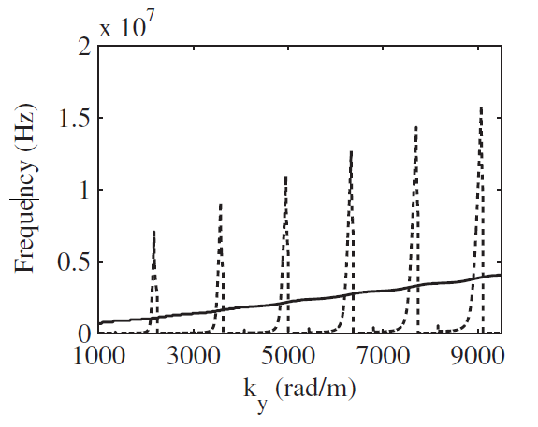
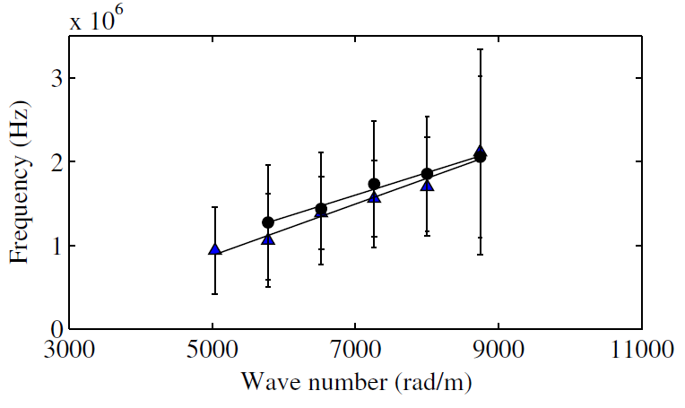
PRAXIS magnetron implementation: some key results
Identification of ECDI in both pulsed and DC regimes
HIPIMS regime
peak discharge voltage = 504 V
peak current = 8.6 A,
P = 15 mTorr; α = 100°, k = 5600 rad/m
linear dispersion relation compatible with theory
S. Tsikata and T. Minea, Phys. Rev. Lett. 114, 185001 (2015)
S. Tsikata PPPL, May 9, 2016

Slide 19
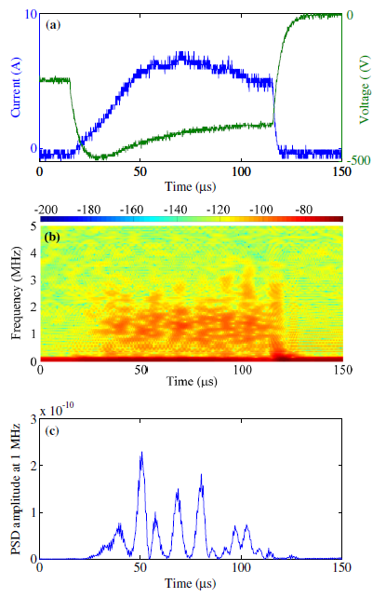
PRAXIS magnetron implementation: some key results
Identification of low frequency modulation of ECDI
such modulations are compatible with the passage of
large structures across the experimental observation
volume
evidence for short scale electric fields in large scale spokes
S. Tsikata and T. Minea, Phys. Rev. Lett. 114, 185001 (2015)
S. Tsikata PPPL, May 9, 2016

Slide 20
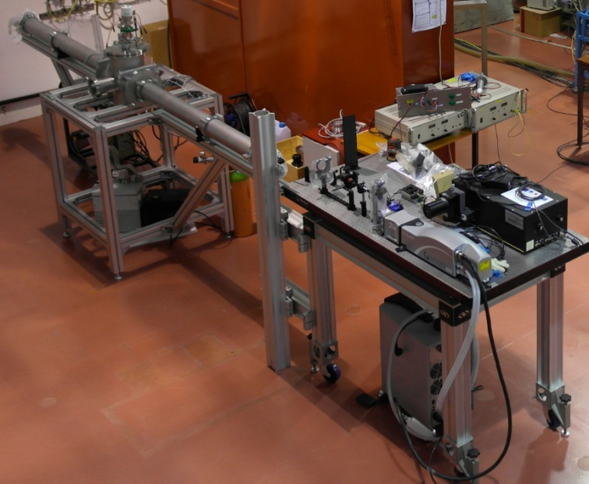
Incoherent Thomson scattering diagnostic development
THETIS optical bench development in progress
requirements: access to large Te range, sensitivity and flexibility
2-stage development
partnership with CEA (French Atomic and Alternative Energy Commission)
test source
diagnostic optimization
Hall thruster
ICARE, Orléans
Planar magnetron
LPGP, Orsay
ECR ion
source
CEA, Saclay
May 2016, diagnostic setup in progress
S. Tsikata PPPL, May 9, 2016

Slide 21
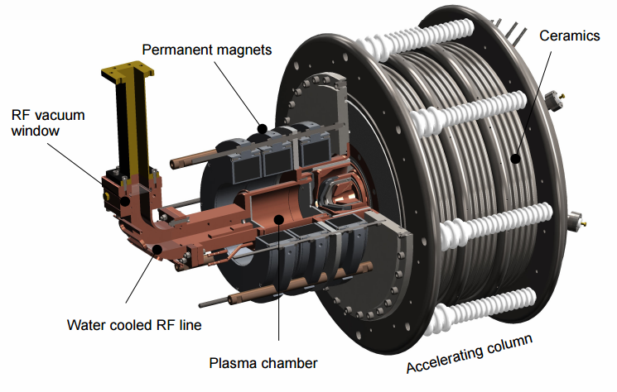
ECR ion source
ECR source for H+ production
2.45 GHz waves into source chamber
magnets to create resonance surface
neutral gas ionized by the highly-energized electrons, ions accelerated (40 – 100 kV potential)
industrial applications: source chamber joined to a process chamber
accelerator applications: process chamber replaced with ion extraction stage.
S. Tsikata PPPL, May 9, 2016

Slide 22
Why incoherent Thomson scattering?
Hall thruster
Planar magnetron
code development, evaluation of new sources and concepts:
wall-less Hall thruster (WLHT), magnetically-shielded Hall thrusters
ECR ion source
ongoing code development and optimization of plasma sources developed by CEA Saclay
national and international accelerator projects:
- SPIRAL2 (Système de production d'Ions Radioactifs en Ligne de 2ème génération), Caen
- IFMIF (International Fusion Materials Irradiation Facility), Japan
- FAIR (Facility for Antiproton and Ion Research), Germany
industrial ion sources (SILHI® with Pantechnik)
S. Tsikata PPPL, May 9, 2016

Slide 23
Summary
many low temperature plasma sources require advanced diagnostics:
- to improve our understanding of anomalous electron transport
- for the determination of particle properties
collective Thomson scattering has been newly applied to such sources:
- providing information on microturbulence
- validating codes
- indicating ways in which theory must be modified and where codes fall short
a new incoherent Thomson scattering diagnostic would provide much-needed information on electron properties
Some upcoming and current work
studies of spoke + microturbulence in wall-less thruster:
- USAF European Office of Aerospace Research and Development (EOARD) contract (ICARE, Greifswald and PPPL)
magnetron studies coupled with pseudo-3D code developed at LPGP, Orsay
time-resolved analyses of microturbulence (ICOPS, June 2016)
S. Tsikata PPPL, May 9, 2016

Slide 24
Supplementary slides

Slide 25
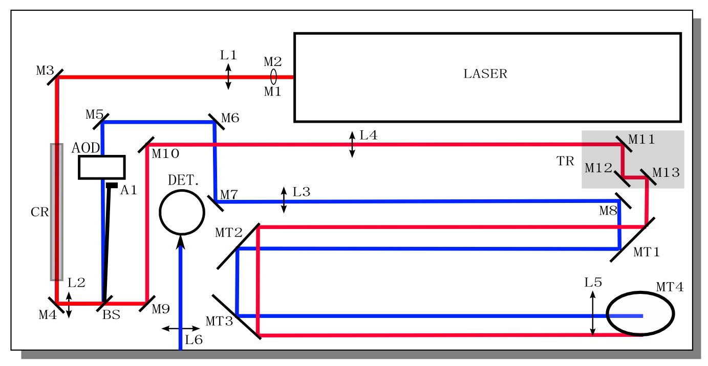
PRAXIS bench design
S. Tsikata PPPL, May 9, 2016

Slide 26
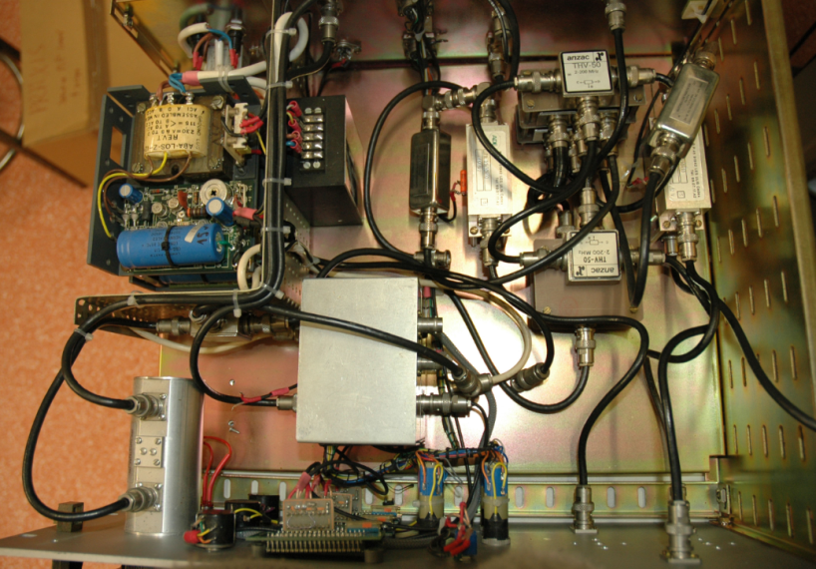
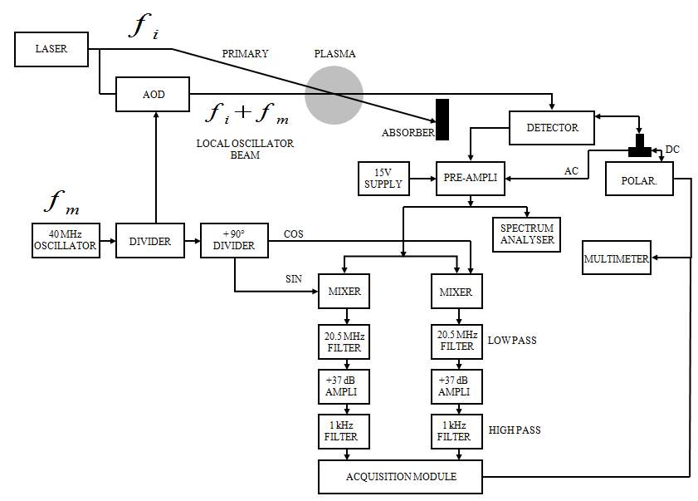
PRAXIS electronics
S. Tsikata PPPL, May 9, 2016

Slide 27
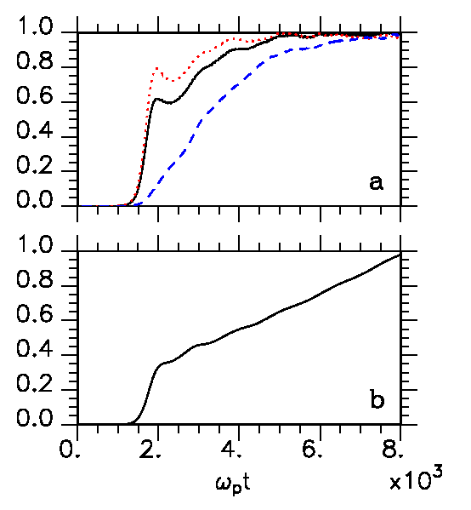
Numerical simulations: radial-azimuthal
evidence that heating due to mode is correlated with current: azimuthal-radial simulations
work by radial field
work by azimuthal field
axial current density
electrostatic energy
- the evolution of system energy and current occurs on identical time scales to those of the instability
Héron and Adam, Phys. Plasmas 20, 082313 (2013)
S. Tsikata PPPL, May 9, 2016

Slide 28
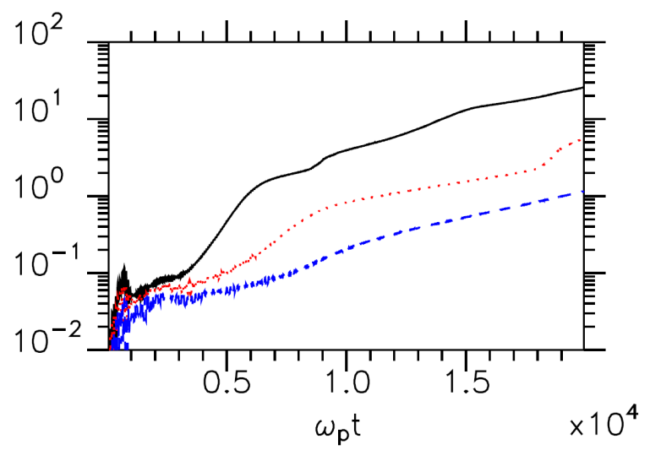
Numerical simulations: radial-azimuthal
▪ weak SEE, with electrons emitted from the wall roughly constant over the simulation time
▪ current increase due to development of ExB mode
 strong dependence of transport on Vd; higher currents expected with carbon velvet, if an increased Vd is achieved
ω_{p}t = 10000  0.3 μs
Vd: 10⁶ – 1.5 x 10⁶ – 2 x 10⁶ m/s (low  high azimuthal drift velocity)
ε* = 50 eV
axial current (A)
S. Tsikata PPPL, May 9, 2016

Slide 29
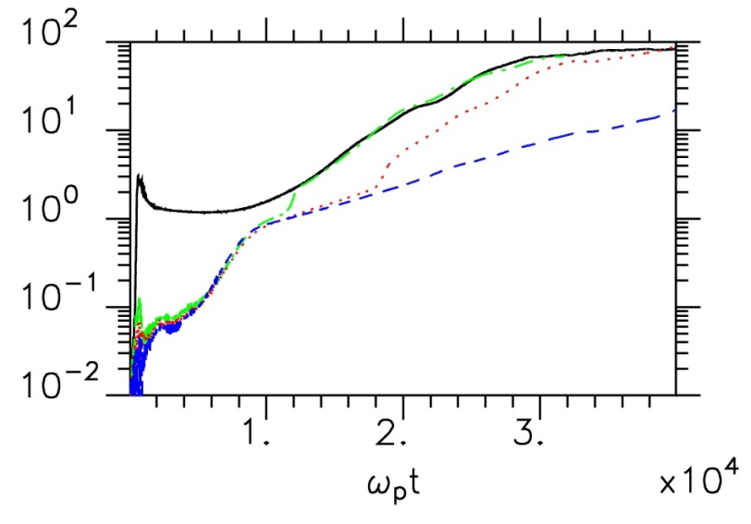
Numerical simulations: radial-azimuthal
▪ start of simulation: transport dominated by ExB mode heating, independent of emissivity
▪ jumps in current: beam-plasma instability due to interaction between ExB mode and wall-emitted electrons
in these simulations: higher mean currents are predicted with emissive materials, but the E-field does not evolve self-consistently (absence of axial direction)
the true E profile obtained with carbon velvet creates conditions which increase electron transport
ε*: 20 – 30 – 50 – 1000 eV (high  low emissivity)
axial current (A)
S. Tsikata PPPL, May 9, 2016

Slide 30
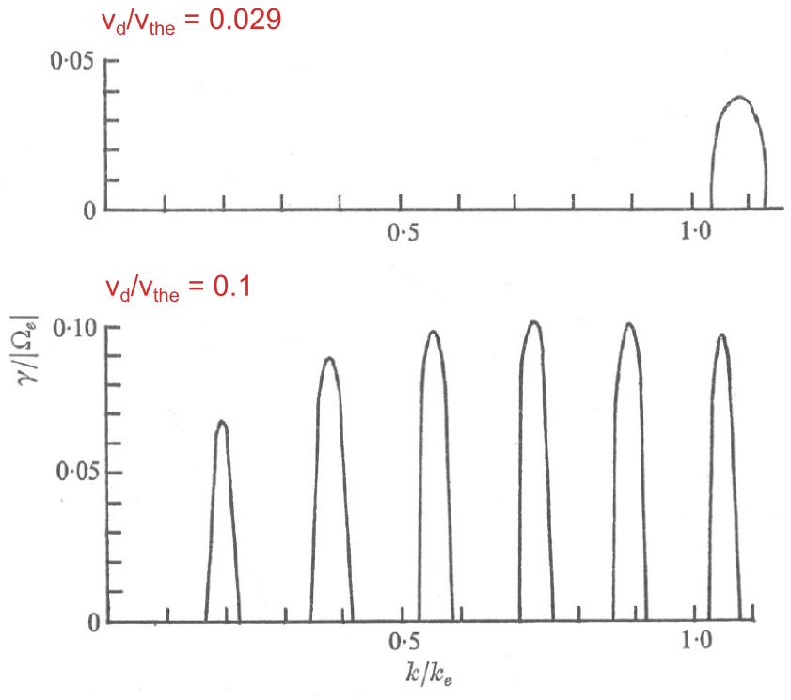
Instability generation
S. P. Gary and J. J. Sanderson, J. Plasma Phys. 4, 739 (1970)
S. Tsikata PPPL, May 9, 2016

Slide 31
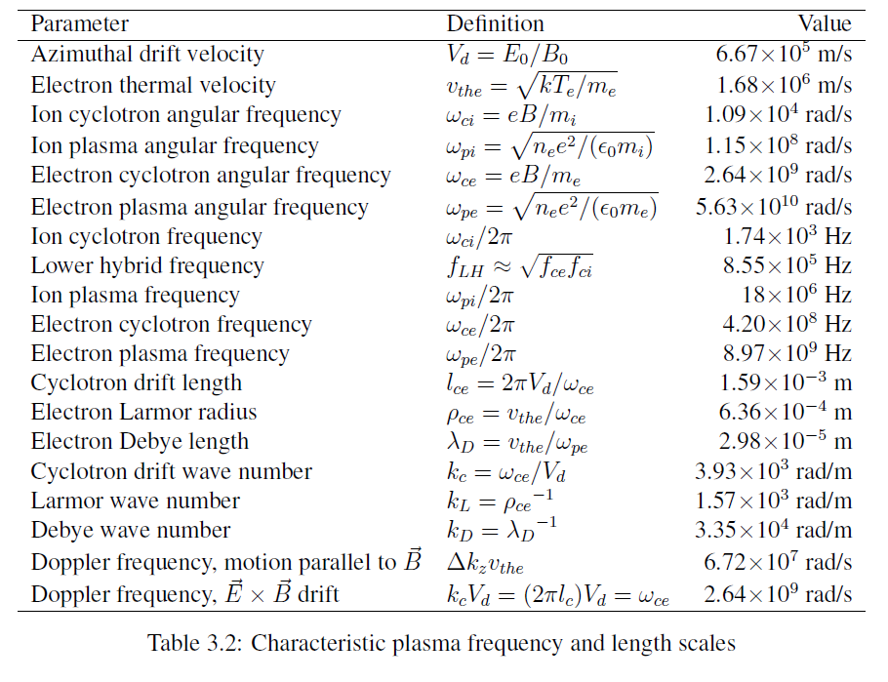
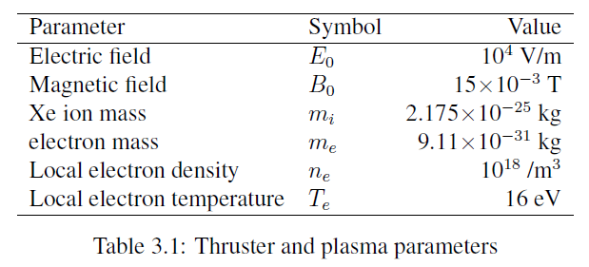
Parameters relevant to presented data
S. Tsikata PPPL, May 9, 2016

Slide 32
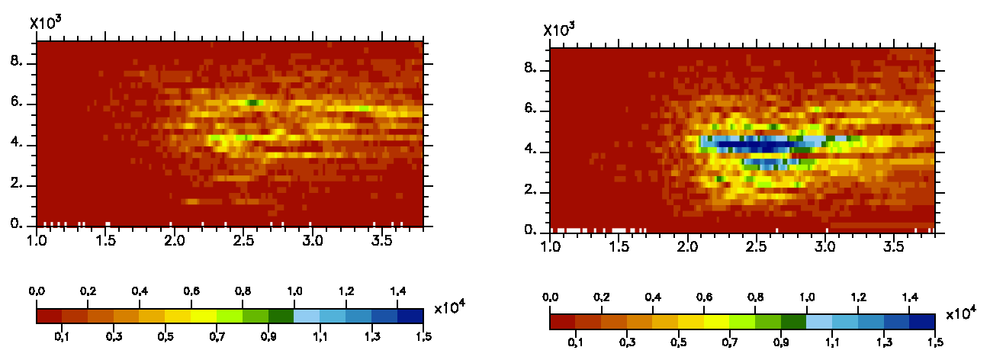
Simulations: parametric investigations
E (V/m) as a function of wavenumber and axial location
Héron and Adam
300 V
800 V
increased axial localization of instability at higher Ud
increased wavenumber localization
S. Tsikata PPPL, May 9, 2016

Slide 33
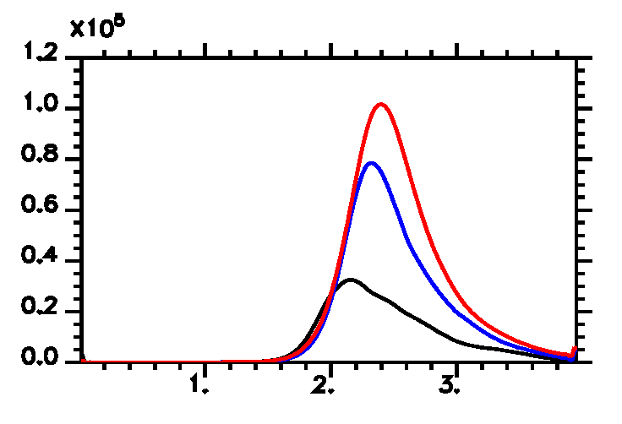
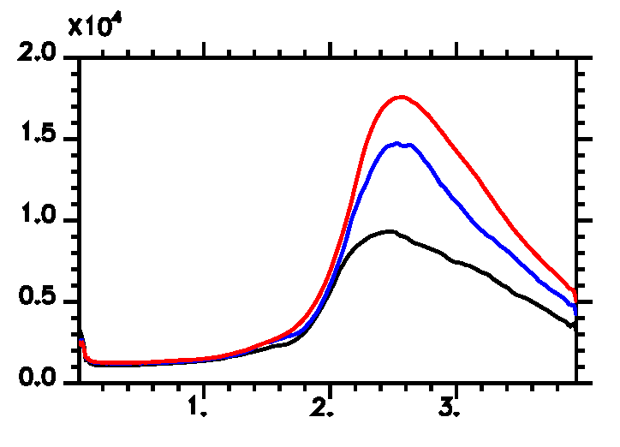
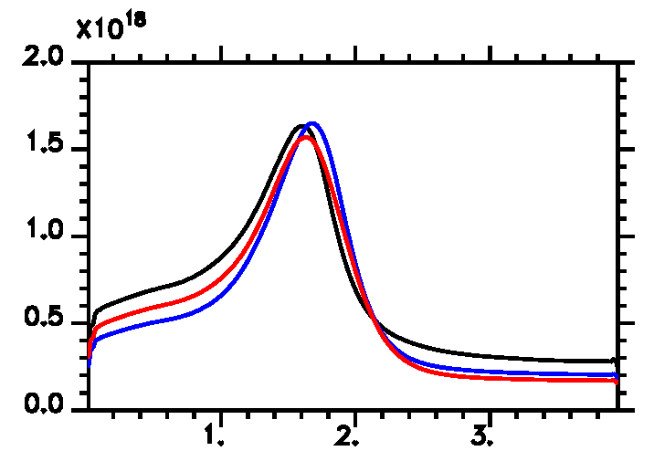
Simulations: parametric investigations
relationship between accelerating E, fluctuating E – azimuthal-axial simulations
accelerating E
ECDI field
Héron and Adam
300 – 600 – 800 V
electron density
S. Tsikata PPPL, May 9, 2016

Slide 34
Carbon velvet investigations
2013 simulations show that the mode influences, and is influenced by, wall emission
new experiments using low-emission carbon velvet, following past studies*
in the presence of non-emissive material, mode features substantially altered:
E field shifted into channel
mode follows E field into region of high azimuthal drift
anomalous mobility inside the channel should increase, even when a large contribution of the wall emission has been suppressed
BNSiO2 chamber
carbon velvet (8 mm wide)
*Raitses et al., J. Appl. Phys. 99, 036103 (2006)
S. Tsikata PPPL, May 9, 2016

Slide 35
PRAXIS thruster implementation: some key results
Studies on the influence of wall emission on instability features
recent azimuthal-radial simulations¹ show the mode contributes to the electron current in two ways:
- heating of electrons in all directions
via increased wall emission due to radial heating
 higher-emissivity materials expected to produce higher electron currents
But can these effects be studied experimentally?
idea: comparisons of microturbulence features and electron currents with and without wall emission
 standard thruster wall material (BNSiO₂) versus non-emissive material (carbon velvet)²
¹Héron and Adam., Phys. Plasmas 20, 0823133 (2013)
²Raitses et al., J. Appl. Phys. 99, 036103 (2006)
S. Tsikata PPPL, May 9, 2016

Slide 36
PRAXIS thruster implementation: some key results
Studies on the influence of wall emission on instability features
carbon velvet
BNSiO2 chamber
carbon velvet
drift velocity (m/s)
BNSiO2
higher electron currents observed despite reduction in emission
retreat of E maximum into channel increases drift velocity, and favors higher ECDI amplitudes
this effect is missed in radial-azimuthal simulations, where E is imposed
form factor variation
S. Tsikata PPPL, May 9, 2016

Slide 37
Carbon velvet investigations
○ discharge current (Id) features
▪ higher mean Id with carbon velvet, despite the absence of wall emission
▪ more pronounced Id fluctuations with velvet
3.5 mg/s
The higher currents encountered are not aberrations: consider results from azimuthal-axial simulations
total current (A)
▪ these simulations can be considered to model the non-emissive case
▪ the increase in Id is due to the increased electron current arising from the ExB mode, with the ion current remaining flat as Ud increases
current (A)
ion current
electron current
discharge voltage Ud (V)
S. Tsikata PPPL, May 9, 2016

Slide 38
Carbon velvet investigations
○ ExB mode features: fluctuation intensity
▪ higher observed ExB mode amplitudes with BNSiO2
▪ high amplitudes for carbon velvet are missed (located inside the channel)
 mode amplitudes observed are consistent with the shifted E field
150 V
S. Tsikata PPPL, May 9, 2016

Slide 39
Carbon velvet investigations
○ regime comparison:
- mean discharge current μId, standard deviation σId
- mode fluctuation intensity S(k)
variations similar for mode intensity and discharge current fluctuation at low Ud
mean discharge current less sensitive to variations in mode intensity
S. Tsikata PPPL, May 9, 2016

Slide 40
Demonstrating role of mode in transport experimentally
attempt to associate regimes of high mode amplitude to those of high mean discharge current/discharge current fluctuation
challenges:
- increase in electron current a fraction of the discharge current
- very precise measurements of ion current required
direct correlation of scattered signal amplitude with discharge current variation
challenges:
- increased constraints on signal to noise ratio
S. Tsikata PPPL, May 9, 2016

Slide 41
Demonstrating role of mode in transport experimentally
○ time variation of mode amplitude and discharge current: absolute signal
x 10⁻⁴ s
110 V
x 10⁻⁴ s
320 V
110 V
mode appears in « packets » due to axial oscillation of electric field and fixed position of observation volume
320 V
mode shows low-frequency breathing mode modulation
mode in phase with discharge current
Time
Time
Frequency
x 10⁷ Hz
Frequency
x 10⁷ Hz
S. Tsikata PPPL, May 9, 2016

