Slide 1
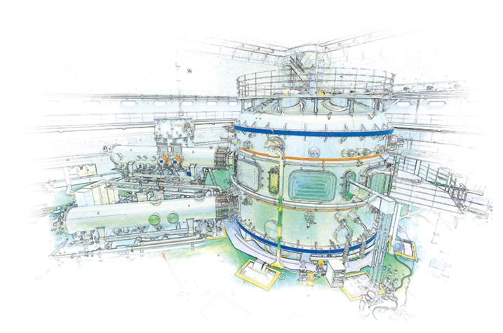



Kinetic equilibrium reconstruction of KSTAR plasmas including internal pitch angle profile measurement
Y.Z. Jiang¹, S.A. Sabbagh¹, Y.-S. Park¹, J.H. Ahn¹,
J.W. Berkery¹ and J. Ko²
¹Department of Applied Physics, Columbia University, New York, NY, USA
²National Fusion Research Institute, Daejeon, Korea
NSTX-U Physics Meeting
November 29th, 2017
PPPL, Princeton, NJ
Supported by US DOE grant DE-SC0016614

Slide 2
Kinetic equilibrium reconstruction of KSTAR plasmas including internal pitch angle profile has begun
Motivation
  Requirement for accurate stability analysis and disruption prediction to support continuous operation of high beta KSTAR tokamak plasmas
Goals
  Built accurate kinetic equilibrium reconstruction of KSTAR plasmas
  Provided input for initial plasma stability evaluation¹ and disruption event characterization and forecasting (DECAF)²
¹ Y.S. Park, S.A. Sabbagh, J.W. Berkery, et al., Nucl. Fusion 51 (2011) 053001
² S.A. Sabbagh, A.C. Sontag, J.M . Bialek, et al., Nucl. Fusion 46 (2006) 635.
Notes:
continuous

Slide 3
Outline
  Overview of kinetic equilibrium reconstruction
  KSTAR diagnostics and model for kinetic equilibrium reconstructions
  Reconstructed profiles and plasma parameters in various KSTAR operation regimes
  Initial determination of ideal MHD stability
  Collaborative improvement of equilibrium diagnostics
Notes:
Simplified, model/maodl/

Slide 4
Kinetic equilibrium reconstruction approach methodically improves accuracy
Philosophy
  Use best model
    for a given physics model/data set, reliably fit all data within error
    improved model/data set reduces artificial constraint
  Provide rapid reconstruction
    between-shots capability
    find constraint set for a given (model/data) pair
rotating plasma
3-D effects
vessel currents
physics model
plasma current
vacuum
  Progress to create more accurate equilibria
    more complete physics
    more complete data
    less artificial constraints
    suitable for stability calculations
basic advanced
magnetics
kinetic
profiles
rotation
profile
MSE
data
Y.S. Park, et al., Nucl. Fus. 51 (2011) 053001
Notes:
To fully model the 3D effects

Slide 5
EFIT* provides a flexible equilibrium reconstruction
Solve for (1) poloidal flux, ψ, and (2) toroidal current, J_{t}
  that satisfy the GS equation: Δ*ψ = -μ₀RJ_{t}(ψ), where
    Δ*ψ = R²∇•(∇ψ/R²); J_{t} = Rp’(ψ) + μ₀ff’(ψ)/(4π²R); f(ψ) = RB_{t} ; ’ ≡ ∂/∂ψ
  that provide a least-squares fit to a set of constraints
Typical constraints for fit
  Diagnostic data - response from plasma and external coils
    magnetic (flux loops, I_{p}, coils, diamagnetic loop, stabilizing plates)
    P_{e} from Thomson scattering
    T_{i} , V_{φ} from charge exchange recomb. spectroscopy (CES)
    field pitch angle from motional Stark effect data (MSE)
*L. Lao, et al., Nucl. Fusion 25 (1985) 1611
S. Sabbagh, et al, Nucl. Fusion 41 (2001) 1601
Notes:
Stabilizing/s’teibl laizing/

Slide 6
Outline
  Overview of kinetic equilibrium reconstruction
  KSTAR diagnostics and model for kinetic equilibrium reconstructions
  Reconstructed profiles and plasma parameters in various KSTAR operation regimes
  Initial determination of ideal MHD stability
  Collaborative improvement of equilibrium diagnostics

Slide 7
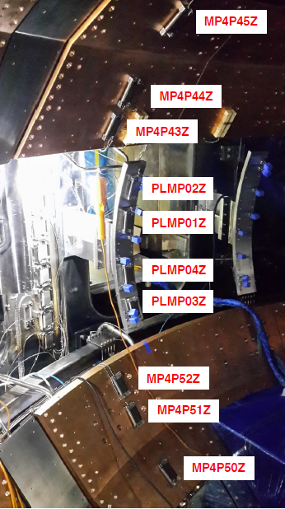
KSTAR magnetic diagnostics provide constraints for equilibrium reconstruction (1)
KSTAR magnetics
  Flux loops (45)
  Magnetic probe(105)
  Plasma currents(1)
  Coil currents(18)
  Voltage loops(5)
  Vessel current group (12)
S.A. Sabbagh, et al., Nucl. Fus. 41 (2001) 1601
Y.S. Park, et al., Nucl. Fus. 51 (2011) 053001

Slide 8
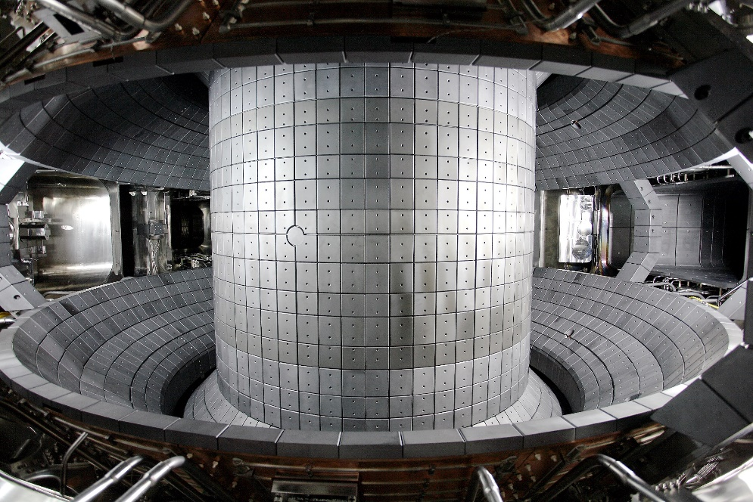
KSTAR magnetic diagnostics provide constraints for equilibrium reconstruction (2)
Interior of KSTAR vessel
Vessel currents required
  Total vessel currents and plasma current
  Vessel / plates broken into 12 groups (poloidally)
  Wall currents determined by local loop voltage data (5 loops)
  Vessel element resistances matched against independent model of vacuum field shots
Stabilizing plates / divertor plates currents are modelled
Copper passive plates
In-vessel control coils(IVCC)
S.A. Sabbagh, et al., Nucl. Fus. 41 (2001) 1601
Y.S. Park, et al., Nucl. Fus. 51 (2011) 053001
Notes:
There are plenty of eddy current flowing/f louing/ in these conductive structures.

Slide 9
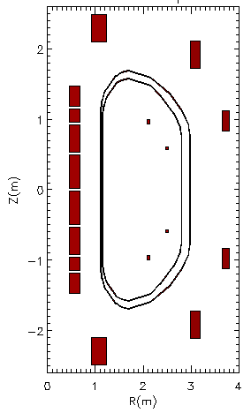
Kinetic data supplements magnetics input for KSTAR kinetic equilibrium reconstructions
2
1
0
-1
-2
Motional Stark Effect (MSE)
  MSE 25 channels
  Plasma magnetic field pitch angle
Thomson scattering (TS)
  TS 27 channels
  Electron Dens. & Temp.(N_{e}, T_{e})
Charge exchange spectroscopy (CES)
  CES 32 channels
  Ion Temp. (T_{i})
MSE
Z (m)
TS
Measure along Z=0
CES
0 1 2 3 4
R (m)
Notes:
The right-hand picture indicates the position of these kinetic measurements at the midplane in KSTAR

Slide 10
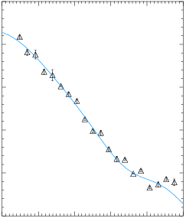
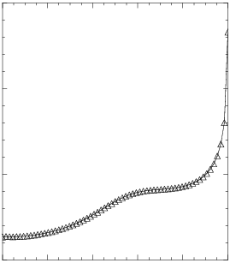
Motional stark effect data provides constraint to improve accuracy of q-profile
15
10
5
0
0.10
0.05
0.00
-0.05
-0.10
-0.15
Pitch angle at z=0
Safety factor
△ data
— fitted
16325
5.986s
Angle (rad)
q
16325
5.986s
1.7 1.8 1.9 2.0 2.1 2.2
R (m)
0.0 0.2 0.4 0.6 0.8 1.0
ψ_{N}
Notes:
(Title), Here is an example of pitch angle. The triangle with tiny error bars are the measured data from MSE; Blue line; They have good consistence; As we can see in the safety factor figure, the q profile is fairly flexible in the kinetic equilibrium reconstruction.

Slide 11
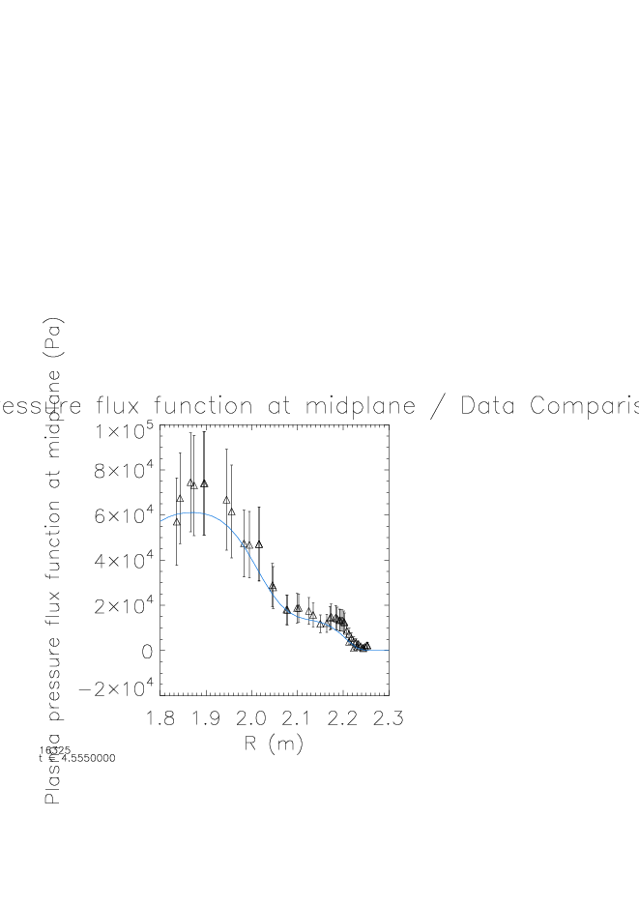
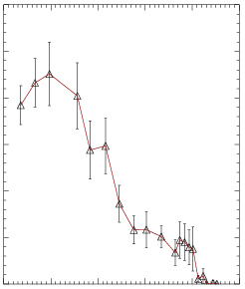
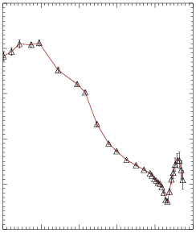
“Partial kinetic” approach for total pressure to allow greater flexibility in profile shape
Electron Pressure P_{e} ← 27 Thomson scattering (T_{e} & N_{e})
Ion Pressure P_{i} ← 32 CES (T_{i} & N_{i} estimated from N_{e})
Fast particle pressure P_{fast} is based on P_{e} with 100% error bar
Total pressure P_{tot} = P_{e} + “P_{i}” + “P_{fast}” with large total error
5
4
3
2
1
0
10
8
6
4
2
0
Total Pressure profile
3.0
2.5
2.0
1.5
1.0
0.5
0.0
Electron pressure profile
Ion temperature profile
△ data
△ data
△ data
— fitted
P_{e} (10⁴Pa)
T_{i} (10³eV)
boundary
boundary
boundary
Total Pressure (10⁴Pa)
Total Pressure (10⁴Pa)
16325
4.555s
16325
4.555s
16325
4.555s
1.8 1.9 2.0 2.1 2.2 2.3
R (m)
1.8 1.9 2.0 2.1 2.2 2.3
R (m)
1.8 1.9 2.0 2.1 2.2 2.3
R (m)
Notes:
We use a partial kinetic approach for total pressure, that allow a greater flexibility in pressure profile shape.
The electron pressure profile is calculated by electron temperature and density from TS data; However, there is no ion density measurement right now, we estimate the ion density by the electron density. So that the ion pressure was estimated from the electron density and ion temperature from CES;
They have a good consistency in the overall trend of change

Slide 12
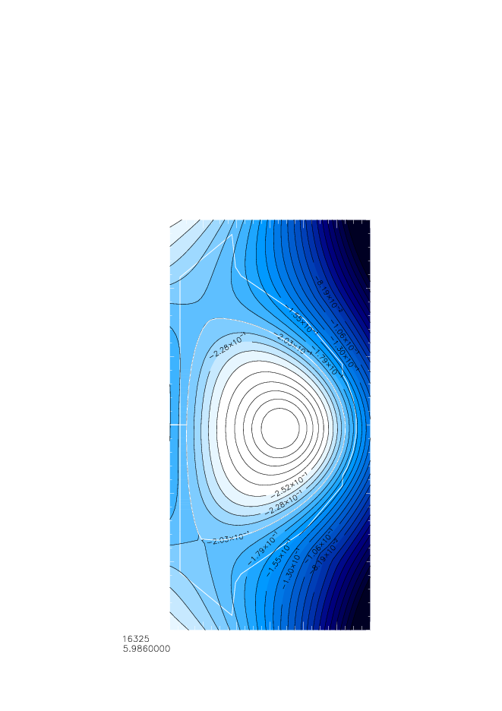
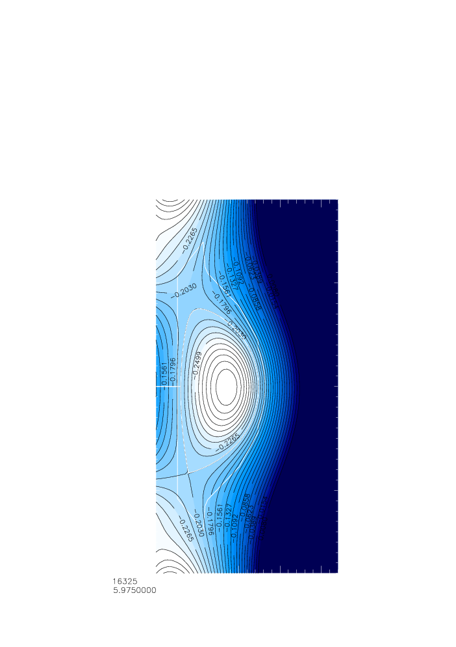
Kinetic equilibria has similar global parameters to magnetic-only equilibria
1
0
-1
1.5
1.0
0.5
0.0
-0.5
-1.0
-1.5
16325
5.986s
Magnetic only | Global Para. | Kinetic +MSE
223.9 | χ² | 202.4
1.87 | R_{axis}(m) | 1.861
-0.026 | Z_{axis}(m) | -0.07
1.704 | elong | 1.682
0.578 | δ_{u} | 0.540
0.578 | δ_{L} | 0.801
1.066 | β_{T} | 0.854
1.948 | β_{p} | 1.855
2.054 | β_{n} | 1.925
0.914 | li | 1.045
5.95 | q₉₅ | 6.39
16325
5.975s
Z (m)
Z (m)
1.2 1.6 2.0 2.4
R (m)
1.2 1.6 2.0 2.4
R (m)
Notes:
Here is the comparision of the magnetic surface for the same time point at last slide. They are quite similar to each other, the plasma boundary has the same poloidal flux value. There are also some difference in the Z-axis position and Low triangle

Slide 13
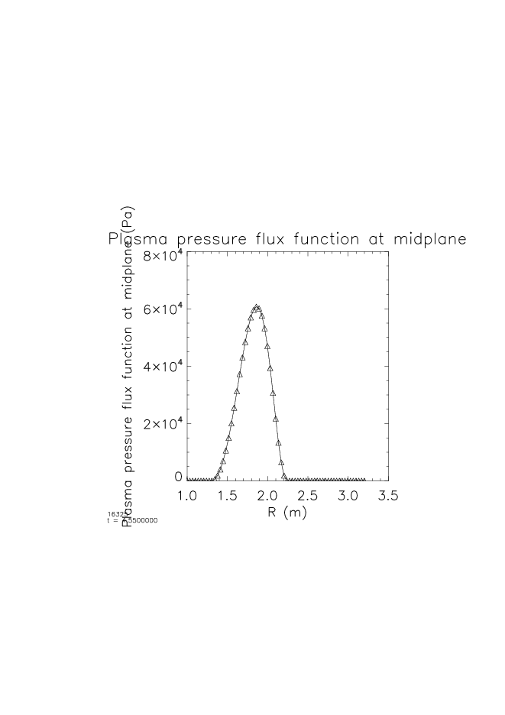
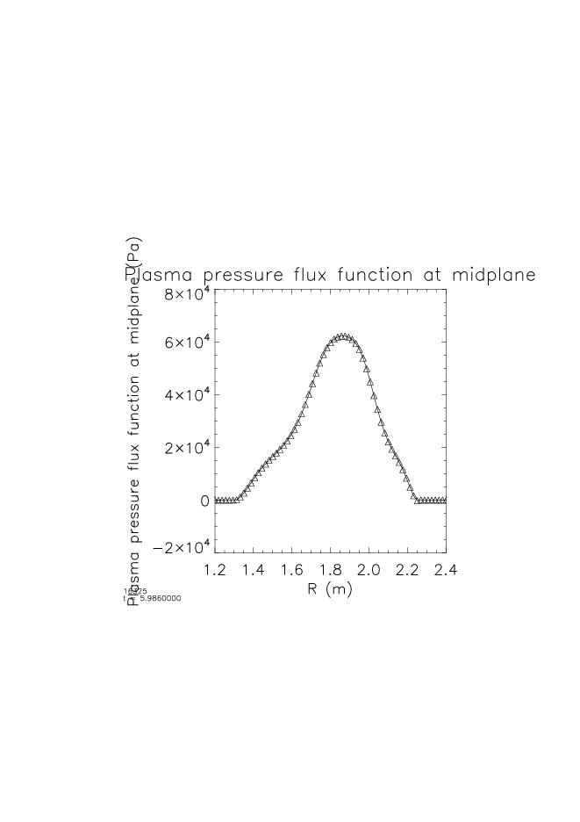
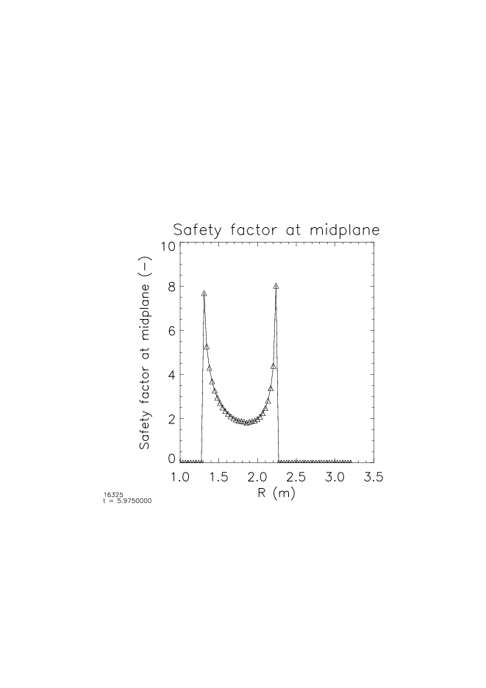
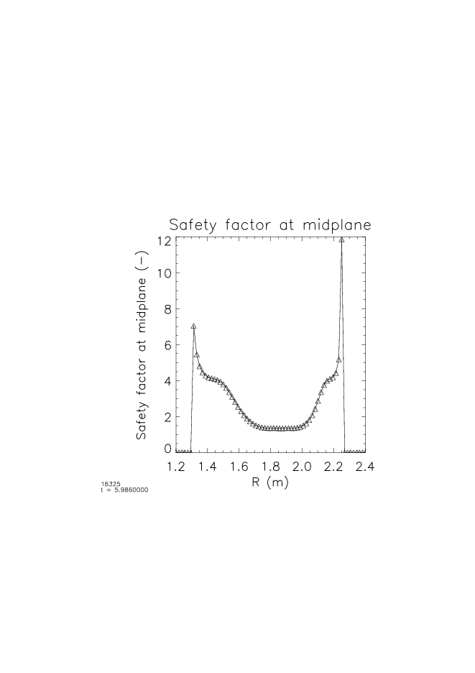
Kinetic equilibrium reconstruction with MSE produces substantial detail in P and q profiles
8
6
4
2
0
8
6
4
2
0
Pressure profile
Pressure profile
Pressure profile
P (10⁴Pa)
Magnetic only
P (10⁴Pa)
16325 5.975s
8
6
4
2
0
8
6
4
2
0
Safety factor
Safety factor
q
q
16325 5.986s
Kinetic + MSE
1.2 1.6 2.0 2.4
R (m)
1.2 1.4 1.6 1.8 2.0 2.2 2.4
R (m)
Notes:
[title] The two list of pictures is the comparison of the equilibria result between magnetic only and Kinetic equilibrium reconstruction. We use the clostest time point in the same shot to compare. Because we use a 7 order polynomial basic function in our model, the pressure and q profile has a quite flexiability especially at the plasma boundary.

Slide 14
Outline
  Overview of kinetic equilibrium reconstruction
  KSTAR diagnostics and model for kinetic equilibrium reconstructions
  Reconstructed profiles and plasma parameters in various KSTAR operation regimes
  Initial determination of ideal MHD stability
  Collaborative improvement of equilibrium diagnostics

Slide 15
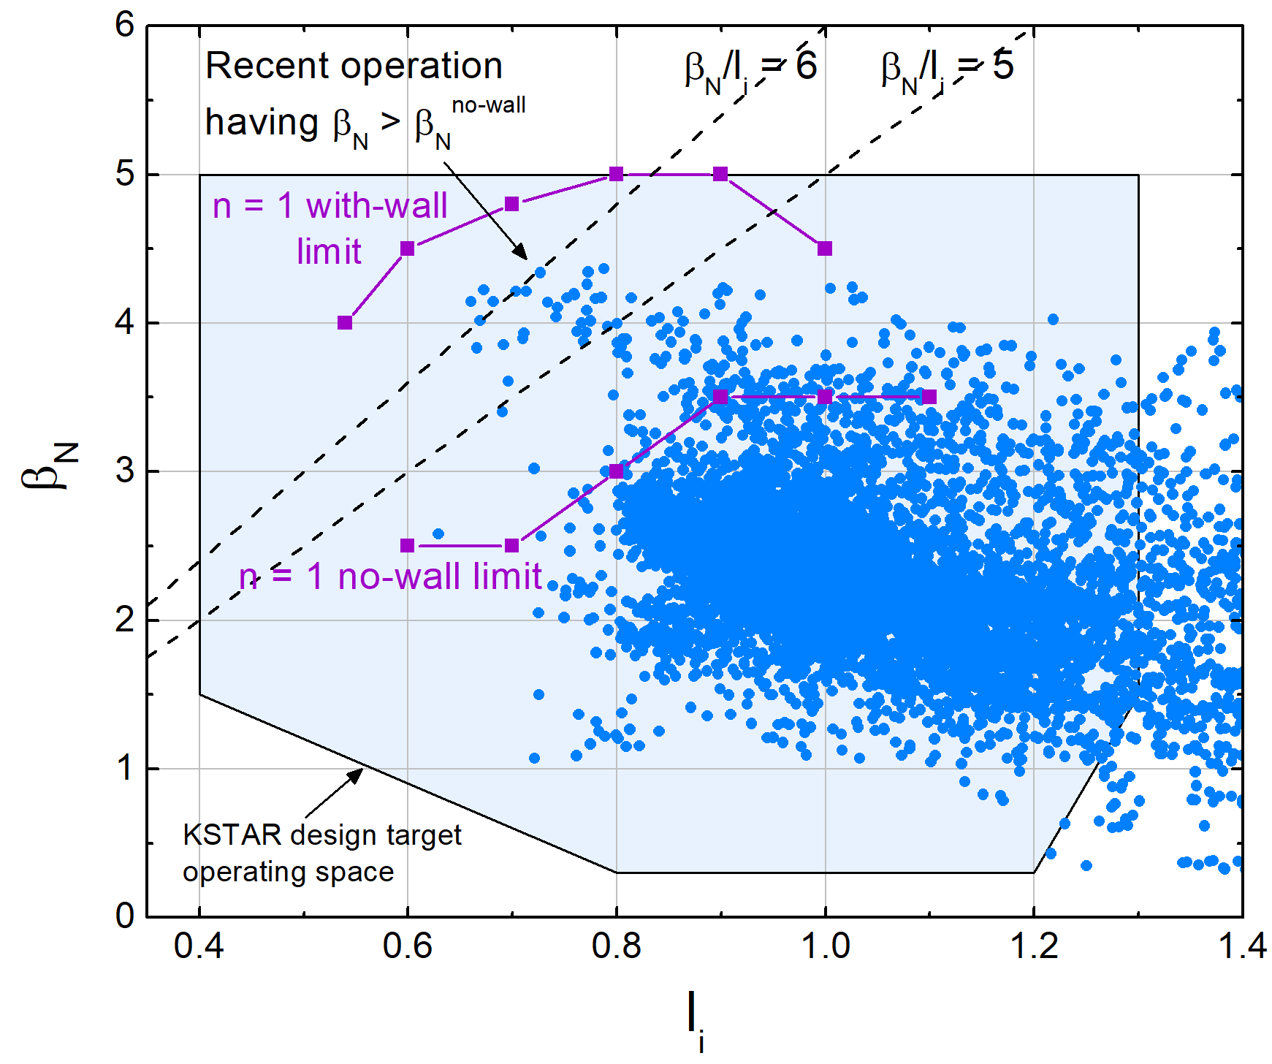
Kinetic Data Helps to Identify Operation Regime
Initial kinetic equilibrium w/ MSE are required for accurate stability analysis
18492
  L-mode
18476 & 16498
  Internal Transport Barrier (ITB)
16295
  High β_{n} mode
16325
  High β_{p} mode
  Edge bootstrap bump
See Y.S. Park’s talk
Y.S. Park, et al., Nucl. Fusion 53 (2013) 083029
Notes:
[title], and which is important to support continuous operation of high beta KSTAR tokamak plasmas. I draw my different case on the noralized beta versus plasma inductance map. And These two purple square line are the predicted n=1 mode with-wall limit and no-wall limit. For the left-upper shots exceeded these limits, the n=1 mode will be unstable. In my talk I will show you the equlibiria result for these five shots with [], these name are used in KSTAR for easily describing the operation regime.

Slide 16
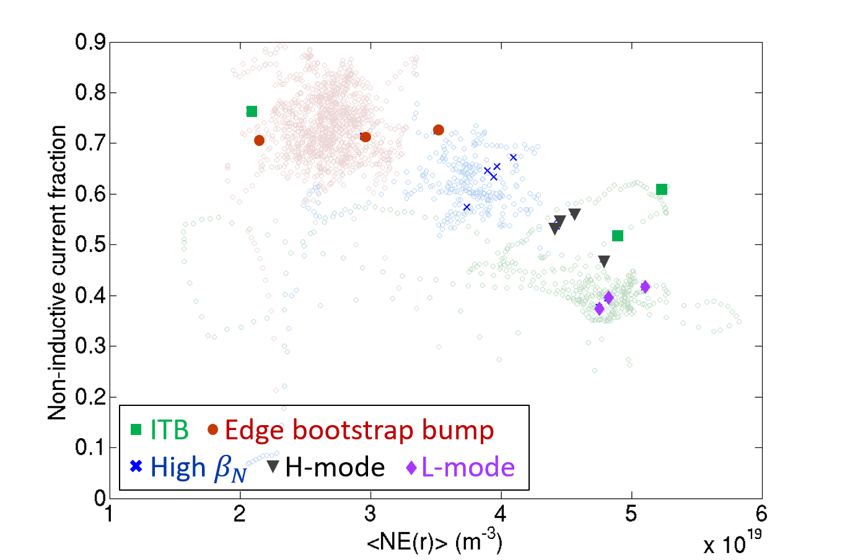
Kinetic reconstructions were performed on plasmas with high-non-inductive fraction
Non-inductive fraction :
  Beam-driven
  Bootstrap
Non-inductive fraction is very important for stable high beta steady state operation
16498
16325
16295
18476
18492
See J.H. Ahn’s talk
Notes:
These shots also have high [non-], which concludes the beam[1],[2] , and [title]. You have seen the map of [non] verse electron density in the last talk. and I marked my examples on the same map.

Slide 17
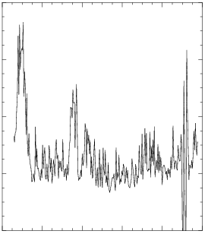
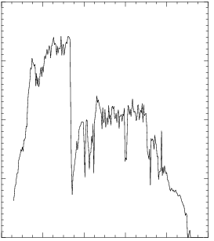
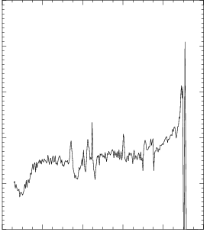
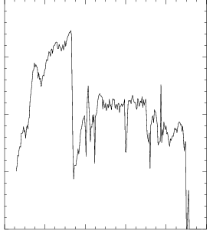
Good convergence in KSTAR kinetic equilibrium reconstruction for L-mode
800
600
400
200
0
4
3
2
1
0
Fit error
Total stored energy
χ²
Wtot (10⁵J)
5
4
3
2
1
0
18492
2.0
1.5
1.0
0.5
0.0
18492
Normalized internal
inductance
Normalized beta
l_{i}
β_{n}
18492
18492
0 2 4 6 8 10
Time (s)
0 2 4 6 8 10
Time (s)
Notes:
Here comes the equilibria results. We have seen [title]. These figure are the time evalution of Fit error[…]. As we can see that it has an low value in fit error and stable value in the other parameters. These large spikes on the lines are normaly un-phyics due to the bad convergence, but some time point like the time round 6s, the fit error is quite small, we think that contains real physics.

Slide 18
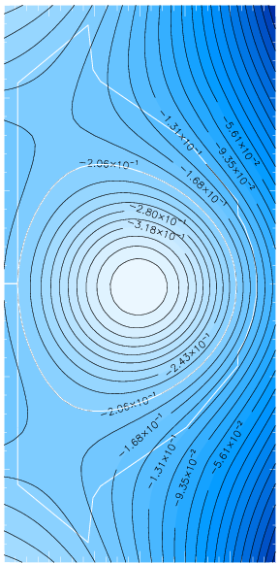
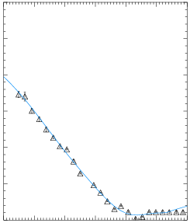
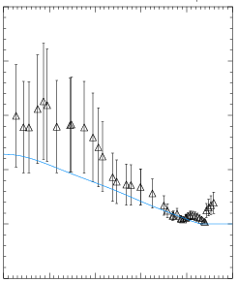
High consistency with field pitch angle
1.51.0
0.5
0.0
-0.5
-1.0
-1.5
0.15
0.05
-0.05
-0.15
18492
t=2.992
Pitch angle
χ² | 207.9
R_{axis}(m) | 1.80
Z_{axis}(m) | -0.17
elong | 1.374
δ_{u} | 0.232
δ_{L} | 0.271
β_{T} | 0.779
β_{p} | 1.302
β_{n} | 1.693
li | 1.392
q₉₅ | 4.814
18492
2.992s
Angle (rad)
△ Input
— Fitted
Z (m)
2.0
1.5
1.0
5.0
0.0
-5.0
1.7 1.9 2.1 2.3
R (m)
Pressure profile
Total Pressure (10⁵Pa)
△ Input
— Fitted
1.2 1.6 2.0 2.4
R (m)
1.8 1.9 2.0 2.1 2.2 2.3
R (m)
Notes:
These are the plasma sureface, global parameters ,pitch angle and pressure profile at t=3s time slice of the same shots in last slide. We can see the reconstructed pitch angle has great consistency with the measure pitch angle.
The pressure profile has relatively bad consistency. We believe that the electron density was over-estimated in the 2017 campaign according to what we see in these shots pressure profile.

Slide 19
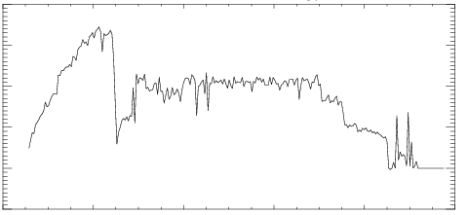
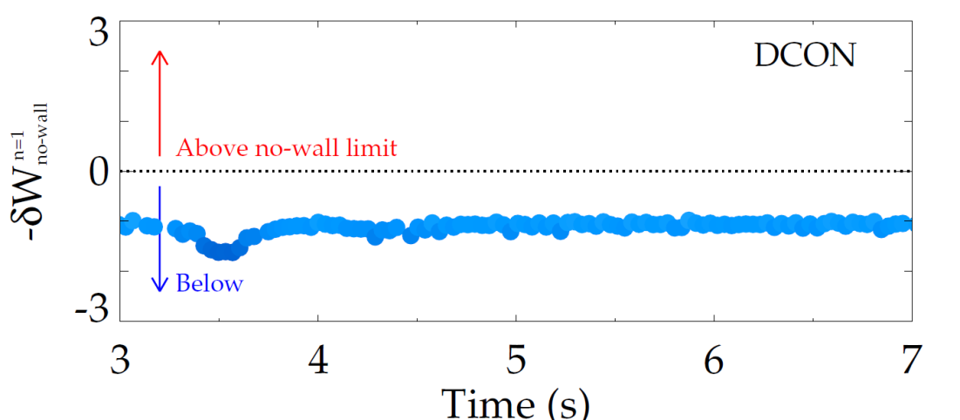
Ideal stability of new kinetic equilibria is examined by DCON
4
3
2
1
0
-1
Plasma total stored energy vs. time
DCON stability calculations of ideal δW indicate whether plasmas are above or below the no-wall beta limit
Analysis of new KSTAR kinetic equilibria indicates ideal stability (below no-wall limit) during later phase (as expected)
KSTAR
18476
Stored energy (10⁵J)
ITB
Limited plasma
0 2 4 6 8 10
Time (s)
DCON: [A. H. Glasser, Physics of Plasmas 23, 072505 (2016)]
See also Y.S. Park and J.H. Ahn’s talk
Notes:
Here is the DCON calculation using our kinetic equilibria input at these time region.

Slide 20
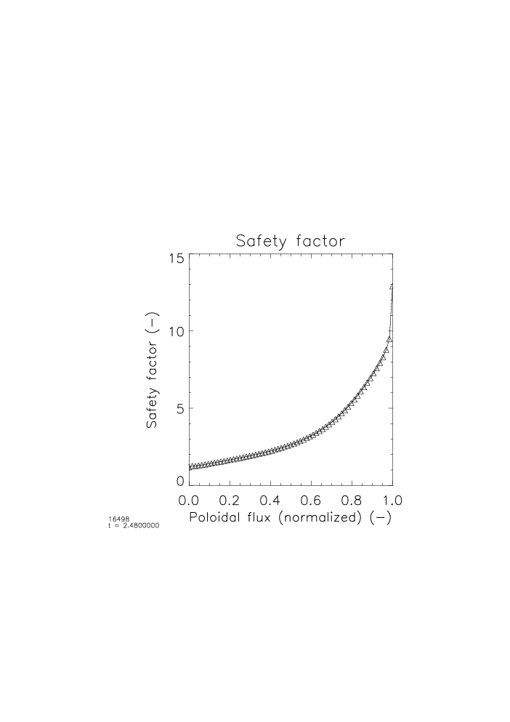

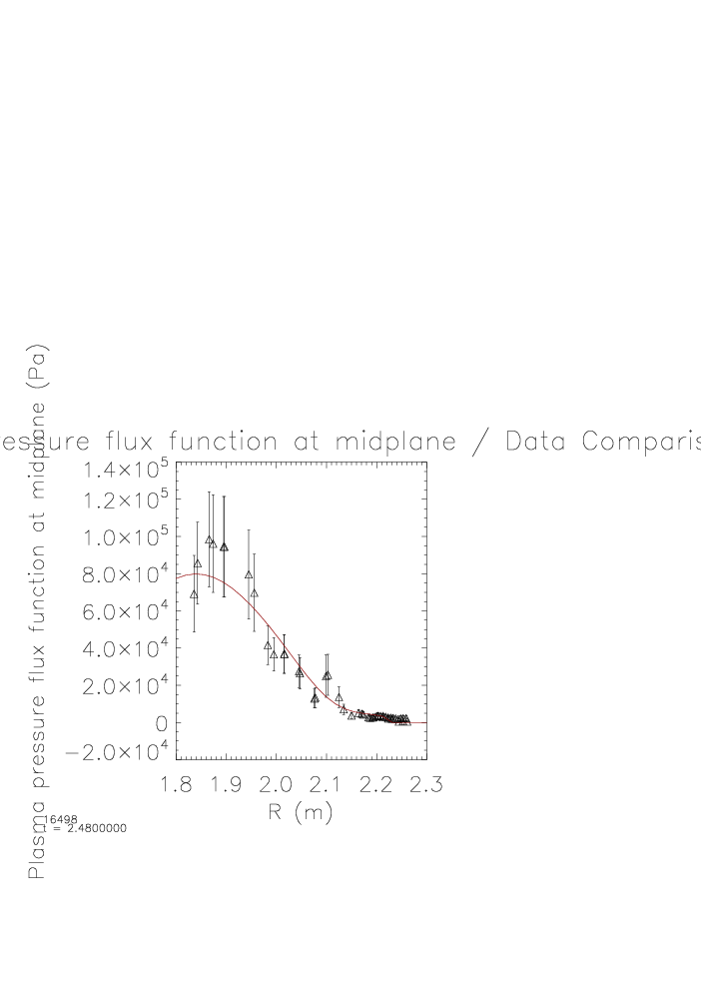
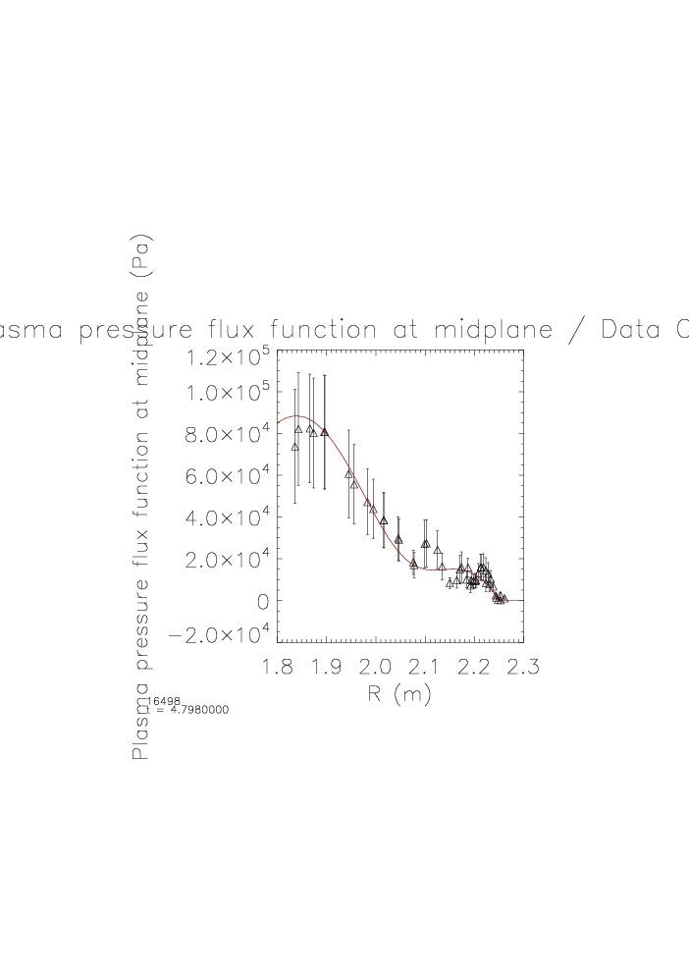
Improvement in confinement is comparable to the H-mode in the discharge
15
10
5
0
15
10
5
0
Safety factor
t = 2.5s
Safety factor
t = 4.8s
KSTAR #16498
Safty factor q
ITB
H-mode
L-mode
0.0 0.2 0.4 0.6 0.8 1.0
ψ_{N}
0.0 0.2 0.4 0.6 0.8 1.0
ψ_{N}
1.2
1.0
0.8
0.6
0.4
2
0.0
-0.2
1.2
1.0
0.8
0.6
0.4
2
0.0
-0.2
Total Pressure
t = 2.5s
Total Pressure
t = 4.8s
Total Pressure (10⁵Pa)
2.5
4.8
△ data
— fitted
△ data
— fitted
1.8 1.9 2.0 2.1 2.2 2.3
R (m)
1.8 1.9 2.0 2.1 2.2 2.3
R (m)
experiment by Jinil Jung
Notes:
These are openration regiem conversion from ITB to h and L mode in this shot. We compared the q and pressure profile at these two time slices. We can see a pedestal at the boundary in the H mode. And the ITB had a low shear q profile

Slide 21
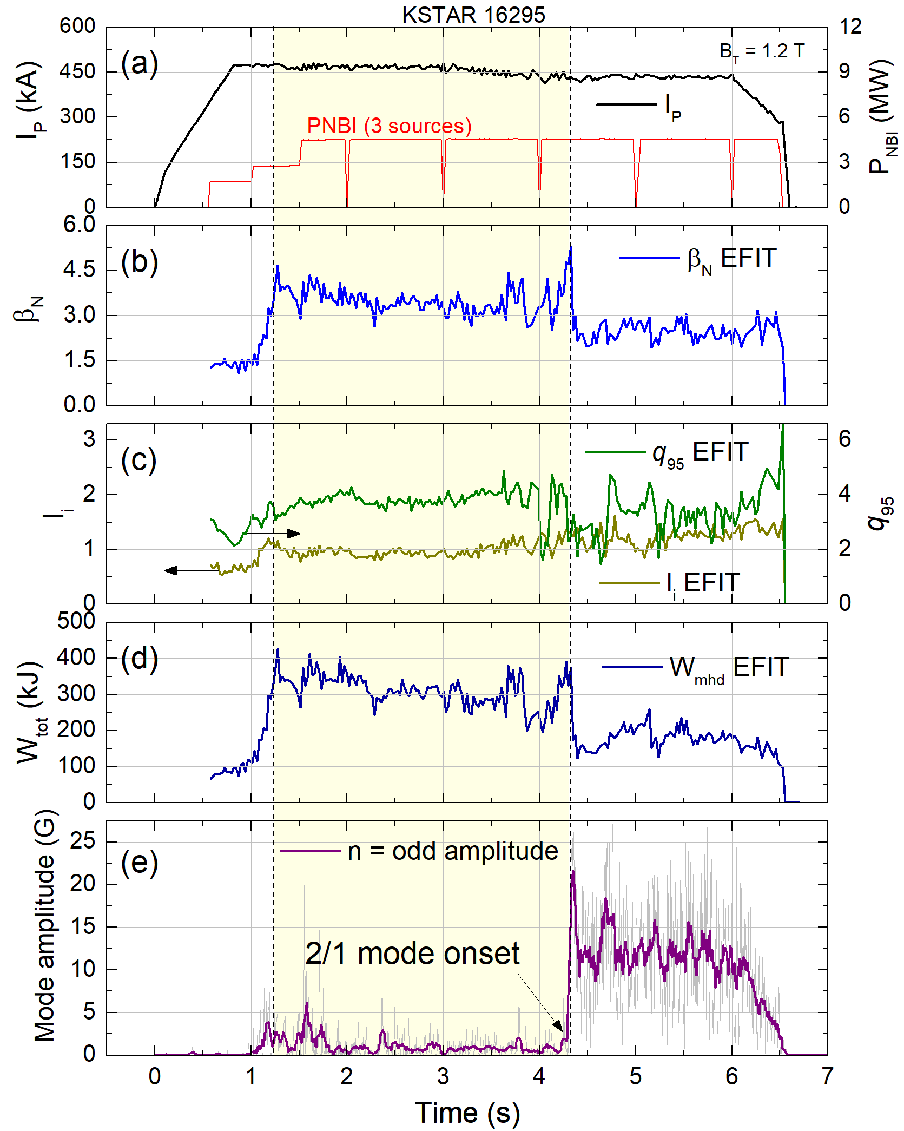
Present kinetic reconstructions will allow more accurate stability determination
β_{n} (>3)
Notes:
Sustained high β_{n} plasma is examined using kinetic equilibrium reconstructions. The High beta N is reduced by an MHD rotating mode. We can understand the stability of theses plasmas for furure avoidance of this mode. This shot will be examined by YS. Park in talk tomorrow.

Slide 22
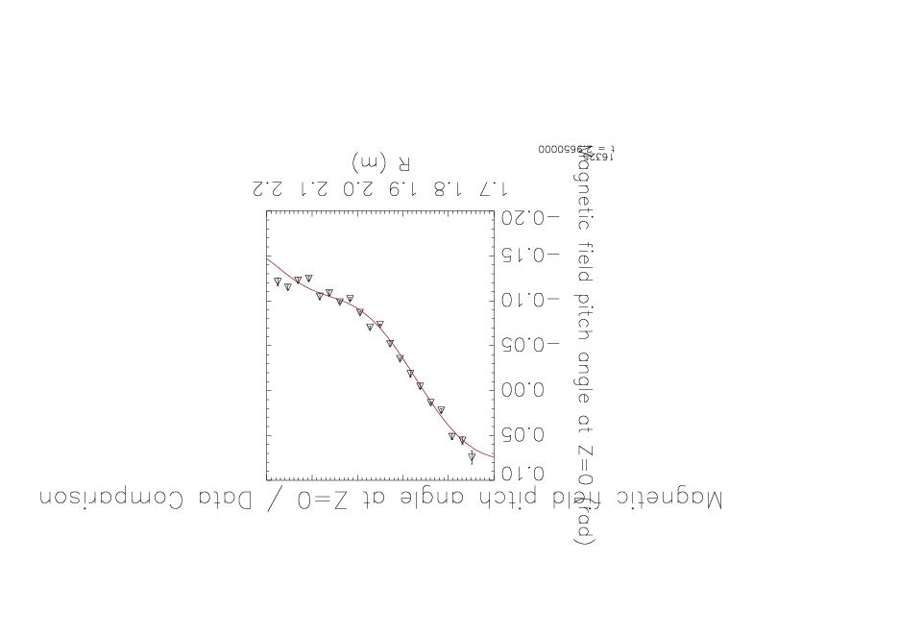
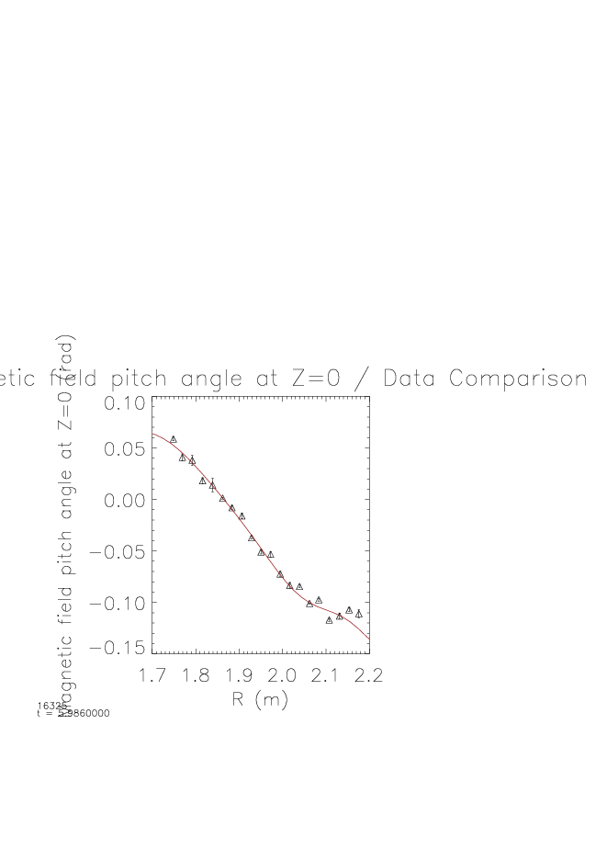
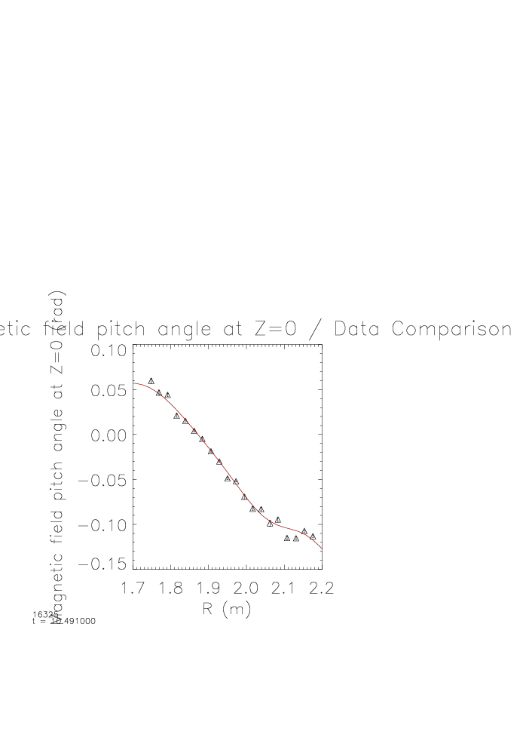
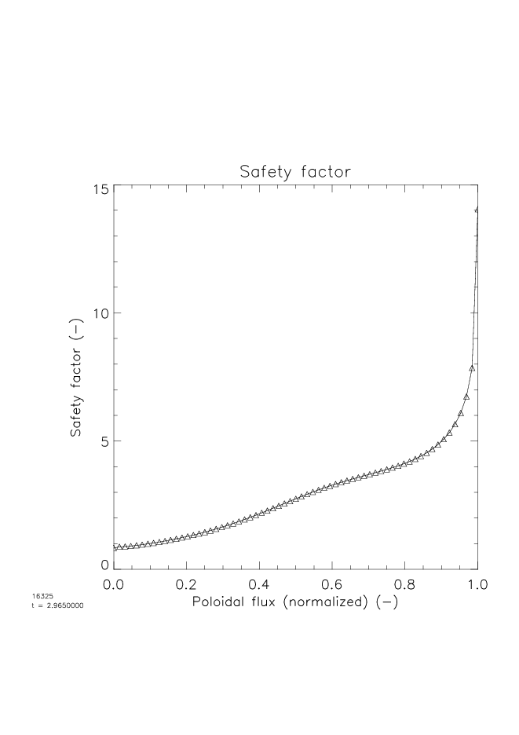
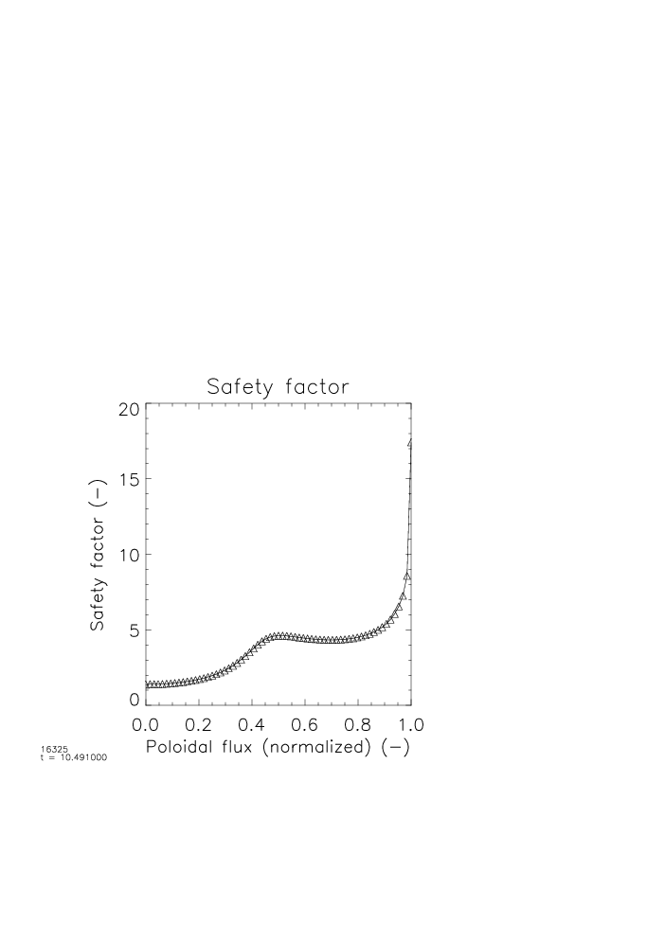
Kinetic equilibria with MSE shows evolution of q-profile to low shear at high q
16325
0.10
0.05
0.00
-0.05
-0.10
-0.15
0.10
0.05
0.00
-0.05
-0.10
-0.15
0.10
0.05
0.00
-0.05
-0.10
-0.15
△ Input
— Fitted
△ Input
— Fitted
△ Input
— Fitted
(rad)
(rad)
(rad)
Pitch angle
t = 2.985s
Pitch angle
t = 5.986s
Pitch angle
t = 10.491s
1.7 1.8 1.9 2.0 2.1 2.2
R (m)
1.7 1.8 1.9 2.0 2.1 2.2
R (m)
1.7 1.8 1.9 2.0 2.1 2.2
R (m)
15
10
5
0
15
10
5
0
15
10
5
0
Safety factor
t = 2.985s
Safety factor
t = 5.986s
Safety factor
t = 10.491s
q
q
q
0.0 0.2 0.4 0.6 0.8 1.0
ψ_{N}
0.0 0.2 0.4 0.6 0.8 1.0
ψ_{N}
0.0 0.2 0.4 0.6 0.8 1.0
ψ_{N}
Notes:
This is another example of high poloidal beta mode, these figure show the time evalution [t equals to 3, 6s and 10.5s] of the pitch angle and q profiles. [title], We think the low shear is due to the Edge bootstrap bump.

Slide 23
Outline
  Overview of kinetic equilibrium reconstruction
  KSTAR diagnostics and model for kinetic equilibrium reconstructions
  Reconstructed profiles and plasma parameters in various KSTAR operation regimes
  Initial determination of ideal MHD stability
  Collaborative improvement of equilibrium diagnostics

Slide 24
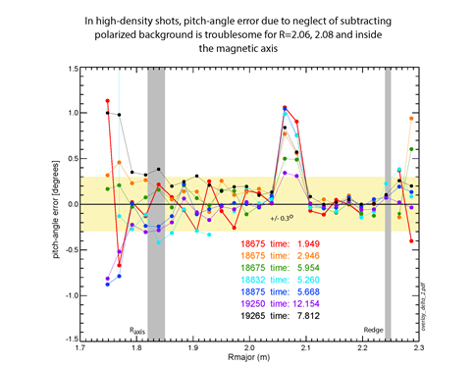
Kinetic reconstructions will continue to improve by Columbia / PPPL / MIT Collaboration
Transferred 10 channel MSE background light polychrometer from C-Mod to KSTAR (4/2017)
  Investigating improvement of MSE measurement by background light subtraction
  Continued calibration improvements through collaborative investigation
Collaborative effort to further improve Thomson scattering data
Continued improvement of kinetic equilibrium reconstructions
  Activate the completed sensor compensation of 3D IVCC coil currents
  Improved modeling / planned neural net delivery of fast particle pressure P_{fast}
(See S.D. Scott poster in 2017 APS DPP meeting)
Pitch angle can be troublesome on some channels due to neglect of background light subtraction
1.5
1.0
0.5
0.0
pitch angle error (deg)
-0.5
-1.0
-1.5
1.7
1.9
2.1
2.3
R (m)
Notes:
Poly krou meter; In-vessel control coils(IVCC)

Slide 25
Kinetic equilibrium reconstruction of KSTAR plasmas including MSE data provide critical input for disruption prediction and avoidance research
Inclusion of key input data
  Thomson scattering, charge exchange spectroscopy, and allowance for fast particle pressure; motional Stark effect data (25 channels)
  External magnetics and shaping field currents, vacuum vessel currents, and passive plate currents allowed
Exploration of operational regimes and new physics
  Plasmas with high non-inductive fraction display advanced tokamak profiles, including weak/reversed shear
  Low shear regions found at various levels of q
Critical input for stability analysis and understanding
  Continue investigation of weak q shear as possible explanation of tearing mode stability at in higher q vs. lower q regions
  Provide key input for disruption prediction, active RWM control in 2018

