Slide 1
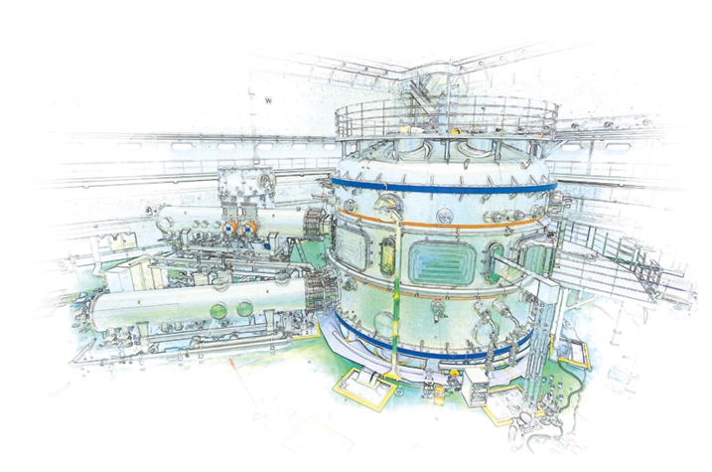
Introduction to recent KSTAR international collaboration analysis
S.A. Sabbagh¹, Y.S. Park¹, J.H. Ahn¹, J.W. Berkery¹, J.M. Bialek¹, Y. Jiang¹, J.D. Riquezes¹, S.D. Scott²
¹Department of Applied Physics, Columbia University, New York, NY
²PPPL, Princeton, NJ
NSTX-U Physics Meeting
PPPL
November 29th, 2017
Princeton, NJ
Supported by US DOE grant DE-SC0016614
V1.0

Slide 2
Present KSTAR international collaborative research follows from our NSTX/-U research effort
DOE solicitation
“Collaborative Research in Magnetic Fusion Energy Sciences on International Long-Pulse Superconducting Tokamaks”
Research Proposal Title
“Disruption Prediction and Avoidance in High Beta Long Pulse KSTAR Plasmas”
Personnel
Columbia U.:
Sabbagh (Lead PI), Y.S. Park, J.H. Ahn, Y. Jiang (full time)
Berkery, Bialek (part time); J.D. Riquezes (Columbia student)
PPPL: S. Scott (~full time, inst. PI), M. Boyer, B. LeBlanc (part time)
MIT/ORISE: E.S. Marmar (inst. PI), B. Mumgaard

Slide 3
Presented collaborative physics research is required analysis for disruption prediction and avoidance
Element 1: Improvements and new capabilities enabling disruption characterization and forecasting (with related experiments)
More detailed equilibrium reconstruction: kinetic required, with MSE
Stability physics: kinetic MHD, NTM, kink/ballooning/RWM
TRANSP analysis supporting stability analysis
Disruption event characterization and forecasting
Element 2: Improvements/support to key diagnostics:
C-Mod MSE background polychrometer sent to KSTAR (10 channels), building 15 more channels to support 25 total channels (2018)
Some support for Thomson diagnostic checkout
Element 3: Experimental active control of dynamic error fields and global MHD instability
Support PID control implementation
Model-based RWM state-space control
Synthetic diagnostics to support disruption prediction
This meeting
This meeting

Slide 4
Talks are a subset of the presentations shown at the recent APS DPP17 meeting
Six presentations given at the APS DPP meeting
Today’s presentations
Transport and stability analyses supporting disruption prediction in high beta KSTAR plasmas (Jae Heon Ahn)
Kinetic equilibrium reconstruction of KSTAR plasmas including internal pitch angle profile measurement (Yanzheng Jiang)
Tomorrow’s presentations
MHD stability analysis and global mode identification for high beta operation in KSTAR (Young-Seok Park)
Automated identification of MHD mode bifurcation and locking in tokamaks (Sabbagh for J.D. Riquezes)
Brief outline of on-going KSTAR international collaboration research (Sabbagh)

