Slide 1
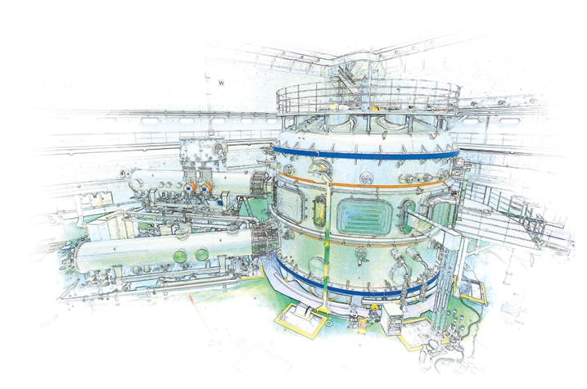



Brief outline of on-going KSTAR international collaboration research – next steps
S.A. Sabbagh¹, Y.S. Park¹, J.H. Ahn¹, J.W. Berkery¹, J.M. Bialek¹, D. Boyer², Y. Jiang¹, B. LeBlanc², J.D. Riquezes¹, S.D. Scott²
¹Department of Applied Physics, Columbia University, New York, NY
²PPPL, Princeton, NJ
NSTX-U Physics Meeting
PPPL
November 30th, 2017
Princeton, NJ
Supported by US DOE grant DE-SC0016614
V1.0

Slide 2
Next-steps in KSTAR physics research will continue to advance key capabilities, start DECAF analysis
Element 1: Improvements and new capabilities enabling disruption characterization and forecasting (DECAF) with related experiments
  Equilibrium reconstruction
    Finalize first kinetic equilibrium reconstructions with MSE, run all shots from 2016 and 2017 run campaigns to build database
    Construct neural net processing of fast particle pressure from TRANSP
  TRANSP analysis
    Refine TRANSP analysis and begin predictive runs to determine impact of new 2nd NBI system on plasma β, profiles, and stability
    Use predictive capability in “feedback” mode to determine optimal stability trajectories for disruption avoidance
  Stability analysis
    Begin stability analysis validation (kinetic MHD, (N)TM, kink, ballooning, RWM) for specific high performance shots and that exhibited MHD modes
  DECAF
    Begin disruption event characterization and forecasting (DECAF) analysis on KSTAR database
    Expand DECAF physics modules to incorporate and utilize automated MHD mode analysis, new density limit module under development, etc.

Slide 3
Next-steps in KSTAR physics research will continue to advance key capabilities, enable global mode control
Element 2: Improvements/support to key diagnostics:
  Construction of 15 additional MSE background polychrometer channels to support 25 total channels for 2018 run (PPPL/MIT)
  Continue support / interaction for Thomson diagnostic improvement
Element 3: Experimental active control of dynamic error fields and global MHD instability
  Begin generalization of model-based RWM state-space control code for the KSTAR Plasma Control System (PCS)
  Begin generalization of synthetic diagnostics code (including for KSTAR PCS) to support disruption prediction

