Slide 1
Supported by
MHD Stability Analysis and Global Mode Identification Preparing for
High Beta Operation in KSTAR*
Y.S. Park¹, S.A. Sabbagh¹, J.W. Berkery¹, Y. Jiang¹, J.H. Ahn¹,
J.G. Bak², J.M. Bialek¹, H.S. Han², B.H. Park², Y.M. Jeon²,
J. Kim², S.H. Hahn², J.H. Lee², W.H. Ko², J.S. Ko², Y.K. In²,
S.W. Yoon², J.G. Kwak², Y.K. Oh², Z. Wang³, N.M. Ferraro³,
C.E. Myers³, S.C. Jardin³, A.H. Glasser⁴, G.S. Yun⁵
¹Department of Applied Physics, Columbia University, New York, NY, USA
²National Fusion Research Institute, Daejeon, Korea
³Princeton Plasma Physics Laboratory, Princeton, NJ, USA
⁴U. Washington, Seattle, WA, USA
⁵POSTECH, Pohang, Korea
NSTX-U Physics Meeting
November 30, 2017
PPPL, Princeton, NJ
In collaboration with
National Fusion
Research Institute
V1.0
*Work supported by the U.S. Department of Energy under contract DE-FG02-99ER54524 and DE-SC0016614

Slide 2
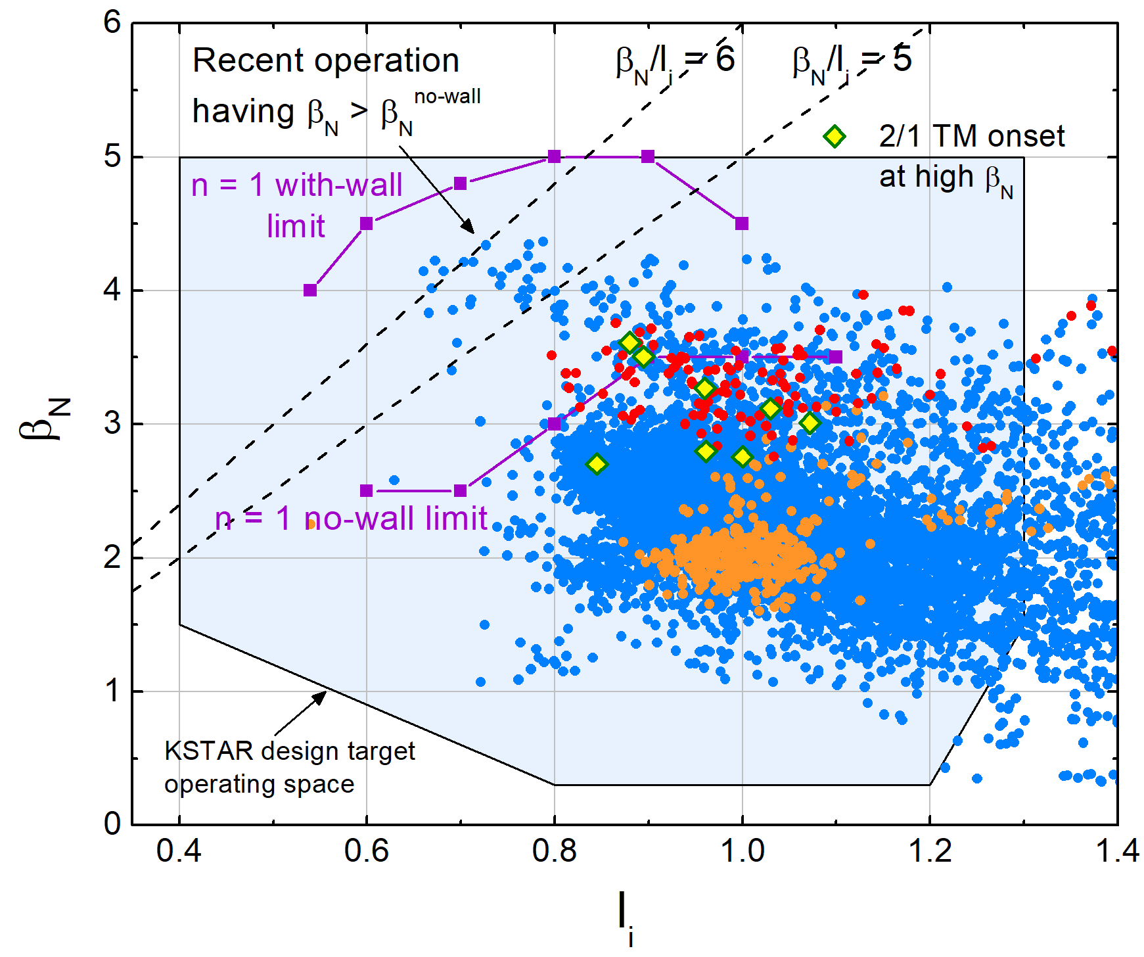
KSTAR H-mode equilibria have reached and exceeded the computed
n = 1 ideal no-wall stability limit
Parameters for high β_{N}
B_{T} in range 0.9-1.3 T
P_{NBI} = 4.5-5.5 MW
Highest β_{N} = 4.3, β_{N}/l_{i} > 6
MHD stability at high β_{N}
Many equilibria operate above the published ideal n = 1 no-wall stability limit (DCON)
Plasma is subject to RWM instability, depending on plasma rotation profile
High β_{N} > β_{N}^{no-wall} operation mostly limited by 2/1 mode
Shot 16295
*
Shot 16325
Normalized beta vs. internal inductance from EFIT reconstruction**
containing ~9,000 equilibria produced in the 2016 device campaign
*O. Katsuro-Hopkins, et al., Nucl. Fusion 50 (2010) 025019
** Y.S. Park, et al., Nucl. Fusion 53 (2013) 083029

Slide 3
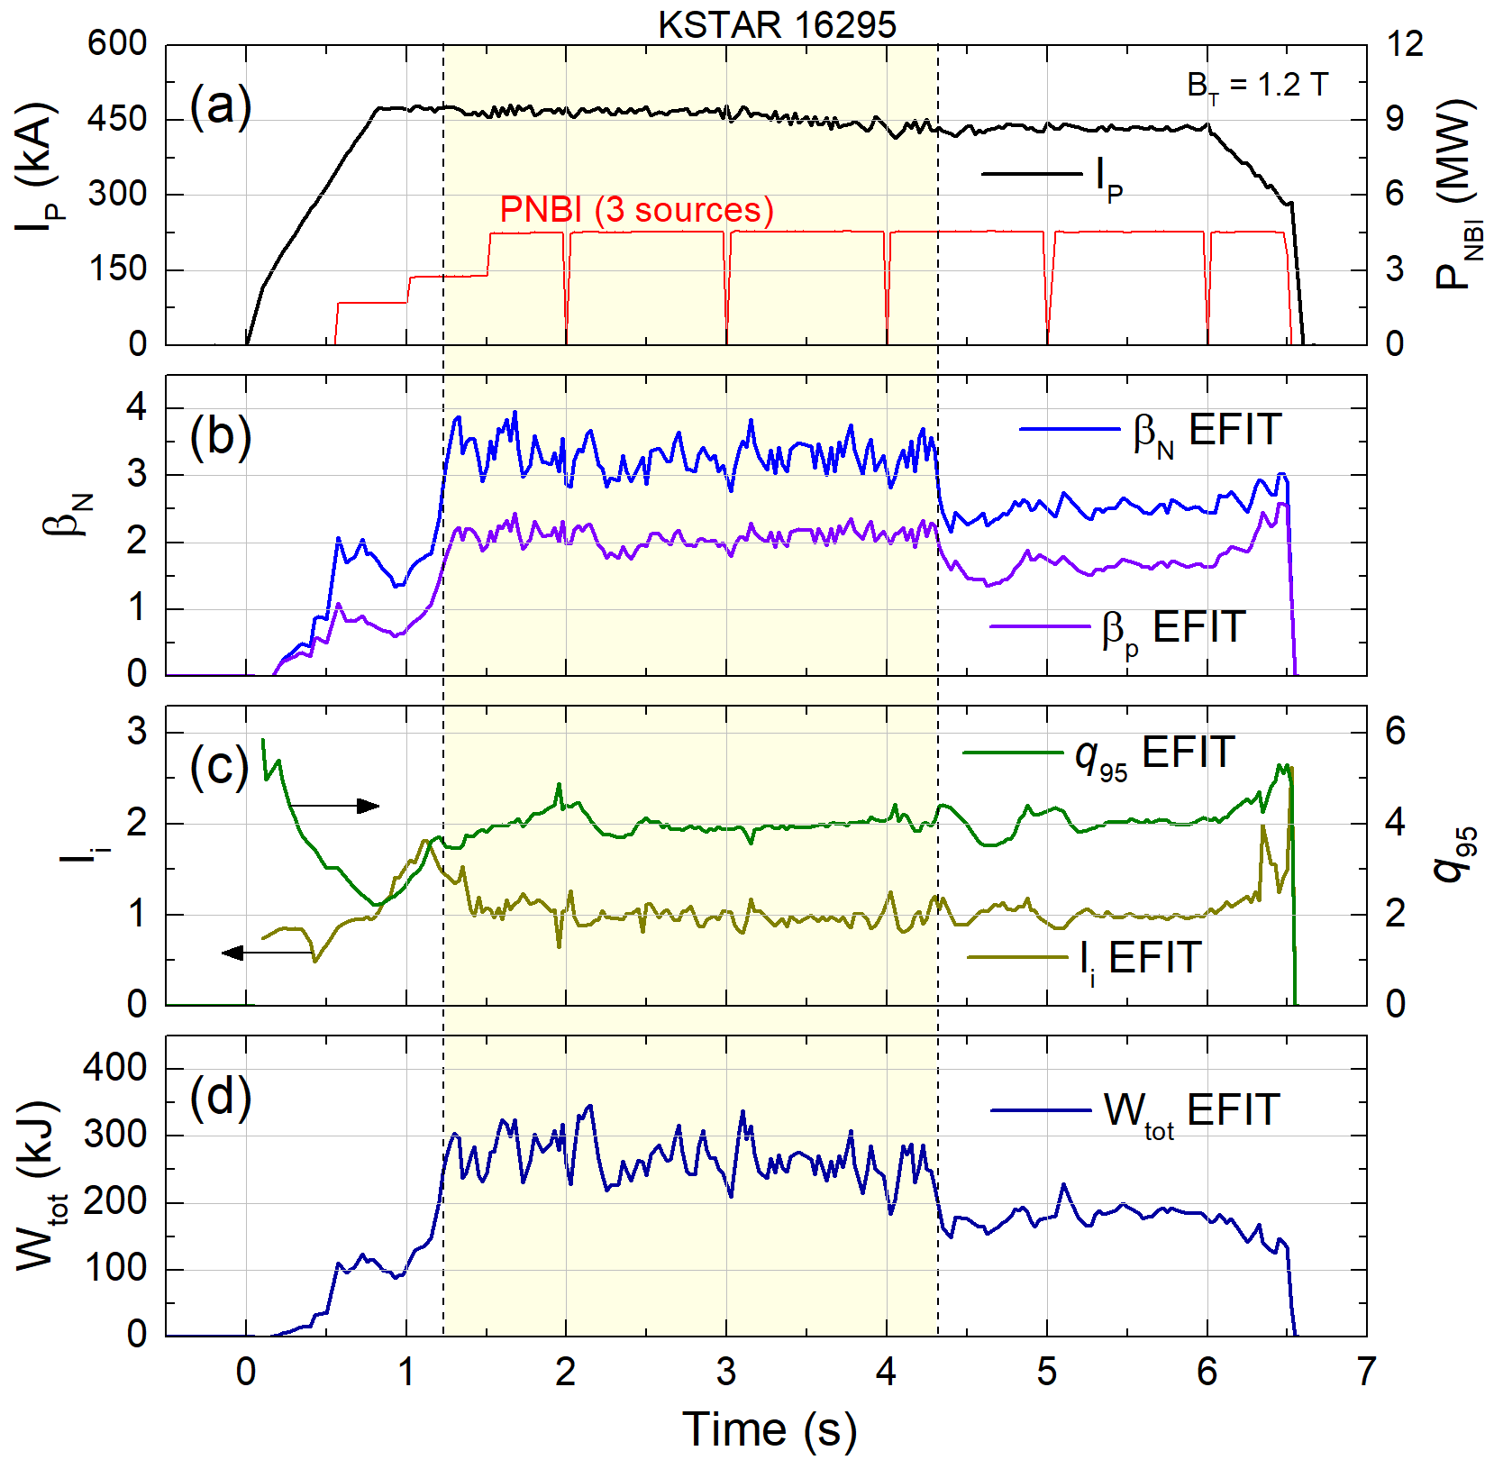
High β_{N} > 3 equilibria limited by MHD - shot 16295
2/1 mode onset
High β_{N} plasmas were significantly extended to longer pulse by utilizing improved plasma control
Sustained high β_{N}^{avg} = 3.3 achieved for 3 s
Used max. available P_{NBI} = 4.5 MW
I_{p} = 430-470 kA, B_{T} = 1.2 T, q₉₅ = 4.0-4.5, W_{tot} = 270 kJ
2/1 tearing mode onset at high β_{N} phase
Consequently reduces β_{N} and W_{tot} by ~35%
β_{N} > 3
q₉₅ ~ 4
Stored energy
KSTAR high β_{N} discharge evolution showing parameters from fully converged EFIT reconstructions

Slide 4
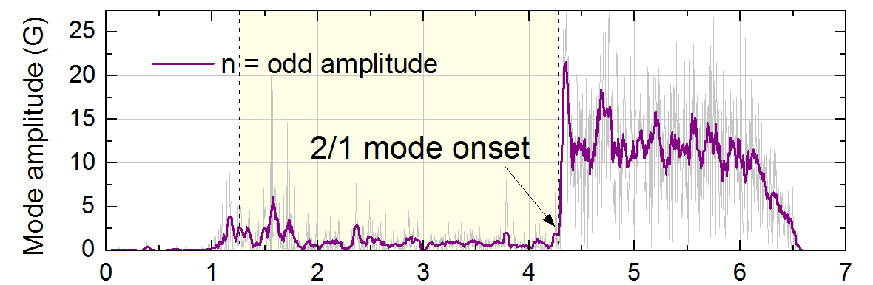
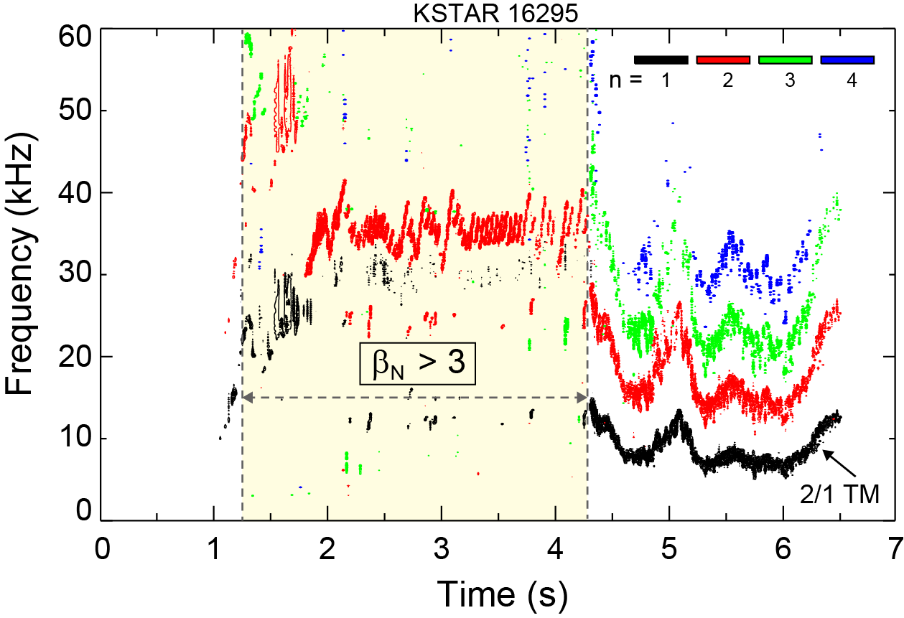
Onset of strong 2/1 tearing mode terminated high β_{N}
KSTAR 16295
At high β_{N} phase, a benign n = 2 mode (presumably 3/2 mode) exists with strong sawteeth
No indication of W_{tot} reduction due to the n = 2 mode having |B_{p}| ~ 2 G
High β_{N} operation was limited by strong 2/1 tearing mode onset
Measured mode amplitude > 20 G
Both W_{tot} and β_{N} were reduced by ~35% but maintained H-mode
Similar discharges exhibited different 2/1 tearing mode onset time (expected to be triggered by sawteeth)
Plasma rotation profile significantly reduced by > 20% due to the 2/1 mode onset
~
Weak n = 2 mode
Toroidal magnetic probe spectrum and mode amplitude in high β_{N} discharge

Slide 5
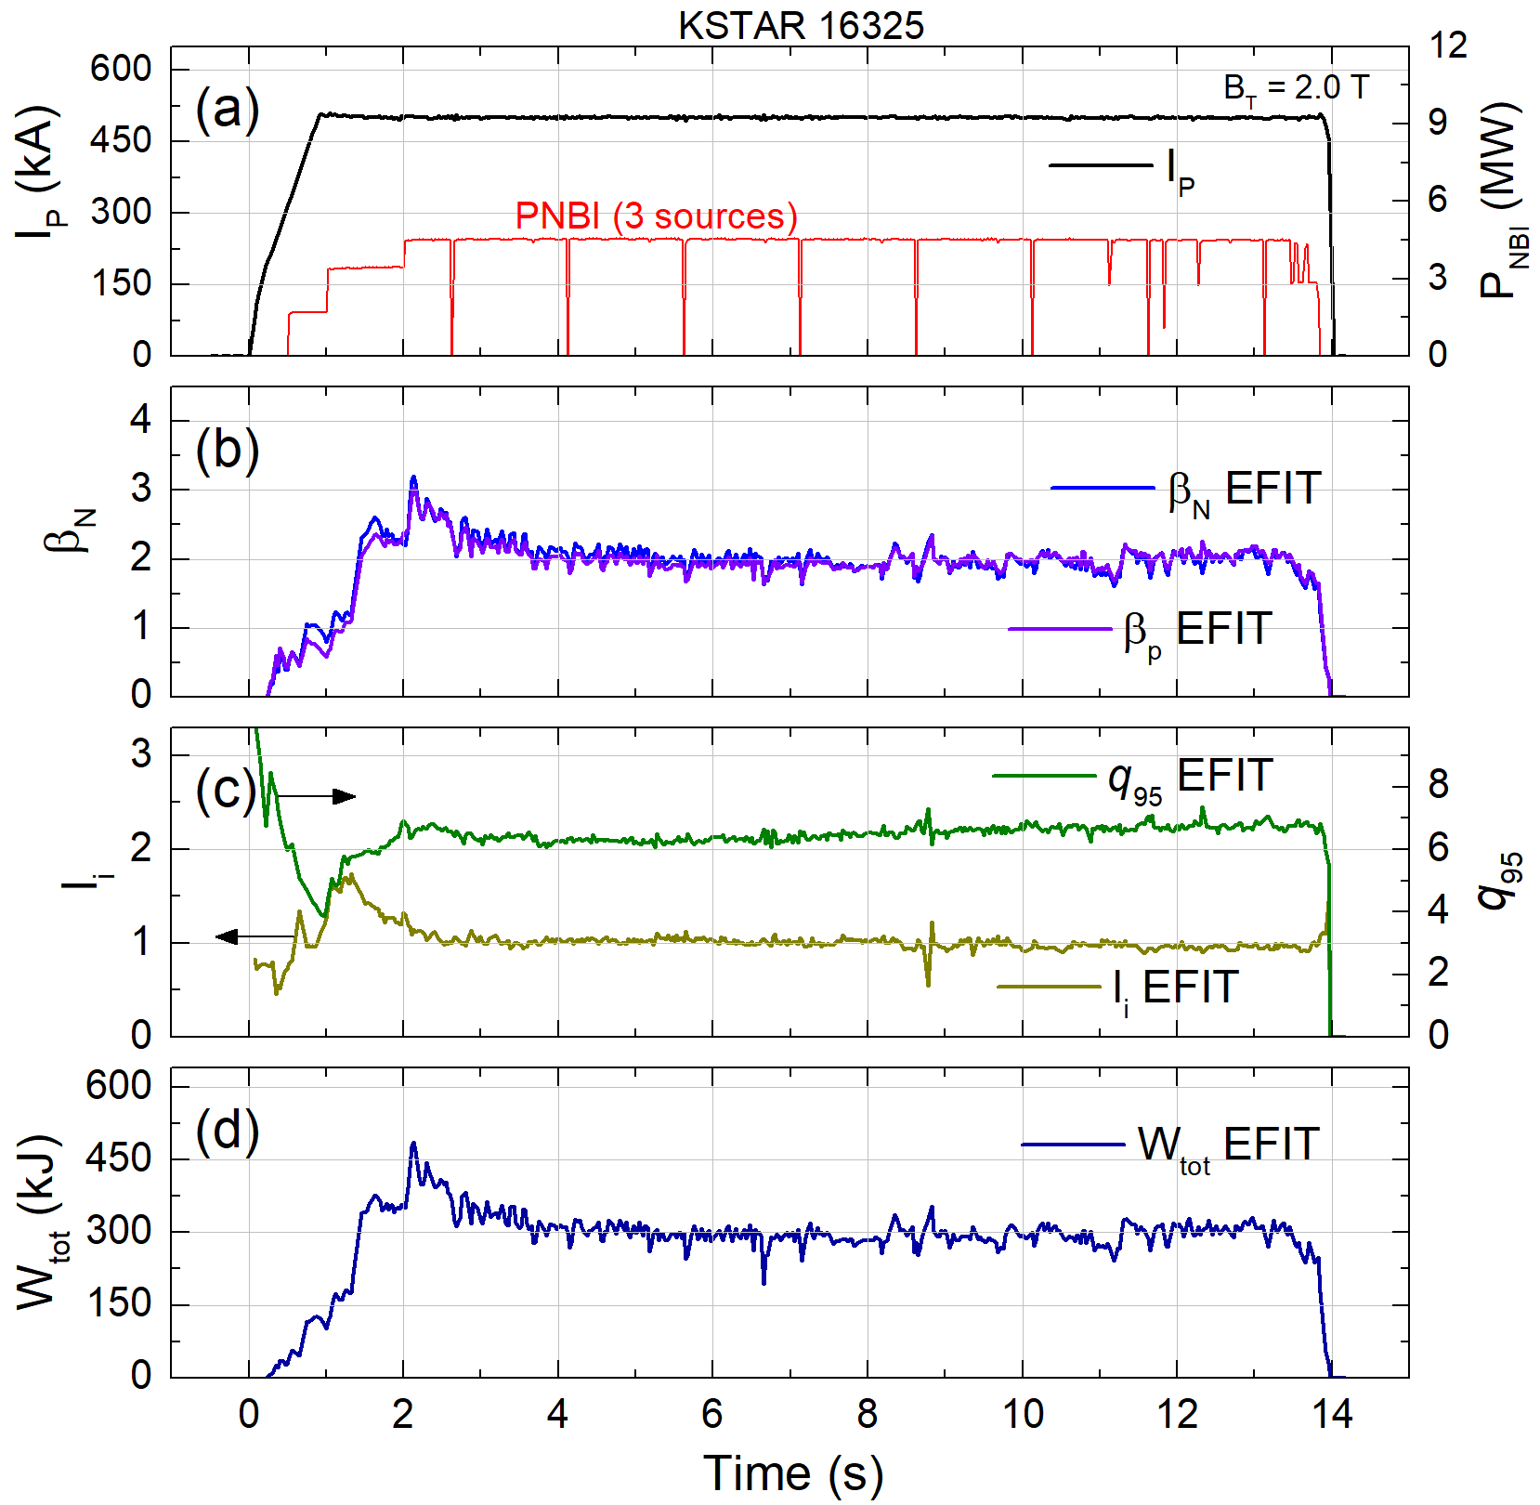
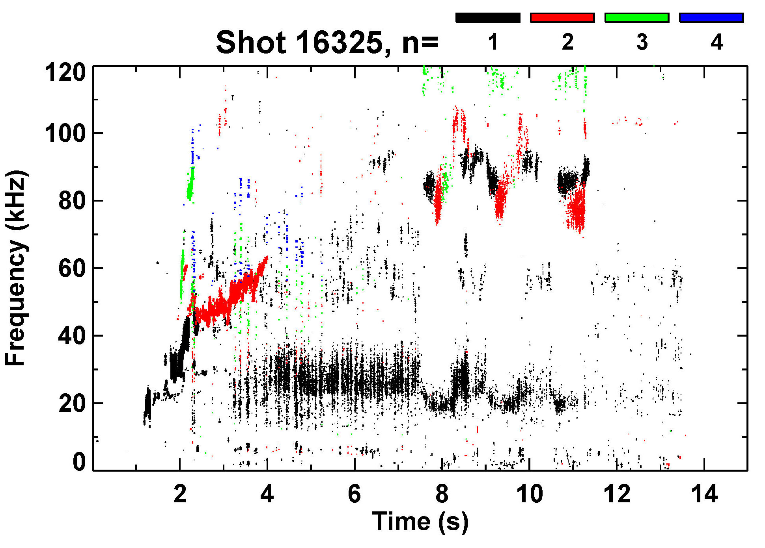
Comparative equilibria having higher q₉₅ and β_{p} shows very different MHD stability - shot 16325
KSTAR 16325
β_{N} ~ β_{p} > 2
Tearing modes absent
q₉₅ > 6
Toroidal magnetic probe spectrum
Plasma operation at elevated B_{T} produced equilibria having higher q₉₅ and β_{p}
Unlike shot 16295, discharge doesn’t experience any major beta-limiting MHD activities
Stored energy
KSTAR 16325 discharge evolution showing parameters from fully converged EFIT reconstructions

Slide 6
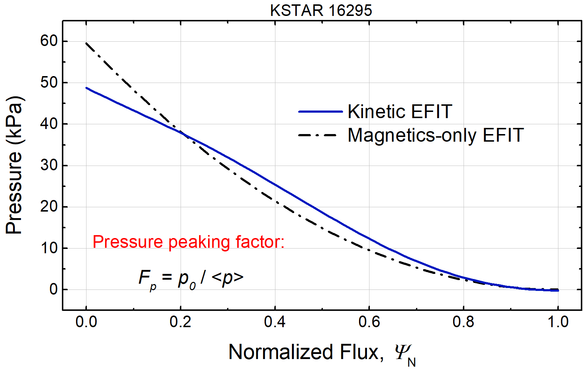
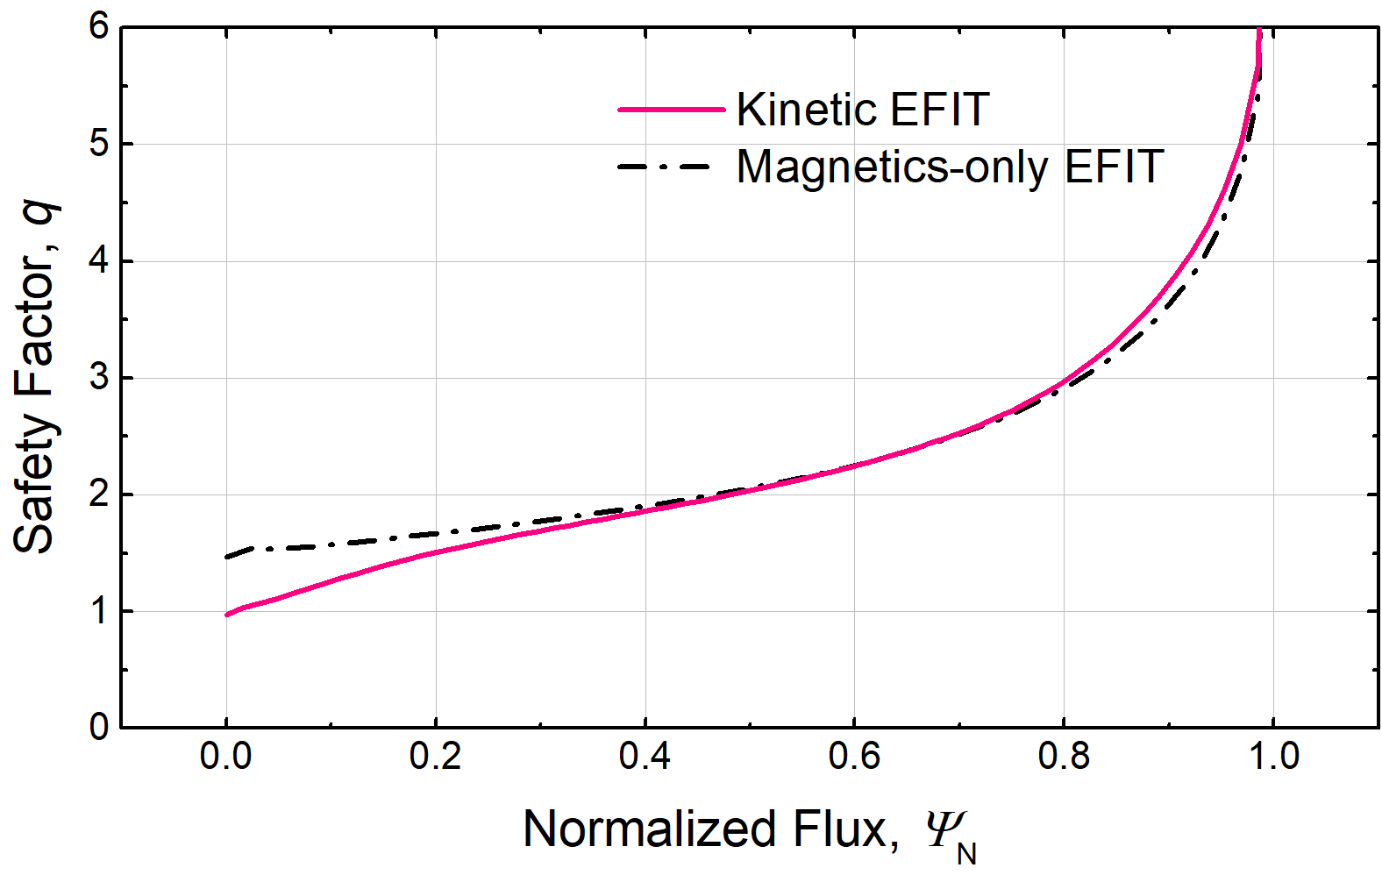
Kinetic EFIT with MSE constraints used for accurate stability analysis for the first time on KSTAR
Equilibrium reconstruction now uses measured internal profile constraints
Provides reliable pressure profile and internal magnetic geometry necessary for stability and transport studies
KSTAR is equipped with key internal profile diagnostics
Charge exchange (T_{i}, V_{φ}) : 32 CHs
Thomson scattering (T_{e}, n_{e}) : 27 CHs
ECE radiometer (T_{e}) : 76 CHs
Motional Stark Effect : 25 CHs
Total number of available constraints for fit : 161 magnetics + 160 kinetics & MSE
F_{p} = 3.6
EFIT pressure profile
F_{p} = 3.0
(t ~ 2.1 s)
S.A. Sabbagh, Nucl. Fusion 41 (2001) 1601
EFIT q-profile
(t ~ 2.1 s)
Unconstrained
MSE constrained
Reconstructed pressure and safety factor profile from kinetic EFIT using internal profile constraints
SEE Y. Jiang’s talk on 11/29/17

Slide 7
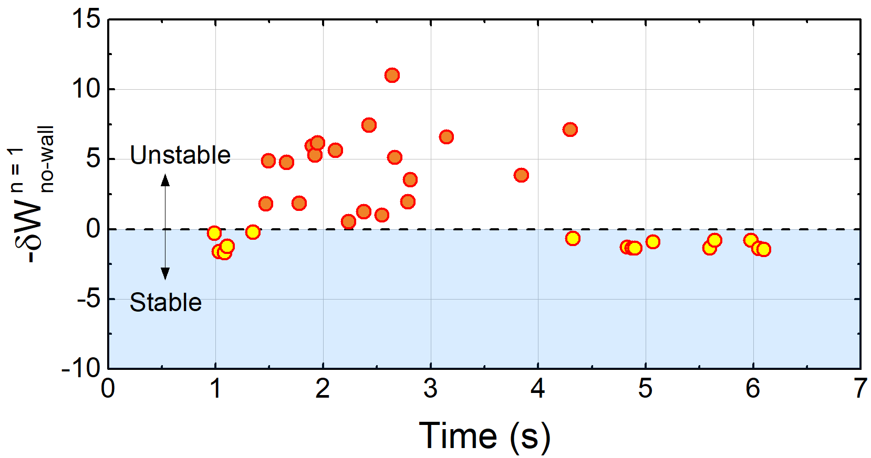
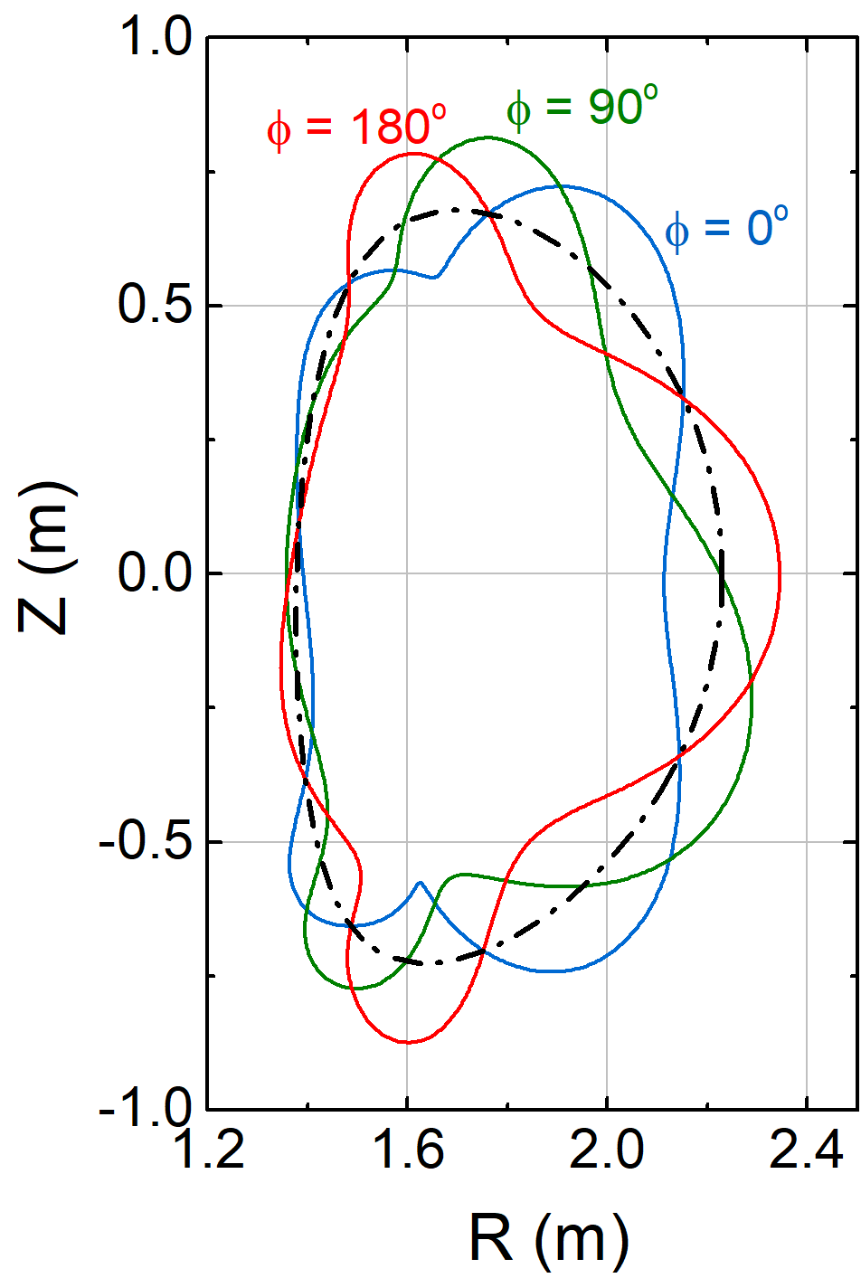
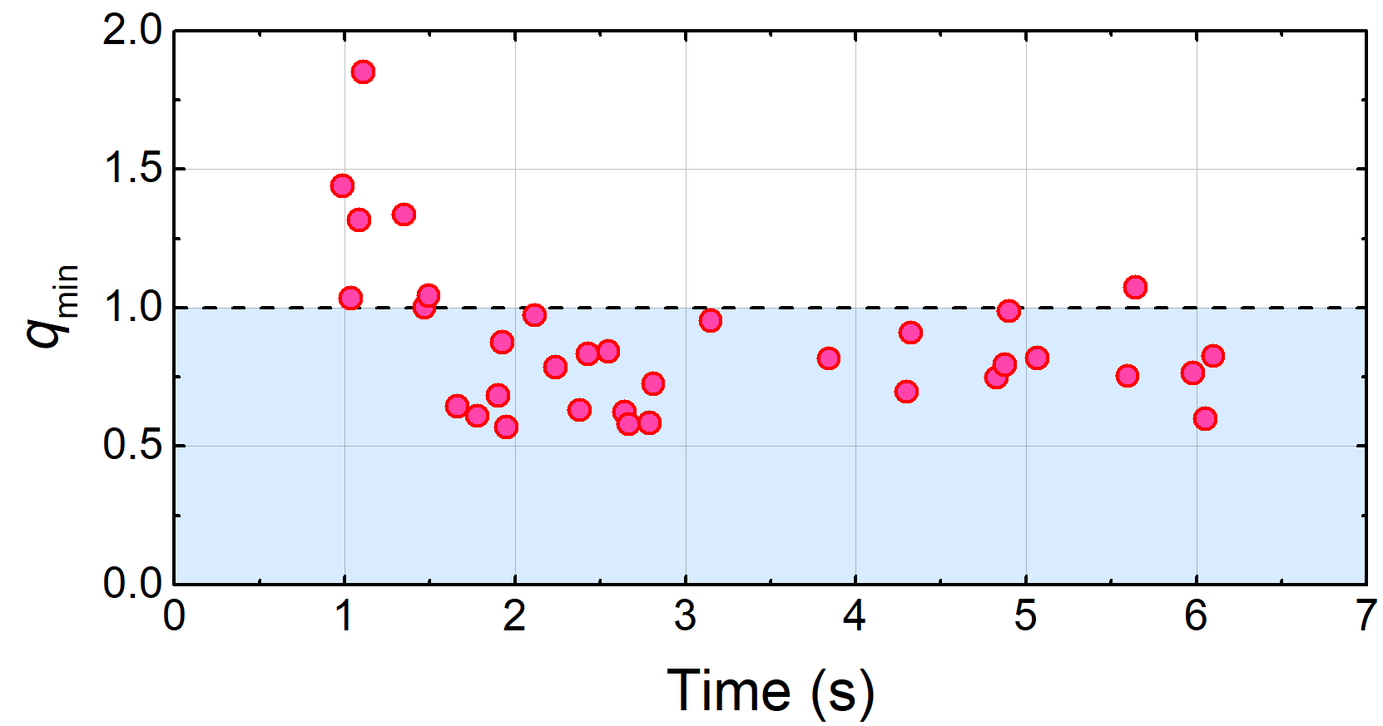
DCON stability calculation shows high β_{N} equilibria are subject to n = 1 ideal instability
KSTAR 16295
High β_{N} equilibria
DCON δW
β_{N} > 3 phase
Unperturbed
boundary
n = 1
β_{N} = 3.2
DCON computed δB_{n} of unstable n = 1 mode at t = 2.356 s
High β_{N} equilibria
q_{min} (w/ MSE)
At observed high β_{N} phase, DCON calculates unstable n = 1 mode with no-wall (β_{N} > β_{N} ^{no-wall})
q_{min} mostly stays below 1 which supports a potential 2/1 mode triggering by sawteeth
DCON computed no-wall δW and EFIT q_{min} in high β_{N} equilibria of shot 16295
A.H. Glasser, Phys. Plasmas 23 (2016) 072505

Slide 8
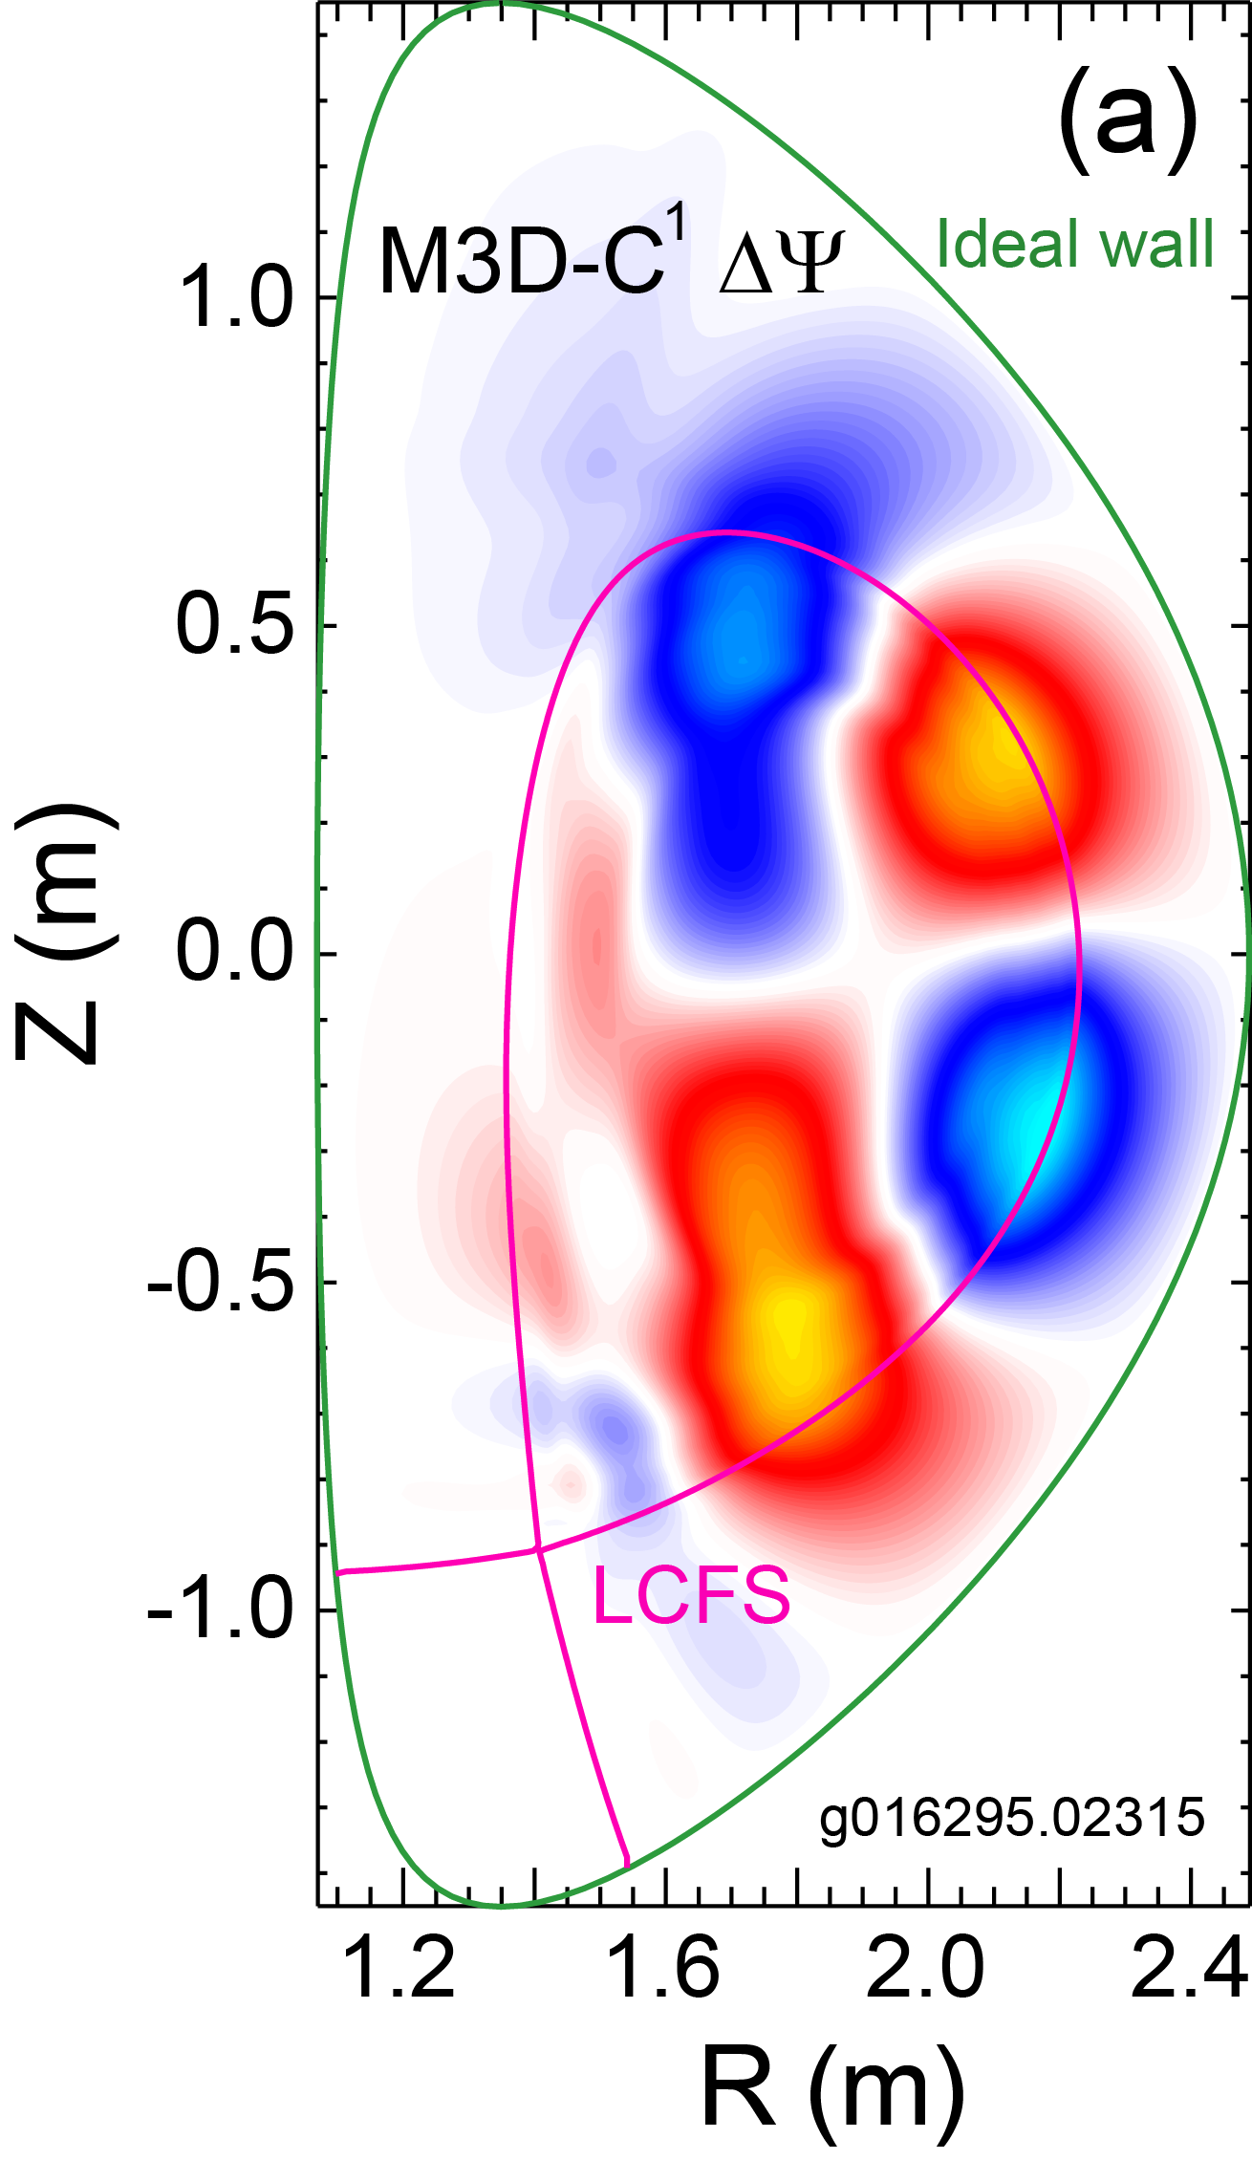
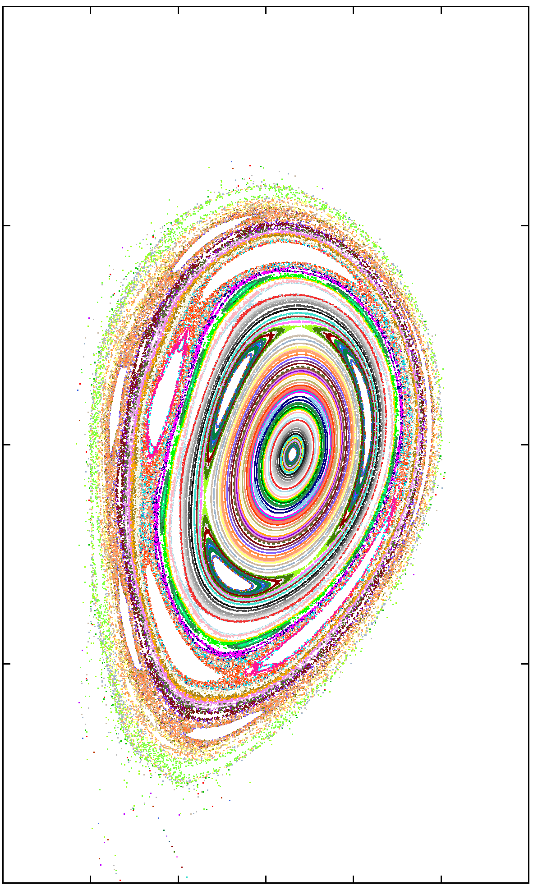
Ideal mode stability computed by M3D-C¹ code shows consistent result with DCON
KSTAR 16295
Ideal mode unstable (γ > 0) in M3D-C¹
Linear stability of ideal mode computed by using resistive MHD code M3D-C¹
Extended MHD code solving two-fluid resistive MHD equations
The high β_{N} equilibrium is computed to be unstable by M3D-C¹ consistent with DCON
Kinetic RWM stability can explain the observed RWM stable operation at β_{N} > β_{N}^{no-wall}
1.0
M3D-C¹
(b)
0.5
Z (m)
0
-0.5
-1.0
1.2
1.4
1.6
1.8
2.0
2.2
2.4
R (m)
(a) The perturbed poloidal flux of unstable ideal mode from M3D-C¹ and (b) corresponding Poincaré plot with exaggerated displacement

Slide 9
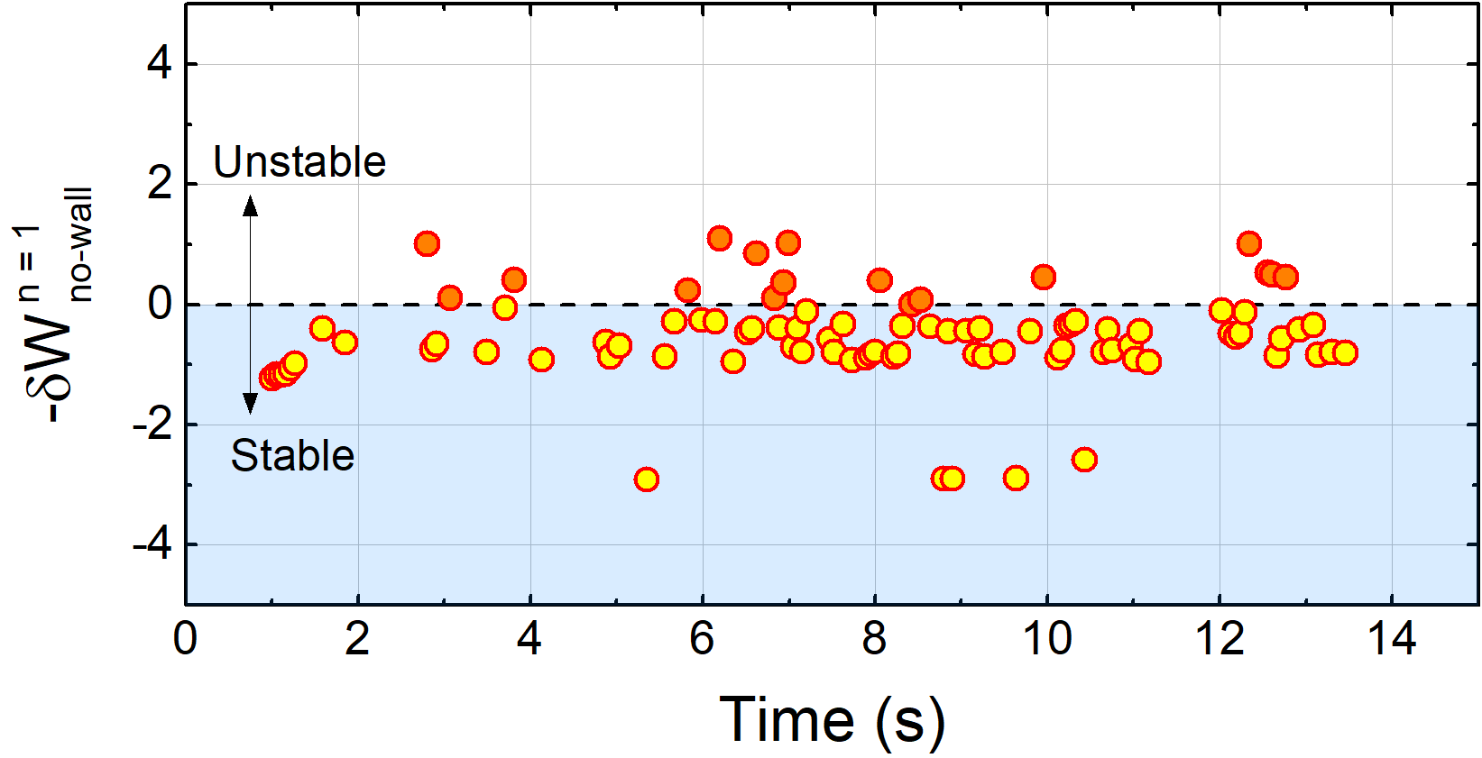
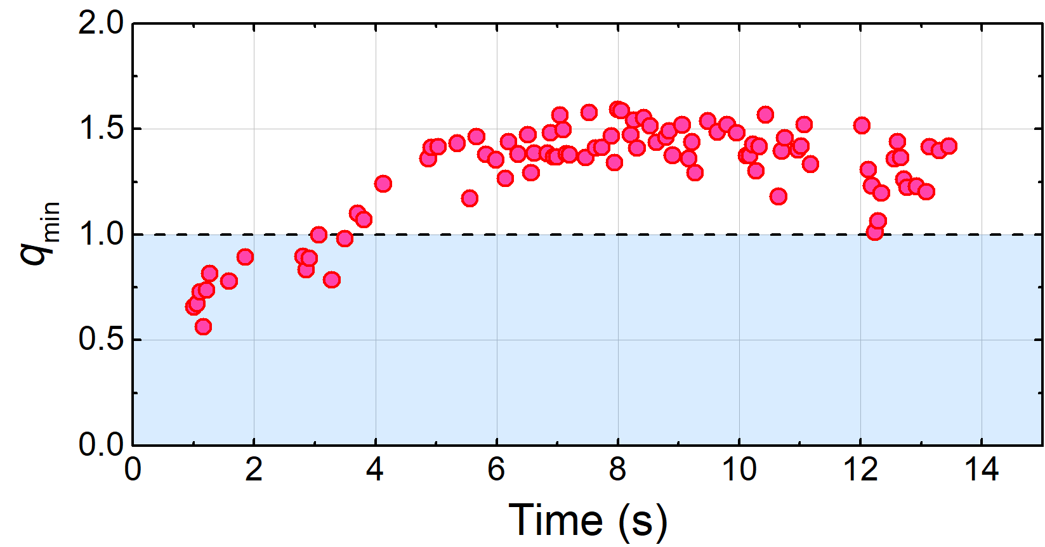
Comparative equilibria with high q₉₅ are stable to n = 1 in DCON
KSTAR 16325
High q₉₅ equilibria
DCON
Unlike the high β_{N} case, equilibria at lower β_{N} is mostly stable to n = 1 ideal modes in DCON
The elevated q-profile at higher B_{T} leads to higher q_{min} above 1
No indication of sawteeth found in the MHD spectrogram
Possible lack of non-linear seeding from sawteeth could improve the neoclassical tearing mode stability
High q₉₅ equilibria
q_{min} (w/ MSE)
DCON computed no-wall δW and EFIT q_{min} in high q₉₅ equilibria of shot 16325

Slide 10
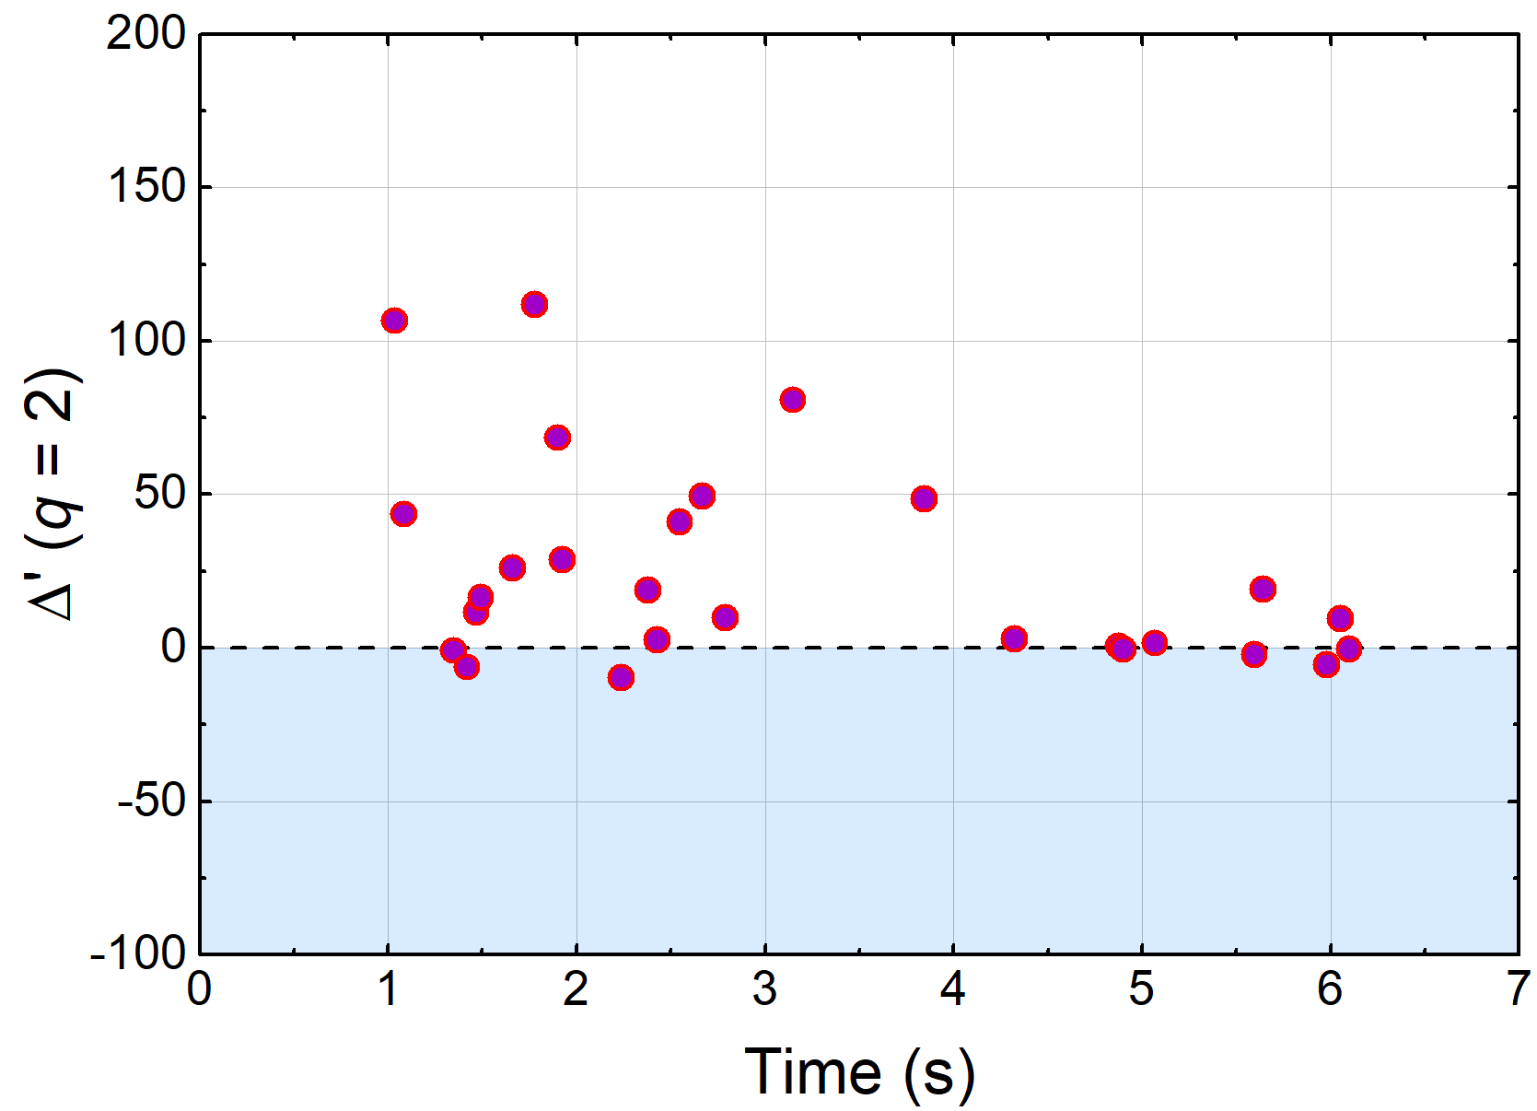
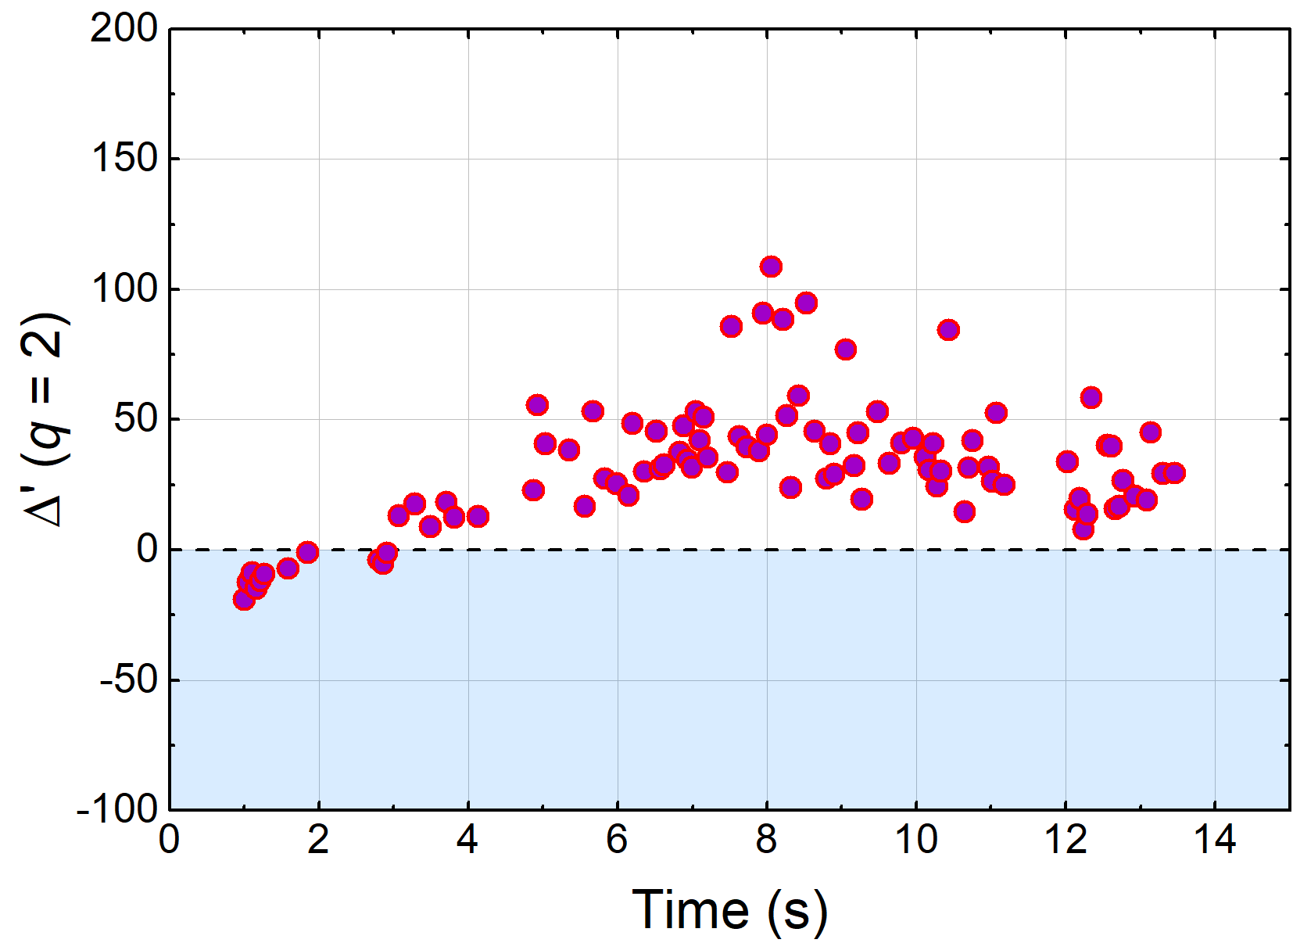
Tearing stability is examined by the resistive DCON code
KSTAR 16295
KSTAR 16325
High β_{N} equilibria
R-DCON $Δ′$
High q₉₅ equilibria
R-DCON $Δ′$
Resistive DCON is used to compute the tearing stability index, Δ′, at q = 2 surface by using the outer layer solutions
Δ′ which is mostly positive in the target equilibria predicts unstable tearing mode, and explains the importance of the neoclassical effects in the observed stability
A.H. Glasser, et al., Phys. Plasmas 23 (2016) 112506

Slide 11
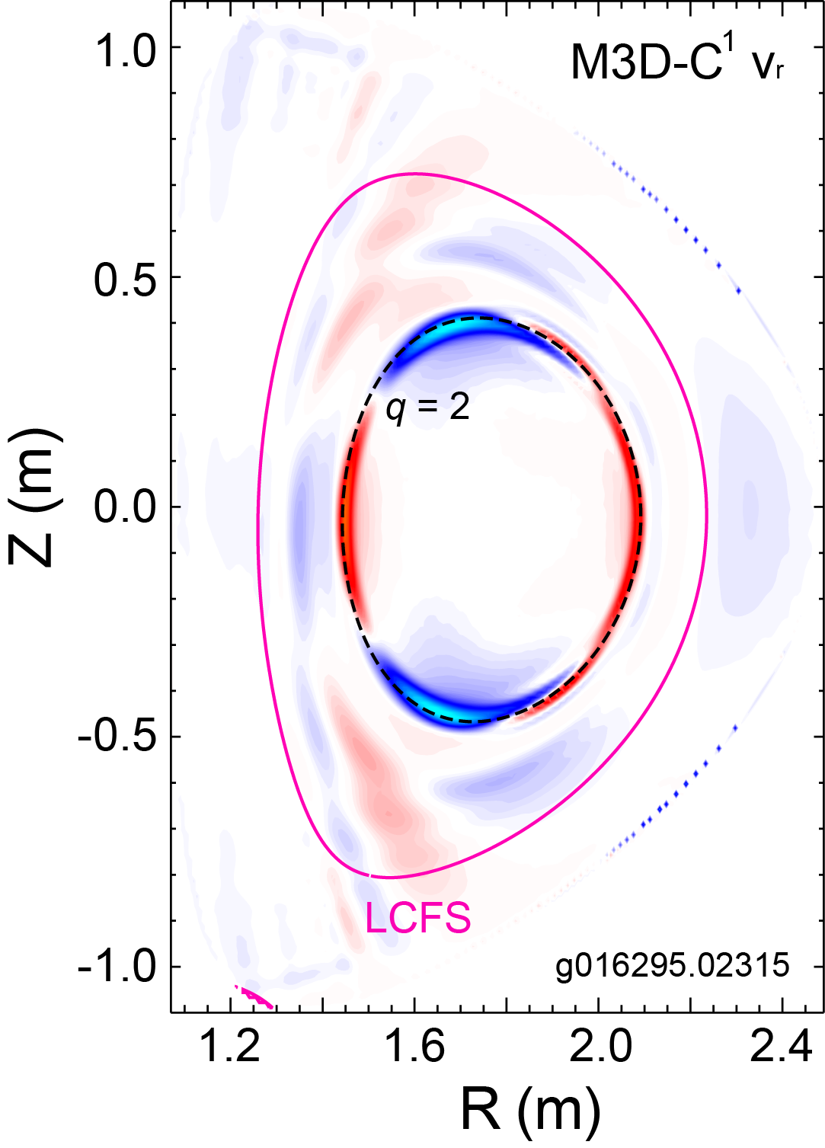
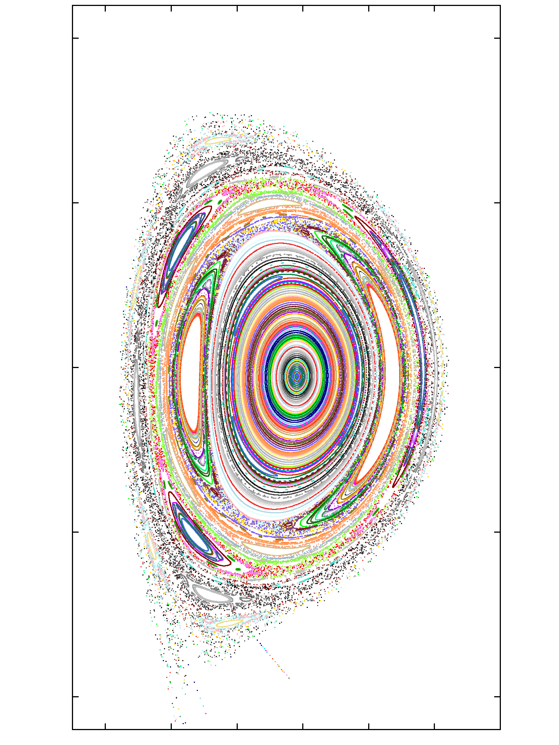
Resistive 2/1 tearing mode stability of high β_{N} equilibria
examined by using M3D-C¹
2/1 tearing mode stable
(γ < 0) in M3D-C¹
KSTAR 16295
Linear stability of the observed 2/1 tearing mode computed by M3D-C¹
Used experimental equilibrium and measured T_{e} profile from TS diagnostic for the input resistivity
Increased resolution around the mode rational surface using the adaptive meshing
The 2/1 tearing mode is marginally stable in M3D-C¹
Unstable experimentally
Computed negative mode growth rate
(a)
1.0
(b)
M3D-C¹
0.5
Z (m)
0
-0.5
-1.0
1.2
1.4
1.6
1.8
2.0
2.2
2.4
R (m)
(a) The radial velocity eigenfunction of a 2/1 tearing mode from M3D-C¹ and (b) corresponding Poincaré plot with exaggerated displacement
S.C. Jardin, et al., J. Comput. Phys. 226 (2007) 2146

Slide 12
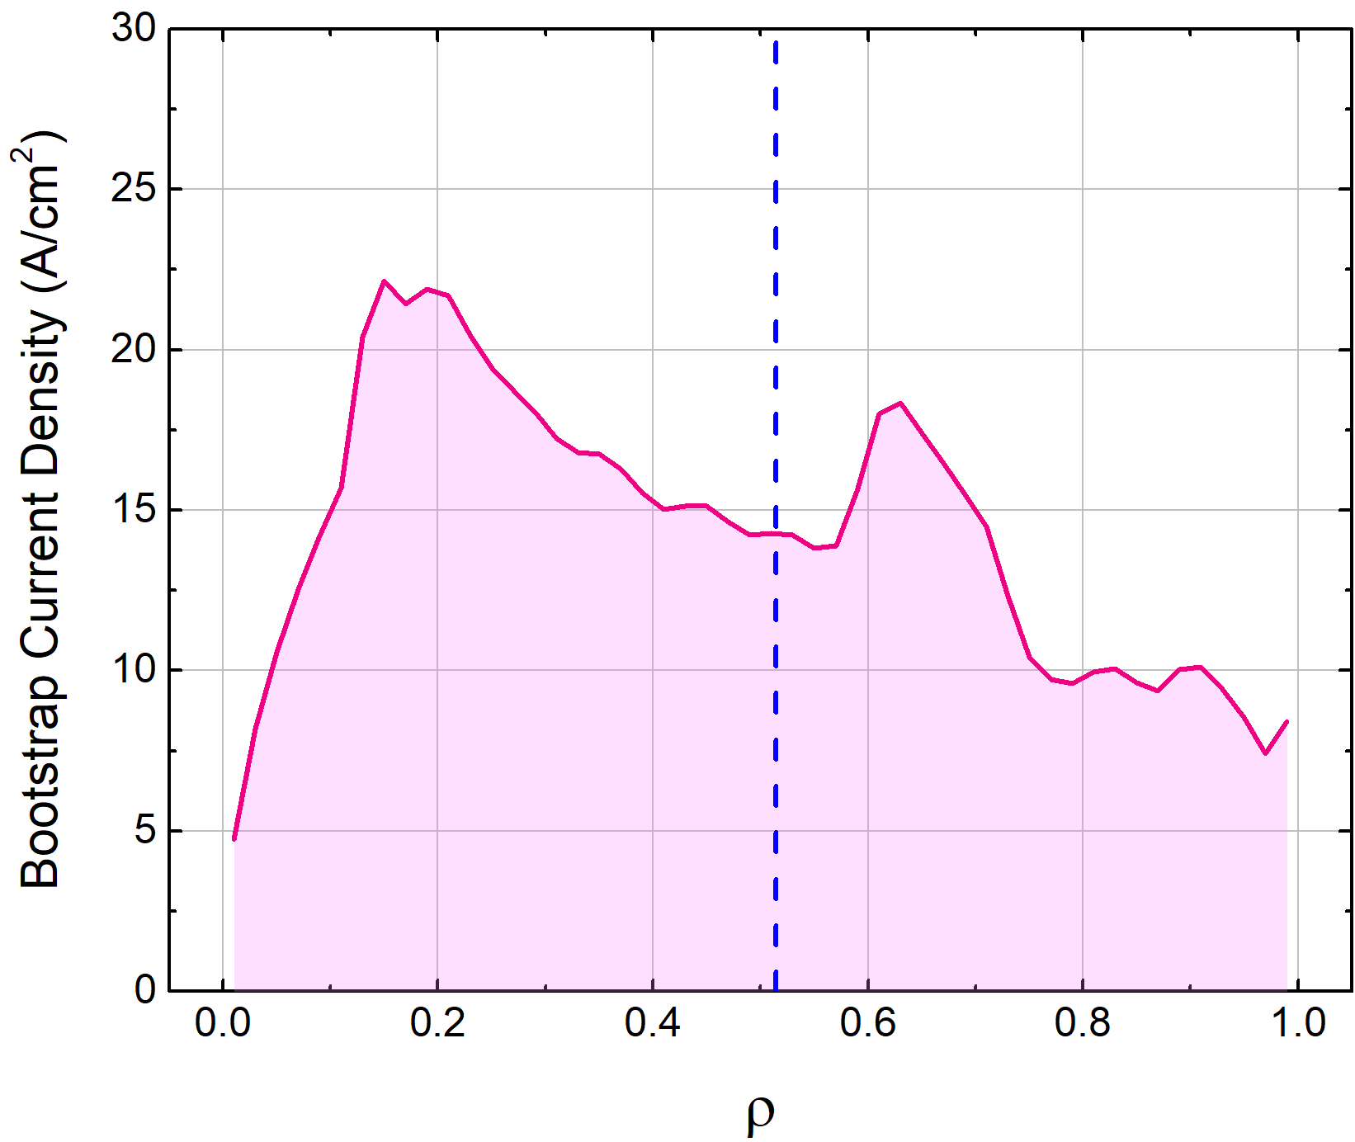
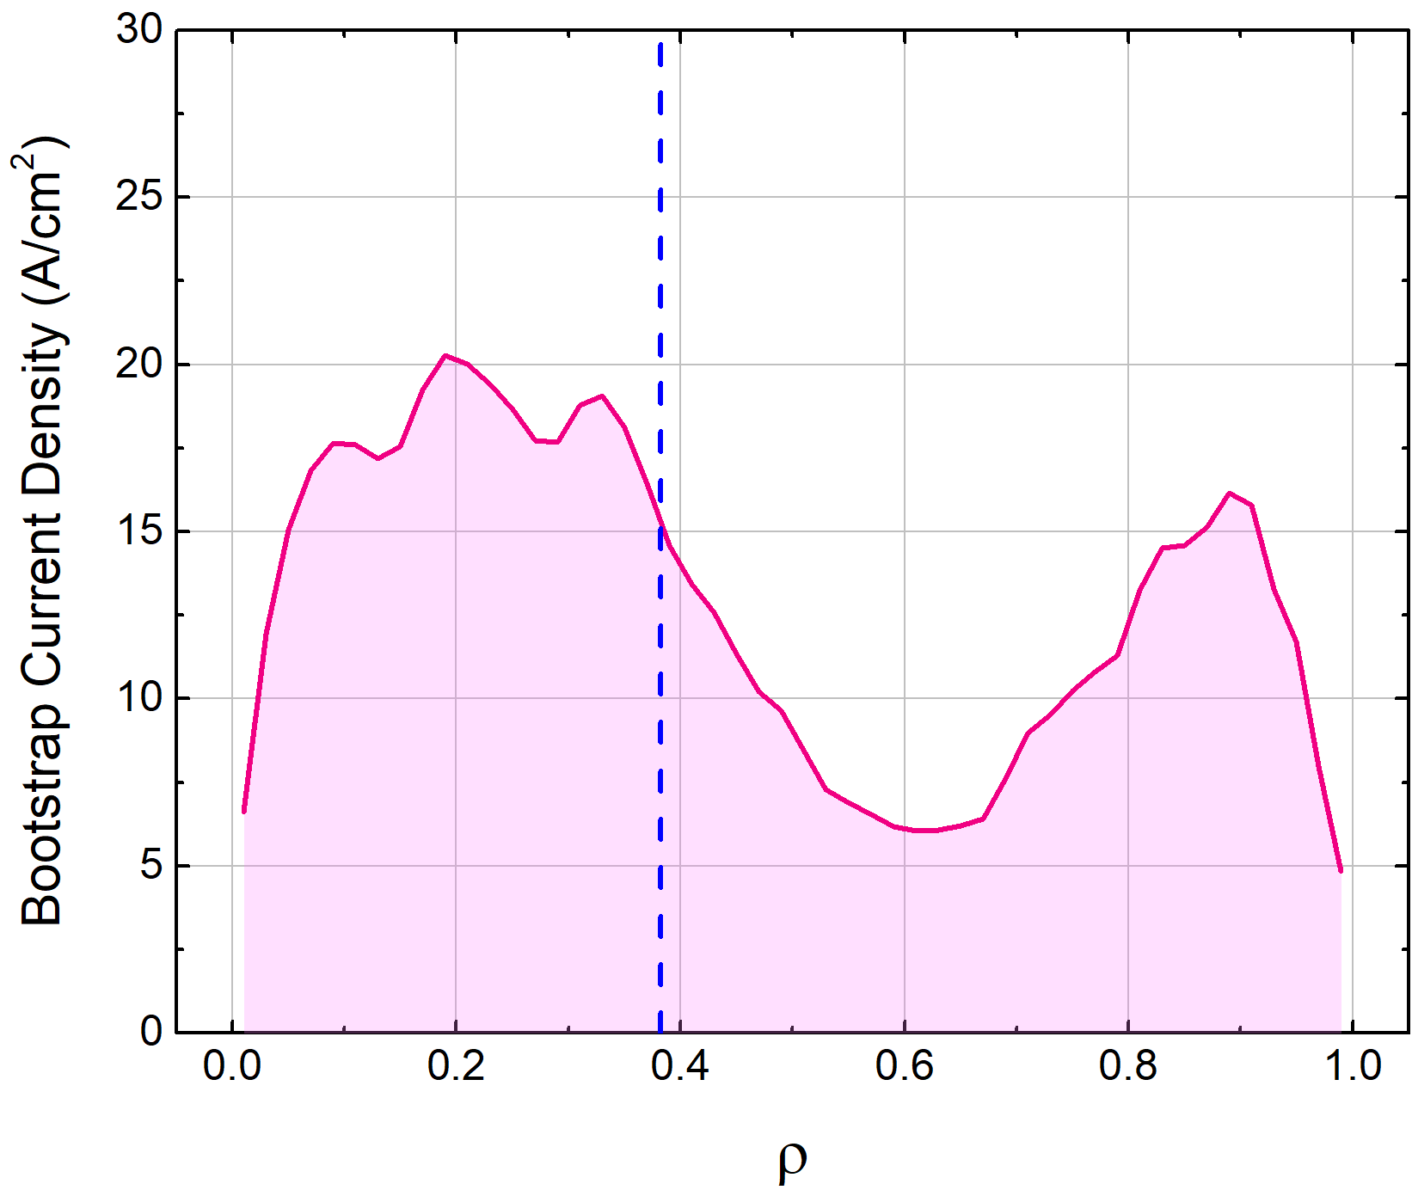
TRANSP analysis examines j_{BS}-profile alignment with tearing rational surface
KSTAR 16295
KSTAR 16325
q = 2
(t = 2.3 s)
High β_{N}
TRANSP j_{BS}
q = 2
(t = 8.3 s)
High q₉₅
TRANSP j_{BS}
Interpretive TRANSP analysis using KSTAR experimental equilibria and measured internal profiles to calculate plasma evolutions especially for the non-inductive plasma current
Bootstrap current profile from TRANSP and q-profile from MSE-constrained EFIT will be used for improved tearing stability analysis including the pressure-driven terms
SEE J.H. Ahn’s talk on 11/29/17

Slide 13
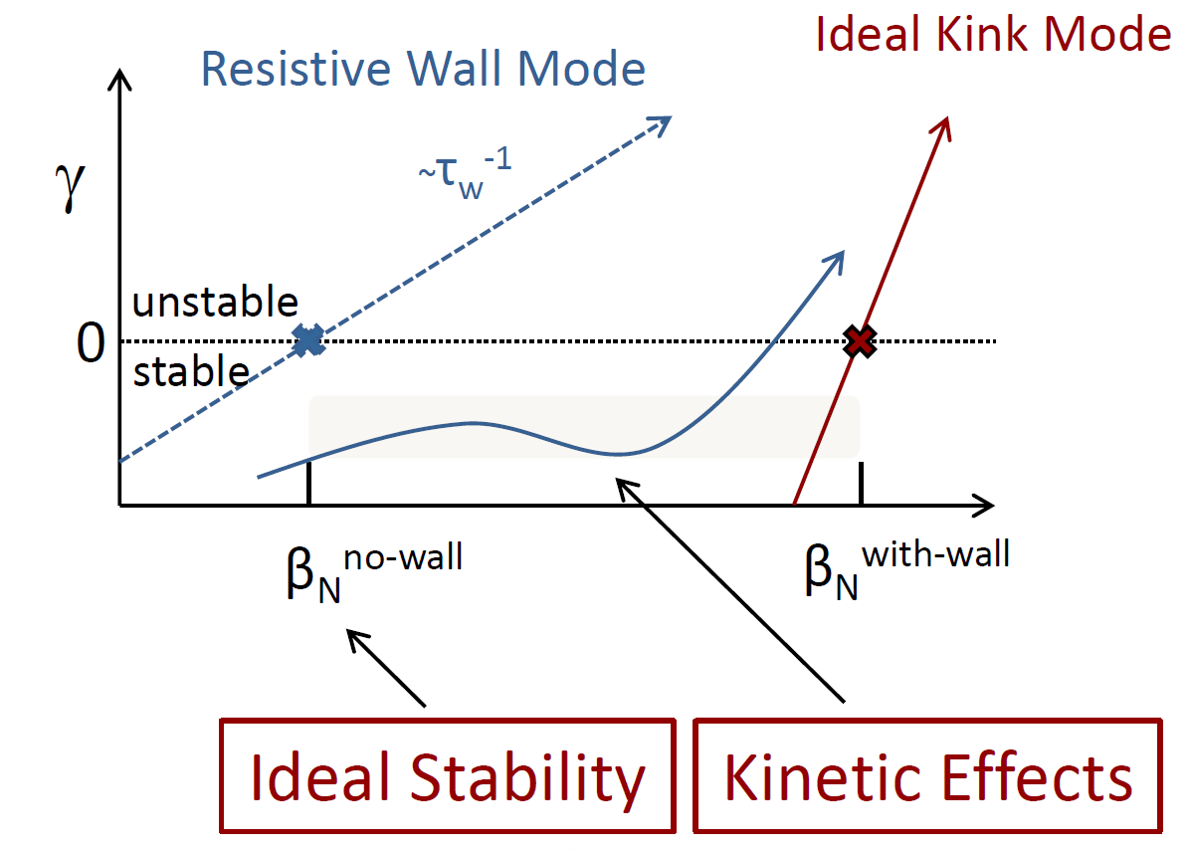
RWM stability evaluated with ideal and kinetic components allows for passive stabilization of the RWM
Kinetic effects modify ideal MHD n = 1 stability (MISK code)
Collisional dissipation
Rotational stabilization
Stability modification depends on
Integrated ω_{φ} profile: resonances in δW_{K}
Particle collisionality
Plasma is stable when rotation is in resonance
l = 0 harmonic : resonance with precession drift frequency
l = -1 harmonic : resonance with bounce frequency
kinetic
modification
B. Hu, et al., PRL 93 (2004) 105002
J.W. Berkery, et al., PRL 104 (2010) 035003
S.A. Sabbagh, et al., Nucl. Fusion 50 (2010) 025020
Trapped ion component (typically dominates Re(δW_{K}))
precession drift
bounce
collisionality
E⨉B
J.W. Berkery, et al., MHD Workshop (2015)

Slide 14
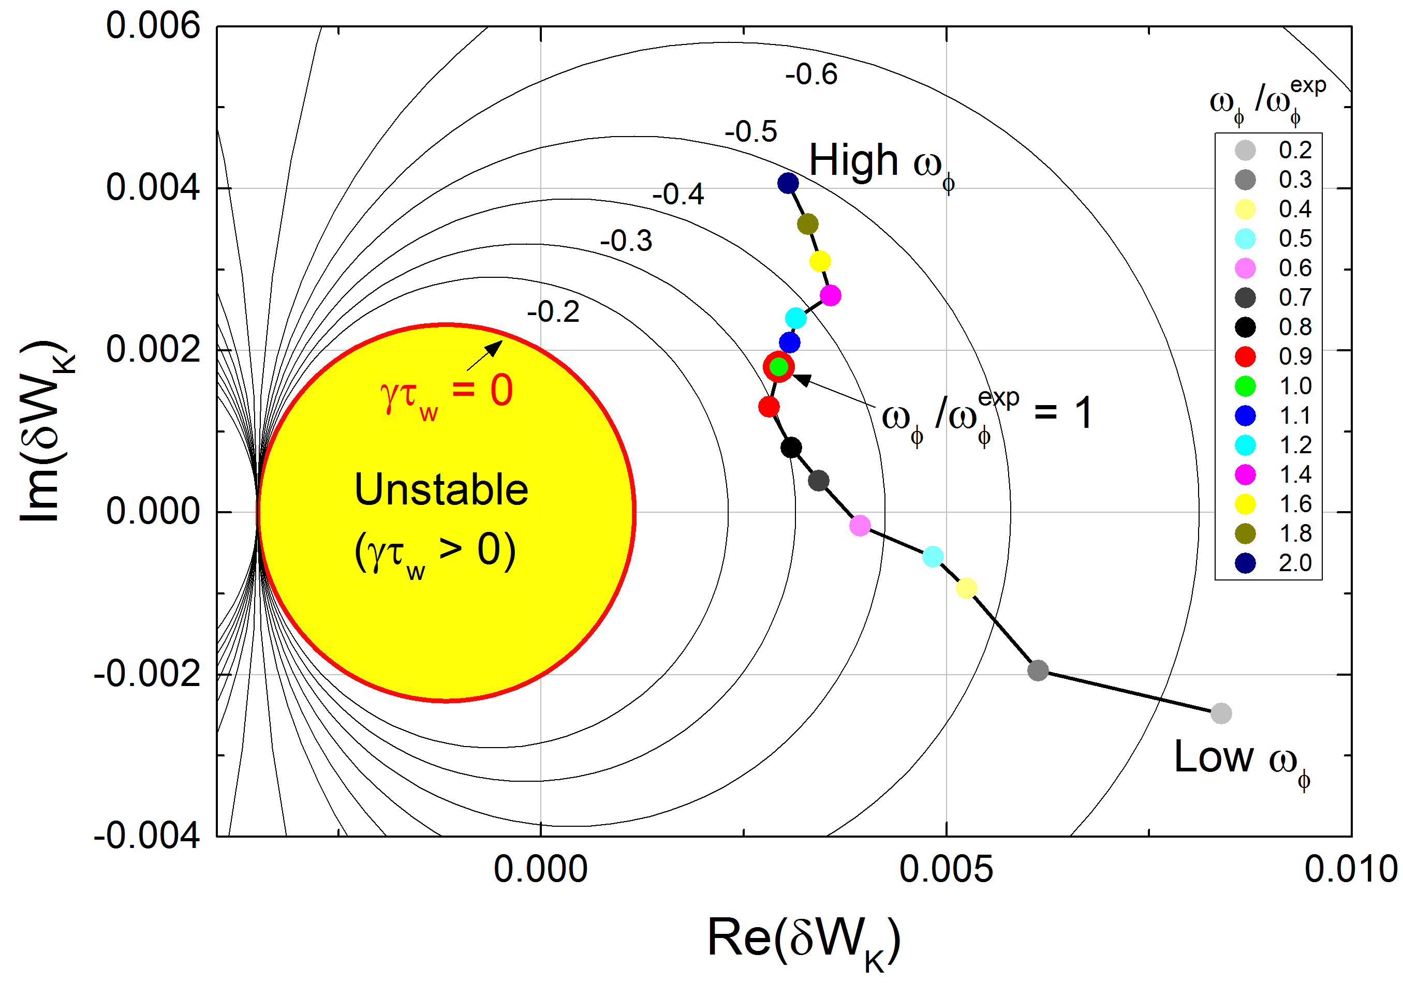
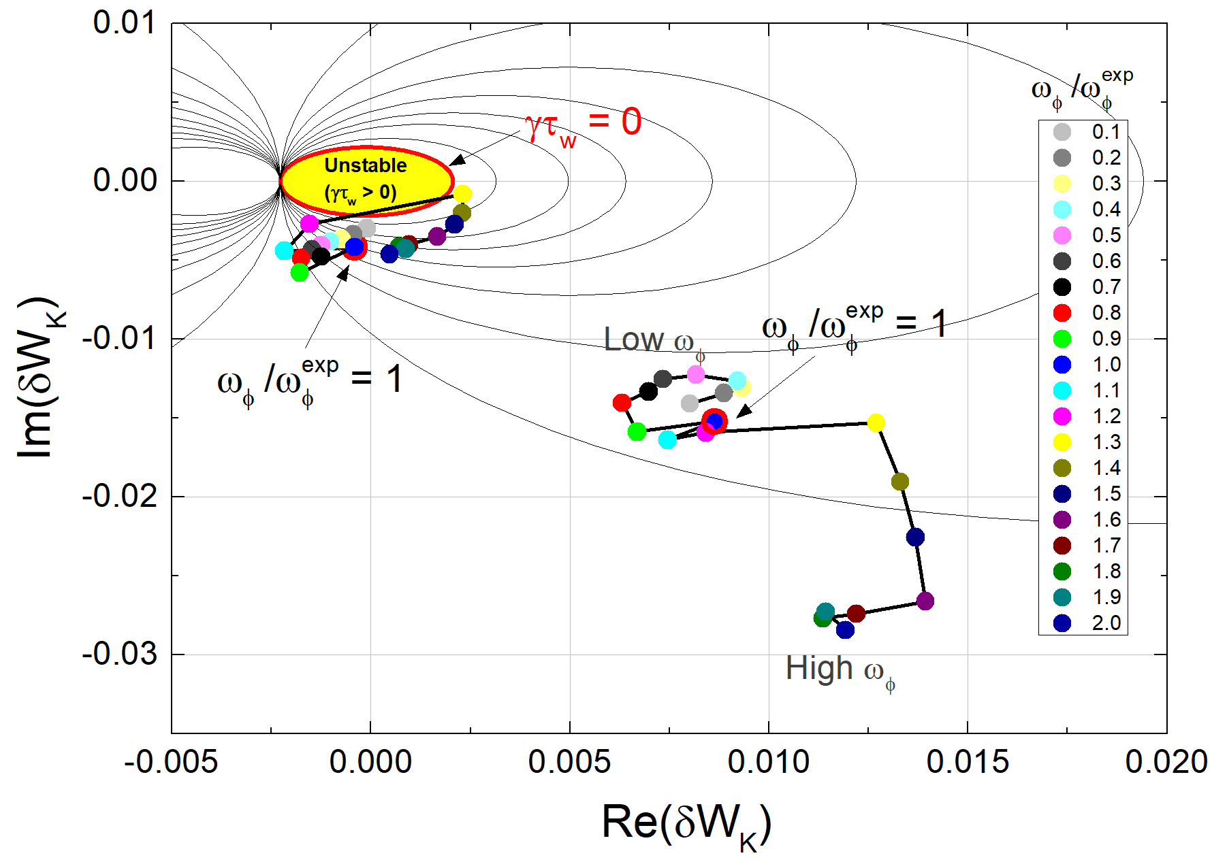
Kinetic modification of RWM stability is evaluated with including energetic particle effects
KSTAR 16295 @ 2.315 s
KSTAR 16325 @ 11.975 s
High β_{N}
MISK δW_{K}
w/o Energetic
particles
Experiment (w/ EP)
Experiment (w/o EP)
Experiment (w/o EP)
w/ Energetic
particles
Stable
(γτ_{w} < 0)
High q₉₅
MISK δW_{K}
n = 1 RWM stability diagram with scaled experimental rotation profiles
MISK calculations find the equilibrium is stable to RWM as is consistent with experiment (rotation profile is scaled from 0.1 to 2 times in the analysis)
Energetic particles are predicted to give a strong stabilizing effect to RWMs
J.W. Berkery, et al., PRL 104 (2010) 035003
Y.S. Park, et al., Nucl. Fusion 51 (2011) 053001

Slide 15
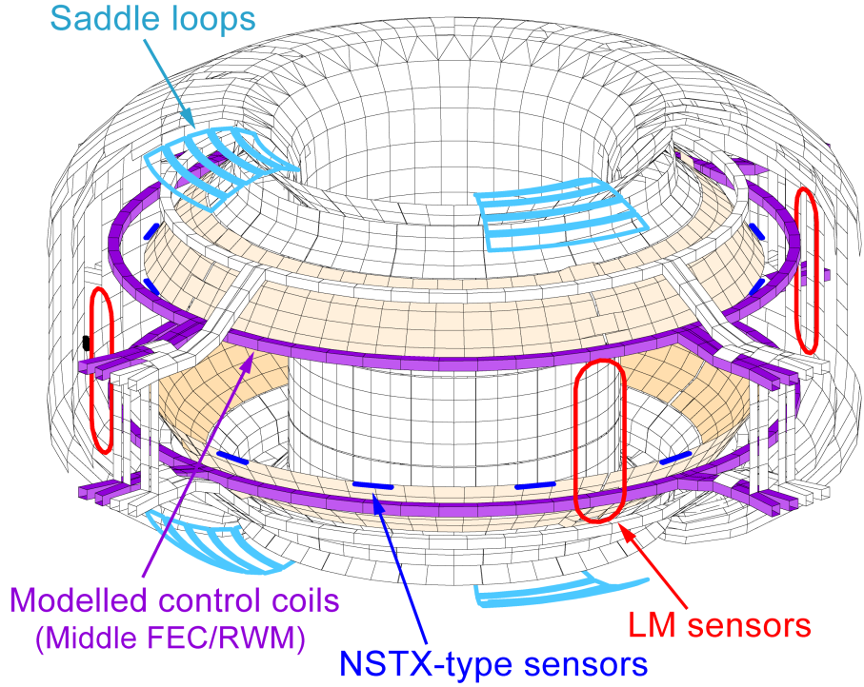
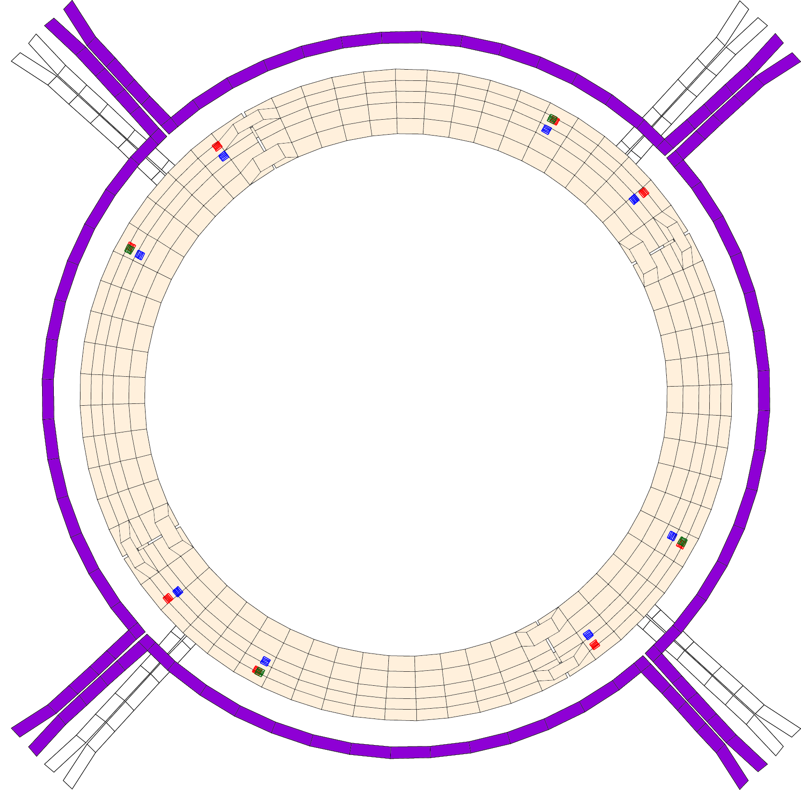
RWM active control system hardware is installed in KSTAR
KSTAR RWM feedback model in VALEN-3D
RWM feedback sensors on passive plates
~8,000 finite elements
RWM sensors
MPZU03 (4 sensors)
(R = 2.18 m,
Z = 0.56 m)
28º
MPZU04 (8 sensors)
(R = 2.10 m,
Z = 0.68 m)
322º
49º
298º
φ
Middle-IVCC
RWM control
coils (4 coils)
MPs
118º
229º
208º
142º
MPZL20 (8 sensors)
(R = 2.18 m,
Z = -0.56 m)
Primary RWM control coils
(Middle FEC/RWM)
NSTX-type future RWM
sensors (imaginary)
Y.S. Park, et al., Phys. Plasmas 21 (2014) 012513
<lower passive plate - top view>
For plasma operation at β_{N} > β_{N}^{no-wall}, RWM control system is prepared in KSTAR
The middle in-vessel control coils (IVCCs) minimizes the inductive shielding by the copper passive stabilizing plates during RWM feedback
Three sets of RWM B_{p} sensors with max. 8 toroidal locations (Upper – MPZU03 & MPZU04, and Lower – MPZL20) have been installed on the inner surface of the passive plates total 20 independent B_{p} measurements for RWM identification (f_{sample} = 20 kHz)

Slide 16
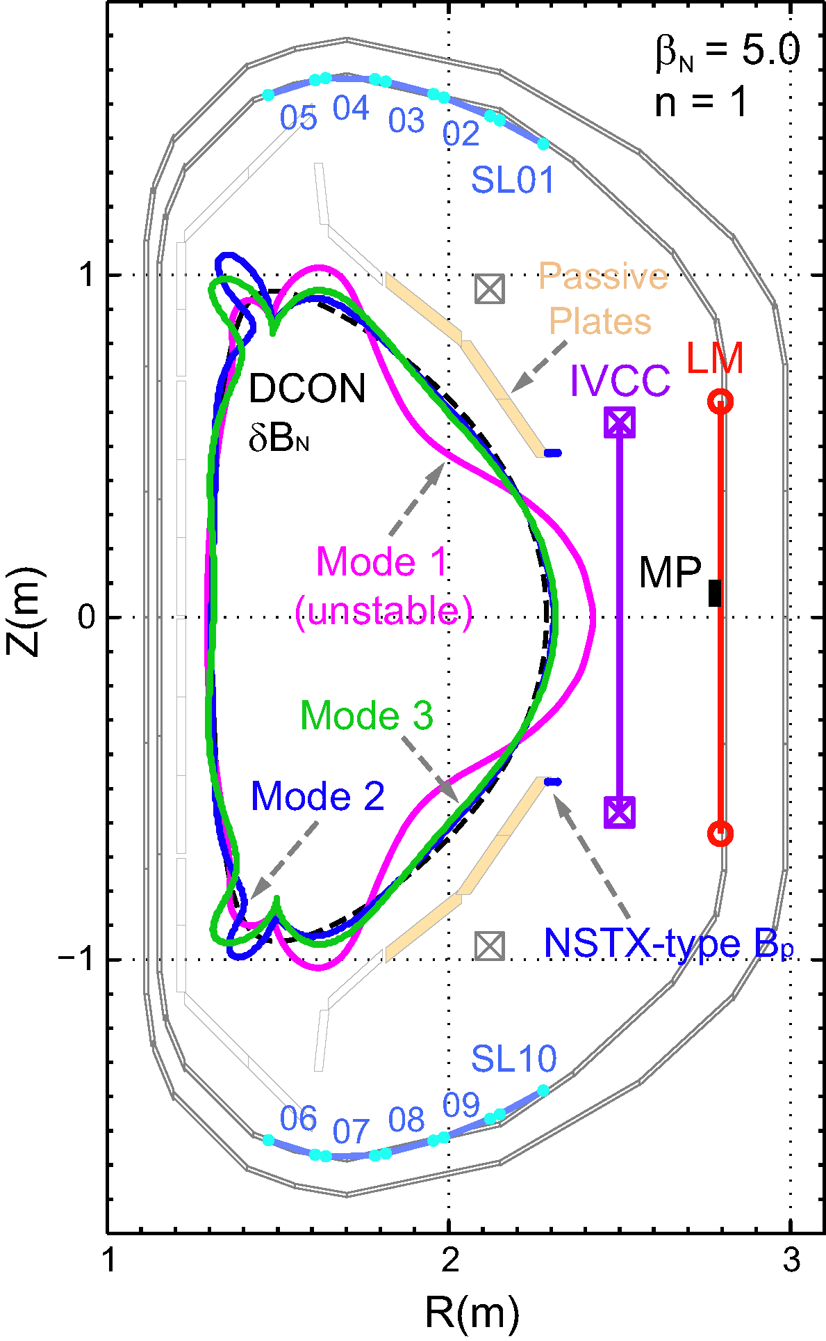
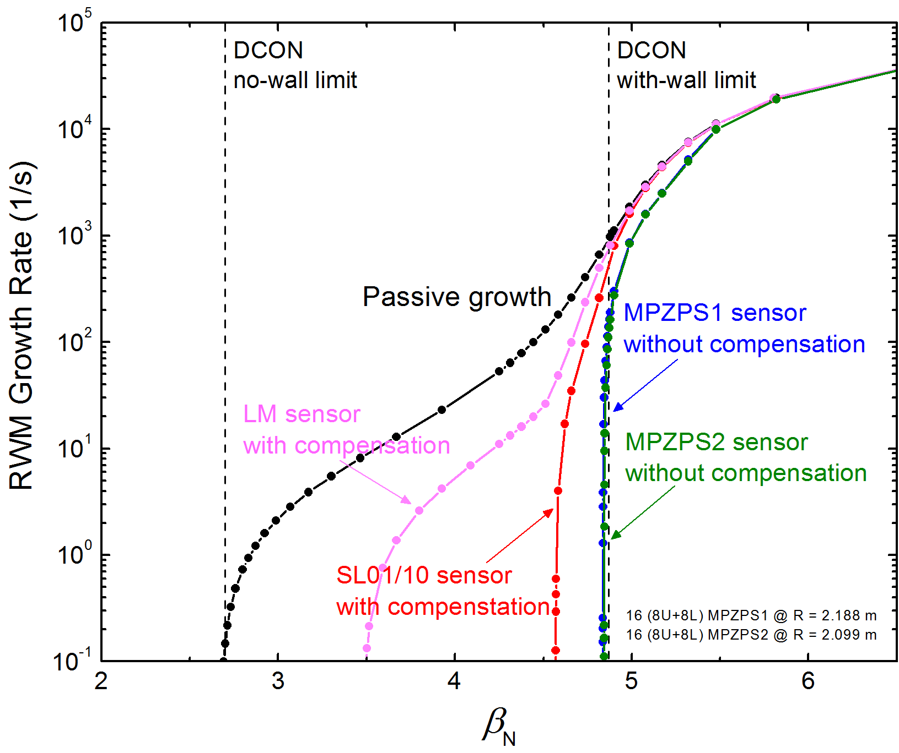
New RWM sensors will give superior control performance over the previous device sensors
SLs
New RWM sensor
performance
New RWM sensors
MPZU03-L20 sensor
w/o compensation
(C_{β} = 37 %)
MPZU04-L19 sensor
w/o compensation
SLs
(C_{β} = 86 %)
MPZU03-L20 (8+8) @ R = 2.188 m
MPZU04-L19 (8+8) @ R = 2.099 m
Y.S. Park, et al., Phys. Plasmas 21 (2014) 012513
RWM control performance of the new RWM sensors
The design advantages of the new RWM sensors result in greater mode control - almost up to the ideal with-wall limit (C_{β} = 98%, β_{N} = 4.8)

Slide 17
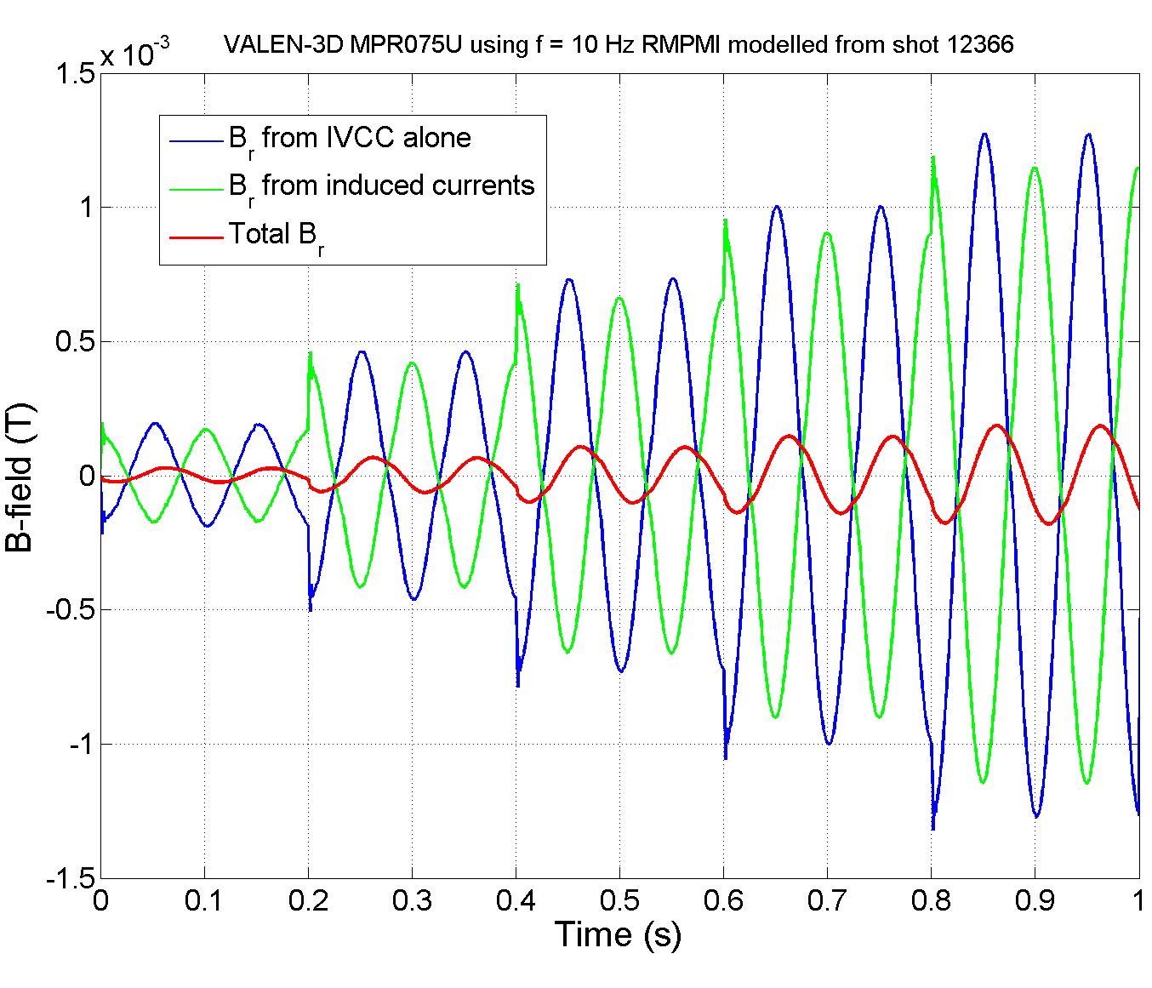
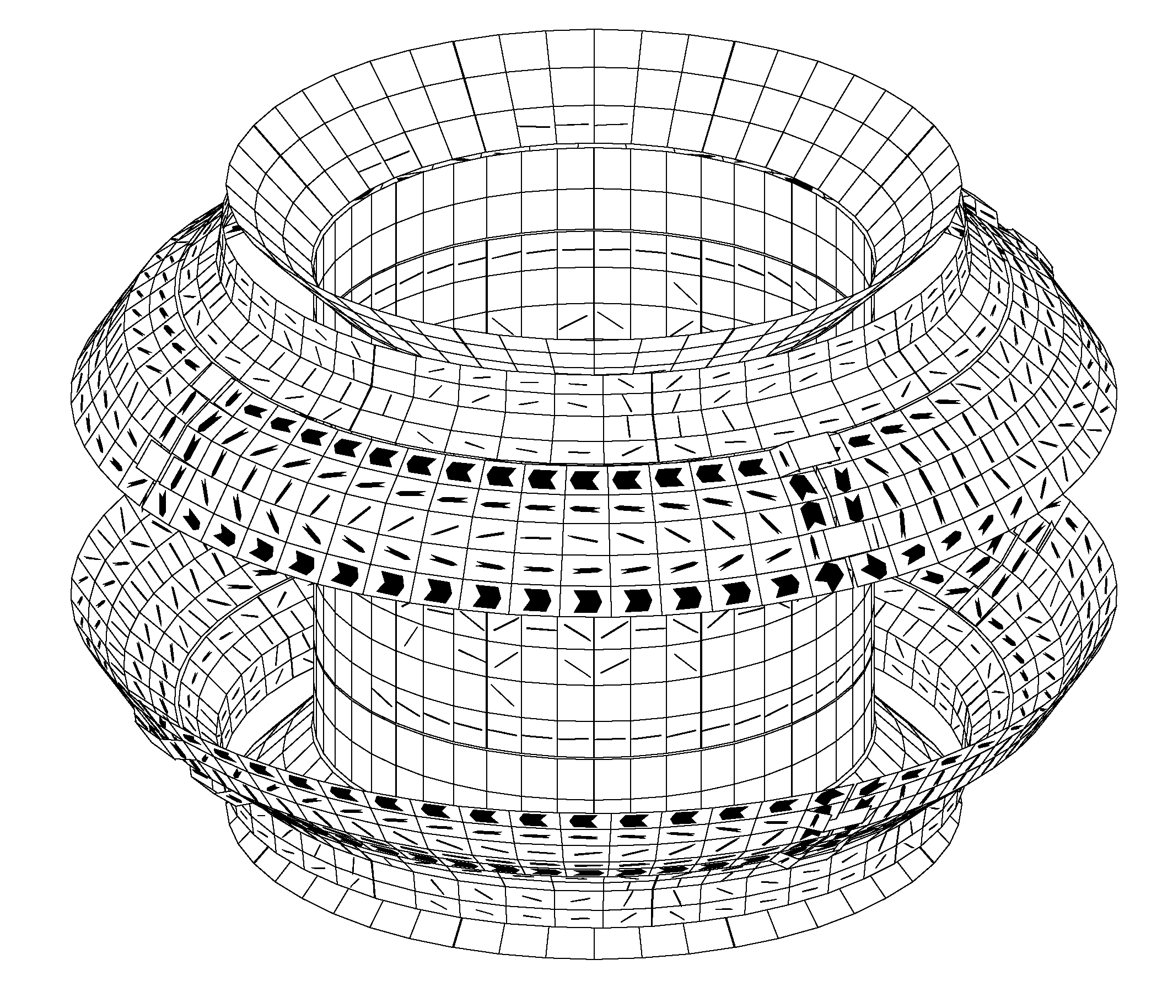
Strong coupling between RWM feedback sensors and passive plates could be detrimental to RWM feedback
15
10
5
0
-5
-10
-15
t = 0.845 s
Magnetic Field (G)
Computed induced currents on the internal passive conductors when 10 Hz n = 1 rotating field is applied from RWM control coils (m-IVCCs)
Time (s)
VALEN-3D computed sensor measurement
Transient effects of the induced currents on the passive plates have been examined by VALEN-3D code
KSTAR passive plates are found to give a significant inductive effect on RWM sensor measurement when RWM coils are activated

Slide 18
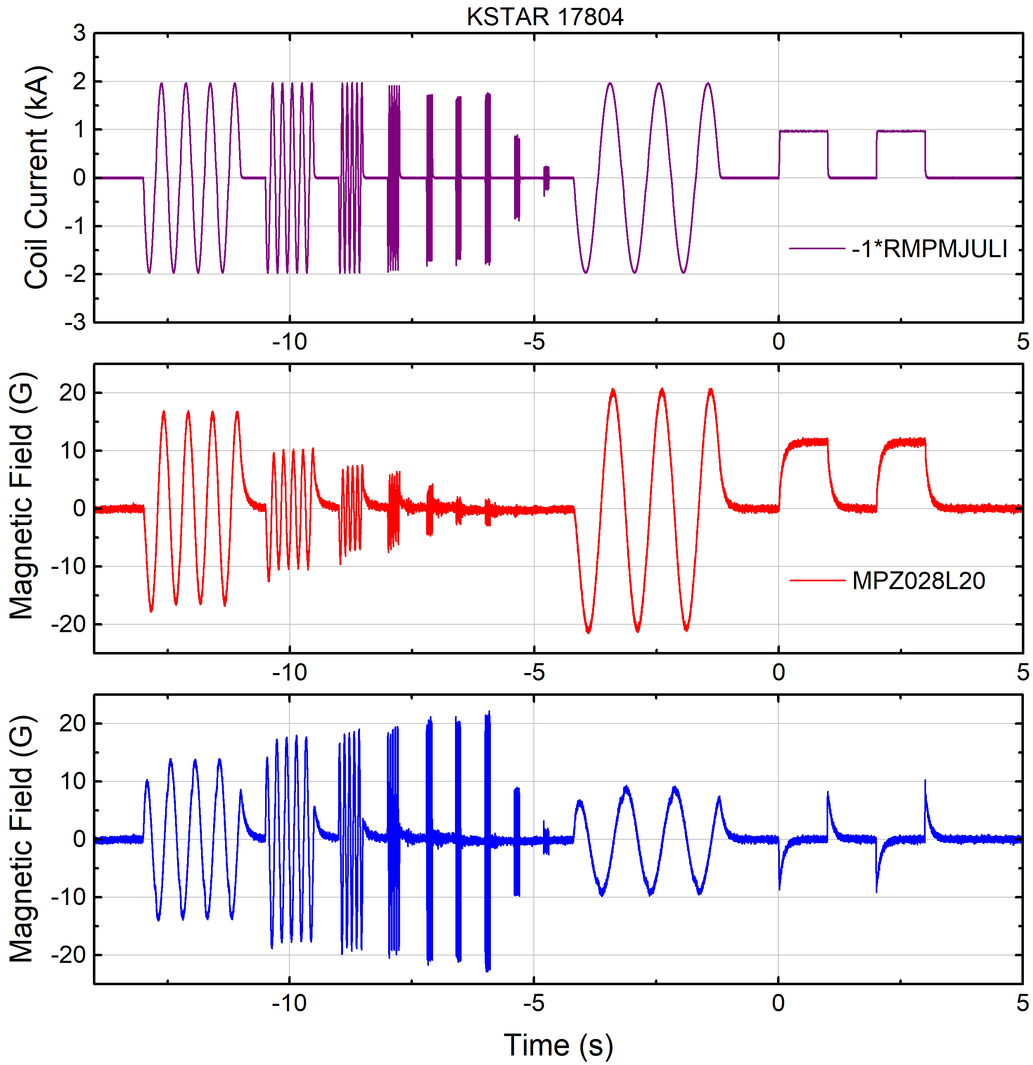
DC sensor compensations for RWM identification
< RWM coil I >
Define the DC-compensated δB:
${ δB}_{COR}$ : corrected$δB$ by base-line subtraction, drift correction
Significant inductive component still remains in δB_{DC} which can be compensated by using either:
- Voltage loops on passive plates (not presently available in KSTAR)
- RWM coil current (dI_{RWM}/dt) as vessel current sources
$${δB}_{DC}={δB}_{COR}−\sum_{j}^{N_{coil}}{M_{j}I_{j}}$$
< Raw δB >
< DC compensated δB_{DC} >

Slide 19
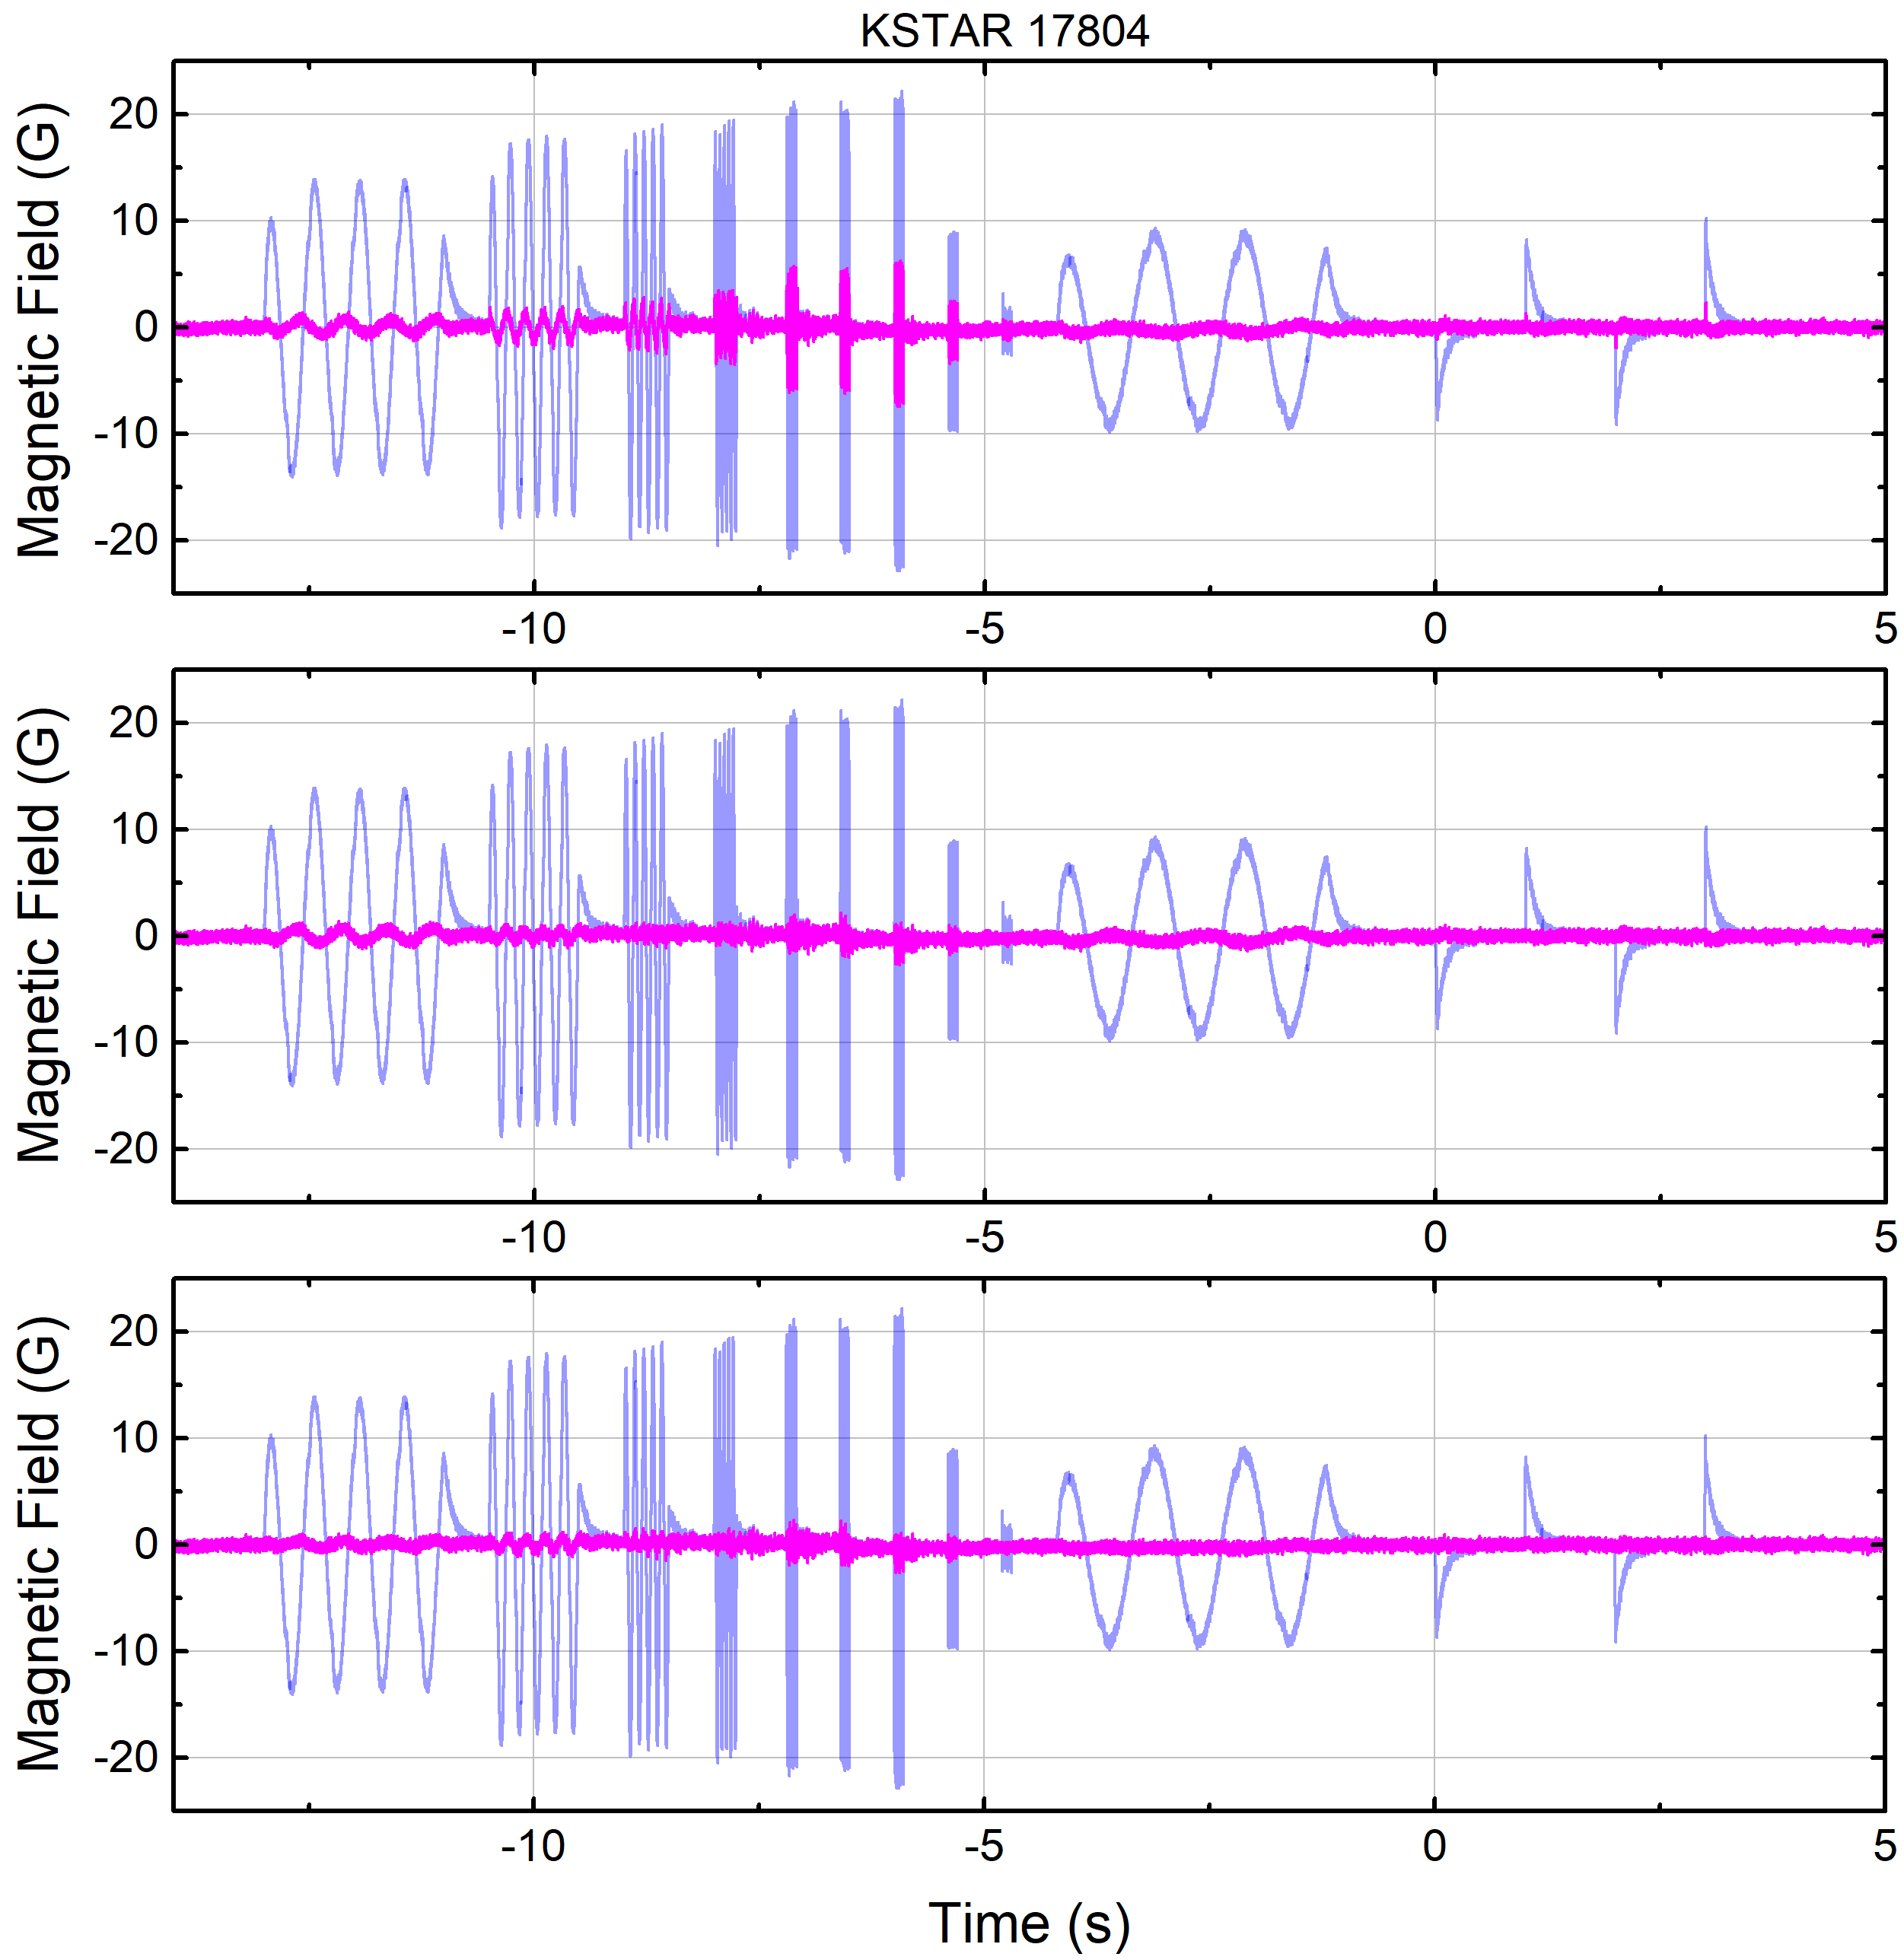
AC sensor compensation can eliminate the remaining δB components after the DC compensations
Similar to NSTX, use low-pass-filtered (LPF) RWM coil currents as the source of the inductive δB
Define the AC compensated δB:
The coefficient matrix p has max. 20 (N_{sensor}) x 12 (N_{coil}) x 3 (N_{τ}) = 720 elements
LPF with 3 different τ values has been tested
Tested τ set well compensates the inductive effect. For the entire RWM sensors, remaining |δB| < 2 G after DC+AC compensations
Remaining after τ₁
δB_{DC}
τ₁ = 92 ms
< δB_{AC} with τ₁ >
$${δB}_{AC}={δB}_{DC}−\sum_{j}^{N_{coil}}{\sum_{k}^{N_{τ}}{p_{j,k}LPF\left(\frac{dI_{RWM,j}}{dt};τ_{AC,k}\right)}}$$
δB_{DC}
τ₂ = 3 ms
Compensated by τ₂
< δB_{AC} with τ₁, τ₂ >
δB_{DC}
τ₃ = 215 ms
Compensated by τ₃
< δB_{AC} with τ₁, τ₂ , τ₃ >

Slide 20
Algorithms for mode identification (mode-ID)
The magnetic perturbation has an amplitude (A_{RWM}) and phase (φ_{RWM})
At the i-th sensor, the measured mode amplitude is:
Combine signals to form an amplitude and phase of the plasma 3D perturbation
Convert the sensor fields at each time point to amplitude and phase
Outputs passed within PCS to RWM feedback algorithms for control current request
Algorithm is presently being implemented in KSTAR PCS for use in 2018
M : mode-ID matrix (20 x 2) for KSTAR

Slide 21
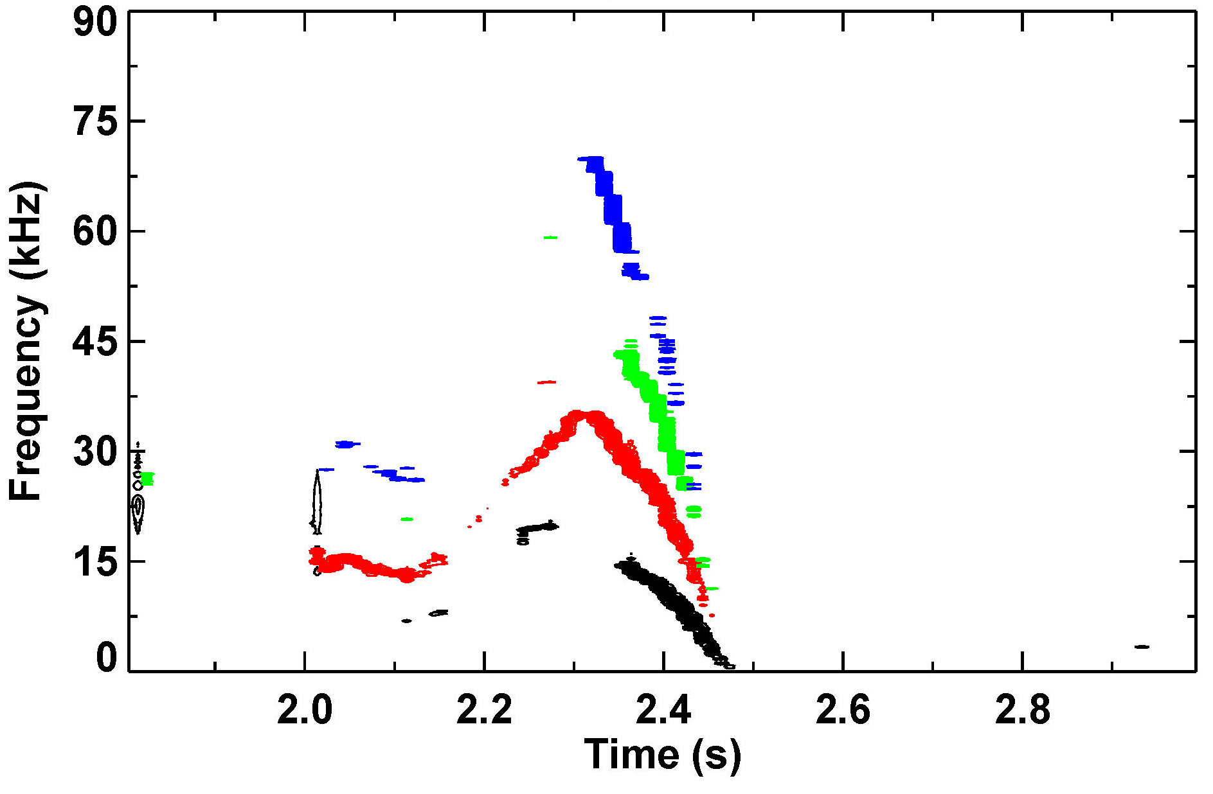
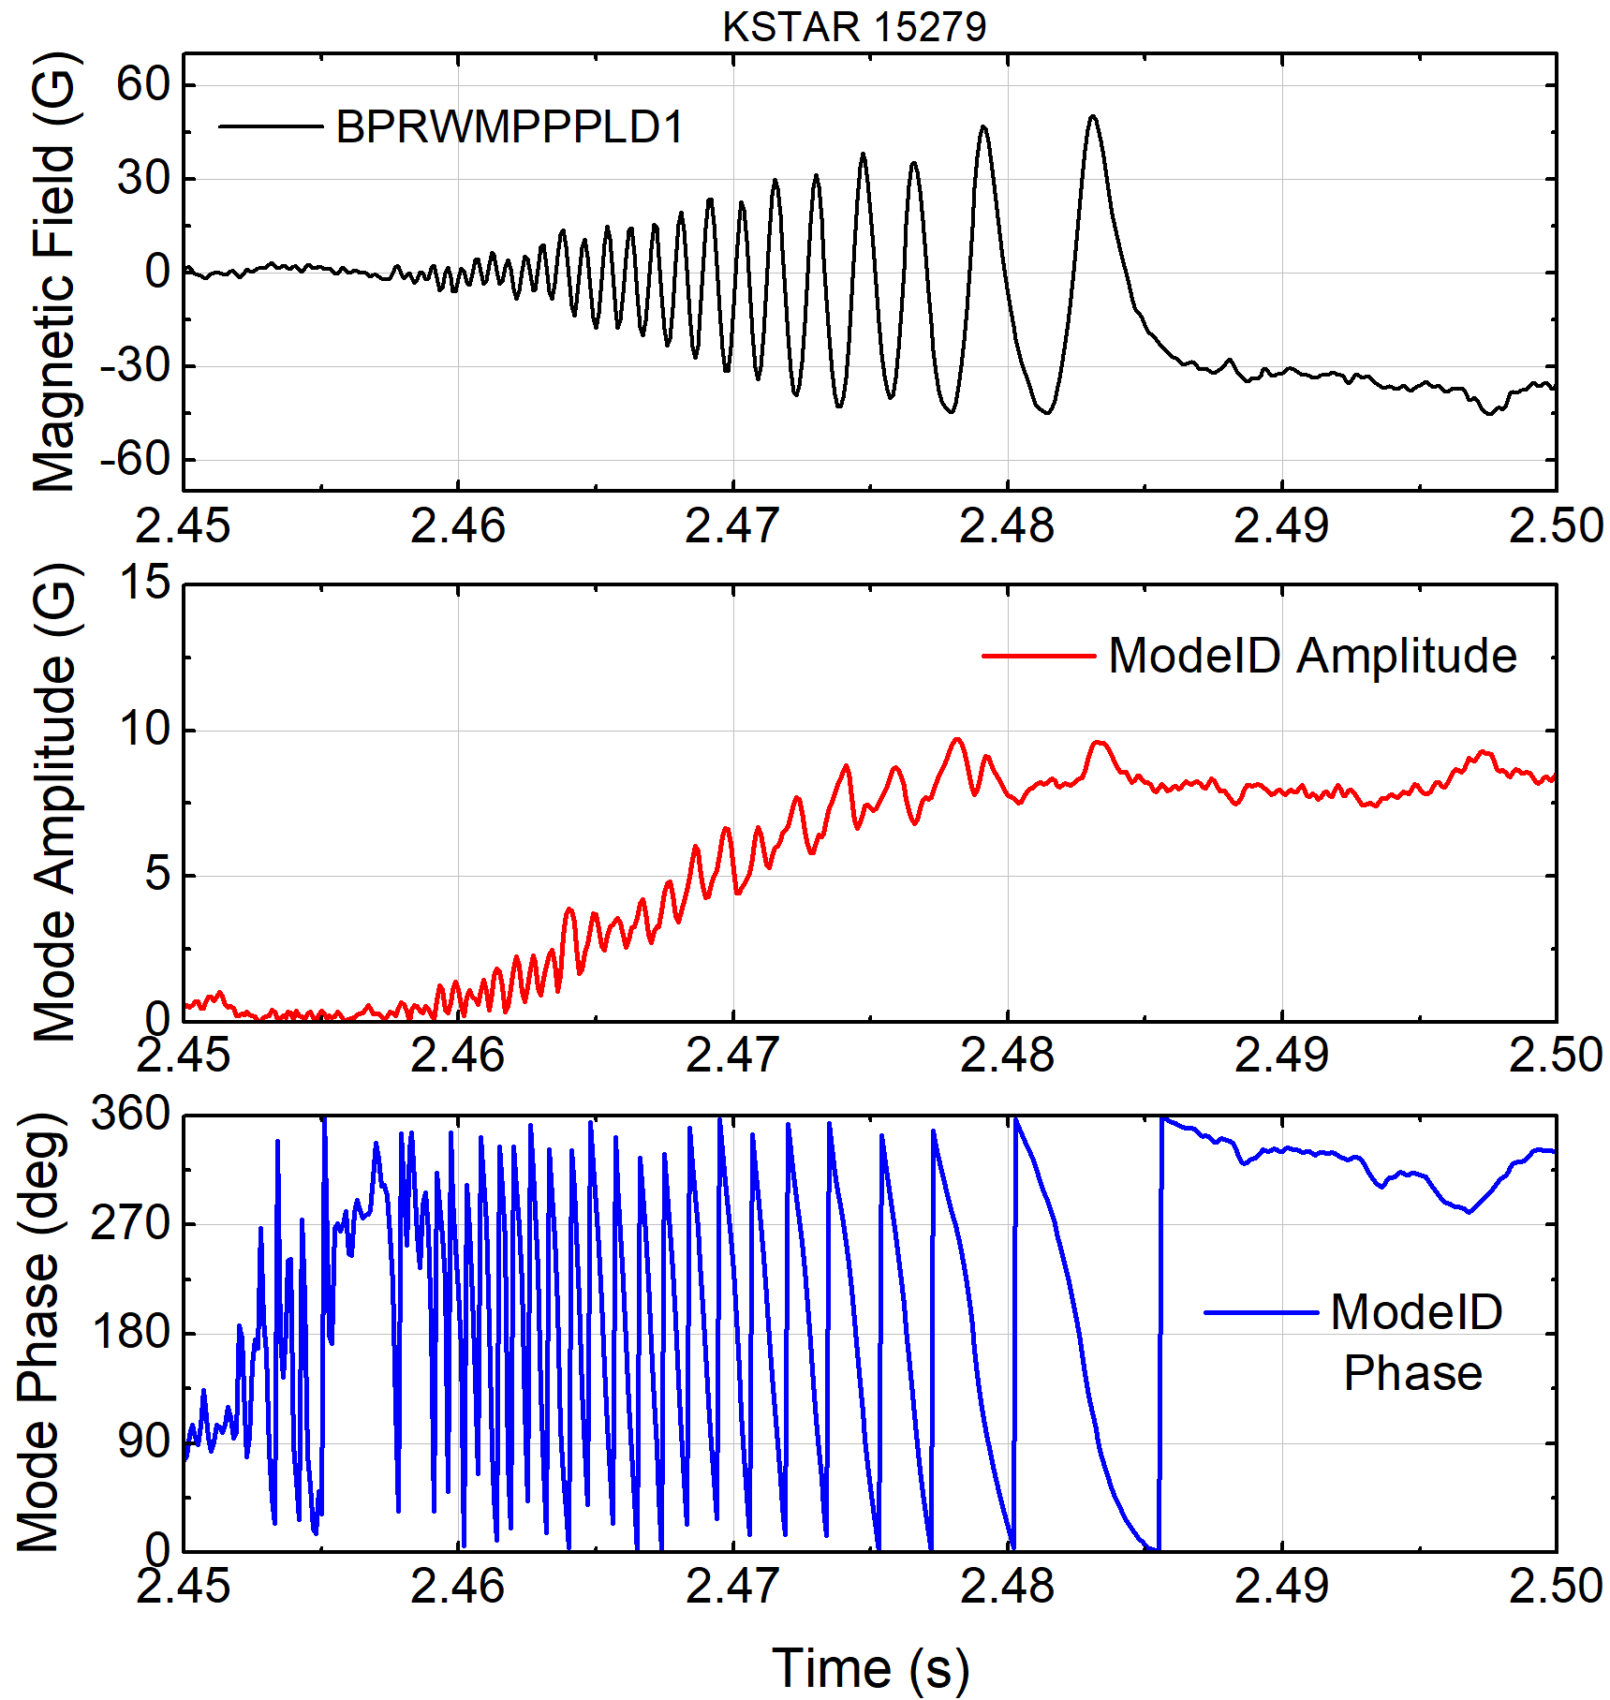
Measured amplitude and phase of slowly rotating MHD mode
KSTAR 15279
Exp. by Y.M. Jeon (NFRI)
Lower B_{p}
difference #1
Mode starts to be
measured by RWM sensors
2/1 mode
locks
Fast Mirnov probe
(f_{sample} = 200 kHz)
Toroidal magnetic probe spectrum and mode amplitude
Measured mode amplitude and phase by mode-ID
Since RWMs have yet to be measured on KSTAR, mode identification has been tested for slowly rotating tearing modes (w/o applied feedback)
Used 10 B_{p} sensor differences (180º opposing sensor pairs) for n = 1 identification
Mode identification well measures the evolution of n = 1 locking tearing mode

Slide 22
Conclusions and Next Steps
KSTAR plasmas have exceeded the predicted ideal n = 1 no-wall limit
Ideal and resistive stability of the achieved high β_{N} is analyzed
Kinetic EFIT with MSE constraints is used for accurate stability analysis
Achieved high β_{N} equilibria are subject to ideal n = 1 mode instability (DCON, M3D-C¹)
Resistive DCON analysis emphasizes the role of the pressure driven effects in the observed tearing stability
Kinetic RWM stability can explain the observed stability at high β_{N} (MISK)
Development of algorithm for RWM identification
Significant δB induced mostly by the passive plate response is well compensated
Next Steps
Improve stability analysis by employing the pressure driven terms calculated by TRANSP, and by further refinement in the kinetic EFIT reconstructions
Implement the developed mode-ID routines into the KSTAR PCS
Attempt experiments in 2018 to improve sustained high β_{N}, and probe MHD stability

