Slide 1

Disruption Modeling with M3D-C1
Nate Ferraro
BC Lyons, SC Jardin, I Krebs, D Pfefferle, Q Teng
NSTX-U Physics Meeting
Aug 6, 2018

Slide 2
M3D-C1 is a Tool for
Integrated Modeling of Disruptions
Goal is to model all stages of a disruption self-consistently with M3D-C1
Linear and nonlinear evolution of MHD instabilities
Interaction of displacing plasma with surrounding conducting structures
  Eddy currents, Halo currents, forces on vessel and coils
Impurity radiation, ionization, and advection
Models for pellet ablation
Runaway electrons
New!
Newer!
Future!

Slide 3
Single-Fluid Model with Impurities
Used for Disruption Simulations
Equations generalized to allow n_{e} / n_{i} to vary in space in time
Single-fluid model assumes u_{e} = u_{i} = u_{z}
Separate equations for T_{i} and T_{e}
All ions (main & impurities) assumed to have same temperature T_{i}
main ion density
total force balance
Faraday’s law
impurity charge state density

Slide 4
Resistive Wall and Open Field-Line Region
Are Included In M3D-C1 Mesh
Three regions of mesh
  Extended-MHD
  Resistive Wall (E = η_{wall} J)
  Vacuum (J = 0)
Walls of arbitrary thickness and resistivity are allowed
Currents into and out of wall are allowed (halo currents)
Open field-line region modeled as a low-temperature plasma
(R,φ,Z) coordinates
  No problems with x-point or large changes to magnetic geometry
XMHD
RW
Vacuum
Superconducting
Wall
Ferraro, et al. Phys. Plasmas 23, 056114 (2016)

Slide 5
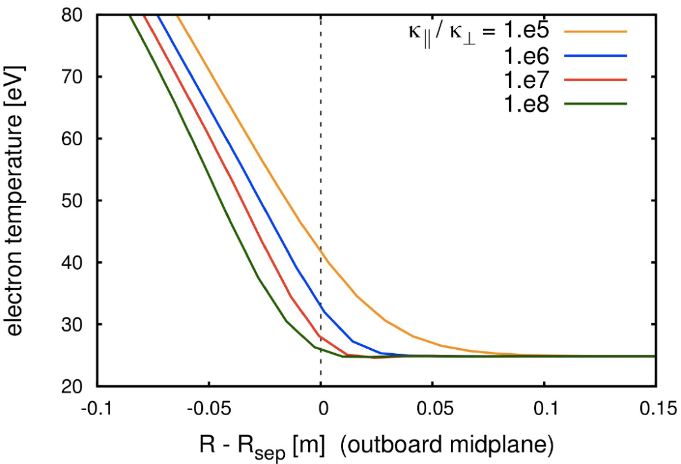
SOL Width Is Determined By Heat Flux Anisotropy
In most 2D disruption models, SOL width is free parameter
  “halo width”
In M3D-C1, SOL width is determined by κ||/κ
VDE growth rate and Halo current distribution are affected by this!
  Kinetic modeling will be needed for first-principles understanding
Wall temperature is a boundary condition, so SOL width determines T_{sep}

Slide 6
VDE Modeling

Slide 7
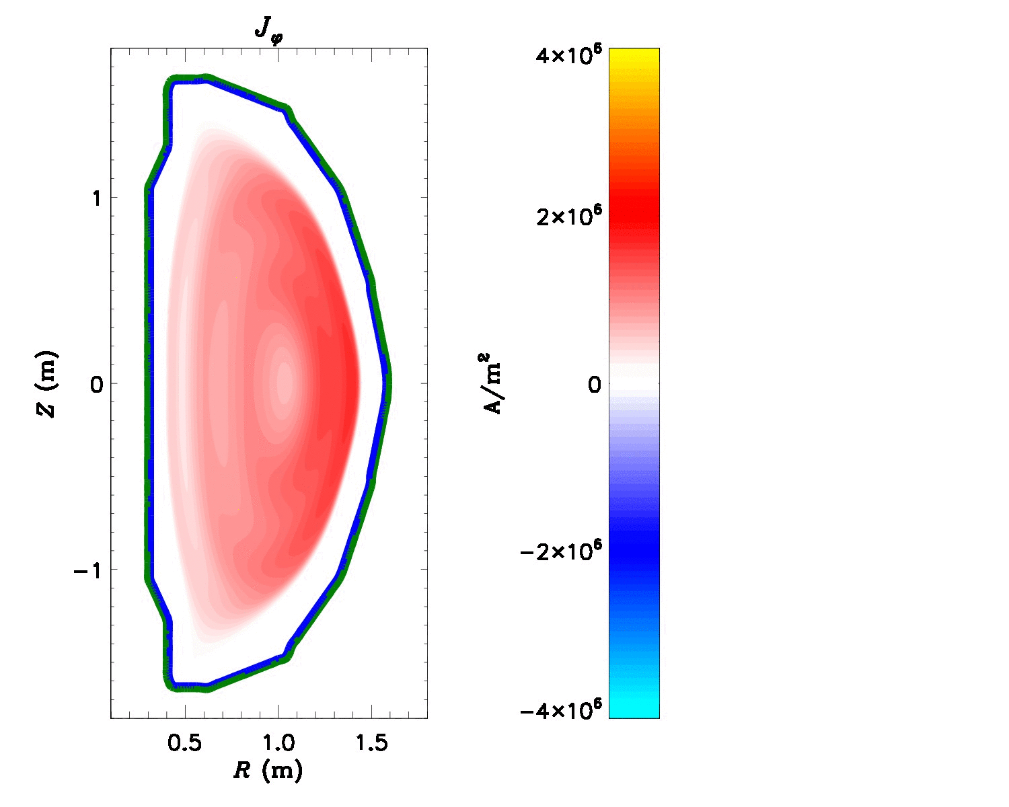
VDE Simulations Investigate
Wall Forces and Halo Currents
“Hot-VDEs” are considered
  No mitigation, plasma remains hot as it hits the wall
  Current quench time is long
  IP is still large when plasma is maximally displaced
Simulations initialized with vertically unstable equilibrium reconstruction
  VDE is not “forced”

Slide 8
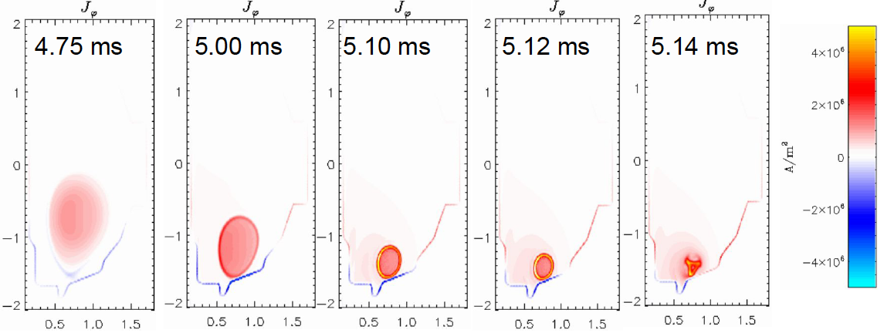
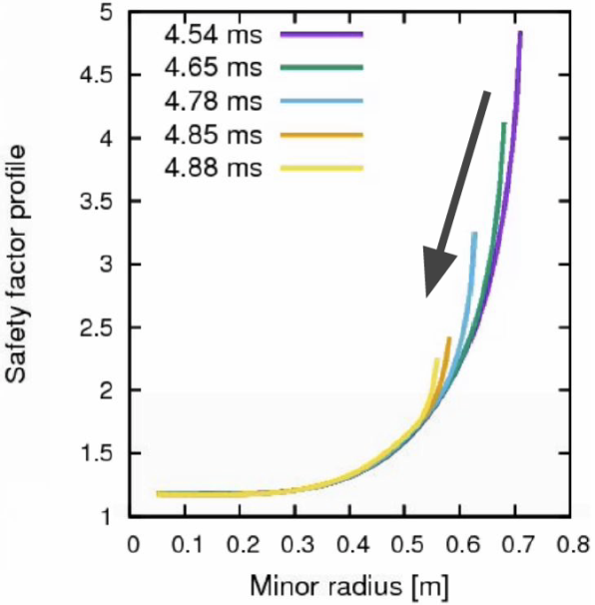
Plasma Develops Strong Skin Currents
Current channel contracts as edge is scraped off
Contraction of current channel causes strong skin currents

Slide 9
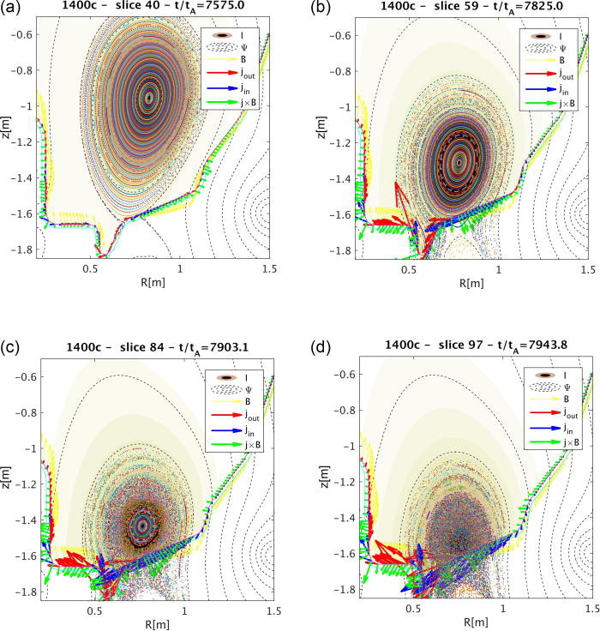
Current Sheets Develop Secondary Instabilities
Secondary instability of edge current stochasticizes magnetic field
Stochastic field leads to fast thermal quench
Pfefferlé et al, Phys. Plasmas 25, 056106 (2018)

Slide 10
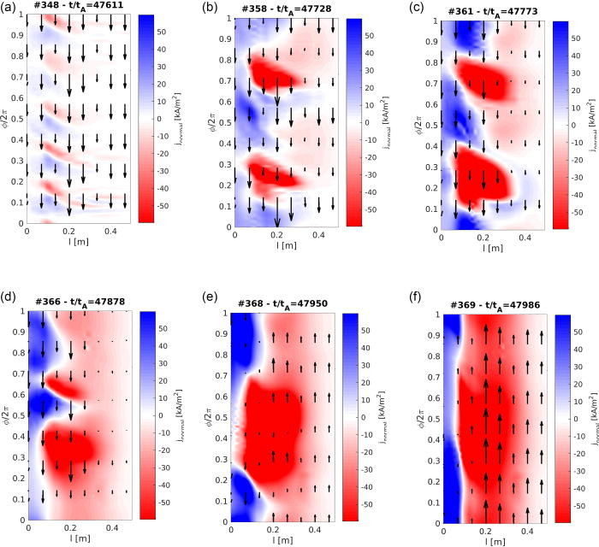
Secondary Instability in Hot VDEs Leads to
Localized Non-Axisymmetric Halo Currents
Halo currents (colored contours) start at moderate-n, evolve to low-n
  Current sheet is most unstable to moderate-n modes, even when q=1 in sheet
Wall currents (arrows) start in counter-IP direction, evolve to co-IP
  Initially eddy currents oppose motion of plasma
  Later, eddy currents oppose current decay
No rotation observed – important physics is missing!
Toroidal Angle
R (m)
R (m)
R (m)
Toroidal Angle
R (m)
R (m)
R (m)

Slide 11
VDE Simulations of Model 2MA NSTX-U Scenario Investigate Forces on Coils
Radial Field from Plasma
Unmitigated cases with ~10 ms and ~20 ms CQ times considered
Max forces are comparable for fast and slow cases
Impulse scales with current decay time
Max excess vertical impulse is ~10 R₀ N-s / kA-t

Slide 12
Impurity Modeling

Slide 13
Impurity Model Enables Mitigation Simulations
Coronal model of impurity ionization / recombination / radiation is used (KPRAD)
  All charge states of impurity species are advanced separately
Does NOT assume “coronal equilibrium”
  Coronal equilibrium is a bad assumption here since equilibration of charge states takes ~10 ms, whereas TQ takes < 1 ms
Presently, only a single impurity species is allowed
With Argon (19 charge states), impurity advance takes < 10% of computational time

Slide 14
Simulation of Disruption Due to
Presence of Fully-Mixed Argon
Simulation initialized with stable NSTX equilibrium reconstruction
Spitzer resistivity is used (S ~ 10⁸ at magnetic axis)
Neutral Argon is initially uniformly distributed n_{Ar}⁰ = 10¹⁹ / m³
Cooling is initially mainly due to ionization
  Ionization increases n_{e}, but does not add energy to the plasma, so p_{e} remains the same. Therefore T_{e} drops.

Slide 15
T_{e}/T_{i} = const.
Is Not Always an Accurate Assumption
Ionization and radiation dominantly cool electrons
Here, electrons cool much faster than electron-ion collision time
Assumption that T_{e}/T_{i} = const significantly overestimates T_{e}
  Assumption becomes better as ionization slows and plasma cools (ν_{ei} increases)
For simplicity, most previous extended-MHD simulations of disruption mitigation have used this assumption

Slide 16
Current Channel Contracts
Despite Well-Mixed Impurities
Cooling is strongest near magnetic axis
  Line radiation is initially strongest near axis
  Dilution cooling from ionization is fastest near axis
Despite this, resistivity rises faster at edge
  Resistivity is much more sensitive to temperature in cooler regions
  η ~ T^{-3/2} → dη/dT ~ -T^{-5/2}
Rapid rise in edge resistivity causes contraction of current channel, increase in l_{i}

Slide 17
Contraction of Current Channel Leads to
Skin Currents and Edge Instability
Instabilities have broad range in toroidal mode number
Instabilities grow on same timescale as q evolves
Kinetic Energy

Slide 18
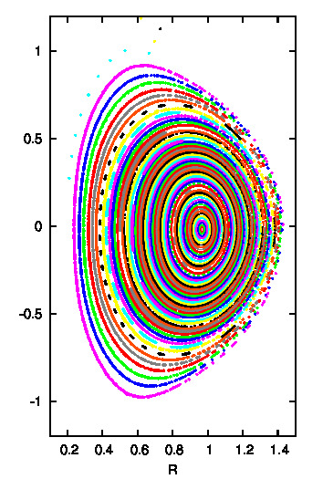
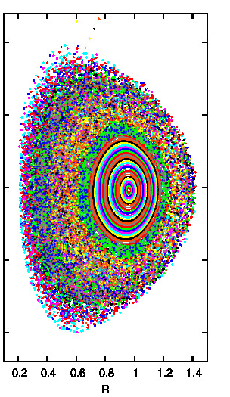
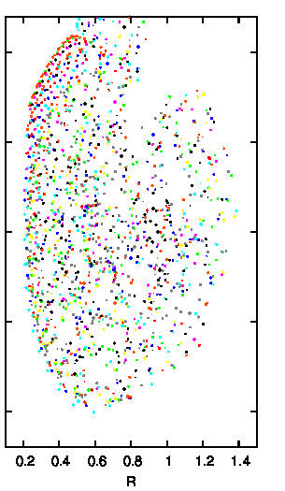
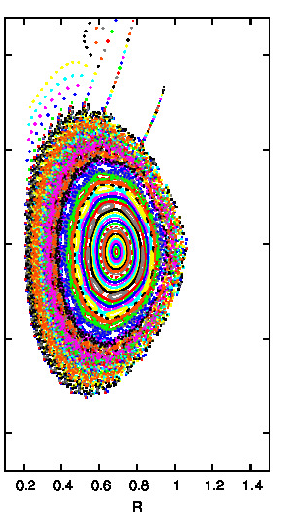
Edge Instability Leads to
Stochastization and Thermal Quench
Edge stochasticizes first, followed by global stochastization and fast TQ
TQ speeds up CQ
Surfaces heal after TQ
t = 65 μs
t = 91 μs
t = 130 μs
t = 221 μs

Slide 19
Instability Can Locally Enhance Parallel Electric Field
Poloidal flux (0.34 We) is dissipated in ~250 μs, implying E ~ ΔΨ / (2πR₀Δt) ~ 270 V/m
Critical field is E_{c} ~ 0.075 (n_{e}/10²⁰ m⁻³) ~ 0.1 V/m
Runaway e-folding time is τ ~ e (E - E_{c})/(2m_{e}c ln Λ) ~ 200 μs
  e-folding time is comparable to CQ time, so we probably don’t expect a lot of runaways
  Instability can briefly increase E|| by a factor of 5 in some regions
Simple model for coupled fluid-RE / MHD simulations will be implemented as part of SCREAM

Slide 20
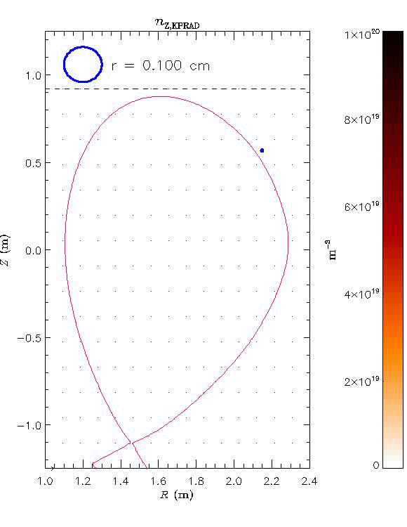
New Pellet Ablation Models
Are Implemented in M3D-C1
Understanding where impurities are deposited is critical to understand disruption mitigation
  Need enough penetration to substantially cool plasma
  Keeping edge hot might help avoid MHD instabilities
Sophisticated model for pellet ablation is now included (A. Fil, B. Lyons, P. Parks)
Work ongoing to couple M3D-C1 with lagrangian pellet code (R. Samulyak)
Goal is to test shattered pellet and shell pellet mitigation strategies
Total Ne density
B. Lyons

Slide 21
Summary
M3D-C1 implements integrated models for simulating disruptions and disruption mitigation in 3D
New impurity model is most accurate among extended-MHD codes
  Conserves energy; does not assume coronal equilibrium
  T_{e} and T_{i} need to be advanced separately to accurately model fast ionization
Both hot VDEs and disruptions due to mixed impurities exhibit a similar sequence of events:
  Current contraction → skin current → secondary instabilities → stochastization → fast TQ
  Even well-mixed impurities cause current contraction due to T^{-3/2} dependence of resistivity
Tools for exploring mitigation methods that avoid MHD instabilities are being tested
  SPI, shell pellets

Slide 22
Extra Slides

Slide 23
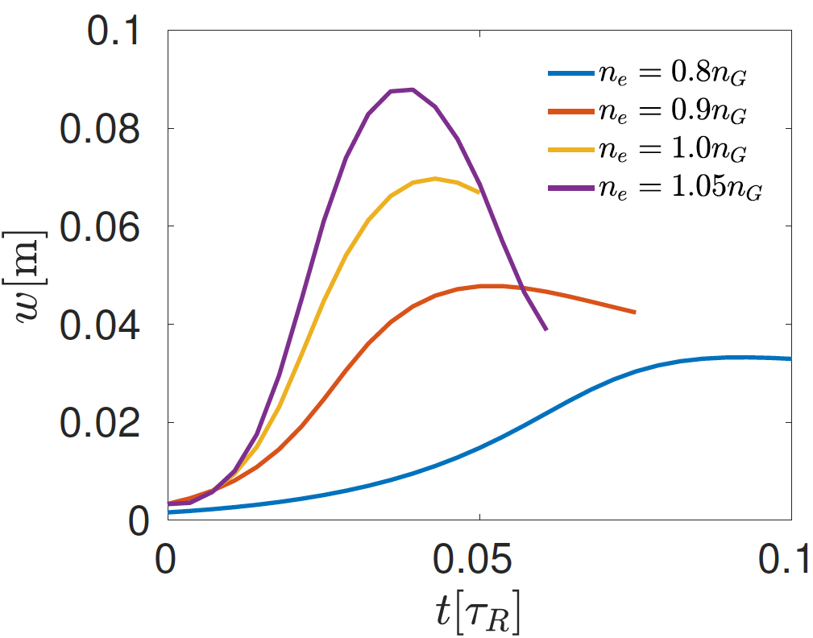
M3D-C1 Used to Model Density Limit Disruptions
Qian Teng explored effect of localized radiation on island size in Ohmic plasma
Assumed impurity radiation near the 2/1 surface
  Impurity density ~ n_{e}
Found large increase in island size near Greenwald limit
  Radiative cooling exceeds Ohmic heating
Subsequent reduction in island size is due to island’s effect on global equilibrium (i.e. thermal quench)

Slide 24
Comparison of Code Capabilities*
 | M3D-C1 | NIMROD | JOREK
Non-LTE Impurities | Yes | Yes | No
Separate Te and Ti with impurities | Yes | In Progress | No
Resistive wall | Yes | In Progress | Yes
Halo currents | Yes | ? | ?
RE Test Particles | No | Yes | No
MHD with RE Currents | No | No | No
3D mesh packing | Yes | No | No
Fast ion model | No | Yes | No
* These are all to the best of my understanding and might not be correct!

Slide 25
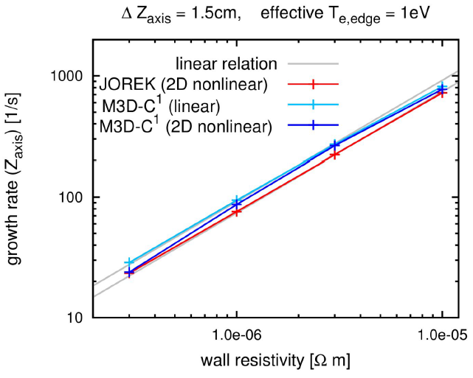
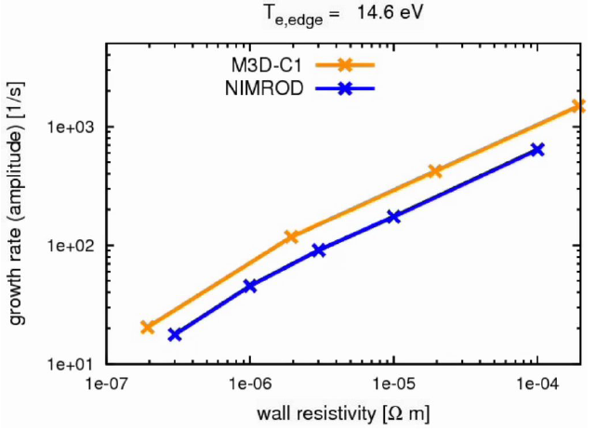
VDE Benchmarking with NIMROD and JOREK is Underway
NSTX equilibrium with with rectangular resistive wall is considered
Excellent agreement between M3D-C1 and JOREK
  Despite fact that JOREK is using a reduced model here
Some difference between M3D-C1 and NIMROD
  Possibly because some parameters were different

Slide 26
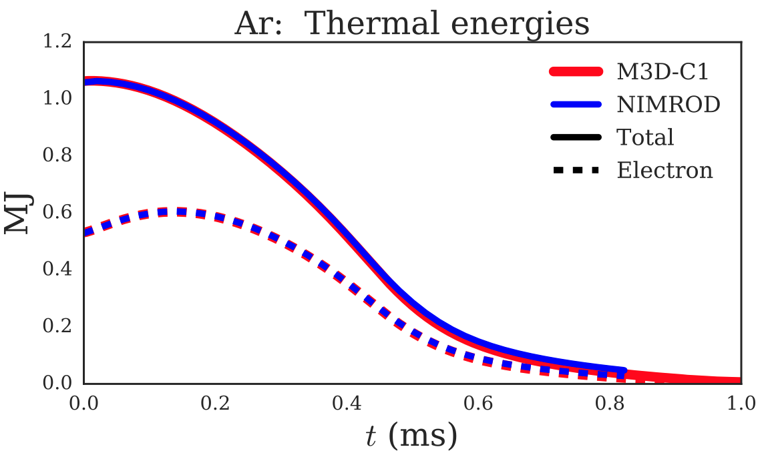
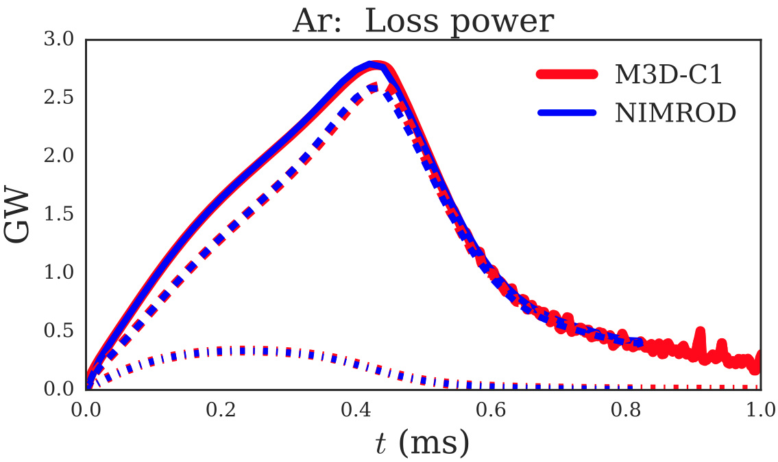
Impurity Benchmark With NIMROD
Shows Excellent Agreement
Impurity model is tested using axisymmetric benchmark case
  T_{e}/T_{i} = const is assumed; constant, uniform resistivity
  Ar impurities are deposited locally near magnetic axis at constant rate
M3D-C1 and NIMROD show nearly identical results

