Slide 1
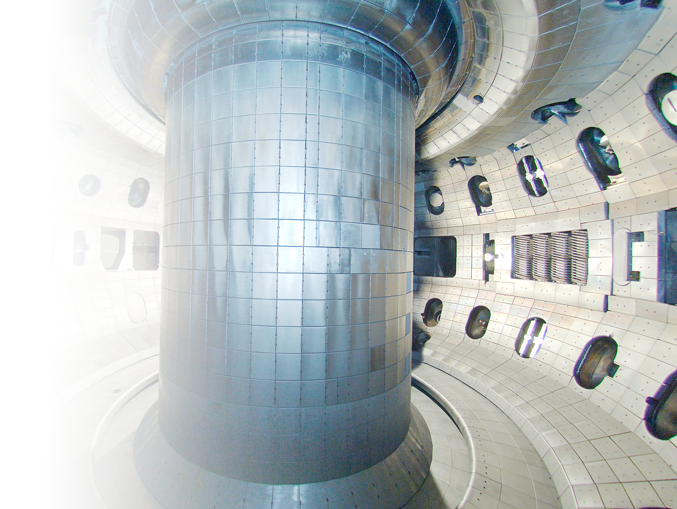
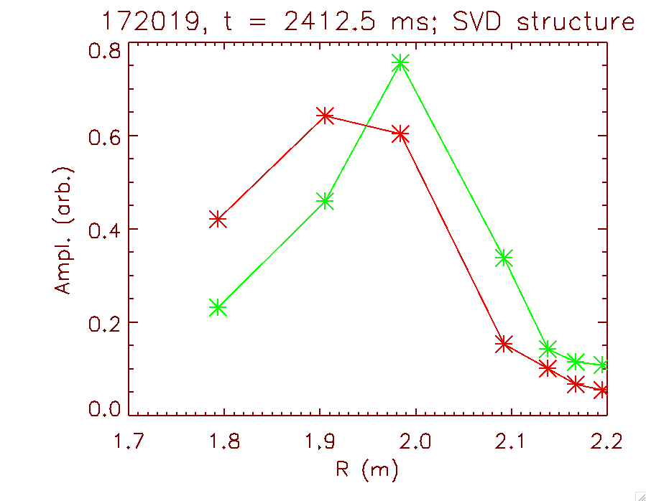




CAE structure measurements in DIII-D
CAE structure
N.A. Crocker, S. Tang, K.E. Thome,
W.W. Heidbrink, D.C. Pace,
R.I. Pinsker, T. L. Rhodes
NSTX-U/Magnetic Fusion Science Meeting
NSTX-U/DIII-D National Campaign
Aug. 27, 2018
magnetic axis

Slide 2
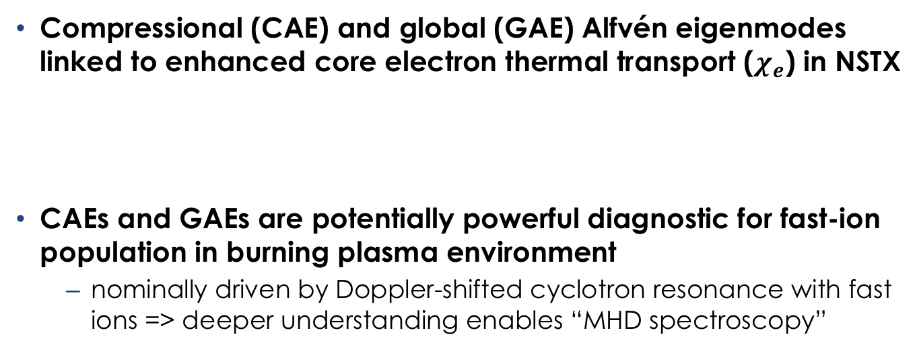
Understanding of high frequency Alfvén activity important to transport and fast-ion diagnosis
Compressional (CAE) and global (GAE) Alfvén eigenmodes linked to enhanced core electron thermal transport ($χ_{e}$) in NSTX
CAEs and GAEs are potentially powerful diagnostic for fast-ion population in burning plasma environment
  nominally driven by Doppler-shifted cyclotron resonance with fast ions => deeper understanding enables “MHD spectroscopy”

Slide 3
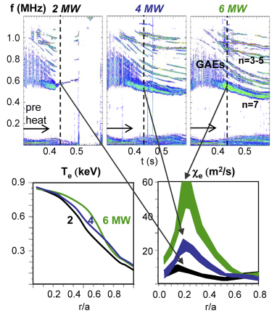
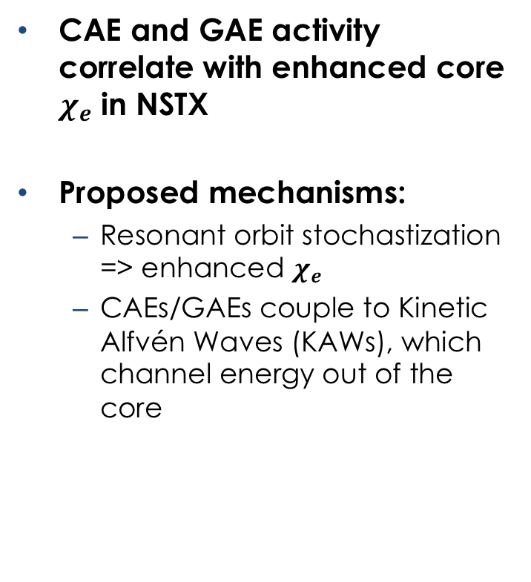
CAE and GAEs linked to enhanced core electron thermal transport in NSTX
CAE and GAE activity correlate with enhanced core $χ_{e}$ in NSTX
Proposed mechanisms:
  Resonant orbit stochastization => enhanced $χ_{e}$
  CAEs/GAEs couple to Kinetic Alfvén Waves (KAWs), which channel energy out of the core
[Gorelenkov NF 2010]
[Kolesnichenko PRL 2010], [Belova PRL 2015]
[D. Stutman PRL 2009]

Slide 4
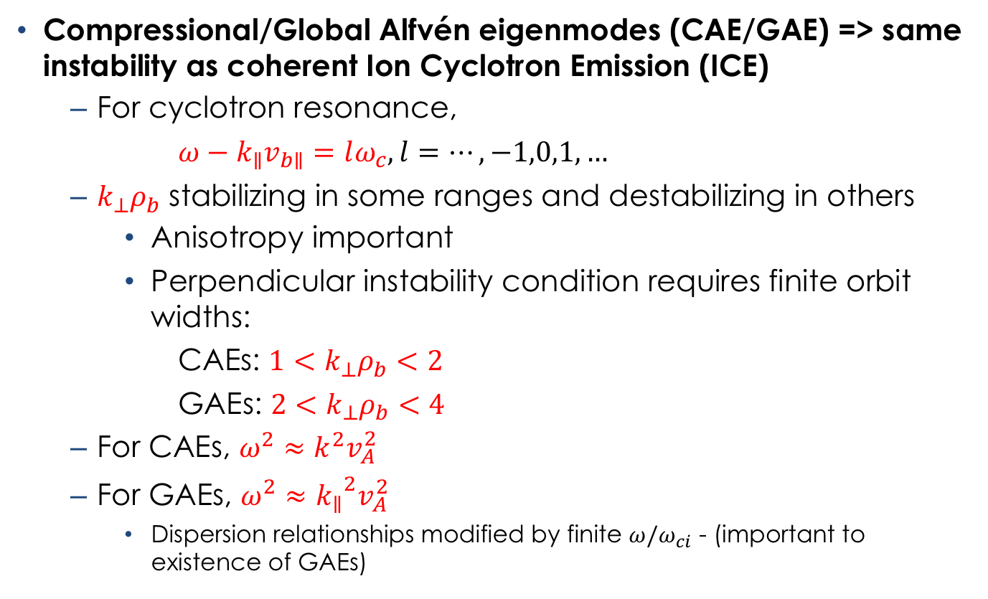
High frequency Alfvén eigenmodes driven unstable by Doppler-shifted cyclotron resonance with fast ions
Compressional/Global Alfvén eigenmodes (CAE/GAE) => same instability as coherent Ion Cyclotron Emission (ICE)
  For cyclotron resonance,
  $ω−k_{∥}v_{b∥}=lω_{c}, l=…,−1,0,1,…$
  $k_{⊥}ρ_{b}$ stabilizing in some ranges and destabilizing in others
    Anisotropy important
    Perpendicular instability condition requires finite orbit widths:
      CAEs: $1<k_{⊥}ρ_{b}<2$
      GAEs: $2<k_{⊥}ρ_{b}<4$
  For CAEs, $ω^{2}≈k^{2}v_{A}^{2}$
  For GAEs, $ω^{2}≈{k_{∥}}^{2}v_{A}^{2}$
    Dispersion relationships modified by finite $ω/ω_{ci}$ - (important to existence of GAEs)
[N.N. Gorelenkov NF 2003]
[Dendy, PoP 1994]

Slide 5



CAE with observed beam current threshold
$${\left|\tilde{b}\right|}^{2}$$
$$\left|\tilde{b}\right|$$
10⁻²
${\left(\text{Autopowe}\text{r}\right)}^{\frac{1}{2} }$ (A.U.)
10⁻⁴
10⁻⁶
dB
I_{B}
V_{B} constant as I_{B} ramped
(variable perveance)
CAEs abruptly disappears as I_{B}
drops below threshold
caveats:
  delay in CAE start => due to beam density build-up?
  CAE reappears => due to sawtoothing?

Slide 6
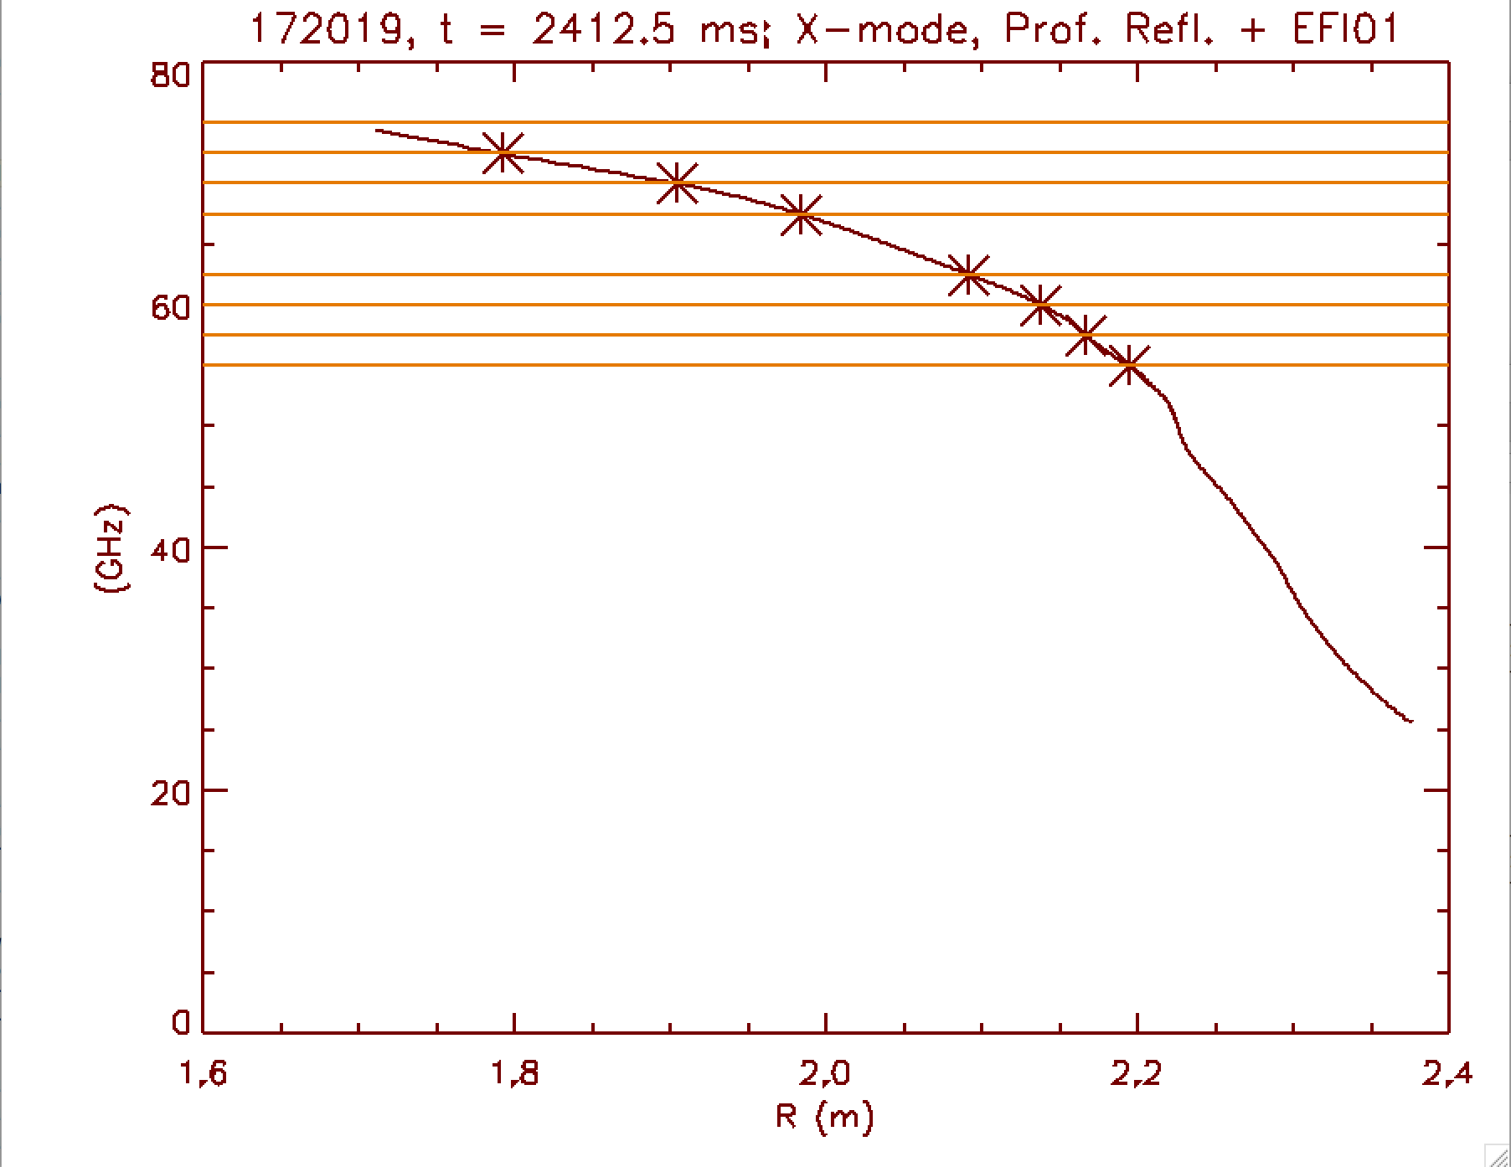
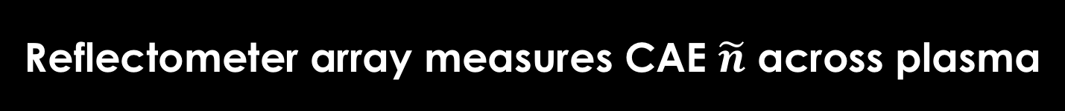
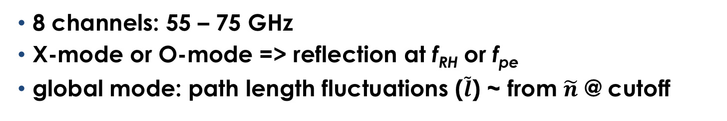
Reflectometer array measures CAE $\tilde{n}$ across plasma
right hand cutoff (f_{RH})
8 channels: 55 – 75 GHz
X-mode or O-mode => reflection at f_{RH} or f_{pe}
global mode: path length fluctuations ($\tilde{l}$) ~ from $\tilde{n}$ @ cutoff

Slide 7
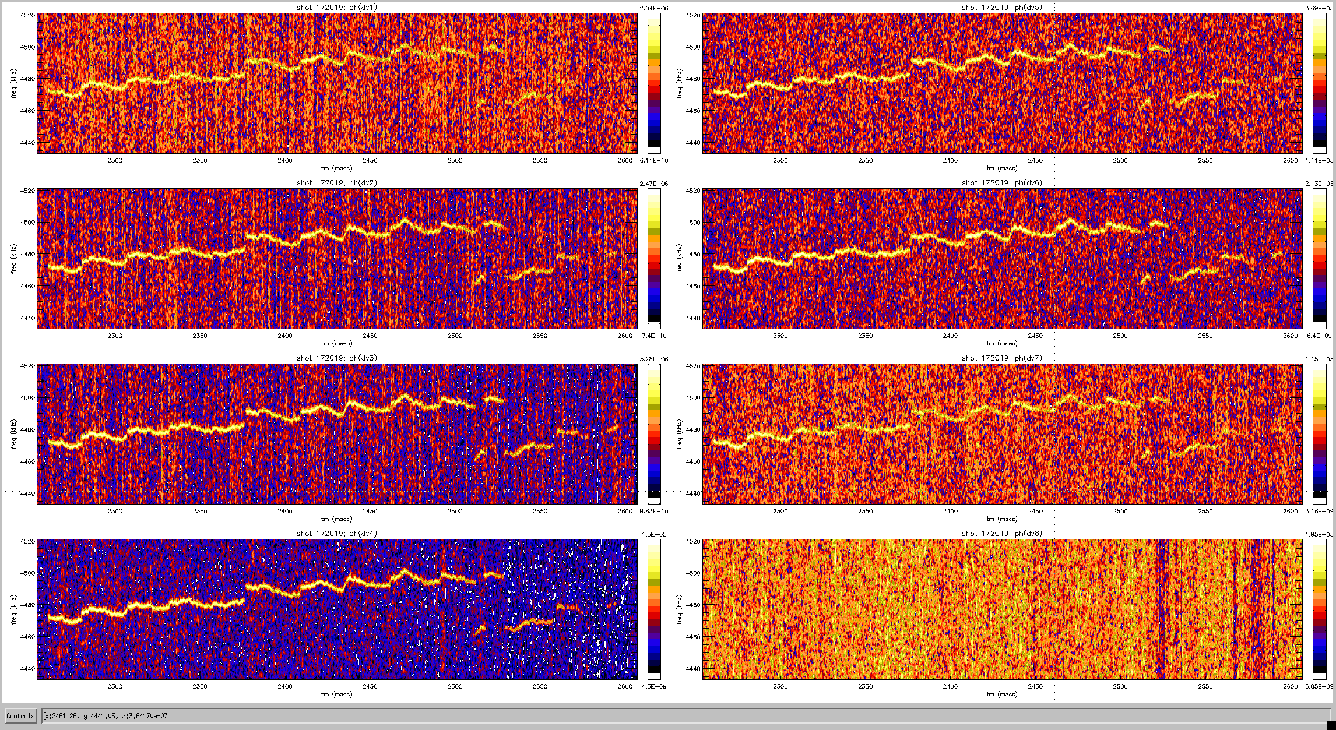

Reflectometer array shows CAE structure is global
${\left|\tilde{φ}\right|}^{2}\left(={\left|k_{0}\tilde{l}\right|}^{2}\right)$ ̃
55 G Hz
67.5 GHz
172019, t = 2250 – 4600 ms, f = 4435 – 4520 kHz
57.5 GHz
30 GHz
60 GHz
72.5 GHz
62.5 GHz
75 GHz
Global CAE observed with reflectometers in I_{B} ramp at constant V_{B}
CAE aliased from f ~ 5.5 MHz to ~ 4.5 MHz (10 MHz sampling rate)

Slide 8
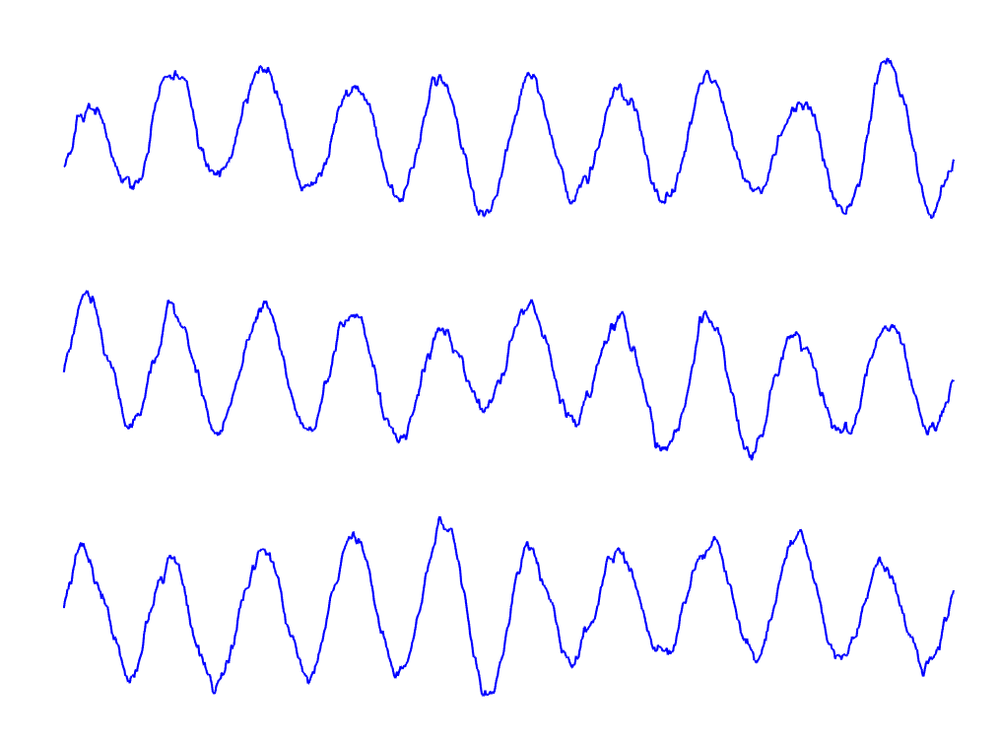
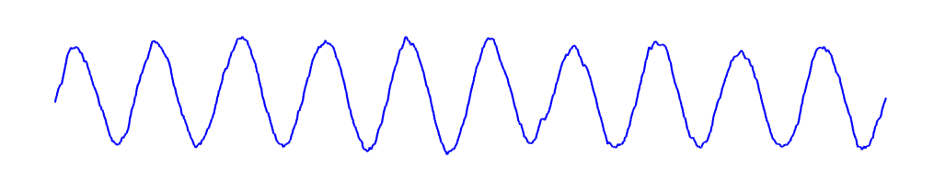
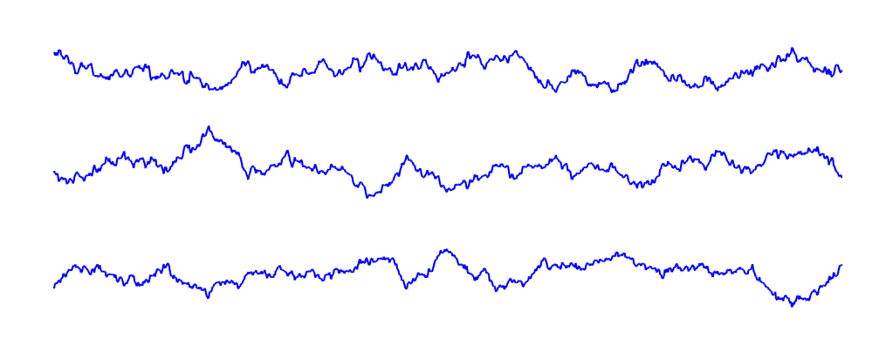
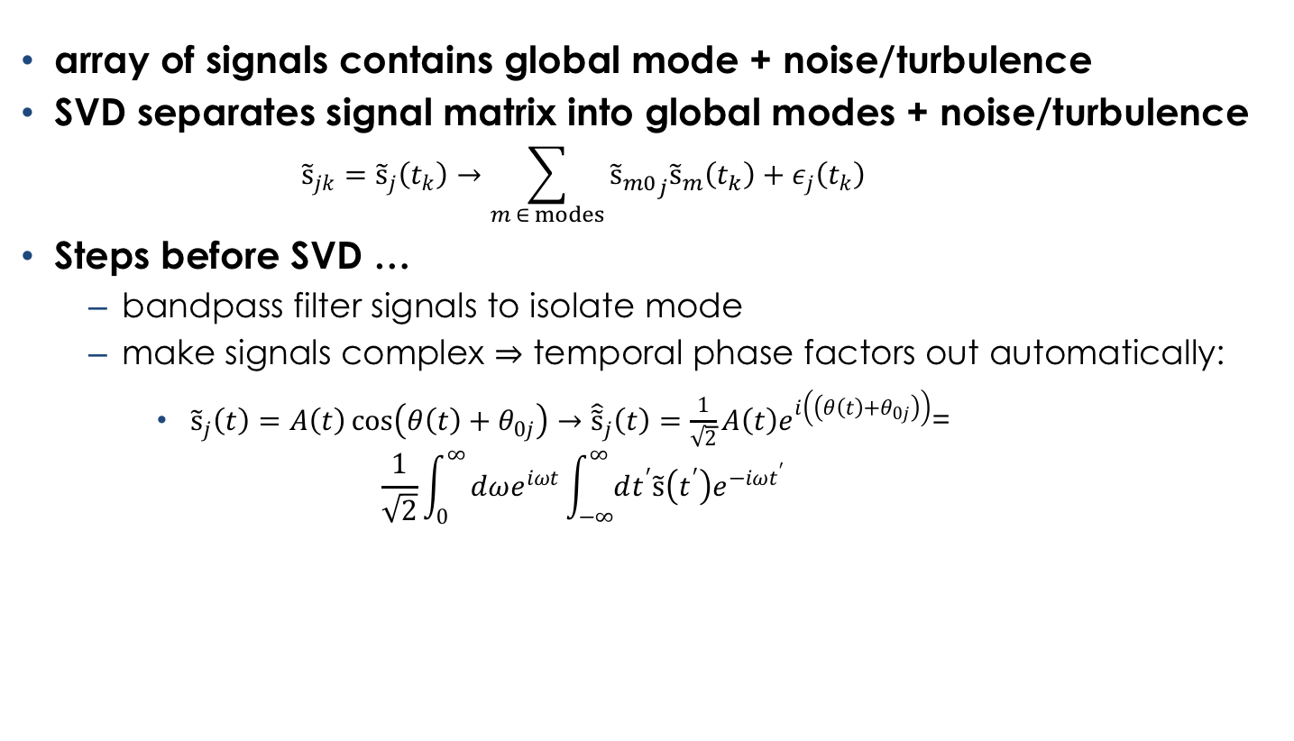
Use singular value decomposition to isolate
“global mode” from signal array
array of signals
“global mode”
SVD
“noise”
array of signals contains global mode + noise/turbulence
SVD separates signal matrix into global modes + noise/turbulence
    $${\tilde{s}}_{jk}={\tilde{s}}_{j}\left(t_{k}\right)→\sum_{m ∈ modes}{{{\tilde{s}}_{m0}}_{j}{\tilde{s}}_{m}\left(t_{k}\right)}+ε_{j}\left(t_{k}\right)$$
Steps before SVD …
  bandpass filter signals to isolate mode
  make signals complex ⇒ temporal phase factors out automatically:
    ${\tilde{s}}_{j}\left(t\right)=A\left(t\right)\cos\left(θ\left(t\right)+θ_{0j}\right)→{\hat{\tilde{s}}}_{j}\left(t\right)=\frac{1}{\sqrt{2}}A\left(t\right)e^{i\left(\left(θ\left(t\right)+θ_{0j}\right)\right)}$=
    $\frac{1}{\sqrt{2}}\int_{0}^{∞}{dωe^{iωt}\int_{−∞}^{∞}{dt^{′}\tilde{s}\left(t^{′}\right)e^{−iωt^{′}}}}$

Slide 9
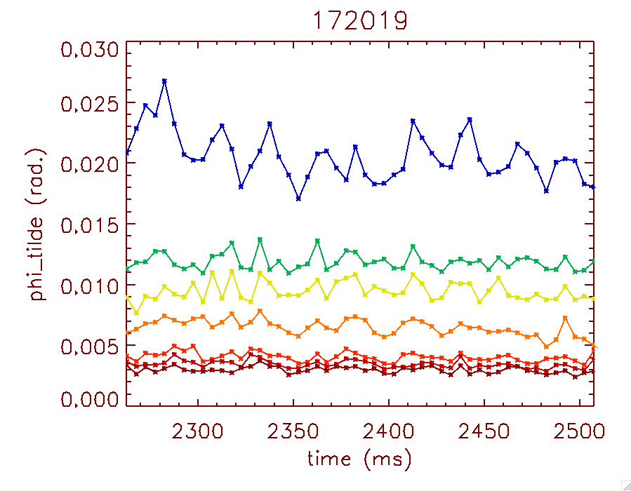
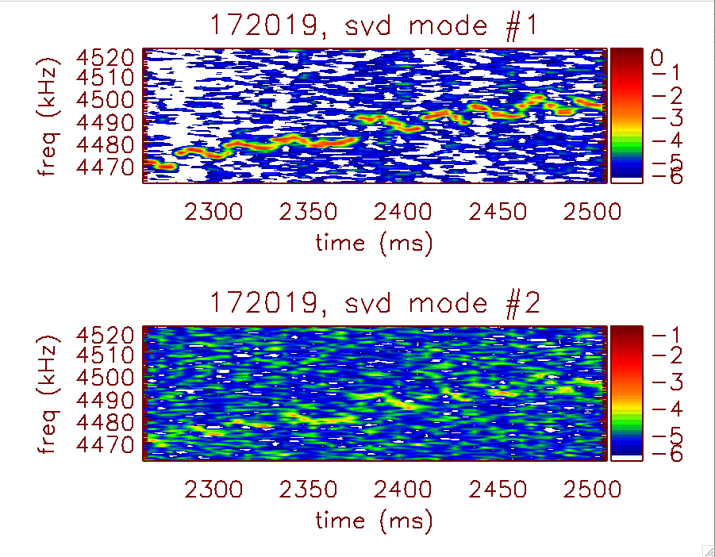


SVD shows one dominant “mode”
$$\tilde{φ}=k_{0}\tilde{l}$$
$${\left|\tilde{φ}\right|}^{2}$$
(rad.)
time (ms)
SVD shows single dominant “mode” (~ 50 % fluctuation power)
  5 ms records (no overlap), 60 kHz bandwidth
  large amplitude subdominant mode (~ 25 % fluctuation power)
  @ ~ same frequency => Distinct modes OR
    #1+#2 = single mode w/time-dependent structure (< ~5 ms modulation)?
    #2 is SVD artifact?
Low amplitude components = noise/turbulence
Notes:
total(abs(wfphmd)^2,/cum)/total(abs(wfphmd)^2)
0.52846811 0.76072866 0.88671370 0.92773094 0.96194185 0.98630429 1.0000000

Slide 10
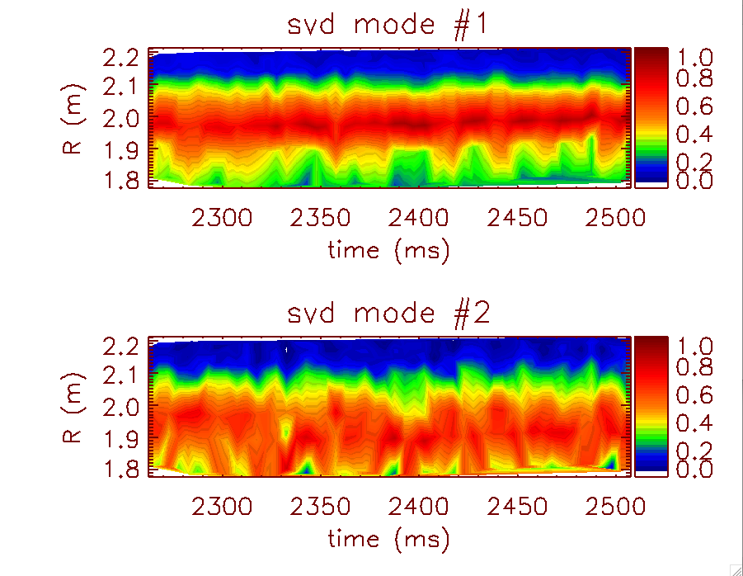
Dominant SVD modes have global structure
#1 (Dominant)
CAE structure
#2 (Subdominant)
magnetic axis
Modes have broad structure
Modes peak at mid-radius (R ~ 2 m)

Slide 11
Conclusions
CAEs observed during beam current ramp at constant voltage
Reflectometers observe global structure
Modes peak at mid-radius (R ~ 2 m)
SVD analysis one dominant mode
  Subdominant mode @ ~ same frequency => time-dependent CAE structure?

Slide 12
Future Work
Toroidal mode numbers from ICE toroidal loops
Comparison with theory/simulation

