Slide 1


Local compressional and global Alfvén eigenmode structure on NSTX and their effect on core energy transport*
NA Crocker,¹ E Belova,² RB White,² ED Fredrickson,² NN Gorelenkov,² K Tritz,³ WA Peebles,¹S Kubota,¹ A Diallo,² BP LeBlanc² and SA Sabbagh
¹UCLA, ²PPPL, ³JHU
NSTX-U/Magnetic Fusion Science Meeting Aug. 27, 2018
*Supported by US DOE Contracts DE­SC0011810, DE-FG02-99ER54527 & DE­AC02­09CH11466

Slide 2
Novel reflectometry analysis improves CAE & GAE measurements and understanding of χ_{e}
Motivation – compressional (CAE) and Global Alfvén eigenmodes (GAE) proposed to cause high anomalous core χ_{e}
New multi-channel reflectometer analysis ⇒ more accurate δn amplitude and structure
δn used to test hypothesis for anomalous core χ_{e}
  simulation of e– drift orbit modification predicts χ_{e} – compared to TRANSP
δn compared to HYM simulations
δn used with HYM to test alternate hypothesis – CAE-KAW coupling

Slide 3
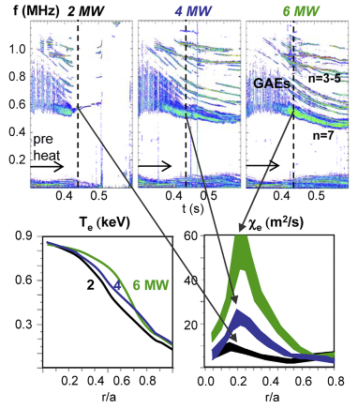

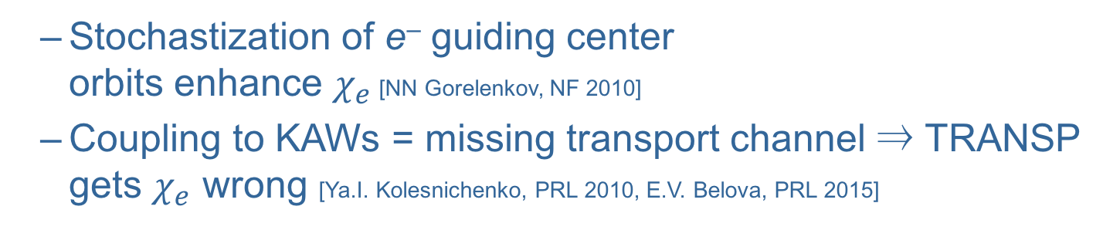
Motivation: CAEs & GAEs candidates for core energy transport in NSTX
CAEs & GAEs excited by Doppler-shifted cyclotron resonance with beam ions
[N. N. Gorelenkov, NF 2003]
CAE & GAE activity correlates with enhanced $χ_{e}$ in core
[D. Stutman, PRL 2009; K. Tritz, APS 2010 Invited Talk; N. A. Crocker, PPCF 2011]
  T_{e} profile flattens as P_{NB} increases
  $χ_{e}$ from TRANSP modeling
Two leading hypotheses:
  Stochastization of e– guiding center
  orbits enhance $χ_{e}$ [NN Gorelenkov, NF 2010]
  Coupling to KAWs = missing transport channel ⇒ TRANSP gets $χ_{e}$ wrong [Ya.I. Kolesnichenko, PRL 2010, E.V. Belova, PRL 2015]
[D. Stutman et al., PRL 102 115002 (2009)]

Slide 4
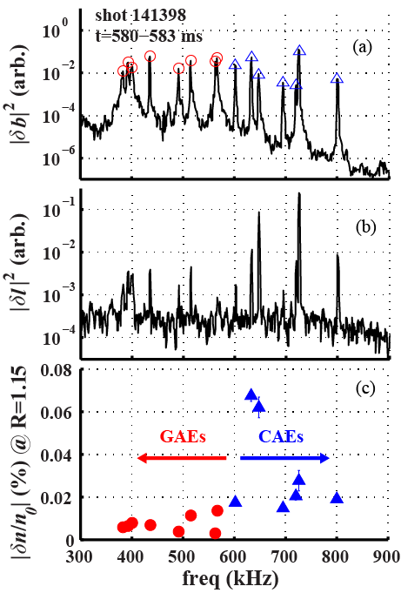
Reflectometer array measures δn of CAEs & GAEs
Reflectometer array sees global modes identified as CAEs & GAEs
[N.A. Crocker, PPCF 2011]
New analysis gives δn/n₀;
in core:
  CAE: δn/n₀ ~ 10⁻⁴ – 10⁻³
  GAE: δn/n₀ ~ 10⁻⁵ – 10⁻⁴
δn from measurements via “synthetic diagnostic”
Reflectometer “signal-to-noise” improved via correlation with δb
core reflectometer (75 GHz )

Slide 5
Measurement Technique

Slide 6
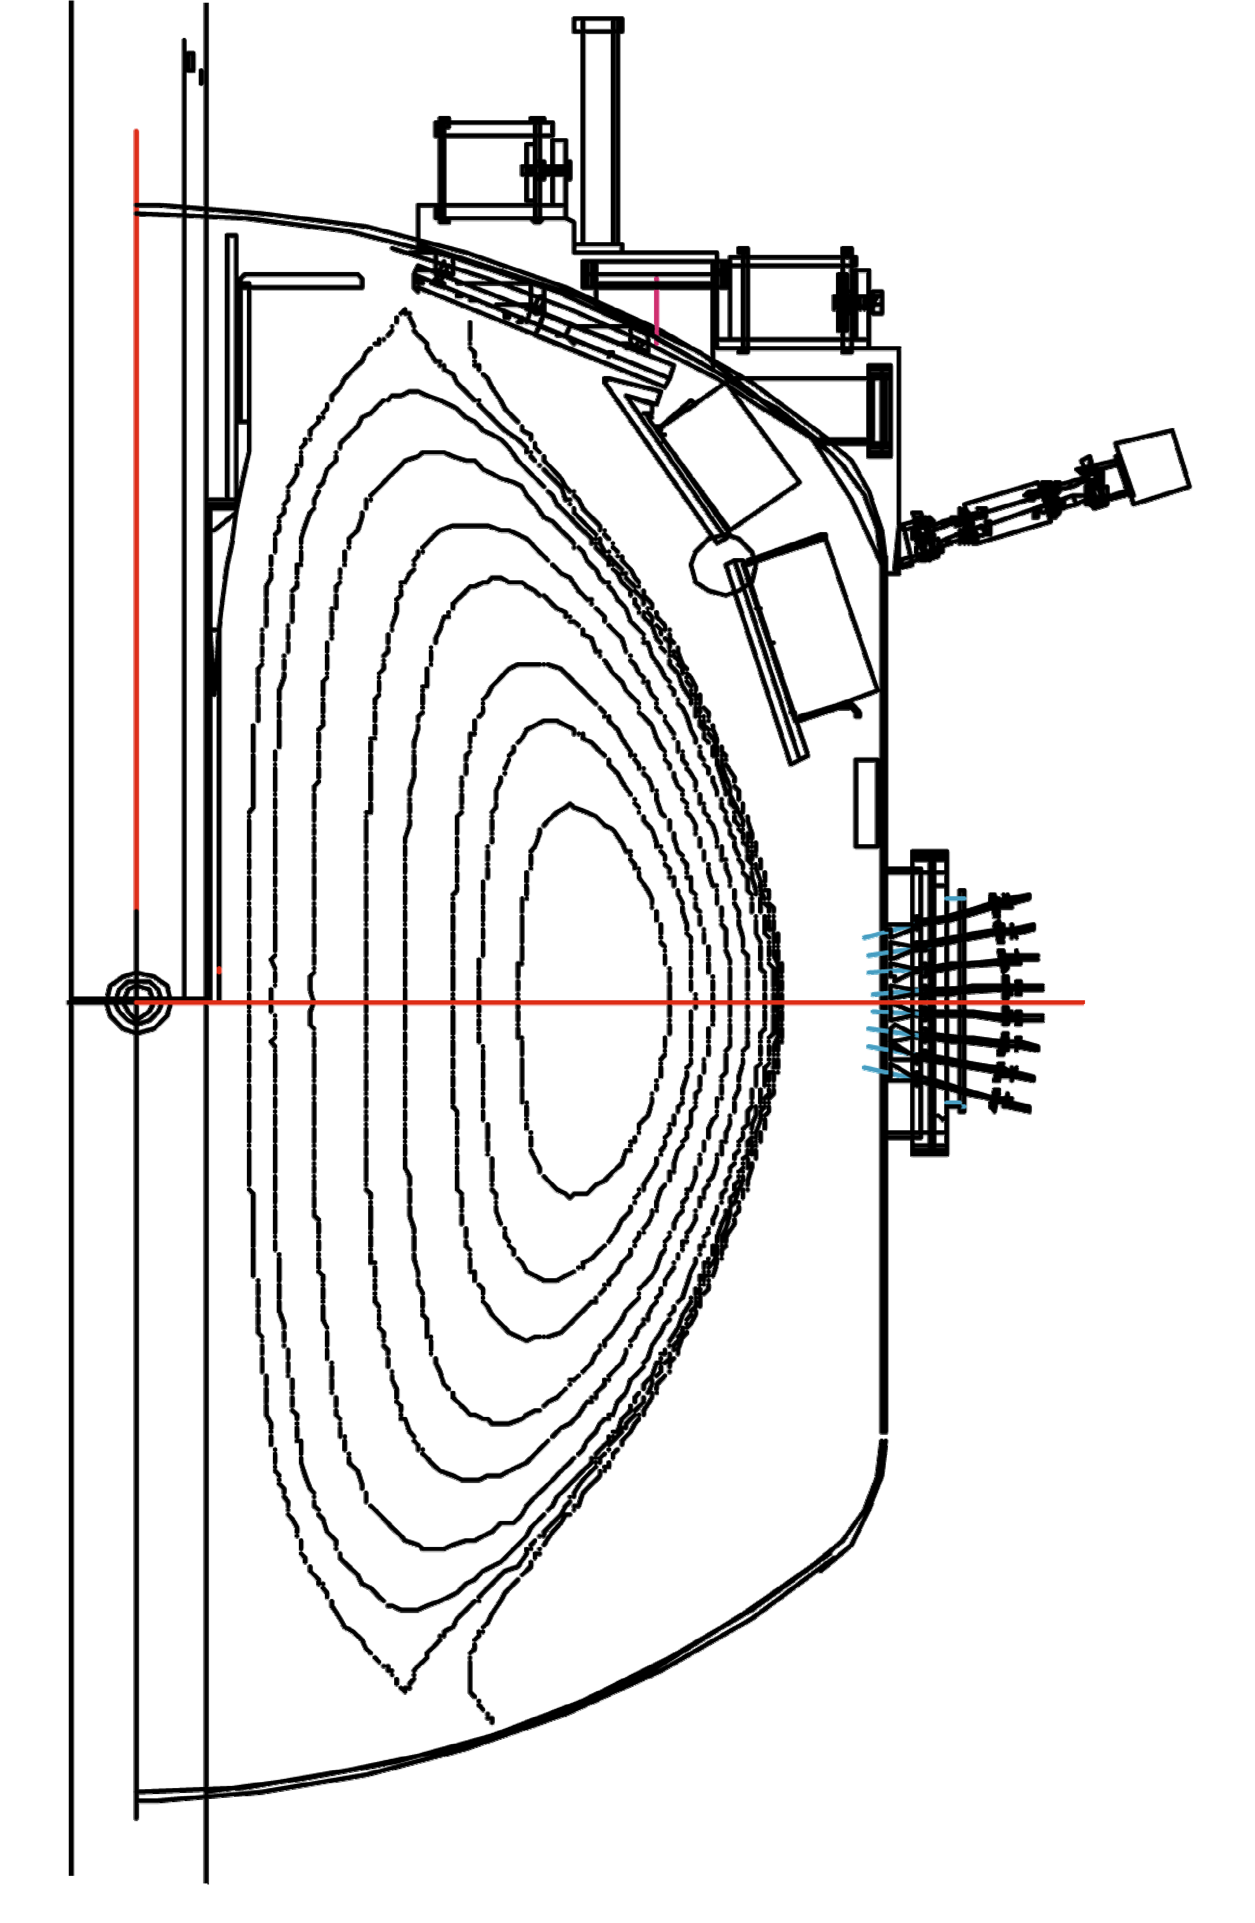
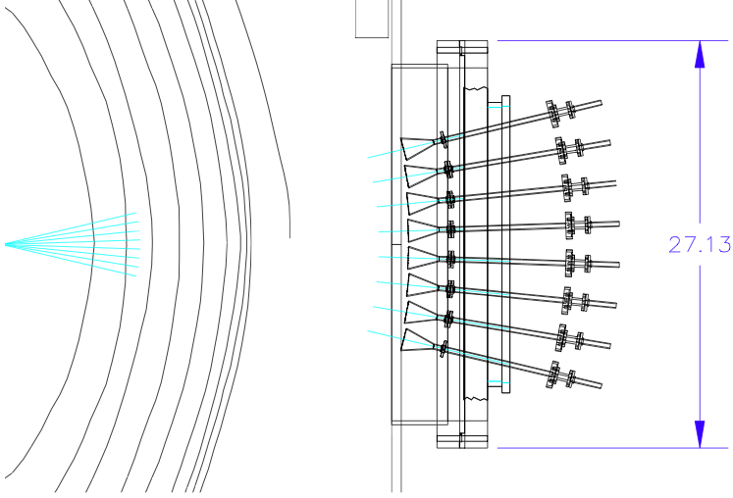
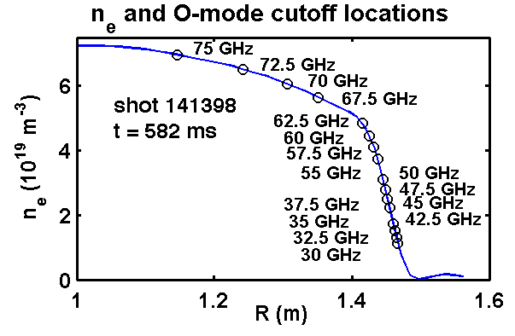
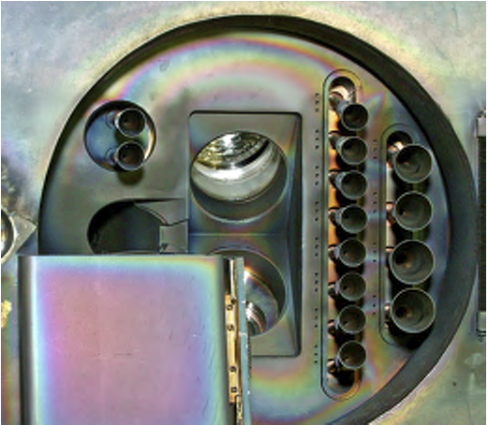
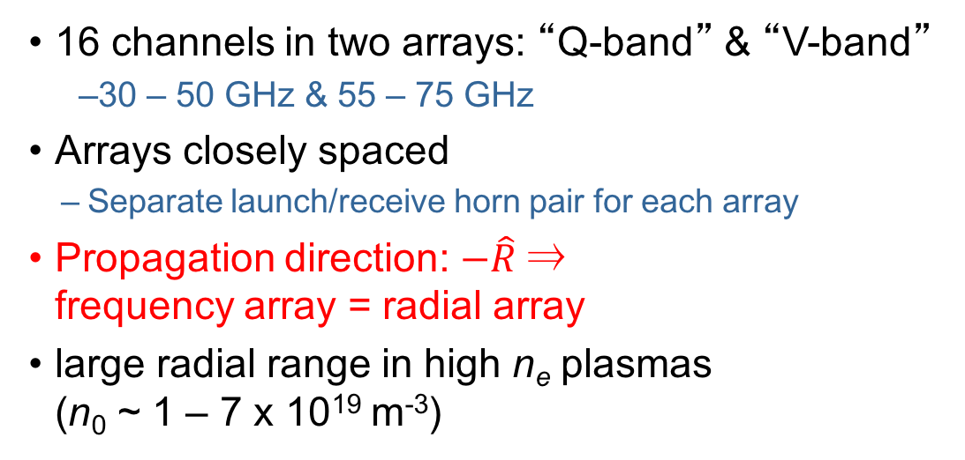
Reflectometers provide radial array of measurements
NSTX cross-section
16 channels in two arrays: “Q-band” & “V-band”
  30 – 50 GHz & 55 – 75 GHz
Arrays closely spaced
  Separate launch/receive horn pair for each array
Propagation direction: $−\hat{R}$⇒
frequency array = radial array
large radial range in high n_{e} plasmas
(n₀ ~ 1 – 7 x 10¹⁹ m⁻³)
Launch and Receive Horns
30-50 GHz
55-75 GHz
n_{e} from Multipoint Thomson Scattering

Slide 7
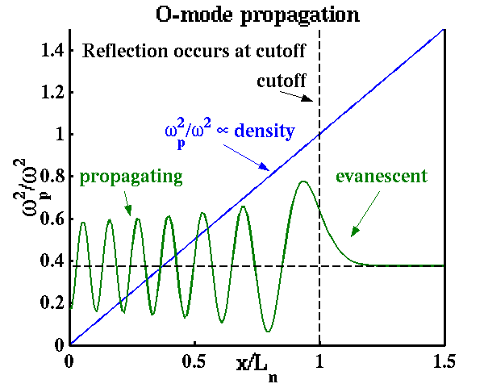
Reflectometers measure density fluctuations in plasma
Microwave (“O-mode”) propagation
Microwaves reflect at “cutoff”
  O-mode: ω² = ω_{p}² + c²k²
  microwaves reflect at k = 0
  (ω_{p} = ω)
Measurement: path length
fluctuations (δl) caused by δn
electric field
δl sensitive to cutoff motion, but δn along path contributes (a.k.a. “interferometer effect”)
  cutoff motion dominates as k_{r} → 0 (rigid displacement)

Slide 8
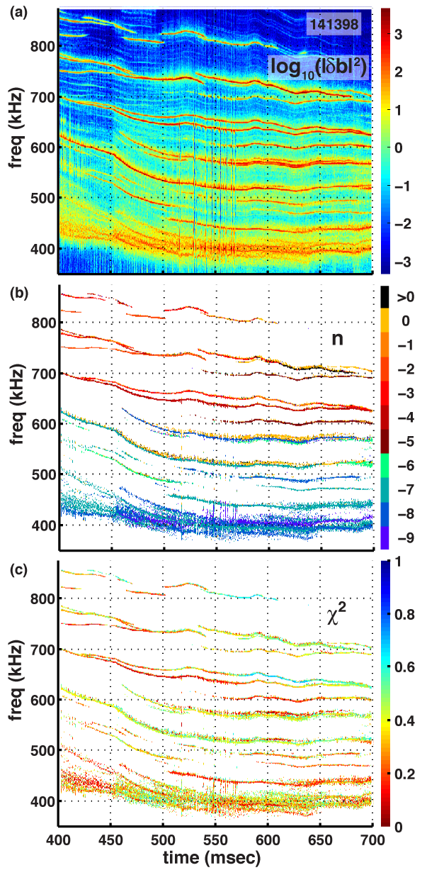
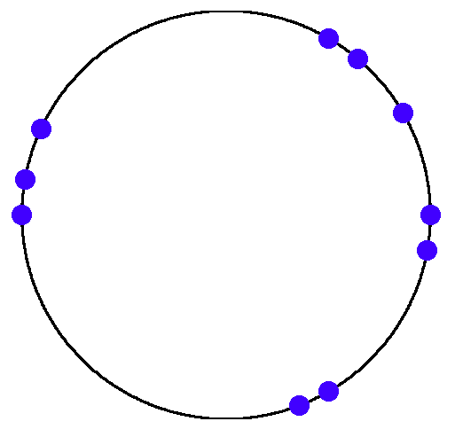
Toroidal mode numbers and frequencies determined with edge B-dot array
Modes appear as peaks in δb spectrum
n determined from δb measured by edge toroidal array of B-dot coils
Smallest coil spacing is 10° ⇒
can distinguish |n| ≤ 18
NSTX
φ
B-dot coil locations
N. A. Crocker, et al. Nucl. Fusion 2013

Slide 9
Reflectometer Analysis Technique

Slide 10
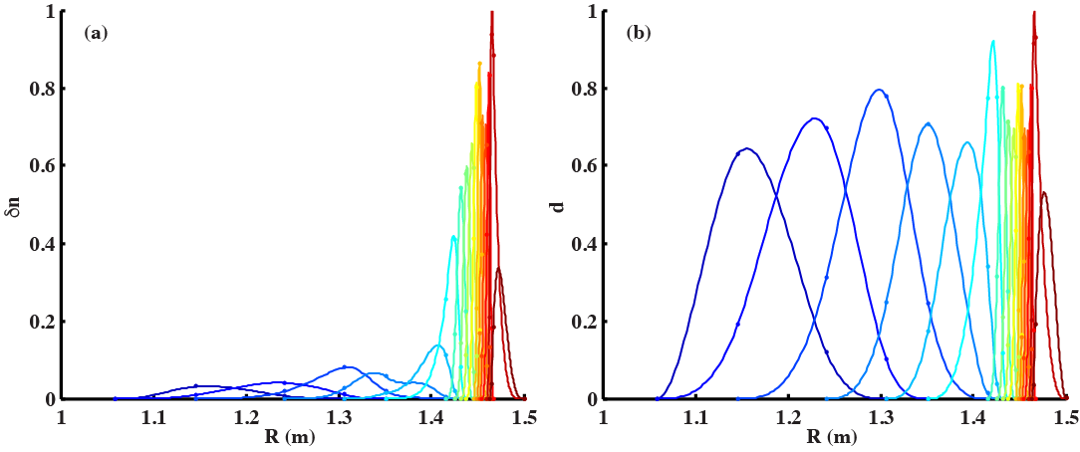
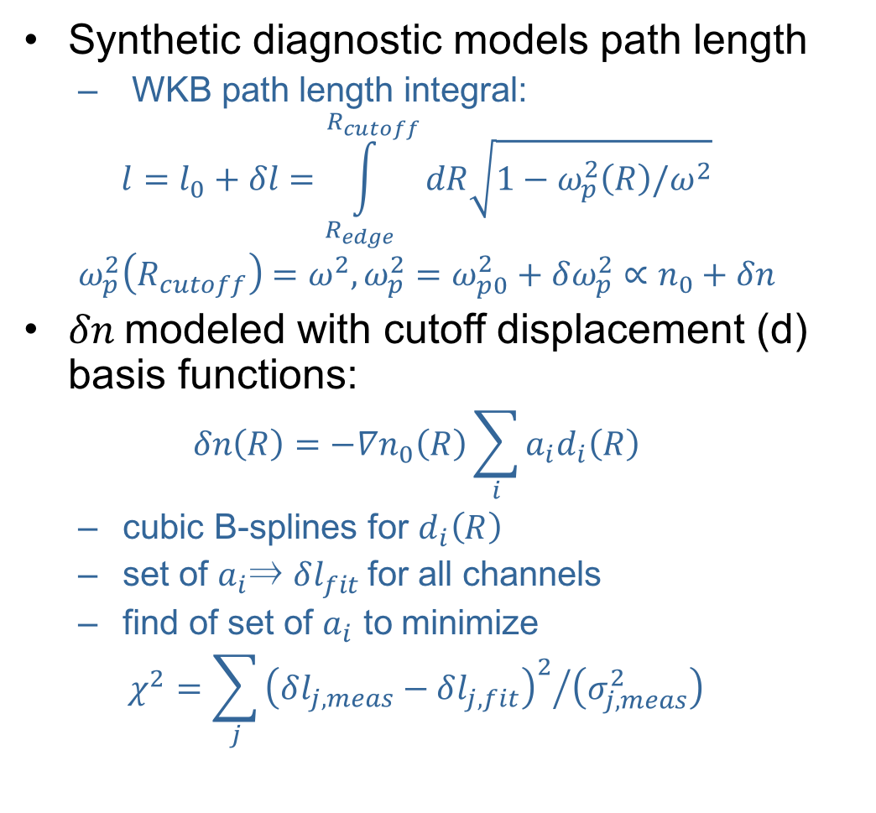


δn determined via synthetic diagnostic
Synthetic diagnostic models path length
  WKB path length integral:
  $$l=l_{0}+δl=\int_{R_{edge}}^{R_{cutoff}}{dR\sqrt{1−ω_{p}^{2}\left(R\right)/ω^{2}}}$$
  $$ω_{p}^{2}\left(R_{cutoff}\right)=ω^{2}, ω_{p}^{2}=ω_{p0}^{2}+δω_{p}^{2}∝n_{0}+δn$$
$δn$modeled with cutoff displacement (d) basis functions:
  $$δn\left(R\right)=−∇n_{0}\left(R\right)\sum_{i}{a_{i}d_{i}\left(R\right)}$$
  cubic B-splines for $d_{i}\left(R\right)$
  set of $a_{i}$⇒ $δl_{fit}$for all channels
  find of set of $a_{i}$ to minimize
  $$χ^{2}=\sum_{j}{{{\left(δl_{j,meas}−δl_{j,fit}\right)}^{2}}/{\left(σ_{j,meas}^{2}\right)}}$$
Cutoff displacement basis functions
(cubic “B-splines”; cutoff locations as knots)
$$d_{i}\left(R\right)$$
$$δn_{i}\left(R\right)= \\ {−d}_{i}\left(R\right)∇n_{0}\left(R\right)$$

Slide 11
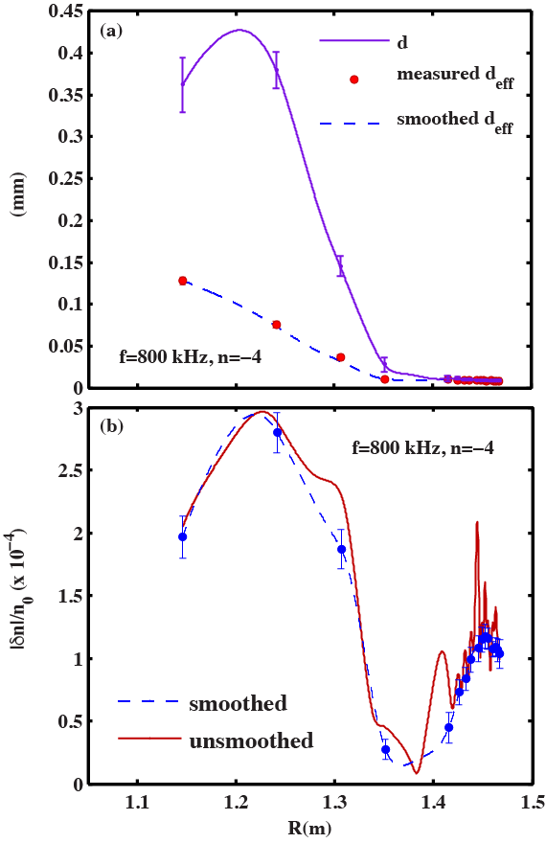
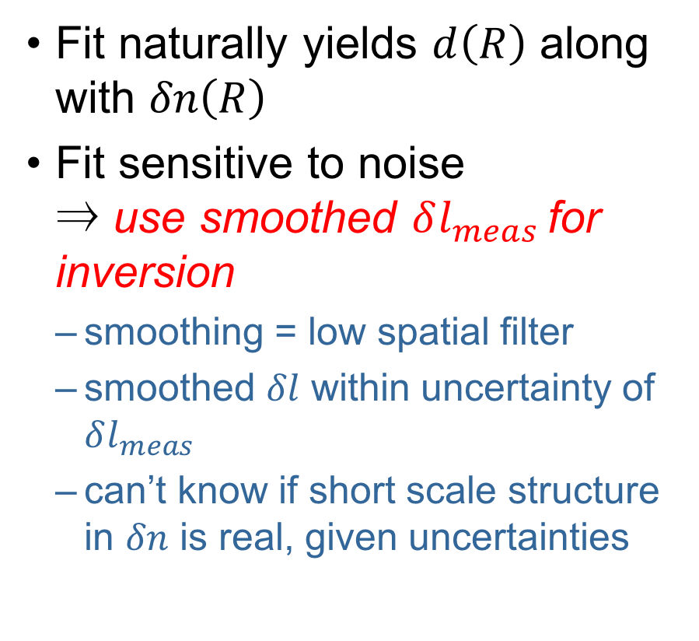


δn determined via synthetic diagnostic
$$d$$
Fit naturally yields $d\left(R\right)$ along with $δn\left(R\right)$
Fit sensitive to noise
⇒ use smoothed $δl_{meas}$ for inversion
  smoothing = low spatial filter
  smoothed $δl$ within uncertainty of $δl_{meas}$
  can’t know if short scale structure in $δn$ is real, given uncertainties
$$d_{eff}=\frac{δl}{2}$$

Slide 12
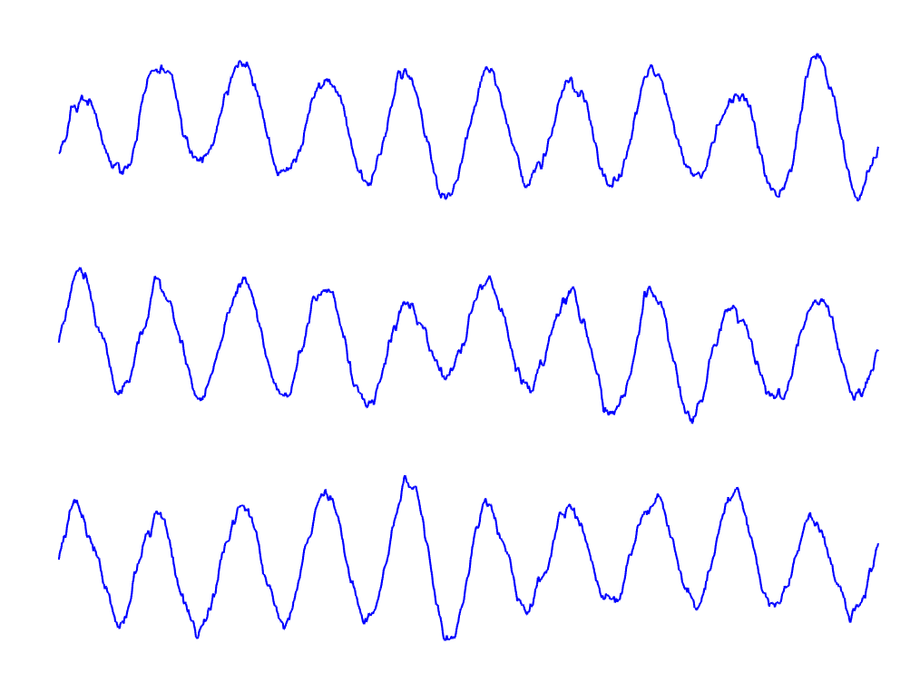
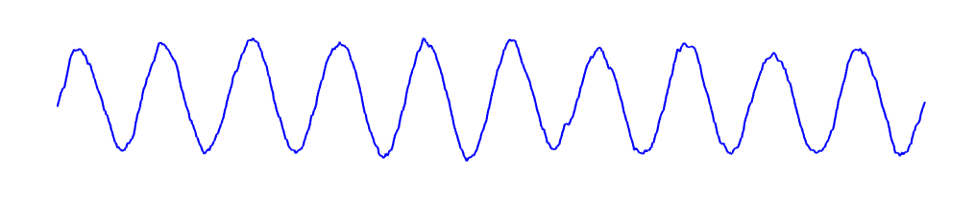
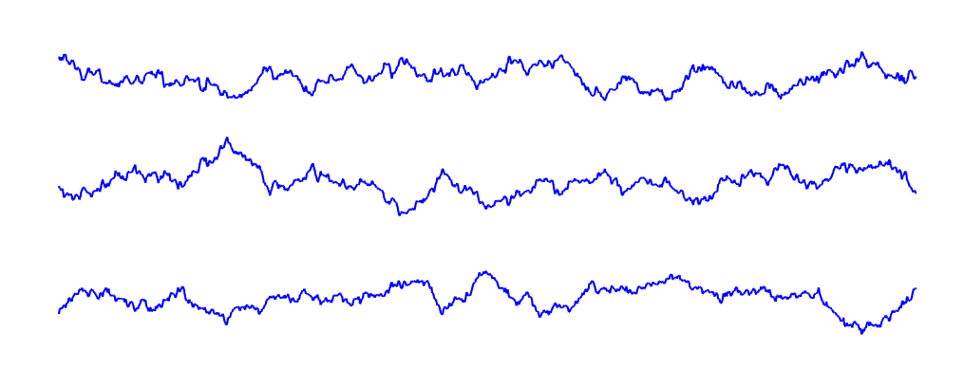
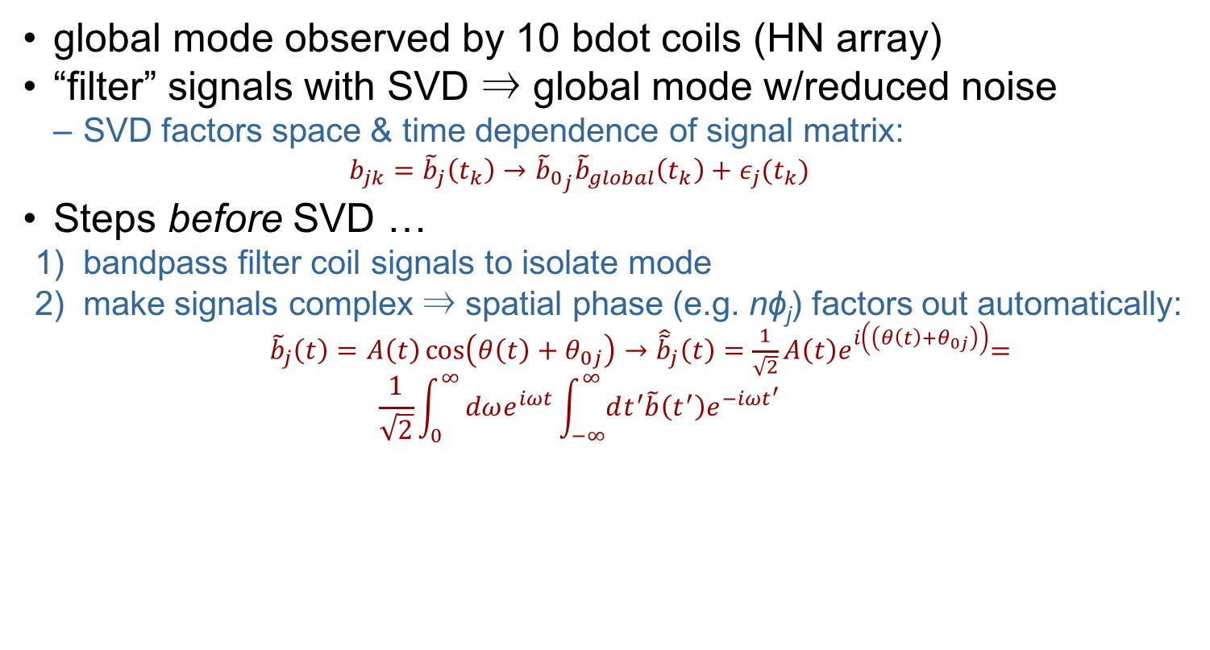
Singular value decomposition gives better “global mode” δb
bdot coil signals
“global mode”
SVD
“noise”
global mode observed by 10 bdot coils (HN array)
“filter” signals with SVD ⇒ global mode w/reduced noise
  SVD factors space & time dependence of signal matrix:
    $$b_{jk}={\tilde{b}}_{j}\left(t_{k}\right)→{{\tilde{b}}_{0}}_{j}{\tilde{b}}_{global}\left(t_{k}\right)+ε_{j}(t_{k})$$
Steps before SVD …
  bandpass filter coil signals to isolate mode
  make signals complex ⇒ spatial phase (e.g. nϕ_{j}) factors out automatically:
    ${\tilde{b}}_{j}\left(t\right)=A\left(t\right)\cos\left(θ\left(t\right)+θ_{0j}\right)→{\hat{\tilde{b}}}_{j}\left(t\right)=\frac{1}{\sqrt{2}}A\left(t\right)e^{i\left(\left(θ\left(t\right)+θ_{0j}\right)\right)}$=
    $$\frac{1}{\sqrt{2}}\int_{0}^{∞}{dωe^{iωt}\int_{−∞}^{∞}{dt^{′}\tilde{b}\left(t^{′}\right)e^{−iωt^{′}}}}$$

Slide 13
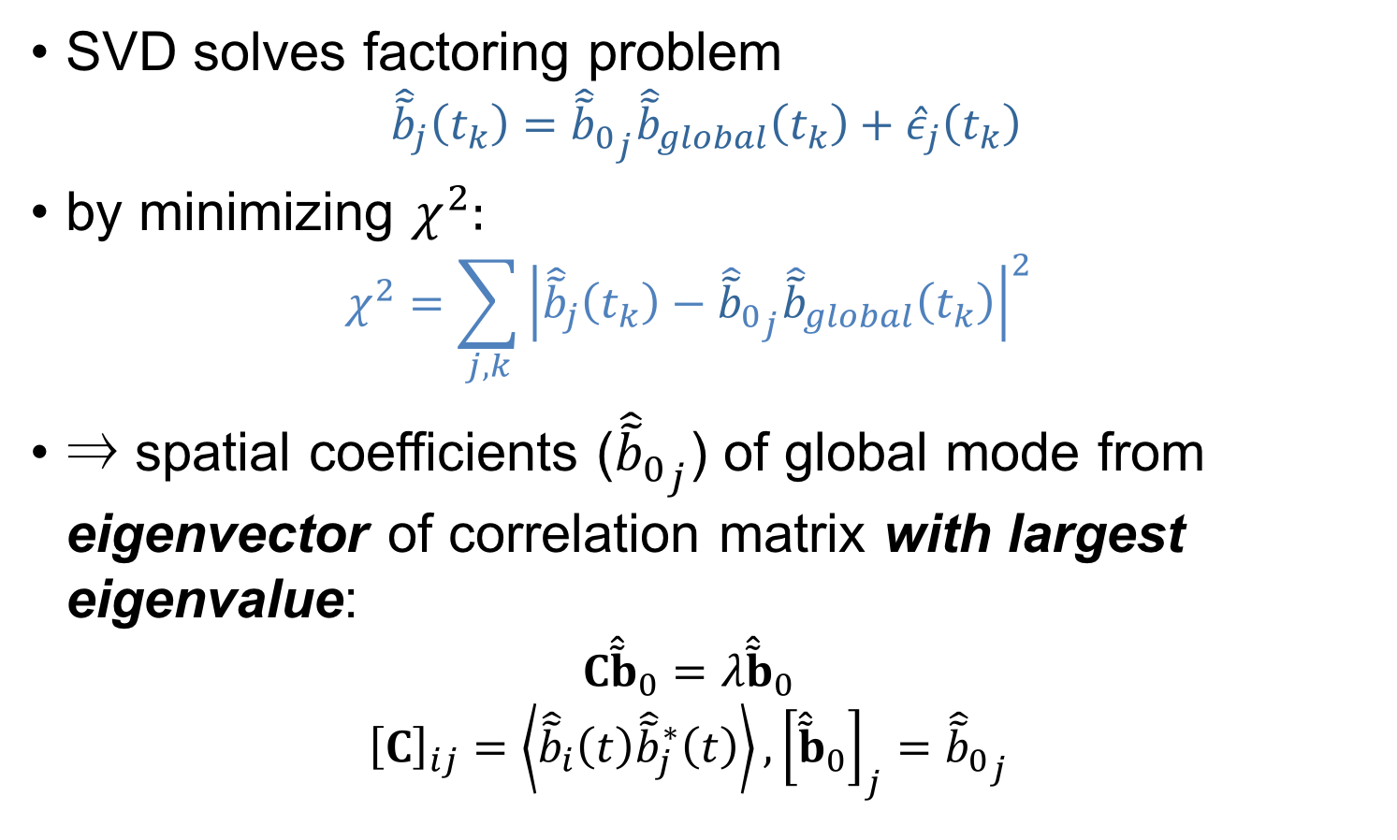
SVD finds global mode from eigenvector of signal correlation matrix
SVD solves factoring problem
  $${\hat{\tilde{b}}}_{j}\left(t_{k}\right)={{\hat{\tilde{b}}}_{0}}_{j}{\hat{\tilde{b}}}_{global}\left(t_{k}\right)+{\hat{ε}}_{j}\left(t_{k}\right)$$
  by minimizing $χ^{2}:$
  $$χ^{2}=\sum_{j,k}{{\left|{\hat{\tilde{b}}}_{j}\left(t_{k}\right)−{{\hat{\tilde{b}}}_{0}}_{j}{\hat{\tilde{b}}}_{global}\left(t_{k}\right)\right|}^{2}}$$
  ⇒ spatial coefficients (${{\hat{\tilde{b}}}_{0}}_{j}$) of global mode from eigenvector of correlation matrix with largest eigenvalue:
  $$C{\hat{\tilde{b}}}_{0}=λ{\hat{\tilde{b}}}_{0}$$
  $${\left[C\right]}_{ij}=\left\langle {\hat{\tilde{b}}}_{i}\left(t\right){\hat{\tilde{b}}}_{j}^{∗}\left(t\right)\right\rangle ,{\left[{\hat{\tilde{b}}}_{0}\right]}_{j}={{\hat{\tilde{b}}}_{0}}_{j}$$

Slide 14
Results of Reflectometer Analysis

Slide 15
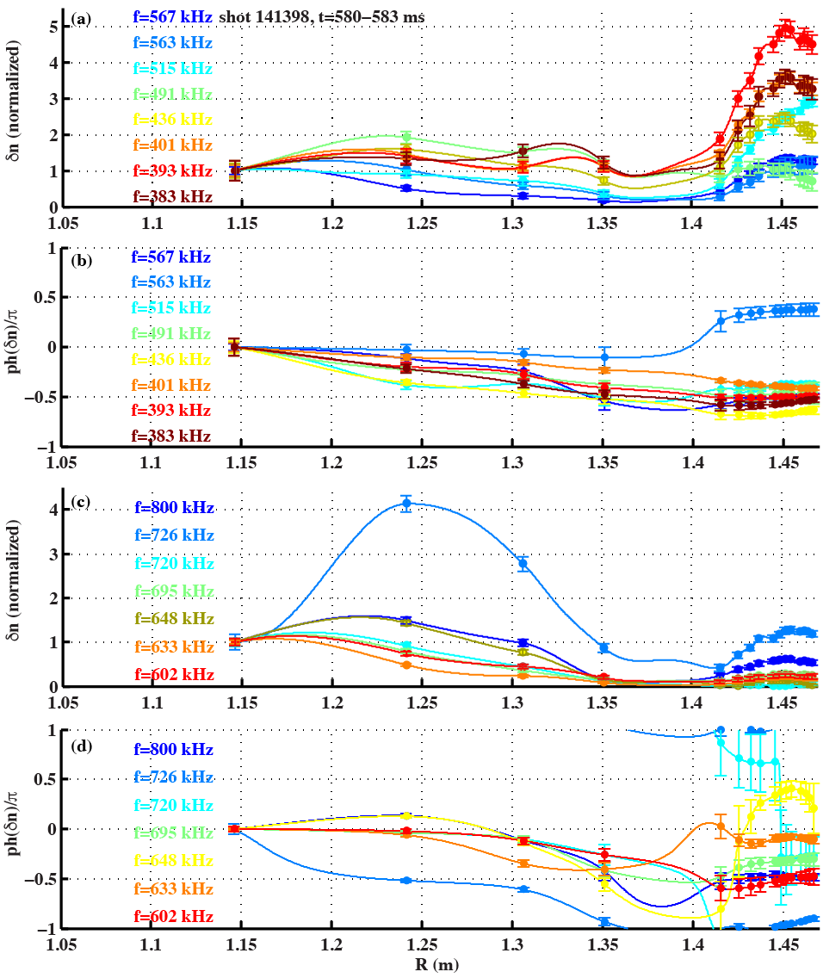
CAEs and GAEs have different δn structure
CAEs
CAEs have large, broad core peaks & small edge amplitude
GAEs have low amplitude, broad structure in core & large edge peaks
Note: large edge peaks can be caused by small edge radial displacements
GAEs

Slide 16
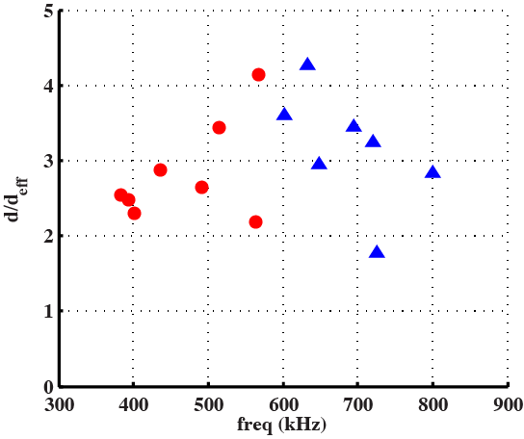
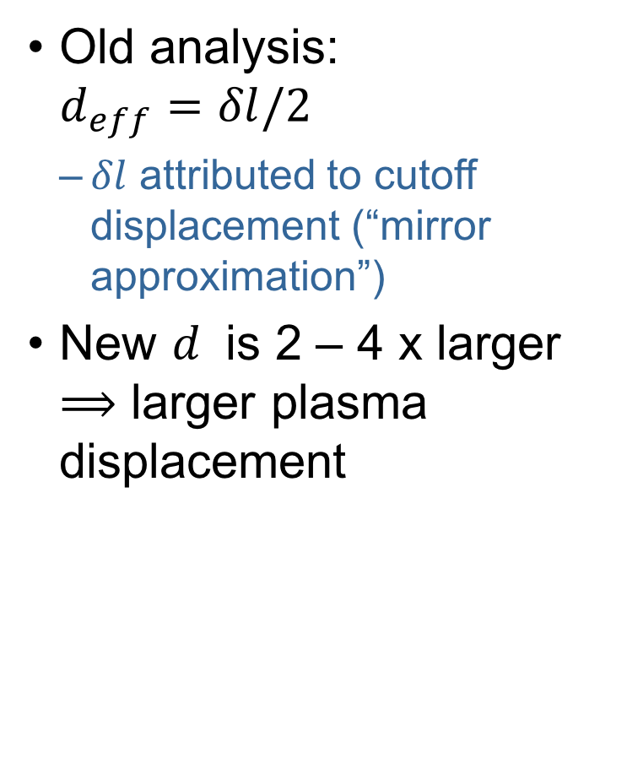
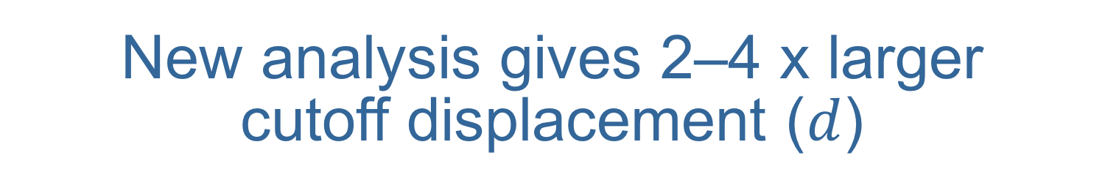
New analysis gives 2–4 x larger cutoff displacement ($d$)
Old analysis:
$d_{eff}=δl/2$
  $δl$ attributed to cutoff displacement (“mirror approximation”)
New $d$ is 2 – 4 x larger $⟹$ larger plasma displacement
Cutoff displacement ≠ plasma displacement
  Compression also causes cutoff displacement

Slide 17
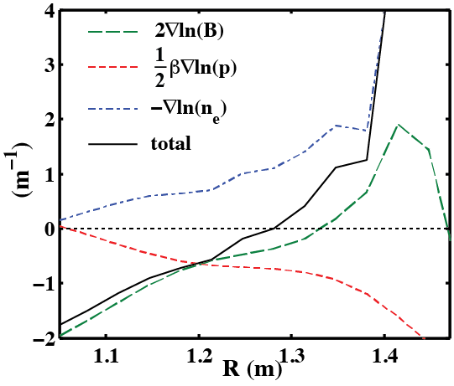
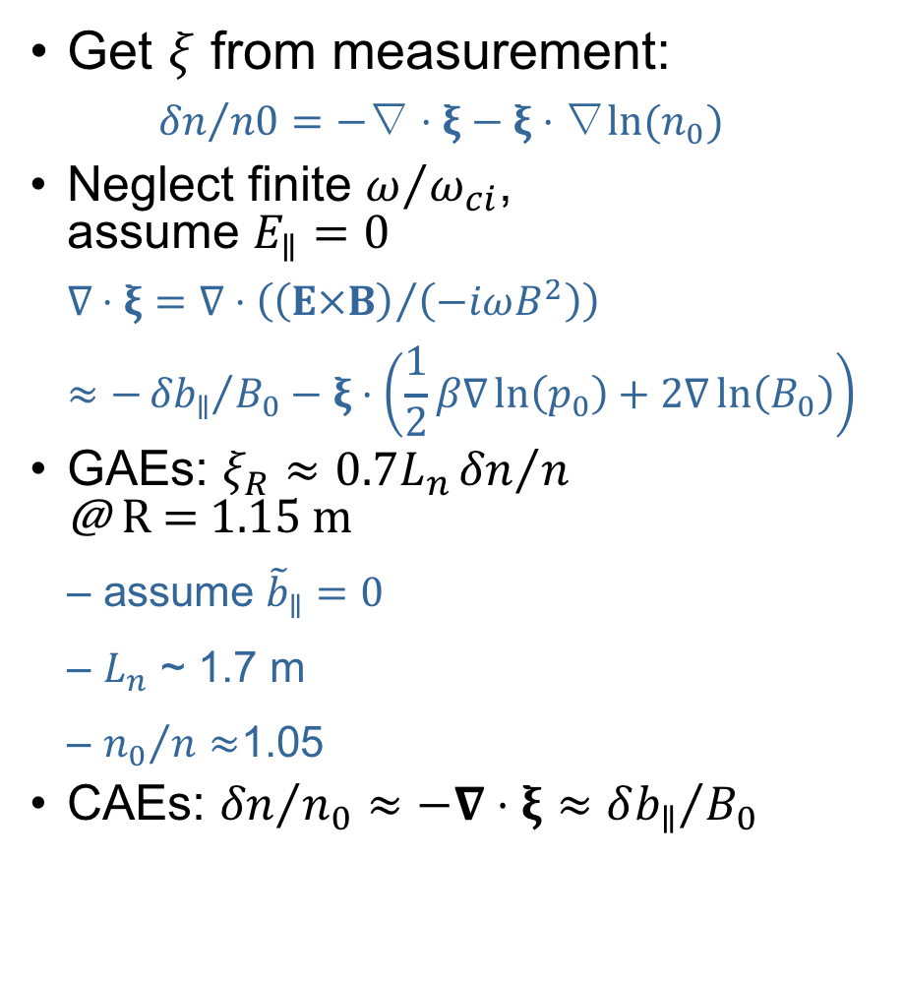
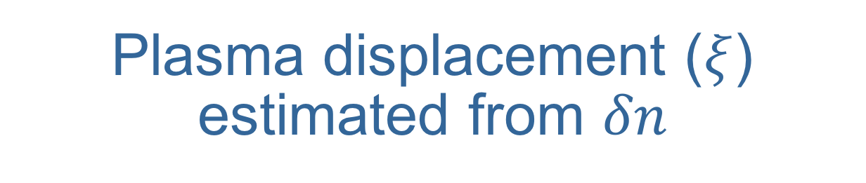
Plasma displacement ($ξ$) estimated from $δn$
shot 141398
t=582 ms
Get $ξ$ from measurement:
  $${δn}/{n0}=−\text{∇}⋅ξ−ξ⋅\text{∇}{ln(n}_{0})$$
  Neglect finite $ω/{ω_{ci}}$,
  assume $E_{∥}=0$
    $$\text{∇}⋅ξ=\text{∇}⋅\left({\left(E×B\right)}/{\left(−iωB^{2}\right)}\right)≈−{{δb}_{∥}}/{B_{0}}−ξ⋅\left(\frac{1}{2}β\text{∇}\ln\left(p_{0}\right)+2\text{∇}\ln\left(B_{0}\right)\right)$$
GAEs: $ξ_{R}≈0.7L_{n}{δn}/n$
@ R = 1.15 m
  assume ${\tilde{b}}_{∥}=0$
  $L_{n}$ ~ 1.7 m
  ${n_{0}}/{n≈}$1.05
CAEs: ${δn}/{n_{0}}≈−∇⋅ξ≈{δb_{∥}}/{B_{0}}$
partial kinetic EFIT + Thomson Scattering

Slide 18

Prediction of $χ_{e}$ and comparison with TRANSP

Slide 19
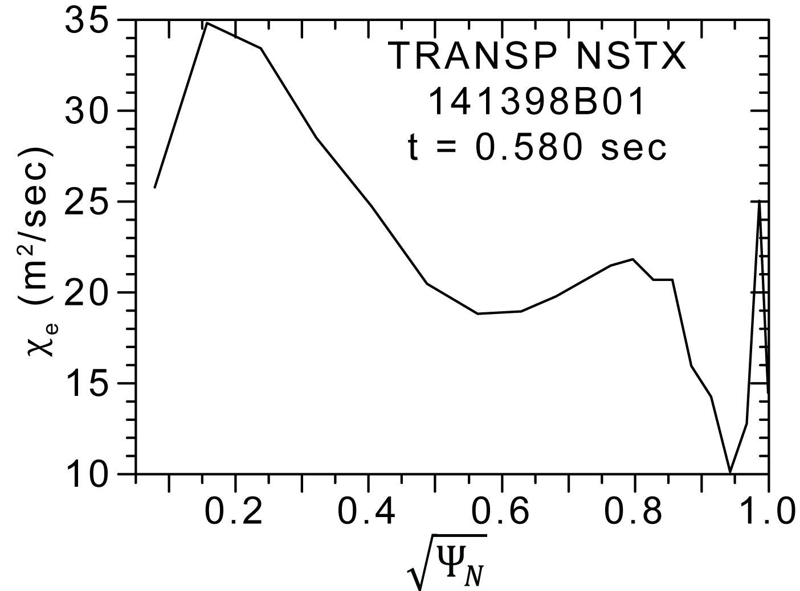
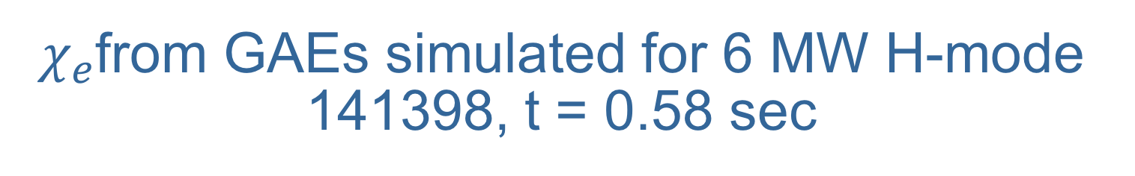
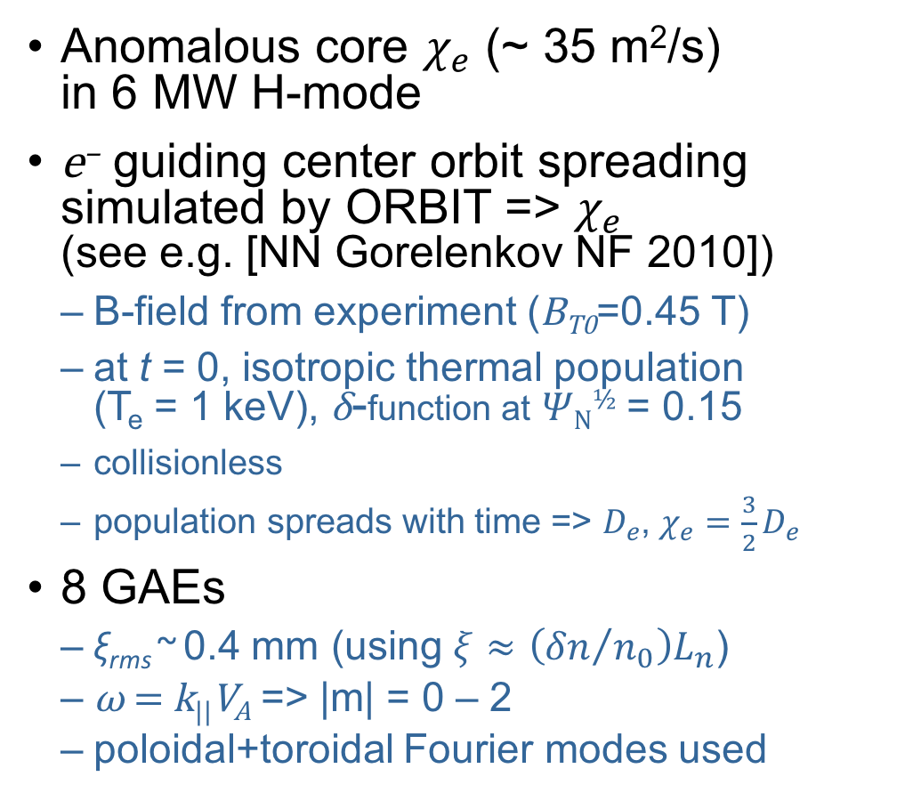
$χ_{e}$from GAEs simulated for 6 MW H-mode 141398, t = 0.58 sec
Anomalous core $χ_{e}$ (~ 35 m²/s)
in 6 MW H-mode
e– guiding center orbit spreading
simulated by ORBIT => $χ_{e}$
(see e.g. [NN Gorelenkov NF 2010])
  B-field from experiment (B_{T0}=0.45 T)
  at t = 0, isotropic thermal population
  (T_{e} = 1 keV), δ-function at 𝛹_{N}^{½} = 0.15
  collisionless
  population spreads with time => $D_{e}$, $χ_{e}=\frac{3}{2}D_{e}$
8 GAEs
  ξ_{rms} ~ 0.4 mm (using $ξ≈\left({δn}/{n_{0}}\right)L_{n}$)
  ω = k||V_{A} => |m| = 0 – 2
  poloidal+toroidal Fourier modes used
simulation
location
f (kHz) | n | m | ξ (mm)
383 | -8 | -2 | 0.1
393 | -7 | -1 | 0.11
401 | -8 | -2 | 0.13
436 | -7 | 0 | 0.12
491 | -8 | 0 | 0.06
515 | -7 | 1 | 0.21
563 | -6 | 2 | 0.05
567 | -8 | 1 | 0.25

Slide 20
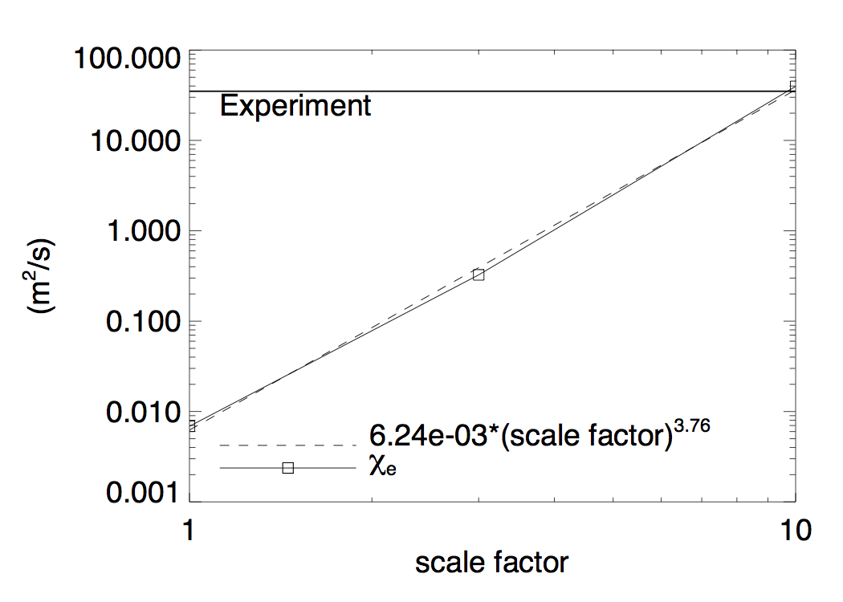
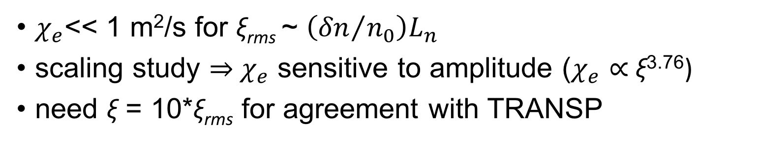
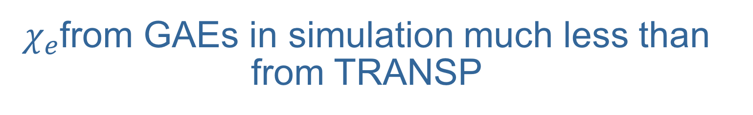
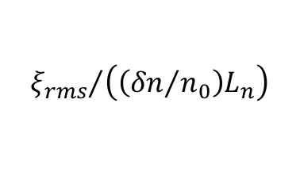
$χ_{e}$from GAEs in simulation much less than from TRANSP
$${ξ_{rms}}/{\left(\left({δn}/{n_{0}}\right)L_{n}\right)}$$
$χ_{e}$<< 1 m²/s for ξ_{rms} ~ $\left({δn}/{n_{0}}\right)L_{n}$
scaling study ⇒ $χ_{e}$ sensitive to amplitude ($χ_{e}$ ∝ ξ^{3.76})
need ξ = 10*ξ_{rms} for agreement with TRANSP

Slide 21
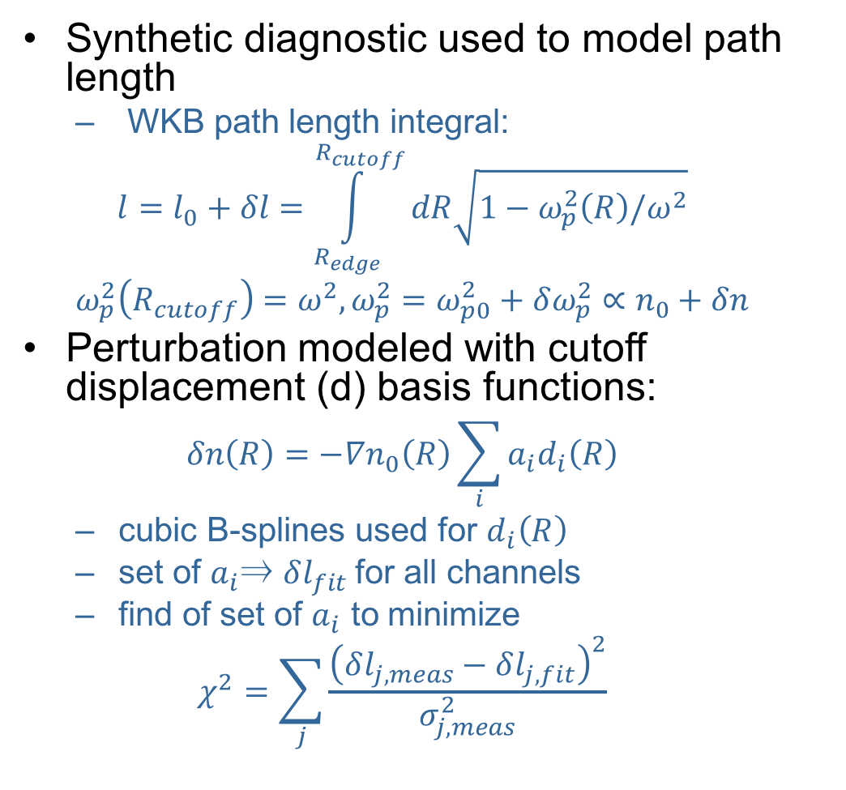
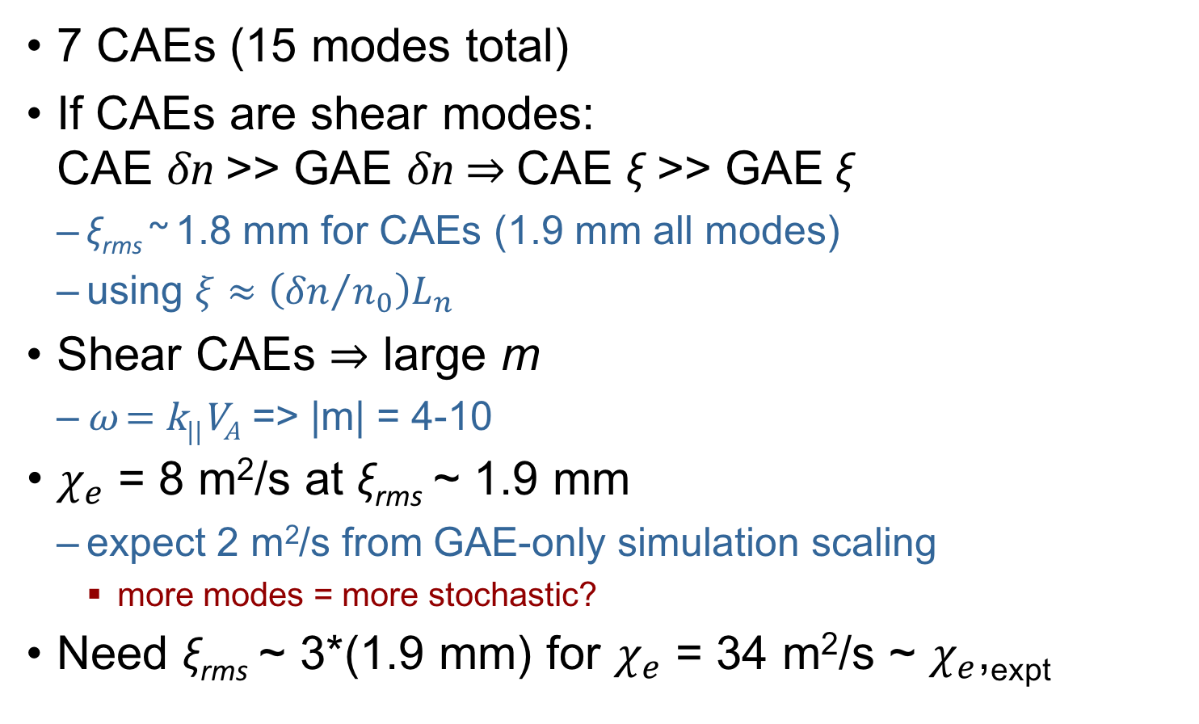
Inclusion of CAEs as shear modes increases simulated $χ_{e}$, but still not enough
7 CAEs (15 modes total)
If CAEs are shear modes:
CAE δn >> GAE δn ⇒ CAE ξ >> GAE ξ
  ξ_{rms} ~ 1.8 mm for CAEs (1.9 mm all modes)
  using $ξ≈\left({δn}/{n_{0}}\right)L_{n}$
Shear CAEs ⇒ large m
  ω = k||V_{A} => |m| = 4-10
$χ_{e}$ = 8 m²/s at ξ_{rms} ~ 1.9 mm
  expect 2 m²/s from GAE-only simulation scaling
    more modes = more stochastic?
Need ξ_{rms} ~ 3*(1.9 mm) for $χ_{e}$ = 34 m²/s ~ $χ_{e}$,_{expt}
f (kHz) | n | m | ξ (mm)
602 | -5 | 4 | 0.31
633 | -4 | 5 | 1.23
648 | -1 | 8 | 1.05
695 | -5 | 5 | 0.26
720 | 0 | 10 | 0.36
726 | -3 | 7 | 0.57
800 | -4 | 7 | 0.32

Slide 22
Comparison with HYM Simulation and Test of CAE-KAW Coupling

Slide 23
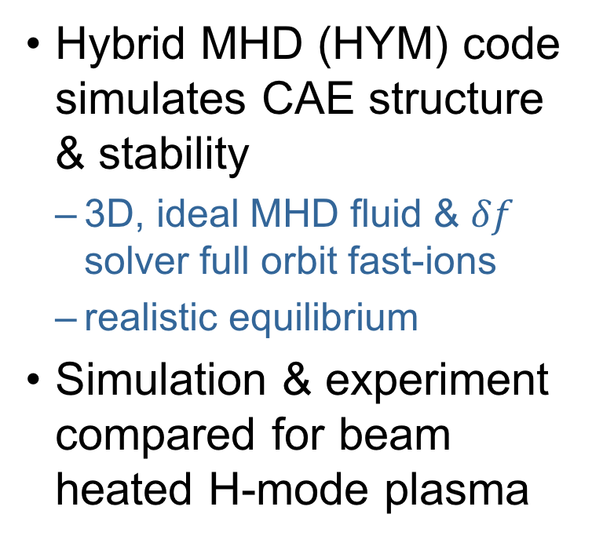
Initial comparison of HYM simulation & measurement promising
Hybrid MHD (HYM) code simulates CAE structure & stability
  3D, ideal MHD fluid & $δf$ solver full orbit fast-ions
  realistic equilibrium
Simulation & experiment compared for beam heated H-mode plasma
shot 141398, t = 580 ms
[E Belova PoP 2017]
Most-unstable modes have f & n similar to observed experimental spectrum [E Belova PoP 2017]

Slide 24
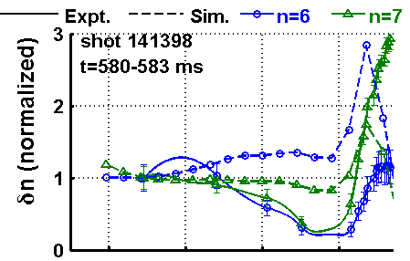
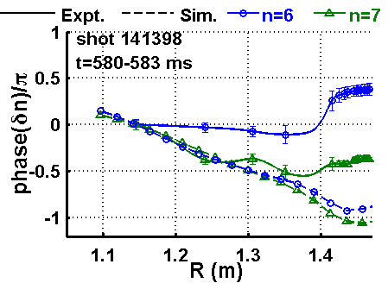
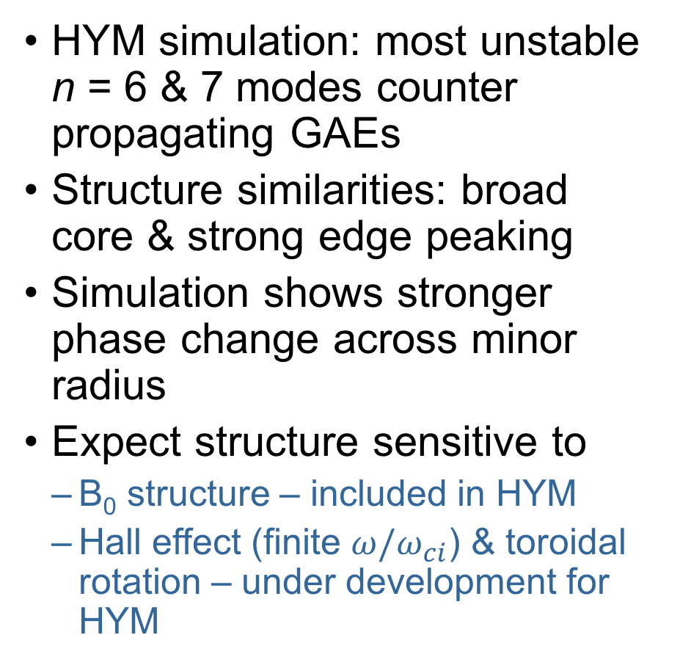
Initial comparison of HYM simulation & measurement promising
HYM simulation: most unstable
n = 6 & 7 modes counter propagating GAEs
Structure similarities: broad core & strong edge peaking
Simulation shows stronger phase change across minor radius
Expect structure sensitive to
  B₀ structure – included in HYM
  Hall effect (finite $ω/ω_{ci}$) & toroidal rotation – under development for HYM
n=-6
n=-7
Expt.: f =
563 kHz
515 kHz

Slide 25
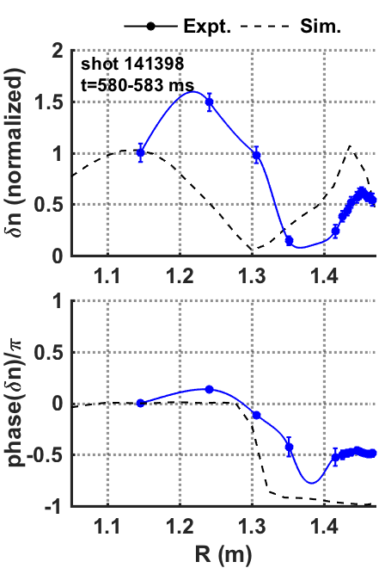
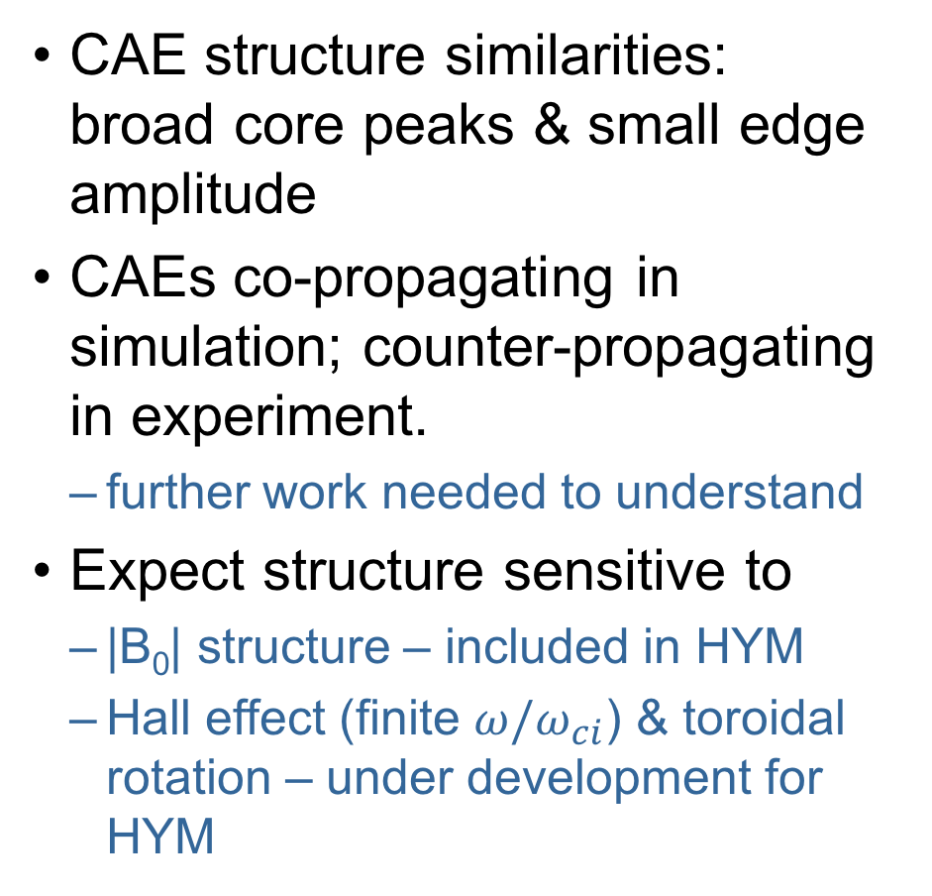
Initial comparison of HYM simulation & measurement promising
CAE structure similarities: broad core peaks & small edge amplitude
CAEs co-propagating in simulation; counter-propagating in experiment.
  further work needed to understand
Expect structure sensitive to
  |B₀| structure – included in HYM
  Hall effect (finite $ω/ω_{ci}$) & toroidal rotation – under development for HYM
Expt.: f = 800 kHz
|n|=4

Slide 26
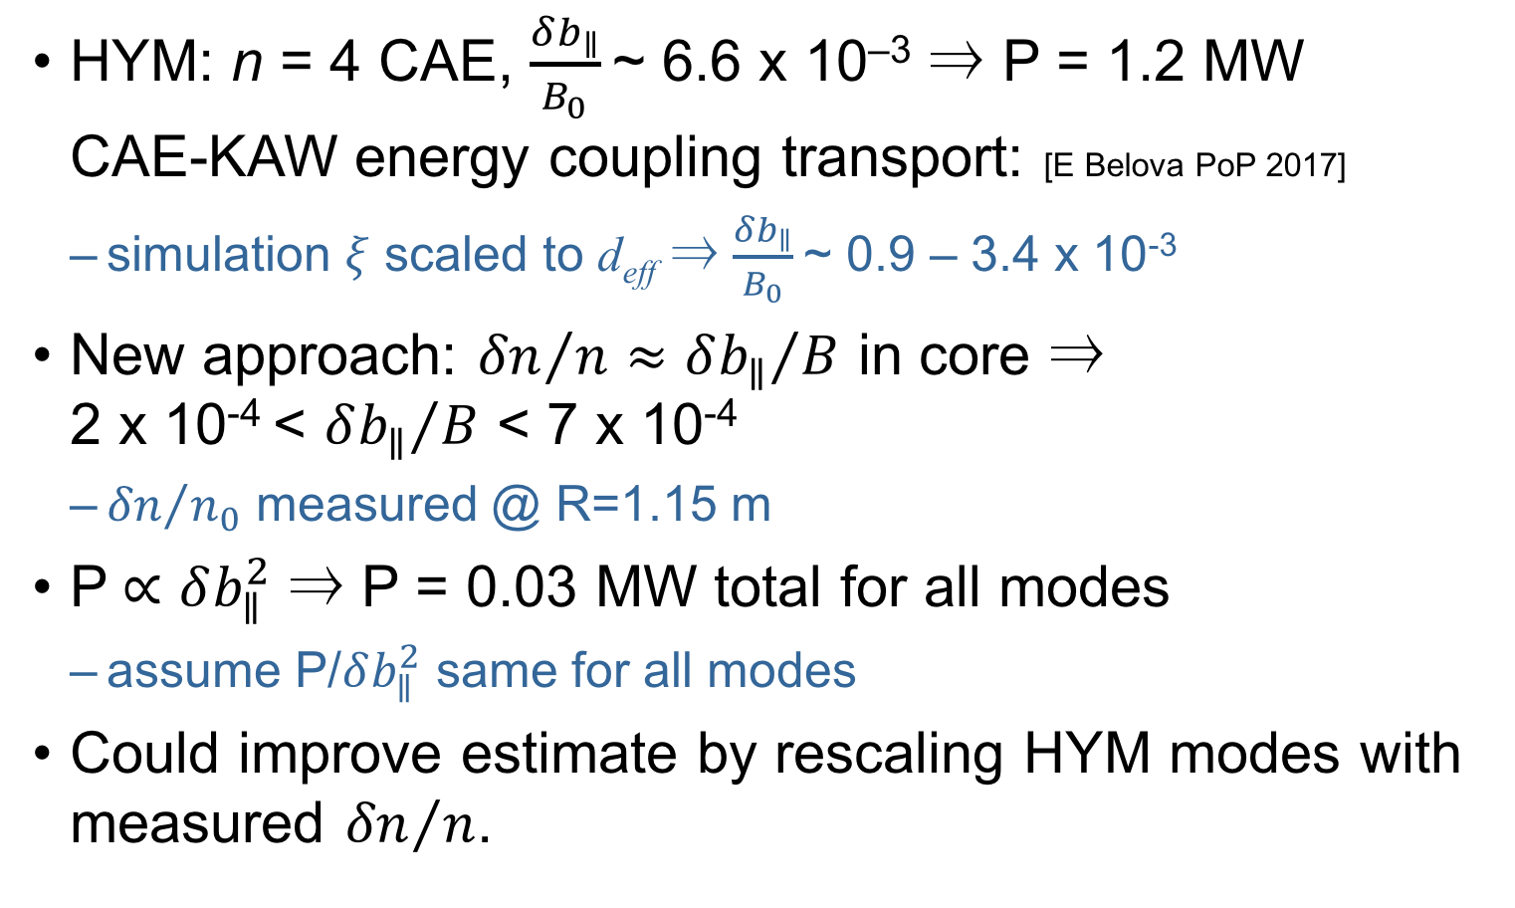
Measurements + Simulation ⇒ Small CAE-KAW energy transport
HYM: n = 4 CAE, $\frac{δb_{∥}}{B_{0}}$~ 6.6 x 10^{–3} ⇒ P = 1.2 MW
CAE-KAW energy coupling transport: [E Belova PoP 2017]
  simulation $ξ$ scaled to d_{eff} ⇒ $\frac{δb_{∥}}{B_{0}}$~ 0.9 – 3.4 x 10⁻³
New approach: ${δn}/n≈{δb_{∥}}/B$ in core ⇒
2 x 10⁻⁴ < ${δb_{∥}}/B$ < 7 x 10⁻⁴
  ${δn}/{n_{0}}$ measured @ R=1.15 m
P$∝δb_{∥}^{2}$ ⇒ P = 0.03 MW total for all modes
  assume P/$δb_{∥}^{2}$ same for all modes
Could improve estimate by rescaling HYM modes with measured ${δn}/n$.

Slide 27
Conclusions and Future Work

Slide 28
New δn measurements advance understanding of CAE & GAE effect on core energy transport
New multi-channel reflectometer analysis ⇒ more accurate δn internal amplitude and structure
  cutoff displacement larger than previous analysis
GAE modification of e– drift orbits ⇒ GAEs (or GAE+shear CAEs) too small to explain χ_{e} from TRANSP
Measured and simulated GAE structures show rough similarities
  HYM development currently under way may explain differences
New δn + HYM Poynting Flux ⇒ CAE-KAW energy flux small

Slide 29
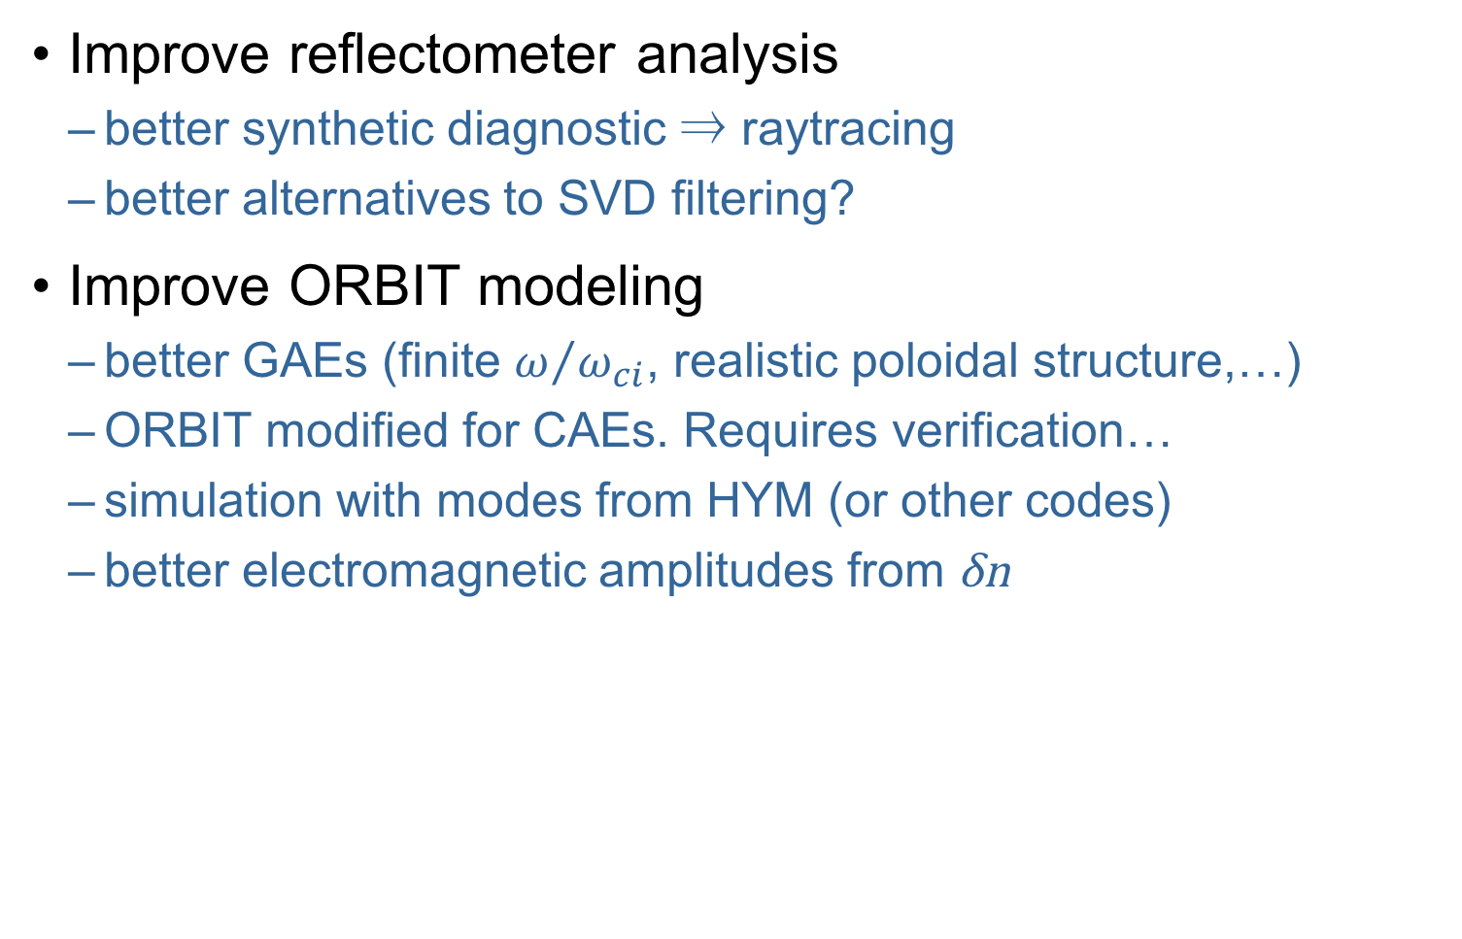
Many avenues for future work
Improve reflectometer analysis
  better synthetic diagnostic ⇒ raytracing
  better alternatives to SVD filtering?
Improve ORBIT modeling
  better GAEs (finite $ω/{ω_{ci}}$, realistic poloidal structure,…)
  ORBIT modified for CAEs. Requires verification…
  simulation with modes from HYM (or other codes)
  better electromagnetic amplitudes from δn

Slide 30

Many avenues for future work
Understand simulation & measured structure differences
  exploit measured phase to understand role of Hall effect & rotation?
Improve CAE-KAW estimate from HYM: rescale HYM modes with measured ${δn}/n$

Slide 31
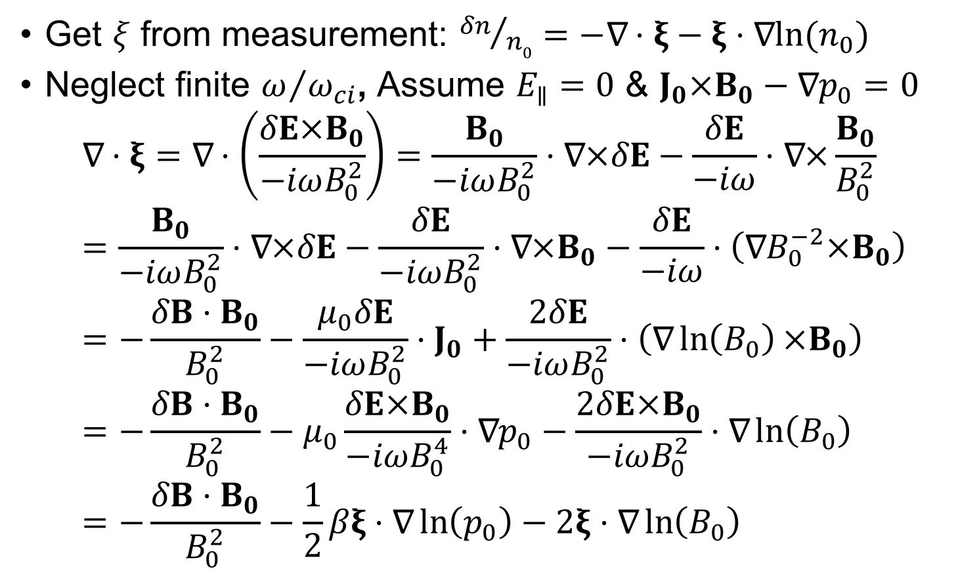
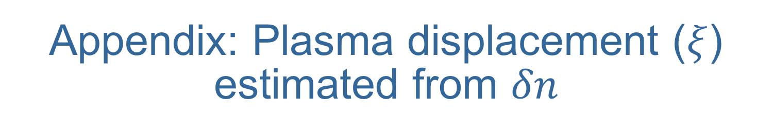
Appendix: Plasma displacement ($ξ$) estimated from $δn$
Get $ξ$ from measurement: ${δn}/{n0}=−\text{∇}⋅ξ−ξ⋅\text{∇}{ln⁡(n}_{0})$
Neglect finite $ω/{ω_{ci}}$, Assume $E_{∥}=0$ & $J_{0}×B_{0}−\text{∇}p_{0}=0$
$$\text{∇}⋅ξ=\text{∇}⋅\left(\frac{δE×B_{0}}{−iωB_{0}^{2}}\right)=\frac{B_{0}}{−iωB_{0}^{2}}⋅\text{∇}×δE−\frac{δE}{−iω}⋅\text{∇}×\frac{B_{0}}{B_{0}^{2}}=\frac{B_{0}}{−iωB_{0}^{2}}⋅\text{∇}×δE−\frac{δE}{−iωB_{0}^{2}}⋅\text{∇}×B_{0}−\frac{δE}{−iω}⋅\left(\text{∇}B_{0}^{−2}×B_{0}\right)=−\frac{δB⋅B_{0}}{B_{0}^{2}}−\frac{μ_{0}δE}{−iωB_{0}^{2}}⋅J_{0}+\frac{2δE}{−iωB_{0}^{2}}⋅\left(\text{∇}\ln\left(B_{0}\right)×B_{0}\right) \\ =−\frac{δB⋅B_{0}}{B_{0}^{2}}−μ_{0}\frac{δE×B_{0}}{−iωB_{0}^{4}}⋅\text{∇}p_{0}−\frac{2δE×B_{0}}{−iωB_{0}^{2}}⋅\text{∇}\ln\left(B_{0}\right) \\ =−\frac{δB⋅B_{0}}{B_{0}^{2}}−\frac{1}{2}βξ⋅\text{∇}\ln\left(p_{0}\right)−2ξ⋅\text{∇}\ln\left(B_{0}\right)$$

