Slide 1
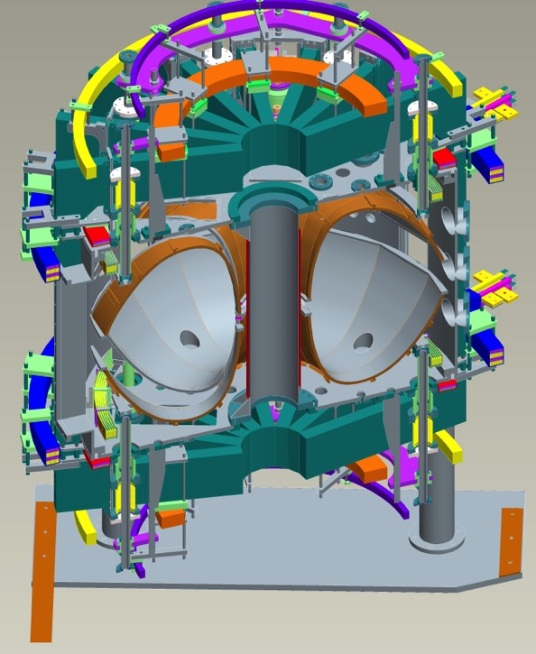
LTX and LTX-β
 | LTX | LTX-β
A | 1.6 | 1.6
R₀ | 40 cm | 40 cm
a | 26 cm | 26 cm
B_{T} | <1.7 kG | <3.4 kG
I_{p} | <100 kA | <200 kA
P_{aux} | 0 | 700 kW
Pulse length | <50 msec | <100 msec
High field-side limited by a conformal, high-Z wall
Operated in hydrogen (gas puffing)
35A neutral beam fueling, improved HFS puffing, topside SGI
CHERs, many new diagnostics
1.4 m

Slide 2
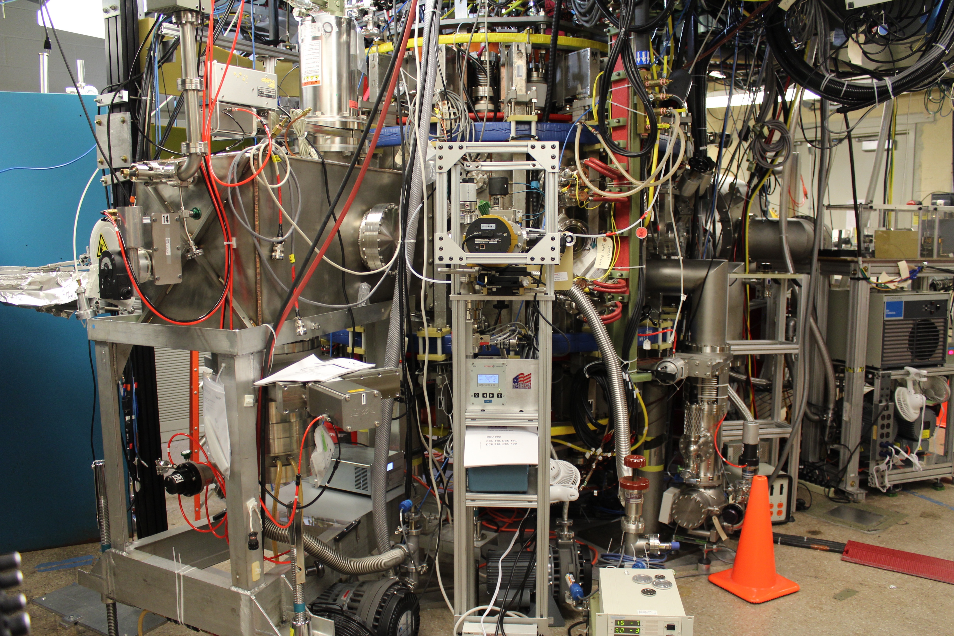
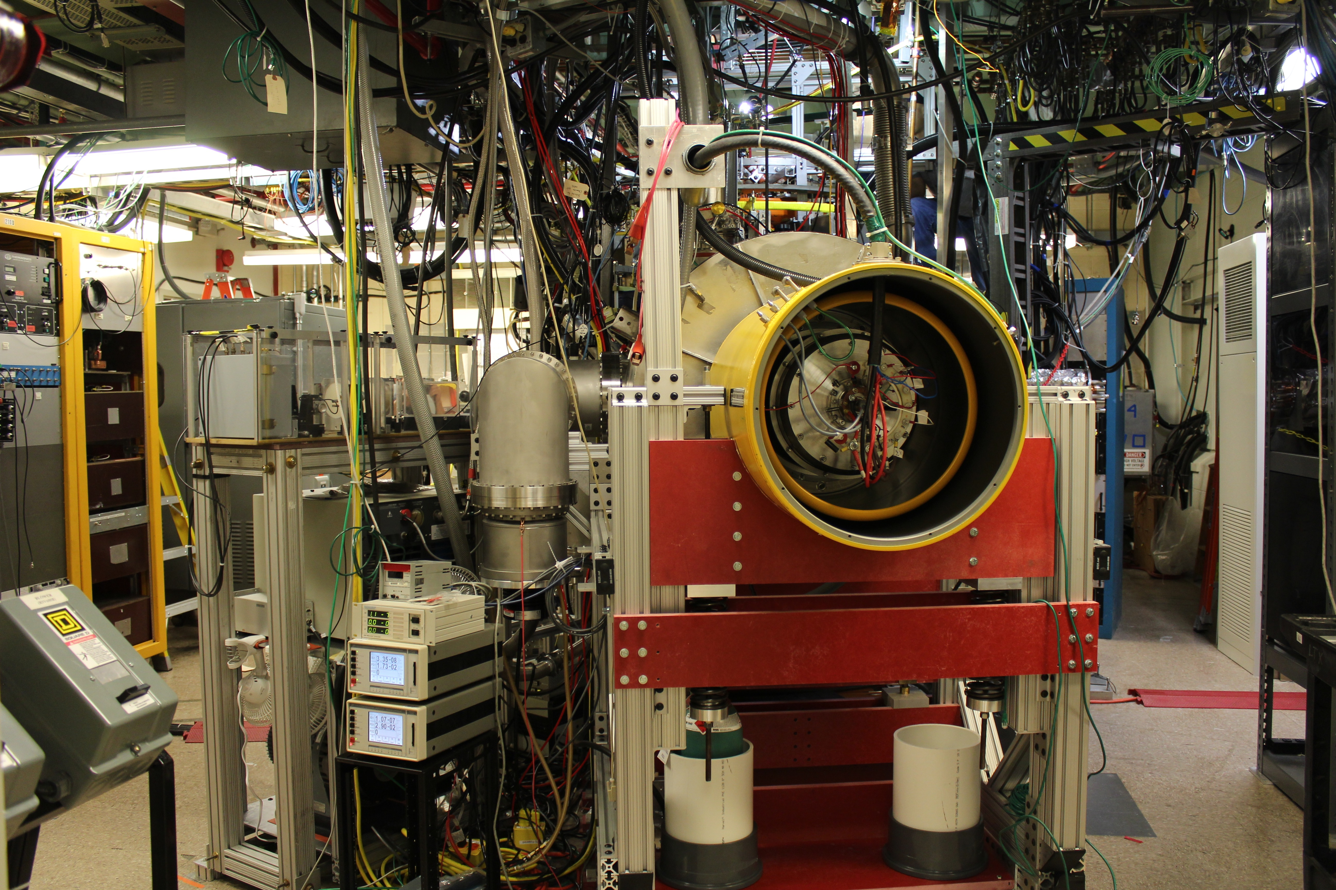
LTX-β status
Machine is fully operational
All coils and power supplies have been run to 100% of startup requirements
Neutral beam power supply tested to full operating parameters
Neutral beam grids have been hipotted to 40 kV
2x operating voltage
Source has not been operated
Mounting the NSTX-U granule injector
Still adding diagnostics
But: permission to run LTX-β with plasma has not been granted

Slide 3
Near-term program
Begin with discharges on uncoated stainless steel walls
Baseline shots
First lithium experiments will use the granule injector
Will permit comparison of lithium granule injection vs. evaporative wall coatings
Evaporative coating of walls with lithium expected in late October/early November
New evaporators also intended for use in NSTX-U
Procedures for beam operation in preparation
Hope to operate beam into the calorimeter late this month or early October
Characterization of beam heated, fueled plasmas with low recycling lithium walls a lab notable for March 2019

