Slide 1
ITER Diagnostics Work at PPPL
Hutch Neilson
U.S. ITER Diagnostics Team Lead
Princeton Plasma Physics Laboratory
NSTX-U / MFE Science Meeting
15 October 2018

Slide 2
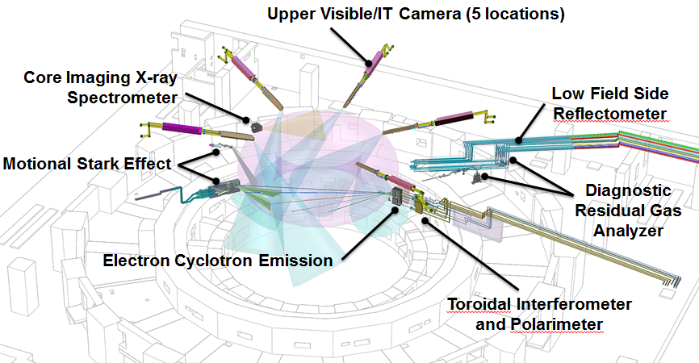
PPPL is responsible for all 7 U.S. ITER diagnostics
Also port integration for four ports: 2 equatorial and 2 upper.
Upper Visible/IR Camera (5 Locations)
Low Field Side Reflectometer is the only active project at this time

Slide 3
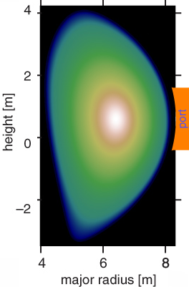
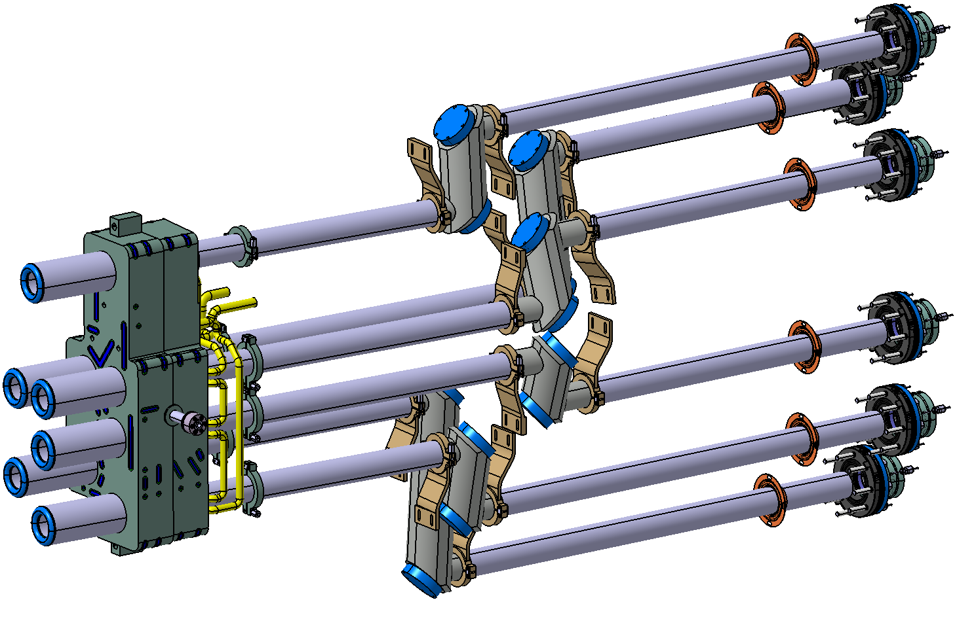
Plasma Density Profile Measurement by Microwave Reflectometry
Reflection layers exist in the plasma depending on density and microwave frequency.
  A given frequency corresponds to a value of density
Sweep through a range of frequencies and measure the time delay (τ) of each frequency component → density profile
Addresses measurement roles:
  edge n_{e} profile
  H-mode and ELM transients
LFSR antenna array
80 GHz
50 GHz
f
Transmit signal
~4 𝜇s
Return signal
~25 GHz
τ
System can also measure density fluctuations and poloidal rotation.
t

Slide 4
Antenna-plasma coupling has been analyzed for a range of conditions including fluctuations.
Antenna-plasma coupling vs frequency
(avg. and 1σ error bands over 300 simulations per frequency)
H-mode equilibrium density profile
G.J. Kramer et al 2018 Nucl. Fusion 58 126014
https://doi.org/10.1088/1741-4326/aadea1

Slide 5
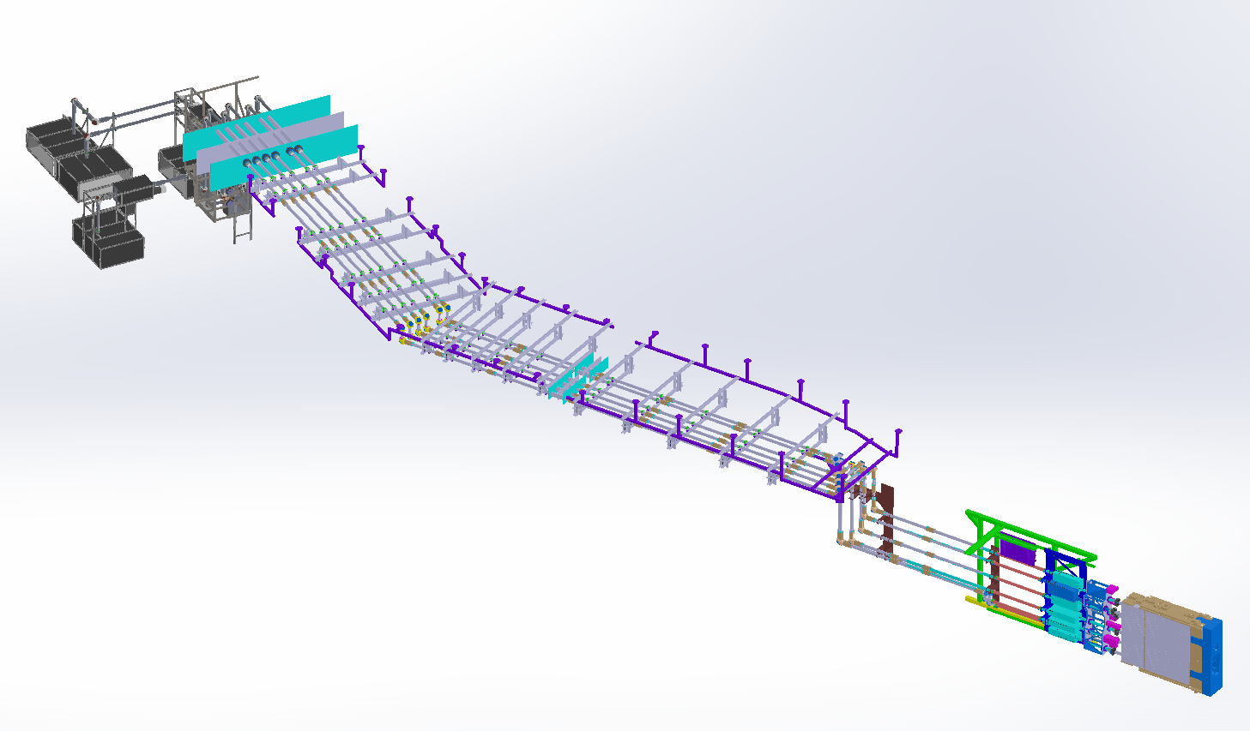
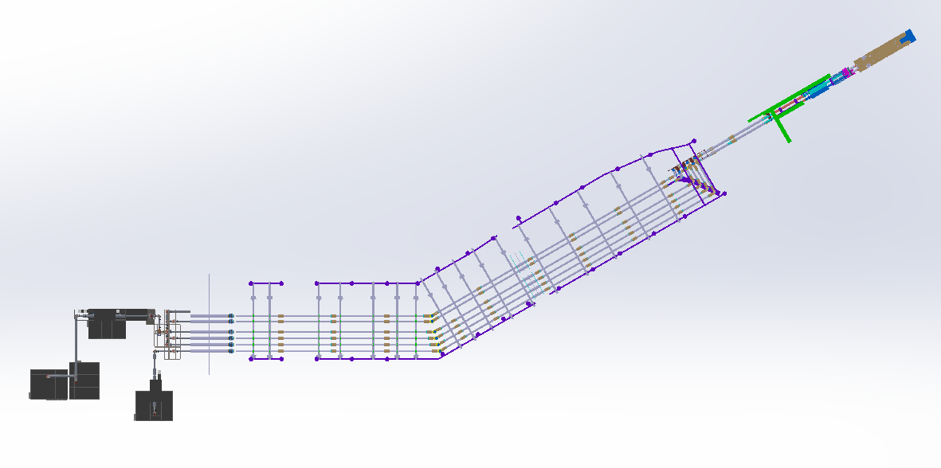
LFSR extends ~50m from first wall to diagnostic hall
Diagnostic Hall
Lintel
Gallery
Port Cell
Interspace
Bio-shield
Overhead View:
Closure Plate
In Vessel

Slide 6
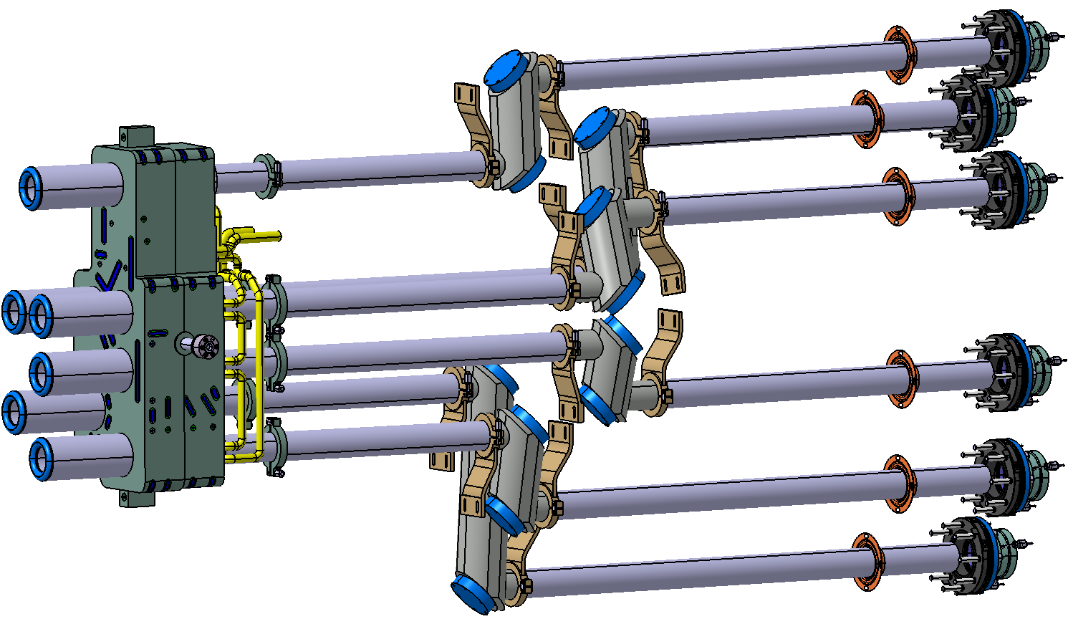
In-vessel Equipment
Stainless steel waveguide with periscope to prevent streaming.
Support straps attach LFSR equipment to port plug structure.
First plasma scope!

Slide 7
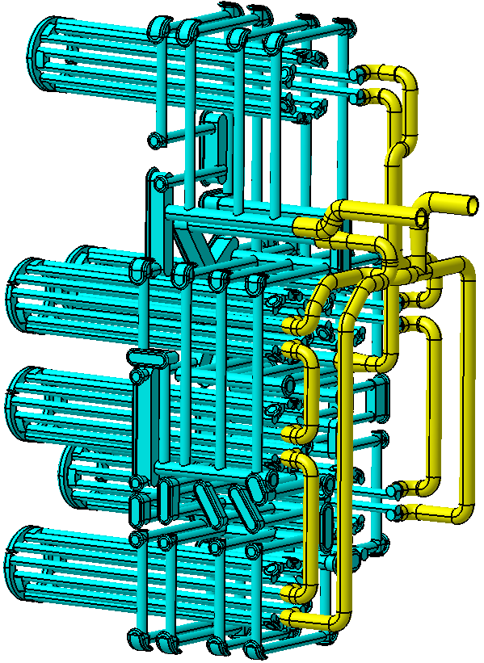
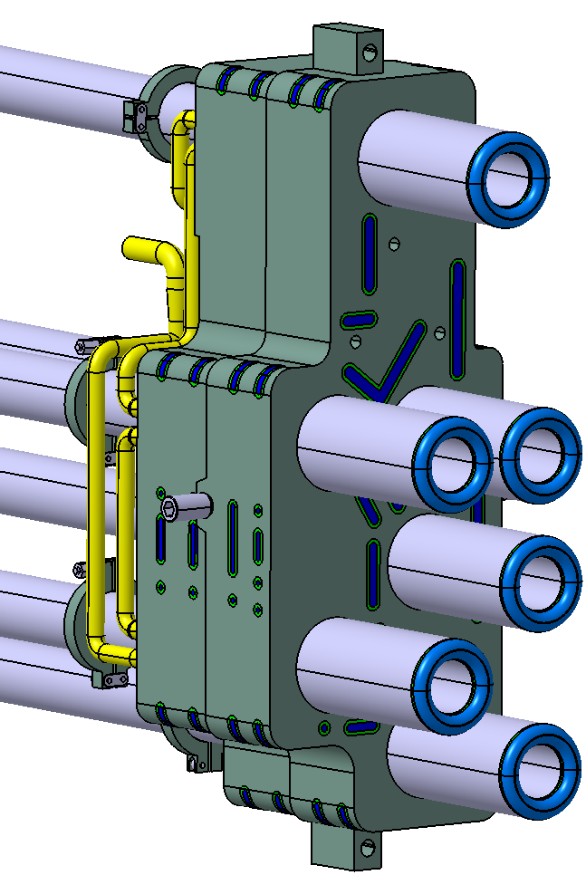
Antenna Assembly
6-antenna array provides required measurement functions
Reflected waves are received by the launching antenna (monostatic)
Water-cooled antennas and support block receive the main nuclear heat loads.
Poloidal rotation
Turbulence
Turbulence & density profile
Density profile

Slide 8
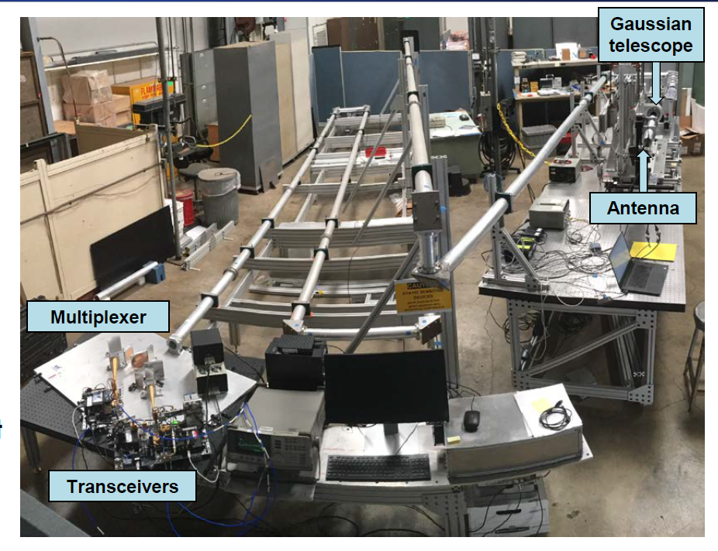
Transmission line system has undergone extensive performance testing at General Atomics.
LFSR transmission-line prototype test stand
Bends
Switches
Beam Splitter / Combiners
Polarization Rotators

Slide 9
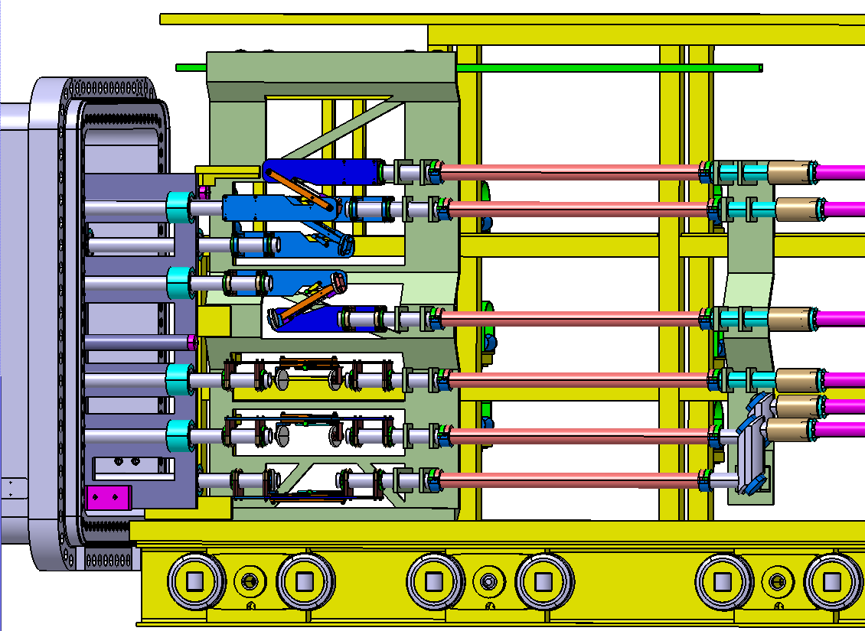
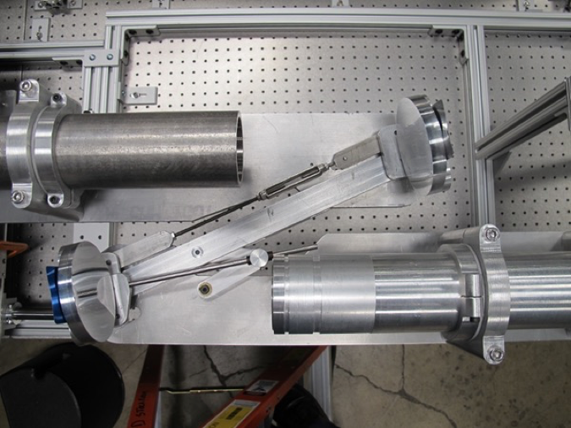
Gaussian Telescope
Maintains beam transmission while accommodating thermal displacements (up to 3 cm) of vessel-mounted waveguides.
Performance successfully demonstrated in proof-of-concept test.
Spherical mirror
Spherical mirror
Gaussian telescope concept test

Slide 10
LFSR Project is Ready for a Preliminary Design Review
Design team: PPPL, General Atomics, UCLA, Palomar Scientific Instruments.
Preparations for Nov. 7-8 PDR are nearly complete.
  >280 system requirements defined
  Design compliance documentation (>100 reports and drawings) submitted and in final review.
  U.S. ITER status review Sept. 11 affirmed readiness to proceed to PDR.

Slide 11
Backups

Slide 12
Required measurement roles: edge electron density (profiles and fluctuations), poloidal rotation
Measurement | Parameter | Contribution | Highest Operation Role | Range Value Coverage | Spatial Coverage | Time Res. | Spatial Res.
Edge electron density profile [1] | Edge n_{e} | Primary | Advanced Control | 5x10¹⁸ – 1x10²⁰ m⁻³ | r/a > 0.85 | 10 ms | 5 mm
Toroidal Alfvén Eigenmode (TAE) density fluctuations [2] | δn_{e} / n_{e} | Primary | Physics | 5x10⁻⁶ – 5x10⁻⁴ | TBD | 30 kHz – 2 MHz | N = 10 - 50
H-mode, ELM and L-H mode transition indicator [3] | ELM / density transient | Primary | Physics | 5x10¹⁸ – 1.5x10²⁰ m⁻³ | r/a > 0.85 | 0.5 ms | 3 mm
Plasma rotation [4] | v_{pol} | Supplementary | Advanced Control | 1 – 50 km/s | r/a > 0.85 | 10 ms | a/50 (~4 cm)
Line-averaged electron density [3] | ∫n_{e} dl / ∫ dl | Supplementary | Basic Control | 5x10¹⁸ – 1.5x10²⁰ m⁻³ | r/a > 0.85 | 10 ms | 3 mm
Core electron density profile [1] | Core n_{e} | Backup | Advanced Control | 5x10¹⁸ – 3x10²⁰ m⁻³ | r/a < 0.85 | 10 ms | a/30 (~7 cm)
Conditions:
Full- and half-field
52 cm range of vertical plasma displacements
[1] “Measurement 23 and 24, Electron Temperature and Density profiles,” SBYVVL
[2] “SRD-55 (Diagnostics) from DOORS,” 28B39L
[3] “Measurement 06 & 14 (line average density and ELMs) Parameter 011, 031,” T8FVZ3
[4] “Measurement Requirements Flow-Down for MP018. Vpol,” R25ZHM
Notes:
This requirement/capability is specific to profile measurements. Fluctuation coverage is smaller, something like 40 cm. Doppler is different yet (I don't have a good number for this at the moment)

Slide 13
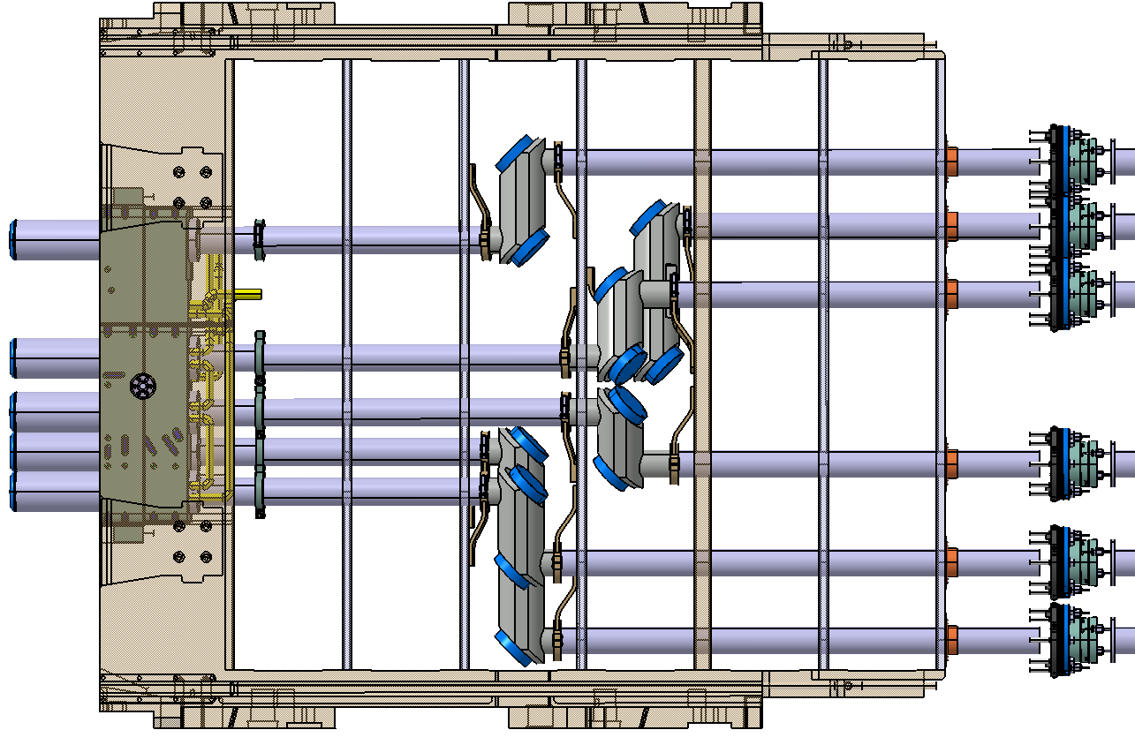
LFSR Integration in Port Plug
Front end components will be installed in a first-plasma port (Equatorial 11) diagnostic shield module (DSM).
Vacuum windows (IO Scope)

