Slide 1
NSTX
Supported by
Transient CHI Plasma Start-up
College W&M
Colorado Sch Mines
Columbia U
Comp-X
General Atomics
INL
Johns Hopkins U
LANL
LLNL
Lodestar
MIT
Nova Photonics
New York U
Old Dominion U
ORNL
PPPL
PSI
Princeton U
Purdue U
SNL
Think Tank, Inc.
UC Davis
UC Irvine
UCLA
UCSD
U Colorado
U Maryland
U Rochester
U Washington
U Wisconsin
R. Raman
University of Washington / NSTX-U
Acknowledgments
T.R. Jarboe, B.A. Nelson (University of Washington)
D. Mueller, M. Bell, M. Ono, J.A. Menard, S.C. Jardin, F. Ebrahimi (PPPL)
K.C. Hammond (IPP Garching),
K. Kuroda, K. Hanada (Kyushu University)
and the NSTX Research Team
Culham Sci Ctr
U St. Andrews
York U
Chubu U
Fukui U
Hiroshima U
Hyogo U
Kyoto U
Kyushu U
Kyushu Tokai U
NIFS
Niigata U
U Tokyo
JAEA
Hebrew U
Ioffe Inst
RRC Kurchatov Inst
TRINITI
KBSI
KAIST
POSTECH
ASIPP
ENEA, Frascati
CEA, Cadarache
IPP, Jülich
IPP, Garching
ASCR, Czech Rep
U Quebec
This work is supported by US DOE contract numbers FG03-96ER5436, DE-FG02-99ER54519 and DE-AC02-09CH11466
NSTX-U Magnetic Science Meeting
PPPL, February 4, 2019

Slide 2
Outline
Motivation for solenoid-free plasma startup
Implementation of Transient CHI capability in STs
Results from HIT-II and NSTX
Scaling and modeling results
Implementation on QUEST (Japan) and on URANIA (Univ. of Wisconsin)
Initial results from QUEST
Application to reactors
Summary and conclusions

Slide 3
Motivation & Plans
Enables lower aspect ratio configurations
  Maybe necessary for a compact ST burning plasma device
  Would also simplify a tokamak, making space in reactor core more useful for other systems (improved fueling, RF launchers, blankets)
Transient Coaxial Helicity Injection plasma startup method first developed on HIT-II at the University of Washington
  NSTX demonstrated Transient CHI feasibility on a large device
  Central Solenoid flux savings
  Transitioning to H-mode when coupled to induction with NBI heating
Now testing reactor relevant electrode configuration on QUEST
  Working on CHI design for URANIA (formerly PEGASUS)
  Examining feasibility for installation on ST-40 (3T device)
  Will conduct Conceptual Design Study for NSTX-U

Slide 4
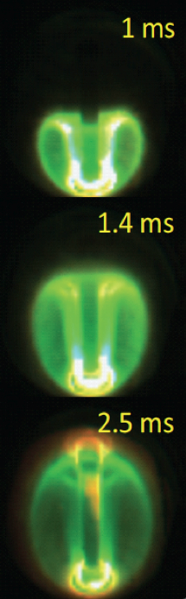
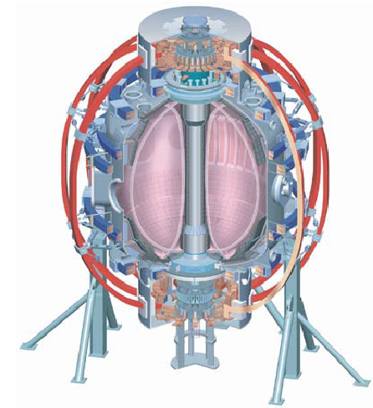
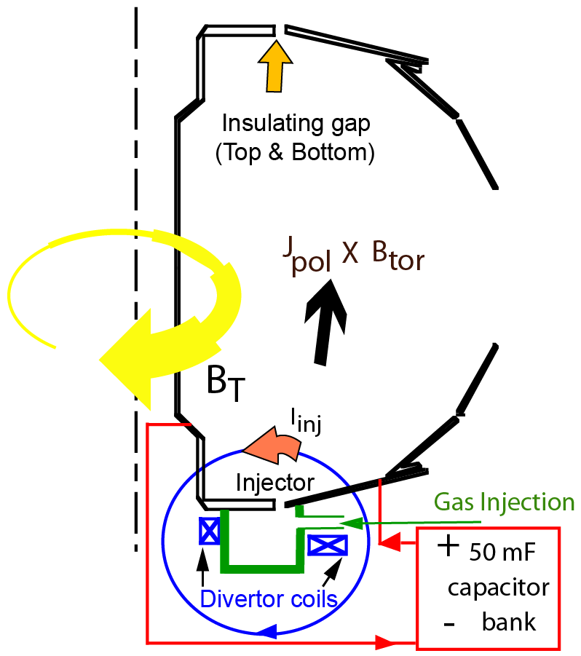
Transient CHI: Axisymmetric Reconnection Leads to Formation of Closed Flux Surfaces
Parameters to consider
  - Current multiplication factor
  - Effect of toroidal field
  - Magnitude of generated plasma current
  - New desirable features?
Fast camera: F. Scotti, L. Roquemore, R. Maqueda

Slide 5
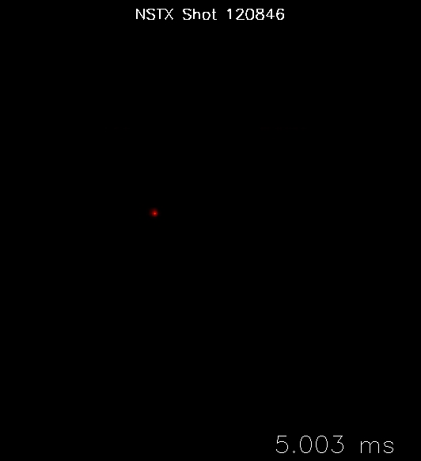
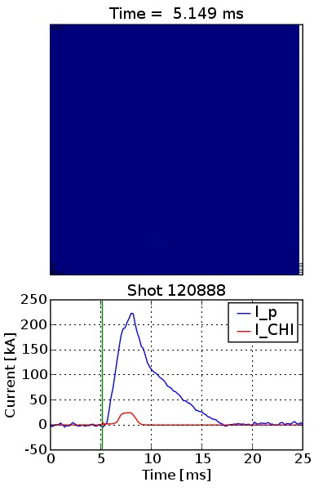
Fast Camera Images of Transient CHI Discharges on NSTX
Fast camera: F. Scotti, L. Roquemore, R. Maqueda

Slide 6
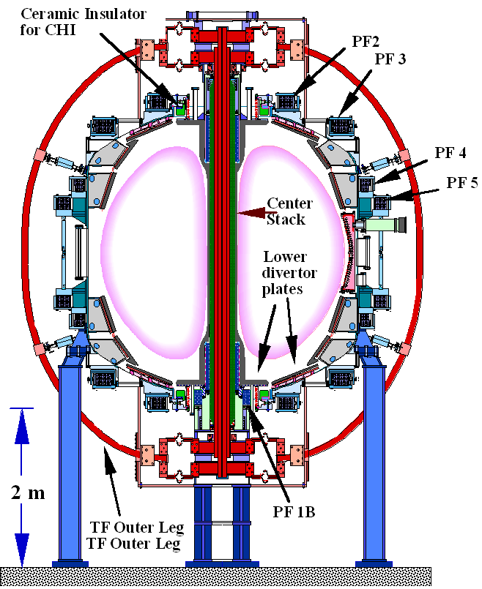
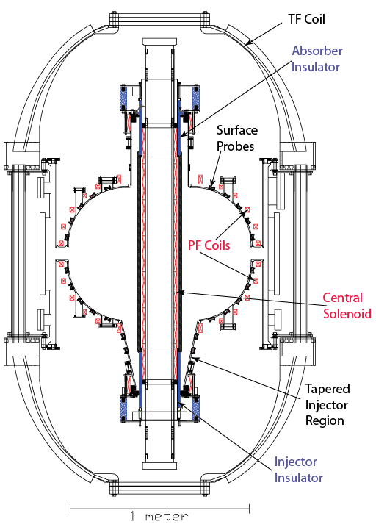
CHI Initially Developed on HIT-II &
Validated and Improved on NSTX
Concept exploration device HIT-II
Built for developing CHI
Many close fitting fast acting PF coils
4kV CHI capacitor bank
Proof-of-Principle NSTX device
Built with conventional tokamak components
Few PF coils
1.7kV CHI capacitor bank
NSTX plasma is ~30 x plasma volume of HIT-II

Slide 7
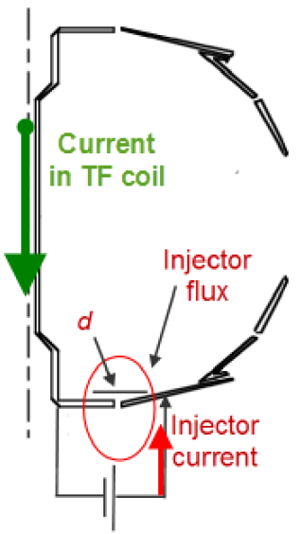
Externally Produced Toroidal Field makes CHI much more Efficient in a High Field ST / Tokamak
Injector current* I_{inj} must meet bubble-burst condition for plasma to expand from injector to main vessel
Toroidal current* generation is proportional to the ratio of toroidal flux ψ_{tor} to injector flux ψ_{inj}
Capacity to generate plasma current I_{p} is proportional to ψ_{inj}
NO NEED TO FIGHT WITH AN ALREADY FORMED PLASMA
* T.R. Jarboe, Fusion Tech. 15, 7 (1989)

Slide 8
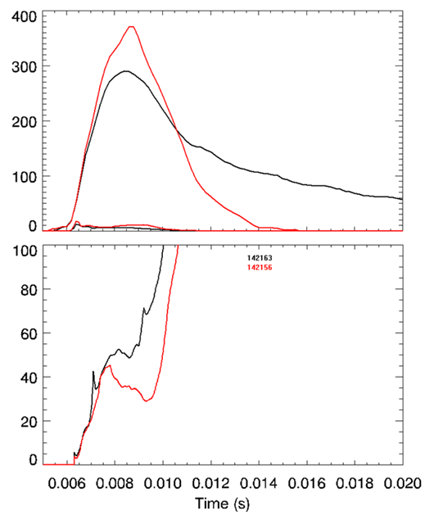
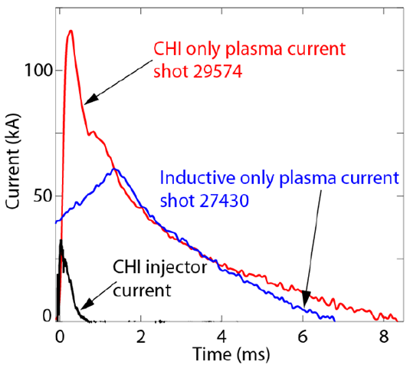
Very High Current Multiplication (Over 70 in NSTX)
Aided by Higher Toroidal Flux
HIT-II
NSTX
(kA)
Plasma current
Injector
Current
30kA of injector current generates 120kA of plasma current
Best current multiplication factor is 6-7
Current multiplication factor in NSTX is 10 times greater than that in HIT-II
Current Multiplication Factor
- Over 200kA of current persists after CHI is turned off
R. Raman, T.R. Jarboe, B.A. Nelson, et al., PRL 90, (2003) 075005-1
R. Raman, B.A. Nelson, D. Mueller, et al., PRL 97, (2006) 17002

Slide 9
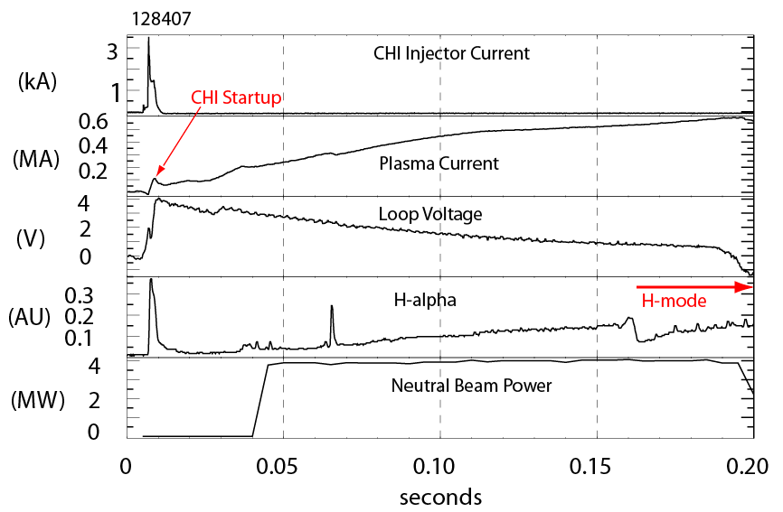
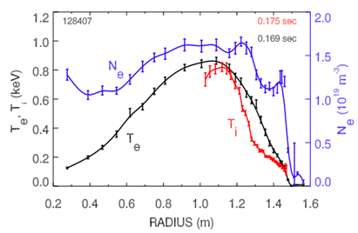
CHI Started Discharge Couples to Induction and Transitions to an H-mode Demonstrating Compatibility with High-performance Plasma Operation
T_{e} & N_{e} from Thomson
T_{i} from CHERS
Discharge is under full plasma equilibrium position control
  Loop voltage is preprogrammed
CHERS : R. Bell
Thomson: B. LeBlanc
R. Raman, D. Mueller, B.A. Nelson, al., PRL 104, (2010) 095003

Slide 10
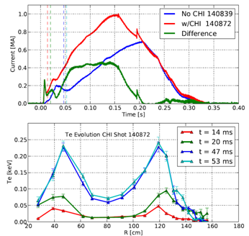
Using Only 27kJ of Capacitor Bank Energy CHI Started a 300kA Discharge that Coupled to Induction
Ramped up to 1MA after startup, using 0.3Wb change in solenoid flux
Hollow electron temperature profile maintained during current ramp
  - Important beneficial aspect of using CHI startup
B.A. Nelson, T.R. Jarboe, D. Mueller, et al., NF 51, (2011) 063008

Slide 11
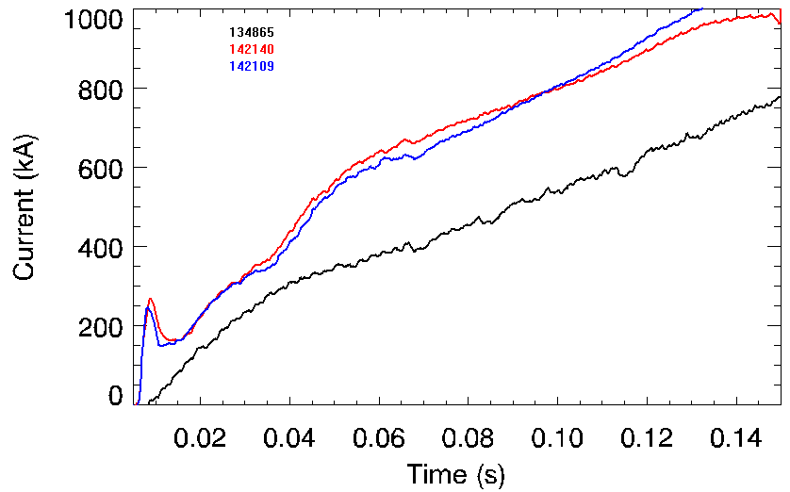
Standard L-mode NSTX Discharge Ramps to 1MA Requiring 50% More Inductive Flux than a CHI Started Discharge
Plasma current
CHI started
Reference NSTX Inductive start-up
Reference Inductive discharge
  - Uses 396mWb to get to 1MA
CHI started discharge
  Uses 258 mWb to get to 1MA (138 mWb less flux to get to 1MA)

Slide 12
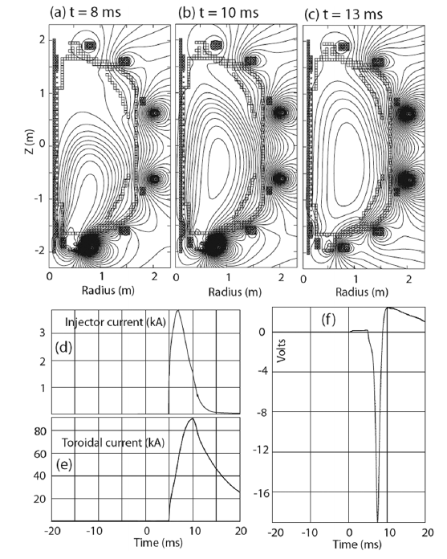
Closed Flux Current Generation in TSC is due to the generation of a positive loop voltage as the injected plasma decays
R. Raman, S.C. Jardin, J. Menard, et al.,
NF 51, 113018 (2011)

Slide 13
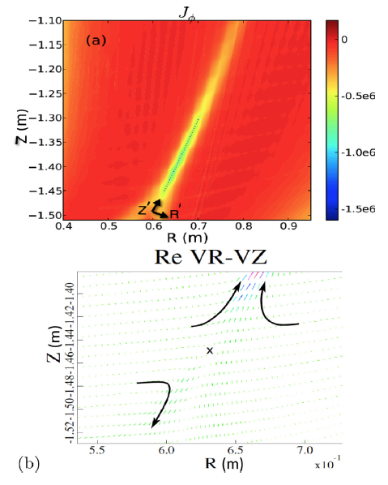
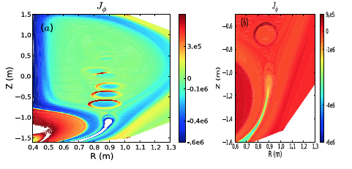
Sweet-Parker Reconnection and Plasmoid Instability also Lead to Reconnection in the Injector Region (NIMROD Simulations)
Sweet-Parker Reconnection
Plasmoid Mediated Reconnection
F. Ebrahimi, et al.,
PoP 20, 090702 (2013)
PoP 21, 056109 (2014)
PRL 114, 205003 (2015)
It would be helpful to experimentally measure these in a ST or off-line setup (with supporting simulations) as it contributes to research related to CHI Start-up, basic plasma sciences, and other applications

Slide 14
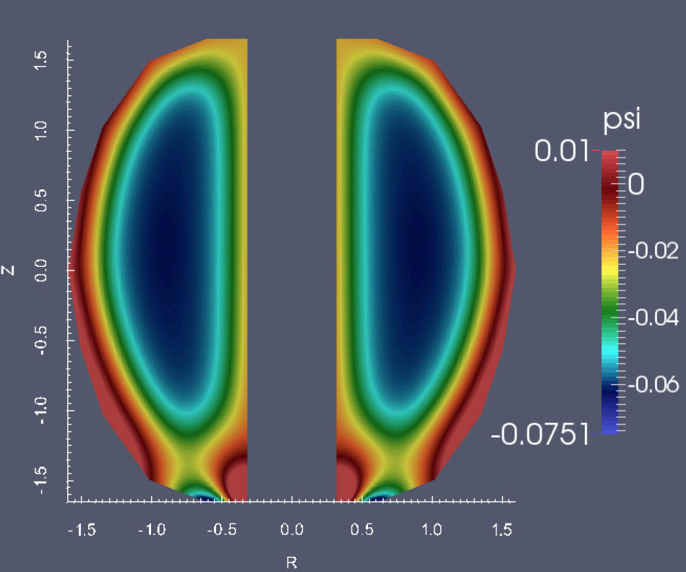
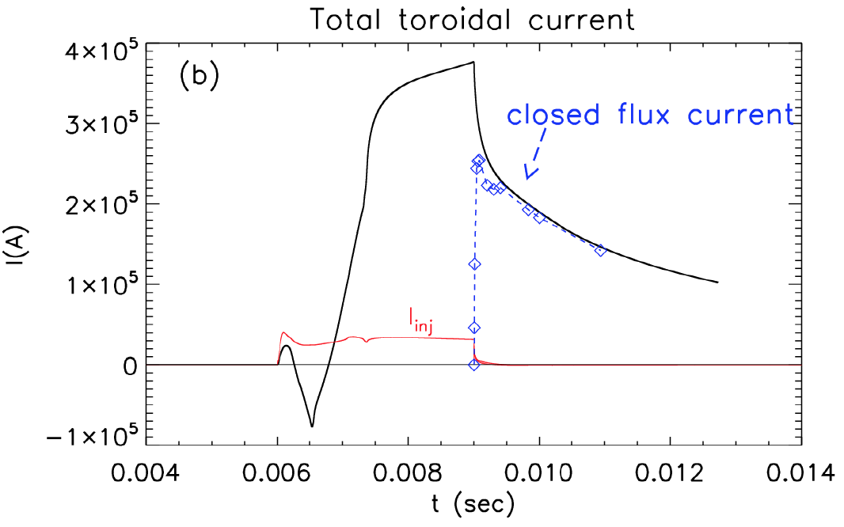
NIMROD Simulations also Show High Fraction of Open Flux Conversion to Closed Flux (~70%, as in HIT-II / NSTX)
F. Ebrahimi, R. Raman, NF-Letter 56 (2016) 044002

Slide 15
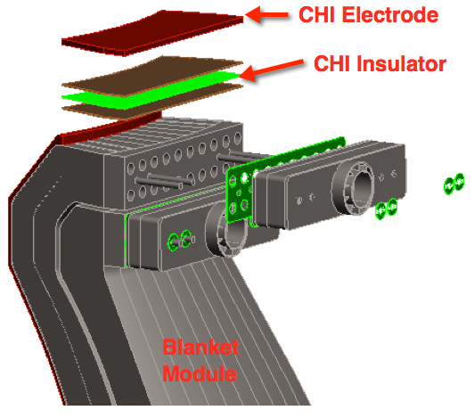
Encouraging Experimental Results From Two STs and Supporting Modeling Results From TSC & NIMROD Motivated Reactor Studies
Toroidally continuous insulator would be located in a region shielded from neutrons
Menard, Brown et al., NF 56 (2016) 106023
Brown, Menard, El Guebaly et al., FS&Technol. 68 (2015) 277
Raman, Brown, El Guebaly et al., FST 68 (2016) 674

Slide 16
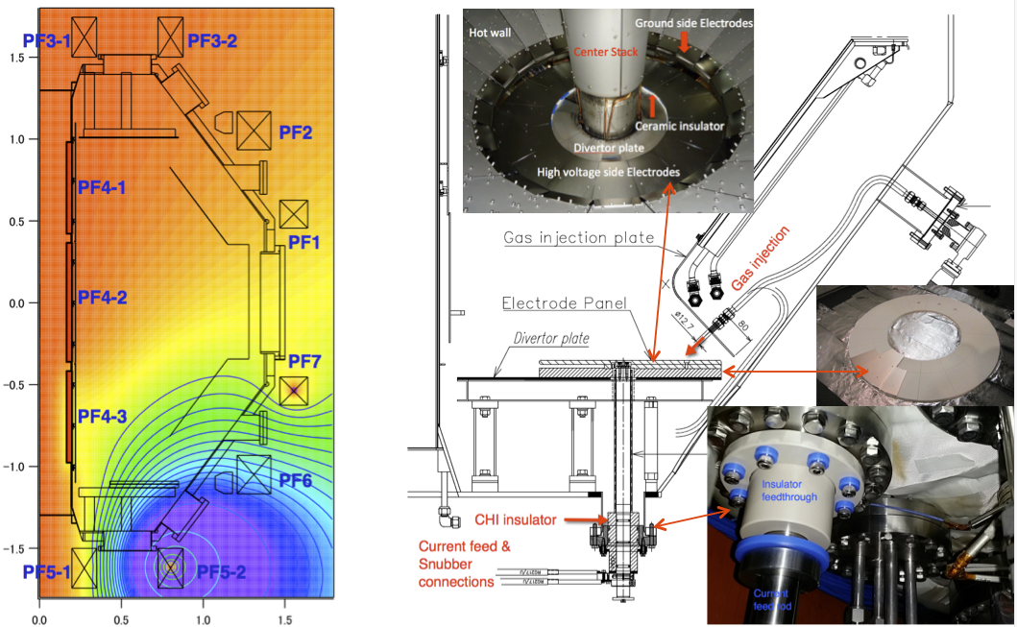
CHI on QUEST is Developing ST-FNSF Relevant Single-Biased Electrode Configuration
R = 0.68m, a = 0.4m, 0.25T

Slide 17
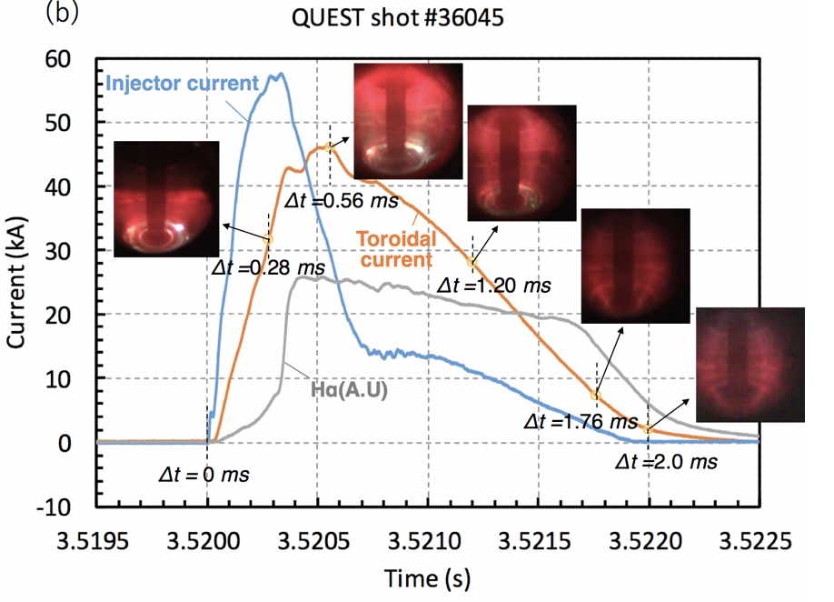
Transient CHI on QUEST has Shown Reliable Discharge Initiation, and Plasma Growth in Biased Electrode Configuration
Current objectives
  Current persistence
  Closed flux current generation
Future objectives
  - Heat CHI plasma with ECH
  - Impurity reduction
  - Increase current magnitude
K. Kuroda, R. Raman, K. Hanada, et al., Plasma Phys. Control. Fusion 60, (2018) 115001

Slide 18
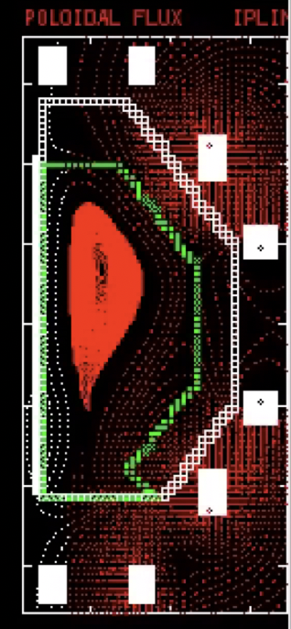
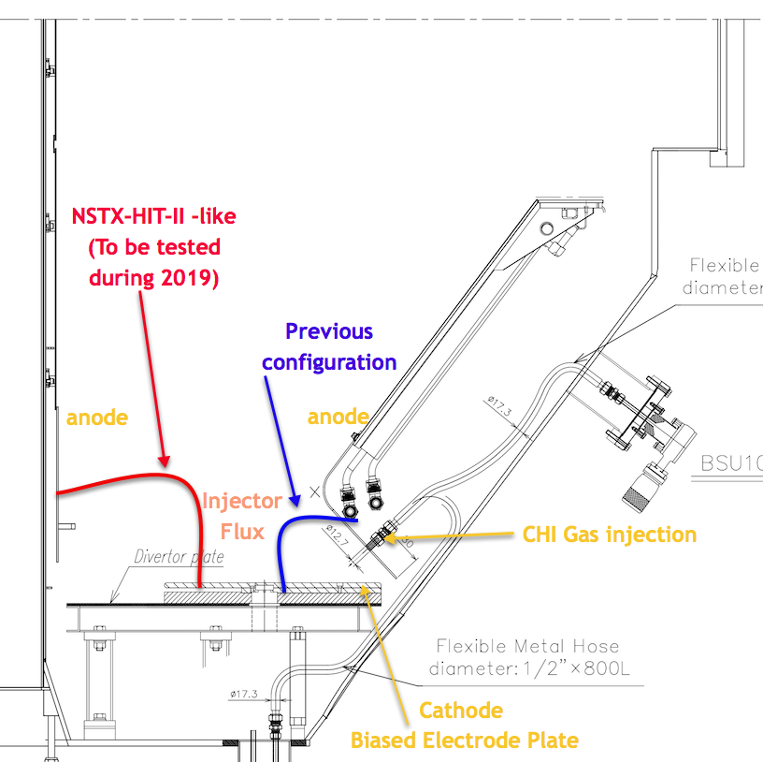
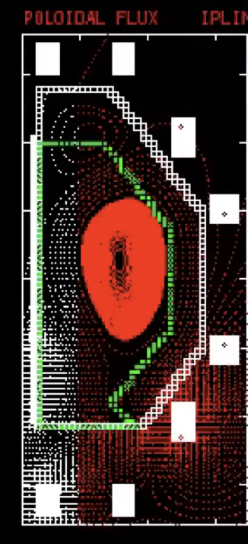
Next experiments will bias electrode plate with respect to inner wall, as on NSTX / HIT-II
TSC simulation of next configuration to be tested – electrode biased to inner wall
TSC simulation of previous configuration – electrode biased to outer wall
K. Kuroda (Kyushu University)

Slide 19
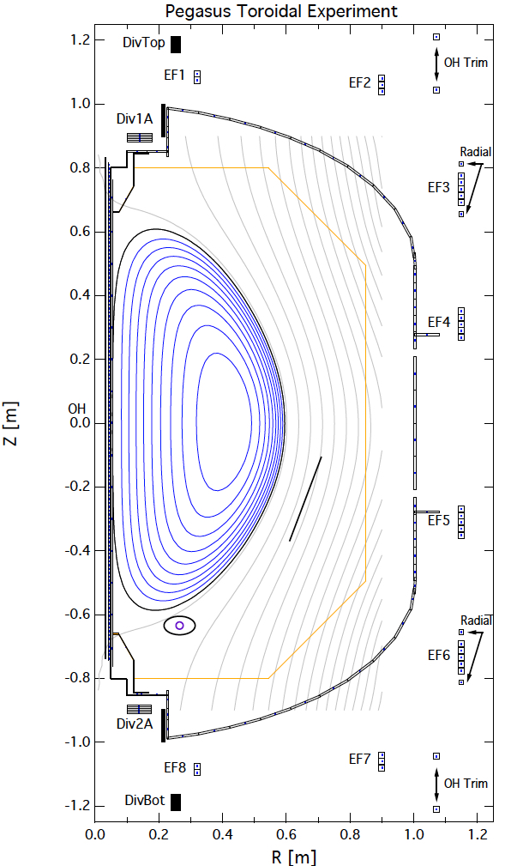
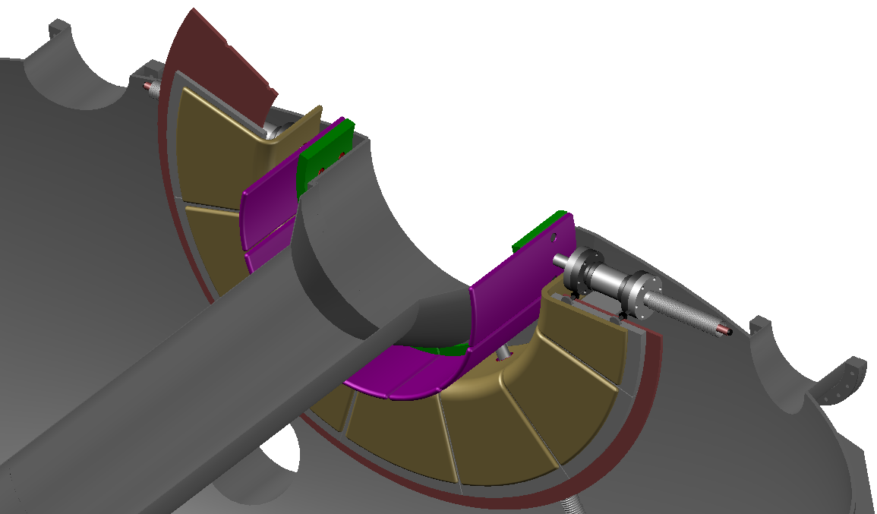

CHI research on URANIA plans to develop a double-biased electrode configuration and maximize current generation
R ~ 0.45m, a ~ 0.3m, 0.6T
NOTE: DRAFT Concept under review, revisions, and discussion – This is not the final design (an important objective is to finalize the design soon)
Cathode
Anode
Coax Current Feed
Benefits of double biased electrodes
High I_{p} up to 300 kA (@ PF coil limits for I_{p})
Coupling to ECH
Collaboration with University of Wisconsin
J. Reusch, R. Fonck, M. Bongard
Drawing by J.A. Rogers (U-Wash.)
F. Ebrahimi (Theory support)

Slide 20
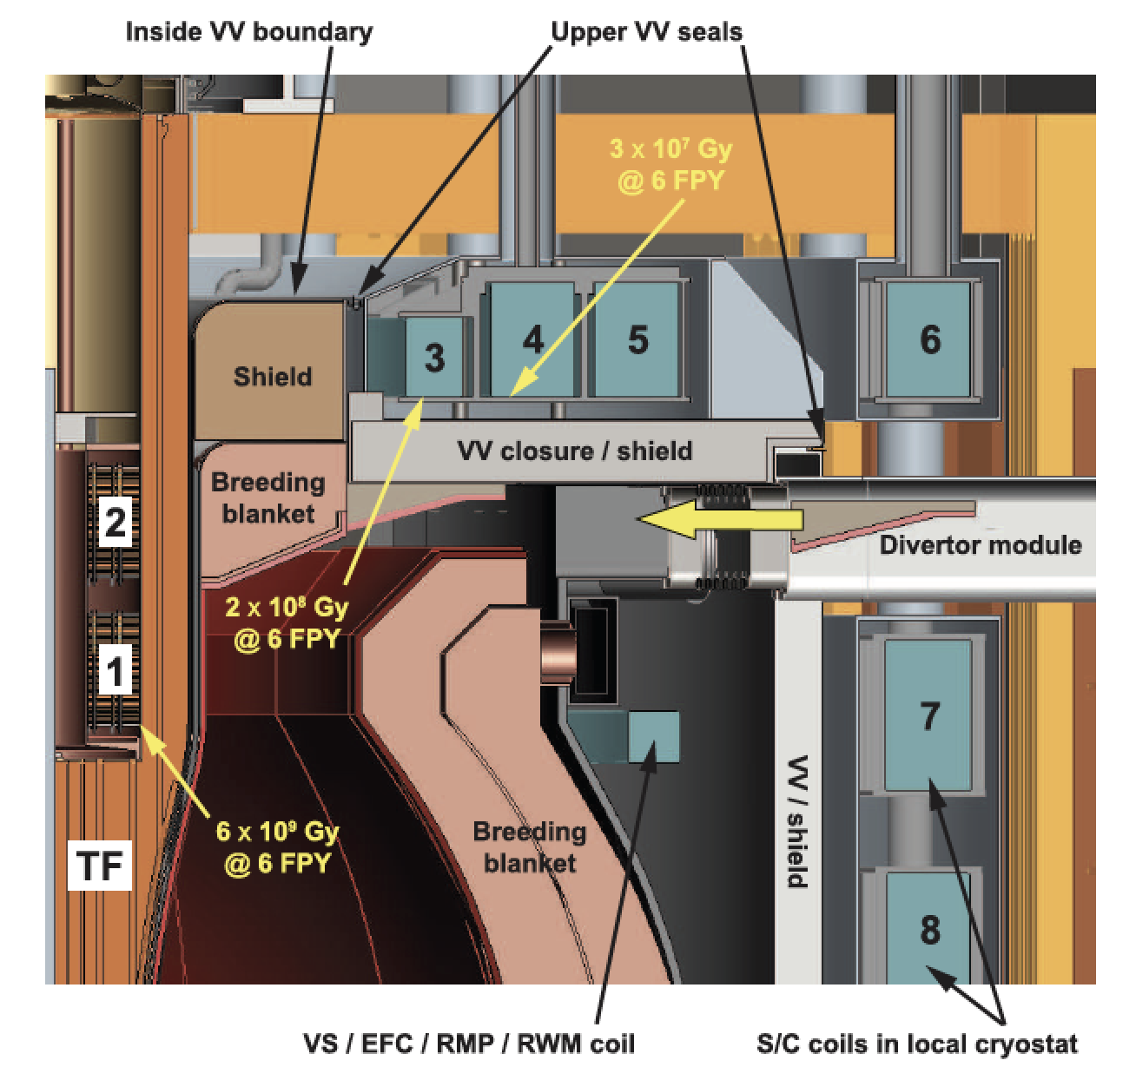
Super-X Divertor-like Configurations Naturally Suited for CHI
& Have Large Injector Flux Capability
Menard, Brown et al., NF 56 (2016) 106023

Slide 21
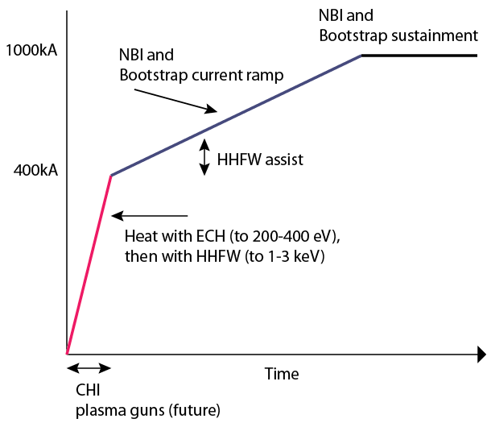
Reactor Scenario for Solenoid-free Plasma Start-up and
Current Ramp-up to Sustained Operation Levels Has Three Phases
Start-up &
Ramp-up strategy
Desirable to to simplify start-up/ramp scenario to two phases
  Reduce reliance on non-inductive current ramp-up phase
  High B_{T} in new emerging experiments should permit CHI start-up at high levels of injector flux
  Super-X divertor configurations may have the needed flux for full current start-up
  NIMROD simulations is studying MHD limits to high current generation, up to levels of full sustained current (no MHD limits obvious thus far)
ECH assist (Ramp-up phase)
ECH heating
(Start-up Phase)
SFPS

Slide 22
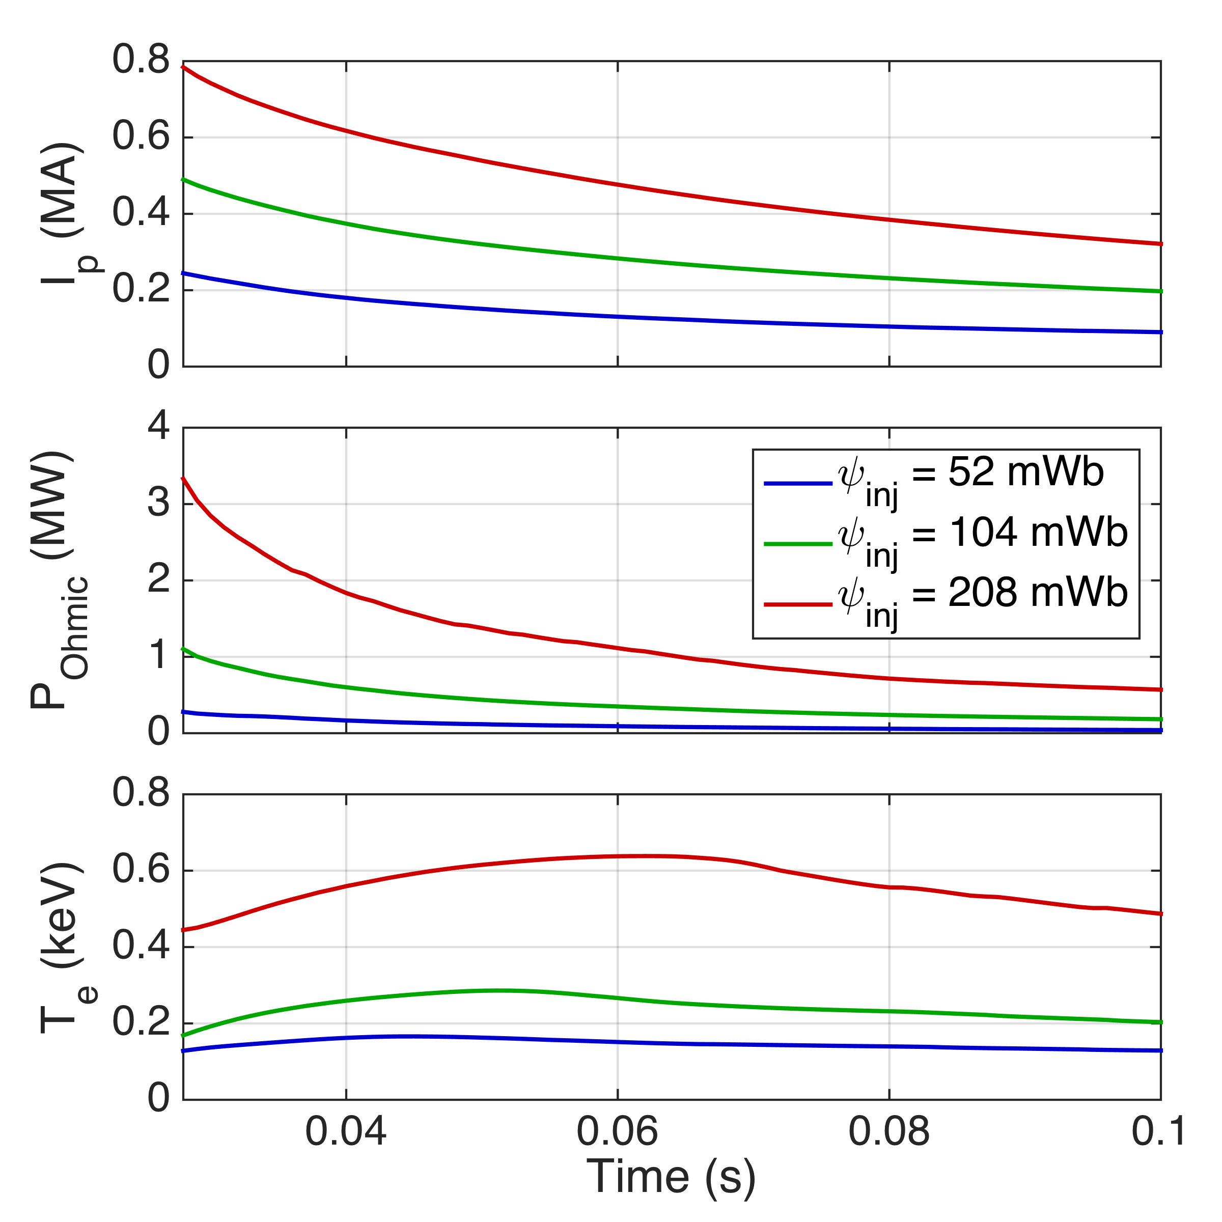
Simulations with TSC support expectations of higher current, self-heating power, and temperatures with increased injector flux
Tokamak Simulation Code (TSC)
  Time-dependent, free-boundary equilibrium and transport solver
  Solves MHD/Maxwell’s equations coupled to transport and Ohm’s law
Initial study: NSTX configuration with increasing levels of injector flux:
  52 mWb (typical NSTX experiment), 104 mWb, and 208 mWb (NSTX-U capability)
Supports main predicted trends
  I_{p} increases in proportion with ψ_{inj}
  Heating power, T_{e} increase faster

Slide 23
ST-40 & NSTX-U Have the Potential to
Demonstrate Full Non-Inductive Operations
Parameters | HIT-II | NSTX | QUEST | URANIA (to be finalized) | ST40 | NSTX-U
Major radius [m] | 0.3 | 0.86 | 0.68 | 0.45 | 0.4 – 0.6 | 0.68
Minor radius [m] | 0.2 | 0.66 | 0.4 | ~0.3 | ~0.3 0.35 | 0.65
B_{T} [T] | 0.5 | 0.55 | 0.25-0.5 | 0.15-0.6 | 3 | 1
Injector flux (mWb) | 16 | 50 | 28 | ~60 | TBD | 200
Projected Start-up current (kA) | 100 | 200 | <150 | ~300 | >500 | >500
Nominal Ip (kA) | 250 | 1400 | ~200 | ~300 | 2000 | 2000

Slide 24
NSTX has Made Considerable Progress Towards Developing Transient CHI as a Viable for Solenoid-Free Plasma Startup Method
Transient CHI first developed on a small ST and then validated on a large ST
Favorable scaling (based on HIT-II / NSTX Experiments and simple scaling relations supported by TSC and NIMROD simulations) gives confidence the method can be applied to larger devices
Successful coupling of CHI started discharges to inductive ramp-up & transition to an H-mode demonstrates compatibility with high-performance plasma operation
CHI start-up has produced the type of plasmas required for non-inductive ramp-up and sustainment (low internal inductance, low density)
Reactor-relevant electrode configuration being developed on QUEST and URANIA
Demonstration of full non-inductive operations including Transient CHI start-up and current ramp-up to sustained operations would provide the confidence necessary to build reactor-scale STs and tokamaks without reliance on the central solenoid

Slide 25
Back-up Slides

Slide 26
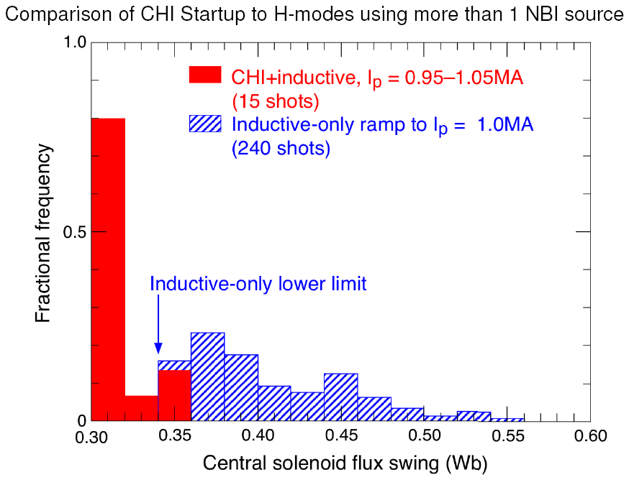
CHI Started Discharges Require Less Inductive Flux than Discharges in NSTX Data Base
Most recent CHI-started discharges require less flux than shown here
NSTX Data Base Analysis: M. Bell

Slide 27
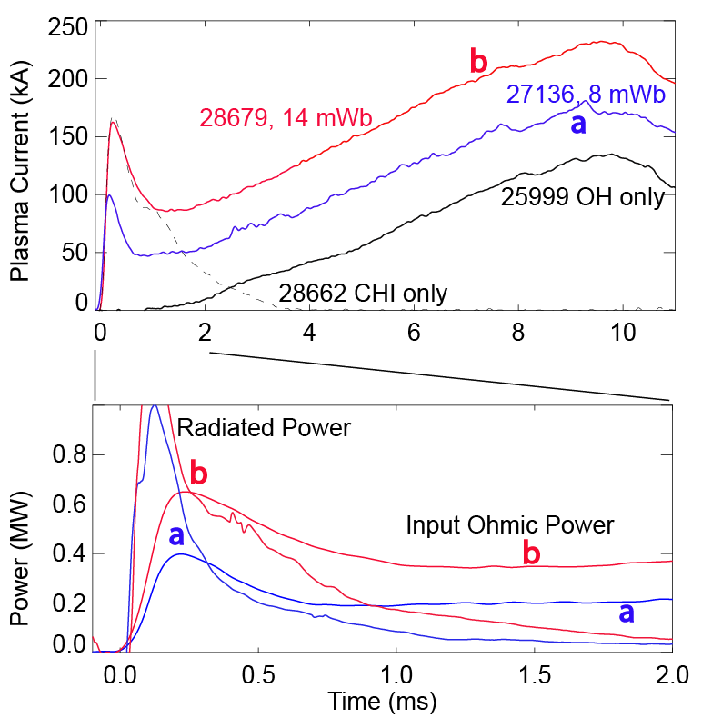
Inductively Coupled Current Ramps-up After Input Power Exceeds Radiated Power
Identical loop voltage programming for all cases
Coupling current increases as injector flux is increased
Radiated power can be decreased by using W or Mo target plates
  Start-up plasma (inductive or CHI) is cold (few 10s of eV)
    Reduce Low-z line radiation
  Auxiliary heating would ease requirements on current ramp-up system
HIT-II Results
R. Raman, T.R. Jarboe, R.G. O’Neill, et al., NF 45 (2005) L15-L19
R. Raman, T.R. Jarboe, W.T. Hamp, et al., PoP 14 (2007) 022504

Slide 28
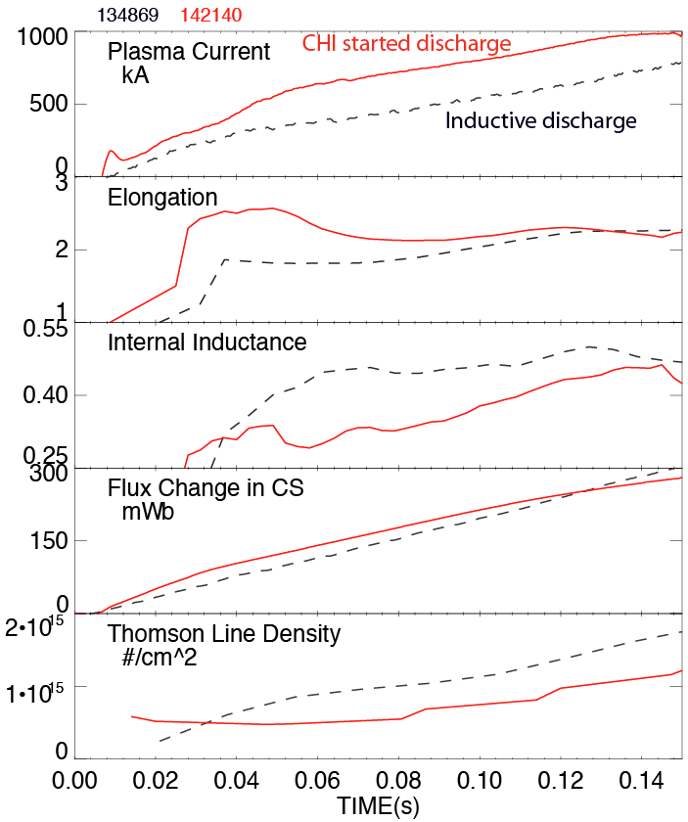
Plasma Discharge Ramping to 1MA Required 35% Less Inductive Flux when Coaxial Helicity Injection (CHI) is Used
CHI assisted startup in NSTX
27 kJ of stored capacitor bank energy used for CHI plasma start-up
High elongation
Low inductance
CHI produced plasma is clean
(Discharges have transitioned to H-mode after coupling to induction)
Low density
CHI generates plasmas with low n_{e} so that ECH could be used to heat these plasmas

