Slide 1
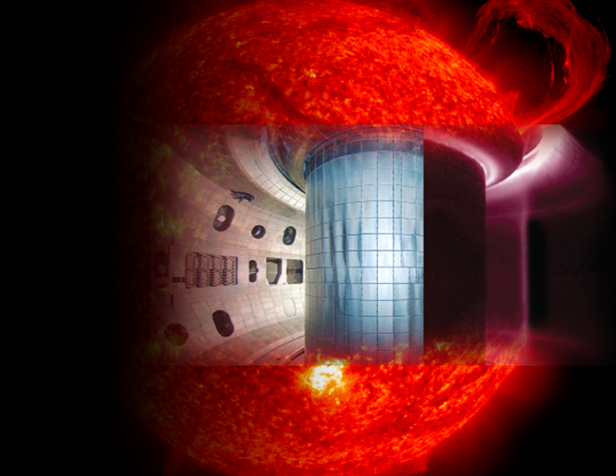


Sustained High Power Density (SHPD) Facility:
Update on Community Initiative in San Diego
presented by
RJ Buttery
with thanks to DIII-D colleagues
on our SHPD team
for the
PPPL Seminar
April 1st 2019

Slide 2
We are here to consult with our PPPL & NSXT-U colleagues
Invite participation in this SHPD analysis effort
  Directly join discussions and analysis projects
  Initiate a group on your favorite topic, calculate metrics,
  draw from equilibria being generated
Invite ideas and good points for SHPD analysis
  What are we missing? What analyses can be done? What metrics can we use?
Identify complementary analysis toward SHPD and wider US roadmap
  Provide richer data set to inform community discussions
Understand points of view, start to find a viable path
Feel free to join our discussion and see what we are up to.
All material on our web at: https://diii-d.gat.com/diii-d/SHPD

Slide 3
What does a Next Step Facility Look Like?
The U.S. program is embarking on a path to a fusion pilot plant
An intermediate facility has been proposed by NAS panel
as part of a wider program to close the gap on the pilot
What are its physics missions?
What are its parameters?
We are undertaking an initiative amongst DIII-D program participants (& others interested) to understand how parameters & feature of the facility enable physics missions toward pilot

Slide 4
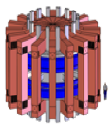


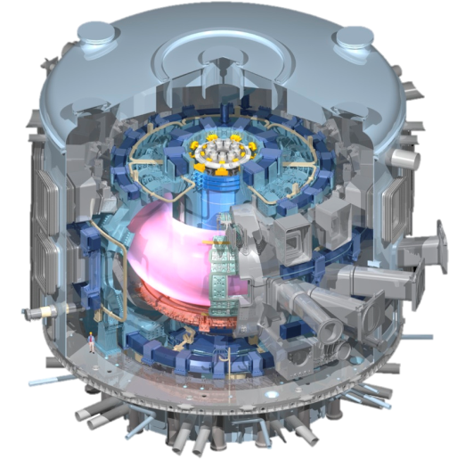
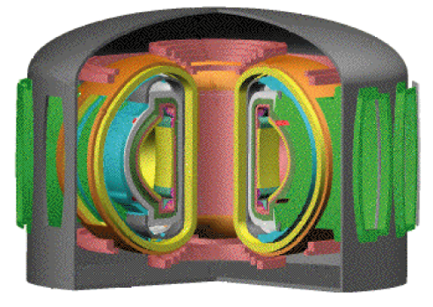
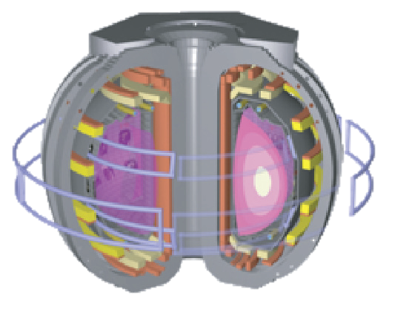

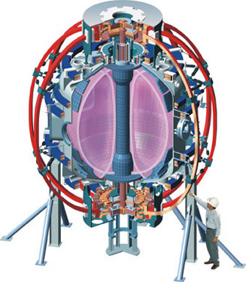
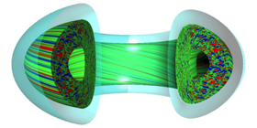
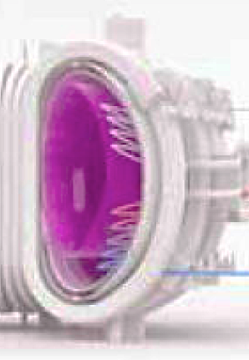
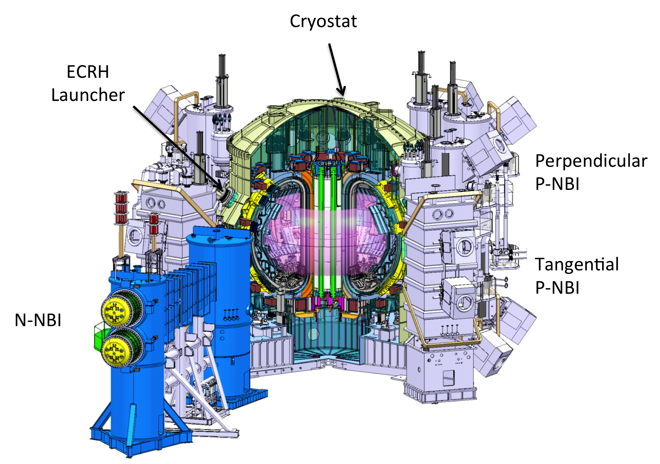
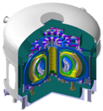
U.S. & NAS Context to Private Fusion
U.S. Pilot Plant &
Nuclear Test Facility
Private 4
ITER
DIII-D
Private 1
NSTX-U
Theory
& Sim
Sustained High Power Density
Private 3
New Technology Lines
International
Facilities
Private 2

Slide 5
What this Initiative is Not
It is not an attempt to determine the mission of the next step U.S. facility
  We see choice of mission as a higher level, community-wide question & discussion
Similarly we do not expect to fix parameters to a particular design point
  We aim to explore a wide parameter space and design choices to inform this
It is not an attempt to develop a DIII-D program position on SHPD
  DOE has merely granted that such community work can be charged to such grants
It is not an attempt to see what can be built in Sorrento Valley
  We neither rule this in or out – its important to simply understand needs from a physics mission & U.S. strategic perspective
It is hoped this effort will lead to a white paper, understanding and capabilities that help assess how physics missions trade off with device parameters and features
Work in this effort might also be used as the basis for other advocacy
white papers by participants in this effort or by other colleagues

Slide 6
Goal of Our Present SHPD Initiative
To develop an understanding of how facility parameters tie to physics missions of an SHPD
  to inform community discussion on what is possible / combinable as a realistic U.S. path

Slide 7
Physics Needs

Slide 8
Why an SHPD is Needed
There is a strong and exciting mission for DIII-D and NSTX-U
  Facilities being upgraded to address critical plasma physics, develop new techniques
  & technologies, find candidate solutions for fusion energy
But there remain critical plasma physics questions that go beyond what the
present generation of facilities can address
  To sustain configuration & power handling beyond what ITER can do
  To access reactor like physics regimes & parameters – remove extrapolation gap
  To integrate parts of the solution that trade off against each other
To move to a pilot plant D-T reactor, we need to have robust plasma solutions
that we can be confident work reliably
  Expensive and beyond scope for pilot to do all this D-D level work
NAS notes needs for: “increase fusion power density”, “continuous high-pressure compact plasma”,
“increased values of normalized size, RB/T^{0.5}”, “larger magnetic field… and… power”,
“A follow-on national facility… provide new advanced tokamak studies closer to burning plasma conditions”
“high power density research facility”, “high field”, “high β_{N}”, “optimal shaping”
🙂
🤔
🤓
Its vital for us to start on a next step facility ASAP

Slide 9


Understanding an Integrated Solution Requires Improved Performance
Core and divertor physics are governed by different parameters:
core
Pedestal
Separatrix
Divertor
q||
Collisionality, ${\text{n}}_{ped}^{∗}\sim n_{ped}^{3}/P_{ped}^{2}$
n_{sep}
n_{div}
Pedestal physics
Closure & neutrals
$$β_{Nped}\sim Shaping.f_{GW}$$
Core
Pressure
Pedestal
Edge transport barrier
Radius
Notes:
$$Shaping, S=0.4+2δ$$

Slide 10
Understanding an Integrated Solution Requires Improved Performance
Core and divertor physics are governed by different parameters:
core
Pedestal
Separatrix
Divertor
q||
Collisionality, ${\text{n}}_{ped}^{∗}\sim n_{ped}^{3}/P_{ped}^{2}$
n_{sep}
n_{div}
Pedestal physics
Closure & neutrals
$$β_{Nped}\sim Shaping.f_{GW}$$
Core
Pressure
Pedestal
Edge transport barrier
Radius
Notes:
$$Shaping, S=0.4+2δ$$

Slide 11


Understanding an Integrated Solution Requires Improved Performance
Core and divertor physics are governed by different parameters:
core
Pedestal
Separatrix
Divertor
q||
Collisionality, ${\text{n}}_{ped}^{∗}\sim n_{ped}^{3}/P_{ped}^{2}$
n_{sep}
n_{div}
Pedestal physics
Closure & neutrals
$$β_{Nped}\sim Shaping.f_{GW}$$
JET pedestal
Peeling
$${\text{n}}_{ped}^{∗}$$
Low
Core
High ${\text{n}}_{ped}^{∗}$
Ballooning
Pressure
(Normalized pressure gradient)
Pedestal
[Maggi, NF2015]
Edge transport barrier
Radius
Notes:
$$Shaping, S=0.4+2δ$$

Slide 12
Understanding an Integrated Solution Requires Improved Performance
Core and divertor physics are governed by different parameters:
core
Pedestal
Separatrix
Divertor
q||
Collisionality, ${\text{n}}_{ped}^{∗}\sim n_{ped}^{3}/P_{ped}^{2}$
n_{sep}
n_{div}
Pedestal physics
Closure & neutrals
$$β_{Nped}\sim Shaping.f_{GW}$$
Core-edge solution depends on progress in each region
  Improved pedestal (n_{sep}:n_{ped}) and divertor (n_{div}:n_{sep}) solutions play a key role
Super H mode?
Shaping, a/r, …
Slots, Snowflake
Super-X, SAS…
Notes:
$$Shaping, S=0.4+2δ$$

Slide 13
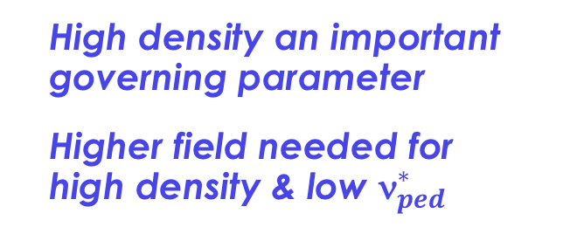
Understanding an Integrated Solution Requires Improved Performance
Core and divertor physics are governed by different parameters:
core
Pedestal
Separatrix
Divertor
q||
Collisionality, ${\text{n}}_{ped}^{∗}\sim n_{ped}^{3}/P_{ped}^{2}$
n_{sep}
n_{div}
Pedestal physics
Closure & neutrals
$$β_{Nped}\sim Shaping.f_{GW}$$
Core-edge solution depends on progress in each region
  Improved pedestal (n_{sep}:n_{ped}) and divertor (n_{div}:n_{sep}) solutions play a key role
Pedestal vs divertor closure
Strong interaction
between these regions
  Depends on opacity
T_{e}
  High density an important
  governing parameter
  Higher field needed for
  high density & low ${\text{n}}_{ped}^{∗}$
n_{e}
Notes:
$$Shaping, S=0.4+2δ$$

Slide 14
May Other Examples of Reactor Needs that Motivate Plasma Research Beyond Present Generation of Tokamaks
Understanding pedestal projection (high pedestal opacity low ν*)
  Identify density limit
High heat flux divertor solution – with high neutral & γ opacity
High bootstrap fraction core to develop predominantly self-driven solutions
  High thermal fraction for relevant EP physics & RWM stabilization physics
  High ion-electron collisionality & low rotation & ν* for core transport projection
Advanced RF schemes with high efficiency and survivability
Understanding wall dynamic
Simply reducing the extrapolation gap
ITER provides key complementary data & validations, but steady state reactor solutions poses additional challenges

Slide 15
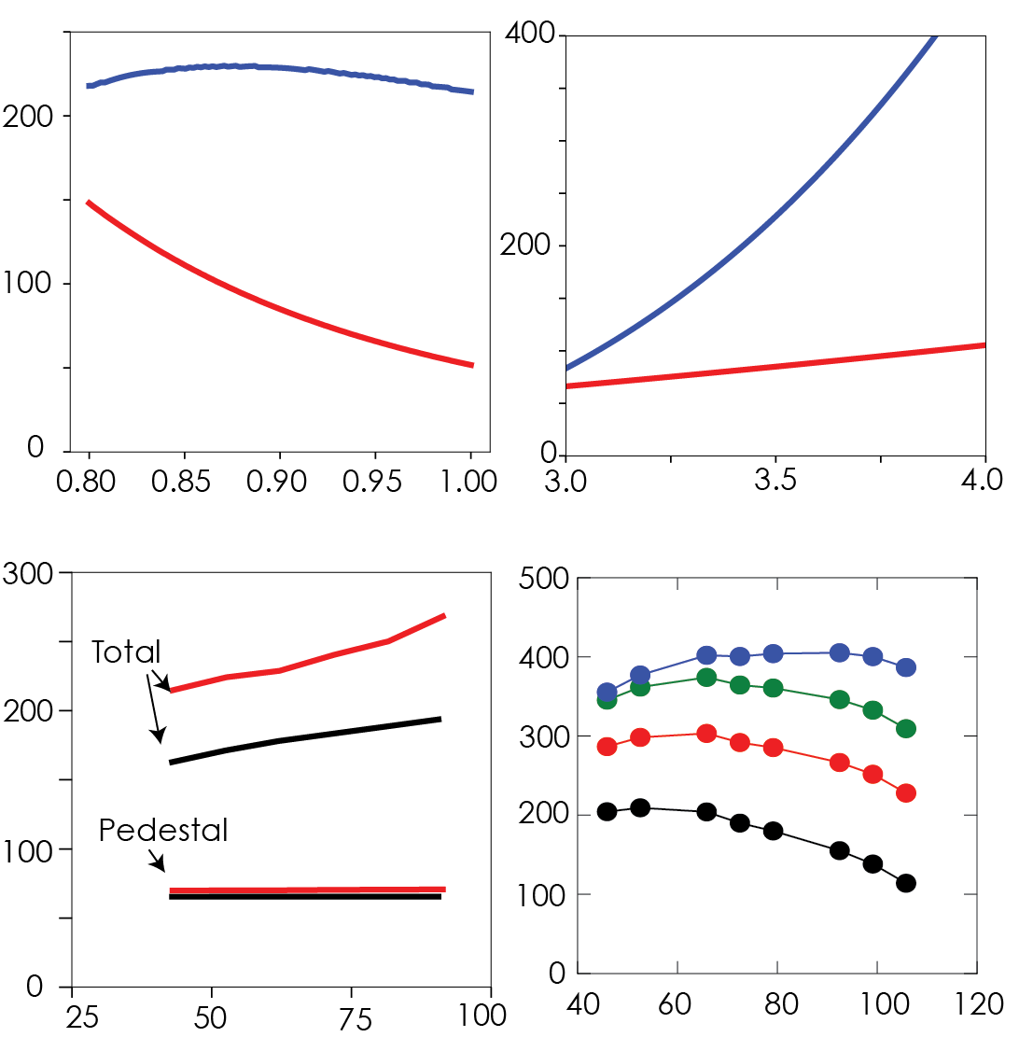






Full Physics Simulations Show Key Levering Parameters to Explore
Projects H₉₈~1.3-1.5 leading to solutions at 4m 6-7T
  Converged self-consistent fully non-inductive plasmas
Trade-offs & optimizations:
  Shaping is key: Q~shaping²
  Higher density reduces H&CD needs
  Higher β_{N} raises fusion performance
  Higher B_{T} improves confinement
  Higher efficiencies raise P_{net-electric}
  Dissipative divertor vs core radiation
  Transients must be controlled
Important to develop and validate these solutions
FASTRAN 4m 7T fully non-inductive plasmas
stationary TGLF-EPED-CD-EFIT solutions
MW
P_{NET}
P_{NET}
P_{H/CD}
$$η_{TH}=η_{CD}=0.4$$
P_{H/CD}
Fix β_{N} = 3.5
Fix n_{eped}/n_{GW} = 0.9
$$n_{eped}/n_{GW}$$
$$β_{N}$$
7T
$$η_{CD}=0.\text{4 } η_{TH}=0.33$$
6T
$$η_{TH}=0.4$$
$$η_{CD}=0.25,$$
$η_{TH}=0.33$
Fixed I_{P} & density
P_{H/CD} (MW)
P_{H/CD} (MW)
Improved physics & technology reduces required scale, fusion power, fluxes and cost
Notes:
ADD SUPER H PART. Shaping is key. NOT ARGUE ONE SPOT…

Slide 16
Physics Needs
Approach of our Initiative

Slide 17
SHPD Initiative: Approach and Boundary Conditions
Identify range of potential missions (NAS, Wade FPA, reactor design needs, etc.)
Identify metrics that characterize access to those missions
Develop an equilibrium parameter space and facility options to span the missions
  Simulation and other analysis efforts
  Simulation: Initial 1D about a center point, then some guided
Calculate metrics to understand how physics access changes over this range
  Interpret under various physics themes
  Write neutral white paper to inform community
There may also be position white papers on various topics
  Not centrally coordinated, but subsets of colleagues may cluster to develop
Boundary conditions ← not hard ones but, guided by NAS
  Something that can be started soon. Manned access as science tool. Not nuclear?
  Example trade offs to discuss: short/long pulse, hot/cold metal/C wall, …

Slide 18
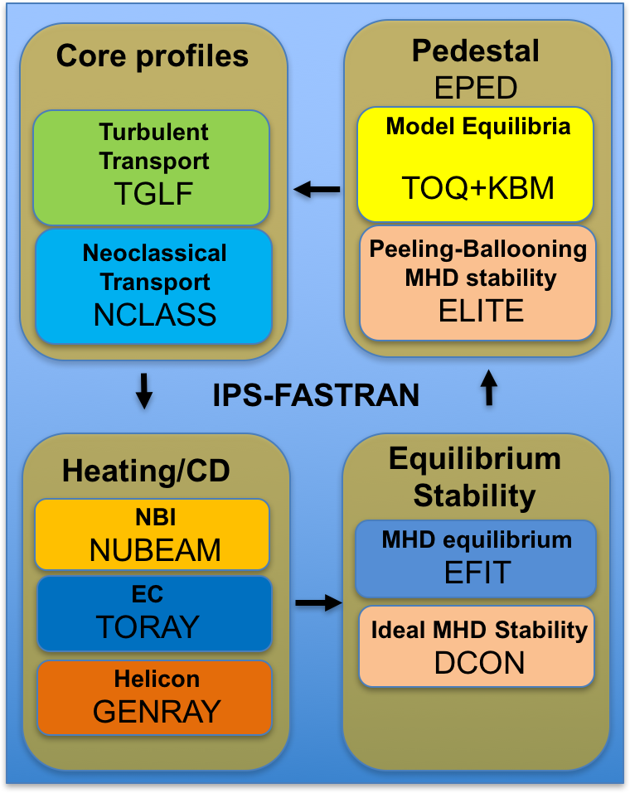
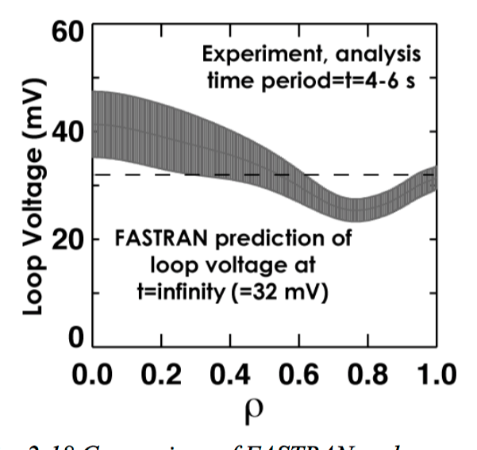
FASTRAN Integrated Simulation Suite Provides Tool To
Validate Physics Models & Project Performance
Equilibrium/Loop Voltage
EFIT
[Park Comp Phys Com 2017]

Slide 19
FASTRAN Integrated Simulation Suite Provides Tool To
Validate Physics Models & Project Performance
Edge Pedestal
EPED
Equilibrium/Loop Voltage
EFIT
[Park Comp Phys Com 2017]

Slide 20
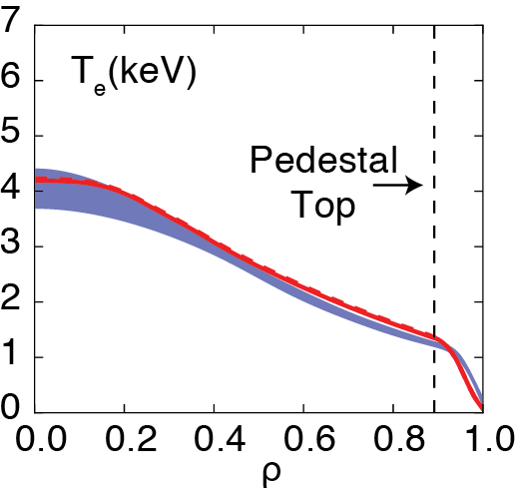
FASTRAN Integrated Simulation Suite Provides Tool To
Validate Physics Models & Project Performance
Turbulent Transport
TGLF
Edge Pedestal
EPED
Equilibrium/Loop Voltage
EFIT
[Park Comp Phys Com 2017]

Slide 21
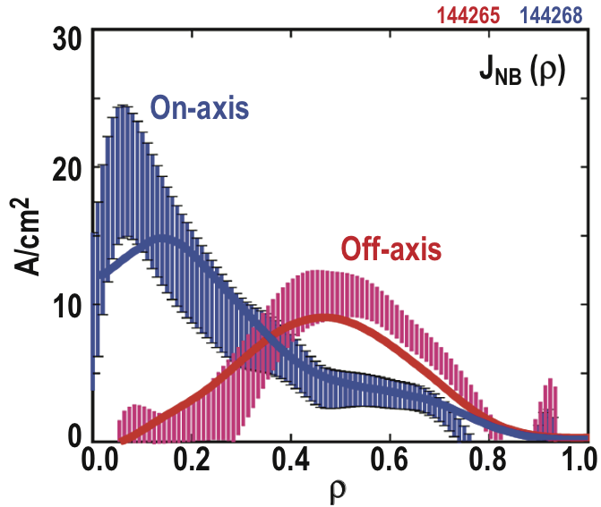
FASTRAN Integrated Simulation Suite Provides Tool To
Validate Physics Models & Project Performance
Turbulent Transport
TGLF
Edge Pedestal
EPED
Off-axis Current Drive
NUBEAM
Equilibrium/Loop Voltage
EFIT
[Park Comp Phys Com 2017]

Slide 22
Initial List of Aspects to Consider
Identify representative mission set & metrics (see next)
Scope out Equilibrium space with integrated physics model solutions
  Serves as basis to calculate range of other parameters
  Shaping: extend codes to calculate & identify benefits
Consider H&CD options
Shaping: extend codes to calculate & identify benefits
Divertor mission, flexibility, metrics
Materials/PMI – mission, choice, needs, metrics
Activation and manned access
Coil options – viability of shape & power needs
More…?
Various subtopic discussions & meetings implied or invited

Slide 23
Missions To Prepare For a Pilot Plant
Various sources and orthogonal sets (E.g. →)
Key Concepts
Facility close physics gaps on pilot
plant – develop robust solutions
Alongside existing technology program & international facilities
Wade, FPA,18

Slide 24
Missions To Prepare For a Pilot Plant
Various sources and orthogonal sets (E.g. →)
Some U.S. strengths and distinctive
opportunities not addressed elsewhere
Key Concepts
Facility close physics gaps on pilot
plant – develop robust solutions
Alongside existing technology program & international facilities

Slide 25
Missions To Prepare For a Pilot Plant
Various sources and orthogonal sets (E.g. →)
Some U.S. strengths and distinctive
opportunities not addressed elsewhere
  Some requirements to incorporate
  into solution / need to be studied
Key Concepts
Facility close physics gaps on pilot
plant – develop robust solutions
Alongside existing technology program & international facilities

Slide 26
Missions To Prepare For a Pilot Plant
Various sources and orthogonal sets (E.g. →)
Some U.S. strengths and distinctive
opportunities not addressed elsewhere
  Some requirements to incorporate
  into solution / need to be studied
Break down to specific physics
& metrics…
Key Concepts
Facility close physics gaps on pilot
plant – develop robust solutions
Alongside existing technology program & international facilities

Slide 27
Developing a Set of Mission Metrics (in progress)
Mission | Metrics | Method
Core edge | Ped-opacity, ν*, n_{ped}, f_{GW}, P_{ped},δ,κ, ioniz depth. Radiation species: Rpeak, Wall Z | Formulae from simulations
Core transport | T_{e}/T_{i}, ν_{ei}, ρ*, τ_{E}, Ω’ | From simulations
High BS solution | f_{BS}, β_{N}, β_{Nthermal}, q₉₅, R/a, τ_{pulse}/τ_{R}, β_{Nwall}, β_{Nnowall} | From simulations
Fast ions | f_{EP}, v_{EP}/v_{alfven}, tools to accelerate ions | From simulations, plus some flexibility statements
Current drive | Te, B, flexibility, …?
Divertor | P/R, PB/R, q||, Ly α, div opacity, radial transport & heat flux width, closure, detachment | TBD
PMI | Material, temperature, retention? Pulse length vs deposition time, heat flux | TBD
Transients | Ip (REs), B_{resped}, …? Actuators? | TBD
  What missions, metrics & methods should be considered?

Slide 28
Some Clear Issues of Debate or Trade off Will Need to be Discussed
Long or short pulse?
  Long pulse tests PMI solutions, but will compromise manned access & so flexibility
How high in field?
  Improvements in fusion relevant metrics vs device activation & access
Tritium capability?
Normal or hot walls? Wall material?
HTS or copper?
H&CD, internal/external 3D coils, etc…
  We see these as issues for broader community discussion
  to converge SHPD mission in wider roadmap
  We hope our analysis can inform the degree of mission
  possible with various options

Slide 29
Initial Parameter Range to Explore
Parameter | Range | Rationale
Paux | 1.5P_{LH} → 100MW | Good H mode to budget ceiling
f_{BS} | 50 to 100% | Explore self-driven solutions (adjust I_{P})
BT | 4 – 7 T | High density & opacities with low ν*
f_{pedGW} | 60 – 120% | Core-ped-div integration
Elongation | To VS limit | Maximize controllable performance
Triangularity | 0.4 to 0.9 | See where benefits saturate & assess divertor challenge
Aspect ratio | 2.2 – 4 (fix a²R) | Bootstrap, EC access (code limits at 2.2)
(Fix size for now, consider R=1.4, 2m later at fixed R/a)
High performance & fully NI, high BS
Based on earlier group wide metrics discussion and focusing conversation of Buttery, Petty, Snyder, Solomon

Slide 30
Initial Parameter Range to Explore
Parameter | Range | Rationale
Paux | 1.5P_{LH} → 100MW | Good H mode to budget ceiling
f_{BS} | 50 to 100% | Explore self-driven solutions (adjust I_{P})
BT | 4 – 7 T | High density & opacities with low ν*
f_{pedGW} | 60 – 120% | Core-ped-div integration
Elongation | To VS limit | Maximize controllable performance
Triangularity | 0.4 to 0.9 | See where benefits saturate & assess divertor challenge
Aspect ratio | 2.2 – 4 (fix a²R) | Bootstrap, EC access (code limits at 2.2)
(Fix size for now, consider R=1.4, 2m later at fixed R/a)
High performance & fully NI, high BS
Optimizations
High power, pressure
High bootstrap
High density
Divertor flux / PB/R
Lower field ($)
Lower H&CD power ($)
Size ($)
Make pedestal NN set → TGLF scaling tool… FASTRAN
Start in center & expand in 1d
  Then pursue multidimensional exploration
  with goal to optimize key parameters →

Slide 31
Some Scan Points Exist from 2018 NAS Exercise
Preliminary 4T 1.7m simulations found high bootstrap solutions:
  First tests not ideal: T_{e}>T_{i}, high ν∗, needs lots of helicon
Equilibria studies identified
high stability and…. ITER like pedestal P
Loarte formula showed opaque pedestal at 4T
NB
  Work needed to explore space and optimize

Slide 32
Progress So Far – We are at Early Stages
Agreed some preliminary missions to metrify
Set ranges to explore (extendable!)
Scoping tool embarking on multi-dimensional scan
  Single point TGLF + EPED-nn. Start in middle and work out.
FASTRAN work just getting started ➔
  Simplified assumptions to start: fixed J profile & density peaking
  (will do self-consistently later)
  Initial scans in B, I_{P}, n, P_{H} ➔ Encouraging trends with density
    But much else to explore & directions to push
⬅H&CD analysis identifies promise options for ECH➔
  4T O mode efficient off axis CD (25A/kW) with 162GHz unit
  4T top launch 170GHz as efficient at helicon CD! (35A/kW) →
  Higher frequency gyrotrons needed for higher field & on axis
  (up to 203GHz available, Toshiba)
4 5 6 7 T
162 GHz
170GHz

Slide 33
All Colleagues Welcome to Join or Tap Into Effort on SHPD
We are just starting equilibria scoping to provide basis for metrics calculation
and physics assessments
Consider what is needed in your field – set up your own discussion group
  Discuss with colleagues
  Work out what physics missions, tools
  Map onto parameter & capability range we are exploring
  Feed back requirements into overall effort, so we understand trade-offs.
Join our discussions and contribute to debate with good points
Use simulations being developed as a basis for further
All material on web at: https://diii-d.gat.com/diii-d/SHPD
  Series of meeting on various themes over coming weeks
Or chat to existing participant:
Buttery, Ferron, Smith, McClenaghan, Guo, Snyder, Groebner, Park, Garofalo, Leuer, Holcomb, Paz-Soldan, VanZeeland, Wu, Osborne, Grierson, Weisberg, Solomon, Wade, Guttenfelder, Meneghini, Abrams, Leonard , Petty

Slide 34
We are here to consult with our PPPL & NSXT-U colleagues
Invite participation in this SHPD analysis effort
  Directly join discussions and analysis projects
  Initiate a group on your favorite topic, calculate metrics,
  draw from equilibria being generated
Invite ideas and good points for SHPD analysis
  What are we missing? What analyses can be done? What metrics can we use?
Identify complementary analysis toward SHPD and wider US roadmap
  Provide richer data set to inform community discussions
Understand points of view, start to find a viable path
Feel free to join our discussion and see what we are up to
All material on our web at: https://diii-d.gat.com/diii-d/SHPD

Slide 36
Preliminary Assessment Suggests Largest Mission Breadth Provided by Modest Size, High Field Facility
Establish Basis for
Low-ρ* Steady State
Advance Fusion
Performance Metrics
Validate Efficient
Current Drive
Approaches
Serve as
ITER Satellite
Demonstrate
Robust Transient
Control
Mitigate
Tritium Retention
A=3,a=0.6,B=4-6T
A=3,a=0.4,B=8-12T
A=2,a=0.6,B=2-4T
Divertor Test Tokamak
Optimize Core-Edge
Integration
Provide Basis for Reactor-Relevant
Heat Flux/Erosion Control

Slide 37
Preliminary Assessment Suggests Largest Mission Breadth Provided by Modest Size, High Field Facility
Establish Basis for
Low-ρ* Steady State
Advance Fusion
Performance Metrics
Validate Efficient
Current Drive
Approaches
Serve as
ITER Satellite
Demonstrate
Robust Transient
Control
Mitigate
Tritium Retention
Optimize Core-Edge
Integration
Provide Basis for Reactor-Relevant
Heat Flux/Erosion Control

Slide 38
U.S. Should Innovate to Enable
Low Capital Cost Net Electric Pilot Plant
Key challenges for self-sustaining reactor:
  Breeding – Nuclear materials – Net electricity
Should address these in a compact ‘pilot plant’ test facility
  Combine missions to remove a generation → more compelling
  Low capital cost so affordable to go forward
  Do not need to be at large, low-COE scale to prove
  approach for that scale
U.S. proposals for ARC, Compact-AT and ST-pilot
  All at scale 100-200MWe, R~3-4m, A~2-3 & benefit from high temperature superconductors
A pilot plant would lever U.S. ITER participation
But requires additional ‘enabling research’
  To raise fusion performance & provide required technologies
Power plants | ACT1 | SlimCS | KoreaDEMO | EU DEMO
R m | 6.3 | 5.5 | 6.8 | 7.9
I_{P} MA | 11 | 17 | 17 | 14
Pfus GW | 1.8 | 3 | 2.9 | 2
Pnet GW | 1 | 1 | 0.5 | 0.5
Distinctive window of opportunity for U.S.
Notes:
BE SMARTER

Slide 39
Research Required in Seven Areas to Enable Low Capital Cost Pilot Plant
ITER participation
  Validated physics models
  & reactor knowhow
Stable high performance
fully noninductive core
Dissipative Divertor
Efficient current drive
Reactor materials
Demountable high temp superconducting magnets
Engineering design &
breeding concepts
Tokamak research enables ITER
& pilot plant missions
DIII-D provides key opportunity
to advance ITER and pilot plant
research agendas
Work on engineering &
technologies to advance
pilot plant approach
These 7 missions provide opportunities for breakthroughs in understanding & performance that transform fusion prospects

Slide 40
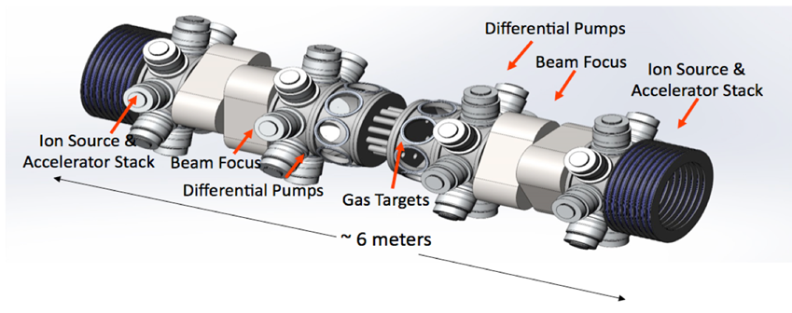
Integrated Facilities Roadmap and Mission Elements
I4
EAST, C-P: Long pulse wall evolution studies, wear, equilibration, metal and flowing walls,
ITER
Nuclear engineering & licensing
Physics ‘size’ scalings. DMS projection
High power W divertor partial detachment
Opaque pedestal. Radiative optimization
Disruption avoidance
Self-heating & α physics
DIII-D
AUG
Underlying physics
Steady state. Novel CD
Transients. Disruption mitigation
Divertor science, closure
& magnetic geometry
Sample/tile tokamak tests
Metal walls, liquid walls
Compact U.S. Pilot Plant Integrated Nuclear Test Facility
Theory
ITER TBM program
Breeder design
Low dpa tests
...
MASTU
NSTX-U
Simulation Nonlinear evolutions
Steady state core: CD projection, high bootstrap & thermal fractions, reactor pedestal & transport
High flux divertor, hot walls: recycling particle control, core compatibility
Component tests
Sustained High Power Density
Close Fuel Cycle
Magnum PSI
PMI
PISCES
MPEX
I4,8
Performance
Licensing
Heat
extraction
Divertor confirmation
Nuclear Optimization
Breeding technology
Component testing
(Wall/breeder
change outs)
TPE T ret
Hipher
FPNS 14MeV
AFNS, Phoenix
spallation, GDT
10dpa 50cm³
Low dpa tests:
structure, blankets
embrittle, swel, trap
Compact
VNS
GDT ST etc
Test breeding concepts
Nuclear components
High dpa 14MeV evoln
Nuc
Engineering design and prototypes
Breeding concepts
Structural elements (joints, etc.)
Stress analysis
Liquid concepts
Pilot Full Design
ENG
T extraction
CFETR
Advanced manufacturing
Nuclear materials
Component tests
Larger path
HTS
Joints
Coils
SPARC
EU-DEMO
Config
QAX
Big QAX

Slide 41
Integrated Facilities Roadmap and Mission Elements
20s
30s
40s
50s
I4
EAST, C-P: Long pulse wall evolution studies, wear, equilibration, metal and flowing walls,
ITER
Nuclear engineering & licensing
Physics ‘size’ scalings. DMS projection
High power W divertor partial detachment
Opaque pedestal. Radiative optimization
Disruption avoidance
Self-heating & α physics
DIII-D
AUG
Underlying physics
Steady state. Novel CD
Transients. Disruption mitigation
Divertor science, closure
& magnetic geometry
Sample/tile tokamak tests
Metal walls, liquid walls
Compact U.S. Pilot Plant Integrated Nuclear Test Facility
Theory
ITER TBM program
Breeder design
Low dpa tests
...
MASTU
NSTX-U
Simulation Nonlinear evolutions
Steady state core: CD projection, high bootstrap & thermal fractions, reactor pedestal & transport
High flux divertor, hot walls: recycling particle control, core compatibility
Component tests
Sustained High Power Density
Close Fuel Cycle
Magnum PSI
PMI
PISCES
MPEX
I4,8
Performance
Licensing
Heat
extraction
Divertor confirmation
Nuclear Optimization
Breeding technology
Component testing
(Wall/breeder
change outs)
TPE T ret
Hipher
FPNS 14MeV
AFNS, Phoenix
spallation, GDT
10dpa 50cm³
Low dpa tests:
structure, blankets
embrittle, swel, trap
Compact
VNS
GDT ST etc
Test breeding concepts
Nuclear components
High dpa 14MeV evoln
Nuc
Engineering design and prototypes
Breeding concepts
Structural elements (joints, etc.)
Stress analysis
Liquid concepts
Pilot Full Design
ENG
T extraction
CFETR
Advanced manufacturing
Nuclear materials
Component tests
Larger path
HTS
Joints
Coils
SPARC
EU-DEMO
Config
QAX
Big QAX

Slide 42
Divertor, Wall & Materials Development: Facilities Role and Time Line
20s
30s
40s
50s
I4
EAST, C-P: Long pulse wall evolution studies, wear, equilibration, metal and flowing walls,
Divertor science
Closure
Magnetic geometry
Core mitigation
ITER
Nuclear engineering & licensing
High power tests w/ partial detachment → ‘conventional’ divertor physics scaling
W divertor behavior
Opaque pedestal
DIII-D
AUG
Compact U.S. Pilot Plant Integrated Nuclear Test Facility
Theory
Sample/tile tokamak tests
Metal walls
ITER TBM program
Breeder design
Low dpa tests
...
MASTU
NSTX-U
Liquid metal tests
Solid-liquid
Simulation Advanced materials evolution
Steady state fusion core
High heat flux divertor
Relevant recycling
Impurity/particle control
with hot metal walls
Component testing (D)
Core-edge compatibility
Sustained High Power Density
I9
Close Fuel Cycle
Magnum PSI
PMI
PISCES
MPEX
I6
I4,8
Performance
Licensing
Heat
extraction
Divertor confirmation
Nuclear Optimization
Breeding technology
Component testing
(Wall/breeder
change outs)
TPE T ret
Hipher
FPNS 14MeV
AFNS, Phoenix
spallation, GDT
10dpa 50cm³
Low dpa tests:
structure, blankets
embrittle, swel, trap
Compact
VNS
GDT ST etc
Test breeding concepts
Nuclear components
High dpa 14MeV evoln
Nuc
I7
Engineering design and prototypes
Breeding concepts
Structural elements (joints, etc.)
Stress analysis
Liquid concepts
Pilot Full Design
ENG
T extraction
I8
CFETR
Advanced manufacturing
I9
Nuclear materials
Component tests

Slide 43
U.S. Roadmap to Private Fusion
20s
30s
40s
50s
60s
ITER
Nuclear engineering
& licensing
Nuclear diagnostics
Physics ‘size’ scalings
DMS projection
Disruption avoidance
Self-heating & α physics
DIII-D
Private 4
Steady state
Transients
Stability
Divertor physics & innv’n
Disruption mitigation
Novel CD
Underlying physics
Theory
Compact U.S. Pilot Plant Integrated Test Facility
Core-Edge
High P Divertor
High bootstrap & thermal fraction
CD projection
Reactor transport
High β control
NSTX-U
Sustained High Power Density
Private 1
New Technology Lines
HTS
Joints
Coils
SPARC
ENG
Reactor design
center
“Challenge” components
Advanced loading
Efficient power extraction
Private 3
Neutron sources…
Breeding designs
MAT
Test beds
Simulations
Long pulse evaluations
CD
DIII-D NSTXU
SHPD high B T
xxx
CFETR
High β core
SND ITER satellite
Nuclear materials
Larger path
Private 2
JT60-SA
EU-DEMO

Slide 44
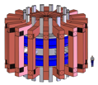
U.S. and NAS Context to Pilot Plant
U.S. Pilot Plant &
Nuclear Test Facility
ITER
DIII-D
NSTX-U
Sustained High Power Density
Theory
& Sim
New Technology Lines
International
Facilities

Slide 45
U.S. Strategy to Lead to Private Fusion
Private 4
U.S. Pilot Plant &
Nuclear Test Facility
ITER
Private 1
DIII-D
NSTX-U
Theory
& Sim
Sustained High Power Density
Private 3
New Technology Lines
International
Facilities
Private 2

