Slide 1
Opportunities and Challenges of Plasma Waves or Radio Frequency Waves for Magnetic Fusion
Masayuki Ono
With Nicola Bertelli, Eun-Hwa Kim, Randy Wilson
RF Physics Division
PPPL, Princeton University
Research Meeting,
April 22, 2019

Slide 2
Joel Hosea
Joel passed away 25 August 2018
Joel has been a leading advocate and major contributor to the advancement of the physics and practical applications of RF heating and current drive processes,
His research career spanned half a century
Early work on the Model C-Stellerator in late 60’s
RF Group Head on the ST tokamak
1980: PLT Project Head
demonstrated the physics of two-ion minority heating and, for the first time, He3 minority heating
1987: RF ICRF group head on TFTR
1991: TFTR Tokamak Operations Head for D-T on TFTR
NSTX Physics Operations Head,
NSTX/NSTX-U RF group leader.

Slide 3
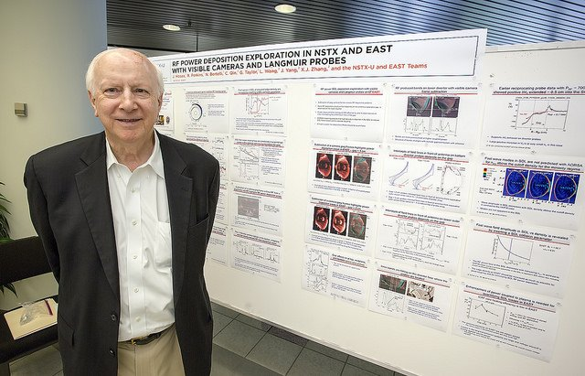
Circa 2016

Slide 4
Plasma Wave or RF can transport energy across strong magnetic fields!
NSTX-U
HHFW
• Plasma waves are widely investigated since the time of Alfven in 1940’s in laboratory, space, and fusion plasmas.
• Plasma waves can interact with plasma particles (electrons or ions) at a given location and velocity so suited for heating plasmas to fusion temperatures and also to drive plasma currents.
• Waves are also known to play important roles, for example, in the NTM/TAE stabilization, impurity expulsion, energetic particles, plasma disruption physics..
• RF appears to be technically attractive for magnetic fusion reactor systems – steady-state, neutron, x-ray, tritium environment…
• RFs sources are largely developed. High power 300 GHz gyrotrons for ECH in fusion reactor are being developed!
• RFs transmission systems are relatively well developed – waveguide, bends, vacuum barrier, etc…
Nicola Bertelli
RF SciDAC

Slide 5
Many RF facilities around world present and future (Partial)
We should take advantage of those facilities to advance physics!
ICRF
HHFW
Helicon
LHCD
ECH
EBW
~ Ω_{i}
~ few Ω_{i}
~ 10s Ω_{i}
~ (Ω_{i}Ω_{e})^{0.5}
~ Ω_{e}
~ Ω_{e}
ASDEX-U
DIII-D
DIII-D
DIII-D
JET
EAST
ASDEX-U
TCV
EAST
KSTAR
KSTAR
KSTAR
WEST
WEST
JT-60SA
ITER
Tokamaks
ITER
STs
QUEST/LATE
GLOBUS-M
NSTX-U
TST-2
QUEST
VEST
ST-40
NSTX-U
GLOBUS-M
Urania
Linear
ST-40
LTX-β
LAPD
NSTX-U
NSTX-U
Stellarators
LHD
LHD
W7-X
W7-X
HSX

Slide 6
JET ICRF to control W accumulation in plasma core

Slide 7
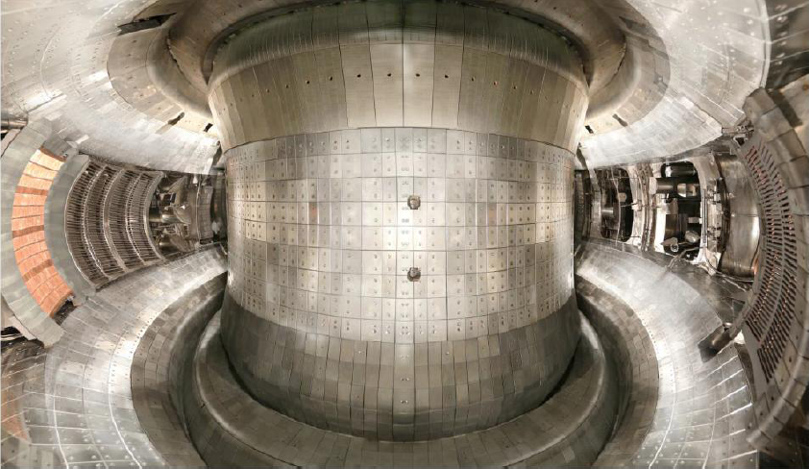
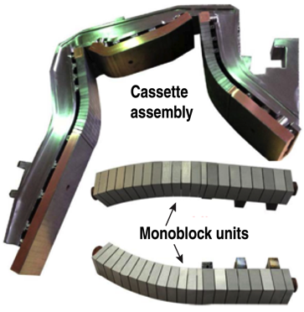
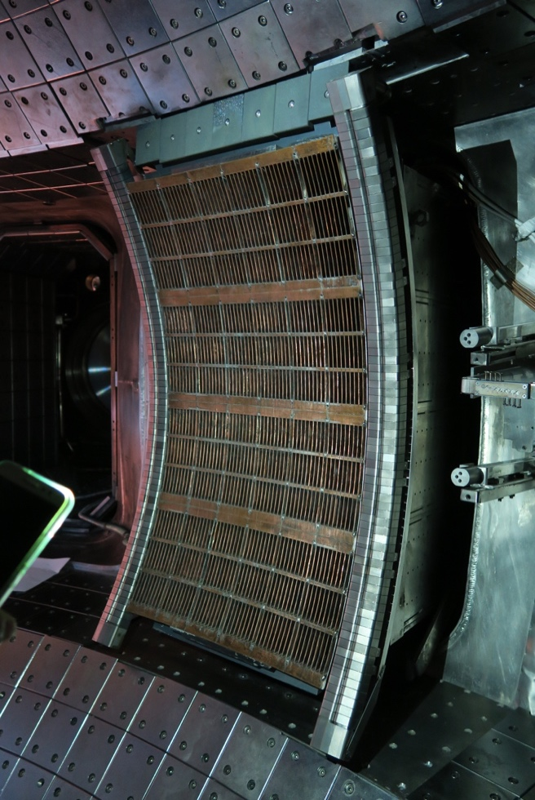
EAST capabilities facilitate to extend high performance to true steady-state operation
ITER-like W/Cu divertor
LHCD 4+6 MW（2.45/4.6GHz）
Fast Electron Source/Edge Current Drive /Profile
ICRH 6+6 MW （25-75MHz）
Ion and Electron Heating Central Current Drive
ECRH 1+1(4) MW (140GHz）
Electron heating/Steering mirror, j_{ϕ} tailoring
TZM/Cu FW
C/Cu FW-NBI
New 4.6GHz LHW W guide limiter
P_{in-Max}~3.5MW

Slide 8
KSTAR has a multiple RF program
Helicon collaboration is on-going but ECH could be also a logical option as PPPL has built launchers for ECH in the past.

Slide 9
WEST has a significant RF capability but with relatively few rf researchers
• PPPL already has a research grant for x-ray camera on WEST.
• A logical synergy with the LHCD research. Exploratory discussions on RF collaboration started.

Slide 10
JT-60SA is an excellent prototype for ITER
ITER may need careful ECH v-s optimization during initial operations
• Strong ECH/ECCD capability – 7 MW for 100 s.
• Can leverage on-going collaboration on XICS and also multi-energy X-ray camera
• Also can leverage on-going collaboration on ECH/ECCD start-up research on QUEST to address ITER plasma start-up issue at half or a third field, 2-3 harmonic ECH?

Slide 11
ITER will have high power ECH and ICRF for H&CD
Overview of ITER Plant Configuration
Stage | PFCs | H&CD | Fuelling | Disruption Mitigation | In-Vessel Coils + PS | Test Blanket Modules
First Plasma & Engineering Operation | Temporary steel PFCs | ECH 7 MW | Gas (partial system) | None | None | None
PFPO-1 ~2029 | Full Be wall & W divertor | ECH 20 MW +10 MW upgrade? | Gas (partial system) Pellets (partial system) | Full system | Vertical Stability ELM control (partial PS set) | None
PFPO-2 ~ 2033 | Full Be wall & W divertor | ECH 20 MW ICH 20 MW NBI 33 MW | Gas Pellets | Full system + Upgrades ? | Vertical Stability ELM control | EM-TBM
FPO ~ 2036 - | Full Be wall & W divertor | ECH 20 MW ICH 20 MW NBI 33 MW + Upgrades ? | Gas Pellets +pellet upgrade? | Full system + Upgrades ? | Vertical Stability ELM control | Nuclear-TBMs

Slide 12
There are however RF-related issues needs resolution for fusion reactor applications
Understand and minimize Fast Wave (ICRF and HHFW) SOL power losses
Helicon CD – new experiments on KSTAR and DIII-D
LHCD loss of efficiency at higher density
Plasma start-up with ECH
Need to develop credible predictive capability!
RF Experiment
RF Modeling
RF Diagnostics

Slide 13
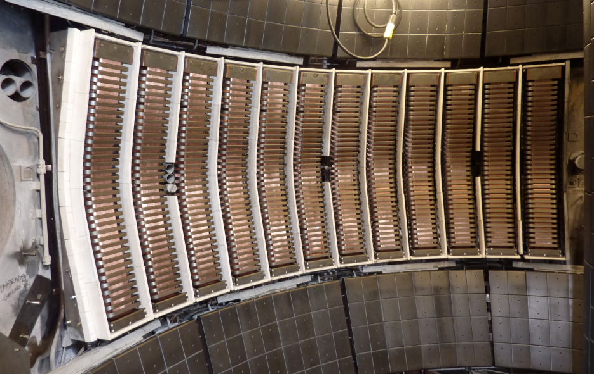
NSTX High Harmonic Fast Wave Heating Produced High T_{e} and High Non-Inductive Fraction Discharges
Full wave simuluation
RH
LH
• HHFW produced high T_{e} ~ 6 keV plasmas in NSTX.
• HHFW can efficiently heat electrons and drive current even at relatively low I_{p} and T_{e} plasmas.
• HHFW has many heating options in NSTX-U. (N. Bertelli, IAEA 2018, Accepted for NF)
Electron
Absorption
Hydrogen
Absorption
NBI
Absorption

Slide 14
NSTX Fast Wave Simulation Shows the SOL loss increases with SOL volume - Implication on ITER will be examined
• NSTX has seen a significant SOL loss during the HHFW experiment (J. Hosea et al. PoP 2008).
• Experiment has performed on EAST (R. Perkins et al, PPCF 2019)
• RF SciDAC has been working on the modeling (N. Bertelli, E-W Kim)
• LAPD is performing basic experiment on the FW SOL physics.
Increasing SOL volume
n_{ll} ~ 11
n_{ll} ~ 19
SOL power loss fractions (arb.)
E-W Kim et al., submitted to PoP

Slide 15
NSTX-U SOL Loss calculations extended to higher ITER-like B_{T}
~ Initial Operation
~ Intermediate
~ Full field
B_{T} = 1.7 T
B_{T} = 3.4 T
B_{T} = 5.1 T
f = 53 MHz
n_{II}
1.8
3.6
6.2
10.8
Higher B_{T} reduced SOL loss fraction but still could be significant
1.8
3.6
6.2
10.8
1.8
3.6
6.2
10.8
SOL loss is less for lower SOL density but antenna loading is also less
SOL power loss fractions (arb.)
SOL loss tends to increase with SOL width and size so it could be important for ITER
We are proposing this SOL loss in WEST and JET ICRF experiments.

Slide 16
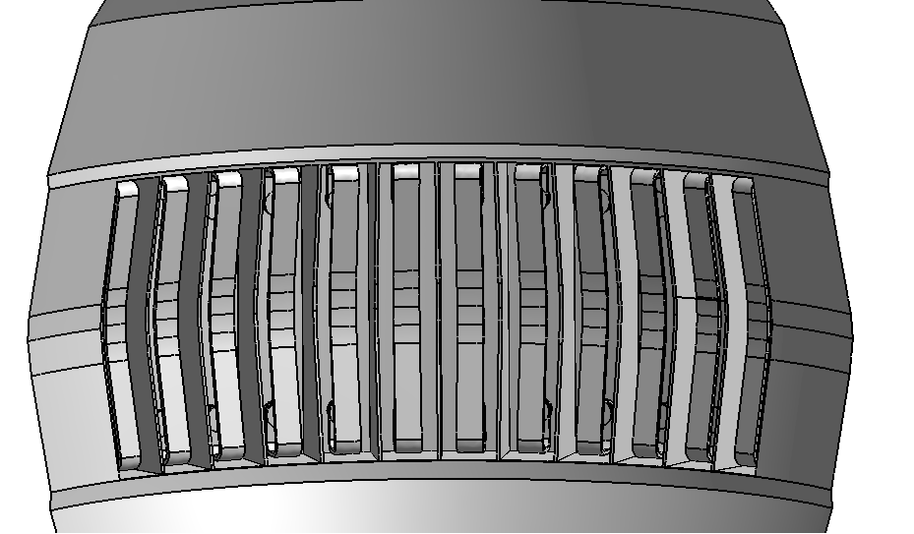
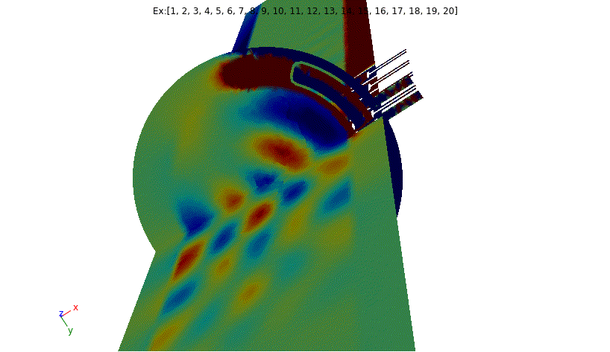
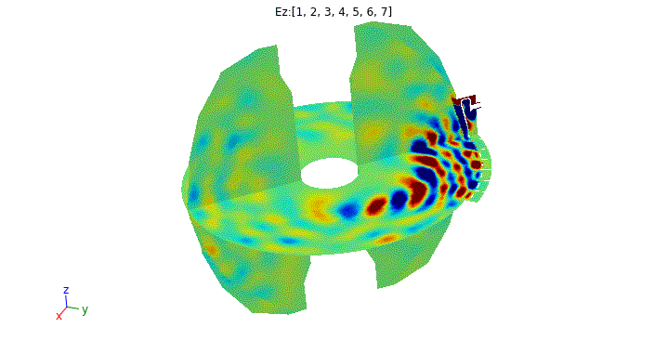
PPPL RF SciDAC activities (con’t)
Participation in the RF experimental campaign on LAPD (UCLA)
New 4 strap antenna installed by TAE
Validation of RF tool vs. LAPD data
Attended two days on March 4-5
Work in progress
3D core+edge full wave simulations in NSTX-U
3D torus geometry
Realistic antenna geometry
Work in progress
NSTX-U 12 strap antenna
N. BERTELLI INVITED TALK AT THE UPCOMING RF TOPICAL CONFERENCE
MAY 2019, HEFEI CHINA
3D core+edge full wave sim. for NSTX-U
With realistic 3D full wave SOL modeling and experiments, we hope to develop improved understanding on the ICRF SOL power loss!

Slide 17
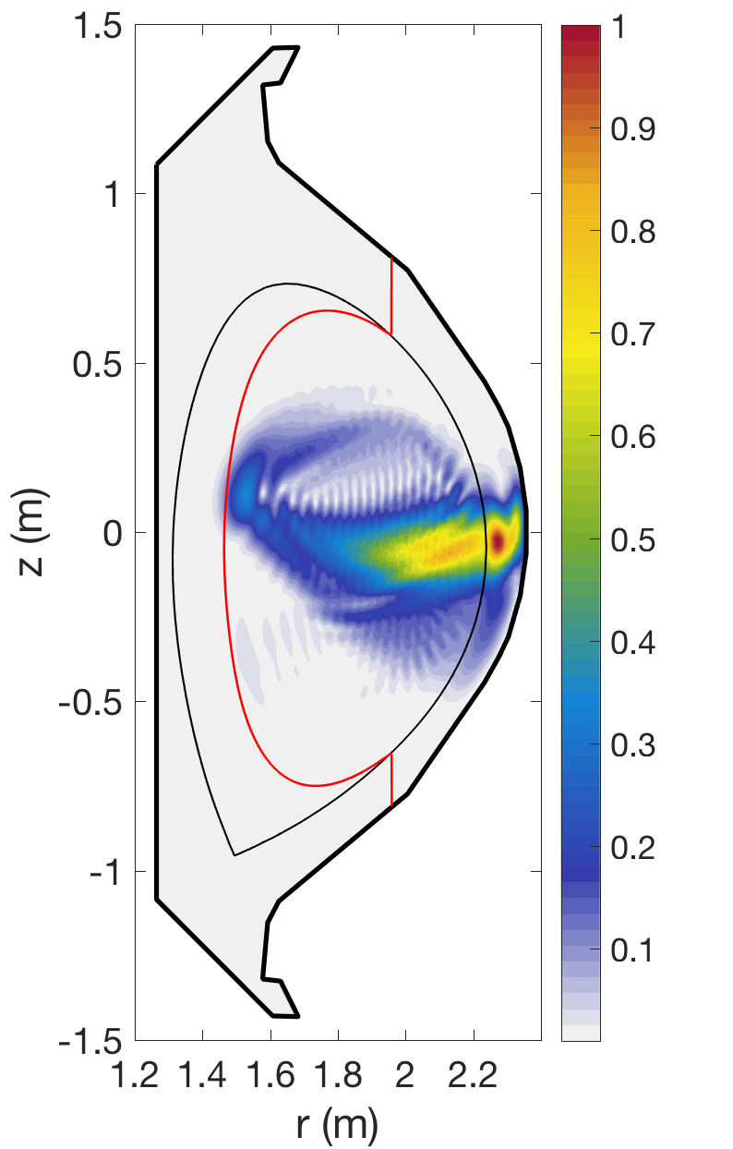
Helicon wave excitation and propagation investigated NSTX-U HHFW 2D Model Extended to KSTAR Helicon in 2D
Helicon in 2D
• Helicon like HHFW can heat electrons and drive plasma current:
Extend the model to 3-D
Realistic antenna geometry
Parasitic excitation of lower hybrid wave may need to be considered
Experimental results should become available in ~ 2020 in DIII-D and KSTAR
|E|
f = 500Mhz
N|| = 3
FW cutoff
|E| / max(|E|)
Realistic Boundary
Last Closed Flux Surface
E-H Kim at RF Topical Conference 2019

Slide 18
LHCD is providing long pulse operations in EAST and WEST
• PPPL has a long history of LHCD: ACT-1, PLT, PBX-M…
• C-Mod saw SOL turbulence scattering at higher density/ loss of LHCD
• NSTX is collaborating with TST-spherical tokamak on LHCD with our x-ray camera.
• LHCD simulation code is advancing in recent years thanks to RF SciDAC
E_{toroidal} of 4.6GHz LH wave propagation
w/o Blob
with Blob
LH launcher
• LH resonance cone propagation is largely destroyed by the SOL “blobs” by S. Shiraiwa of MIT
Distance from Midplane (cm)
• The main motivation of the in-board LHCD launcher for DIII-D is to minimize SOL scattering.
• Proposing LHCD study on WEST using dynamic Stark-effect spectroscopy and x-ray camera.
• KSTAR will consider LHCD if helicon is not performing as expected in ~ 2021-2022.

Slide 19
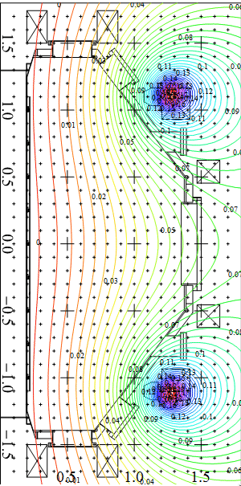
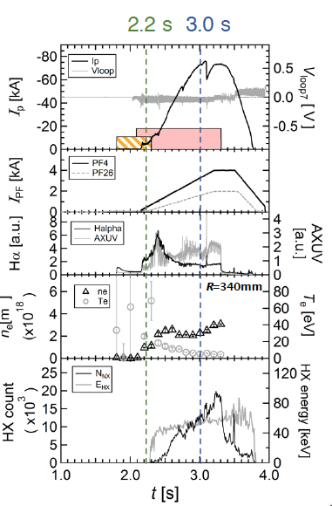
QUEST ECH Start-up produced I_{p} = 86 kA with 230 kW 2nd Harmonic scenario attractive due to higher accessible density
2Ω_{e}Layer
Strong ECH focusing
3 Ω_{e}Layer
4Ω_{e}Layer
H. Idei, et al., IAEA2018
This start-up scenario is quite efficient and potentially reactor relevant!

Slide 20
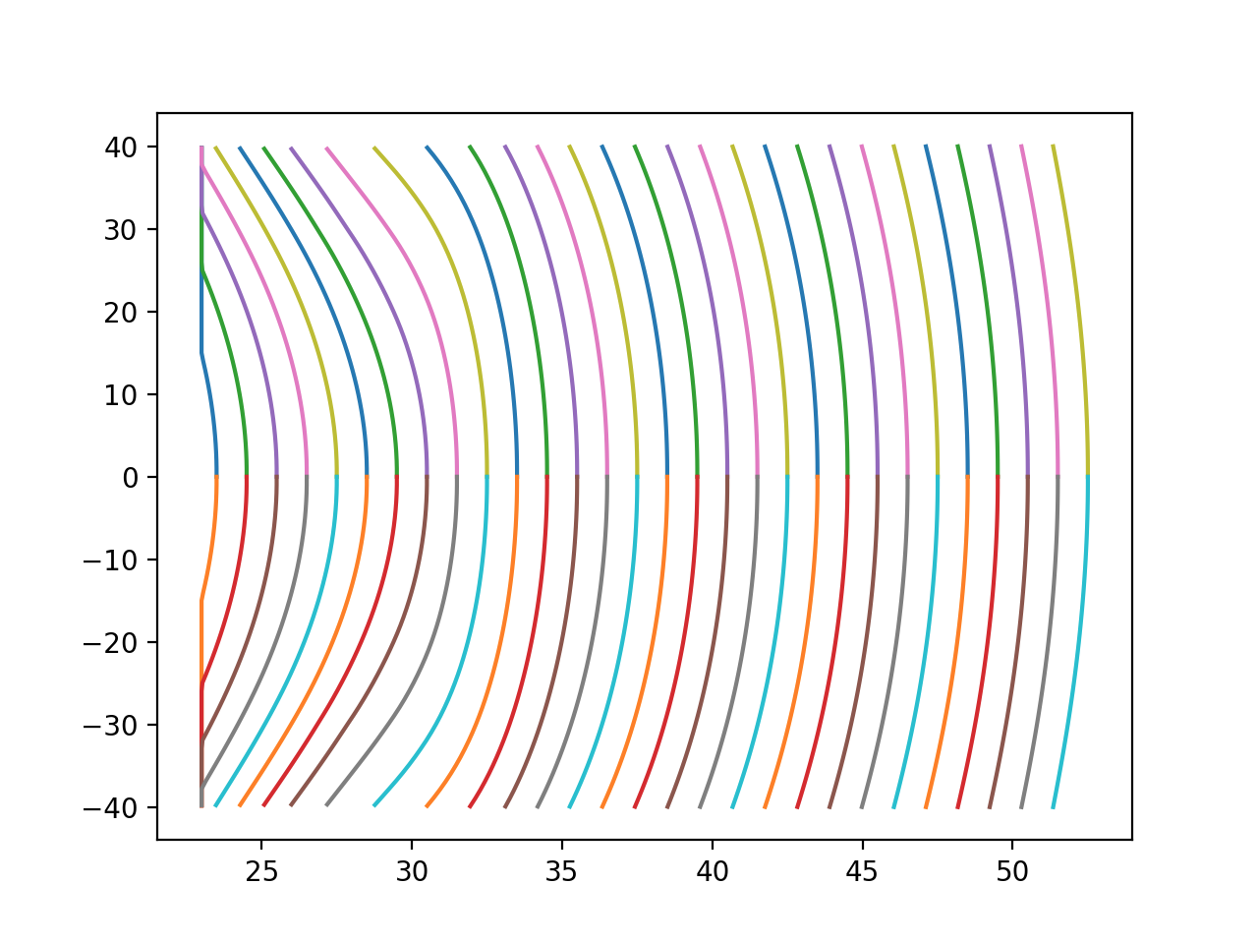
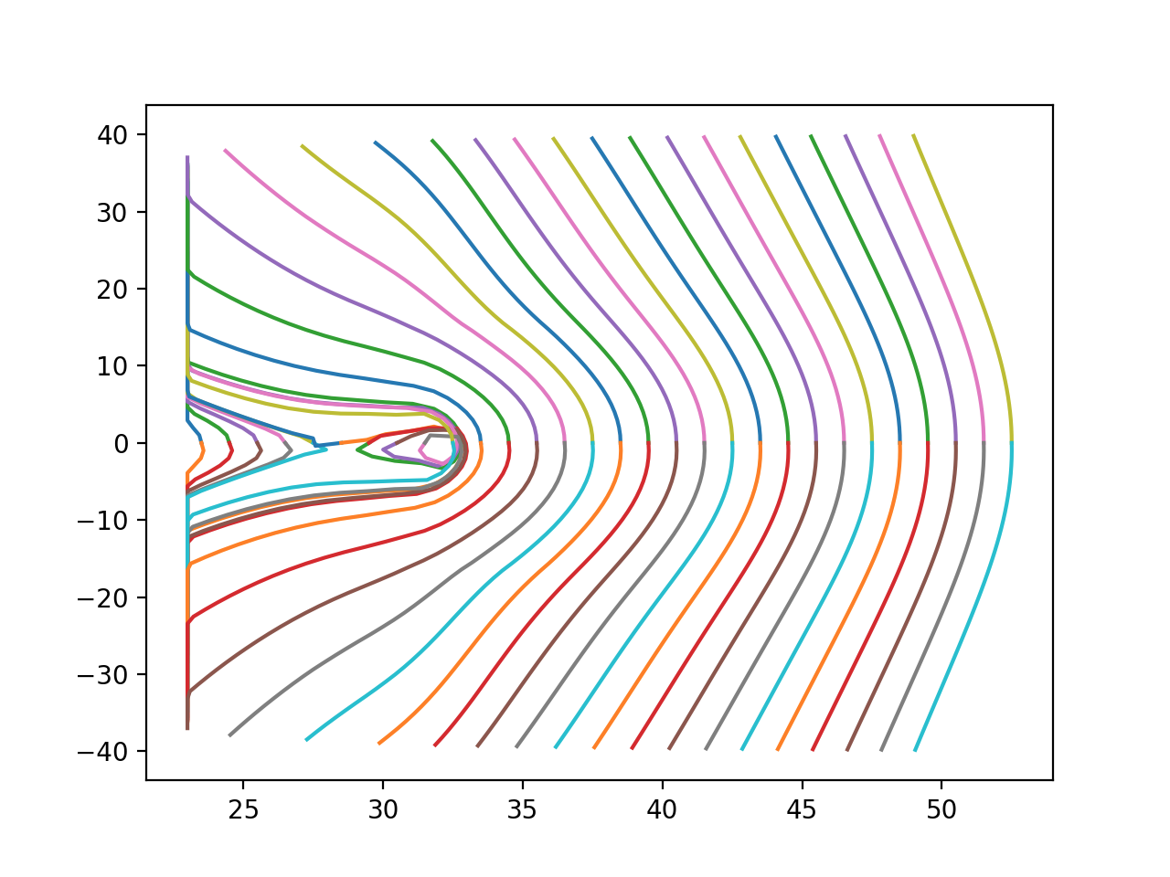
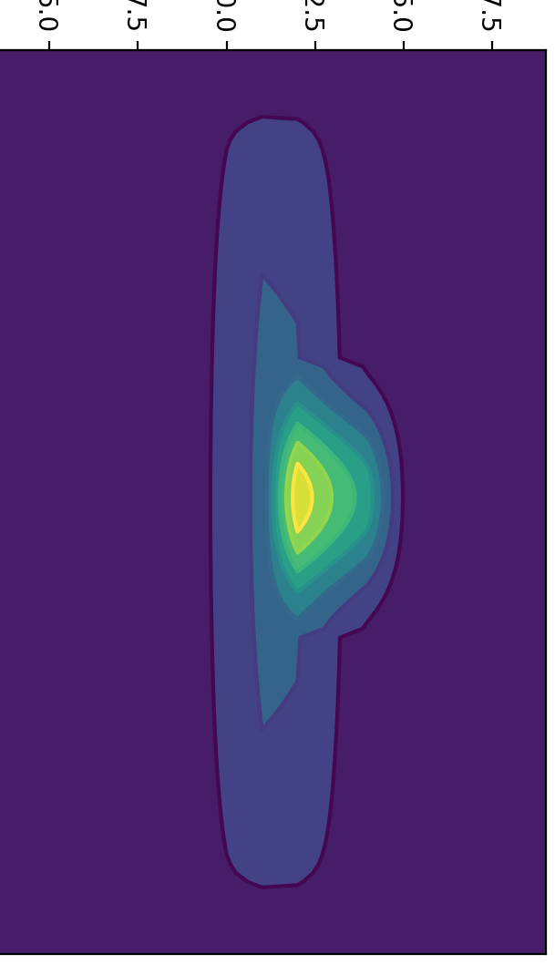
A Grid-based ECH Tokamak Start-up Modeling being Developed
Tracking evolution from open to closed field line configurations
QUEST ECH Start-up
P_{ECH} = 100 kW
B_{v} = 10 G
n_{e} = 10¹²cm⁻³
I_{p} = 556A
I_{p} = 835A
Trapped Particles
Precessional Currents
J _{B}
Precessional Driven Currents Can Create Closed Flux
Trapped particles are robustly confined in open and closed fields
• Trapped particles precessional toroidal drifts generate toroidal current ~ P_{e} / RB_{v-midplane}
• Electron heating of trapped particles is quite efficient - power loss actually decreases with T_{e}
• Mid-plane J-precession location is effective in creating small closed flux surfaces.
• J-precession continues to exist even within the closed flux surfaces.

Slide 21
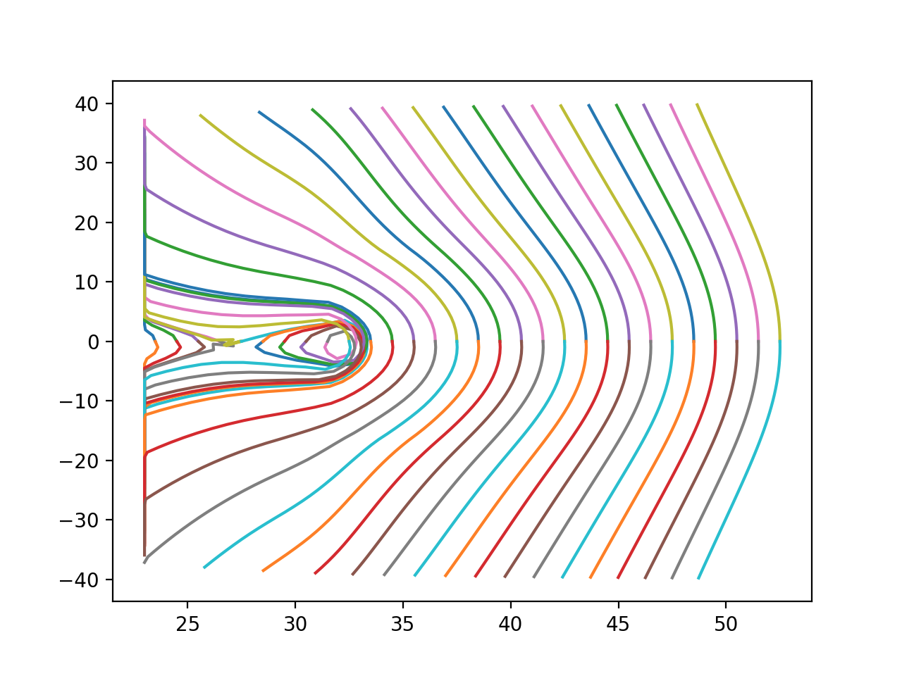
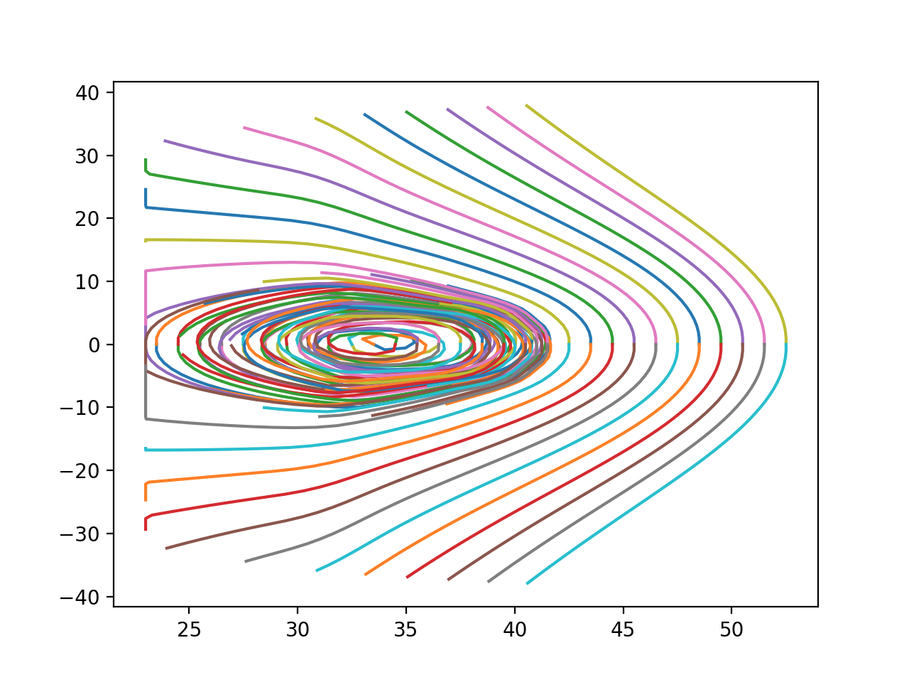
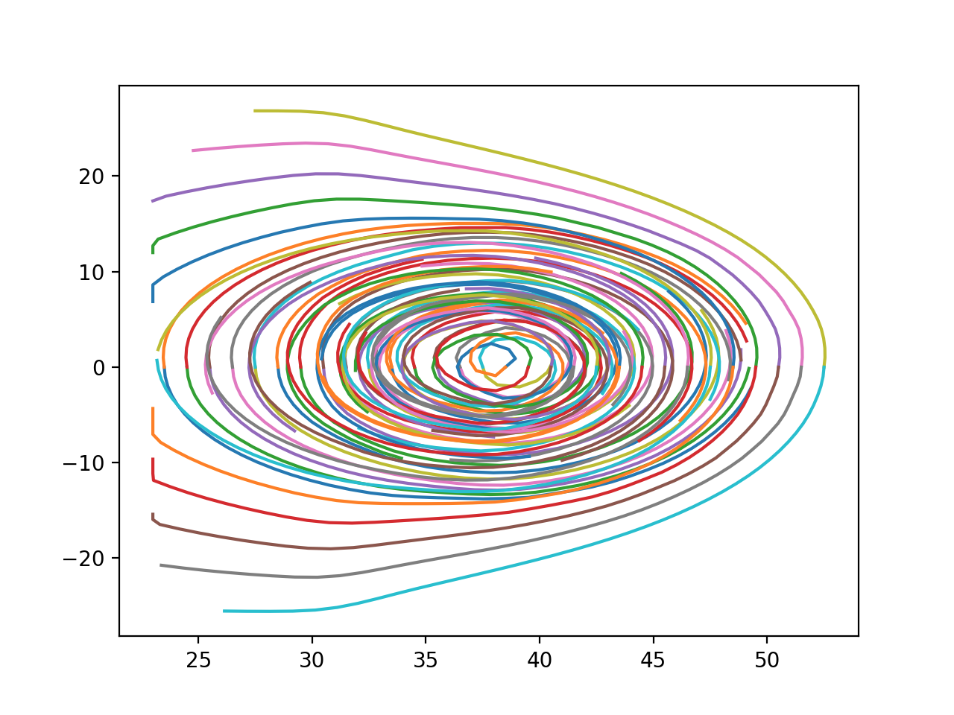
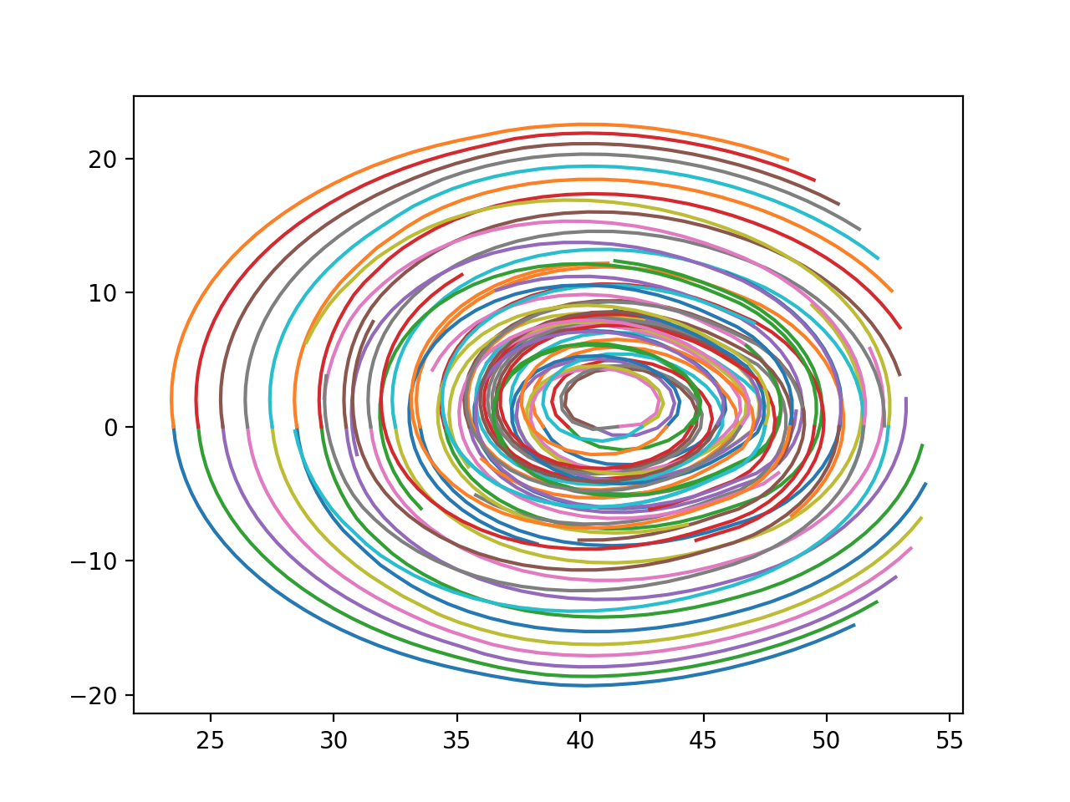
ECH Induced Pressure-Driven Plasma Start-up
Bootstrap current plays important role for robust flux surface formation
Ip (A)
M. Ono APS-DPP 2018
Closed flux surfaces formed
I-boostrap
I-precession
I-grad-B
# of steps
• NSTX-U is providing high resolution x-ray camera on QUEST to support the modeling. • Collaboration on ST-40 is also starting. Luis Delgado-Aparicio

Slide 22
ITER only has ECH until 2033. ECH must help the tokamak start-up and achieve high quality H-mode and more!
Overview of ITER Plant Configuration
Stage | PFCs | H&CD | Fuelling | Disruption Mitigation | In-Vessel Coils + PS | Test Blanket Modules
First Plasma & Engineering Operation | Temporary steel PFCs | ECH 7 MW | Gas (partial system) | None | None | None
PFPO-1 ~2029 | Full Be wall & W divertor | ECH 20 MW +10 MW upgrade? | Gas (partial system) Pellets (partial system) | Full system | Vertical Stability ELM control (partial PS set) | None
PFPO-2 ~ 2033 | Full Be wall & W divertor | ECH 20 MW ICH 20 MW NBI 33 MW | Gas Pellets | Full system + Upgrades ? | Vertical Stability ELM control | EM-TBM
FPO ~ 2036 - | Full Be wall & W divertor | ECH 20 MW ICH 20 MW NBI 33 MW + Upgrades ? | Gas Pellets +pellet upgrade? | Full system + Upgrades ? | Vertical Stability ELM control | Nuclear-TBMs
170 GHz
From Alberto Loarte at KSTAR Conference Feb. 2019
KSTAR with high power 105 GHz and 140 GHZ ECH (and 170 GHz ECH in 2021) is ideally suited for the ITER relevant ECH research.

Slide 23
KSTAR 2nd Harmonic ECH might be attractive for plasma start-up
Also for off-axis current drive and low li discharges
Te0 = 1 keV – 5.5 keV
R₀+a₀
ne0 = 3.0e13
nee =3.e12
2Ω_{e}
3Ω_{e}
Y(cm)
B_{T} ~ 2.0 T
R₀-a₀
f ~ 140 GHz
n_{ll} ~ 0.5 launched
X(cm)
Power (MW)
ECCD (KA)
1.0
0.8
0.6
0.4
0.2
0
T_{e0} = 1 keV
Start
40
30
20
10
0
2Ω_{e}
3Ω_{e}
T_{e0} = 5.5 keV
Exit
R(cm)

Slide 24
Thank you!
With advance in theory/modeling and diagnostics, RF research has a significant near term opportunity for developing credible predictive capabilities!
There are nice PhD thesis opportunities as well!

