Slide 1
NSTX-U
Supported by
Electromagnetic Particle Injector (EPI) for
Fast Time Response Disruption Mitigation in Tokamaks
College W&M
Colorado Sch Mines
Columbia U
Comp-X
General Atomics
INL
Johns Hopkins U
LANL
LLNL
Lodestar
MIT
Nova Photonics
New York U
Old Dominion U
ORNL
PPPL
PSI
Princeton U
Purdue U
SNL
Think Tank, Inc.
UC Davis
UC Irvine
UCLA
UCSD
U Colorado
U Maryland
U Rochester
U Washington
U Wisconsin
Culham Sci Ctr
U St. Andrews
York U
Chubu U
Fukui U
Hiroshima U
Hyogo U
Kyoto U
Kyushu U
Kyushu Tokai U
NIFS
Niigata U
U Tokyo
JAEA
Hebrew U
Ioffe Inst
RRC Kurchatov Inst
TRINITI
KBSI
KAIST
POSTECH
ASIPP
ENEA, Frascati
CEA, Cadarache
IPP, Jülich
IPP, Garching
ASCR, Czech Rep
U Quebec
R. Raman¹, R. Lunsford², et al.,
¹University of Washington
²Princeton Plasma Physics Laboratory
APS-2019 Invited Talk Outline
29 April 2019
Magnetic Fusion Science Meeting
B318, PPPL

Slide 2
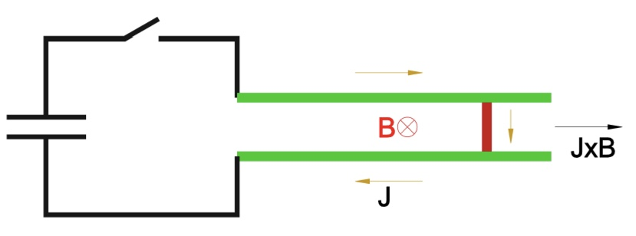
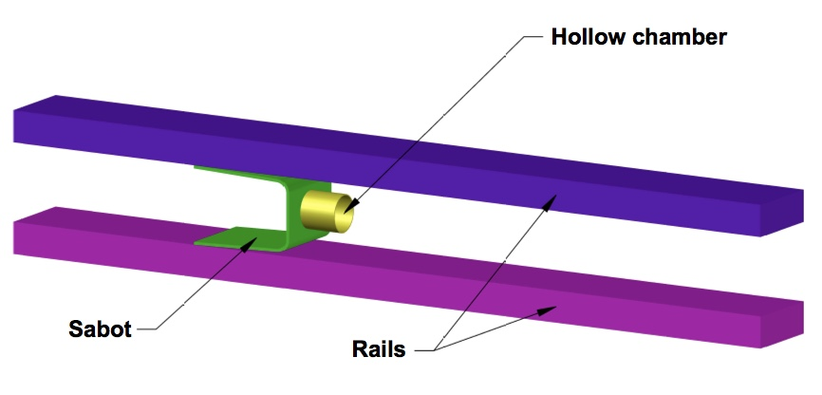
EPI accelerates a metallic sabot to high-velocity in a simple rail gun configuration
Injector can be positioned very close to the vessel, if EPI is part of the original reactor design
Can use high-field SC boost coils (>8T) if located outside ITER port plug
Raman, et al., Nucl. Fusion 59 (2019) 016021

Slide 3
Controlling Major Disruptions on ITER and Tokamak-Based Reactors is an Essential Requirement
The present baseline system for ITER is based on SPI, but this may change, and other improved technologies may be implemented
    The Electromagnetic Particle Injector (EPI) is a possible candidate
Disruption mitigation on ITER would be much more challenging
    High edge Te will make radiative penetration to q=2 quite difficult
    On DIII-D some SPI fragments penetrate to q=2 surface, but simple, single fragment injection, calculations indicate that these would be ablated at the edge in ITER plasmas.
    Will SPI on ITER be more like MGI on DIII-D?
    Would MHD mixing be needed to transport the radiative payload to the core (MGI) or would inside-out quench using new technologies be superior and provide greater safety margin on ITER?
    How well can we control the amount of required radiative material as the plasma energy content changes (to control the current quench time duration)
    How well would runaway currents be controlled on ITER
Reliable and safe operation of ITER is absolutely necessary for the future of any tokamak-based reactors, and for magnetic fusion energy in general

Slide 4
Major uncertainties exist in the present baseline DMS for ITER
EPI has the potential for protecting the ITER infrastructure (fast response time & high velocity)
Off-line setup (with EPI-2) has demonstrated key aspects of concept, including 300 m/s velocities with 1.5ms response time consistent with calculations. (@ ~50% energy of EPI-1 for 150m/s)
  Payload separation from sabot and sabot capture demonstrated at 160m/s and the concept can be extended to >2km/s
Goals for APS Talk
  Briefly summarize key results on radiative payload penetration from present experiments (will SPI on ITER be more like MGI on DIII-D)
  Describe the EPI concept with results from EPI-1 and EPI-2
    On EPI-2, extend operation to full 2T (possibly higher) boost coil fields
    Possible test inside a vacuum chamber
  Include a M3D-C1 simulation on typical EPI fragment injection into a DIII-D/KSTAR scale plasma

Slide 5
Back-up slides

Slide 6
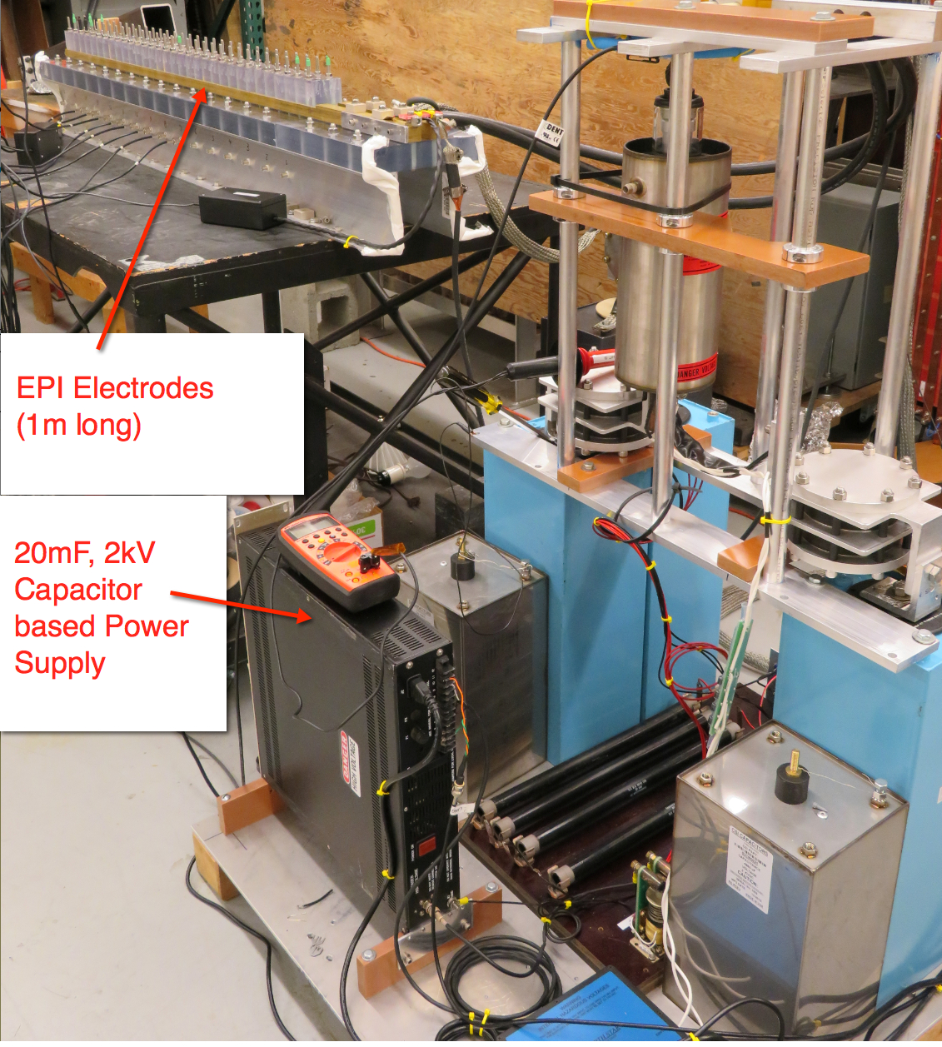
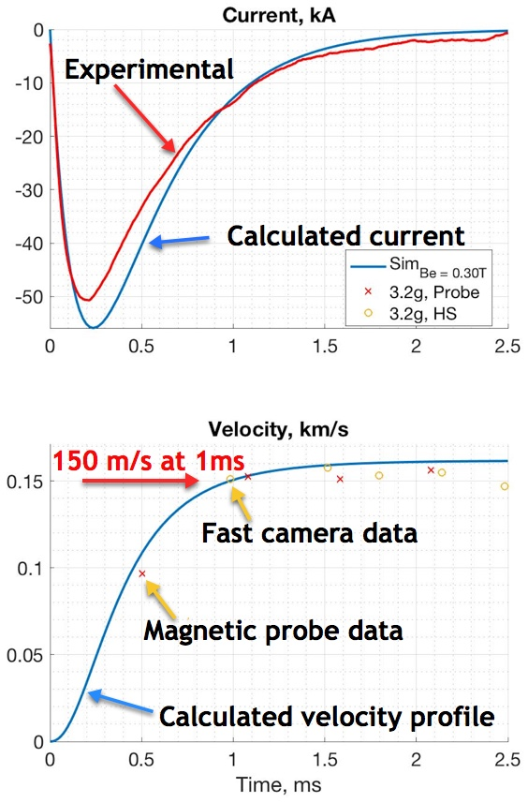
Measured EPI-1 system parameters with 0.3T B-field augmentation in agreement with calculations
Maximum velocity limited by power supply limits
R. Raman, et al., Nuclear Fusion 59 (2019) 016021

Slide 7
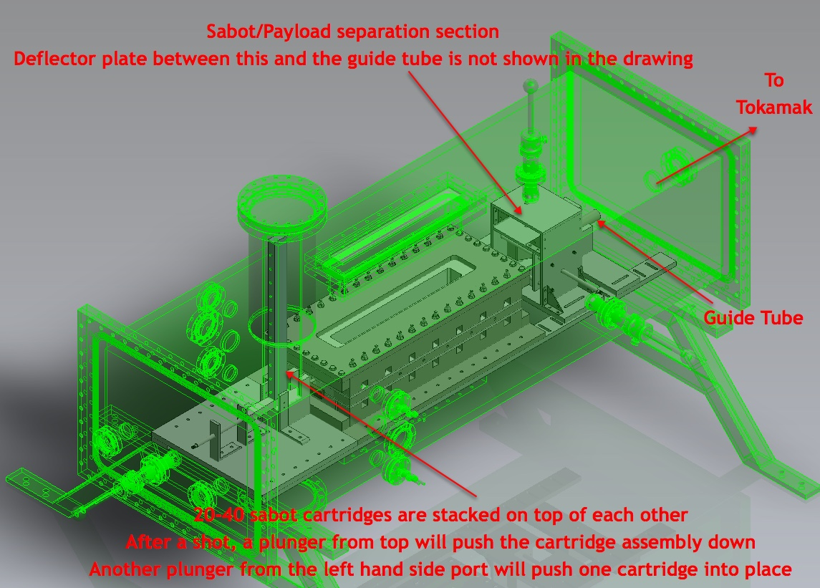
EPI-3 Conceptual Layout (KSTAR configuration)
Vacuum Chamber Dimensions (1.5m x 0.6m x 0.5m)
EPI Core region

Slide 8
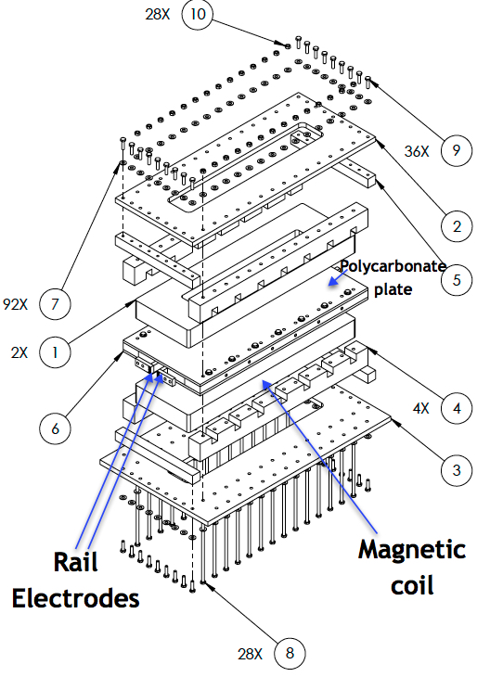
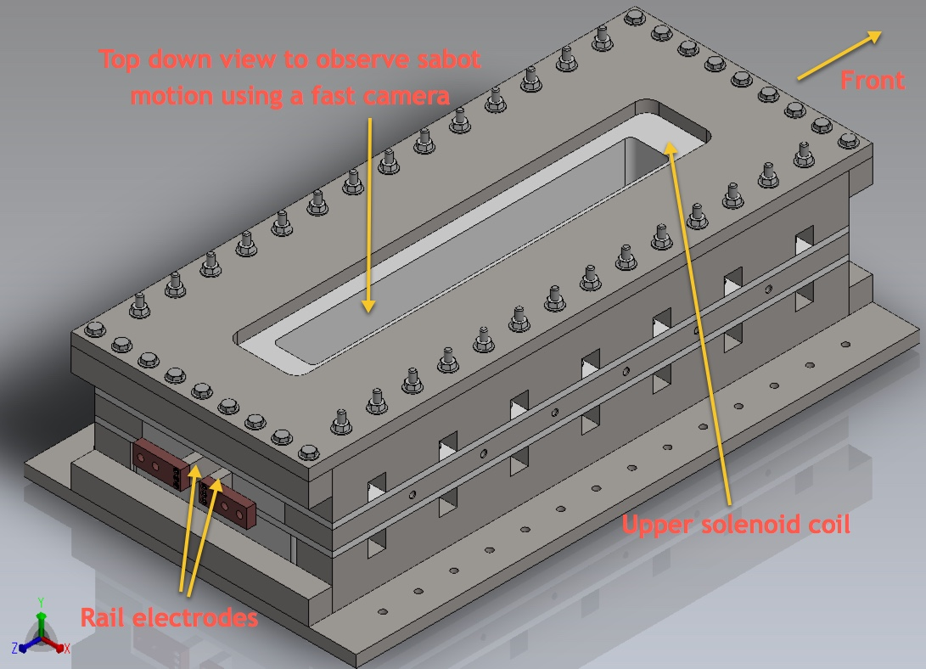
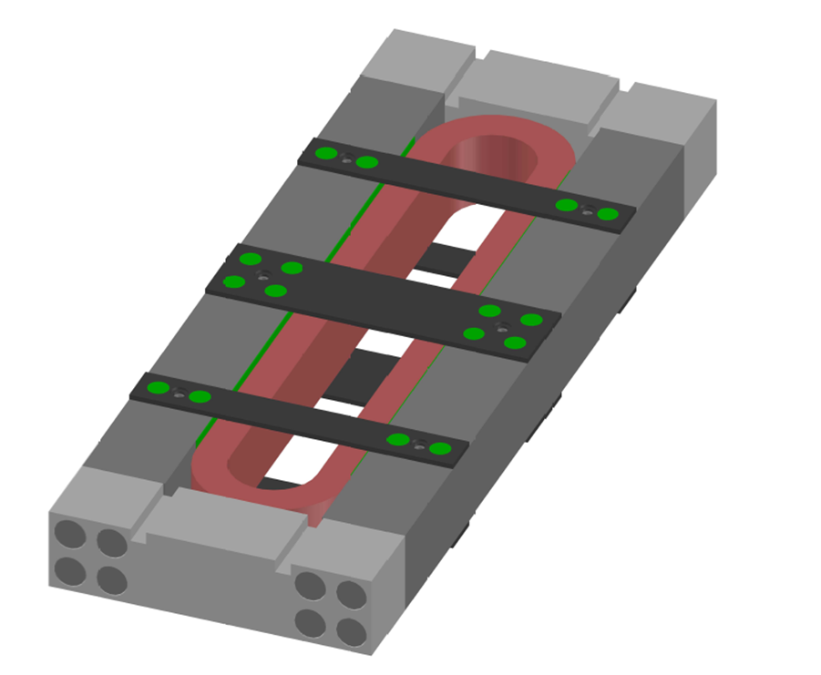
EPI-2 Core Components (KSTAR Configuration)
Racetrack
Coil with
supports

Slide 9
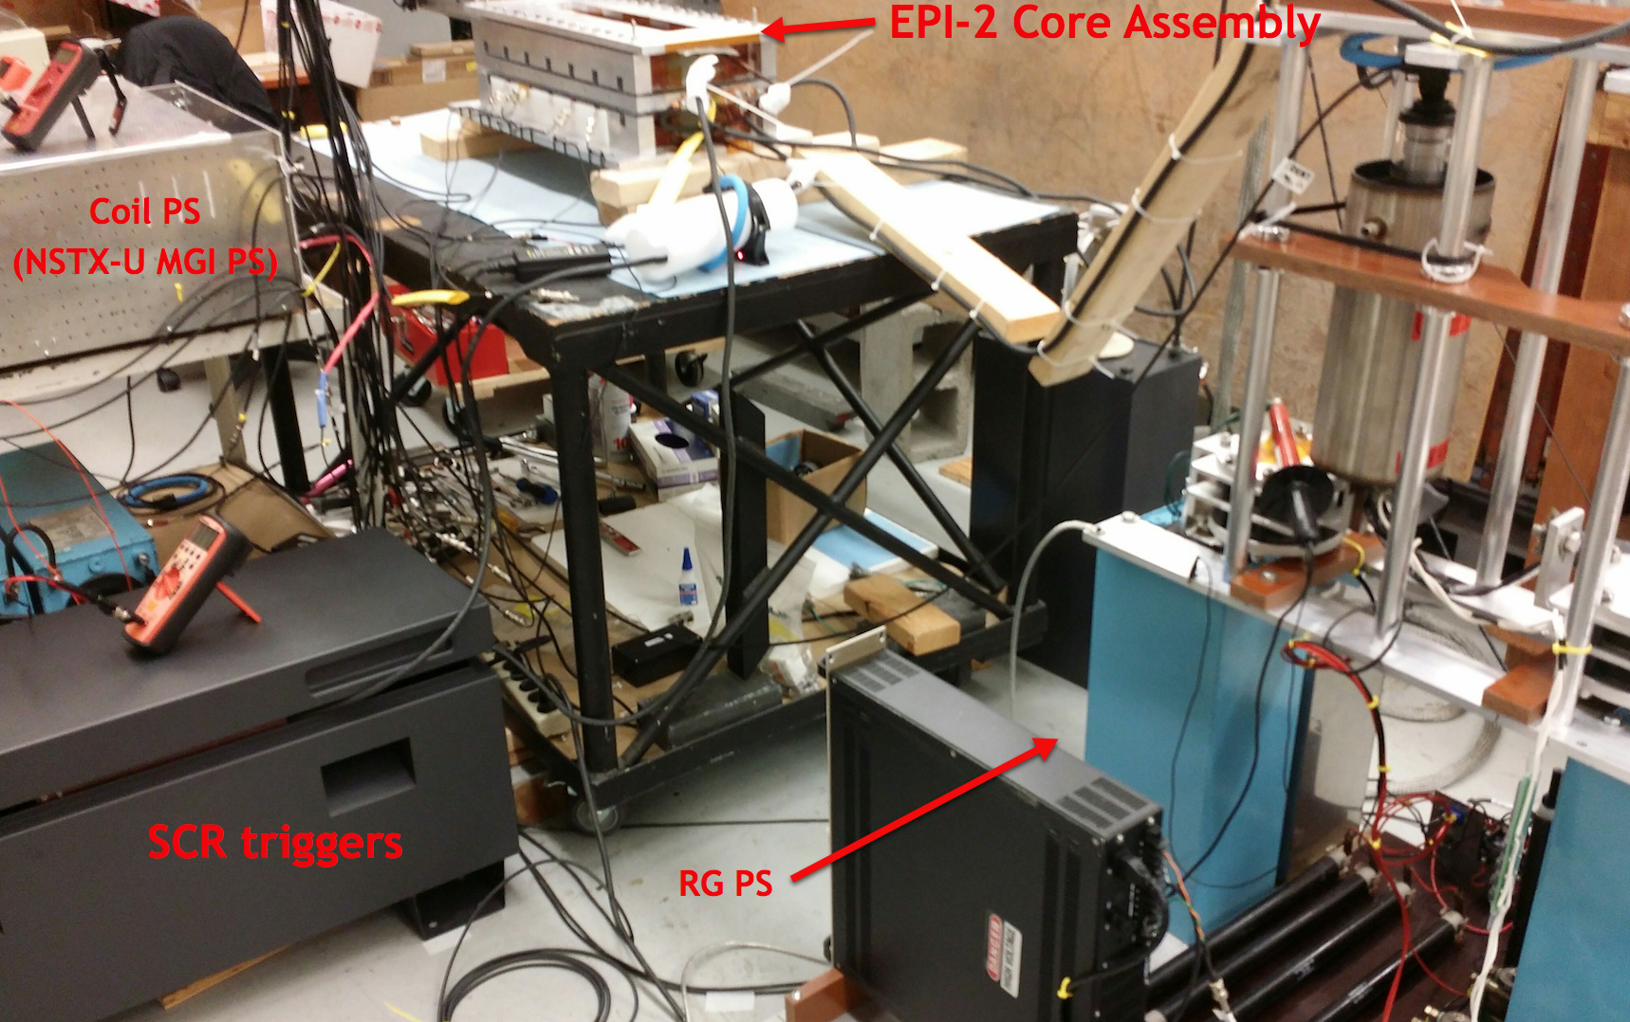
All key components of EPI-2 (except vacuum operation) have been tested

