Slide 1
Theory of Alfven-Sound Frequency Gaps
and
Discovery of Alfven-Sound Eigenmodes in Tokamaks
C. Z. Cheng, PPPL
Co-authors:
G. J. Kramer, PPPL
M. Podesta, PPPL
R. Nazikian, PPPL

Slide 2
Outline
Introduction
- Alfven frequency gaps and Eigenmodes (TAE, EAE, NAE, RSAE, etc.)
Theory of Alfven-Sound Frequency Gaps
  MHD continuous spectrum of Alfven wave and slow mode
  Coupling of Alfven wave and slow mode breaks up continuous spectrum to form Alfven-Sound (AS) gaps; Gap width increases with plasma pressure
  Discovery of Alfven-Sound Eigenmodes (ASE)
  Existence of many types of ASEs: BAAE is one type of ASEs
  5 types of ASEs for β(0)=5% ; 6 types of ASEs for β(0)=25%
  ASEs can have dominant shear Alfven wave nature, or dominant compressional slow mode nature, or mixture of shear and compressional components
  Summary - Application of ASEs

Slide 3
Introduction:
Zoo of Alfven Eigenmodes in Toroidal Plasmas
Coupling physics between Alfven wave and slow mode was not well studied !

Slide 4
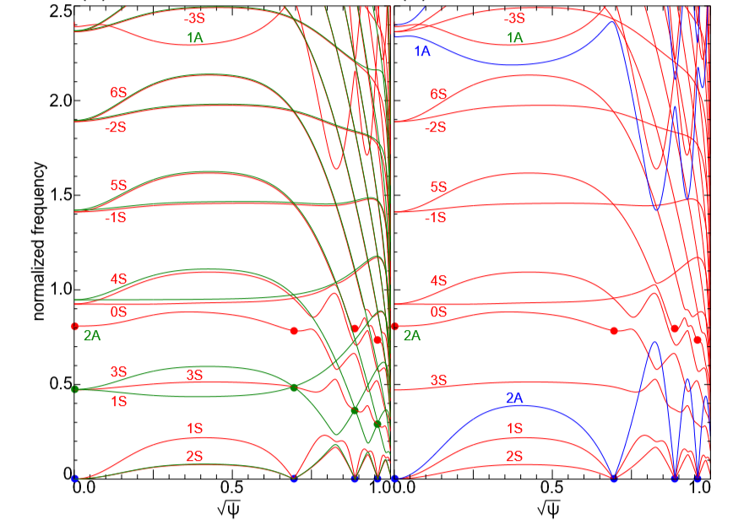
Comparison: Full MHD Solution and
Uncoupled Alfven & Slow Mode Continuous Spectrum
n = 2, β(0) = 5%
Reverse shear, circular shape tokamak equilibrium with R/a = 3; q(0) = 1;
q_{min} = 0.92; q(1)=2.42
Alfven wave - slow mode coupling breaks up continuous spectrum below TAE gap to form Alfven-Sound (AS) gaps
Several types of Alfven-Sound Eigenmodes (ASE) exist with frequency in AS gaps
Red curves: Full MHD results
Green curves: uncoupled slow mode
Blue curves: uncoupled Alfven wave

Slide 5
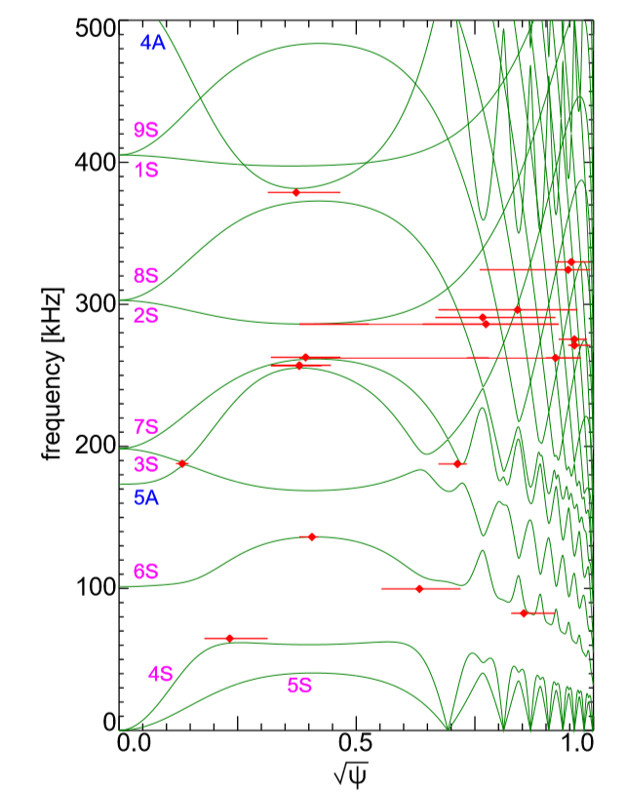
Alfven-Slow Mode Coupling:
Alfven-Sound Gaps & Alfven-Sound Eigenmodes
n = 5 AS gaps & ASEs for β(0)=5% Circular Tokamak
q(0) = 1; q_{min} = 0.92; q(1) = 2.42; R/a=3
Full MHD
Coupling of Alfven wave and slow mode breaks up continuous spectrum below TAE gap to form Alfven-Sound (AS) gaps
Several types of Alfven-Sound Eigenmodes (ASE) exist with frequency in AS gaps
TAE
RSAE
Type 3
Type 3
Type 2
Type 1
Type 4
Type 5

Slide 6





MHD Continuous Spectrum
Coupling of Alfven wave and slow mode (Cheng-Chance (1986)):
Alfven wave
Slow mode
coupling
Magnetic field:
; Safety factor: q
Shear displacement:
Plasma compression:
Geodesic magnetic curvature:

Slide 7
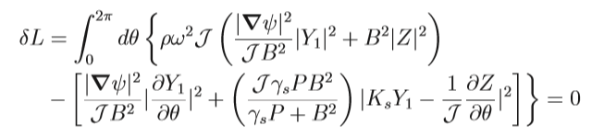





Continuous Spectrum by Lagrangian Functional
Cheng-Chance (1986):
Jacobian:
Toroidal mode number: n

Slide 8
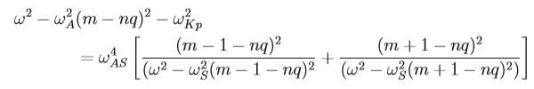








Coupling of Slow Mode m−1 and m+1 Harmonics
with Alfven Wave m harmonic
;
;
Large aspect ratio limit:
;
;
;
;

Slide 9
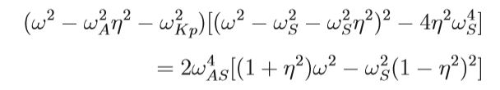





Coupling of Slow Mode m−1 and m+1 Harmonics
with Alfven Wave m harmonic
Dispersion relation:
, and consider
, so that
Three solutions:
Alfven m harmonic:
One of slow mode m 1 harmonic:
Other slow mode m 1 harmonic:

Slide 10


Coupling of Slow Mode m−1 and m+1 Harmonics
with Alfven Wave m harmonic
Large aspect ratio limit,
and for
Alfven m harmonic:
One of slow mode m 1 harmonic:
Other slow mode m 1 harmonic:

Slide 11
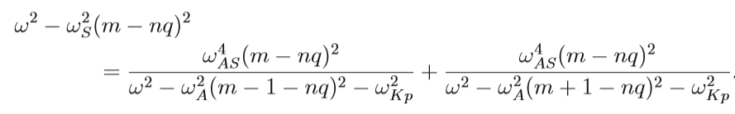

Coupling of Alfven Wave m−1 and m+1 Harmonics
with Slow Mode m harmonic
Slow mode m-harmonic:
Large aspect ratio limit:
Alfven m 1 harmonics:

Slide 12
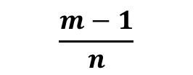
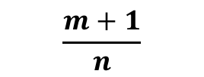

ω
Δω
m(A)
ω_{S}
m+1
m−1
m
m
m−1
m+1
m−1
m+1
m
m
0
m−1
m
m
m+1
q
$$\frac{m−1}{n}$$
$$\frac{m}{n}$$
$$\frac{m+1}{n}$$

Slide 13
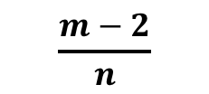
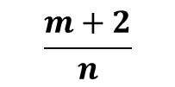
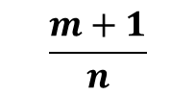

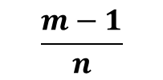
ω
Δω
(m−1)(A)
m(A)
(m+1)(A)
m
m+1
m+2
ω_{S}
m−2
m−1
m
m−2
m
m−1
m+1
m
m+2
0
m−1
m−1
m
m
m+1
m+1
q
$$\frac{m−2}{n}$$
$$\frac{m−1}{n}$$
$$\frac{m}{n}$$
$$\frac{m+1}{n}$$
$$\frac{m+2}{n}$$

Slide 14


n = 0
ω²
m = 0 (A)
m = 1 (S)
m = 0 (S)
0
q

Slide 15
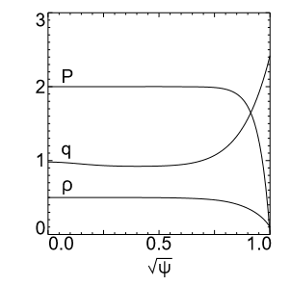
Circular Tokamak
Reverse shear,
Circular shape tokamak equilibrium with
R/a = 3
q(0) = 1; q_{min} = 0.92 ;
q(1)=2.42

Slide 16
Comparison: Full MHD Solution and
Uncoupled Alfven & Slow Mode Continuous Spectrum
n = 2, β(0) = 5%
Reverse shear, circular shape tokamak equilibrium with
R/a = 3
q(0) = 1; q_{min} = 0.92
q(1)=2.42
Red curves:
Full MHD results
Green curves:
Uncoupled slow mode
Blue curves:
  uncoupled Alfven wave

Slide 17
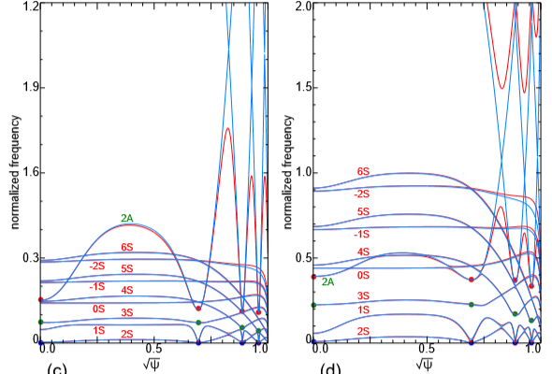
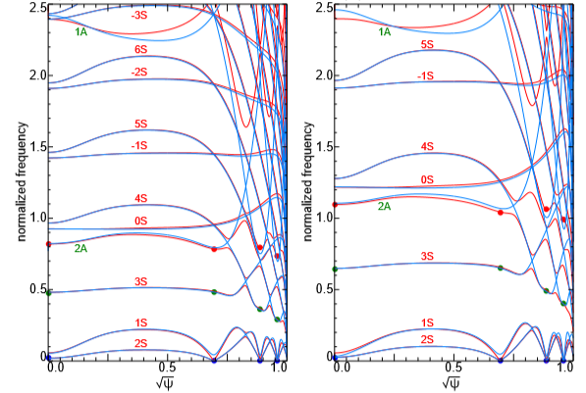
n = 2 Continuous Spectrum:
Comparison of 3-Harmonic Coupling Theory and Full MHD Solution
β(0)=0.1%
β(0)=1%
β(0)=5%
β(0)=10%
Blue curves: theory results ; Red curves: NOVA full MHD results

Slide 18
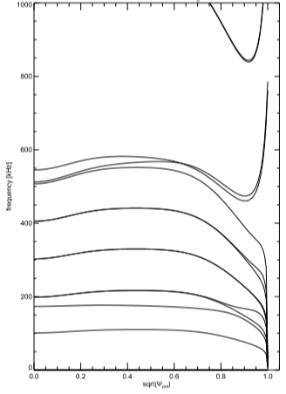
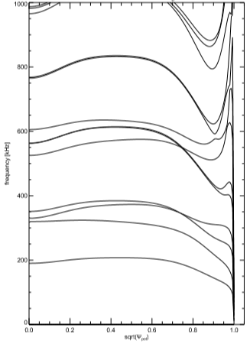
n = 0 MHD Continuous Spectrum
Coupling between Alfven Wave & Slow Mode
Reverse shear, circular shape equilibrium with
R/a = 3; q(0) = 1; q_{min} = 0.92; q(1)=2.42
normalized frequency
=214 kHz
n=0, β(0)=5%
n=0, β(0)=25%
4
4S
1
3
1A
1A
n=0 MHD results
Coupling of Alfven m=0 harmonic with slow mode m= 1 harmonics creates Alfven-Sound gaps
Can GAM eigenmodes exist in the n=0 AS gaps ?
3S
4S
2
2S
3S
0A
2S
1
0A
m=1S
m=1S
−1S, 0S
−1S, 0S

Slide 19
n = 5 Eigenmodes for β(0)=5% Tokamak
n=5, β(0)=5%
q(0) = 1; q_{min} = 0.92; q(1) = 2.42
5 types of ASEs are found:
Type 1: Frequency above m=nq−1= 4 slow mode continuum in core region;
Type 2: Frequency above m=nq+1= 6 slow mode continuum in core region ;
Type 3: Frequencies in AS gaps due to coupling of Alfven m=5 harmonic with slow mode m-2 = 3 and m+2= 7 harmonics in core region
  Type 4 (BAAE): Frequency below m=nq+1= 6 slow mode continuum; mode localized around q=m/n
  Type 5: Frequency in lowest AS gap, mode localized in outer radial region
Full MHD
TAE
RSAE
Type 3
Type 3
Type 2
Type 1
Type 4
Type 5

Slide 20
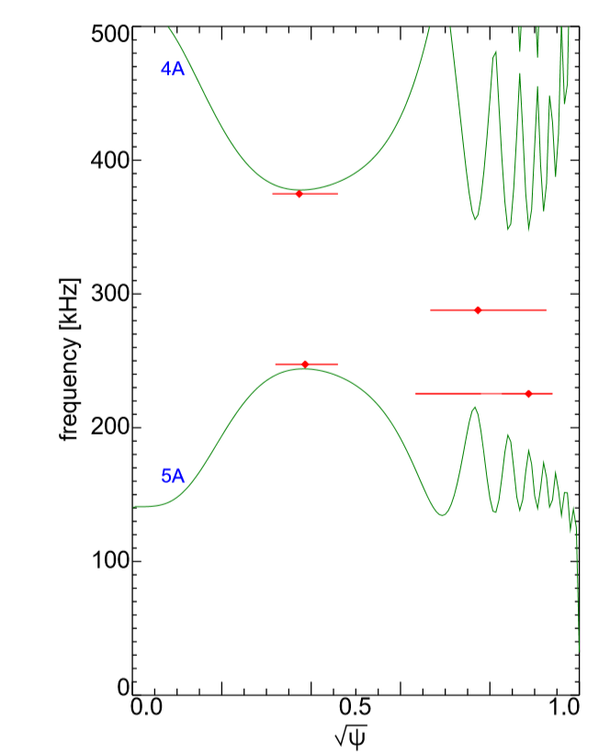
n = 5 Eigenmodes for β(0)=5% Circular Tokamak
n=5, β(0)=5%
n=5, β(0)=5%
Slow-mode approximation
Horizontal bars indicate eigenmode frequencies & half-width of radial structure
normalized frequency
Slow-mode approximation
- no Alfven-Sound coupling physics
- no ASE solutions
- less number of
TAEs & RSAEs
Full MHD
TAE
RSAE
Type 3
Type 3
Type 2
Type 1
Type 4
Type 5

Slide 21
Five Types of ASEs for β(0)=5% Case
Type 1: Frequency above (m=nq-1) slow mode continuum in core region; for n=5, q=1, m=4
  Type 2: Frequency above (m=nq+1) slow mode continuum in core region ; for n=5, q=1, m=6
  Type 3: Frequencies in AS gaps due to coupling of Alfven m-harmonic and slow mode (m-2) and (m+2) harmonics in core region
  Type 4 (BAAE): Frequency below (m=nq+1) slow mode continuum; mode localized around q=m/n ; for n=5, q=1, m=6
  Type 5: Frequency in lowest AS gap, mode localized in outer radial region

Slide 22
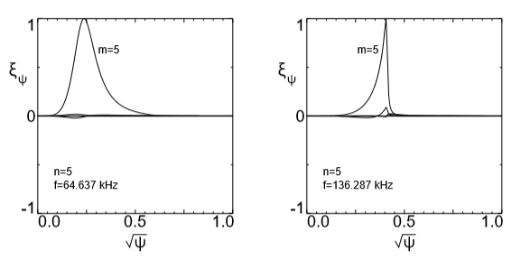
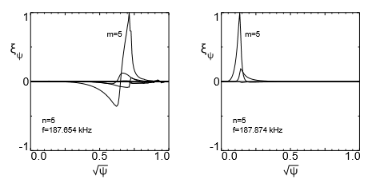
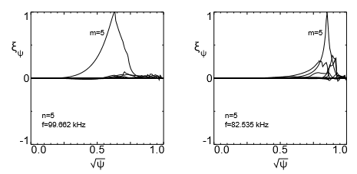
n = 5 Alfven-Sound Eigenmodes for β(0)=5%
Type 1
Type 2
Type 3
Type 3
Type 4
Type 5

Slide 23
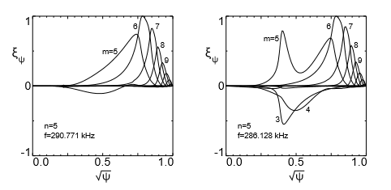
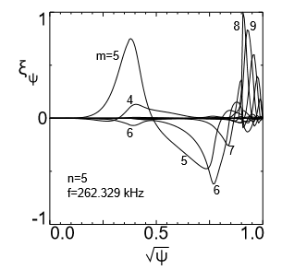
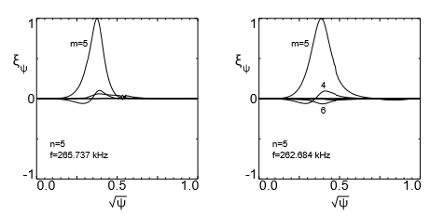
n = 5 Eigenmodes for β(0)=5%
TAE
RSAE-Sound-TAE
RSAE-TAE-Sound
RSAE
RSAE-Sound
More TAEs, RSAEs than model without considering Alfven-Sound coupling.
New modes with mixed features of TAE, RSAE, slow mode

Slide 24
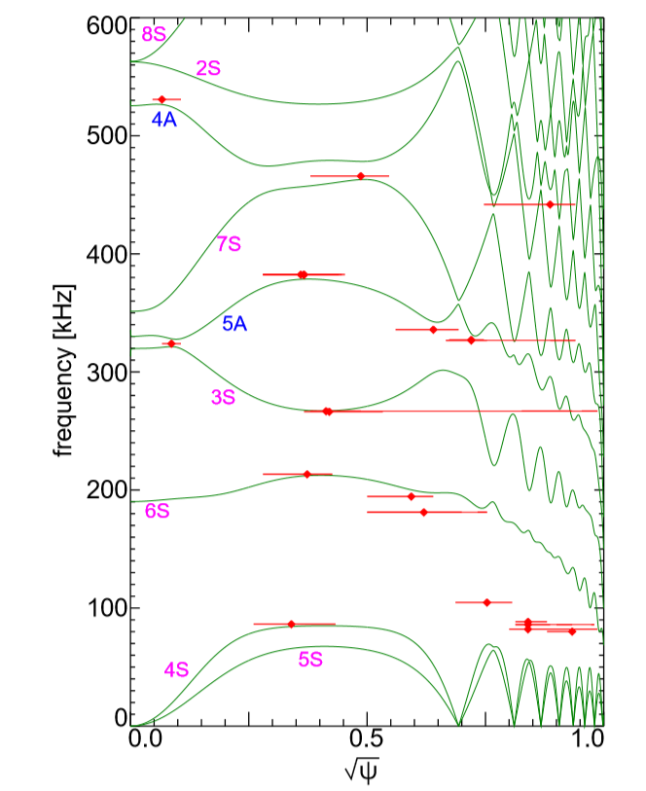
n = 5 Eigenmodes for β(0)=25% Circular Tokamak
β(0)=25%
Horizontal bars indicate eigenmode frequencies & half-width of radial structure
normalized frequency
6 types of ASEs
- more ASE Type than β(0)=5% case
- more ASE solutions per Type
- less number of TAEs & RSAEs
Type 3
Type 3
Type 2
Type 6
Type 4
Type 1
Type 5

Slide 25
Six Types of ASEs for β(0)=25% Case
Type 1: Frequency above (m=nq-1) slow mode continuum in core region; for n=5, q=1, m=4
  Type 2: Frequency above (m=nq+1) slow mode continuum in core region; for n=5, q=1, m=6
  Type 3: Frequencies in AS gaps due to coupling of Alfven m-harmonic and slow mode (m-2) and (m+2) harmonics in core region
  Type 4 (BAAE): Frequency below (m=nq+1) slow mode continuum; mode localized around q=m/n ; for n=5, q=1, m=6
  Type 5: Frequency in lowest AS gap, mode localized in outer radial region
  Type 6: Frequency below (m=nq−2) slow mode continuum in core region; for n=5, q=1, m=3

Slide 26
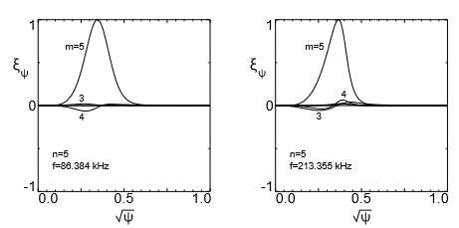
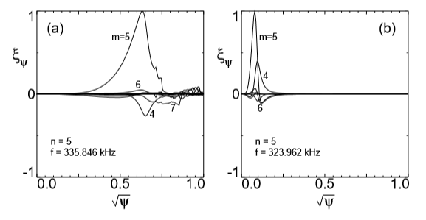
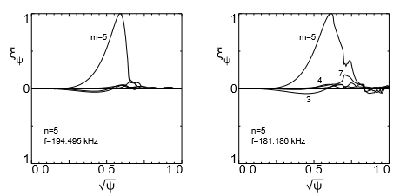
n = 5 Alfven-Sound Eigenmodes for β(0)=25%
Type 1
Type 2
Type 3
Type 4

Slide 27
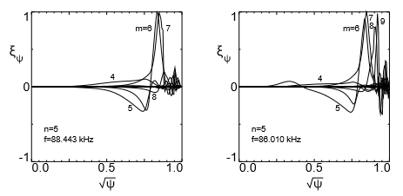
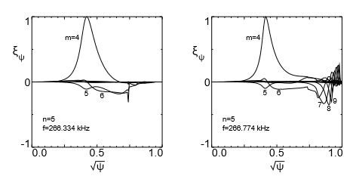
n = 5 Alfven-Sound Eigenmodes for β(0)=25%
Type 5
Type 6
Alfven-Sound
Alfven-Sound

Slide 28
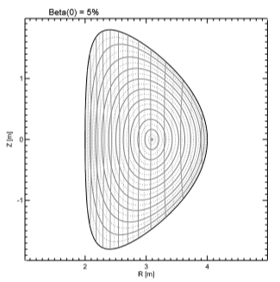
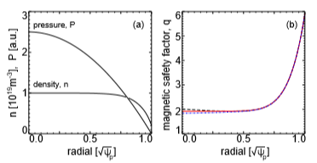
β(0)=5% Triangular Tokamak
Reverse shear, triangular shape equilibrium with
R/a = 3
q(0) = 2; q_{min} = 1.92 ; q(1)=6

Slide 29
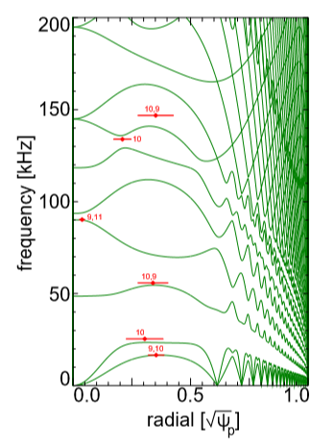
n = 5 Eigenmodes for β(0)=5% Triangular Tokamak
6S
Horizontal bars indicate eigenmode frequencies & half-width of radial structure
normalized frequency
new types of ASEs
- 5 types of ASEs
- 2 new types of ASEs
- no BAAE
13S
RSAE
7S
10A
Type 3
12S
Type 8
8S
Type 2
11S
Type 1
9S
10S
Type 7

Slide 30
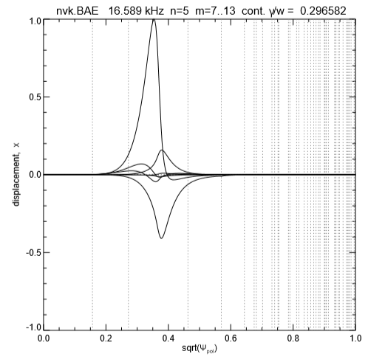
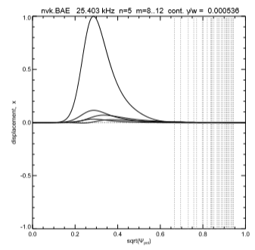
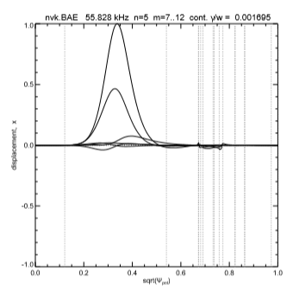
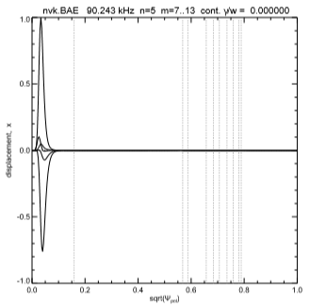
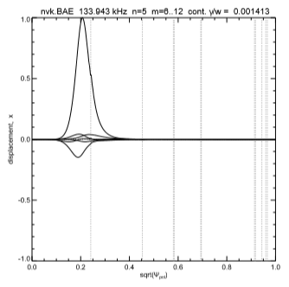
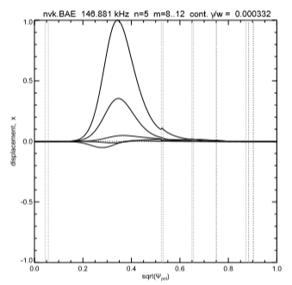
n = 5 Eigenmodes for β(0)=5% Triangular Tokamak
Type 7
Type 1
Type 2
m=10
m=9
m=10
9
10
Type 8
Type 3
RSAE
m=10
m=9
m=10
9
11

Slide 31
Summary
Theory of coupling between Alfven wave and slow magnetosonic wave
  Formation of Alfven-Sound (AS) gaps
  Discovery of Alfven-Sound Eigenmodes (ASE)
  ASEs are ubiquitous in tokamak plasma for different q, P, ρ profiles, plasma β and toroidal mode number n
  More than 5 types of ASEs are found in circular tokamak; BAAE is one type of ASEs
  Slow-mode approximation does not have slow mode physics and thus has no AS gaps and ASEs
  Application of ASE concept
    Explanation of BAEs observed in high-β tokamak experiments
    ASEs resonance with lower energy fast particles than TAEs or RSAEs
    Removal of Helium ash (slowing-down α population) from fusion reactor core

