Slide 1
Stellarator Initiative and New Approaches
M.C. Zarnstorff, C. Zhu, D. A. Gates, S. Cowley (PPPL)
M. Landreman (Maryland), P. Helander (IPP-Greifswald)
PPPL
June 24, 2019

Slide 2
  Initiatives on Stellarators for Fusion
PPPL Strategic Initiative
  W7X and LHD collaborations
  Theory 5-year Plan: advances in stellarator modeling
  LDRD activities on experiment design
Simons Foundation: Hidden Symmetries and Fusion Energy” study
DPP/Community Planning Initiative
  Aim for the minimum cost, steady-state fusion pilot plant (NAS recommendation)
  As recommended by the recent NAS report
  Strategy: Simplify
Proposal for new experiment: SAS

Slide 3
Why Stellarators?
Stellarators simplify fusion systems:
Steady, low risk operation: Intrinsically avoid disruptions, runaways EM loads.
Efficient, Compact Facility: No need for current drive (v.low recirculating power, smaller unit size)
MHD Stability at high β: higher power density without complexity of v. high field
Reduced risk: Fields are from coils, not self-organization
Easier first wall: Stellarators have longer connection length divertors, higher plasma density (lower heat loads)

Slide 4
2010 Pilot Plant Studies Identify Opportunities
Eliminate CD need & systems
  Increase energy efficiency
  Reduce required nTτ for fixed P-electric
  Retire η_{CD} risk, disruption risks
  Simplify and increase TBR
Produce net power at moderate
scale and plasma power flux. Aim for
- ~50 - 100 MWe
- 30-100 MW plasma heating, JET/W7X scale
- low tritium inventory
Need compatible high-β, high confinement & PFC solution
[H. Zohm et al., 2017]
[J.E. Menard et al., NF 2011)]

Slide 5
What has changed? Understanding
W7-X has Rapidly Exceeded Expectations: (Klinger et al, NF 59 (2019) 112004)
  T_{e}(0) ~ 10 keV; τ_{E} up to ~0.24 sec
  Initial validation of neoclassical optimization
  Turbulence dominated confinement
  No impurity accumulation
  Well functioning 3D divertor, controlled detachment
  Building on results from HSX and LHD
Conclusion: Stellarator optimization works!
Theory and modeling-based understanding improved:
- How to design for fast ion orbit confinement (2 methods)
- Unifying tokamak and stellarator understanding and codes (esp. turbulence)
Tokamak exploration of PFC materials (high Z; low Z; liquids)

Slide 6
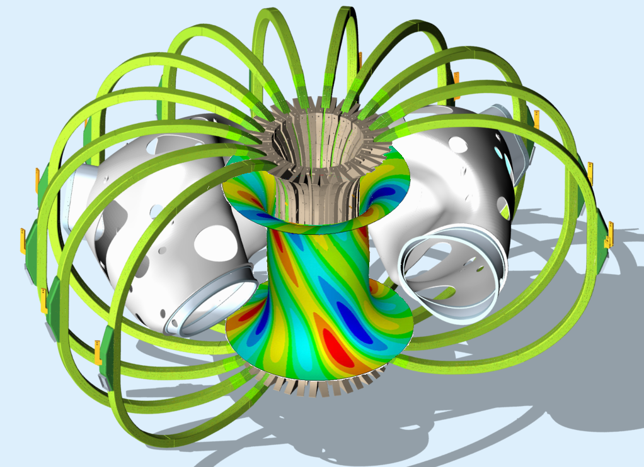
What has changed? Coil Simplification
Highest priority need in previous assessments
  Crucial for maintenance and availability
  Construction costs
Three approaches, likely used in combination
  Permanent magnets for 3-D shaping
  Bulk superconductors, for simple 3D shaping at high B
  Improved coil-design codes, enabling coil shape simplification
Permanent magnets: simplify engineering & design
  Equivalent to saddle coils (early design for NCSX)
  Primarily on inside, outer thickness ~zero
  Planar coils for TF (simplest possible)
  At highest B, may only be usable on outer half of torus
  Guarantee straight coil outer legs for maintenance access
Need to get experience with these methods, mature engineering approaches

Slide 7
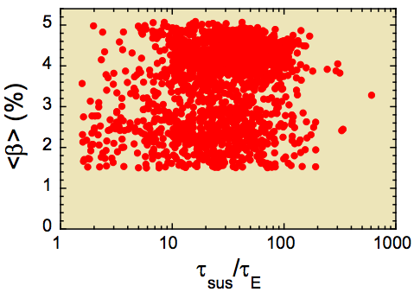
Outstanding Needs for Pilot Plant
What β-value to design for?
  β =5.4% (LHD), β=3.4% (W7-AS) sustained;
  soft-maximum; limit?
  Much higher than predicted by linear MHD
  Can high-β with high-H be extrapolated?
Integration with metal PFCs (pref. low-Z, liq.)
Integrated simplified designs
  Engineering
  Stellarator plasma physics design & boundary approach (metal PFCs)
  Rest of fusion energy system
Integration validation (TRL advance)
LHD

Slide 8
SAS: Advance Stellarator Innovation, 3 ideas
  Overall goal: Develop basis toward reduced-cost practical fusion energy stellarator (e.g. NAS study)
Leverage stellarator advances
  Improved understanding from recent stellarator (W7X,…) and tokamak experiments
  Synergy with Simons “Hidden symmetries and fusion energy” study results: focus on QS
Extreme simplification of 3-D Stellarator coils using permanent magnets
  Resolve primary engineering risk and barrier for stellarators
  Disruptive technology to simplify construction, reduce costs, greatly reduce maintenance complexity
  Made possible by modern, neodymium/RE magnets
Liquid-metal first wall, building on LTX-β and other initiatives
  Increase confinement
  Path to robust handling of power exhaust
  Use increased confinement to explore β limit and physics

Slide 9
Proposal Opportunities & Timeline
Simons Foundation has expressed interest in providing partial funding
  In partnership with Hidden Symmetries project
  At modest finding scale
  In partnership with DOE and other funders
  “SAS”: Simons Advanced Stellarator
ARPA-E will solicit new proposals for next round of fusion proposals
  Fusion energy development and technology focused
  Solicitation expected Sept. 2019. Proposals probably Oct. 2019. Funding ~ 1/1/2020 ?
  Requires co-funding, effectively requires private participation

Slide 10
SAS Approach
Establish initial progress at minimum cost,
  World’s first simple optimized stellarator!
  Improved confinement, through optimized QS and Lithium-boundary
  Target key topics
Re-use components, when possible
  Some parts from NCSX (TF coils, vacuum vessel), but room-temperature
  Li-approach, NB (1.5MW, 20kV) and some diagnostics from LTX-β
  Make improved equilibrium – beyond NCSX. Most likely QA.
Make re-configurable (via re-arranging magnets)
  Vehicle for testing Hidden Symmetries results
  For research flexibility
  Increase capabilities (incl. B) over time

Slide 11
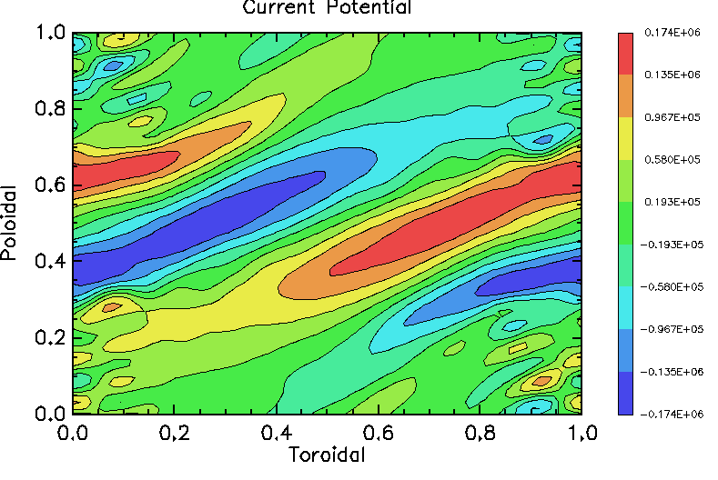
Permanent Magnets Dramatically Simplify Engineering & Design
Shell of magnets around plasma
  “Current potential” (NESCOIL, REGCOIL) calculations give simple indication of needed surface-magnetization
Advanced magnet technology approach
  Halbach array (1980): for higher magnet efficiency.
  Uses tangential magnetization to reduce magnetic reluctance, increase field strength at plasma
  Used in high efficiency motors, generators
  Open NMR magnet systems
Solutions by C.Zhu & M.Landreman for finite thickness calculations.
Outside
Inside
Outside

Slide 12
“Rare Earth” magnets are almost ideal
Typical curves
μ_{r} = 1.01 – 1.05. Highly anisotropic.
Remnant magnetic field and coercivity depend on detailed recipe and processing
Both increase as temperature drops
Nd-Fe-B has a phase change at 100-150K
Arnold: NdFeB at 293K with Br=1.49T
Pr-Fe-B goes to higher performance < 100K
Commercially available in lg. quantity
Fe-N may (someday) offer B_{r} > 2.5T
C.Benabderrahmane et al
E.Moog et al, ANL

Slide 13
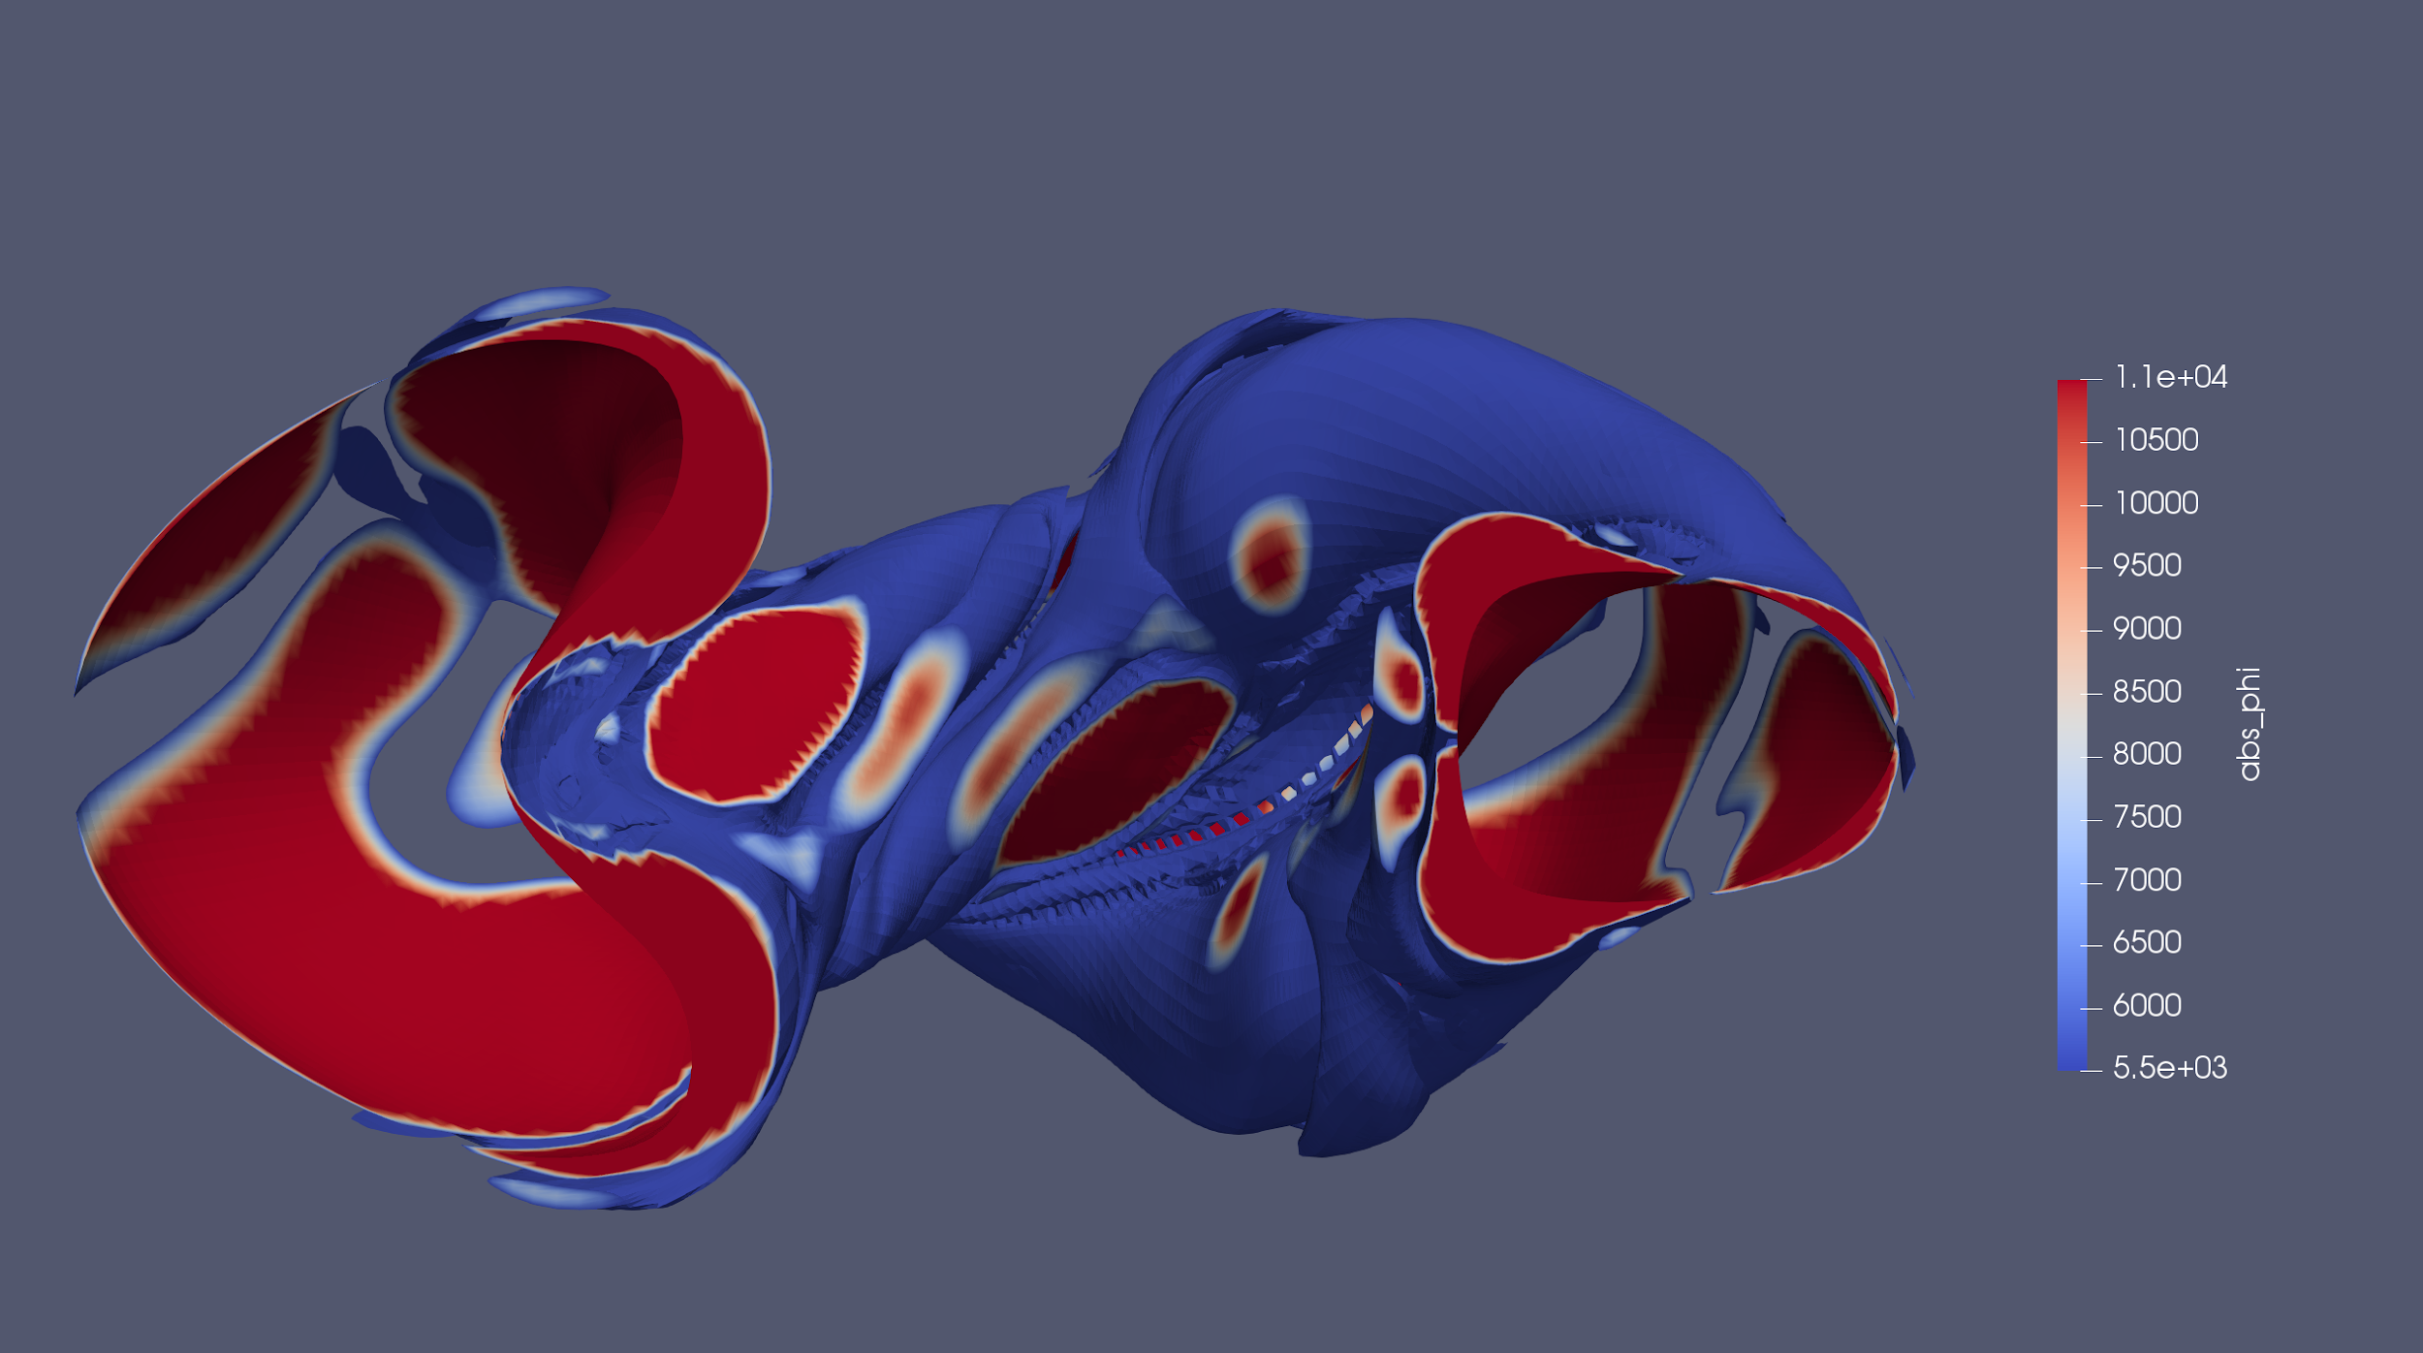
Initial Finite-Thickness Solution
Perpendicular only (C.Zhu)
Volume: 2.96 m³ (~24 tons ~ $1.2M)
Bn residual error:
3.76E-4 (clipped)
2.70E-4(whole)
Max thickness ~20cm
With non-perp. elements, Landreman has max-thickness ~13cm

Slide 14
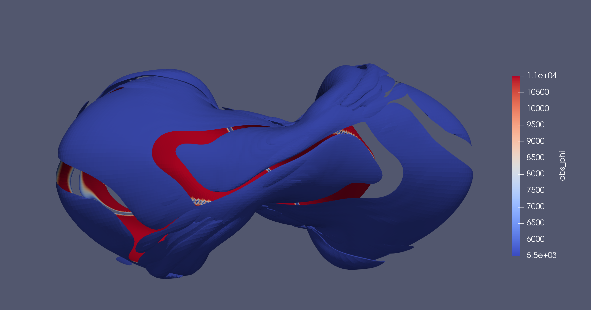
Viewing from the outboard.

Slide 15
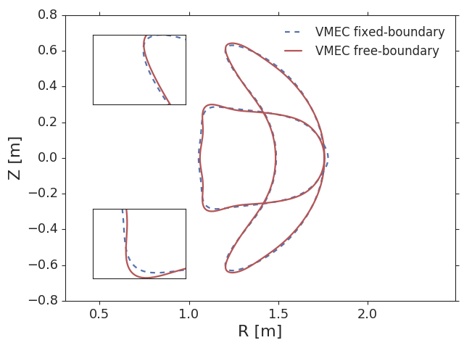
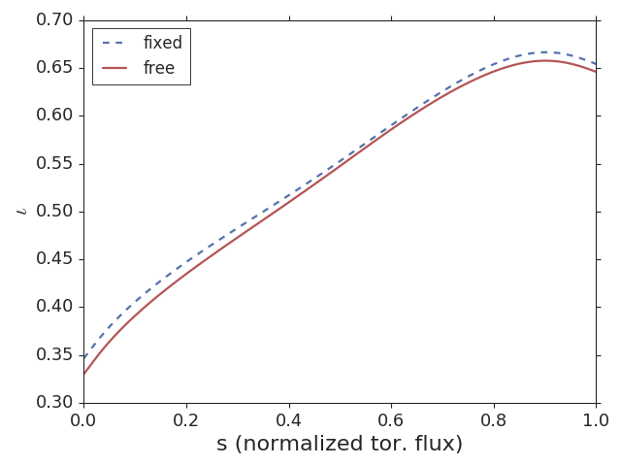
Free-boundary VMEC shows good approximation.
Comparisons of plasma surfaces.
Rotational transform profile comparisons.

Slide 16
Opportunities for Configuration Improvement
Improve fast particle confinement (ala Nemov or Henneberg)
Reduce turbulent transport
Maximize β
Divertor design
Optimize for PM approach (different than coils!)
  Reduce needed on plasma
  Reduce elongation(?)
Incorporate guidance from Pilot Plant studies

Slide 17
We welcome suggestions and contributions, on all aspects
Lots of work to come:
Overall Mission and Expected Impact
Research goals, plan, and basis
  Design, heating, confinement, diagnostics
  Phased research goals/plan and milestones
Engineering goals, plan, basis
  Enough design to be confident in approach and risk control
Cost estimate
By Sept./Oct. 2019

Slide 18
Initiate a Path to a Pilot Plant
Near term experiment(s)
  Test & develop engineering of simpler coils
  Test confinement & β with low-Z metal PFCs
  Test ability to design for reduced turbulence
  Our plan is to start this with the
  permanent magnet stellarator
  Rapid deployment of design improvements
Integration validation experiment (TRL advance)
  Integrated Engineering
  Plasma physics (i.e. coils) & boundary (plumbing & cooling)
  Mainly DD, perhaps trace T to validate reactivity?
Pilot Plant, demonstration

Slide 20
Potential Innovations for Compact Pilot
Stellarator
Coils – HTS for higher B_{T}, J_{winding-pack}
Confinement – Optimize turbulence, low-Z wall
Stability – Disruption avoidance, β_{N} > no-wall limit intrinsically avoid runaways, EM loads
Aspect Ratio – cost; maintenance vs. mass-power density
Heating & Current Drive – New efficient RF, Negative NBI
Divertors – Further design needed, liquid metals
Blankets – Liquid metal? Salt? high efficiency not required

Slide 21
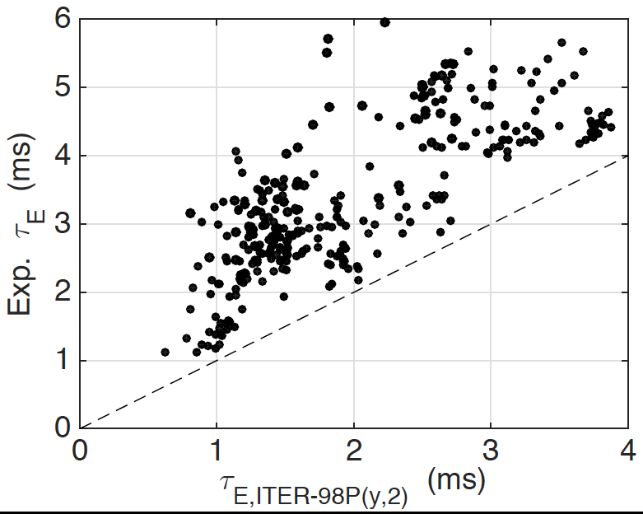
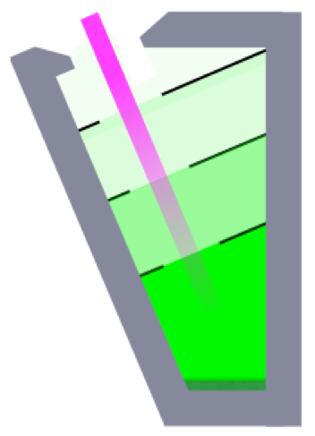
Liquid Metal Boundaries offer multiple improvements
Eliminate erosion damage and morphology changes
Insensitive to neutron and other
radiation damage
Only way to have low-Z boundary
  Much higher plasma confinement with Lithium, both LTX and NSTX (and other devices)
  Can change transport boundary conditions
Can handle much larger power & particle fluxes than solids
  Vapor shielding at high fluxes
  Similar to heat pipe
LTX
Vapor-box
divertor

Slide 22
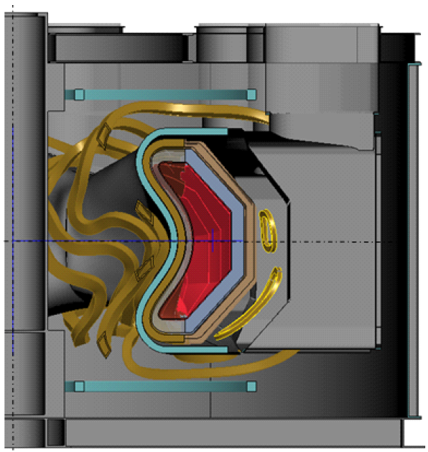
Size of compact stellarator (CS) pilot driven by magnet technology and neutron wall loading, but not Q_{eng}
Q_{eng}=1.1 accessible at H_{ISS04} ≥ 1.1 (~L-mode)
6
  B_{coil} = 14T
= Pilot design point
B [T]
1.1
5
⟨W_{n}⟩ ≥ 1MW/m²
A = 4.5 = 4.75m / 1.05m
B_{T} = 5.6T, I_{P} = 1.7MA (BS)
Avg. W_{n} = 1.2-2 MW/m²
Peak W_{n} = 2.4-4 MW/m²
1.5
β=6%
H_{ISS04} = 2
4
η_{th} = 0.3
3
4
5
6
4.75m
H_{ISS04}=2 → Q_{eng}=2-3, high Q_{DT} (~H-mode)
3
5
6
Major Radius [m]
4
6
B [T]
3
2
Can go to smaller Radius with higher
confinement, limited by coil current density
and blanket/shield thickness
⟨W_{n}⟩ ≥ 1MW/m²
70
5
β=6%
Q_{eng} = 1
26
η_{th} = 0.3
Q_{DT} = 9
4
3
4
5
6
Major Radius [m]

