Slide 1
NSTX
Supported by
Demonstration of solenoid-free start-up of low inductance plasma for advanced ST or tokamak scenarios using transient Coaxial Helicity Injection
College W&M
Colorado Sch Mines
Columbia U
Comp-X
General Atomics
INL
Johns Hopkins U
LANL
LLNL
Lodestar
MIT
Nova Photonics
New York U
Old Dominion U
ORNL
PPPL
PSI
Princeton U
Purdue U
SNL
Think Tank, Inc.
UC Davis
UC Irvine
UCLA
UCSD
U Colorado
U Maryland
U Rochester
U Washington
U Wisconsin
R. Raman¹, M. Ono², T.R. Jarboe¹, B.A. Nelson¹,
D. Mueller², F. Ebrahimi², T. Brown²,
S.C. Jardin², K.C. Hammond²
¹University of Washington / ²PPPL
Acknowledgments
M. Bell², J. Menard²
and the NSTX Research Team
Culham Sci Ctr
U St. Andrews
York U
Chubu U
Fukui U
Hiroshima U
Hyogo U
Kyoto U
Kyushu U
Kyushu Tokai U
NIFS
Niigata U
U Tokyo
JAEA
Hebrew U
Ioffe Inst
RRC Kurchatov Inst
TRINITI
KBSI
KAIST
POSTECH
ASIPP
ENEA, Frascati
CEA, Cadarache
IPP, Jülich
IPP, Garching
ASCR, Czech Rep
U Quebec
This work is supported by US DOE contract numbers FG03-96ER5436, DE-FG02-99ER54519 and DE-AC02-09CH11466
CPP Workshop # 1
July 23, 2019, Madison, WI

Slide 2
Motivation
A compact tokamak/ST facility is proposed as the next major step in the development of fusion energy in the United States.
“Compact” means “use innovation” & not just squeeze existing systems into a smaller package (end product should attract utilities)
Innovations should strive for eliminating complex, expensive, problematic components not necessary for steady state operation
  Without a solenoid it is easier to increase B_{T} on axis, permitting higher device efficiency
Increased space in central core would also permit improved steady state capability to enable higher bootstrap current fractions & reducing recycling power
  Inboard high velocity pellet injection for density profile control
  Inboard RF launchers for current drive

Slide 3
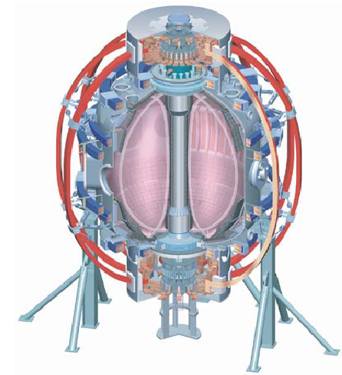
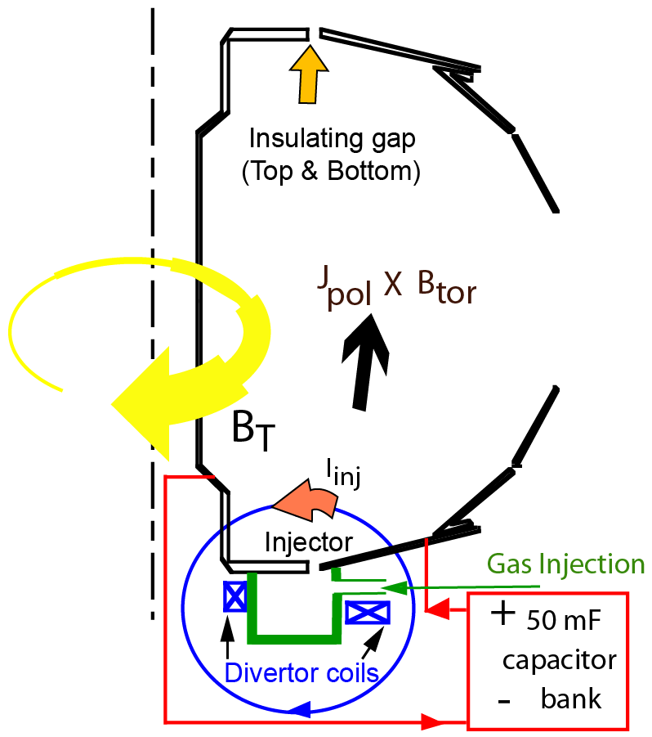
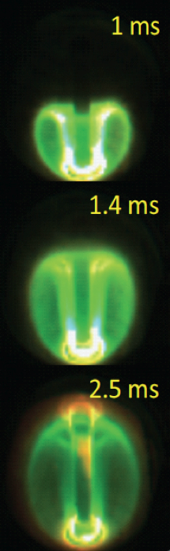
Transient CHI: Axisymmetric Reconnection Leads to Formation of Closed Flux Surfaces
Magnetic flux is injected
Injected flux organizes itself into a relaxed state
This is a low inductance closed flux equilibrium
No need to try to drive additional current in a pre-formed plasma (this is how transient CHI is different)
Fast camera: F. Scotti, L. Roquemore, R. Maqueda

Slide 4
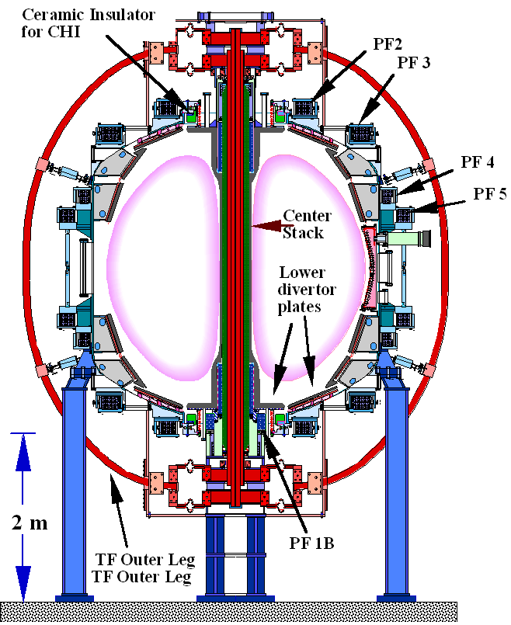
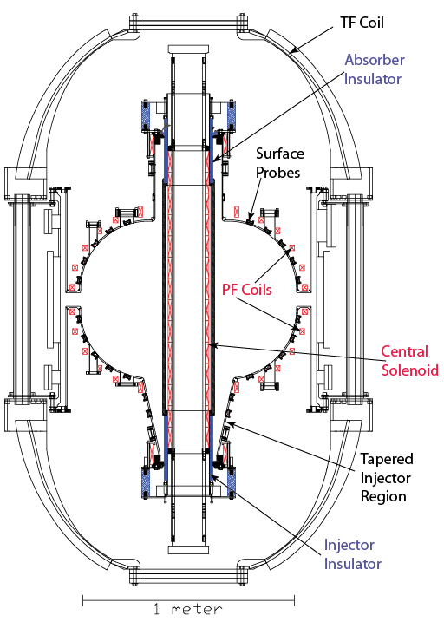
Transient CHI Initially Developed on the small HIT-II
& Verified and Improved on the much larger NSTX
Concept exploration device HIT-II
NSTX plasma is ~30 x plasma volume of HIT-II
Proof-of-Principle NSTX device

Slide 5
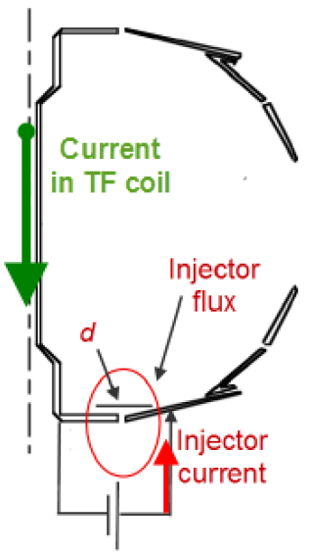

Current Scaling: Ip $∝$ amount of Flux Injected
Injector current* I_{inj} must meet bubble-burst condition for plasma to expand from injector to main vessel
Capacity to generate closed flux plasma current I_{p} is proportional to ψ_{inj}
External Power
supply current
* T.R. Jarboe, Fusion Tech. 15, 7 (1989)

Slide 6
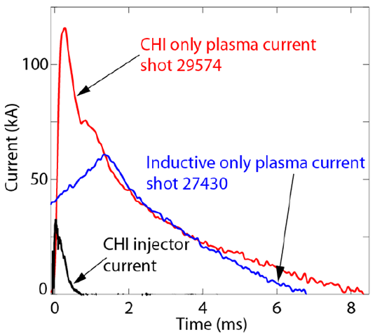
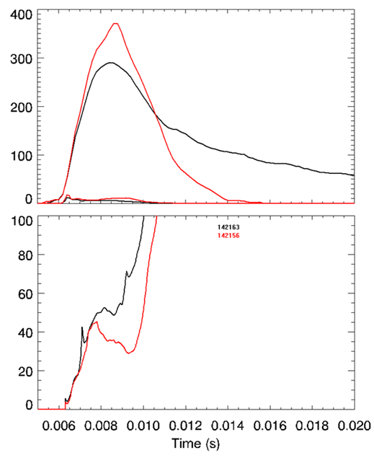
In NSTX: <10 kA Power Supply current & 50 mWb Flux Injection Generates 200 kA of Closed Flux Current
HIT-II
NSTX
(kA)
Plasma current
Injector
Current
HIT-II: 30 kA of injector current generates 100 kA of plasma current
NSTX: <10 kA of injector current generates 200 kA of plasma current (Nice result as device size is increased)
Current Multiplication Factor
R. Raman, T.R. Jarboe, B.A. Nelson, et al., PRL 90, (2003) 075005-1
R. Raman, T.R. Jarboe, R.G. O’Neill, et al., NF-Letter 45, (2005) L15-L19
R. Raman, B.A. Nelson, D. Mueller, et al., PRL 97, (2006) 17002

Slide 7
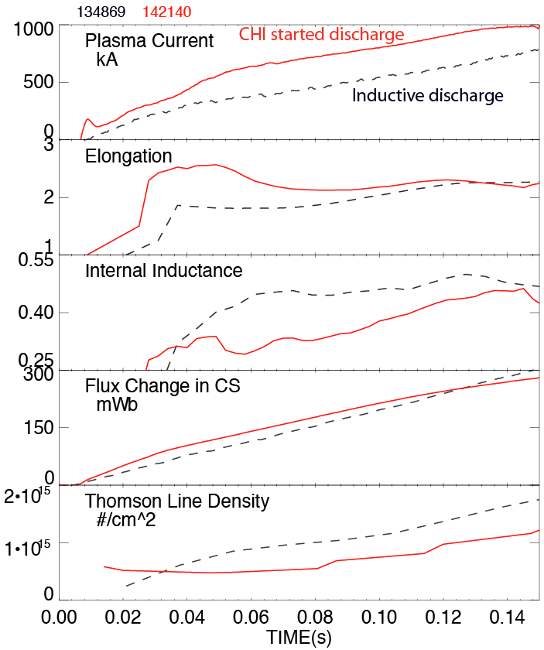
CHI Start-up Has Produced the type of plasmas required for Non-Inductive Ramp-up and Sustainment (Low Inductance & Density)
CHI assisted startup in NSTX
Only 27 kJ of stored capacitor bank energy used for CHI plasma start-up
CHI produced plasma is clean
  - Discharges have transitioned to H- mode after coupling to induction
High elongation
Low inductance
Low density
CHI generates plasmas with low n_{e} so that ECH could be used to heat these plasmas
R. Raman, D. Mueller, B.A. Nelson, al., PRL 104, (2010) 095003

Slide 8
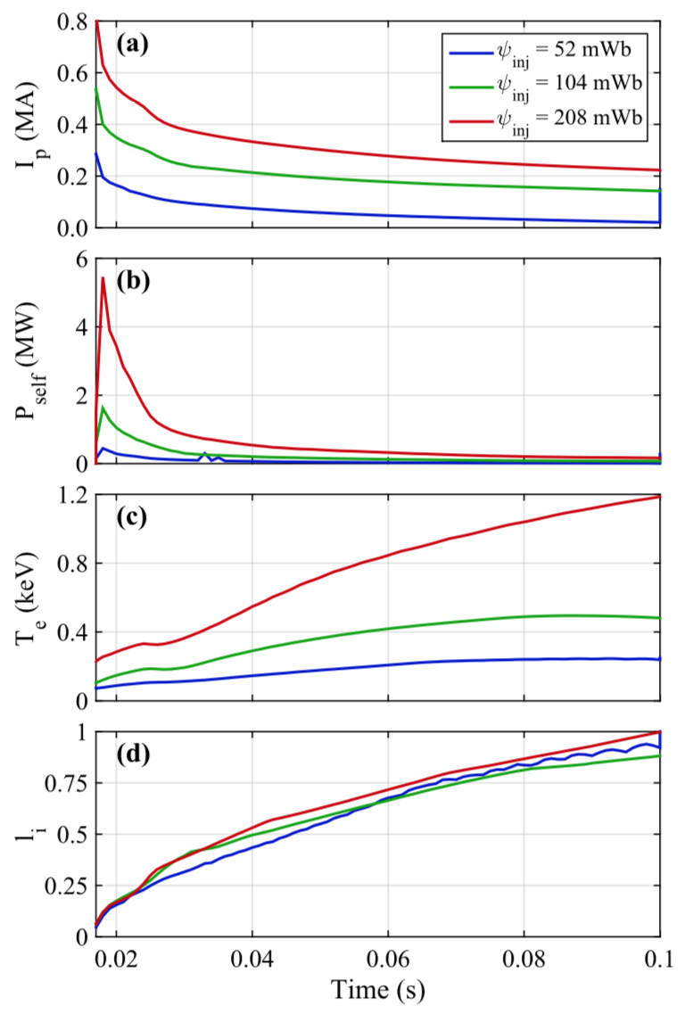
In TSC: Closed Flux Current Generation is due to the generation of a positive loop voltage as the injected plasma decays
Closed flux current increases in proportion to injected flux (as per simple scaling)
Self heating power rapidly increases with higher flux injection
Plasma can self-heat to high temperatures
  Reactors will use about 1Wb or more
Normalized plasma inductance < 0.7 during start-up phase as needed for ST
K.C. Hammond, R. Raman, S.C. Jardin, Phys. Plasmas 26, 032501 (2019)

Slide 9
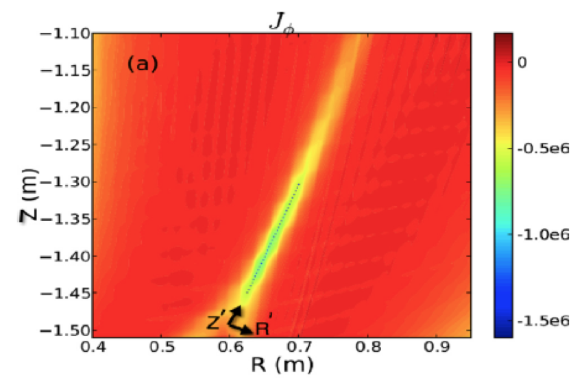
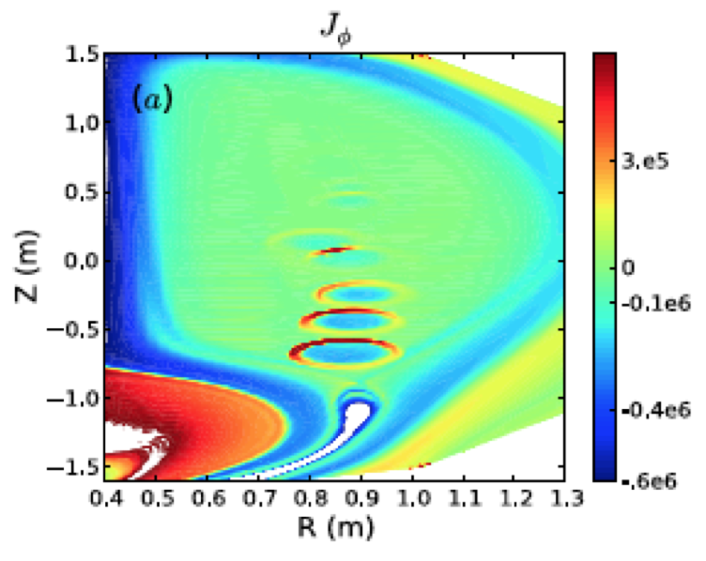
In NIMROD: Sweet-Parker Reconnection and Plasmoid Instability also lead to Reconnection in the Injector Region Increasing Flux Closure
Sweet-Parker Reconnection
Plasmoid Mediated Reconnection
F. Ebrahimi, et al.,
PoP 20, 090702 (2013)
PoP 21, 056109 (2014)
PRL 114, 205003 (2015)
>70% open to closed flux conversion seen on NIMROD simulations

Slide 10
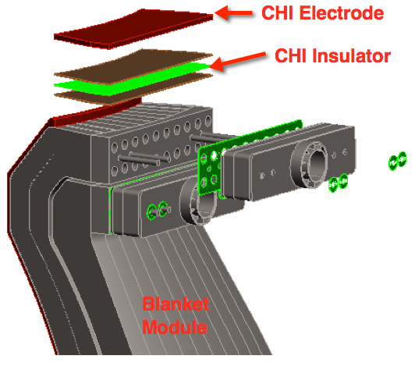
Encouraging Experimental Results From Two STs and Supporting Modeling Results From TSC & NIMROD Motivated Reactor Studies
Toroidally continuous insulator would be located in a region shielded from neutrons
Menard, Brown et al., NF 56 (2016) 106023
Brown, Menard, El Guebaly et al., FS&Technol. 68 (2015) 277
Raman, Brown, El Guebaly et al., FST 68 (2016) 674

Slide 11
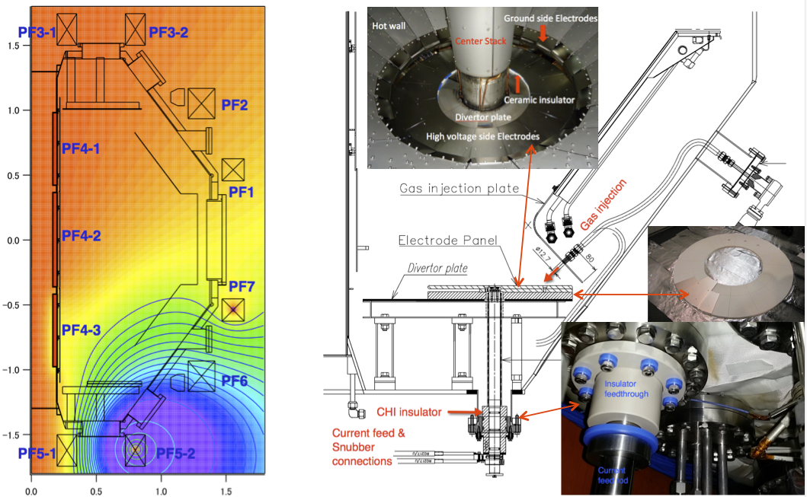
CHI on QUEST is Developing Reactor Relevant
Single-Biased Electrode Configuration
R = 0.68m, a = 0.4m, 0.25T

Slide 12
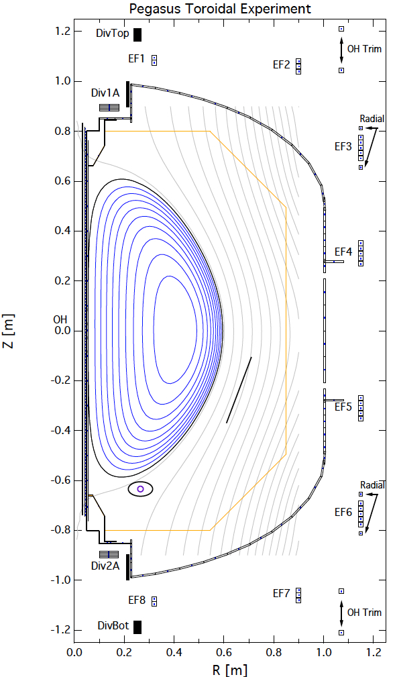
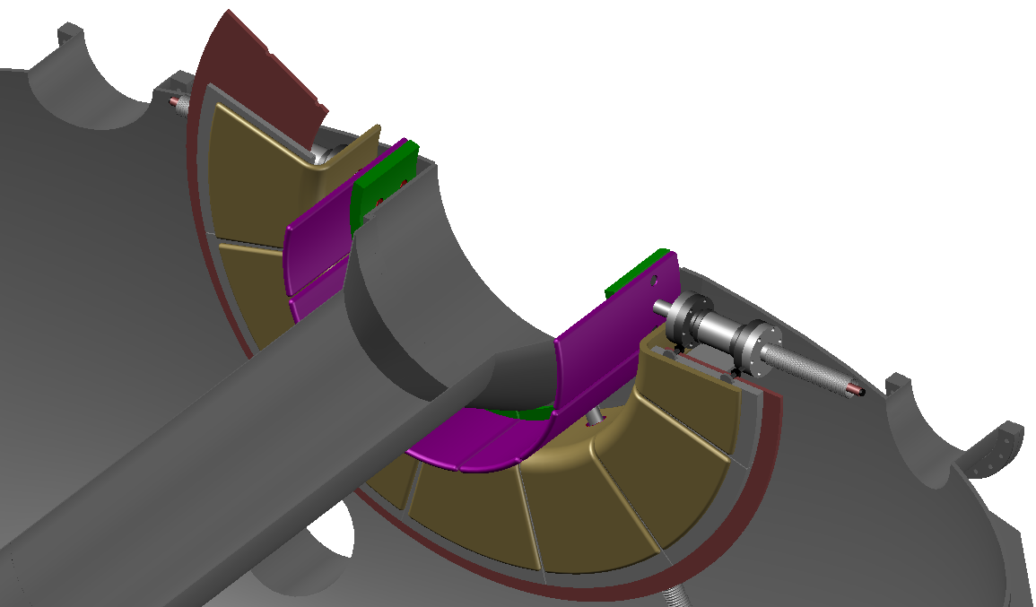

CHI research on URANIA will Develop a Double-Biased Electrode Configuration and Maximize Current Generation
R ~ 0.45m, a ~ 0.3m, 0.6T
NOTE: Design not finalized
Cathode
Anode
Coax Current Feed
Benefits of double biased electrodes
High I_{p} up to 300 kA (@ PF coil limits for I_{p})
Coupling to ECH
Collaboration with University of Wisconsin
J. Reusch, R. Fonck, M. Bongard
F. Ebrahimi (Theory support)

Slide 13
Required Next Steps for
Incorporating Transient CHI in ST/AT Reactor Systems
Demonstration of full non-inductive operations including Transient CHI start-up and current ramp-up to sustained operations would provide the confidence necessary to build reactor-scale STs and tokamaks without reliance on the 50 year old central solenoid technology
ST-40s mission is to demonstrate reactor-level operations without using a solenoid
  Focusing on ECH until 2021
  If ECH is not successful, transient CHI will be tested
  Design studies of a transient CHI system for ST-40 are underway for a possible implementation during 2022 (100 – 200 mWb Flux Injection)
Desirable to have validation from a second large facility such as NSTX-U or MAST-U
  Present reactor studies should also develop parallel configurations assuming that solenoid free plasma start-up capability is available as the much improved capability of these new configuration would motivate speedier development of these capabilities (plasma start-up, density profile control, efficient balance of current drive)

Slide 14
Back-up Slides

Slide 15
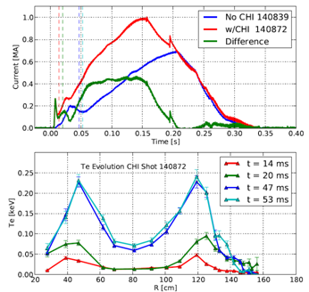
Using Only 27kJ of Capacitor Bank Energy CHI Started a 300kA Discharge that Coupled to Induction
Ramped up to 1MA after startup, using 0.3Wb change in solenoid flux
Hollow electron temperature profile maintained during current ramp
  - Important beneficial aspect of using CHI startup
B.A. Nelson, T.R. Jarboe, D. Mueller, et al., NF 51, (2011) 063008

Slide 16
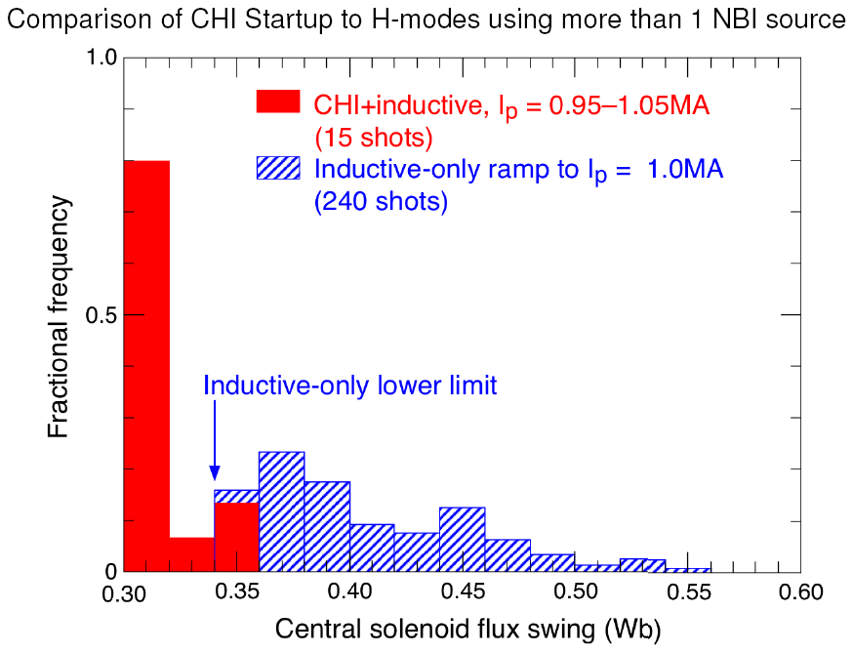
CHI Started Discharges Require Less Inductive Flux than Discharges in NSTX Data Base
Most recent CHI-started discharges require less flux than shown here
NSTX Data Base Analysis: M. Bell

Slide 17
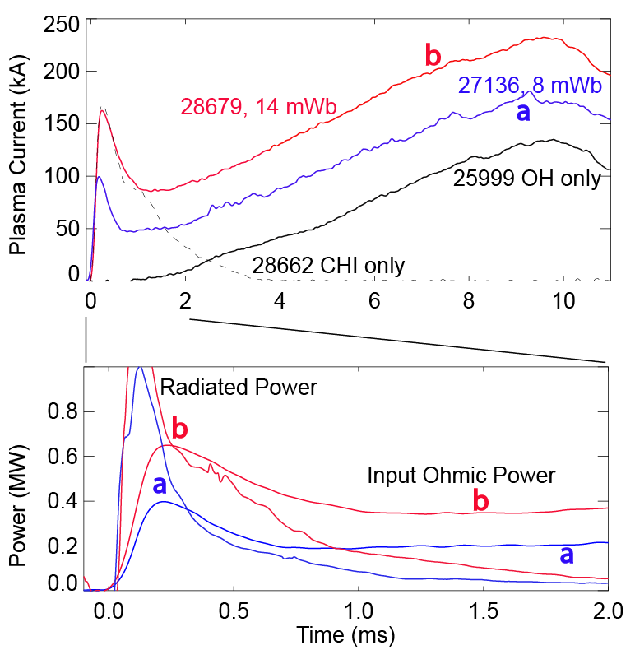
Inductively Coupled Current Ramps-up After Input Power Exceeds Radiated Power
Identical loop voltage programming for all cases
Coupling current increases as injector flux is increased
Radiated power can be decreased by using W or Mo target plates
  Start-up plasma (inductive or CHI) is cold (few 10s of eV)
    Reduce Low-z line radiation
  Auxiliary heating would ease requirements on current ramp-up system
HIT-II Results
R. Raman, T.R. Jarboe, R.G. O’Neill, et al., NF 45 (2005) L15-L19
R. Raman, T.R. Jarboe, W.T. Hamp, et al., PoP 14 (2007) 022504

Slide 18
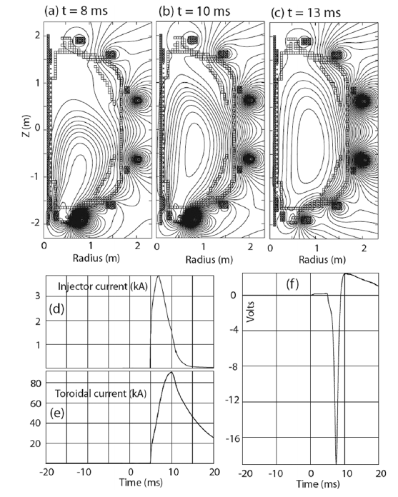
Closed Flux Current Generation in TSC is due to the generation of a positive loop voltage as the injected plasma decays
R. Raman, S.C. Jardin, J. Menard, et al.,
NF 51, 113018 (2011)

Slide 19
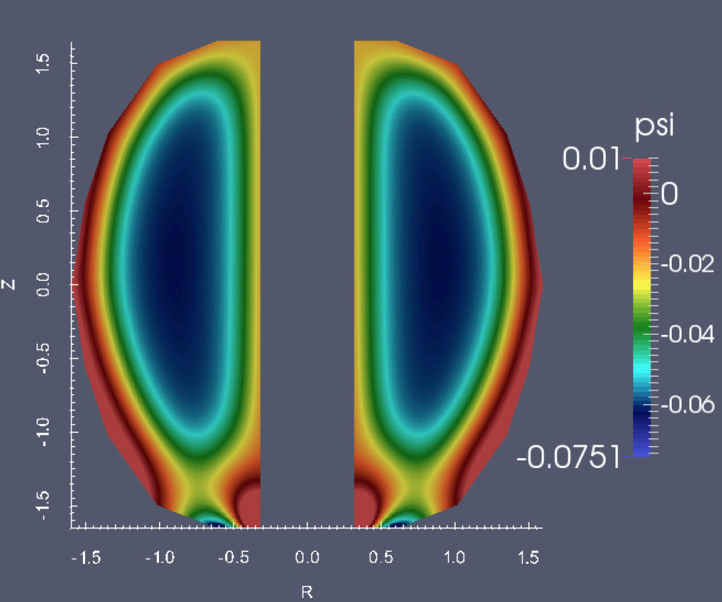
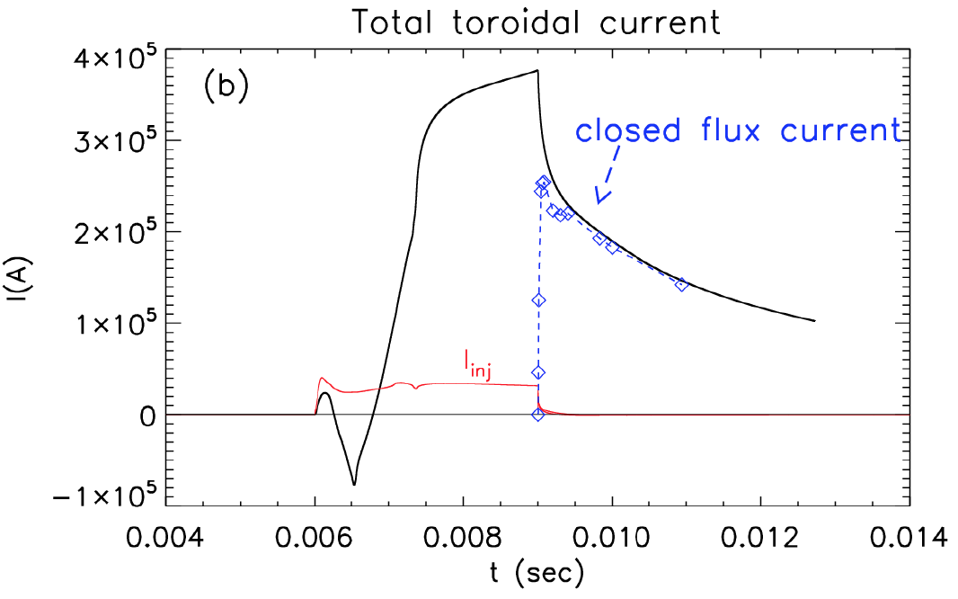
NIMROD Simulations also Show High Fraction of Open Flux Conversion to Closed Flux (~70%, as in HIT-II / NSTX)
F. Ebrahimi, R. Raman, NF-Letter 56 (2016) 044002

Slide 20
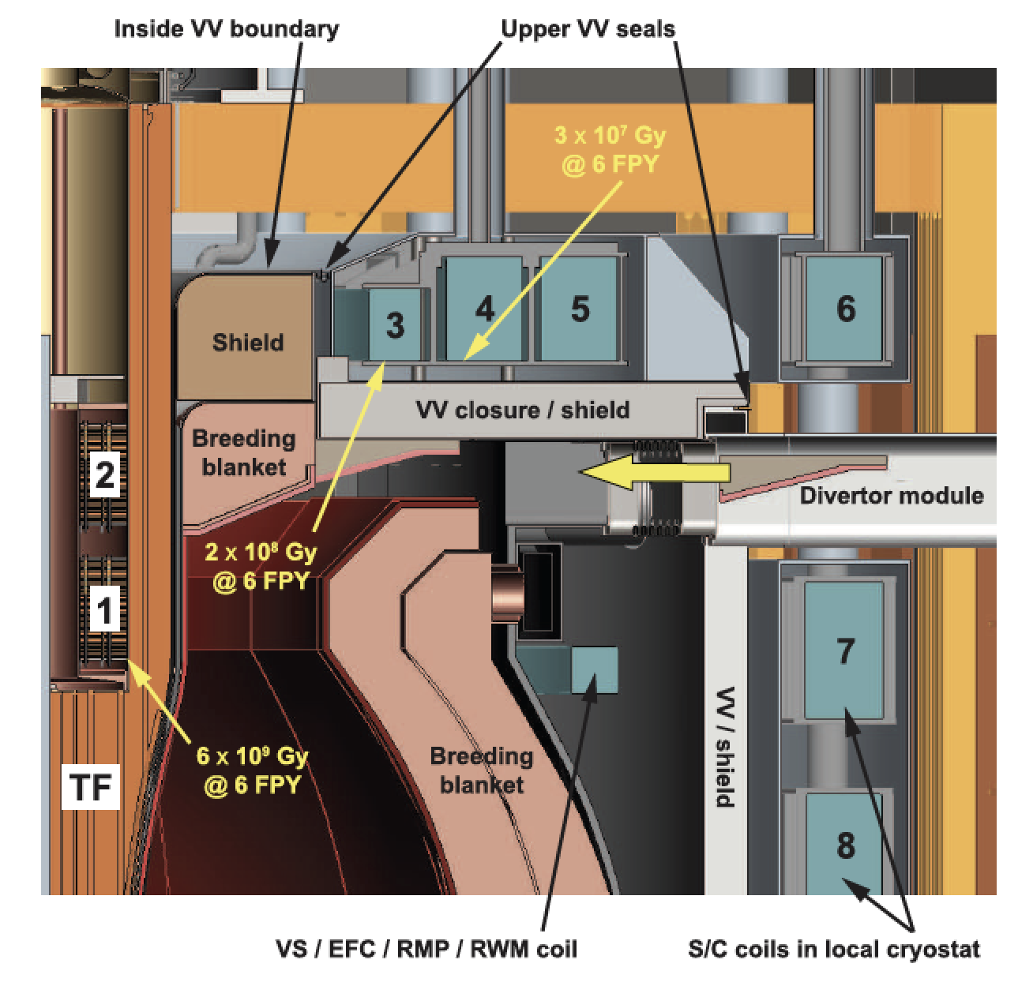
Super-X Divertor-like Configurations Naturally Suited for CHI
& Have Large Injector Flux Capability
Menard, Brown et al., NF 56 (2016) 106023

Slide 21
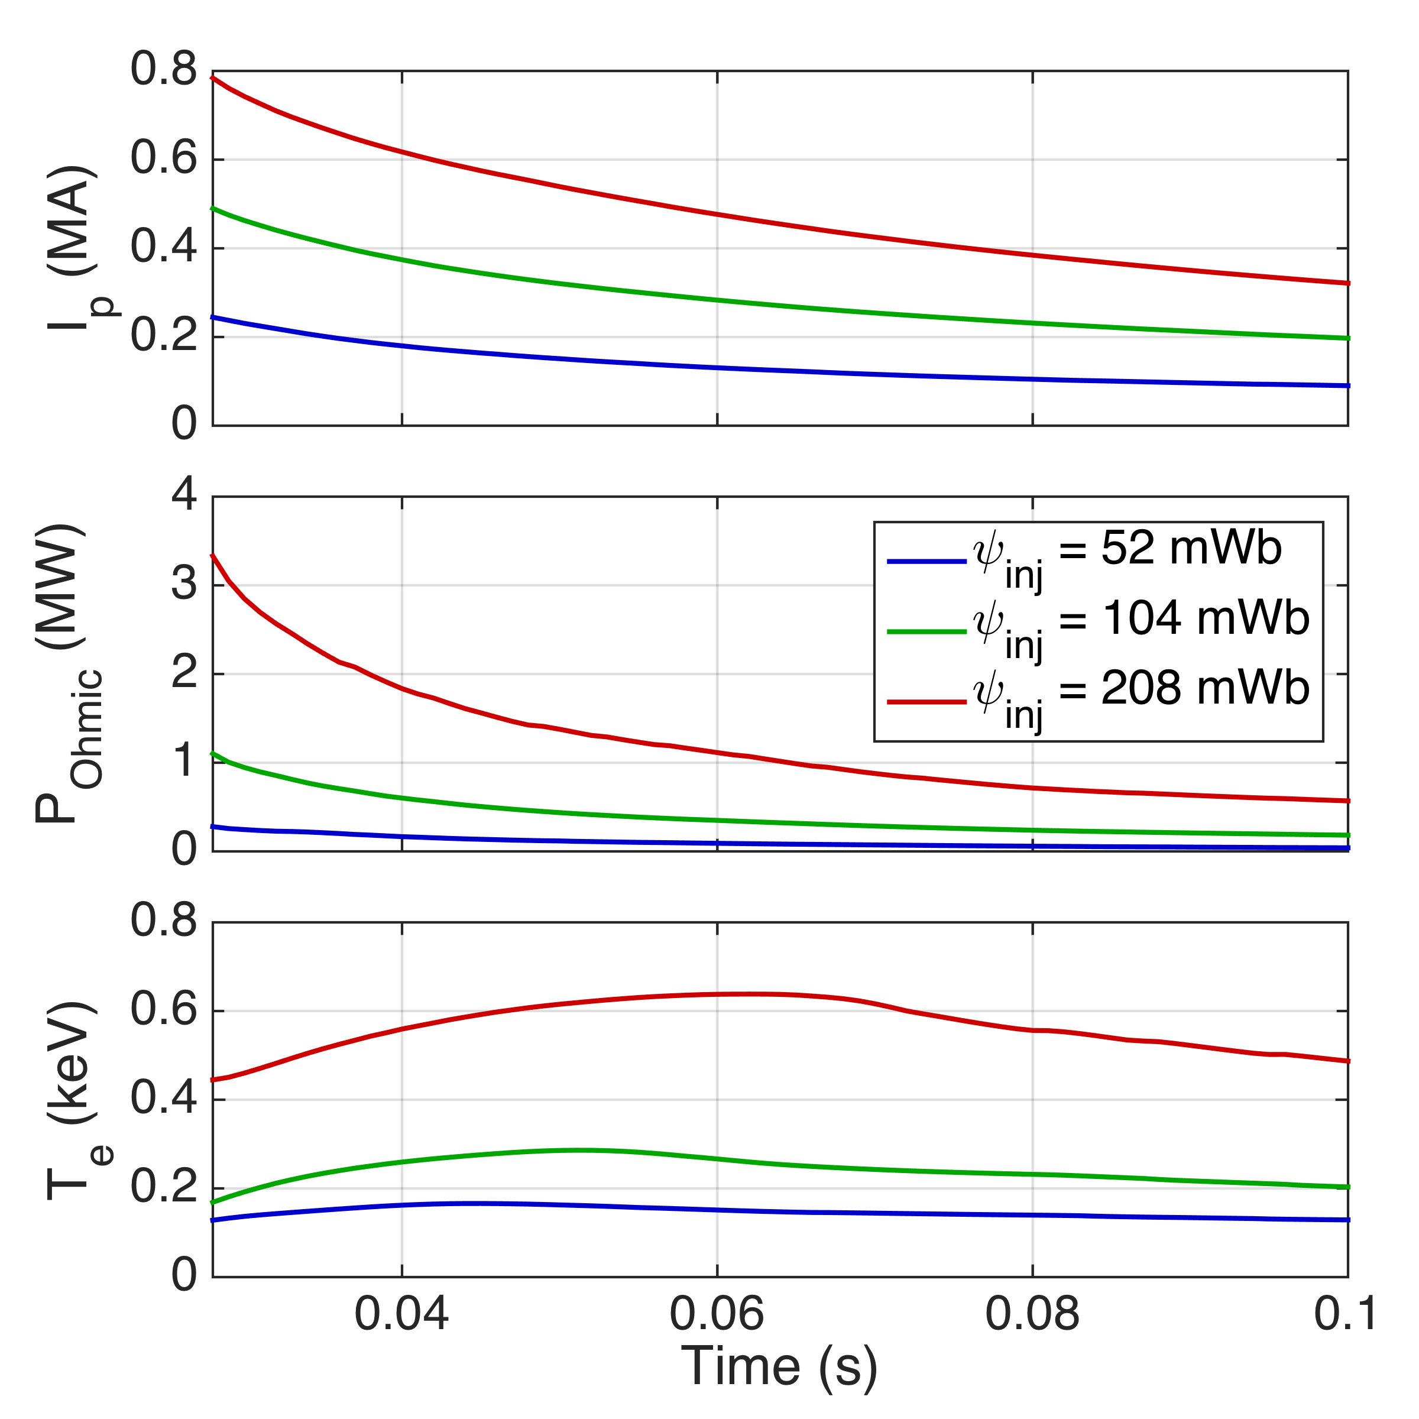
Simulations with TSC support expectations of higher current, self-heating power, and temperatures with increased injector flux
Tokamak Simulation Code (TSC)
  Time-dependent, free-boundary equilibrium and transport solver
  Solves MHD/Maxwell’s equations coupled to transport and Ohm’s law
Initial study: NSTX configuration with increasing levels of injector flux:
  52 mWb (typical NSTX experiment), 104 mWb, and 208 mWb (NSTX-U capability)
Supports main predicted trends
  I_{p} increases in proportion with ψ_{inj}
  Heating power, T_{e} increase faster

Slide 22
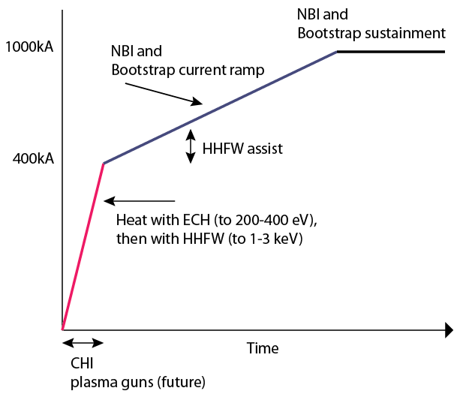
Reactor Scenario for Solenoid-free Plasma Start-up and
Current Ramp-up to Sustained Operation Levels Has Three Phases
Start-up &
Ramp-up strategy
Desirable to to simplify start-up/ramp scenario to two phases
  Reduce reliance on non-inductive current ramp-up phase
  High B_{T} in new emerging experiments should permit CHI start-up at high levels of injector flux
  Super-X divertor configurations may have the needed flux for full current start-up
  NIMROD simulations is studying MHD limits to high current generation, up to levels of full sustained current (no MHD limits obvious thus far)
ECH assist (Ramp-up phase)
ECH heating
(Start-up Phase)
SFPS

Slide 23
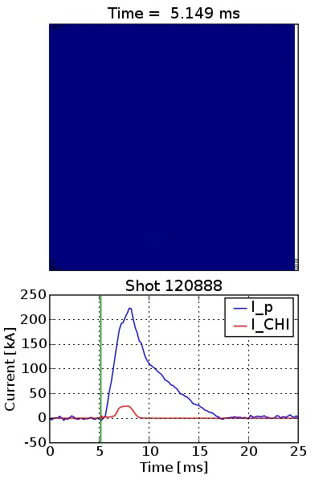
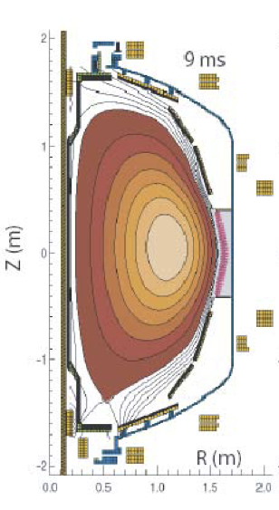
Fast Camera Movie of Transient CHI Discharge on NSTX
Equilibrium reconstruction (J. Menard)
Fast camera: F. Scotti, L. Roquemore, R. Maqueda

Slide 24
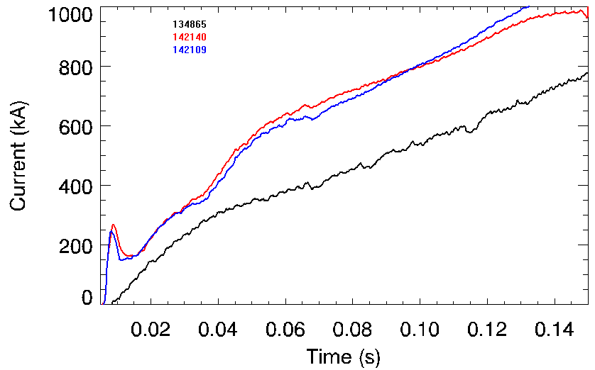
Standard L-mode NSTX Discharge Ramps to 1MA Requiring 50% More Inductive Flux than a CHI Started Discharge
Plasma current
CHI started
Reference NSTX Inductive start-up
Improvements on NSTX
  Transitioned to an H-Mode when coupled to induction and NBI heating
  Have low inductance as needed for high-performance plasma operation
R. Raman, D. Mueller, B.A. Nelson, al., PRL 104, (2010) 095003

Slide 25
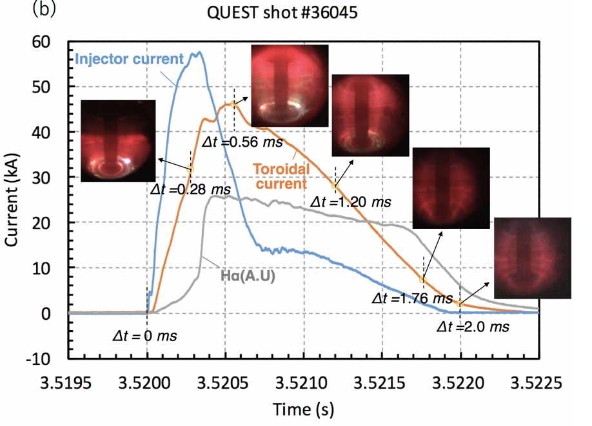
Transient CHI on QUEST has Shown Reliable Discharge Initiation, and Plasma Growth in Biased Electrode Configuration
Current objectives
  Closed flux current generation
Future objectives
  - Heat CHI plasma with ECH
  - Increase current magnitude
K. Kuroda, R. Raman, K. Hanada, et al., Plasma Phys. Control. Fusion 60, (2018) 115001

Slide 26
Externally Produced Toroidal Field makes CHI much more Efficient in a High Field ST / Tokamak
Injector current* I_{inj} must meet bubble-burst condition for plasma to expand from injector to main vessel
Toroidal current* generation is proportional to the ratio of toroidal flux ψ_{tor} to injector flux ψ_{inj}
Capacity to generate plasma current I_{p} is proportional to ψ_{inj}
* T.R. Jarboe, Fusion Tech. 15, 7 (1989)

Slide 27
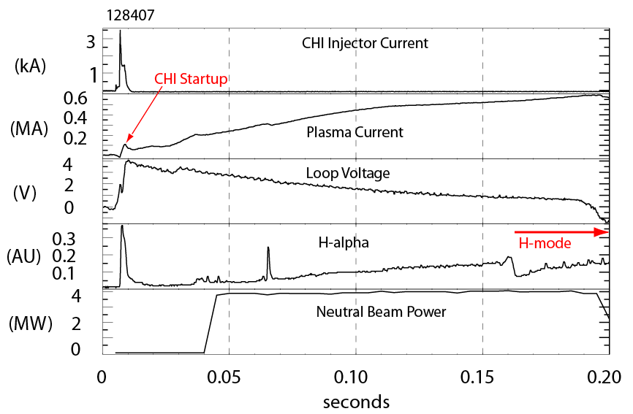
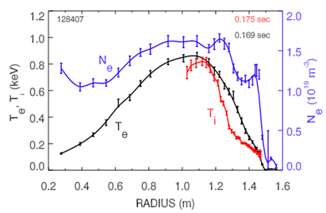
CHI Started Discharge Couples to Induction and Transitions to an H-mode Demonstrating Compatibility with High-performance Plasma Operation
T_{e} & N_{e} from Thomson
T_{i} from CHERS
Discharge is under full plasma equilibrium position control
  Loop voltage is preprogrammed
CHERS : R. Bell
Thomson: B. LeBlanc
R. Raman, D. Mueller, B.A. Nelson, al., PRL 104, (2010) 095003

Slide 28
ST-40 & NSTX-U Have the Potential to
Demonstrate Full Non-Inductive Operations
Parameters | HIT-II | NSTX | QUEST | URANIA (to be finalized) | ST40 | NSTX-U
Major radius [m] | 0.3 | 0.86 | 0.68 | 0.45 | 0.4 – 0.6 | 0.68
Minor radius [m] | 0.2 | 0.66 | 0.4 | ~0.3 | ~0.3 0.35 | 0.65
B_{T} [T] | 0.5 | 0.55 | 0.25-0.5 | 0.15-0.6 | 3 | 1
Injector flux (mWb) | 16 | 50 | 28 | ~60 | >100 (TBD) | 200
Projected Start-up current (kA) | 100 | 200 | <150 | ~300 | >500 (- 1 MA) | >500 (- 1MA)
Nominal sustained Ip (kA) | 250 | 1400 | ~200 | ~300 | 1000 | 1000

