Slide 1
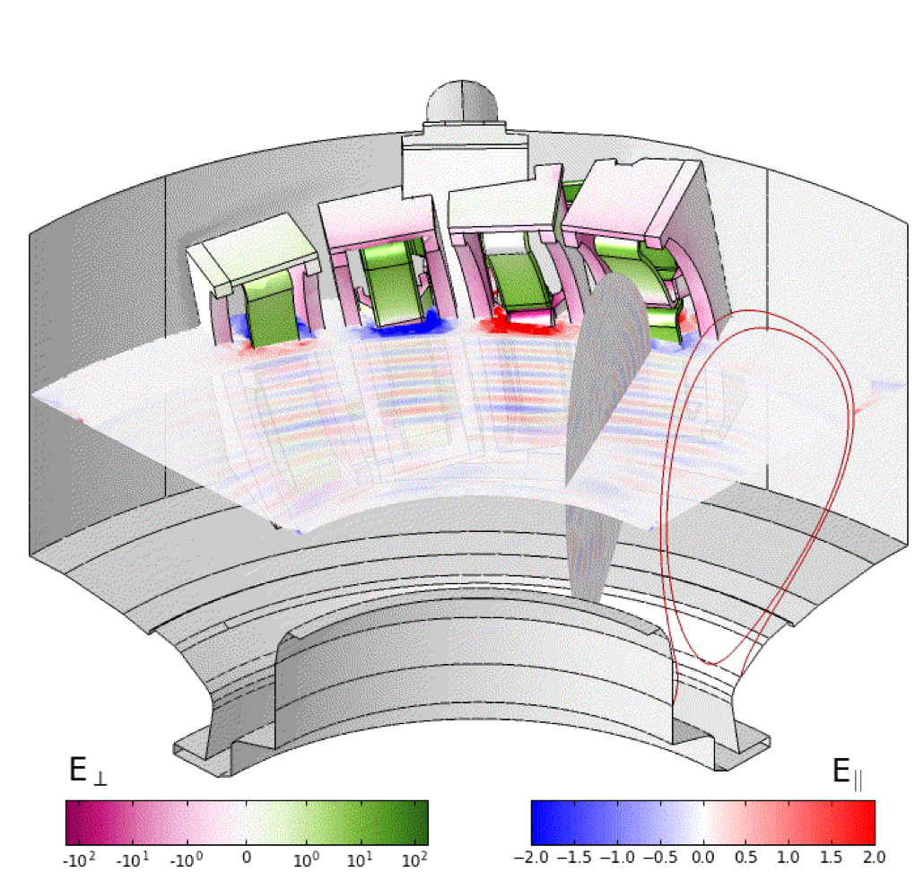
From hot core to antenna: towards whole device RF actuator modelling
Syun’ichi Shiraiwa
Ackowlegement: J. C. Wright, N.Bertelli¹, P. T. Bonoli,
J. Myra², T. Kolev³, M. Stowell³, Y. Lin, C. Lau⁴,
O. Meneghini, G. Wallace, S. Wukitch, L. Zhou, W. Beck,
the Alcator C-Mod team and the RF-SciDAC team
PSFC-MIT, PPPL¹, Lodestar², LLNL³, and ORNL⁴

Slide 2

RF actuator in the ideal world
P_{in}
RF generator
P_{core}
P_{wall}
P_{out}
Power injected to the plasma (P_{in})
Power reflected from the plasma (P_{out})
Power absorbed in core plasma (P_{core})

Slide 3
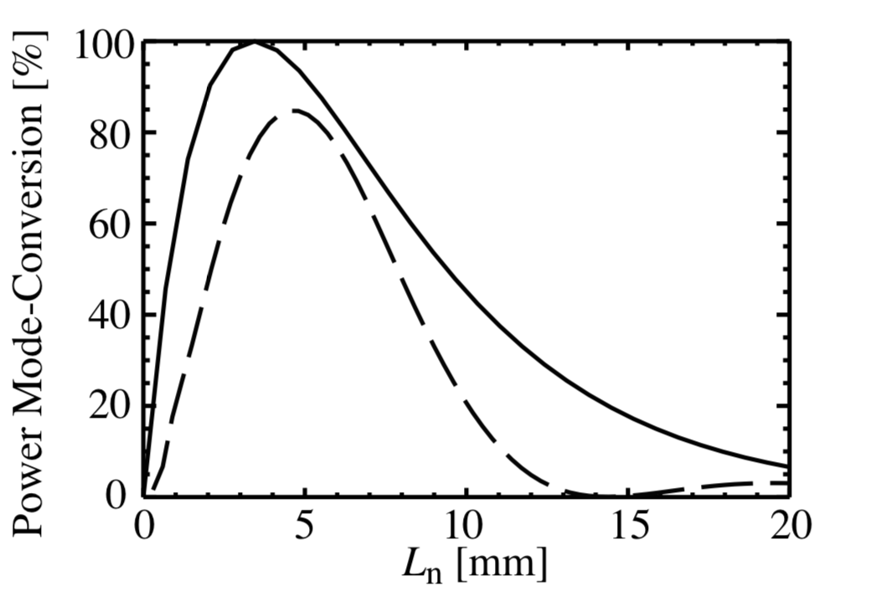
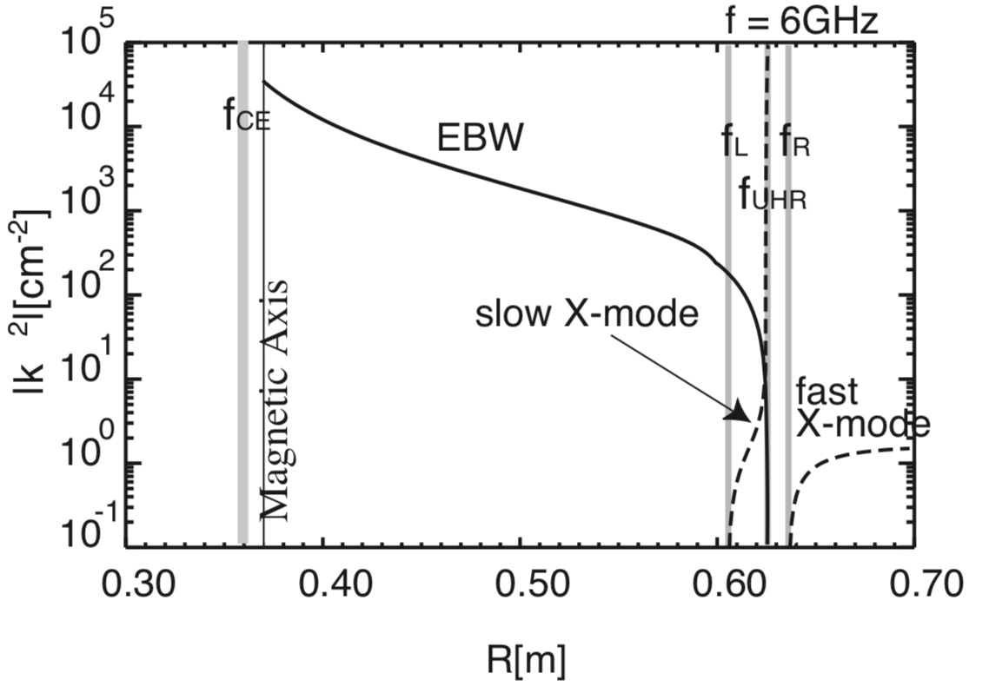
Example: excitation scenario for electron Bernstein waves
X-B mode conversion scenario
  Width of L_{cutoff}-UHR-R_{cutoff} triplet determines the transmission efficiency
  P_{in} = P_{absorbed} + P_{reflected}

Slide 4
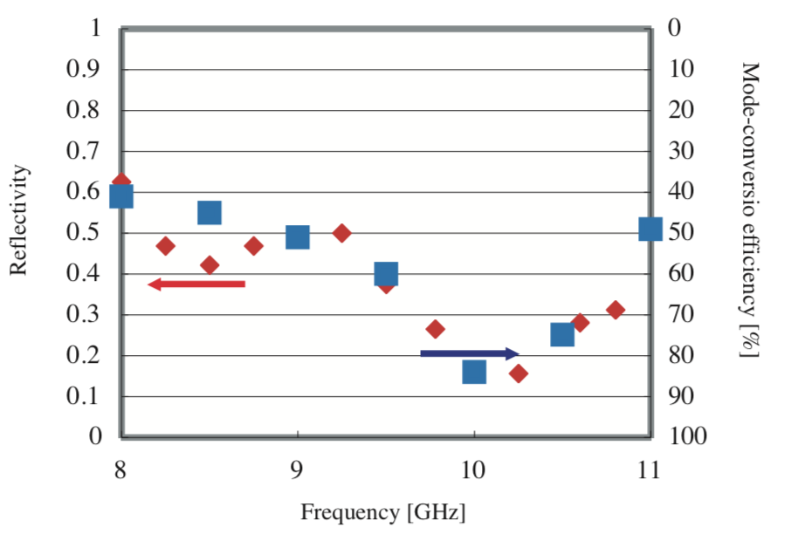
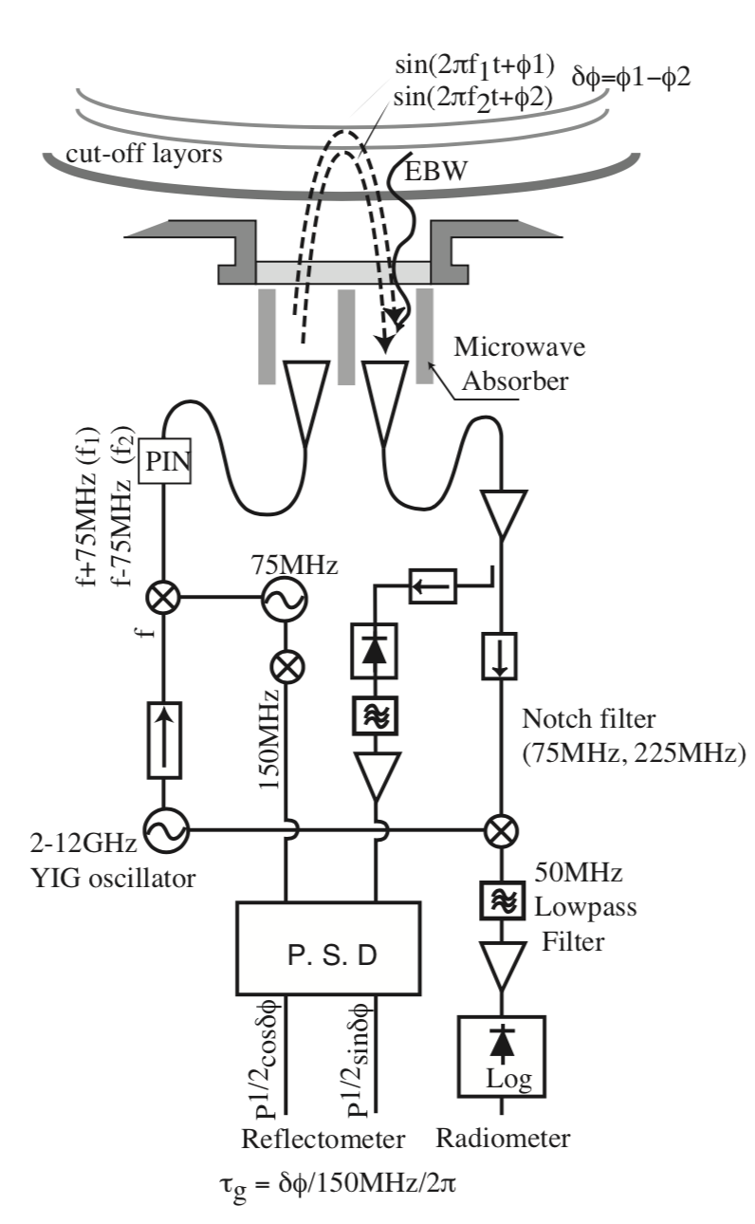
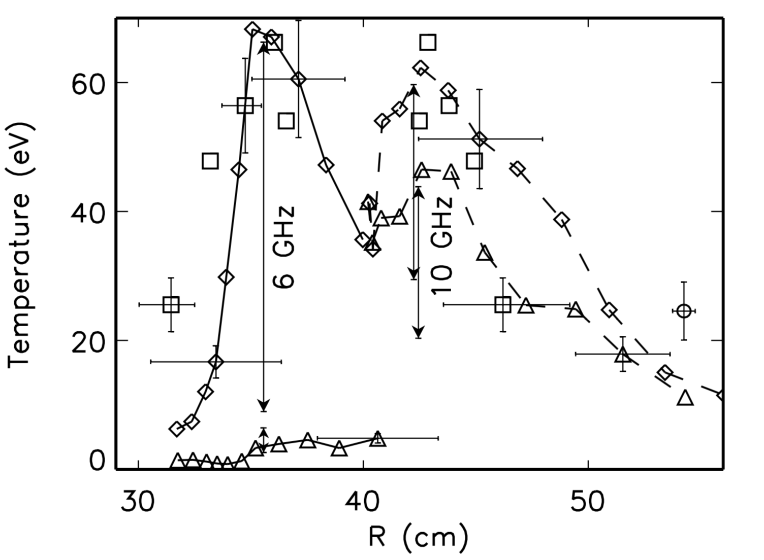
1D theory explained well low power experiments
CDX-U
TST-2
(right) EBW power emission measurement on CDX-U¹ (left) Comparison of power transmission efficiency and reflectivity measured by radio-reflectometer²,
B. Jones, et al., Phys. Rev. Lett. 90, 165001 (2003)
S. Shirawia, et. al., Rev. Sci. Instrum. 74, 1453 (2003)

Slide 5
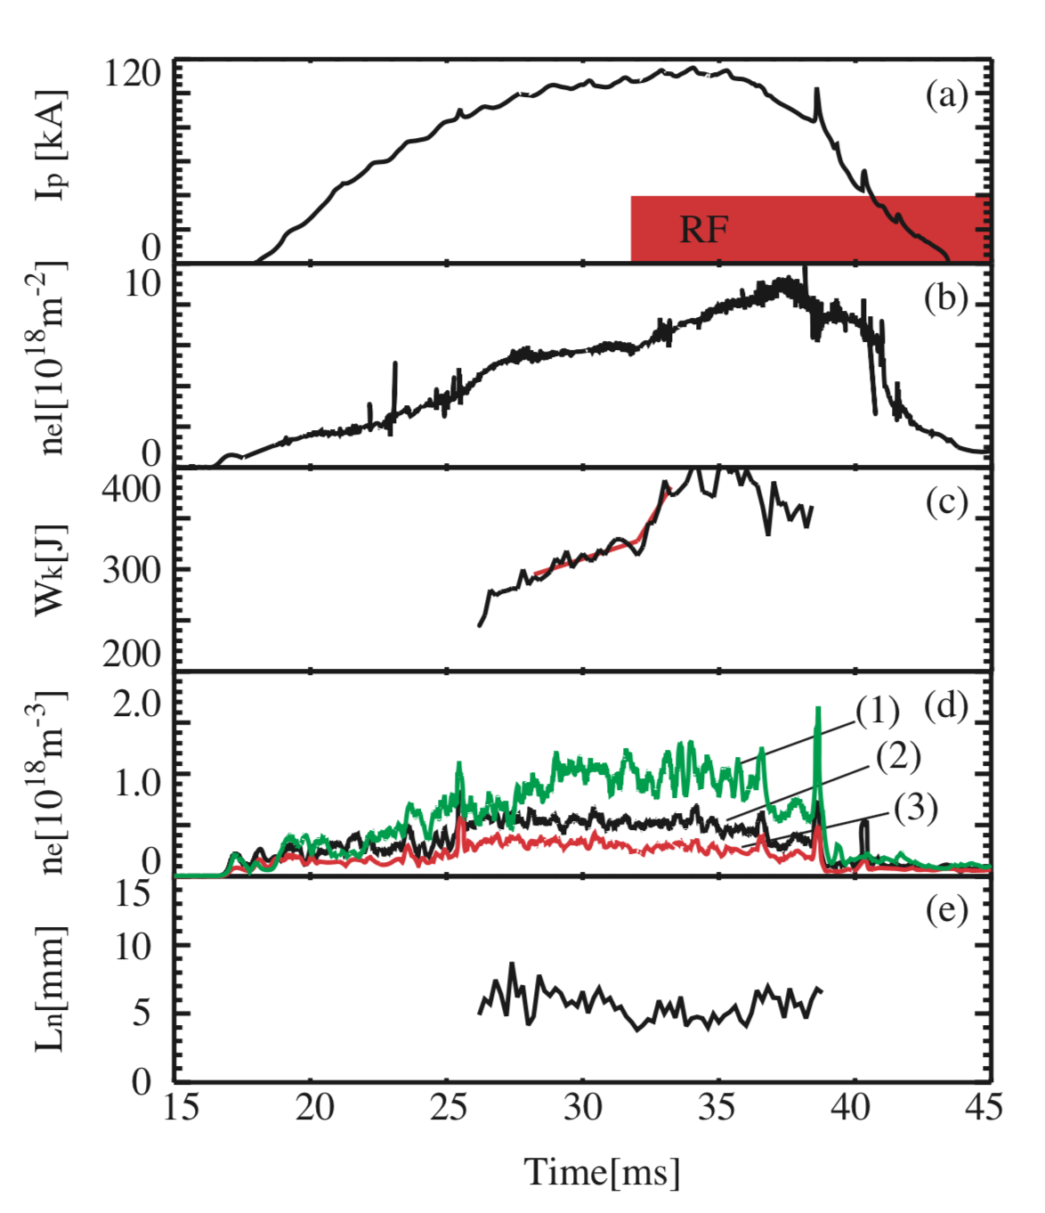
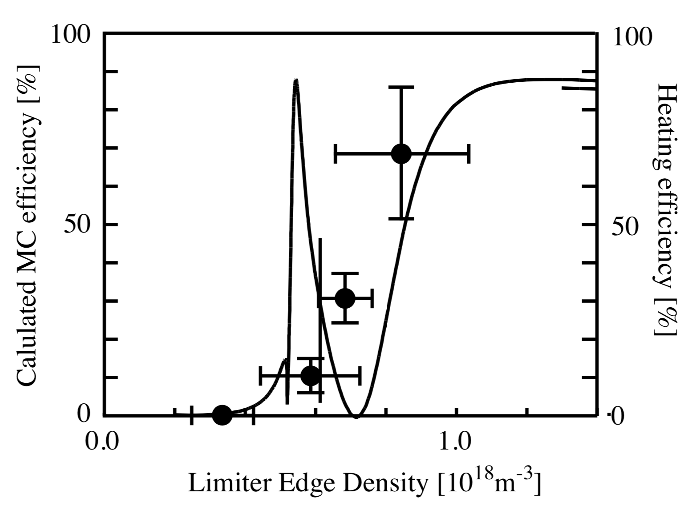
…and even at high power to some extent
TST-2
Reverse process was used to heat ST plasma, showing the core heating when the triplet with is suitable.
S. Shirawa, et. al., Phys. Rev. Lett. 96, 185003 (2006)

Slide 6
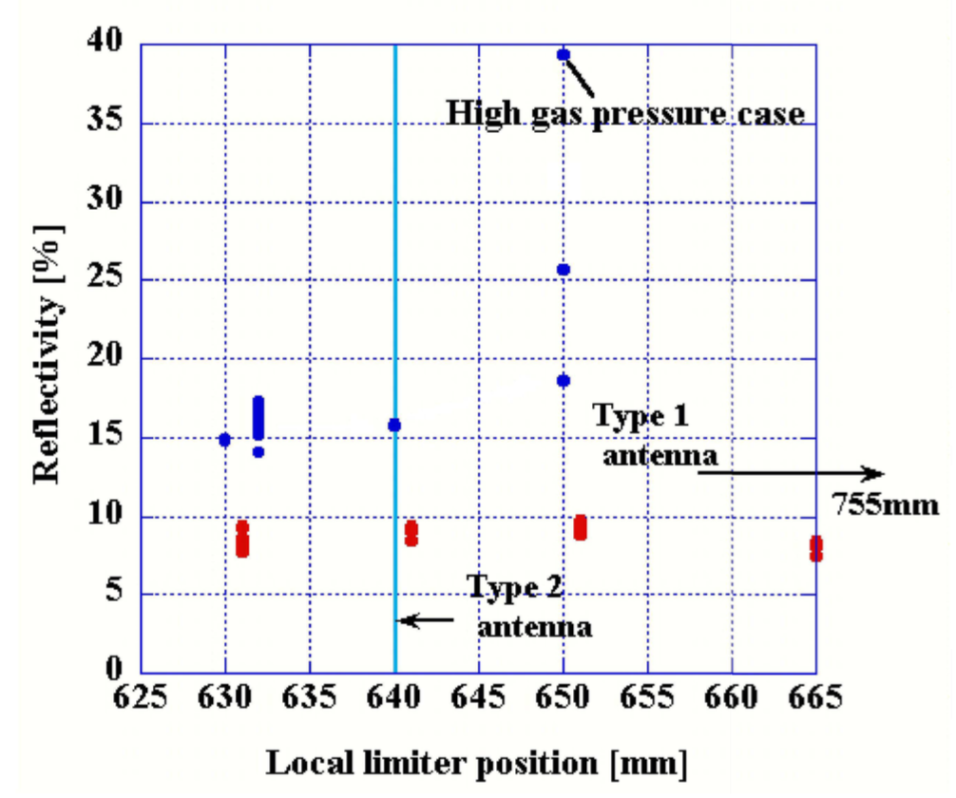
But a question remains
TST-2
The power reflection is always low !
S. Shirawa, et. al., Phys. Rev. Lett. 96, 185003 (2006)

Slide 7
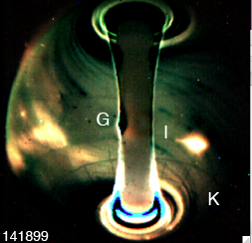
A key to understand and improve the RF actuators is to model parasitic losses and associated adverse effects on plasmas accurately
NSTX
C-Mod^{1,2, 3}
Common issue on many RF experiments
  ICRF : Alcator C-Mod, ASDEX, JET…
  LH : Alcator C-Mod, FTU, EAST, Toru Supra…
  HHFW : NSTX
G. M. Wallace, et al., Phys. Plasmas 17, 082502 (2010)
S. Shiraiwa, Physics of Plasmas 080705 18 (2011)
I. Faust, Ph. D thesis
R. J. Perkins, et al., Phys. Plasmas 22, 042506 (2015)

Slide 8
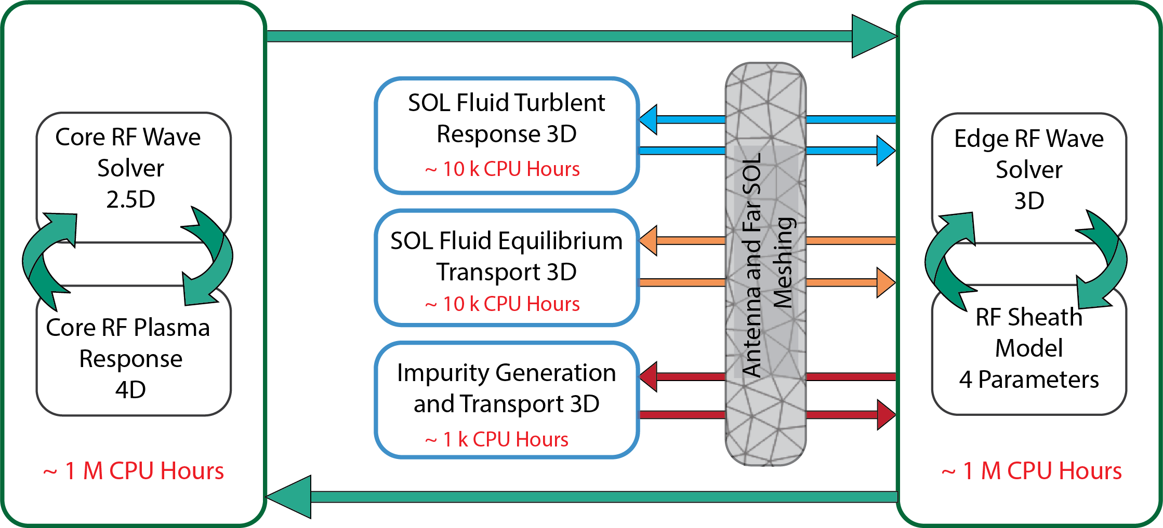
RF Modeling needs to handle a realistic 3D antenna, coupled with advanced physic models
    3D geometry
      Antenna coupling in 3D geometries (C-Mod field aligned ICRF, stellarators)
      Open field line SOL plasmas
    Advanced physics
      edge turbulence
      RF stheath
      …and more
RF SciDAC-4 proposal

Slide 9
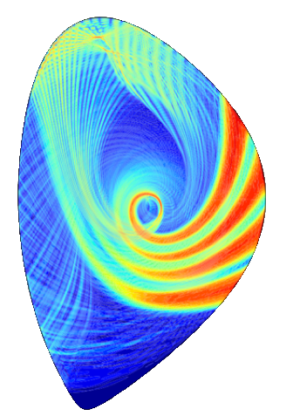
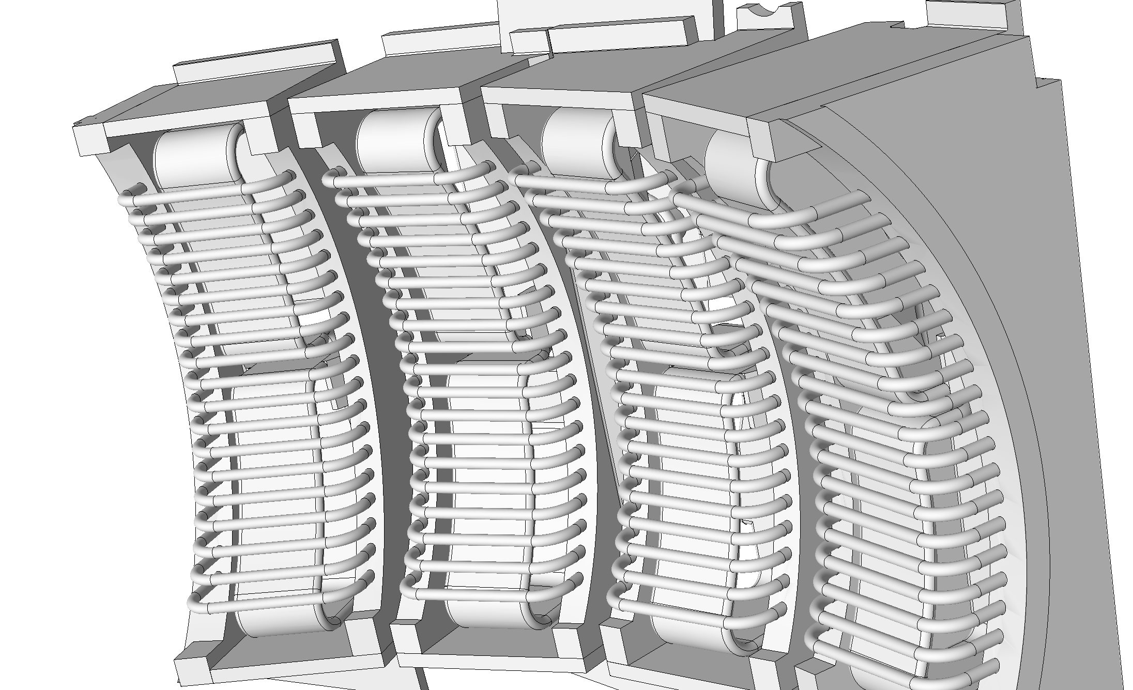
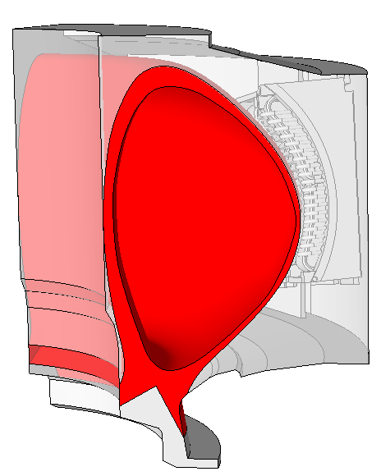
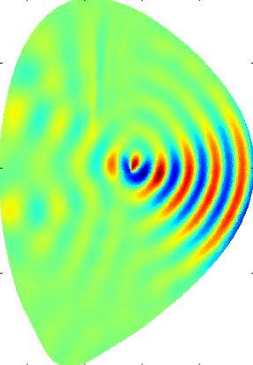
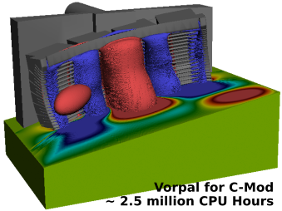
High fidelity (physics and geometrical) RF modeling requires an integrated approach
RF waves in core
SOL plasma
It is customary in RF simulations to handle hot core and antenna coupling separately.
We need to treat them self-consistently, which requres…
  A generic platform to implement technically transparent and scalable FEM application.
  Formulation to connect RF wave field between different regions.
LH grill launcher

Slide 10
Outline
Petra-M platform on scalable MFEM library
Whole device scale RF wave simulation ¹
Integration of hot core plasmas ^{2, 3, 4}
Future and summary
N. Bertelli, S. Shiraiwa, et. al. RF topical conf. 2019
J. C. Wright and S. Shiraiwa, RF topical conf. 2017
S. Shiraiwa, J.C. Wright et. al., APS 2017
S. Shiraiwa, J.C. Wright et al. N.F. (2017)
J. C. Wright, S.Shiraiwa, et. al. EPS 2018

Slide 11
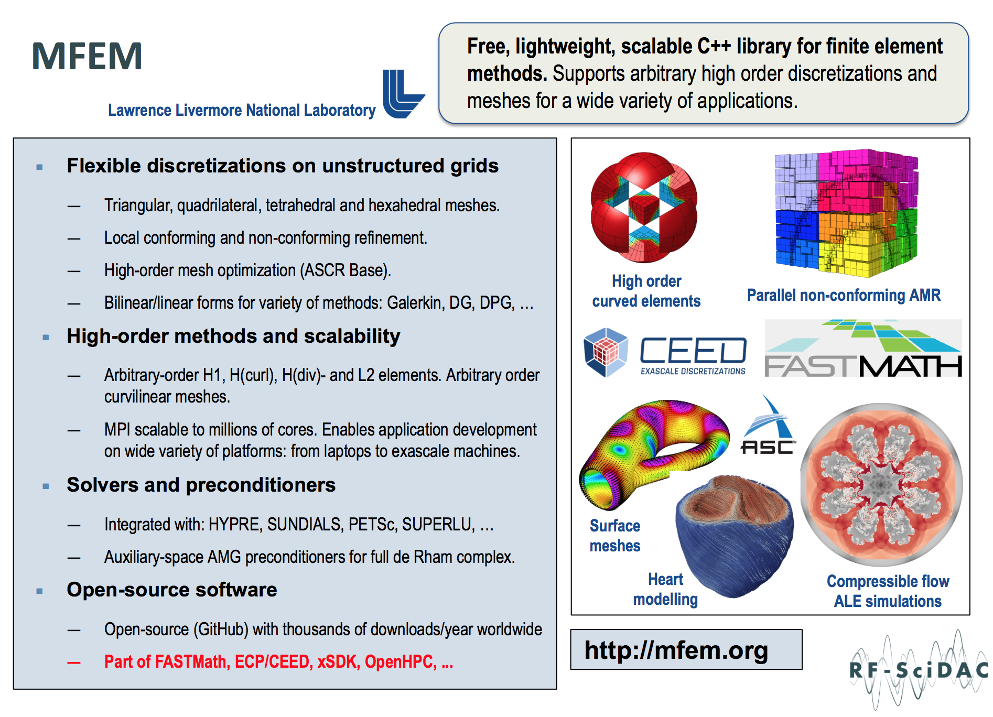

Slide 12

C++ and Fortran layer is wrapped for rapid application development using Python
PyMFEM
Auto-generate C++ wrapper codes from mfem header files using SWIG
Wrapper allows to use C++ objects in MFEM from Python,
    (c++)
    double data[] = {1,2,3};
    o = Vector (data, 3);
    (python)
    v = mfem.Vector(np.array([1,2,3.])
    Distributed from mfem.org
Using the same technique for linear solvers (MUMPS, Strumpack), and mesh adaptation (PUMI)
Available under MFEM site (LGPLv2)

Slide 13
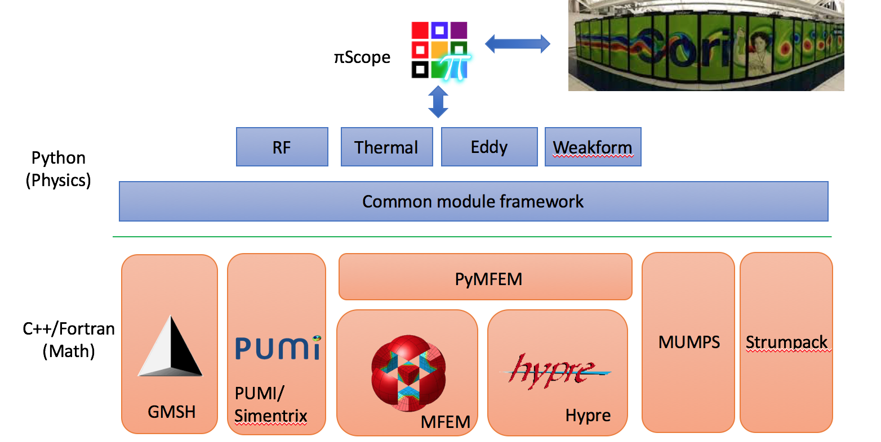
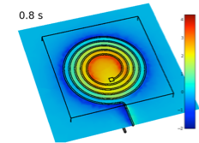
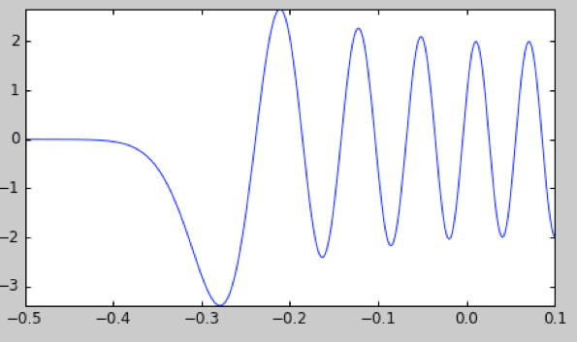
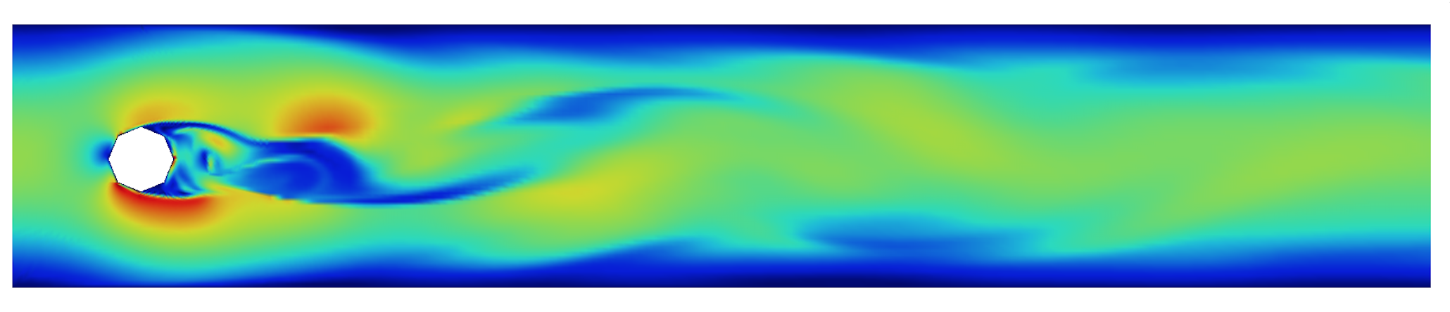
Petra-M (Physics Equation Translator for MFEM)
FEM analysis platform
Front-end interface to open source software
Integrated FEM modeling from geometry to FEM assembly and solve.
Deployment tool for our advanced physics model
Started as RF modeling tool
Use case is expanding even outside RF waves such as SPARC magnet.
1D RF wave
Navier-Stokes
EM-thermal coupled PDE

Slide 14
Scalable RF wave solver with high geometrical fidelity

Slide 15
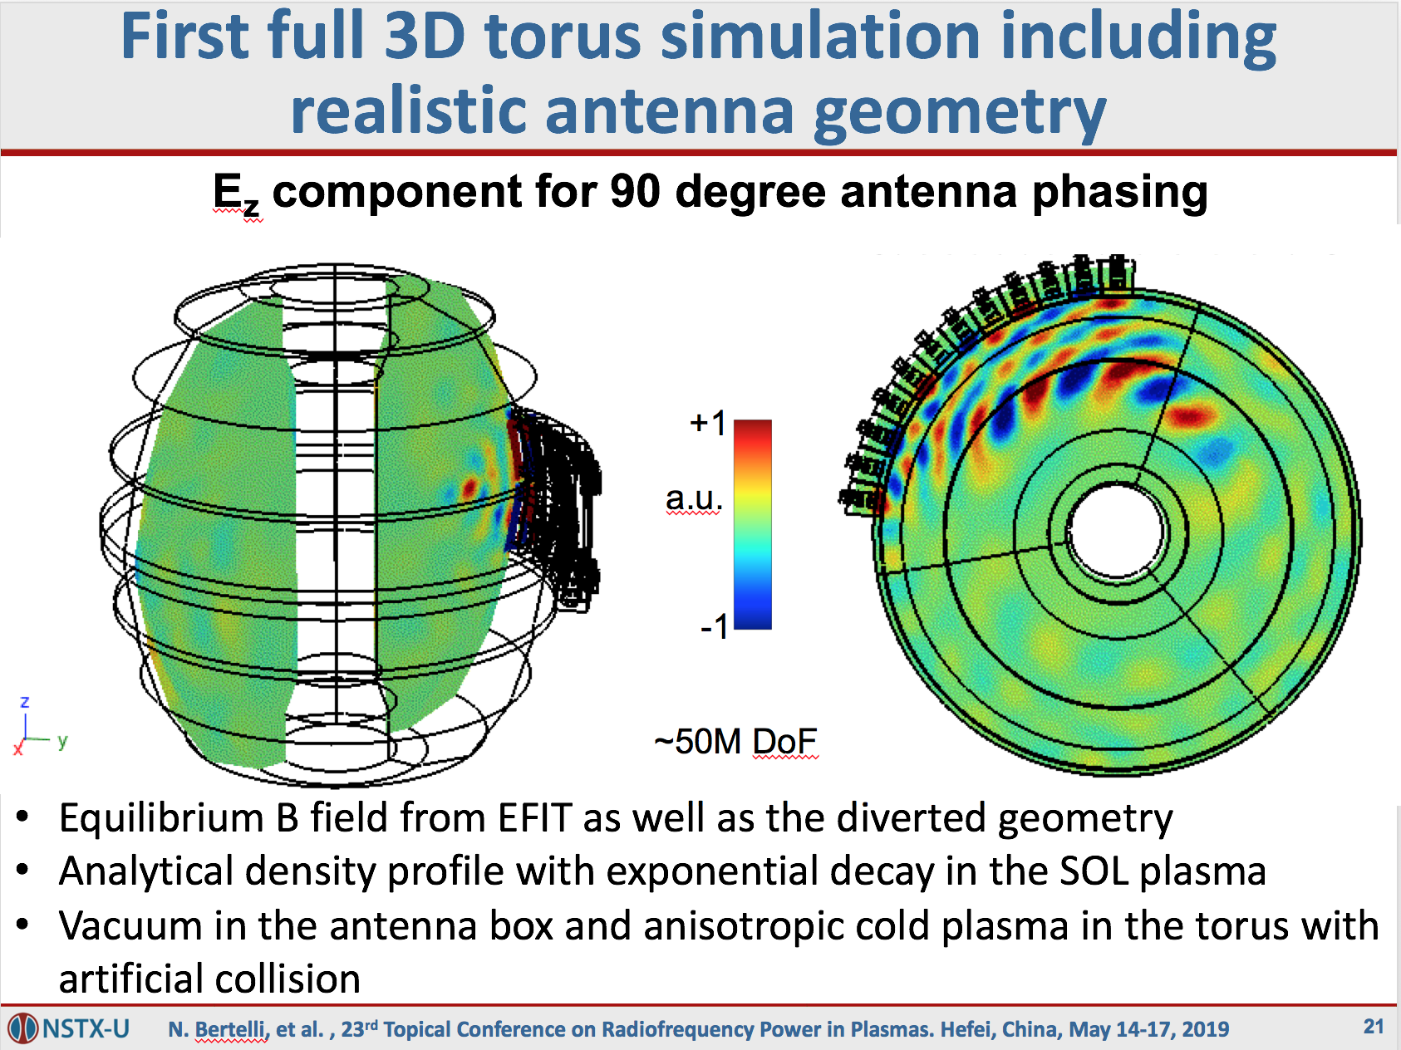

Slide 16
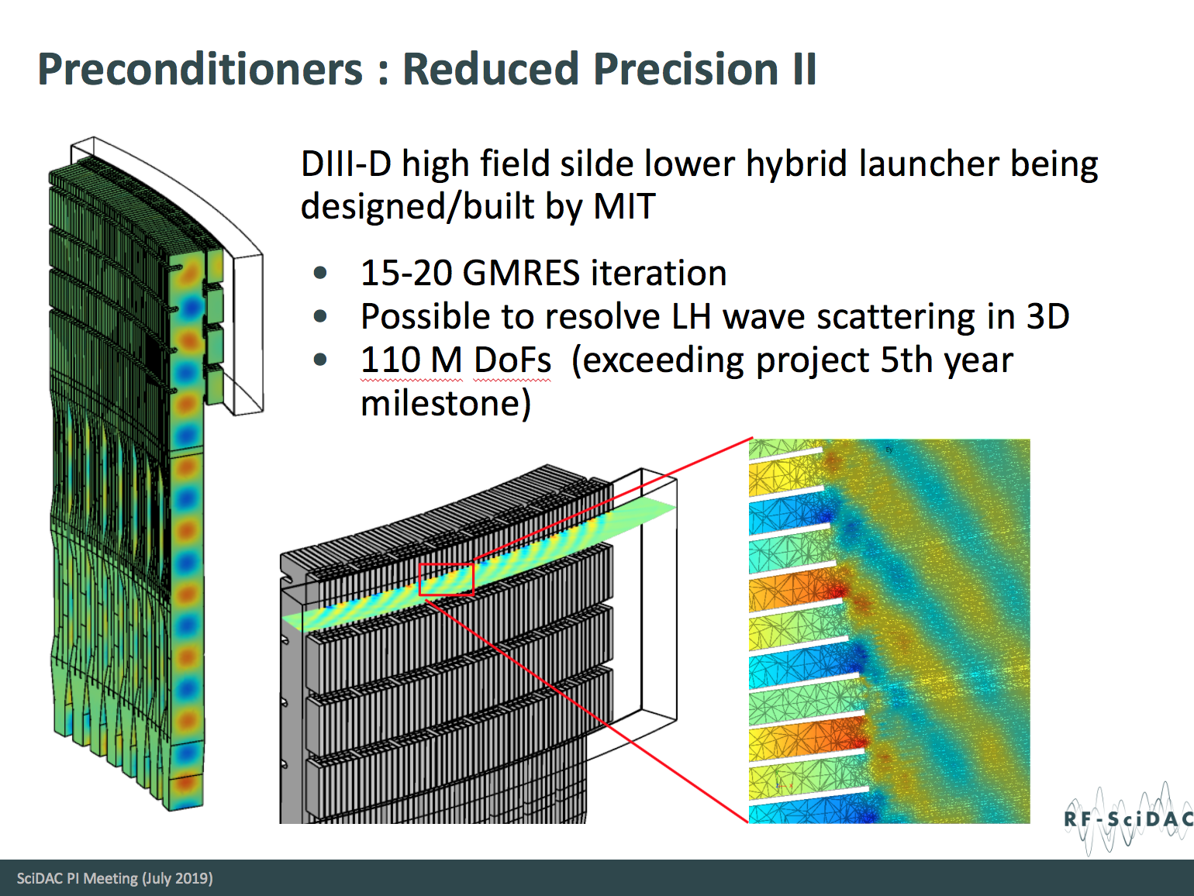

Slide 17
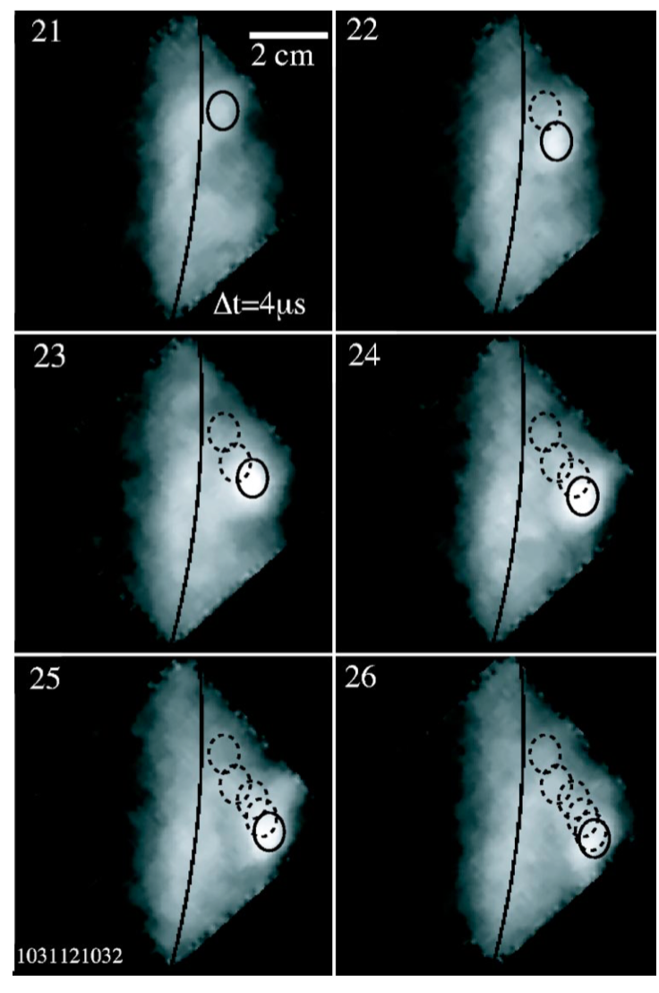
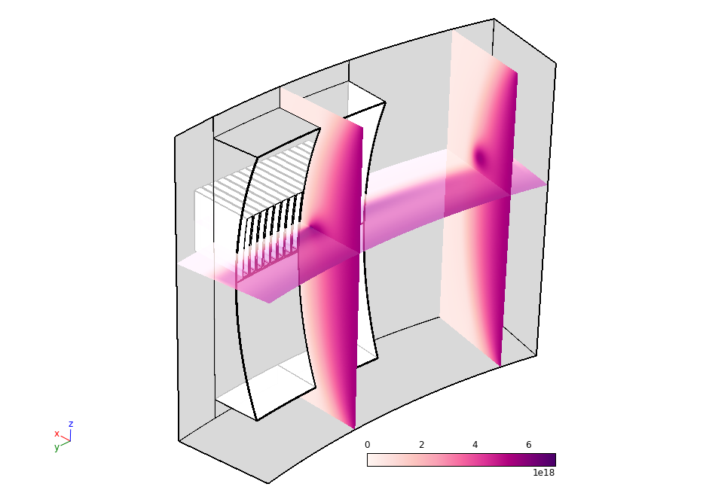
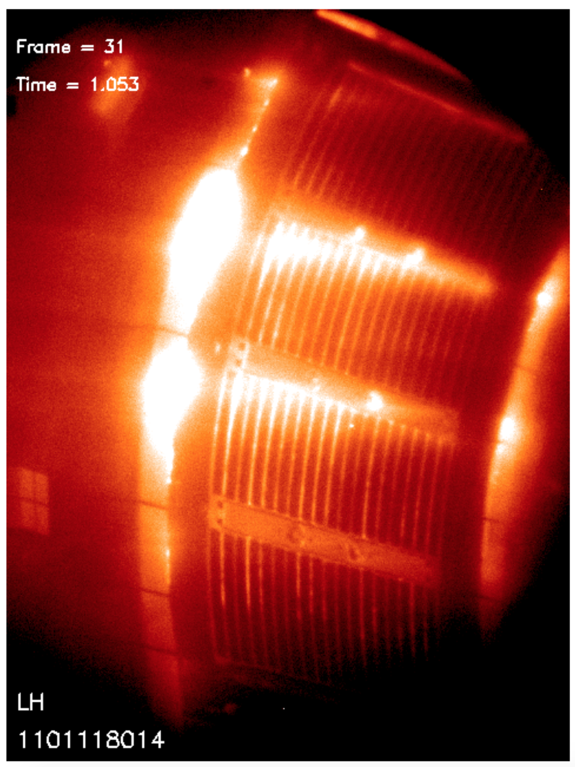
LH-wave scattering due to 3D density perturbation in front of antenna impacts RF wave propagation
Experiment shows various field-line aligned density perturbations
    Striation (stationary)
    Turbulent blobs
C-Mod
Simulation geometry with model blob perturbations
LH launcher
Field aligned density modulation placed in front of LH launcher
The modulation was computed by solving diffusion eq. from particle source in front of the launcher
Glowing striations at LHCD launcher¹
High speed movie of blob I SOL²
density
¹O. Meneghini, et. al.,“Modeling Non-linear Plasma-wave Interaction
at the Edge of a Tokamak Plasma”, (2011)
²J. L Terry. et. al., “High speed movies of turbulence in Alcator C-Mod”, RSI, (2004)
Notes:
Add or mention elijah’s measurements.

Slide 18
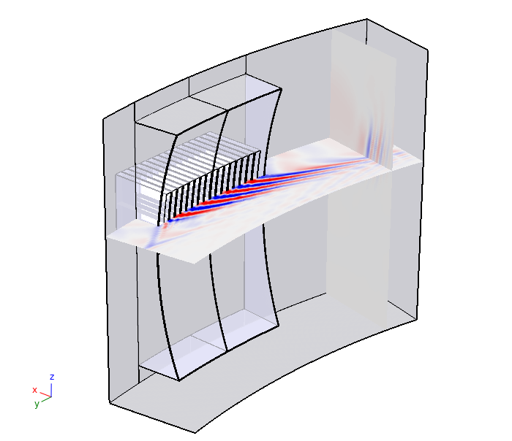
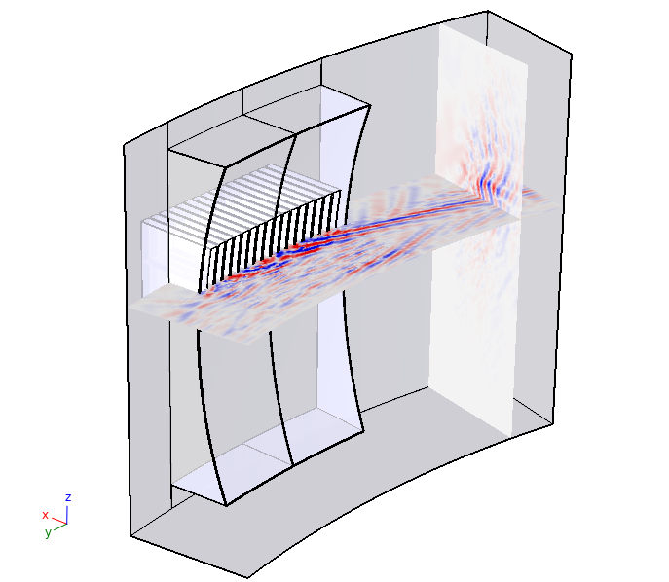
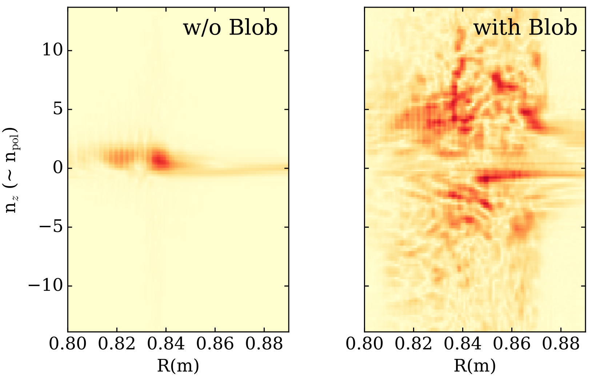
Initial results indicate that the LH wave field pattern can be significantly altered, potentially improving the agreement with experiment
n_{perp} spectrum vs R
C-Mod
E_{tor}
Simulated HXR profile
with Blob
w/o Blob
with Blob
LH resonance-cone propagation is largely destroyed, leading to broadening of the vertical wave-number (n_{perp}) spectrum.
K-vector rotation impacts the core power deposition filling it in. S. Shiraiwa APS (2018), S. G Baek, RF conf. (2019)
w/o Blob
Notes:
On going work to characterize the sensitivity. See Decker 2011. Yves Peysson and Cesario refs. Note this is scattering of kperp not kparallel. Ram and Myra references?

Slide 19
Integration with hot-core wave solver

Slide 20
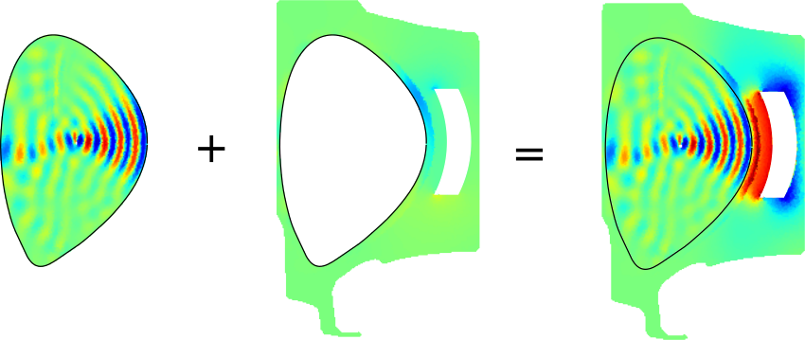
Hybrid integration of SOL
Core
  Axisymmetric flux surface regular grid
  Hot plasma conductivity
  Dense Matrix Solver
Edge
  Unstructured mesh with complicated geometry (either 2D or 3D)
  Cold plasma with collision.

Slide 21
Core and edge connecting rule = cascading of RF components
S
RF network characterized by the Scattering matrix, S
When connecting two networks…
T₁: response to the power from the external input
T₂: response to the power from S
S
S
T

Slide 22
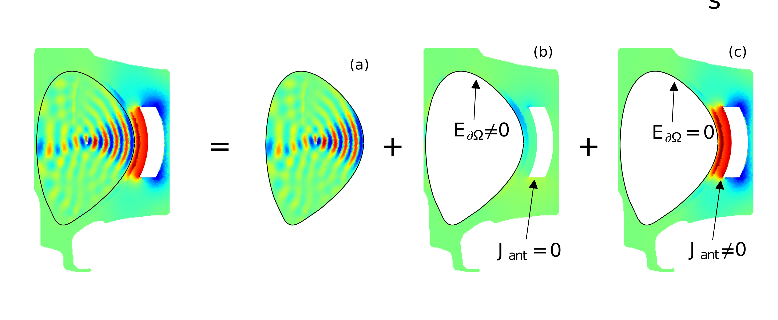
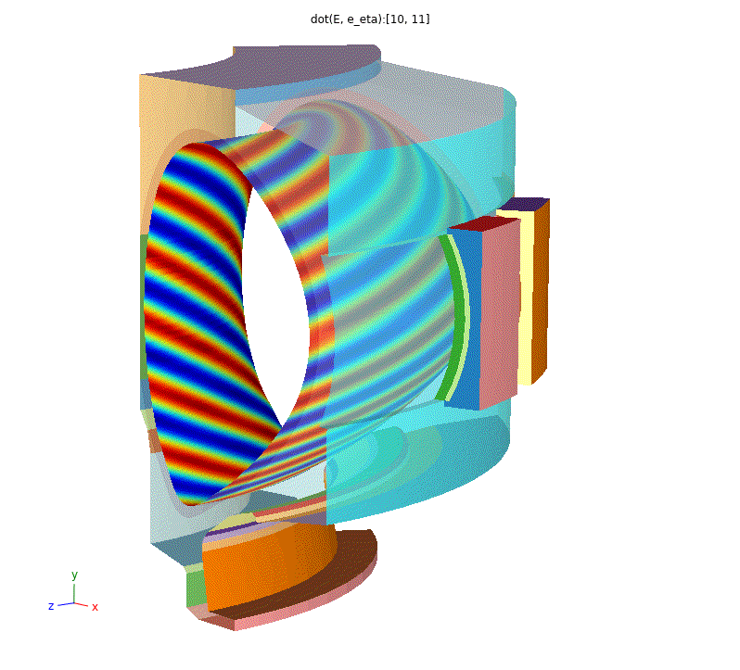
Final solution constitutes from three components
Fourier decomposed modes (poloidal/toroidal) , not discrete RF port voltages.
This method is exact – no approximations.
Equivalent for requiring the continuity of tangential E and B on the connecting boundary.
Changing antenna excitation does not require re-computing (b)
S. Shiraiwa et. al, et al. N.F. (2017), J. Wright et. al., RF conf. (2017)
Mode coupling method
Calculate the separate solutions in core (in) and edge (out) regions for different modal excitations.
Superimpose the solutions, so that boundary conditions are satisfied.
Note that linear system needs to be assembled so that mass matrices are the same
Electric fields match for each
mode at interface by
construction
Matching magnetic fields in
presence of antenna currents
given the matching
amplitudes

Slide 23
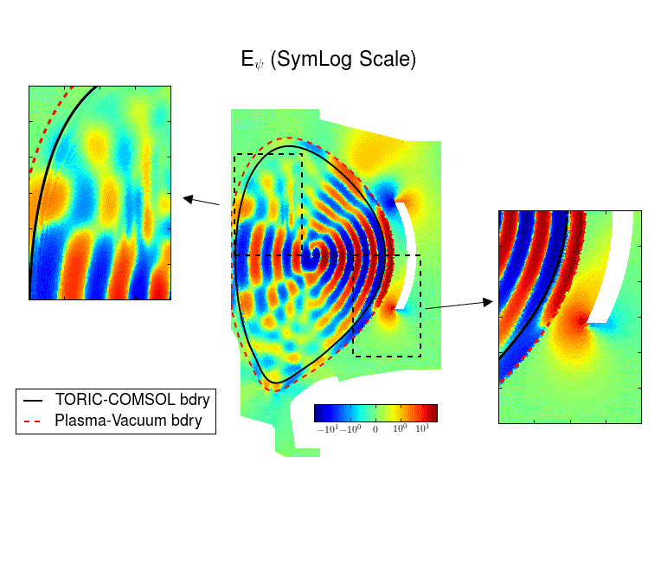

E_{ψ} continuity at domain boundary can be used for verification
Continuity of radial component is not given by construction and provides a way to verify the approach.
Smoothly connected at TORIC/FEM boundary, but it is not at vacuum/plasma boundary.
Consistent with a continuous dielectric at the former boundary, while it is not at the latter.
Shiraiwa – 59th APS-DPP 2017

Slide 24
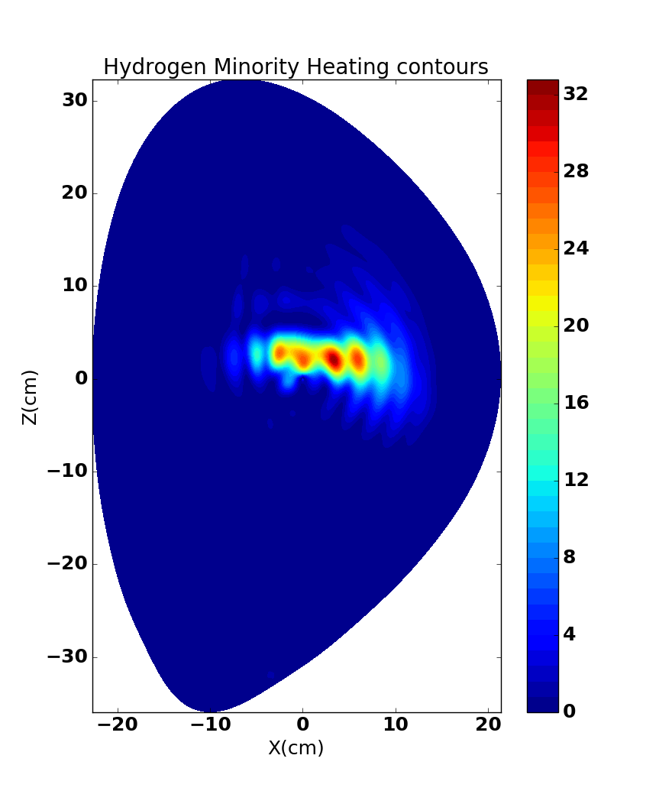
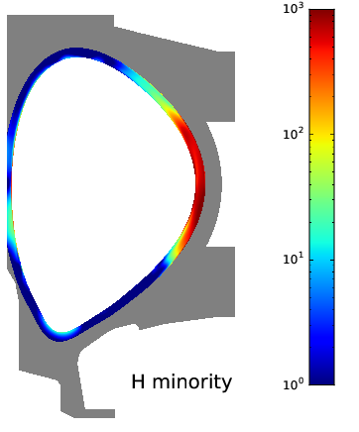
In D-(H) MH, the power is absorbed dominantly in the core
D-(H) loading 16.1 Ω, power partition: 15% edge, 85% core.
(note: Te_{SOL}= 15ev, which is low for C–Mod experiments)
D-(3He) loading 14.5 Ω, power partition, 50% edge, 50% core.
Loading is different than efficiency: power does not necessarily go into the core.
In D-(3He), significant power lost in far SOL – possible source of far field RF sheath rectification
Notes:
19 W total power in D-H . D 24%, H 67%, e 9%

Slide 25
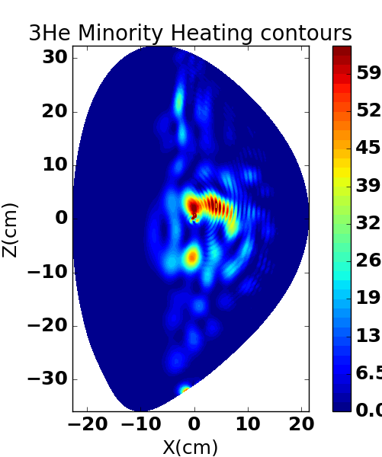
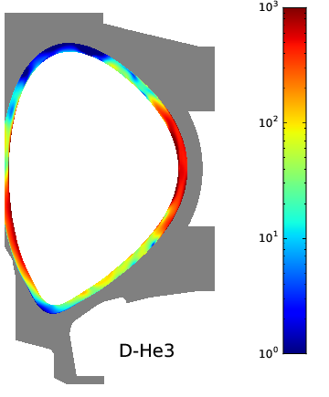
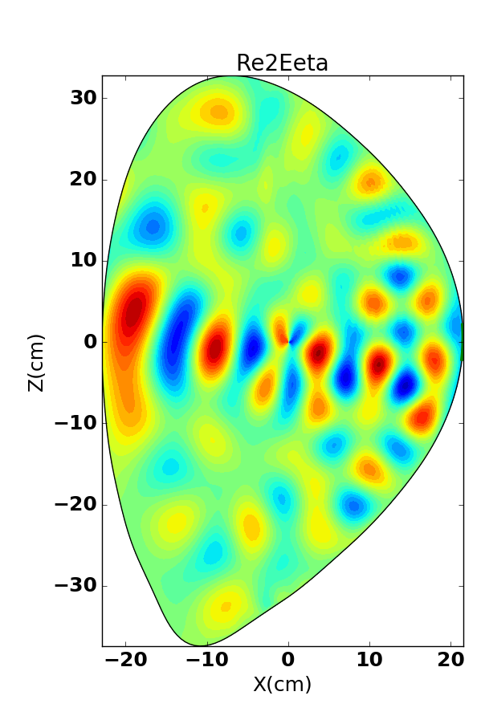
In D-(3He) MC, absorption in SOL increases due to weaker absorption
D-(H) loading 16.1 Ω, power partition: 15% edge, 85% core.
(note: Te_{SOL}= 15eV, which is low for C–Mod experiments)
D-(3He) loading 14.5 Ω, power partition, 50% edge, 50% core.
Loading is different than efficiency: power does not necessarily go into the core.
In D-(3He), significant power lost in far SOL – possible source of far field RF sheath rectification
Notes:
Core power is 90% 3He.

Slide 26
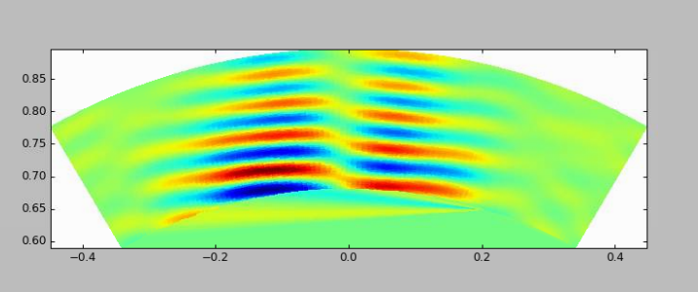
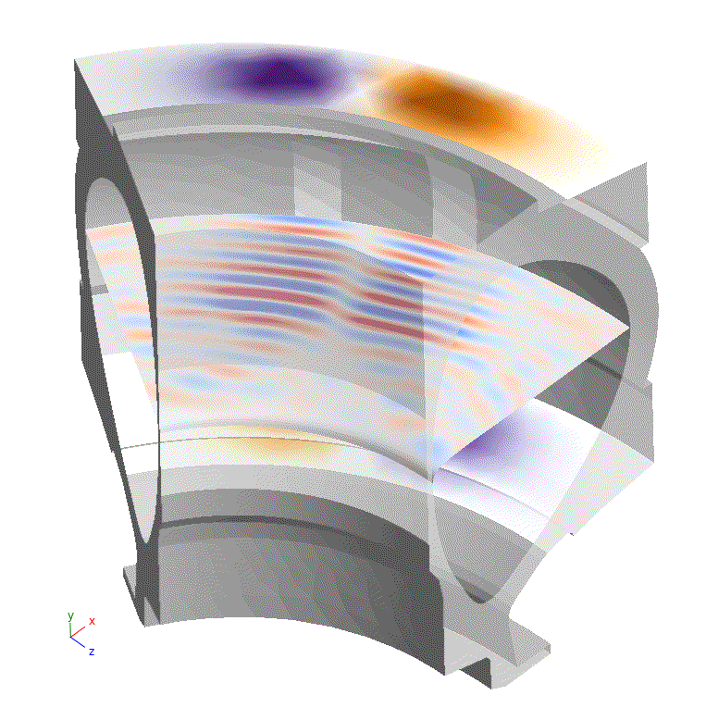
3D simulations using simply revolved 3D geometry indicates we need more realistic antenna structure
D-(H) case on Alcator C-Mod
Accurate toroidal spectrum can be essential for finding RF amplitudes ‘far’ from antenna^{[1]}.
Midplane cut of low field side
Outer midplane radius
Toroidal direction

Slide 27
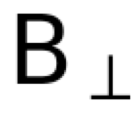
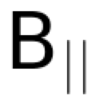

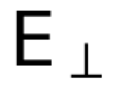
3D simulations using simply revolved 3D geometry indicates we need more realistic antenna structure
D-(H) case on Alcator C-Mod
Accurate toroidal spectrum can be essential for finding RF amplitudes ‘far’ from antenna^{[1]}.
Midplane cut of low field side
Outer midplane radius
|T₂|
Toroidal direction
1) N. Tsujii, PhD thesis (2010)

Slide 28
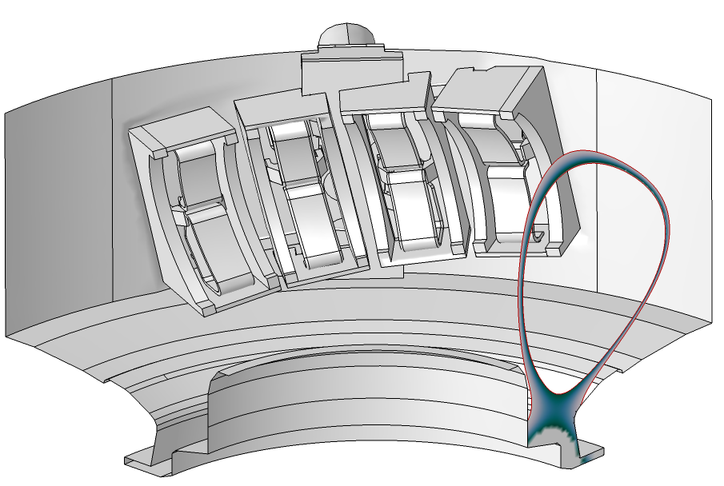
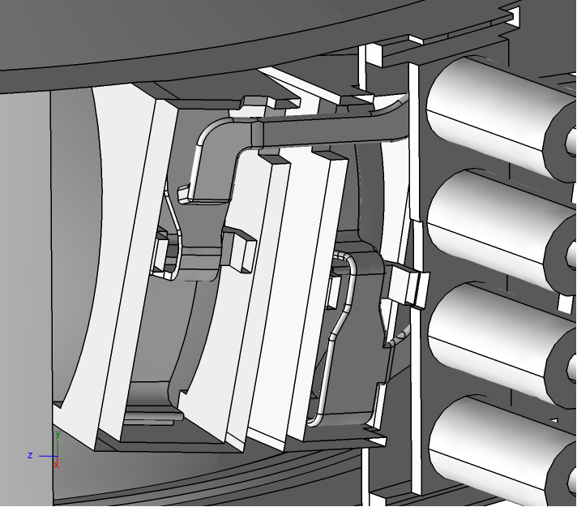
J-port antenna RF geometry model built from engineering CAD drawing
Front
Back
3D antenna structure and SOL plasma (diverted geometry is made from EFIT) is added

Slide 29
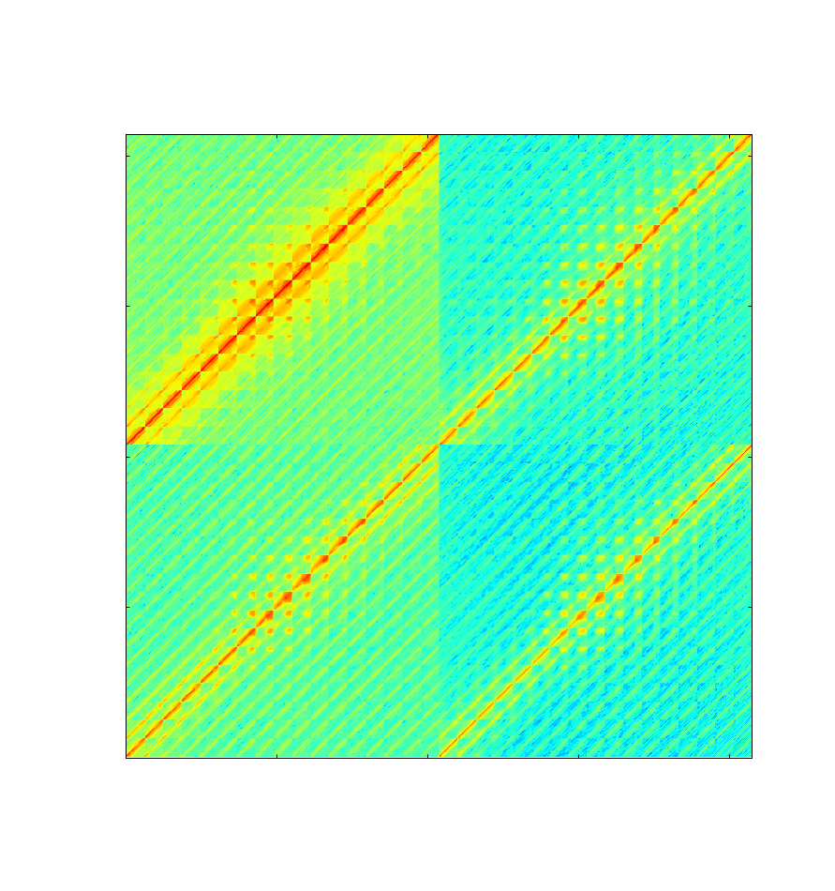
3D geometry introduces coupling among toroidal modes.
|T₂|
Output (magnetic field)
Input (Electric field)
Different toroidal modes communicate each other via surface RF current on the antenna structure

Slide 30
3D geometry introduces coupling among toroidal modes.
|T₂|
Flat VV
Output (magnetic field)
Input (Electric field)
Different toroidal modes communicate each other via surface RF current on the antenna structure

Slide 31
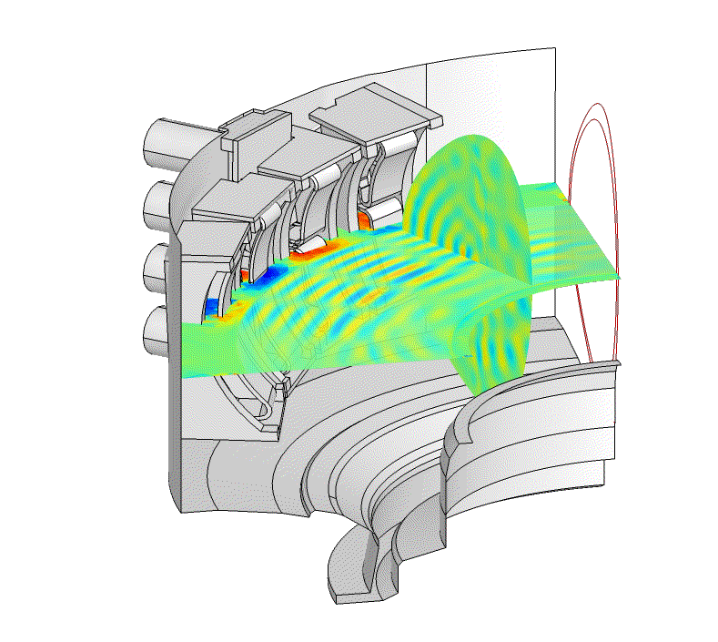
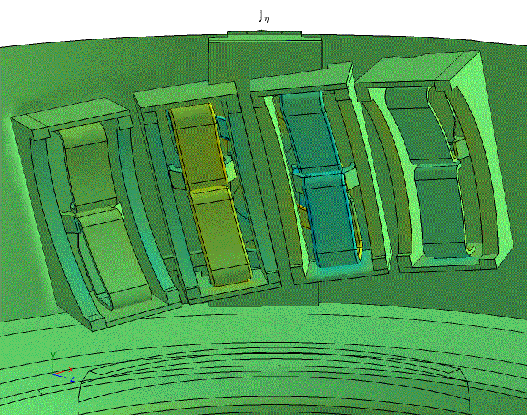
Core-edge integrated solution for C-Mod field-aligned ICRF antenna
Wave propagates smoothly from antenna to the core
Surface currents indicates phasing is not exactly 0-pi-0-pi

Slide 32
Future plan

Slide 33
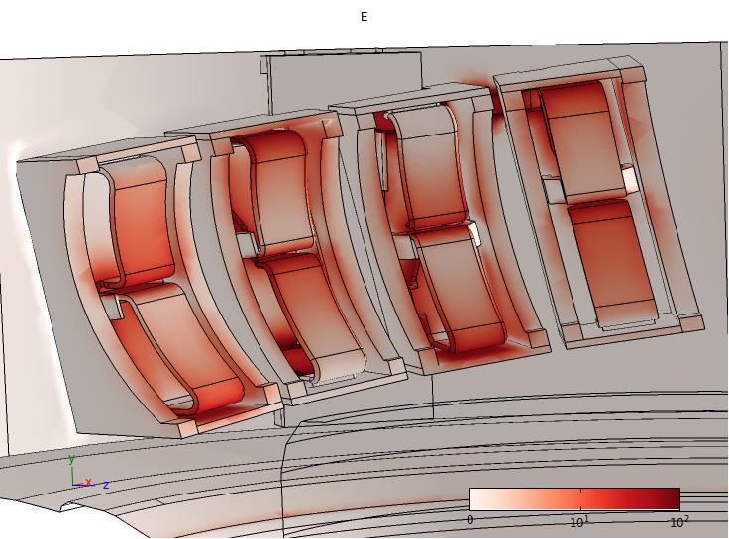
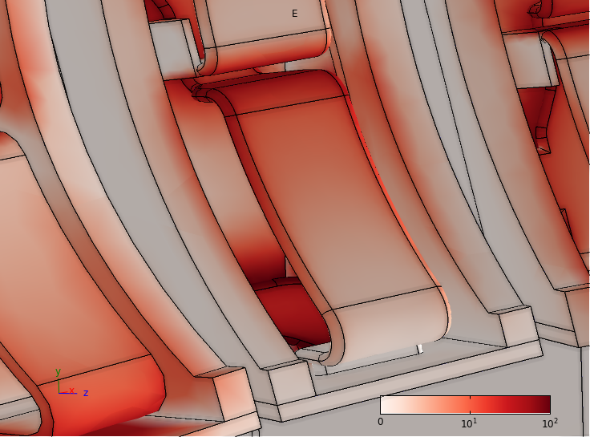
Moving on the validation using existing C-Mod experimental data
    RF voltage/current probes
    PCI diagnostics

Slide 34

… and future experiments

Slide 35

Investigation of slow wave has begun
Slow wave excitation in the low density region near the antenna structure
has very short wave length
produces nonlinear RF rectified potential
responsible for impurity regeneration
Work with J. Myra (Lodestar)
P = 0
S = 0
1) J. R. Myra and D. A. D’Ippolito, Phys. Plasmas 22 , 062507 (2015)
2) H. Kohno, J.R. Myra, and D.A. D'Ippolito, Phys. Plasmas 22, 072504 (2015)

Slide 36
Conclusions
A new RF modeling capability permits exploration of RF wave physics at whole device scale
  Petra-M FEM platform
    built on the scalable MFEM library
    designed to be versatile allowing for integrating advanced RF physics such as RF sheath
  Hot core – cold edge coupling
    built upon existing code infrastructure, algorithms and methods.
    applicable to any full wave RF simulation in any frequency regime.
  Integrates for the first time, antenna coupling, SOL propagation with realistic geometry, and hot core plasma.
A step towards whole device scale RF modeling
  RF sheath models
  Core Fokker-Planck models
  SOL fluid and turbulence models
  Impurity generation and transport models
Validation is critical
Collaboration domestic and international
Notes:
We have demonstrated HHFW and ICRF here.

Slide 37
Back up slides

Slide 38
Question : any possible application of Petra-M to different field ?
Petra-M is a generic FEM analysis tool, and application is not limited to frequency domain RF. Could be applied to broad range of physics and engineering issues.
HTS magnet modeling
MHD waves
What else?

Slide 39
Investigation of slow wave has begun
Slow wave excitation in the low density region near the antenna structure…
has very short wave length
produces nonlinear RF rectified potential
responsible for impurity regeneration
Work with J. Myra (Lodestar)
~few mm
(S=0)
R=n||²
P=0
Vacuum
limit
slow wave
1) J. R. Myra and D. A. D’Ippolito, Phys. Plasmas 22 , 062507 (2015)
2) H. Kohno, J.R. Myra, and D.A. D'Ippolito, Phys. Plasmas 22, 072504 (2015)
Fig.2 from Berro and Morales IEEE Trans. (1990).

Slide 40


Investigation of slow wave has begun
Slow wave excitation in the low density region near the antenna structure
has very short wave length
produces nonlinear RF rectified potential
responsible for impurity regeneration
Work with J. Myra (Lodestar)

Slide 41



Petra-M (Physics Equation Translator for MFEM)
Scalable MFEM library
  http://mfem.org/features
Petra-M physics
based FEM modeling interface
Workflow management using πScope
  http://piscope.psfc.mit.edu
HFS LH DIII-D
Image uses cold plasma in the entire domain and solved by MFEM
LAPD

Slide 42





Petra-M (Physics Equation Translator for MFEM)
Geometry/Mesh
Procedural geometry/mesh generation in 2D/3D
NASTRAN file import
Utilize GMSH/OpenCASECADE for backend
On-going work to use RPI/Simmetrix mesh tools
FEM interfaces for MFEM
Tightly integrated with πScope Python workbench
RF Physics module
  1D/2D axis-symmetric/3D
Weakform module
  Multiphysics coupling
Solver/Post-processing
Steady State and Time dependent solver
MUMPS/Strumpack direct solver
Hypre iterative solvers
Visualization on πScope
NSTX HHFW
JET ILA
3D HHFW
LH wave

Slide 43

How to stitch to two regions…
Let’s follow the power flow….
  Antenna current inject the RF power to SOL

Slide 44
How to stitch to two regions…
Let’s follow power flow….
  Antenna current inject the RF power to SOL
  The RF power goes through the SOL and across the connecting boundary to enter the core

Slide 45
How to stitch to two regions…
Let’s follow power flow….
  Antenna current inject the RF power to SOL
  The RF power goes through the SOL and across the connecting boundary to enter the core
  The power not being absorbed comes out to SOL

Slide 46
How to stitch to two regions…
Let’s follow power flow….
  Antenna current inject the RF power to SOL
  The RF power goes through the SOL and across the connecting boundary to enter the core
  The power not being absorbed comes out to SOL
  The power is sent back to core or to the transmitter

Slide 47



Leading-class computing facilities allow for RF wave physics simulations in core and edge regions with great detail
TORLH
~ 1-10k CPU Hours
RF wave propagation and absorption including linear and non-linear effects
    Full wave spectral code simulations of core LH and IC waves
    FDTD (finite difference time domain) simulation of ICRF antenna on C-Mod
These models are now being able to couple RF non-linear effects such as modification of velocity distribution function and RF sheath rectified potential.
However, core and edge regions are modeled separately…

Slide 48

The reconstructed solution is very similar to a standalone TORIC simulation.
    In the core region, the superimposed solution (left) agrees well with the core solution of TORIC stand alone simulation (right) providing verification of the method.
    There is only vacuum outside LCF.
Notes:
Explain Red curve from syunichi. Broadening by load. But same as any antenna load code. Red curve is vacuum loading. TORIC vacuum solution is low res (15 modes). In TORIC6, more modes can be used.

Slide 49
The reconstructed solution is very similar to a standalone TORIC simulation.
    In the core region, the superimposed solution (left) agrees well with the core solution of TORIC stand alone simulation (right) providing verification of the method.
    There is only vacuum outside LCF.
    Mode amplitude of superimposed solution (blue) spread wider than the antenna excitation amplitude (red).
Notes:
Explain Red curve from syunichi. Broadening by load. But same as any antenna load code. Red curve is vacuum loading. TORIC vacuum solution is low res (15 modes). In TORIC6, more modes can be used.

Slide 50

Our HIS formulation extends to 3D naturally
However, significantly larger resources are required
Geometry made by revolving previous poloidal cross section.
    60 deg vessel section
    two strap antenna
  Even a FE mesh, which is fine enough to resolve only the relatively long wavelength fast waves, yields a linear problem with ~5 M DoF.
  Expecting 30 M ➔ 100 M DoF for resolving slow waves.
Surface current
1342 x 2 solutions

