Slide 1
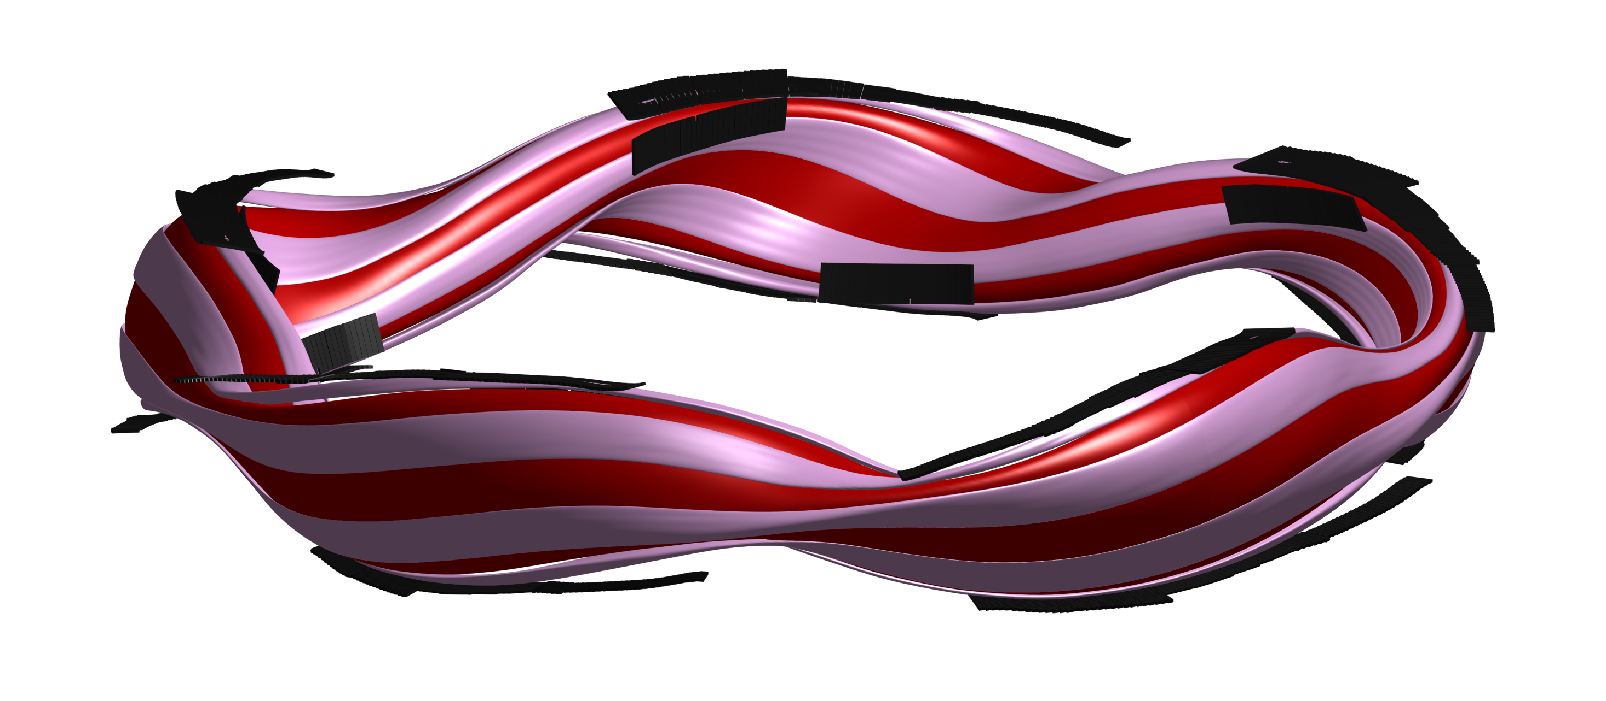
Drift effects on W7-X edge heat and particle fluxes
K. C. Hammond^{1,6}
Y. Gao², M. Jakubowski¹, C. Killer¹, H. Niemann¹, L. Rudischhauser¹, A. Ali¹, T. Andreeva¹, B. D. Blackwell³, K. J. Brunner¹, B. Cannas⁴, P. Drewelow¹, P. Drews², M. Endler¹, Y. Feng¹, J. Geiger¹, O. Grulke¹, J. Knauer¹, S. Klose¹, S. Lazerson¹, M. Otte¹, F. Pisano⁴, U. Neuner¹, A. Puig Sitjes¹, K. Rahbarnia¹, J. Schilling¹, H. Thomsen¹, G. A. Wurden⁵, and the W7-X team
¹ Max Planck Institute for Plasma Physics, Greifswald, Germany
² Forschungszentrum Jülich, Jülich, Germany
³ Australian National University, Canberra, Australia
⁴ University of Cagliari, Cagliari, Italy
⁵ Los Alamos National Laboratory, Los Alamos, NM, USA
⁶ Present affiliation: Princeton Plasma Physics Laboratory, Princeton, NJ, USA
International Stellarator and Heliotron Workshop, Madison, WI, USA
September 27, 2019

Slide 2
Motivation
It is important to understand the physics governing heat and particle exhaust in magnetic fusion devices
Drifts are known to influence heat and particle fluxes
Tokamaks: extensive observation and modeling [Stangeby and Chankin, Nucl. Fusion 1996; Rozhansky et al., Nucl. Fusion 2012; etc.]
Stellarators: effects observed (Heliotron J, W7-AS, LHD), but more difficult to model [Feng et al., PPCF 1998, Ang et al., J. Fusion Res. 2002; Grigull et al., J. Nuclear Mater. 2003; Masuzaki et al., Nucl. Mater. Energy 2019]
In this talk: first dedicated study of drifts in W7-X
Drifts cause up-down asymmetries in heat loads to targets
Results at low densities have a clear interpretation

Slide 3
Outline
The W7-X edge plasma
Magnetic topology
Expected drift flows
Drift effects on edge fluxes at low density (~ 2 × 10¹⁹ m⁻³)
Asymmetric head loads in shadowed regions of the targets
Radial offsets in strike lines
Drift effects on edge fluxes at higher density (~ 6 × 10¹⁹ m⁻³)
Non-ambipolar current flows

Slide 4
Outline
The W7-X edge plasma
Magnetic topology
Expected drift flows
Drift effects on edge fluxes at low density (~ 2 × 10¹⁹ m⁻³)
Asymmetric head loads in shadowed regions of the targets
Radial offsets in strike lines
Drift effects on edge fluxes at higher density (~ 6 × 10¹⁹ m⁻³)
Non-ambipolar current flows

Slide 5
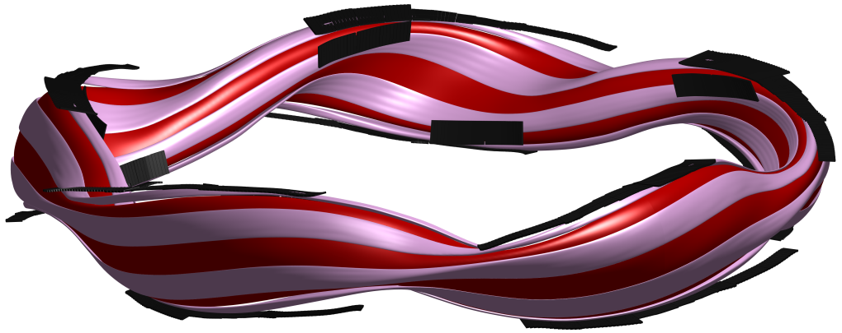
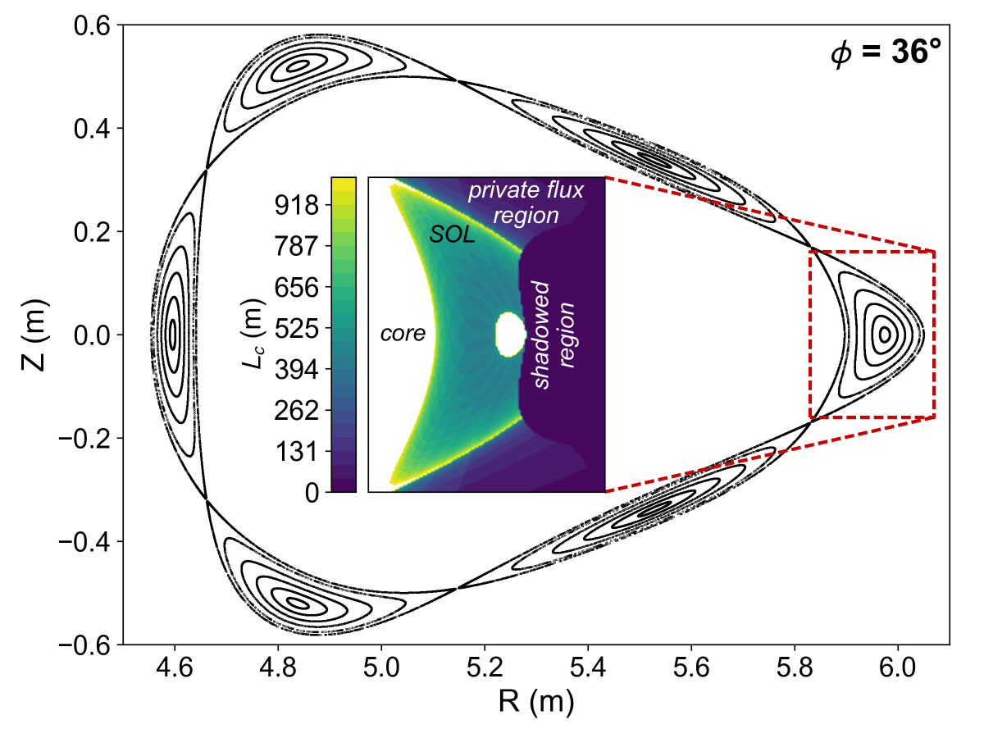
Experiments were conducted in the W7-X low-iota configuration
Island resonates with ⍳ = 5/6 → low error-field sensitivity
Long connection lengths → greater role of drifts relative to parallel flows
Good coverage of different topological regions by target diagnostics
Infrared cameras
Divertor Langmuir probes
Notes:
The experiments for the drift study were carried out in a special magnetic configuration called the “low-iota” configuration.
Here’s a rendering of the core plasma in red and the edge island structure in pink.
This configuration has a single island with rotational transform 5/6, meaning that it circles the core plasma 5 times toroidally and 6 times poloidally before biting its tail.
In this picture, you can also see the W7-X divertor, consisting of 10 identical discontinuous targets with intersect the edge island both on the upper and lower sides of the plasma.
While this configuration was not often employed in W7X experiments, it was advantageous for drift studies for a number of reasons.
First, the edge island does not resonate with the 1/1 field error, making it less vulnerable to asymmetric deformations that would otherwise convolute asymmetries resulting from drifts.
In addition, the connection lengths of the open field lines in the scrape-off layer are longer than for any other configuration tested in W7-X.
This will emphasize the importance of perpendicular drift transport over parallel transport, making drift effects easier to see.
Finally, there is good downstream diagnostic coverage of multiple topological regions of the edge in this configuration, in particular by the infrared cameras and divertor Langmuir probes.

Slide 6
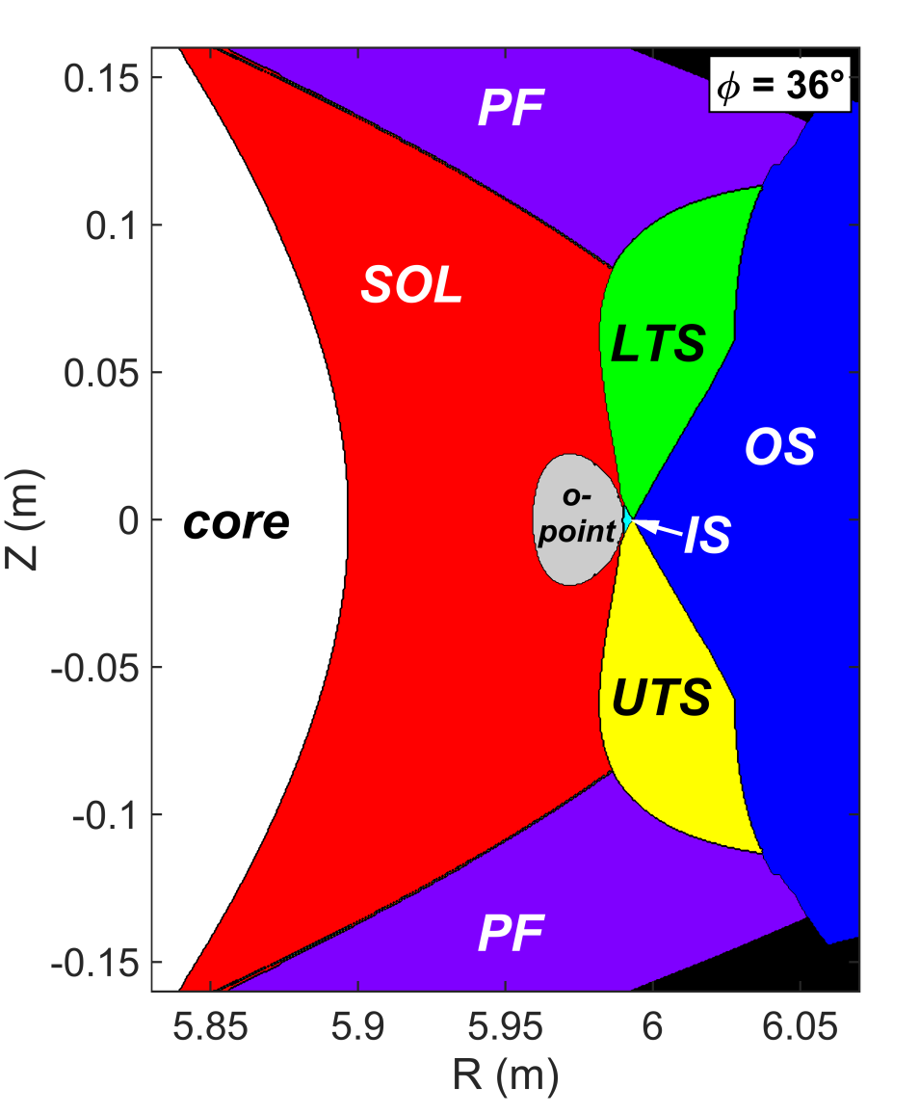
The edge magnetic field can be divided into key topological regions
Scrape-off layer (SOL)
Longest connection lengths
Direct contact with core
Private flux region
Outside island and core
Intermediate Lc
Shadowed regions
Upper-target shadow (UTS): connect upper targets
Lower-target shadow (LTS): connect lower targets
All other regions (shadowed, SOL, PFR) connect upper targets with lower targets
Notes:
The scrape-off layer is located on the side of the island that faces the core plasma.
This has the longest connection lengths and is the main channel for parallel transport from upstream to downstream (i.e., from core to targets).
Outside the island, across the separatrix, is the private flux region.
This has intermediate connection lengths, and only comes into contact with the core plasma at the x-points.
Finally, on the outward-facing side of the island, there are shadowed regions.
These are a consequence of the 3d helical island structure with discontinuous divertor targets, and have no analogue in axisymmetric tokamaks.
Here, the open field lines quickly run into targets and never get close to the core plasma.
Hence, any transport into these regions must be perpendicular.
We can subdivide the shadowed region into sections according to which targets they intersect.
The lower-target shadow only intersects lower targets.
The upper-target shadow only intersects upper targets.
The rest of the shadow, as well as the scrape off layer and private flux regions, exhibit field lines that run from an upper target to a lower target.
You may wonder why I’m dwelling on these seemingly arcane details of the edge topology, but they will come in handy later on!

Slide 7
Radial electric fields E_{r} would give rise to up-down asymmetric poloidal E × B flows v_{𝞱}
Tokamak
Lower single null configuration
Stellarator
W7-X low-iota configuration
upper target
private flux region
Z
shadow
SOL
E_{r}
v_{θ}
(φ = φ ₀)
v_{θ}
×
R
core
×
B
E_{r}
B
core
Z
B
(φ = φ ₀)
scrape-off layer
core
×
Z
R
E_{r}
(φ = -φ ₀)
v_{θ}
shadow
E_{r}
v_{θ}
R
SOL
private flux region
private flux region
lower target
inner target
outer target
Notes:
Shifting gears a bit, I’d like to describe one of the drift flow patterns that we might expect to see in the edge plasma.
This is called poloidal ExB flow due to radial electric fields in the edge plasma.
To explain how this works, it’s instructive to start with the simpler case of a lower-single-null tokamak configuration.
Here are the three basic topological regions – the core, the scrape-off layer, and the private flux region.
Due to a fall-off of temperature as you move away from the separatrix, radial electric fields will tend to form that point away from the separatrix both above and below the x-point.
This will give rise to a poloidal drift flow that goes counterclockwise around the core plasma.
Hence, the drift flow goes from outer targets to inner targets in the scrape-off layer, and from inner targets to outer targets in the private flux region.
This type of flow pattern has been well-established in tokamaks in both modeling and observation.
Now, what happens when we apply these flow patterns to the island divertor geometry in W7-X?
Here’s a schematic of an upper and lower divertor target for the low-iota configuration.
We see the same three basic topological regions as in the tokamak – the core, the scrape-off layer inside the island, and the private flux region outside the island.
Note the addition of the shadowed region intersecting part of the target, which has no equivalent in the axisymmetric tokamak.
The radial electric fields would point away from the core plasma and the island separatrix.
This gives rise to drift flow that goes clockwise in the island and anti-parallel in the private flux region.
Note that the flow in the scrape-off layer goes away from the upper target and toward the lower target, illustrating how the drift flow pattern introduces up-down asymmetry into a configuration that is geometrically up-down symmetric.

Slide 8
Outline
The W7-X edge plasma
Magnetic topology
Expected drift flows
Drift effects on edge fluxes at low density (~ 2 × 10¹⁹ m⁻³)
Asymmetric head loads in shadowed regions of the targets
Radial offsets in strike lines
Drift effects on edge fluxes at higher density (~ 6 × 10¹⁹ m⁻³)
Non-ambipolar current flows

Slide 9
Infrared cameras provide a view of heat flux distributions across all targets
Notes:
I’ll start by showing the results from one of our main diagnostic tools for assessing the asymmetry, the infrared cameras.
Here we see measurements of the power flux distribution across an upper and lower target, as viewed by the cameras.
In the plots, the targets are contorted into a 2D grid of toroidal angle and major radius.
At first glance, the upper and lower targets have roughly similar distributions: a long, thin strike line extending mostly in the toroidal direction.

Slide 10
Heat flux distributions on the targets are up-down asymmetric
Notes:
However, upon closer inspection, there are some differences between the upper and lower distributions.
I’ll start by calling your attention to the left of the dashed line in each plot.
On the lower target, there’s a fairly wide patch of deposition with intermediate intensity.
On the upper target, the deposition here is narrow and a bit outboard, mostly above this “x” marker.

Slide 11
Up-down asymmetric features “switch places” in response to magnetic field reversal
Notes:
Now what makes this especially interesting is what happens to this asymmetry when we reverse the direction of the magnetic field.
Here are the distributions on the upper and lower targets with the magnetic field reversed, but other plasma parameters the same.
Focusing still on the left-hand side of the dashed line, we see that the upper and lower targets have essentially switched places.
Now the lower target has a thin streak above the x-mark, and the upper target has a thick patch below the x mark.

Slide 12
Asymmetric loads in shadowed regions are consistent with poloidal E × B drift flow patterns
Forward field
Reversed field
Notes:
Now, I will argue that this up-down asymmetry is consistent with those poloidal ExB drift flow patterns that I described earlier.
To explain why, first look at the footprints on the targets of the topological regions of the edge plasma from an earlier slide.
We have the scrape-off layer in red, private flux region in purple, lower-target shadow in green on the lower target, and upper-target shadow in yellow on the upper target.
Recall that in a forward magnetic field, the drift flow is clockwise around the island in the scrape-off layer.
This means that it flows from the scrape-off layer into the lower target shadow.
Note that the footprint of the lower-target shadow is adjacent to the footprint of the scrape-off layer below the x-mark, which is where we see that patch of deposition on the lower target in forward field.
Similarly, in reversed field, the drift flow goes counterclockwise in the scrape-off layer, and some gets deposited into the upper-target shadow.
The upper target shadow’s footprint similarly borders the scrape-off layer footprint below the x-mark on the upper target, in agreement with the existence of the wide deposition patch there in reversed field.

Slide 13
Strike line positions exhibited a radial offset between upper and lower targets
Offset of ~ 3 cm reversed with field reversal
Offset also visible in particle fluxes
T_{e} peak near island separatrix creates conditions for radial flow
Notes:
We see further evidence in support of these flow patterns by looking profiles of the main strike line, where the heat flux is at its maximum.
Here are plots of power flux across nine of the targets in the cross-section indicated by the dotted line here.
The upper-target profiles in blue shades, and the lower target profiles are in red shades.
Note that there’s a systematic offset of the peak location of about 3 cm between upper and lower targets.
This offset notably reverses when you reverse the field.
We see a similar offset in the particle flux to the targets, indicated by the ion saturation current density to the Langmuir probes.
Another think that we see from the Langmuir probe results is that the electron temperature is sharply peaked on the border between the footprint of the scrape-off layer and the private flux region, indicated by the vertical dashed line to the left.
This indicates the presence of temperature gradients falling off on both sides of the island separatrix, with is an underlying assumption of the poloidal drift flow patterns.

Slide 14
Up-down radial offset in strike line is also consistent with poloidal E × B flow patterns
Forward field:
SOL flow ⟶ lower target
PFR flow ⟶ upper target
Reversed field:
SOL flow ⟶ lower target
PFR flow ⟶ upper target
Notes:
Now, why is this offset consistent with poloidal drift flows?
Let’s look back at the diagram of the flow directions.
In forward field, the drift flow in the scrape-off layer goes toward the lower target, and in the private flux region it goes toward the upper target.
This is consistent with the peak in the footprint of the scrape-off layer, left of the dashed line, for the lower targets; and in the footprint of the private flux region, right of the dashed line, on the upper targets.
Under reversed field, the poloidal drift flow reverses direction, and the opposite orientation is both expected and observed.

Slide 15
Outline
The W7-X edge plasma
Magnetic topology
Expected drift flows
Drift effects on edge fluxes at low density (~ 2 × 10¹⁹ m⁻³)
Asymmetric head loads in shadowed regions of the targets
Radial offsets in strike lines
Drift effects on edge fluxes at higher density (~ 6 × 10¹⁹ m⁻³)
Non-ambipolar current flows
Notes:
So overall, I would argue that the interpretation in these lower-density plasmas is fairly clear.
By studying the locations of the asymmetric features in target fluxes relative to the footprints of the different topological regions, we can conclude that the poloidal ExB drift flow prominent.
At higher densities, on the other hand, the outcome is more difficult to interpret, at least so far.
Nonetheless, the results were quite interesting, so I will go through them briefly.

Slide 16
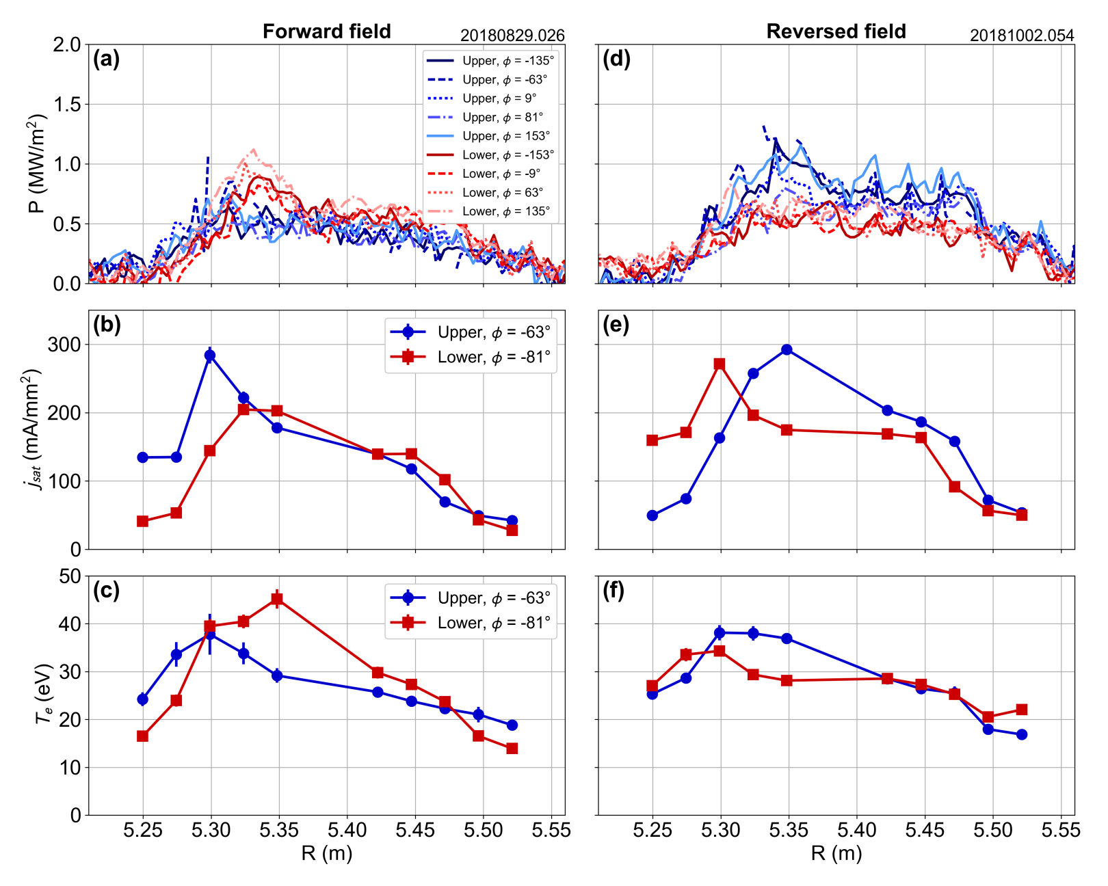
Heat and particle flux distributions changed substantially as plasma density increased
Heat flux
Lower peak values
Peaked at lower radii
Wider distributions
Particle flux
Peaked at lower radii
Higher particle flux
Lower temperatures
Reasons for changes not yet understood
Notes:
In terms of the heat flux profiles at higher density, we found that the overall values were lower by more than a factor of two.
The profiles were more spread out, and the peak values were radially inward relative to low density.
The up-down asymmetry isn’t very noticeable in the power flux, although you can see some in the particle flux in the peaking at the inner radii, which reverses on field reversal.
The electron temperatures are lower and not so sharply peaked as well.
The reasons for these changes at higher density are not yet understood. They are likely due to a combination of multiple drift flows, as well as changes in the edge topology due to beta effects.

Slide 17
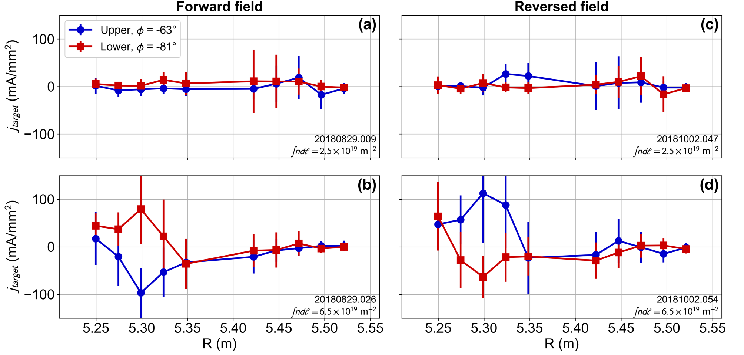
Non-ambipolar current flows to targets appears to be a drift-based effect
Currents only significant in higher-density plasmas
Up-down asymmetry reversed with field reversal
Low density (~ 2 × 10¹⁹ m⁻³)
Low density (~ 2 × 10¹⁹ m⁻³)
Higher density (~ 2 × 10¹⁹ m⁻³)
Higher density (~ 2 × 10¹⁹ m⁻³)
Notes:
Another interesting effect we observed at higher density was the appearance of nonambipolar current flows to the targets.
As you can see from these profiles from the Langmuir probes, there wasn’t much current observed at low density, even where density and temperature were sharply peaked.
But at higher density, there are substantial currents, and the sign of the current is different for upper and lower targets.
Furthermore, this sign reverses along with field reversal, indicating that it is likely driven by drift flows.
Drift-induced currents in the scrape-off layer have been studied a lot in tokamaks, and it seems like they play a role in this configuration as well.

Slide 18
Conclusions
Drift effects drive asymmetry in the W7-X low-iota configuration
Heat and particle flux patterns on upper and lower targets “switched places” in response to field reversal
Fluxes at low density are consistent with poloidal E × B flows
Asymmetric deposition in shadowed regions
Radial up-down offsets in strike lines
Supported through comparison of flux patterns with topological footprints
Flux patterns change substantially as density increases
Causes not fully understood – likely a combination of drift and beta effects
Motivation for development of 3D edge models with drift effects

Slide 19
Drift effects on W7-X edge heat and particle fluxes
K. C. Hammond^{1,6}
Y. Gao², M. Jakubowski¹, C. Killer¹, H. Niemann¹, L. Rudischhauser¹, A. Ali¹, T. Andreeva¹, B. D. Blackwell³, K. J. Brunner¹, B. Cannas⁴, P. Drewelow¹, P. Drews², M. Endler¹, Y. Feng¹, J. Geiger¹, O. Grulke¹, J. Knauer¹, S. Klose¹, S. Lazerson¹, M. Otte¹, F. Pisano⁴, U. Neuner¹, A. Puig Sitjes¹, K. Rahbarnia¹, J. Schilling¹, H. Thomsen¹, G. A. Wurden⁵, and the W7-X team
¹ Max Planck Institute for Plasma Physics, Greifswald, Germany
² Forschungszentrum Jülich, Jülich, Germany
³ Australian National University, Canberra, Australia
⁴ University of Cagliari, Cagliari, Italy
⁵ Los Alamos National Laboratory, Los Alamos, NM, USA
⁶ Present affiliation: Princeton Plasma Physics Laboratory, Princeton, NJ, USA
International Stellarator and Heliotron Workshop, Madison, WI, USA
September 27, 2019

Slide 20
Supplement: radial E × B drift flow patterns due to poloidal electric fields
upper target
private flux region
shadow
E_{θ}
Z
SOL
v_{r}
(φ = φ ₀)
core
×
R
B
core
B
×
Z
(φ = -φ ₀)
SOL
R
shadow
E_{θ}
v_{r}
private flux region
lower target

Slide 21
Supplement: discharges in forward and reversed field exhibited essentially the same global parameters
…despite occurring 5 weeks apart in the experiment campaign
Most profile comparisons done at t = ~ 1.1 s

Slide 22
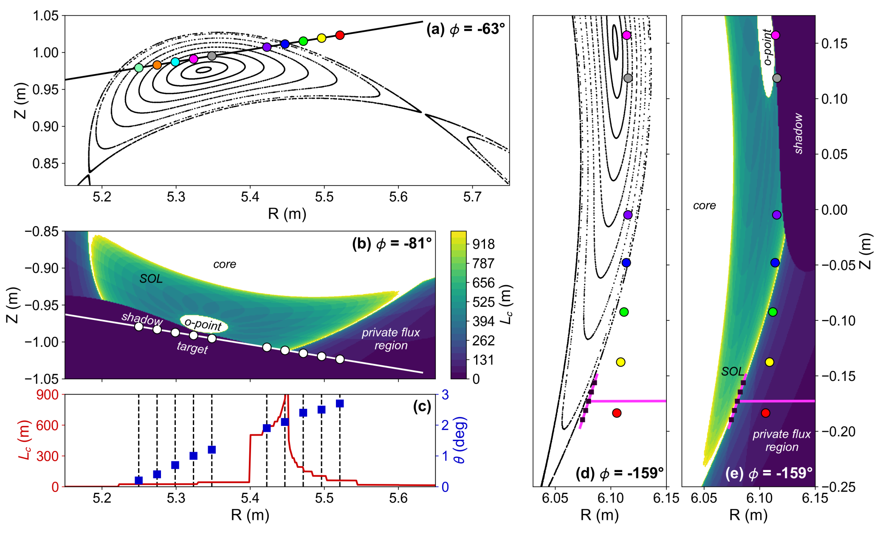
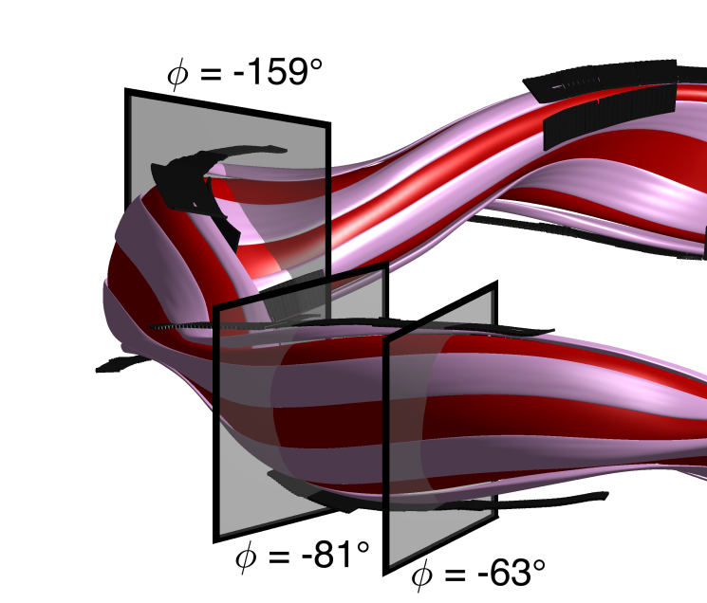
Supplement: diagnostic coverage of the different topological regions
Upper target Langmuir probes
Lower target Langmuir probes
Multi-purpose manipulator (profiles of poloidal velocity)

Slide 23
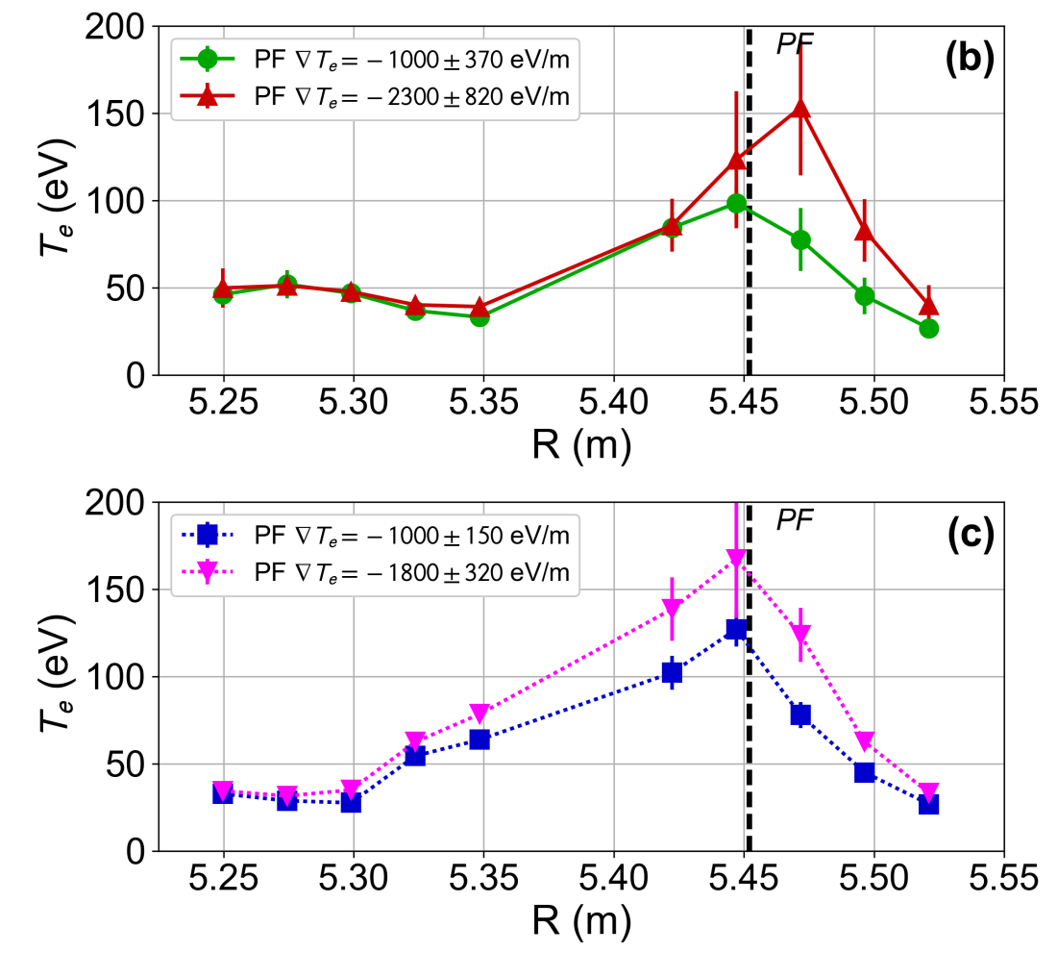
Supplement: v_{𝞱} profiles in PF region are consistent with poloidal drift flow patterns (at low density)
Sign of velocity in PF region as expected for both field directions
Magnitude of velocity tends to increase with T_{e} gradient in PF region

Slide 24
Supplement: comparison of v_{𝞱}, v∥ in PF region indicate decisive role of drift flow at low density
Drift flow can in principle determine the upstream-downstream transit time
Although v_{𝝷} < v∥, r_{island}/v_{𝞱} (~ 0.01 ms) ≪ L_{c}/v∥ (~ 1 ms)

Slide 25
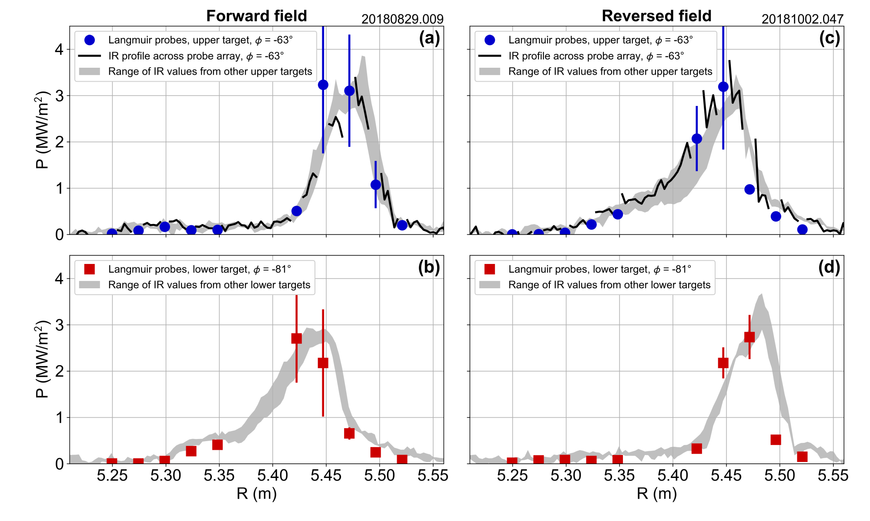
Supplement: Langmuir measurements agree with IR with consistent heat transmission factor
Low-density case:
P = 𝞭 j_{sat}T_{e} sin𝞱
𝞭 = 4 assumed at all positions

Slide 26
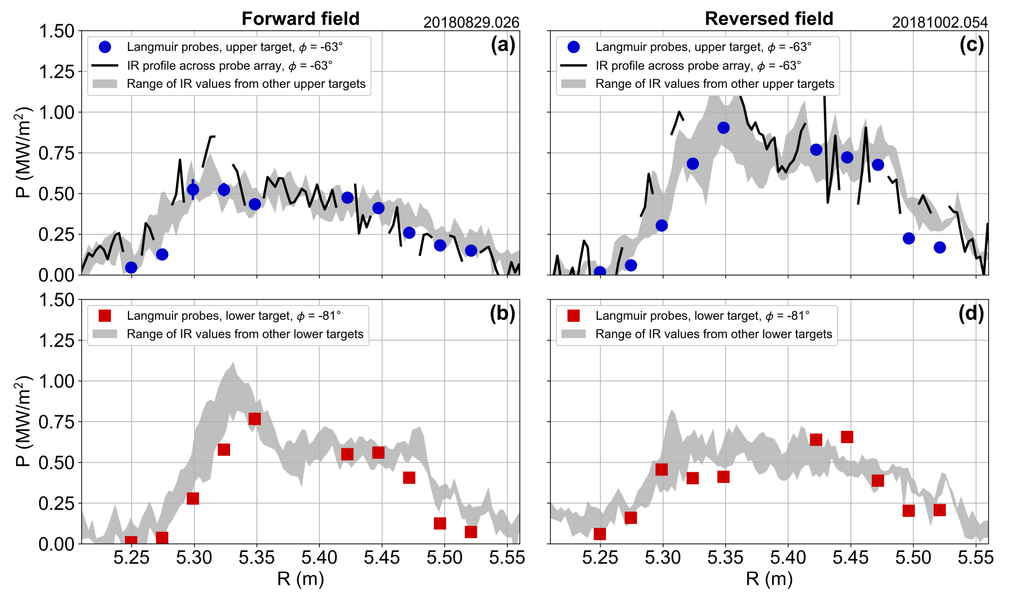
Supplement: Langmuir measurements agree with IR with consistent heat transmission factor
High-density case:
P = 𝞭 j_{sat}T_{e} sin𝞱
𝞭 = 4 assumed at all positions
Same value of 𝞭 produces agreement across plasma parameter regimes

