Slide 1

Integrated modeling and predict-first experiments
of perturbative cold pulses in tokamak plasmas
Pablo Rodriguez-Fernandez*
A.E. White¹, N.T. Howard¹, X. Yuan², B.A. Grierson², G.M. Staebler³, J.E. Rice¹, L. Zeng⁴, M.E. Austin⁵,
N.M. Cao¹, A.J. Creely¹, M.J. Greenwald¹, A.E. Hubbard¹, J.W. Hughes¹, J.H. Irby¹, O. Meneghini³,
T. Odstrcil¹, T. L. Rhodes⁴, F. Sciortino¹, K. Thome³, C. Angioni⁶, E. Fable⁶
¹MIT-PSFC, ²PPPL, ³GA, ⁴UCLA, ⁵UT-Austin, ⁶MP-IPP
*pablorf@mit.edu
PPPL Magnetic Fusion Science Meeting
Princeton (NJ), September 9th 2019
Work supported by US DoE under grants DE-FC02-99ER54512,
DE-FC02-04ER54698, DE-SC0014264 and DE-SC0017381 and La Caixa Fellowship
Notes:
Presentation time: 25-30min slot

Slide 2
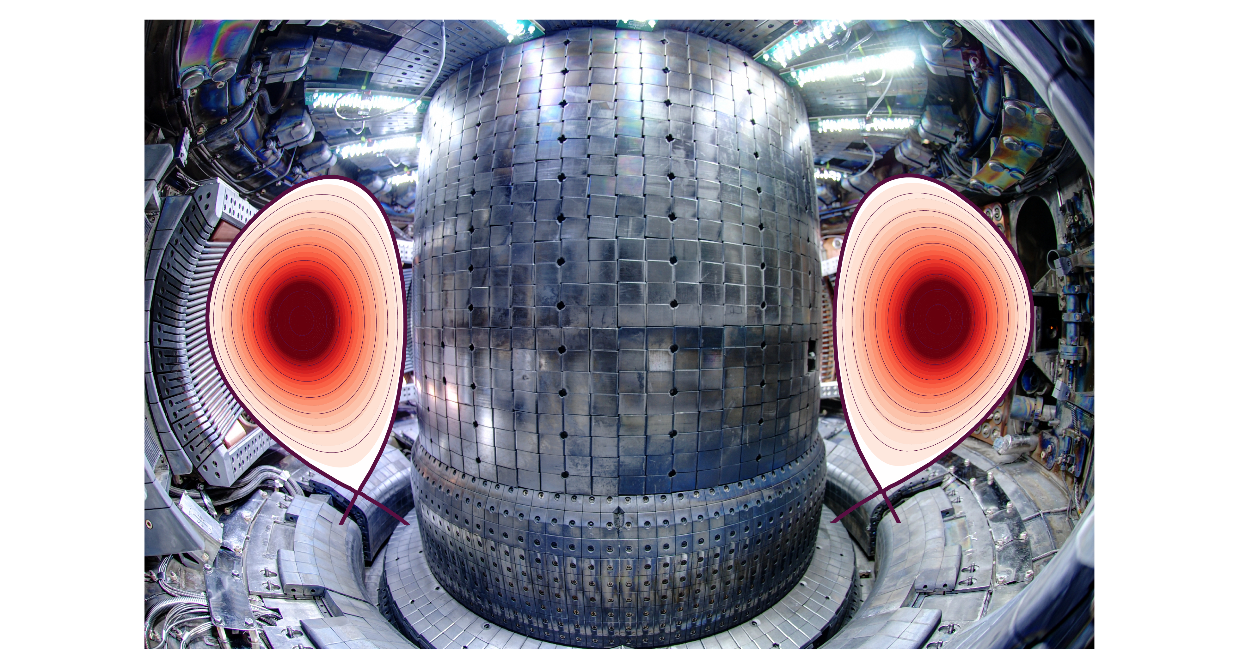
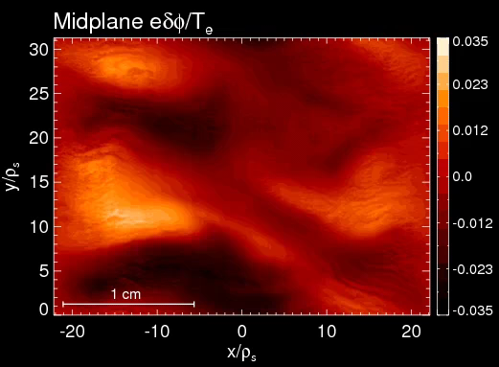
  Core transport determines plasma density and temperature profiles, critical for fusion power
Turbulent transport is the dominant heat exhaust mechanism in the core of tokamak plasmas.
Nonlinear gyrokinetics as “gold standard” to describe turbulent transport, but too expensive to predict profiles.
Courtesy of N.T. Howard

Slide 3
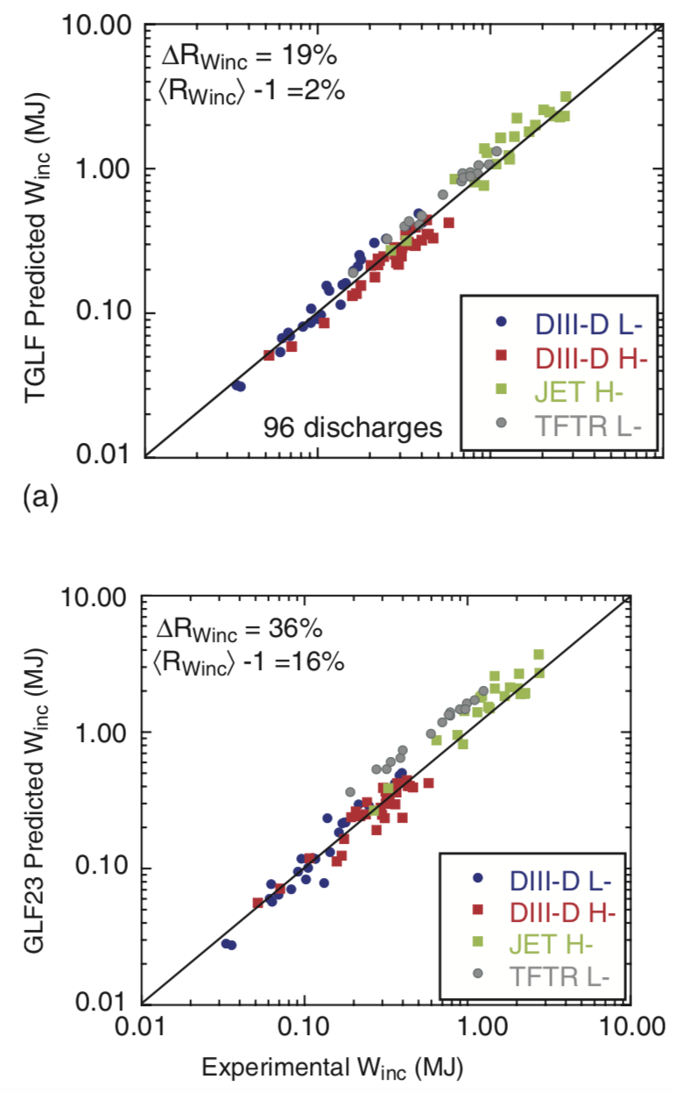
  Core transport determines plasma density and temperature profiles, critical for fusion power
Turbulent transport is the dominant heat exhaust mechanism in the core of tokamak plasmas.
Nonlinear gyrokinetics as “gold standard” to describe turbulent transport, but too expensive to predict profiles.
J.E. Kinsey et al Phys. Plasmas 2008
Theory-based reduced models like TGLF are developed based on gyrokinetic simulations.

Slide 4
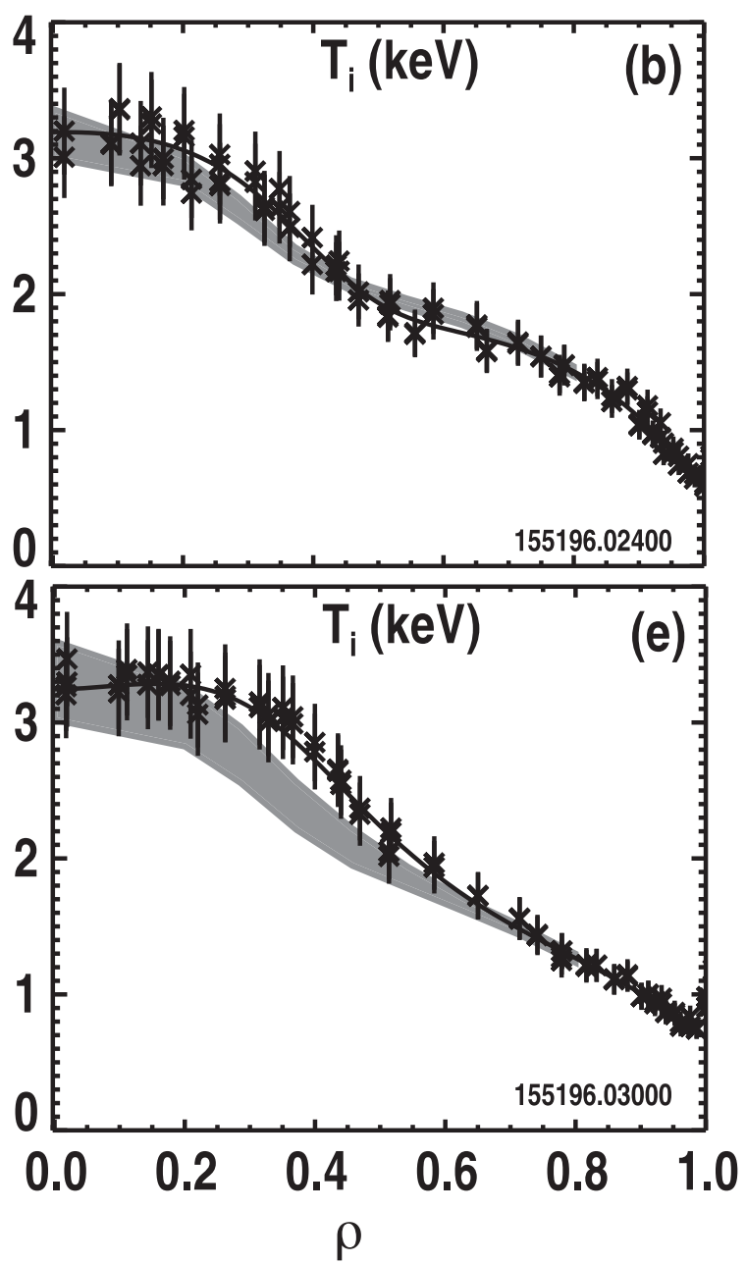
  Core transport determines plasma density and temperature profiles, critical for fusion power
Turbulent transport is the dominant heat exhaust mechanism in the core of tokamak plasmas.
Nonlinear gyrokinetics as “gold standard” to describe turbulent transport, but too expensive to predict profiles.
DIII-D
Experiment
Simulation
Theory-based reduced models like TGLF are developed based on gyrokinetic simulations.
Worldwide efforts are dedicated to validate predictions of transport and kinetic profiles in current machines.
B.A. Grierson et al Phys. Plasmas 2018

Slide 5
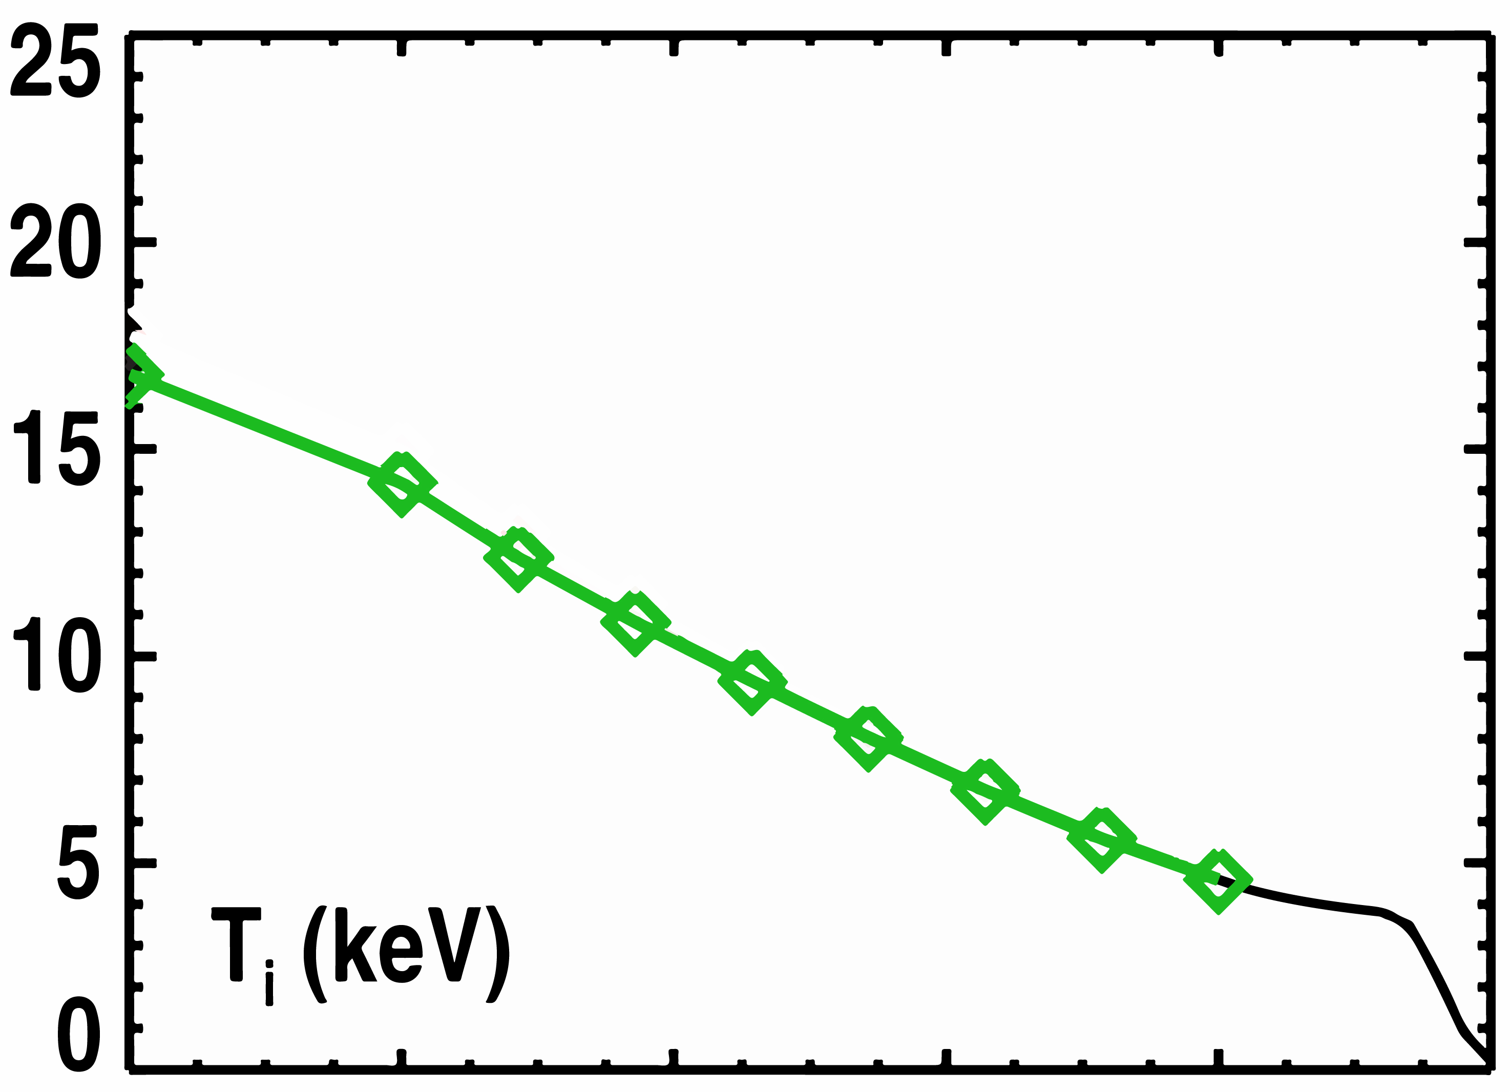
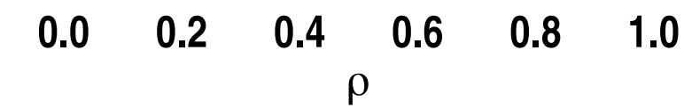
  Core transport determines plasma density and temperature profiles, critical for fusion power
Turbulent transport is the dominant heat exhaust mechanism in the core of tokamak plasmas.
Nonlinear gyrokinetics as “gold standard” to describe turbulent transport, but too expensive to predict profiles.
DIII-D
Experiment
Simulation
Theory-based reduced models like TGLF are developed based on gyrokinetic simulations.
Worldwide efforts are dedicated to validate predictions of transport and kinetic profiles in current machines.
Reduced models are being used to predict ITER.
TGLF
ITER
B.A. Grierson et al Phys. Plasmas 2018

Slide 6
  Core transport determines plasma density and temperature profiles, critical for fusion power
Turbulent transport is the dominant heat exhaust mechanism in the core of tokamak plasmas.
Nonlinear gyrokinetics as “gold standard” to describe turbulent transport, but too expensive to predict profiles.
DIII-D
Experiment
However, some experiments call the fundamental assumptions
of these models into question…
Simulation
Theory-based reduced models like TGLF are developed based on gyrokinetic simulations.
Worldwide efforts are dedicated to validate predictions of transport and kinetic profiles in current machines.
Reduced models are being used to predict ITER.
TGLF
ITER
B.A. Grierson et al Phys. Plasmas 2018

Slide 7
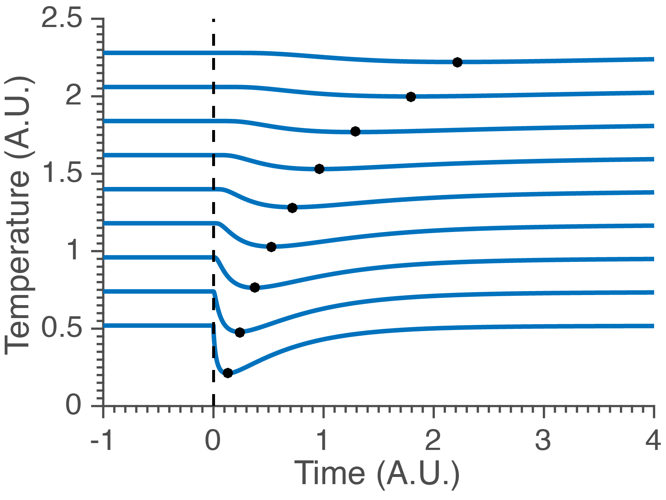

  Transient transport can be tested as an edge
  cold pulse travels to plasma core
In cold-pulse experiments,
edge temperature drops and transient transport is studied as perturbation travels to core.
Expected response from local transport physics (modeled by diffusion):
    Delay in time
    Decreasing in amplitude.
CARTOON
CORE
$$\vec{q}=−n χ ∇T$$
EDGE

Slide 8
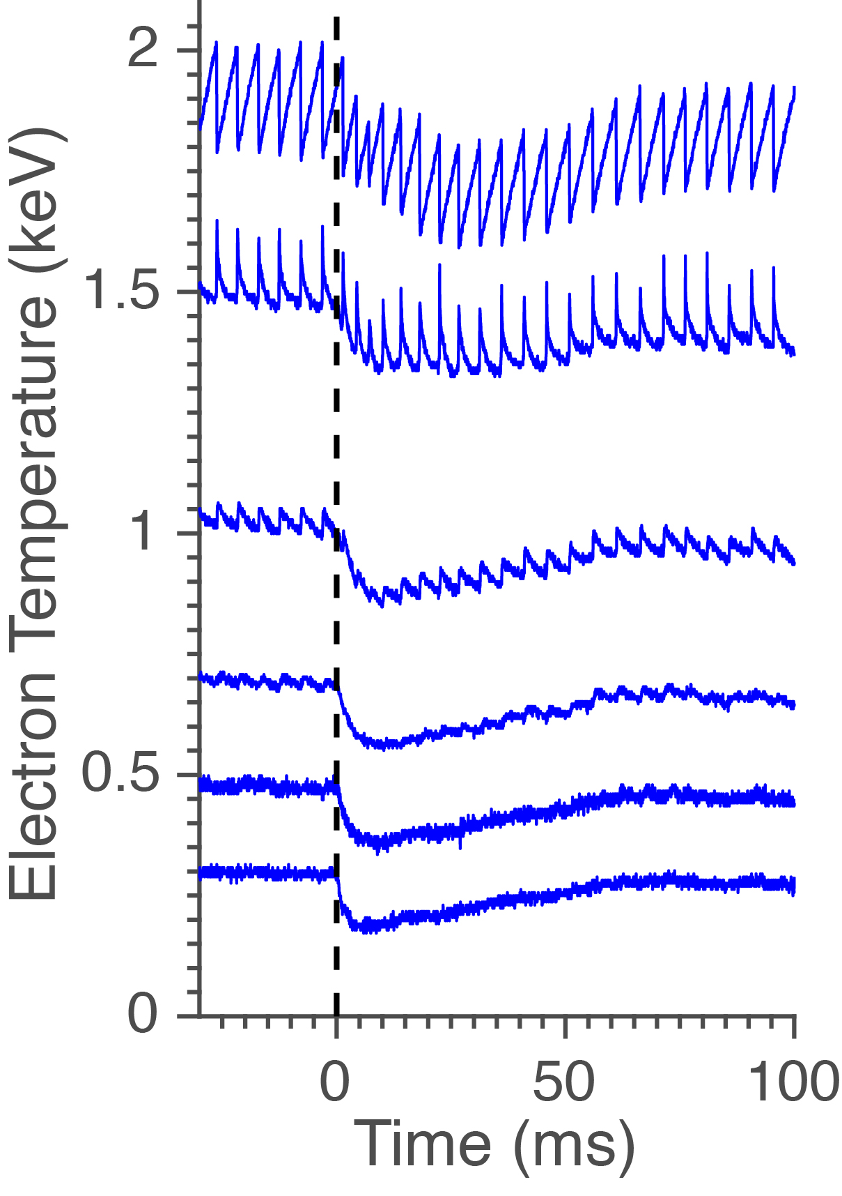
  Transient transport can be tested as an edge
  cold pulse travels to plasma core
Alcator C-Mod
In cold-pulse experiments,
edge temperature drops and transient transport is studied as perturbation travels to core.
Expected response from local transport physics (modeled by diffusion):
    Delay in time
    Decreasing in amplitude.
CORE
EDGE

Slide 9
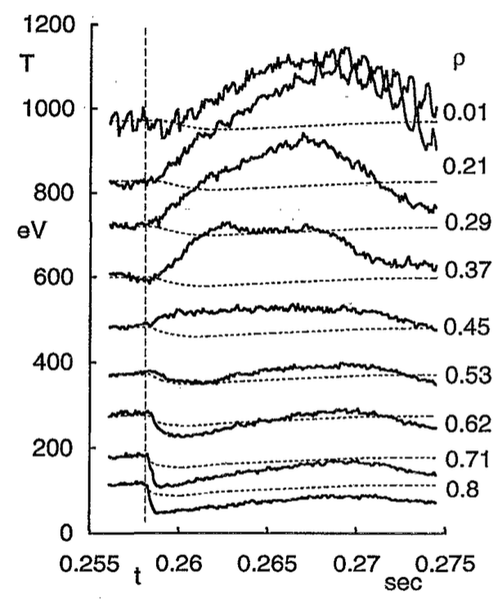
  Cold-pulse experiment is a classical example of the
  so-called “nonlocal” transport
At low collisionality, core temperature rapidly rises after edge cold-pulse injection.
Cold-pulse experiments show counter-example to diffusive, local transport.
Past work referred to these phenomena as “non-local” transport events.
CORE
EDGE
K.W. Gentle et al Phys. Rev. Lett. 1995

Slide 10
  Temperature inversions following edge cold pulses have been
  observed in many machines around the world
1995
2000
2005
2010
2015

Slide 11
  Temperature inversions following edge cold pulses have been
  observed in many machines around the world
1995
2000
2005
2010
2015
TEXT (US)
K.W. Gentle et al Phys. Rev. Lett. 1995

Slide 12
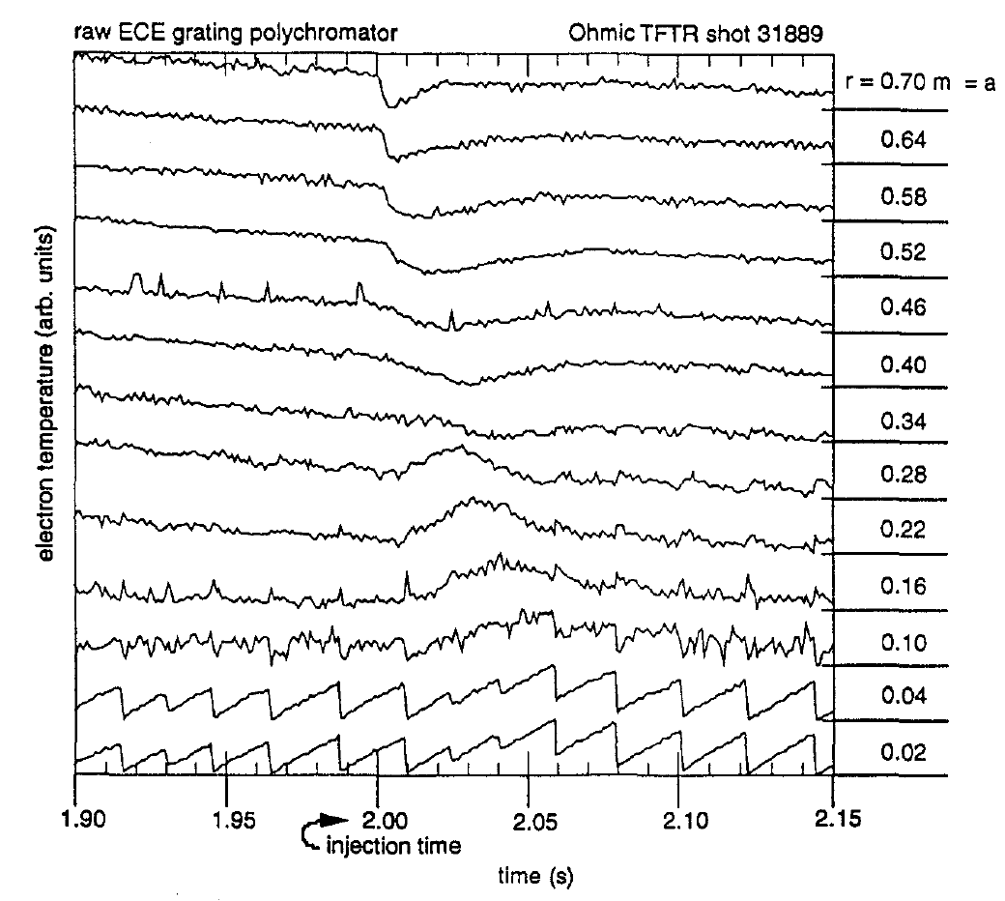
  Temperature inversions following edge cold pulses have been
  observed in many machines around the world
1995
2000
2005
2010
2015
TFTR (US)
TEXT (US)
M.W. Kissick et al Nucl. Fusion 1996

Slide 13
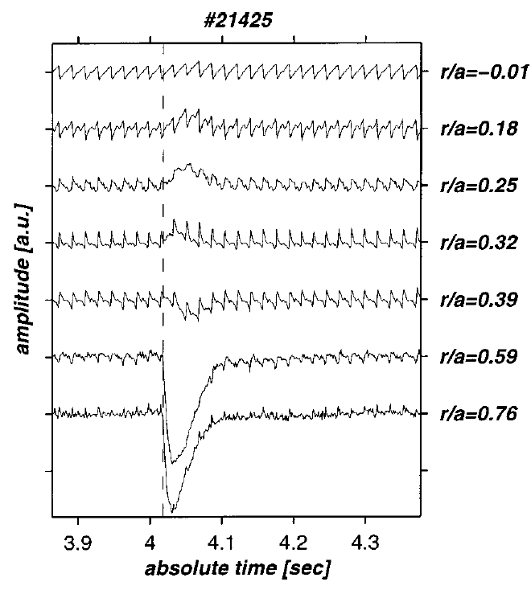
  Temperature inversions following edge cold pulses have been
  observed in many machines around the world
1995
2000
2005
2010
2015
Tore Supra (France)
TFTR (US)
TEXT (US)
T.D. de Wit et al Phys. Plasmas. 1998

Slide 14
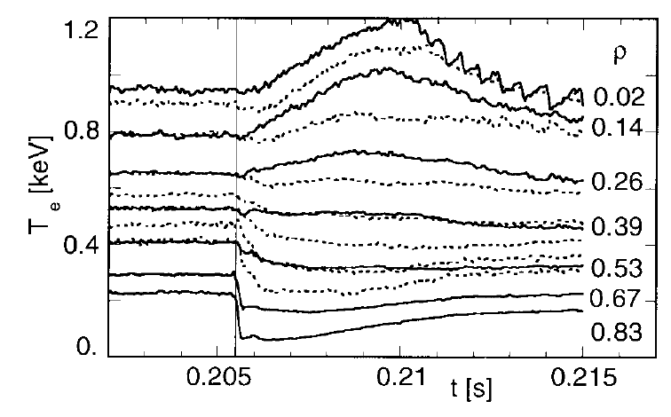
  Temperature inversions following edge cold pulses have been
  observed in many machines around the world
1995
2000
2005
2010
2015
RTP (Netherlands)
Tore Supra (France)
TFTR (US)
TEXT (US)
P. Mantica et al Phys. Rev. Lett. 1999

Slide 15
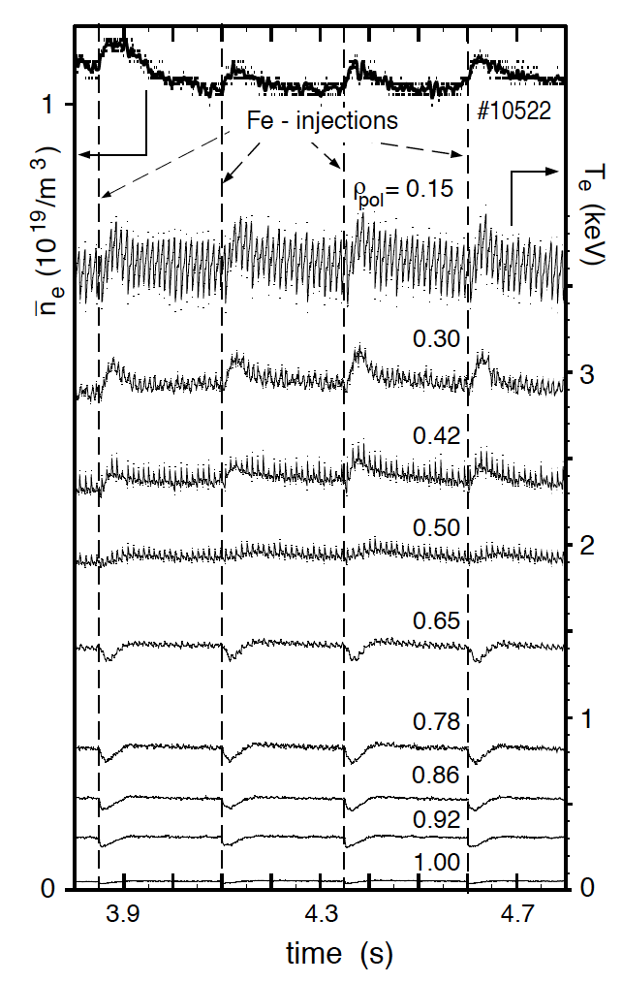
  Temperature inversions following edge cold pulses have been
  observed in many machines around the world
1995
2000
2005
2010
2015
ASDEX Upgrade (Germany)
RTP (Netherlands)
Tore Supra (France)
TFTR (US)
TEXT (US)
F. Ryter et al Nucl. Fusion 2000

Slide 16
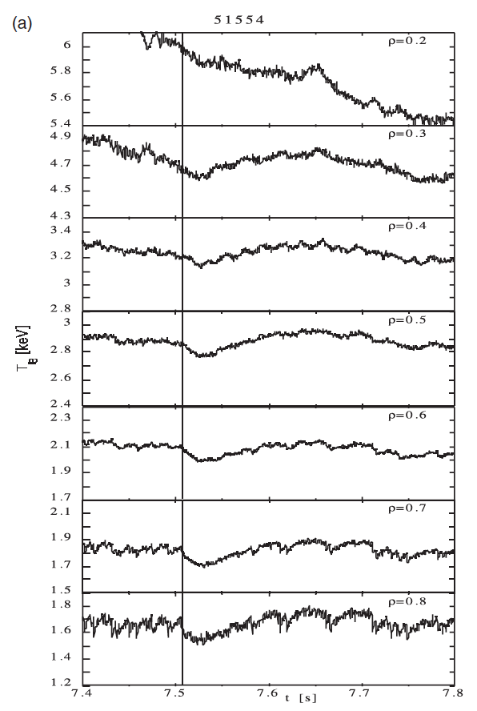
  Temperature inversions following edge cold pulses have been
  observed in many machines around the world
1995
2000
2005
2010
2015
JET (UK)
ASDEX Upgrade (Germany)
RTP (Netherlands)
Tore Supra (France)
TFTR (US)
TEXT (US)
P. Mantica et al Pl Phys. Control Fusion. 2002

Slide 17
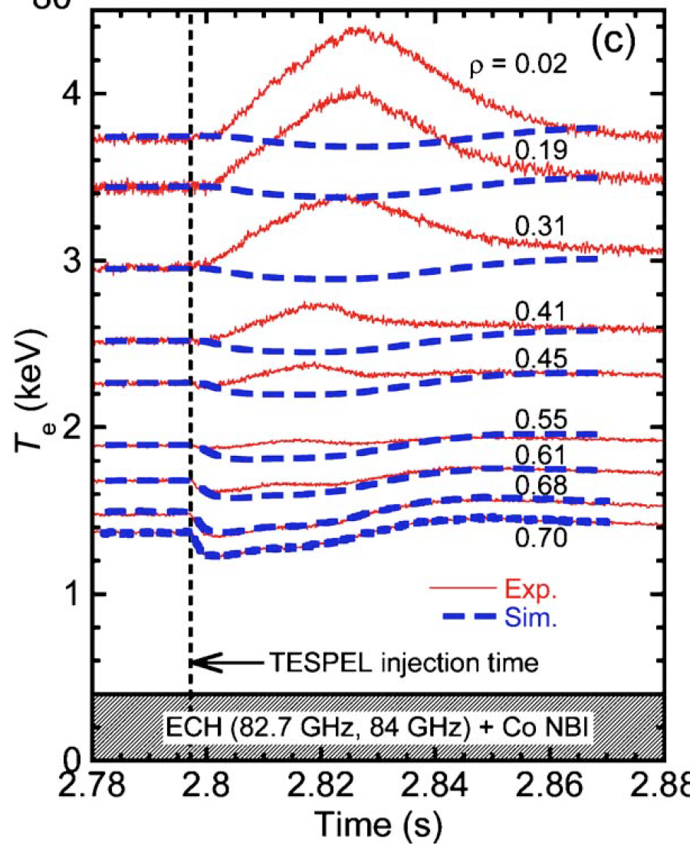
  Temperature inversions following edge cold pulses have been
  observed in many machines around the world
1995
2000
2005
2010
2015
LHD (Japan)
JET (UK)
ASDEX Upgrade (Germany)
RTP (Netherlands)
Tore Supra (France)
TFTR (US)
TEXT (US)
N. Tamura et al Phys. Plasmas 2005

Slide 18
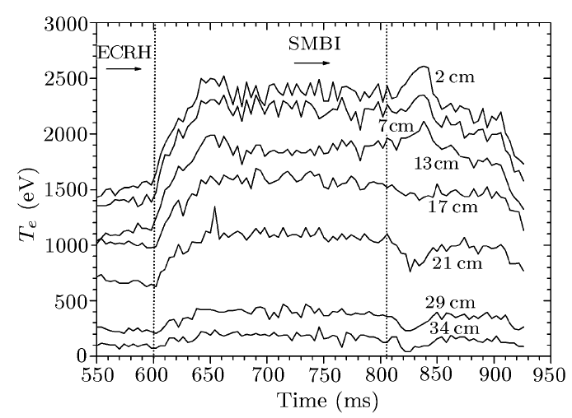
  Temperature inversions following edge cold pulses have been
  observed in many machines around the world
1995
2000
2005
2010
2015
HL-2A (China)
LHD (Japan)
JET (UK)
ASDEX Upgrade (Germany)
RTP (Netherlands)
Tore Supra (France)
TFTR (US)
TEXT (US)
H.-J. Sun et al Chin. Phys. Lett. 2007

Slide 19
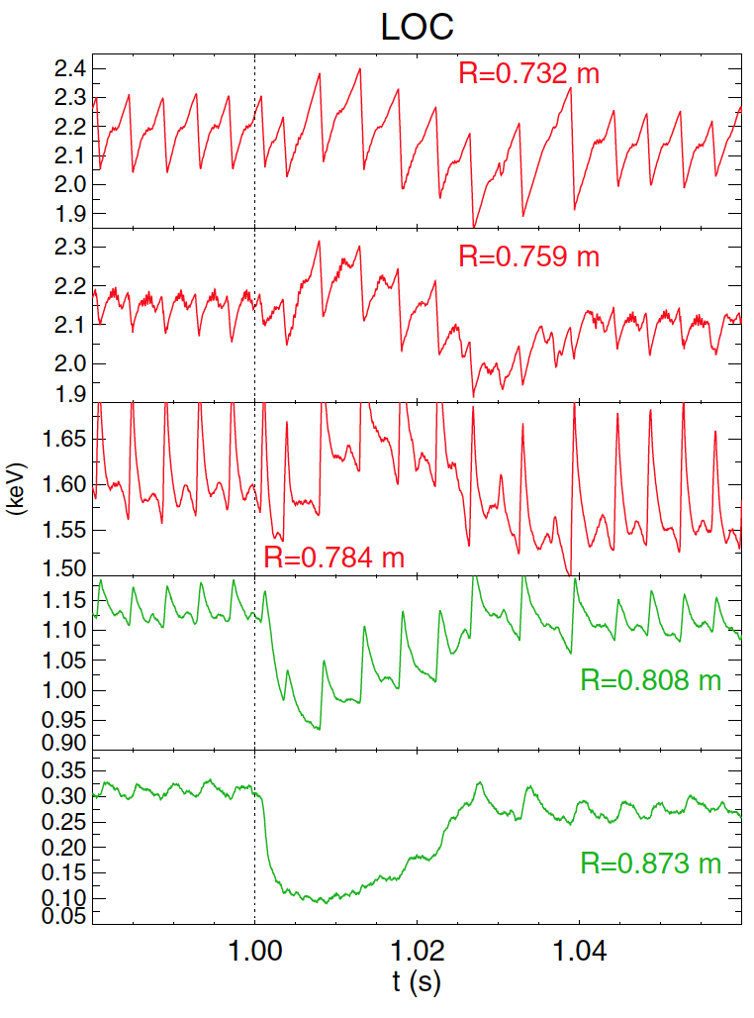
  Temperature inversions following edge cold pulses have been
  observed in many machines around the world
1995
2000
2005
2010
2015
Alcator C-Mod (US)
HL-2A (China)
LHD (Japan)
JET (UK)
ASDEX Upgrade (Germany)
RTP (Netherlands)
Tore Supra (France)
TFTR (US)
TEXT (US)
J.E. Rice et al Nucl. Fusion 2013

Slide 20
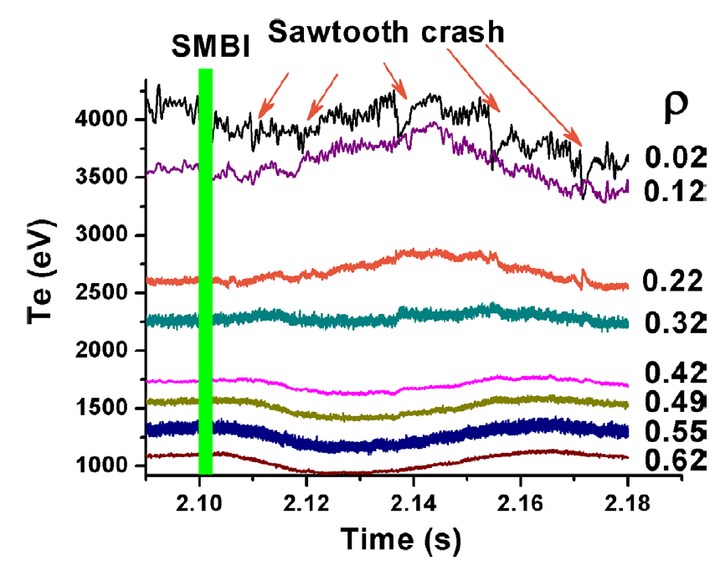
  Temperature inversions following edge cold pulses have been
  observed in many machines around the world
1995
2000
2005
2010
2015
KSTAR (Korea)
Alcator C-Mod (US)
HL-2A (China)
LHD (Japan)
JET (UK)
ASDEX Upgrade (Germany)
RTP (Netherlands)
Tore Supra (France)
TFTR (US)
TEXT (US)
Y.J. Shi et al Nucl. Fusion 2017

Slide 21
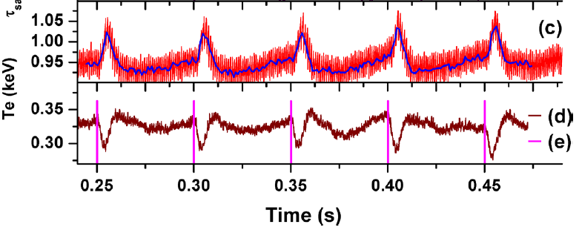
  Temperature inversions following edge cold pulses have been
  observed in many machines around the world
1995
2000
2005
2010
2015
J-TEXT (China)
KSTAR (Korea)
Alcator C-Mod (US)
HL-2A (China)
LHD (Japan)
JET (UK)
ASDEX Upgrade (Germany)
RTP (Netherlands)
Tore Supra (France)
TFTR (US)
TEXT (US)
Y.J. Shi et al Nucl. Fusion 2018

Slide 22
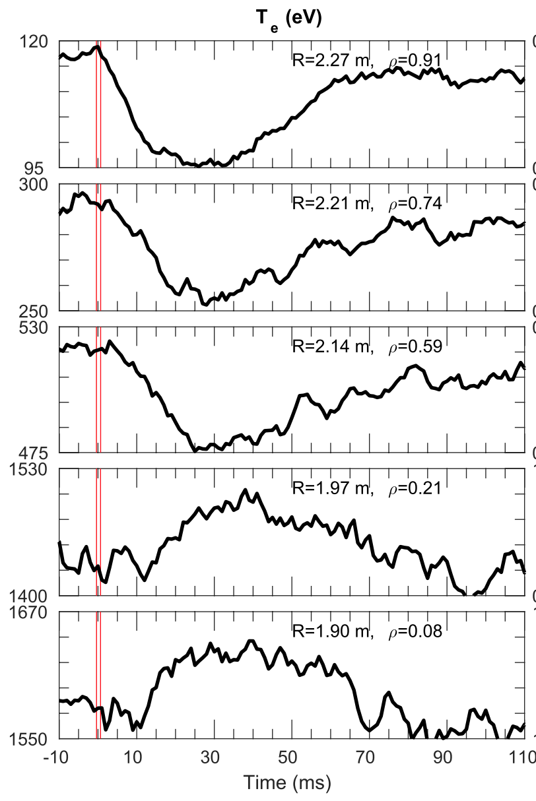
  Temperature inversions following edge cold pulses have been
  observed in many machines around the world
1995
2000
2005
2010
2015
EAST (China)
J-TEXT (China)
KSTAR (Korea)
Alcator C-Mod (US)
HL-2A (China)
LHD (Japan)
JET (UK)
ASDEX Upgrade (Germany)
RTP (Netherlands)
Tore Supra (France)
TFTR (US)
TEXT (US)
Y. Liu et al Nucl. Fusion 2019

Slide 23
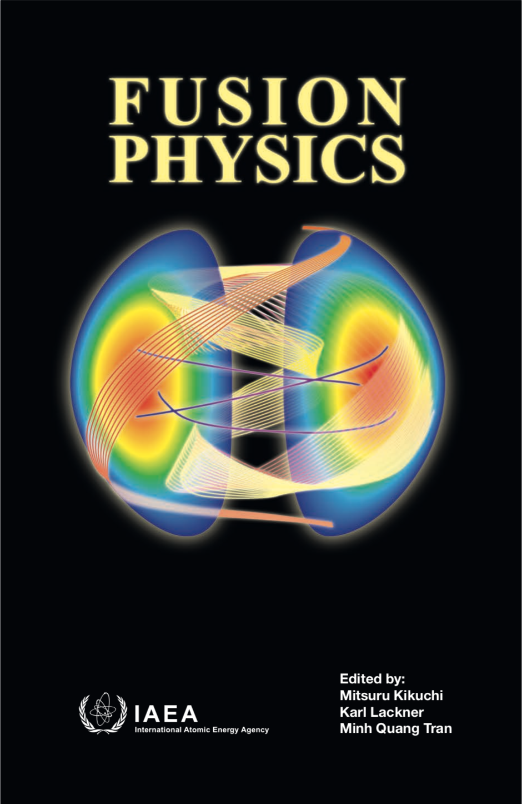

  Temperature inversions following edge cold pulses have been
  observed in many machines around the world
1995
2000
2005
2010
2015
Observed in 12 machines.
>40 journal publications have been devoted to this effect.
Featured in plasma physics books and review articles.
EAST (China)
J-TEXT (China)
KSTAR (Korea)
Alcator C-Mod (US)
HL-2A (China)
LHD (Japan)
JET (UK)
ASDEX Upgrade (Germany)
RTP (Netherlands)
Tore Supra (France)
TFTR (US)
TEXT (US)

Slide 24
  Temperature inversions following edge cold pulses have been
  observed in many machines around the world
1995
2000
2005
2010
2015
Observed in 12 machines.
>40 journal publications have been devoted to this effect.
Featured in plasma physics books and review articles.
Review article on nonlocal transport [K. Ida et al Nucl. Fusion 2015]:
“[…] the violation of the familiar local expression compels us to explore new approaches to the predictive modelling for burning plasmas.”
ITER transport physics basis paper [E.J. Doyle et al Nucl. Fusion 2007]:
“[the] propagation of the pulses from the plasma edge to the core has been a challenge to be explained by local diffusive transport models.”
EAST (China)
J-TEXT (China)
KSTAR (Korea)
Alcator C-Mod (US)
HL-2A (China)
LHD (Japan)
JET (UK)
ASDEX Upgrade (Germany)
RTP (Netherlands)
Tore Supra (France)
TFTR (US)
TEXT (US)

Slide 25
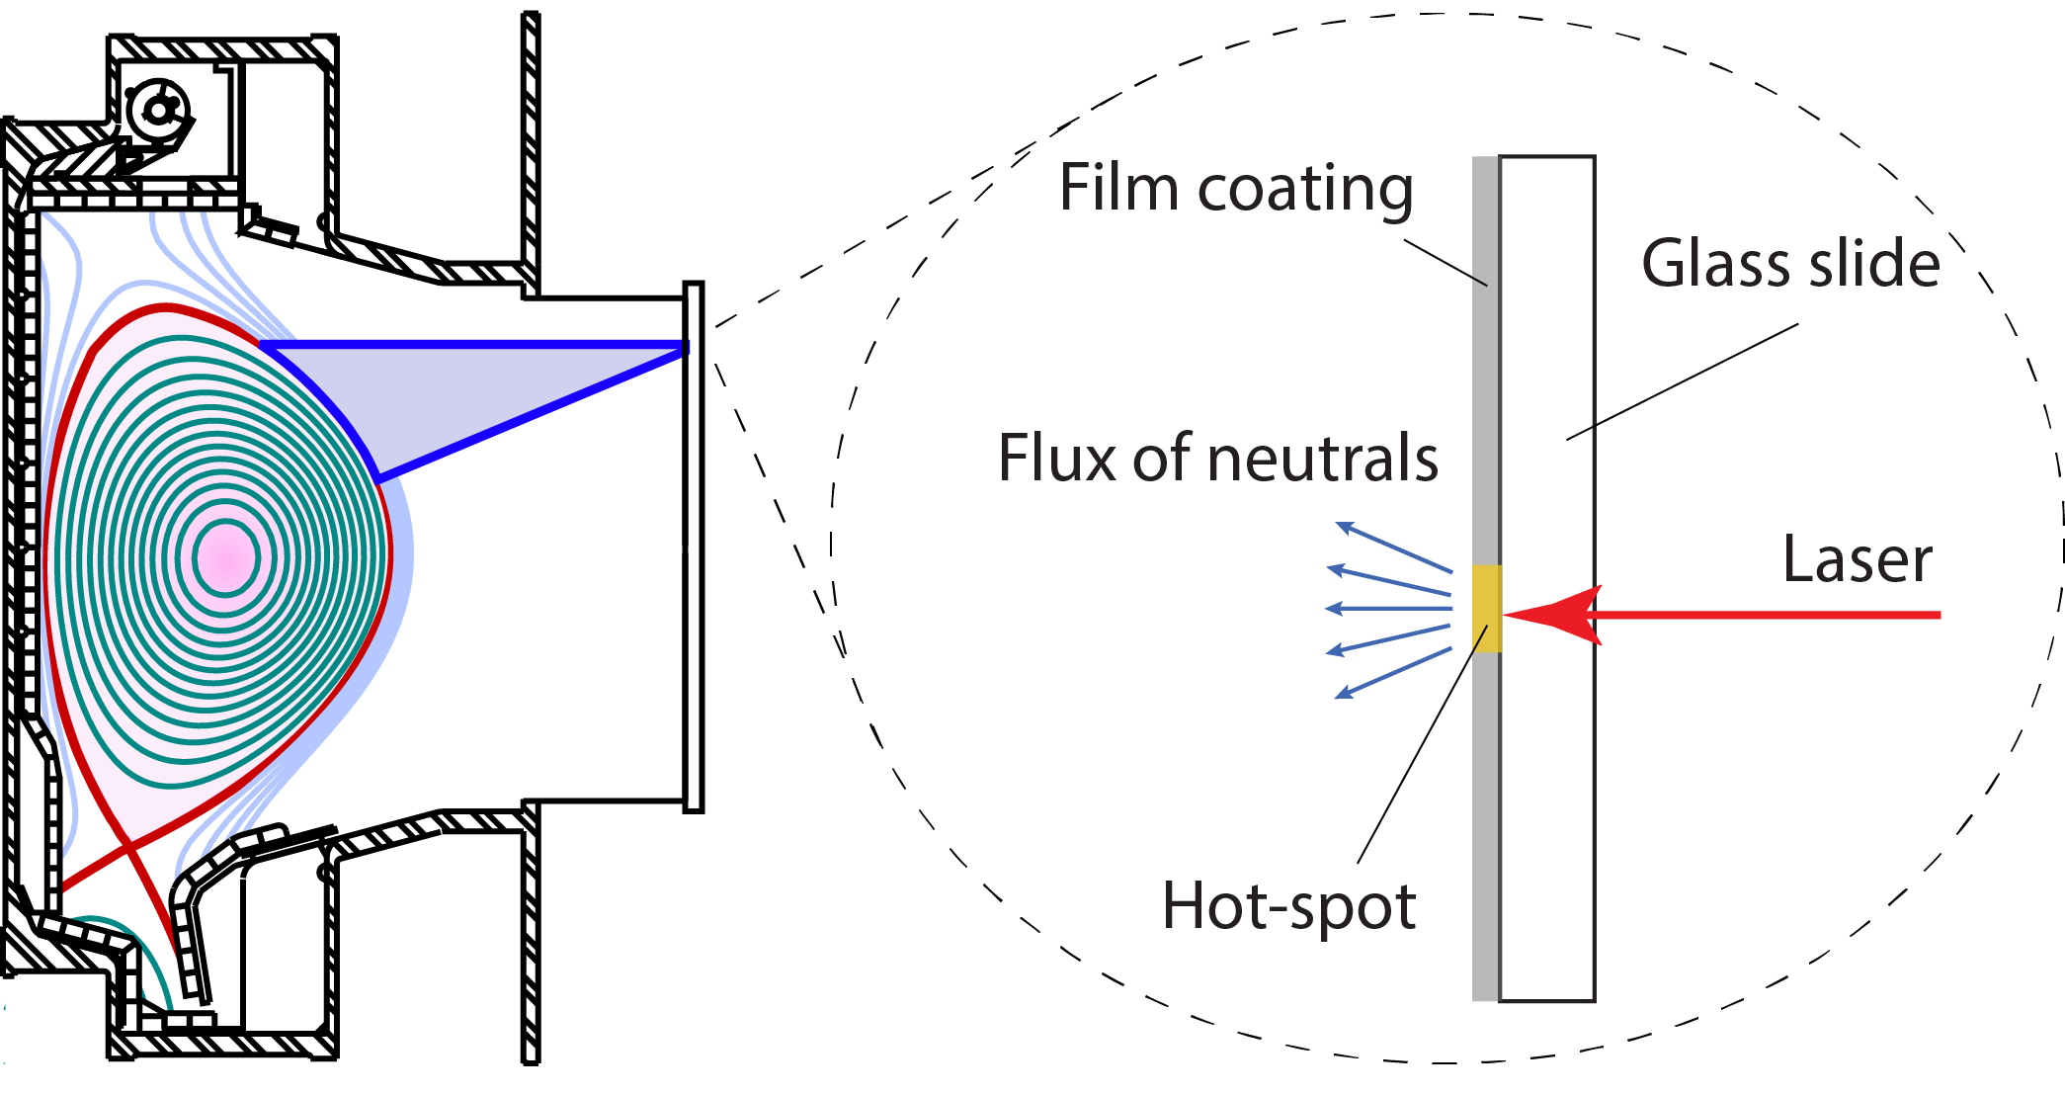
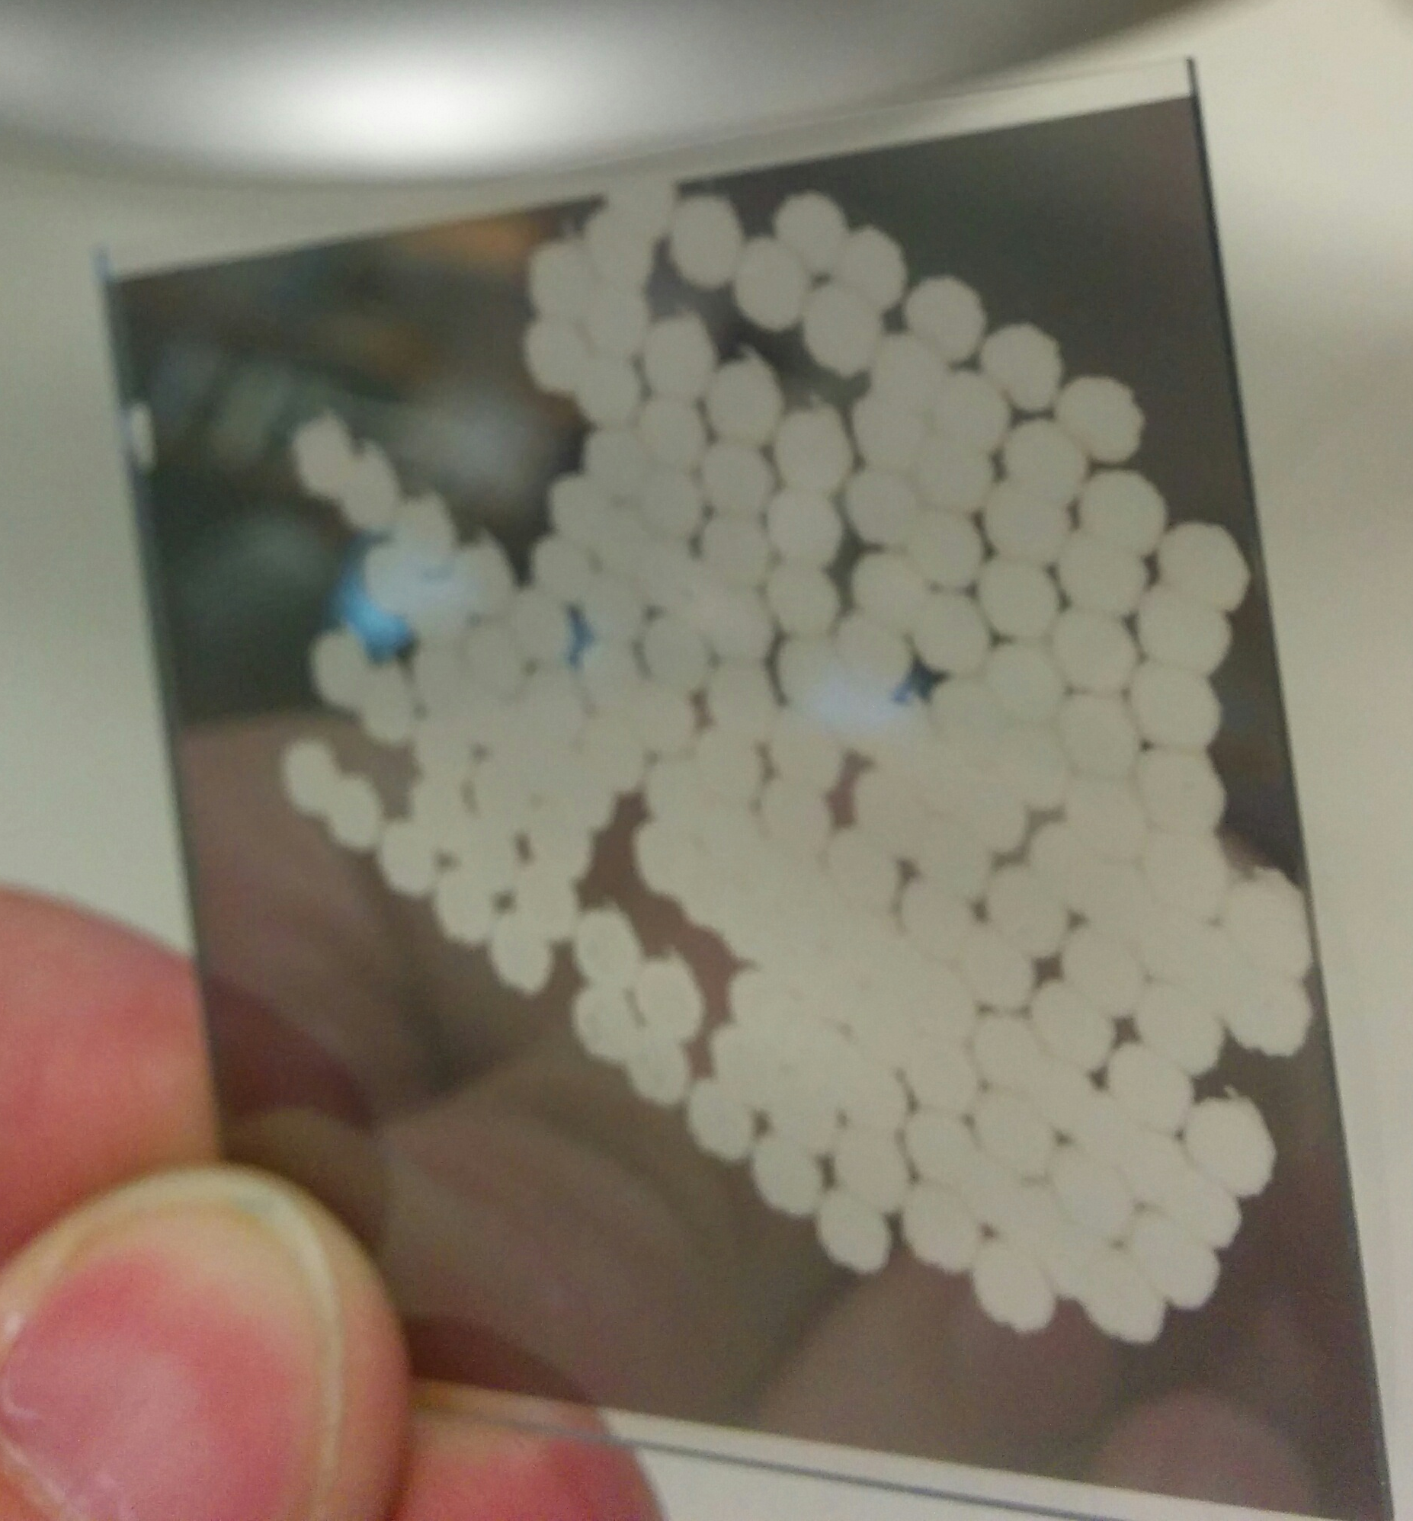
  Transient transport is studied using perturbative
  cold-pulse injections with Laser Blow-Off
Edge cold-pulses are injected using laser blow-off (LBO) technique.
Laser pulse ablates coating in glass slide, resulting in flux of neutrals to plasma.

Slide 26
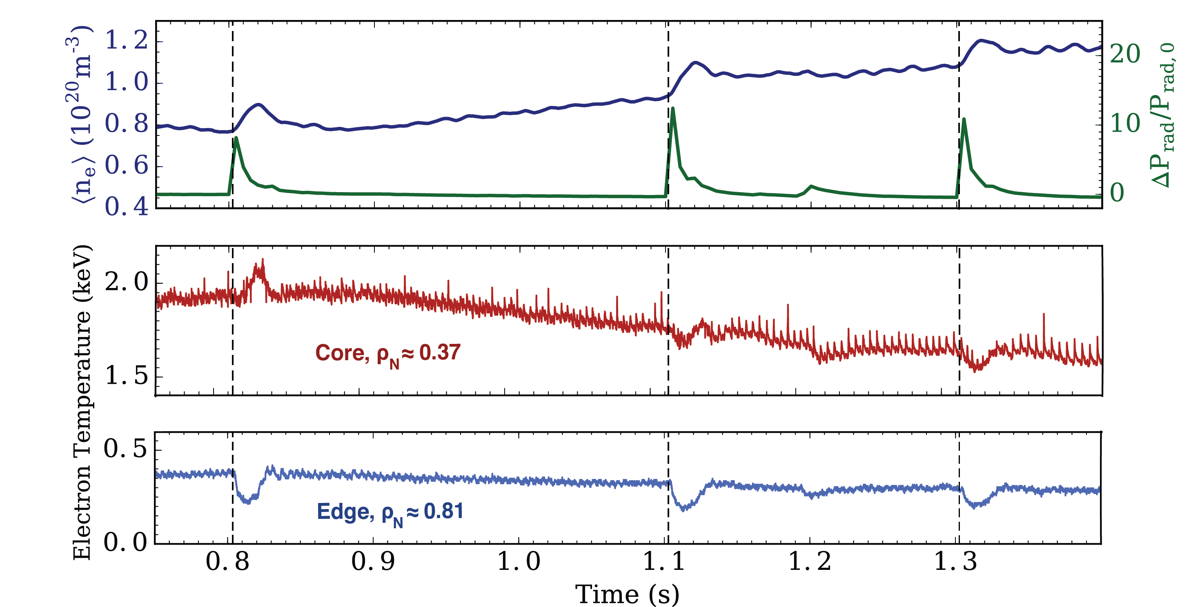
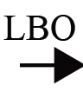
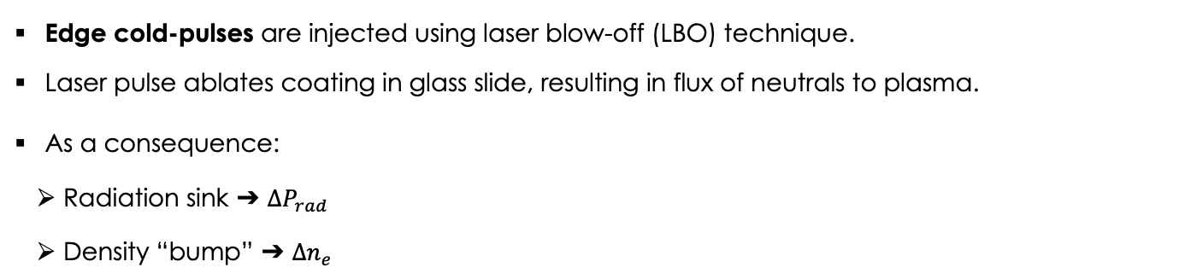


  Transient transport is studied using perturbative
  cold-pulse injections with Laser Blow-Off
Edge cold-pulses are injected using laser blow-off (LBO) technique.
Laser pulse ablates coating in glass slide, resulting in flux of neutrals to plasma.
As a consequence:
  Radiation sink ➔ $∆P_{rad}$
  Density “bump” ➔ $∆n_{e}$
Line-average density
Total radiation
Core $T_{e}$
Edge $T_{e}$

Slide 27
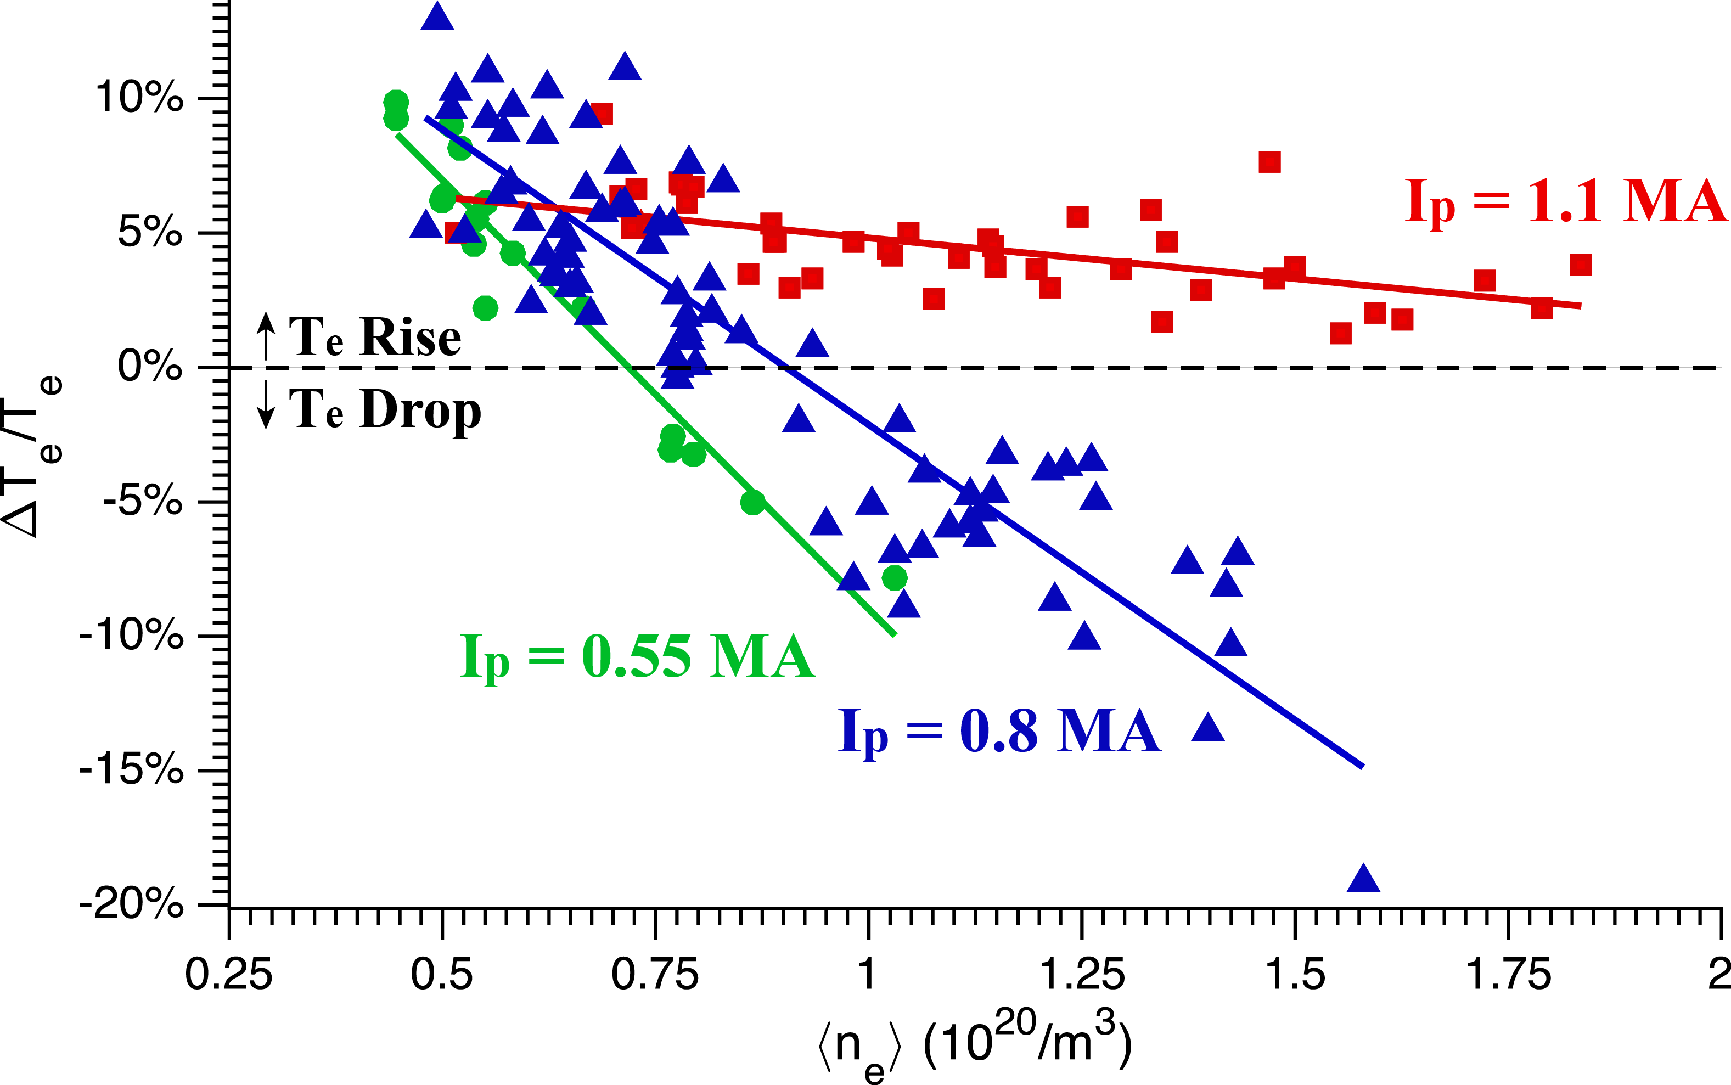
  Strong effect of density and current on temperature
  inversions is observed experimentally
Temperature inversions get weaker as density increases, and eventually disappear.
Temperature inversions return at high-density with high-current.
Alcator C-Mod
Rot. Rev.
Rot. Rev.
Rot. Rev.
P. Rodriguez-Fernandez et al
Nucl. Fusion 2017

Slide 28
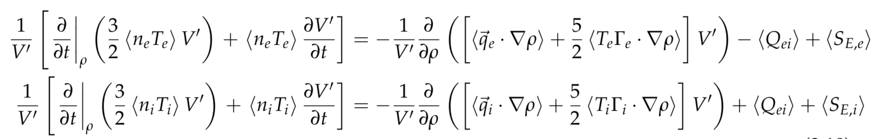
  Integrated modeling of perturbative transport
  phenomena performed using TRANSP+TGLF
TRANSP power balance code solves for evolution of electron and ion temperatures:

Slide 29
  Integrated modeling of perturbative transport
  phenomena performed using TRANSP+TGLF
TRANSP power balance code solves for evolution of electron and ion temperatures:
TGLF SAT1

Slide 30
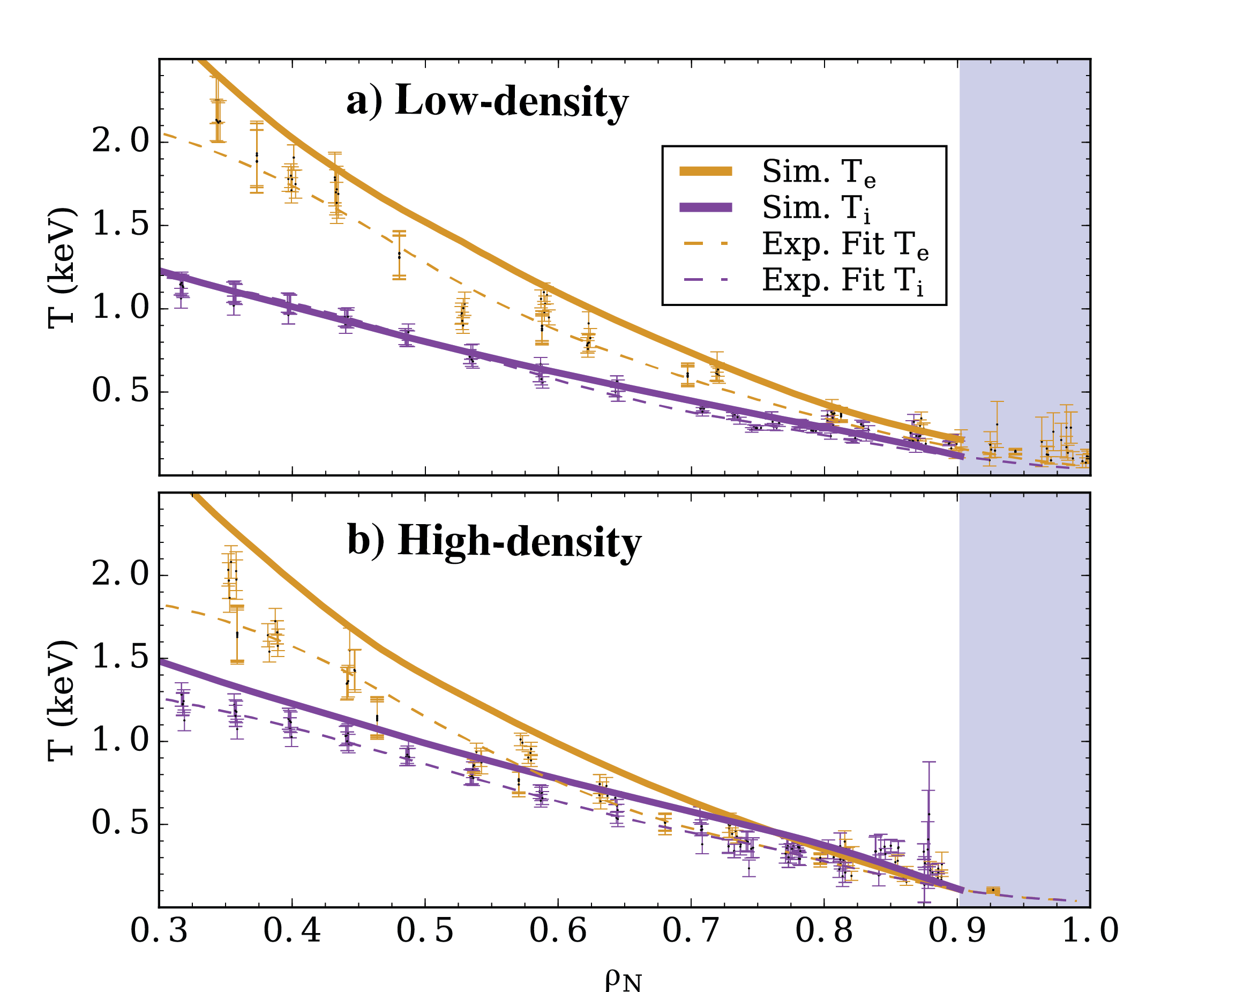
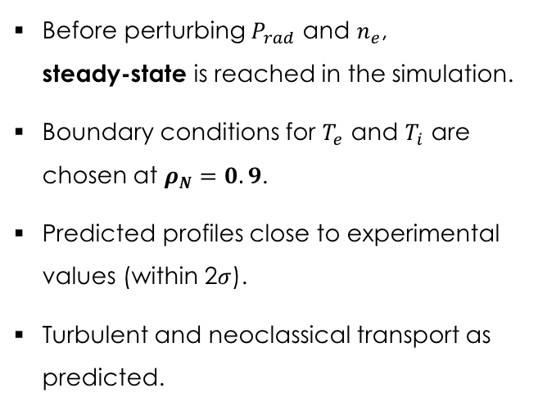
  Ion and electron temperatures are evolved until
  reaching steady-state in the simulation
C-Mod
Before perturbing $P_{rad}$ and $n_{e}$,
steady-state is reached in the simulation.
Boundary conditions for $T_{e}$ and $T_{i}$ are chosen at $ρ_{N}=0.9$.
Predicted profiles close to experimental values (within 2$σ$).
Turbulent and neoclassical transport as predicted.

Slide 31
  Integrated modeling of perturbative transport
  phenomena performed using TRANSP+TGLF
TRANSP power balance code solves for evolution of electron and ion temperatures:

Slide 32
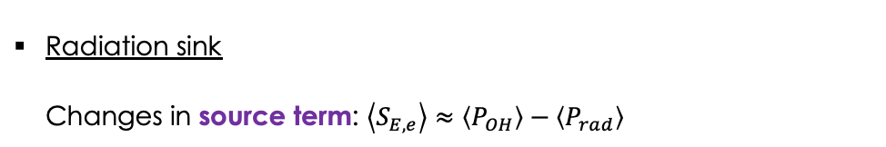
  Integrated modeling of perturbative transport
  phenomena performed using TRANSP+TGLF
TRANSP power balance code solves for evolution of electron and ion temperatures:
Sources/Sinks
Radiation sink
Changes in source term: $\left\langle S_{E,e}\right\rangle ≈\left\langle P_{OH}\right\rangle −\left\langle P_{rad}\right\rangle$

Slide 33
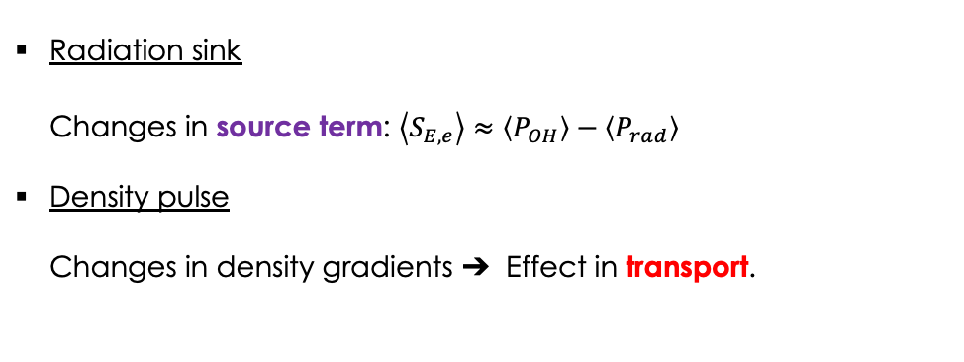
  Integrated modeling of perturbative transport
  phenomena performed using TRANSP+TGLF
TRANSP power balance code solves for evolution of electron and ion temperatures:
Sources/Sinks
Transport
Radiation sink
Changes in source term: $\left\langle S_{E,e}\right\rangle ≈\left\langle P_{OH}\right\rangle −\left\langle P_{rad}\right\rangle$
Density pulse
Changes in density gradients ➔ Effect in transport.

Slide 34
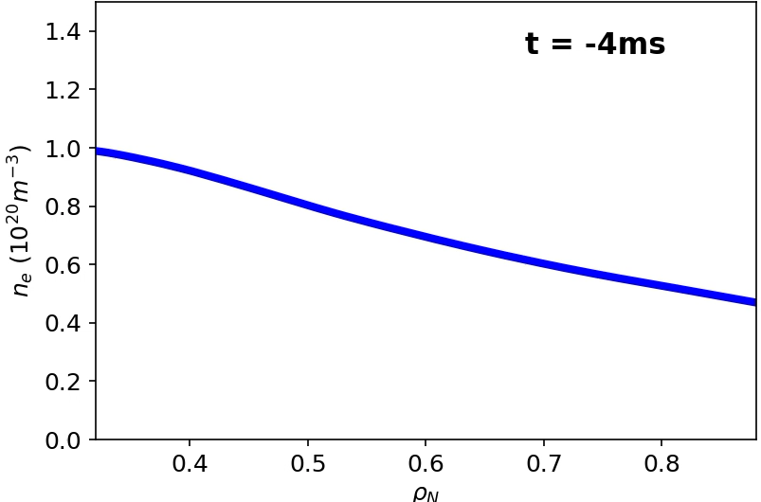
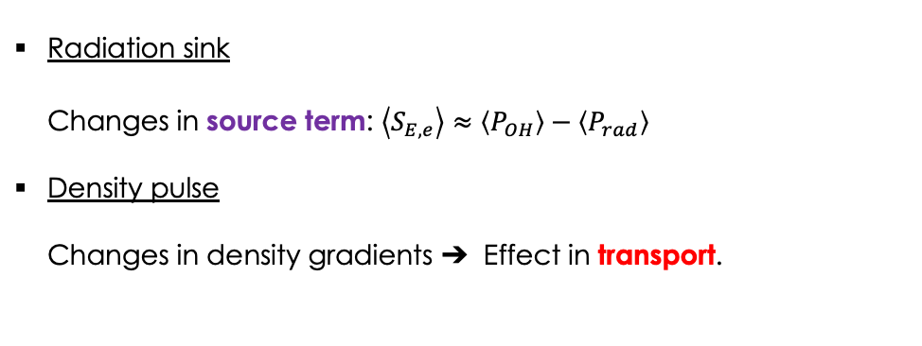
  Integrated modeling of perturbative transport
  phenomena performed using TRANSP+TGLF
TRANSP power balance code solves for evolution of electron and ion temperatures:
Sources/Sinks
Radiation sink
Changes in source term: $\left\langle S_{E,e}\right\rangle ≈\left\langle P_{OH}\right\rangle −\left\langle P_{rad}\right\rangle$
Density pulse
Changes in density gradients ➔ Effect in transport.
Density gradient
flattens
Before
pulse
Density Profile

Slide 35
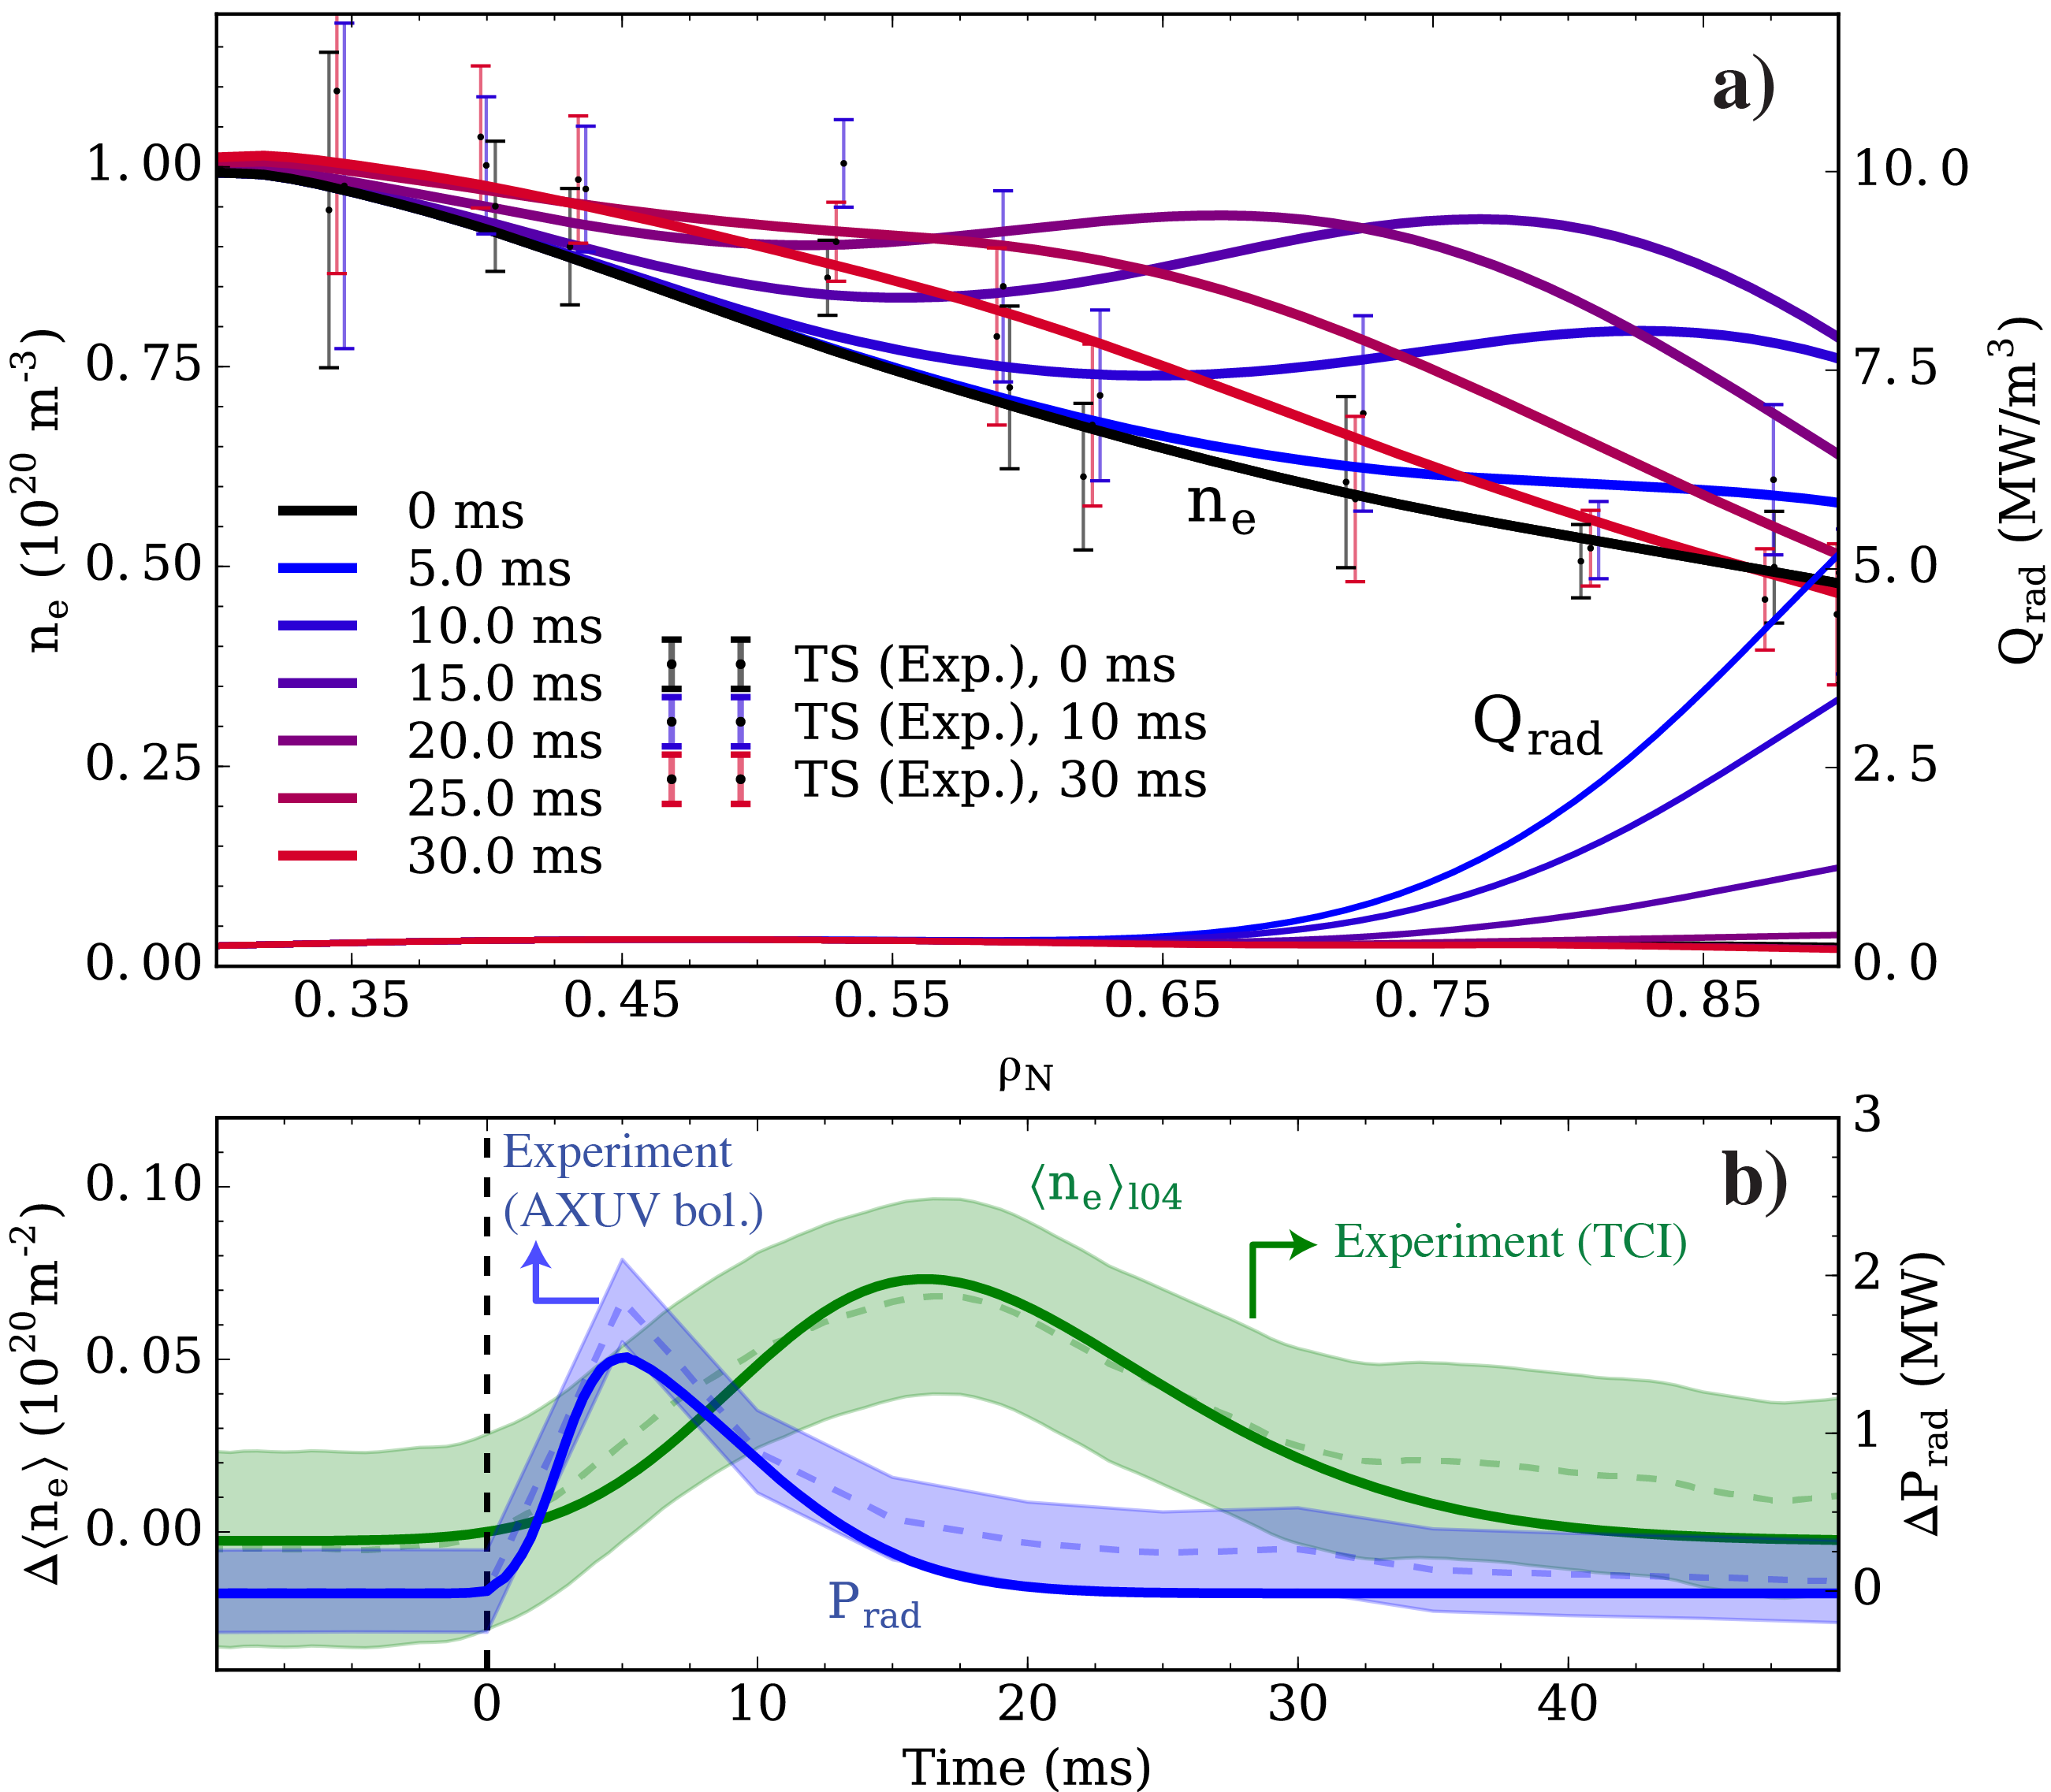
  Experimentally-constrained model of LBO injection
  is introduced in the simulations
Radiative losses and density profiles were not available in high time resolution in Alcator C-Mod.
We made an educated guess: experimentally-constrained Gaussian pulses.
Edge radiation sink constrained by total radiative power (bolometers).
Density perturbation constrained by line-average density (interferometer).

Slide 36
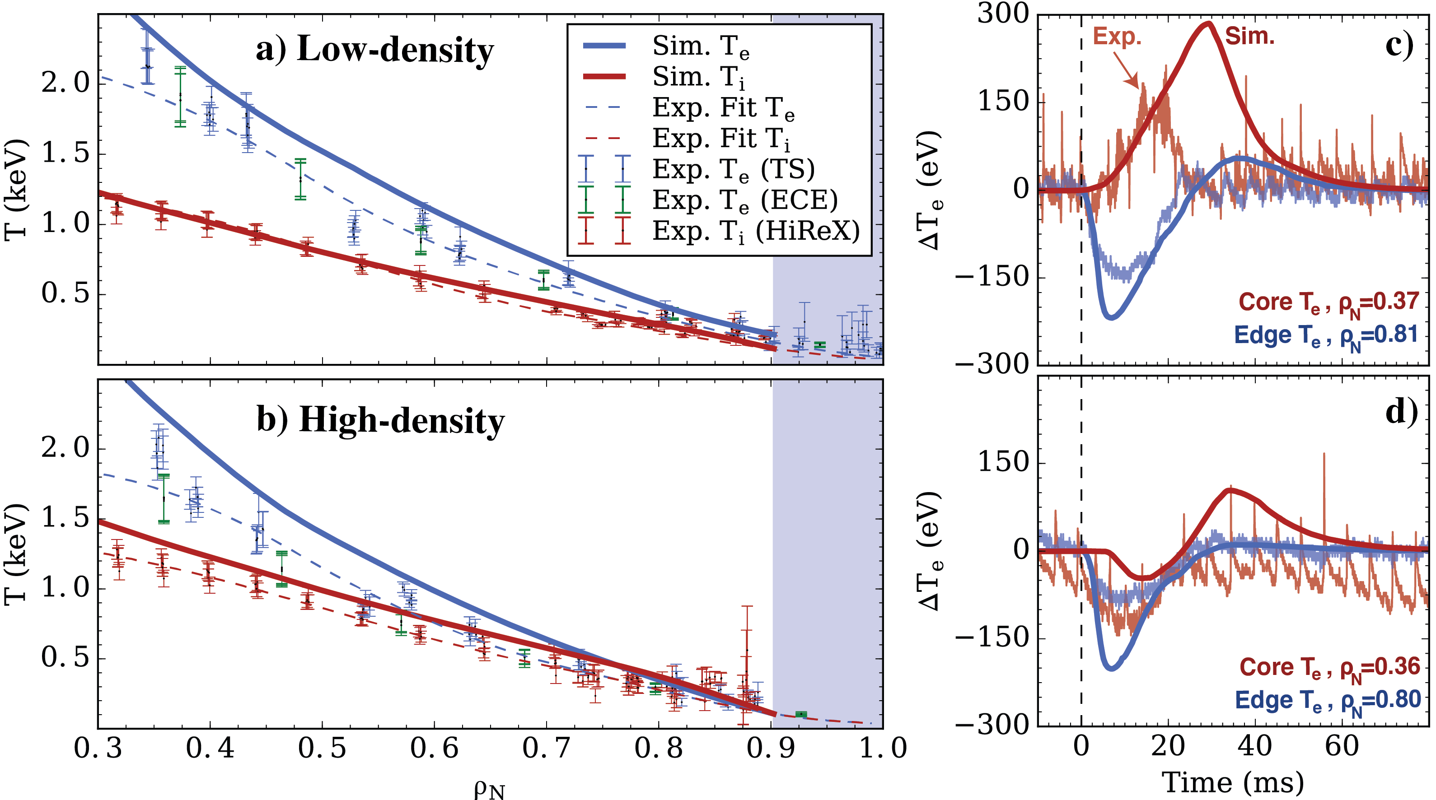
  Core temperature inversions following edge cold pulses
  appeared at low collisionality
Core temperature increases at low density following edge drop.
P. Rodriguez-Fernandez et al
Phys. Rev. Lett. 2018

Slide 37
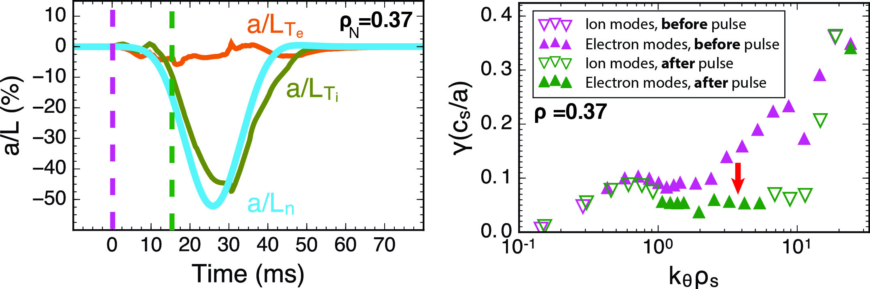
  Core temperature inversions following edge cold pulses
  appeared at low collisionality
Core temperature increases at low density following edge drop.
Flattening of density gradients
before pulse
during pulse
P. Rodriguez-Fernandez et al
Phys. Rev. Lett. 2018

Slide 38
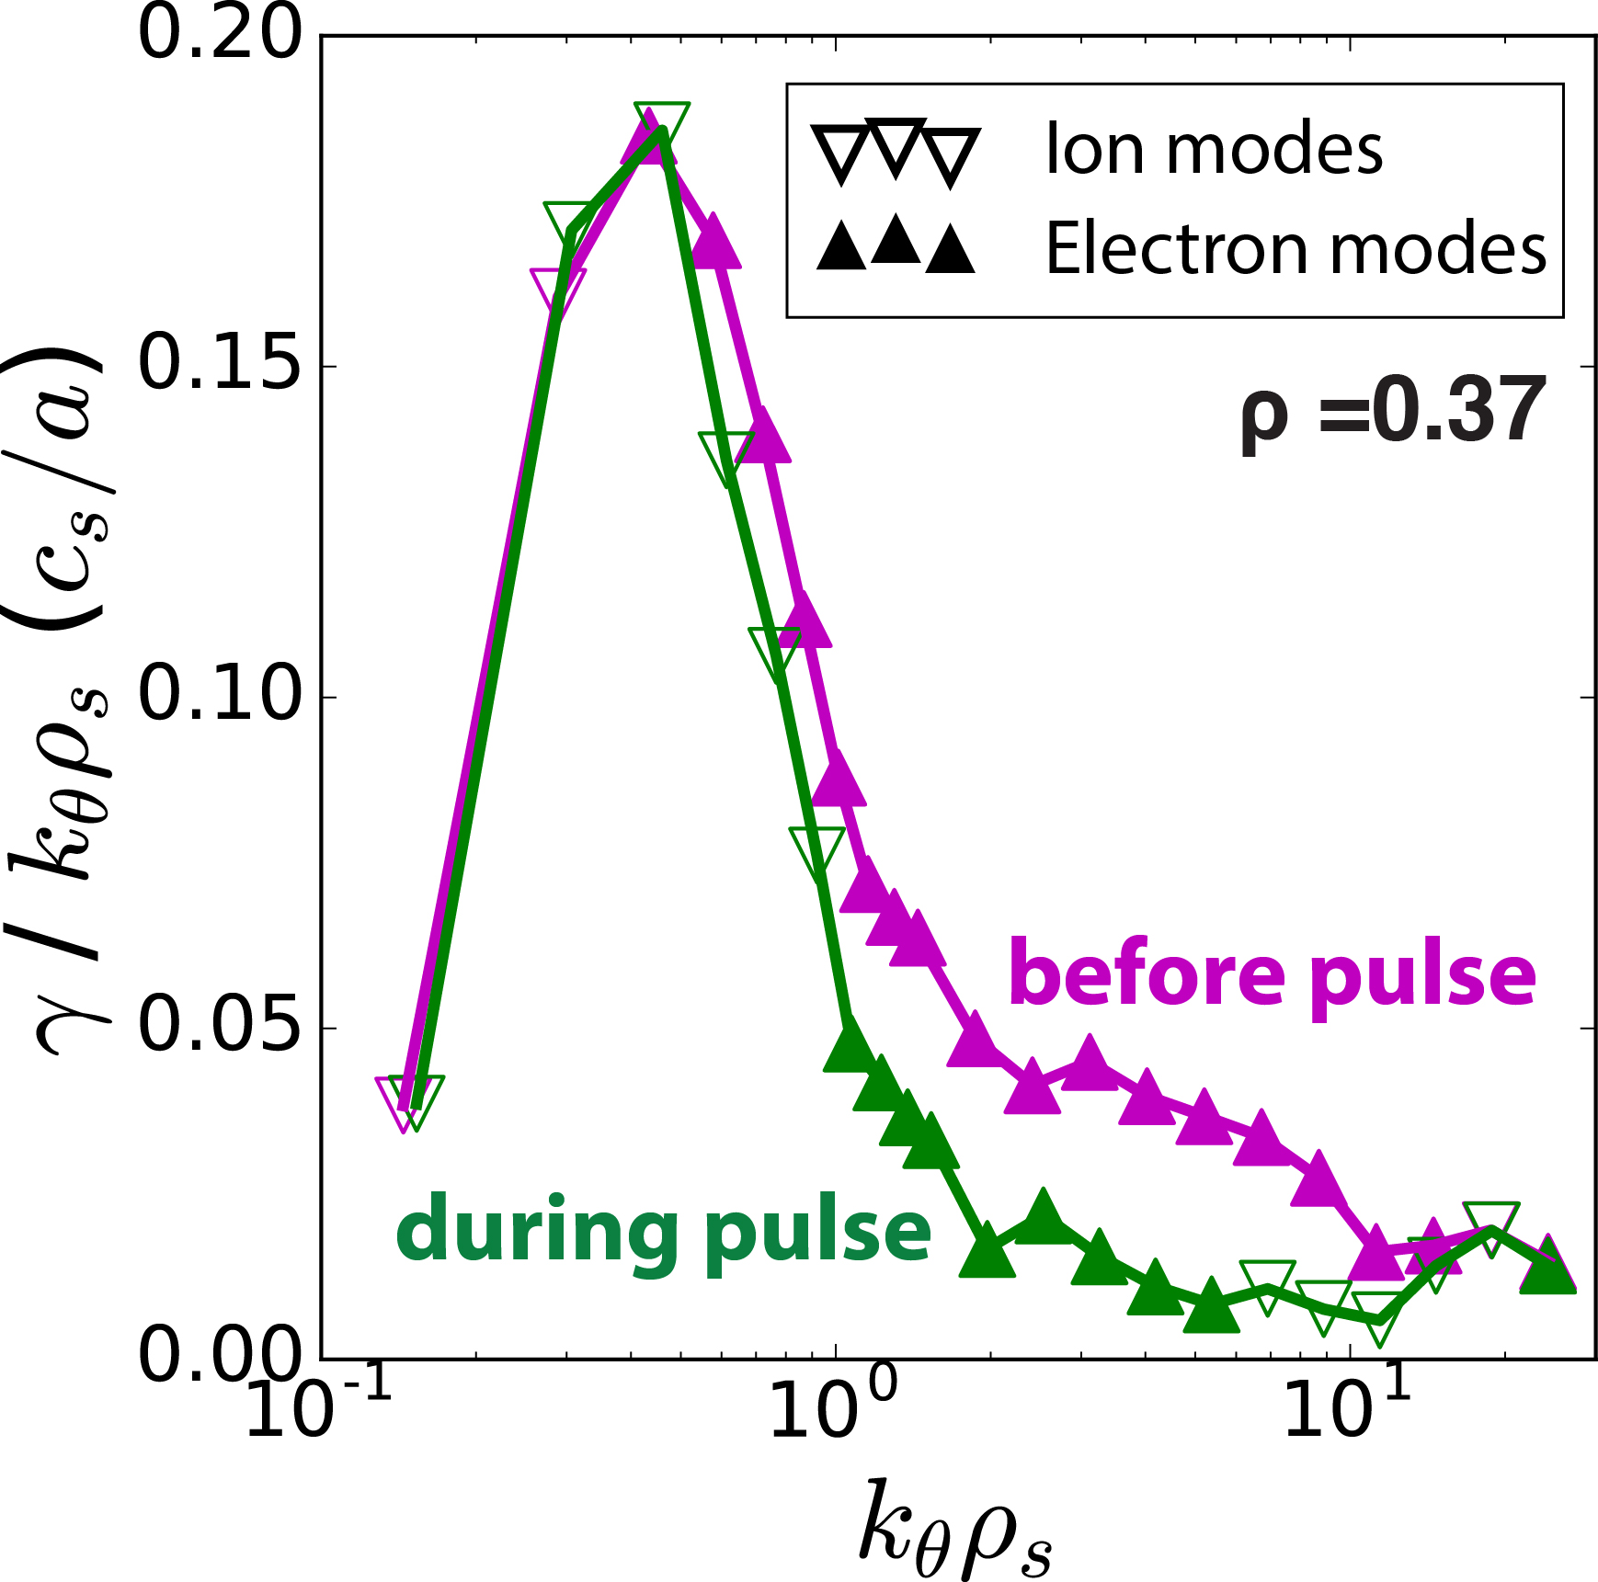
  Core temperature inversions following edge cold pulses
  appeared at low collisionality
Core temperature increases at low density following edge drop.
Flattening of density gradients stabilizes TEM turbulence.
before pulse
during pulse
P. Rodriguez-Fernandez et al
Phys. Rev. Lett. 2018

Slide 39
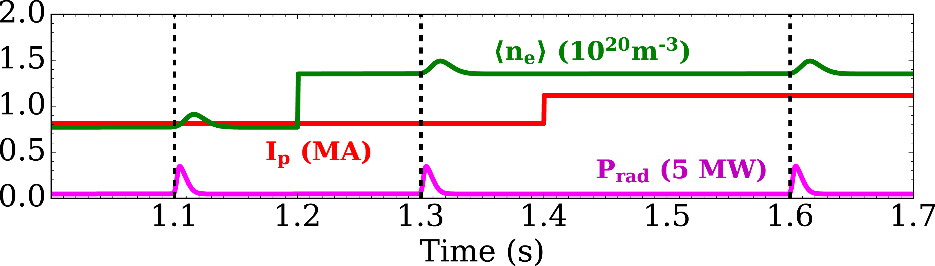
  Simulations with variations of density and plasma current
  show that trends are captured by the model
Simulation

Slide 40
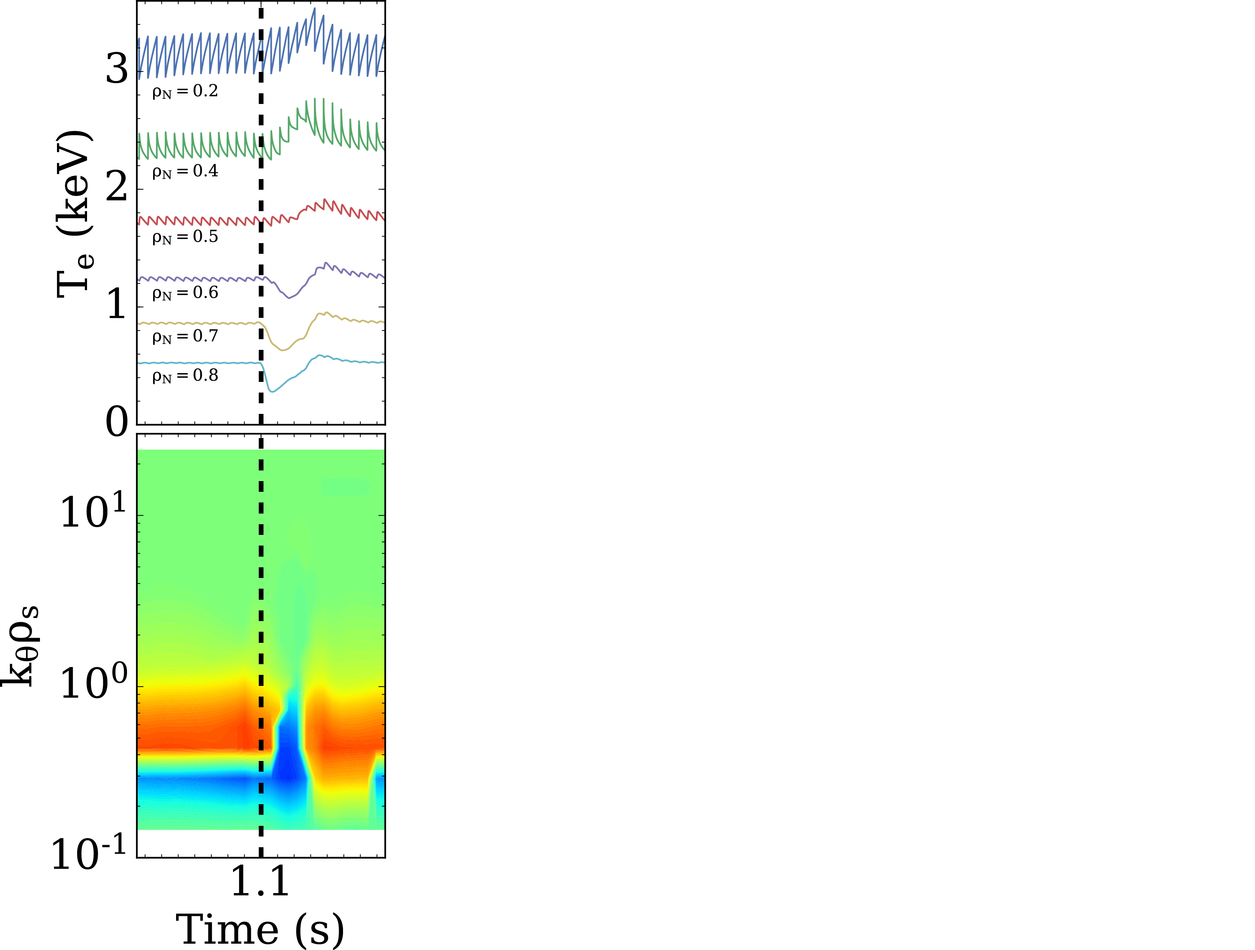
  Simulations with variations of density and plasma current
  show that trends are captured by the model
Simulation
#1: Low density, low current

Slide 41
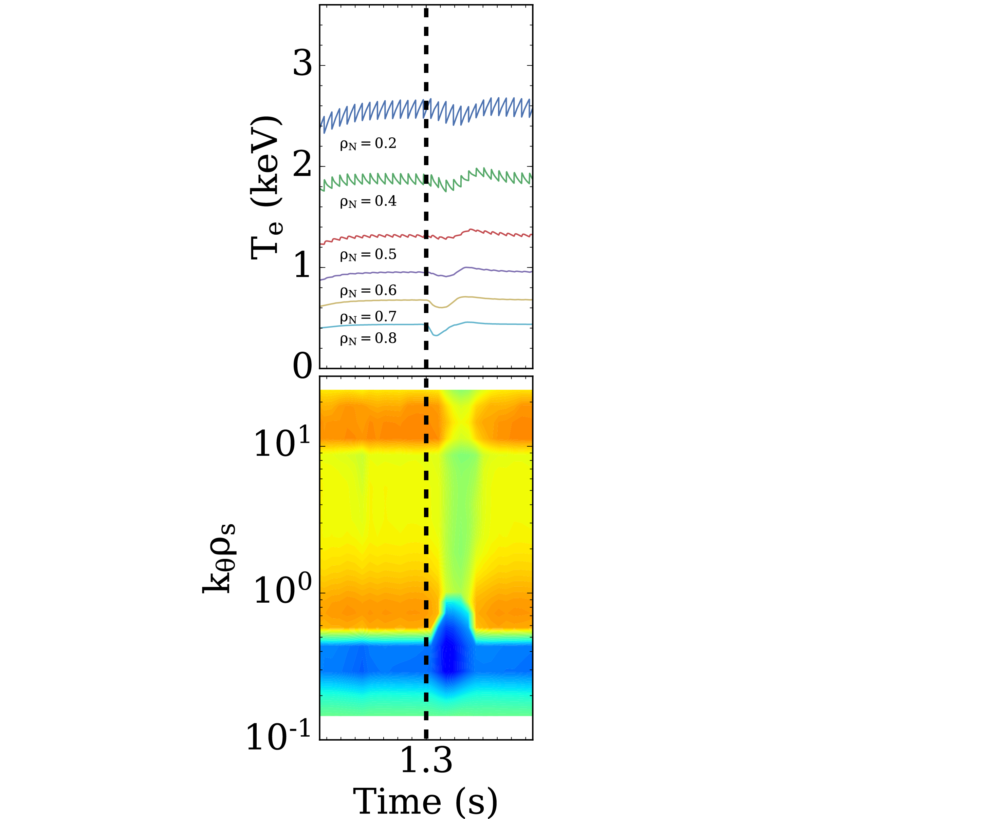
  Simulations with variations of density and plasma current
  show that trends are captured by the model
Simulation
#2: High density, low current

Slide 42
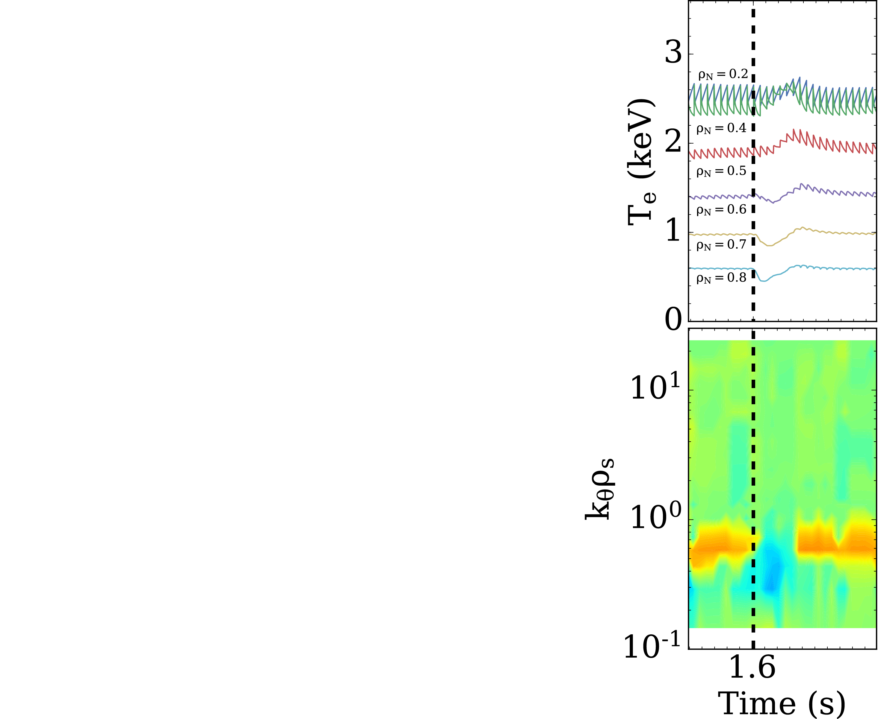
  Simulations with variations of density and plasma current
  show that trends are captured by the model
Simulation
#3: High density, high current

Slide 43
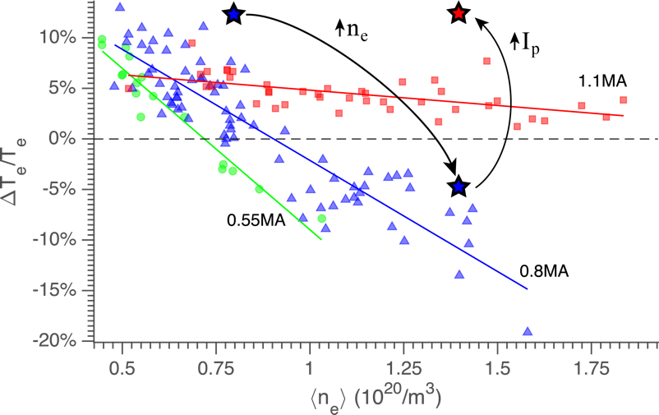
  Simulations with variations of density and plasma current
  show that trends are captured by the model
Simulation
#1
#3
#3
#1
#2
#2

Slide 44
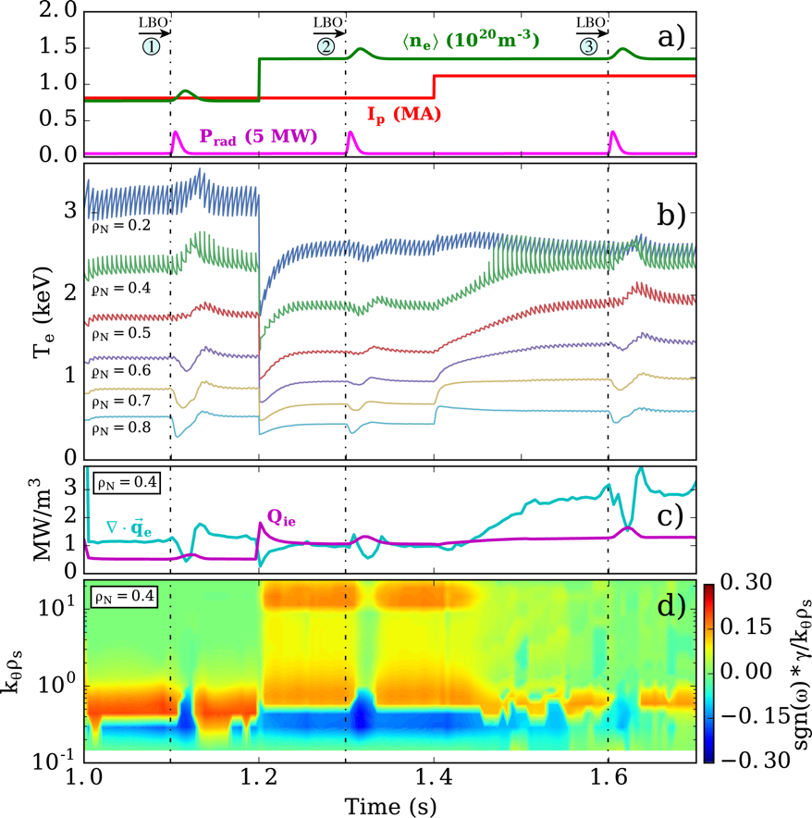
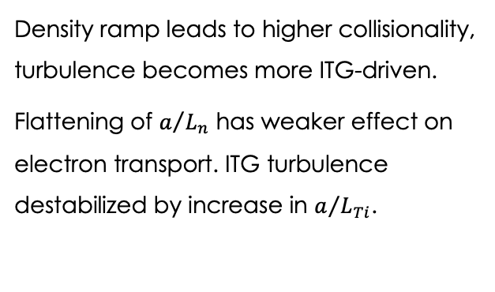
  Simulations with variations of density and plasma current
  show that trends are captured by the model
Density ramp leads to higher collisionality, turbulence becomes more ITG-driven.
Flattening of $a/{L_{n}}$ has weaker effect on electron transport. ITG turbulence destabilized by increase in $a/{L_{Ti}}$.
Simulation
e⁻-direction
ETG
TEM
TEM
ITG
i⁺-direction

Slide 45
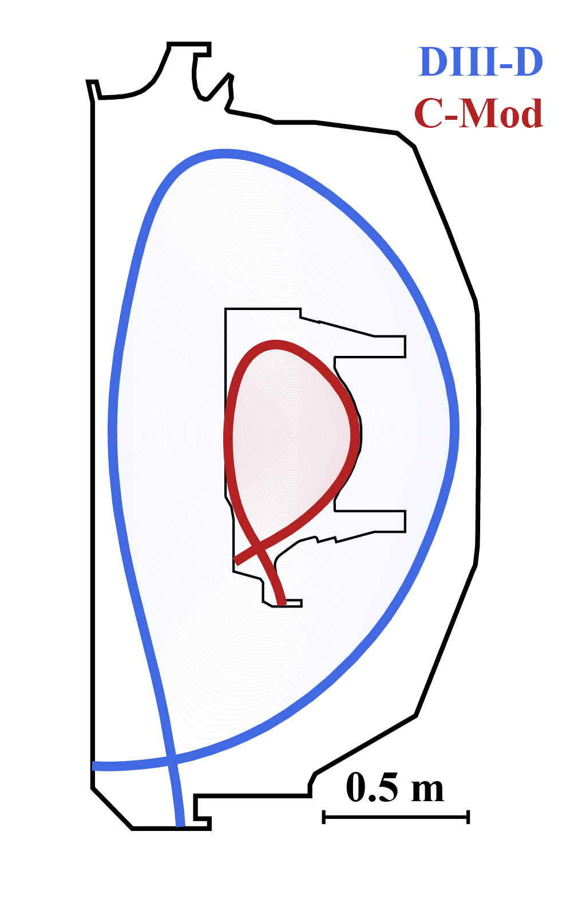
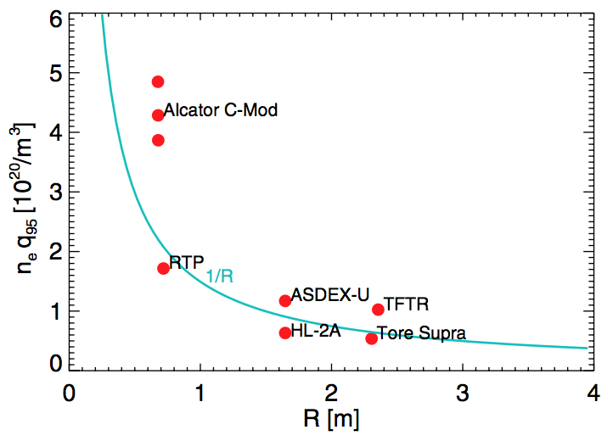



  Temperature inversion had never been observed in DIII-D before. Perfect test case to validate our model
Transition density observed experimentally to follow 1/R dependence.
C. Gao et al Nucl. Fusion 2014
$n_{e}$ at transition (a.u.)
$$(−)∆T_{e}^{core}$$
$$(+)∆T_{e}^{core}$$

Slide 46
  Temperature inversion had never been observed in DIII-D before. Perfect test case to validate our model
Transition density observed experimentally to follow 1/R dependence.
C. Gao et al Nucl. Fusion 2014
$n_{e}$ at transition (a.u.)
$$(−)∆T_{e}^{core}$$
DIII-D?
$$(+)∆T_{e}^{core}$$

Slide 47
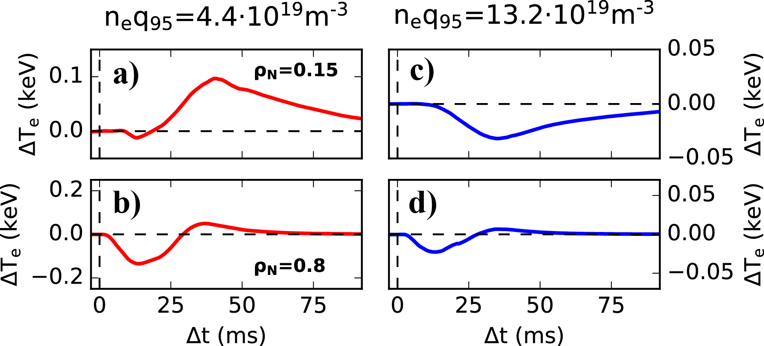
  Temperature inversion had never been observed in DIII-D before. Perfect test case to validate our model
Transition density observed experimentally to follow 1/R dependence.
Predictions
C. Gao et al Nucl. Fusion 2014
$n_{e}$ at transition (a.u.)
$$(−)∆T_{e}^{core}$$
DIII-D?
$$(+)∆T_{e}^{core}$$

Slide 48
  Temperature inversion had never been observed in DIII-D before. Perfect test case to validate our model
Transition density observed experimentally to follow 1/R dependence.
Predictions
C. Gao et al Nucl. Fusion 2014
$n_{e}$ at transition (a.u.)
$$(−)∆T_{e}^{core}$$
DIII-D?
$$(+)∆T_{e}^{core}$$

Slide 49
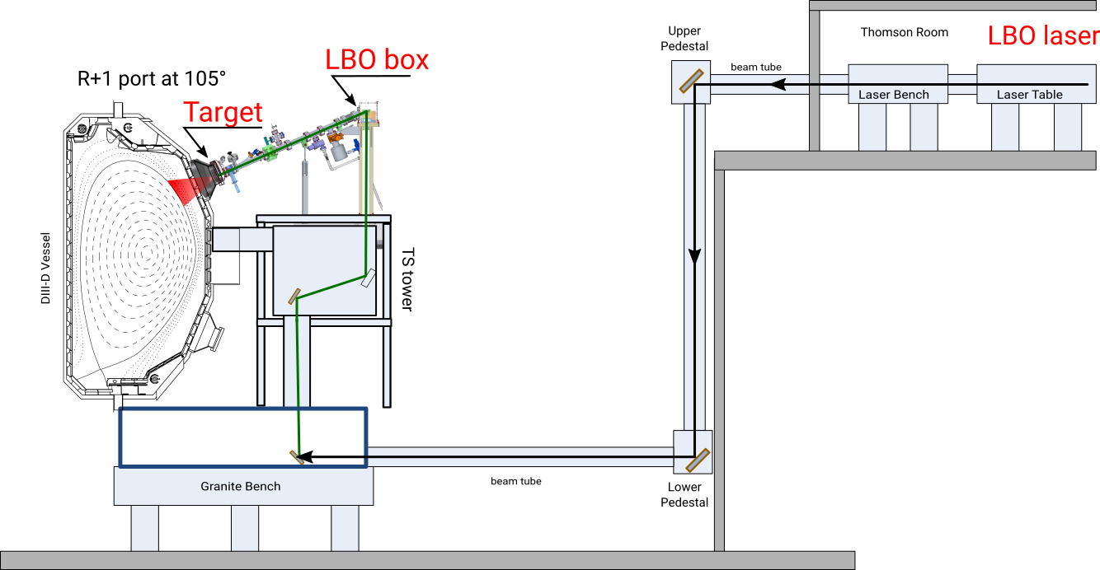

  New predict-first experiments in DIII-D confirm that TGLF predictions
  capture 1/R dependence
MIT Team has recently installed a new LBO for impurity transport studies, but can also be used to introduce cold pulses in DIII-D!

Slide 50
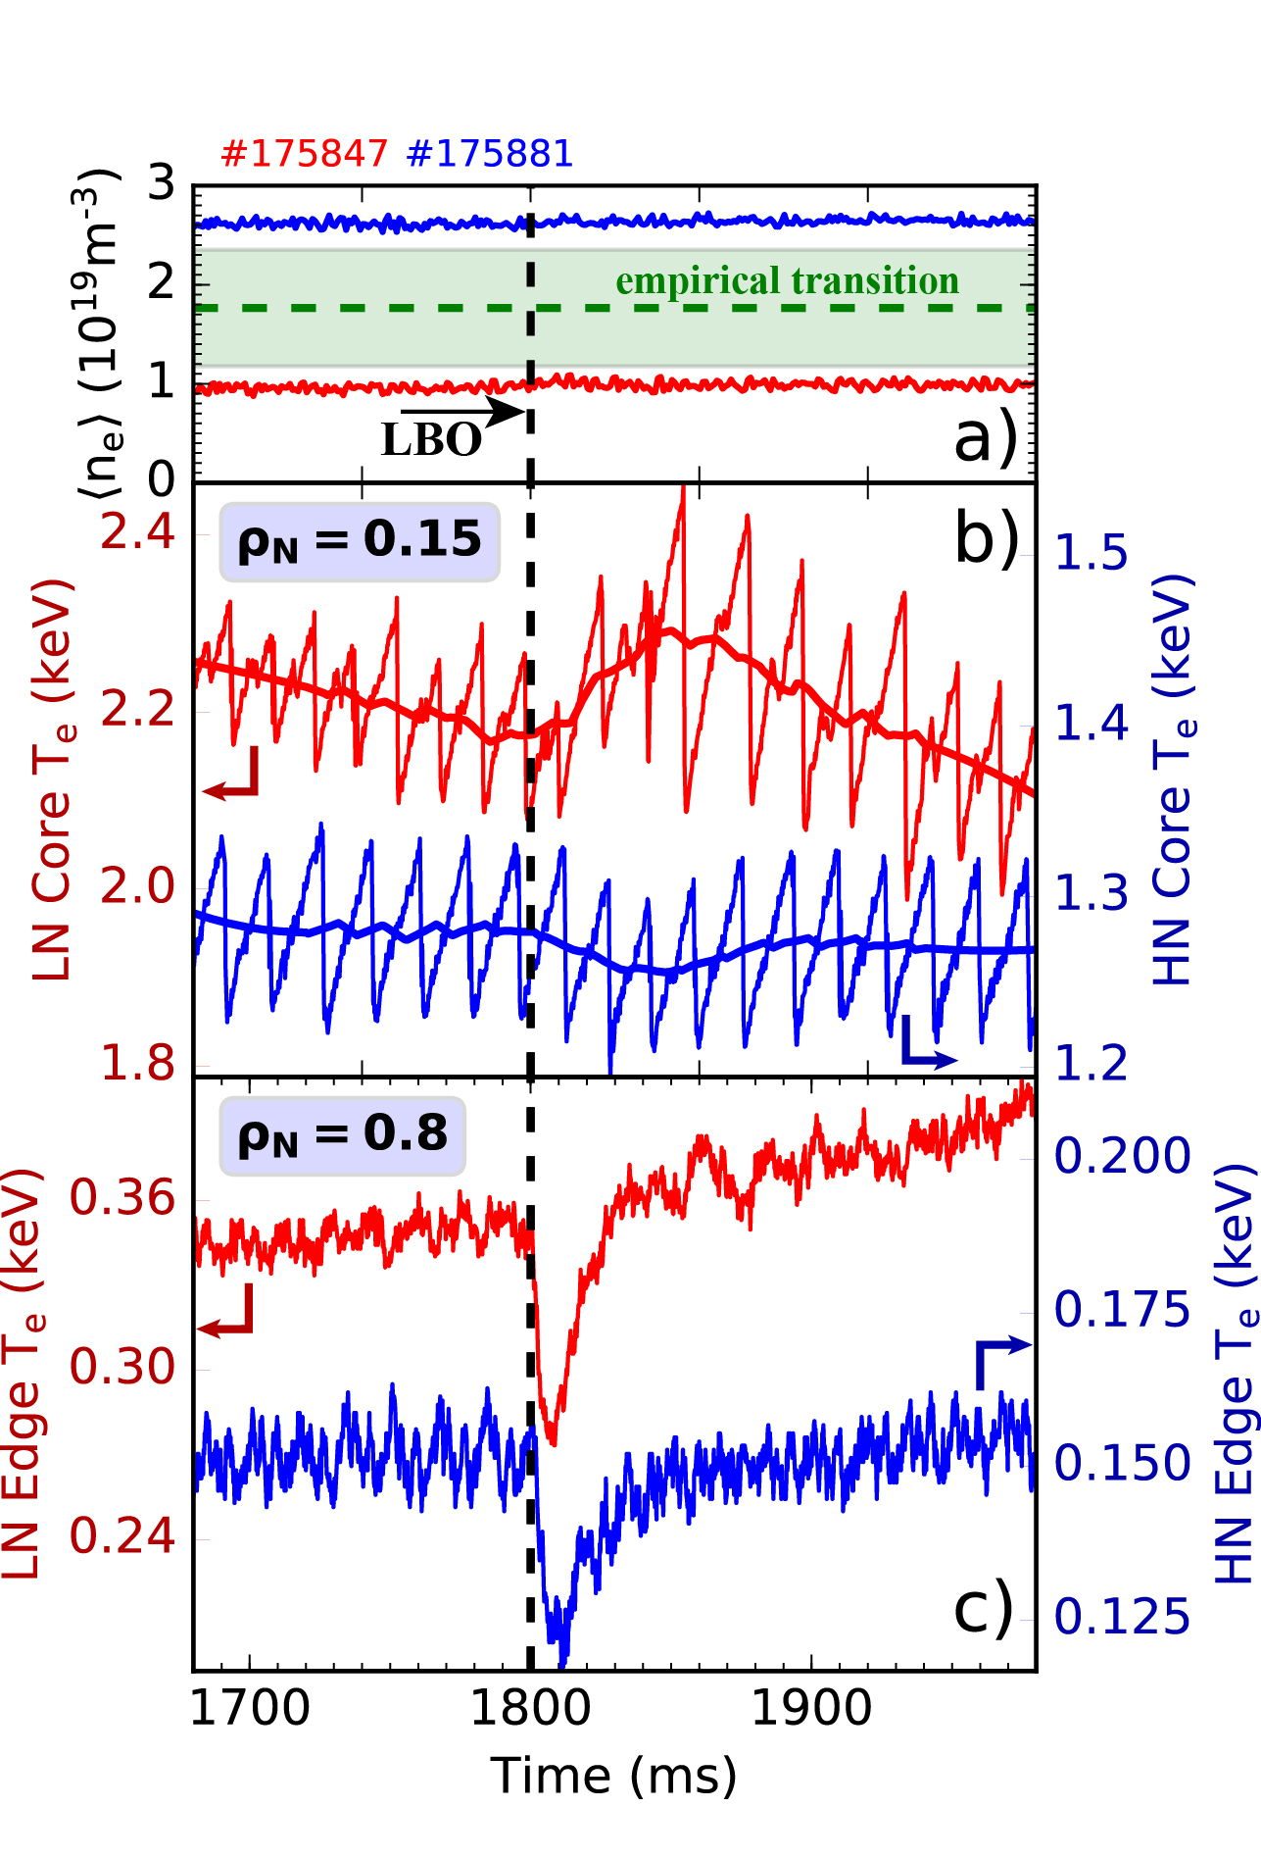
  New predict-first experiments in DIII-D confirm that TGLF predictions
  capture 1/R dependence
MIT Team has recently installed a new LBO for impurity transport studies, but can also be used to introduce cold pulses in DIII-D!
New experiments confirmed validity of predictions.
Experiment

Slide 51
  New predict-first experiments in DIII-D confirm that TGLF predictions
  capture 1/R dependence
MIT Team has recently installed a new LBO for impurity transport studies, but can also be used to introduce cold pulses in DIII-D!
New experiments confirmed validity of predictions.
Experiment
Predictions

Slide 52
  Density pulse consistent with reflectometer data
  is introduced in simulation
A big caveat in C-Mod was the imposed density pulse (Gaussian, constrained by line-integrated measurements).
Does the density pulse actually move that fast?

Slide 53

  Density pulse consistent with reflectometer data
  is introduced in simulation
A big caveat in C-Mod was the imposed density pulse (Gaussian, constrained by line-integrated measurements).
Does the density pulse actually move that fast?
High time resolution density profile reflectometer
confirms a density pulse that travels quickly.

Slide 54

  Simulations with constrained density pulse exhibit
  temperature inversion effect
Density profile can be constrained in time with experimental data.
Simulation of temperature evolution exhibit inversion.
Sim.
Exp.

Slide 55


  Simulations with constrained density pulse exhibit
  temperature inversion effect
Density profile can be constrained in time with experimental data.
Simulation of temperature evolution exhibit inversion.
Temperature inversion triggered by small change in density profile…
looks like a “nonlocal” effect!
Sim.
Exp.
Very small core density change
$T_{e}$ inversion
region
Density profile

Slide 56
  Fast flattening of the density profile also predicted in
  ASTRA/STRAHL/TGLF simulations
Previously, $T_{e}$ inverts due to fast density pulse… but is this captured by TGLF?

Slide 57


  Fast flattening of the density profile also predicted in
  ASTRA/STRAHL/TGLF simulations
Previously, $T_{e}$ inverts due to fast density pulse… but is this captured by TGLF?
ASTRA/STRAHL/TGLF simulations of ECH-plasma performed with prediction of carbon and main ion densities.

Slide 58

  Fast flattening of the density profile also predicted in
  ASTRA/STRAHL/TGLF simulations
Previously, $T_{e}$ inverts due to fast density pulse… but is this captured by TGLF?
ASTRA/STRAHL/TGLF simulations of ECH-plasma performed with prediction of carbon and main ion densities.
Fast flattening of density profile is predicted.

Slide 59



  Fast flattening of the density profile also predicted in
  ASTRA/STRAHL/TGLF simulations
Previously, $T_{e}$ inverts due to fast density pulse… but is this captured by TGLF?
ASTRA/STRAHL/TGLF simulations of ECH-plasma performed with prediction of carbon and main ion densities.
Fast flattening of density profile is predicted.
Transiently, Carbon density strongly hollowed (large reversed gradient) → Destabilizes impurity mode → Large inward flux

Slide 60
  Main message: Nonlocal effects are not needed to capture
  cold-pulse phenomena in tokamaks plasmas
Summary:
For 20 years, cold-pulse experiments suggested important missing piece of physics in transport models.
Dedicated experiments in Alcator C-Mod were designed to isolate cold-pulse effect from momentum transport.
Simulations of Alcator C-Mod show that local transport models capture full dynamics of cold pulses.
Simulations with measured density pulse in new DIII-D experiments show consistency with Alcator C-Mod results.
Simulations of particle transport in AUG show that local transport models also capture fast inward flux of impurities.
P. Rodriguez-Fernandez MIT PhD Thesis (May 2019)
K.W. Gentle et al. Phys. Rev. Lett. 74, 3620 (1995)
P. Rodriguez-Fernandez et al. Nucl. Fusion 57, 074001 (2017)
P. Rodriguez-Fernandez et al. Phys. Rev. Lett. 120, 075001 (2018)
P. Rodriguez-Fernandez et al. Nucl. Fusion 59, 066017 (2019)
P. Rodriguez-Fernandez et al. Phys. Plasmas 26, 062503 (2019)
C. Angioni et al. Nucl. Fusion 59, 106007 (2019)

Slide 61

  References

