Slide 1
Electron confinement in a plasma-filled magnetic mirror with Fermi-Ulam-like B-field-parallel heating
Charles Swanson
2019/09/16
Notes:
I am Charles Swanson and I will be giving my FPOE on some interesting fast electron dynamics in a magnetic mirror.
This FPOE is on a subset of my dissertation, so the title is a subset of the dissertation title, “Measurement and modeling of spontaneous fast electron heating in a low-power magnetic mirror.”

Slide 2
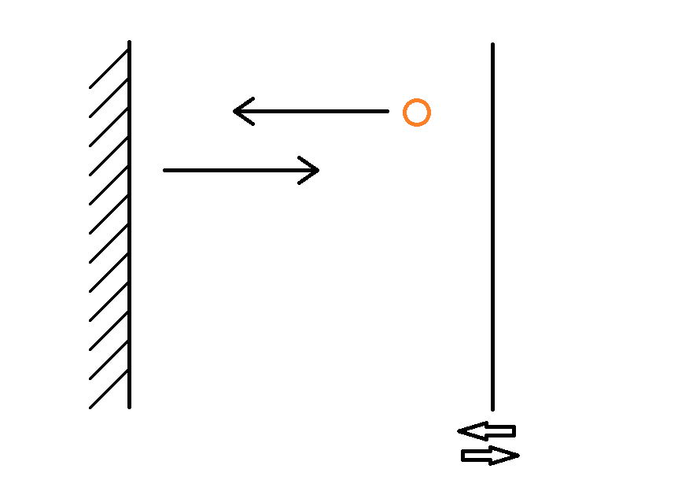
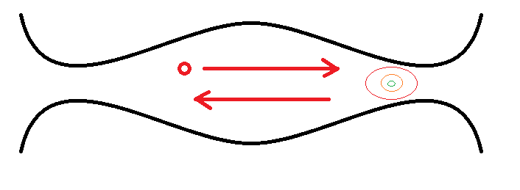
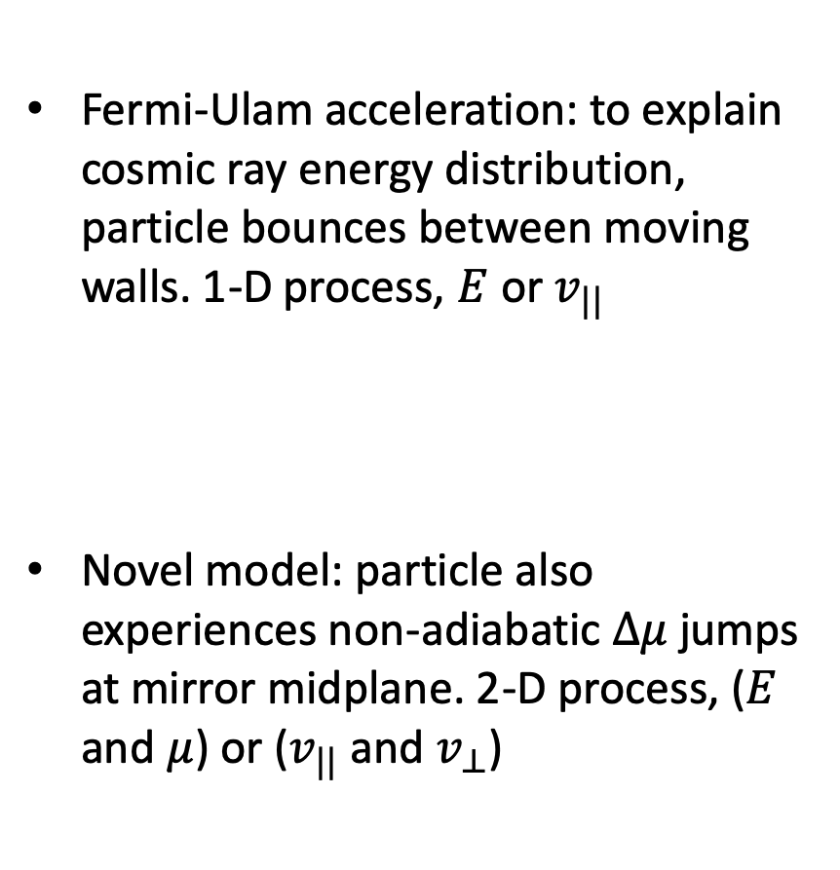


Fermi-Ulam Acceleration in a Magnetic Mirror
Fermi-Ulam acceleration: to explain cosmic ray energy distribution, particle bounces between moving walls. 1-D process, $E$ or $v_{||}$
Novel model: particle also experiences non-adiabatic $Δμ$ jumps at mirror midplane. 2-D process, ($E$ and $μ$) or ($v_{||}$ and $v_{⊥}$)
$$\tilde{V}$$
$$Δμ$$

Slide 3
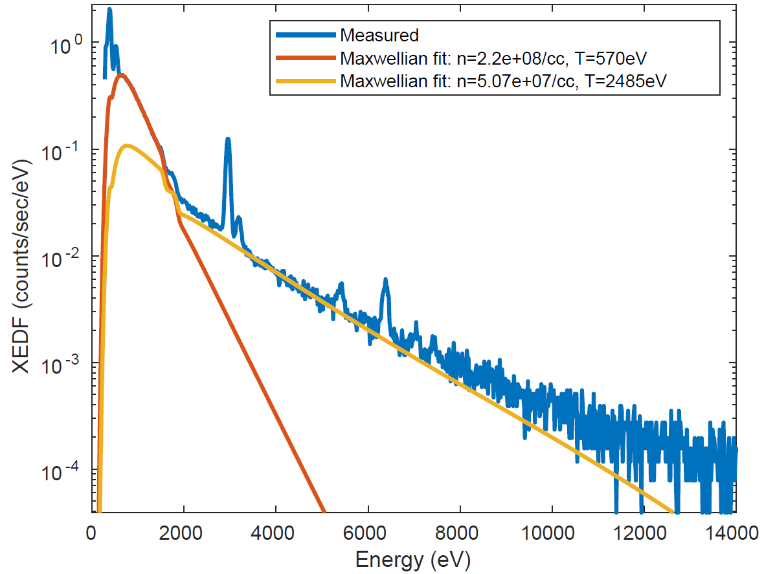
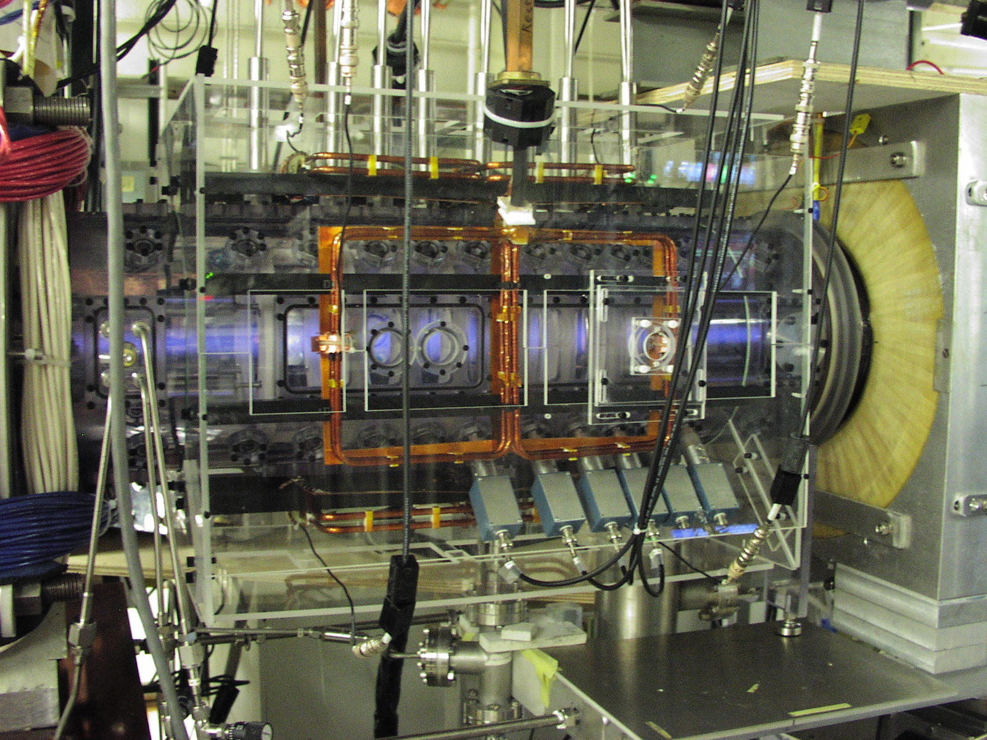

Photograph
$$T_{eff}=2.5 keV$$
88 cm length
Notes:
This is the PFRC-II experimental apparatus. As you can see, it’s a small magnetic mirror of the kind of which there are dozens in the world. It’s fed by a 300 W antenna in one end cell.
*CLICK*
The measurement that motivated this work was an x-ray spectrum like the one depicted here. It shows that from our small, low-power apparatus, there is a signal from a spontaneously generated multi-keV population of electrons. This talk is on the process that produces these electrons, and supporting measurements.

Slide 4
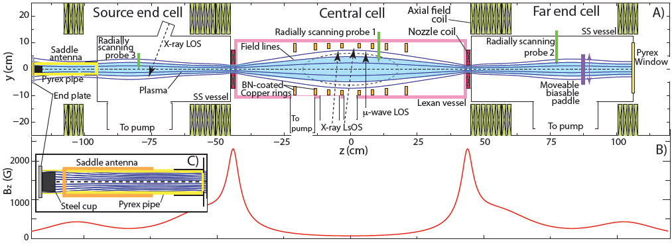
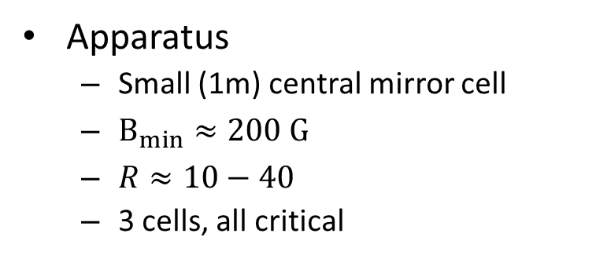
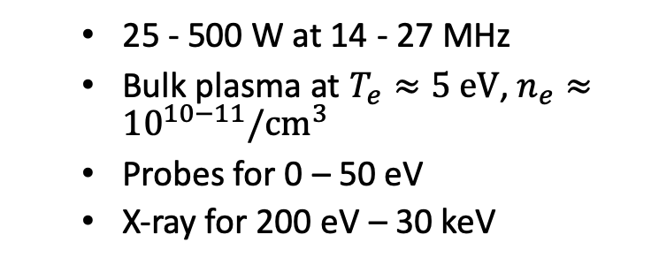
Apparatus
Apparatus
  Small (1m) central mirror cell
  $B_{min}≈200 G$
  $R≈10−40$
  3 cells, all critical
  25 - 500 W at 14 - 27 MHz
  Bulk plasma at $T_{e}≈5 eV$, $n_{e}≈{10}^{10−11}/{cm}^{3}$
  Probes for 0 – 50 eV
  X-ray for 200 eV – 30 keV
SEC: Source End Cell
  Plasma and warm electrons created
CC: Center Cell
  Warm electrons trapped
  Warm electrons accelerated into hot electrons
FEC: Far End Cell
  Plasma terminates
  Beam produced
Plasma was expected to be “cold,” 5 eV, lightbulb-like
X-ray detectors added to study a different plasma, fortuitously discovered this population alongside the cold population
Notes:
Now that I’ve described the process, I’d like to take a moment to describe the apparatus, the PFRC-II. It’s a small-scale experiment. It fits in one room and runs in a steady state for hours at a time.
The minimum magnetic field is around 200 Gauss, with a mirror ratio of 10 – 40. It has three cells, each of which is essential to the spontaneous heating of electrons to 3 keV. The source end cell produces warm electrons by a process that I won’t describe here. The far end cell produces the conditions necessary for the oscillation that we measure. The central cell is where the particles are heated, from an oscillation near the nozzle here.
The bulk plasma is the majority of the density. It has 10^10 or 10^11 /cc of density depending on where you are. We only expected this population to exist, so previously we diagnosed it only with Langmuir probes, which are sensitive to temperatures and densities of the bulk plasma. We put x-ray detectors on the machine to study a completely different plasma formation technique, and just happened to be looking at the right time. We didn’t expect to find keV electrons.

Slide 5
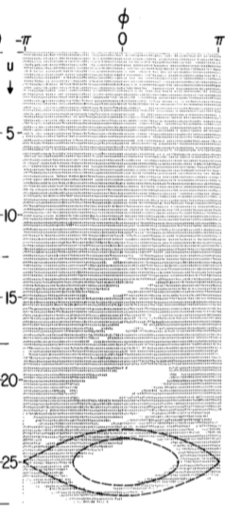
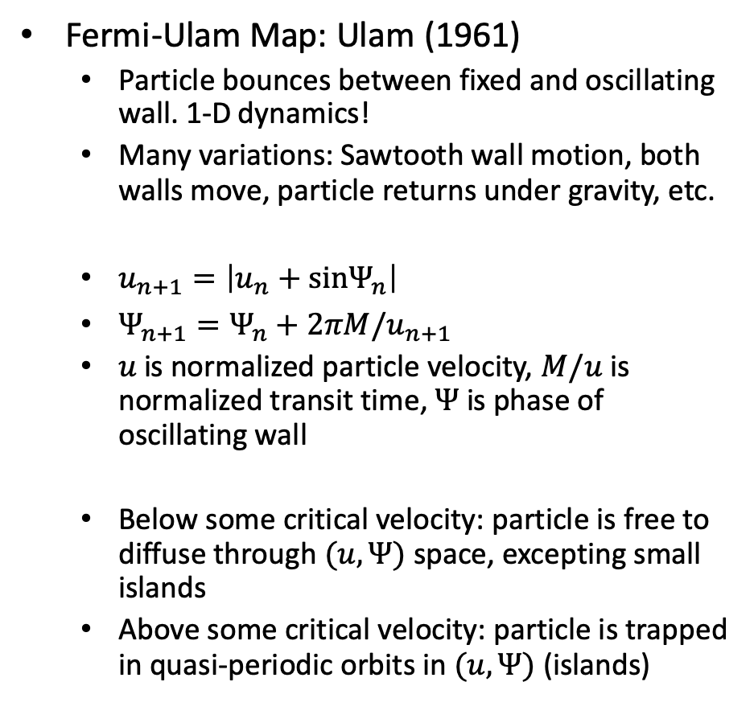
Fermi-Ulam Map
Fermi-Ulam Map: Ulam (1961)
  Particle bounces between fixed and oscillating wall. 1-D dynamics!
  Many variations: Sawtooth wall motion, both walls move, particle returns under gravity, etc.
  $u_{n+1}=\left|u_{n}+sinΨ_{n}\right|$
  $Ψ_{n+1}=Ψ_{n}+2πM/u_{n+1}$
  $u$ is normalized particle velocity, $M/u$ is normalized transit time, $Ψ$ is phase of oscillating wall
  Below some critical velocity: particle is free to diffuse through $(u,Ψ)$ space, excepting small islands
  Above some critical velocity: particle is trapped in quasi-periodic orbits in $(u,Ψ)$ (islands)
Lieberman (1972)

Slide 6
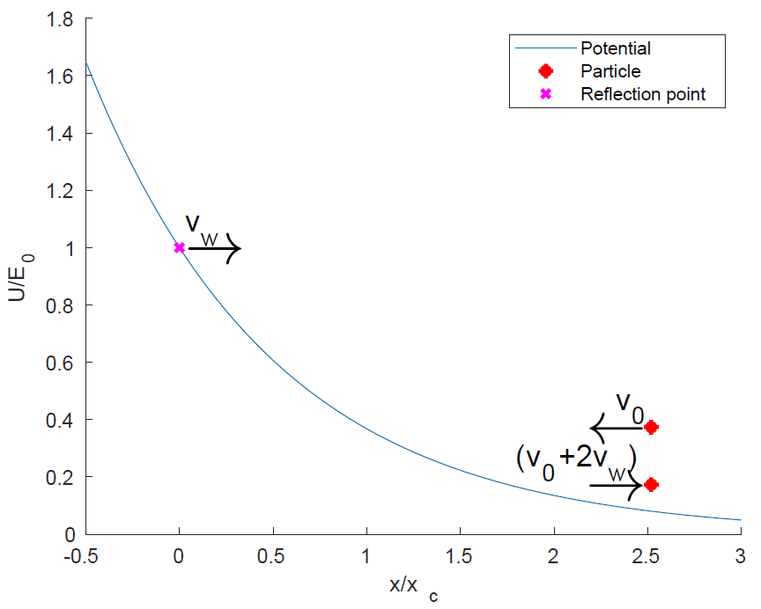


Electrostatic fluctuation in a magnetic mirror
Localized voltage fluctuation
  Electrons passing close to the nozzle get increments to ${\vec{v}}_{||}$ component of velocity, as though bouncing from a moving wall
  ${\vec{v}}_{⊥}$ is unchanged
Particles either de-trapped or prevented from heating
$$\tilde{V}$$
Mirror with localized potential fluctuation
Critical v
Heated up to v
Loss cone
Lost
A changing potential acts like
a moving wall, reflects particles
Notes:
This talk is all about heating in a mirror by electrostatic fluctuation. That’s depicted schematically in this top-left plot. You can see an electron bouncing in a mirror and a region of fluctuating voltage. On the right figure, you can see how an electron incident on a changing potential can be reflected at a different velocity. A simple, intuitive model of this behavior is that of a particle bouncing between two walls, one of which is moving.

Slide 7
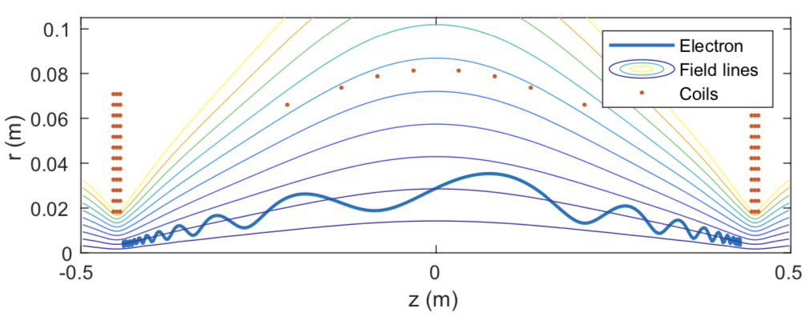
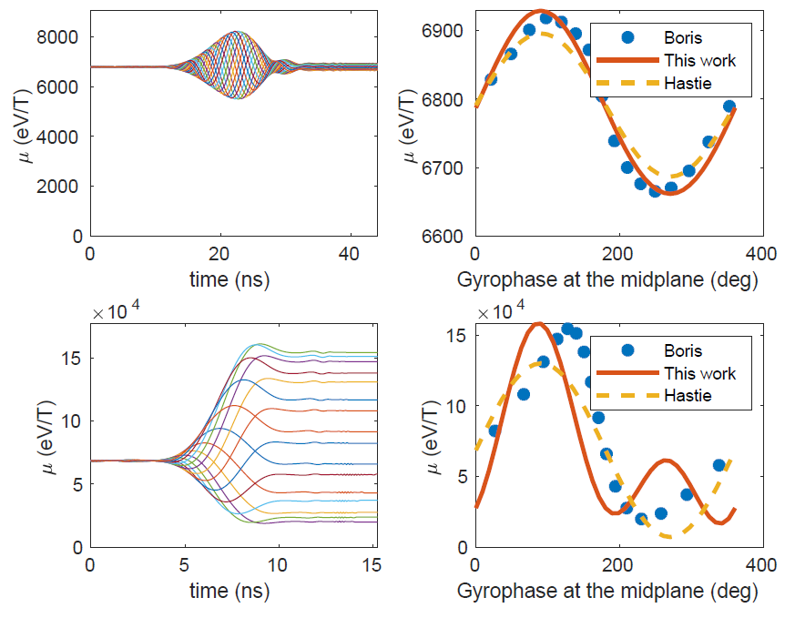
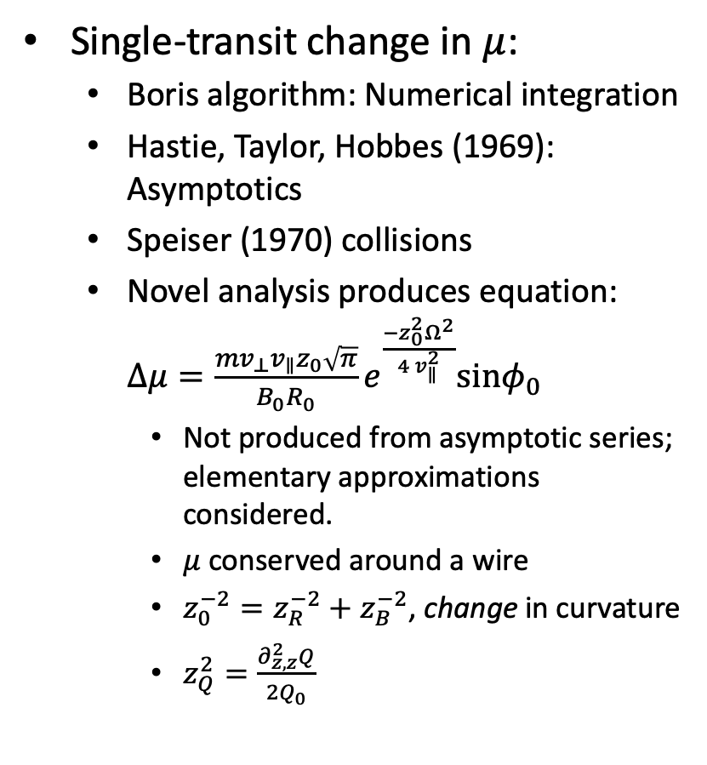
Non-adiabaticity of magnetic moment in magnetic mirror
Single-transit change in $μ$:
  Boris algorithm: Numerical integration
  Hastie, Taylor, Hobbes (1969): Asymptotics
  Speiser (1970) collisions
  Novel analysis produces equation: $Δμ=\frac{mv_{⊥}v_{∥}z_{0}\sqrt{π}}{B_{0}R_{0}}e^{\frac{−z_{0}^{2}Ω^{2}}{4 v_{∥}^{2}}}sinφ_{0}$
    Not produced from asymptotic series; elementary approximations considered.
    $μ$ conserved around a wire
    $z_{0}^{−2}=z_{R}^{−2}+z_{B}^{−2}$, change in curvature
    $z_{Q}^{2}=\frac{∂_{z,z}^{2}Q}{2Q_{0}}$
5.4 keV electron in PFRC-II
Eqn. at left
Eqn. at left
1.5 keV electron (top) and 15 keV electron (bottom) in PFRC-II

Slide 8
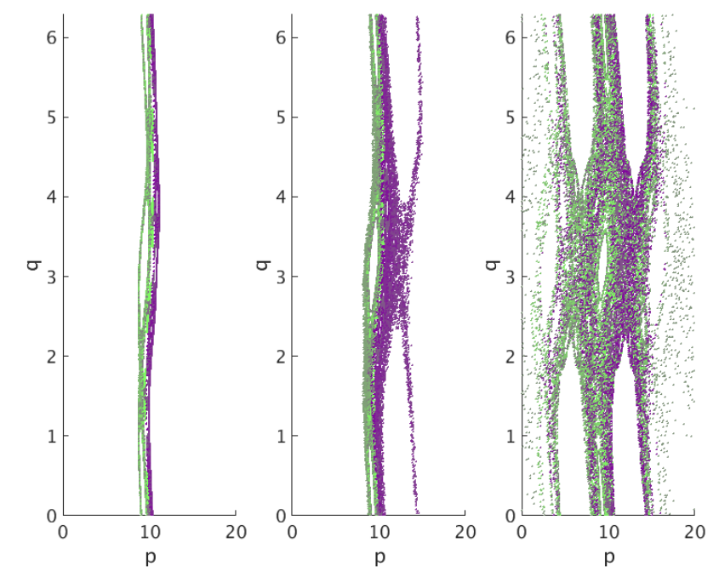
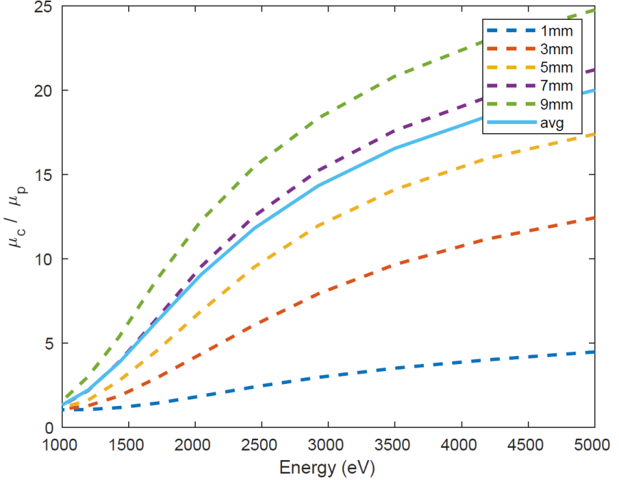
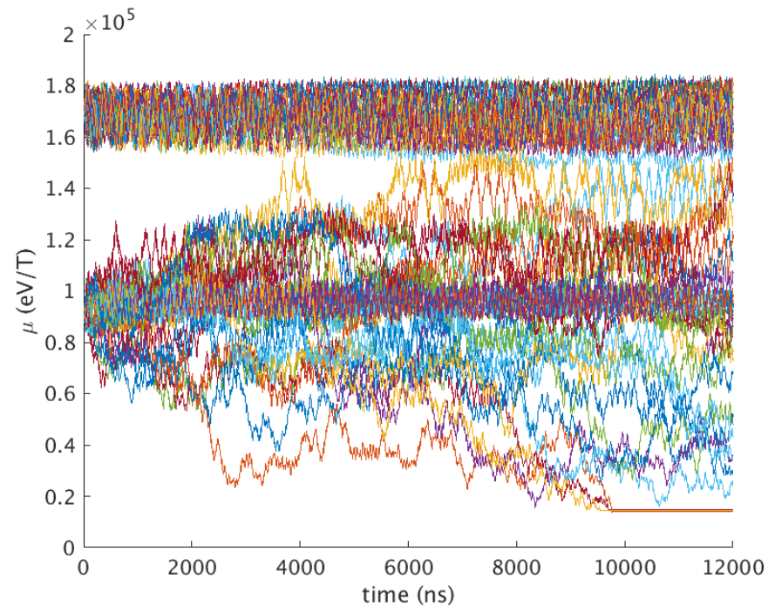






Non-adiabaticity of magnetic moment in magnetic mirror
Long-time behavior: Chirikov (1978)
  Equations for $μ,ψ$ reduce to standard map:
    $p_{n+1}=p_{n}+Ksinq_{n}$; $q_{n+1}=q_{n}+p_{n+1}$
    $K≡−∂_{μ}Δψ×δμ$
    $p=∂_{μ}Δψ×μ$; $q=ψ+π$
    $ψ$ the gyrophase at the midplane
$$K=0.9$$
$$K=1.1$$
$$K=1.3$$
The map at left exhibits a separatrix until $K=1$
$(μ_{c},E)$ for $K=1$ in PFRC. $μ_{c}$ is separatrix between diffusive and quasiperiodic.
Boris algorithm confirmation

Slide 9


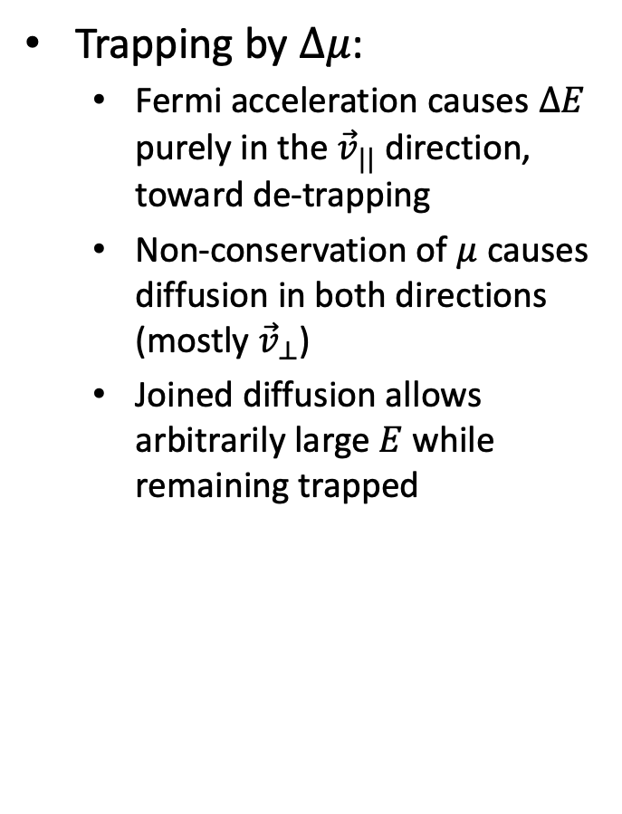

Non-adiabaticity provides trapping mechanism
Trapping by $Δμ$:
  Fermi acceleration causes $ΔE$ purely in the ${\vec{v}}_{||}$ direction, toward de-trapping
  Non-conservation of $μ$ causes diffusion in both directions (mostly ${\vec{v}}_{⊥}$)
  Joined diffusion allows arbitrarily large $E$ while remaining trapped
$Δμ$
$$ΔE$$
Having diffusion in $μ$ allows Fermi acceleration not to de-trap particles

Slide 10
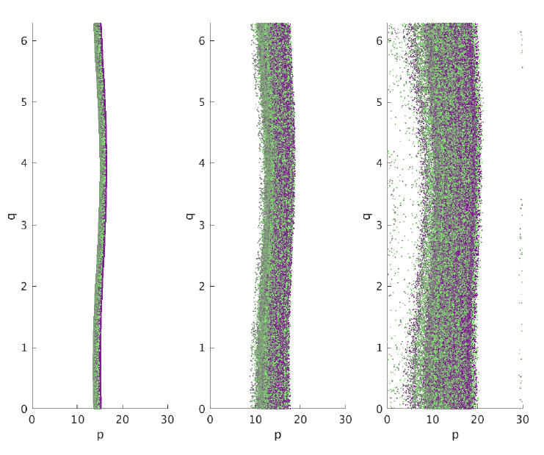

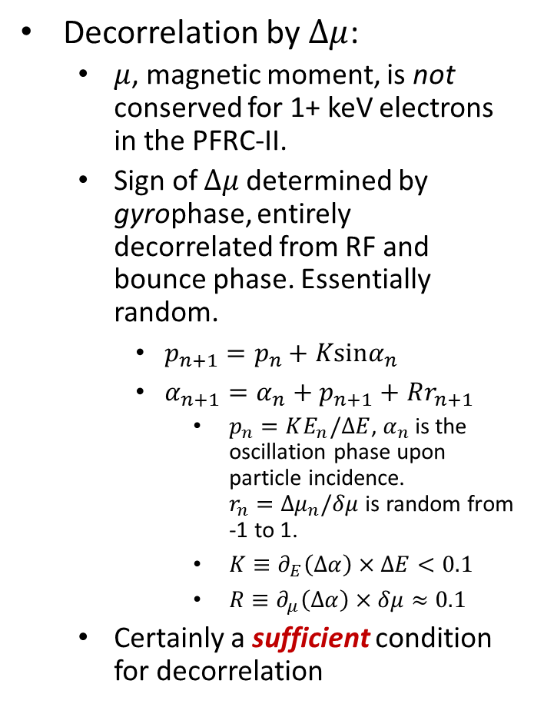



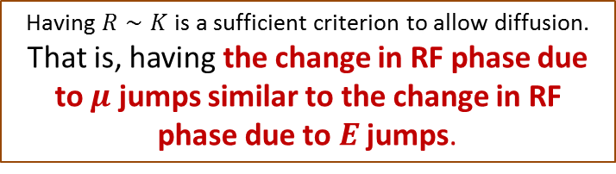


Non-adiabaticity provides adequate decorrelation
Decorrelation by $Δμ$:
  $μ$, magnetic moment, is not conserved for 1+ keV electrons in the PFRC-II.
  Sign of $Δμ$ determined by gyrophase, entirely decorrelated from RF and bounce phase. Essentially random.
    $p_{n+1}=p_{n}+Ksinα_{n}$
    $α_{n+1}=α_{n}+p_{n+1}+Rr_{n+1}$
      $p_{n}=KE_{n}/ΔE$, $α_{n}$ is the oscillation phase upon particle incidence. $r_{n}=Δμ_{n}/δμ$ is random from -1 to 1.
      $K≡∂_{E}\left(Δα\right)×ΔE<0.1$
      $R≡∂_{μ}\left(Δα\right)×δμ≈0.1$
  Certainly a sufficient condition for decorrelation
$$α$$
$$α$$
$$α$$
$$K=0.1, R=0$$
$$K=0.1,R=0.1$$
$$K=0.1,R=0.2$$
Having $R∼K$ is a sufficient criterion to allow diffusion.
That is, having the change in RF phase due to $μ$ jumps similar to the change in RF phase due to $E$ jumps.
Notes:
However, \mu is very mobile in the PFRC. It changes a significant amount in each transit. Because change in \mu depends on gyro-phase and change in energy depends on oscillation phase, they’re entirely decoupled dynamics.
Here, I’ve reproduced the standard map, but with this random term R*r, for “random”. This is mimicking the effect of mu-jumps on the Fermi-Ulam map. The size of the random term is determined by big-R, which is the amount that oscillation phase is changed by a characteristic \mu jump, rather than energy jump as for K. In the PFRC, this number is about 0.1 for a 1 keV particle.
On the right here, I’ve plotted 3 cases: the perfectly adiabatic case of K=0.1, R=0, in which there is no diffusion, the realistic case of K=0.1 and R=0.1, in which diffusion takes place and there is no maximum energy, and the extreme case of K=0.1, R=0.2 in which there is a lot of diffusion.
The result of this numerical experiment is that if a change in \mu can affect the next interaction’s oscillation phase by as much or more as the change in energy, decorrelation is significant and diffusion can occur.

Slide 11
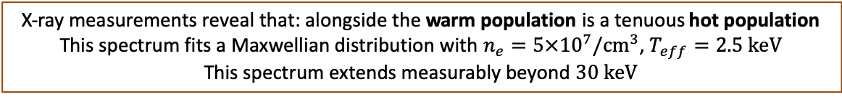
Typical Properties of the Hot Electrons
C
N
Ar
Cr
Fe
Warm population
Hot population
30+ keV
X-ray measurements reveal that: alongside the warm population is a tenuous hot population
This spectrum fits a Maxwellian distribution with $n_{e}=5×{10}^{7}/{cm}^{3}$, $T_{eff}=2.5 keV$
This spectrum extends measurably beyond $30 keV$
Notes:
X-ray measurements proved the most useful for probing this plasma. Here, you can see a typical x-ray spectrum recorded from the PFRC-II. You can see the x-ray Bremsstrahlung that I’ve fit to two Maxwellian populations here, one tenuous one at 2*10^8/cc with temperature 600 eV, and one even more tenuous one at 5*10^7 with temperature 2.5 keV. These are the “warm” and “hot” electrons I’ve mentioned previously. You can see spectral lines from impurities in the plasma, most notably carbon and nitrogen. I’d plotted this spectrum in its entirety, you’d see counts all the way out beyond 30 keV, indicating that there are at least some electrons with energies higher than 30 keV.
These measurements are x-ray measurements, but they took care to analyze and interpret. In the next slide I’ll talk about the x-ray data in this talk.

Slide 12
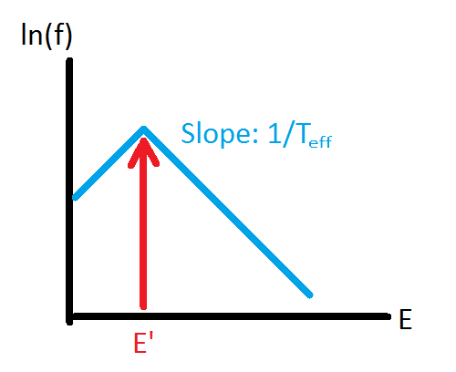


Background on particle heating via electrostatic waves
Decorrelation allows diffusion in EEDF
  $∂_{t}f=∂_{E}D_{E}∂_{E}f−f/τ$
  Green’s function for solution: $f∝e^{±E/T_{eff}}$, $T_{eff}=ΔE\sqrt{\frac{τ}{t_{t}}}$
$f$ EEDF
$D_{E}$ energy diffusivity
$τ$ loss time
$t_{t}$ transit time
$ΔE$ energy increment
Electrostatic
Fluctuation
Confinement
Phase Decorrelation
Hot electrons
~ 3 W
Warm electrons
~ 30 W
Particles injected at $E^{′}$ are shaped into an exponential function
of energy by the action of energy diffusion and loss
Notes:
Here’s the model I’ll be using to explain the electron heating. Because of the decorrelation, a diffusion-plus-loss equation can be used, right here. This diffusion-plus-loss process actually produces an exponential electron energy distribution function in steady state, with this temperature.
*CLICK*
This diagram of the process actually includes all of the effects I showed on the outline slide. Warm electrons are what are accelerated by an electrostatic fluctuation, causing confined hot electrons. And phase decorrelation allows the gain to be diffusive. In the coming slides, I’ll be describing them in this order
*CLICK CLICK CLICK CLICK CLICK*
I should mention the efficiency of this system.
*CLICK*
Recall that roughly 300 W is the input power. Evaluating the power coupled to the warm electrons by a process I won’t discuss unless you’re curious at the end, I estimate that these warm electrons get about 30 W. Evaluating the power coupled to the hot electrons, I estimate about 3 W, a factor of 10 loss each time.

Slide 13
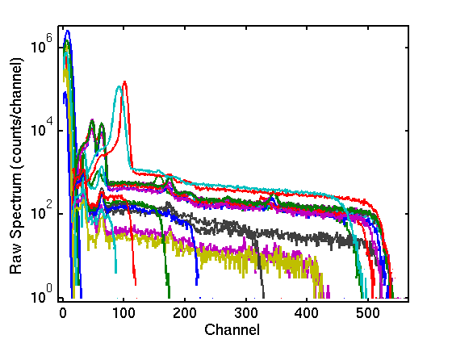
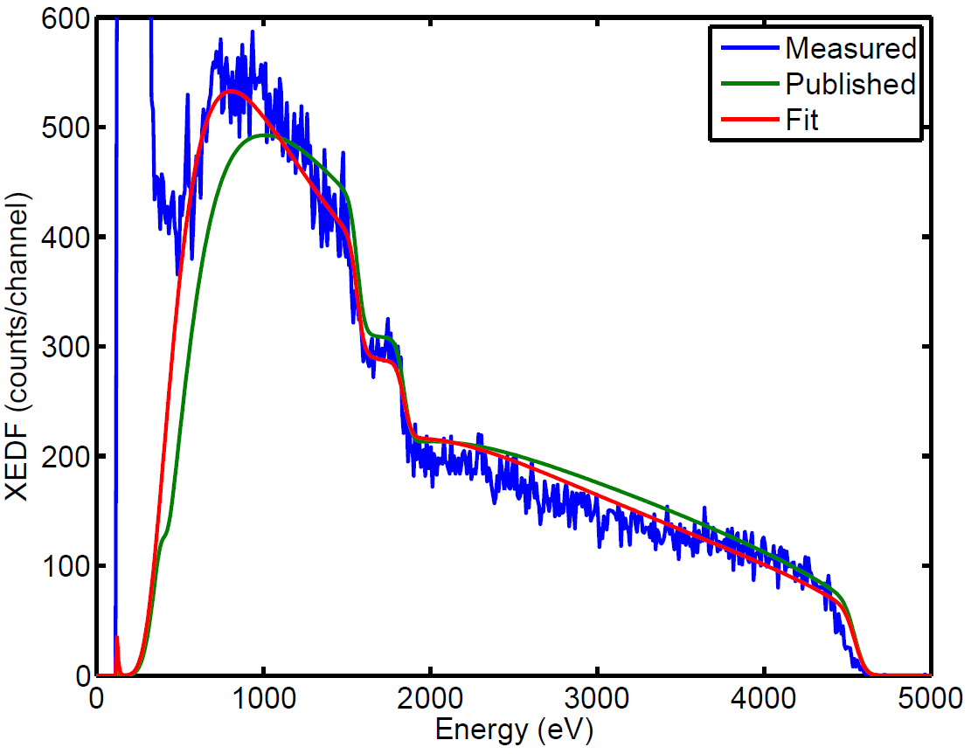
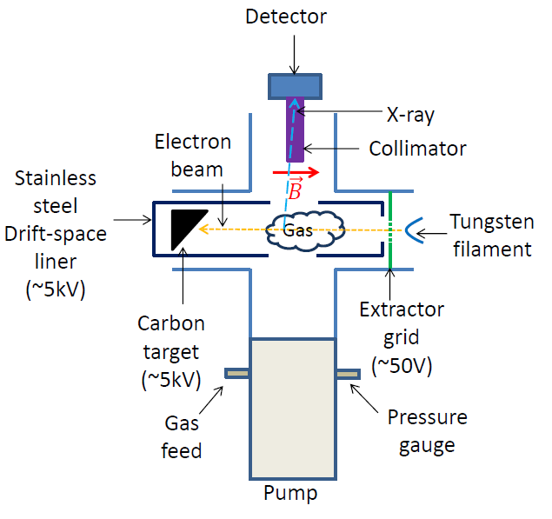
Detector Calibration Via Gas-target Bremsstrahlung
Aside: x-ray measurement (Swanson, 2018)
  Slope: line-averaged temperature
  Intensity: line-averaged density
  4 detector mounts on PFRC
  Calibration, Poisson-regularized inversion
    EEDF features from 600 eV to 100 keV
    Bayesian. Self-consistently includes effects of
      Window transmission
      Detector resolution
      Counting statistics
CNO
Ne
Window transmission calibrated
Energy calibrated
Al
Ar
Notes:
If you want to know more, you can read the paper I published in AIP advances with Peter Jandovitz and Sam Cohen, you can read Chapter 2 of the dissertation, or you can a question at the end of this talk.
The PFRC group has two Amptek Silicon Drift Detector x-ray detectors. In order to get all the information we possibly could out of them, Bruce Berlinger and I constructed this gas-target x-ray tube. A monoenergetic beam of x-rays is injected over here, and a feed gas is let into the tube. I measure the x-ray emission from this setup over here.
First, I calibrated the energy using the spectral lines of known targets. You can see that here, in this figure.
*CLICK*
Then, critical to evaluating density, I calibrated the window transmission. The detector is protected by a silicon nitride window, whose energy-dependent transmission is published by Amptek. But the windows are manufactured to some finite tolerance. The blue line is a spectrum measured from a monoenergetic electron beam, and the green line is what you’d expect from the published values. The red line is an improved fit, which is only obtainable via this calibration procedure.
On the far left there, you can see I mention Poisson-regularized Inversion. That’s a process by which a measured x-ray spectrum can recover a complete electron energy distribution, self-consistently treating the effects of window transmission, detector resolution, and counting statistics. We can apply this process to the data I fit on the previous slide…

Slide 14
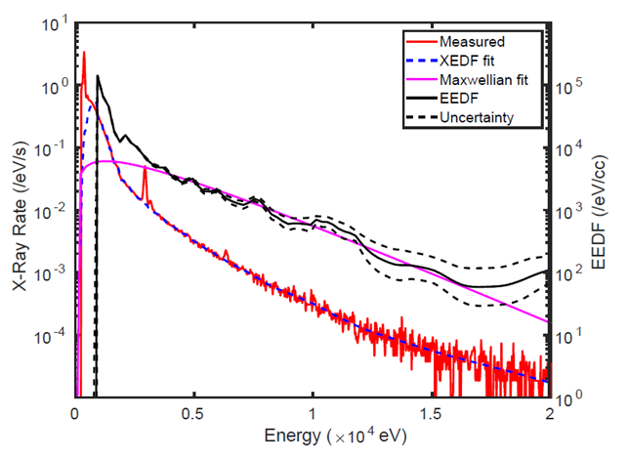
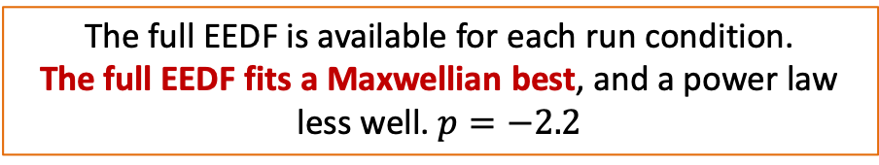


Typical Properties of the Hot Electrons
Measurement of EEDF allows:
  Non-Maxwellian features to be discovered
  Energy-dependent quantities (risetime, decay time) to be measured
  Radial profiles to be measured (Abel transform requires linear quantity)
$$n_{e}=3×{10}^{7}/{cm}^{3}$$
$$T_{e}=2.5 keV$$
The full EEDF is available for each run condition.
The full EEDF fits a Maxwellian best, and a power law less well. $p=−2.2$
Notes:
Here, you can see plotted on one plot both the measured x-ray spectrum in red and the inverted EEDF in black. You can see that the Maxwellian-looking fit I showed to slides ago really does translate into a good fit with a Maxwellian EEDF, in magenta. This EEDF fits a Maxwellian, but it also fits marginally a power law with p=-2.2. It does not fit the Kolmogorov 5/3.
In this specific case, the inversion justified our choice of a Maxwellian, but in other cases, it’s been useful in detecting non-maxwellian features. For example, we’ve seen EEDF flattening and truncation.
The inversion also allows us to measure energy-dependent quantities, like loss time of electrons with a specific energy.
An inversion into EEDF, rather than a fit, gives a linear property from which an abel inversion may be calculated. For a fit, the fit temperature of a line-integrated x-ray spectrum is not the line-integration of the temperature. You can’t do an Abel inversion on fit parameters. But you can do them on EEDF-derived parameters, like density or kinetic energy density above a certain energy.
Now I will go more into depth on those phenomena I introduced in the outline slide, the electrostatic fluctuation, the initial, warm plasma, the confinement, and the decorrelation.

Slide 15
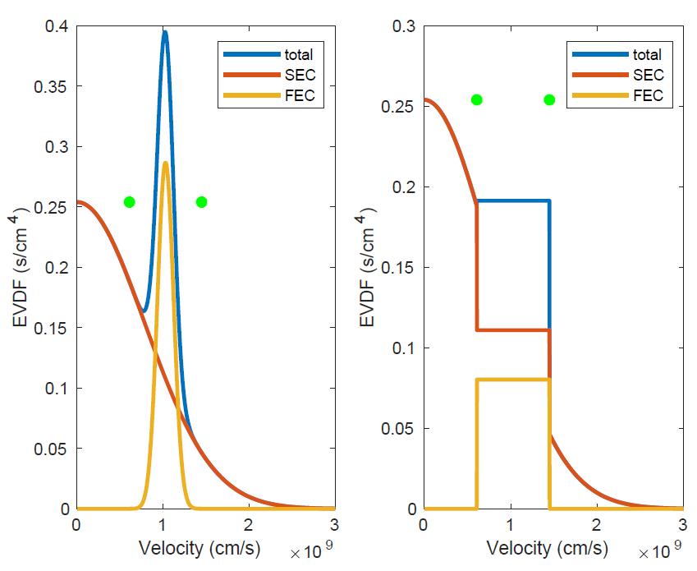
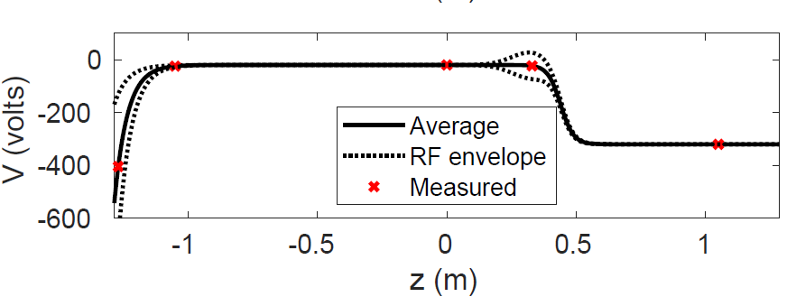


Stronger fluctuation -> Hotter electrons
Spontaneous potential fluctuation measured via probe
Measurements are consistent with two-stream instability
Recall $T_{eff}=ΔE\sqrt{\frac{τ}{t_{t}}}$
Beam
Probe
Beam
Expected saturation is $∼50$ V
Beam comes from ionization downstream of a potential drop
Notes:
I’ve identified this voltage fluctuation is my proposed mechanism for acceleration. It comes about spontaneously, unlike the mirrors which deliberately inject beams. I use an electrostatic probe to measure it, here.
I’ve identified a candidate mechanism for the cause of this fluctuation: It is two-stream instability from a spontaneous, monoenergetic beam of electrons entering from the far end cell. I won’t discuss that process, but if you’re curious, you can read the dissertation chapter 6 or ask during the questions part of the talk.
At right, I’ve plotted a candidate velocity distribution informed by x-ray measurements of the center cell and probe measurements of the far end cell. As you can see, this EVDF is unstable, and we can get a feel for the saturation voltage we’d expect from this EVDF by determining the velocity range over which you need to flatten it to get a decreasing function.
The oscillation I discuss here, today, has an amplitude of about 50 V and a frequency of 200 MHz. These are consistent with the mechanism I’ve summarized on this slide.

Slide 16
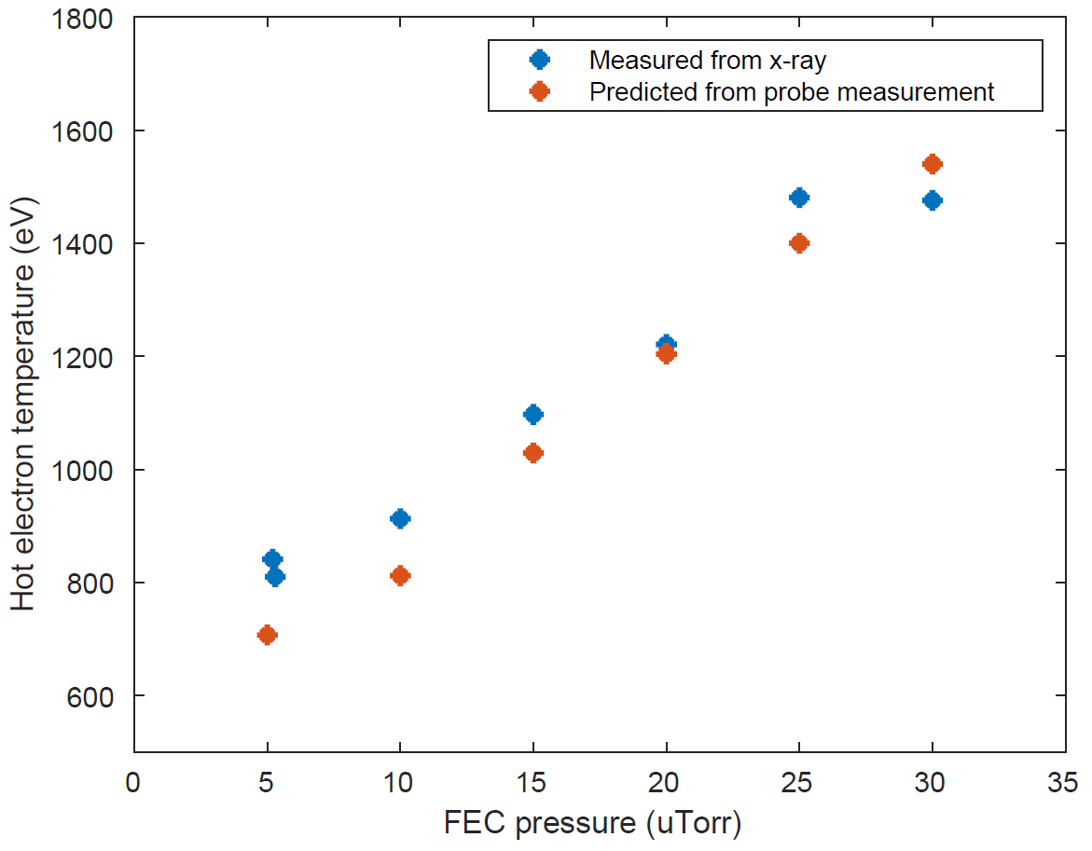
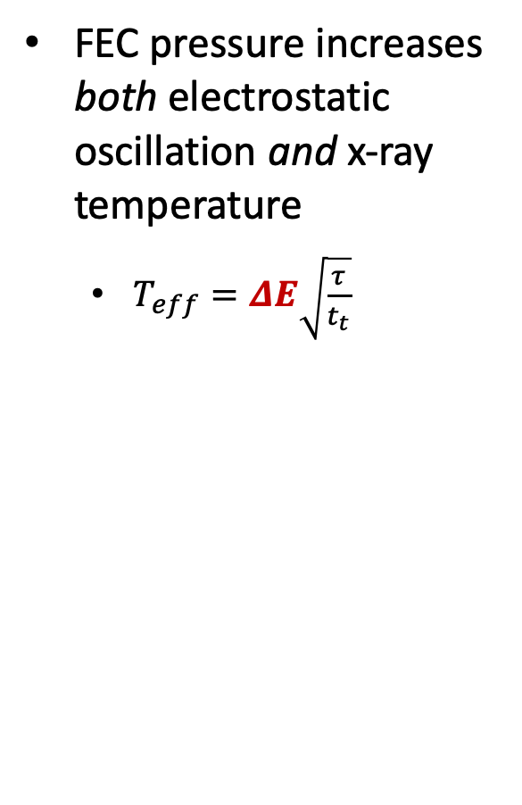
Stronger fluctuation -> Hotter electrons
FEC pressure increases both electrostatic oscillation and x-ray temperature
  $T_{eff}=ΔE\sqrt{\frac{τ}{t_{t}}}$
Temperature and fluctuation amplitude vary in the way predicted by the diffusion-loss model
Notes:
For reasons I don’t plan to discuss, increasing the gas pressure in the far end cell increases the beam current. It gives us a great knob to hold other quantities constant, and just change the amplitude of the voltage fluctuation. Here on the right, I plot x-ray fit quantities versus that gas pressure. I also plot the measured voltage oscillation amplitude, here.
*CLICK*
You can see that they’re linear with each other. Later, I’ll make this more quantitative, but for now I’ll just say they’re linear.
*CLICK*
You may have noticed these little outliers. This is my justification for why I measured the x-ray spectrum and voltage fluctuation a different times; inserting the probe actually changed the x-ray signal.

Slide 17
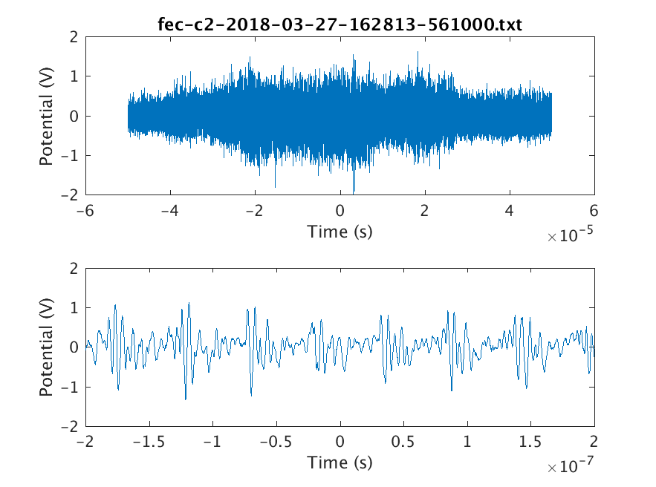
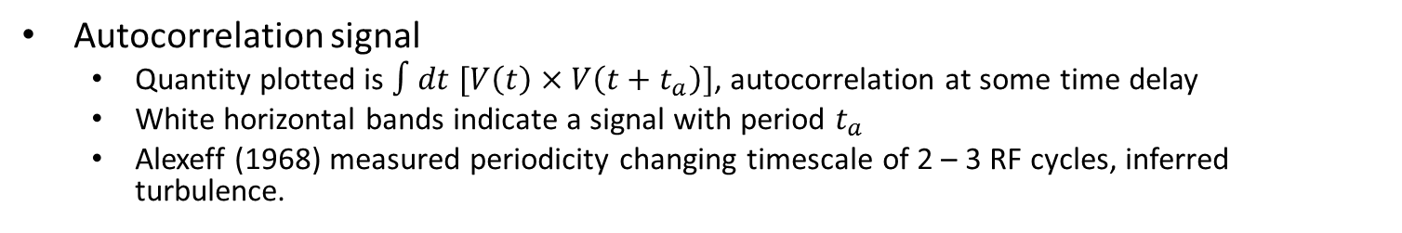
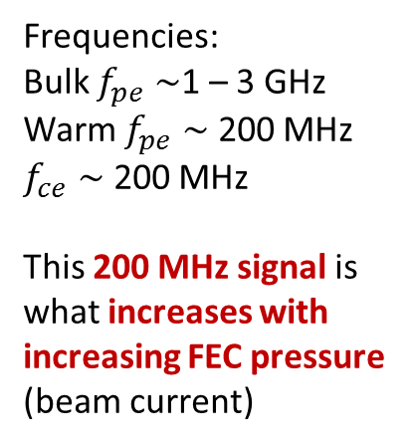
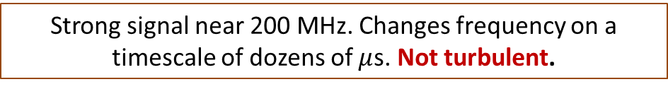
Stronger fluctuation -> Hotter electrons
Autocorrelation signal
  Quantity plotted is $∫dt [V\left(t\right)×V\left(t+t_{a}\right)]$, autocorrelation at some time delay
  White horizontal bands indicate a signal with period $t_{a}$
  Alexeff (1968) measured periodicity changing timescale of 2 – 3 RF cycles, inferred turbulence.
Frequencies:
Bulk $f_{pe}∼$1 – 3 GHz
Warm $f_{pe}∼$ 200 MHz
$f_{ce}∼$ 200 MHz
This 200 MHz signal is what increases with increasing FEC pressure (beam current)
200 MHz
19 MHz RF
Strong signal near 200 MHz. Changes frequency on a timescale of dozens of $μ$s. Not turbulent.
Notes:
Here I’ve plotted some data taken directly from a probe voltage time trace; the quantity plotted is the autocorrelation at some time delay.
Here’s how to read this plot: A white, horizontal bar is a periodic signal with some duration with a period the auto-correlation time. You can see here that this signal down here is the 19 MHz RF signal that generates the plasma. This is too slow to cause acceleration; if you have a 50 V oscillation but only change by half a volt during the time that the electron is interacting, you only gain half an eV of energy.
The more interesting signal is up here, at 200 MHz. This is large enough amplitude and high enough frequency to cause the heating we see.
You can see that modes pop in and out of existence on a dozen-microsecond timescale. This is in contrast to what Alexeff et al have seen in their beam-generated turbulence; they also looked at correlation time and found coherence on only a couple of RF cycles. That short correlation time is enough to cause energy diffusion. This spectrum is too periodic.
Here are some relevant frequencies. I want to remind you that this 200 MHz signal up here is the one that I measured in the last slide to increase with increasing far end cell pressure and therefore supposedly increasing beam current.

Slide 18
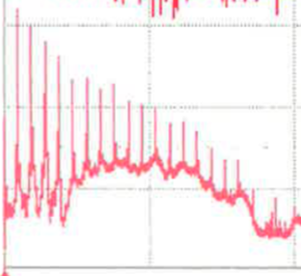
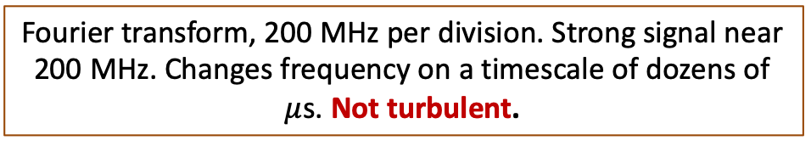
Stronger fluctuation -> Hotter electrons
Autocorrelation signal
  Quantity plotted is $∫dt [V\left(t\right)×V\left(t+t_{a}\right)]$, autocorrelation at some time delay
  White horizontal bands indicate a signal with period $t_{a}$
  Alexeff (1968) measured periodicity changing timescale of 2 – 3 RF cycles, inferred turbulence.
Frequencies:
Bulk $f_{pe}∼$1 – 3 GHz
Warm $f_{pe}∼$ 200 MHz
$f_{ce}∼$ 200 MHz
This 200 MHz signal is what increases with increasing FEC pressure (beam current)
200 MHz
19 MHz RF
Fourier transform, 200 MHz per division. Strong signal near 200 MHz. Changes frequency on a timescale of dozens of $μ$s. Not turbulent.
Notes:
Here I’ve plotted some data taken directly from a probe voltage time trace; the quantity plotted is the autocorrelation at some time delay.
Here’s how to read this plot: A white, horizontal bar is a periodic signal with some duration with a period the auto-correlation time. You can see here that this signal down here is the 19 MHz RF signal that generates the plasma. This is too slow to cause acceleration; if you have a 50 V oscillation but only change by half a volt during the time that the electron is interacting, you only gain half an eV of energy.
The more interesting signal is up here, at 200 MHz. This is large enough amplitude and high enough frequency to cause the heating we see.
You can see that modes pop in and out of existence on a dozen-microsecond timescale. This is in contrast to what Alexeff et al have seen in their beam-generated turbulence; they also looked at correlation time and found coherence on only a couple of RF cycles. That short correlation time is enough to cause energy diffusion. This spectrum is too periodic.
Here are some relevant frequencies. I want to remind you that this 200 MHz signal up here is the one that I measured in the last slide to increase with increasing far end cell pressure and therefore supposedly increasing beam current.

Slide 19
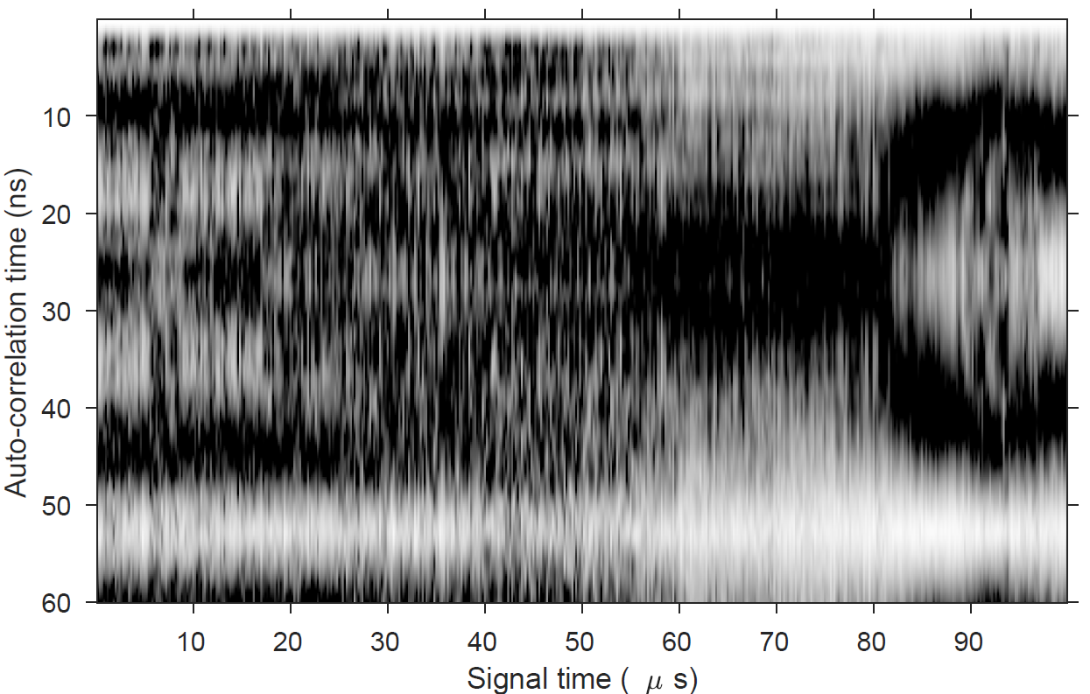
Stronger fluctuation -> Hotter electrons
Autocorrelation signal
  Quantity plotted is $∫dt [V\left(t\right)×V\left(t+t_{a}\right)]$, autocorrelation at some time delay
  White horizontal bands indicate a signal with period $t_{a}$
  Alexeff (1968) measured periodicity changing timescale of 2 – 3 RF cycles, inferred turbulence.
Frequencies:
Bulk $f_{pe}∼$1 – 3 GHz
Warm $f_{pe}∼$ 200 MHz
$f_{ce}∼$ 200 MHz
This 200 MHz signal is what increases with increasing FEC pressure (beam current)
200 MHz
19 MHz RF
Strong signal near 200 MHz. Changes frequency on a timescale of dozens of $μ$s. Not turbulent.
Notes:
Here I’ve plotted some data taken directly from a probe voltage time trace; the quantity plotted is the autocorrelation at some time delay.
Here’s how to read this plot: A white, horizontal bar is a periodic signal with some duration with a period the auto-correlation time. You can see here that this signal down here is the 19 MHz RF signal that generates the plasma. This is too slow to cause acceleration; if you have a 50 V oscillation but only change by half a volt during the time that the electron is interacting, you only gain half an eV of energy.
The more interesting signal is up here, at 200 MHz. This is large enough amplitude and high enough frequency to cause the heating we see.
You can see that modes pop in and out of existence on a dozen-microsecond timescale. This is in contrast to what Alexeff et al have seen in their beam-generated turbulence; they also looked at correlation time and found coherence on only a couple of RF cycles. That short correlation time is enough to cause energy diffusion. This spectrum is too periodic.
Here are some relevant frequencies. I want to remind you that this 200 MHz signal up here is the one that I measured in the last slide to increase with increasing far end cell pressure and therefore supposedly increasing beam current.

Slide 20
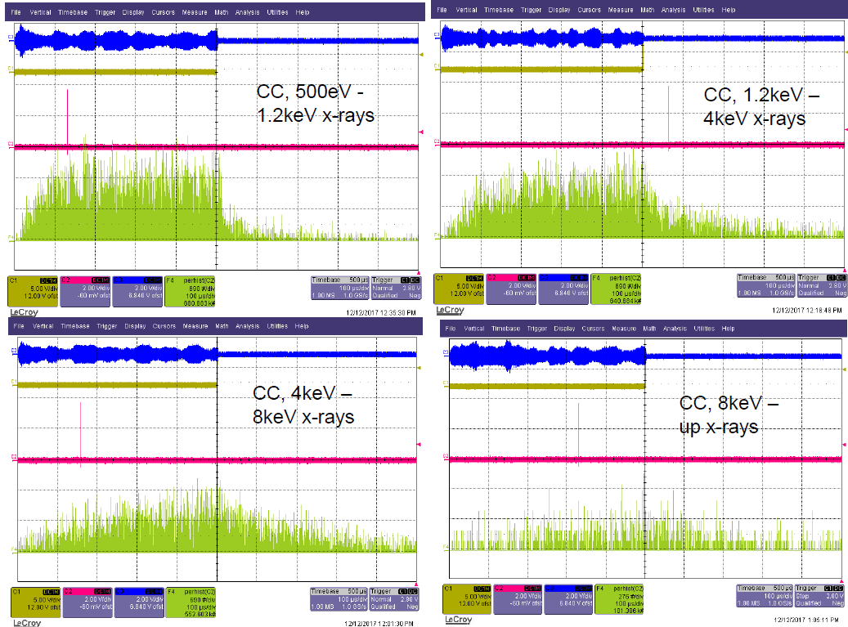
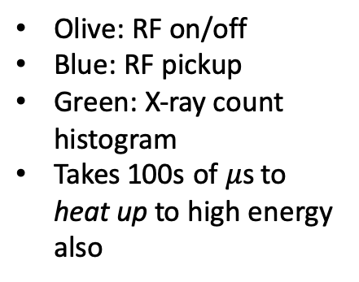
Confinement increases with energy
Olive: RF on/off
Blue: RF pickup
Green: X-ray count histogram
Takes 100s of $μ$s to heat up to high energy also
X-ray detector set to trigger on x-rays of an energy range. Raw oscillographs show that confinement time is larger for higher energy electrons.
Notes:
These are oscillographs in time of raw x-ray data; for each one I plotted incident x-rays after the cessation of RF in a specific band of energy. After RF is ceased, the low-energy x-rays decay almost immediately. As you go higher in energy, the x-rays persist for longer and longer, until at 8+ keV, they’re so long they’re still around from the last pulse of RF when the new one starts.
By applying the spectral inversion technique I described before, we can quantify this behavior.

Slide 21
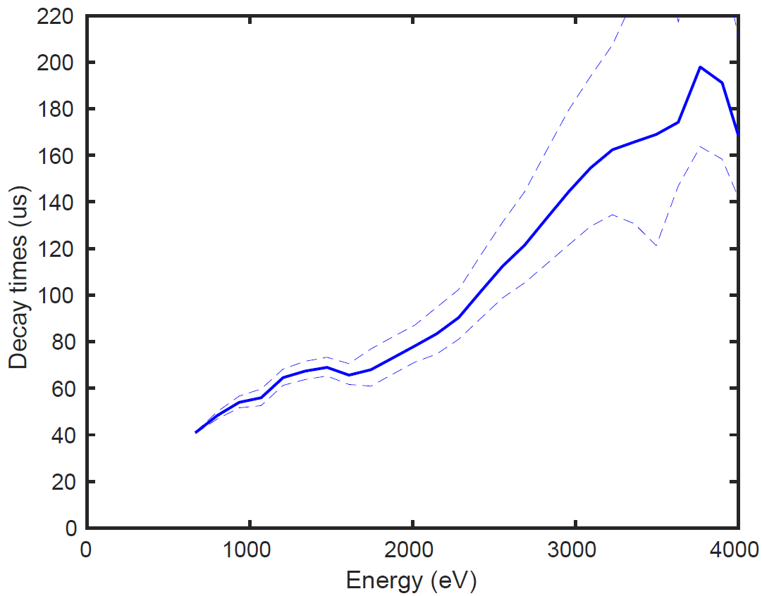
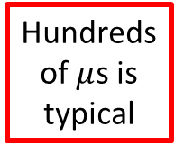
Confinement increases with energy
Hundreds of $μ$s is typical
Uncertainty is large
With the help of spectral inversion, we may quantify the e-folding time for each energy. Linear and sub-linear dependences are consistent with data.
Notes:
This is the energy-dependent e-folding time I obtained from measuring x-ray spectra at four different times after the cessation of RF. The uncertainty is large, but you can see that it’s an increasing function of energy, and that hundreds of microseconds is typical.
Because of the uncertainty, this could be linear or sublinear. This plot took eight hours of data collection.

Slide 22
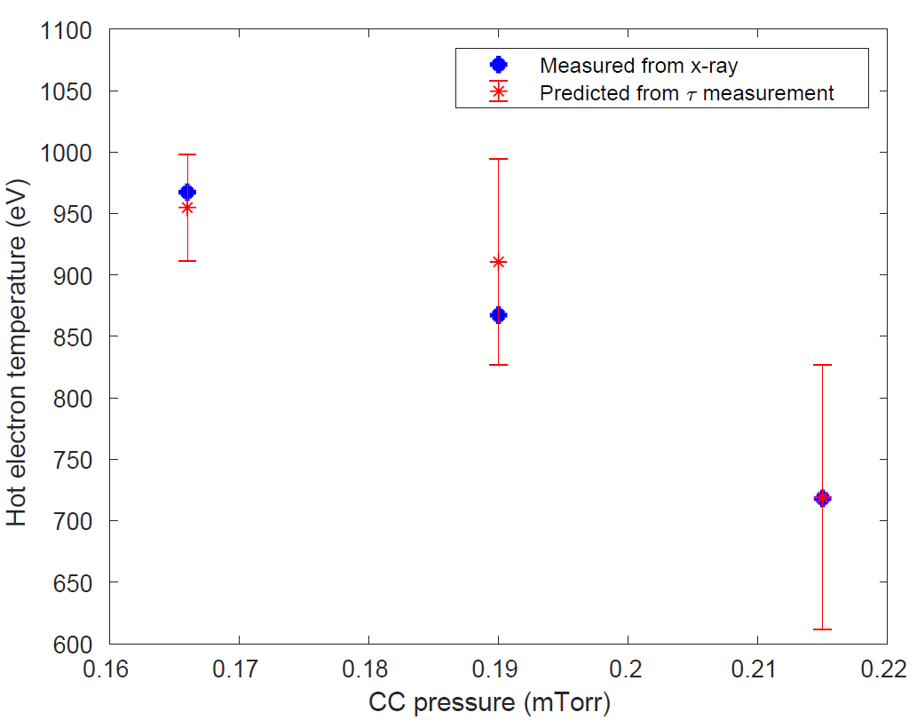
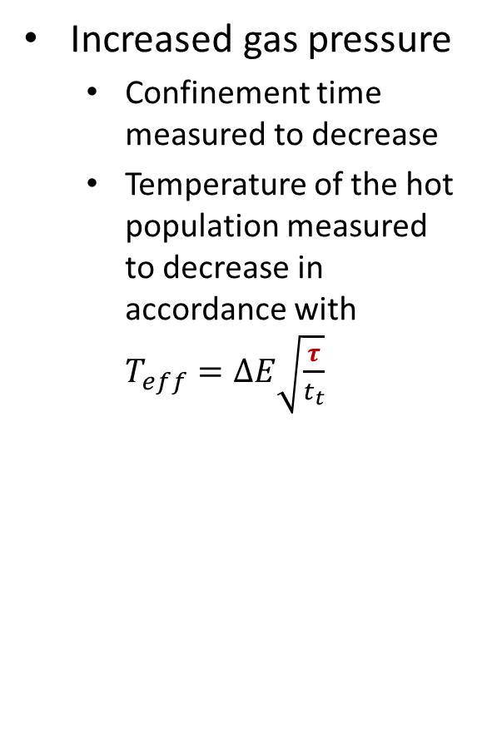
Confinement increases with energy
Increased gas pressure
  Confinement time measured to decrease
  Temperature of the hot population measured to decrease in accordance with $T_{eff}=ΔE\sqrt{\frac{τ}{t_{t}}}$
Changing confinement time by changing the gas pressure has the effect predicted by the diffusion model.
Notes:
For this plot, I changed the gas pressure in the central cell. This had the effect of keeping most quantities constant, but changing the confinement time. I measured three quantities, the x-ray temperature which is plotted as “T 3keV+” on the right, and the confinement time as before and the voltage fluctuation. These last two were combined into an effective temperature using the diffusion-loss model and plotted with red x’s.
Because the measured and predicted temperatures agree, this figure is evidence for the validity of the diffusion-loss model.
Now I’ve discussed the particle loss time, I can go ahead and shed some light on the FEC pressure plot, earlier. In it, I showed that fluctuation amplitude and measured temperature were linear, but I hadn’t discussed confinement yet. Now I can say that they’re not just linear; they agree.

Slide 23
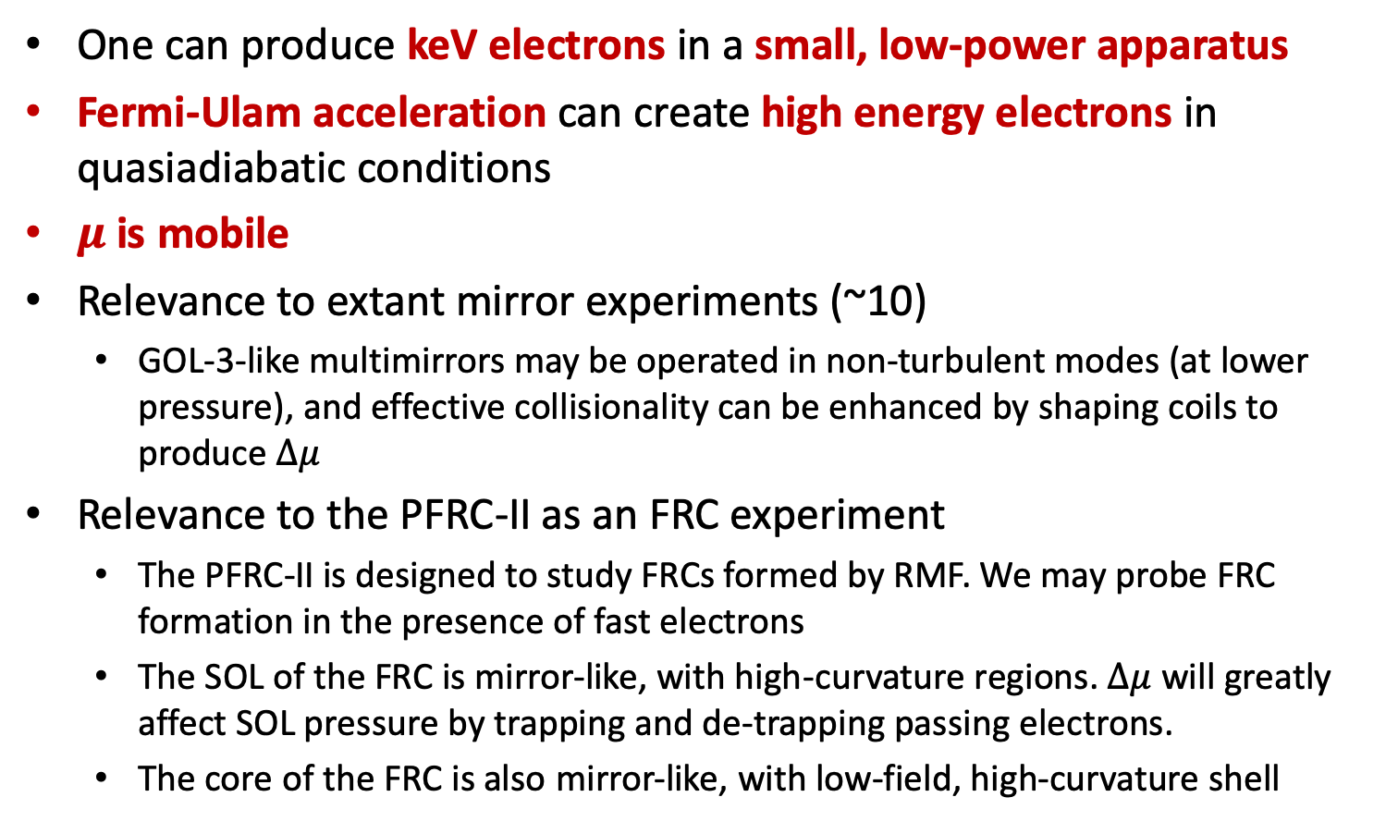
Conclusions
One can produce keV electrons in a small, low-power apparatus
Fermi-Ulam acceleration can create high energy electrons in quasiadiabatic conditions
$μ$ is mobile
Relevance to extant mirror experiments (~10)
  GOL-3-like multimirrors may be operated in non-turbulent modes (at lower pressure), and effective collisionality can be enhanced by shaping coils to produce $Δμ$
Relevance to the PFRC-II as an FRC experiment
  The PFRC-II is designed to study FRCs formed by RMF. We may probe FRC formation in the presence of fast electrons
  The SOL of the FRC is mirror-like, with high-curvature regions. $Δμ$ will greatly affect SOL pressure by trapping and de-trapping passing electrons.
  The core of the FRC is also mirror-like, with low-field, high-curvature shell

Slide 24
Backup Slides & References

Slide 25
References (1/3)
Fermi, ENRICO. “On the Origin of the Cosmic Radiation.” Physical Review 75, no. 8 (April 15, 1949): 1169–74. https://doi.org/10.1103/PhysRev.75.1169.
Ulam, S. “On Some Statistical Properties of Dynamical Systems.” In Proceedings of the Fourth Berkeley Symposium on Mathematical Statistics and Probability, 315. University of California Press, 1961.
Speiser, T. W. “Conductivity without Collisions or Noise.” Planetary and Space Science 18, no. 4 (April 1, 1970): 613–22. https://doi.org/10.1016/0032-0633(70)90136-4.
Dodin, Ilya. 2014. AST 553, Plasma Waves and Instabilities, Lecture 9 notes. Retrieved from http://www.princeton.edu/~idodin/ast553/lectures/lecture-09/lecture-09.pdf
Lichtenberg, A. J., M. A. Lieberman, and R. H. Cohen. “Fermi Acceleration Revisited.” Physica D: Nonlinear Phenomena 1, no. 3 (September 1, 1980): 291–305. https://doi.org/10.1016/0167-2789(80)90027-5.
I. Alexeff, R. V. Neidigh, W. F. Peed, E. D. Shipley, and E. G. Harris. Hot-Electron Plasma by Beam-Plasma Interaction. Physical Review Letters, 10(7):273–276, April 1963. doi: 10.1103/PhysRevLett.10.273. URL https://link.aps.org/doi/10.1103/PhysRevLett.10.273.
I. Alexeff, R. V. Neidigh, and W. F. Peed. Beam-Plasma Interaction Experiments and Diagnostics. Physical Review, 136(3A):A689–A695, November 1964. doi: 10.1103/PhysRev.136.A689. URL https://link.aps.org/doi/10.1103/PhysRev.136.A689.
I. Alexeff, G. E. Guest, D. Montgomery, R. V. Neidigh, and D. J. Rose. Oscillations Present in Plasma-Electron Heating by an Electron Beam. Physical Review Letters, 21(6):344–347, August 1968. doi: 10.1103/PhysRevLett.21.344. URL https://link.aps.org/doi/10.1103/PhysRevLett.21.344.
Hutchinson, I. H. Principles of Plasma Diagnostics. 2nd Edition. Cambridge, MA: Cambridge University Press, 2002. https://doi.org/10.1017/CBO9780511613630.
C. Swanson, P. Jandovitz, and S. A. Cohen. Using Poisson-regularized inversion of Bremsstrahlung emission to extract full electron energy distribution functions from x-ray pulse-height detector data. AIP Advances, 8(2):025222, February 2018. doi: 10.1063/1.5019572. URL http://aip.scitation.org/doi/full/10.1063/1.5019572.
H. Alfven. Cosmical Electrodynamics. Oxford University Press, 1950. ISBN 1-5413-4840-0. URL http://archive.org/details/CosmicalElectrodynamics
R. F. Post. SUMMARY OF UCRL PYROTRON (MIRROR MACHINE) PROGRAM. Technical Report UCRL-5044, California. Univ., Livermore. Radiation Lab., June 1958. URL http://www-naweb.iaea.org/napc/physics/2ndgenconf/data/Proceedings%201958/papers%20Vol32/Paper31_Vol32.pdf
N. Hershkowitz, S. Miyoshi, and D. D. Ryutov. Mirror devices. Nuclear Fusion, 30(9):1761, 1990. ISSN 0029-5515. doi: 10.1088/0029-5515/30/9/007. URL http://stacks.iop.org/0029-5515/30/i=9/a=007

Slide 26
References (2/3)
R. F. Post. Magnetic mirror fusion systems: Characteristics and distinctive features. Article, Lawrence Livermore National Laboratory, Livermore, CA, August 1987. URL https://digital.library.unt.edu/ark:/67531/metadc1112475/. http://www.iaea.org/inis/collection/NCLCollectionStore/ Public/19/015/19015255.pdf
John Sheffield. The physics of magnetic fusion reactors. Reviews of Modern Physics, 66(3):1015–1103, July 1994. doi: 10.1103/RevModPhys.66.1015. URL https://link.aps.org/doi/10.1103/RevModPhys.66.1015
Thomas C. Simonen. Development and Applications of Axisymmetric Magnetic Mirror Concepts. Fusion Science and Technology, 57(4):305–311, May 2010. ISSN 1536-1055. doi: 10.13182/FST10-A9491. URL https://doi.org/10.13182/FST10-A9491
L. R. Henrich. Departure of Particle Orbits from the Adiabatic Approximation. In Proc. Conf. on Thermonuclear Reactions, Gatlinburg, Tennessee, 1956. United States Atomic Energy Comission.
Alper A. Garren, Robert J. Riddell, Lloyd Smith, George Bing, John E. Roberts, Theodore G. Northrop, and Louis R. Henrich. Individual particle motion and the effect of scattering in an axially symmetric magnetic field. Journal of Nuclear Energy (1954), 7(3-4):283–284, September 1958. ISSN 08913919. doi:10.1016/0891-3919(58)90136-0. URL http://linkinghub.elsevier.com/retrieve/pii/0891391958901360.
G. Gibson, W. C. Jordan, and E. J. Lauer. Particle Behavior in a Static, Asymmetric, Magnetic Mirror Geometry. Physics of Fluids (1958- 1988), 6(1):133–141, January 1963. ISSN 0031-9171. doi: 10.1063/1.1724498. URL http://scitation.aip.org/content/aip/journal/pof1/6/1/10.1063/1.1724498
R. J. Hastie, G. D. Hobbs, and J. B. Taylor. Non-Adiabatic Behaviour of Particles in Inhomogeneous Magnetic Fields. Plasma Physics and Controlled Nuclear Fusion Research. Proceedings of the Third International Conference on Plasma Physics and Controlled Nuclear Fusion Research. Vol. I, 1969. URL http://inis.iaea.org/Search/search.aspx?orig_q=RN:44064054
Thomas J. Birmingham. Pitch angle diffusion in the Jovian magnetodisc. Journal of Geophysical Research: Space Physics, 89(A5):2699–2707, 1984. URL https://agupubs.onlinelibrary.wiley.com/doi/10.1029/JA089iA05p02699.
A. M. Dykhne and V. L. Pokrovskii. Change of the Adiabatic Invariant of a Paricle in a Magnetic Field. Journal of Experimental and Theoretical Physics, 39(2):373, 1960. URL http://www.jetp.ac.ru/cgi-bin/e/index/e/12/2/p264?a=list.
Ronald H. Cohen, George Rowlands, and James H. Foote. Nonadiabaticity in mirror machines. Physics of Fluids (1958-1988), 21(4):627–644, April 1978. ISSN 0031-9171. doi: 10.1063/1.862271. URL http://scitation.aip.org/content/aip/journal/pof1/21/4/10.1063/1.862271.
Boris V Chirikov. A universal instability of many-dimensional oscillator systems. Physics Reports, 52(5):263–379, May 1979. ISSN 0370-1573. doi:10.1016/0370-1573(79)90023-1. URL https://www.sciencedirect.com/science/article/pii/0370157379900231.
Jaeger, F., A. J. Lichtenberg, and M. A. Lieberman. “Theory of Electron Cyclotron Resonance Heating. I. Short Time and Adiabatic Effects.” Plasma Physics 14, no. 12 (1972): 1073. https://doi.org/10.1088/0032-1028/14/12/002.
Decker, R. B. “Particle Acceleration at Shocks with Surface Ripples.” Journal of Geophysical Research: Space Physics 95, no. A8 (August 1, 1990): 11993–3. https://doi.org/10.1029/JA095iA08p11993.
D. C. Delcourt, R. F. Martin, and F. Alem. A simple model of magnetic moment scattering in a field reversal. Geophysical Research Letters, 21(14):1543–1546, July 1994. ISSN 1944-8007. doi: 10.1029/94GL01291. URL http://onlinelibrary.wiley.com/doi/10.1029/94GL01291/abstract

Slide 27
References (3/3)
B. V. Chirikov. Stability of the Motion of a Charged Particle in a Magnetic Confinement System. Sov. J. Plasma Phys. (Engl. Transl.); (United States), 4:3, May 1978. URL http://www.osti.gov/scitech/biblio/6191252.
S. G. Tagare. Motion of charged particles in an axisymmetric magnetic mirror. Physical Review A, 34(2):1587–1590, August 1986. doi: 10.1103/PhysRevA.34.1587. URL https://link.aps.org/doi/10.1103/PhysRevA.34.1587.
C. Nakashima, Z. Yoshida, H. Himura, M. Fukao, J. Morikawa, and H. Saitoh. Injection of electron beam into a toroidal trap using chaotic orbits near magnetic null. Physical Review E, 65(3):036409, February 002. doi: 10.1103/PhysRevE.65.036409. URL https://link.aps.org/doi/10.1103/PhysRevE.65.036409.
Lev M. Zelenyi, Anatolii I. Neishtadt, Anton V. Artemyev, Dmitrii L. Vainchtein, and Helmi V. Malova. Quasiadiabatic dynamics of charged particles in a space plasma. Physics-Uspekhi, 56(4):347, 2013. ISSN 1063-7869. doi: 10.3367/UFNe.0183.201304b.0365. URL http://iopscience.iop.org/article/10.3367/UFNe.0183.201304b.0365/meta.
James Chen. Nonlinear dynamics of charged particles in the magnetotail. Journal of Geophysical Research: Space Physics, 97(A10): 15011–15050, October 1992. ISSN 2156-2202. doi: 10.1029/92JA00955. URL http://onlinelibrary.wiley.com/doi/10.1029/92JA00955/abstract.
P. Jandovitz, C. Swanson, J. Matteucci, R. Oliver, J. Pearcy, and S. A. Cohen. Demonstration of fast-electron populations in a low-pressure, low-power, magnetized RF plasma source. Physics of Plasmas, 5(3):030702, March 2018. ISSN 1070-664X. doi: 10.1063/1.4998735. URL https://aip.scitation.org/doi/10.1063/1.4998735.
Semiconductor Industry Association 2017 Annual Databook, .
Lin Xu, Lee Chen, Merritt Funk, Alok Ranjan, Mike Hummel, Ron Bravenec, Radha Sundararajan, Demetre J. Economou, and Vincent M. Donnelly. Diagnostics of ballistic electrons in a dc/rf hybrid capacitively coupled discharge. Applied Physics Letters, 93(26):261502, 2008. ISSN 00036951. doi: 10.1063/1.3062853. URL http://scitation.aip.org/content/aip/journal/apl/93/26/10.1063/1.3062853.
Valery A. Godyak and Natalia Sternberg. Dynamic model of the electrode sheaths in symmetrically driven rf discharges. Physical Review A, 42(4):2299–2312, August 1990. doi: 10.1103/PhysRevA.42.2299. URL https://link.aps.org/doi/10.1103/PhysRevA.42.2299.
Charles Swanson and Igor D. Kaganovich. Modeling of reduced effective secondary electron emission yield from a velvet surface. Journal of Applied Physics, 120(21):213302, December 2016. ISSN 0021-8979, 1089-7550. doi: 10.1063/1.4971337. URL http://scitation.aip.org/content/aip/journal/jap/120/21/10.1063/1.4971337.
Charles Swanson and Igor D. Kaganovich. Feathered fractal surfaces to minimize secondary electron emission for a wide range of incident angles. Journal of Applied Physics, 122(4):043301, July 2017. ISSN 0021-8979. doi: 10.1063/1.4995535. URL http://aip.scitation.org/doi/full/10.1063/1.4995535.
Charles Swanson and Igor D. Kaganovich. Modeling of reduced secondary electron emission yield from a foam or fuzz surface. Journal of Applied Physics, 123(2):023302, January 2018. ISSN 0021-8979. doi: 10.1063/1.5008261. URL http://aip.scitation.org/doi/abs/10.1063/1.5008261.

Slide 28

Non-adiabaticity of magnetic moment in magnetic mirror
Background:
  $μ$ assumed conserved or nearly so: Alfven (1950), Post (1958), many contemporary and modern reviews [Herskowitz (1990), Post (1987), Sheffield (1994), Simonen (2010)]
    Popular models can assume constant $μ$, such as MHD with anisotropic pressure and gyrokinetics.
    A common “adiabatic parameter” which is assumed to control constancy of $μ$ is $ε=ρ∇B/B$
  $Δμ$ accurately measured or computed: Henrich (1956), Garren (1958), Gibson (1963), Hastie (1969), Birmingham (1984), Dykhne (1960), Cohen (1978), Chirikov (1979)
    $Δμ$ actually seen to change significantly in regions where $ε=ρ∇B/B$ is very small.
    Actual adiabatic dependence includes $v_{∥}$,$R_{c}$, $R_{c}^{′′}$ the radius of curvature and its derivative.
    Intuitive picture from Delcourt (1994): centrifugal impulse.
  Long-term behavior of many $Δμ$ compounded over many mirror transits: Chirikov (1978), Tagare (1986), Nakashima (2002), Zelenyi (2013), Chen (1992)
    One parameter $K≡{−∂}_{μ}\left(Δψ\right)×δμ$ controls whether $μ$ is free to diffuse or is trapped in a small band.

Slide 29

Non-adiabaticity of magnetic moment in magnetic mirror
  Deuteron in Generic mirror
Plot shows energy at which a particle’s $μ$ may change by $1\%×v_{∥}/v_{⊥}$

Slide 30

Non-adiabaticity of magnetic moment in magnetic mirror
  Deuteron in large FRC
Plot shows energy at which a particle’s $μ$ may change by $1\%×v_{∥}/v_{⊥}$

Slide 31



Radial Profile
Profiles as a function of main magnetic field
  “Threshold” energy is 600 eV
  These are the only non-line-averaged densities in this FPOE
  $B_{min}$ is 240 G and 100 G, respectively
    Nozzle-bore-limiting field lines at 2.5 cm and 3.3 cm, respectively.
    $ρ_{max}$ are 3.1 mm and 7.5 mm, respectively
Density is peaked on-axis or weakly off-axis.
Lower-energy density falls sharply outward of limiting field-line, but higher-energy density does not. High-energy particles have mobile $μ$.

Slide 32


5. Confinement increases with energy
Rise-time of signal upon application of RF power
  “Threshold” energy is 600 eV
  X-rays are collected until a set time after the RF power is turned on
Density and temperature of hot population take hundreds of $μ$s to rise. That’s thousands of mirror transits.
Notes:
This is an odd one, because it doesn’t fit anywhere else. It’s a plot of the rise-time of parameters, after the initiation of RF. On the left, you can see that hot electron density takes hundreds of microseconds to build up. On the right, you can see that the average electron energy, proportional to the temperature, takes hundreds of microseconds, also. Hundreds of microseconds is thousands of transits, and so this is evidence for the validity of the diffusion-loss model.

Slide 33


Fermi acceleration in the PFRC-II creates 3+ keV e⁻
Conditions in the FEC
  Negative space potential (-600 V) from SEC fast electrons
  Ionization in FEC causes 600 eV beam in CC
  Unstable EVDF (from inverse Landau damping limit and Nyquist theorem)
  Approx. saturation voltage known
Plots showing space potential and density in the FEC vs the gas pressure in the FEC

Slide 34


Column incident on sapphire window
Hollow profile exhibited
Explicable via $Δμ$
Angle 1: head-on
Angle 2: nozzle visible

Slide 35



SEs are created warm by self-bias and SEE
Self-bias
  Large electron mobility causes RF electrodes to float at negative potential (Godyak 1990)

Slide 36

Acceleration process couples to extant warm electrons
Warm electron steady state
Warm electron average transits
X-ray measurements show that electrons in the CC persist for 300 transits or more after the cessation of RF power
X-ray measurements show 30% higher density of fast electrons in the CC, despite what we’d expect from the weaker magnetic field $B_{CC}≈B_{SEC}/3.5$
Electron density in the CC is anomalously high by a factor of ~5
Notes:
I’ll be giving two measurements that justify the picture of the warm electrons on the previous slide. These measurements were recorded at higher pressure than the other measurements. The acceleration process isn’t observed at these conditions, so we’ve isolated the other effects.
*CLICK*
The first measurement is just an anomalously high measured density. If the warm electrons born in the source end cell were not trapped in the CC, we’d expect their density to be lower because of the lower magnetic field in the CC. Instead, I measure a higher density. The anomaly is about a factor of 5. This agrees well with the model of quasiadiabatic trapping I describe in my dissertation.
*CLICK CLICK*
The second measurement is further evidence of trapping: when RF is ceased, the source end cell warm electrons go away immediately. But the center cell warm electrons take 300 transits on average to leave. They must have been trapped.

