Slide 1
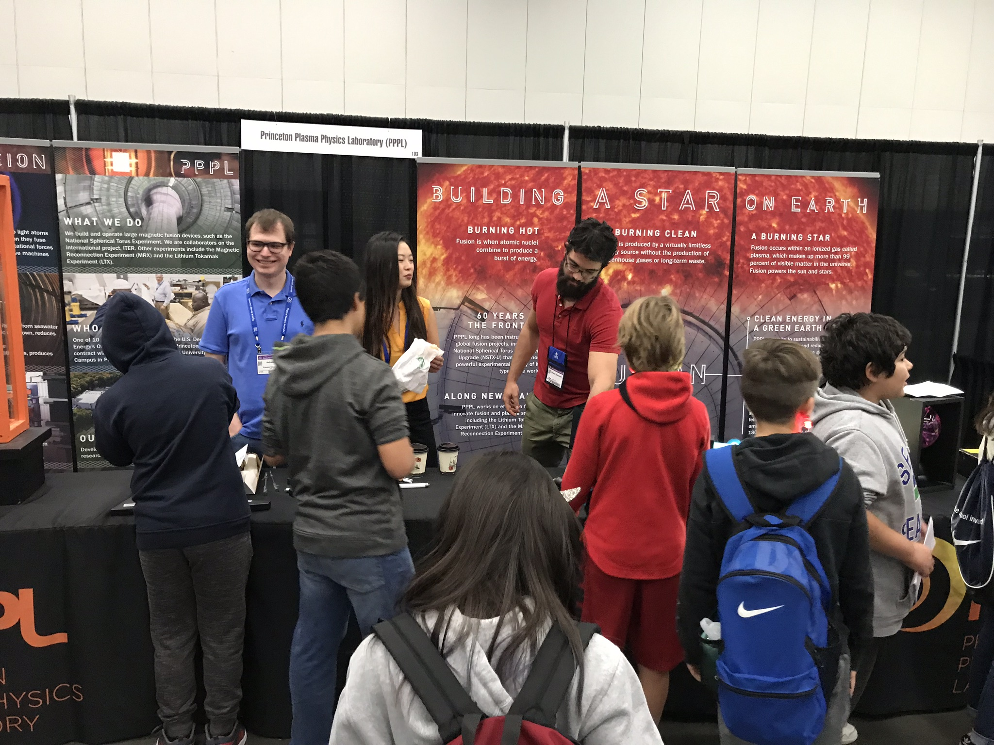
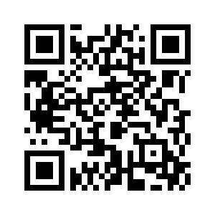
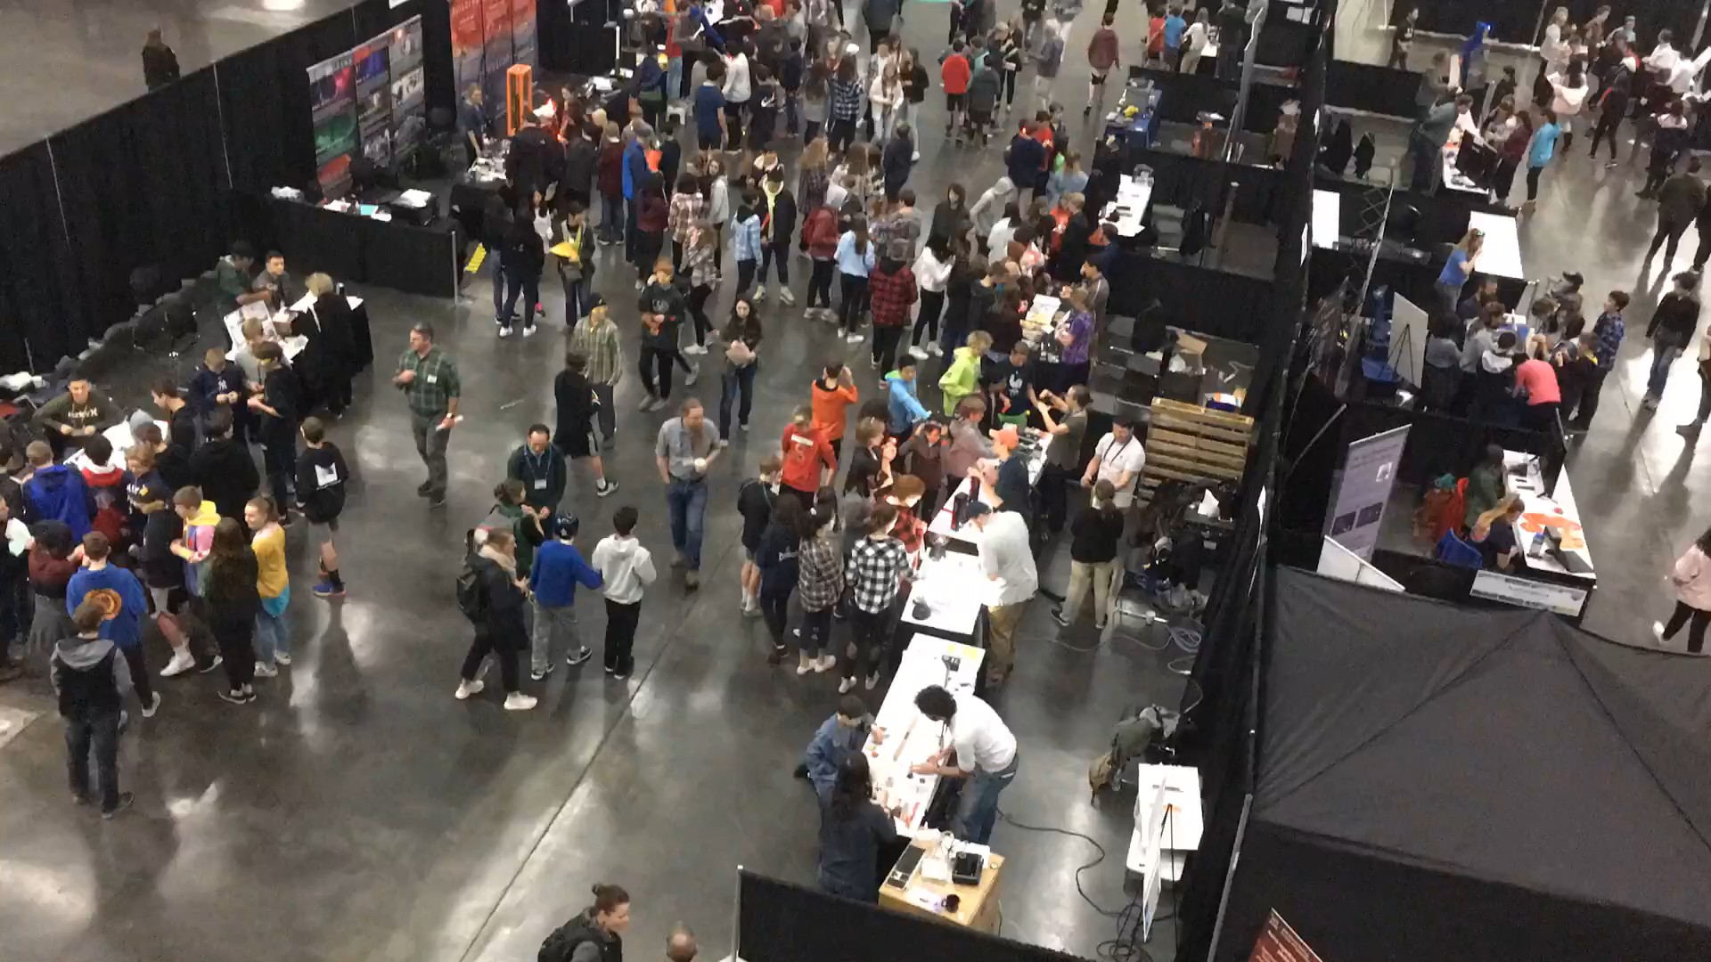
PPPL Booth at APS still needs volunteers!
The PPPL Booth at the expo needs you! Here's the form: https://forms.gle/CPsUUBiiqFM9rv9s7
Wednesday
4 volunteers from 2-4 to unpack and set up PPPL booth
Thursday
10am-12pm= 2 more volunteers
12pm-2pm= 2 more volunteers
Friday
8:30am-10am= 2 more volunteers
10am-12pm= 2 more volunteers
12pm-2:30pm= 2 more volunteers
Booth break down and pack up
Just point your camera at this

