Slide 1



First time realization of a detached, stable, efficient particle and heat exhaust regime in the island divertor of Wendelstein 7-X
Oliver Schmitz¹, Y. Feng², M. Jakubowski², R. Koenig², M. Krychowiak², M. Otte², F. Reimold², G. Anda³, T. Barbui¹, C. Biedermann², S. Bozhenkov², S. Brezinsek⁴, B. Buttenschoen², K.J. Brunner², P. Drewelow², F. Effenberg¹,
D. A. Ennis⁵, T. Estrada⁴, E. Flom¹, H. Frerichs¹, O. Ford², G. Fuchert², Y. Gao⁴, D. Gradic², O. Grulke²,
K. C. Hammond², U. Hergenhahn², U. Höfel², J. Knauer², P. Kornejew², G. Kocsis³, T. Kremeyer¹, S. Kwak²,
H. Niemann², E. Pasch², A. Pavone², V. Perseo², L. Rudischhauser², G. Schlisio², T. Sunn Pedersen², J. Svensson²,
T. Szepesi³, U. Wenzel², V. Winters¹, G.A. Wurden⁶, D. Zhang², S. Zoletnik³ and the W7-X experiment team
¹Univ. of Wisconsin - Madison, Dept. of Engineering Physics, WI, USA
²Max Planck Institute for Plasma Physics, Greifswald, Germany
³Wigner, RCP RMI, Budapest, Hungary
⁴Inst. of Energy- and Climate Research, FZ Jülich, Jülich, Germany
⁵Auburn University, Auburn, USA
⁶Los Alamos National Laboratory, Los Alamos, USA
Acknowledgement: This work was funded in part by the U.S. Department of Energy under grant DE-SC00014210 and DE-SC00013911 and has been carried out within the framework of the EUROfusion Consortium with funding from the Euratom research and training program 2014-2018 and 2019-2020 under grant agreement No 633053. The views and opinions expressed herein do not necessarily reflect those of the European Commission.
Princeton Plasma Physics Laboratory FES seminar
December 10, 2019

Slide 2
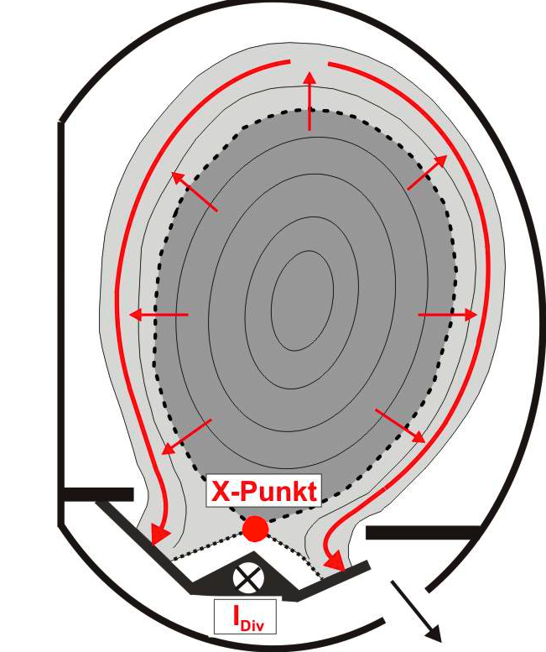
Heat flux detachment and a low level of eroding particle fluxes need to be combined with sufficient particle exhaust in a successful divertor concept
What’s a divertor supposed to do?
Plasma core performance is to be maximized
Stable density control
Low impurity influx (Z_{eff})
Helium exhaust (τ_{p,He}*/τ_{E})
Radial Transport into SOL
D⊥, χ⊥
Divertor plasma defines
plasma wall interface
Heat and particle flux handling within technical limits
Power dissipation
Neutral compression
Impurity retention
Pumping system: stable particle exhaust needs sufficient p_{n}
1

Slide 3
Heat flux detachment and a low level of eroding particle fluxes need to be combined with sufficient particle exhaust in a successful divertor concept
What’s a divertor supposed to do?
Plasma core performance is to be maximized
Stable density control
Low impurity influx (Z_{eff})
Helium exhaust (τ_{p,He}*/τ_{E})
Radial Transport into SOL
D⊥, χ⊥
Divertor plasma defines
plasma wall interface
Heat and particle flux handling within technical limits
Power dissipation
Neutral compression
Impurity retention
Upstream
where particle and heat flux come from (separatrix region)
Pumping system: stable particle exhaust needs sufficient p_{n}
Downstream
where particle and heat flux go to (divertor targets)
1

Slide 4
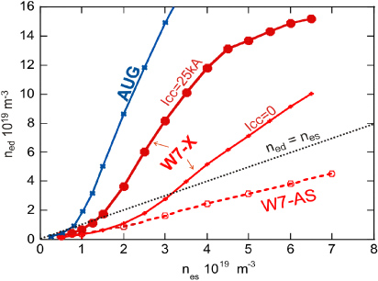
Heat flux detachment and a low level of eroding particle fluxes need to be combined with sufficient particle exhaust in a successful divertor concept
[Y. Feng et al., Contri. Plasma Phys. 54 (2014) 426-431]
Downstream
Radial Transport into SOL
D⊥, χ⊥
Upstream
Importance of high n_{ed} == high Γ_{d} ?
2

Slide 5
Heat flux detachment and a low level of eroding particle fluxes need to be combined with sufficient particle exhaust in a successful divertor concept
[Y. Feng et al., Contri. Plasma Phys. 54 (2014) 426-431]
Downstream
Radial Transport into SOL
D⊥, χ⊥
Upstream
Importance of high n_{ed} == high Γ_{d} ?
Ionization energy loss
Energy loss by impurity radiation
Rapid ionization
2

Slide 6
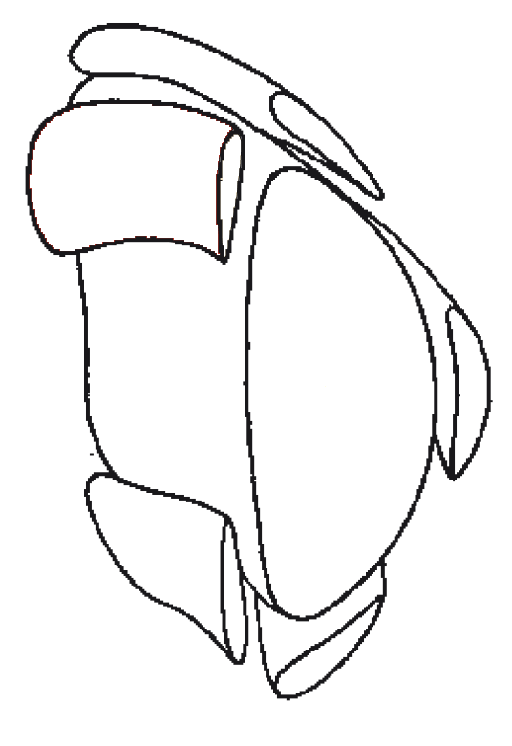
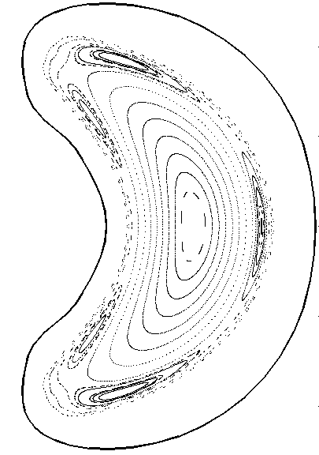
The island divertor at Wendelstein 7-X is a promising helical resonant divertor¹ concept for stellarators
A low order resonance placed in the plasma edge defines the divertor structure
Magnetic islands
Plasma core
Plasma edge
[X. Bonin et al., Nuclear Fusion 45 (2005) 22-29]
3
¹[F. Karger und K. Lackner, Phys. Lett. A, 66 (1977) 385 ], [R. Koenig et al., PPCF 44 (2002) 2365 ]

Slide 7
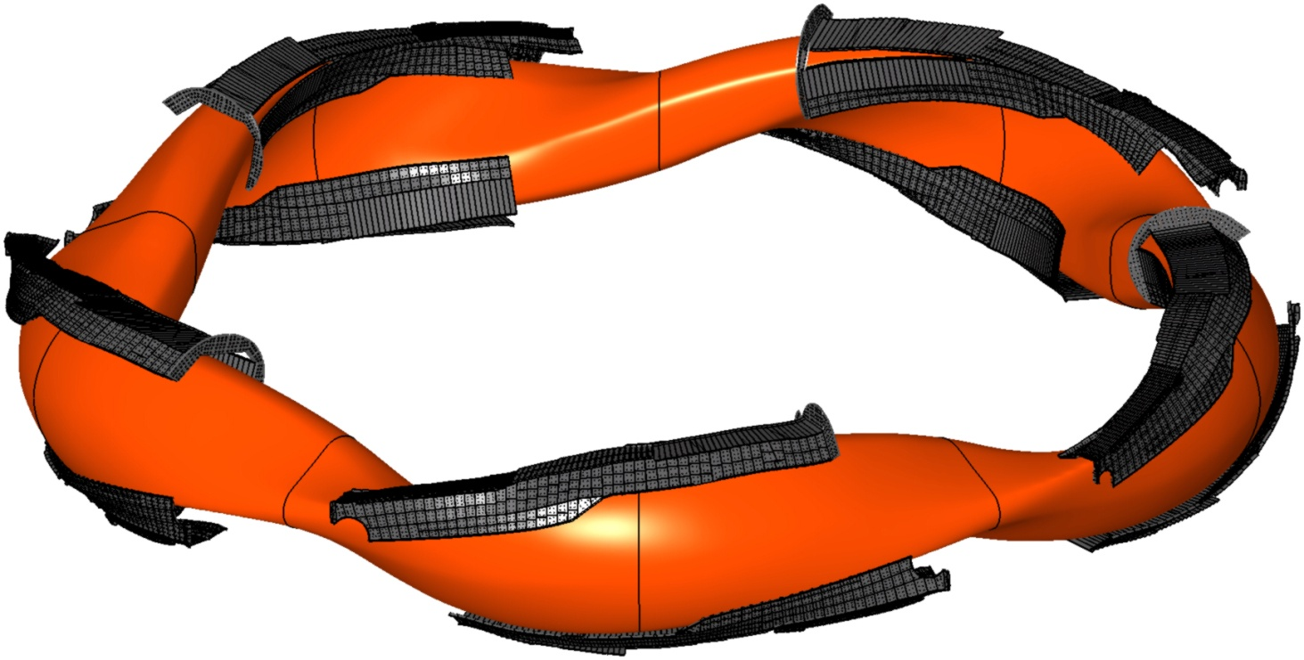
The island divertor at Wendelstein 7-X is a promising helical resonant divertor¹ concept for stellarators
A low order resonance placed in the plasma edge defines the divertor structure
Magnetic islands
The Island Divertor is a modular divertor
Plasma core
The divertor target plates intersect the islands
Plasma edge
[X. Bonin et al., Nuclear Fusion 45 (2005) 22-29]
¹[F. Karger und K. Lackner, Phys. Lett. A, 66 (1977) 385 ], [R. Koenig et al., PPCF 44 (2002) 2365 ]
Plasma contour
4

Slide 8
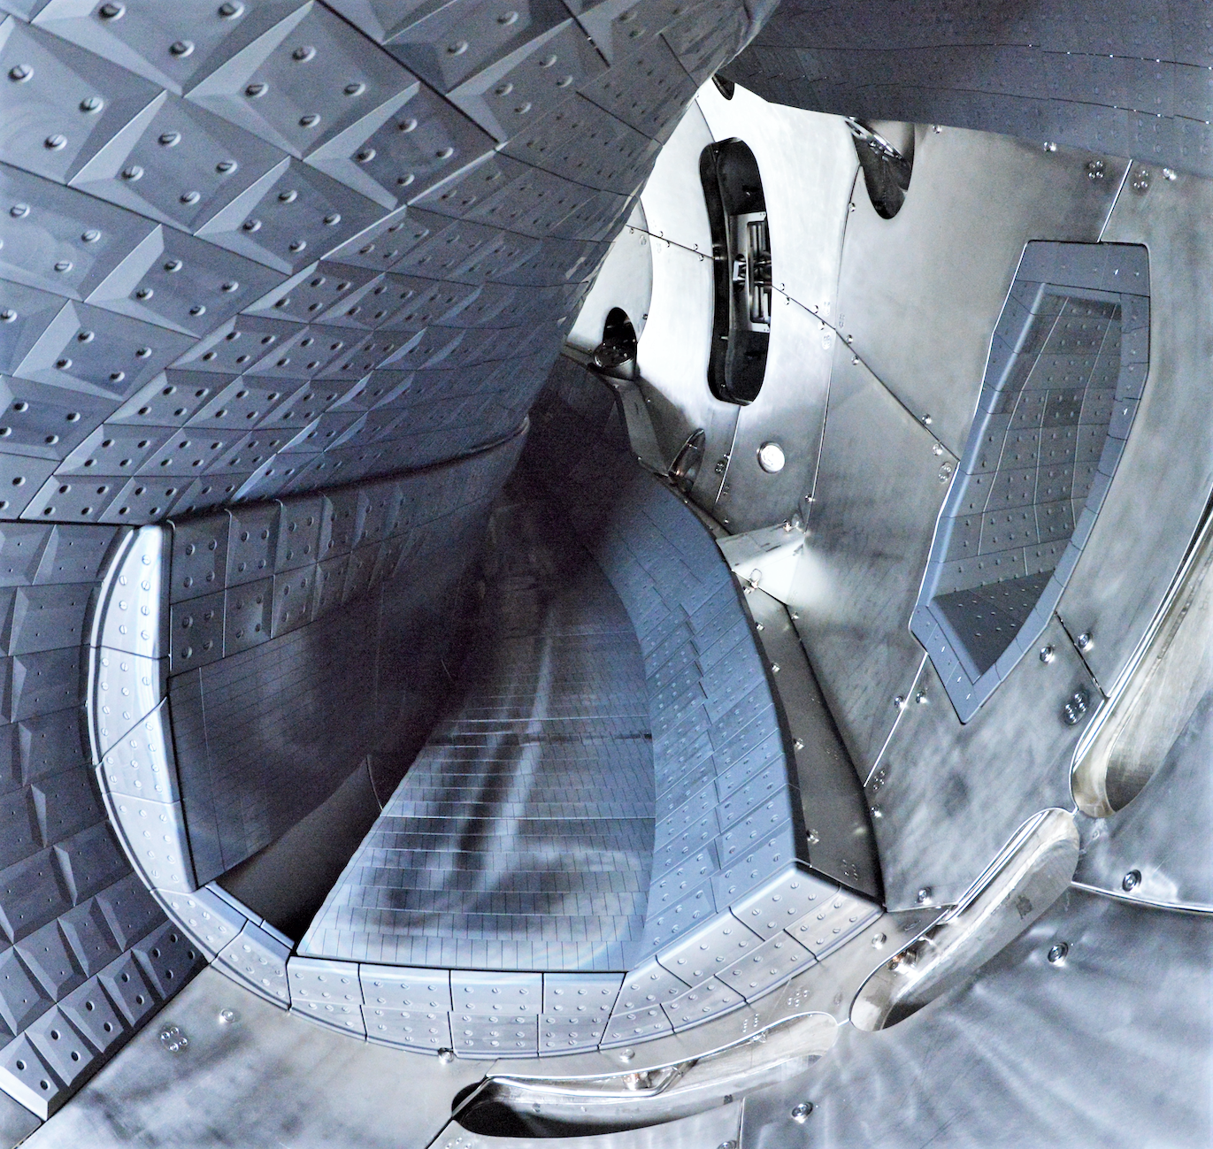
The island divertor at Wendelstein 7-X is a promising helical resonant divertor¹ concept for stellarators
A low order resonance placed in the plasma edge defines the divertor structure
Magnetic islands
Structure of 1 out of 10 divertor modules
Plasma core
Plasma edge
[X. Bonin et al., Nuclear Fusion 45 (2005) 22-29]
5
¹[F. Karger und K. Lackner, Phys. Lett. A, 66 (1977) 385 ], [R. Koenig et al., PPCF 44 (2002) 2365 ]

Slide 9
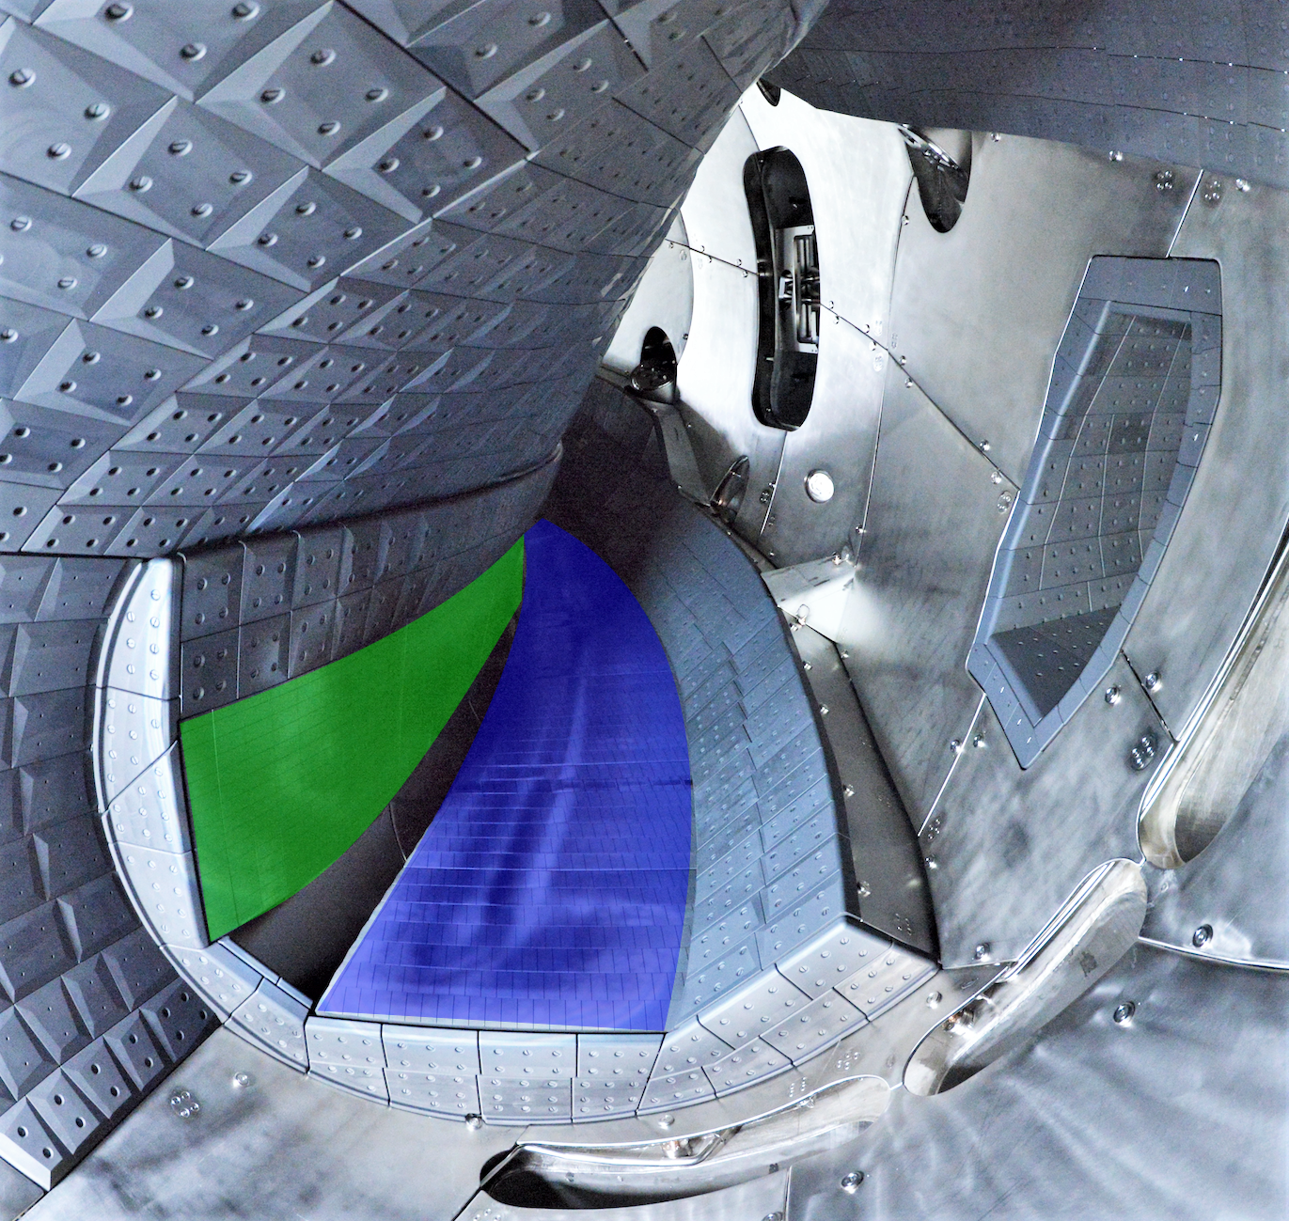
The island divertor at Wendelstein 7-X is a promising helical resonant divertor¹ concept for stellarators
A low order resonance placed in the plasma edge defines the divertor structure
Magnetic islands
Structure of 1 out of 10 divertor modules
Plasma core
Vertical Target
Plasma edge
[X. Bonin et al., Nuclear Fusion 45 (2005) 22-29]
5
¹[F. Karger und K. Lackner, Phys. Lett. A, 66 (1977) 385 ], [R. Koenig et al., PPCF 44 (2002) 2365 ]
Horizontal Target

Slide 10
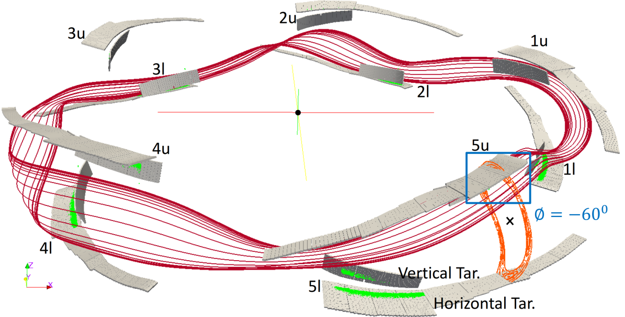
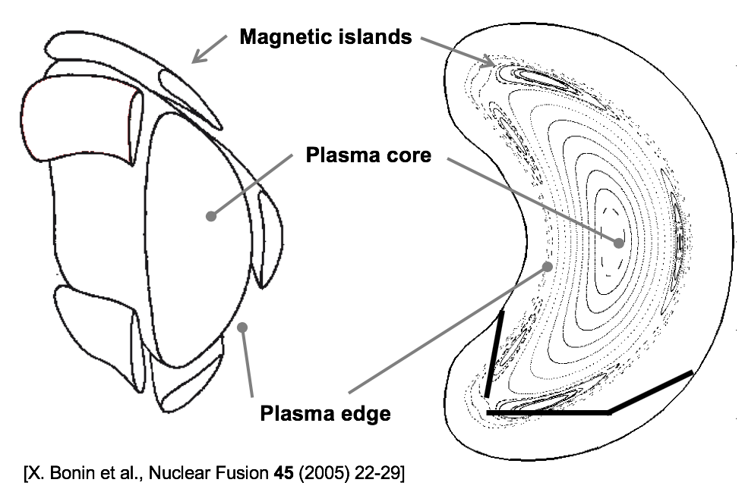
The island divertor at Wendelstein 7-X is a promising helical resonant divertor¹ concept for stellarators
A low order resonance placed in the plasma edge defines the divertor structure
[Y. Gao et al., Nuclear Fusion (2019)]
Standard divertor configuration (SDC): pairs of modules 180 degree apart toroidally are connected by magnetic flux tubes
6
¹[F. Karger und K. Lackner, Phys. Lett. A, 66 (1977) 385 ], [R. Koenig et al., PPCF 44 (2002) 2365 ]

Slide 11
The island divertor at Wendelstein 7-X is a promising helical resonant divertor¹ concept for stellarators
A low order resonance placed in the plasma edge defines the divertor structure
[Y. Gao et al., Nuclear Fusion (2019)]
This divertor concept was tested at W7-AS and now needs to be qualified as a viable stellarator system component for steady state plasma operation.
6

Slide 12
Outline of this talk in form of an executive summary
A stable, thermally fully detached island divertor regime with small divertor particle fluxes but still sufficient divertor neutral pressures was shown for the first time.
This detached island divertor regime is reached with minimal feedback control in a reliable fashion and the divertor operational point is defined through sufficient radiative losses at a given input power.
The geometry of the magnetic islands forming the divertor allow to fine tune the divertor neutral distribution for maximized neutral pressure in the detached state.
This island divertor regime is compatible with steady state particle exhaust for the upcoming high-performance campaign of W7-X.
7

Slide 13
Outline of this talk in form of an executive summary
A stable, thermally fully detached island divertor regime with small divertor particle fluxes but still sufficient divertor neutral pressures was shown for the first time.
This detached island divertor regime is reached with minimal feedback control in a reliable fashion and the divertor operational point is defined through sufficient radiative losses at a given input power.
The geometry of the magnetic islands forming the divertor allow to fine tune the divertor neutral distribution for maximized neutral pressure in the detached state.
This island divertor regime is compatible with steady state particle exhaust for the upcoming high-performance campaign of W7-X.
8

Slide 14
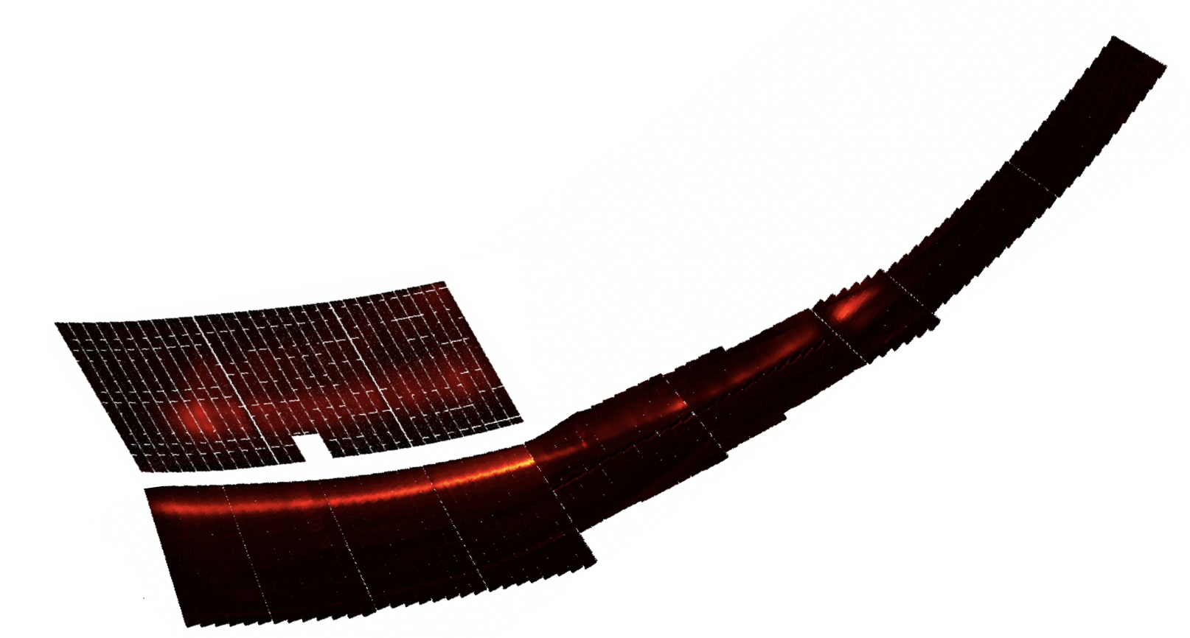
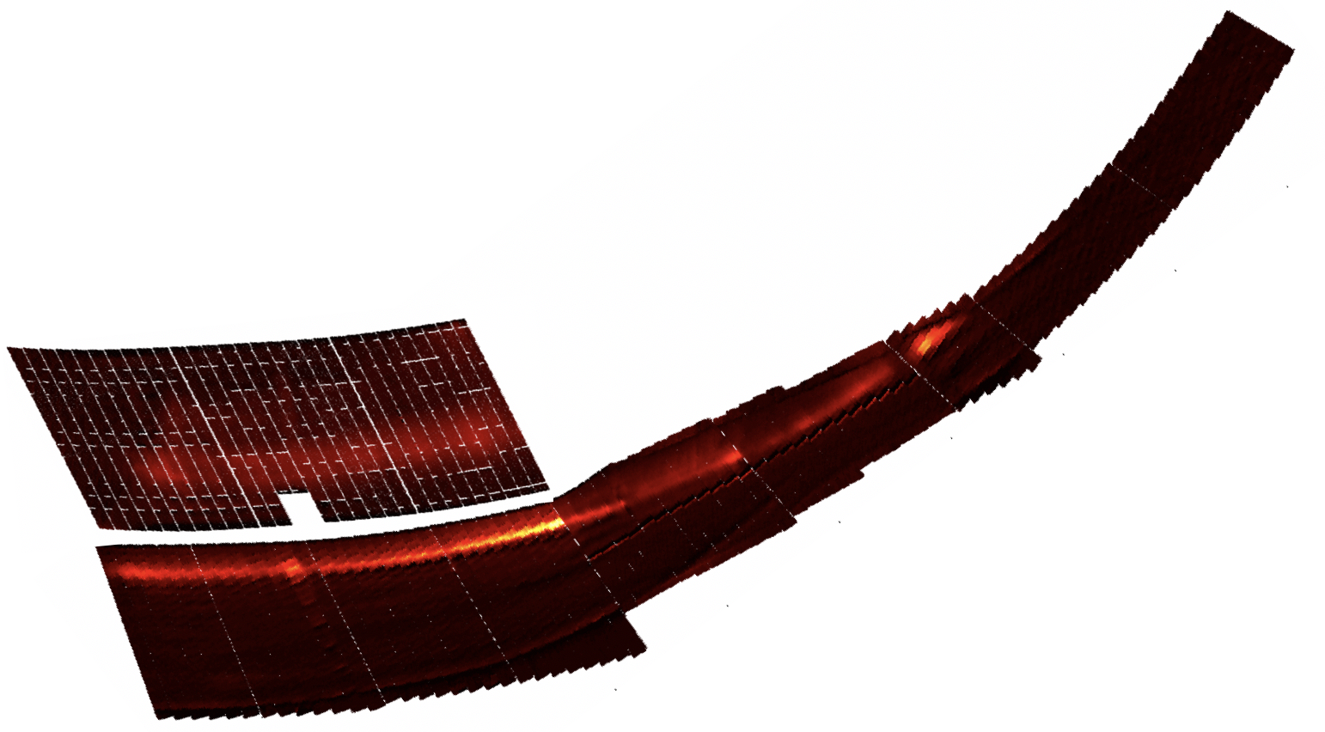
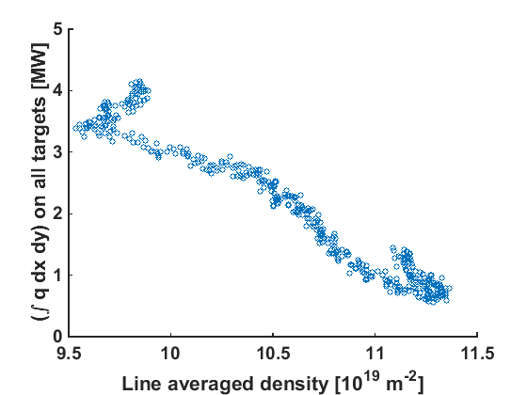
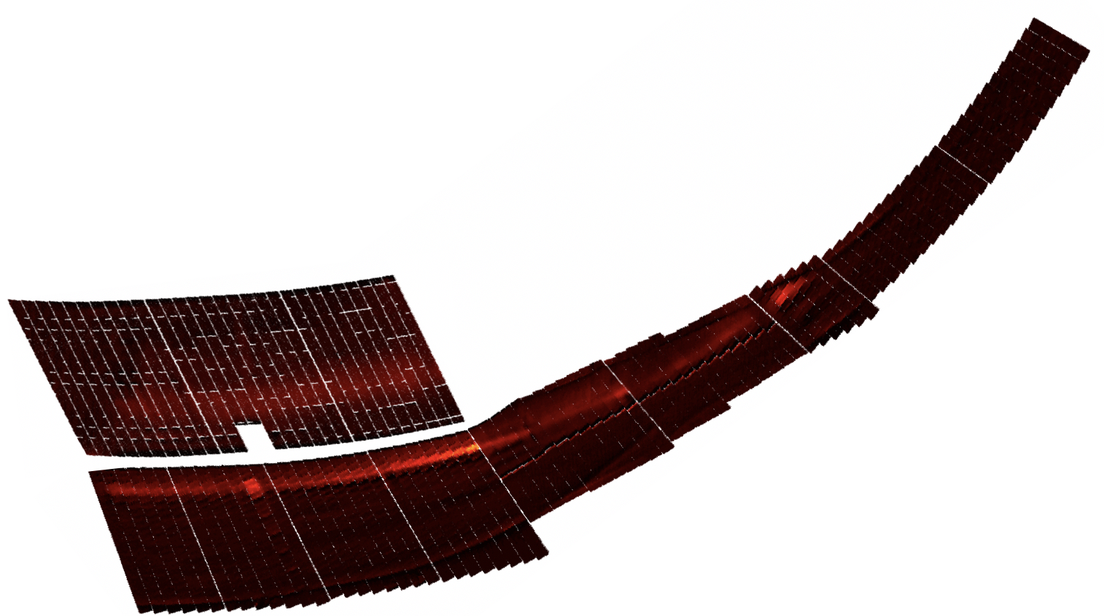
Full and homogeneous thermal detachment was obtained during a gradual density increase by just 20% - a reliable access scenario due to f_{rad} dependence
Target heat flux density q [MW m⁻²]
t=5s, n_{e,l.i.}=9.5 10¹⁹ m⁻², f_{rad}=0.35
0
q_{max}
q_{max} = 3MW m⁻²
t=6s, n_{e,l.i.}=10.2 10¹⁹ m⁻², f_{rad}=0.7
q_{max} = 1.5MW m⁻²
t=7s, n_{e,l.i.}=11.3 10¹⁹ m⁻², f_{rad}=0.8
20180814.024
Line integrated density n_{e,l.i.} [10¹⁹ m⁻²]
q_{max} = 0.5MW m⁻²
9

Slide 15
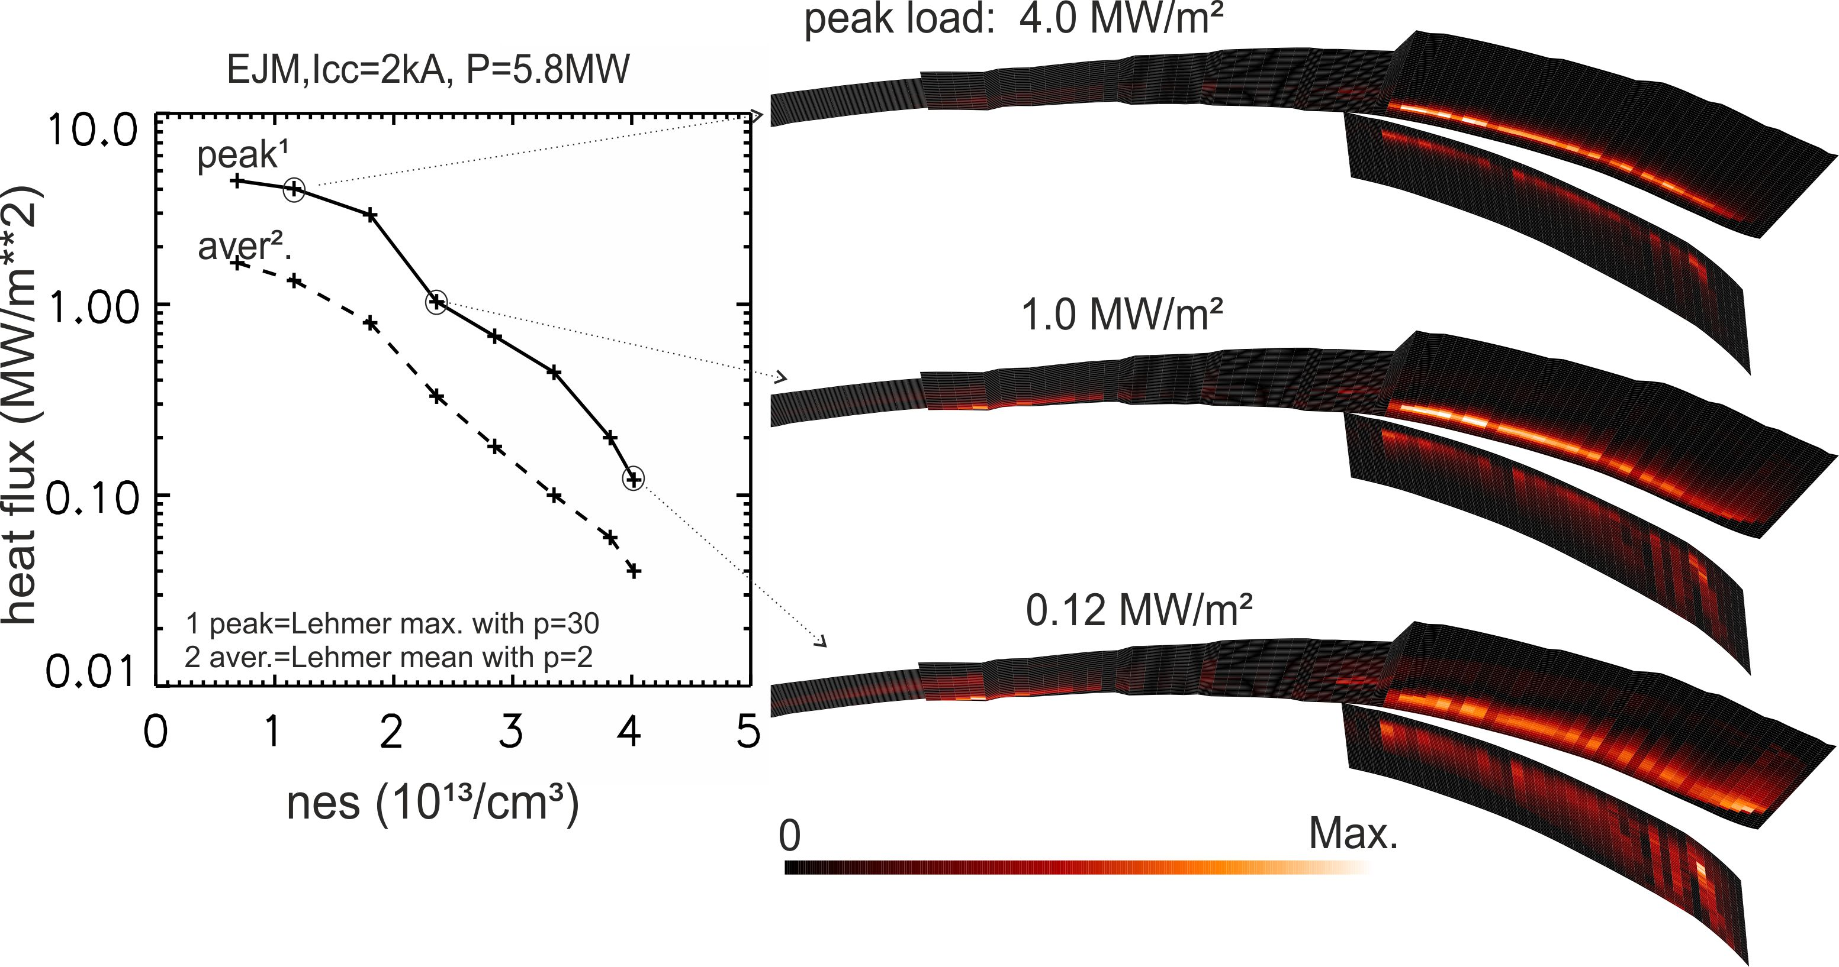
The homogeneous dissipation of the divertor power load during the density increase is reproduced in EMC3-EIRENE modeling
11

Slide 16
The heat flux reduction is driven by a density scaling of f_{rad} and a complete thermal detachment is combined with significant neutral pressures
Integral heat flux to targets vanishes with increasing density
20180814.024
Line integrated density n_{e,l.i.} [10¹⁹ m⁻²]
12

Slide 17
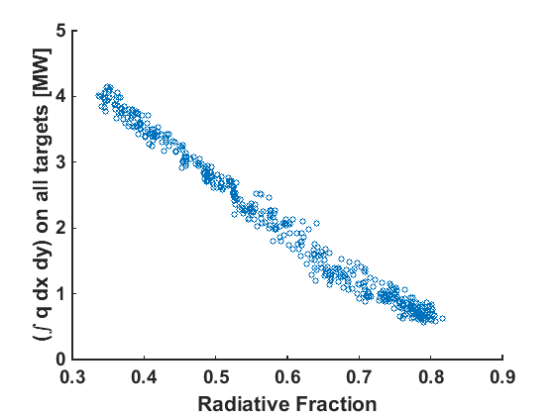
The heat flux reduction is driven by a density scaling of f_{rad} and a complete thermal detachment is combined with significant neutral pressures
Integral heat flux to targets vanishes with increasing density
Radiative fraction drives heat flux dissipation into detached regime
20180814.024
20180814.024
Line integrated density n_{e,l.i.} [10¹⁹ m⁻²]
12

Slide 18
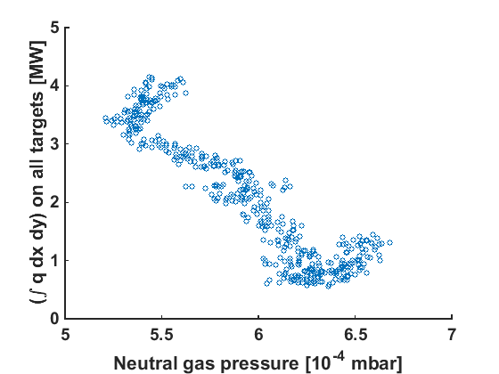
The heat flux reduction is driven by a density scaling of f_{rad} and a complete thermal detachment is combined with significant neutral pressures
Integral heat flux to targets vanishes with increasing density
Radiative fraction drives heat flux dissipation into detached regime
Small heat flux can be combined with significant neutral pressures
20180814.024
20180814.024
20180814.024
Line integrated density n_{e,l.i.} [10¹⁹ m⁻²]
A regime of small integral heat flux (<0.5MW) and small peak (<0.2 MW m⁻²) has been accomplished at up to 0.05-0.1 Pa (10⁻³ mbar) neutral pressure levels
12

Slide 19
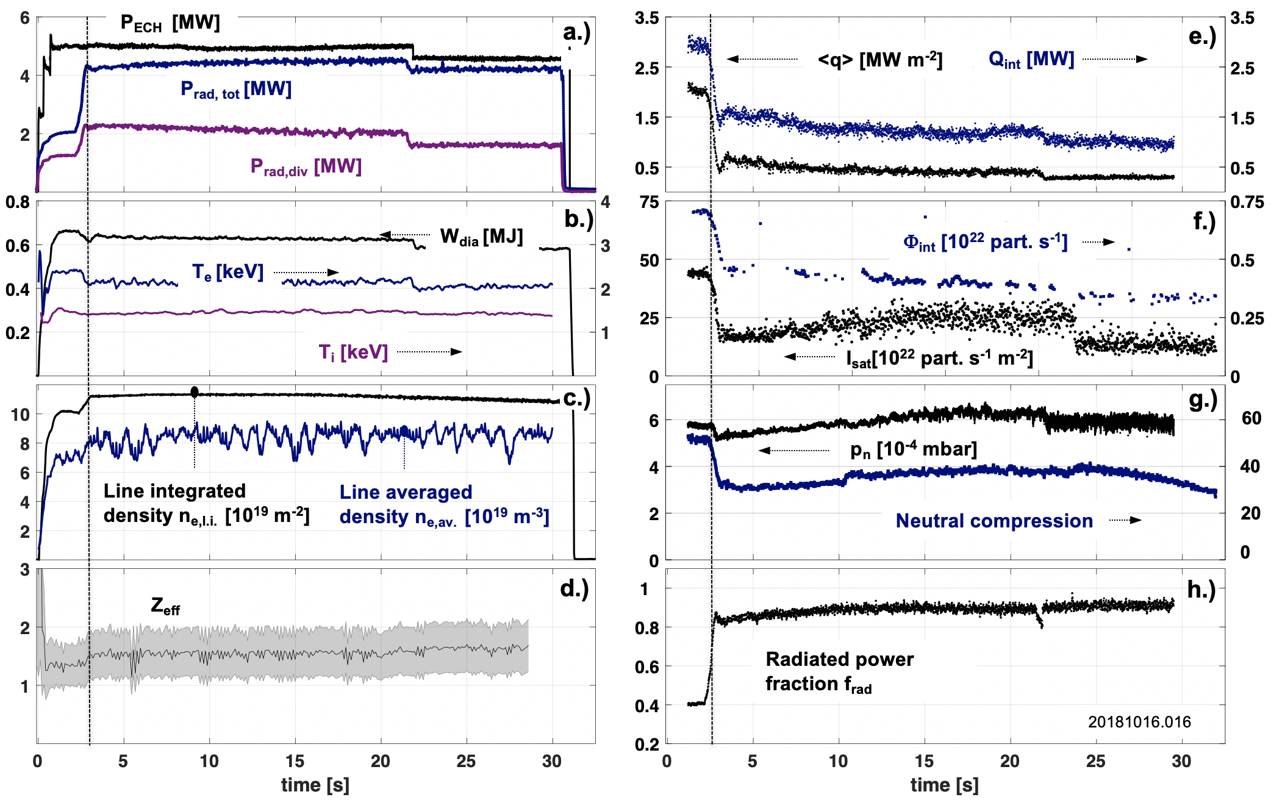
This stable detachment was obtained with high divertor neutral pressures for up to 30s only limited by input energy limits in the uncooled divertor phase
13

Slide 20
Outline of this talk in form of an executive summary
A stable, thermally fully detached island divertor regime with small divertor particle fluxes but still sufficient divertor neutral pressures was shown for the first time.
This detached island divertor regime is reached with minimal feedback control in a reliable fashion and the divertor operational point is defined through sufficient radiative losses at a given input power.
The geometry of the magnetic islands forming the divertor allow to fine tune the divertor neutral distribution for maximized neutral pressure in the detached state.
This island divertor regime is compatible with steady state particle exhaust for the upcoming high-performance campaign of W7-X.

Slide 21
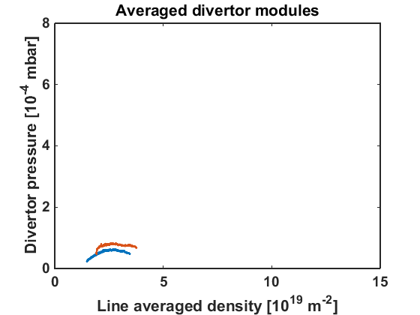
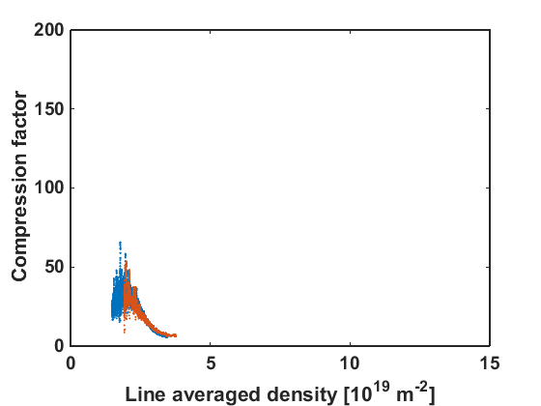
Moderate divertor neutral pressures within a quite limited density range was seen at W7-X without a boronization
Averaged neutral particle pressure at pumping gap
Neutral particle compression in divertor
3MW, pre-boronization
2MW, pre-boronization
Line integrated density n_{e,l.i.} [10¹⁹ m⁻²]
Line integrated density n_{e,l.i.} [10¹⁹ m⁻²]
Before boronization: oxygen and carbon were the dominant impurities
14

Slide 22
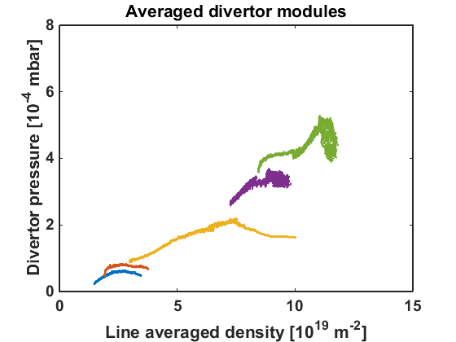
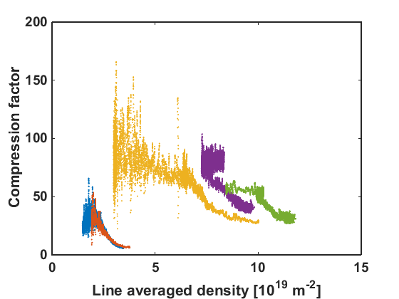
Boronization of W7-X yielded build up of substantial divertor neutral pressure at largely increased density limits
Averaged neutral particle pressure at pumping gap
Neutral particle compression in divertor
6MW, post-boronization
2MW, post-boronization
3MW, post-boronization
32 - 45
10 - 15
Line integrated density n_{e,l.i.} [10¹⁹ m⁻²]
Line integrated density n_{e,l.i.} [10¹⁹ m⁻²]
After boronization: oxygen content was reduced by up to a factor of 20
15

Slide 23
This attractive scenario could be fine tuned by adjustment of the structure of the magnetic island that form the divertor
Averaged neutral particle pressure at pumping gap
Structure of the magnetic island
>1000
Pumping gap
6MW, post-boronization
Wall to wall connection length L_{c} [m]
2MW, post-boronization
3MW, post-boronization
Plasma core domain
I_{cc}=0.0kA
Line integrated density n_{e,l.i.} [10¹⁹ m⁻²]
16

Slide 24
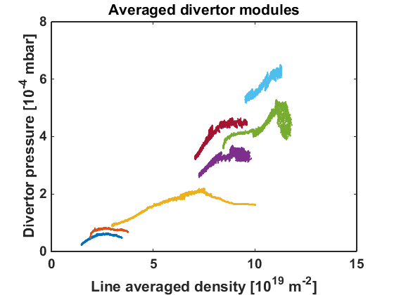
Applying a stationary divertor control current allows to increase the divertor neutral pressure by up to 50%
Averaged neutral particle pressure at pumping gap
Change of island structure with divertor control coil current I_{cc}
>1000
6MW, 2kA ICC
Pumping gap
3MW, 2kA ICC
6MW, post-boronization
Wall to wall connection length L_{c} [m]
Plasma core domain
2MW, post-boronization
3MW, post-boronization
I_{cc}=2.0kA
Line integrated density n_{e,l.i.} [10¹⁹ m⁻²]
Island widening, closure of outer gap
Strike point moves towards gap
Connection length L_{c} reduced
17

Slide 25
Increasing the divertor island size allows to increase the divertor neutral pressure by up to 50% compared to small island configuration
Analysis target
Change of island structure with divertor control coil current I_{cc}
>1000
6MW, 2kA ICC
Pumping gap
3MW, 2kA ICC
6MW, post-boronization
Wall to wall connection length L_{c} [m]
Plasma core domain
2MW, post-boronization
3MW, post-boronization
I_{cc}=2.5kA
Line integrated density n_{e,l.i.} [10¹⁹ m⁻²]
Island widening, closure of outer gap
Strike point moves towards gap
Connection length L_{c} reduced
17

Slide 26
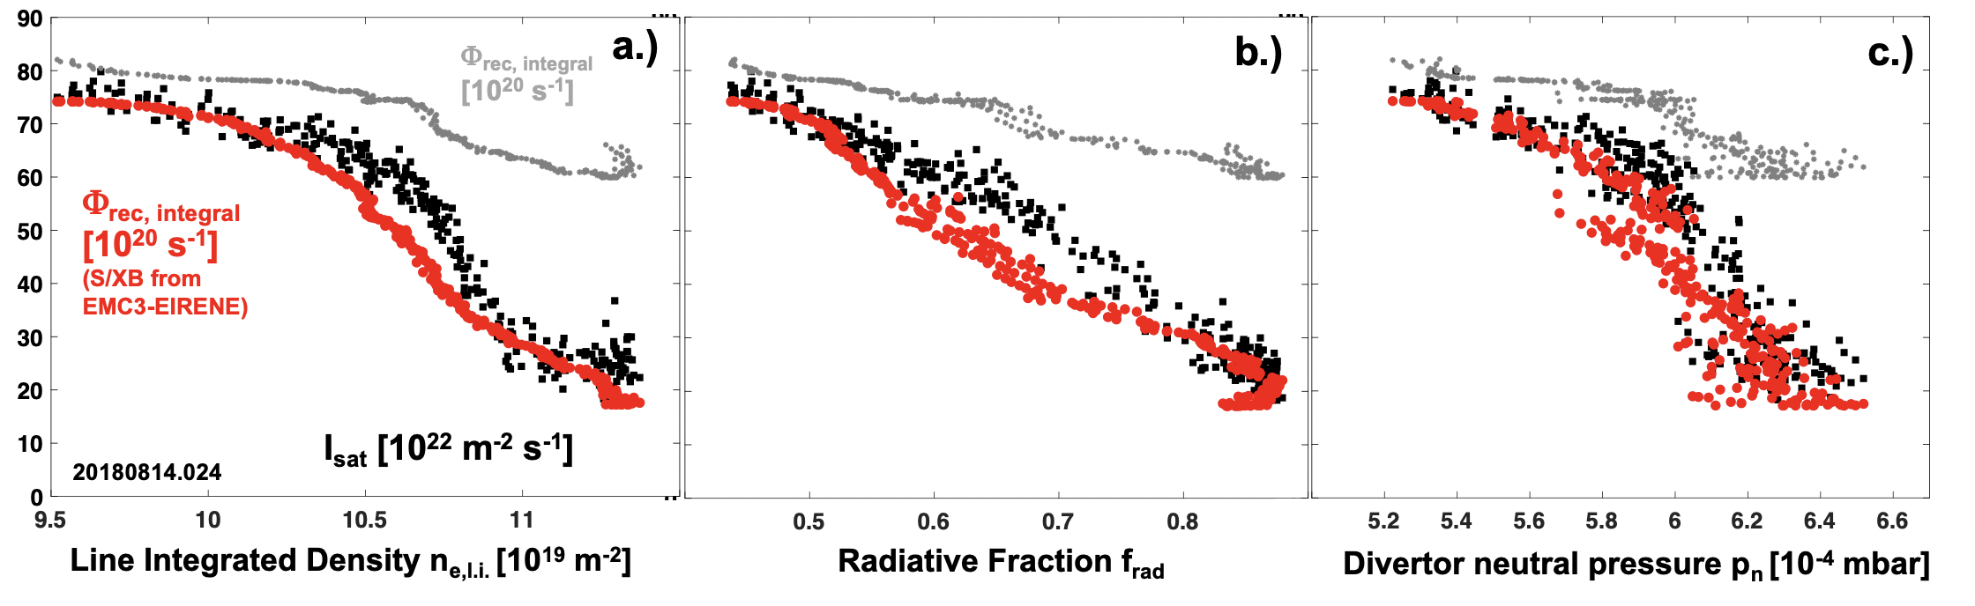
Particle flux detachment develops together with power detachment and pressure build up due to increasing radiation
18

Slide 27
Particle flux detachment develops together with power detachment and pressure build up due to increasing radiation
Both, heat and also particle fluxes are detached but still a high neutral pressure of up to 6.5 10⁻⁴ mbar are reached! What is behind this interesting feature?
18

Slide 28
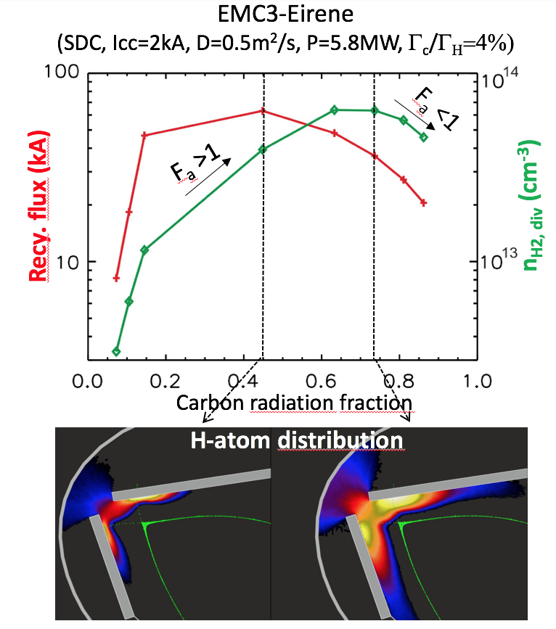
Particle flux detachment can be combined with sustainment of neutral particle exhaust under power detachment in the island divertor
Distribution of neutrals in island divertor module defines neutral influx Γ_{in, H0} into pumping domain.
19

Slide 29
Particle flux detachment can be combined with sustainment of neutral particle exhaust under power detachment in the island divertor
Distribution of neutrals in island divertor module defines neutral influx Γ_{in, H0} into pumping domain.
Intuitive model:
Neutral distribution is defined by local plasma parameters in island
Mean free ionization λ_{io} lengths vs. mean distance to pump entrance l_{p} defines p_{n}
Increasing f_{rad} reduces T_{e} and hence increases ionization length scale λ_{io}, also n_{e,target} is reduced
More neutrals can enter the pumping domain
[Y. Feng et al., W7-X workshop, 2017]
[Y. Feng et al., Nuclear Fusion 56 (2016) 126011]
19

Slide 30
3D modeling predicts that f_{rad} moderates the neutral ionization distribution such that an increase of λ_{io} yields increasing p_{n} with reduced Φ_{target}
Distribution of neutrals in island divertor module defines neutral influx Γ_{in, H0} into pumping domain.
Intuitive model:
[Y. Feng et al., W7-X workshop, 2016]
Key plasma parameter
attenuation factor
recycling flux
Regulated through
mean distance to pumping gap
mean ionization length scale
[Y. Feng et al., Nuclear Fusion 56 (2016) 126011]
20

Slide 31
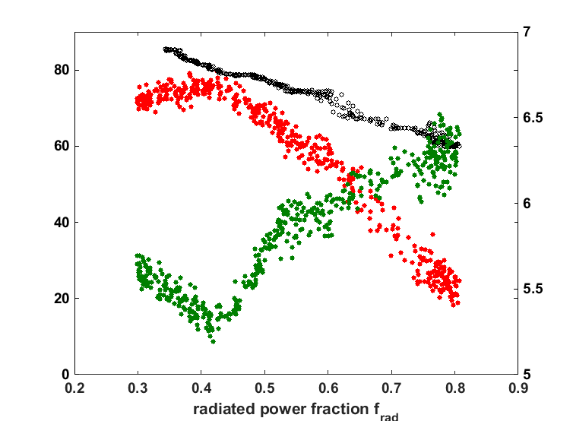
Particle flux detachment can be combined with sustainment of neutral particle exhaust under power detachment in the island divertor
Experimental data support this intuitive model
Φ_{rec, integral} [10²¹ s⁻¹]
I_{sat} [10²² m⁻² s⁻¹]
Averaged neutral pressure [10⁻⁴ mbar]
21

Slide 32
Particle flux detachment can be combined with sustainment of neutral particle exhaust under power detachment in the island divertor
Experimental data support this intuitive model
Φ_{rec, integral} [10²¹ s⁻¹]
I_{sat} [10²² m⁻² s⁻¹]
Averaged neutral pressure [10⁻⁴ mbar]
No p_{n} roll-over is observed in the experiment due to f_{rad} limit from ECH heating scenario
21

Slide 33
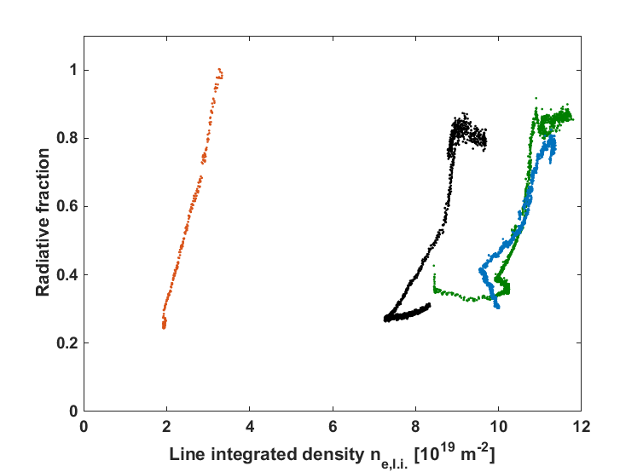
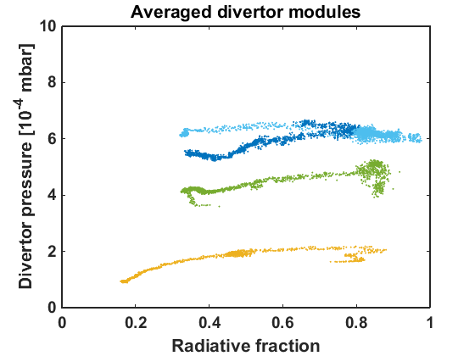
The radiation fraction is dependent of the heating power for a given density range – this is the basis for the regulation of divertor temperature in the island
Heat and particle flux detachment domain with stable neutral pressure
3.0MW, I_{cc}=0kA
5.8MW, I_{cc}=2.5kA
6.2MW, I_{cc}=2kA
5.8MW, I_{cc}=0kA
6.2MW, I_{cc}=2kA
3MW, I_{cc}=0kA
3MW, I_{cc}=0kA
Pre-boronization
5.8MW, I_{cc}=0kA
Line integrated density n_{e,l.i.} [10¹⁹ m⁻²]
The radiated fraction depends on density which in turn is defined by the available heating power through ECRH – this sets the stage for the detached regime.
22

Slide 34
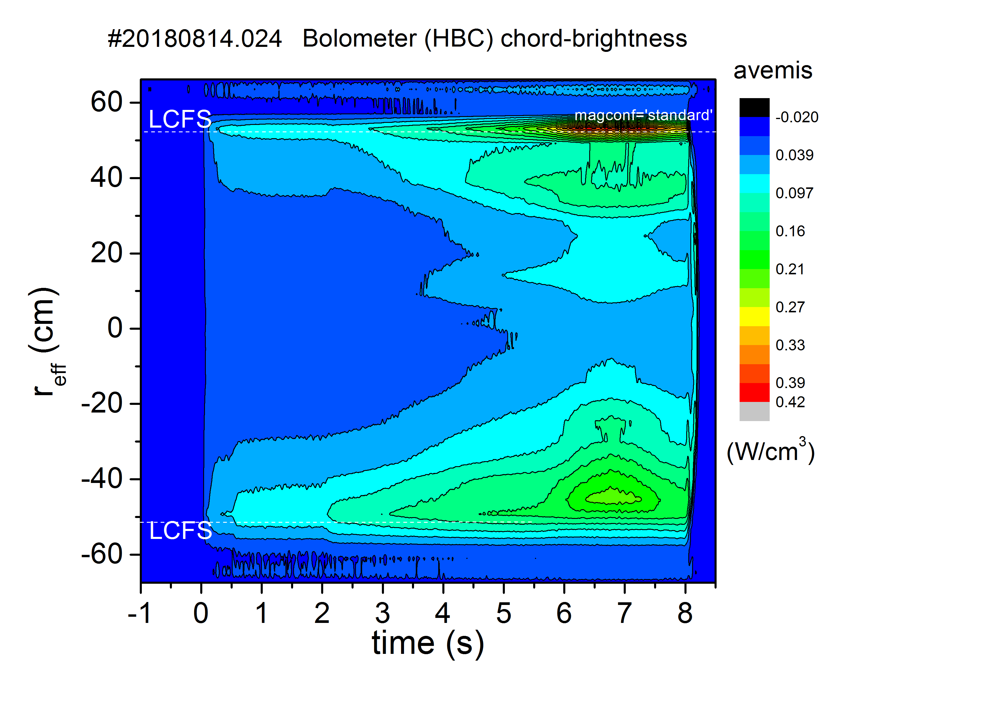
Radiation in detached state is localized predominantly around separatrix – exact resolution so far very challenging due to limited resolution of bolometer
Exact power balance in the plasma edge layer is a high priority topic to disentangle radiation contributions
23

Slide 35
Radiation in detached state is localized predominantly around separatrix – exact resolution so far very challenging due to limited resolution of bolometer
Island size dependence of C radiation around islands at f_{rad}=0.8
Small island
Medium island
Large island
Radiation localized at strike point
Radiation fills island domain
Radiation reaches separatrix
Exact power balance in the plasma edge layer is a high priority topic to disentangle radiation contributions – modeling suggests radiation inside SOL up to f_{rad} ~0.8
24

Slide 36
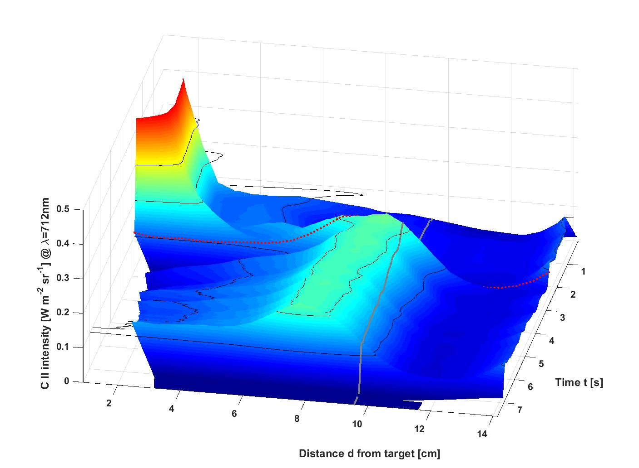
Carbon impurity source and C-II line emission define the local radiation equilibrium which detaches from surface
Detachment transition
0.3
0.2
0.1
0.2
0.1
Divertor target
LCFS
25

Slide 37
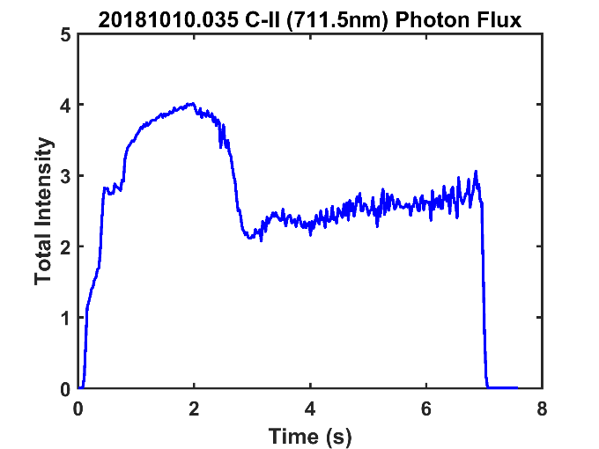
Carbon impurity source and C-II line emission define the local radiation equilibrium which detaches from surface
Detachment transition
Detachment transition
0.3
0.2
0.1
0.2
0.1
The integrated C-II emission is reduced but the C-source estimated (10²² part. s⁻¹) shows almost no significant reduction.
Divertor target
LCFS
Effect of local plasma parameters!
25

Slide 38
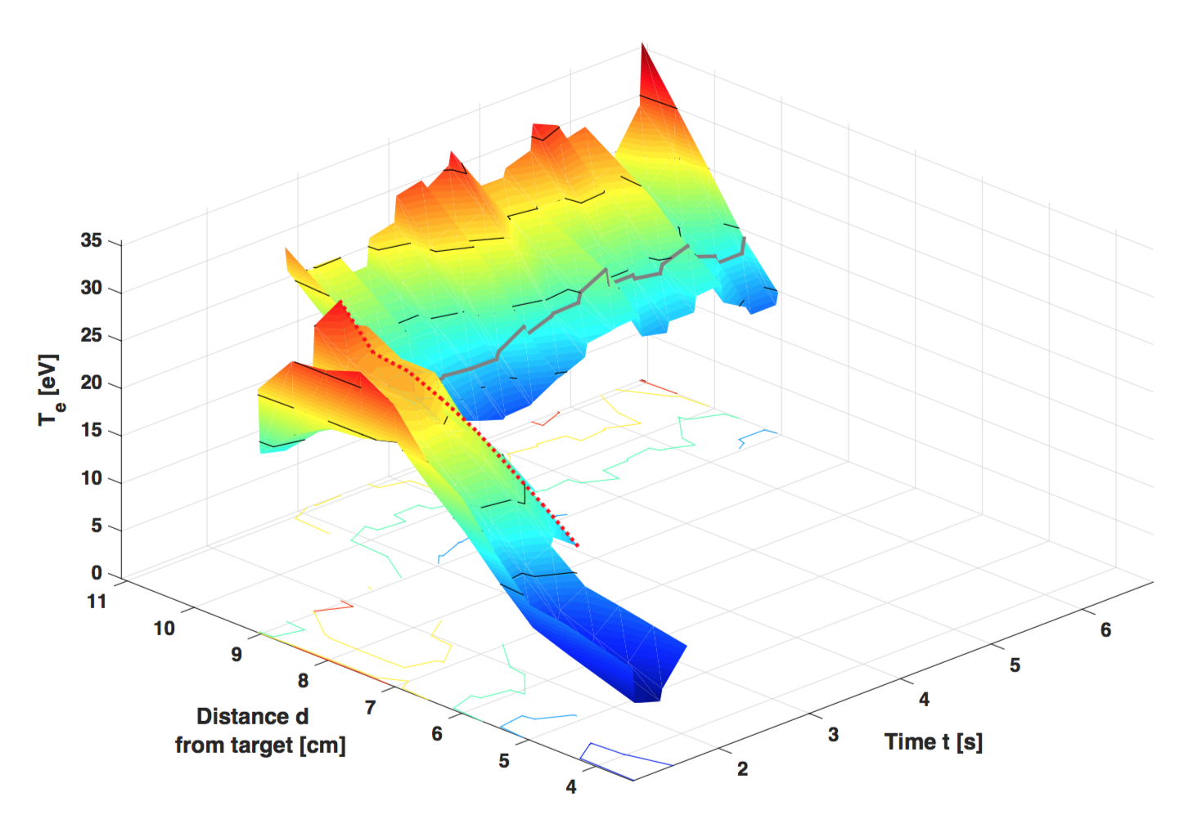
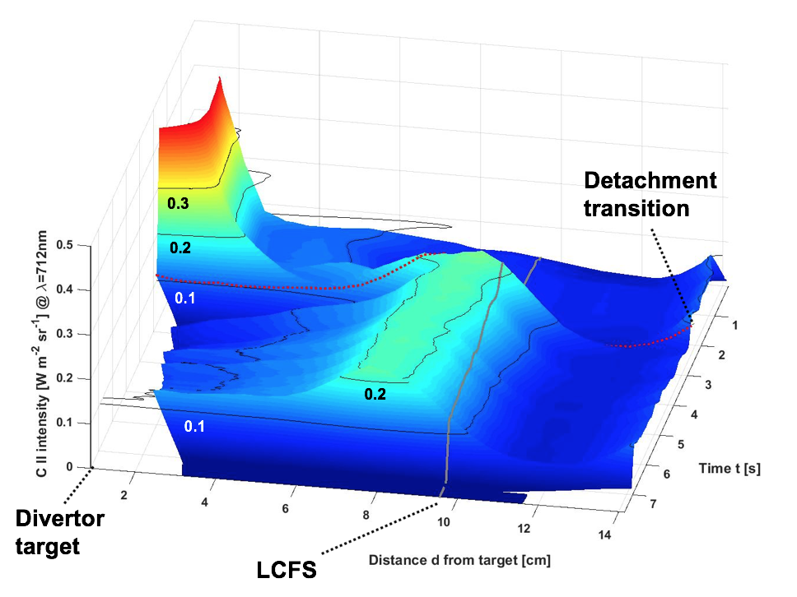
Carbon radiation distribution is followed by position of 15 eV isothermal surface in island divertor domain
Iso-thermal surface (T_{e} ~15 eV) moves inward with radiation front.
LCFS
Detachment transition
25
20
15
He-I emission too low
15
10
Density at the position of this surface is almost constant (n_{e} ~ 5.0 10¹⁹ m⁻³)
Divertor target
26

Slide 39
Outline of this talk in form of an executive summary
A stable, thermally fully detached island divertor regime with small divertor particle fluxes but still sufficient divertor neutral pressures was shown for the first time.
This detached island divertor regime is reached with minimal feedback control in a reliable fashion and the divertor operational point is defined through sufficient radiative losses at a given input power.
The geometry of the magnetic islands forming the divertor allow to fine tune the divertor neutral distribution for maximized neutral pressure in the detached state.
This island divertor regime is compatible with steady state particle exhaust for the upcoming high-performance campaign of W7-X.

Slide 40
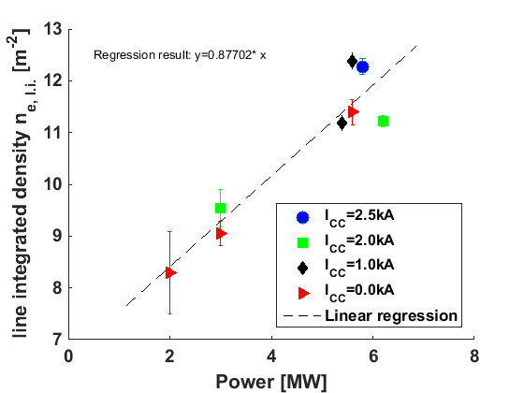
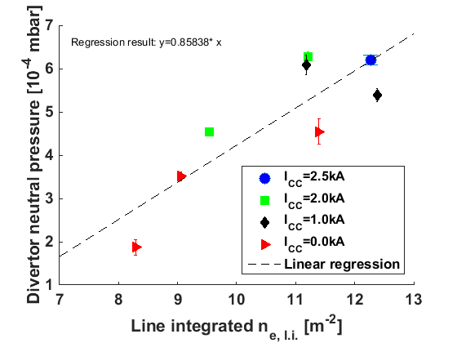
Linear scaling of plasma density with input power enables build up of sufficient divertor neutral pressures and maximize by island size increase
Data were averaged over stable detached windows for various experimental programs with [0.75<f_{rad}<0.9]
Line integrated density ne, l.i. [10¹⁹ m⁻²]
Line integrated density ne, l.i. [10¹⁹ m⁻²]
27

Slide 41
Linear scaling of plasma density with input power enables build up of sufficient divertor neutral pressures and maximize by island size increase
Data were averaged over stable detached windows for various experimental programs with [0.75<f_{rad}<0.9]
Line integrated density ne, l.i. [10¹⁹ m⁻²]
Line integrated density ne, l.i. [10¹⁹ m⁻²]
The divertor neutral pressures obtained scale favorably towards steady state
27

Slide 42
Pumping particle flux level reached under reliably detached conditions is compatible with exhaust requirements for steady state
Basic observation: increase of neutral back pressures of <8.0 10⁻⁴ mbar averaged across all available pump ducts for after Boronization from <5.0 10⁻⁵ mbar before Boronization
Existing pumping capacity from Turbo-Pumps: 10 x 3 x 1250 l/s=37500 ltr. Hydrogen /s
Expected pumping capacity with Cryo-pump: 70.000 ltr. Hydrogen /s
Value | TMP scenario | Cryo scenario
Pumped flux Γ_{pump} | 5.2 10²⁰ H2/s | 9.25 10²⁰ H2/s
Fueled flux Γ_{in} | 5.0 10²⁰ - 1.0 10²¹ H2/s | 5.0 10²⁰ - 1.0 10²¹ H2/s
Based on example 20180814.024 with 8.0 10⁻⁴ mbar averaged divertor pressure
Pumped flux Γ_{pump} | 9.0 10¹⁹ H2/s | 1.6 10²⁰ H2/s
Fueled flux Γ_{in} | 2.2 10²⁰ - 2.0 10²¹ H2/s | Does not scale, low n_{e}
Executed based on example 20180801.039 and 20171207.024 with 5.0 10⁻⁵ mbar averaged divertor pressure
OP1.2.b
OP1.2.a
28

Slide 43
Summary and conclusions
The attractive detached island divertor regime was reached through intrinsic radiation scaling with density, which is defined by the input power.
A possible hierarchy of the process
Input power level defines density, Φ_{rec} and f_{rad} level
Magnetic island size, magnetic connection length and strike line position as actuators
Φ_{rec} builds p_{n} with λ_{n} tuned by local T_{e}
f_{rad} >0.75 yields detachment
This regime was only limited by input energy limits, which will be overcome with the actively cooled High-Heat Flux (HHF) divertor.
Heat and particle flux detachment with large enough neutral source access to pump domain for steady state exhaust
The results so far have laid ground for a promising outlook on the overall steady state compatibility of the island divertor concept.
29

Slide 44
Appendix

Slide 45
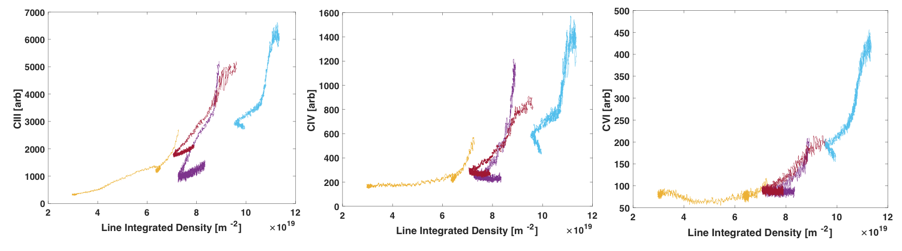
Carbon charge states emit across the island divertor volume featuring a quadratic dependence on density which defines divertor T_{e}
Quadratic rise of carbon line radiation close to the target (C-III), in the island domain (C-IV) and around separatrix (C-VI) supports facilitation of detachment by intrinsic impurity radiation
6.0MW, I_{cc}=2.0kA
3MW, 2kA ICC
3MW, I_{cc}=0kA
3MW, post-boronization
Carbon as intrinsic impurity supports the necessary radiative losses localized inside and in the close vicinity of the island domain.
A2

Slide 46
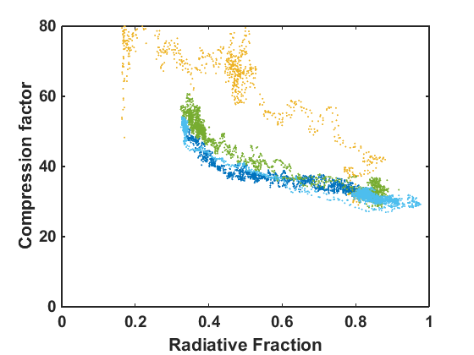
The divertor neutral pressure level depends on density scaling with increasing heating power – access to detachment for f_{rad}>0.75
Heat and particle flux detachment domain with stable neutral pressure
5.8MW, I_{cc}=2.5kA
6.2MW, I_{cc}=2kA
5.8MW, I_{cc}=0kA
Common compression ratio of >30 is seen at detachment level radiative fractions
3MW, I_{cc}=0kA
At a radiated fraction of 0.75 < f_{rad} < 0.9 a saturated neutral pressure p_{n} regime is seen with p_{n} being set by the plasma density
A3

Slide 47
The volume of the magnetic island is predicted to serve as a reliable interface layer with a beneficial radiation and ionization equilibrium
Island size dependence of C radiation around islands at f_{rad}=0.8
Small island
Medium island
Large island
Radiation localized at strike point
Radiation fills island domain
Radiation reaches separatrix
Interplay of radiation distribution with power dissipation and divertor neutral capture is key to understand the island divertor!
[Y. Feng et al., Nuclear Fusion 56 (2016) 126011]
A4

Slide 48
The EMC3-EIRENE model in a nutshell
Figure courtesy of H. Frerichs
[Y. Feng et al., JNM 266-269 (1999) 812]
[Y. Feng et al., PPCF 59 (2017) 034006]
[Y. Feng et al., Contri. Plasma Phys. 54 (2014) 426-431]
A6

Slide 49
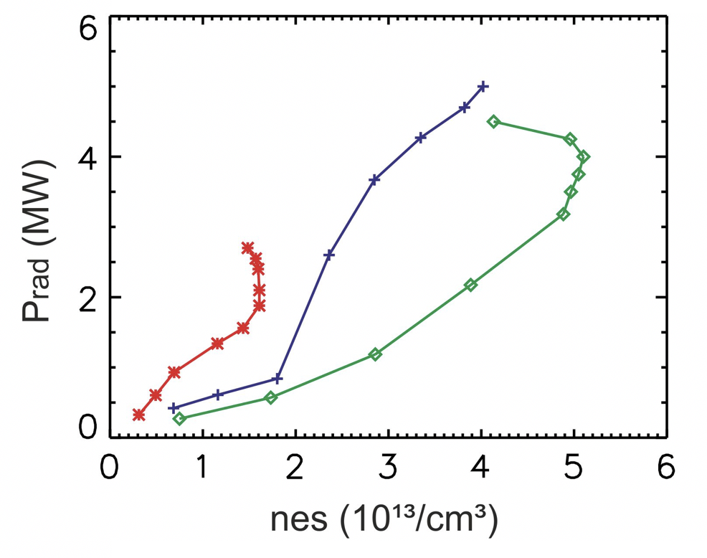
The radiation fraction is dependent of the heating power for a given density range – this is the basis for the regulation of divertor temperature in the island
EMC3-EIRENE predicts comparable scaling of radiation in island with density
Heat and particle flux detachment domain with stable neutral pressure
5.8MW, I_{cc}=2kA, 4% C
3.0MW, I_{cc}=0kA
3MW, I_{CC}=0kA, 10% O
5.0MW, I_{cc}=0kA, 4% C
6.2MW, I_{cc}=2kA
3MW, I_{cc}=0kA
Pre-boronization
5.8MW, I_{cc}=0kA
The radiated fraction depends on density which in turn is defined by the available heating power through ECRH – this sets the stage for the detached regime.
A7

Slide 50
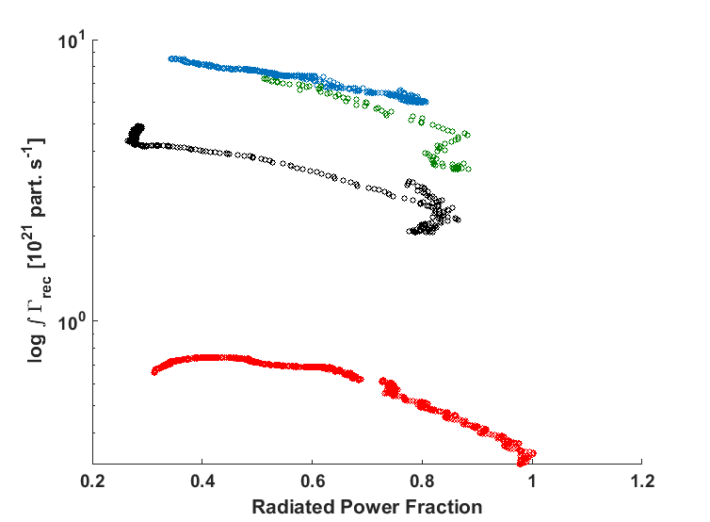
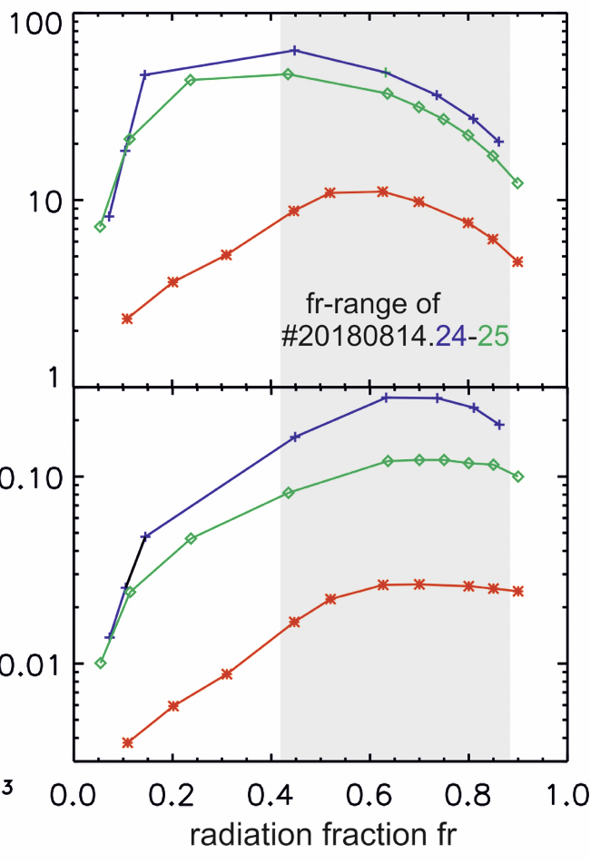

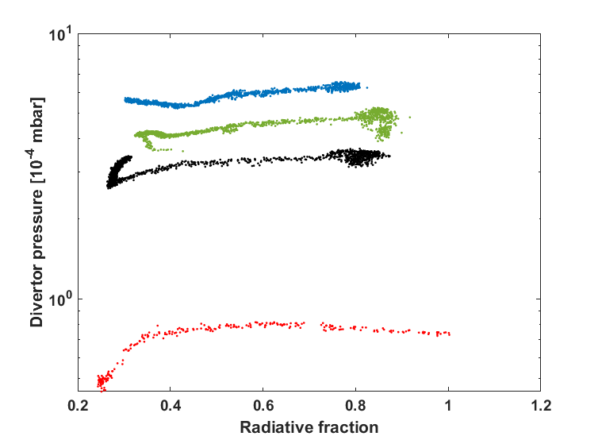

Dependence of target parameters on f_{rad} is consistent between experiment and EMC3 model, but a significantly weaker dependence is found in measurement
EMC3-EIRENE modelling
6.2MW, I_{cc}=2kA
5.8MW, I_{cc}=0kA
3.0MW, I_{cc}=0kA
3MW, I_{cc}=0kA
Pre-boronization
A8

Slide 51
Dependence of target parameters on f_{rad} is consistent between experiment and EMC3 model, but a significantly weaker dependence is found in measurement
EMC3-EIRENE modelling
6.2MW, I_{cc}=2kA
5.8MW, I_{cc}=0kA
A possible hierarchy of the process
3.0MW, I_{cc}=0kA
Power level defines density and hence Φ_{rec}
3MW, I_{cc}=0kA
Pre-boronization
Φ_{rec} provides source for p_{n}
Optimal neutral particle distribution for good pump access is defined by f_{rad}
A9

Slide 52
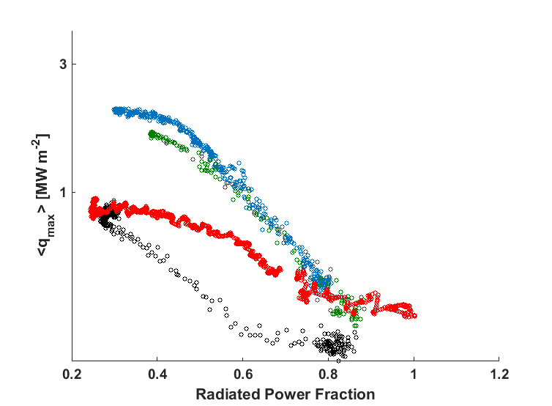

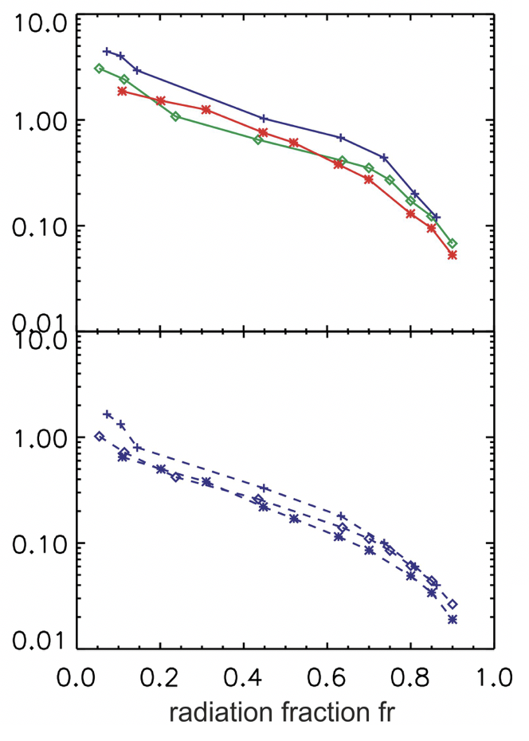
Dependence of target parameters on f_{rad} is consistent between experiment and EMC3 model, but a significantly weaker dependence is found in measurement
EMC3-EIRENE modelling
6.2MW, I_{cc}=2kA
5.8MW, I_{cc}=0kA
3MW, I_{cc}=0kA
Pre-boronization
Power dissipation due to radiation from intrinsic impurity yields thermal detachment
A10

Slide 53
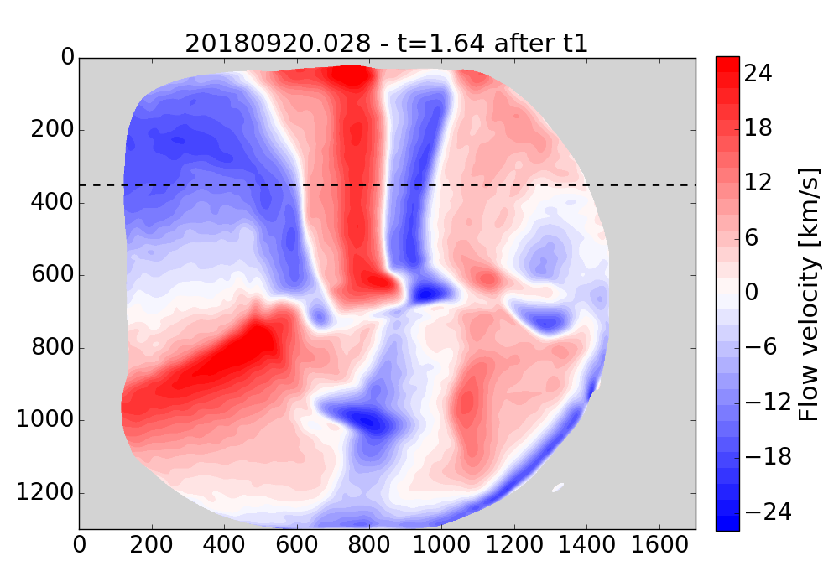
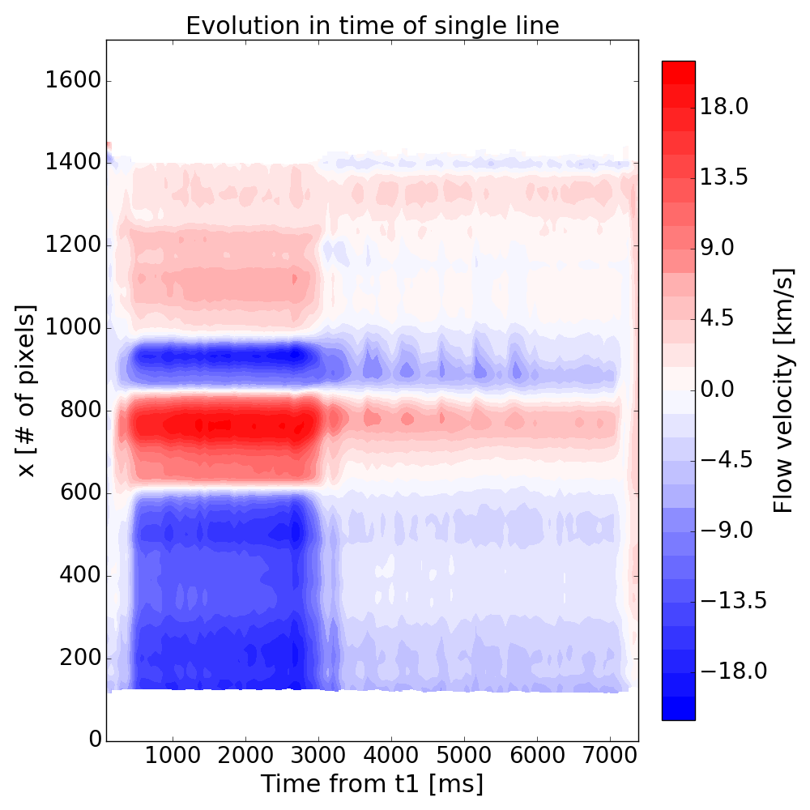
Particle flows are reduced at transition into detachment
Detachment
achieved
A11
Acknowledgement: V. Perseo

