Slide 1
Safety, economic, and environmental foundations of fusion reactor design
Paul Humrickhouse
Fusion Safety Program Lead
Idaho National Laboratory
May 11, 2020

Slide 2
Why Fusion?
APS DPP Community Planning Process consensus: we should build a fusion pilot plant!
We take the logic of this for granted but… why would we want to?
The answer to this has to be, because it is better than the alternatives
The answers to this question dictate a lot about the balance of a fusion pilot plant
We pursue fusion because:
  Compared to fossil sources, fusion has no carbon emissions
  Compared to fission energy, fusion potentially
    Has abundant fuel resources (D, Li)
    Produces less radioactive waste (environmentally benign)
    Is safer (no radioactive emissions, or severe accidents)
In addition to those things, widespread adoption of fusion as an energy source depends on utilities wanting to purchase and operate fusion plants

Slide 3
Utility perspectives on fusion
US Utility Requirements (1994) | Example Attributes
Cost advantage over other available options | High thermal conversion efficiency and component efficiencies, compact (high beta), low recirculating power (e.g. high I_{BS}), high availability, low cost of fabrication.
Eased licensing process | Plant standardization, low activation materials, low energy release potential, low tritium inventory.
No need for evacuation plan | Low activation materials, low energy release potential, passive safety, reliable containment, low tritium inventory
Produce no high-level waste | Materials choices, waste management
Reliable, available, and stable | Ample design margins, uncomplicated designs, rapid maintenance
No local or global atmospheric impact | Low CO₂ emissions, low tritium emissions
Fuel cycle is closed and on-site, High fuel availability | Fuel cycle is closed and on-site, High fuel availability
Capable of partial load operation, Available in a range of unit sizes | 500 MW – 1 GW
Safety/Environmental Issues
Practical/Economic Issues
M. Tillack, 2014 TOFE, based on J. Kaslow et al., Journal of Fusion Energy 13 (2/3) 1994.

Slide 4
DOE Fusion Safety Standard
The DOE standard¹ safety policy for fusion:
  The public shall be protected such that no individual bears significant additional risk to health and safety from the operation of those facilities above the risks to which members of the general population are normally exposed.
  Fusion facility workers shall be protected such that the risks to which they are exposed at a fusion facility are no greater than those to which they would be exposed at a comparable industrial facility.
  Risks both to the public and to workers shall be maintained as low as reasonably achievable (ALARA).
  The need for an off-site evacuation plan shall be avoided.
  Wastes, especially high-level radioactive wastes, shall be minimized.
¹DOE-STD-6002-96, “Safety of Magnetic Fusion Facilities: Requirements”

Slide 5
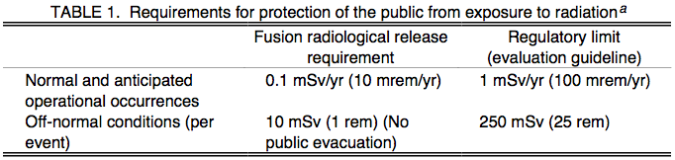
DOE Fusion Safety Standard
Potential safety concerns:
  Ensuring afterheat removal when required
  Providing rapid controlled reduction in plasma energy when required
  Controlling coolant energy (e.g., pressurized water, cryogens)
  Controlling chemical energy sources
  Controlling magnetic energy (e.g., toroidal and poloidal field stored energy)
  Limiting airborne and liquid releases to the environment
Radioactive and hazardous material confinement barriers of sufficient number, strength, leak tightness, and reliability shall be incorporated in the design of fusion facilities to prevent releases of radioactive and/or hazardous materials from exceeding evaluation guidelines during normal operation or during off-normal conditions:

Slide 6
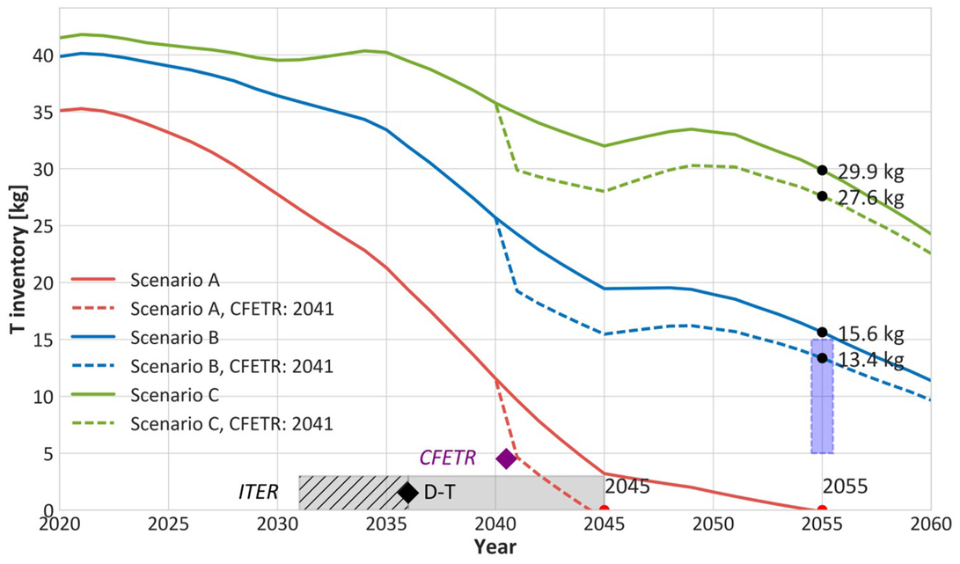
D-T fuel cycle and tritium availability
D-T is the most achievable fusion reaction, but there is no natural supply of tritium (~12 yr half life)
The existing civilian supply comes from CANDU reactors (in Canada, Romania, South Korea), which produce tritium via activation of D₂O moderator
ITER’s tritium will come from the Canadian supply
The availability of the necessary startup inventory for any other future fusion reactor depends on the future operation of the CANDU fleet worldwide
For sustained operation of those future fusion reactors, tritium breeding will be required
  With a tritium breeding ratio > 1
M. Kovari, Nuclear Fusion 58 (2018) 026010.

Slide 7
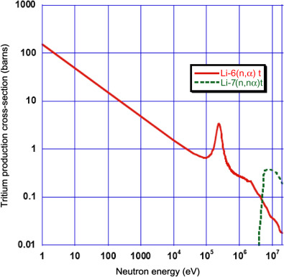
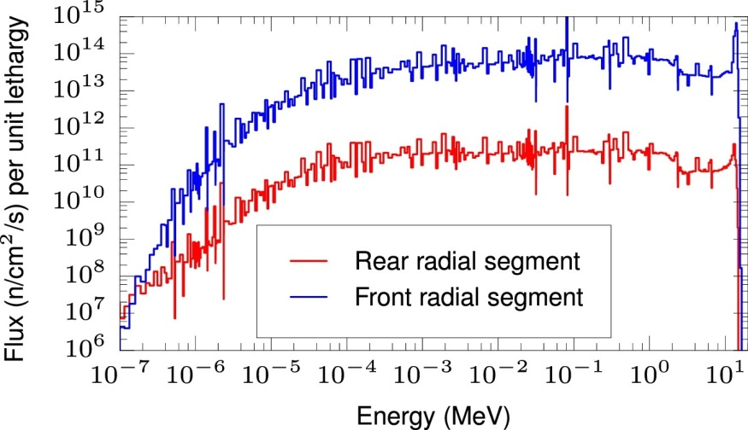
Tritium breeding
A variety of nuclear reactions can produce tritium, but only lithium is capable of producing it at the necessary rates, via the reactions:
n + ⁶Li → ⁴He + T + 4.785 MeV
n + ⁷Li → ⁴He + T + n’ - 2.5 MeV
The ⁷Li reaction has threshold of ~2 MeV, produces an additional neutron, and has a higher reaction rate at high energy
As neutrons are moderated in the blanket, the neutron energy spectrum flattens:
At lower energies, only the ⁶Li reaction occurs, and it is therefore necessary to enrich in ⁶Li (e.g., to ~90%)
A pure Li blanket can achieve a TBR > 1
J. Shimwell, Fusion Engineering and Design 98-99 (2015) 1868-1871.
R. Yoshioka et al. in Molten Salt Reactors and Thorium Energy (2017) 189-207.

Slide 8
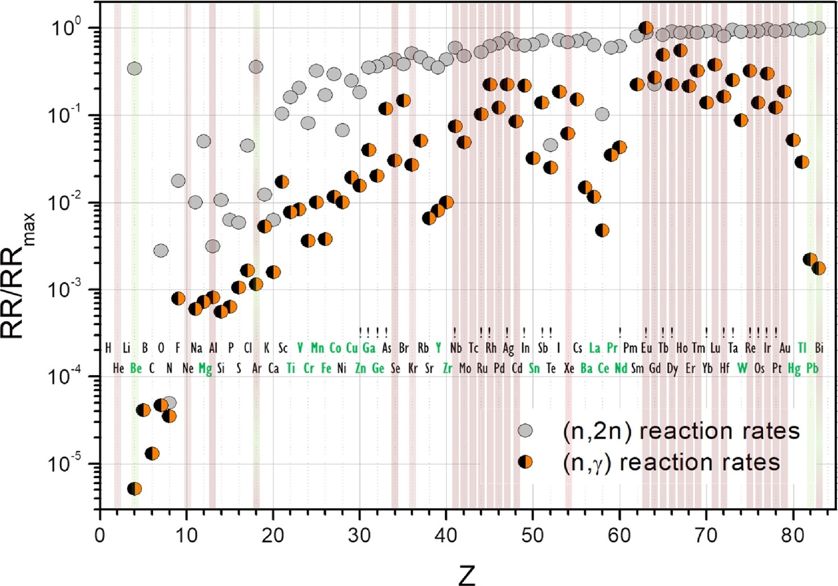
Neutron Multipliers
Most blanket concepts lose a fraction of neutrons to parasitic absorption in structural materials, and require the addition of a neutron multiplier, which produces additional neutrons through (n,2n) reactions
Suitable materials must have a high (n,2n) reaction rate combined with a low (n,𝛾) parasitic absorption rate
There are only two that achieve this: beryllium and lead
F. Hernandez and P. Pereslavtsev, Fusion Engineering and Design 137 (2018) 243-256.

Slide 9
Breeder Materials
So, viable breeder materials must consist of Li plus Be or Pb
Any other constituent materials must have sufficiently low parasitic absorption to maintain (TBR > 1)
Breeder materials should should additionally:
  Facilitate release of tritium produced in them (i.e. not retain this and build up large tritium inventories)
  Minimize neutron activation
    All activation products contribute to decay heat
    Long-lived activation products in particular are a radioactive waste issue

Slide 10
Blanket materials and coolants
First Wall/Blanket structural materials should:
  Minimize neutron activation
    All activation products contribute to decay heat
    Long-lived activation products in particular are a radioactive waste issue
  Be compatible with breeder/multiplier materials
  Not retain large amounts of tritium
  Limit, to the extent possible, permeation of tritium
  Function as structural materials, under:
    Large temperature gradients
    High neutron flux/fluence
    Large electromagnetic forces
Blanket coolants should:
  Maximize thermal conversion efficiency
  Not retain large amounts of tritium
  Be compatible with breeder & structural materials, including in off-normal events (passive safety)

Slide 11
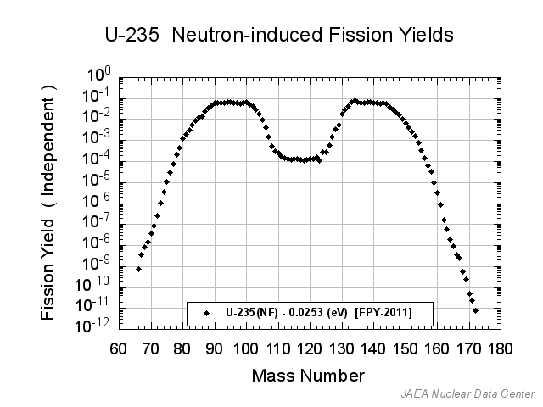
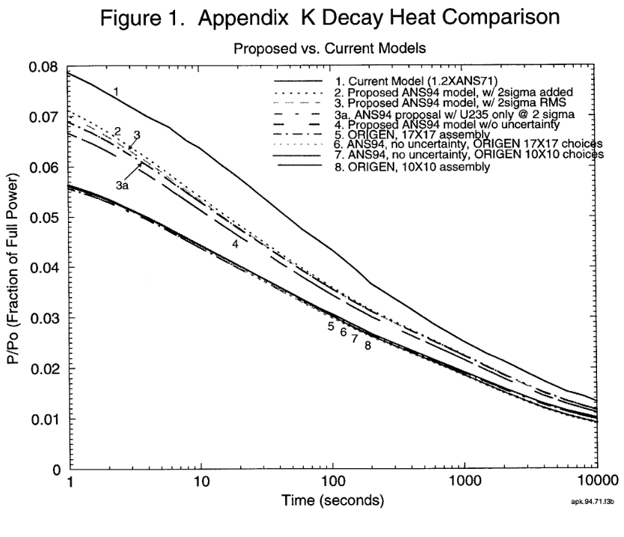
Activation and Waste – fission vs. fusion
Decay heat and waste from fission is dominated by fission products, which are produced according to the yield curve
In fusion, decay heat and waste are the result of only activation products, and these are dictated entirely by our choice of materials
So, in principle we can reduce both by selecting low-activation constituents from the periodic table…
https://www.nrc.gov/docs/ML0217/ML021720702.pdf

Slide 12
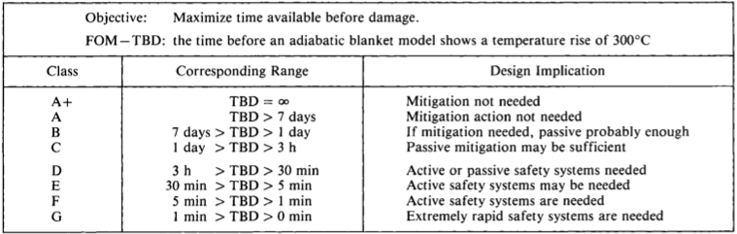
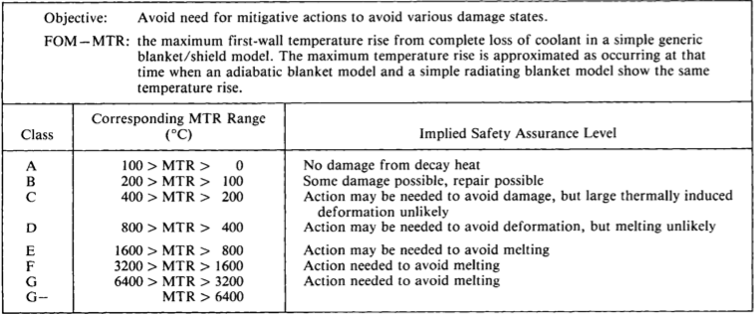
Decay Heat
Ideal objective: no damage (e.g. melting) even if all coolants are drained from reactor during accident
Guidance on material constituents from very simple thermal model:
Adiabatic FW with steel-like properties (specific heat)
Decay heat from activation of each element in the periodic table
Assign each element a “letter grade” based on the temperature rise, and time to damage
S. Piet, Fusion Technology 17 (1990) 636-657.

Slide 13
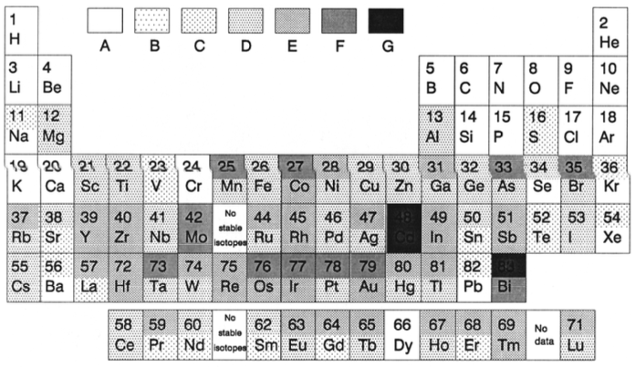
Decay Heat – “Time Before Damage” FOM

Slide 14
Decay Heat (a more colorful representation)
1
2
H
DH<10⁻⁴
10⁻⁴<DH<10⁻³
10⁻³<DH<10-²
10⁻²<DH<10⁻¹
10⁻¹<DH<10⁰
10⁰<DH<10¹
He
3
4
kW/kg
5
6
7
8
9
10
Li
Be
Top half of box:
at 10⁻⁵ years
B
C
N
O
F
Ne
11
12
Bottom half of box:
at 10⁻² years
13
14
15
16
17
18
Na
Mg
Al
Si
P
S
Cl
Ar
19
20
21
22
23
24
25
26
27
28
29
30
31
32
33
34
35
36
K
Ca
Sc
Ti
V
Cr
Mn
Fe
Co
Ni
Cu
Zn
Ga
Ge
As
Se
Br
Kr
37
38
39
40
41
42
no
44
45
46
47
48
49
50
51
52
53
54
Rb
Sr
Y
Zr
Nb
Mo
stable
Ru
Rh
Pd
Ag
Cd
In
Sn
Sb
Te
I
Xe
isotopes
55
56
57
72
73
74
75
76
77
78
79
80
81
82
83
Cs
Ba
La
Hf
Ta
W
Re
Os
Ir
Pt
Au
Hg
Tl
Pb
Bi
58
59
60
no
62
63
64
65
66
67
68
69
70
71
Ce
Pr
Nd
stable
Sm
Eu
Gd
Tb
Dy
Ho
Er
Tm
Yb
Lu
isotopes
Based on C. B. A. Forty, et al., Handbook of Fusion Activation Data; Part 1. Elements Hydrogen to Zirconium, AEA FUS 180, May, 1992. Assumes 4.15 MW/m² for 25 years

Slide 15
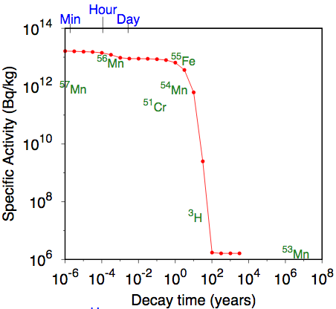
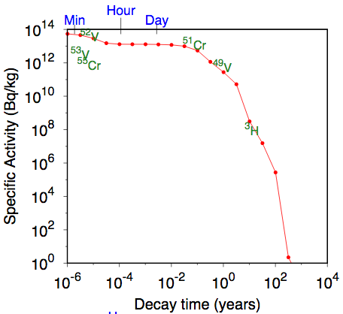
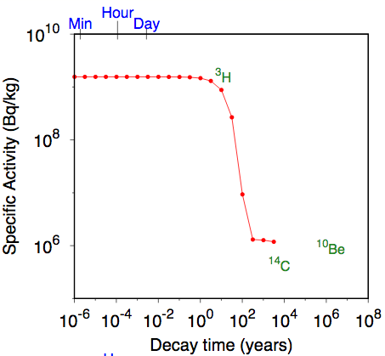
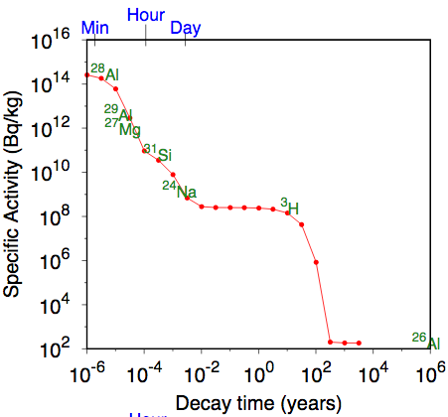
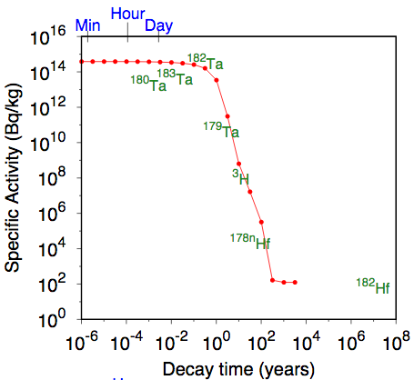
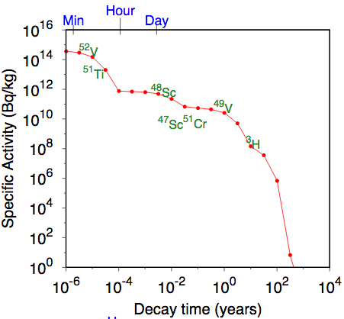
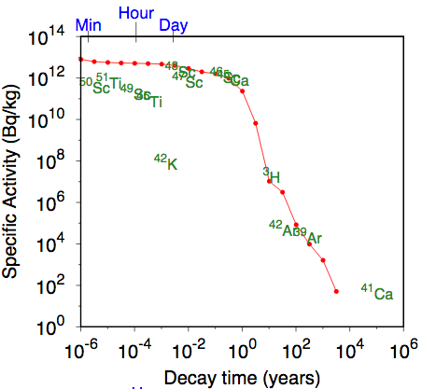
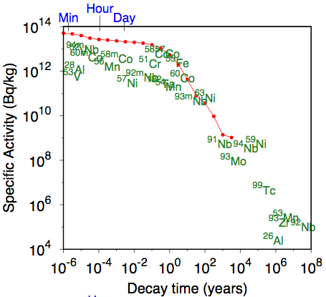
Decay heat of elements over time
At ITER FW flux and spectrum, following 14 year ITER operational scenario (from CCFE-R(16)37)
Fe
Si
C
Cr
V
Ta
Ti
Inconel-718

Slide 16
Decay Heat Grades (Piet 1990)
Austenitic Steels: D-E, ≤ 1 hour to damage
Ferritic Steels: D, 1-2 hours to damage
Vanadium alloys: C-D, 6-7 hours until damage
SiC: A, no damage occurs

Slide 17
Radioactive Waste
NRC waste classifications (10 CFR 61.55):
  High Level Waste (HLW)
    Spent fuel and materials resulting from reprocessing of spent fuel
    “Other highly radioactive materials that the Commission may determine require permanent isolation”
    Requires deep geologic repository
    Fusion can avoid high level waste!
  Low Level Waste (LLW)
    Class A (lowest hazard), B, and C
    Class C can be disposed of by shallow land burial (5m below surface with natural or engineered barrier)
      Class C criterion: “intruder dose” < 500 mrem/yr after 500 years
        Scenario: someone builds a house on top of unrecognizable waste 500 years in the future, lives there, and grows half their food on the waste site¹
    Objective for fusion is structural materials that meet class C
      Reference below outlines concentration limits for fusion materials
¹S. Fetter et al., Fusion Engineering and Design 6 (1988) 123-130.

Slide 18
Alloy concentrations to meet Class C disposal
From: Piet, et al., “Initial Integration of Accident Safety, Waste Management, Recycling, Effluent, and Maintenance
Considerations for Low-Activation Materials”, Fusion Technology, Vol. 19, Jan. 1991, pp. 146-161.
Assumes 5 MW/m² for 4 years; and E. T. Cheng, “Concentration Limits of Natural Elements
in Low Activation Materials”, presented at ICFRM-8, Sendai, Japan,October 1997

Slide 19
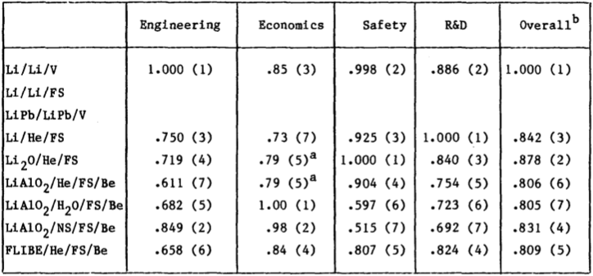
Blanket Comparison and Selection Study
In the early 1980s, a comprehensive Blanket Comparison and Selection Study was conducted, to identify the most promising blanket concepts, prioritize R&D issues, and provide input for a program plan
69 Contributors produced a 1190 page report at the end of the two year study
~130 different concepts were initially considered; the seven most promising were evaluated in more detail based on engineering, economic, safety, and R&D requirements, and ranked:

Slide 20
Since BCSS
A lot has changed! None of the BCSS concepts are still being pursued; concepts now under development were not evaluated by the BCSS
Better ceramics developed¹: Li₄SiO₄ and Li₂TiO₃ replaced Li₂O (chemical reactivity and material compatibility concerns) and LiAlO₂ (low lithium density, high activation of Al)
PbLi preferred over pure liquid Li, which has high chemical reactivity with air and water
Challenges in vanadium alloy development (deleterious effect of O, C, N impurities; joining techniques; insulator coating development; helium generation under fusion neutron irradiation)²
Major progress in SiC/SiC composite development; challenges for fusion applications remain (helium production and transmutation under fusion neutron irradiation, joining techniques; corrosion)³
Development of Reduced Activation Ferritic/Martensitic (RAFM) steels
  Mod9Cr-1Mo (Grade91) steel, with Mo replaced by W, and Nb replaced by Ta
  EU (EUROFER-97, Fe-9Cr-1W-0.2V-0.12Ta), Japan (F82H, Fe-8Cr-2W-0.2V-0.04Ta), Korea, China (but not US) have all developed alloys
  Challenges include helium production and transmutation under fusion neutron irradiation…
    This is why we need a fusion prototypic neutron source!
¹F. Hernandez and P. Pereslavtsev, Fusion Engineering and Design 137 (2018) 243-256.
²R. Kurtz et al., Journal of Nuclear Materials 283-287 (2000) 70-78.
³L. Snead et al., Journal of Nuclear Materials 417 (2011) 330-339.
⁴H. Tanigawa et al., Nuclear Fusion 57 (2017) 092004.

Slide 21
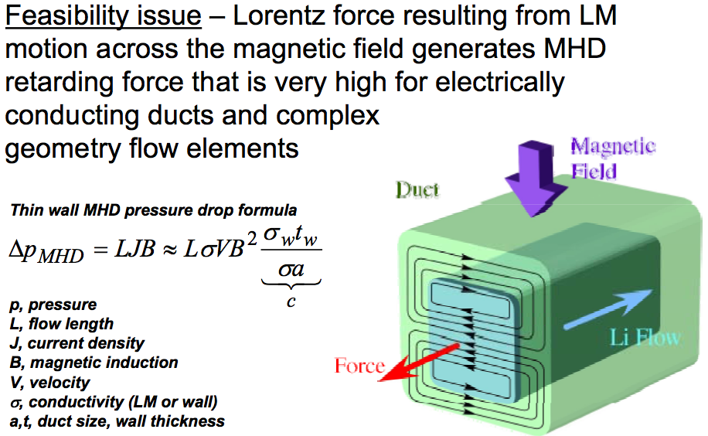
PbLi Breeder Concepts
The simplest configuration for a liquid breeder is to use it also as the coolant, i.e. “self-cooled”
The flow rate must be high enough to achieve adequate cooling
Liquid metals must overcome a large MHD pressure drop; high velocities exacerbate this
Insulating walls (e.g. SiC) can mitigate this; most self-cooled liquid metal blanket concepts have assumed SiC as the structural material
If RAFM must be the structural material,
  Another sort of insulator is needed
  Or, the flow velocity can be decreased
  PbLi concepts with lower flow rates need a separate or additional coolant
    Helium and water are both candidates
  RAFM structure limited to 550 °C by thermal aging
  Further limited to 470 °C to avoid excessive corrosion by PbLi
Mohamed Abdou, 2007

Slide 22
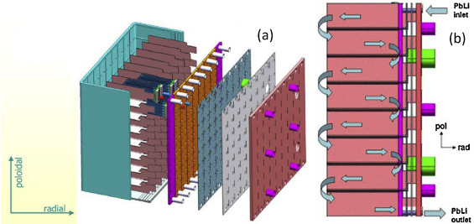
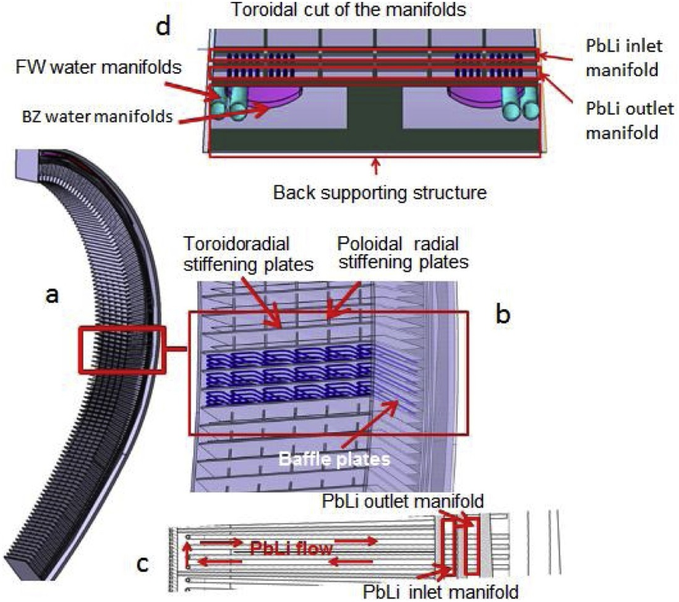
Separately cooled PbLi breeder concepts: HCLL/WCLL
M. Abdou et al. / Fusion Engineering and Design 100 (2015) 2–43
Helium-cooled lead-lithium (HCLL)
  Former EU ITER TBM design and DEMO concept
  PbLi breeder flows very slowly and serves no cooling function
    High tritium partial pressure; permeation barriers required
  Cooling is provided entirely by separate helium channels
Water-cooled lead-lithium (WCLL)
  Similar slow PbLi flow
  ~PWR coolant conditions, 15.5 MPa, Tin = 295 °C, Tout= 328 °C
  Double-walled tubes in breeding zones to prevent “in-box LOCA,” PbLi-water interactions
HCLL
WCLL
G. Federici et al.,
Fusion Engineering and Design 141 (2019) 30-42.

Slide 23
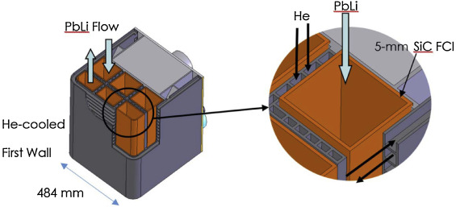
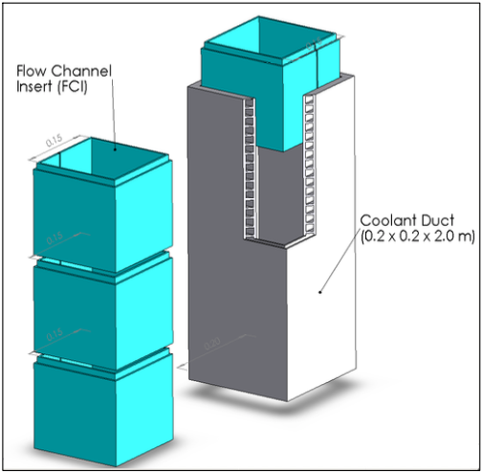
PbLi breeder concepts
Dual-coolant lead-lithium (DCLL)
US TBM conceptual design (not pursued) and DEMO concept
Philosophy: push toward high temperature and thermal efficiency with present generation materials
RAFM steel structure with non-structural SiC flow channel inserts (FCI)
SiC provides necessary electrical and thermal insulation to mitigate MHD forces and allow PbLi temperatures up to 700 °C while maintaining RAFM structure below 470 °C
Higher PbLi flow rates: ~50% of power extracted from PbLi, ~50% from separate helium coolant
Higher flow rate and SiC barrier help mitigate tritium permeation
DCLL a potential transformative enabling capability¹
DCLL
M. Abdou et al. / Fusion Engineering and Design 100 (2015) 2–43
¹FESAC, "Transformative Enabling Capabilities for Efficient Advance Toward Fusion Energy," 2018.
Mohamed Abdou, 2007

Slide 24
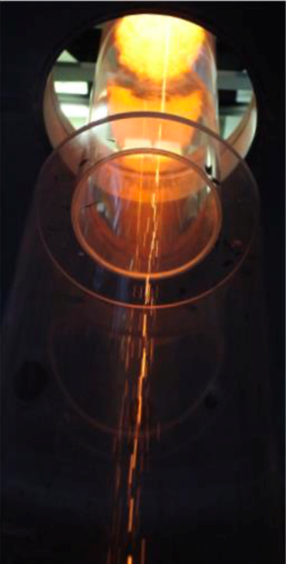
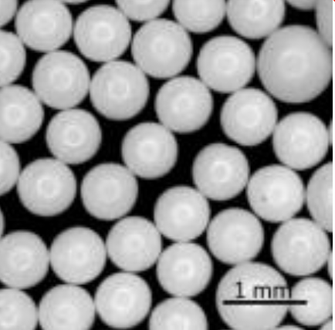
Ceramic Breeder Materials
Lithium is the only viable element from which to breed tritium, but it melts at 180 ºC
Lithium-based ceramics are an attractive solid form due to their thermal stability and chemical inertness
Requirements:
  Withstand stresses (under irradiation, high temperature, etc.) without excessive fragmentation
  Stability of ceramic at high temperature
  Compatibility with structural materials
  Low tritium retention
  Low activation
Current primary candidates are Li₂TiO₃ and Li₄SiO₄
  Others such as LiO₂ and LiAlO₂ have been investigated previously
  Others containing Zr, Pb, others are being explored
All current concepts employ ~1mm pebbles (small fuel form needed to minimize impact of cracking and fragmentation under stress)
F. Hernandez, IEEE Transactions on Plasma Science, 2018

Slide 25
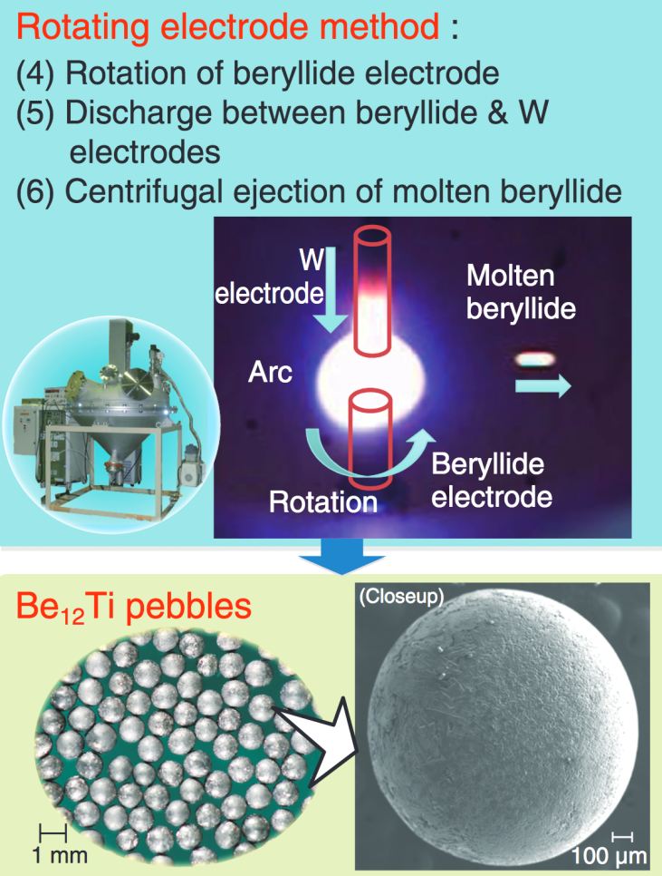
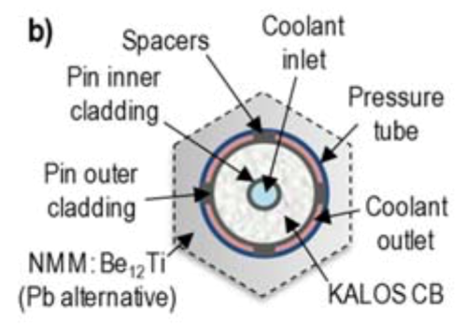
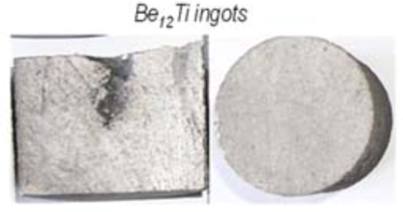
Neutron Multiplier Materials
Only Pb and Be offer suitable neutron multiplication coupled with low neutron absorption
  If a solid multiplier is desired, then Be is the only option
There are a lot of issues with pure beryllium (aside from toxicity):
  High swelling under irradiation, especially at high temperature (> 600 °C)
  High tritium retention (40% at 600 °C)
  High chemical reactivity with water (heat addition and explosive H₂ generation)
To address these concerns, DEMO designs have increasingly (entirely?) migrated to beryllide intermetallic compounds such as Be₁₂Ti or Be₁₂V. Beryllides have:
  Higher melt temperature and operating window
  Lower swelling under irradiation
  Low tritium retention (~0% at 600 °C)
  Lower chemical reactivity (by an order of magnitude or so)
Form is traditionally pebbles, but swelling of beryllides is low enough to permit solid blocks
https://rdreview.jaea.go.jp/fukyu/review_en/2013/pdf_high/4-3.pdf
F. Hernandez, 2018 TOFE

Slide 26
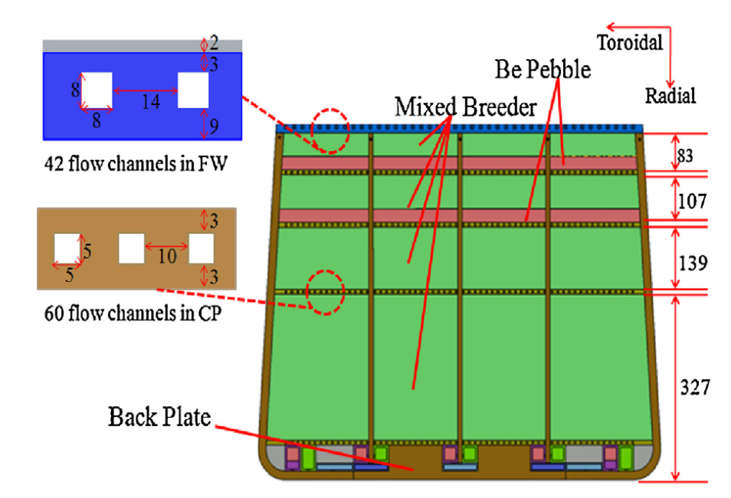
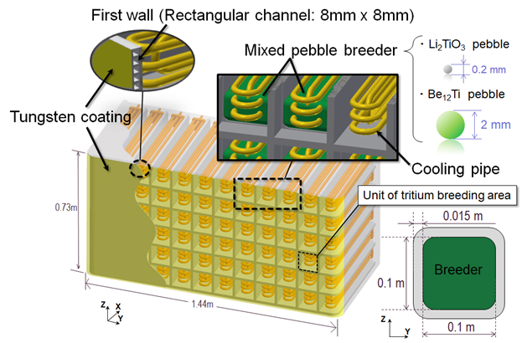
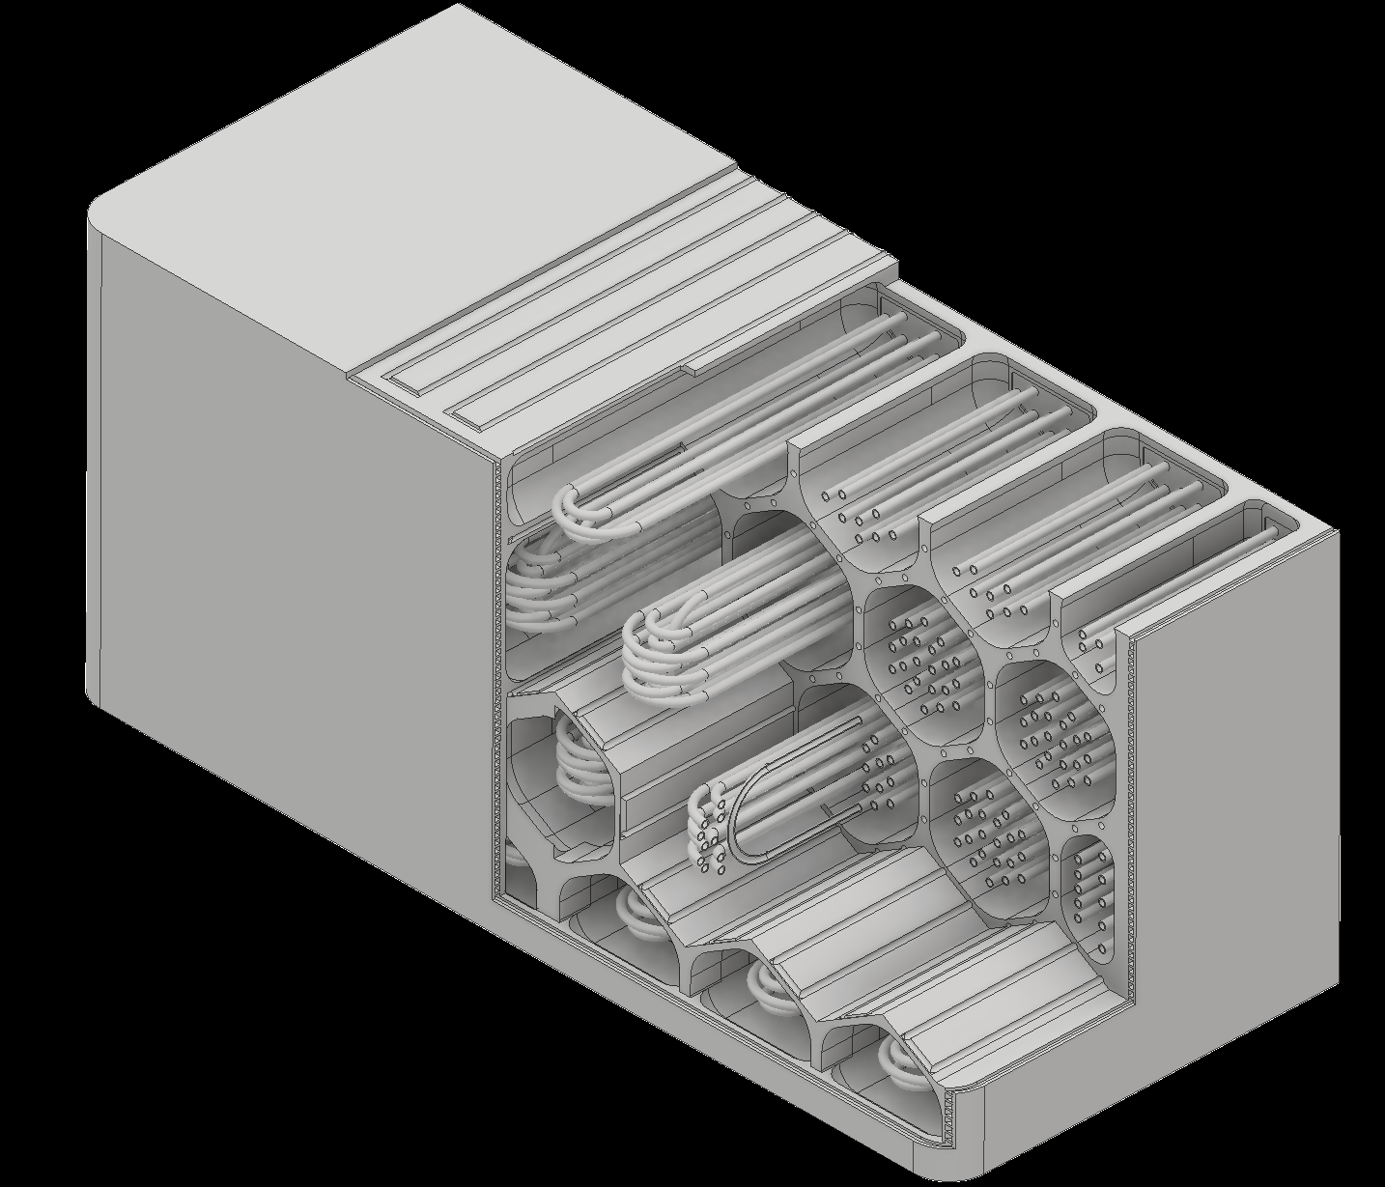
Design Concepts
Designs typically feature:
  Pebble bed(s) of Li ceramic and Be/beryllide
    Mixed beds are ok with beryllides, otherwise separate breeder and multiplier beds
    Swept by slow, low pressure (~atmospheric) purge gas flow (He)
      Purge gas flow typically includes ~0.1% H₂ to accelerate tritium release at surfaces
  Separate water or helium coolant channels
All ITER TBM partners (EU, JA, KO, CN) are pursuing a ceramic breeder concept, either helium or water cooled
WCCB - CFETR
JA DEMO Design
Y. Someya, 2018 US-JA Workshop
S. Liu et al. / Fusion Engineering and Design 124 (2017) 865–870

Slide 27
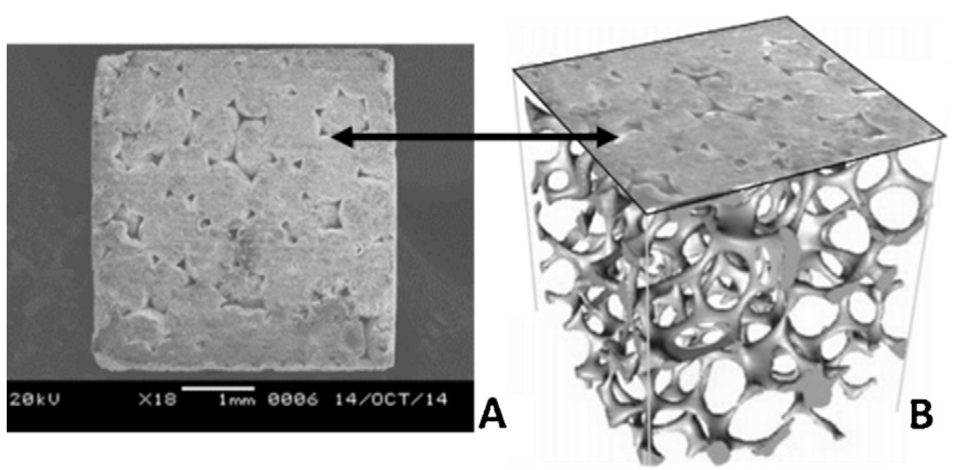
Advances in ceramic breeders
Drawbacks of pebble bed configuration:
  Potentially marginal breeding due to inherent void volume
  Low effective thermal conductivity (relies on pebble contacts)
  Sintering at high temperature effects thermal performance and tritium release
“Cellular ceramic breeder” fabricated by casting breeder material into a highly porous carbon foam skeleton, which is subsequently removed by oxidation
Result is >90% dense material, with interconnected porosity facilitates tritium release
Thermal conductivity 2-3x pebble beds
No possibility of sintering or loss of contact
Material is Li₂ZrO₃, other ceramics of interest for R&D
US program investigating ceramic breeders again; analysis will be part of present systems study (FNSF variant)
Another potential transformative enabling capability¹
¹FESAC, "Transformative Enabling Capabilities for Efficient Advance Toward Fusion Energy," 2018.
S. Sharafat et al., Fusion Engineering and Design 109-111 (2016) 119-127

Slide 28
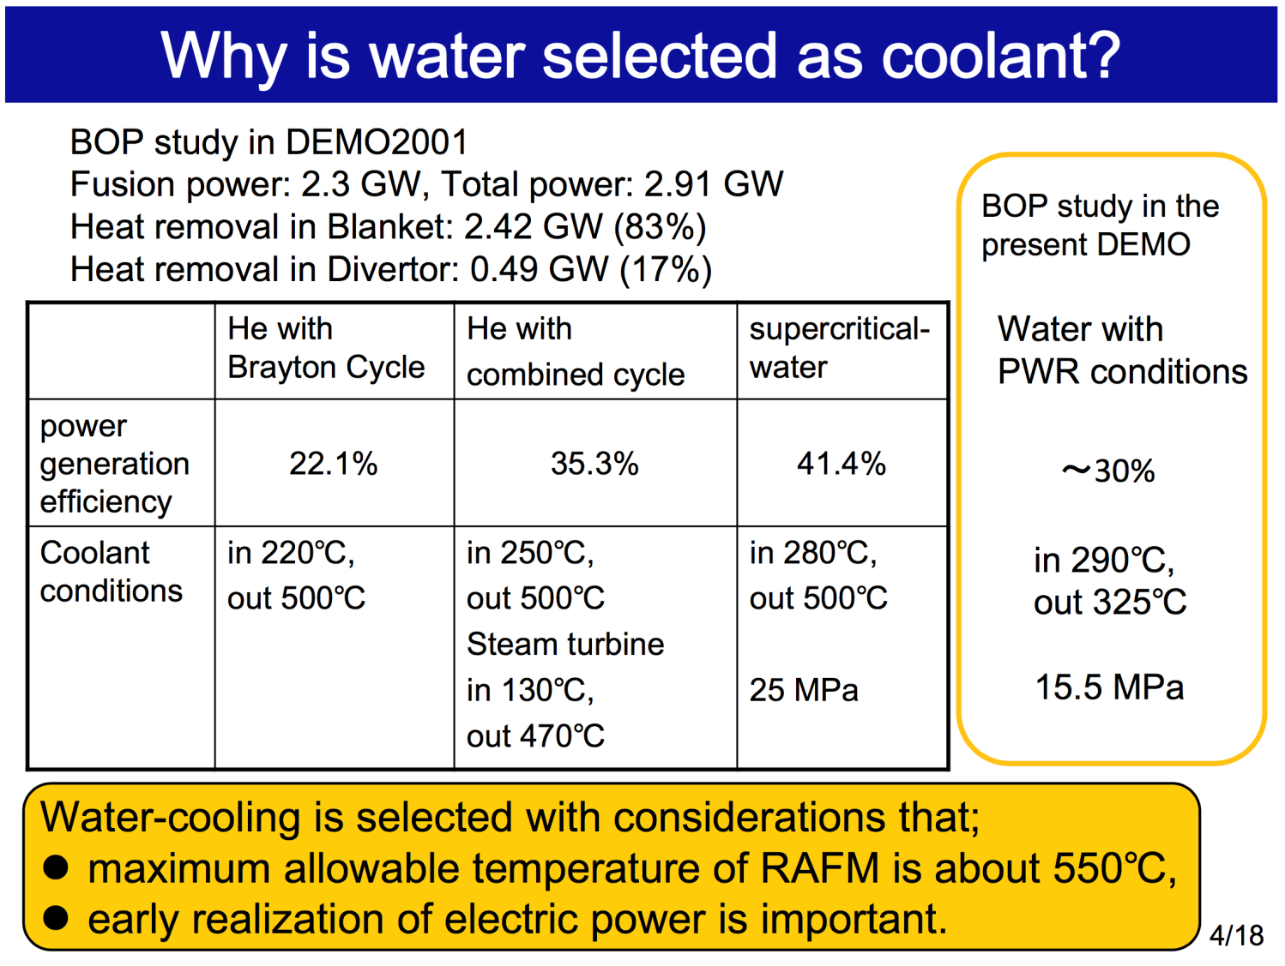
Why choose water?
Japan selected water for DEMO because:
  Higher efficiency not achievable with helium if temperature is limited by RAFM steel
  Perceived technological maturity, and desire for near-term deployment
Choice of water dictates high pressure and low temperature coolant, i.e. PWR conditions
H. Tanigawa, 3rd IAEA DEMO Programme Workshop, 2015.

Slide 29
Water Challenges – Pressure, Phase Change
In order to keep water in the liquid phase, high pressures (~15-16 MPa) are needed- this is twice the pressure of the helium coolant in HCPB designs
In-box LOCA (water tube break into the larger pebble bed region) remains a major design challenge
  JA DEMO design must withstand pressurization to 17.2 MPa
    (15.5 MPa coolant pressure + 1.21 MPa primary pressure drop + 0.5 MPa margin
Requirement leads to increased structure, which has a detrimental effect on TBR
  JA evaluating various structural configurations, as well as the use of heavy water, to try and mitigate this
More generally, boiling of water has to be avoided or dealt with in off-normal situations
  In loss of heat sink or loss of flow accidents (LOFA), boiling and overpressure will occur
    Pressure relief needed, but this releases radioactive material (tritium)
    Natural circulation or emergency cooling schemes may be necessary

Slide 30
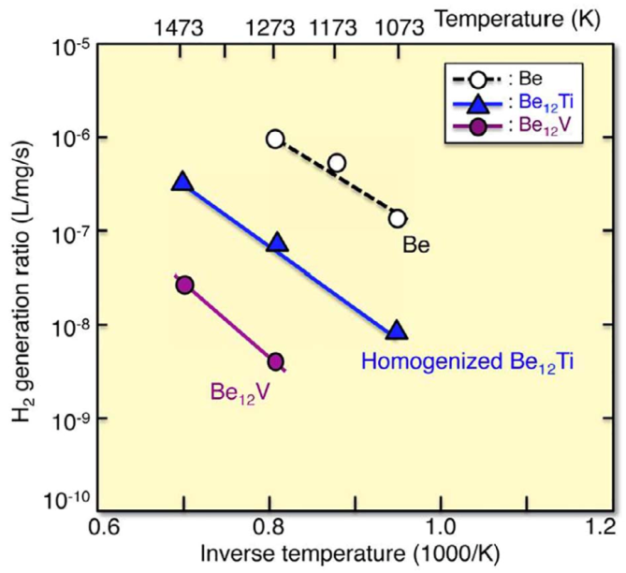
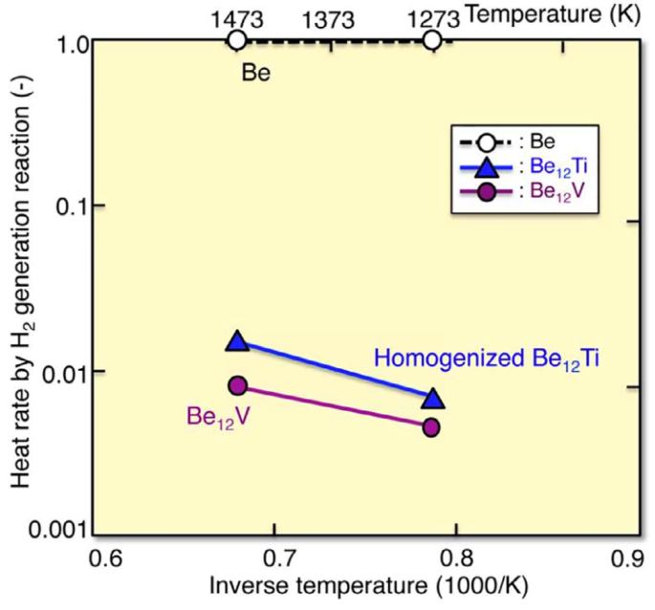
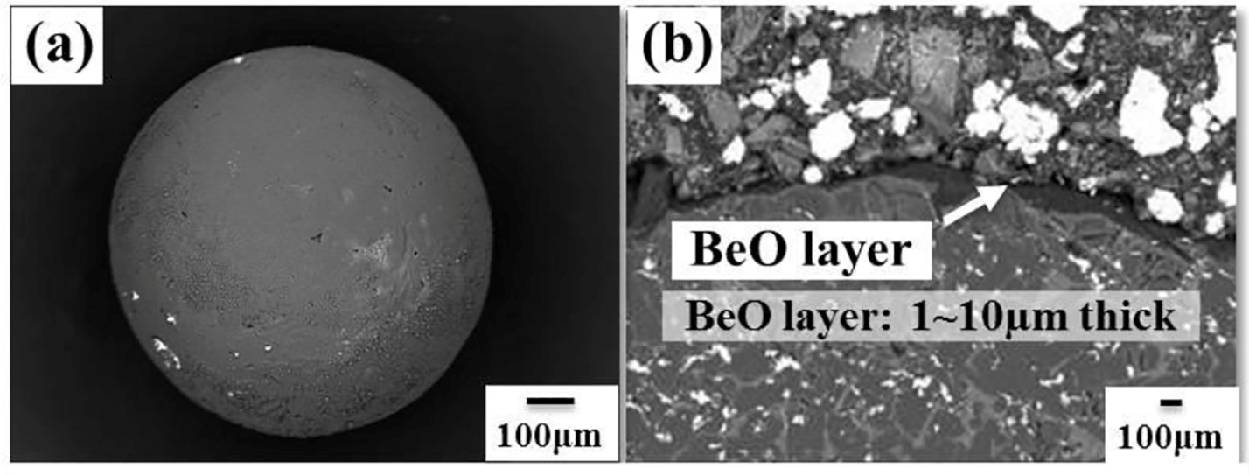
Water Challenges – Chemical Reactions
Beryllium reacts very exothermically with water, adding additional heat and generating potentially explosive hydrogen in an accident scenario
This risk appears to be substantially mitigated by the use of beryllides, which have much lower reaction rates
The reason appears to be that the oxide layer generated in beryllide oxidation is stable and protective, unlike the porous, unprotective layer resulting from oxidation of pure beryllium
M. Nakamichi et al. Nuclear Materials and Energy 15 (2018) 71–75

Slide 31
Water Challenges – Tritium Management
If bred tritium permeates into water coolant, there is potentially a very large quantity of it to de-tritiate
There is a considerable experience with water detritiation, resulting especially from the needs of CANDU reactors; can it be scaled up to meet WCCB needs?
Recent Japanese DEMO design anticipates permeation of ~3 g/day of tritium into water coolant¹
Water detritiation systems in use at Wolsong in Korea are cited as tritium removal system; rates demonstrated are apparently sufficient to maintain tritium concentrations in the water to CANDU levels (~1 TBq/kg)
May be significant tritium inventory in water detritiation systems
¹Y. Someya, 2018 US-JA Workshop
²F. Hernandez, IEEE Transactions on Plasma Science, 2018

Slide 32
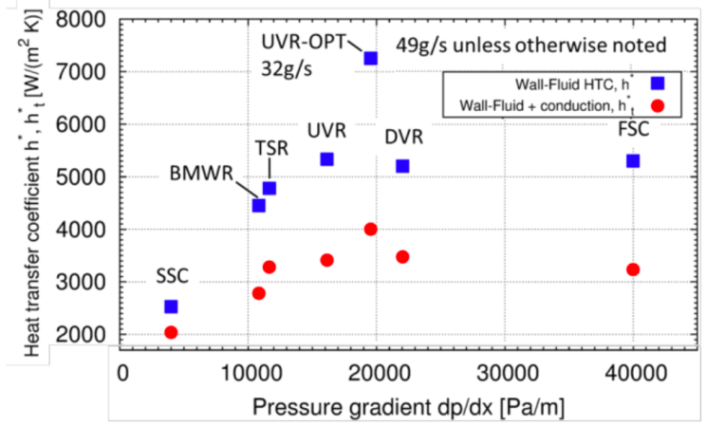
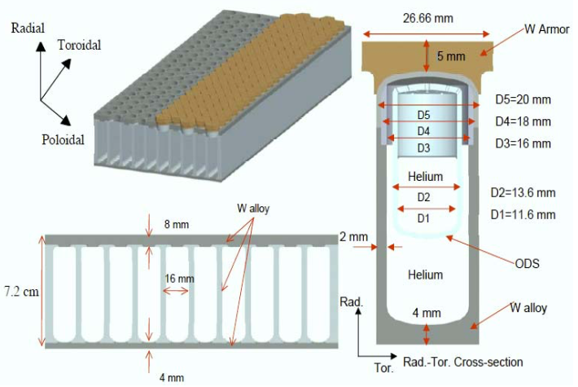
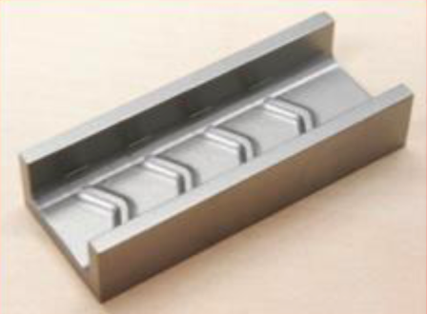
How do alternatives to water address these concerns?
High pumping power required to remove sufficient heat with He is a concern, but appropriate design can ensure this is reasonably low
Roughened surfaces can achieve significantly enhanced heat transfer rather than simply increasing velocity
ARIES blanket and divertor designs had helium pumping power < 5% and < 10% of that removed, respectively
DCLL ARIES designs have both high temperature divertor He (requires advanced steel) and PbLi (> RAFM limits due to thermal insulation from FCIs) that contribute to increased overall plant efficiency
Helium heat transfer and power conversion technology is perhaps not as mature or widely deployed as that for water, but was regarded as “developed technology” even 30 years ago¹
ARIES-ACT Divertor
X. R. Wang et al.,
Fusion Science and Technology
60 (2011) 218-222
F. Hernandez, IEEE Transactions on Plasma Science, 2018
¹G. Melese and R. Katz, “Thermal and Flow Design of Helium-Cooled Reactors,” 1984.

Slide 33
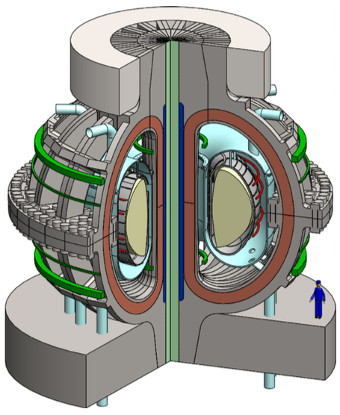
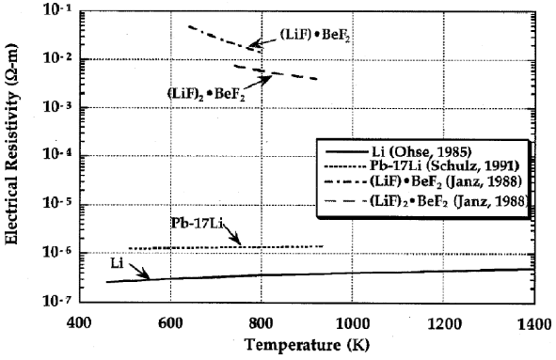
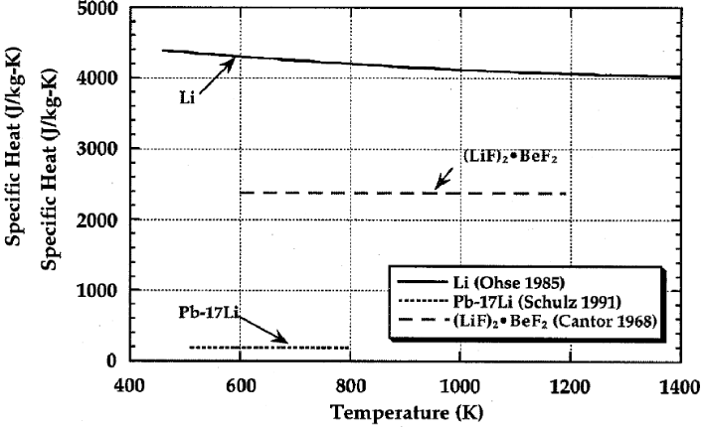
Molten Salt
FLiBe (2LiF-BeF₂) has been revived as a blanket concept by the ARC design
High-field, compact design may be challenging for other blanket concepts:
  MHD pressure drop in liquid metals ∝B², could simply be too high
  High power density challenging for ceramic breeders
FLiBe potentially mitigates these concerns:
  Electrical conductivity is much lower than liquid metals
  Heat capacity is significantly higher than PbLi
Some other relevant FLiBe attributes:
  Relatively high melting point (460 °C)
  High boiling point, low vapor pressure
    Potential for high temperature, low pressure operation
  High heat capacity but low thermal conductivity
  Additional Be multiplier probably necessary to achieve TBR > 1
B. Sorbom et al., Fusion Engineering and Design 100 (2015) 378-405
http://www.fusion.ucla.edu/APEX/interim_report/chapter8full2.pdf

Slide 34
Molten Salt Challenges
FLiBe has significant material compatibility concerns
Nickel alloys are most compatible with FLiBe
  Inconel 718 identified as “first-round” material
  ~50Ni-17Fe-17Cr-5Nb-3Mo…
  ⁵⁹Ni: t_{1/2} = 76,000 y, ⁹⁴Nb: t_{1/2} = 20,300 y, ⁹³Mo: t_{1/2} = 4,000 y
  Not attractive from decay heat/waste perspective!
  High helium generation in nickel will degrade mechanical properties, limit component lifetimes
  Further materials research needed to identify more suitable material¹
Chemistry control necessary:
  Consuming Li frees fluorine, which forms TF
  Excess beryllium can reduce this², needed for additional neutron multiplication anyway
¹B. Sorbom et al., Fusion Engineering and Design 100 (2015) 378-405
²D. A. Petti et al., Fusion Engineering and Design 81 (2006) 1439-1449

Slide 35
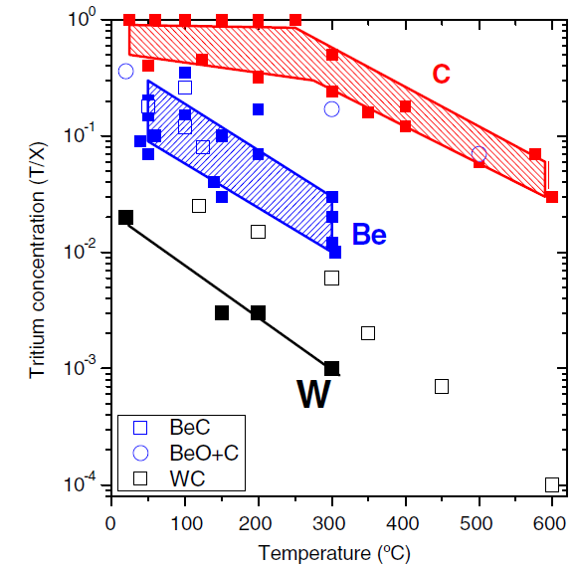
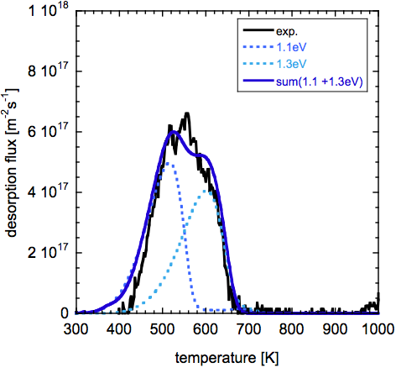
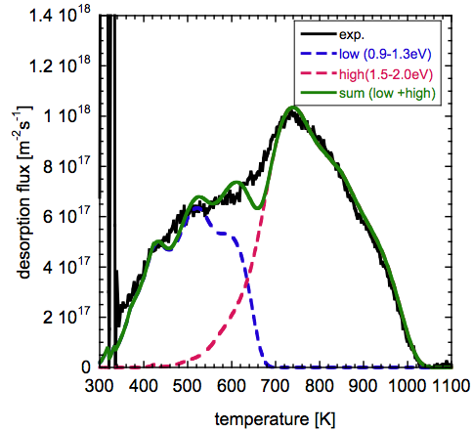
Divertor/PFC considerations
From Roth et al., PPCF 50(2008)103001
Tritium retention issues motivated a shift from carbon to tungsten PFCs
Irradiation increases tritium retention in tungsten
Increased retention in all irradiated materials likely due to creation of defects that act as trapping sites, and possibly also as a result of increased helium production in fusion neutron energy spectrum (TBD in FPNS!)
Tungsten is not a low activation material; decay heat in tungsten PFCs may be significant
Liquid metal PFCs are an alternative…
From a pure heat transfer perspective, Sn is attractive
  Low vapor pressure, large temperature window
  Activation manageable
  But incompatible with steels
Liquid Li attractive for plasma, less so for safety:
  High tritium retention and chemical reactivity
    Different T extraction concepts required
  Li designs should minimize circulating Li inventory
M. Shimada et.al., JNM (2011)
for 0 dpa W, 200C
0.025 dpa W, 200C

Slide 36
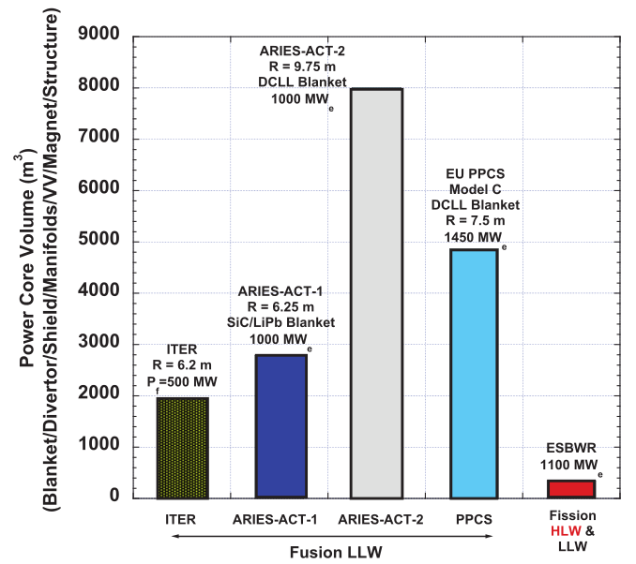
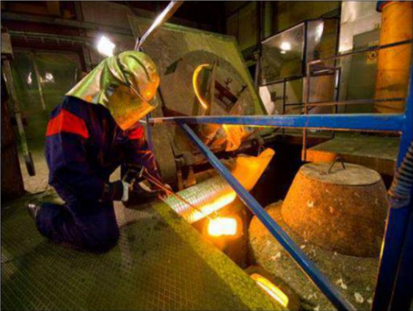
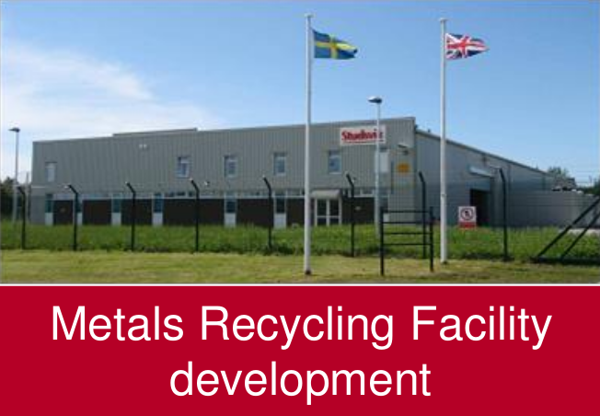
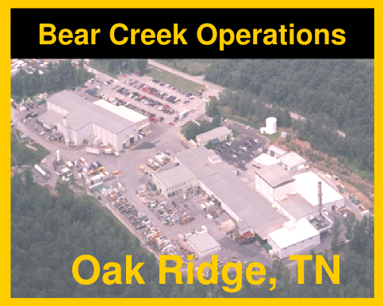



Waste Management
Even if our design choices result in radioactive waste that meets low-level Class C criteria, the volume of it is unfortunately large
New disposal facilities would be required to accommodate this; construction of these can be politically unpopular
Recycling has been suggested as an alternative- melt down and re-use (after separation of some radionuclides with slag) of material to form new components for use within nuclear industry
Facilities exist to do this for very low level (e.g. contaminated, not activated) waste (< 20 mrem/hr)
Likely to be very challenging and costly for highly radioactive fusion components, and require much R&D
L. El-Guebaly, Fusion Science and Technology 67 (1) 2015.
Studsvik recycling facility, UK
J. Robinson, Symposium on
Recycling of Metals, 2014
Studsvik melt facility, Sweden
P. Lidar, Symposium on
Recycling of Metals, 2014
EnergySolutions, Waste Management conference 2012

Slide 37
Identifying accident scenarios
PWR event frequencies
Historical experiences of similar facilities
Review of safety documentation generated for similar facility designs
Assessment of facility hazards (energy sources and hazardous inventories)
  This is the traditional approach- determining if the worst case consequences of the largest releases of energy, radioactive materials, or toxicological materials will remain within limits
Probabilistic Risk Assessment
  Uses best estimates of plant responses to accident initiating events to determine realistic releases
  Makes use of Failure Modes and Effects Analysis (FMEA) and Master Logic Diagrams to identify system vulnerabilities, accident initiators, and release paths
A large-break LOCA is consequential but rare
Station blackout (LOFA) is also rare; natural convection and avoiding phase change (water boiling) help mitigate
Both of these can serve as bounding design-basis accidents to demonstrate robustness of the design
Event (NUREG 6928 and 5750) | Frequency
Large Loss of Coolant Accident | 1×10⁻⁶/yr
Medium Loss of Coolant Accident | 1×10⁻³/yr
Small Loss of Coolant Accident | 1×10⁻³/yr
Very Small Loss of Coolant Accident | 3×10⁻³/yr
Steam Generator Tube Rupture | 1×10⁻²/yr
Loss of Component Cooling Water | 1×10⁻³/yr
Loss of Heat Sink | 1×10⁻¹/yr
Loss of Vital AC Power | 1×10⁻²/yr
Loss of Vital DC Power | 1×10⁻³/yr
Loss of Instrument Air | 1×10⁻²/yr
Loss of Feedwater Flow | 1×10⁻¹/yr
Loss of Offsite Power | 5×10⁻²/yr
Station Blackout | 1×10⁻⁴/yr
General plant transient | 1/yr
Fire in plant | 3×10⁻²/yr
Flood in plant | 3×10⁻³/yr

Slide 38
Frequency/Consequence targets
Frequency-consequence targets for advanced fission reactors, from NEI 18-04:

Slide 39

Safety Analysis
The primary mobilizable radioactive materials in fusion are:
  Tritium, wherever it resides
  Dust created by plasma-surface interactions, which contains activation products from FW and divertor materials (W, RAFM)
  Breeder/coolant activation products (e.g. ²¹⁰Po and ²⁰³Hg from PbLi)
A code called MELCOR (modified by INL for fusion reactors) is used to model a coarsely nodalized plant, and the fluid flows, heat transfer (conduction, radiation, forced & natural convection), and mass (tritium permeation, radioactive dust resuspension and aerosol transport) that result from the accident progression
Radionuclides released during the event are subject to atmospheric transport to the site boundary; the resultant dose there needs to meet our regulatory limits
  Note that the dose can be reduced by having a large site
  Cheaper and simpler for operator to have a small site!
Component temperatures during ARIES-ACT1 LOFA
P. Humrickhouse, Fusion Science and Technology 67 (2015) 167-178
Like the 890 sq. mile INL site!

Slide 40

Tritium management
Tritium is a unique concern- it can readily permeate through structures at high temperature, resulting in environmental releases from normal operations
With efficient tritium extraction systems but no other mitigations, losses (~6 g/y estimated from FNSF) tend to exceed limits (~0.3 g/y to meet dose limits for generic ITER site)
Losses and inventories are predicted by modeling with TMAP code, with facility-scale models incorporating transport phenomena including diffusion, surface adsorption/recombination, trapping, etc.
Experimental investigation of extraction concepts, fundamental transport properties is key part of INL Fusion Safety Program
P₁
P₂
Tritium flux limited by diffusion
J_{d,1}
J_{r,2}
Tritium flux limited by surface effects
J_{r,1}
Transport properties K_{d}, D, K_{S} are Arrhenius functions of temperature
J_{D}
C₁
C₂

Slide 41

Defense in depth
Permeation barrier coatings
Multiple barriers to tritium permeation losses are being investigated
Concentric piping
Vaults/enclosures
Ongoing design, a part of fusion energy systems studies program
Safety considerations should be an integral part of the design process!

Slide 42








