Slide 1
Fast-ion Diagnostics and Physics Research
W. W. Heidbrink, Deyong Liu, L. Stagner
February 15, 2021

Slide 2
Goal: Provide key data & analysis for Thrust 1
Guttenfelder

Slide 3
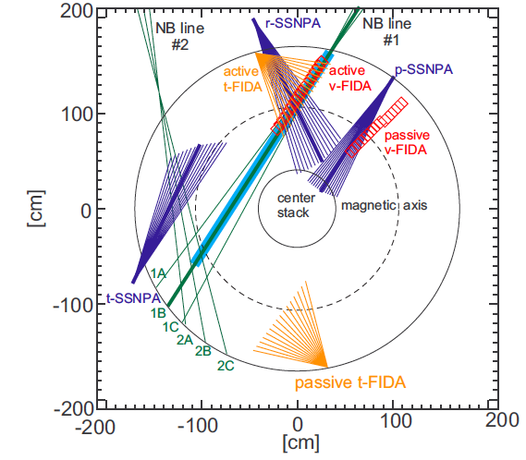
Goal before 1st plasma: Make 2016 diagnostics operational again
Vertical & Tangential fast-ion D-alpha (FIDA)
Radial & Tangential solid-state neutral particle analyzer (SSNPA)
Active & passive views for both FIDA & SSNPA
Suite of neutron scintillators
Liu, NF 58 (2018) 082028

Slide 4
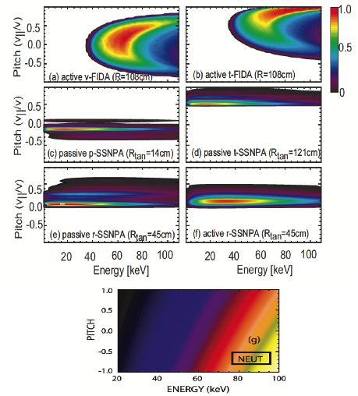
These instruments diagnose different parts of velocity space (have different “weight functions”)
Differentiate signals from 1st and 2nd beamline
Key to reconstruction of the distribution function
Liu, NF 58 (2018) 082028
Heidbrink, PPCF 49 (2007) 1457

Slide 5
Fast-ion diagnostics for initial operation period
v-FIDA and t-FIDA systems
Purchase new CCD cameras (similar to CHERS system) and write the DAQ program
Replace the active t-FIDA fiber header since some components suffered water damage in 2015. Need to polish fibers and assemble the fiber header in the NSTX-U test cell.
Fabricate a new entrance slit for the v-FIDA.
Install a fiber-optic patch panel in DARM for v-FIDA system.
Need to polish the existing v-FIDA fibers and install SMA connectors in the DARM.
Better subtraction of scattered light or filter of cold D-alpha light
SSNPA systems
The tangential-SSNPA was installed on MAST-U, only the radial- and passive- SSNPA remained on NSTX-U. UCI fabricates a new t-SSNPA assembly based on the drawings.
Fabricate a Vespel gasket for each subsystem to isolate the SSNPA from the vacuum vessel.
Purchase a new D-DACQ digitizer since one of the old ones was installed on MAST-U.
Purchase new AXUV detector arrays.
Test the newly upgraded transimpedance amplifiers.

Slide 6
Fast-ion diagnostics for initial operation period (Cont’d)
Neutron scintillator array for neutron signal with fast resolution
Existing: 1 NE-451 ZnS scintillator and 3 plastic BC-400 scintillators
Add two more scintillators so that
Four plastic scintillators with different fixed HV to cover the whole neutron flux range from 10¹⁰ to 10¹³
(2) A pair of Zns and plastic scintillator with adjustable gain to provide different sensitivity to neutrons and hard x-rays.
Use the old neutron rack in the test cell.
Purchase a new digitizer (6 channel, sampling rate ~ 500 kHz)

Slide 7
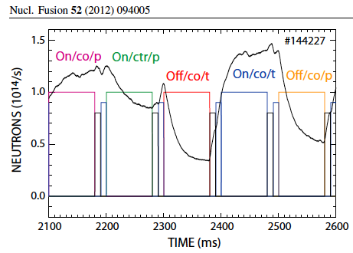
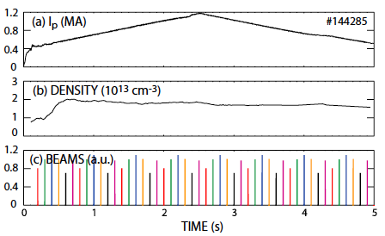
Beam checkout experiments are a focus in the first year of operation
Deyong Liu had an approved 2016 XP base on successful DIII-D experiments

Slide 8
Fast-ion diagnostic improvement in Year 3
Design and build pulse-counting SSNPA to measure HHFW accelerated fast ions.
Pulse-counting measurements provide an energy spectrum of fast ions
We want to use the bottom half of the D-shape flange at Bay L for pulse-counting SSNPA system.

Slide 9
These instruments diagnose different parts of velocity space (have different “weight functions”)
$$S=\int{W\left(X\right)F\left(X\right)dX}$$
S = measured signal X = phase-space variables
F = the distribution function
W = the weight function = diagnostic sensitivity

Slide 10
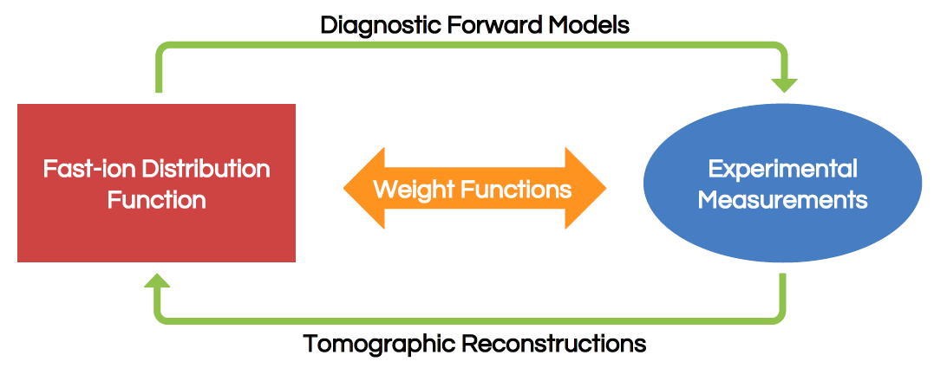
Weight functions are the link between measurements and the distribution function
$$S=\int{W\left(X\right)F\left(X\right)dX}$$
$$F=W^{−1}∗S$$
FIDASIM is our synthetic diagnostic code
Stagner will oversee student project in tomographic reconstructions

Slide 11
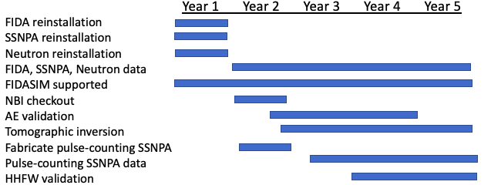
Gantt chart for the project

Slide 12
The work is organized around two PhD projects
*
*
*Stagner
Deyong Liu accepted an Energetic Particle position at DIII-D

