Slide 1

Soft X-ray measurements of transport and MHD activity in the core and edge NSTX-U plasma
Kevin Tritz (PI)
Dan Stutman (co-PI)
Department of Physics and Astronomy
Johns Hopkins University
Baltimore, MD
Work supported by the U.S. Department of Energy, Office of Science, Fusion Energy Sciences under award: DE-SC0021207

Slide 2
JHU Contributions to NSTX-U 5-year plan research goals
The goals for the JHU diagnostic collaboration are to upgrade, maintain, and operate a set of soft X-ray and VUV diagnostics on NSTX-U to contribute to a broad range of research goals including:
  MHD (ELMs, NTMs, RWMs)
  transport (extrinsic impurities, heat/cold pulse)
  boundary physics (pedestal dynamics, boundary motion)
Objective 1
1.a.ii.) Determine pedestal scaling (height, width) at lower collisionality.
1.a.iii.) Investigate impurity transport, especially high-Z transport prior to any PFC changes, and ability to control e.g. with HHFW
1.c.) Investigate the role of shaping and wall conditioning in determining core transport and pedestal characteristics
2.a.i - iii.) Validate theory, modeling and high-fidelity simulation predictions of transport with comprehensive experimental data
2.c.) Validate the role of 3D field effects on core and pedestal performance
Objective 2
1.a.) Access small-ELM and ELM-free regimes with high f_{BS}
1.b.iii.) Induce and control impurity transport via profile control in ELM-free and small-ELM regimes
1.c.) Integrate heat flux mitigation with long pulse scenarios
2.a.i) Advance capabilities of real-time equilibrium boundary reconstruction and MIMO control of the boundary shape
2.b) Understand operational stability boundaries at high 𝜷_{N} and develop reduced models
3.a) Establish high non-inductive fraction operation and validate integrated predictive simulations
Objective 3
2.) Develop and evaluate power exhaust techniques for mitigating high projected NSTX-U heat fluxes

Slide 3
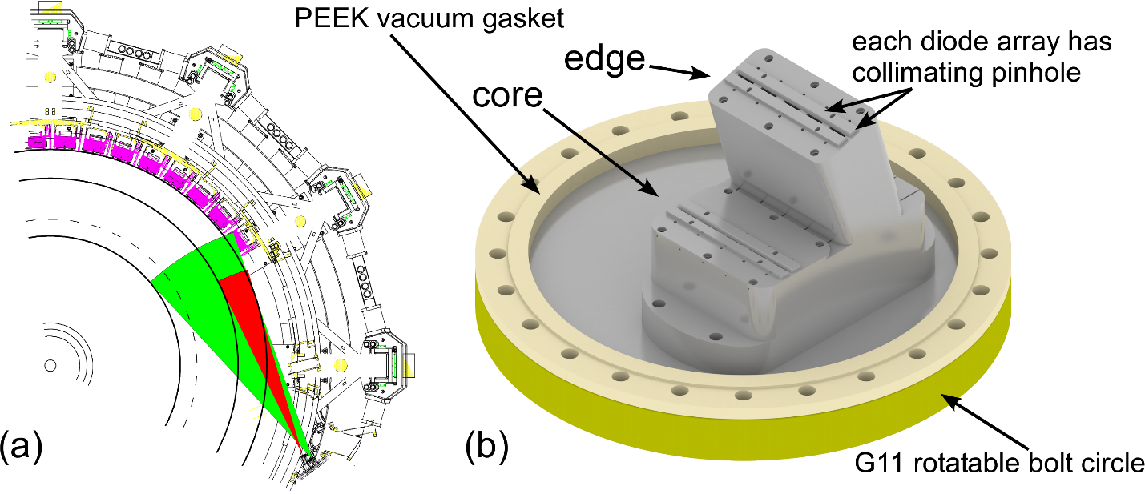
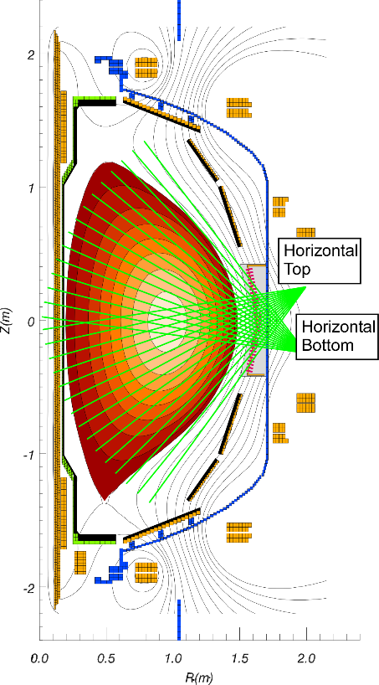
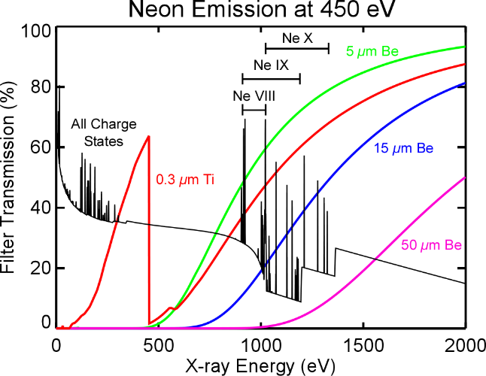
JHU diagnostic hardware include filtered soft X-ray diode arrays and spatially resolved VUV spectra
Poloidal Ultra-Soft X-ray (USXR) Arrays
Multi-Energy Soft X-ray (ME-SXR)
(a) schematic showing edge (red) and core (green) ME-SXR fields of view on NSTX-U and (b) CAD model of present ME-SXR diagnostic.

Slide 4
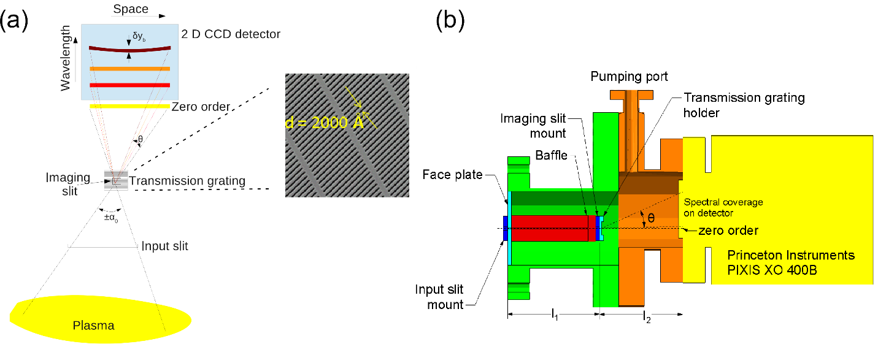
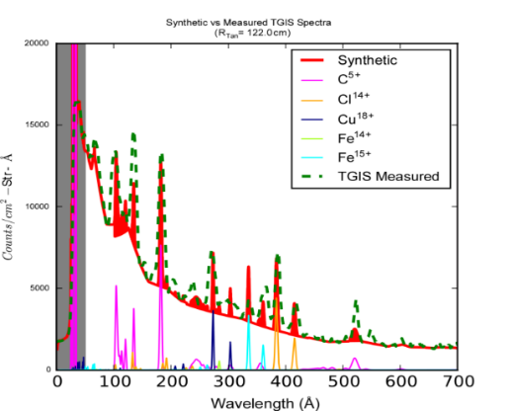
JHU diagnostic hardware include filtered soft X-ray diode arrays and spatially resolved VUV spectra
Modeled and measured TGIS spectrum.
Transmission Grating Imaging Spectrometer (TGIS) (Gen II)
showing (a) schematic of grating imaging chain and (b) hardware implementation using a direct detection CCD camera.

Slide 5
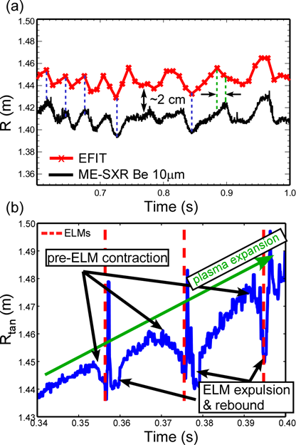
High resolution Soft X-ray measurements provide high speed dynamics of boundary and pedestal
Curve fitting (1st or 2nd degree) of filtered SXR edge channels to find ‘boundary’
  EFIT offset corresponds to filter energy cut-off
  Tracks EFIT boundary with high time resolution
  Extrapolation provides sub-cm precision
  Phase shift can identify non-axisymmetric modes
  High time resolution for ELM cycle dynamics
  ME-SXR measurements improve pedestal details
Objective 1: 1.a.ii, 1.c, 2.c
Objective 2: 2.a.i
SXR measurements showing a) a slow RWM/external kink in shot 133775, and b) a series of SXR 5 μm boundary contractions/expansions during ELM cycles for shot 142194.

Slide 6
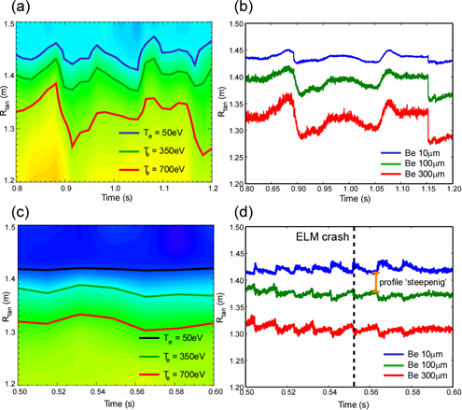
High resolution Soft X-ray measurements provide high speed dynamics of boundary and pedestal
Multi-Energy SXR signals track different iso-temperature boundaries
  Continuous, high time resolution measurements (10 kHz)
  High resolution pedestal measurements
  Captures ELM cycle dynamics
Objective 1: 1.a.ii, 1.c, 2.c
Objective 2: 2.a.i
Comparison between a) MPTS contours of constant Te and b) ME-SXR boundary for NSTX shot 135700 and c) MPTS and d) ME-SXR boundary for NSTX shot 133048.

Slide 7
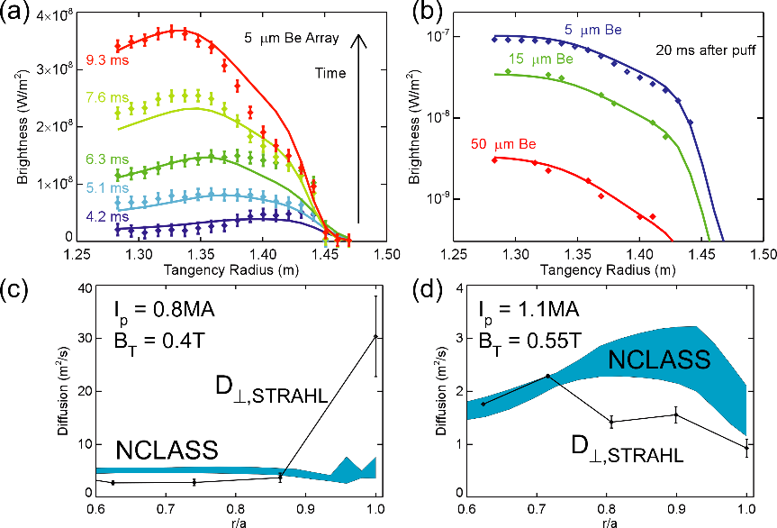
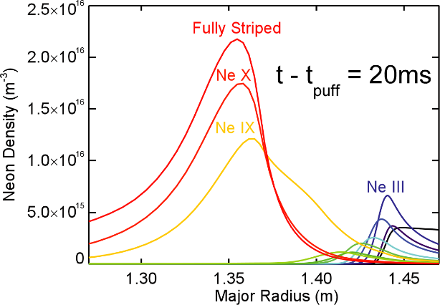
ME-SXR spectral sub-sampling provides good constraints for STRAHL impurity transport code
Transport measurements using SXR emission from Neon injection
Simulated neon charge state distribution in NSTX plasma following gas puff.
Objective 1: 1.a.iii, 2.a.i-iii
Objective 2: 1.b.iii
Using STRAHL to generate transport coefficients by fitting (a) ME-SXR profiles in time and (b) each ME-SXR array simultaneously with results for (c) low field and (d) high field NSTX plasmas.

Slide 8
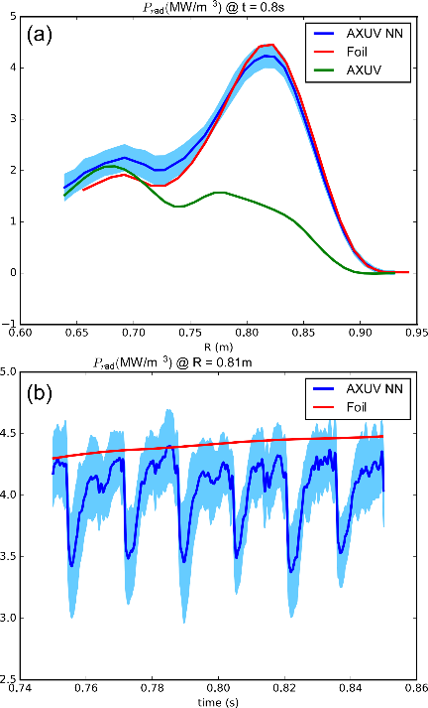
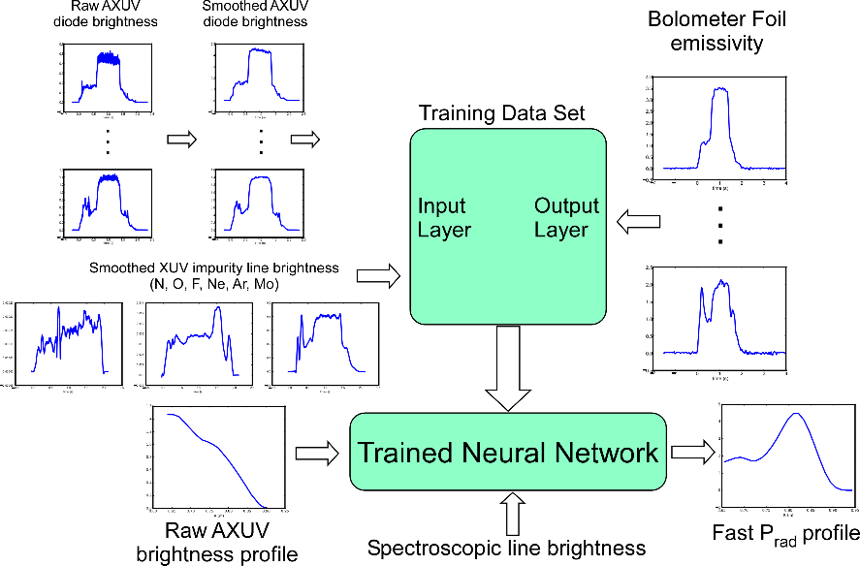
Machine learning combines slow/accurate bolometry with fast unfiltered AXUV diode signals for P_{rad}
Training
Inputs
Raw AXUV signals
Impurity line brightness
Training data
Bolometer emissivity
Implementation
Inputs
Raw AXUV signals
Impurity line brightness
Output
Fast P_{rad} profile
Objective 2: 1.c
Objective 3: 2.
Workflow schematic of neural network for fast radiated power measurements.
(a) comparison of radiated power profiles and (b) radiated power over sawtooth cycles on C-MOD

Slide 9
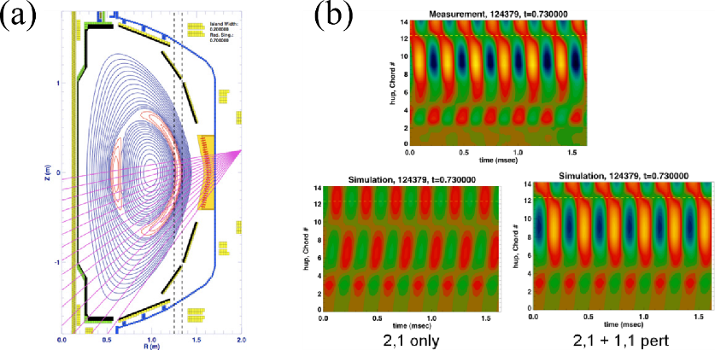
Poloidal USXR arrays provide fast (500 kHz) measurements of MHD phenomena
Objective 1: 2.c
Objective 2: 2.a.i
(a) Diagram showing reconstructed island equilibrium and positions of USXR chords for NSTX shot 124379, t=0.730. (b) Comparison of simulated perturbed plasma state with and without (1, 1) component to measured multichord signal.

Slide 10
Initial work has focused on off-site hardware and software development
New AXUV-SP2 diodes obtained for USXR arrays (Optodiode, Inc. custom fab run)
Development of amplified diode testing station (gain/bandwidth, frequency response, noise)
New beryllium filters for USXR arrays (5, 15, 50, 150 μm)
Phidget hardware for filter positioning system (replaces computer, stepper controller, steppers, LabVIEW)
Princeton Instruments ProEM CCD python library module
Upcoming work:
  Test & replace diodes, refurbish USXR arrays (Summer 21)
  Assemble upgraded TGIS (Summer 21)
  Test/calibrate upgraded TGIS (Fall 21)
Personnel and Responsibilities:
  Kevin Tritz (PI): USXR refurbishment, on-site management and research
  Dan Stutman (co-PI): TGIS assembly and testing, off-site management
  Deepak Kumar (eta June 21): TGIS assembly, testing, calibration, and installation
  Post-doc (eta Spring/Summer 22): on-site operation and maintenance, research

Slide 11
5-Year work plan supports NSTX-U research objectives
Year 1:
ME-SXR and USXR refurbishments
TIGS detector upgrade
PI camera python module
Validate data acquisition workflow
Year 2:
ME-SXR/USXR operations in support of NSTX-U research
Impurity injection transport experiments
Investigate extrinsic impurity injection for cold pulse generation
Install upgraded TGIS
Year 3:
ME-SXR/USXR operations in support of NSTX-U research
Thermal transport experiments using cold pulses
Machine learning impurity identification using TGIS data
Year 4-5:
ME-SXR/USXR/TGIS operations in support of NSTX-U research
Continue JHU transport experiments in expectation of new NSTX-U plasma regimes

Slide 12
Key Needs
Shielded enclosure for TGIS Princeton Instruments camera (in RoD)
Near term (summer 21): bench space at PPPL for USXR refurbishment, diode testing
Help identifying post-doc candidates for NSTX-U on-site hire

