Slide 1






Electric Field and
Atomic Nitrogen Density Measurements in
Nanosecond Discharges
Tat Loon (TL) Chng
26th Jul 2021
Princeton Plasma Physics Laboratory (PPPL)

Slide 2
Outline
Non-Equilibrium Nanosecond Plasmas
  What are they?
  Why is there research interest?
Electric Field Measurements
Fast ionization wave (FIW) Discharge inception Electric field induced second harmonic generation (EFISH)
Species Density Measurements
Atomic nitrogen (N₂ → N + N) Late afterglow Two-photon absorption laser-induced fluorescence (TALIF)

Slide 3
Non-Equilibrium Plasmas
Commonly known as ‘Low Temperature’ or ‘Cold’ plasmas
Special class of plasmas
  Temperature of ions and neutrals << Temperature of electrons
  Minimal thermal stress exerted on system
Initiated by a (nsec to µsec duration) high voltage pulse
  Rapid response time, energy efficient
High electric fields (above breakdown)
  Enhances chemical reactivity of system
  Ideal as standalone or assistive technology
Notes:
Two distinct features: chemical disequilibrium + temp. Application of HV pulse enables access to high efields… these high efields in turn enhance chem reac, which main reason for its broad applicability

Slide 4
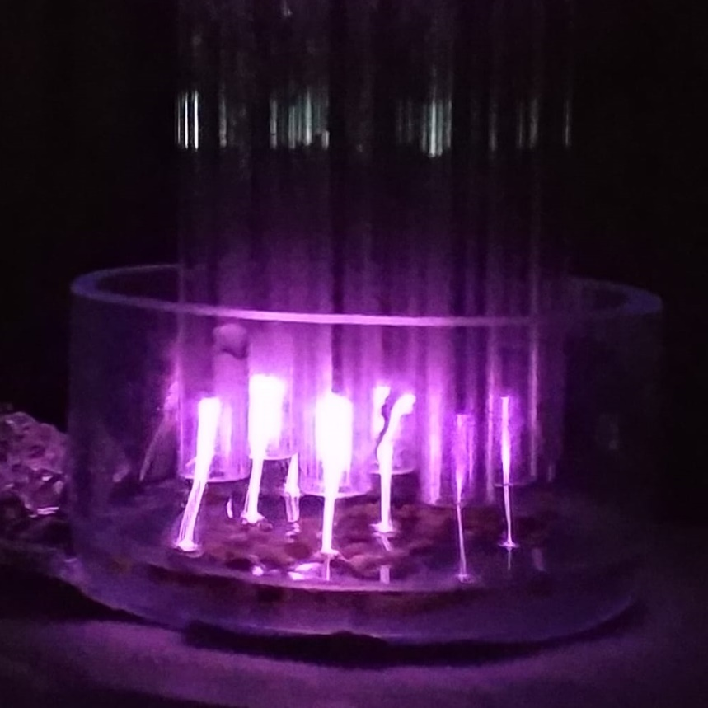
Non-Equilibrium Plasma Applications
Medicine
Agriculture
Aerodynamics
Plasma ‘OFF”
Plasma ‘ON”
Weltmann and Woedtke, (2017). Plasma Phys. Control Fusion, (014031).
Zheng et al, (2016). Phys. Rev. Fluids, (073501)
Wound Healing
Better produce
Flow Control
Notes:
On the left and right are examples of applications in medicine and agriculture where ne plasmas have been used to achieve chronic wound healing an better produce

Slide 5
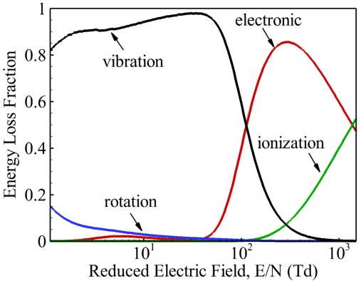
Importance of E-Field in N-E Plasmas
Reduced E-field (E/N) controls the energy partition in a plasma
  Determines how the coupled energy is distributed
Pure N₂
Yang et al (2017), J. Phys. D, 50(43), 433001
Notes:
For each E/N, the values on each of these curves should add up to 1. Two important features: E/N determines how the energy is distributed

Slide 6
Importance of E-Field in N-E Plasmas
E/N directly influences the reactive species generation
  i.e. plasma-induced chemistry and system reactivity
Electronic excitation, dissociation, ionization – rapid thermalization ≡ high reactivity
Vibrational excitation – slower thermalization
Pure N₂
Yang et al (2017), J. Phys. D, 50(43), 433001
Notes:
For each E/N, the values on each of these curves should add up to 1. Two important features: E/N determines how the energy is distributed

Slide 7
Efficiency of N-atom Production vs E/N
Objective: Characterize atomic species production in nanosecond discharges as a function of E/N
Amount of energy needed to produce one N-atom
(N. A. Popov, Plasma Physics Reports, 2013)
Notes:
To put these ideas together, the objective of the work that I am going to be presenting is… In particular, we wanted to validate some of the modeling results from our collaborator Nikolay Popov. Implicit in this objective is the need to quantify both the efield and N-atom density

Slide 8
Electric field evolution in a
nanosecond plasma
using E-FISH

Slide 9
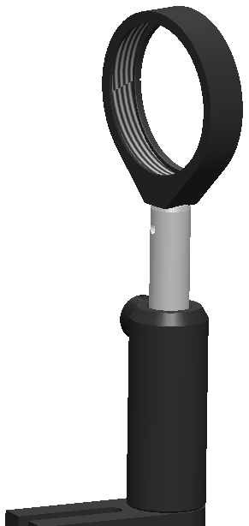
E-FISH: Working Principles
E_{ext} > 0
Probe beam, λ
Signal, λ/2
Lens
Optical second harmonic signal when E_{ext} > 0
No signal when E_{ext} = 0
Signal is coherent but path-integrated

Slide 10
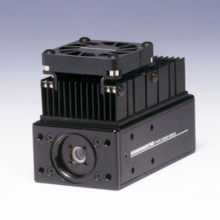
E-FISH: Working Principles
E_{ext} > 0
Prism
PMT
Probe beam, λ
Lens
Signal, λ/2
Probe beam intensity >> Signal
Separate these two beams
Focus signal into a photomultiplier (PMT) or ICCD camera

Slide 11
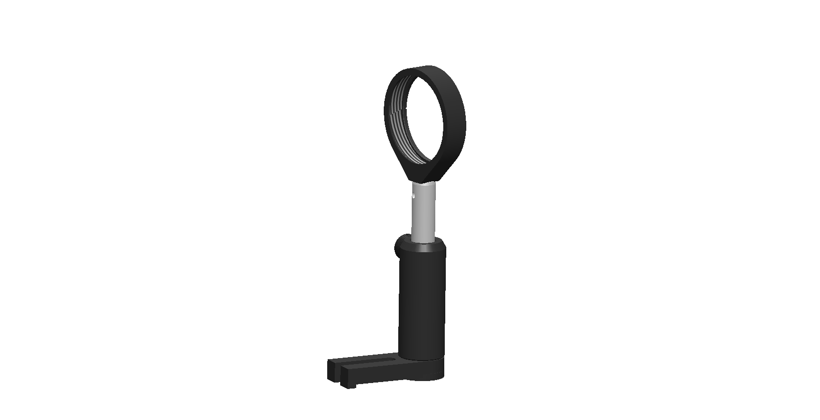
In a Plasma
Probe beam, λ
Signal, λ/2
Calibration (typically) in electrostatic field
Field sensitivity ~ kV/cm
Notes:
Focu

Slide 12
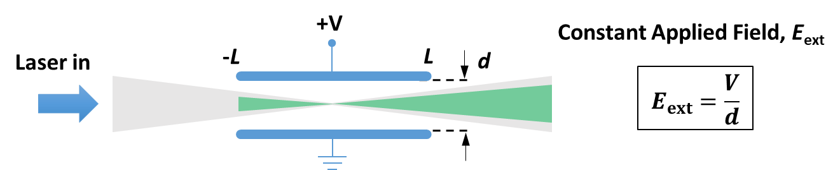
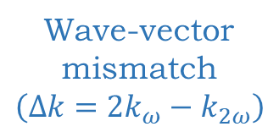
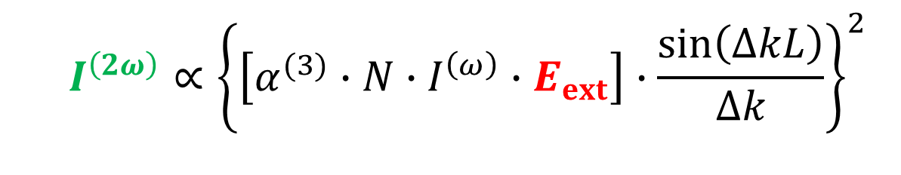

E-FISH Signal (Plane-Wave Approximation)
E-FISH signal intensity
Neutral number density
Electrode half-length
Externally applied field
  $$I^{\left(2ω\right)}∝{\left\{\left[α^{(3)}∙N∙I^{\left(ω\right)}∙E_{ext}\right]∙\frac{sin\left(∆kL\right)}{∆k}\right\}}^{2}$$
Probe beam
intensity
$$\left(∆k∙z\right)$$
Wave-vector mismatch
$$\left(Δk=2k_{ω}−k_{2ω}\right)$$
Non-linear hyperpolarizability
Notes:
Just to illustrate the considerations which affect an E-FISH experiment, here is a 2D projection of the cartoon shown a while ago

Slide 13
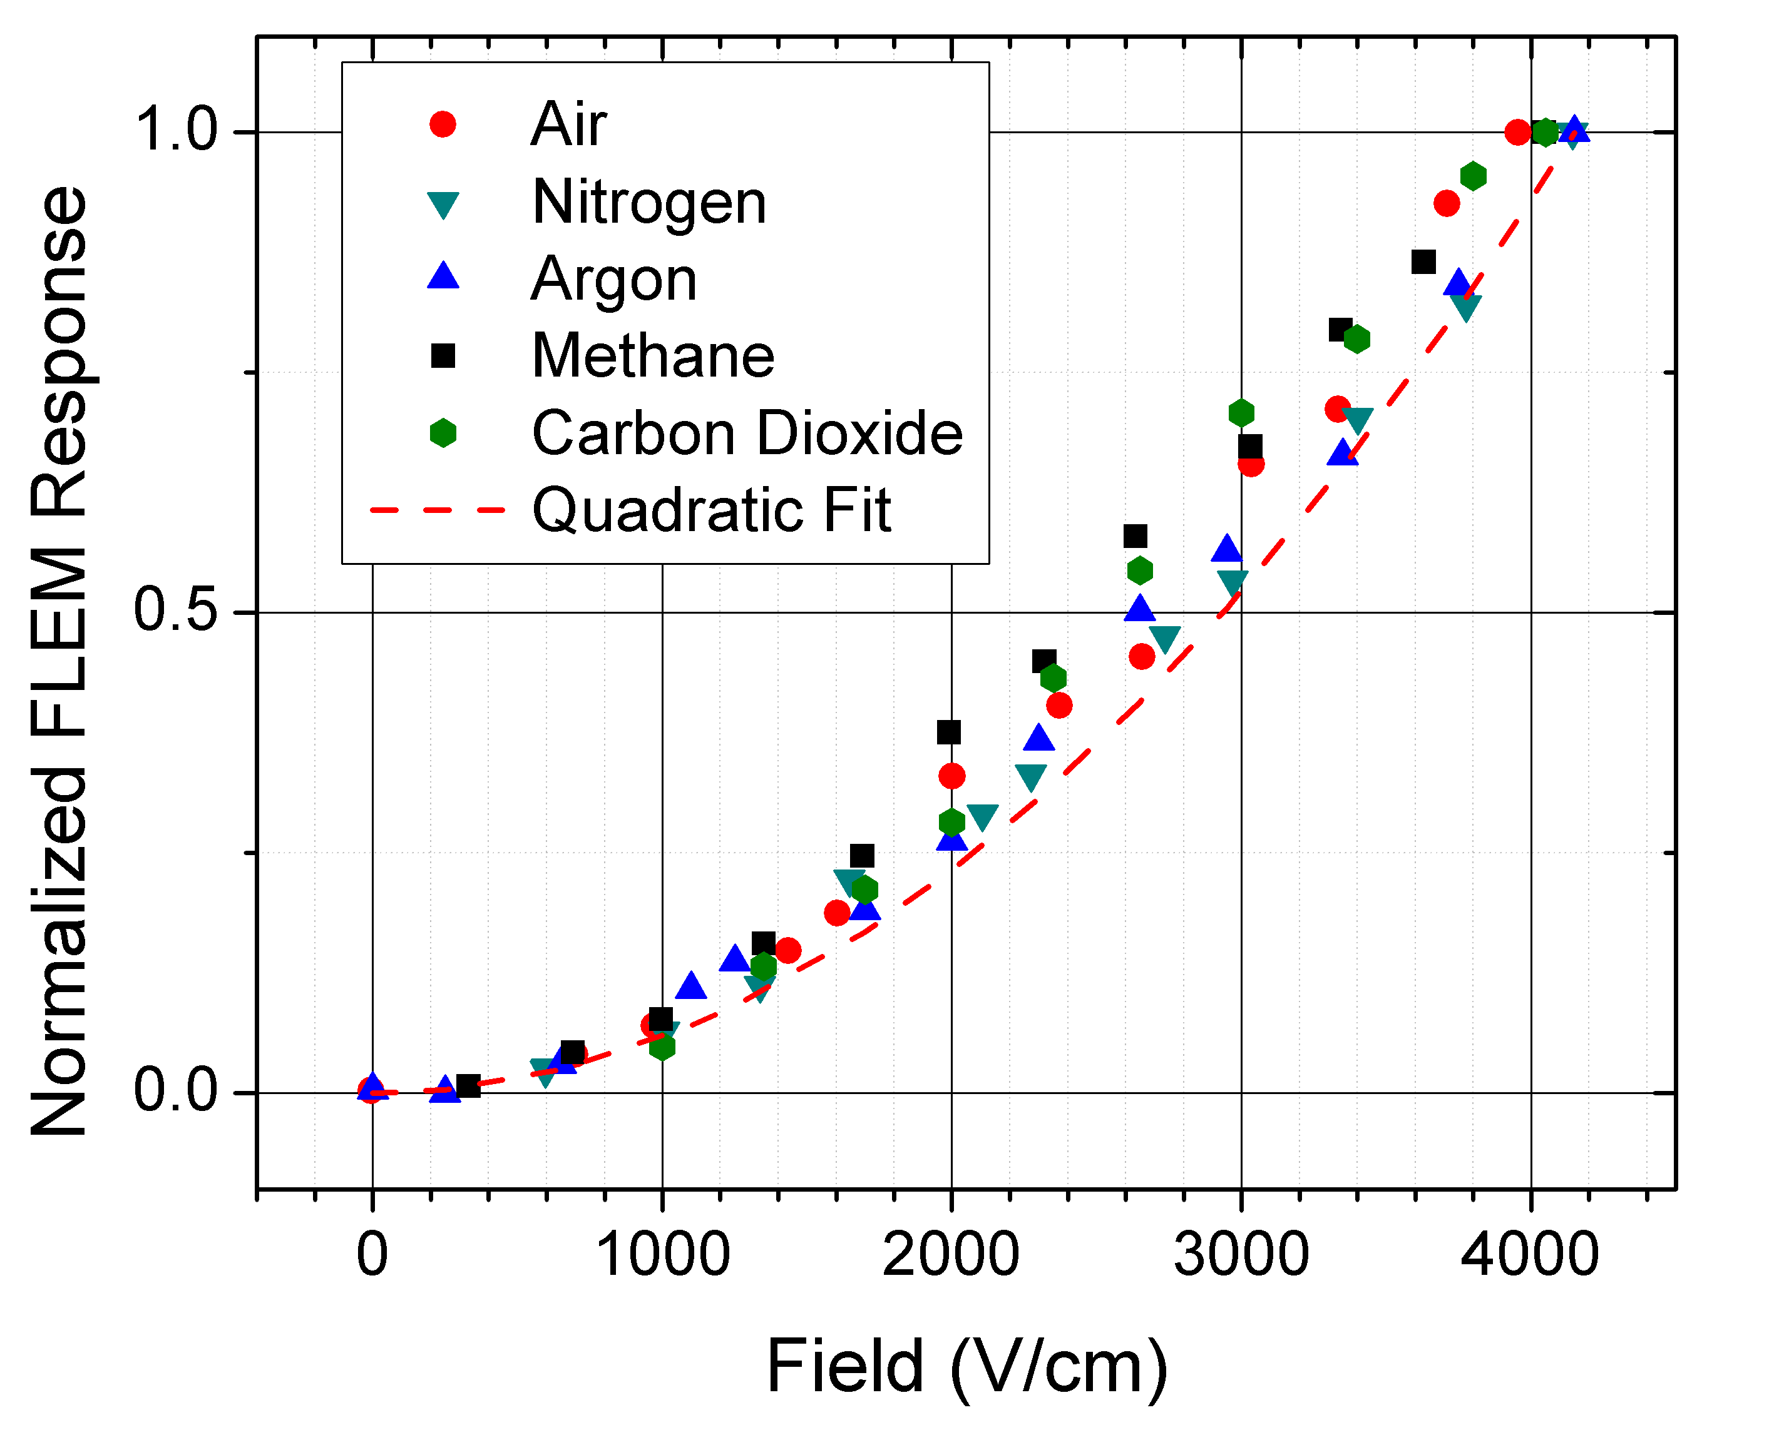
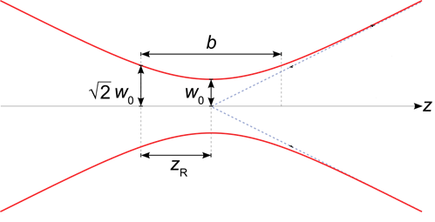



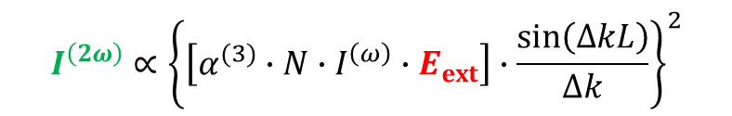
E-FISH : Strengths
$$I^{\left(2ω\right)}∝{\left\{\left[α^{(3)}∙N∙I^{\left(ω\right)}∙E_{ext}\right]∙\frac{sin\left(∆kL\right)}{∆k}\right\}}^{2}$$
High temporal and spatial resolution
  Temporal resolution: Pulse duration of probe beam
    Typically sub-ns (even < 1 psec)
  Spatial resolution limit: 2 x Rayleigh range (z_{R})
    Typically a few mm (even sub-mm)
Non-resonant method
  Works with most centrosymmetric gases
  No constraint on laser wavelength
Sensitive, one beam technique
  Detection sensitivity (< 1 kV/cm at 100 Torr)
  Minimal alignment required
Field vector sensitivity
  Signal polarization follows $E_{ext}$ polarization
$$I^{\left(2ω\right)}∝{\left(I^{\left(ω\right)}\right)}^{2}$$
Norm. E-FISH signal
y
E_{ext}
θ
x
$$I^{\left(2ω\right)}∝{\left(E_{ext}\right)}^{2}$$
Source: Wikipedia
Chng et al (2020), Opt. Lett., 45(7), 1942
Dogariu et al Phys. Rev. App., 7(2), 024024.
Notes:
Mm or sub-mm spatial resolution; fsec, psec time resolution; Mention non-resonance implies flexibility in choosing the probe laser wavelength, choice can be dictated by other considerations: available lasers, avoid background emission from the plasma. One beam technique, learning curve is not steep.

Slide 14
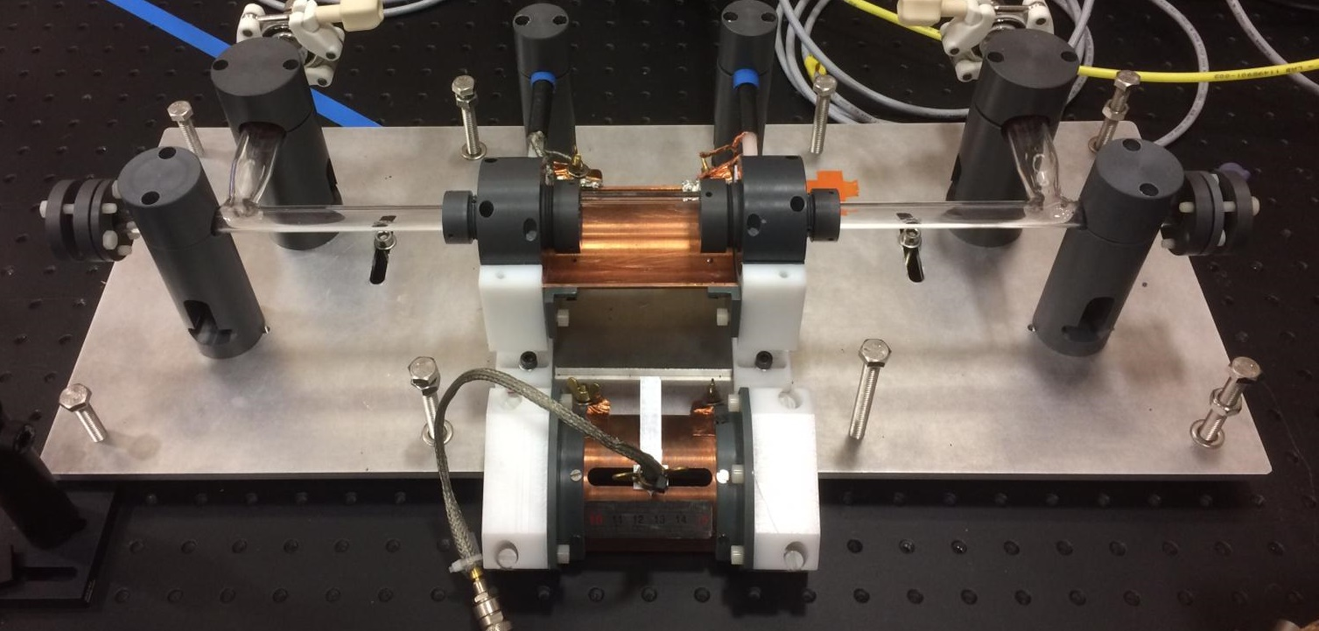
Nanosecond Discharge Setup
Feed gas: Pure N₂, Pressure: 20 – 100 mbar
HV Pulse
V = 18.6kV
Discharge tube, D = 2 cm
Grounded metallic screen
t_{p} ~ 30 ns (FWHM)
Notes:
Quartz discharge tube

Slide 15
Optical Schematic
Probe beam
  30 ps, 6 mJ, 1064 nm, 10 Hz, Nd:YAG laser
Notes:
Poor man’s psec laser

Slide 16

E-FISH Optical Setup
Prism
PMT
Probe beam, λ
Lens
Signal, λ/2
Discharge tube

Slide 17
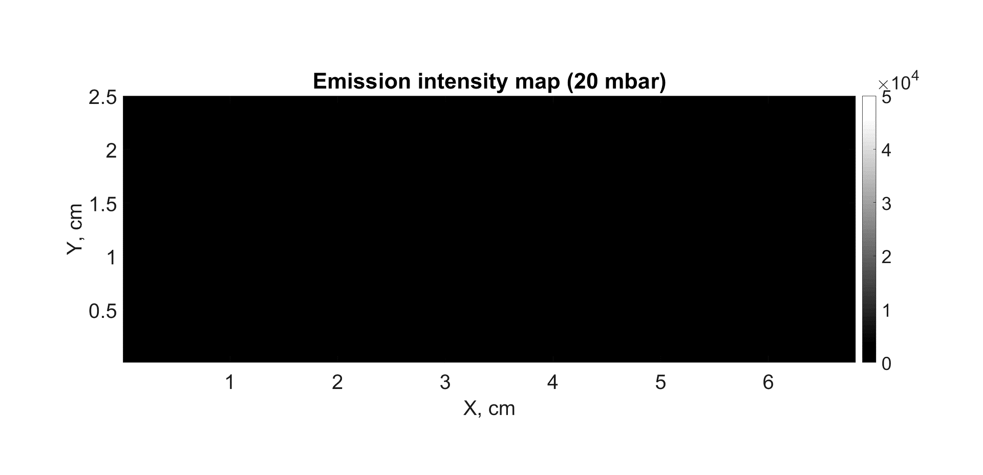

Fast Ionization Wave (FIW) Animation
Feed gas: Pure N₂, Pressure: 20 – 100 mbar
Positive polarity, Peak voltage: 18.6 kV, FWHM: 30 ns, Rise time: 3 – 4 ns
Wave speed: ≈ 1.6 cm/ns
t = 0 ns
t = 0.8 ns
Notes:
Just to put the results that I am going to show you into the context of what has already been known… when you apply a HV pulse is applied to the anode, electron avalanche that builds up into a sufficient space charge, which then results in wave high energy electrons propagating from the H to LV electrode. These hi energy electrons produce a lot of excited state molecules which in turn fluoresce. So what is in fact an ionization wave, is effectively visualized in the form of a luminous front which …. Very fast, close to luminal speeds. People have known that the electric fields in the front are very high, but there is been, in particular, a lack of experimental data, in quantifying these field strengths. Part of the reason is that there has been a lack of diagnostics capable of making such measurements

Slide 18
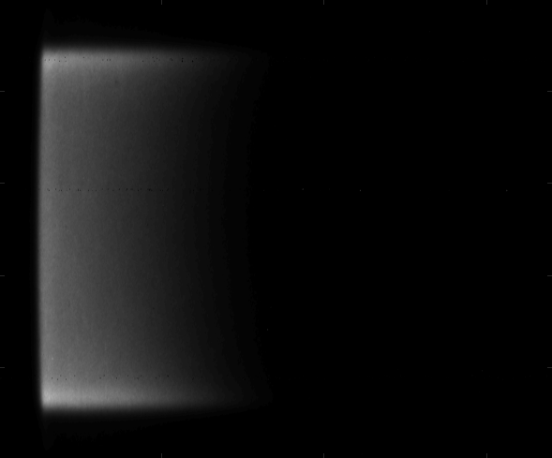
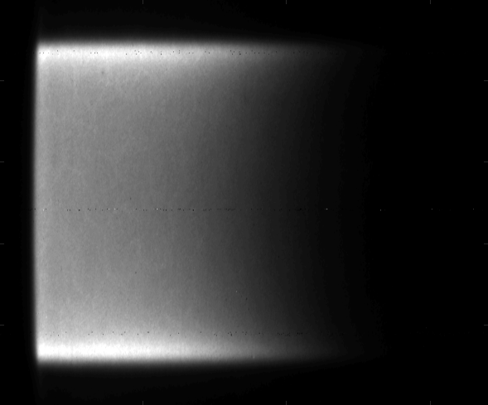
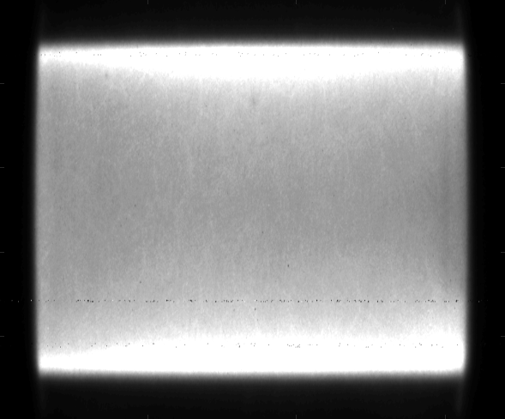
Electric Field Evolution in a Fast Ionization Wave
II. Field drop behind the front
Representative Emission Images
I
I. Field overshoot ahead of
front
III. Quasi-steady-
state discharge
II
III
Measurement location
Single laser shot
Averaged
Notes:
Time delay the arrival of the laser wrt HV pulse → time evolution of the electric field. We see 3 distinct regimes

Slide 19
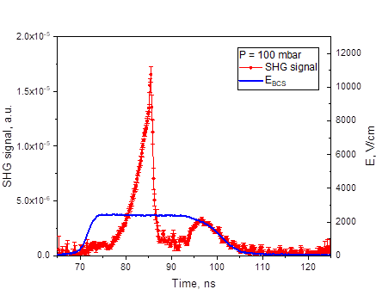
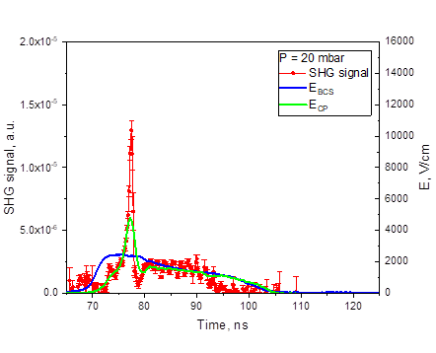
Effect of Pressure on Electric Field Evolution
(E/N)_{max}: ~ 500 Td
(E/N)_{max}: ~ 2000 Td
FWHM: ~3 ns
FWHM: ~1 ns
FIW Speed: 0.4 cm/ns
FIW Speed: 1.6 cm/ns
Notes:
Plot on the left is the same plot in the previous slide, with the addition of the efield predicted by a BCS. BCS’ are electrical probes that are v effective at measuring the electric field in the conductive phase, but they are insensitive to the propagation of the FIW. Added reason for using efish.

Slide 20
Pin-Plane Atm. Pressure Nsec Discharge
Discharge Specifics
Pin tip radius | 100 µm
Inter-electrode gap | 16 mm
Pulse repetition rate | 5 Hz
Working pressure | 1 atm air
Emission Image
Pin
16 mm
HV Pulse
Plane
V = 85 kV
Discharge remains diffuse even at ambient pressure
t_{p} ~ 5 ns (FWHM)
Notes:
Poor man’s psec laser

Slide 21
Similar Shape of E-Field Evolution Curve
Pin
z = 3 mm
Plane
Notes:
Poor man’s psec laser

Slide 22
Tracking the consequent species production
using N-TALIF

Slide 23
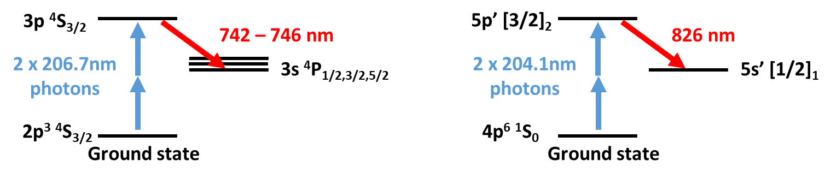
Two-Photon Absorption Laser-Induced Fluorescence
Relates fluorescence from a two-photon excited state to the ground state number density
  Ground state number density = species number density (for most cases)
Calibration with a noble gas (Kr)
  Challenging to produce a known amount of N-atoms
N TALIF Scheme
Kr TALIF Scheme
Notes:
Difficult to make an absolute measurement, you need to account for the collection solid angle, efficiency of the collection optics, etc. One way is to perform calibration with a noble gas that has a two-photon resonance in the spectral vicinity of the species of interest. Point out how easy it is to mess up

Slide 24
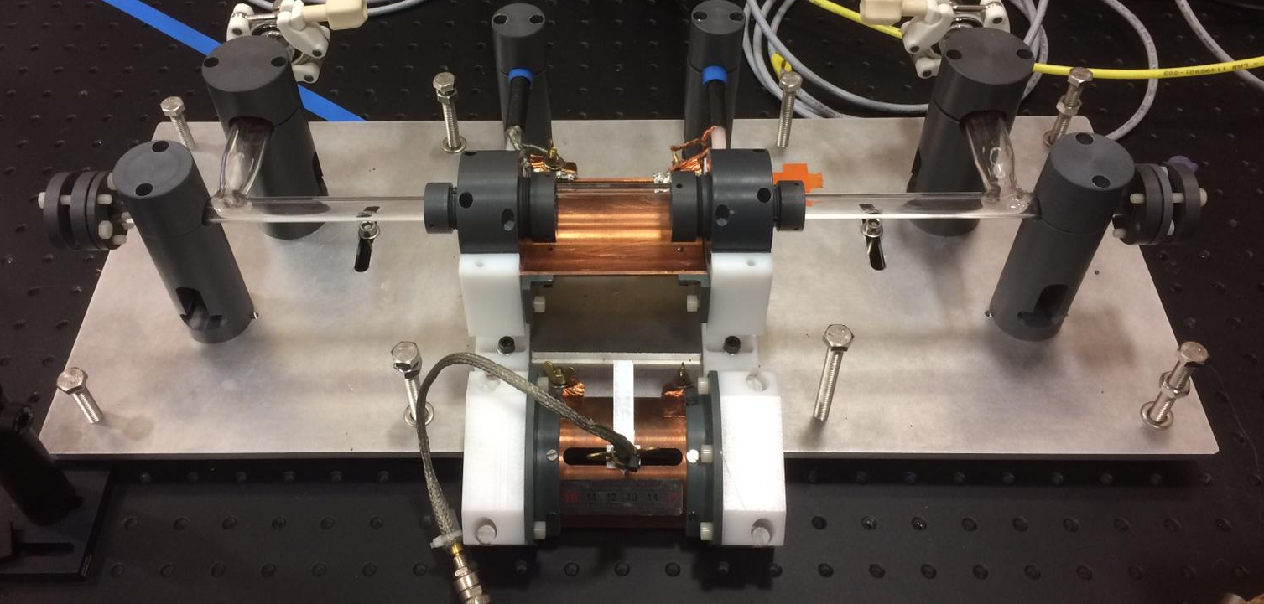
Discharge Setup for TALIF
Discharge tube
UV laser beam
200 µJ,
10 Hz
(Nsec dye laser)
Fluorescence
TALIF imaging system
(PMT with bandpass filter)
N₂ pressure: 20 mbar
Flow rate: 10 sccm

Slide 25
Time Evolution of N-atom Density
1st measurement point is t = 5 µs after discharge initiation
Peak N-atom density of about 5 x 10¹² cm⁻³
Reasonable for a specific deposited energy of 0.01 eV/molecule
Fluorescence
Excitation Wavelength
Notes:
One way is to position laser on resonance and simple time delay the arrival of the laser pulse

Slide 26
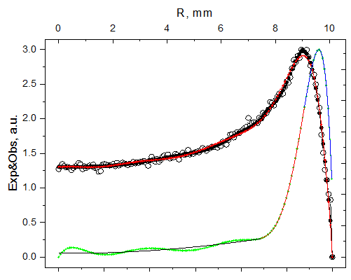
Problems Encountered: Radial Non-Uniformity
Emission Intensity Image
Raw emission profile
Emission Intensity
True emission profile
(inverse-abelized)
HV
LV
Intensity at the center of the tube is ~60 times smaller than at the edge
Challenge for comparisons with modeling predictions

Slide 27
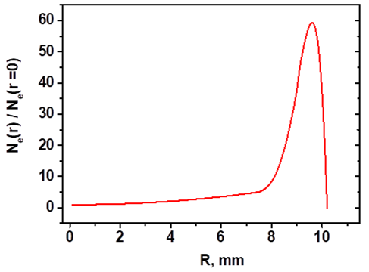
Non-Uniformity Affects Modeling Predictions
Emission Intensity Image
HV
LV
Influences the initial electron density distribution (input to the model)
=> Predicted N-atom density is very sensitive to radial position
Uncertainties in inverse Abel transform translate to uncertainties in N-atom density
Notes:
Emission intensity is directly related to the initial electron density distribution

Slide 28
Comparison with Modeling Predictions
First TALIF expt. data point
Better agreement with expt. data
Provided non-uniform radial distribution is considered
Main pathway: electron impact dissociation
    e- + N₂ -> N + N

Slide 29
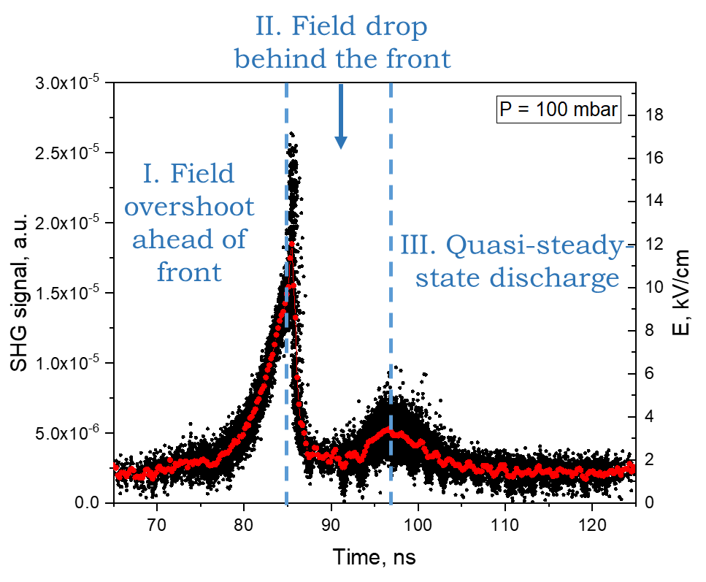
Summary
First step towards connecting discharge inception phenomena with the consequent plasma chemistry
Electric field evolution in FIW
N-atom density evolution in late afterglow
Time
0
Initiation phase t < 100 ns
Post-discharge phase (t > 5 µs)

Slide 30
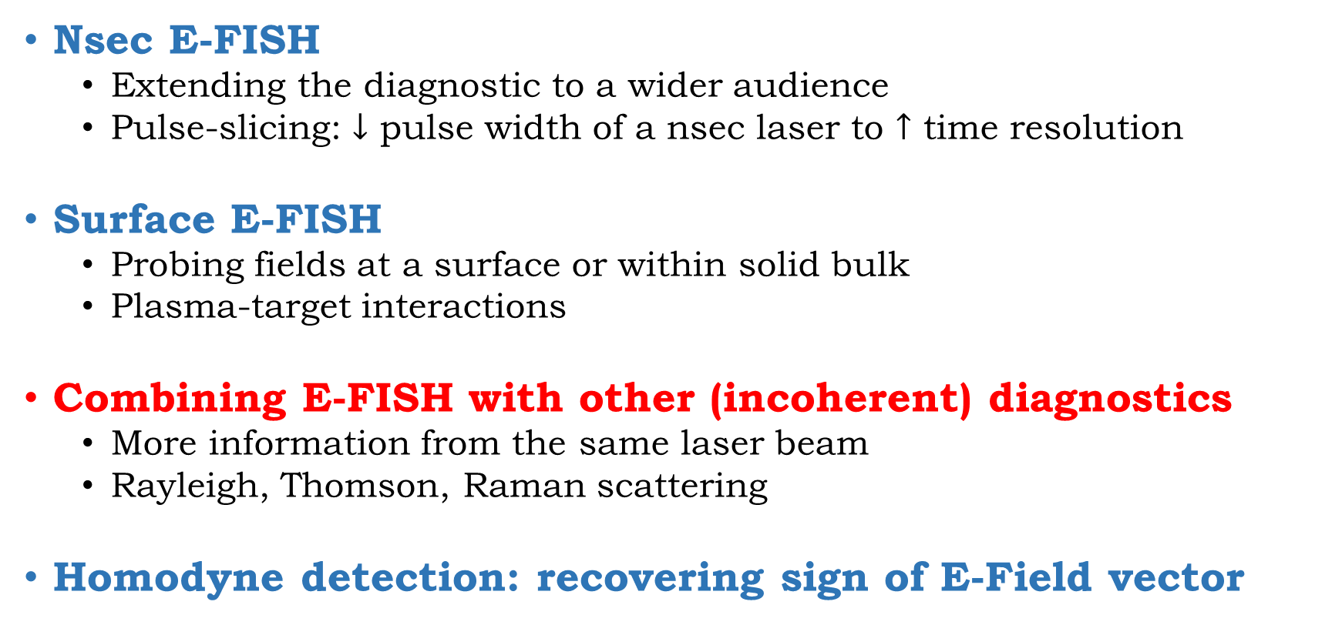
Other Research Themes
Nsec E-FISH
  Extending the diagnostic to a wider audience
  Pulse-slicing: $↓$ pulse width of a nsec laser to $↑$ time resolution
Surface E-FISH
  Probing fields at a surface or within solid bulk
  Plasma-target interactions
Combining E-FISH with other (incoherent) diagnostics
  More information from the same laser beam
  Rayleigh, Thomson, Raman scattering
Homodyne detection: recovering sign of E-Field vector

Slide 31
Simultaneous Measurements with a Single Laser Beam
E-FISH Signal, λ/2
Rayleigh scattering, λ
Probe beam, λ
Thomson scattering, λ
- E-FISH : PMT (or ICCD camera)
- Thomson scattering : Bragg filter + Spectrometer
- Rayleigh scattering : ICCD camera
Incoherent

Slide 32
Acknowledgments
Co-workers:
Svetlana Starikovskaia, École Polytechnique (Post-doctoral advisor)
Igor Adamovich, Ohio State University, USA
Nikolay Popov, Moscow State University
Nikita Lepikhin, Ruhr University Bochum, Germany
Orel Inna, École Polytechnique, France
Pierre Tardiveau, Univ. Paris-Sud, France
Alexandra Brisset, Univ. Paris-Sud, France
Others:
Cyril Drag and Jean Paul Booth (École Polytechnique) for advice and equipment loan
Pascal Pariset (École Polytechnique) for mechanical design and support
Notes:
Shorter the pulse, the more energy one is throwing away

Slide 33
Acknowledgments
This work was supported by the following projects and organizations:
  Laboratories of Excellence (LabEx): Plas@Par
  French National Research Agency (ANR): ASPEN project
  Direction Générale de l’armament (DGA)
  French-Russian International Laboratory (LIA): KaPPA project
  Various fellowships from the Department of International Relations (DRI), École Polytechnique

Slide 34
Thank you for your attention!

