Slide 1
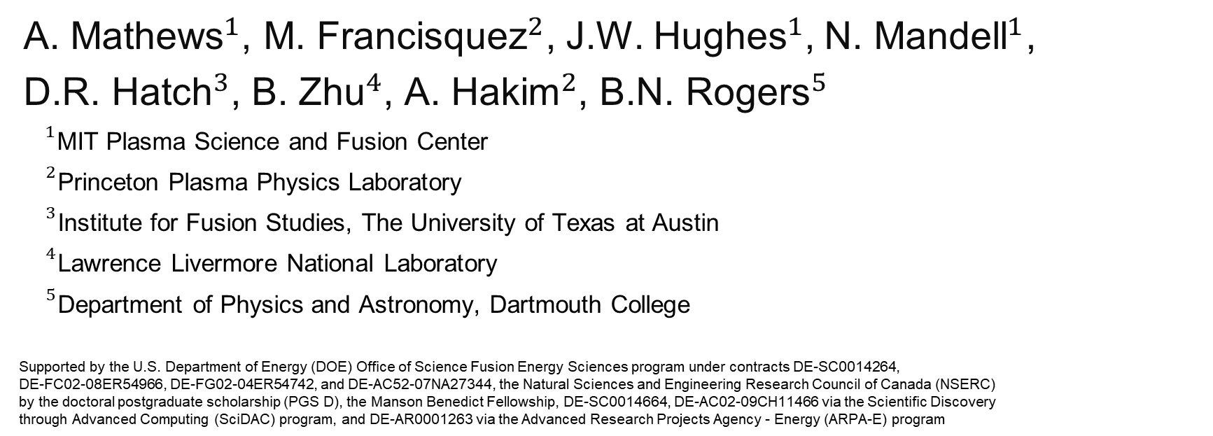
Physical Review E 104 (2), 025205
Uncovering turbulent plasma dynamics via deep learning from partial observations in fluid and gyrokinetic plasmas
arXiv:2107.09744
A. Mathew${\text{s}}^{1}$, M. Francisque${\text{z}}^{2}$, J.W. Hughe${\text{s}}^{1}$, N. Mandel${\text{l}}^{1}$,
D.R. Hatc${\text{h}}^{3}$, B. Zh${\text{u}}^{4}$, A. Haki${\text{m}}^{2}$, B.N. Roger${\text{s}}^{5}$
${}^{1}$MIT Plasma Science and Fusion Center
${}^{2}$Princeton Plasma Physics Laboratory
${}^{3}$Institute for Fusion Studies, The University of Texas at Austin
${}^{4}$Lawrence Livermore National Laboratory
${}^{5}$Department of Physics and Astronomy, Dartmouth College
Supported by the U.S. Department of Energy (DOE) Office of Science Fusion Energy Sciences program under contracts DE-SC0014264,
DE-FC02-08ER54966, DE-FG02-04ER54742, and DE-AC52-07NA27344, the Natural Sciences and Engineering Research Council of Canada (NSERC)
by the doctoral postgraduate scholarship (PGS D), the Manson Benedict Fellowship, DE-SC0014664, DE-AC02-09CH11466 via the Scientific Discovery
through Advanced Computing (SciDAC) program, and DE-AR0001263 via the Advanced Research Projects Agency - Energy (ARPA-E) program

Slide 2
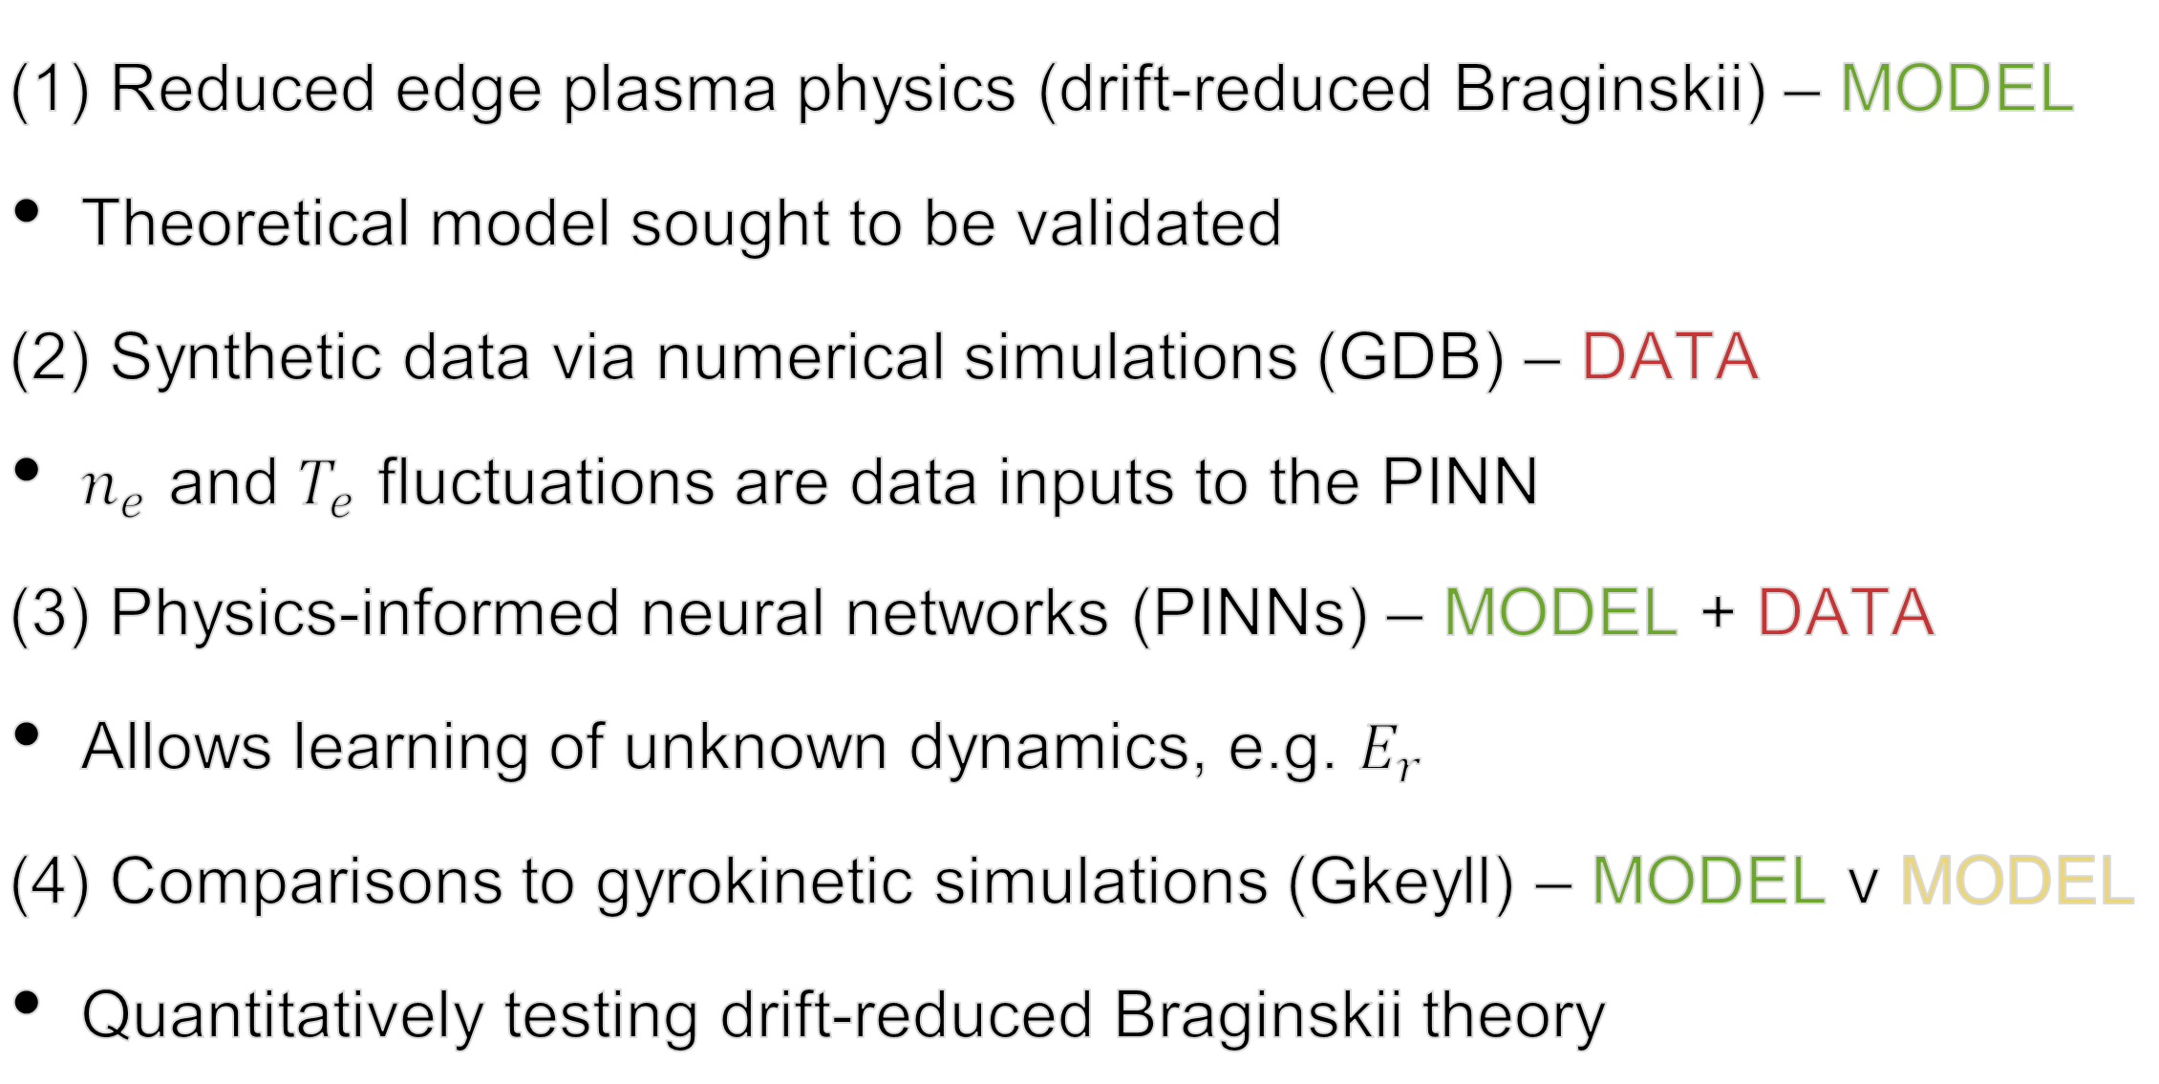
Outline of test case towards validating an edge plasma model
(1) Reduced edge plasma physics (drift-reduced Braginskii) – MODEL
Theoretical model sought to be validated
(2) Synthetic data via numerical simulations (GDB) – DATA
$n_{e}$ and $T_{e}$ fluctuations are data inputs to the PINN
(3) Physics-informed neural networks (PINNs) – MODEL + DATA
Allows learning of unknown dynamics, e.g. $E_{r}$
(4) Comparisons to gyrokinetic simulations (Gkeyll) – MODEL v MODEL
Quantitatively testing drift-reduced Braginskii theory

Slide 3
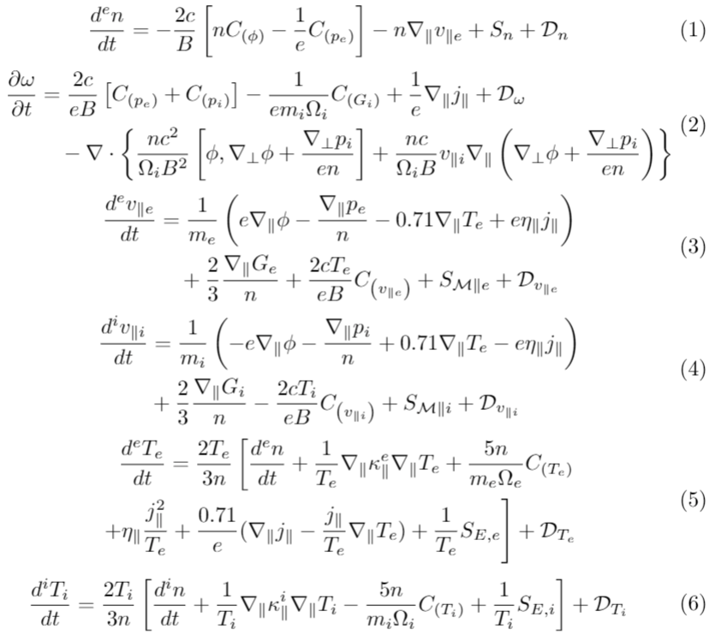
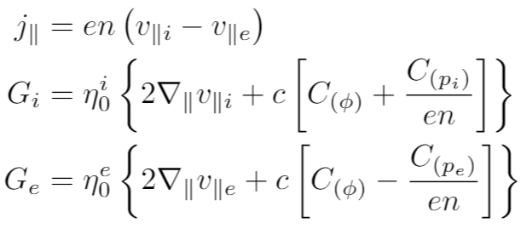
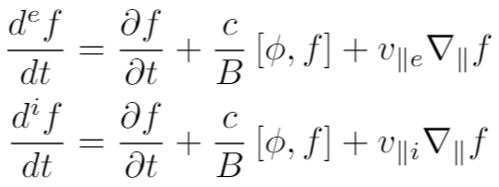
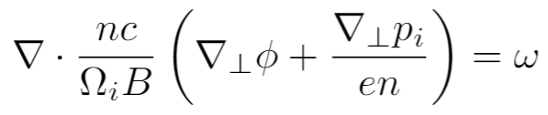

Drift-reduced ($\text{∂}\text{/}\text{∂}t≪Ω_{i}$) Braginskii two-fluid equations
current + gyroviscous terms
convective derivatives
generalized vorticity
curvature operator

Slide 4
Outline of test case towards validating an edge plasma model
(1) Reduced edge plasma physics (drift-reduced Braginskii) – MODEL
Theoretical model sought to be validated
(2) Synthetic data via numerical simulations (GDB) – DATA
$n_{e}$ and $T_{e}$ fluctuations are data inputs to the PINN
(3) Physics-informed neural networks (PINNs) – MODEL + DATA
Allows learning of unknown dynamics, e.g. $E_{r}$
(4) Comparisons to gyrokinetic simulations (Gkeyll) – MODEL v MODEL
Quantitatively testing drift-reduced Braginskii theory

Slide 5
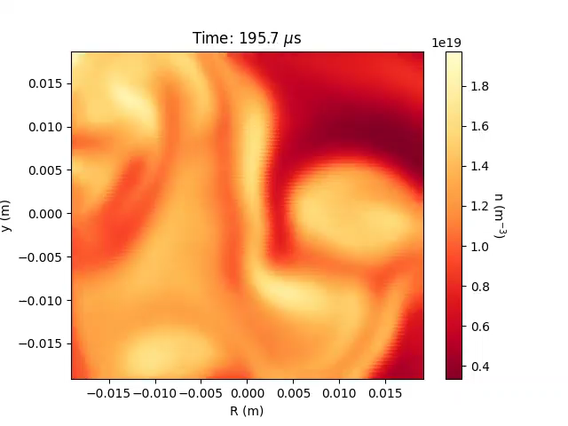
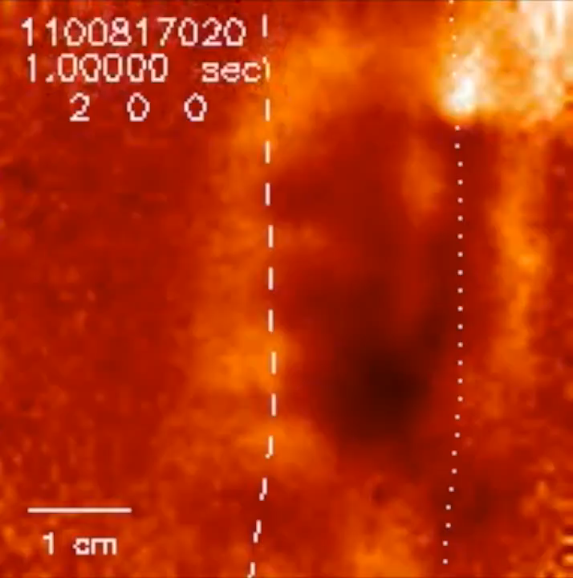

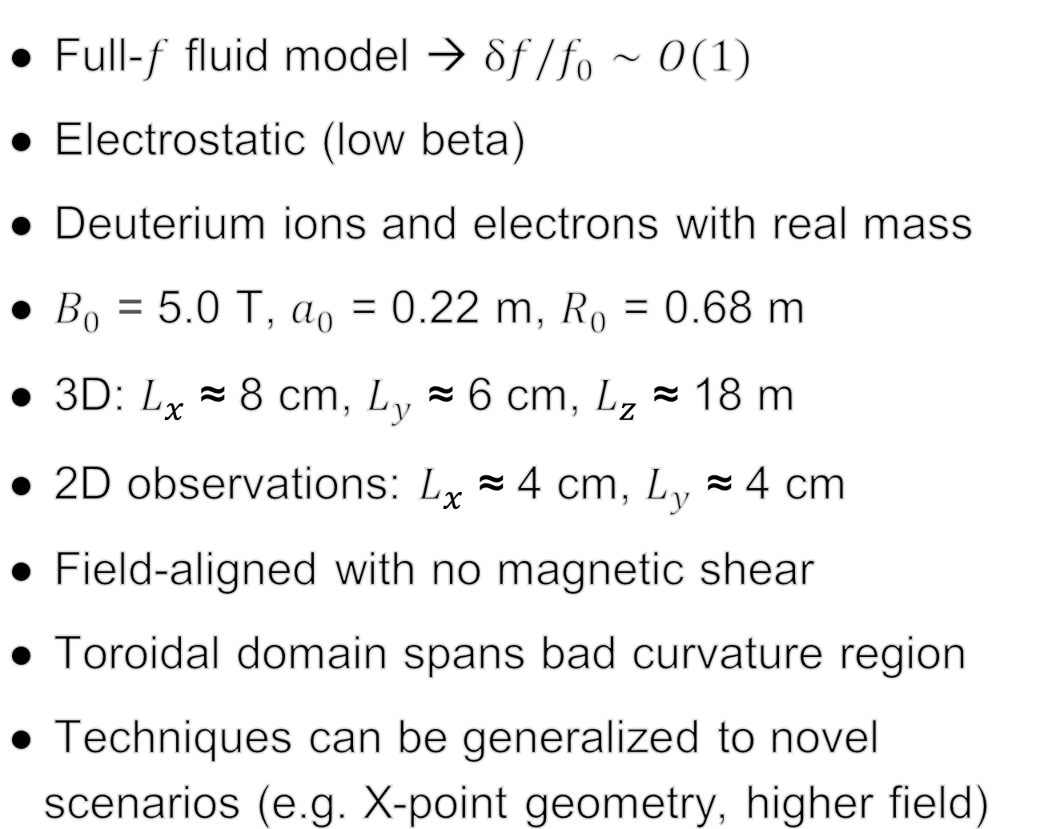
GDB simulations developed to test a synthetic C-Mod plasma
Full-$f$ fluid model → δ$f$/$f_{0}∼O(1)$
Electrostatic (low beta)
Deuterium ions and electrons with real mass
$B_{0}$ = 5.0 T, $a_{0}$ = 0.22 m, $R_{0}$ = 0.68 m
3D: $L_{x}$ ≈ 8 cm, $L_{y}$ ≈ 6 cm, $L_{z}$ ≈ 18 m
2D observations: $L_{x}$ ≈ 4 cm, $L_{y}$ ≈ 4 cm
Field-aligned with no magnetic shear
Toroidal domain spans bad curvature region
Techniques can be generalized to novel scenarios (e.g. X-point geometry, higher field)
Gas Puff Imaging
(experimental data)
GDB
(simulated data)
Source: J. Terry (MIT) & S. Zweben (PPPL)
B. Zhu et al 2018 Comp. Physics Comm. 232 46–58
M. Francisquez et al 2020 Physics of Plasmas 27 082301

Slide 6
Outline of test case towards validating an edge plasma model
(1) Reduced edge plasma physics (drift-reduced Braginskii) – MODEL
Theoretical model sought to be validated
(2) Synthetic data via numerical simulations (GDB) – DATA
$n_{e}$ and $T_{e}$ fluctuations are data inputs to the PINN
(3) Physics-informed neural networks (PINNs) – MODEL + DATA
Allows learning of unknown dynamics, e.g. $E_{r}$
(4) Comparisons to gyrokinetic simulations (Gkeyll) – MODEL v MODEL
Quantitatively testing drift-reduced Braginskii theory

Slide 7
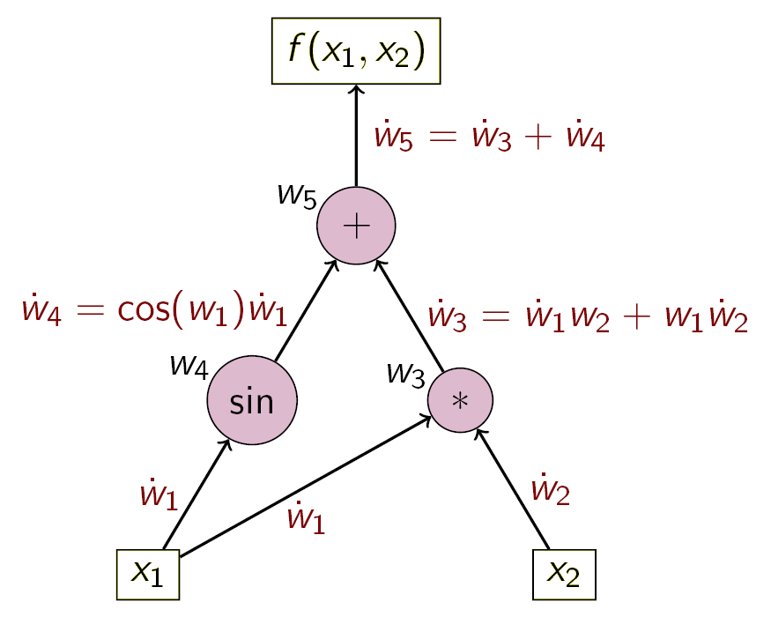
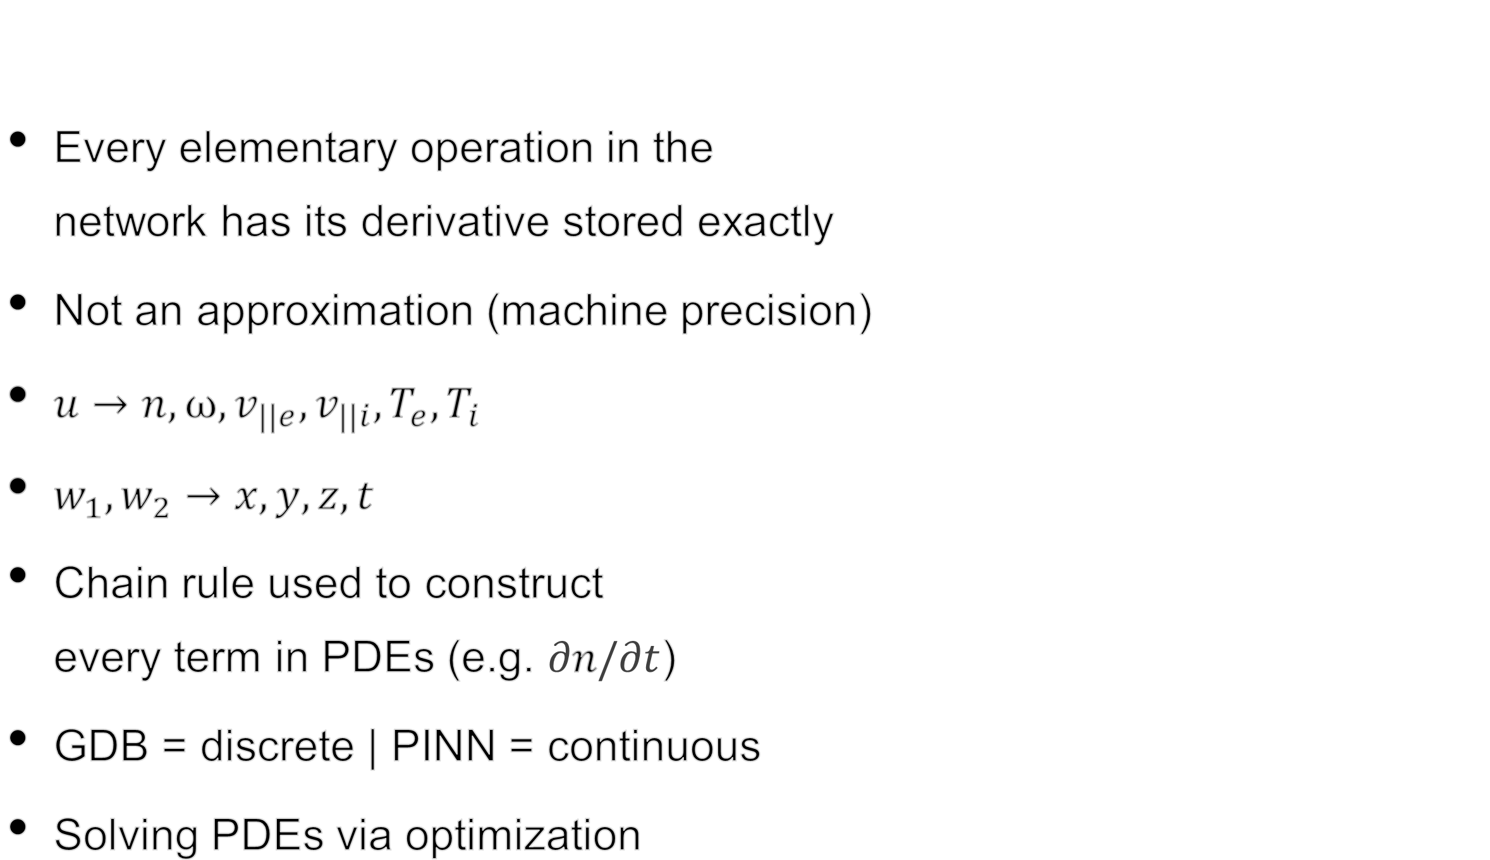



Every elementary operation in the network has its derivative stored exactly
Not an approximation (machine precision)
$u→n,ω,v_{||e},v_{||i},T_{e},T_{i}$
$w_{1},w_{2}→x, y, z, t$
Chain rule used to construct every term in PDEs (e.g. $\text{∂}n\text{/}\text{∂}t$)
GDB = discrete | PINN = continuous
Solving PDEs via optimization
PDEs are constructed by aid of automatic differentiation
$$u(w_{1},w_{2})$$
$${ w}_{1}$$
$${ w}_{2}$$

Slide 8
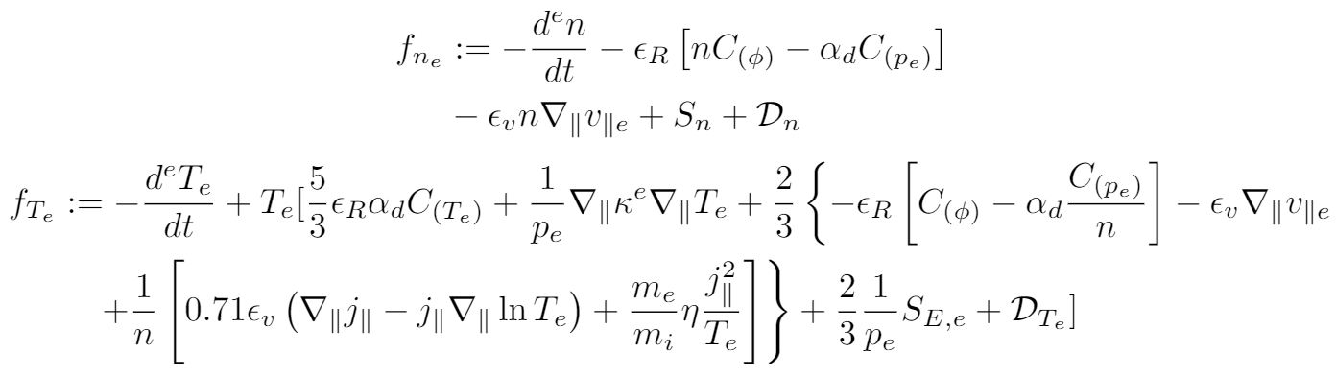


Physics-informed neural networks (PINNs): data-model optimization
GOAL: Make the DATA and MODEL loss terms as close to 0 as possible
DATA
MODEL
$$\frac{1}{N_{u}}\sum_{i=1}^{N_{u}}{{\left|u\left(t_{u}^{i},x_{u}^{i}\right)−u^{i}\right|}^{2}}$$
$$\frac{1}{N_{f}}\sum_{i=1}^{N_{f}}{{\left|f\left(t_{f}^{i},x_{f}^{i}\right)\right|}^{2}}$$
+
LOSS =

Slide 9
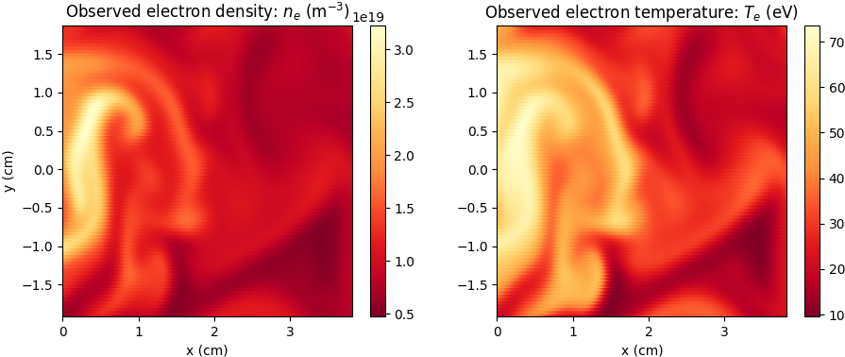
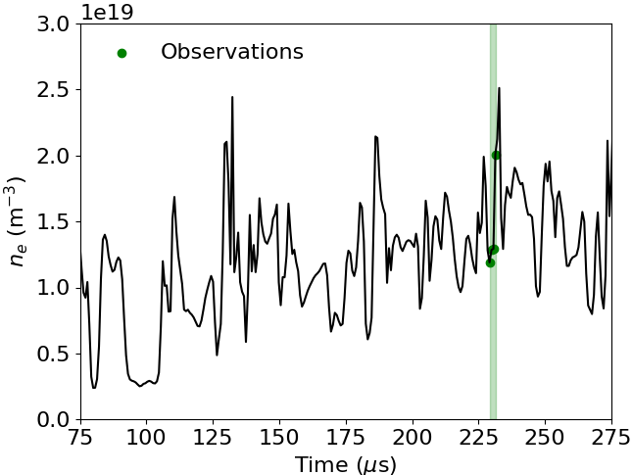
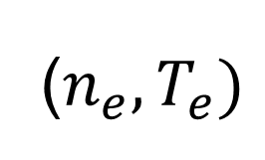
Only 2-dimensional $n_{e}$ and $T_{e}$ of the 3-dimensional plasma observed
DATA THEORY
PINN
+
($n_{e},T_{e})$
(Braginskii)
Long time series can be easily
handled in the framework
×
#33883059
*No validation nor testing sets – just one plasma discharge*

Slide 10
The PINN is constrained by our sought theory for $\text{∂}n_{e}\text{/}\text{∂}t$ and $\text{∂}T_{e}\text{/}\text{∂}t$
DATA THEORY
PINN
+
($n_{e},T_{e})$
(Braginskii)

Slide 11
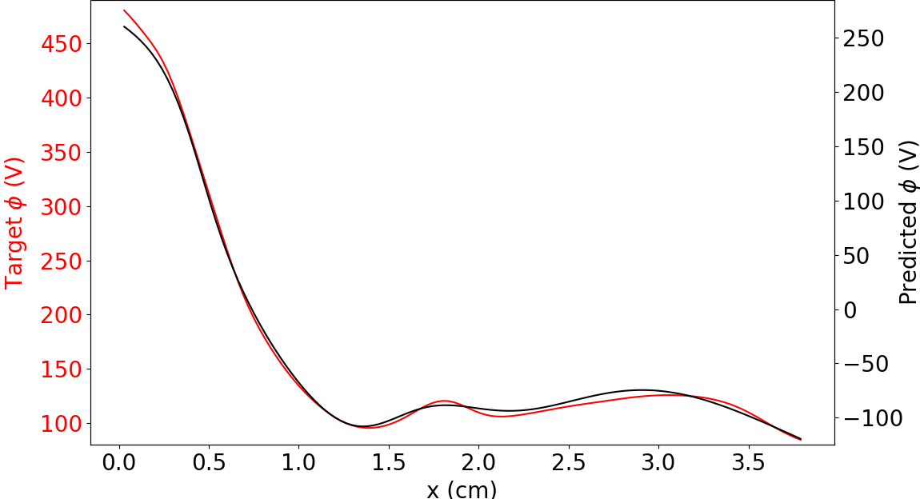
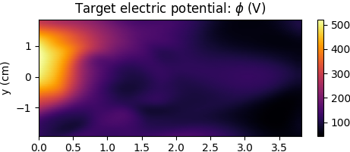
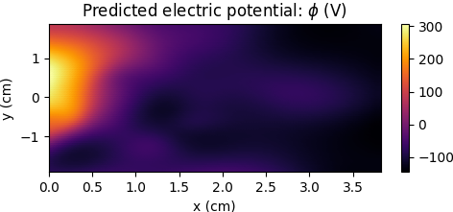

Electric potential is completely unobserved…yet almost fully learned
Electric potential is completely unobserved…
DATA THEORY
PINN
+
($n_{e},T_{e})$
(Braginskii)
- - - - - - - - - - - - - - - - -
- - - - - - - - - - - - - - - - -
#33883059

Slide 12
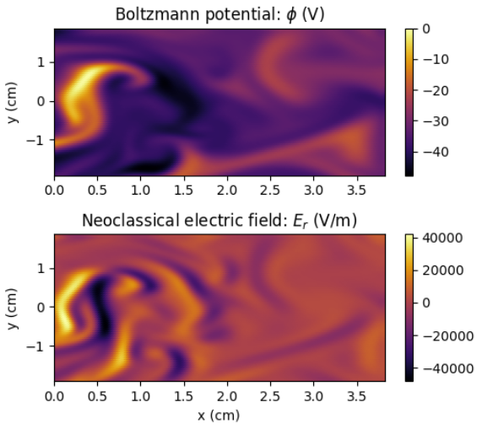
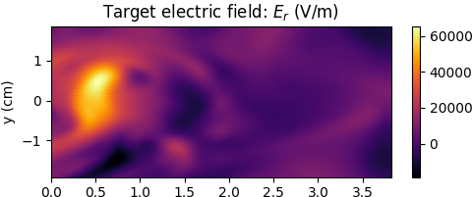

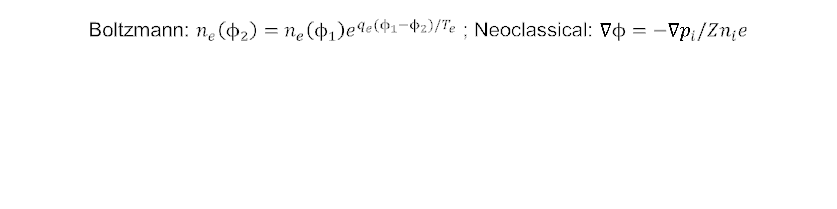
Can a simple equilibrium model predict the electric potential & field?
Boltzmann: $n_{e}\left(ϕ_{2}\right)=n_{e}\left(ϕ_{1}\right)e^{{q_{e}(ϕ}_{1}−ϕ_{2})/T_{e}}$ ; Neoclassical: ∇${ϕ=\text{−}\text{∇}p}_{i}/Zn_{i}e$
Contrasts classical analytic methods: inverse learning not possible (cannot learn $n_{e}$ from just $T_{e}$ and ϕ in this framework)

Slide 13
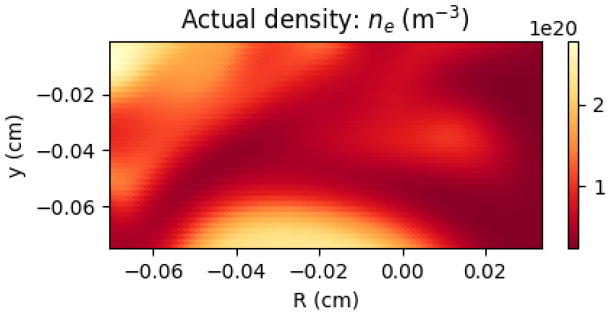
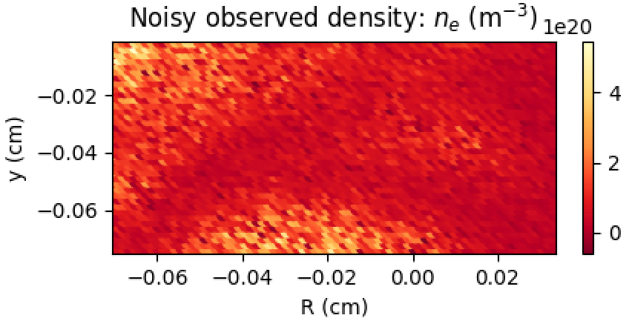
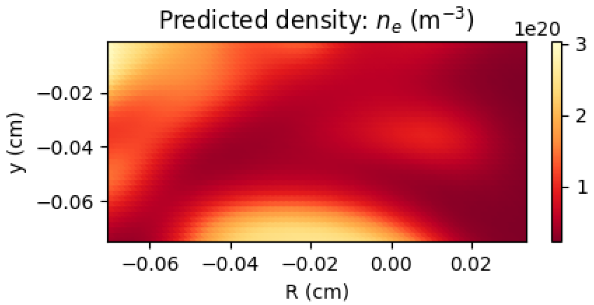
Able to “uncorrupt” measurements with even 50% Gaussian noise
Density fluctuations with strong noise present can still be learned
29926655

Slide 14
Outline of test case towards validating an edge plasma model
(1) Reduced edge plasma physics (drift-reduced Braginskii) – MODEL
Theoretical model sought to be validated
(2) Synthetic data via numerical simulations (GDB) – DATA
$n_{e}$ and $T_{e}$ fluctuations are data inputs to the PINN
(3) Physics-informed neural networks (PINNs) – MODEL + DATA
Allows learning of unknown dynamics, e.g. $E_{r}$
(4) Comparisons to gyrokinetic simulations (Gkeyll) – MODEL v MODEL
Quantitatively testing drift-reduced Braginskii theory

Slide 15
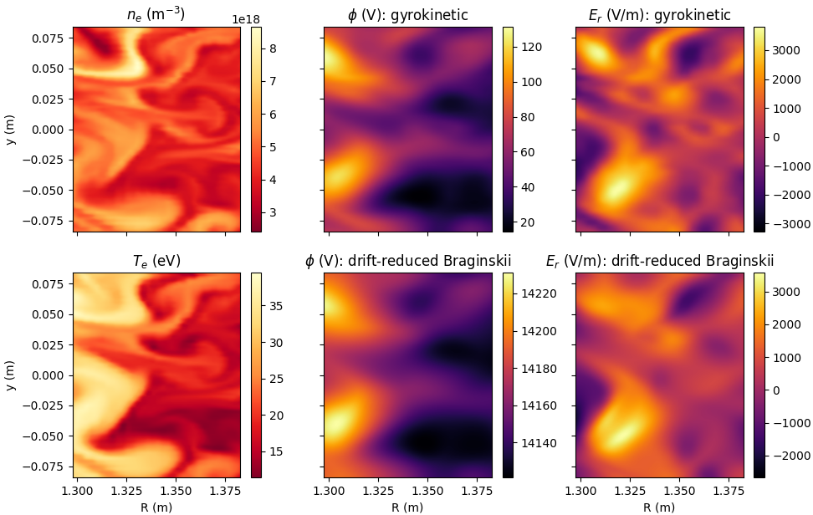
DRB vs. gyrokinetic theory: electric field in the SOL of NSTX
DRB theory closely matches gyrokinetic $E_{r}$ in low-β helical plasma
Given an electron pressure fluctuation, what is the turbulent ϕ expected from electromagnetic gyrokinetic modelling and electrostatic drift-reduced Braginskii theory?
M. Francisquez et al 2020 Physics of Plasmas 27 082301
N. Mandell et al 2020 Journal of Plasma Physics 86(1) 905860109
#34587378

Slide 16
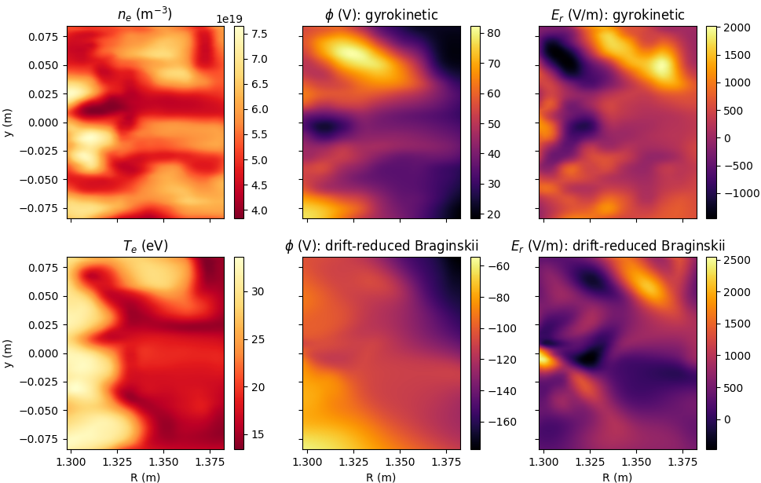
ES DRB theory inconsistent with EM gyrokinetic $E_{r}$ at high-β
#37003300

Slide 17
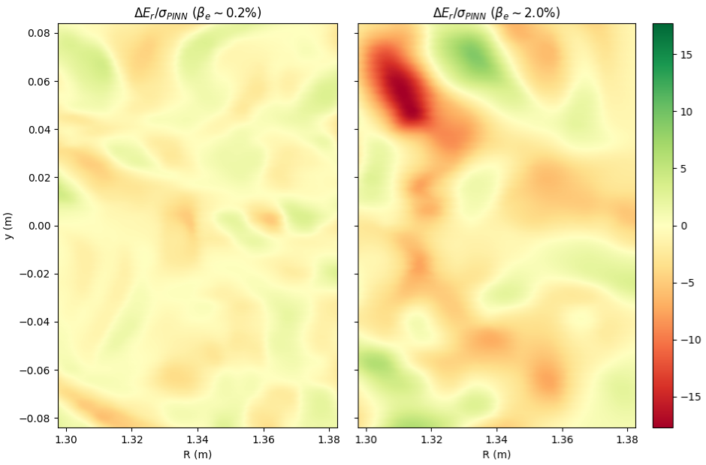
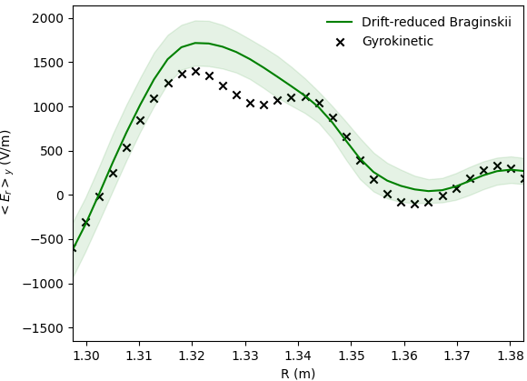
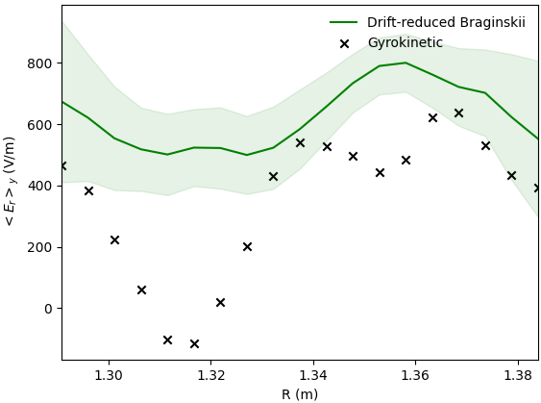


Can now precisely quantify fluid-gyrokinetic model (dis)agreement
As expected, the ES reduced model becomes less accurate as β increases
${\text{β}}_{e}$ ~ 0.2%
${\text{β}}_{e}$ ~ 2.0%
#34587378-37003300

Slide 18
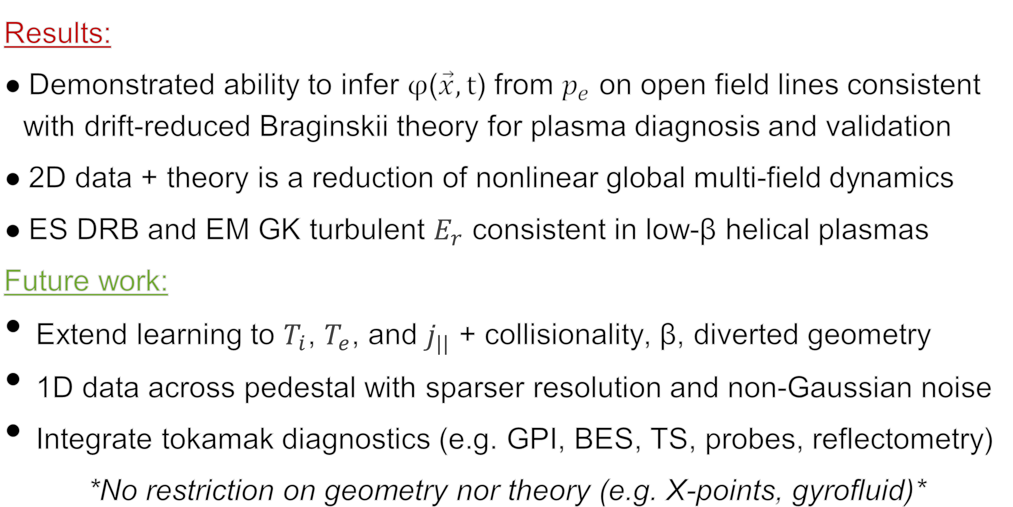
On the path towards developing accurate edge-pedestal models
Results:
Demonstrated ability to infer φ($\vec{x},t$) from $p_{e}$ on open field lines consistent with drift-reduced Braginskii theory for plasma diagnosis and validation
2D data + theory is a reduction of nonlinear global multi-field dynamics
ES DRB and EM GK turbulent $E_{r}$ consistent in low-β helical plasmas
Future work:
Extend learning to $T_{i}$, $T_{e}$, and $j_{||}$ + collisionality, β, diverted geometry
1D data across pedestal with sparser resolution and non-Gaussian noise
Integrate tokamak diagnostics (e.g. GPI, BES, TS, probes, reflectometry)
*No restriction on geometry nor theory (e.g. X-points, gyrofluid)*

