Slide 1




NBI fast-ions in the RFP and LTX-β
Studies on well-developed to developing EP populations

Slide 2
Fast-ion studies* in the RFP and ST
Critical fast-ion pressure measured on Madison Symmetric Torus
  Natural fast-ions in RFP
  Fast-ion dynamics in RFP
  Large NBI ion population drives Alfvén continuum mode (bursting mode)
  Collimated D-D neutron flux diagnostic developed to measure fast-ion profile
Start of fast-ion studies in LTX-β
  Initial NBI operation- no coupling to plasma
  Extensive modeling to optimize coupling
  New higher current equilibria
  Upcoming work
    Characterization of beam: NPA, IR thermography, spectroscopy
    3d equilibria- large toroidal asymmetry due to shells could drive significant loss
    Mode activity (?)

Slide 3
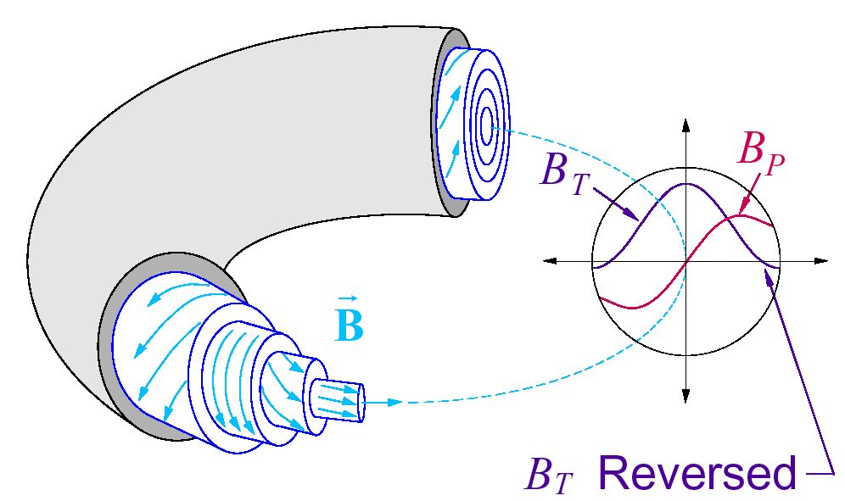
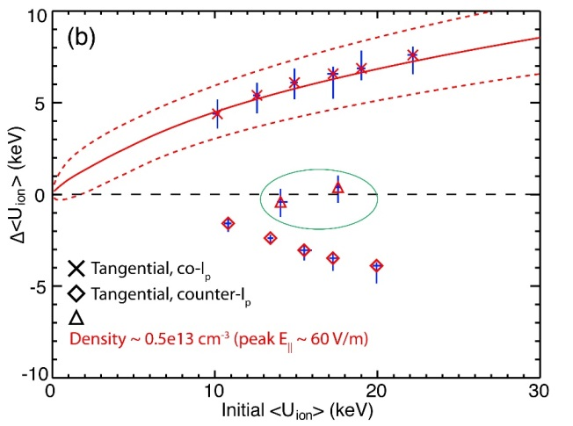
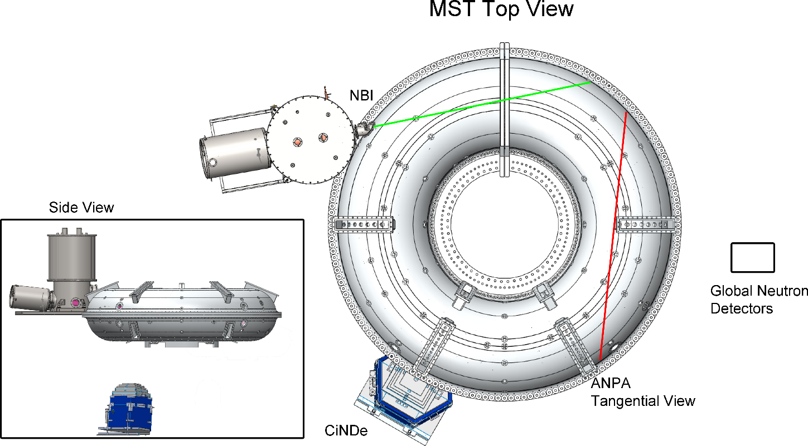
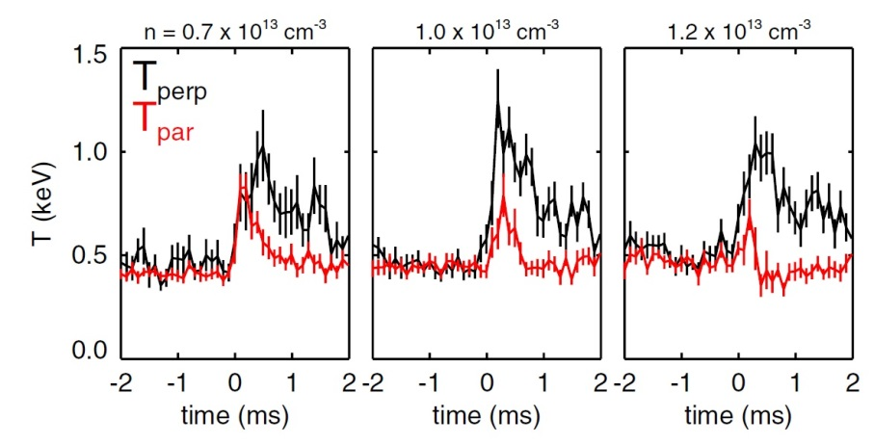
Good EP population to study in RFP
Madison Symmetric Torus- good testbed for interesting EP physics
  Low magnetic field → higher fast-ion beta (stronger drive)
  High shear → Increased stability against continuum modes (EPMs)
Dynamics influenced by tearing instability
  Largely impacts evolution of equilibrium, heat/particle transport
  Ion heating- natural fast ion population
    Perpendicular heating at sawtooth
    Runaway ion tail develops during relaxation
    Large anisotropy in confinement phase space
Madison Symmetric Torus
R=1.5 m; a=0.52 m
I_{p} ~ 200 – 500 kA
|B| ~ 0.2 – 0.5 T
T_{e}(0) ~ 200 – 2000 eV
n_{e} ~ n_{D} ~ 10¹³ cm⁻³
Pulse length ~ 60-100 ms
[Anderson 2016]

Slide 4
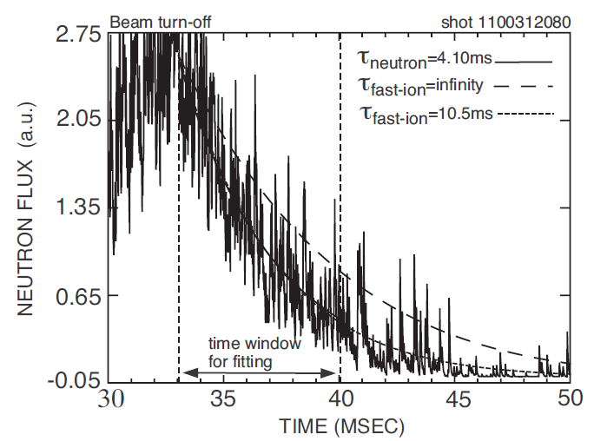
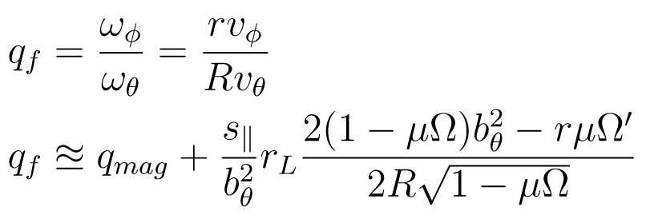
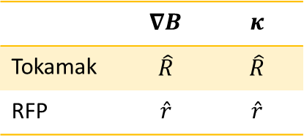


EP motion decoupled from local $b_{r}$
Fast-ion drift velocity stays on flux surface
$$v_{GC}=v_{∥}b+\frac{v_{⊥}^{2}}{2ω_{c}}\frac{B×∇B}{{\left|B\right|}^{2}}+\frac{v_{∥}^{2}}{ω_{c}}\frac{B×κ}{\left|B\right|}$$
Rational surfaces shifted from locations of tearing mode activity
  Near classical confinement of co-injected EP (~10ms)
  (Counter-Ip: ~1ms, perpendicular injection ~4-5ms)
 | $$∇B$$ | $$κ$$
Tokamak | $$\hat{R}$$ | $$\hat{R}$$
RFP | $$\hat{r}$$ | $$\hat{r}$$
[Hudson 2006]
[Anderson et al. 2011]

Slide 5
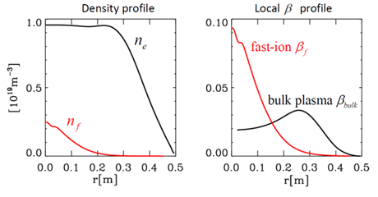
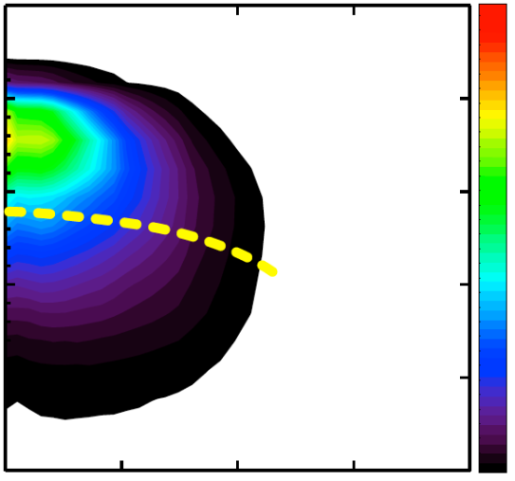
Good EP population to study in RFP
Wanted to investigate what limits fast-ion content in RFP
NBI provides well-confined super-Alfvénic population to study
  Mode activity is species dependent- ran D-beam into D-plasma
  Discharge style chosen to isolate single mode activity
    Removal of m=0 surface eliminates most sawteeth
    Mode activity observed during NBI then corresponds to an “unavoidable” limit in these discharges
NBI Parameter | Specification
Beam energy | 25 keV
Beam power | 1 MW
Pulse length | 20 ms
Composition | 100% D
TRANSP Fast Ion Distribution
TRANSP
(NUBEAM)
2.0
(10⁶ m/s)
V_{A}
Madison Symmetric Torus
R=1.5 m; a=0.52 m
I_{p} ~ 200 – 500 kA
|B| ~ 0.2 – 0.5 T
T_{e}(0) ~ 200 – 2000 eV
n_{e} ~ n_{D} ~ 10¹³ cm⁻³
Pulse length ~ 60-100 ms
1.0
V||
0
0
0.1
0.2
0.3
0.4
r (m)

Slide 6
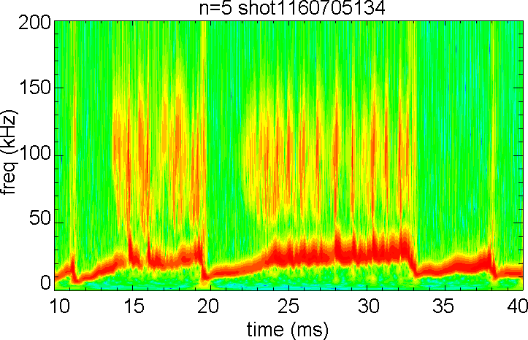
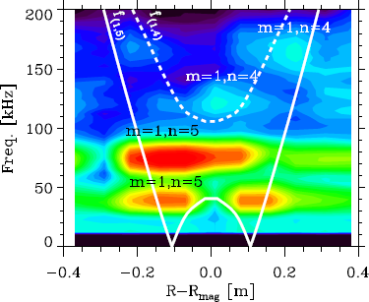
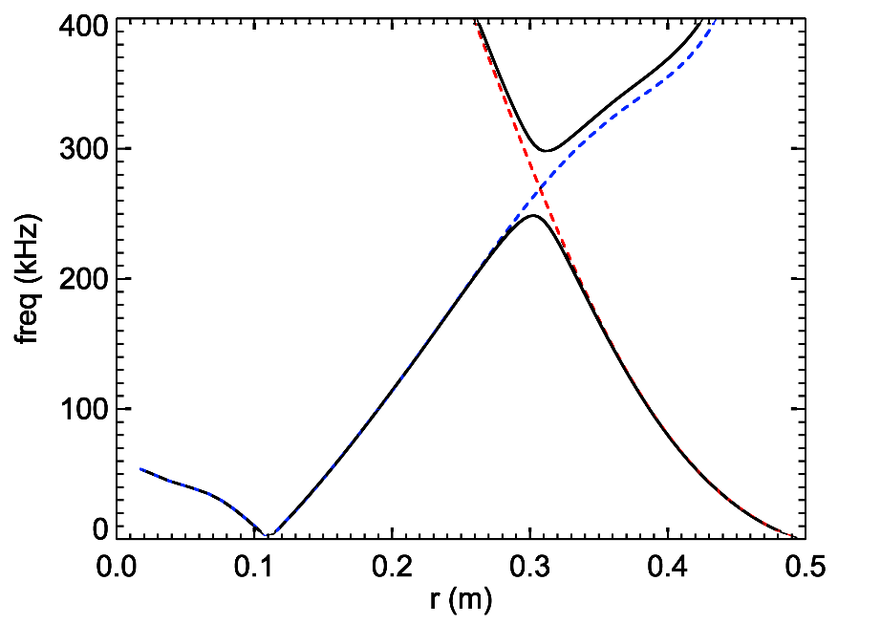
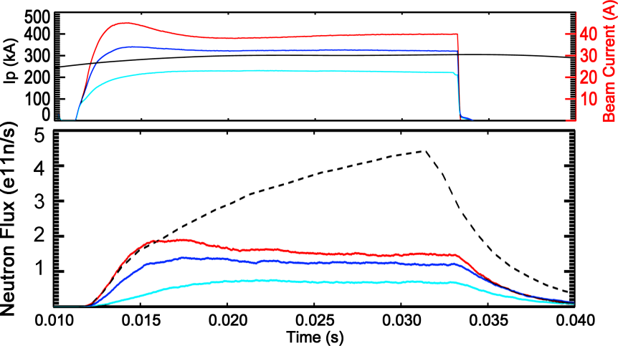
EPM resonant with NBI population
Periodic “bursting” mode observed during NBI, concurrent with saturation of neutron signal
Mode indicative of destabilization of Alfvén continuum mode via strong particle drive
  Alfvén eigenmodes cause resonant transport and were avoided
  Without AE activity EP population grows until EPM destabilized
  Isolated mode: only (1,5) activity (prior MST work on n=4 IAE)
beam on
(0,5)
weakly damped
TAE gap
strongly damped
No AE/EPM
(1,5)
[Lin 2014]

Slide 7
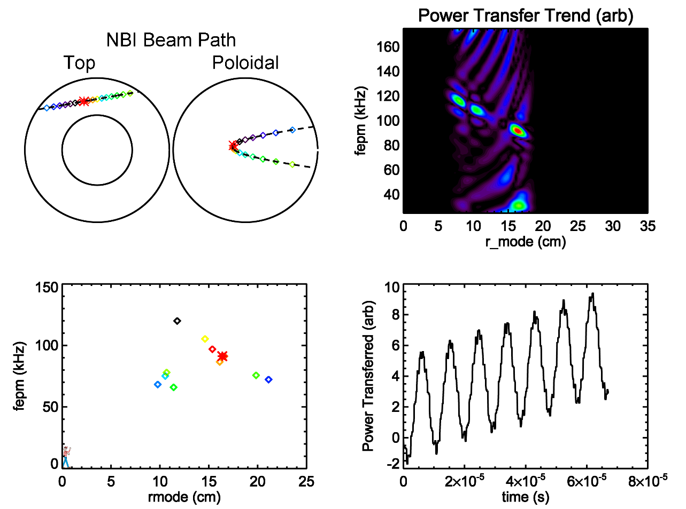
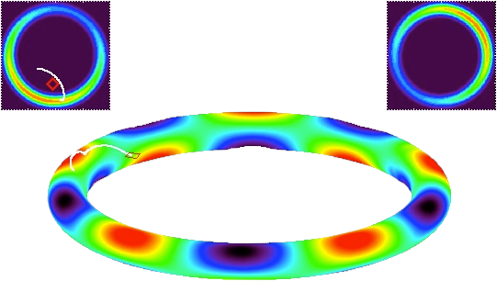
EPM resonant with NBI population
Full orbit code (POET) developed to probe mode-particle resonance
Energy transfer to mode:
  From spatial gradient in fast-ion distribution (NPA shows E constant with r)
  Transfer via resonant fast-ions
Resonance observed with mode
  Power transferred observed using simple (1,5) mode structure
  Multiple full orbits representative of NBI born ions modeled that showed positive power transfer
  Consistent with radial location and frequency of observed bursting mode
beam on
Notes:
Note similarity of POET to SPIRAL code, but no incorporation of mode, slowing, or other effects- test particle only

Slide 8
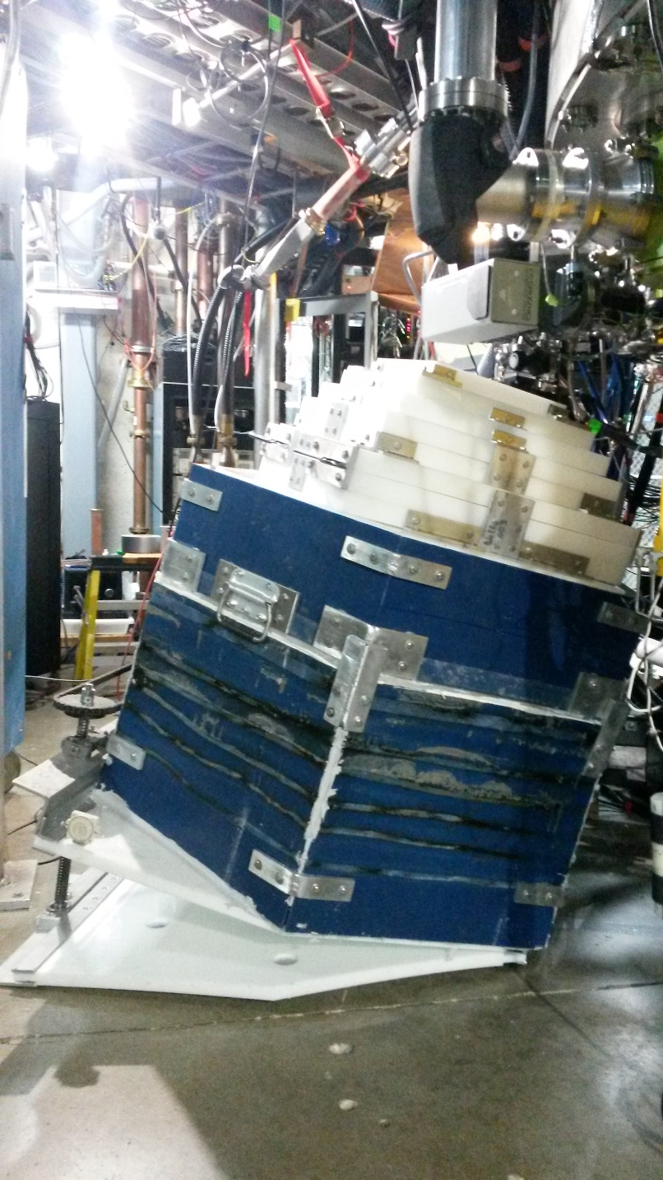
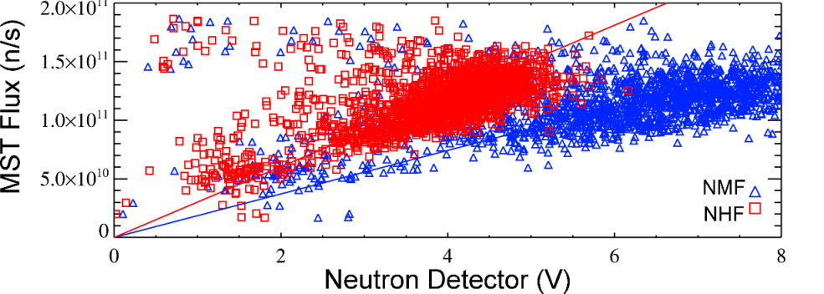

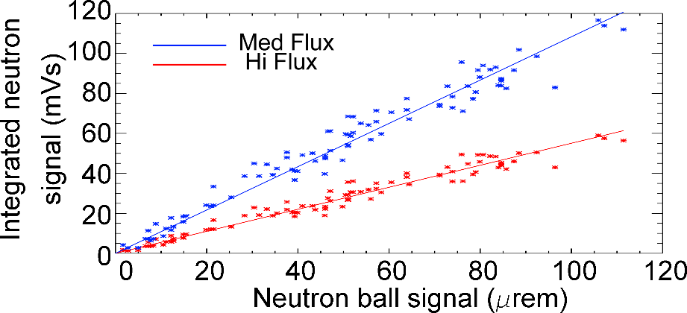

EP profile measured via D-D neutron flux
Full D beam, almost all fusion from beam-plasma interactions
$$Γ_{MST}≅Γ_{bt}=\iint{f_{f}n_{i}σv_{f}dVdE}$$
Neutron detectors calibrated via multiple methods, good linearity over MST flux range
Novel collimated neutron detector measured EP profile

Slide 9
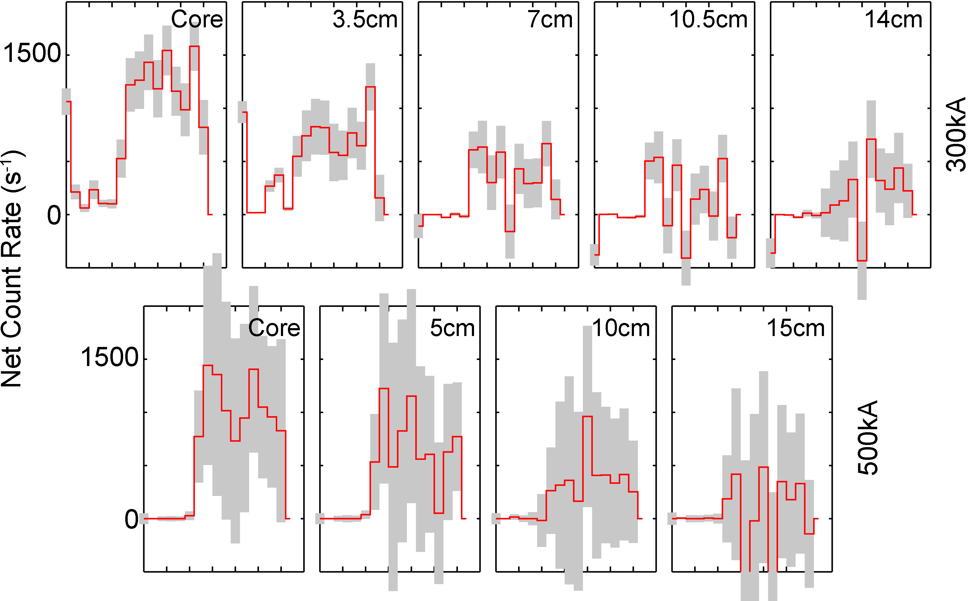
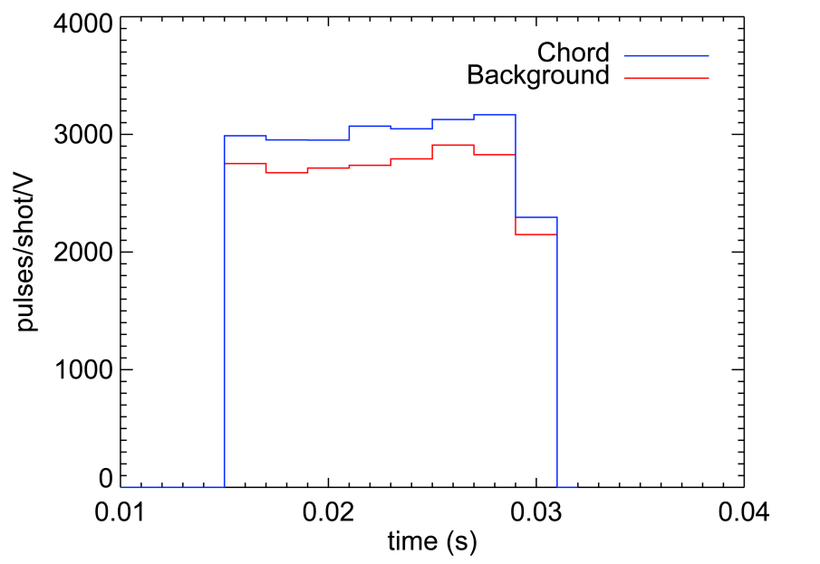
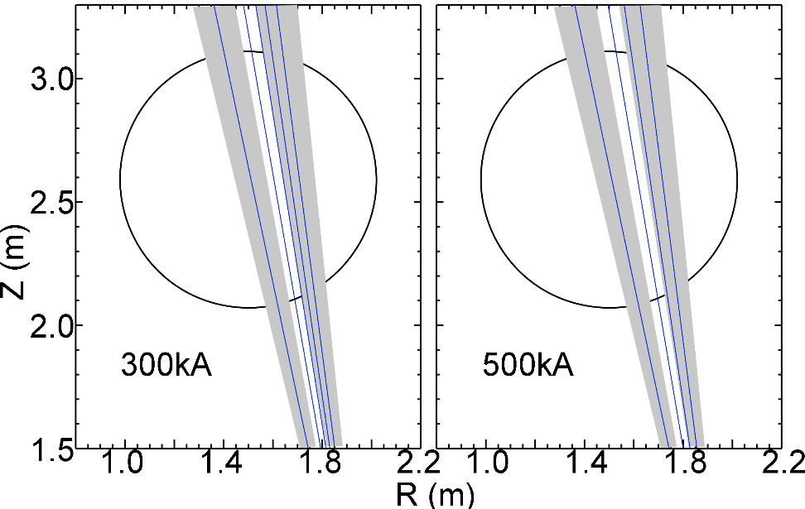
Collimated neutron measure of EP profile
Code developed to validate collimator design
  Model of background suppression of moderating material (validated with MCNP)
  Optimization of scintillator to increase sensitivity to direct capture neutrons
Large background persisted
  Scintillator-PMT type detector sensitive to
  fast neutrons, but also high energy photons
  Pulse shape discrimination possible
  Differencing technique on large datasets

Slide 10
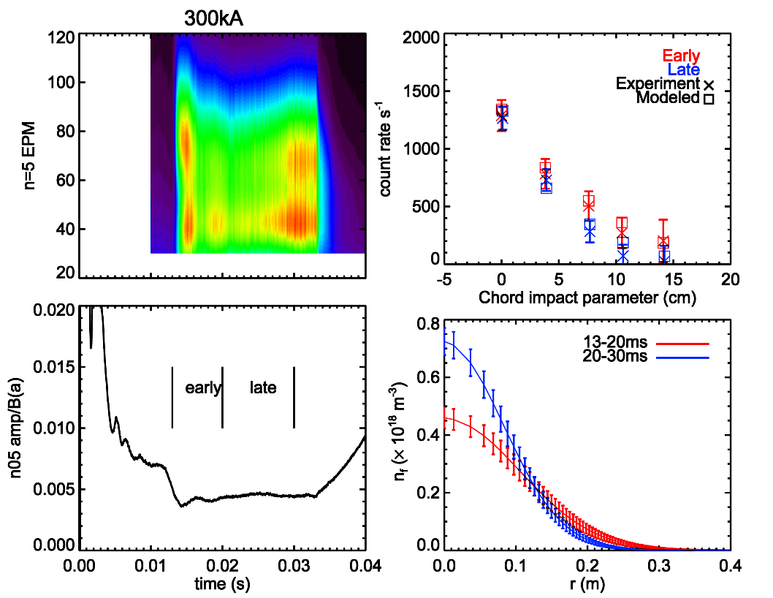
Collimated neutron measure of EP profile
EP beta profile inverted onto 2-parameter model
  Good agreement between experimental/modeled flux
  “early” and “late” time windows were analyzed to provide information on profile development while maintaining good statistics

Slide 11
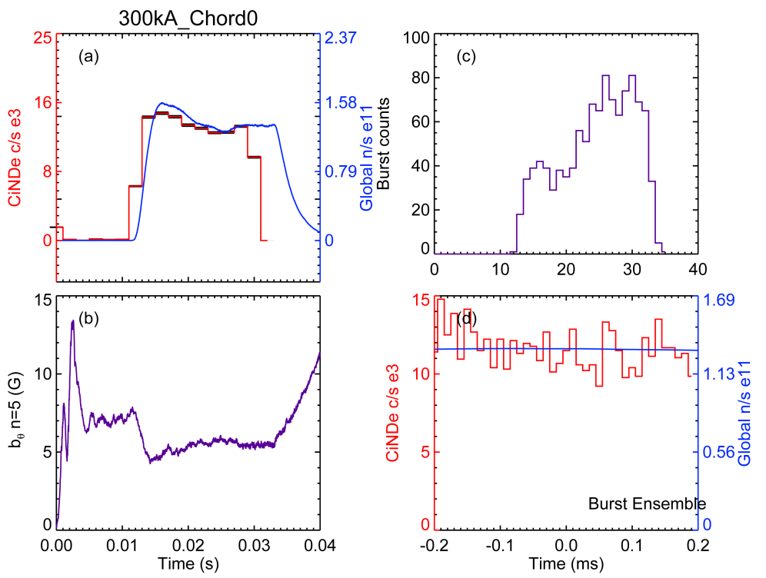
Collimated neutron measure of EP profile
EP beta profile inverted onto 2-parameter model
  Good agreement between experimental/modeled flux
  “early” and “late” time windows were analyzed to provide information on profile development while maintaining good statistics
Burst ensemble showed no drop in neutron rate
  Prior work with H-NBI saw drop in NPA signal
    Triplet mode activity- mode coupling enhanced losses
  Suggests transport but not loss- local flattening

Slide 12
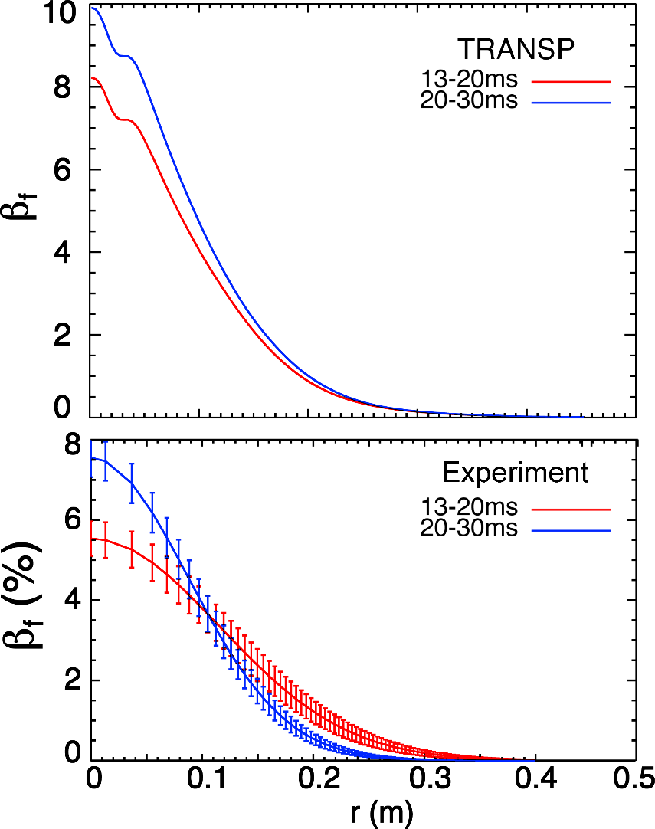
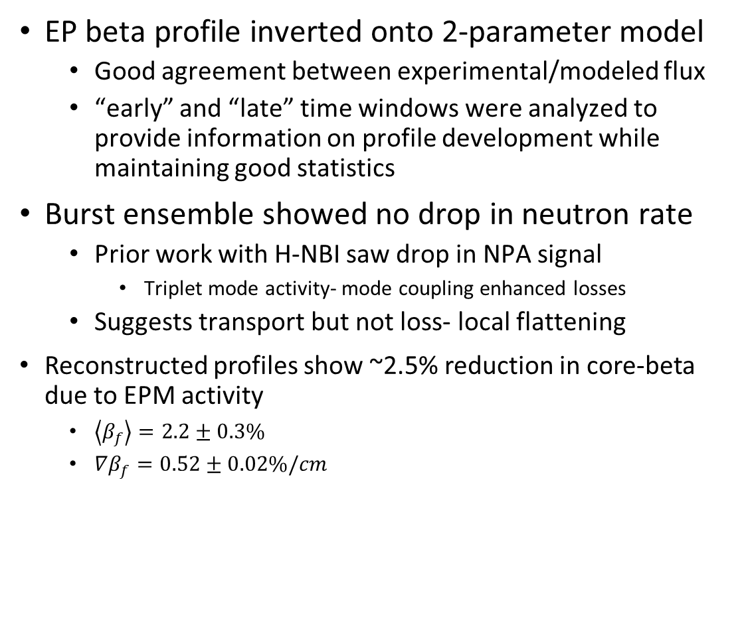
Collimated neutron measure of EP profile
EP beta profile inverted onto 2-parameter model
  Good agreement between experimental/modeled flux
  “early” and “late” time windows were analyzed to provide information on profile development while maintaining good statistics
Burst ensemble showed no drop in neutron rate
  Prior work with H-NBI saw drop in NPA signal
    Triplet mode activity- mode coupling enhanced losses
  Suggests transport but not loss- local flattening
Reconstructed profiles show ~2.5% reduction in core-beta due to EPM activity
  $\left\langle β_{f}\right\rangle =2.2±0.3\%$
  $∇β_{f}=0.52±0.02\%/cm$

Slide 13
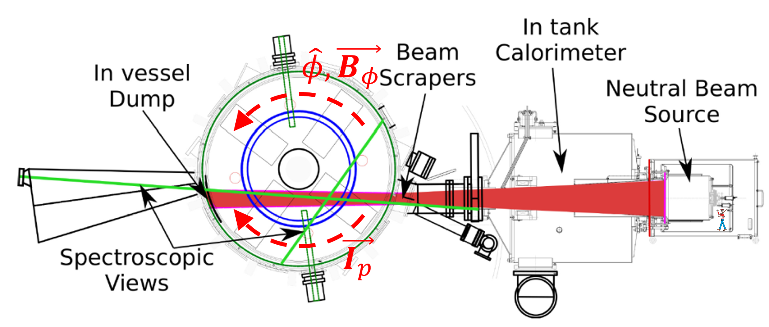
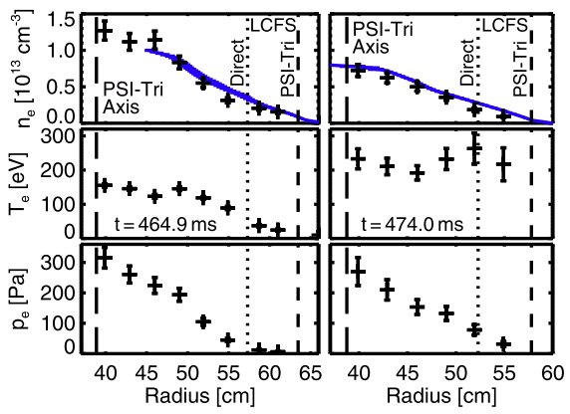
Fast-ion studies in LTX-β
Flat Te achieved with Li walls
NBI installed 2019 to further low-recycling boundary studies
  Core fueling to sustain plasma
  Heating for study of energy scaling
  Possible stabilization against density gradient modes
NBI Parameter | Specification
Beam energy | 20 keV
Beam power | 700 kW
Pulse length | 5-7 ms
Composition | 100% H
Lithium Tokamak Experiment Beta
R=0.4 m; a=0.25 m
I_{p} ~ 100 – 150(?) kA
|B| ~ 0.3 T
T_{e}(0) ~ 200 eV
n_{e} ~ 10¹³ cm⁻³
Pulse length ~ 50 ms
[Boyle 2017]

Slide 14
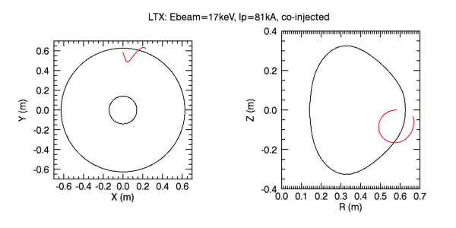
Fast-ion studies in LTX-β
Flat Te achieved with Li walls
NBI installed 2019 to further low-recycling boundary studies
  Core fueling to sustain plasma
  Heating for study of energy scaling
  Possible stabilization against density gradient modes
Initial operation (Ip<100kA) total loss of EPs
[Hughes et. al, PPCF 2021]

Slide 15
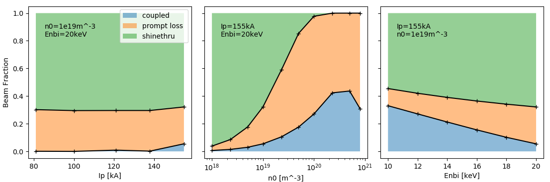
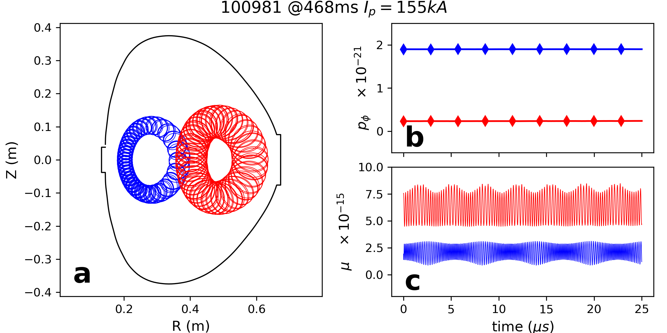
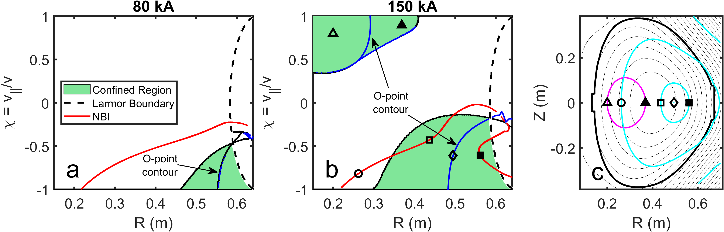

Optimizing NBI coupling
TRANSP maps potential gains in adjusting $n_{e}$, $I_{p}$, $E_{nbi}$
POET (3d orbits)- FLR effects, non-adiabatic effects unimportant
CONBEAM- retrofit to ST geometry, illustrates EP confinement regions
Notes:
New puff valves
Replaced bad caps
Cap restack possible for extended pulse

Slide 16
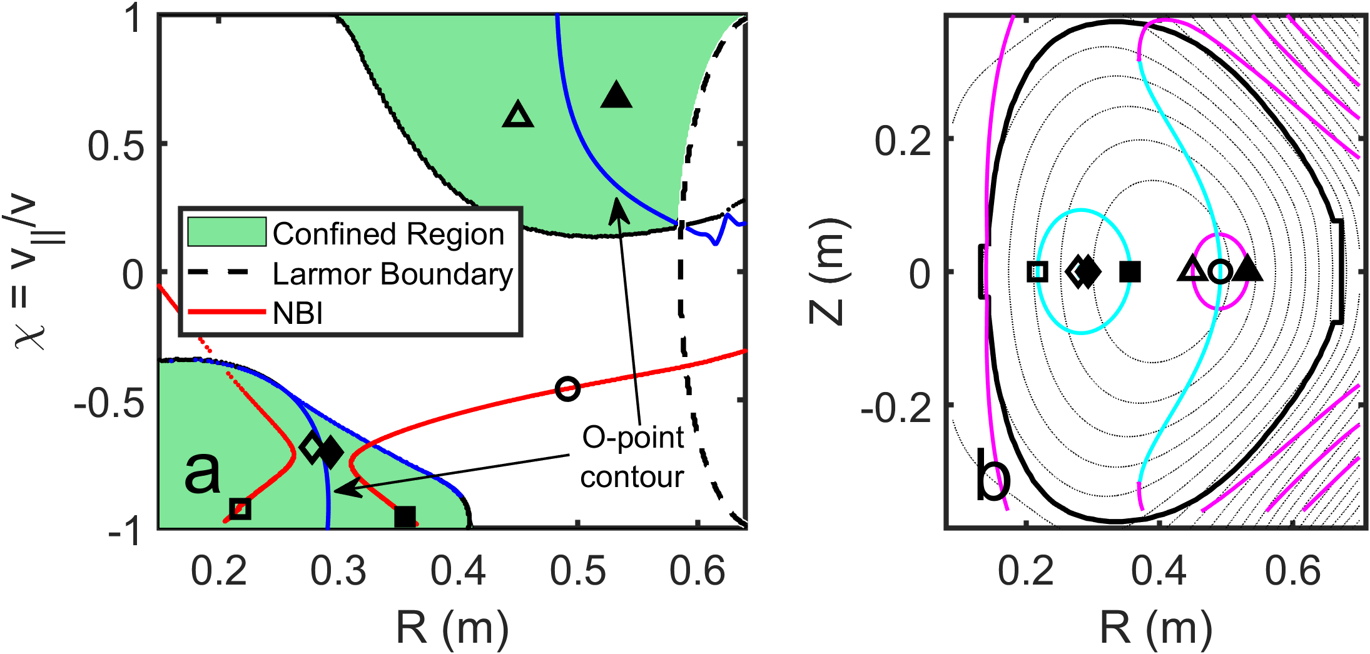
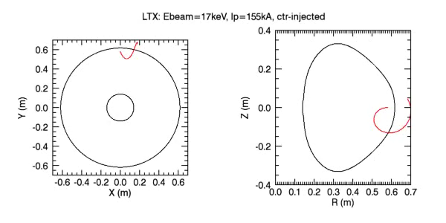
Optimizing NBI coupling
Preference for HFS/LFS coupling
  Reversed-current operation for HFS coupling
  Tangency scan optimum at 35cm
Large (but very localized) heat flux to walls
Results very sensitive to equilibrium geometry, data gathering ongoing
Co-inj
Ctr-inj
Notes:
New puff valves
Replaced bad caps
Cap restack possible for extended pulse

Slide 17
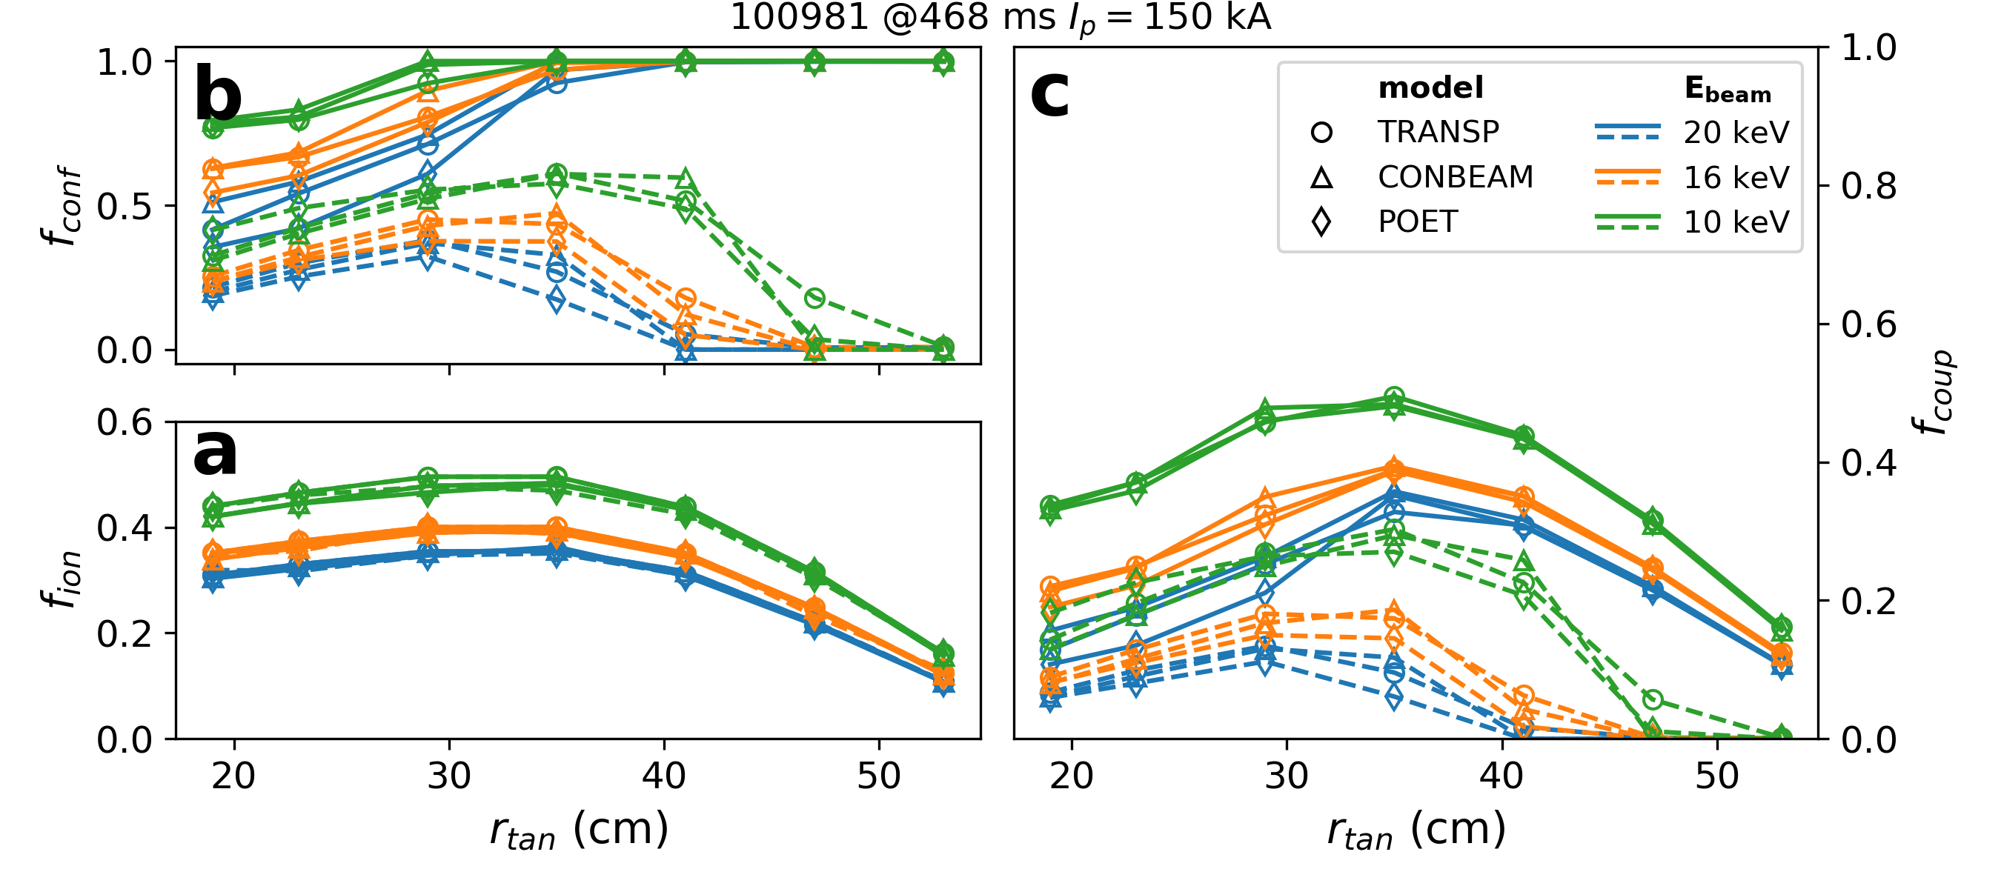
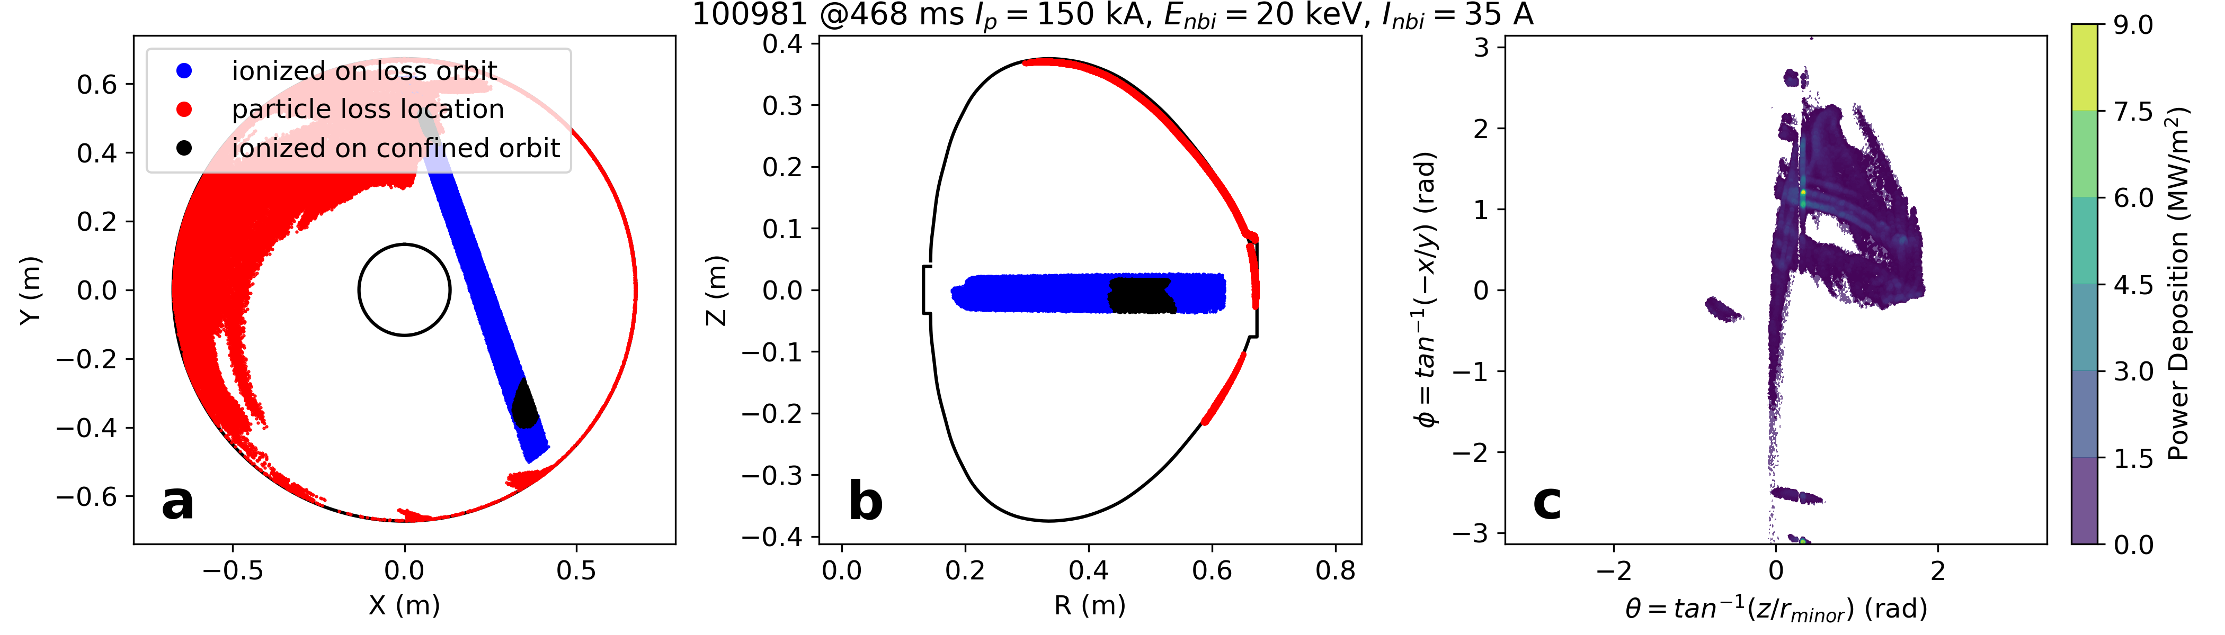
Optimizing NBI coupling
Preference for HFS/LFS coupling
  Reversed-current operation for HFS coupling
  Tangency scan optimum at 35cm
Large (but very localized) heat flux to walls
Results very sensitive to equilibrium geometry, data gathering ongoing
LTX NBI
Notes:
New puff valves
Replaced bad caps
Cap restack possible for extended pulse

Slide 18
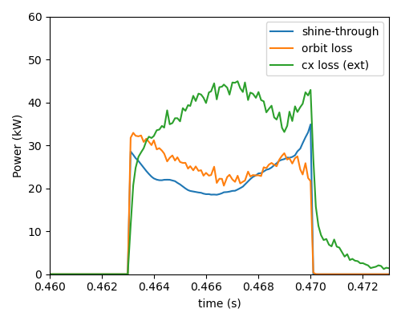
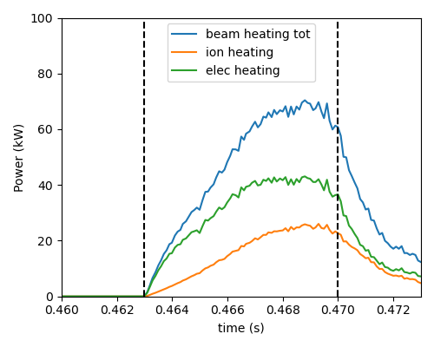
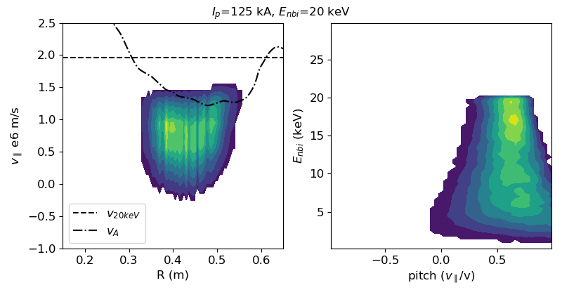
Recent upgrades enable EP population
Recent shot development Ip~130kA
Mechanical upgrades
TRANSP/NUBEAM shows growth of population mid-outboard region
  Appreciable shine-through, orbit, and cx loss
  But measurable beam heating (ohmic ~200kW)
  Just sub-Alfvénic, could see modes in future
Eb = 11 keV
Ib = 15 A
TRANSP Fast Ion Distribution
Eb = 20 keV
Ib = 40 A

Slide 19
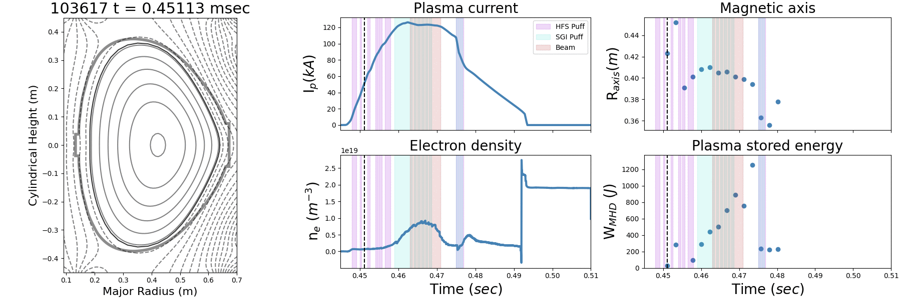
Post-discharge tools for NBI coupling data
Equilibrium reconstruction is (semi) automatic
Equilibrium is dynamic
  Amassing data on coupling as mag axis shifts
  CONBEAM set up to analyze equilibria (no TS data)

Slide 20
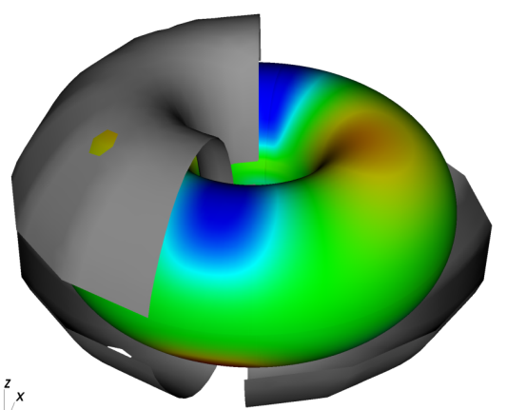
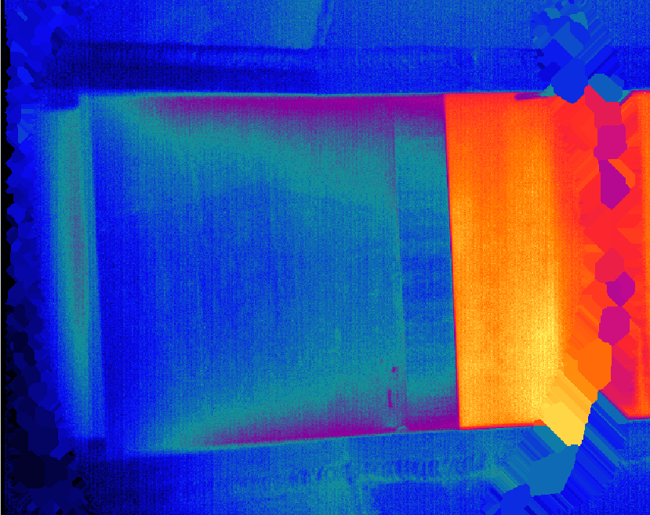
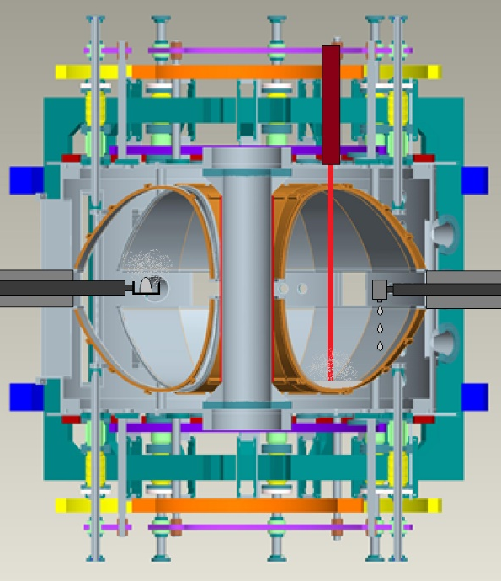
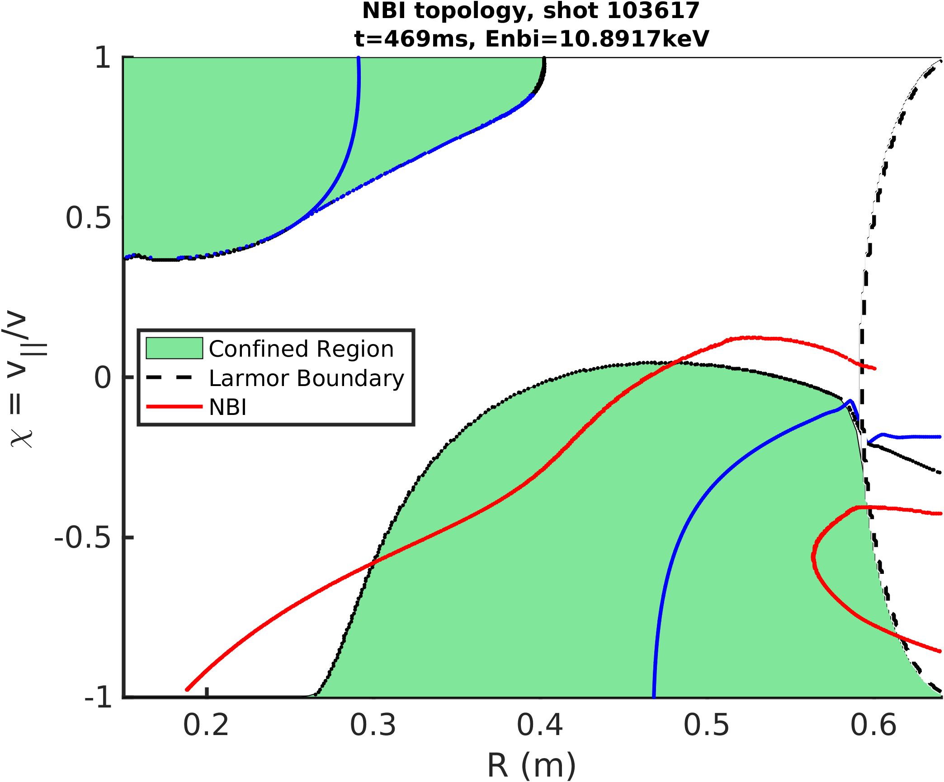
Fast-ion studies in LTX-β
Upcoming: IR thermography, spectroscopy
NPA: diagnose EP pitch/energy distribution
  Degas2 modeling underway
Inter-shot beam analysis (no real-time plasma control)
  “tangency” scan data
  Assess impact of reversed-current ops
Fast-ion transport in 3D fields
[J. Reusch 2012]
C. Hansen
No beam- yet!

Slide 21
Thank you!

Slide 22
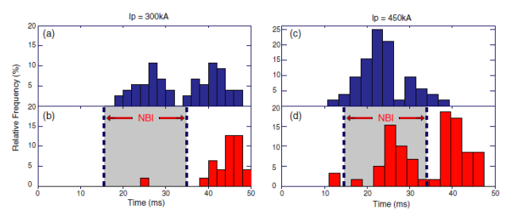
Extras
EPs stabilizing effect on core tearing mode, suppress transition to QSH

Slide 23
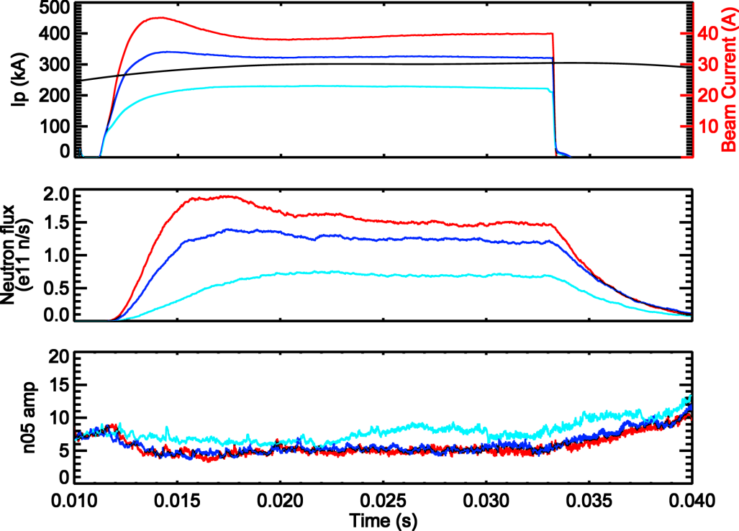
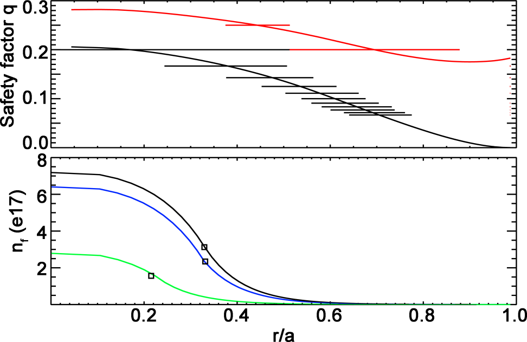
Extras
Explanation of differing neutron flux saturation
  Diffusive boundary at mid-radius set by fast-ion island overlap
  Lower Ip reduces particle flux, slowing lowers average energy
  This reduces qfi moving diffusive boundary inward
EPM gradient
limited
Diffusive

Slide 24
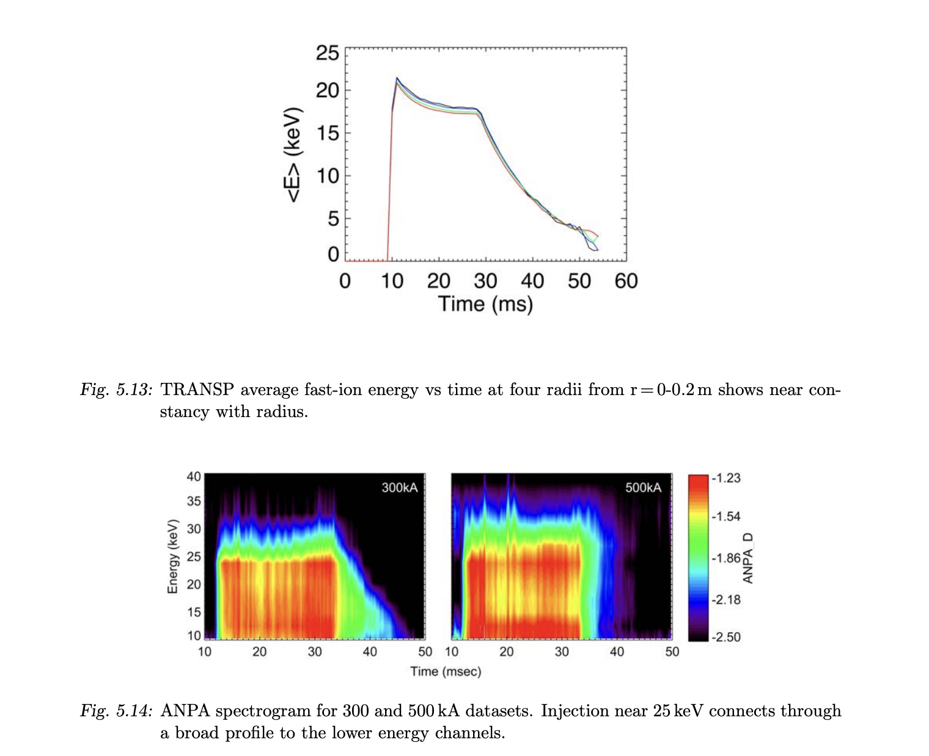
Extras
Beta->pressure->density
E spatially constant, B fields well known
[Capecchi thesis, TRANSP, Liu, Anderson et al]

Slide 25

Extras
Very small EP population sensitive to chances in magnetic moment

Slide 26

Extras
TRANSP scan shows good beam heating at higher Eb despite increases to orbit loss/shine-through
Assumes identical beam optics

