Slide 1



Filaments as the origin of HHFW losses in NSTX
W. Tierens, R. Bilato, N. Bertelli, S. Shiraiwa, J.R. Myra, L. Colas
Lodestar Research Corporation

Slide 2
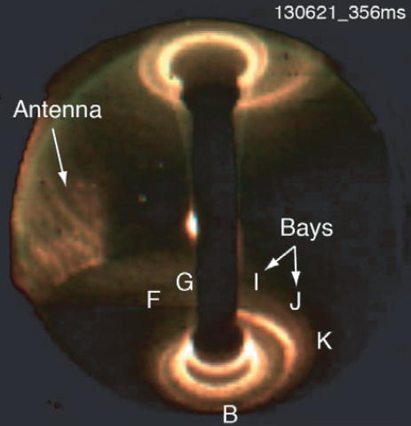

HHFW heating in NSTX
High Harmonic Fast Wave heating $\frac{ω}{Ω_{i}}≈7$
Lodestar Research Corporation
[Perkins et al 2013]

Slide 3
HHFW edge losses in NSTX
In some conditions, up to about
60% of incident power lost
Lodestar Research Corporation
[Perkins et al 2013]

Slide 4
HHFW edge losses in NSTX
Up to about 60% of incident power lost
Power flow along field lines
Lodestar Research Corporation
[Perkins et al 2013]

Slide 5
HHFW edge losses in NSTX
“A dramatic increase in core heating efficiency was first achieved [...] when the onset for perpendicular wave propagation was moved away from the antenna and nearby vessel structures.
Efficient core heating [...] was then accomplished by reducing the edge density
in front of the launcher with lithium conditioning and avoiding operational points prone to instabilities.”
Up to about 60% of incident power lost
Power flow along field lines
Losses increase with increasing density
Lodestar Research Corporation
[Phillips et al 2009]

Slide 6
HHFW edge losses in NSTX
Note that the conventional point of view is
The Fast Wave must tunnel through an evanescent layer
This evanescent layer is made narrower as the density increases
Thus, higher edge density improves ICRF power coupling
Which is the reasoning behind using gas puffing to improve coupling, as done successfully on AUG [Zhang et al 2017] and planned on ITER [Zhang et al 2022].
But NSTX does the opposite!
“A dramatic increase in core heating efficiency was first achieved [...] when the onset for perpendicular wave propagation was moved away from the antenna and nearby vessel structures.
Efficient core heating [...] was then accomplished by reducing the edge density
in front of the launcher with lithium conditioning and avoiding operational points prone to instabilities.”
Up to about 60% of incident power lost
Power flow along field lines
Losses increase with increasing density
Lodestar Research Corporation
[Phillips et al 2009]

Slide 7
HHFW edge losses in NSTX
Note that the conventional point of view is
The Fast Wave must tunnel through an evanescent layer
This evanescent layer is made narrower as the density increases
Thus, higher edge density improves ICRF power coupling
Which is the reasoning behind using gas puffing to improve coupling, as done successfully on AUG [Zhang et al 2017] and planned on ITER [Zhang et al 2022].
But NSTX does the opposite!
“A dramatic increase in core heating efficiency was first achieved [...] when the onset for perpendicular wave propagation was moved away from the antenna and nearby vessel structures.
Efficient core heating [...] was then accomplished by reducing the edge density
in front of the launcher with lithium conditioning and avoiding operational points prone to instabilities.”
Up to about 60% of incident power lost
Power flow along field lines
Losses increase with increasing density
Lodestar Research Corporation
[Phillips et al 2009]

Slide 8
HHFW edge losses in NSTX
Note that the conventional point of view is
The Fast Wave must tunnel through an evanescent layer
This evanescent layer is made narrower as the density increases
Thus, higher edge density improves ICRF power coupling
Which is the reasoning behind using gas puffing to improve coupling, as done successfully on AUG [Zhang et al 2017] and planned on ITER [Zhang et al 2022].
But NSTX does the opposite!
“A dramatic increase in core heating efficiency was first achieved [...] when the onset for perpendicular wave propagation was moved away from the antenna and nearby vessel structures.
Efficient core heating [...] was then accomplished by reducing the edge density
in front of the launcher with lithium conditioning and avoiding operational points prone to instabilities.”
Up to about 60% of incident power lost
Power flow along field lines
Losses increase with increasing density
Lodestar Research Corporation
[Phillips et al 2009]

Slide 9
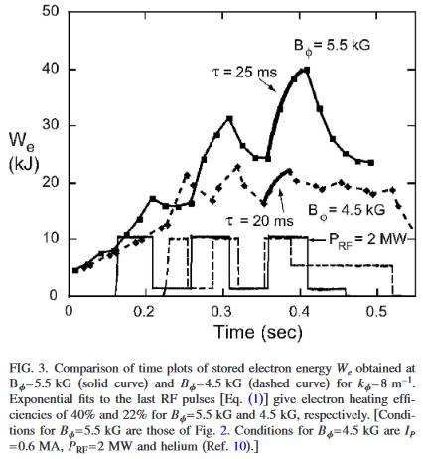
HHFW edge losses in NSTX
Up to about 60% of incident power lost
Power flow along field lines
Losses increase with increasing density
Losses increase with decreasing B
Lodestar Research Corporation
[Hosea et al 2008]

Slide 10
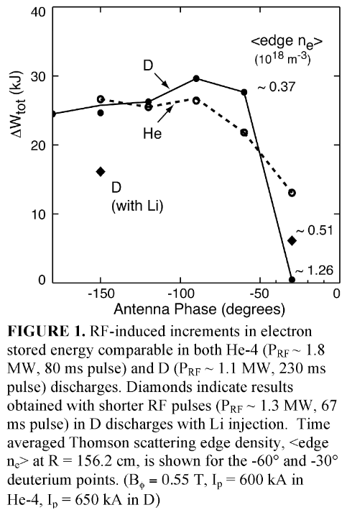

HHFW edge losses in NSTX
Up to about 60% of incident power lost
Power flow along field lines
Losses increase with increasing density
Losses increase with decreasing B
Losses increase with decreasing $k_{∥}$
Lodestar Research Corporation
[Hosea et al 2009]

Slide 11
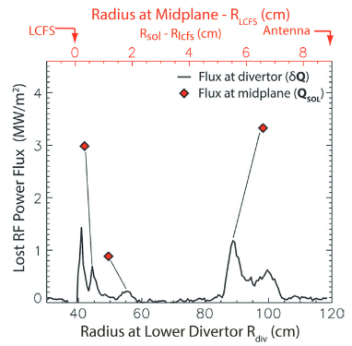
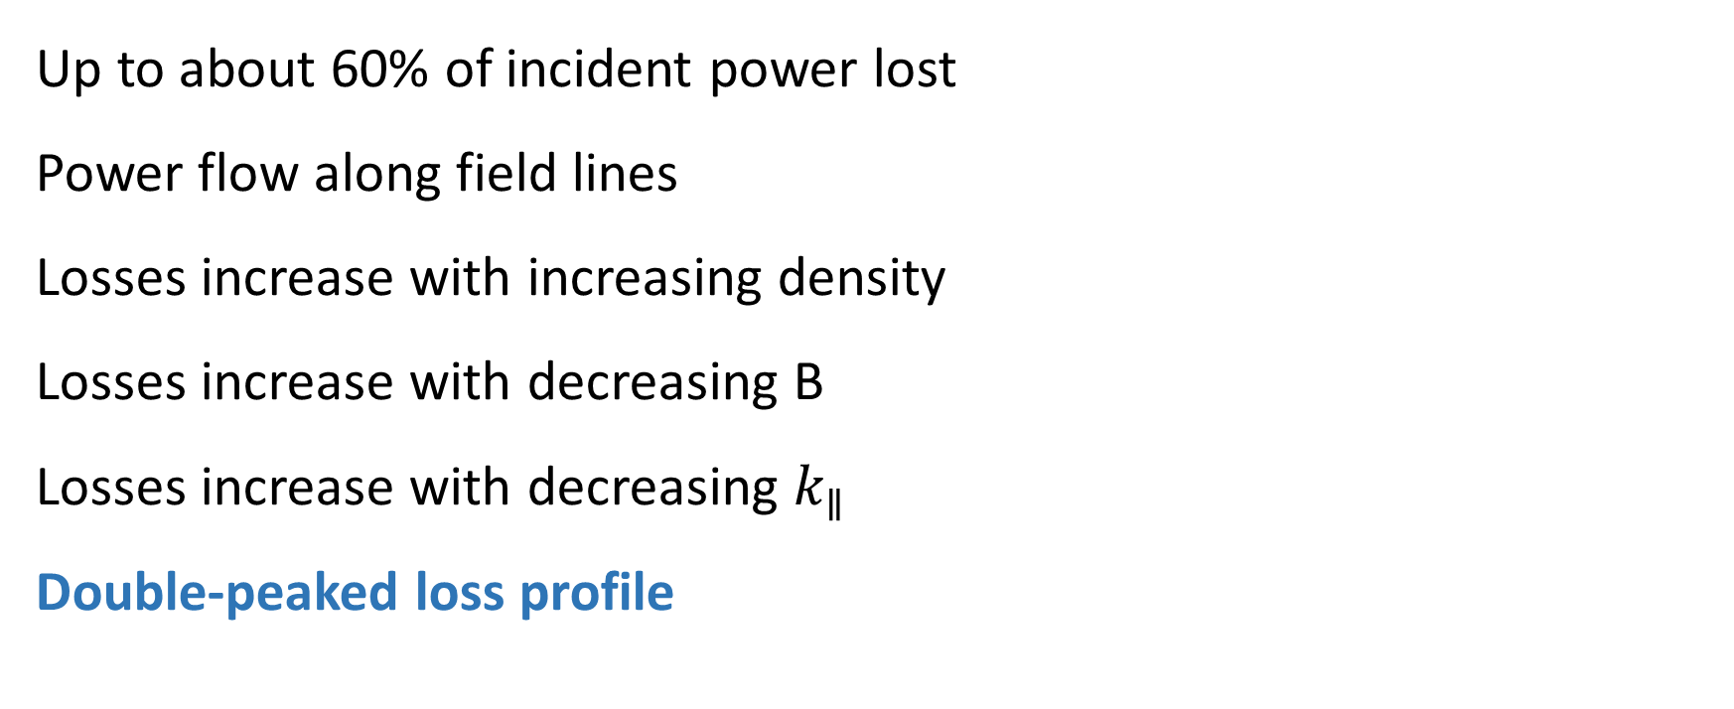
HHFW edge losses in NSTX
Up to about 60% of incident power lost
Power flow along field lines
Losses increase with increasing density
Losses increase with decreasing B
Losses increase with decreasing $k_{∥}$
Double-peaked loss profile
Lodestar Research Corporation
[Perkins et al 2013]

Slide 12
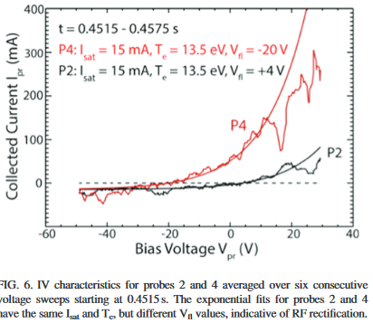
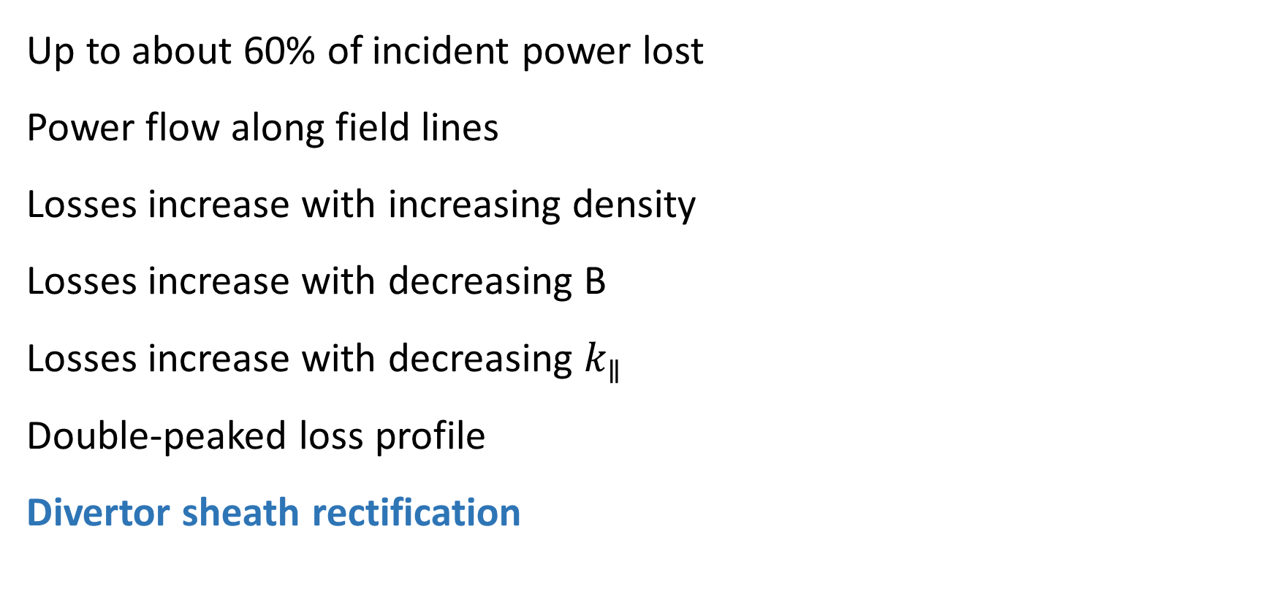
HHFW edge losses in NSTX
Up to about 60% of incident power lost
Power flow along field lines
Losses increase with increasing density
Losses increase with decreasing B
Losses increase with decreasing $k_{∥}$
Double-peaked loss profile
Divertor sheath rectification
Lodestar Research Corporation
[Perkins et al 2015]

Slide 13
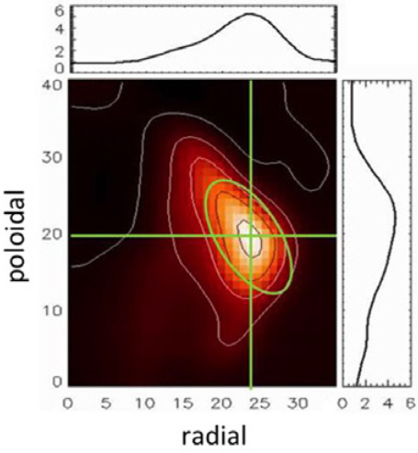
Filaments in NSTX
Gas puff imaging reveals many filaments
Density perturbation
Localized radially/poloidally
Stretched along B
Lodestar Research Corporation
[Zweben et al 2016]

Slide 14
Filaments in NSTX
Gas puff imaging reveals many filaments
Many filaments in SOL at all times
Lodestar Research Corporation
[Zweben et al 2016]

Slide 15
Filaments in NSTX
Gas puff imaging reveals many filaments
Many filaments in SOL at all times
Filaments are B-aligned
Lodestar Research Corporation
[Zweben et al 2016]

Slide 16
Surface waves
Given an incident amplitude a,
What is the amplitude of the transmitted wave?
What is the amplitude of the reflected wave?
Lodestar Research Corporation
Material 1
Material 2
Reflected
Transmitted
Incident a

Slide 17
Surface waves
Given an incident amplitude a,
What is the amplitude of the transmitted wave?
What is the amplitude of the reflected wave?
When is this problem underspecified?
Lodestar Research Corporation
Material 1
Material 2
Reflected
Transmitted
Incident a

Slide 18
Surface waves
Given an incident amplitude a,
What is the amplitude of the transmitted wave?
What is the amplitude of the reflected wave?
When is this problem underspecified?
Lodestar Research Corporation
Material 1
Material 2

Slide 19
Surface waves on filaments
Steep density gradient acts as "material interface"
Lodestar Research Corporation
[Zweben et al 2016]

Slide 20
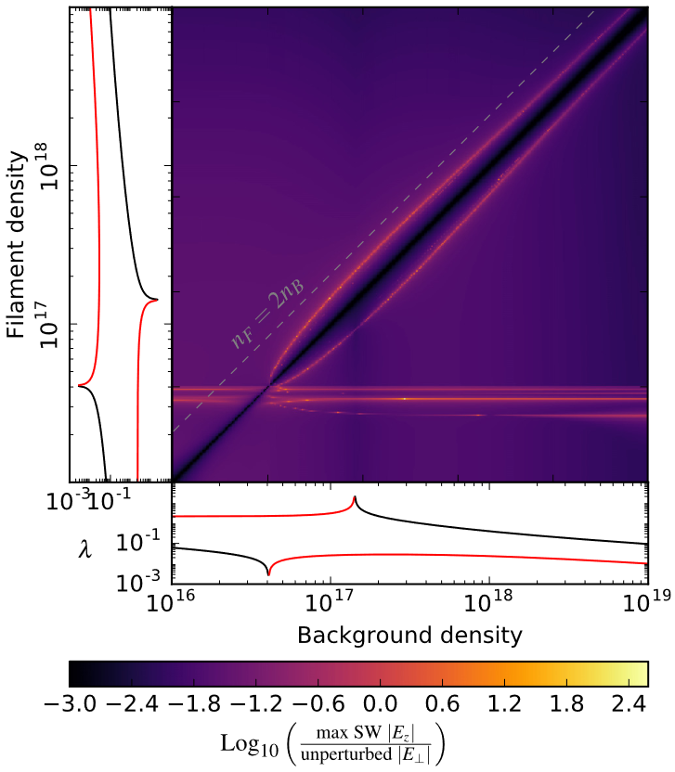
Surface waves on filaments
Steep density gradient acts as "material interface"
Analytic description possible
Lodestar Research Corporation
[Tierens et al 2020]

Slide 21

Surface waves on filaments
Steep density gradient acts as "material interface"
Analytic description possible
Simplified dispersion relation
[Myra]
$$R=\frac{n_{f}}{n_{b}}=\frac{φm−ξ\frac{K_{m}^{′}(ξ)}{K_{m} (ξ)}}{φm−ξ\frac{I_{m}^{′}(ξ)}{I_{m} (ξ)}}$$
Lodestar Research Corporation

Slide 22
Surface waves on filaments
Steep density gradient acts as "material interface"
Analytic description possible
Simplified dispersion relation
$$R=\frac{n_{f}}{n_{b}}=\frac{φm−ξ\frac{K_{m}^{′}(ξ)}{K_{m} (ξ)}}{φm−ξ\frac{I_{m}^{′}(ξ)}{I_{m} (ξ)}}$$
Lodestar Research Corporation
Density ratio

Slide 23

Surface waves on filaments
Steep density gradient acts as "material interface"
Analytic description possible
Simplified dispersion relation
Azimuthal mode number
$$R=\frac{n_{f}}{n_{b}}=\frac{φm−ξ\frac{K_{m}^{′}(ξ)}{K_{m} (ξ)}}{φm−ξ\frac{I_{m}^{′}(ξ)}{I_{m} (ξ)}}$$
Lodestar Research Corporation

Slide 24

Surface waves on filaments
Steep density gradient acts as "material interface"
Analytic description possible
Simplified dispersion relation
$$R=\frac{n_{f}}{n_{b}}=\frac{φm−ξ\frac{K_{m}^{′}(ξ)}{K_{m} (ξ)}}{φm−ξ\frac{I_{m}^{′}(ξ)}{I_{m} (ξ)}}$$
Lodestar Research Corporation
$φ=\frac{ω}{Ω_{i}}≫1$ in HHFW

Slide 25
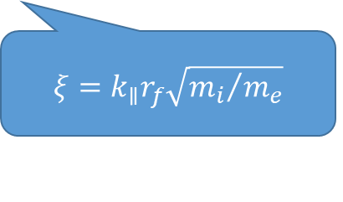
Surface waves on filaments
Steep density gradient acts as "material interface"
Analytic description possible
Simplified dispersion relation
$$R=\frac{n_{f}}{n_{b}}=\frac{φm−ξ\frac{K_{m}^{′}(ξ)}{K_{m} (ξ)}}{φm−ξ\frac{I_{m}^{′}(ξ)}{I_{m} (ξ)}}$$
Lodestar Research Corporation
$ξ=k_{∥}r_{f}\sqrt{{m_{i}}/{m_{e}}}$

Slide 26
Surface waves on filaments
Steep density gradient acts as "material interface"
Analytic description possible
Simplified dispersion relation
$$R=\frac{n_{f}}{n_{b}}=\frac{φm−ξ\frac{K_{m}^{′}(ξ)}{K_{m} (ξ)}}{φm−ξ\frac{I_{m}^{′}(ξ)}{I_{m} (ξ)}}$$
Bessel functions
Lodestar Research Corporation

Slide 27
Surface waves on filaments
Steep density gradient acts as "material interface"
Analytic description possible
Simplified dispersion relation – favours HHFW
$$R=\frac{n_{f}}{n_{b}}=\frac{φm−ξ\frac{K_{m}^{′}(ξ)}{K_{m} (ξ)}}{φm−ξ\frac{I_{m}^{′}(ξ)}{I_{m} (ξ)}}$$
Lodestar Research Corporation
$φ=\frac{ω}{Ω_{i}}≫1$ in HHFW

Slide 28
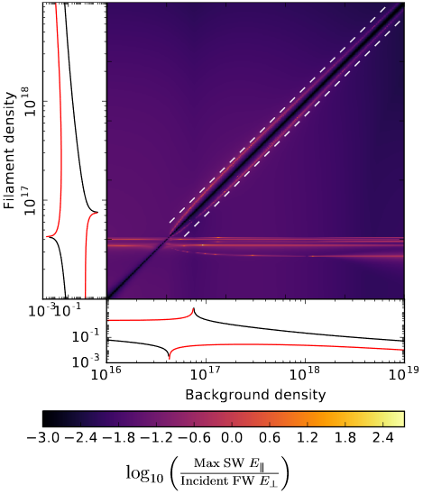

Surface waves on filaments
Simplified dispersion relation
$$R=\frac{n_{f}}{n_{b}}=\frac{φm−ξ\frac{K_{m}^{′}(ξ)}{K_{m} (ξ)}}{φm−ξ\frac{I_{m}^{′}(ξ)}{I_{m} (ξ)}}$$
Lodestar Research Corporation
[Tierens et al 2021]

Slide 29
Surface waves on filaments
Blob-filaments: m=1
Simplified dispersion relation
$$R=\frac{n_{f}}{n_{b}}=\frac{φm−ξ\frac{K_{m}^{′}(ξ)}{K_{m} (ξ)}}{φm−ξ\frac{I_{m}^{′}(ξ)}{I_{m} (ξ)}}$$
Hole-filaments: m=-1
Lodestar Research Corporation
[Tierens et al 2021]

Slide 30
Filaments exist
Surface waves on filaments exist
Lodestar Research Corporation

Slide 31
Filaments exist
Surface waves on filaments exist
Carry power along filaments i.e. along B
Favour HHFW conditions
Lodestar Research Corporation

Slide 32
Filaments exist
Surface waves on filaments exist
How much power can be lost to these waves?
Lodestar Research Corporation

Slide 33
Filaments exist
Surface waves on filaments exist
How much power can be lost to these waves?
I.e. mode-converted to filament surface waves, to be absorbed either collisionally as they propagate along the filament, or via other loss mechanisms at the filament endpoints.
Lodestar Research Corporation

Slide 34
Power lost to filament surface waves
For infinite filaments, losses can be quantified by
Regularizing the scattering problem
Lodestar Research Corporation

Slide 35
Power lost to filament surface waves
For infinite filaments, losses can be quantified by
Regularizing the scattering problem
Taking the collisionless limit
Lodestar Research Corporation

Slide 36
Power lost to filament surface waves
For infinite filaments, losses can be quantified by
Regularizing the scattering problem
Taking the collisionless limit, which is finite
[Tierens et al 2021]
Lodestar Research Corporation
This counter-intuitive result stresses the need to regularize the initial scattering problem and to take the collisionless limit only at the end of the calculations, to obtain valid results
- L. Colas

Slide 37
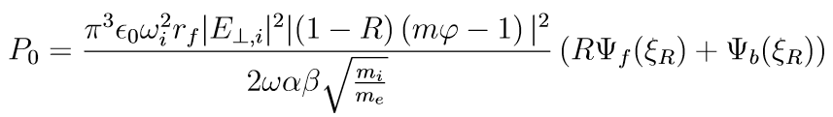
Power lost to filament surface waves
Lodestar Research Corporation
[Tierens et al 2021]

Slide 38
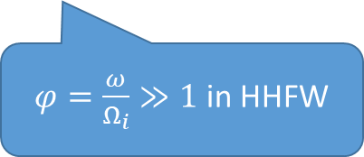
Power lost to filament surface waves
Density ratio
Incident power spectrum
$φ=\frac{ω}{Ω_{i}}≫1$ in HHFW
Lodestar Research Corporation
[Tierens et al 2021]

Slide 39
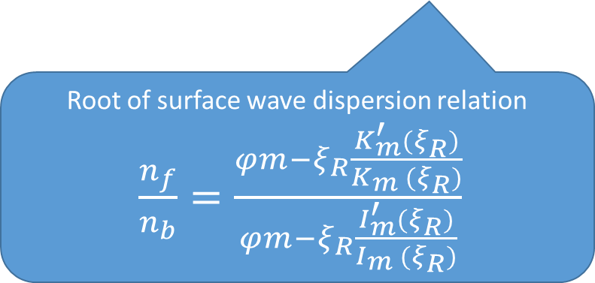
Power lost to filament surface waves
Lodestar Research Corporation
Root of surface wave dispersion relation
$\frac{n_{f}}{n_{b}}=\frac{φm−ξ_{R}\frac{K_{m}^{′}(ξ_{R})}{K_{m} (ξ_{R})}}{φm−ξ_{R}\frac{I_{m}^{′}(ξ_{R})}{I_{m} (ξ_{R})}}$
[Tierens et al 2021]

Slide 40

Power lost to filament surface waves
Power lost to specific filament
Power lost to average filament
$$<P>=\int{P_{0}P\left(r_{f},\frac{n_{f}}{n_{b}}\right)dr_{f} d\frac{n_{f}}{n_{b}}}$$
Lodestar Research Corporation
[Tierens et al 2021]

Slide 41
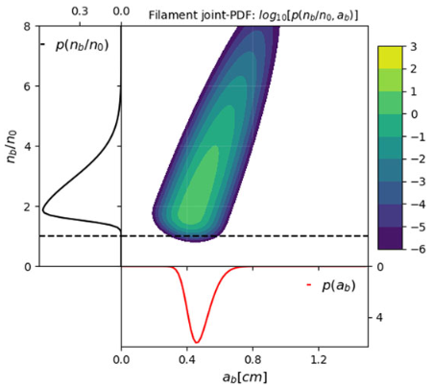


Power lost to filament surface waves
Power lost to average filament
$$<P>=\int{P_{0}P\left(r_{f},\frac{n_{f}}{n_{b}}\right)dr_{f} d\frac{n_{f}}{n_{b}}}$$
[Biswas et al 2021]
[Garcia et al 2016]
$$P\left(\frac{n_{f}}{n_{b}}\right)=\frac{e^{−γ\frac{n_{f}}{n_{b}}}{\left(γ\frac{n_{f}}{n_{b}}\right)}^{γ}}{\frac{n_{f}}{n_{b}}Γ(γ)}$$
Lodestar Research Corporation

Slide 42
Power lost to filament surface waves
Power lost to average filament
$$<P>=\int{P_{0}P\left(r_{f},\frac{n_{f}}{n_{b}}\right)dr_{f} d\frac{n_{f}}{n_{b}}}$$
Or, we could view experimental measurements
[NSTX: Zweben et al 2016] as samples drawn
from this distribution
Lodestar Research Corporation

Slide 43
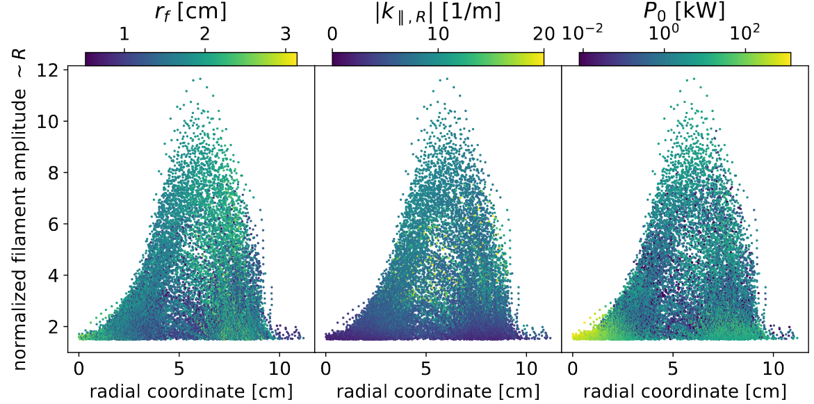
Data from [Zweben et al 2016]: a new perspective
Lodestar Research Corporation
antenna
antenna
antenna
LCFS
LCFS
LCFS

Slide 44
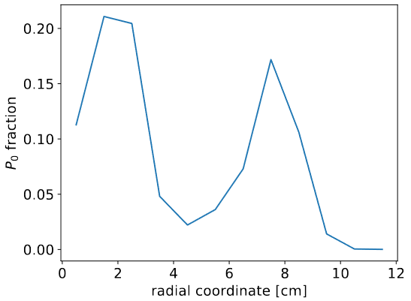
We promised to explain experimental results…
[Perkins et al
2013]
Lodestar Research Corporation
Double-peaked absorption profile ✓

Slide 45
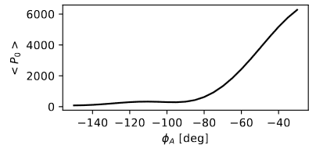
We promised to explain experimental results…
Lodestar Research Corporation
Double-peaked absorption profile ✓
k||-dependence ✓
[Hosea et al 2009]

Slide 46
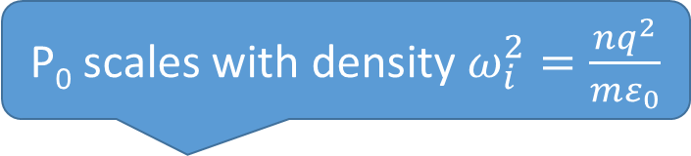
We promised to explain experimental results…
P₀ scales with density $ω_{i}^{2}=\frac{nq^{2}}{mε_{0}}$
Lodestar Research Corporation
Double-peaked absorption profile ✓
k||-dependence ✓
Density dependence ✓

Slide 47
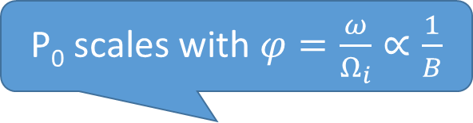
We promised to explain experimental results…
P₀ scales with $φ=\frac{ω}{Ω_{i}}∝\frac{1}{B}$
Lodestar Research Corporation
Double-peaked absorption profile ✓
k||-dependence ✓
Density dependence ✓
Magnetic field dependence ✓

Slide 48
We promised to explain experimental results…
Lodestar Research Corporation
Double-peaked absorption profile ✓
k||-dependence ✓
Density dependence ✓
Magnetic field dependence ✓
Power flow along B ✓

Slide 49
We promised to explain experimental results…
Double-peaked absorption profile ✓
k||-dependence ✓
Density dependence ✓
Magnetic field dependence ✓
Power flow along B ✓
Divertor sheath rectification ✓
Lodestar Research Corporation

Slide 50
Other explanations
 | Standing FW | Propagating SW | DC currents | Parametric decay | Filaments
n-dependence | ✓ |  |  |  | ✓
k||-dependence | ✓ |  |  |  | ✓
B-dependence | ✓ |  |  |  | ✓
Parallel power flow |  | ✓ | ✓ |  | ✓
Edge heating | ✓ |  |  | ✓ (ion specific) | ✓
IBW harmonics |  |  |  | ✓
Divertor sheath rectification |  | ✓ | ✓ |  | ✓
Deposition profile | ✓ |  |  |  | ✓
Lodestar Research Corporation

Slide 51
Other explanations
[Bertelli et al 2014] proposed that a standing fast wave might be trapped between the antenna and the plasma
 | Standing FW | Propagating SW | DC currents | Parametric decay | Filaments
n-dependence | ✓ |  |  |  | ✓
k||-dependence | ✓ |  |  |  | ✓
B-dependence | ✓ |  |  |  | ✓
Parallel power flow |  | ✓ | ✓ |  | ✓
Edge heating | ✓ |  |  | ✓ (ion specific) | ✓
IBW harmonics |  |  |  | ✓
Divertor sheath rectification |  | ✓ | ✓ |  | ✓
Deposition profile | ✓ |  |  |  | ✓
Lodestar Research Corporation

Slide 52
Other explanations
[Smithe et al 2014] proposed that a propagating slow wave, which propagates nearly parallel to B, might be responsible
 | Standing FW | Propagating SW | DC currents | Parametric decay | Filaments
n-dependence | ✓ |  |  |  | ✓
k||-dependence | ✓ |  |  |  | ✓
B-dependence | ✓ |  |  |  | ✓
Parallel power flow |  | ✓ | ✓ |  | ✓
Edge heating | ✓ |  |  | ✓ (ion specific) | ✓
IBW harmonics |  |  |  | ✓
Divertor sheath rectification |  | ✓ | ✓ |  | ✓
Deposition profile | ✓ |  |  |  | ✓
Lodestar Research Corporation

Slide 53
Other explanations
[Perkins et al 2015] investigated the role of DC currents, excited by sheath rectification, flowing along B
 | Standing FW | Propagating SW | DC currents | Parametric decay | Filaments
n-dependence | ✓ |  |  |  | ✓
k||-dependence | ✓ |  |  |  | ✓
B-dependence | ✓ |  |  |  | ✓
Parallel power flow |  | ✓ | ✓ |  | ✓
Edge heating | ✓ |  |  | ✓ (ion specific) | ✓
IBW harmonics |  |  |  | ✓
Divertor sheath rectification |  | ✓ | ✓ |  | ✓
Deposition profile | ✓ |  |  |  | ✓
Lodestar Research Corporation

Slide 54
Other explanations
[Wilson et al 2005] investigated the role of parametric decay instabilities
 | Standing FW | Propagating SW | DC currents | Parametric decay | Filaments
n-dependence | ✓ |  |  |  | ✓
k||-dependence | ✓ |  |  |  | ✓
B-dependence | ✓ |  |  |  | ✓
Parallel power flow |  | ✓ | ✓ |  | ✓
Edge heating | ✓ |  |  | ✓ (ion specific) | ✓
IBW harmonics |  |  |  | ✓
Divertor sheath rectification |  | ✓ | ✓ |  | ✓
Deposition profile | ✓ |  |  |  | ✓
Lodestar Research Corporation

Slide 55
Other explanations
Model for sheath rectification
where filament strikes wall
 | Standing FW | Propagating SW | DC currents | Parametric decay | Filaments
n-dependence | ✓ |  |  |  | ✓
k||-dependence | ✓ |  |  |  | ✓
B-dependence | ✓ |  |  |  | ✓
Parallel power flow |  | ✓ | ✓ |  | ✓
Edge heating | ✓ |  |  | ✓ (ion specific) | ✓
IBW harmonics |  |  |  | ✓
Divertor sheath rectification |  | ✓ | ✓ |  | ✓
Deposition profile | ✓ |  |  |  | ✓
Lodestar Research Corporation

Slide 56
Other explanations
Speculation that surface waves,
rather than FW, may play role in PD
 | Standing FW | Propagating SW | DC currents | Parametric decay | Filaments
n-dependence | ✓ |  |  |  | ✓
k||-dependence | ✓ |  |  |  | ✓
B-dependence | ✓ |  |  |  | ✓
Parallel power flow |  | ✓ | ✓ |  | ✓
Edge heating | ✓ |  |  | ✓ (ion specific) | ✓
IBW harmonics |  |  |  | ✓
Divertor sheath rectification |  | ✓ | ✓ |  | ✓
Deposition profile | ✓ |  |  |  | ✓
Lodestar Research Corporation

Slide 57
Other explanations
 | Standing FW | Propagating SW | DC currents | Parametric decay | Filaments
n-dependence | ✓ |  |  |  | ✓
k||-dependence | ✓ |  |  |  | ✓
B-dependence | ✓ |  |  |  | ✓
Parallel power flow |  | ✓ | ✓ |  | ✓
Edge heating | ✓ |  |  | ✓ (ion specific) | ✓
IBW harmonics |  |  |  | ✓
Divertor sheath rectification |  | ✓ | ✓ |  | ✓
Deposition profile | ✓ |  |  |  | ✓
Lodestar Research Corporation

Slide 58
Conclusion
 | Standing FW | Propagating SW | DC currents | Parametric decay | Filaments
n-dependence | ✓ |  |  |  | ✓
k||-dependence | ✓ |  |  |  | ✓
B-dependence | ✓ |  |  |  | ✓
Parallel power flow |  | ✓ | ✓ |  | ✓
Edge heating | ✓ |  |  | ✓ (ion specific) | ✓
IBW harmonics |  |  |  | ✓
Divertor sheath rectification |  | ✓ | ✓ |  | ✓
Deposition profile | ✓ |  |  |  | ✓
Lodestar Research Corporation

Slide 59
Future work
Interaction between surface waves on filaments and sheaths
Applicability outside of HHFW
Full-wave dispersion relation
Lodestar Research Corporation

Slide 60
References
[Perkins et al 2013] Perkins, R. J., et al. "Fast-wave power flow along SOL field lines in NSTX and the associated power deposition profile across the SOL in front of the antenna." Nuclear Fusion 53.8 (2013): 083025.
[Phillips et al 2009] Phillips, C. K., et al. "Spectral effects on fast wave core heating and current drive." Nuclear Fusion 49.7 (2009): 075015.
[Hosea et al 2008] Hosea, J., et al. "High harmonic fast wave heating efficiency enhancement and current drive at longer wavelength on the National Spherical Torus Experiment." Physics of Plasmas 15.5 (2008): 056104.
[Hosea et al 2009] Hosea, J. C., et al. "Recent fast wave coupling and heating studies on NSTX, with possible implications for ITER." AIP Conference Proceedings. Vol. 1187. No. 1. American Institute of Physics, 2009.
[Perkins et al 2015] Perkins, R. J., et al. "The contribution of radio-frequency rectification to field-aligned losses of high-harmonic fast wave power to the divertor in the National Spherical Torus eXperiment." Physics of Plasmas 22.4 (2015): 042506.
[Zweben et al 2016] Zweben, S. J., et al. "Blob structure and motion in the edge and SOL of NSTX." Plasma Physics and Controlled Fusion 58.4 (2016): 044007.
[Tierens et al 2020] Tierens, Wouter, et al. "Filament-assisted mode conversion in magnetized plasmas." Physics of Plasmas 27.1 (2020): 010702.
[Tierens et al 2021] Tierens, Wouter, et al. "Resonant wave–filament interactions as a loss mechanism for HHFW heating and current drive." Plasma Physics and Controlled Fusion 64.3 (2022): 035001.
[Biswas et al 2021] Biswas, Bodhi, et al. "A hybrid full-wave Markov chain approach to calculating radio-frequency wave scattering from scrape-off layer filaments." Journal of Plasma Physics 87.5 (2021).
[Garcia et al 2016] Garcia, Odd Erik, et al. "Stochastic modelling of intermittent fluctuations in the scrape-off layer: Correlations, distributions, level crossings, and moment estimation." Physics of Plasmas 23.5 (2016): 052308.
[Bertelli et al 2014] Bertelli, Nicola, et al. "Full wave simulations of fast wave heating losses in the scrape-off layer of NSTX and NSTX-U." Nuclear Fusion 54.8 (2014): 083004.
[Smithe et al 2014] D. Smithe et al, Plasma in contact with metal: RF antenna near field behaviors in tokamaks, see https://apam.columbia.edu/files/seasdepts/applied-physics-and-applied-math/pdf-files/Smithe_Colloquium_06.pdf
[Wilson et al 2005] Wilson, J. R., et al. "Parametric decay during HHFW on NSTX." AIP Conference Proceedings. Vol. 787. No. 1. American Institute of Physics, 2005.
Lodestar Research Corporation

