Slide 1
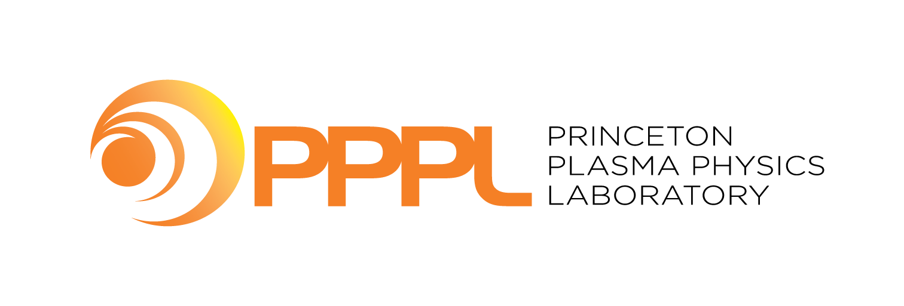
IEA Spherical Torus Technology Coordination Program (TCP) Annual Report
Rajesh Maingi, Chair of the ST TCP Executive Committee
NSTX-U Magnetic Fusion Science Meeting, 27 March 2023

Slide 2
ST TCP work conducted under three annexes
Annex I – “Co-operation on ST Science R & D”: Much of the work is carried out under this annex -bi-lateral and multi-lateral research collaboration, joint publications, exchange of equipment and personnel, information exchange at workshops and conferences, organization of the International Spherical Tokamak Workshops, outreach, communication and dissemination to the wider community etc.
Annex II – “Co-operation on the Physics and Technology of Future Spherical Torus Devices”: This work aims to accelerate progress on the physics and technology of future ST devices through co-ordination of activities and exchange of technical information relating to physics and technology challenges which are common to a range of future ST devices.
Annex III – “Co-operation on the Steady State Operation of Fusion Devices”: Here we seek to accelerate progress on the physics and technology of steady state operation of fusion devices through coordinated planning and cooperative research.

Slide 3
Growing number of STs worldwide, both public and private
China: EXL-50, NCST, SUNIST, SUNIST-2
EU: Proto-Sphera, SMART
Japan: LATE, QUEST, TST-2, TS-6, TS-4U, UTST
S. Korea: VEST, VEST-II
UK: MAST-U, ST-40, STEP
US: LTX-β, NSTX-U, PEGASUS-III

Slide 4
ST TCP very active in 2022
TCP was renewed in 2022 for 5 years
Outline
International ST Workshop (virtual) held Oct. 31 – Nov. 4, 2022
Highlights from worldwide experiments

Slide 5
ST Workshop succeeded in re-connecting the worldwide ST community
Year | Location
1994 | Oak Ridge, TN
1995 | Princeton, NJ
1996 | Culham, UK
1997 | St. Petersburg, Russia
1998 | Tokyo, Japan
1999 | Seattle, WA
2001 | Sao Jose dos Campos, Brazil
2002 | Princeton, NJ
2003 | Culham, UK
2004 | Kyoto, Japan
2005 | St. Petersburg, Russia
2006 | Chengdu, China
2007 | Fukuoka, Japan
2008 | Frascati, Italy
2009 | Madison, WI
2011 | Toki, Japan
2013 | York, UK
2015 | Princeton, NJ
2017 | Seoul, Korea
2019 | Frascati, Italy
2022 | Virtual (Beijing, China)
ST Workshop (virtual) held 10/31-11/3/22
Many members from the IEA ST TCP ExCom served on the ISTW Program Committee – thank you!
Thanks to Prof. Gao for offering Tsinghua Univ. to be the host
Special thanks to Prof. Tan Yi and Jack Berkery for their coordination efforts
ISTW 2024 will be in person, site TBD by ST TCP ExCom – stay tuned

Slide 6
International ST Workshop had excellent worldwide participation
92 people registered
  43 requested an oral presentation
  23 requested a poster
  23 requested no presentation (most of these were from Tsinghua U.)
Eight countries represented
  31 from China
  19 U.S.
  15 U.K.
  11 Japan
  6 Korea
  4 Russia
  3 Spain
  3 Italy
~24 Institutions represented
  Led by:
  25 Tsinghua University
  13 PPPL
  9 UKAEA
  6 Seoul National University
Courtesy of J. Berkery

Slide 7
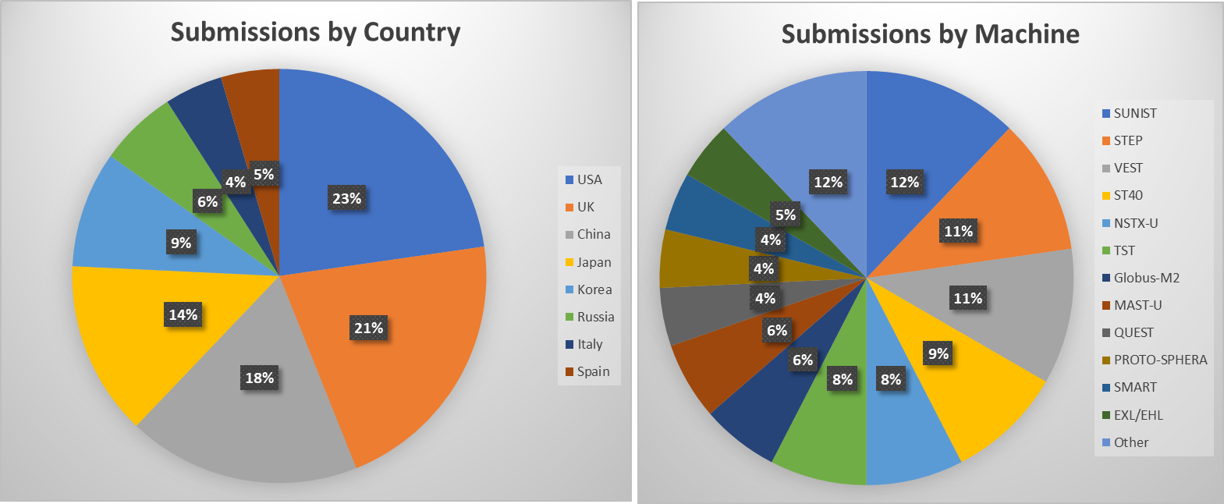
Abstract submissions received by ST Workshop
Total number: 66
  43 requested an oral presentation
  23 requested a poster
Courtesy of J. Berkery

Slide 8
ST TCP very active in 2022
Outline
International ST Workshop (virtual) held Oct. 31 – Nov. 4, 2022
Highlights from worldwide experiments (in reverse alphabetical order)

Slide 9

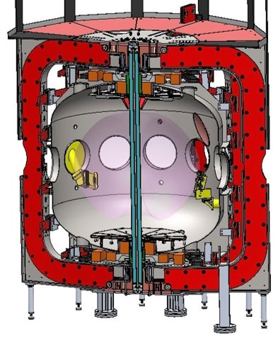




US: Next Steps for STs: Elimination of Solenoid to Establish Non-Inductive Startup Pathway for Fusion Energy
PEGASUS-III Mission: Solving solenoid-free startup for STs (and ATs)
  Advanced Local Helicity Injection
  Floating Coaxial Helicity Injection
  Microwave assist, sustainment and startup
  Compatibility with NBI heating and current drive
Research program will provide a predictive understanding of these solenoid-free techniques
  Extrapolatable techniques to MA-class STs (and ATs)
Pegasus-III features:
No solenoid
4x toroidal field
Advanced control
Expanded diagnostics
CHI
EC/EBW
LHI
Divertor Coils
Diem – ISTW 2022
Courtesy of S. Diem
9

Slide 10
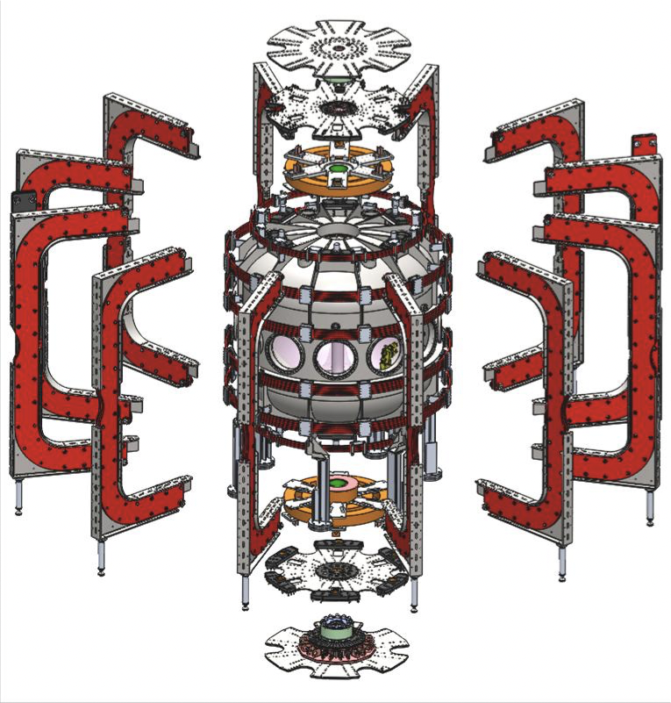
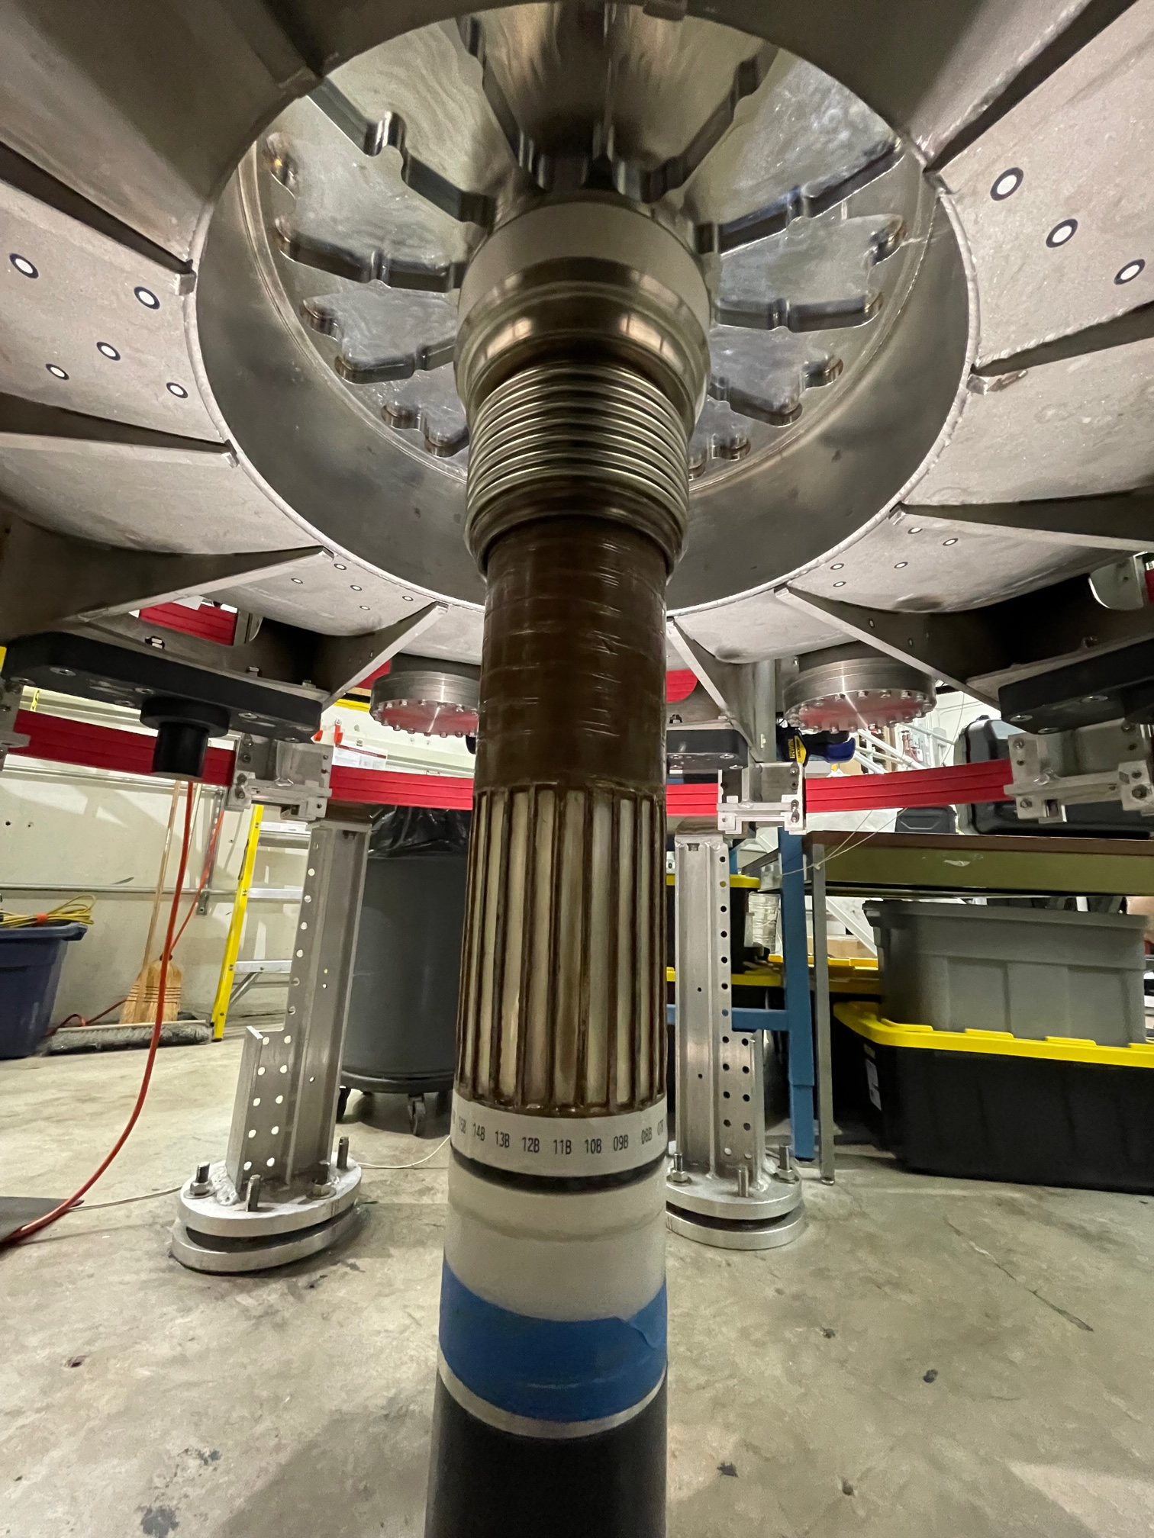
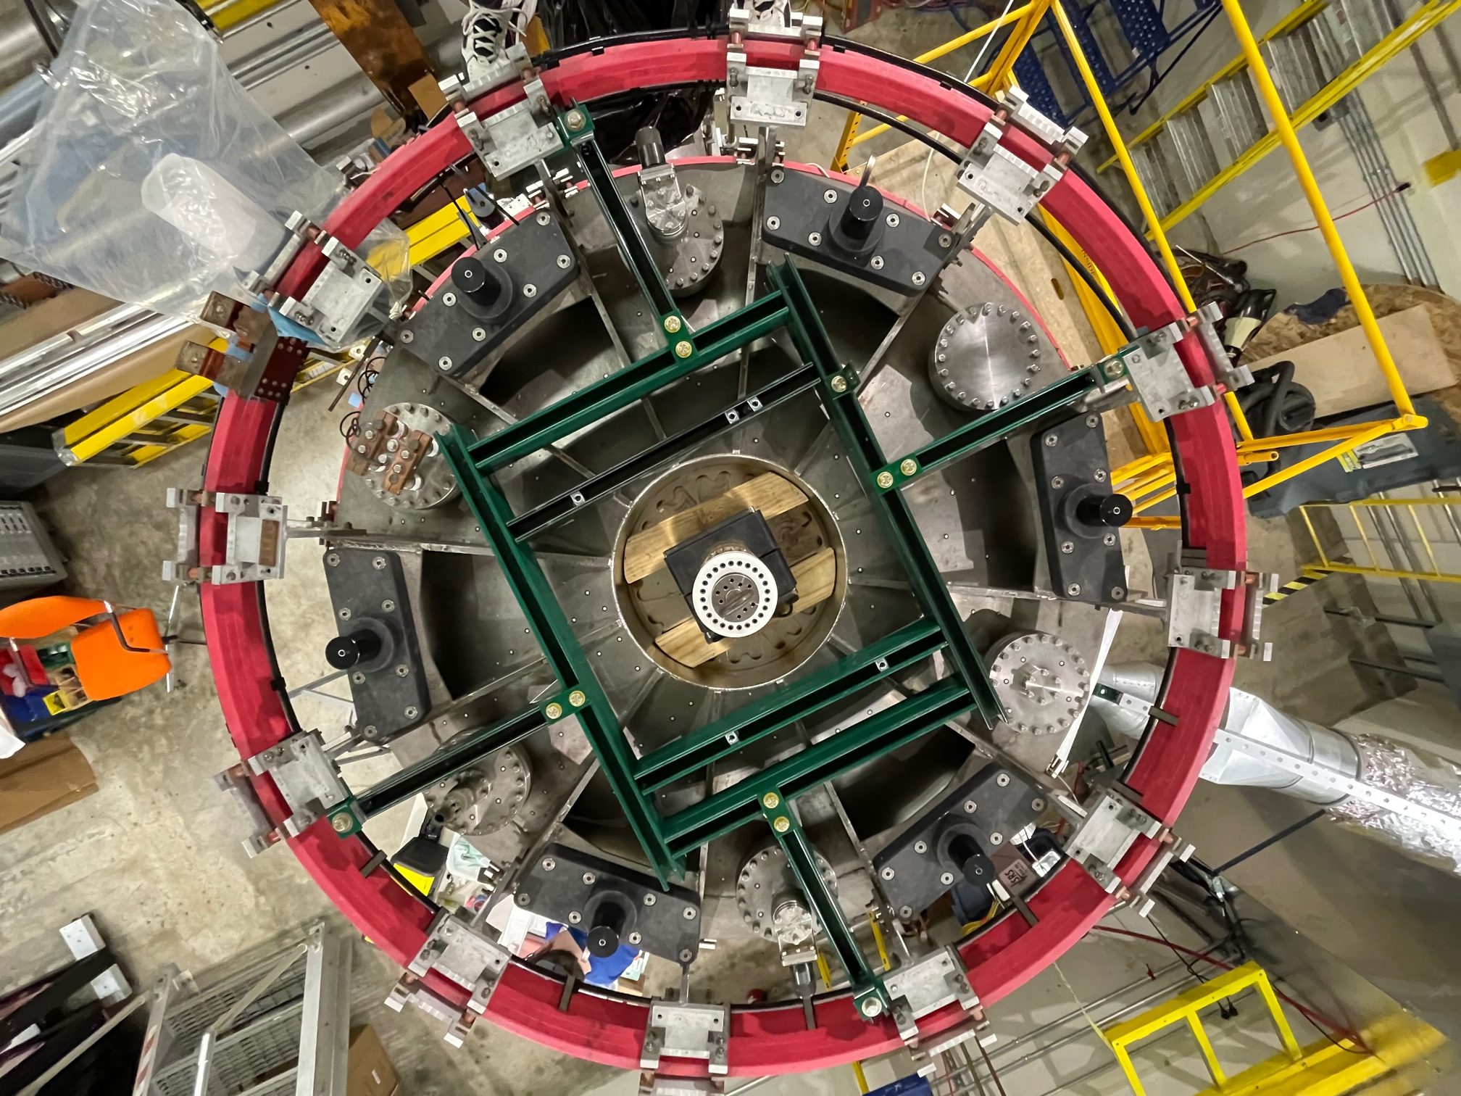
US: All Major Pegasus-III Upgrade Sub-Assemblies Nearing Completion
TF bundle installed in vacuum wall
Six pin blocks and pins installed
on vessel (top shown here)
Pin block with pin attached to
gusset plate reinforced ribs
Contact - indexing area
Diem – ISTW 2022
10
Courtesy of S. Diem

Slide 11
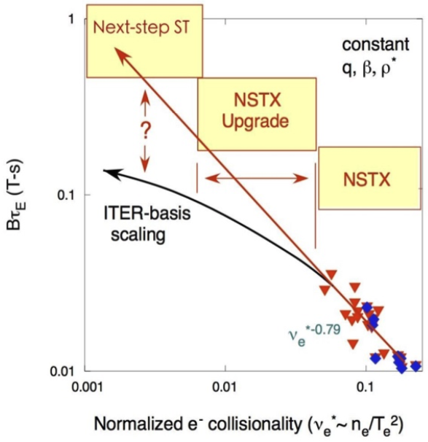
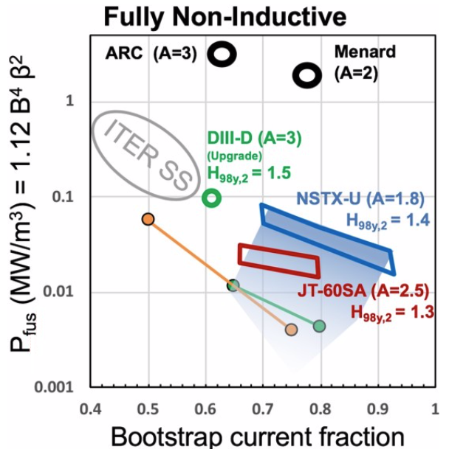
Three high-level Objectives comprise the mission-oriented NSTX-U research program
  Extend confinement and stability physics basis at low aspect ratio and high beta to lower collisionality
    Enhanced confinement necessary for FPP (of any aspect ratio)
    Does good ST confinement extend to low collisionality?
  Develop non-inductive (NI) operation at high-performance and low-disruptivity
    Steady-state compact ST fusion devices require enhanced confinement, NI operation
    Develop unique high-beta, strong shaping route to NI operation
  Develop and evaluate conventional and innovative power and particle handling techniques
    NSTX-U designed for 8 MW/m² for 5 s; can access 50-100 MW/m²
NSTX-U rebuild continues, First Plasma 3/2025 (early finish)

Slide 12
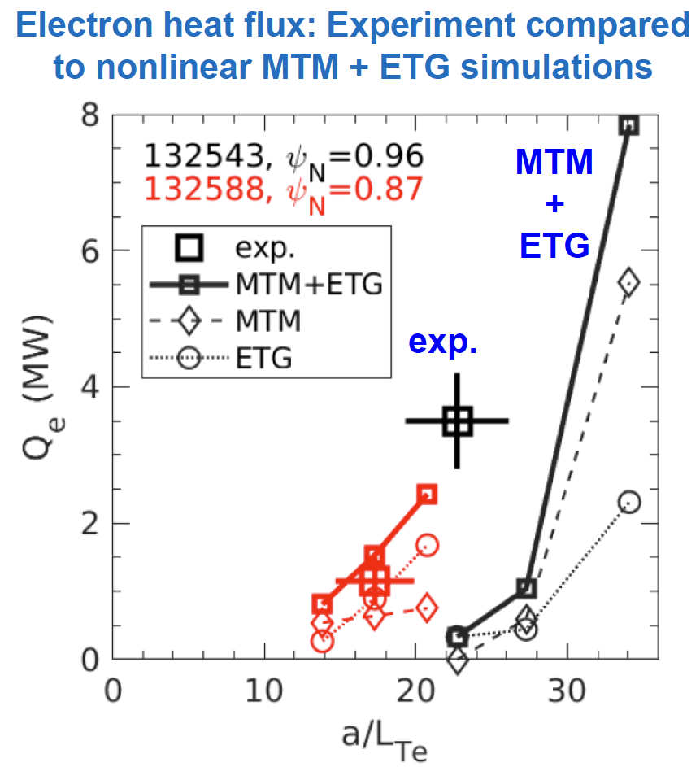
US: NSTX Data Analysis in key objective areas
Core physics: gyrokinetic simulations of electron heat flux match data
  Substantial work on developing an R/a independent pedestal model, both on pressure gradient limits and ideal MHD limits
Evaluating ECCD effectiveness for next step STs based on NSTX-U physics basis
Developing liquid metal PFCs to be tested in NSTX-U, based on designs for FNSF
Guttenfelder IAEA FEC 2023

Slide 13
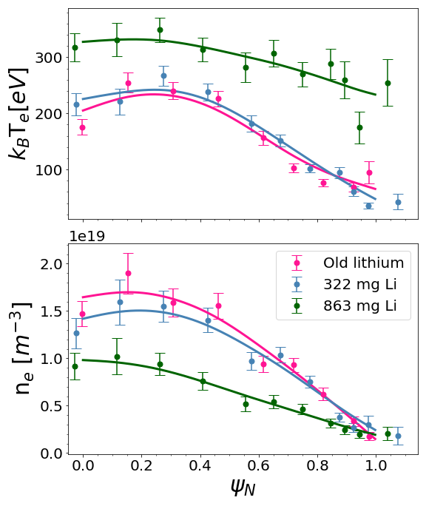
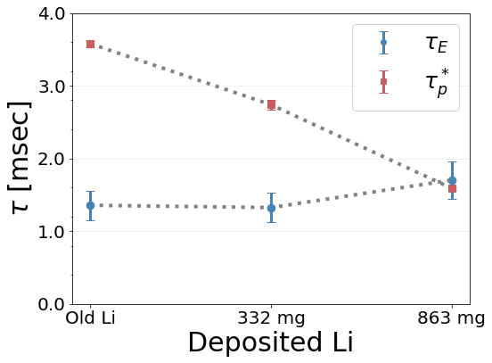
US: LTX-beta sustained flat T_{e} profiles with lithium PFCs
Flat T_{e} profiles sustained: edge Te ~ core T_{e}
  Results extended with neutral beam injection to extend core heating beyond ohmic heating
Recycling reduced with Li PFCs: τ_{p}* ~ τ_{E}
Maan NME 2022
Boyle NF 2023

Slide 14

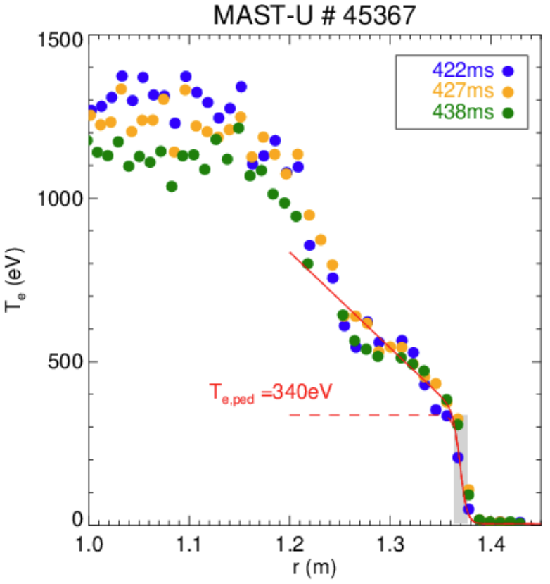

UK: MAST-U achieved high performance operating scenarios
Developed 1s long type-I ELMy H-mode scenarios
  Sustained T_{e,ped} up to ~340 eV, 400 eV transiently
  T_{e,core} up to 2 keV, T_{i,core} up to 3 keV
  Injected NBI power up to 3.6 MW
  ELM mitigation with RMPs observed
Developed initial 1 MA plasma scenario
  Increased toroidal field from 0.65T to 0.72T on axis
Courtesy of H. Meyer

Slide 15
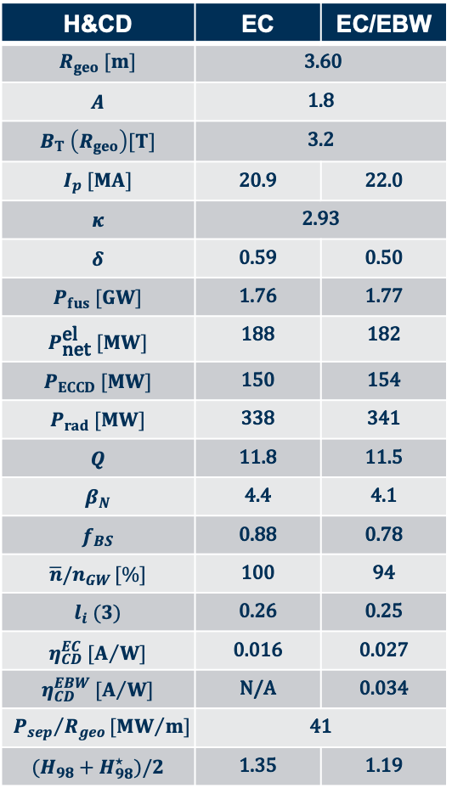
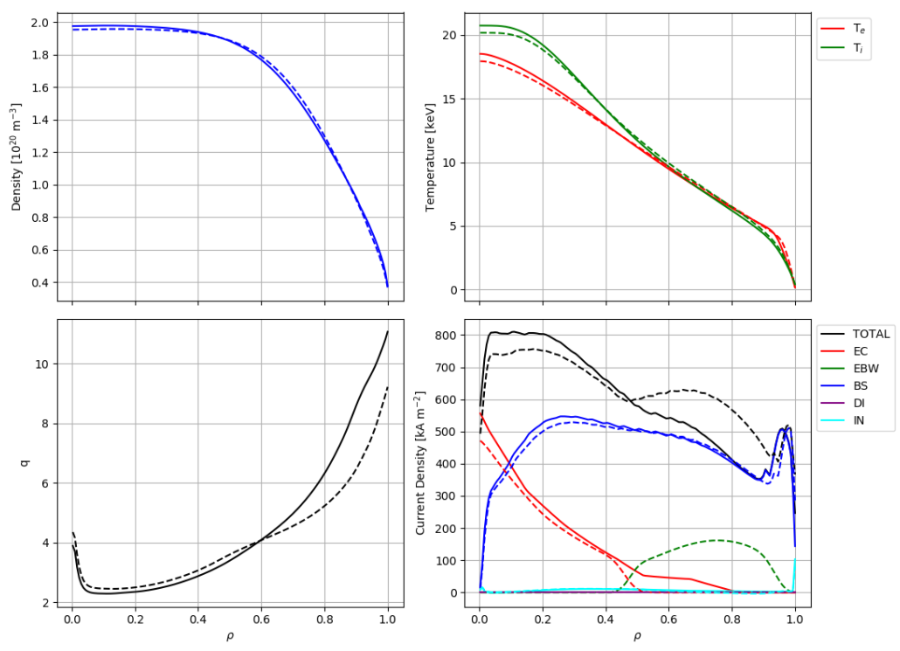
UK: Preferred non-inductive operating points on STEP give access to ECCD and EBW
ECCD: Electron cyclotron heating & current drive
EBW: Electron Bernstein wave heating & current drive
K. McClements et al. — 21st International Spherical Torus Workshop (ISTW 2022), 1/11/2022
Courtesy of H. Meyer
F. Casson, F. Koechl, S. Marsden, G. Szepesi, E. Tholerus, T. Wilson

Slide 16
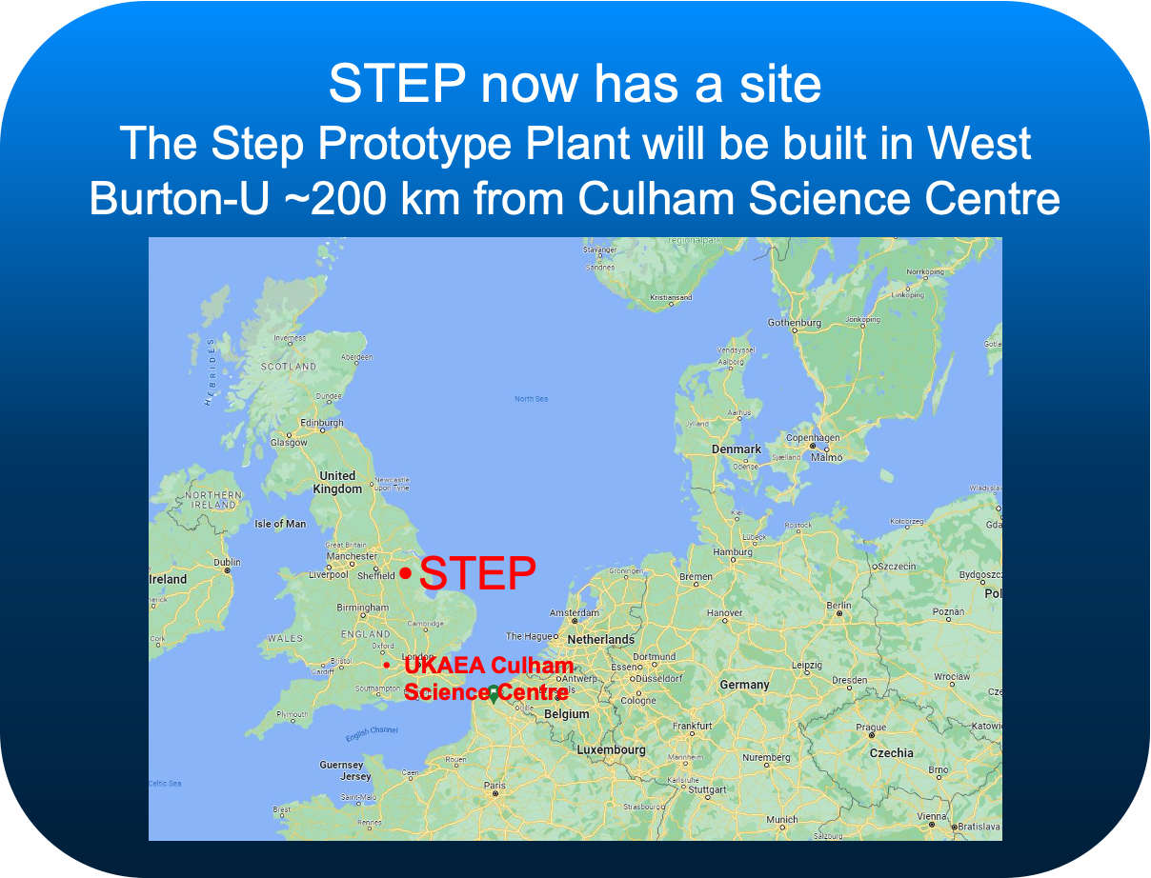
UK: Preferred non-inductive operating points on STEP give access to ECCD and EBW
ECCD: Electron cyclotron heating & current drive
EBW: Electron Bernstein wave heating & current drive
K. McClements et al. — 21st International Spherical Torus Workshop (ISTW 2022), 1/11/2022
Courtesy of H. Meyer
F. Casson, F. Koechl, S. Marsden, G. Szepesi, E. Tholerus, T. Wilson

Slide 17

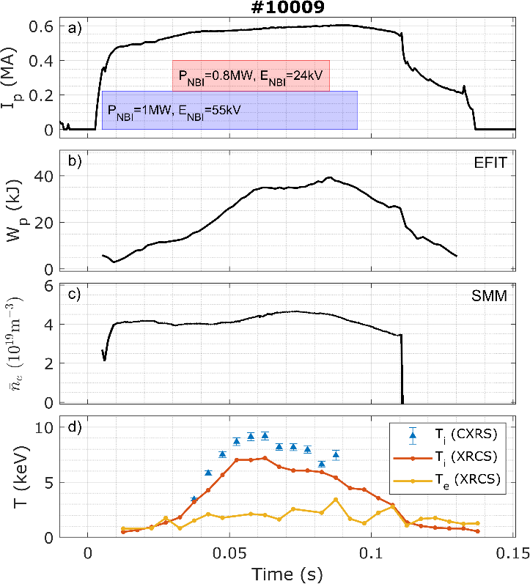
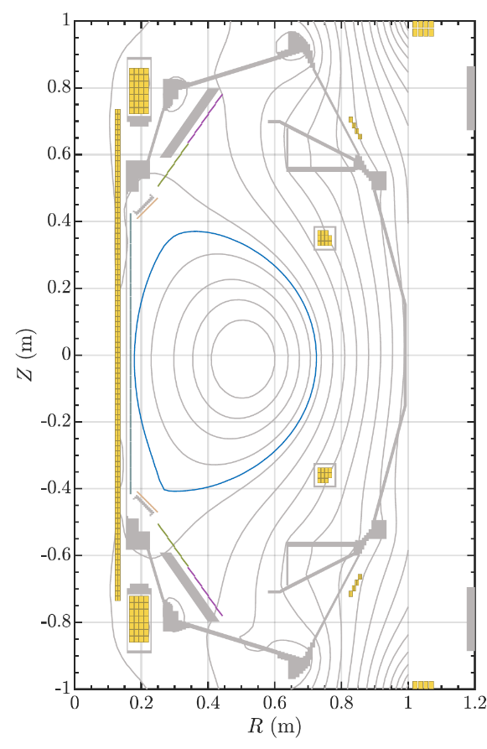
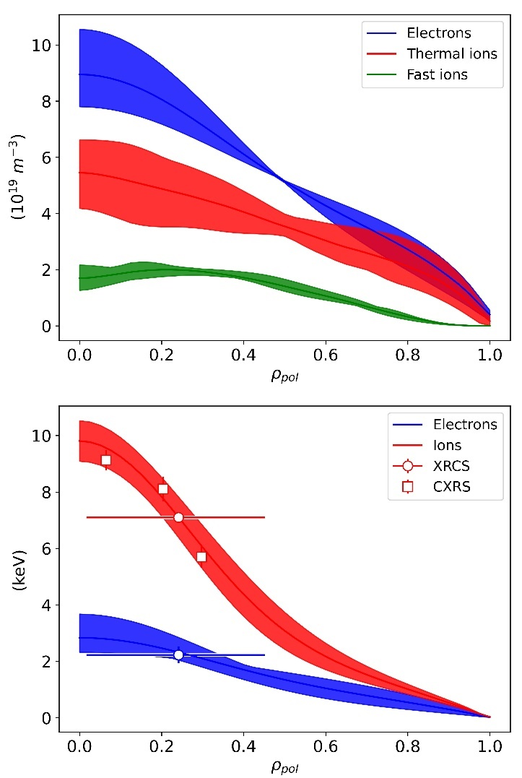
UK: ST-40 achieved T_{i} in excess of 100 million Kelvins
Profiles of (a) electron density, ion and fast particle densities, (b) ion and electron temperature determined using the integrated data analysis approach (#10009, t=58 ms at maximum T_{i})
S. McNamara, NF 2023

Slide 18
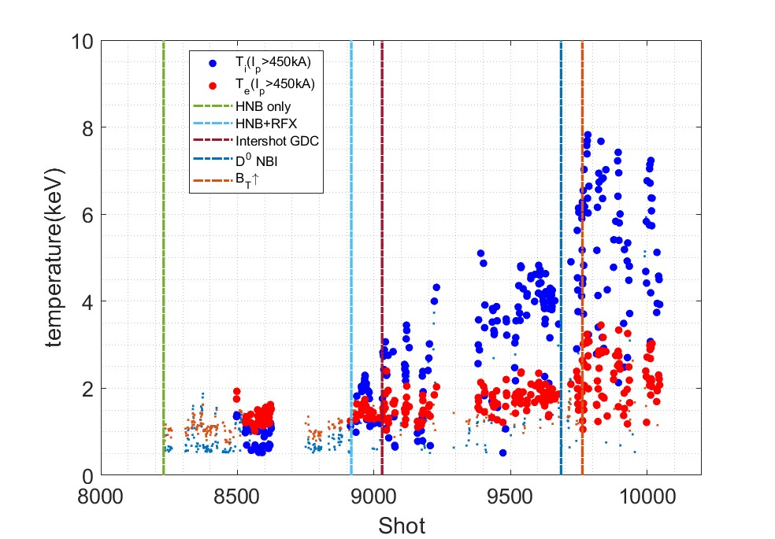
UK: Higher $B_{t}$ and NBI enables access to higher $T_{i}$ and $T_{e}$ on ST-40
Increased power B_{T} acts to suppress sawteeth, which contributes to increase in T_{e}
TRANSP analysis shows that increase in T_{e} and T_{i} to confinement improvement in both channels
Scenario optimisation + P_{NBI} increases
Courtesy of Tokamak Energy

Slide 19
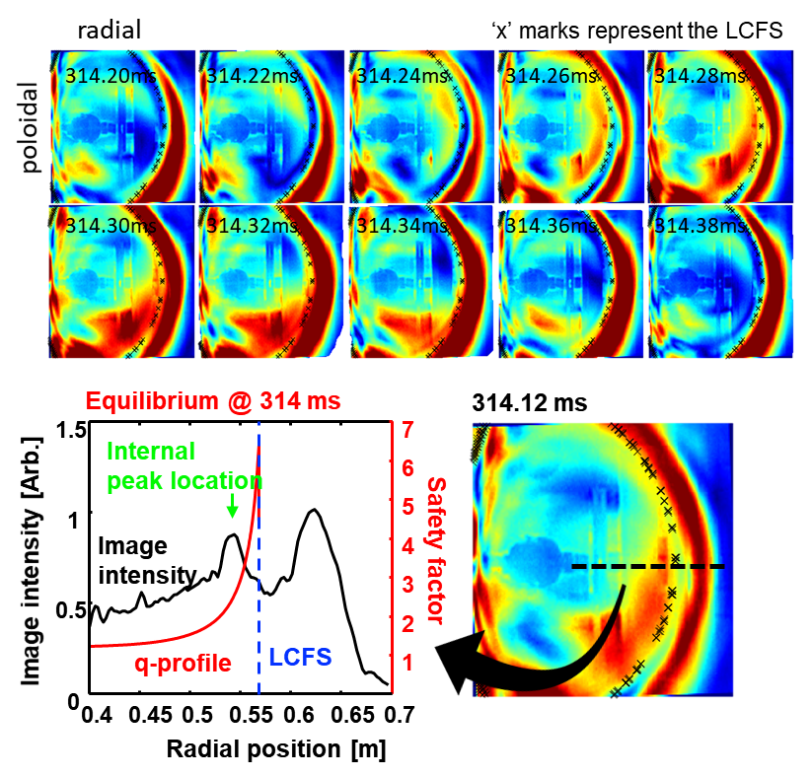
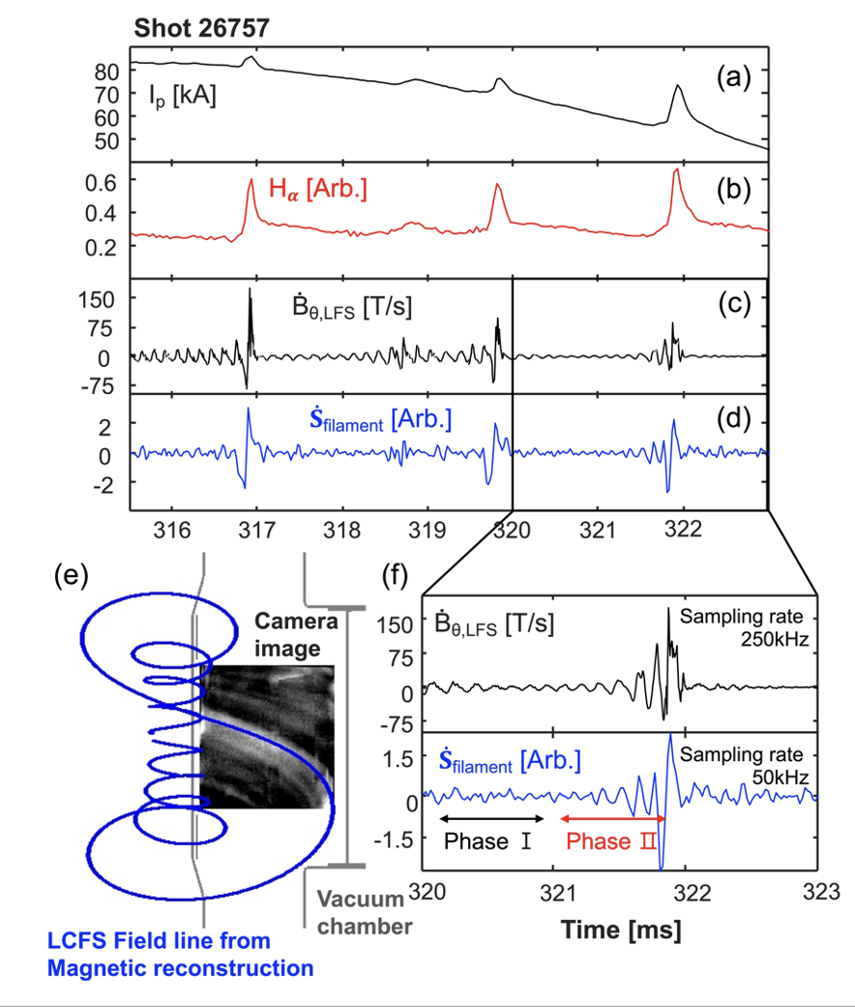
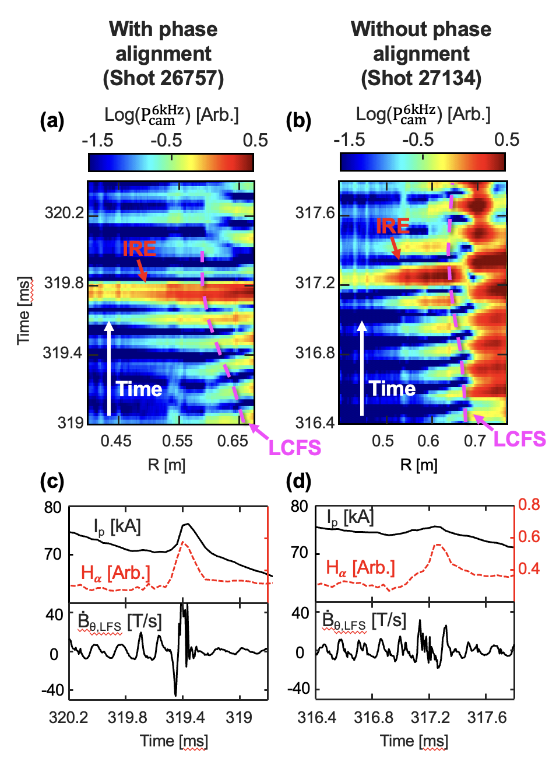
KO: Interaction between external Blobs and internal MHD modes during IRE
Internal Reconnection Event (IRE)
Phase alignment between MHD and blobs
MHD-correlated blobs before IRE
Courtesy of Y.S. Hwang
E.C. Jung et al, Nucl. Fusion 62 (2022) 126029

Slide 20
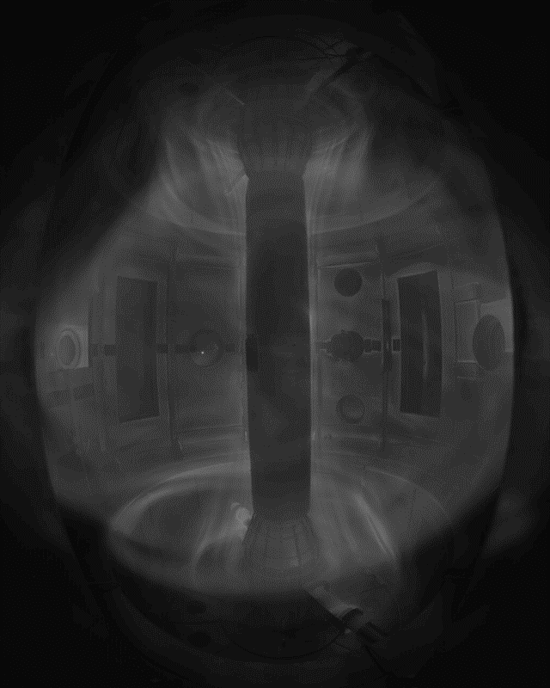
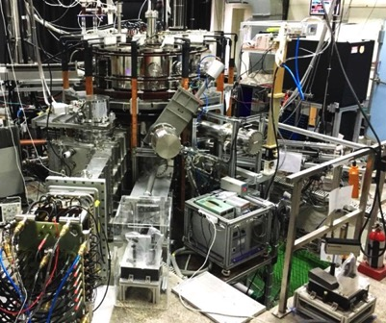
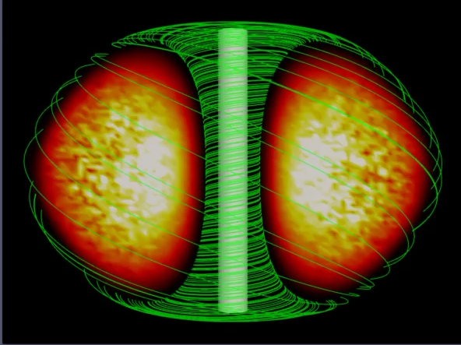

KO: Center for ST Fusion Metaware Research (7/2021-12/2025)
Establish Cyber Physical ST System
for the realization of compact ST fusion reactor
Real experimental results
VEST will be upgraded by doubling Ohmic power and NBI power as well as diagnostic capabilities
Digital Twins (DT)
VEST (Versatile Experiment Spherical Torus)
Virtual ST plasma model
GPU-based 6-D full PIC simulation code
Courtesy of Y.S. Hwang

Slide 21
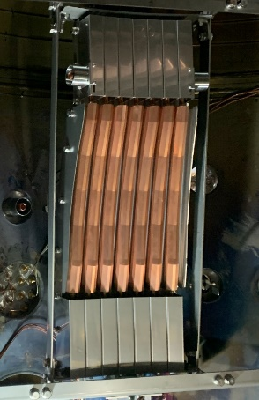
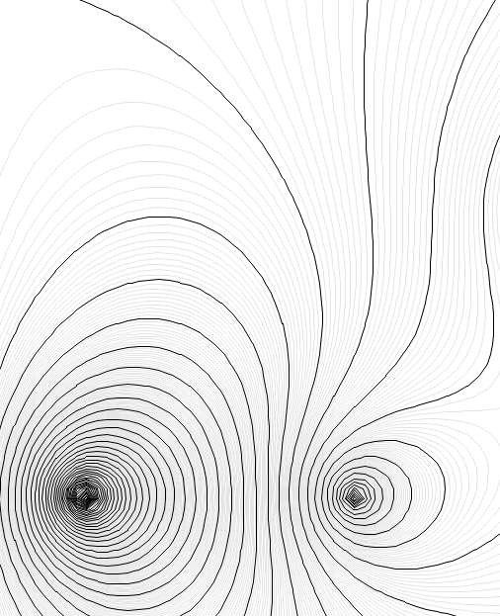
JA: progress on QUEST and TST-2
TST-2 (Univ. Tokyo)
Installation of a new off-midplane comb line antenna to excite LHW (100kW/200 MHz) (see the right photograph).
Preliminary results showed better efficiency than an old antenna.
QUEST (Kyushu Univ.)
Transient CHI start-up operation on a single biased electrode configuration.
0.20 m
Single biased electrode incorporated on lower divertor for Transient CHI start-up
Injected plasma is confined in the center.
Center stack
Bt
Center stack
Ceramic cover
Gas nozzles
PF5-1
PF5-2
Comparison of plasmas sustained by the outer-midplane(black) and the new off-midplane (red) antennas.
Courtesy of A. Ejiri

Slide 22
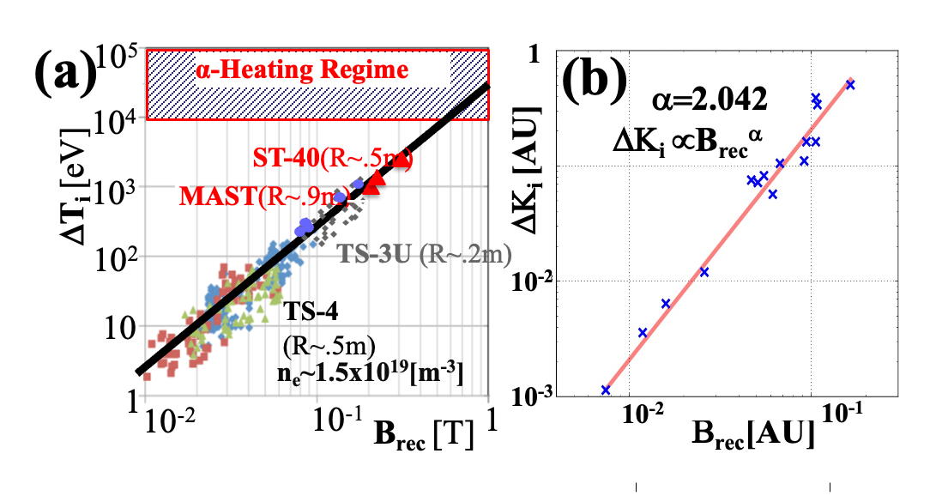
JA: progress on TS-6, TS-4U, UTST
The high-power reconnection heating experiments TS-6 successfully formed ultra-high beta STs with absolute minimum-B configuration.
TS-6, TS-4U, UTST (Univ. Tokyo)
The ST reconnection heating experiments TS-6 and TS-4 studied the ion temperature scaling Δw_{ion}∝Β_{rec}²∝Β_{p}²
for direct access to the burning plasms.
0.06
R[m]
0.28
0.2
Y
Based on collaboration between TSs and ST-40, high-field merging experiment is being made in TS-40 and documented 10⁶K ion temperature using both of merging and NBI.
Z[m]
0
-0.2
q₀~0
q₀~0.8
q₀~1.1
q₀~1.5(High-beta ST)
FRC
low-q ST
ST
Y
0
|B|[kG]
0.3
TS-6 Merging
Experiment
Low-beta ST
w/o merging
q₀~1.5(Low-beta ST)
Courtesy of A. Ejiri

Slide 23
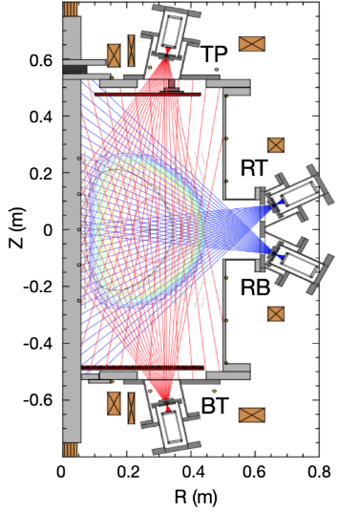
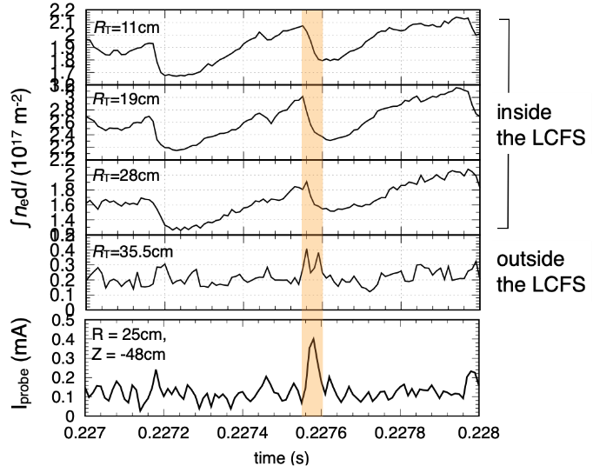
JA: progress on LATE
LATE (Kyoto University)
Non-inductive formation of overdense ST plasma by exciting electron Bernstein wave (EBW) via O-X-B mode conversion process.
* Soft X-ray CT system is under development to investigate the plasma ejection phenomena in the overdense ST plasma.
Courtesy of A. Ejiri

Slide 24
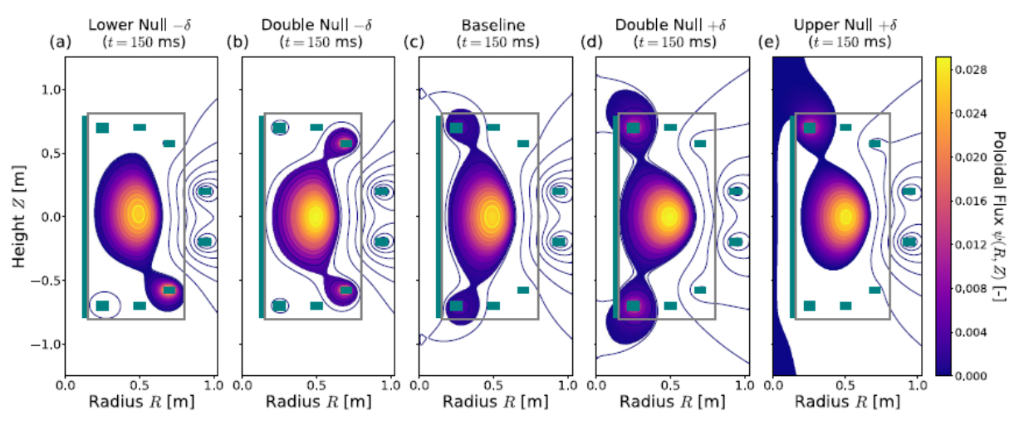
EU: SMART Will Explore a Wide Shaping Range at Relatively High I_{p} / B_{t}
  SMART aims at high confinement regimes in Spherical Tokamaks (STs) with flexible shaping, high β, and fusion-relevant T_{i}, T_{e}, n_{e}, and collisionalities
Parameters | Phase 1 | Phase 2 | Phase 3
I_{p} [kA] | 100 | 500 | >500
B_{t} [T] | 0.1 | 0.3 | 1.0
τ_{pulse} [sec] | 0.15 | 0.5 | >1
R/a (m) | 0.45 / 0.25
Aspect Ratio | 1.4 – 3.0
κ | < 3
δ | -0.6 – +0.6
P_{e}[kW] | 6 | 6 | 200
P_{NBI} [MW] | - | 1 | 1
  Exploiting novel diagnostic and exhaust and plasma control techniques
  Training next generation of fusion physicists and engineers
A. Mancini et al, Fus. Eng. Des. 171 112542 (2021)
M. Garcia-Munoz | 21st International Spherical Torus Workshop (ISTW) | Remote | Nov 1st 2022

Slide 25




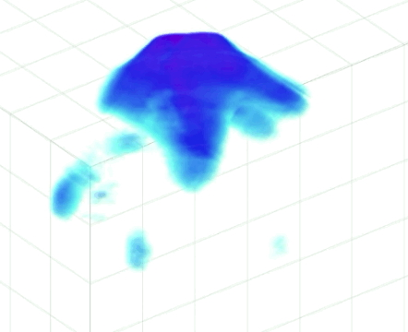
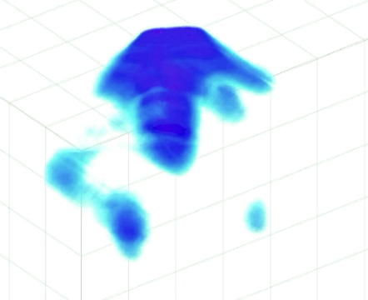
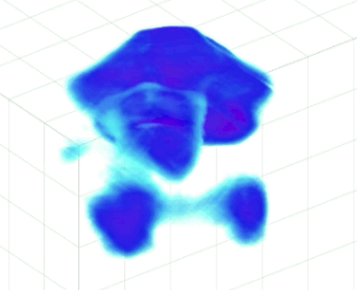
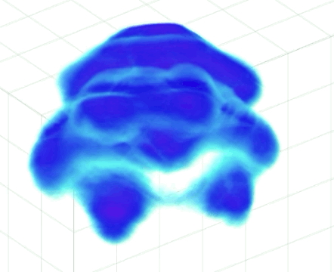
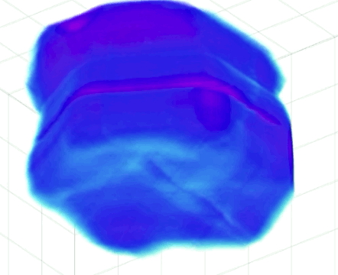
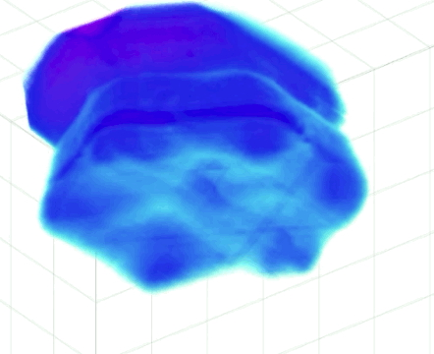
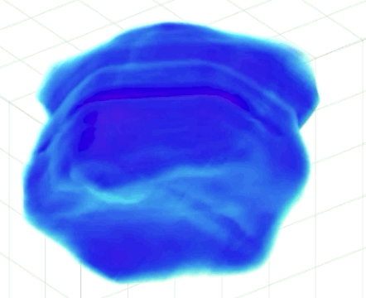
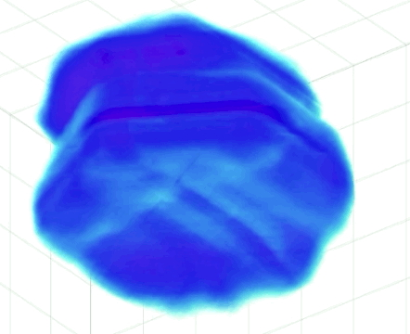
EU: PROTO-SPHERA confined torus sustained for up to 1 sec
Preliminary (still with some artifacts) 3D tomographic
reconstruction from 6 cameras around main plasma
PROTO-SPHERA Plasma Torus forms in 5 ms, as the Centerpost Plasma current & toroidal field grow
The Plasma Torus is a slightly oblique rotator
maintained by 3D magnetic reconnections
toroidal Plasma current enters torus in bursts
5 ms
10 ms
The Plasma Torus grows from a kinked filament, formed inside a pre-existing purely Magnetostatic Field:
→ a toroidal ~ axisymmetric confined plasma could be produced and maintained in steady-state by permanent magnets only
Courtesy of H. Meyer and P. Micozzi

Slide 26
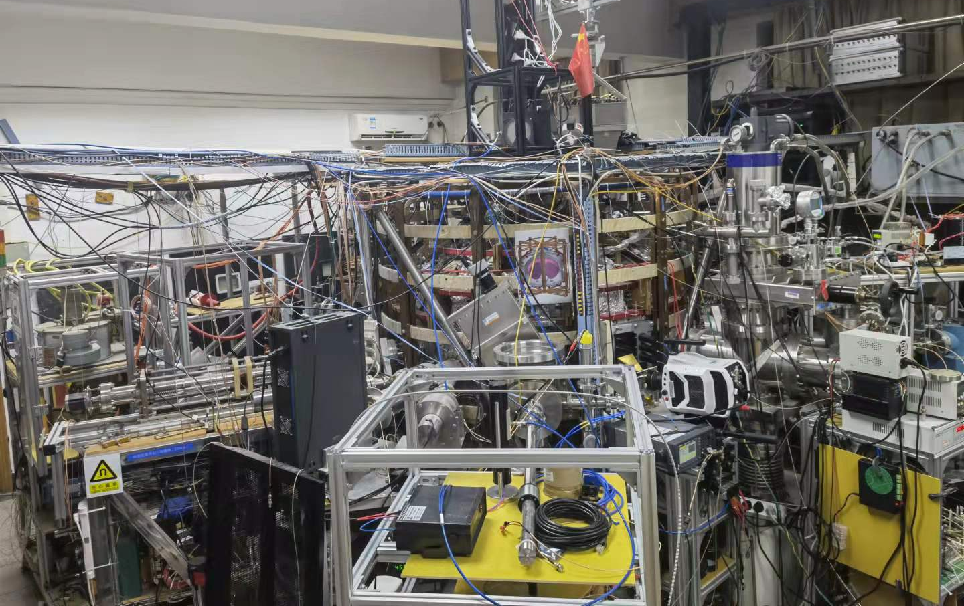
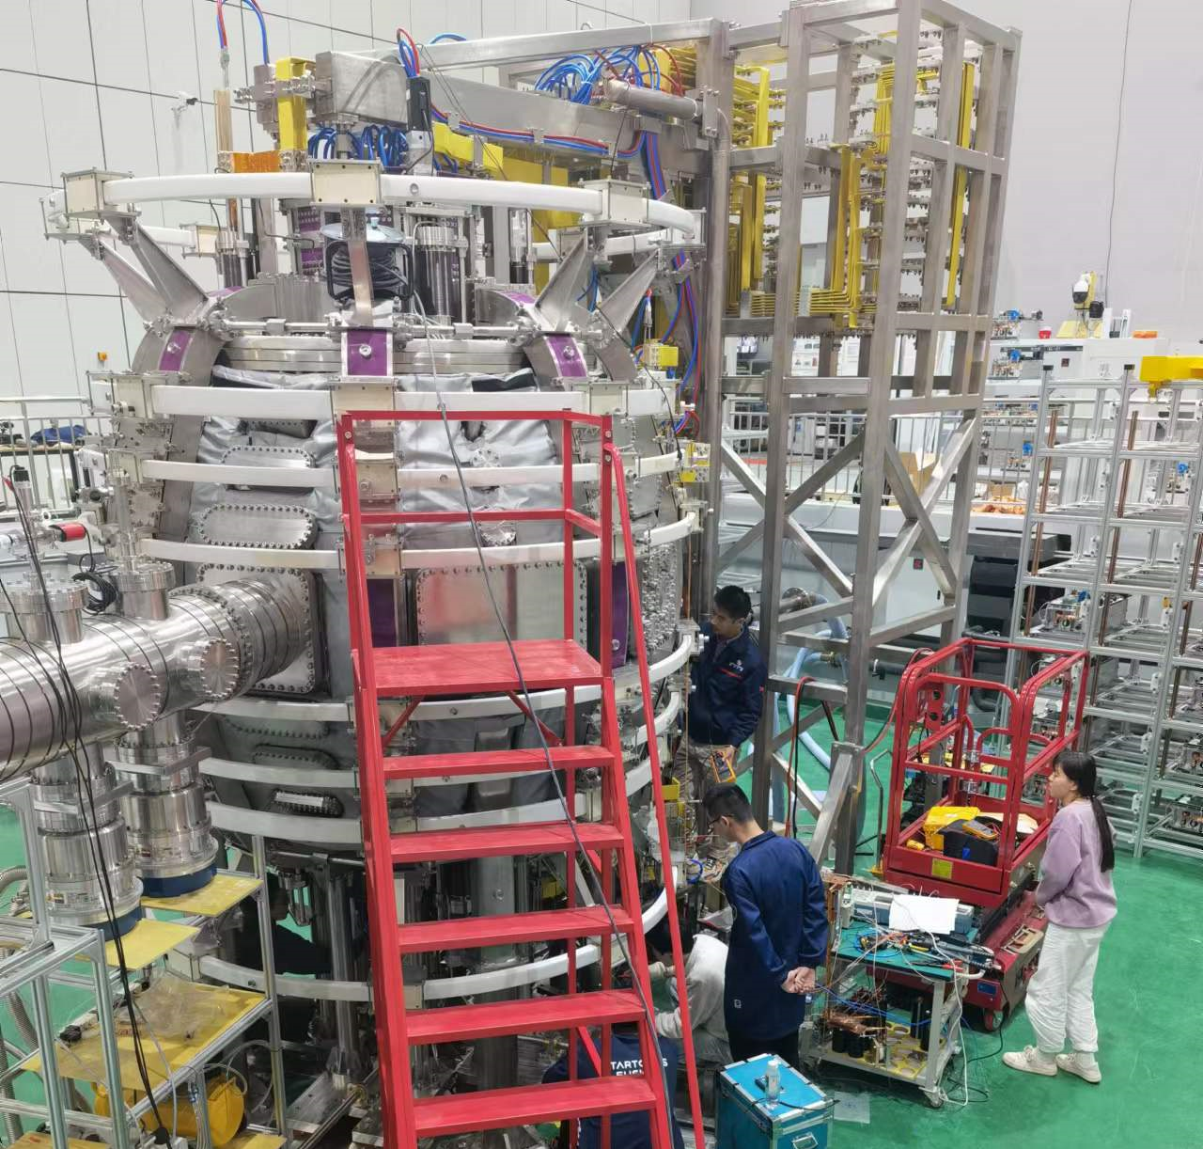
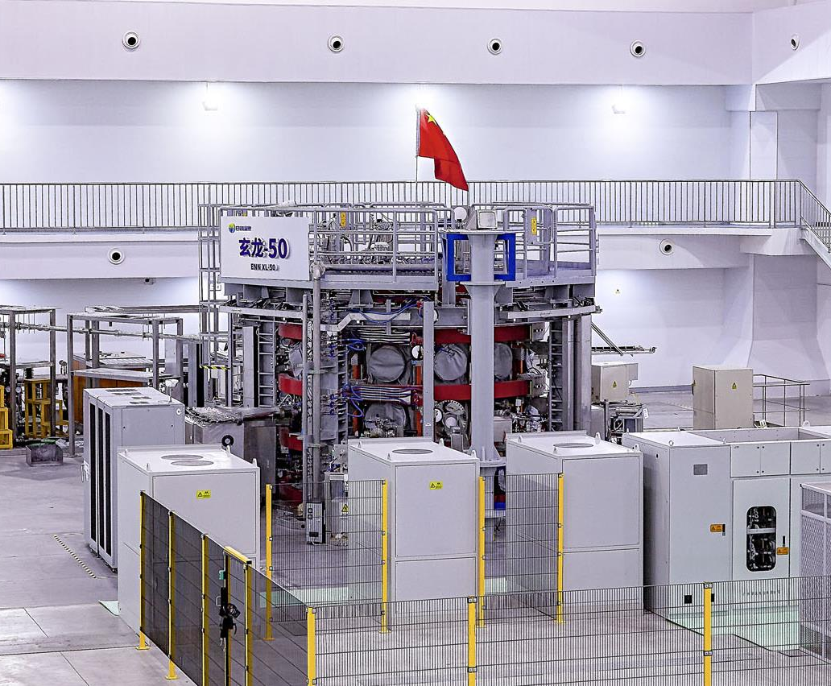
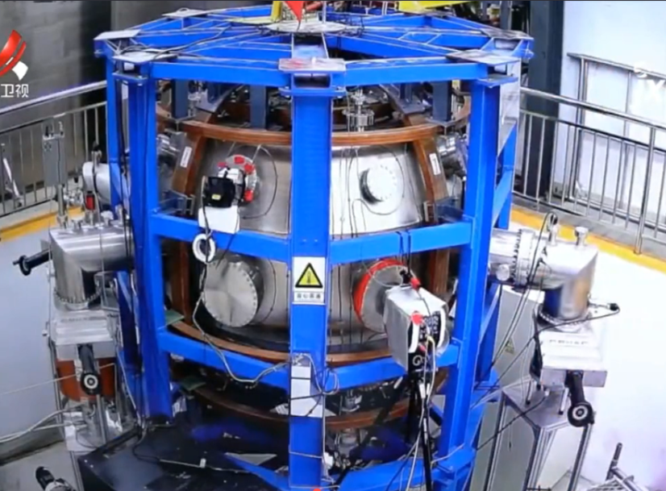
Spherical Tokamaks in China
tanyi@sunist.org
SUNIST
Tsinghua University, Beijing
Construction started at 2000, first plasma in 2002
R₀ / a: 0.3 / 0.23 m
B_{T0}: 0.15 (0.27) T
I_{P}: 50 (120) kA
Black: design, red: achieved
Research topics
Basic properties of spherical tokamak plasmas
EBW heating / Alfven eigenmodes
NCST
Nanchang University, Jiangxi
Construction started at 2018, first plasma in 2021
R₀ / a: 0.4 / 0.24 m
B_{T0}: 0.36 T, I_{P}: 100-300 (30) kA
Research topics
Solenoid-free startup by merging
Basic properties of spherical tokamak plasmas
EXL-50
ENN, Langfang, Hebei
Construction started at 2018, first plasma in 2019
R₀ / a: 0.58 / 0.39 m
B_{T0}: 0.5 T, I_{P}: 500 (160) kA
EC waves: 1.75 MW 28 / 50 GHz
Research topics
Solenoid-free current drive up to 140 kA by 115 kW 28 GHz EC
p-B¹¹ ST reactor
SUNIST-2
Tsinghua University, Xi’an
Construction started at 2020, first plasma in 2022 (expected)
R₀ / a: 0.525 / 0.325 m
B_{T0}: 1 T, I_{P}: 500 kA
Research topics
Confinement of spherical tokamak at 1 Tesla
Reconnection heating
Courtesy of T. Yi

Slide 27
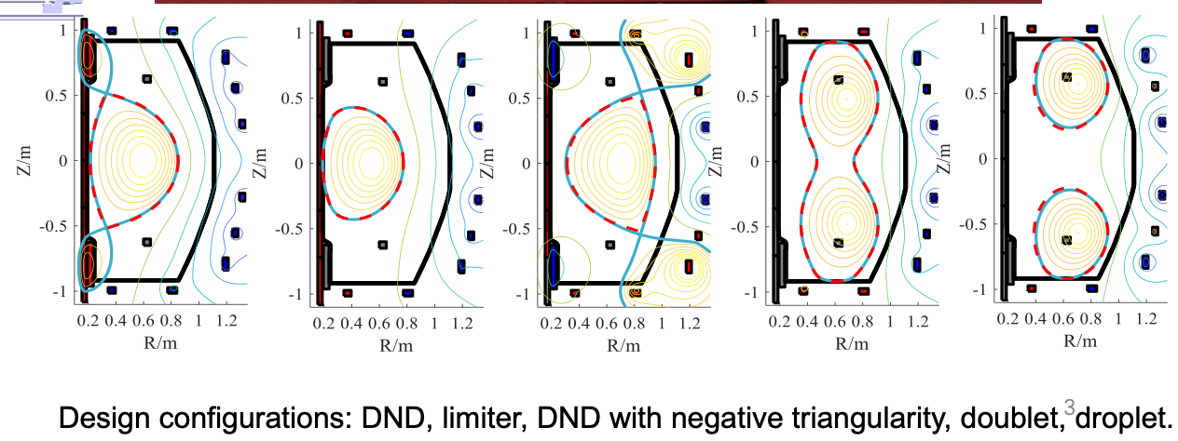
China: SUNIST-2 device construction nearly completed
R = 0.525m, a = 0.325m, κ ~ 1.6
I_{p} ~ 500 kA, B_{t} from 0.4 – 1.0 T
Substantial shape flexibility
Construction delayed by COVID-19, completion imminent
Courtesy of T. Yi

Slide 28
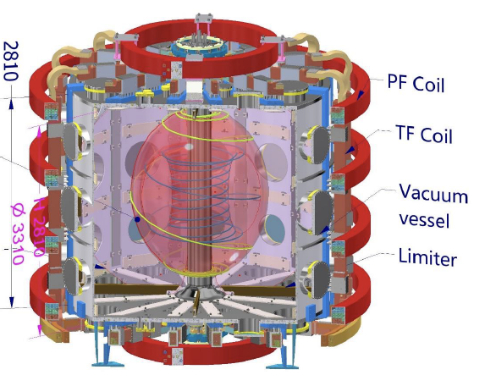
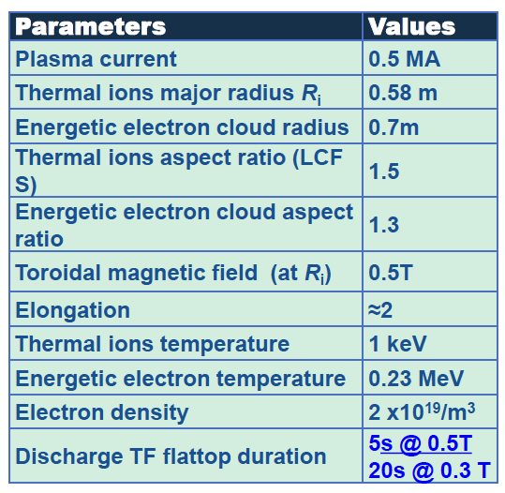
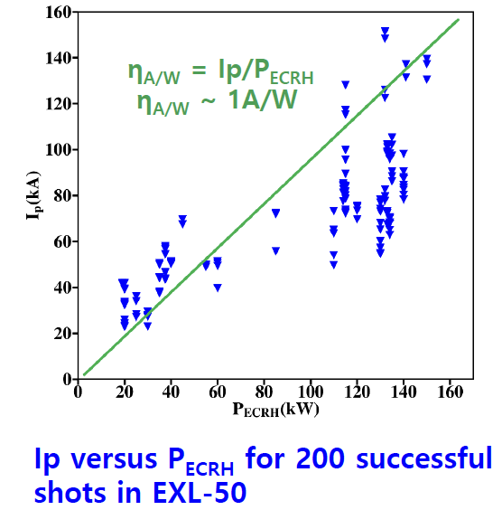
China: EXL-50 achieved efficient CD

Slide 29
Very productive year in the ST TCP!
Looking forward to 2023, with several device upgrades coming online

