Slide 1






Yong-Su Na, Jaemin Seo, et al, Nature Comm. 13 6477 (2022)
Observation of a New Self-generated Current
in KSTAR
Yong-Su Na^{1†}, J. Seo^{1,2}, Y. Lee¹, G.J. Choi¹, M.S. Park¹, S.J. Park¹, S. Yi³, W.X. Wang⁴, M.G. Yoo^{4,5}, M.S. Cha¹, B.S. Kim¹,
Y.H. Lee³, B. Kim¹, C.Y. Lee³, S.K. Kim^{4,6}, S.M. Yang⁴, C.S. Byun⁶, H.S. Kim³, J. Ko³ and T.S. Hahm¹
¹Department of Nuclear Engineering, Seoul National University, Seoul, Republic of Korea
²Physics Department, Choong Ang University, Seoul, Republic of Korea
³Korea Institute of Fusion Energy, Daejeon, Republic of Korea
⁴Princeton Plasma Physics Laboratory, Princeton, New Jersey, USA
⁵General Atomics, San Diego, California, USA
⁶Princeton University, Princeton, New Jersey, USA
†ysna@snu.ac.kr
NSTX-U / Magnetic Fusion Science Meeting Monday
September 11, PPPL, USA

Slide 2

Contents
Plasma current in a tokamak
The appearance of a new self-generated current in dedicated experiments on KSTAR
The reproducibility of occurrence of the new current
Evidence that turbulence does not drive the anomalous current
Conclusion

Slide 3
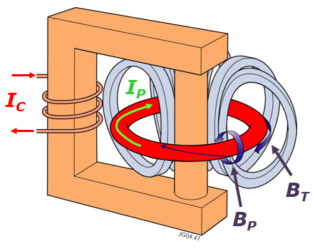
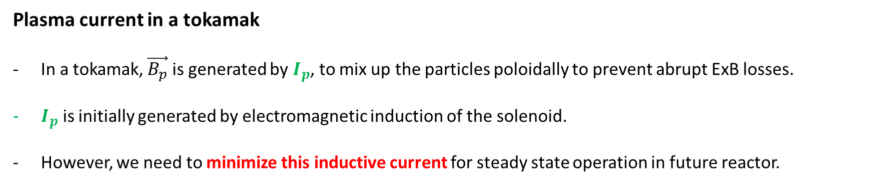
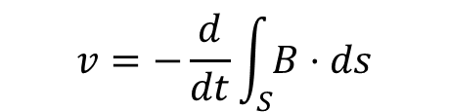
Tokamak relies on plasma current for confinement
Plasma current in a tokamak
In a tokamak, $\vec{B_{p}}$ is generated by $I_{p}$, to mix up the particles poloidally to prevent abrupt ExB losses.
$I_{p}$ is initially generated by electromagnetic induction of the solenoid.
However, we need to minimize this inductive current for steady state operation in future reactor.
dI_{C}
Induction
I_{OH}
dt
$$v=−\frac{d}{dt}\int_{S}{B}⋅ds$$
Faraday‘s law
I_{P} = I_{OH} + I_{NI}

Slide 4
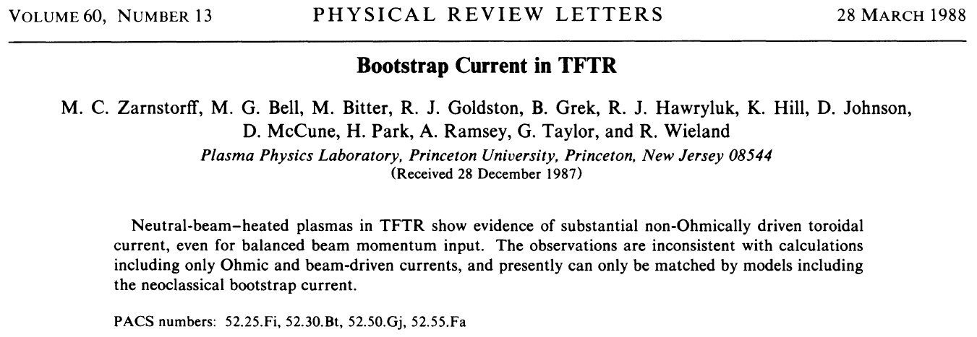
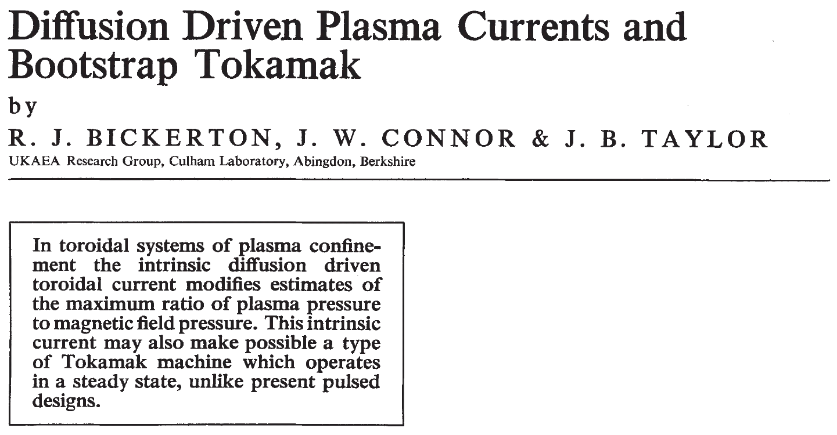
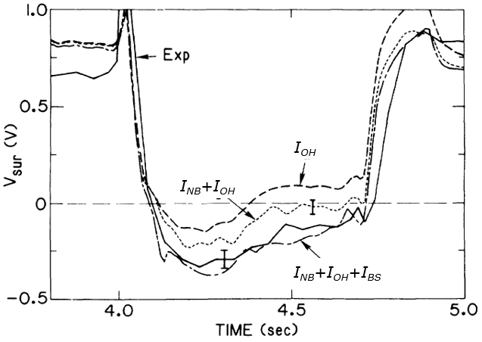
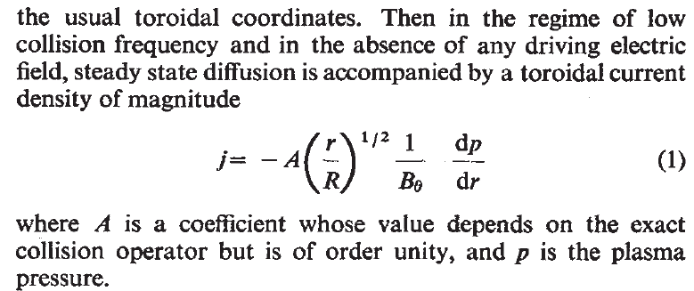
Non-inductive current drive sources
External current drive: NBI, EC, IC, LH, etc.
Internal current drive (Self-generated): Bootstrap current
Nature Physical Science 229 110 (1971)

Slide 5
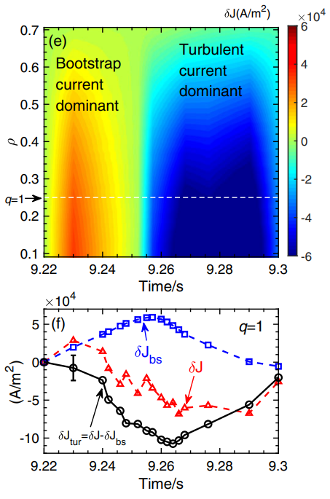
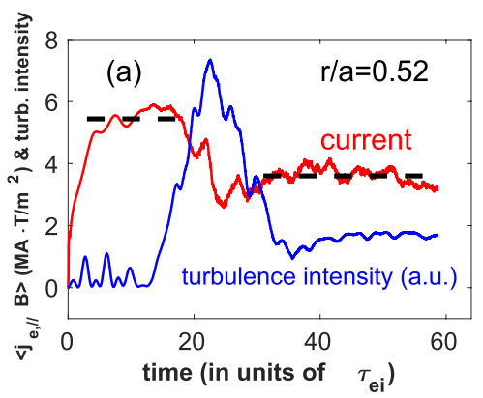
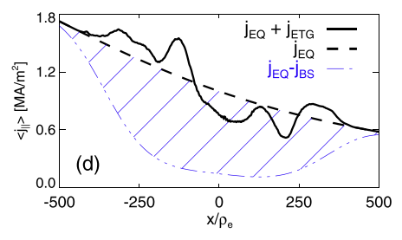
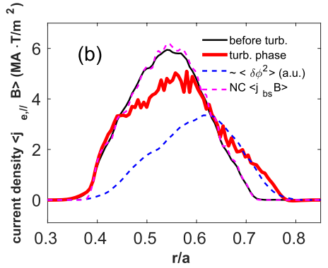
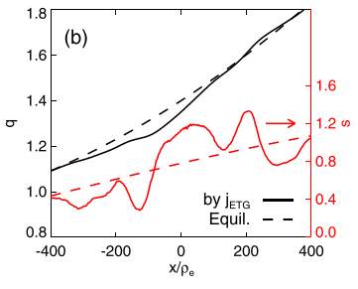
Non-inductive current drive sources
External current drive: NBI, EC, IC, LH, etc.
Internal current drive (Self-generated): Bootstrap current, turbulence-driven current
E. Li et al, PRL 128 085003 (2022)
W. Wang et al., NF 59 084002 (2019)
Sumin Yi et al., PoP 23 102514 (2016)

Slide 6
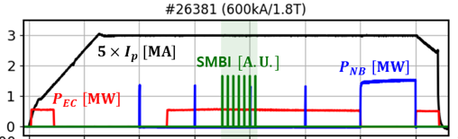
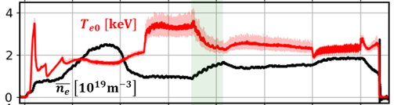
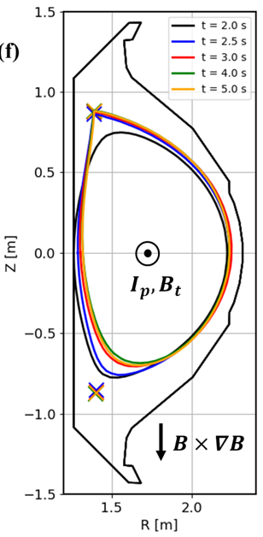
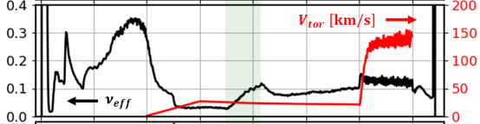
The appearance of a self-generated current in KSTAR
A dedicated experiment (#26381)
To minimize the current drive,
(i) Injecting the EC wave in a nearly perpendicular direction
(ii) Avoiding the L-H transition by forming an unfavorable
null configuration to reduce the bootstrap current
SMBI applied,
- To increase the electron density
- To decrease the electron temperature
→ Increasing the plasma resistivity (η∝T_{e}^{-1.5})
→ Loop voltage should be increased
to keep the plasma current constant!
(I_{p} ~ V_{L} /R)

Slide 7
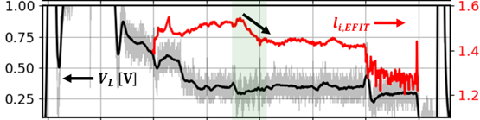
The appearance of a self-generated current in KSTAR
A dedicated experiment (#26381)
To minimize the current drive,
(i) Injecting the EC wave in a nearly perpendicular direction
(ii) Avoiding the L-H transition by forming an unfavorable
null configuration to reduce the bootstrap current
SMBI applied,
- To increase the electron density
- To decrease the electron temperature
→ Increasing the plasma resistivity (η∝T_{e}^{-1.5})
→ Loop voltage should be increased
to keep the plasma current constant!
(I_{p} ~ V_{L} /R)
Why?
→ Loop voltage stays constant
or even reduced!

Slide 8
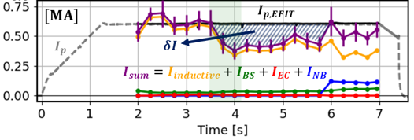
The appearance of a self-generated current in KSTAR
Interpretive simulation with the integrated tokamak simulator, TRIASSIC(Tokamak Reactor Integrated Automated Suite for Simulation and Computation)* (#26381)
Before SMBI
- Interpretive simulation agrees with the experiment.
After SMBI
- The inductive current reduces due to the increased
resistivity by SMBI.
- An anomalous current gap (δI) appears between
the simulation and the experiment.
- This discrepancy is sustained for longer than 2 s until NBI is
applied, longer than τ_{r}=(μ₀a²)/2η~ 0.5 s.
- Internal inductance (l_{i}) drops.
V_{L} from LV23 (inboard)
→ Possibility of an additional steady source of the current!
in the off-axis region?
*C. Y. Lee et al. Nucl. Fusion 61 096020 (2021)

Slide 9
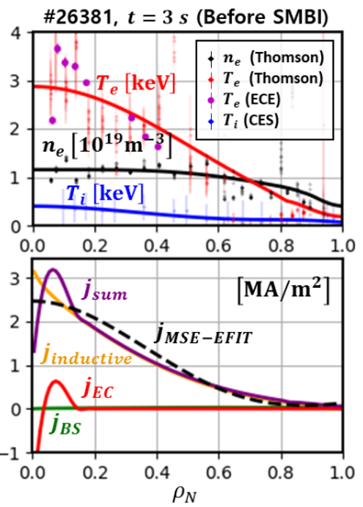
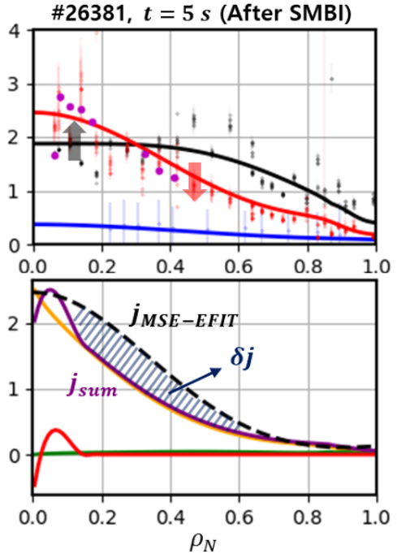
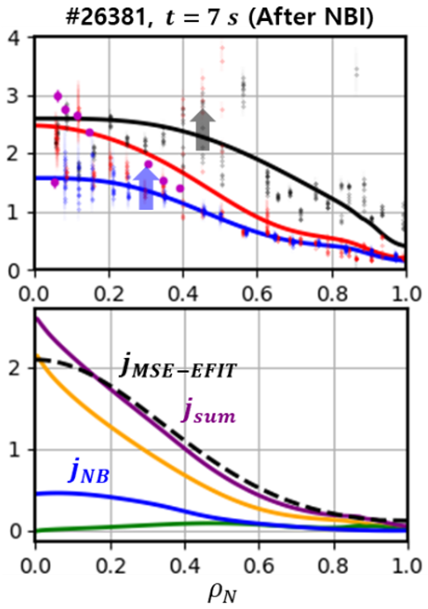
The appearance of a self-generated current in KSTAR
Interpretive simulation with the integrated tokamak simulator, TRIASSIC(Tokamak Reactor Integrated Automated Suite for Simulation and Computation)* (#26381)
There are several uncertainties such as Z_{eff} or neoclassical transport models.
We scanned 1.2≤Z_{eff}≤3.0 with different radial profile shapes and tried other neoclassical models but the discrepancy persists nevertheless.

Slide 10
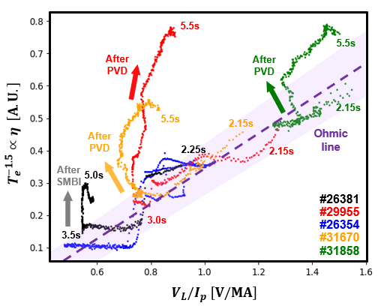
The reproducibility of occurrence of the new current
The trajectory of $T_{e}^{−1.5}$ (η) versus $V_{L}/I_{p}$
This phenomenon is also observed in other discharges,
- #29955, #31670: EC with gas puffing (PVD*)
instead of SMBI
- #31858: Ohmic (no EC) with gas puffing (PVD)
It is apparent that the relation between T_{e}^{-1.5} (∝η) and V_{L}/I_{p} in #26381, #29955, #31670, and #31858 diverges from the ohmic relation after the fueling
reference
EC+PVD
EC+PVD
→ Robust appearance of a new current after the fuelling
OH+PVD
*Piezoelectric valve at D-port

Slide 11
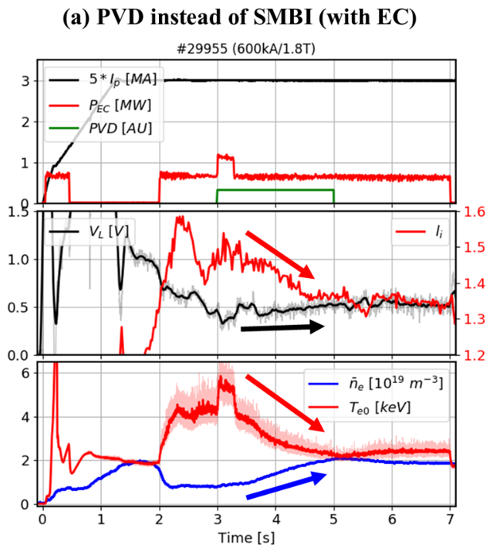
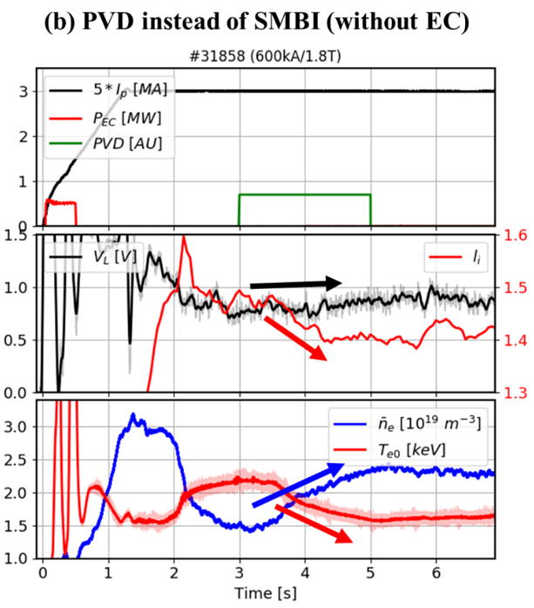
The overviews of PVD discharges, #29955 and #31858
In both shots, PVD instead of SMBI increases the plasma density from
t = 3 s to 5 s.
The induced loop voltage remains almost constant even though the electron temperature and the plasma resistivity significantly change.
The internal inductance is also lowered in the same manner as #26381 and maintained after the fueling turned off.
→ The observation of the anomalous current drive is not a special effect caused by SMBI
and seems to be related to the level of the density or the collisionality.

Slide 12
The overviews of PVD discharges, #29955 and #31858
In both shots, PVD instead of SMBI increases the plasma density from
t = 3 s to 5 s.
The induced loop voltage remains almost constant even though the electron temperature and the plasma resistivity significantly change.
The internal inductance is also lowered in the same manner as #26381 and maintained after the fueling turned off.
Where does this current come from?
→ The observation of the anomalous current drive is not a special effect caused by SMBI
and seems to be related to the level of the density or the collisionality.

Slide 13
Turbulence driven current?
Kinetic profiles and current density profiles in #26381
Since the anomalous current density is mainly at the off-axis region where the electron temperature gradient is high, there is a possibility that the micro-instabilities such as TEM or ETG mode could drive this additional electric current in this region.

Slide 14
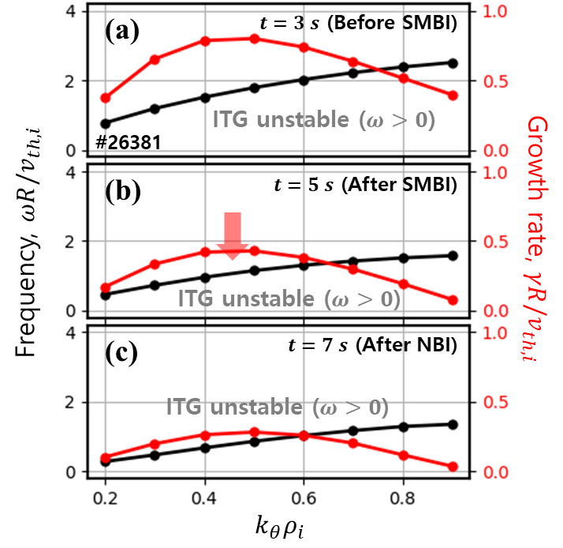
Evidence that turbulence does not drive the anomalous current (I)
Linear gyro-kinetic analysis by GKW at 𝝆_{𝑵} = 𝟎.𝟒 in #26381
It shows that the electron turbulence is sub-dominant during the whole discharge, and instead, ITG modes are most unstable.
This happens despite T_{e}-profile peaking, probably due to the favorable role of high T_{e}/T_{i} for the ITG excitation.
Those ITG modes become slightly mitigated after SMBI is applied.

Slide 15
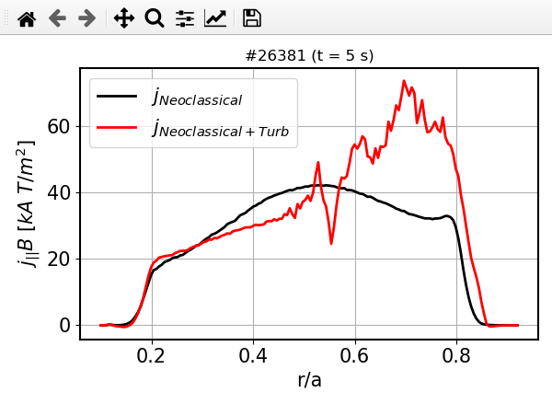
Evidence that turbulence does not drive the anomalous current (II)
Non-linear gyro-kinetic analysis by GTS at 5 s in #26381
The level of the additional current driven by the turbulence is notable.
However, considering that the bootstrap current is less than 5 % of the total current, the additional current
by the turbulence is not enough to explain the amount of anomalous current observed in the experiment,
about 30 % of the total current.

Slide 16
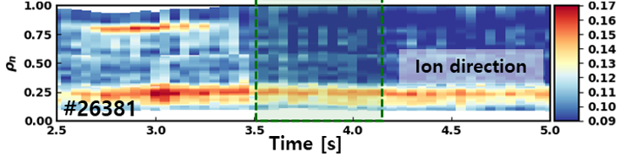
Evidence that turbulence does not drive the anomalous current (III)
Fluctuation coherence from ECEI in #26381
SMBI
The fluctuation data measured by ECEI exhibits similar trends with the linear stability analysis.
Before SMBI is applied, fluctuations are observed in the core region and also slightly in the edge region, which are
in the ion-diamagnetic direction.
After SMBI, the core fluctuation is mitigated and the edge fluctuation vanishes, whereas the anomaly in the current appears.
→ The anomalous current observed after SMBI is not likely to be driven by the long-wavelength
turbulence measured by ECEI.

Slide 17
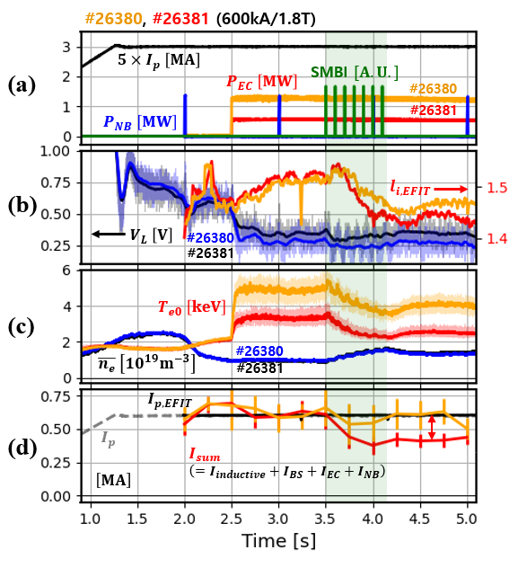
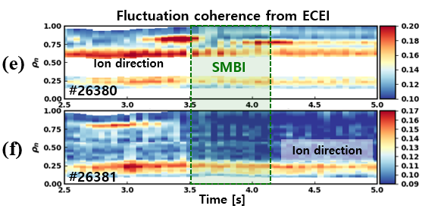
Evidence that turbulence does not drive the anomalous current (IV)
Comparison of two identical discharges except P_{EC}, #26380 (~1.3 MW) and #26381 (0.6 MW)
#26380
#26381
In #26380, due to the higher EC heating, the electron temperature is higher and the resulting turbulent fluctuations are also stronger.
However, the anomalous current gap exists only in the lower EC heating case, #26381.
There is no new appearance of a fluctuation and the existing fluctuations become even diminished when the anomalous current drive occurs.

Slide 18
Conclusion
We report a conclusive experimental evidence of a new self-generated current observed in the KSTAR tokamak.
In dedicated experiments with minimized known external and self-generated current drives, we observed an anomalous current gap that is not explained with present theories.
It is a robust phenomenon with high reproducibility observed in a specific electron temperature and density range when density fuelling is applied.
Our studies have not found any supporting evidence for the existing current drive mechanisms so far including those related to micro-instabilities with long-wavelength.
It is required to understand this novel current drive mechanism for its steady-state operation scenario application.
- Extend turbulence measurements to a broader k_{θ}-range including shorter wavelengths
- Perform further global non-linear gyrokinetic simulations followed by detailed analyses
- Evaluate zonal flows which regulate turbulence and nonlocal phenomena
- …
Yong-Su Na, Jaemin Seo, et al, Nature Comm. 13 6477 (2022)

Slide 19

Thank you

Slide 20
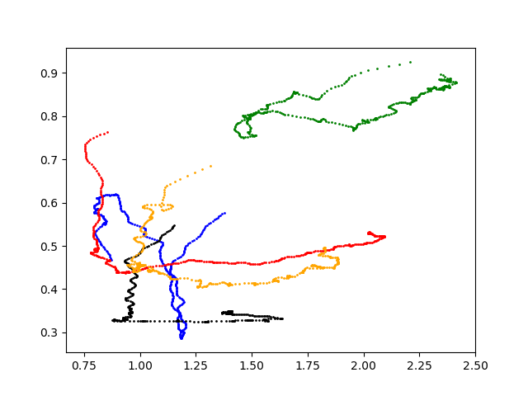
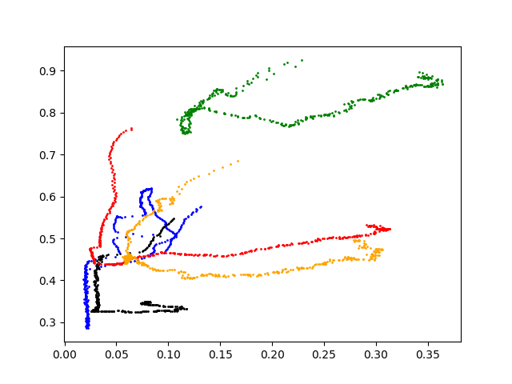
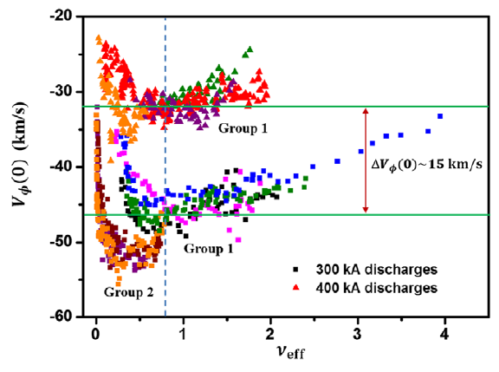




2.15s
5.5s
2.15s
5.5s
2.15s
2.15s
2.15s
2.15s
$$V_{L} \left[V\right]$$
$$V_{L} \left[V\right]$$
2.25s
5.5s
2.25s
5.5s
5.5s
5.5s
#26381(SMBI)
#29955(PVD)
#26354(no fuel)
#31670(PVD)
#31858(PVD)
#26381(SMBI)
#29955(PVD)
#26354(no fuel)
#31670(PVD)
#31858(PVD)
5.0s
5.0s
$n_{e}$ [10¹⁹m⁻³]
$$ν_{eff}$$
* #31858(PVD): Ohmic

Slide 21
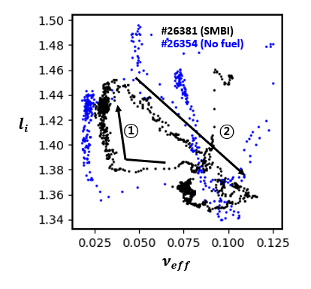
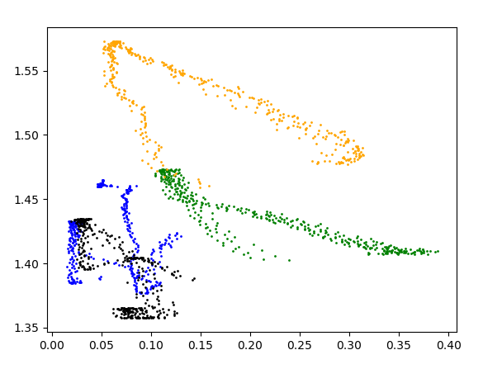

#26381(SMBI)
#29955(PVD) (X)
#26354(no fuel)
#31670(PVD)
#31858(PVD)
$$l_{i}$$
$$ν_{eff}$$

Slide 22
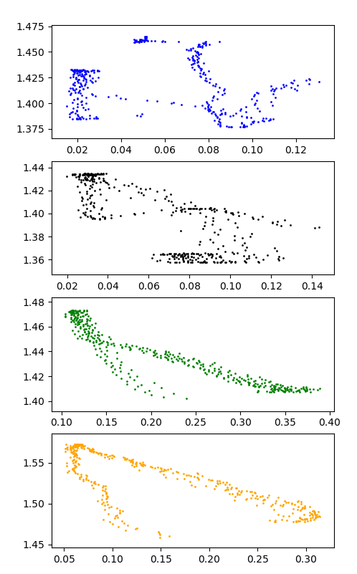
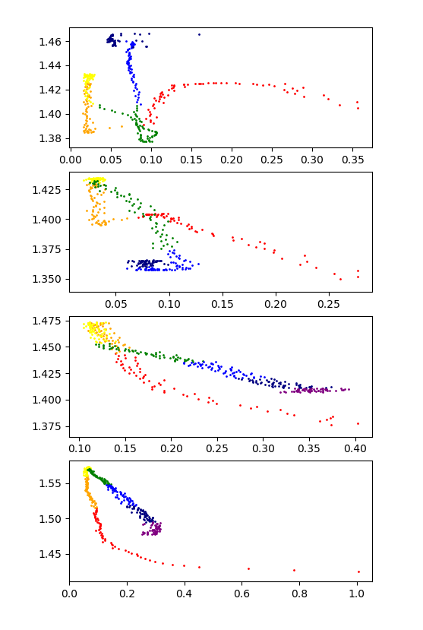



①
③
#26354(no fuel)
#26354(no fuel)
②
무지개 색깔 순서
2.0 – 2.5 s | Red
2.5 - 3.0 s | Orange
3.0 – 3.5 s | Yellow
3.5 – 4.0 s | Green
4.0 – 4.5 s | blue
4.5 – 5.0 s | navy
5.0 – 5.5 s | purple
5.5 – 6.0 s | grey
6.0 – 6.5 s | black
②
#26381(SMBI)
#26381(SMBI)
①
③
$$l_{i}$$
②
#31858(PVD)
#31858(PVD)
①
②
#31670(PVD)
#31670(PVD)
①
$$ν_{eff}$$
$$ν_{eff}$$

