Slide 1
ICRF wave propagation and absorption modelling
via machine learning
Álvaro Sánchez-Villar
Princeton Plasma Physics Laboratory
in collaboration with
N. Bertelli , D. Corona and S. Shiraiwa (PPPL), Z. Bai and T. Perciano (LBNL),
W. Bethel (SFSU), G. Wallace and J. Wright (MIT, USA)
September 18, 2023
NSTX-U / Magnetic Fusion Science meeting, LSB-B318, PPPL, Princeton
Notes:
My name is Alvaro Sanchez Villar Princeton Plasma Physics Laboratory. I would like to thank the organizers of the EPS for giving us the opportunity to present this results here. I would also like to thank our collaborators for their respective contributions to this work. Today I am going to present our surrogate modeling efforts on ICRF wave propagation and absorption.

Slide 2
Outline
Álvaro Sánchez-Villar
Motivation
TORIC-ML
Results for HHFW at NSTX
Results for minority heating at WEST
Surrogate predictions of HHFW TORIC outliers
Ramp-up regime at NSTX (D. Corona)
Concluding thoughts
NSTX-U / Magnetic Fusion Science meeting
September 18, 2023, Princeton, USA

Slide 3
Outline
Álvaro Sánchez-Villar
Motivation
TORIC-ML
Results for HHFW at NSTX
Results for minority heating at WEST
Surrogate predictions of HHFW TORIC outliers
Ramp-up regime at NSTX (D. Corona)
Concluding thoughts
NSTX-U / Magnetic Fusion Science meeting
September 18, 2023, Princeton, USA

Slide 4
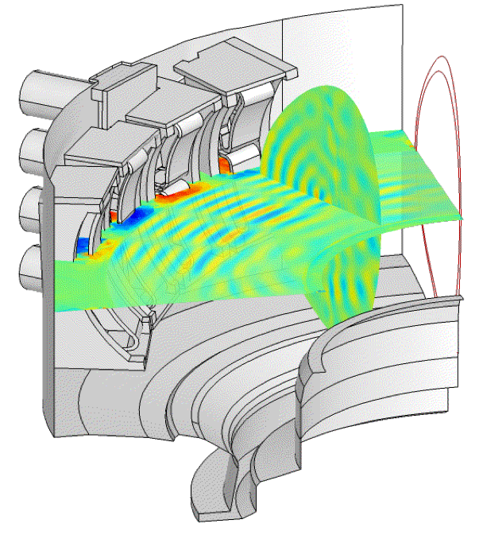
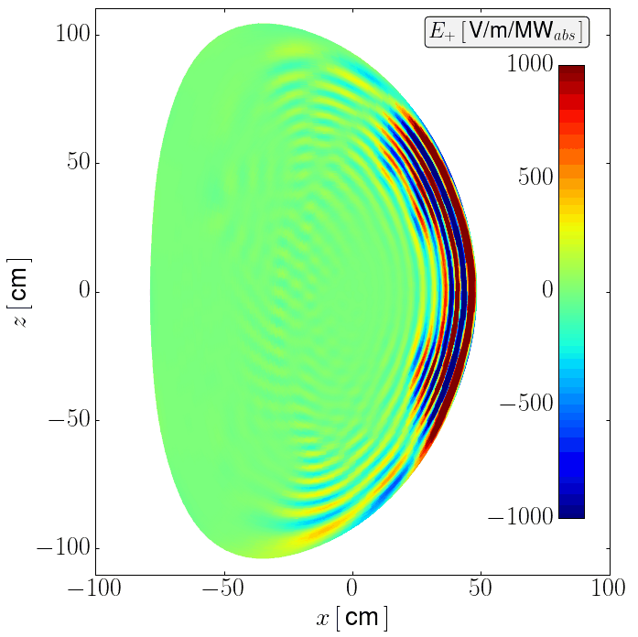
Full-wave codes unfeasible for applications as real-time control
Álvaro Sánchez-Villar
RF-actuators modeling ⇨ evaluate antenna impact ⇨plasma response
Full-wave codes (AORSA, Petra-M, CYRANO, TORIC, etc) are computationally expensive even with HPC
Unfeasible simulation times for applications as:
  Specific scenario optimization
  Inter-shot predictive modeling
  Real-time control
Machine Learning (ML) models ⇨ Simplify and accelerate computation
Is it possible to apply ML algorithms to the ICRF full-wave problem?
  Thorough data acquisition & handling
  Adequate algorithm implementation ⇨ high-fidelity models
Petra-M
TORIC
NSTX-U / Magnetic Fusion Science meeting
September 18, 2023, Princeton, USA
Notes:
INCLUDE SOME INTRO AS RF actuatormodels are crucial to estimate the impact of RF antennas on plasma dynamics
For that purpose, the typical approach is to use full-wave RF codes which to this day are still computationally expensive. Simulations depending on the application can take from minutes (as 2D toric simulations) to hours in some cases as it is the case for Petra-M. even with the use of High Performance Computing Techniques
This strongly limits their application for some applications that are desirable for fusion models as:
The optimization of specific scenarios in terms of design and operation parameters
In order to predict plasma behavior between shots
Or eventually reach real-time control capabilities.
ML models allow to simplify and accelerate estimation of physical quantities but require
1) a thorough data acquisition process
2) adequate selection of the ML model to reach high-fidelity results.
Is it possible to create a surrogate model that would allow to bring this physics closer to the abovementioned applications while maintaining:

Slide 5
Outline
Álvaro Sánchez-Villar
Motivation
TORIC-ML
Results for HHFW at NSTX
Results for minority heating at WEST
Surrogate predictions of HHFW TORIC outliers
Ramp-up regime at NSTX (D. Corona)
Concluding thoughts
NSTX-U / Magnetic Fusion Science meeting
September 18, 2023, Princeton, USA

Slide 6
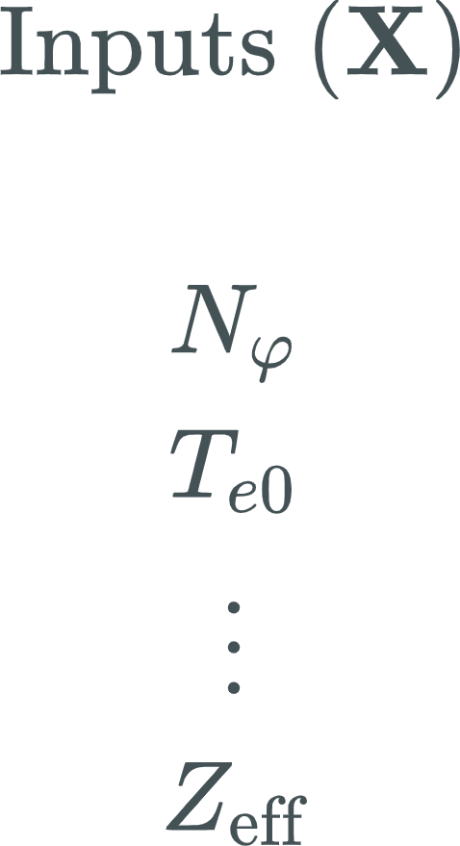
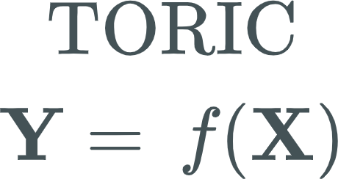
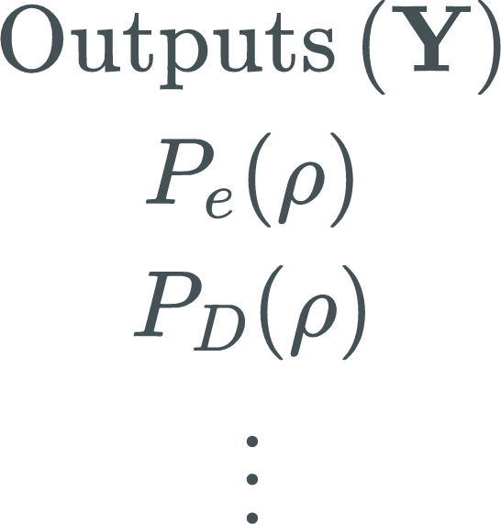

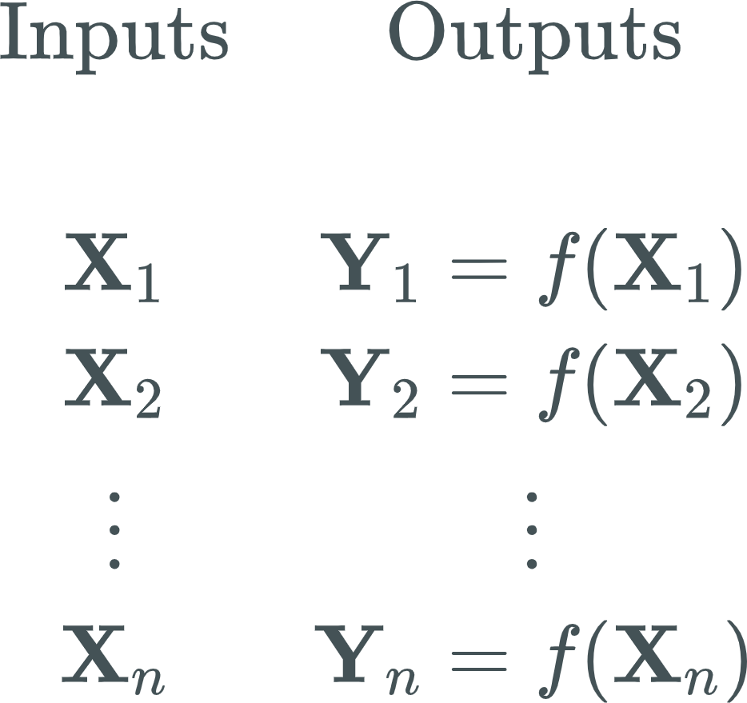
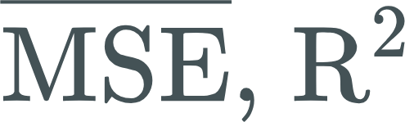
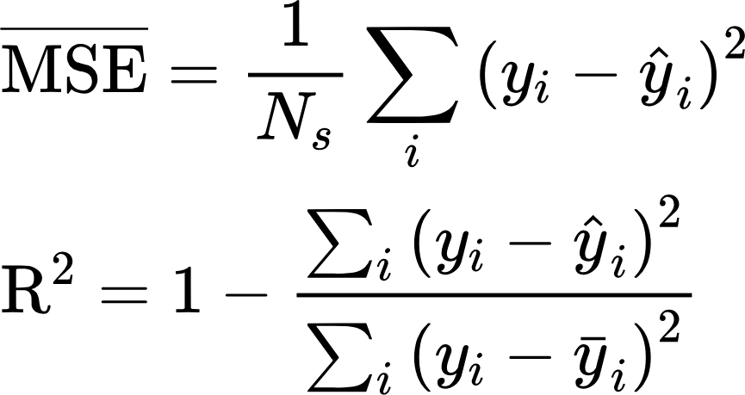

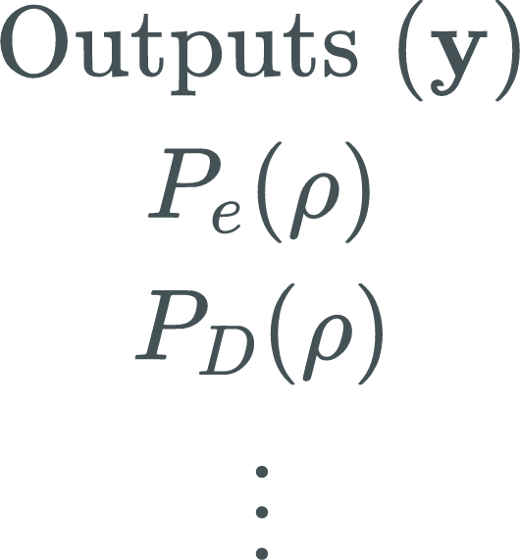


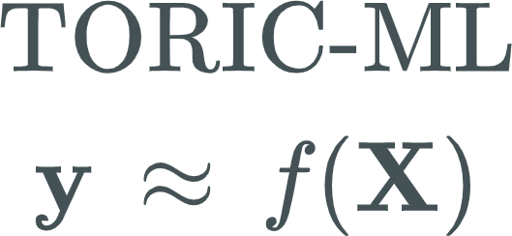
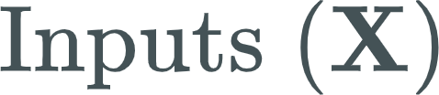
TORIC-ML : A surrogate model for TORIC
Álvaro Sánchez-Villar
TORIC[1,2]: ICRF full-wave simulation code
Goal ⇨ TORIC-ML: TORIC surrogate model
TORIC-ML requirements:
  Finite database, accuracy and speed
Database:
  Regime and parametric space of interest
  Latin Hypercube Sampling method
ML algorithm (for 1D profiles):
  Random Forest Regressor (RFR)
  Multilayer Perceptron (MLP)
  Hyperparameter tuning and validation
NSTX-U / Magnetic Fusion Science meeting
September 18, 2023, Princeton, USA
Notes:
A typical approach is to obtain solutions using a full-wave code
TORIC is full-wave code that solves electromagnetic waves in hot plasmas in the ion cyclotron range of frequencies (ICRF) and is frequently used by the fusion community to predict wave propagation and absorption in tokamak plasmas.
In fact this code, and the version used in this work is the same as that used in TRANSP.
The main goal is to create a surrogate model for TORIC that we have named ⇨TORIC-ML
A surrogate model is a model trained to capture the connections between inputs and outputs. It requires the generation of a database and proper training. Model scoring is measured in terms of mean squared error and the coefficient of determination R2. While the first metric is self-defined, the second is 1-RSS/TSS sum of squared residuals divided by the total sum of residuals.
Its main requirements are to have a finite database that allows to obtain accurate and fast predictions of TORIC outputs
Database is generated over the regime and parametric space of interest with the use of the Latin Hypercube Sampling method that allows to sample randomly and uniformly through parameter space.
For the work here that refers to the 1D profiles, two models have been exploited:
Random Forest Regressor (RFR)
Multilayer Perceptron (MLP)
Dedicated hyperparameter tuning

Slide 7
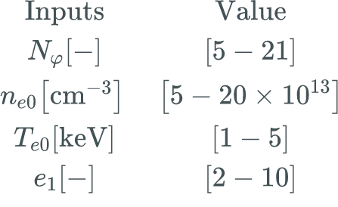
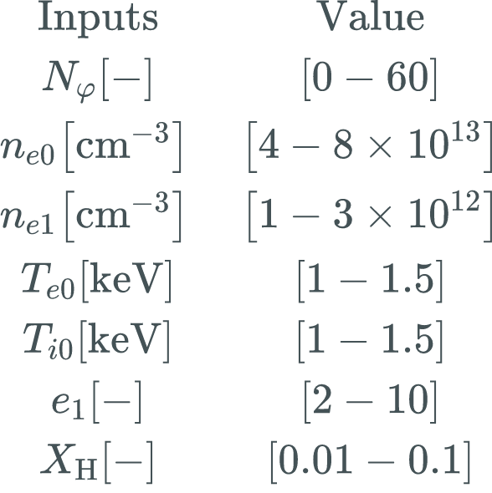
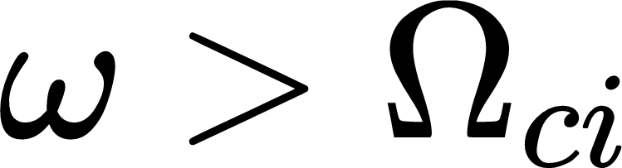
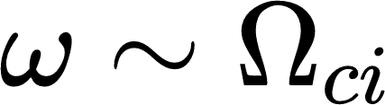
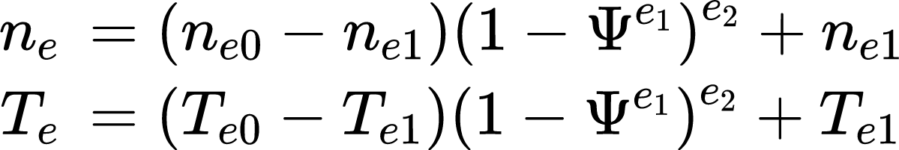
TORIC-ML is trained for NSTX and WEST
Álvaro Sánchez-Villar
Facilities: NSTX/WEST
  ～10000 cases per scenario
  Frequency: 30/53 MHz
  Magnetic field (B): 0.55/3.7 T
  Major radius (R): 0.85/2.5 m
Heating regimes:
  HHFW:
  Minority:
Plasma species: D/D-H
Flat-top scenarios:
  Plasma property profiles as
Input parametric spaces investigated
Number of free input parameters:
  4 for NSTX
  7 for WEST
NSTX [3]
WEST [4]
NSTX-U / Magnetic Fusion Science meeting
September 18, 2023, Princeton, USA
Notes:
In particular we have investigated two scenarios with over 10000 cases each: NSTX and WEST.
The former representing an example of HHFW scheme (frequencies above the ion cyclotron frequency) and the latter the minority heating (comparable to the ion cyclotron frequency).
Both scenarios present different types of plasma, magnetic field, major radius, etc.
For these we have selected a input parametric range and sampled 10000 cases with the use of the LHS method.
Note that while in the NSTX we used 4 parameters, the minority required higher number of free input parameters as the minority concentration.

Slide 8
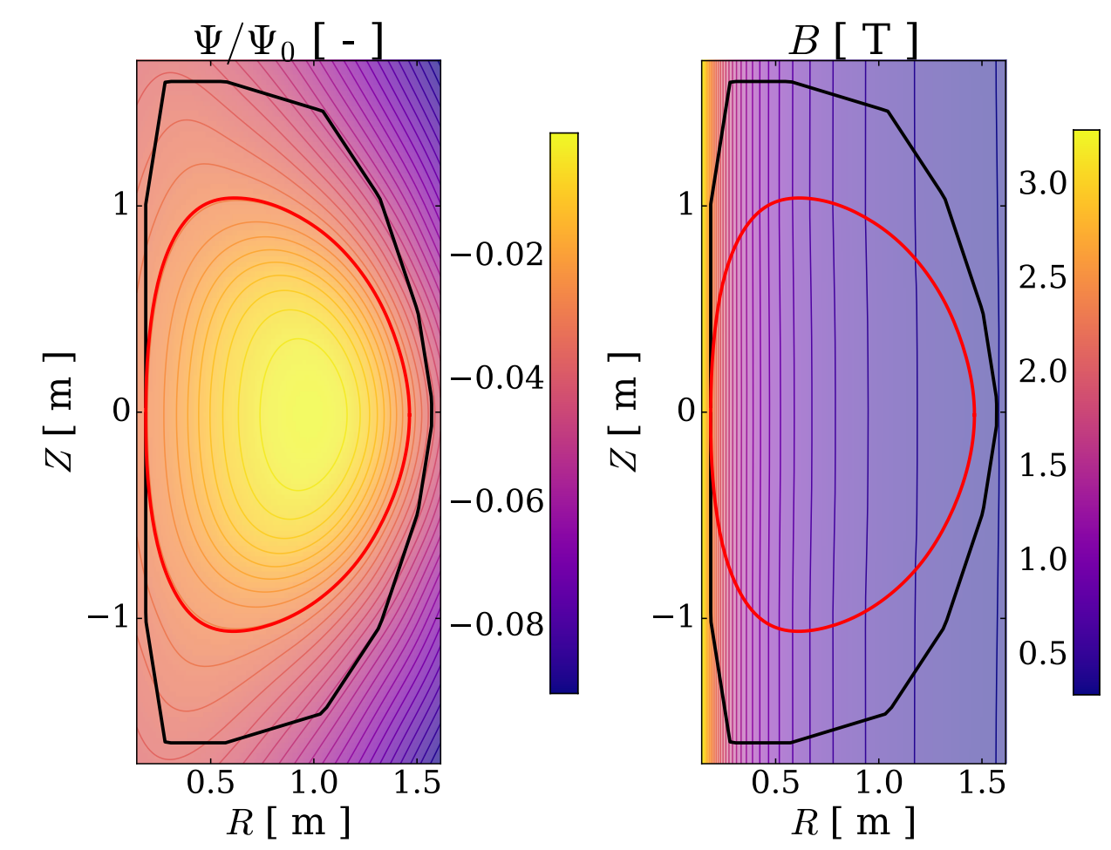
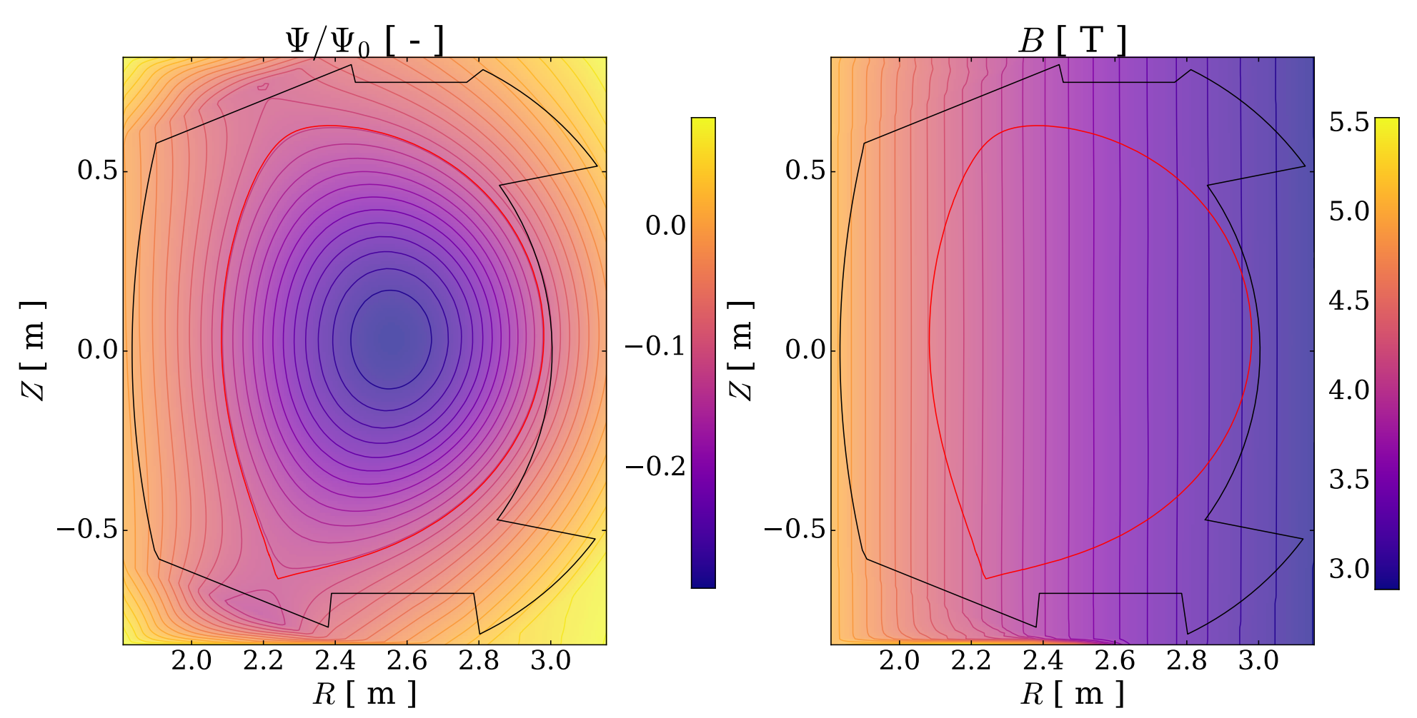
Equilibriums used for NSTX and WEST
Álvaro Sánchez-Villar
NSTX - Shot 138506 [3]
WEST - Shot 56898 [5]
NSTX-U / Magnetic Fusion Science meeting
September 18, 2023, Princeton, USA
Notes:
In particular we have investigated two scenarios with over 10000 cases each: NSTX and WEST.
The former representing an example of HHFW scheme (frequencies above the ion cyclotron frequency) and the latter the minority heating (comparable to the ion cyclotron frequency).
Both scenarios present different types of plasma, magnetic field, major radius, etc.
For these we have selected a input parametric range and sampled 10000 cases with the use of the LHS method.
Note that while in the NSTX we used 4 parameters, the minority required higher number of free input parameters as the minority concentration.

Slide 9
Outline
Álvaro Sánchez-Villar
Motivation
TORIC-ML
Results for HHFW at NSTX
Results for minority heating at WEST
Surrogate predictions of HHFW TORIC outliers
Ramp-up regime at NSTX (D. Corona)
Concluding thoughts
NSTX-U / Magnetic Fusion Science meeting
September 18, 2023, Princeton, USA

Slide 10
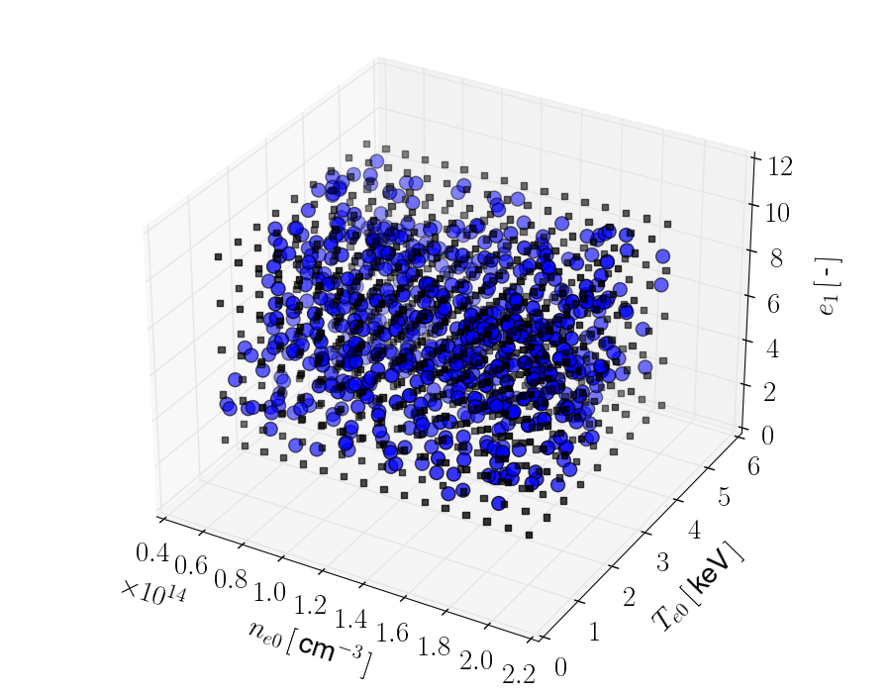
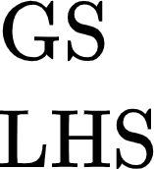
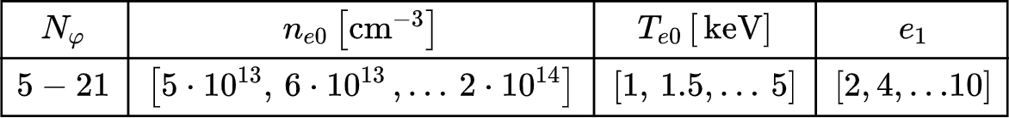
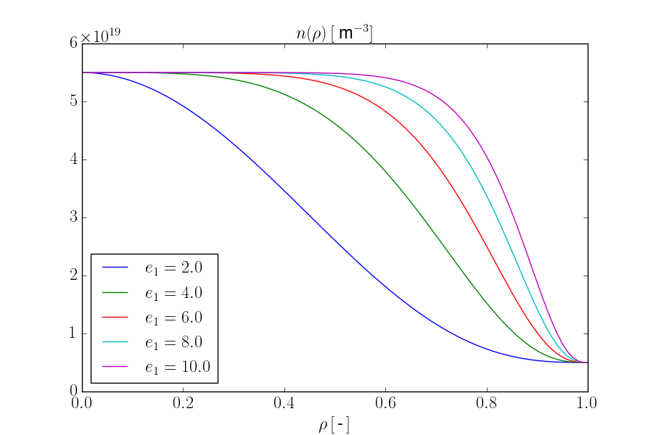
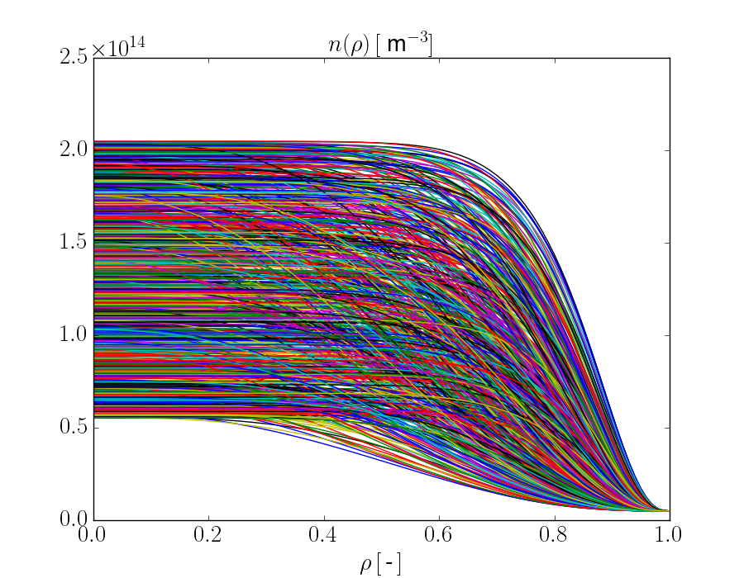


Two sampling strategies tested
Álvaro Sánchez-Villar
Two databases generated using:
  Gridded Sampling (GS):
    Equispaced
    Fixed intervals for all combinations
  Latin Hypercube sampling (LHS):
    Statistical method
    Pseudo-random sample set of parameter values in a multidimensional distribution
    Marginal distribution stratified into n splits, n being sample points
    Method reduces the statistical bias in the sampling method
NSTX-U / Magnetic Fusion Science meeting
September 18, 2023, Princeton, USA
Notes:
These full-wave codes are computationally expensive many of them requiring high performance computing (HPC) techniques even to make their simulations attainable.
Associated high computational costs impede their application to disruptive applications that could help for the achievement of high performance fusion reactors:
Specific RF scenario optimization
Integrated modeling (coupling with other models of plasma transport, impurity dynamics, etc)
Inter-shot predictive modeling
Real-time control
For instance, TORIC computational time for the flat-top NSTX scenarios is ～1-5 minutes
Machine Learning (ML) models have found a niche in computational sciences especially due to their associated efficient handling of exascale data in multivariable models.
Surrogate models based on supervised ML algorithms allow to simplify the workflow of obtention of model predictions/estimations by the acceleration of computational codes.
The main drawbacks of these models are:
Thorough data acquisition process
Adequate algorithm selection
Uncertainty in the achievement of high-fidelity models
However, several examples of high-fidelity surrogate models have shown significant acceleration of computational codes in the field of fusion energy sciences, including some direct real-time capable applications.

Slide 11

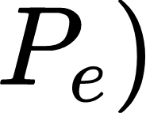
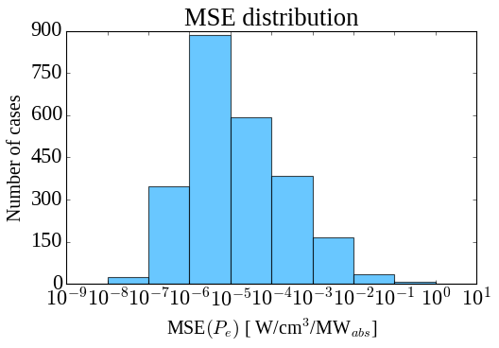
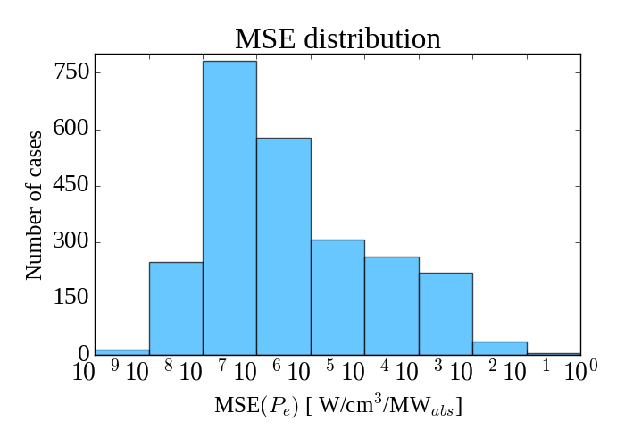
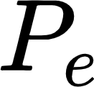
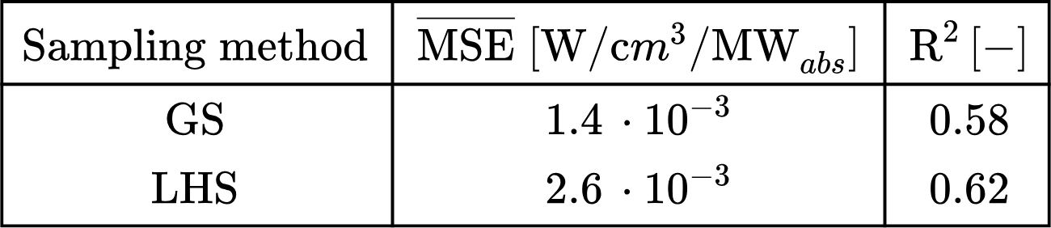
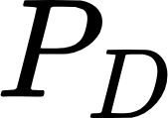
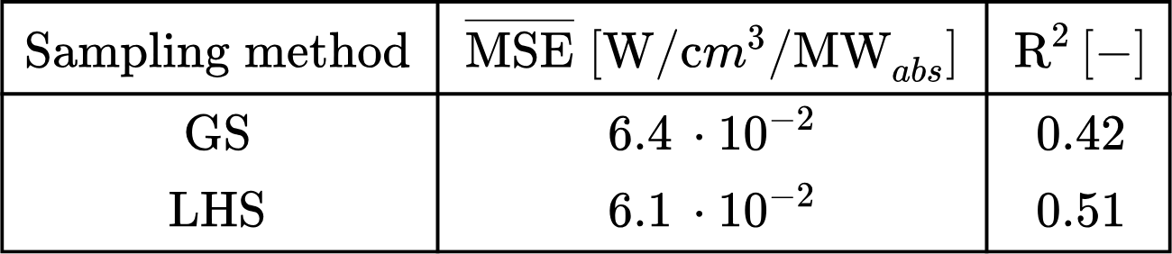
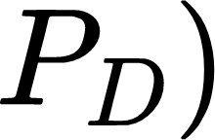
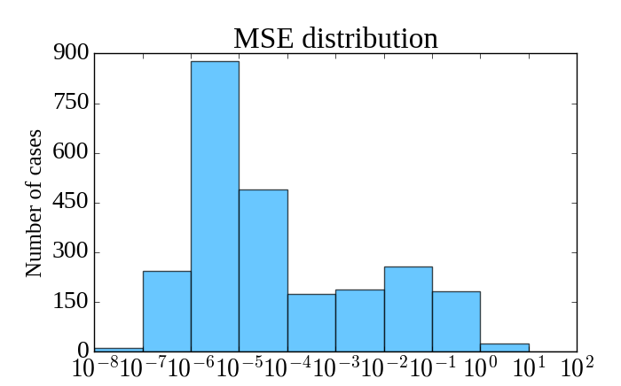
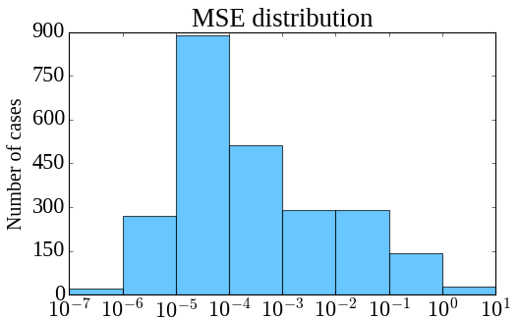
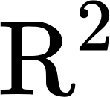
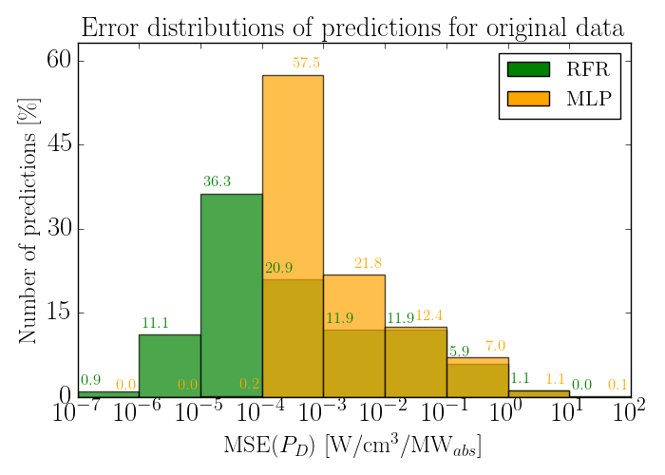
Influence of sampling on RFR scoring results
Álvaro Sánchez-Villar
Results for the predictions:
Results for the predictions
LHS / GS
  LHS features slightly better
  GS (in this case) halves the average MSE
  LHS useful for low resolution per input
NSTX-U / Magnetic Fusion Science meeting
September 18, 2023, Princeton, USA
Notes:
These full-wave codes are computationally expensive many of them requiring high performance computing (HPC) techniques even to make their simulations attainable.
Associated high computational costs impede their application to disruptive applications that could help for the achievement of high performance fusion reactors:
Specific RF scenario optimization
Integrated modeling (coupling with other models of plasma transport, impurity dynamics, etc)
Inter-shot predictive modeling
Real-time control
For instance, TORIC computational time for the flat-top NSTX scenarios is ～1-5 minutes
Machine Learning (ML) models have found a niche in computational sciences especially due to their associated efficient handling of exascale data in multivariable models.
Surrogate models based on supervised ML algorithms allow to simplify the workflow of obtention of model predictions/estimations by the acceleration of computational codes.
The main drawbacks of these models are:
Thorough data acquisition process
Adequate algorithm selection
Uncertainty in the achievement of high-fidelity models
However, several examples of high-fidelity surrogate models have shown significant acceleration of computational codes in the field of fusion energy sciences, including some direct real-time capable applications.

Slide 12
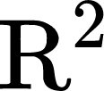
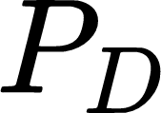
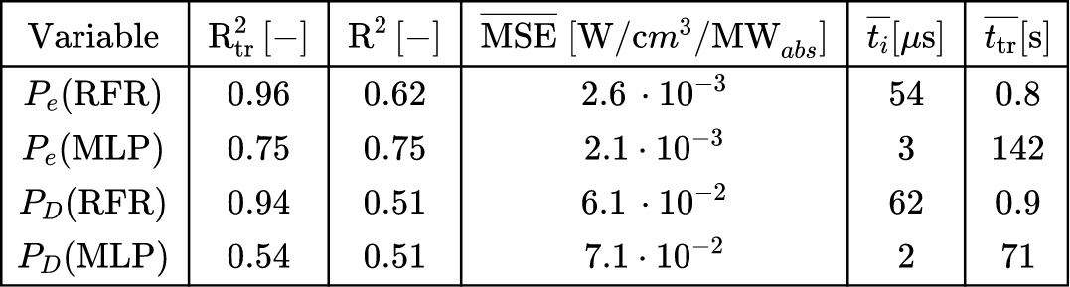
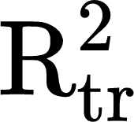
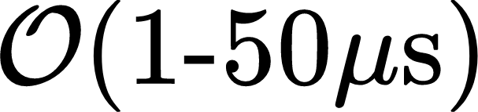
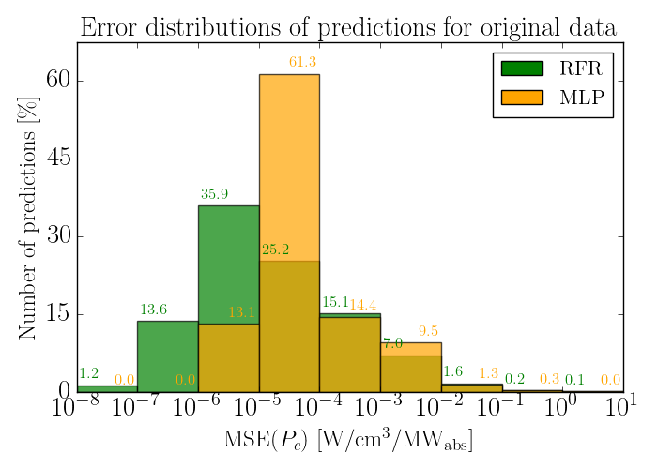
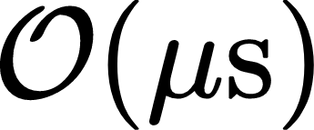
Poor scoring obtained without analyzing the HHFW database
Álvaro Sánchez-Villar
Poor surrogate scoring ( ) for 1D electron ( ) & deuterium ( ) power absorption profiles using original data, worse for
RFR training score is greater than that of MLP, in fact above 0.9 for both &
Accelerated predictions with average inference times
RFR is an effective regressor:
  Simple implementation
  Short training times:
    Faster retraining
MLP can be a faster alternative:
  Standardization & thorough hyperparameter tuning
  Longer training times
  inference times
NSTX-U / Magnetic Fusion Science meeting
September 18, 2023, Princeton, USA
Notes:
First results without analyzing the HHFW database showed an order 50 us average inference time for either electron/deuterium power prediction profiles.
Both profiles show a rather poor estimation of the profiles.
Significantly lower accuracy is found in the case of deuterium predictions.

Slide 13
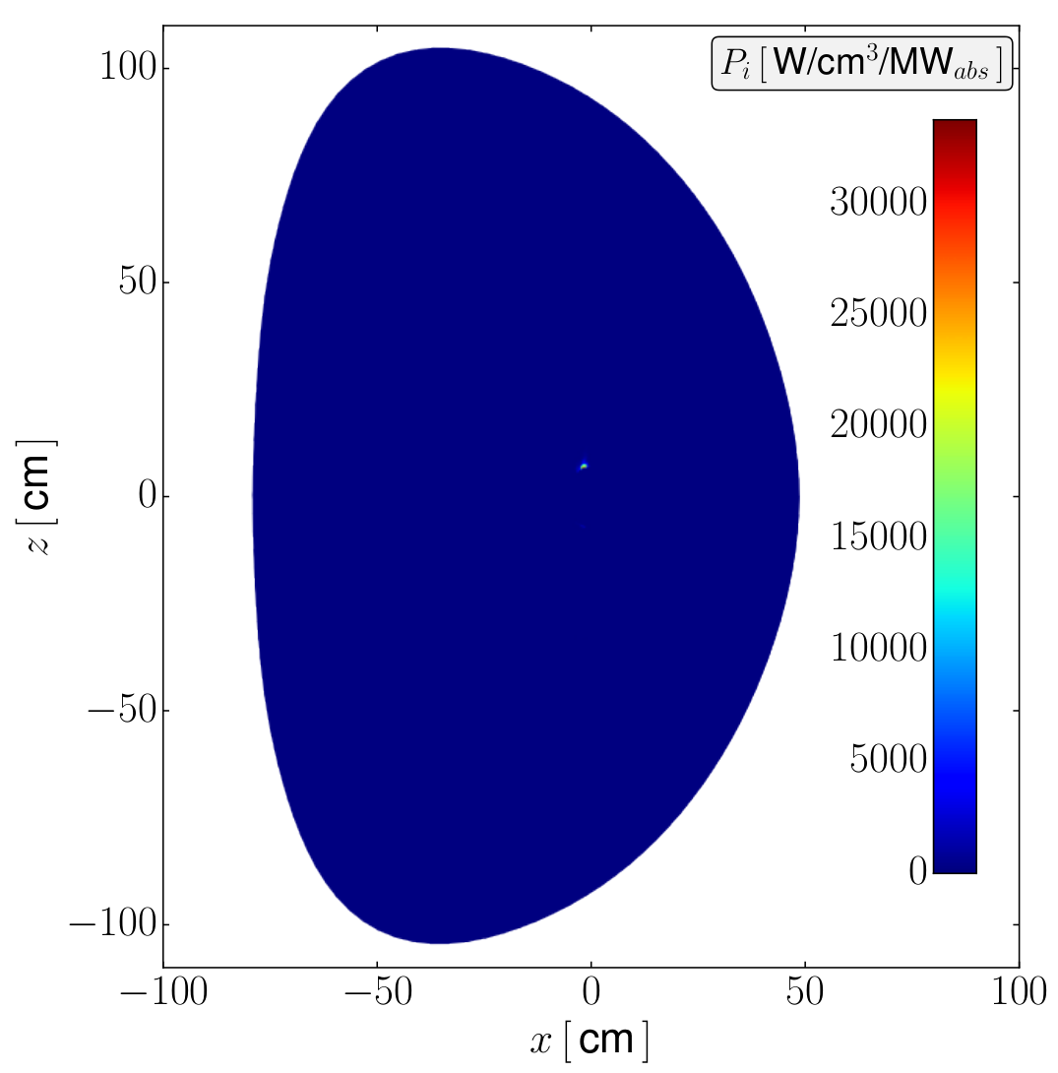
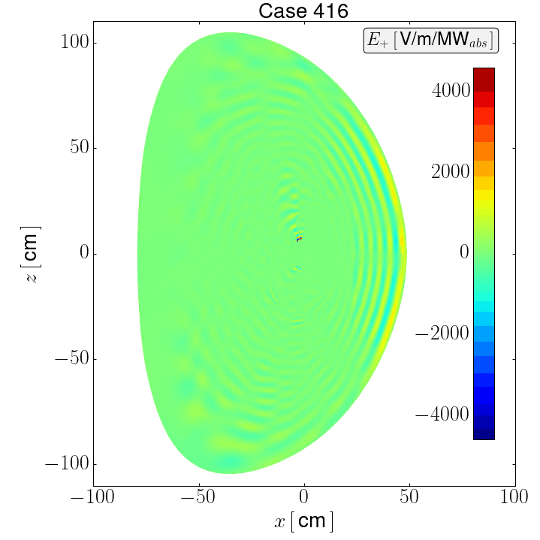
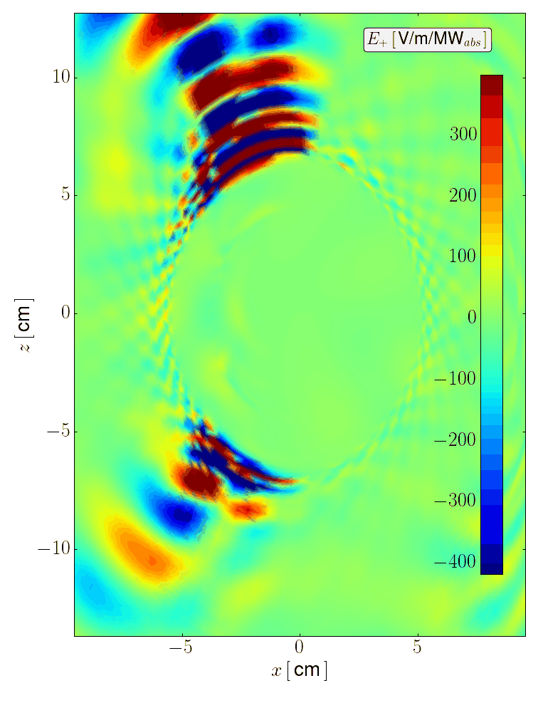
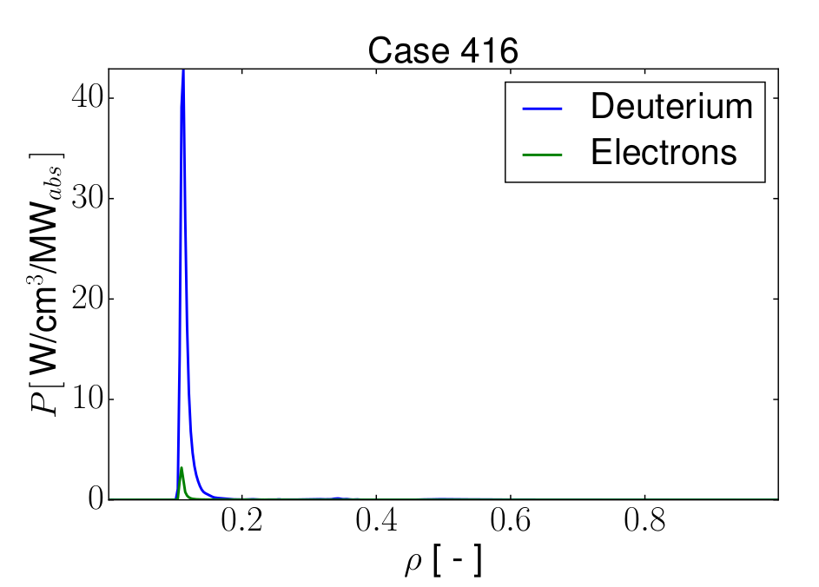
Exploratory data analysis shows outliers in the HHFW database
Outlier
example
Álvaro Sánchez-Villar
NSTX-U / Magnetic Fusion Science meeting
September 18, 2023, Princeton, USA

Slide 14
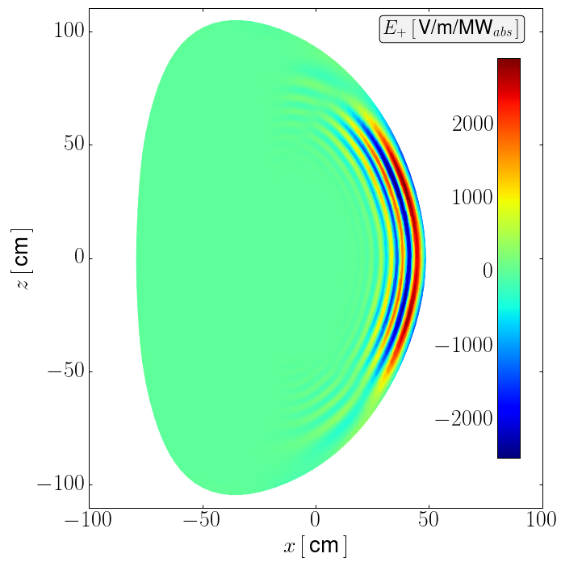
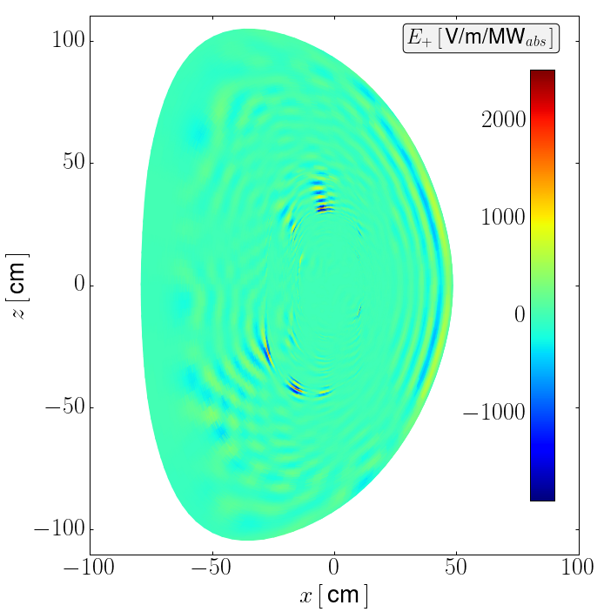
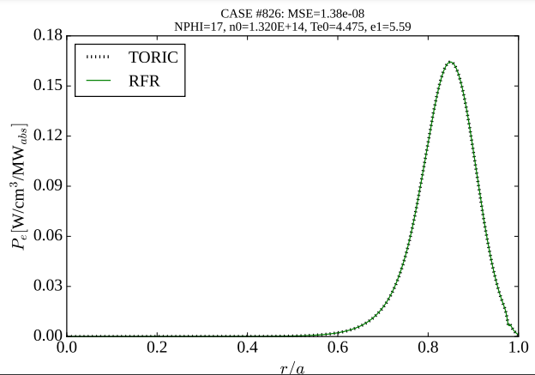
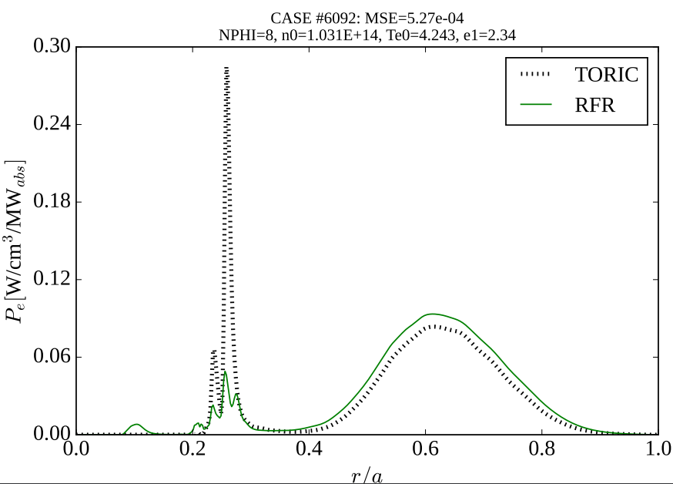






HHFW database analysis and outlier filtering
Álvaro Sánchez-Villar
Definition of a metric for anomaly/outlier identification
  Not MSE based
  ~21-23% of the cases feature outlier behavior
Correlation between outliers and computationally
expensive parametric space:
  Low toroidal mode number
  Lower temperature (low damping)
  Higher density (small wavelengths)
TORIC unexpected solutions for certain parameter combinations, also impacting RMSE
Outliers represent a ∼23% of the database
Typical scenario
Outlier scenario
NSTX-U / Magnetic Fusion Science meeting
September 18, 2023, Princeton, USA
Notes:
Closer look at the database revealed the presence of outliers.
While in typical scenario, TORIC would provide a smooth profile and a fast wave that progressively damps out as propagating in the hot plasma, outlier cases where observed where the output from TORIC did not appear to be correct.
A metric designed to identify such outliers allowed to quantify the amount of these outliers in the database to a 22%.
The outliers were observed to be correlated to different regions parametric space, specially to low toroidal mode number, lo temperature and high density.
Another region of very low temperature and density was found.
We are currently still investigating this type of outliers in TORIC.

Slide 15

Data processing & analysis leads to high-fidelity surrogates
Álvaro Sánchez-Villar
NSTX-U / Magnetic Fusion Science meeting
September 18, 2023, Princeton, USA
Notes:
As expected filtering this outlier cases (22% of the database) resulted in highly improved predictions to high fidelity levels.
Here we can see that the coefficient of determination
Outlier elimination not only removed their increased errors but also removed the errors induced in the prediction of typical scenarios as the algorithm was trained including outliers.

Slide 16





Data processing & analysis leads to high-fidelity surrogates
Álvaro Sánchez-Villar
NSTX-U / Magnetic Fusion Science meeting
September 18, 2023, Princeton, USA
Notes:
As expected filtering this outlier cases (22% of the database) resulted in highly improved predictions to high fidelity levels.
Here we can see that the coefficient of determination
Outlier elimination not only removed their increased errors but also removed the errors induced in the prediction of typical scenarios as the algorithm was trained including outliers.

Slide 17

Data processing & analysis leads to high-fidelity surrogates
Álvaro Sánchez-Villar
NSTX-U / Magnetic Fusion Science meeting
September 18, 2023, Princeton, USA
Notes:
As expected filtering this outlier cases (22% of the database) resulted in highly improved predictions to high fidelity levels.
Here we can see that the coefficient of determination
Outlier elimination not only removed their increased errors but also removed the errors induced in the prediction of typical scenarios as the algorithm was trained including outliers.

Slide 18








Electron absorption profile predictions (training and test)
Álvaro Sánchez-Villar
NSTX-U / Magnetic Fusion Science meeting
September 18, 2023, Princeton, USA
Notes:
As expected filtering this outlier cases (22% of the database) resulted in highly improved predictions to high fidelity levels.
Here we can see that the coefficient of determination
Outlier elimination not only removed their increased errors but also removed the errors induced in the prediction of typical scenarios as the algorithm was trained including outliers.

Slide 19




Deuterium absorption profile predictions (training and test)
Álvaro Sánchez-Villar
NSTX-U / Magnetic Fusion Science meeting
September 18, 2023, Princeton, USA
Notes:
As expected filtering this outlier cases (22% of the database) resulted in highly improved predictions to high fidelity levels.
Here we can see that the coefficient of determination
Outlier elimination not only removed their increased errors but also removed the errors induced in the prediction of typical scenarios as the algorithm was trained including outliers.

Slide 20




Data processing & analysis leads to high-fidelity surrogates
Álvaro Sánchez-Villar
Electron power absorption
NSTX-U / Magnetic Fusion Science meeting
September 18, 2023, Princeton, USA
Notes:
As expected filtering this outlier cases (22% of the database) resulted in highly improved predictions to high fidelity levels.
Here we can see that the coefficient of determination
Outlier elimination not only removed their increased errors but also removed the errors induced in the prediction of typical scenarios as the algorithm was trained including outliers.

Slide 21


Data processing & analysis leads to high-fidelity surrogates
Álvaro Sánchez-Villar
Deuterium power absorption
NSTX-U / Magnetic Fusion Science meeting
September 18, 2023, Princeton, USA
Notes:
As expected filtering this outlier cases (22% of the database) resulted in highly improved predictions to high fidelity levels.
Here we can see that the coefficient of determination
Outlier elimination not only removed their increased errors but also removed the errors induced in the prediction of typical scenarios as the algorithm was trained including outliers.

Slide 22
Outline
Álvaro Sánchez-Villar
Motivation
TORIC-ML
Results for HHFW at NSTX
Results for minority heating at WEST
Surrogate predictions of HHFW TORIC outliers
Ramp-up regime at NSTX (D. Corona)
Concluding thoughts
NSTX-U / Magnetic Fusion Science meeting
September 18, 2023, Princeton, USA

Slide 23






Outliers in the minority database (WEST)
Álvaro Sánchez-Villar
Closer observation of TORIC solutions for Minority also revealed the presence of outliers
Correlated to
  Deuterium dominant power absorption cases in minority heating (unusual)
  Lower toroidal mode numbers
Noticeable effect on deuterium power absorption profiles
Currently kept in the database used for training
Typical scenario
Outlier scenario
Hydrogen dominates power absorption
Underresolved undamped IBW in HFS
NSTX-U / Magnetic Fusion Science meeting
September 18, 2023, Princeton, USA
Notes:
These full-wave codes are computationally expensive many of them requiring high performance computing (HPC) techniques even to make their simulations attainable.
Associated high computational costs impede their application to disruptive applications that could help for the achievement of high performance fusion reactors:
Specific RF scenario optimization
Integrated modeling (coupling with other models of plasma transport, impurity dynamics, etc)
Inter-shot predictive modeling
Real-time control
For instance, TORIC computational time for the flat-top NSTX scenarios is ～1-5 minutes
Machine Learning (ML) models have found a niche in computational sciences especially due to their associated efficient handling of exascale data in multivariable models.
Surrogate models based on supervised ML algorithms allow to simplify the workflow of obtention of model predictions/estimations by the acceleration of computational codes.
The main drawbacks of these models are:
Thorough data acquisition process
Adequate algorithm selection
Uncertainty in the achievement of high-fidelity models
However, several examples of high-fidelity surrogate models have shown significant acceleration of computational codes in the field of fusion energy sciences, including some direct real-time capable applications.

Slide 24





Poor-fair surrogate scoring for minority heating scenario
Álvaro Sánchez-Villar
Predictions obtained using both methods
Expected scoring decrease due to:
  Increased variance of the dataset:
    Physics complexity (multi-ion cyclotron and e-Landau damping)
    Parametric space dimensions and ranges (e.g. )
NSTX-U / Magnetic Fusion Science meeting
September 18, 2023, Princeton, USA

Slide 25




















Surrogate models capture the 1D profiles of the minority database
Álvaro Sánchez-Villar
Results for the predictions:
Results for the predictions:
Results for the predictions:
NSTX-U / Magnetic Fusion Science meeting
September 18, 2023, Princeton, USA

Slide 26










Application of PCA to WEST data results in improved MLP scoring
Álvaro Sánchez-Villar
Raw-data
PCA-data
Principal component analysis (PCA):
  linear transformation
  eigenvectors maximize the ‘captured’ variance
NSTX-U / Magnetic Fusion Science meeting
September 18, 2023, Princeton, USA

Slide 27
Application of PCA to WEST data results in improved MLP scoring
Álvaro Sánchez-Villar
Raw-data
PCA-data
Principal component analysis (PCA):
  linear transformation
  eigenvectors maximize the ‘captured’ variance
NSTX-U / Magnetic Fusion Science meeting
September 18, 2023, Princeton, USA

Slide 28
Outline
Álvaro Sánchez-Villar
Motivation
TORIC-ML
Results for HHFW at NSTX
Results for minority heating at WEST
Surrogate predictions of HHFW TORIC outliers
Ramp-up regime at NSTX (D. Corona)
Concluding thoughts
NSTX-U / Magnetic Fusion Science meeting
September 18, 2023, Princeton, USA

Slide 29


TORIC-ML predicts main HHFW physics in outlier scenarios (P_{e})
Álvaro Sánchez-Villar
In case the outlier disturbs the whole solution surrogate provides a more “physical” profile
NSTX-U / Magnetic Fusion Science meeting
September 18, 2023, Princeton, USA

Slide 30


TORIC-ML predicts main HHFW physics in outlier scenarios (P_{D})
Álvaro Sánchez-Villar
NSTX-U / Magnetic Fusion Science meeting
September 18, 2023, Princeton, USA

Slide 31
Outline
Álvaro Sánchez-Villar
Motivation
TORIC-ML
Results for HHFW at NSTX
Results for minority heating at WEST
Surrogate predictions of HHFW TORIC outliers
Ramp-up regime at NSTX (D. Corona)
Concluding thoughts
NSTX-U / Magnetic Fusion Science meeting
September 18, 2023, Princeton, USA

Slide 32

Ramp-up regime - Methodology (D. Corona)
D. Corona & Á. Sánchez-Villar
Start-up phase TORIC database for ML implementation, reconstruction of power electron and current drive density profiles.
Intricate regime due to low density, presence of standing waves and the influence of damping effects.
Real-time application of the reconstructions for future control porpoises to be simulated.
NSTX-U / Magnetic Fusion Science meeting
September 18, 2023, Princeton, USA

Slide 33




Ramp-up regime - Results (D. Corona)
D. Corona & Á. Sánchez-Villar
 | MLP regressor | XGBoost regressor
Training time | ≈ 30 seconds | ≈ 5.8 minutes
R² | ≈ 0.686 | ≈ 0.668
 | MLP regressor | XGBoost regressor
Training time | ≈ 25 seconds | ≈ 3.6 minutes
R² | ≈ 0.746 | ≈ 0.762
NSTX-U / Magnetic Fusion Science meeting
September 18, 2023, Princeton, USA

Slide 34
Outline
Álvaro Sánchez-Villar
Motivation
TORIC-ML
Results for HHFW at NSTX
Results for minority heating at WEST
Surrogate predictions of HHFW TORIC outliers
Ramp-up regime at NSTX (D. Corona)
Concluding thoughts
NSTX-U / Magnetic Fusion Science meeting
September 18, 2023, Princeton, USA

Slide 35
Concluding thoughts
Álvaro Sánchez-Villar
TORIC-ML :
  Surrogate model for ICRF wave propagation & absorption in NSTX & WEST
  Outliers in TORIC generated databases (still under investigation)
  Features appealing for integrated modeling & control algorithms:
    Captures 1D electron/ion power absorption profiles (R² = 0.71-0.97)
    Average inference times ~ 2-50 μs (compared to 1-5 min. TORIC)
    More robust model (i.e. in outlier scenarios)
  Ramp-up scenario: electron power absorption and current drive density
Future steps: outliers nature, 2D-field surrogates, and other ML algorithms
This work has been funded by the U.S. Department of Energy under contract number DE-AC02-09CH1146
NSTX-U / Magnetic Fusion Science meeting
September 18, 2023, Princeton, USA

