Slide 1
Exploring connections between electron temperature profile evolution and disruptions through Disruption Event Characterization and Forecasting (DECAF) analysis
Columbia U.: G. Bustos-Ramirez, S.A. Sabbagh, Y.S. Park, J.D. Riquezes,
M. Tobin, V. Zamkovska, F. Sheehan, G. Tillinghast
KFE: J.G. Bak, M.J. Choi, H. Han, J. Kim, J. Ko, W.H. Ko, J.W. Lee, K.D. Lee

Slide 2





A little about myself…
Office 211, PPPL
gbustosr@pppl.gov
gb2878@columbia.edu
Guillermo Bustos Ramirez NSTX-U / Magnetic Fusion Science meeting, January 8th 2024

Slide 3

Talk outline
Introduction to DECAF and ECE diagnostic in KSTAR.
Analysis of $T_{e}$ core crashes.
  Sawtooth crashes.
  DECAF implementation.
ELM crashes.
Conclusions and future work.
Guillermo Bustos Ramirez NSTX-U / Magnetic Fusion Science meeting, January 8th 2024

Slide 4

Talk outline
Introduction to DECAF and ECE diagnostic in KSTAR.
Analysis of $T_{e}$ core crashes.
  Sawtooth crashes
  DECAF implementation
ELM crashes.
Conclusions and future work.
Guillermo Bustos Ramirez NSTX-U / Magnetic Fusion Science meeting, January 8th 2024

Slide 5
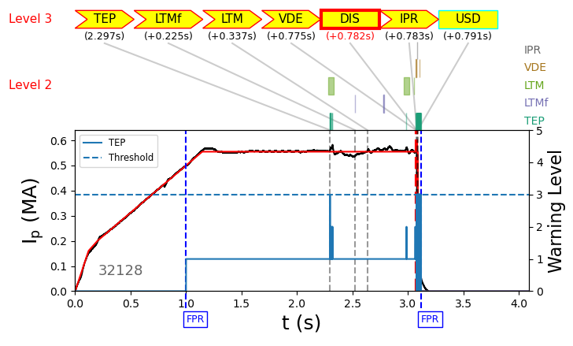
The DECAF code identifies the event chain leading to a disruption
A collection of physical models analyzes experimental data to raise a warning level when in proximity to a disruption.
Level 3 warning indicates imminent disruption if no action is taken.
Automated analysis of up to all shots available from multiple machines
  Test physics models.
  Iterative workflow to improve accuracy of warning level thresholds.
  Provides physics understanding of events leading to disruptions.
Guillermo Bustos Ramirez NSTX-U / Magnetic Fusion Science meeting, January 8th 2024

Slide 6
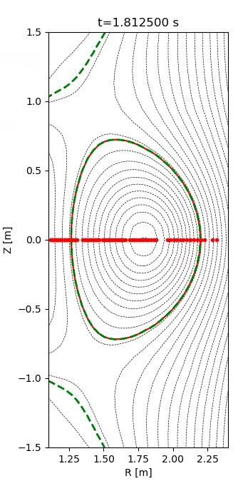
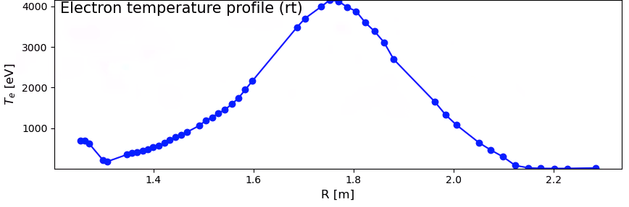
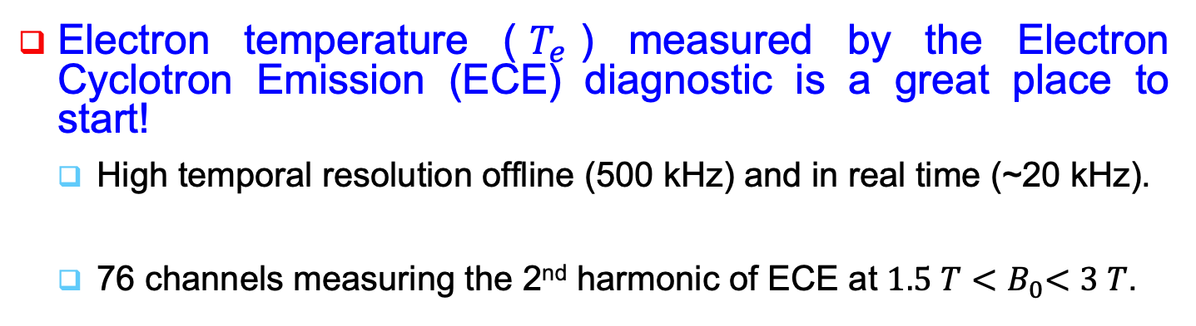
ECE in KSTAR is a powerful tool to forecast plasma event
DECAF is being updated to perform analysis on the evolution of plasma profiles (1D, 2D).
Electron temperature ($T_{e}$) measured by the Electron Cyclotron Emission (ECE) diagnostic is a great place to start!
  High temporal resolution offline (500 kHz) and in real time (~20 kHz).
  76 channels measuring the 2nd harmonic of ECE at $1.5 T{<B}_{0}<3 T$.
KSTAR shot 32143 at t=1.81 s
Location of the ECE measurement channels in KSTAR.
Guillermo Bustos Ramirez NSTX-U / Magnetic Fusion Science meeting, January 8th 2024

Slide 7
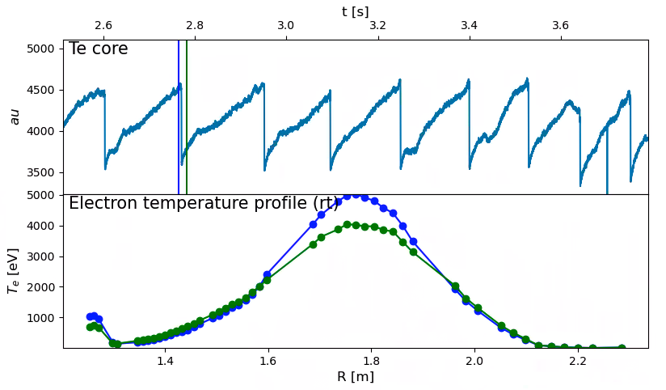
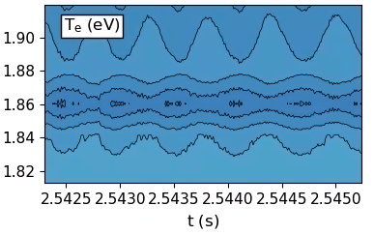

ECE diagnoses the ‘health’ of the flux surfaces and particle confinement.
If the magnetic surfaces are modified, electrons are the first to know, and such dynamics can be captured by the ECE.
Sawtooth crashes [1,2,3]
Magnetic islands [4,5]
$$T_{e} [eV]$$
R (m)
[1] S H Jeong et al Review of Scientific Instruments 81, 10D922 (2010)
[2] M. van Berkel et al, Fusion Engineering and Design, Volume 86, Issue 12, 2011
[3] H van den Brand et al, Plasma Phys. Control Fusion 58 075002
[4] Y S Park and A S Welander, Plasma Phys. Control. Fusion 48 (2006) 1447–1454
[5] A O Nelson Fusion Engineering and Design 141 (2019) 25–29.
Guillermo Bustos Ramirez NSTX-U / Magnetic Fusion Science meeting, January 8th 2024

Slide 8
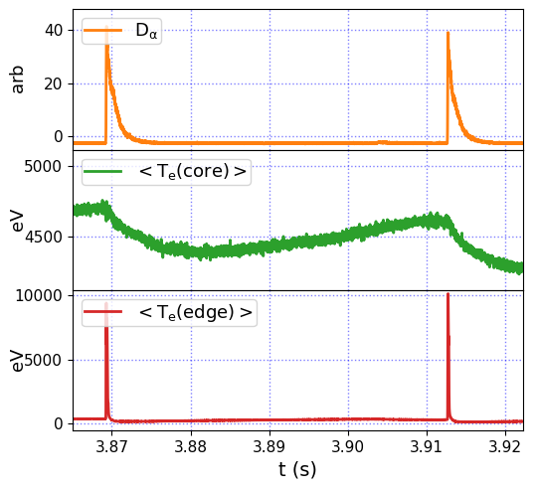
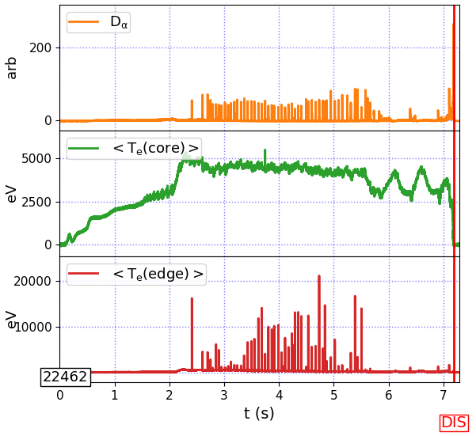
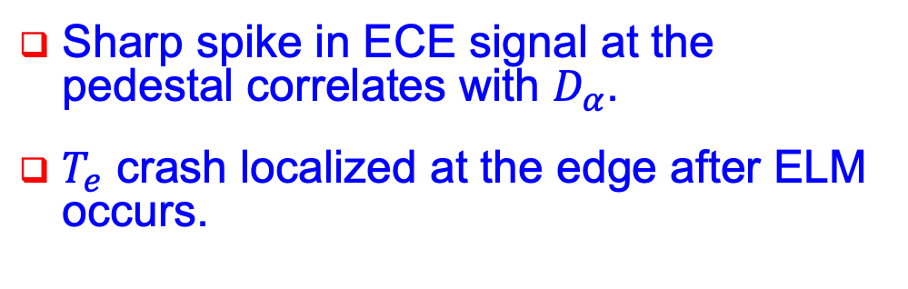
ELMing phase also clearly identified on edge ECE channels
Sharp spike in ECE signal at the pedestal correlates with $D_{α}$.
$T_{e}$ crash localized at the edge after ELM occurs.

Slide 9

Talk outline
Introduction to DECAF and ECE diagnostic in KSTAR.
Analysis of $T_{e}$ core crashes.
  Sawtooth crashes and more.
  DECAF implementation.
ELM crashes.
Conclusions and future work.
Guillermo Bustos Ramirez NSTX-U / Magnetic Fusion Science meeting, January 8th 2024

Slide 10
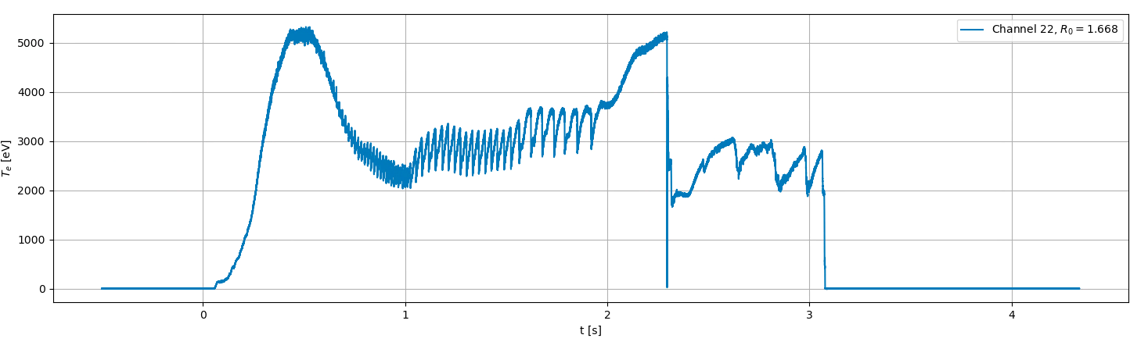



Following $T_{e}$ crashes and their connection to disruptions.
Crashes in the $T_{e}$ profile might indicate a reconnection or a radiative event, which might forecast a disruption.
  Indicate a confinement degradation (might or might not be severe).
  Serve as island seeds → DIS
  Easy to track.
Full $T_{e}$ collapse (TEC)
32128
‘slow’ $T_{e}$ core crashes
Disruption event
SAW crashes
Guillermo Bustos Ramirez NSTX-U / Magnetic Fusion Science meeting, January 8th 2024

Slide 11
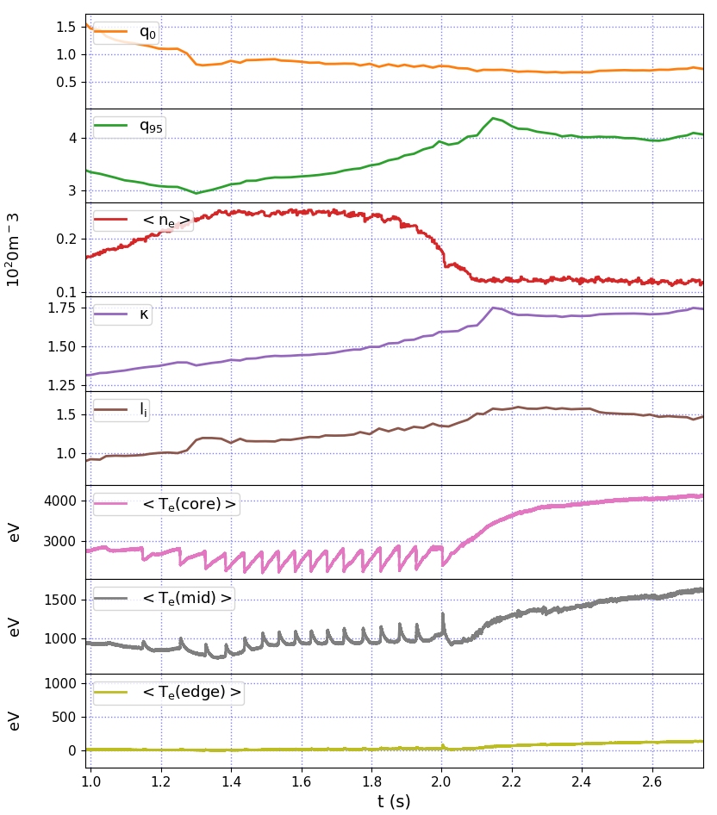
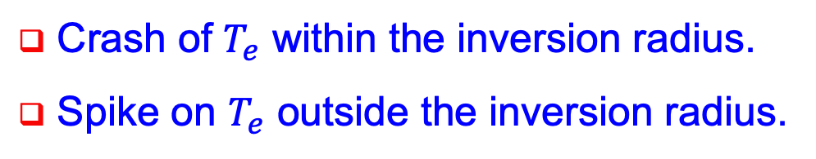
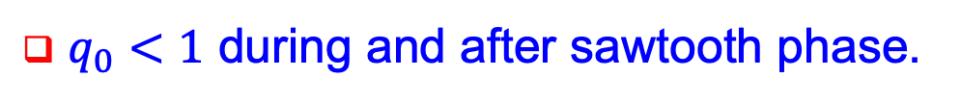
Sawtooth phase is clearly identified on the average of $T_{e}$ at different regions of the plasma
29879
$q_{0}<1$ during and after sawtooth phase.
Sawtooth phase ends due to change in plasma conditions, pushing the state to the stable domain.
Crash of $T_{e}$ within the inversion radius.
Spike on $T_{e}$ outside the inversion radius.
No significant changes at the edge.
Guillermo Bustos Ramirez NSTX-U / Magnetic Fusion Science meeting, January 8th 2024

Slide 12
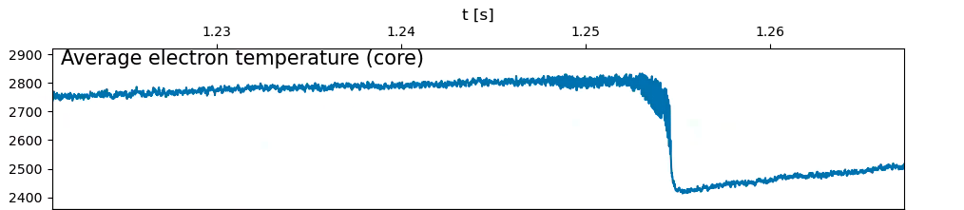
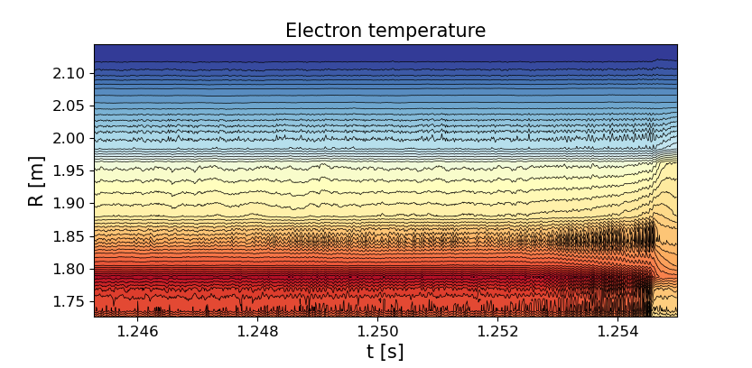
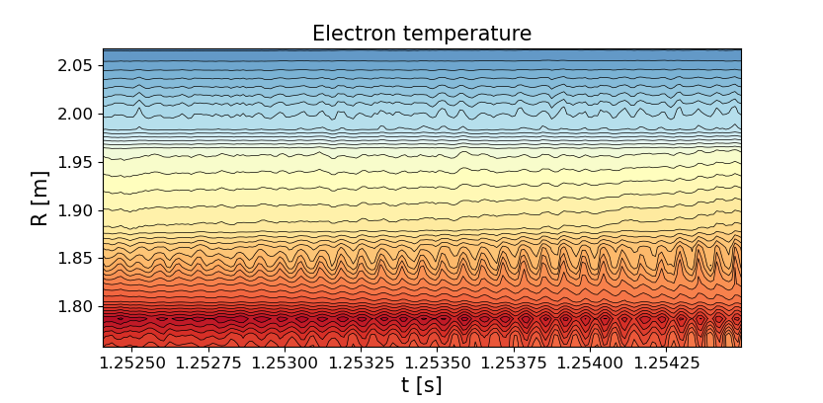
ECE diagnostic can clearly resolve the full sawtooth cycle
eV
Recovery phase
Mode growth
(precursor)
29879
Sawtooth crash
CORE
Guillermo Bustos Ramirez NSTX-U / Magnetic Fusion Science meeting, January 8th 2024

Slide 13
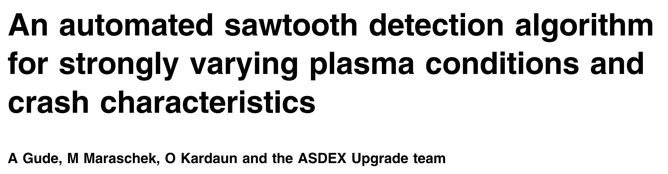
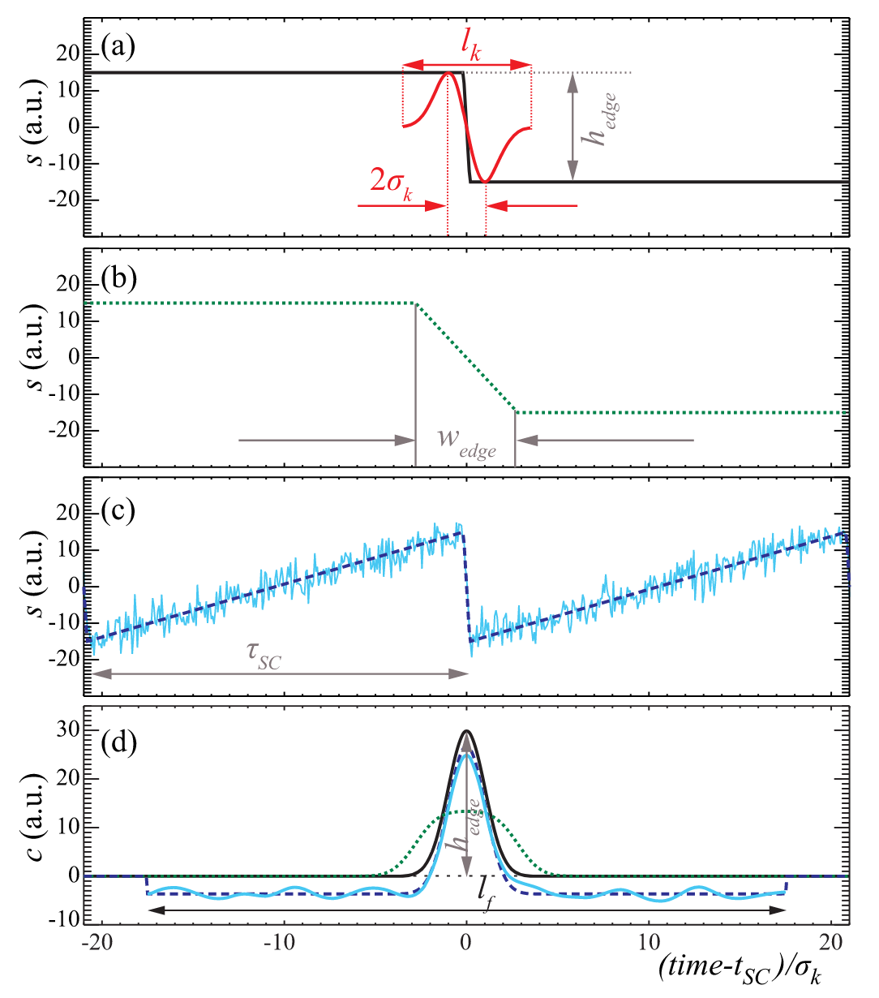
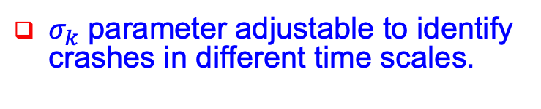
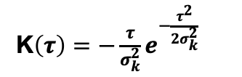
Extensive literature can be found on sawtooth identification
Convolution with first derivative of Gaussian
Peak discrimination to remove small crashes and noise
K$\left(τ\right)=−\frac{τ}{σ_{k}^{2}}e^{−\frac{τ^{2}}{{2σ}_{k}^{2}}}$
Profile analysis to identify SAW crashes
$σ_{k}$ parameter adjustable to identify crashes in different time scales.
Guillermo Bustos Ramirez NSTX-U / Magnetic Fusion Science meeting, January 8th 2024

Slide 14
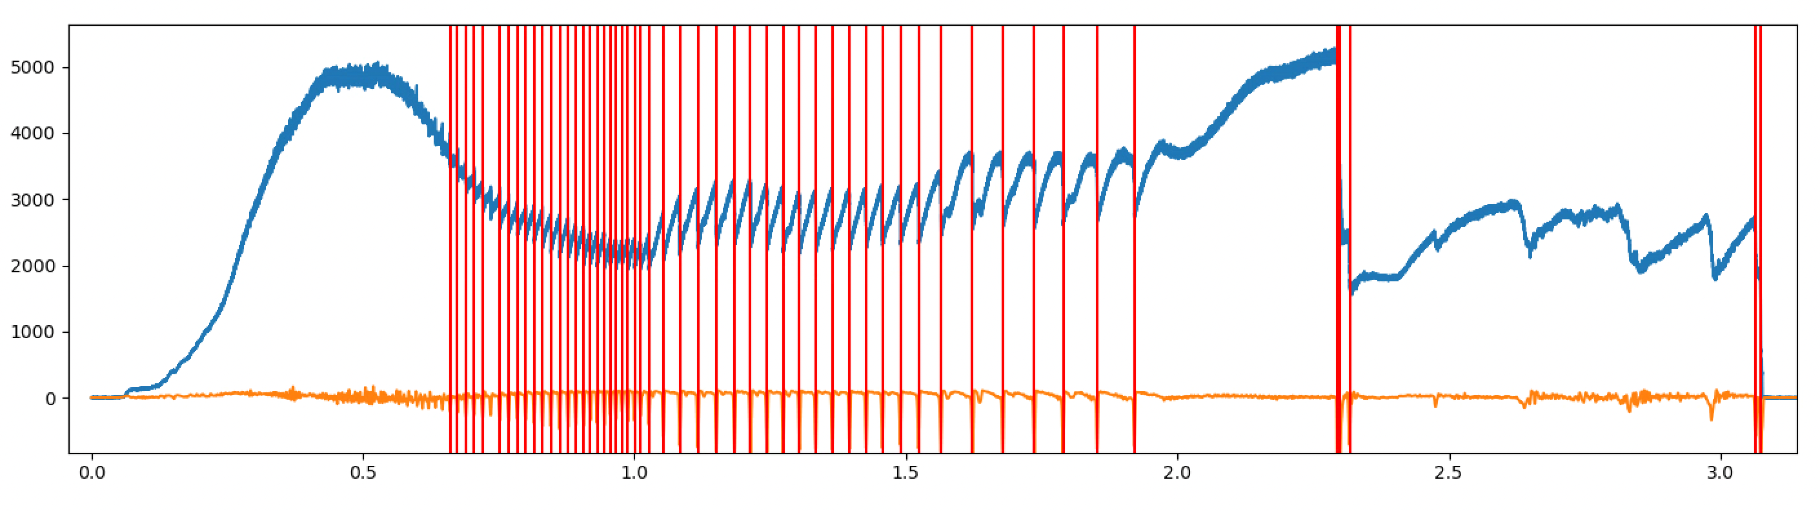
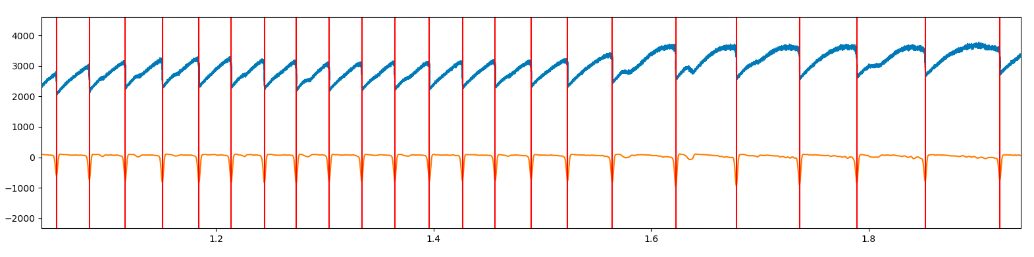

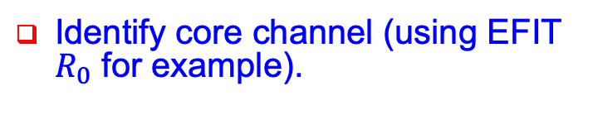




Algorithm successfully identifies most crashes
Identify core channel (using EFIT $R_{0}$ for example).
$$T_{e}[eV]$$
Peak discrimination.
$$t [s]$$
$T_{e}$ channel
Multichannel analysis to remove non-physical peaks and noise.
$$T_{e}[eV]$$
Profile analysis of every crash.
  Measuring the peak height in every channel.
Convoluted signal
$$t [s]$$
Guillermo Bustos Ramirez NSTX-U / Magnetic Fusion Science meeting, January 8th 2024

Slide 15
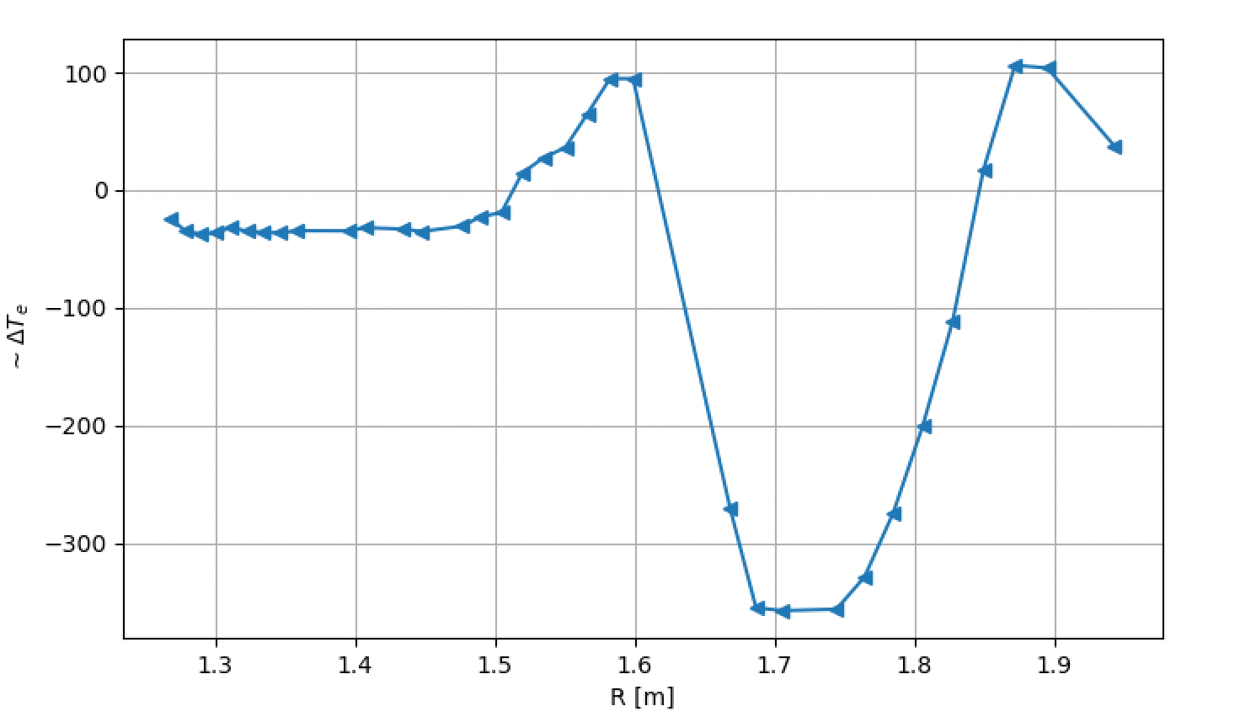
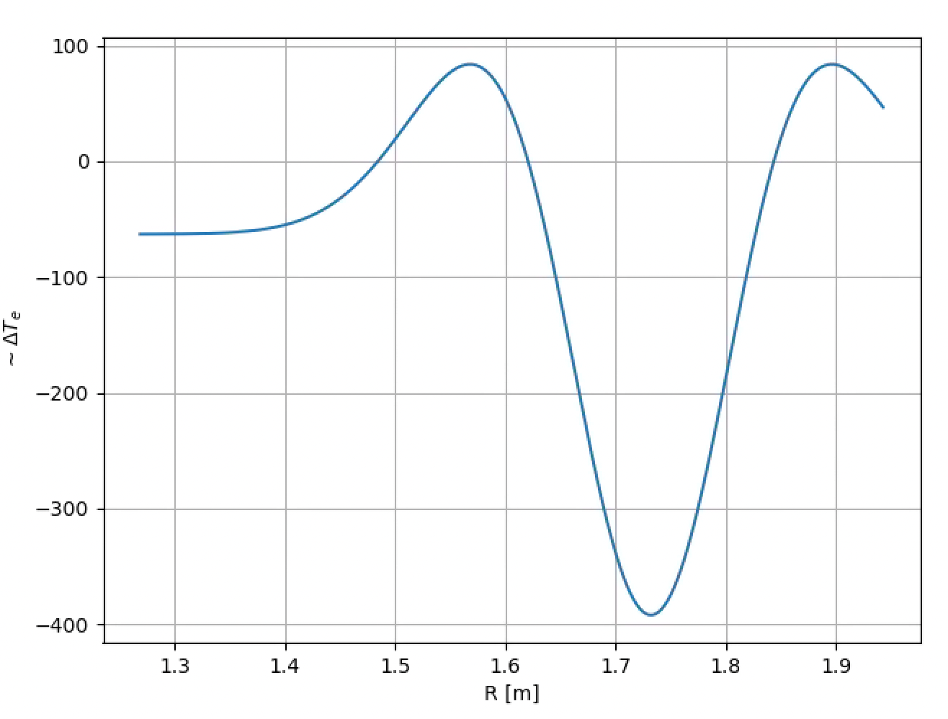
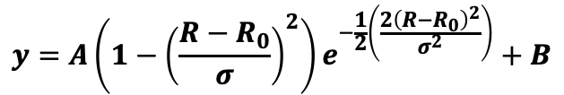
At every event, we reconstruct a ‘crash profile’
Crash profile for SAW is related to a particular base function
Core crash
$$y=A\left(1−{\left(\frac{R−R_{0}}{σ}\right)}^{2}\right)e^{−\frac{1}{2}\left(\frac{2{\left(R−R_{0}\right)}^{2}}{σ^{2}}\right)}+B$$
Inversion radius
Inversion radius is a useful parameter in sawtooth models.
  Help prediction of sawtooth-induced disruptions?
Guillermo Bustos Ramirez NSTX-U / Magnetic Fusion Science meeting, January 8th 2024

Slide 16
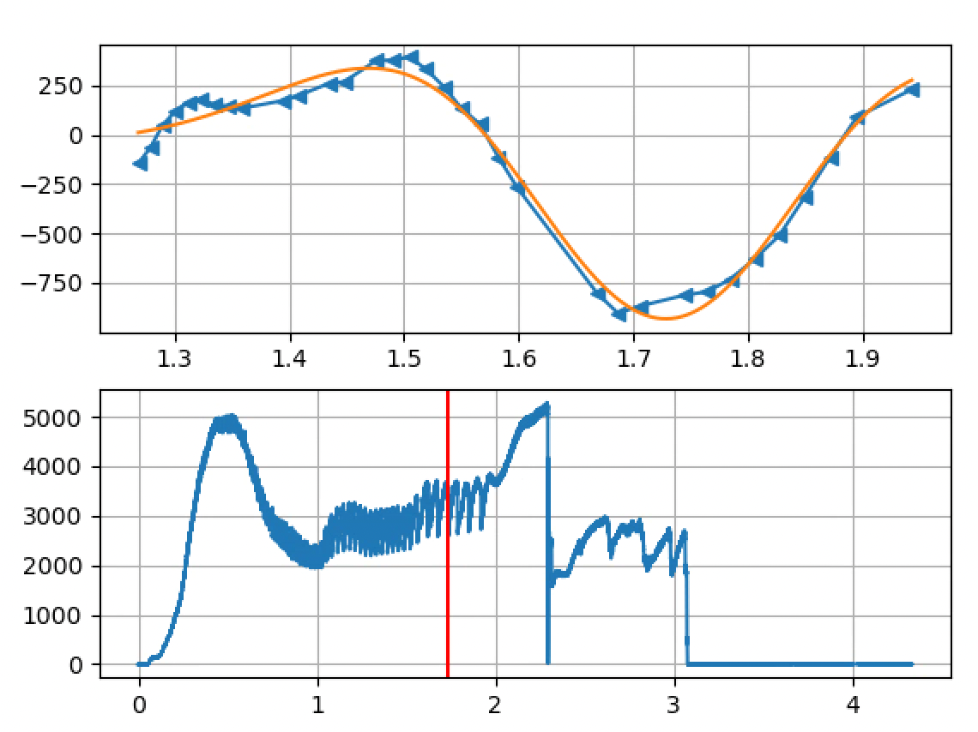
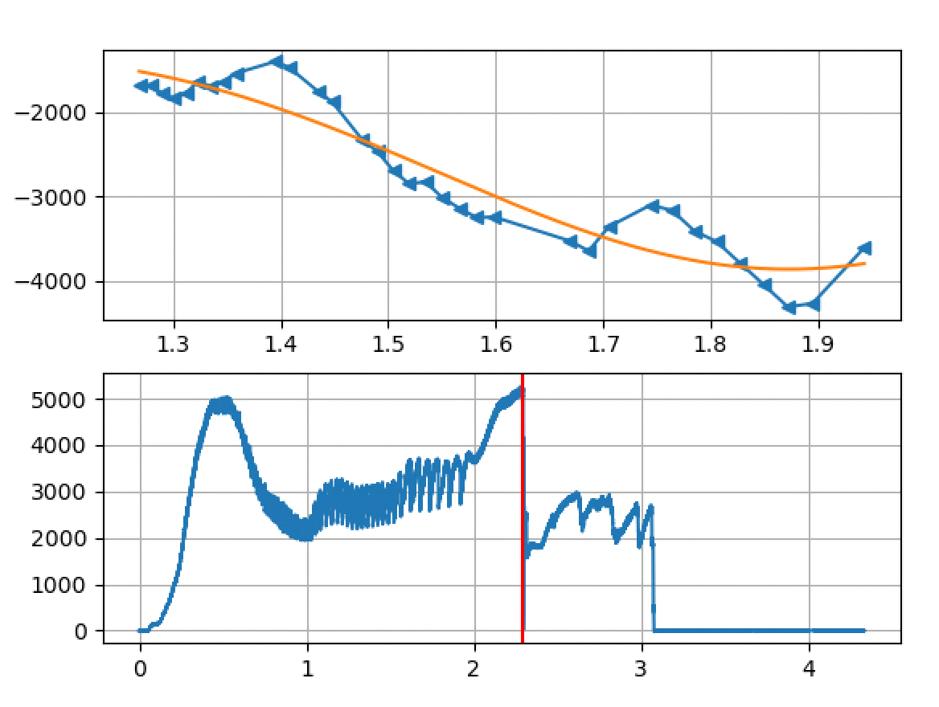
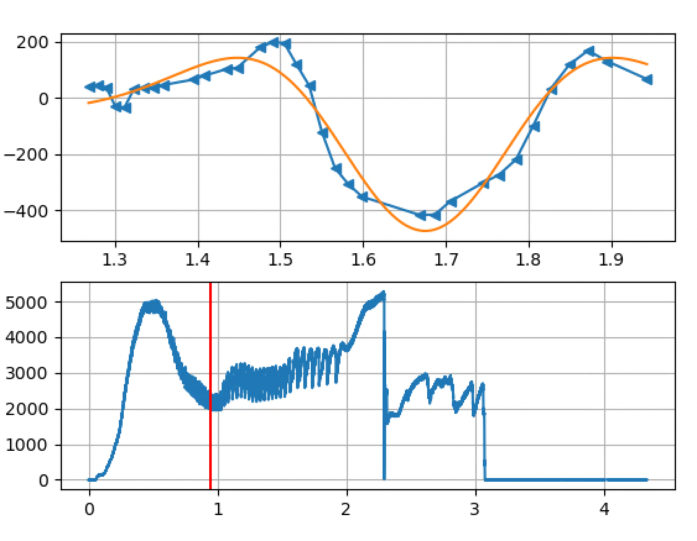
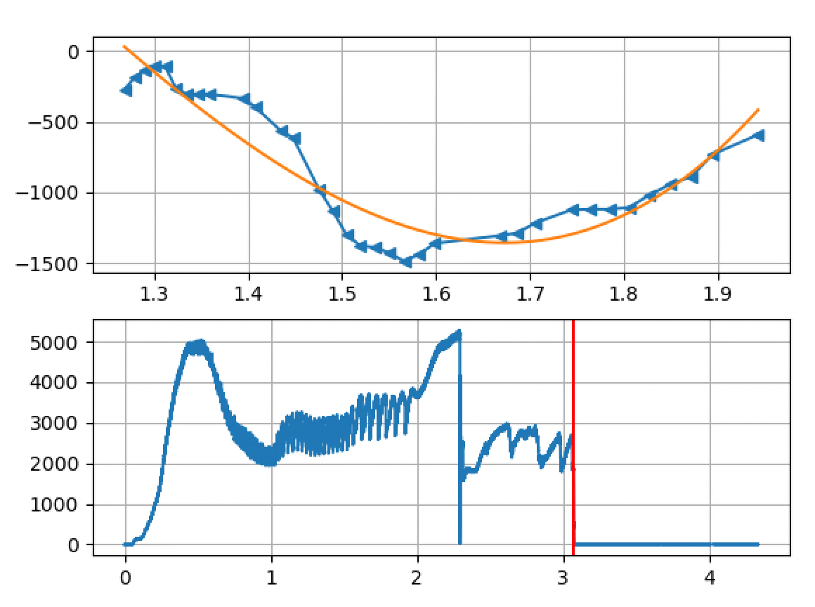
Correlation with base function identifies a SAW event
SAW
TEC
  Directly applicable to different profile measurements, on multiple devices, thanks to DECAF.
SAW
TEC
Guillermo Bustos Ramirez NSTX-U / Magnetic Fusion Science meeting, January 8th 2024

Slide 17

Talk outline
Introduction to DECAF and ECE diagnostic in KSTAR.
Analysis of $T_{e}$ core crashes.
  Sawtooth crashes and more.
  DECAF implementation.
ELM crashes.
Conclusions and future work.
Guillermo Bustos Ramirez NSTX-U / Magnetic Fusion Science meeting, January 8th 2024

Slide 18
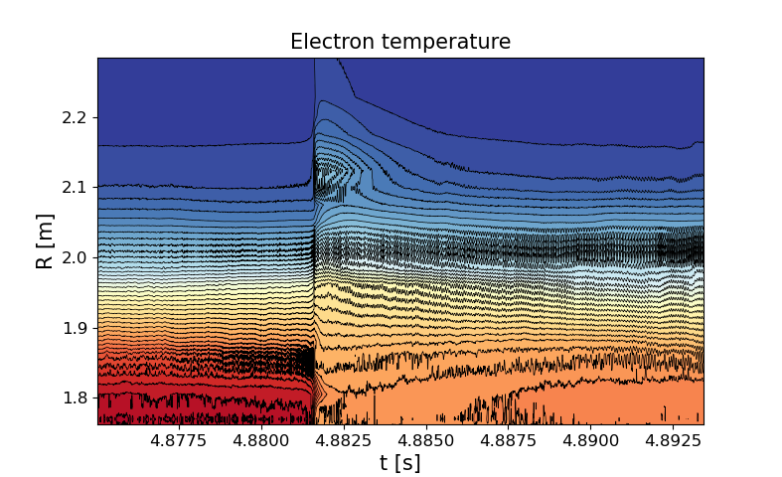
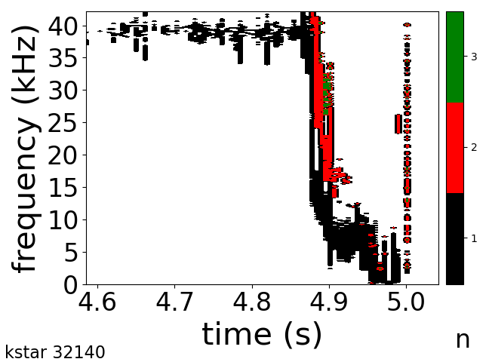
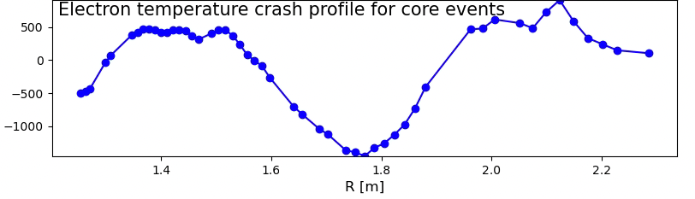

SAW events can trigger more dangerous instabilities
Mode locks and plasma disrupts.
32140
(2,1)
(3,2)
SAW precursor
Plasma state before and after the crash
  Extract crash amplitude, period, width, etc.
  Can we forecast disruptions based on this?
$$T_{e}[eV]$$
Guillermo Bustos Ramirez NSTX-U / Magnetic Fusion Science meeting, January 8th 2024

Slide 19
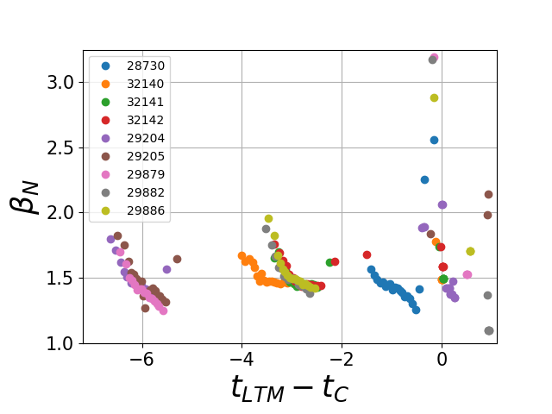
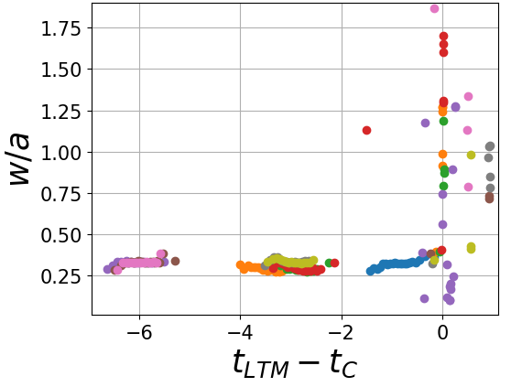
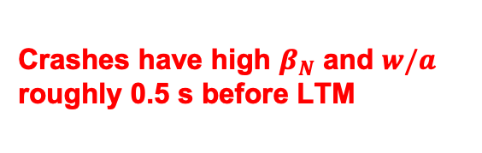
Quantitative difference in $β_{N}$ and w/a ~0.5 s before LTM onset
[1] F. Felici etal 2012 Nucl.Fusion 52 074001
[2] L. Bardóczi etal 2023 Nucl.Fusion 63 126052
[3] V. Igochine etal 2017 Nucl.Fusion 57 036015
…
Assume the crash events can seed magnetic islands → LTM [1,2,3]
Obtain crash parameters with respect to the time of LTM onset (Level 3 DECAF warning).
Crashes have high $β_{N}$ and $w/a$ roughly 0.5 s before LTM
Initial SAW phase
Guillermo Bustos Ramirez NSTX-U / Magnetic Fusion Science meeting, January 8th 2024

Slide 20
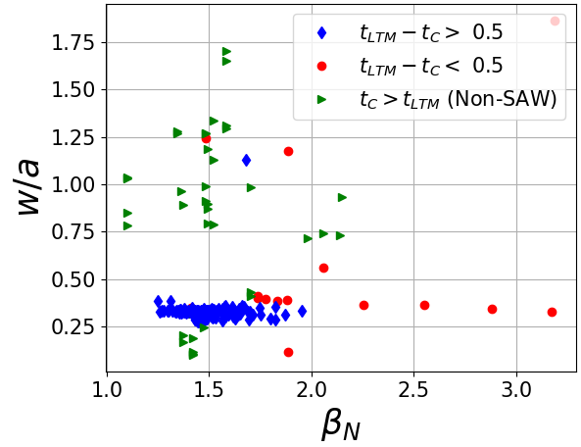
Parameter space with respect to $β_{N}$ and w/a defines a ‘stable’ region
Threshold implemented in DECAF.
Analysis can be applied to full database.
Comparisons with theory [1,2] in the near future.
  Physics-based threshold implementation.
  Optimization through DECAF workflow.
[1] F Porcelli et al, Plasma Phys. Control. Fusion 38 (1996) 2163–2186.
[2] L. Bardóczi et al, PHYSICAL REVIEW LETTERS 127, 055002 (2021)
Guillermo Bustos Ramirez NSTX-U / Magnetic Fusion Science meeting, January 8th 2024

Slide 21
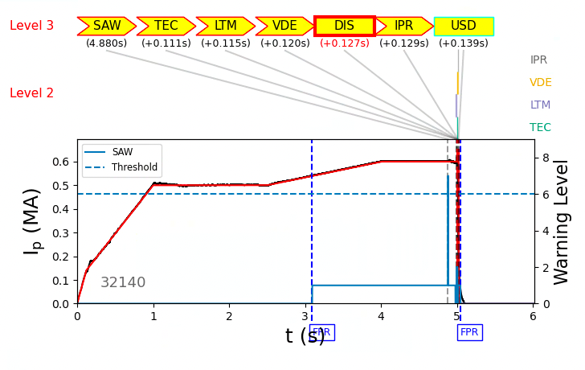
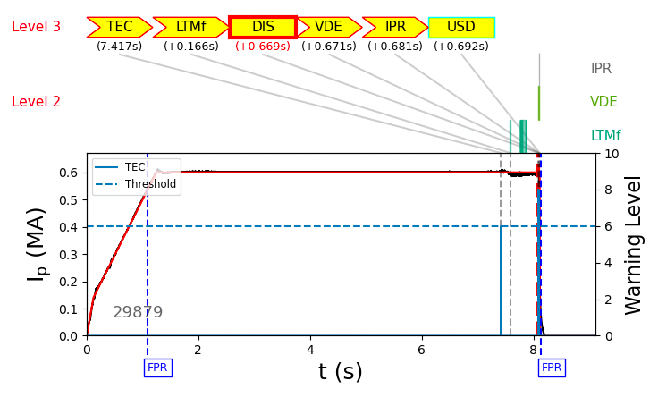
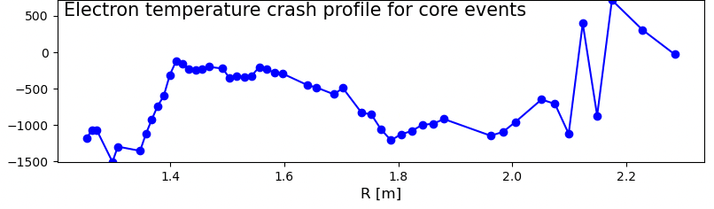


Two examples of $T_{e}$crash-induced disruptions
Chain analysis identifies SAW and TEC as disruption triggers.
Crash profiles identify the different kind of level 3 event.
$$T_{e}[eV]$$
$$T_{e}[eV]$$
Guillermo Bustos Ramirez NSTX-U / Magnetic Fusion Science meeting, January 8th 2024

Slide 22

Talk outline
Introduction to DECAF and ECE diagnostic in KSTAR.
Analysis of $T_{e}$ core crashes.
  Sawtooth crashes and more.
  DECAF implementation.
ELM crashes.
Conclusions and future work.
Guillermo Bustos Ramirez NSTX-U / Magnetic Fusion Science meeting, January 8th 2024

Slide 23
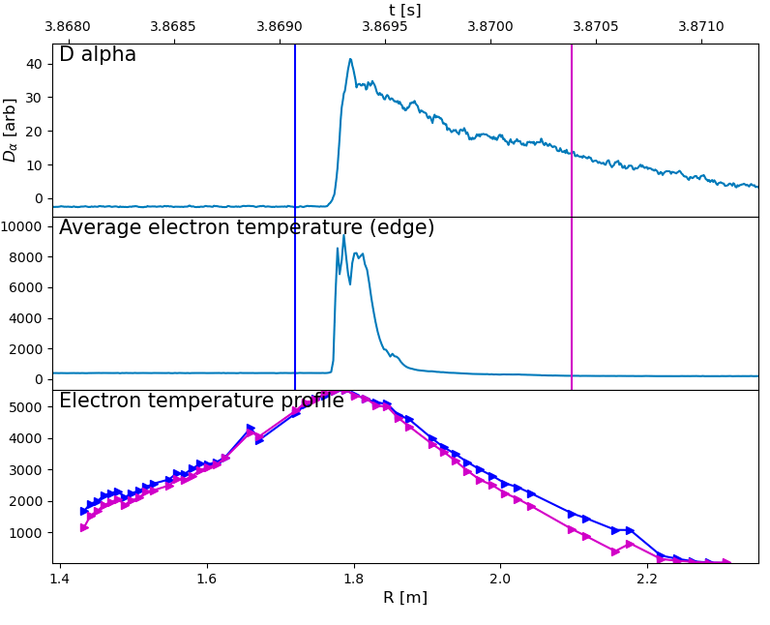
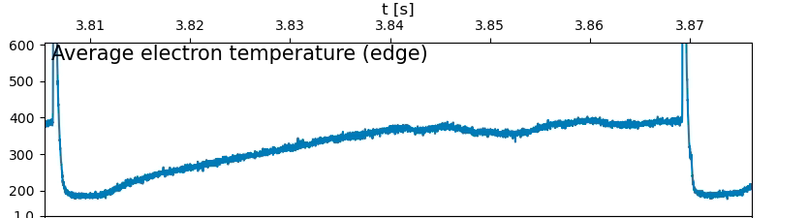
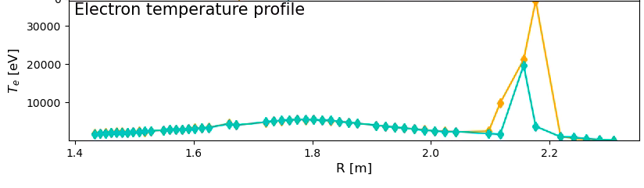



The ELM cycle as seen by the ECE diagnostic
Very localized increase in the pedestal ECE signal occurring in a sub-millisecond timescale (~200 $μs$)
$T_{e}(ped)$ steadily increases during inter-ELM phase, and crashes after ELM.
$$T_{e}[eV]$$
$$T_{e}[eV]$$
Pedestal
Rise of pedestal temperature
22462
ELM
Guillermo Bustos Ramirez NSTX-U / Magnetic Fusion Science meeting, January 8th 2024

Slide 24







Crash profile fundamentally differs from SAW
Same technique used to identify ELM crashes and build their crash profile.
$T_{e}$ spike
$$T_{e}[eV]$$
Signal(t)
Convoluted signal
$T_{e}$ crash
Thr(t)
$$t[s]$$
22464
29882
Ongoing work to connect plasma state before and after crash with disruption onset.
Guillermo Bustos Ramirez NSTX-U / Magnetic Fusion Science meeting, January 8th 2024

Slide 25

Talk outline
Introduction to DECAF and ECE diagnostic in KSTAR.
Analysis of $T_{e}$ core crashes.
  Sawtooth crashes and more.
  DECAF implementation.
ELM crashes.
Conclusions and future work.
Guillermo Bustos Ramirez NSTX-U / Magnetic Fusion Science meeting, January 8th 2024

Slide 26
First step to profile evolution analysis in DECAF is in place, much work to look ahead..
A preliminary analysis of the electron temperature profile evolution measured by the ECE diagnostic in the context of DECAF is presented.
High temporal resolution of the ECE diagnostic allows for the investigation of fast plasma dynamics:
  Sawtooth identification and characterization.
  ELMing phases and precursors.
  Disruption precursors through the analysis crash parameters.
Future work will focus on the implementation of physics-based models to understand and characterize the observed phenomena.
Short-time goal is to apply the offline analysis to real-time in KSTAR.
Guillermo Bustos Ramirez NSTX-U / Magnetic Fusion Science meeting, January 8th 2024

Slide 27
Thanks!
Questions? Comments?
Office 211, PPPL
gbustosr@pppl.gov
Guillermo Bustos Ramirez NSTX-U / Magnetic Fusion Science meeting, January 8th 2024

