Slide 1
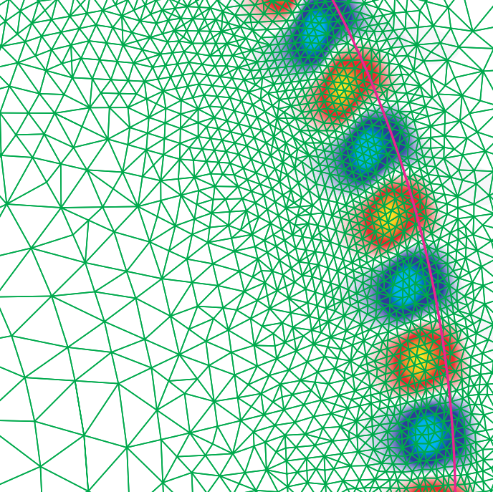
Making yourself clear
Rachel Kremen rkremen@pppl.gov
Feb. 1, 2024
when your research is complicated
Looking for our media relations worksheets? Click here!

Slide 2
Why is it important to communicate our work beyond the expert community?

Slide 3
Educate the public
Scientific support & funding
Workforce development
Change the narrative
Increase awareness
Spark curiosity

Slide 4
Communications can help!
Prepare for a written or recorded media interview
Advise on a research paper, book or public appearance promotion
Assist with fact sheets, webpages and presentations
Aid with on-site interviews

Slide 5
Giving an inspiring presentation

Slide 6
What is your message?

Slide 7
Think about the why first
Why would someone who does not work in the field care about your work?

Slide 8
Starting sequence
Jargon free!
A simplified, 1-2 sentence description of WHAT you did:
What was the biggest take-away?
Why would someone who does not work in the field care?
Who are you and where do you work?
Tie one aspect of the Lab’s mission back to your work.
What were your results?
How did you do your research?

Slide 9
Eliminate jargon
Define your terms
Write out all acronyms in full on first reference
Try the De-jargonizer @ scienceandpublic.com
Ask Communications for help!

Slide 10
Come up for air
Offer intermittent moments with less scientific detail
or explain how the science relates back to the why.
Sequence
1, 2, 3
4, 5
Time
What all of this means is…
The reason this is important is…
Technical Depth
Data
Data
Data

Slide 11
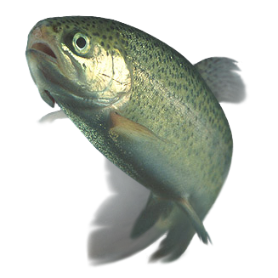
Focus on key details
Avoid trying to attempt to cram in too much information
and leave time for questions instead.
Sequence
1, 2, 3
4, 5
Time
Technical Depth

Slide 12
Interact
Offer contact information
Ask a question
Why would a non-expert care?
Check for understanding

Slide 13
Media interviews

Slide 14
Contacted by the media?
Speak with the PPPL Communications Department before committing to an interview.
Rachel Kremen Science Communications Manager ‪609-552-1135 rkremen@pppl.gov | B. Rose Huber Head of Communications 609-480-1030 rhuber@pppl.gov

Slide 15
Why talk to Communications first?
Notify PPPL’s Communications Department before any media interview.
Almost all media interactions need Department of Energy approval
Communications keeps lists of journalists to avoid
We can help you prepare

Slide 16
Initial questions for the reporter
“Why are you writing the piece now?”
“Have you ever covered this field before?”
“Who else is being interviewed?”
“Where can I find your work?”
“What’s the best way to reach you?”
“Is it okay if I record our conversation?”

Slide 17
Interview tips
Write down your three most important points in advance
Provide context
Ensure implications are not overstated
Ask to see the story before publication
Stay on the record and on message until you leave the room

Slide 18
Only answer questions you like
If you don’t agree with the premise of a question, it’s okay to say so!
Remember:
You are the expert!
“That’s not an issue actually.”
“That’s not quite right.”
“A better question would be…”
“Let’s reconsider your question. I don’t agree with the premise.”
“I’m not prepared to talk about that at this time.”

Slide 19
Be clear about uncertainty
It’s always better to be honest if you aren’t sure about the answer.
“That’s not my area of expertise.”
“I’m not the best person to answer that question. Try Ms. X…”
“I don’t know about that. What I do know is…”
“Can I get back to you with an answer on that? I just want to confirm.”

Slide 20
Communicating about timing
If timing is uncertain or likely to shift, opt for percent completion.
Instead of: “NSTX-U is slated for completion in 202X.”
Try: “NSTX-U is XX% complete.” ← Click and scroll for latest data.

Slide 21
Communicating about challenges
Be transparent without oversharing
There is no need to lie or avoid talking about past mistakes.
We can provide straightforward and clear information without storytelling.

Slide 22
Consider an email interview
Reduces errors
Time for consultation
Lowers stress
Allows for de-jargnozing

Slide 23
Thank you for attending!
Any questions?
?
Click here for our our media relations worksheets!
Q&A

