Slide 1



Formation of cryogenic pellets for emergency shutdown of ITER plasma discharges
Sandor ZOLETNIK
Head of Fusion Plasma Physics department
Contributions from:
Fusion Plasma Physics department
E. Walcz, T. Szepesi, T. Szabolics, G. Anda, G. Bartók, G. Cseh, D. Dunai, G. Gárdonyi,
S. Hegedűs, I. Katona, Á. Kovács, G. Kocsis, M. Málics, D. Nagy, R. Nagy, D. Oravecz,
L. Poszovecz, D. Réfy, M. Vécsei, A. Zsákai, HUN-REN CER
S. Jachmich, U. Kruezi, M. Lehnen, M. Kochergin ITER IO

Slide 2


Who we are?
Centre for Energy Research (CER) Budapest, Hungary
~400 staff
3 institutes: Nuclear Energy (AEKI), Materials Science (MFA)
Environmental Research
Budapest Research Reactor
(10 MW, neutron techniques, fusion-fission irradiation)
Fusion Plasma Physics Department (FPLab)
Former Plasma Physics Department of the Wigner Research Centre
Ph.D. Physicist | 12
Mechanical engineer | 11
Software developer | 2
Project management and admin | 2
Technician | 3
Ph.D. student (physics) | 4
B.Sc. and M.Sc. students | ~6-8

Slide 3
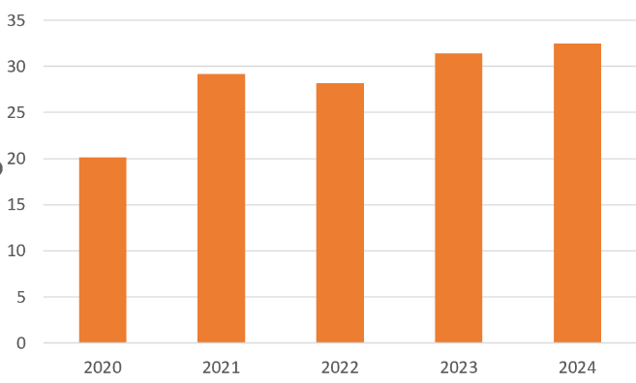
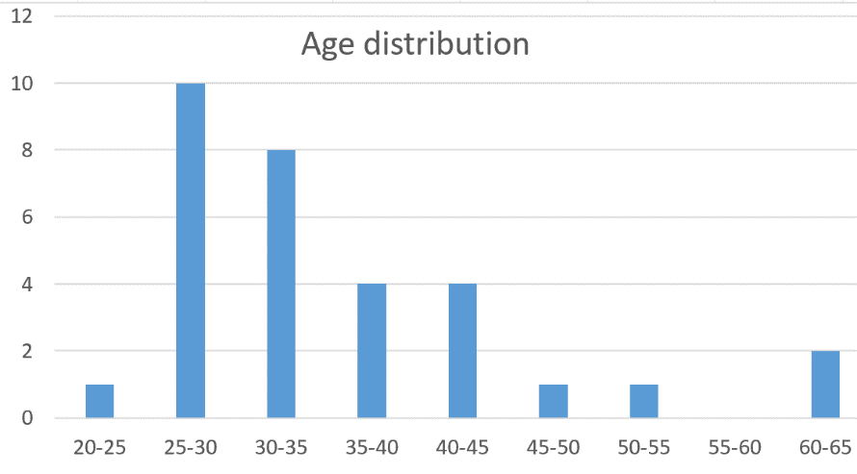
FPLab staff
Part of former Plasma Physics Department at Wigner RCP: Moved to CER from 1 January, 2020
35 years in fusion, 22 years in Euratom/Eurofusion
Fusion energy research is broad field: from basic science to machine construction
FPLab has optimal staff composition for this field: ~ 50:50 physicist:engineer
Expanding team with „future-safe” age composition
(gap in 45-55 age group is result of recession in the 1990’s)
No of Staff vs year
Training:
6 Ph.D. students (Physicists and engineers)
5 B.Sc. and M.Sc. students
~5 interns per year

Slide 4

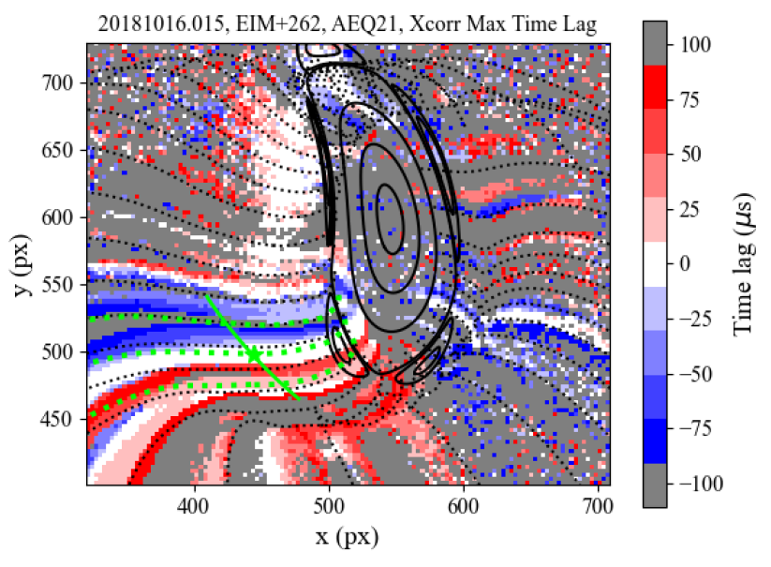
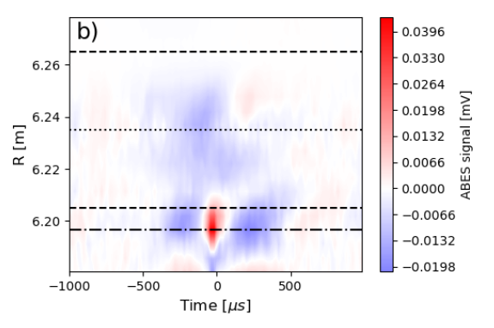
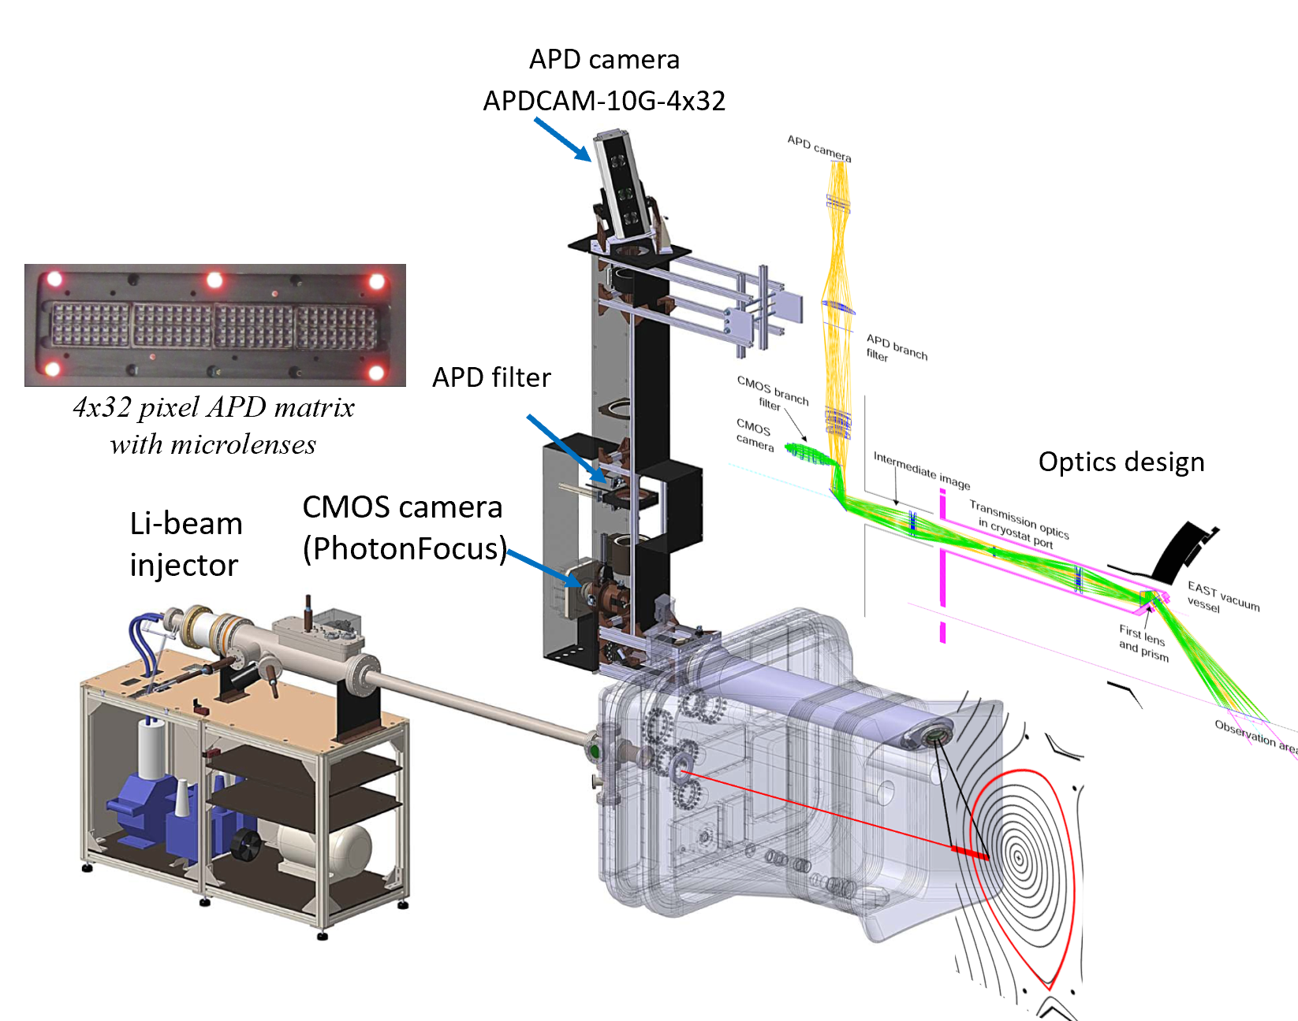
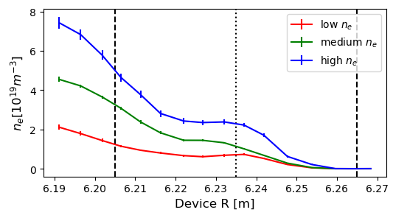
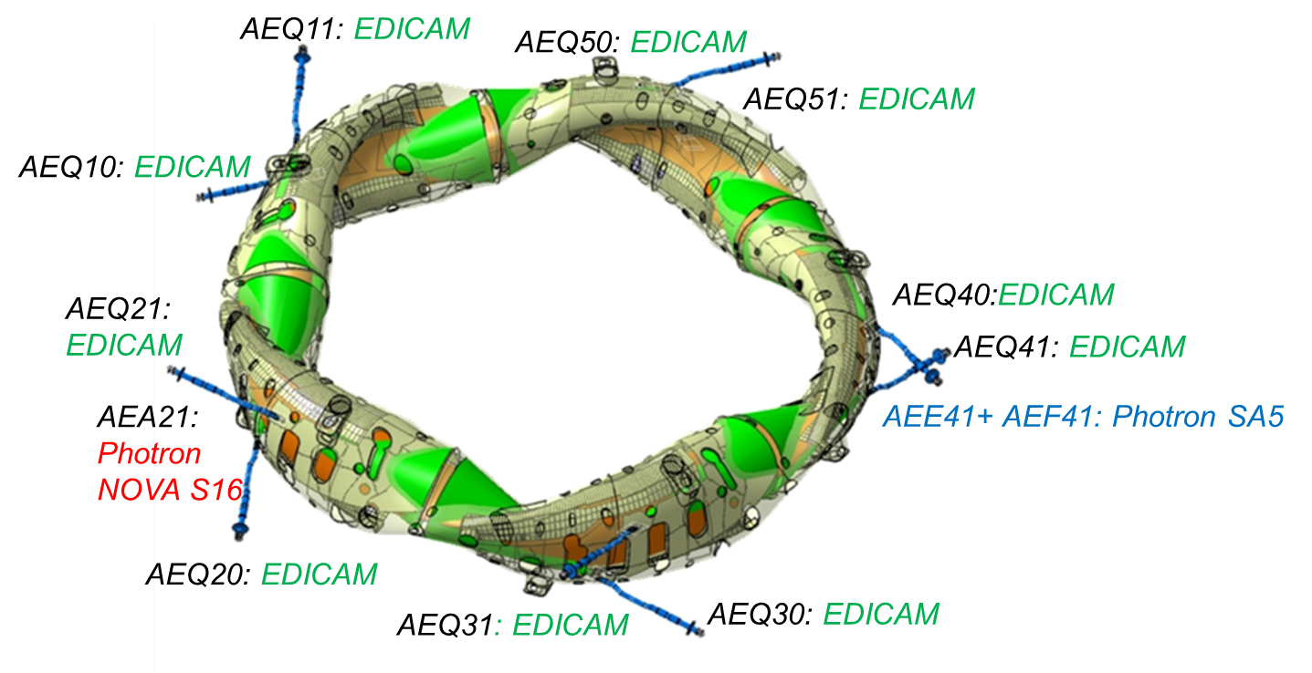

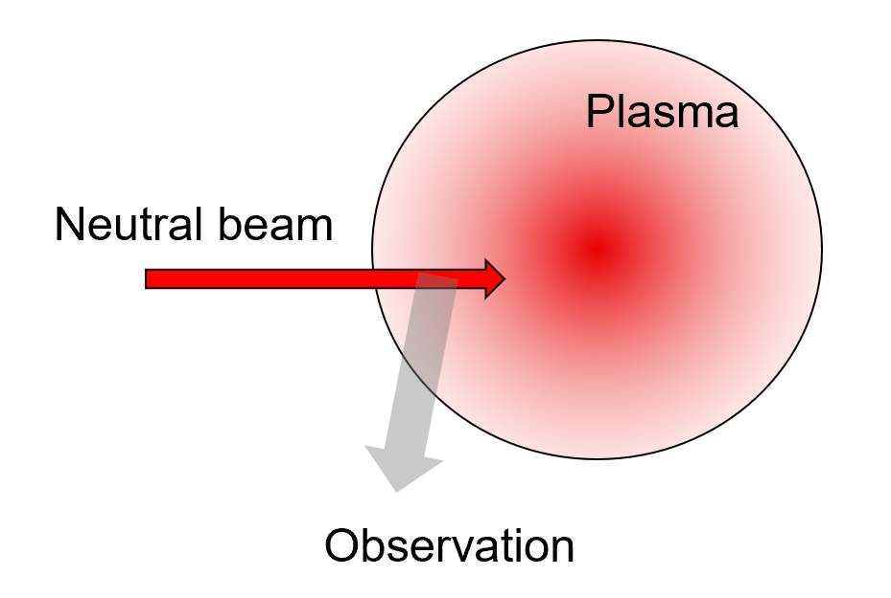
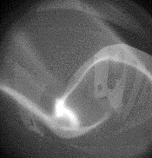
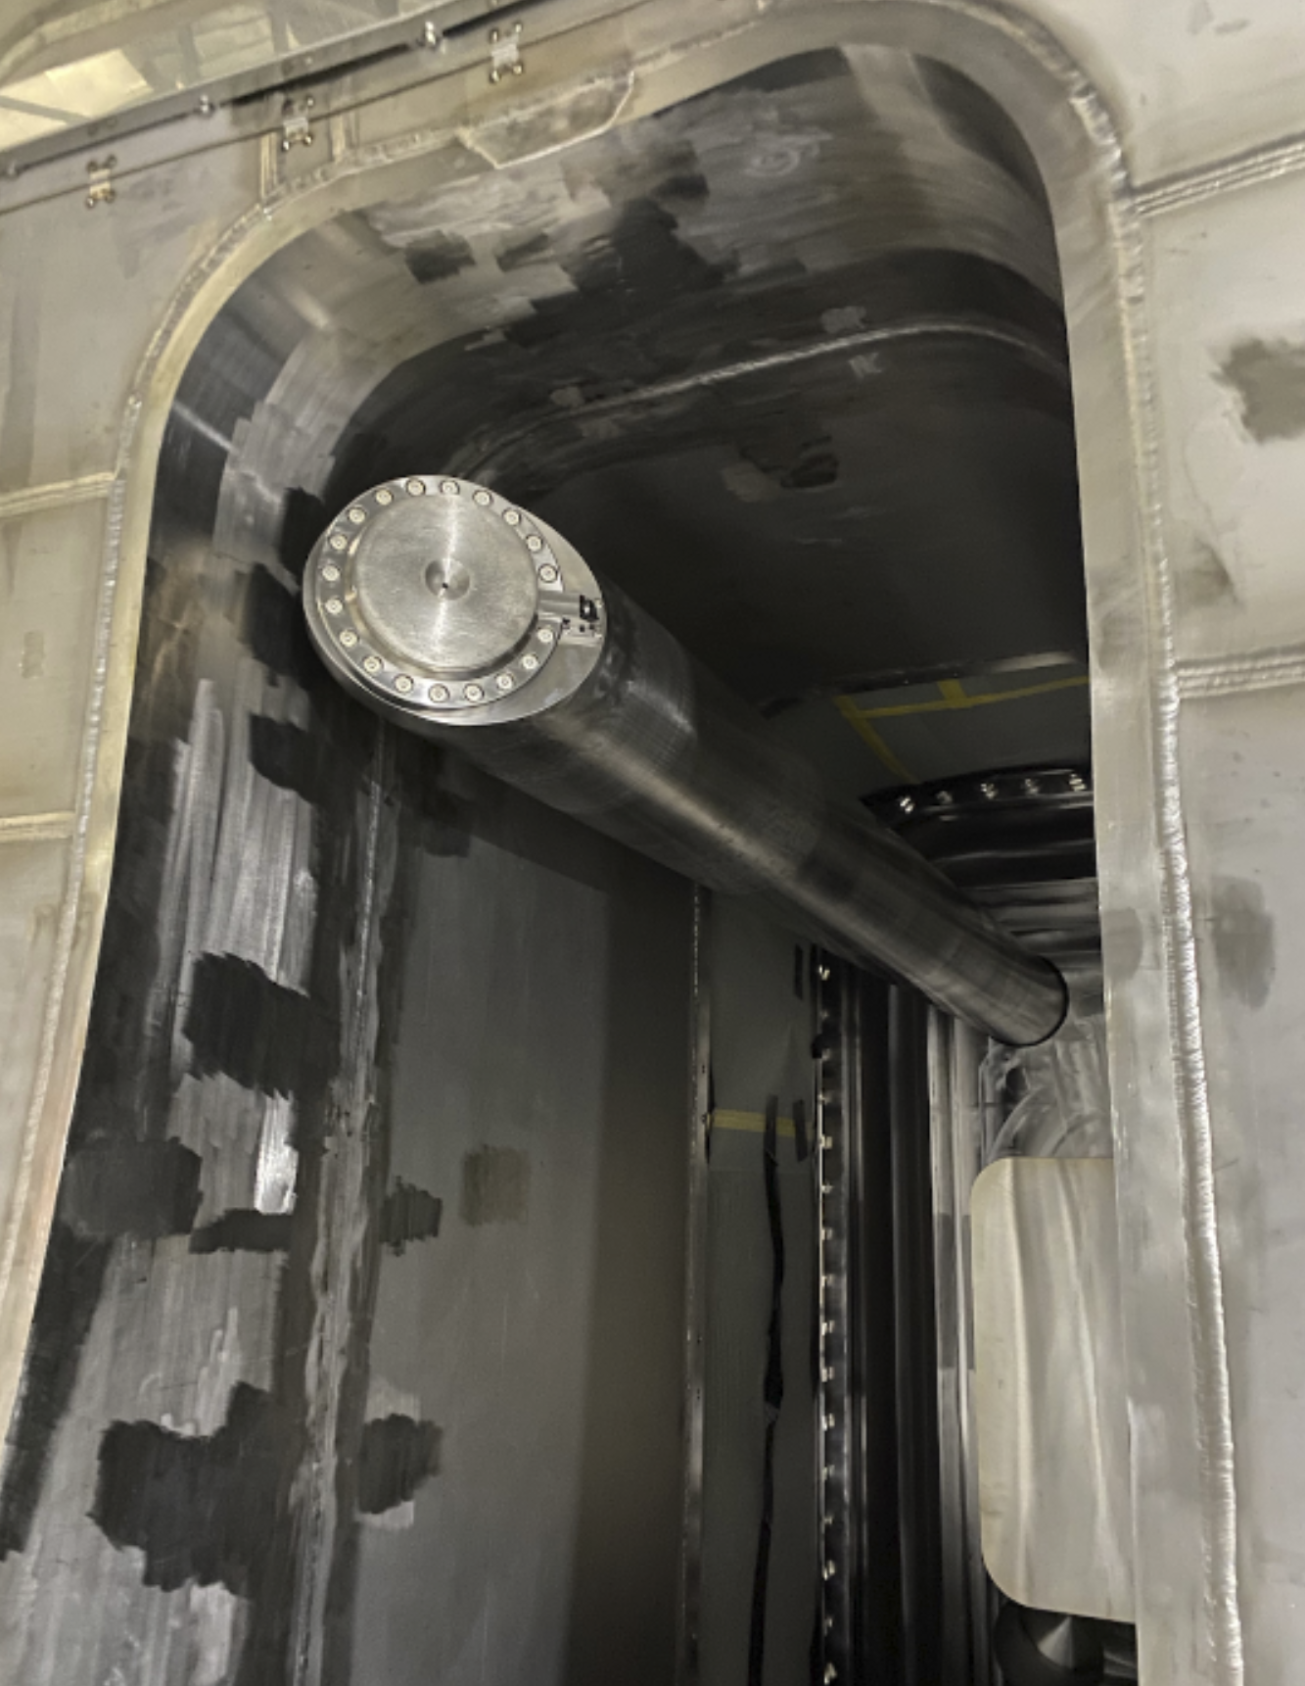
Participation in present-day experiments
Diagnostic development, construction,
installation and operation
Plasma physics measurements,
modeling, theory
Publications in Nuclear Fusion, Rev, Sci. Instrum.
Plasma Physics and Controlled Fusion
FPLab systems, measurements
Collaborations
Video diagnostics:
Special camera development
Overview diagnostic
Turbulence measurement
Beam Emission Spectroscopy
Alkali beam injectors
Optics and detectors
Density profile and
turbulence measurements
Wendelstein 7-X (DE)
JT-60SA (EU-JP)
EAST (CN)
S. Zoletnik Fusion Plasma Physics Department (FPLab) 5 March, 2024 4

Slide 5
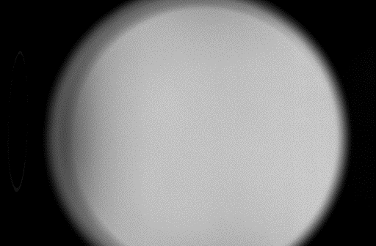
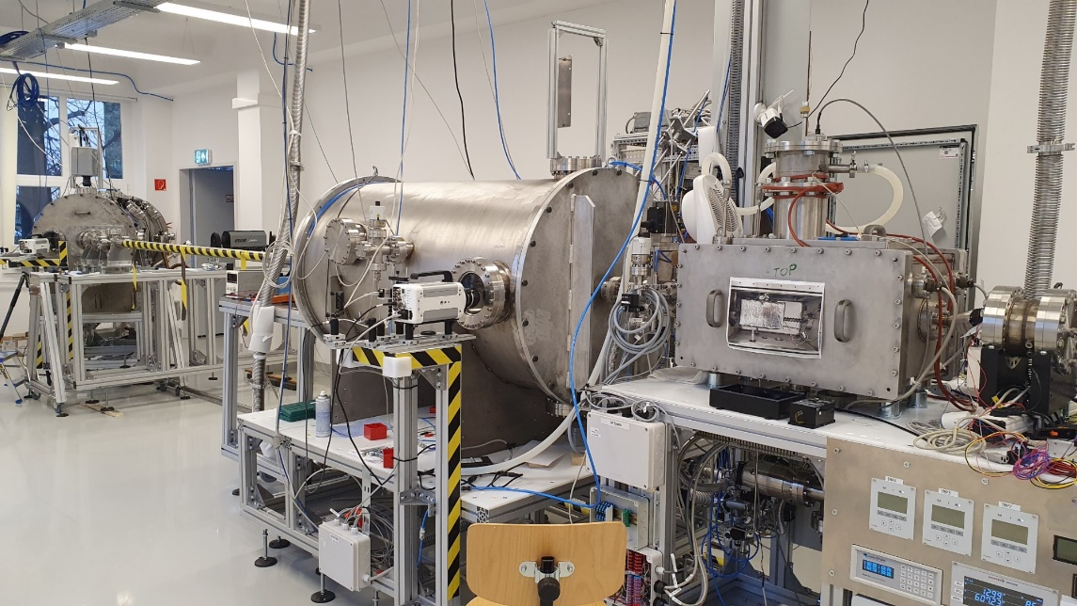
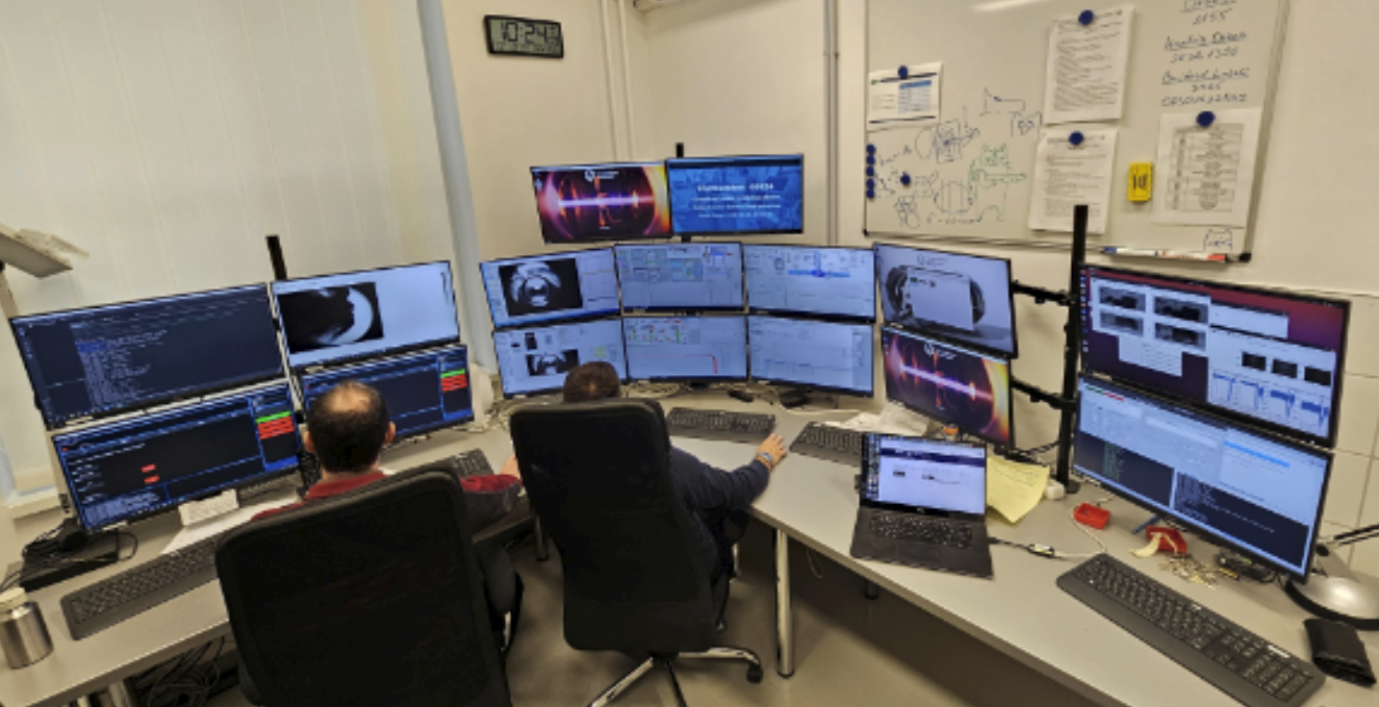
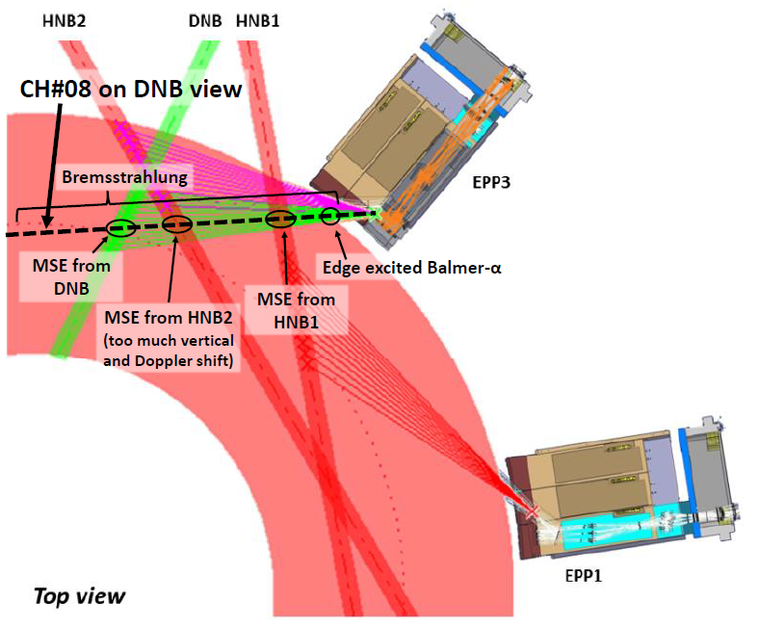
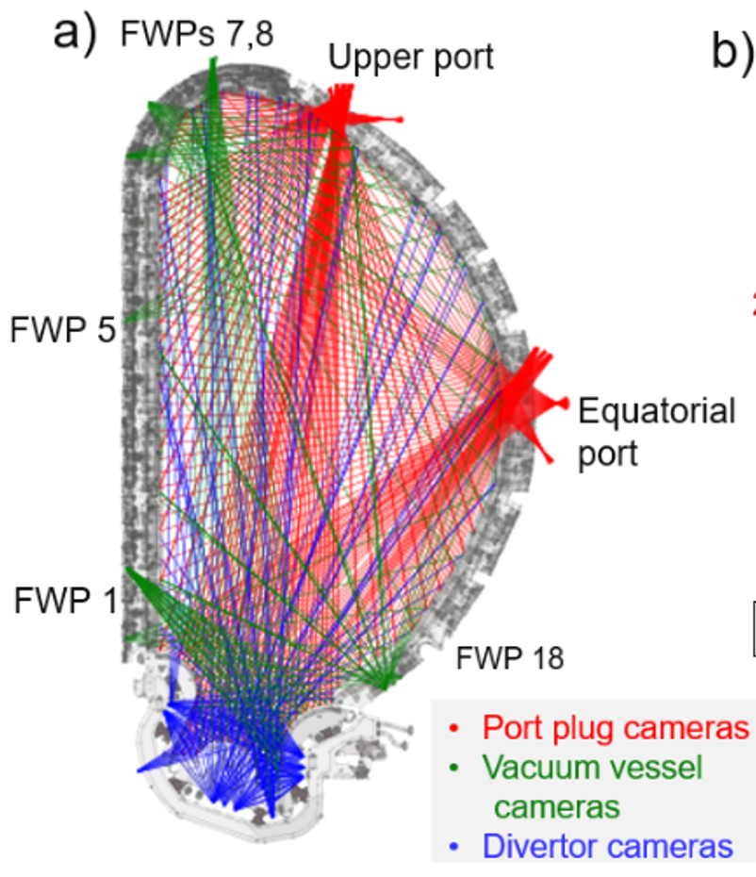
ITER
Disruption Mitigation System (DMS) development: Shattered cryogenic pellets (H, D, Ne)
ITER DMS Support Laboratory
  Cryogenic technology, diagnostics, modeling
  Gas flow modelling and measurement
DMS fast shutter development
  Design and concept test of setup
Optical Pellet Diagnostic prototype
  Started in January, 2024
  Radiation-hard system
  Real-time processing
Synthetic diagnostic, modeling
Active beam diagnostic
synthetic model
Runaway electrons
Beam atomic physics model with AI
Bolometer tomography
International Tokamak Physics Activity
(ITER science organization)
Diagnostics Topical Group
Chair: S. Zoletnik
Participation in various activities
Publications in Nuclear Fusion,
Fusion Engineering and Design

Slide 6
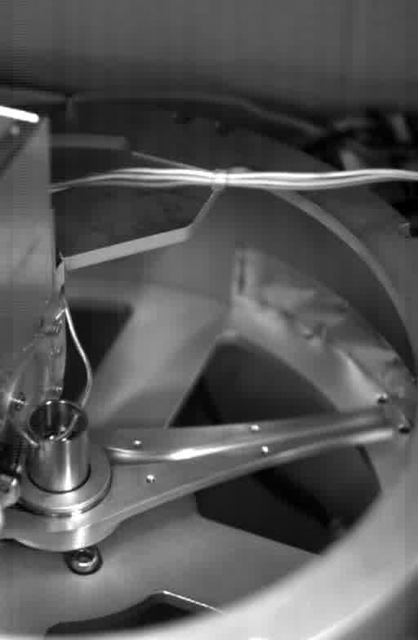
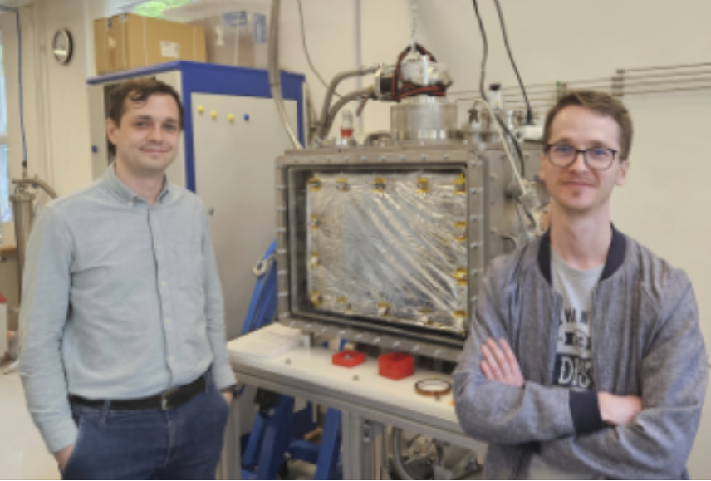
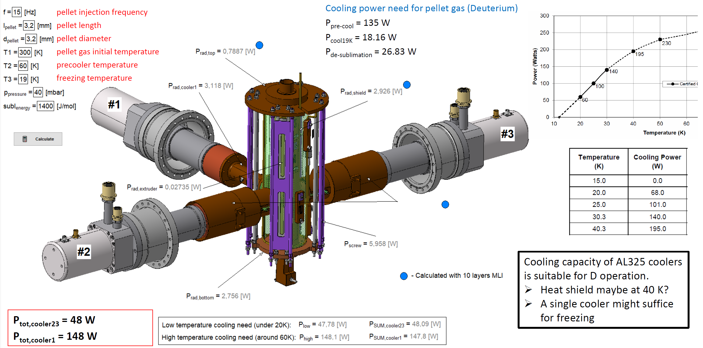
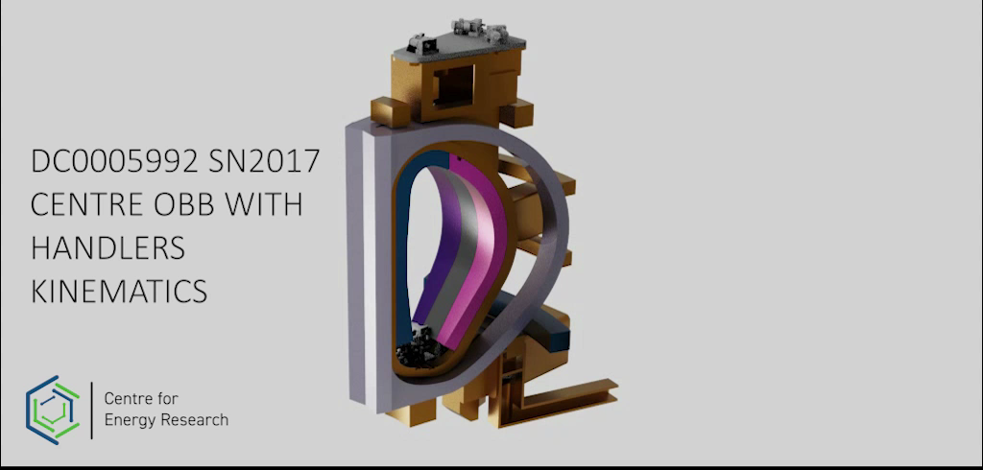
DEMOnstrator reactor
Fuelling system development: cryogenic pellet injector for EU DEMO
Participation in pellet centrifuge design
Pellet cutter design and testing (collaboration: KIT, IPP-Garching)
Development of deuterium ice extruder
In-house technology development:
Alternative extruder
Centrifuge development
Integrated pellet cutter
→ test pellet injector on COMPASS-Upgrade (IPP-Prague)
CryPT-ON
Cryogenic infrastructure
5K with Cryocooler or lHe
Computer controlled
Various development project
Table-top solid-state
pellet centrifuge
EU DEMO remote maintenance concept
Robotic mover concept for large components
Collaboration:
UKAEA
Optical diagnostic concept development
for EU DEMO
EU Task leader is at FPL (EU-wide team)
Divertor, pellet, limiter monitoring
Optical and engineering design
Eurofusion Engineeing Grant:
optical diagnostic engineer training
c
Publications in Fusion Engineering and Design

Slide 7
Formation of cryogenic pellets for emergency shutdown of ITER plasma discharges

Slide 8
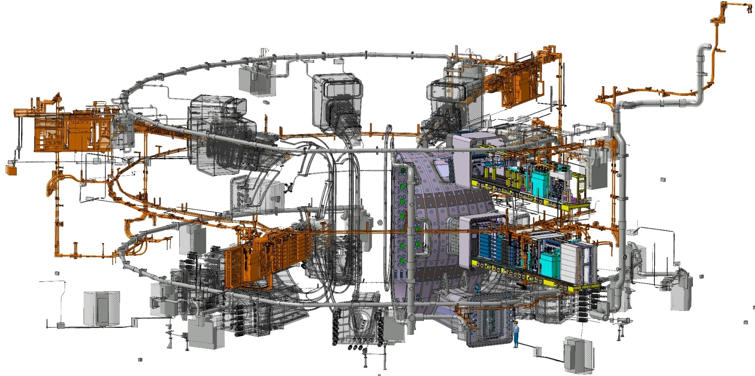
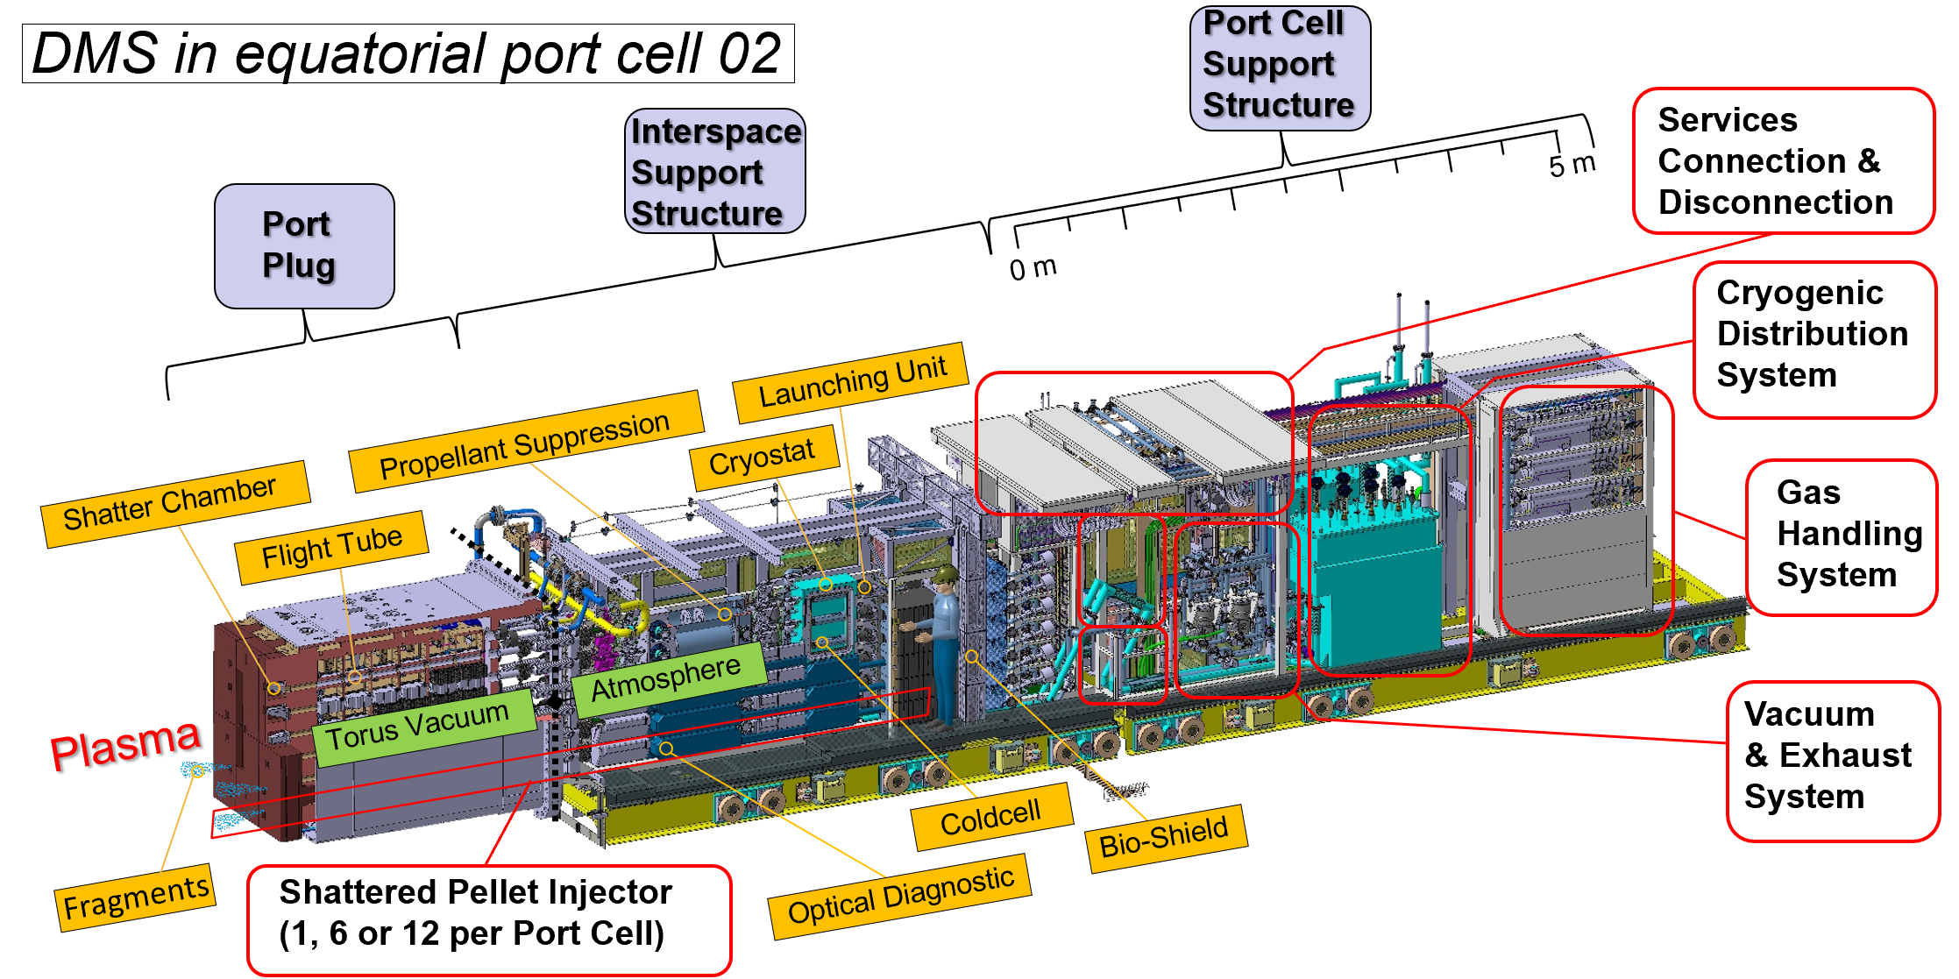
Disruption mitigation at ITER
Disruptions are a major risk for ITER: thermal and EM loads, runaway beam generation
ITER plans Shattered Pellet Injection (SPI) technology as Disruption Mitigation System (DMS)
27 injectors with H, Ne and H-Ne mixture pellets
A key “investment protection system”
System should be ready for Augmented First Plasma (AFP, SRO) operation
The ITER SPI system and a 12-injector block
in Eq. port 2.
(Uron Kruezi, DMS FDR)

Slide 9
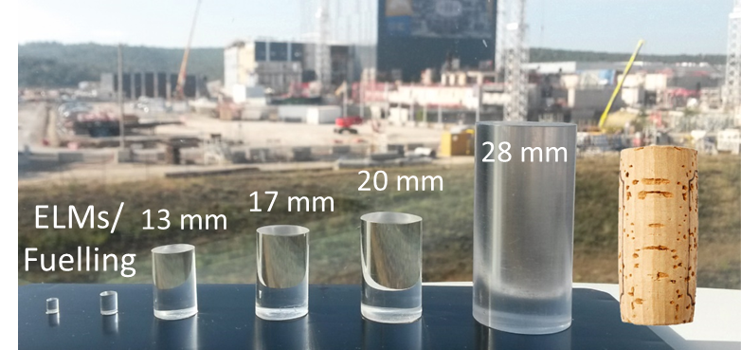
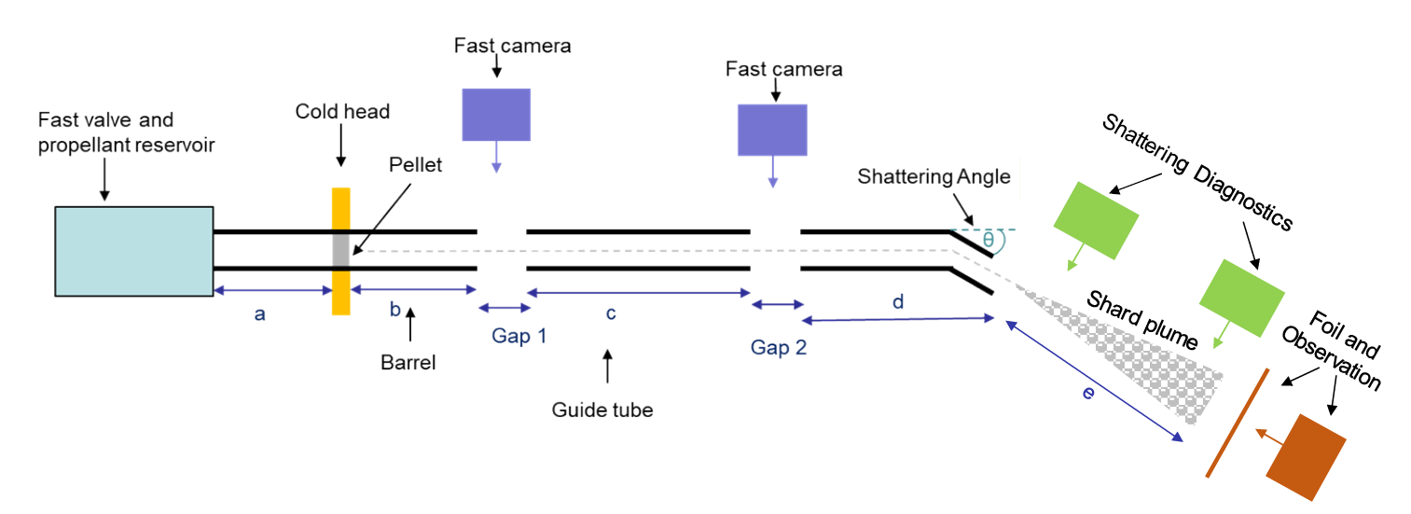
ITER DMS Support Laboratory
Although SPI technology has been demonstrated on several devices it was not done with ITER-size pellets → ITER started technology development program
ITER DMS support laboratory tender won by CER FPL (2020):
Designing, manufacturing, commissioning and operating an SPI
injector for 19 and 28.5 mm diameter H, D, Ne, H-Ne pellets
Measuring pellet fragmentation
Testing various components of the ITER SPI system
Figure from M. Lehnen
JET ITER
Support laboratory design in the tender

Slide 10
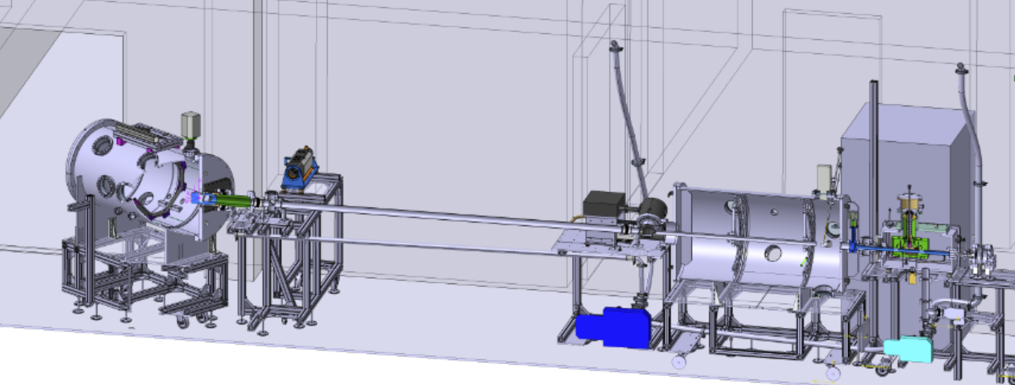
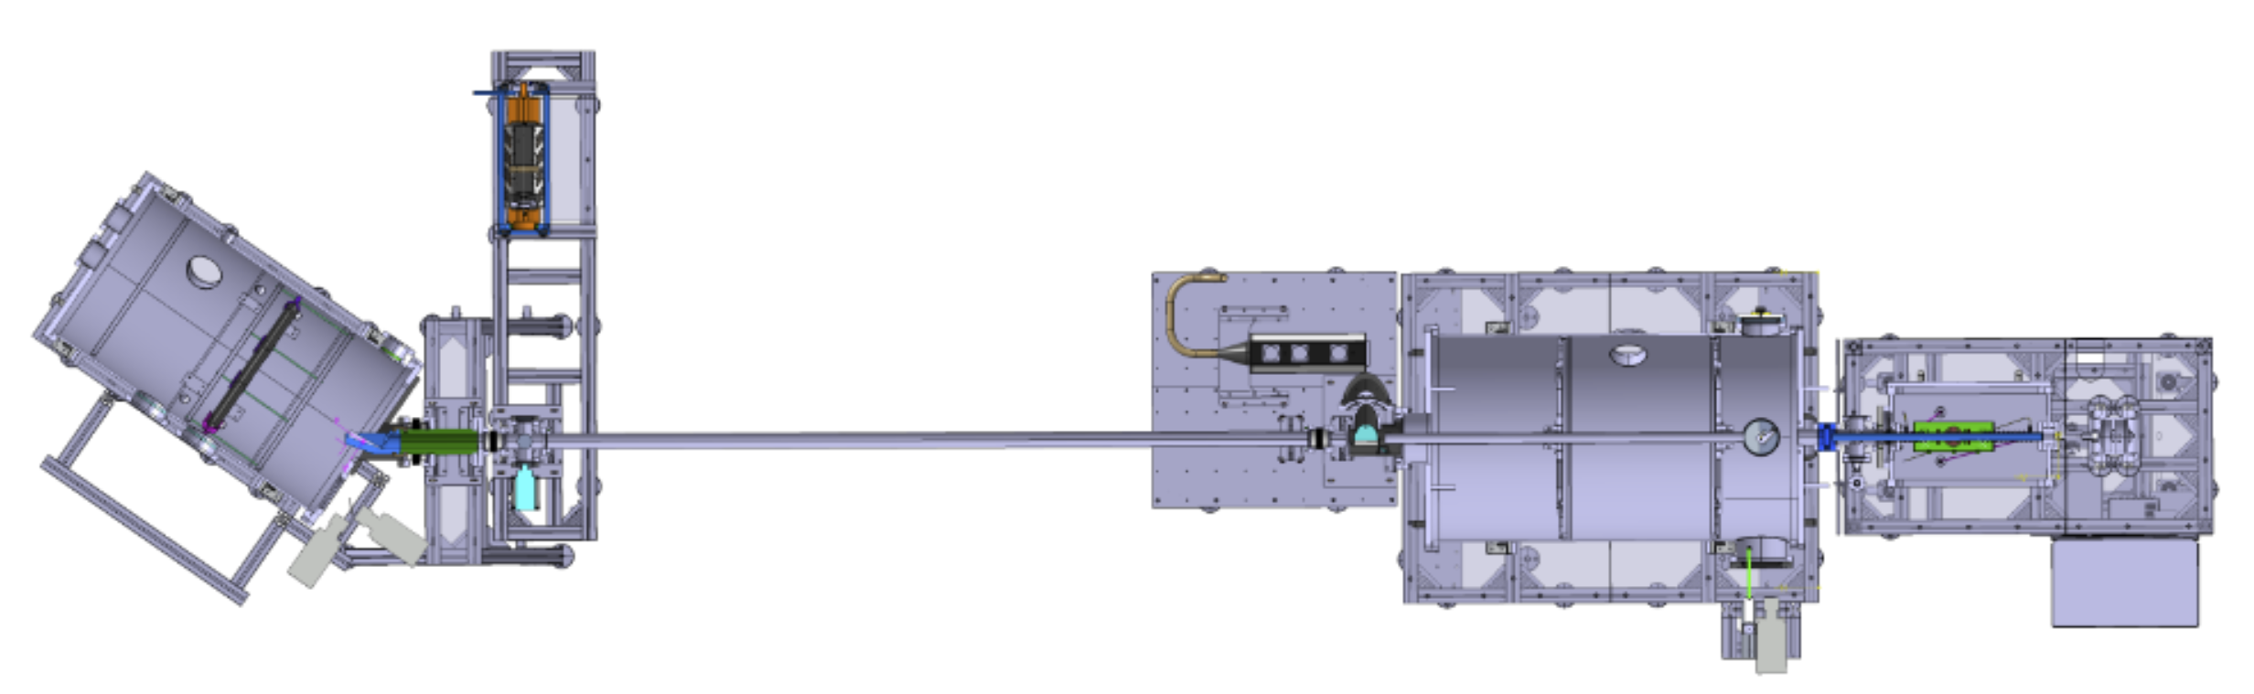

Support laboratory design
Setup has been fully designed and built by CER and consortium partners
Injector with fast valve
Computer controlled gas system
Propellant gas recovery chamber
Flight tube
Shard analysis chamber with
shattering device
Diagnostics:
  Pellet production
  Gas pressure (barrel, gap1)
  Pellet flight (gap1, gap3)
  ITER Optical Pellet Diagnostic
  (OPD) concept test (gap2)
  Shattering view
  Double laser curtain
Shard analysis chamber
Gap3
OPD @ Gap2
Gap1
Injector
Flight tube
Prop. rec.
chamber
Fast valve
S. Zoletnik, et al, Fus. Eng. Des. 190 113701 (2023)

Slide 11
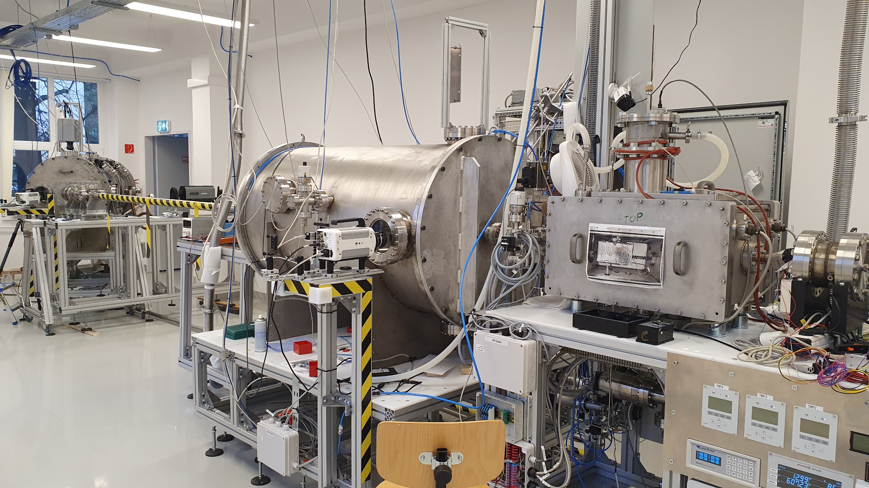
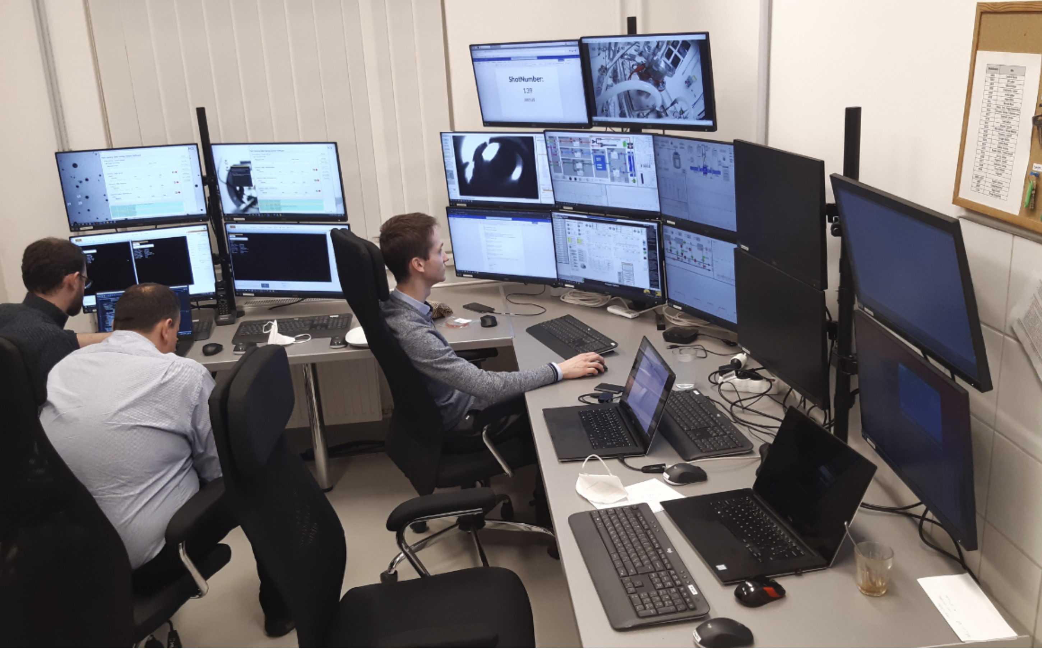
Support laboratory implementation
First pellet achieved 13 month after start of project
Diagnostic
chamber
Propellant recovery chamber
Flight tube
Propellant
valve
Injector

Slide 12
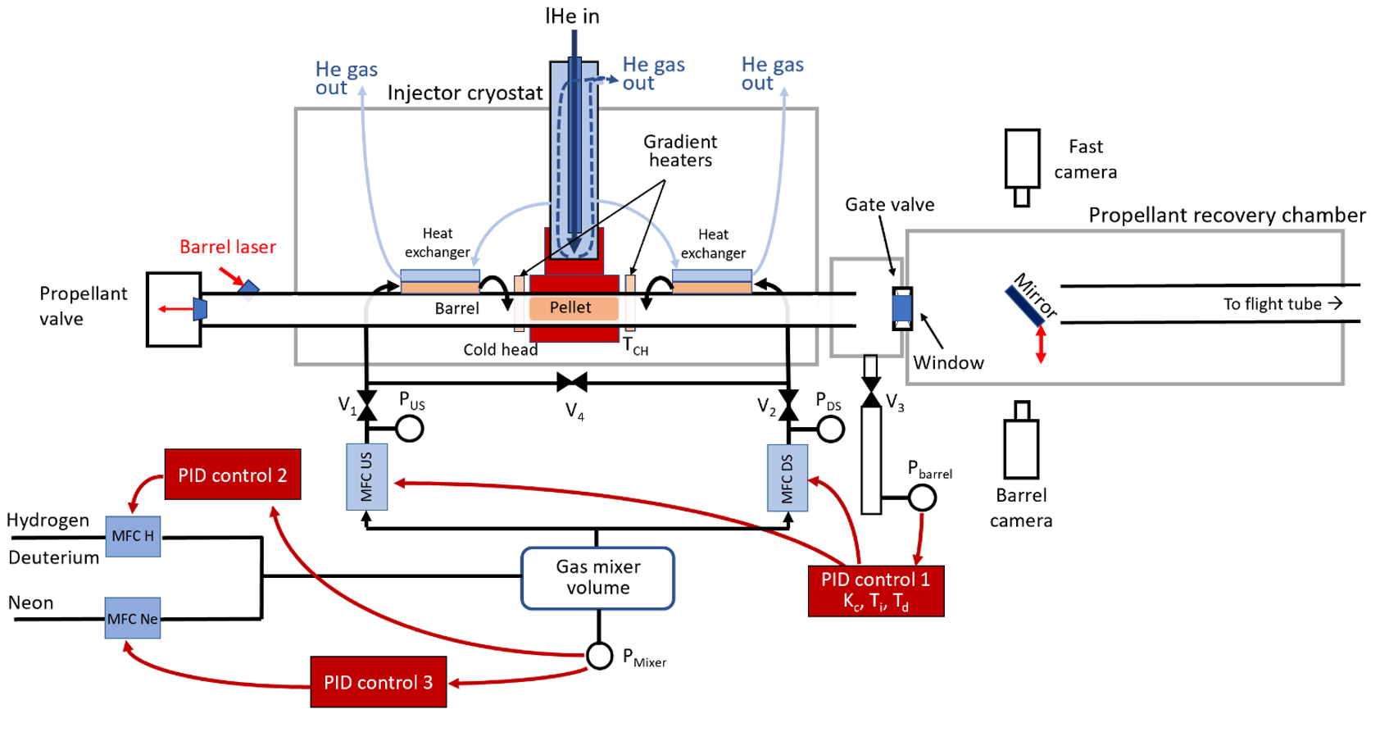
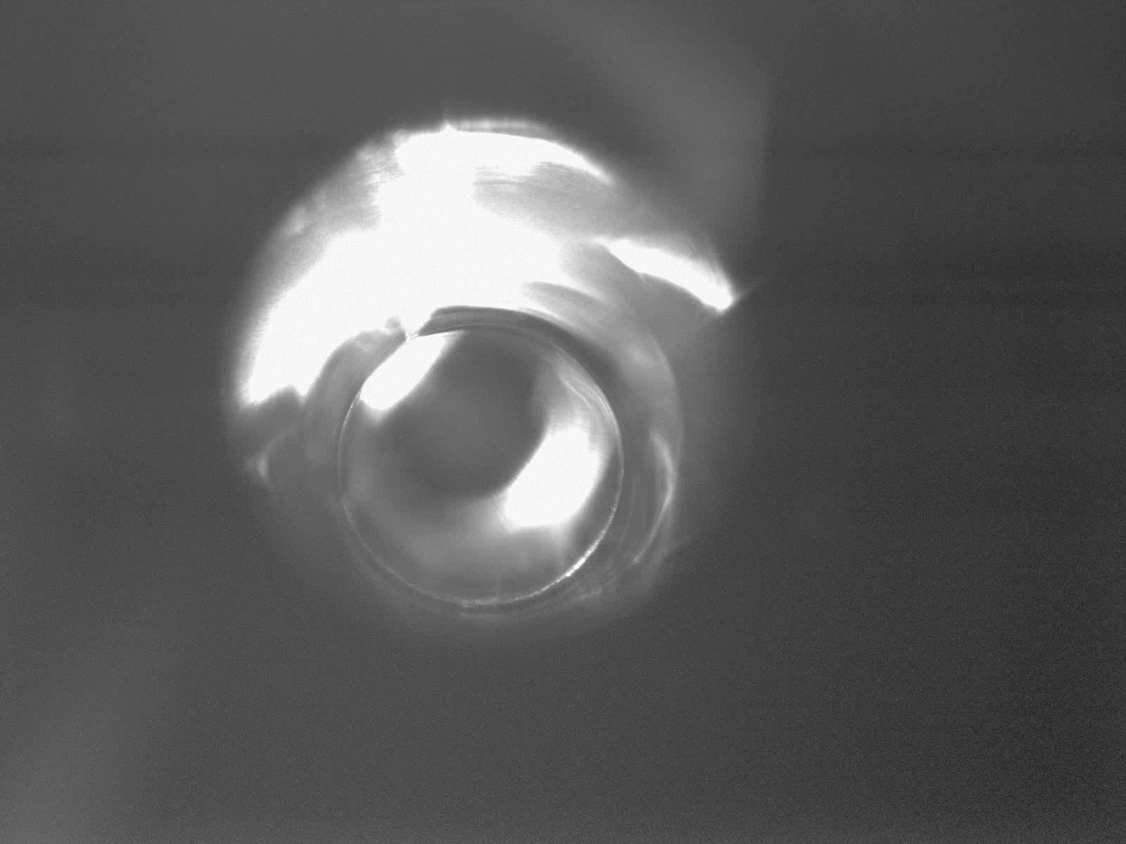
Pellet injector and diagnostics
D.I. Réfy, et al, Fus. Eng. Des.
194 113893 (2023)
G. Kocsis, et al, Fus. Eng. Des. 190 113515 (2023)
E. Walcz, et al, Fus. Eng. Des. 191 113584 (2023)

Slide 13
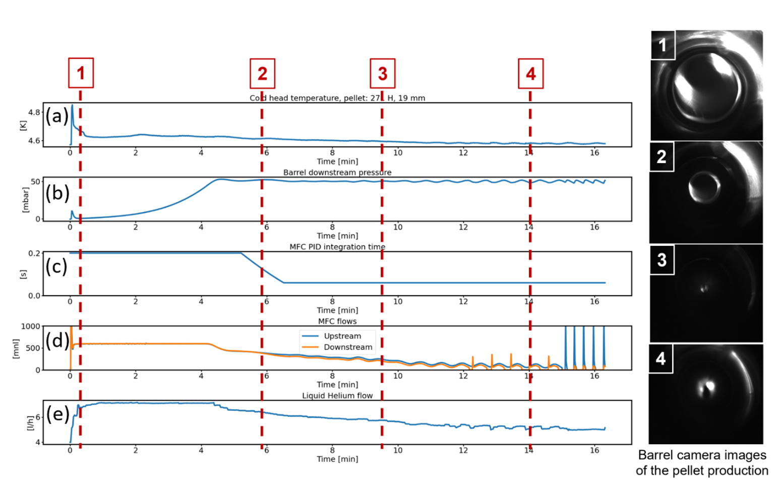
Pellet formation process
Cold head at 5K normally
Pellet gas flow PID controlled to set barrel pressure + feed limit
First few minutes: feed limit active, strong cryopumping by pellet
PID parameters changed as function of desublimated material (proxy for layer thickness)
lHe flow offset-linear proportional to gas flow
Barrel camera sees closure of hole, but formation is stopped when ideal amount of gas is desublimated

Slide 14
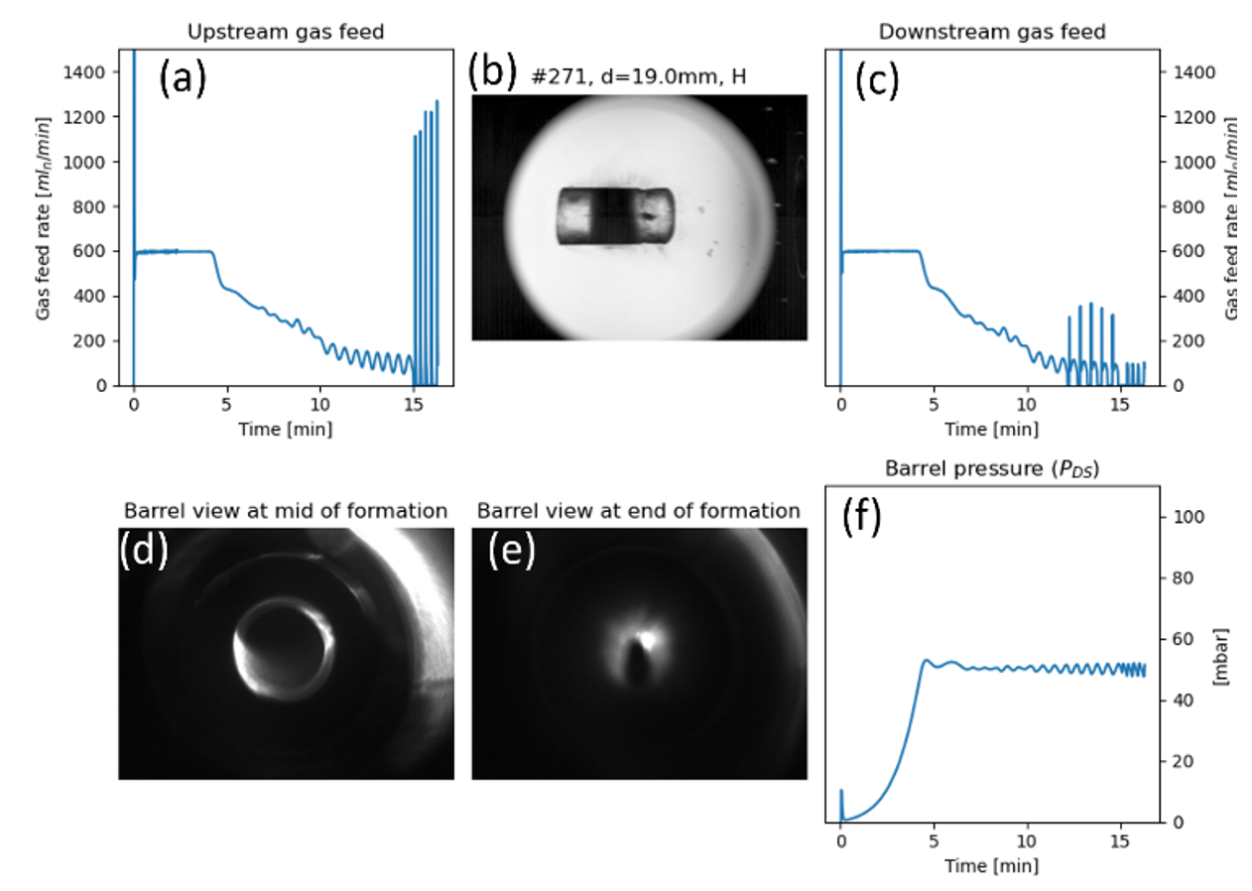
Standard pellet plot
Same plot presented for many pellet types
gap1 shadowgraphy image:
pellet quality
gas fed rate on two sides
Barrel pressure
Barrel camea at halfway and end
of formation: pellet quality

Slide 15
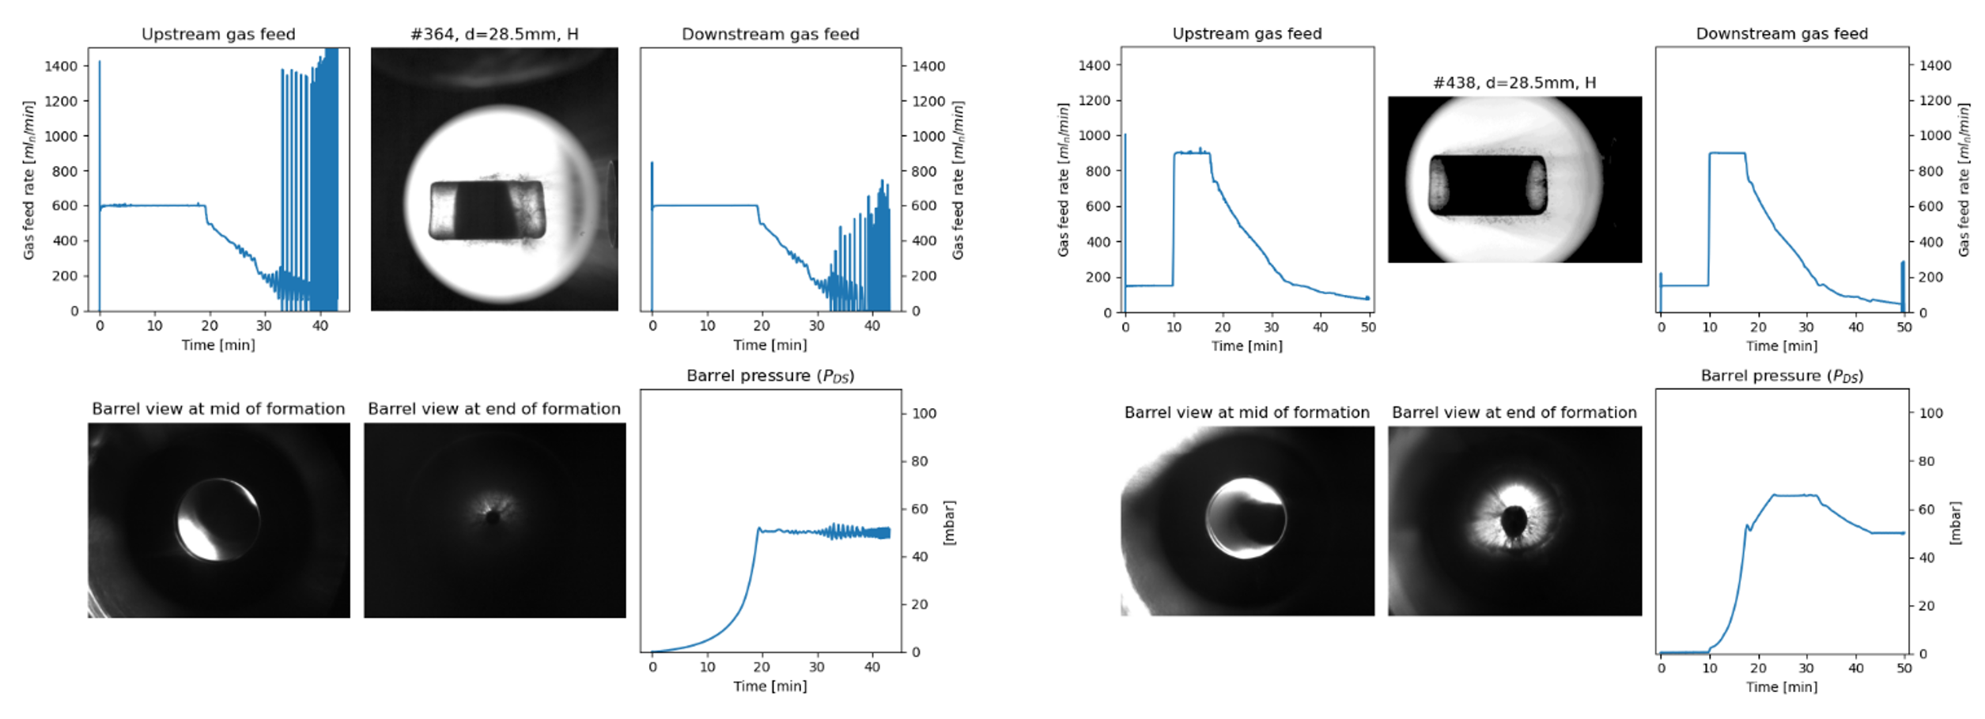
Protium pellets: darkwaist and darkshell
Dark waist
Axial dark stipe
19 mm
28.5 mm
darkwaist darkshell
Darkshell is the standard
hydrogen recipe

Slide 16
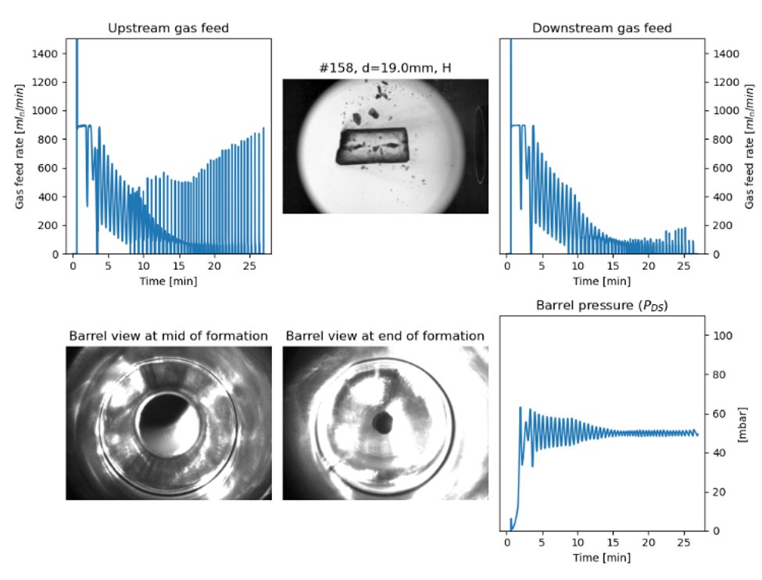
Transparent protium pellets
19 mm pellet with high gas feed rate
19 mm hydrogen pellets are also transparent when formed at 8, 10 K cold head temperature
Transparent pellets break

Slide 17
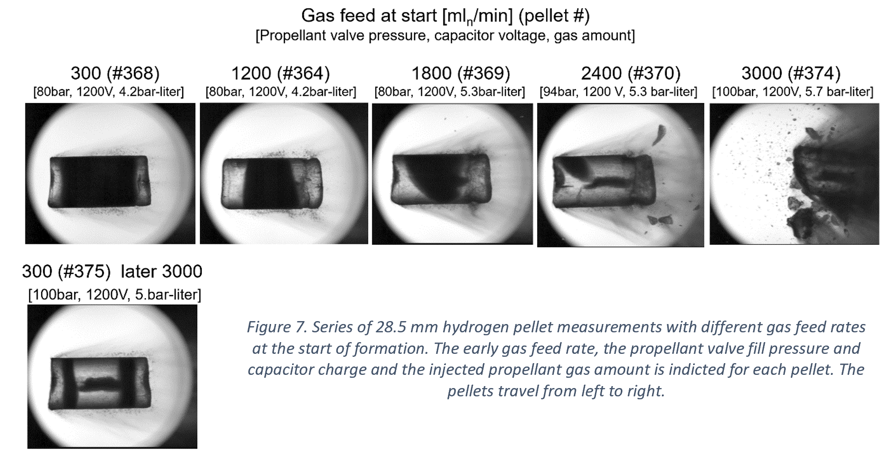
Protium pellet launch
The pellet launch and darkness depends systematically on gas feed rate at start of formation
Series of 28.5 mm hydrogen pellet measurements with different
gas feed rates at the start of formation.
Dark pellets form when the gas feed rate is low

Slide 18
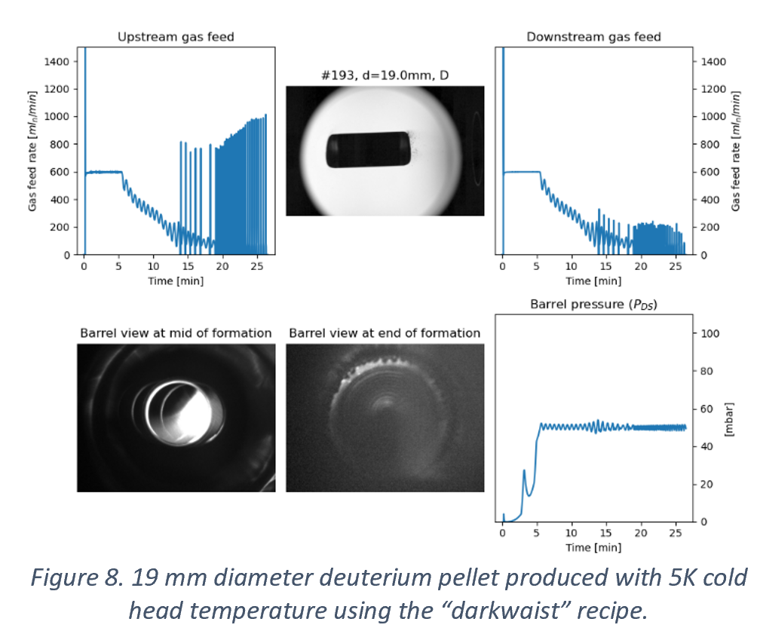
Deuterium pellets
Deuterium pellets are always dark
19 mm deuterium pellet formed at 5 K cold head temperature
with darkwaist recipe

Slide 19
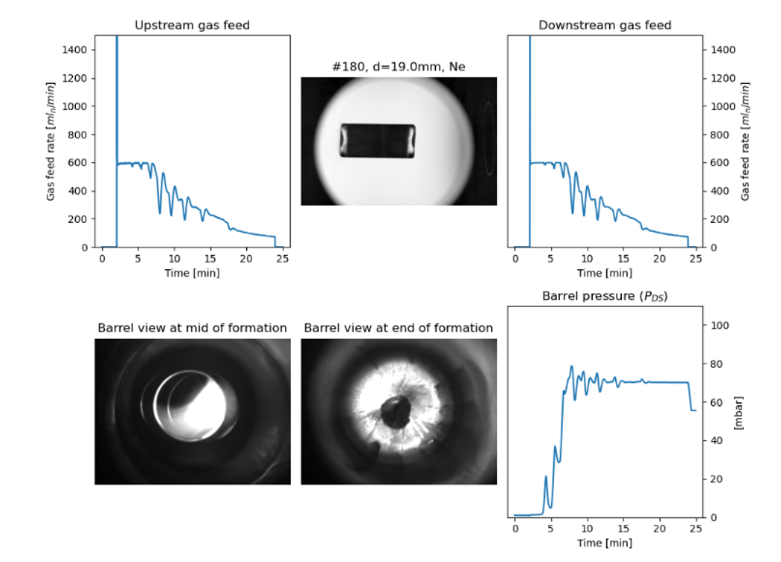
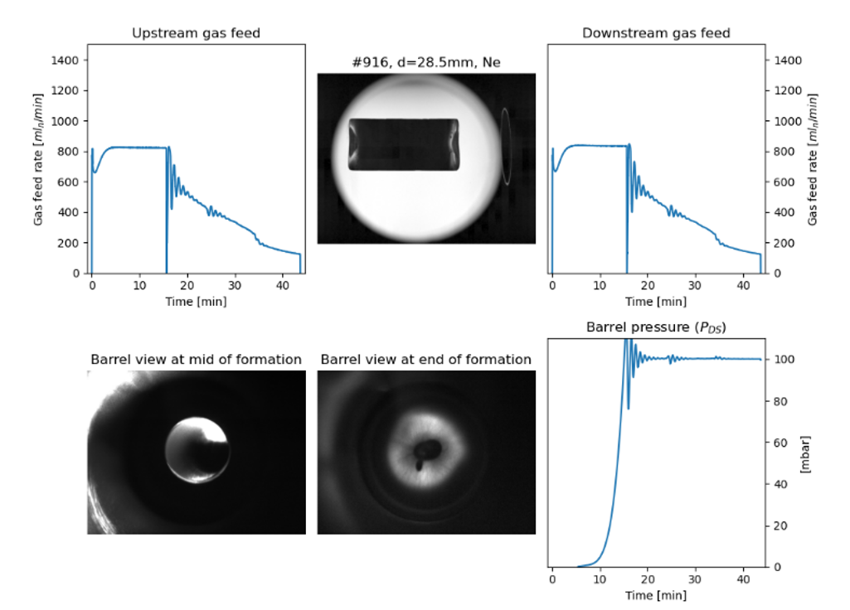
Neon pellets at 5 Kelvin
19 mm neon pellet @ 5K
28.5 mm neon pellet @ 5K
Neon pellets at 5 Kelvin are always dark.
They can be easily launched, despite of expectation

Slide 20
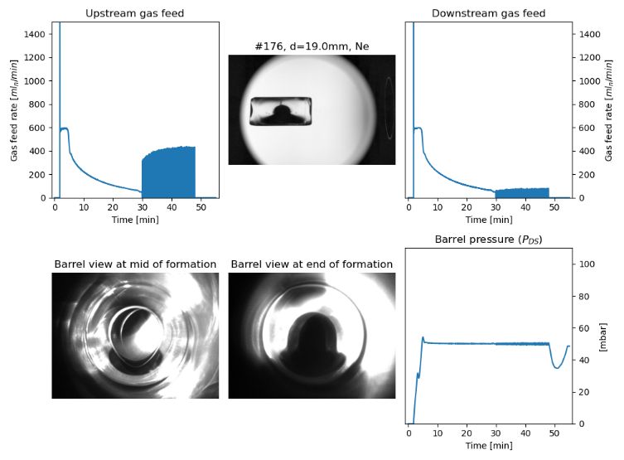
Neon pellets at 12 Kelvin
Neon pellets at 12 Kelvin are mostly transparent.
They can not be launched even with 150 bar valve pressure.
They can be launched only when warmed to 18 Kelvin.

Slide 21
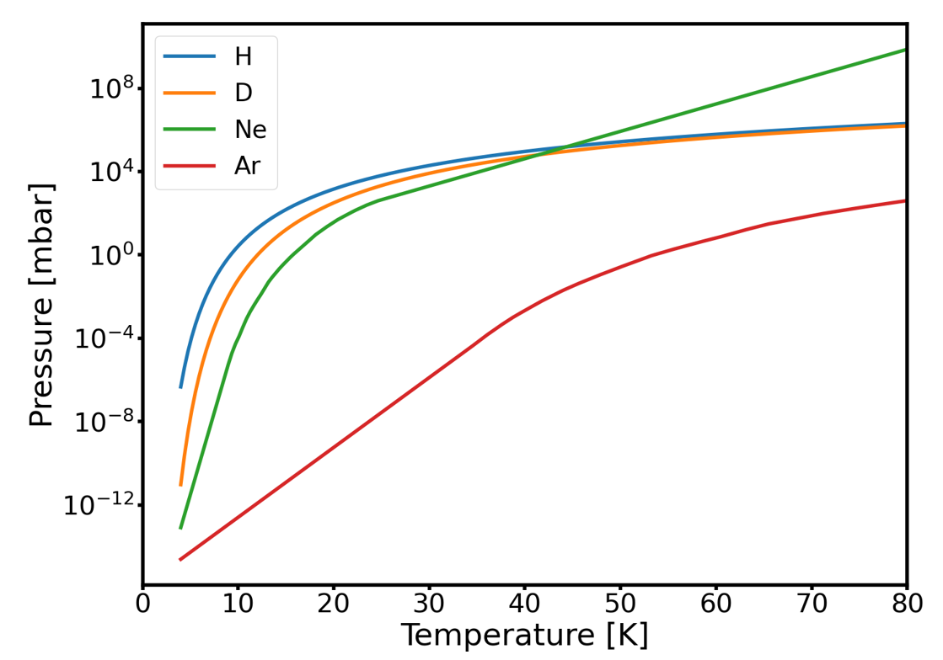
Cryogenic snow formation
Assumption 1:
The dark layer forms when the pellet gas cools below the temperature corresponding to the temperature where the pressure equals the saturation pressure → saturation temperature
Assumption 2:
The dark (snow) layer is limited to the pellet surface
→ consider conditions at start of formation
Saturation pressure vs temperature
T_{sat} (Ne)
T_{sat} (H)
T_{sat} (D)

Slide 22

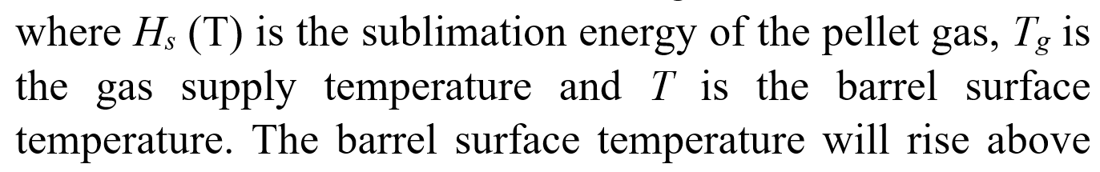
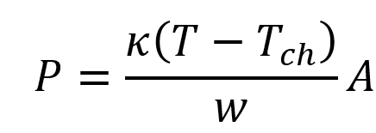
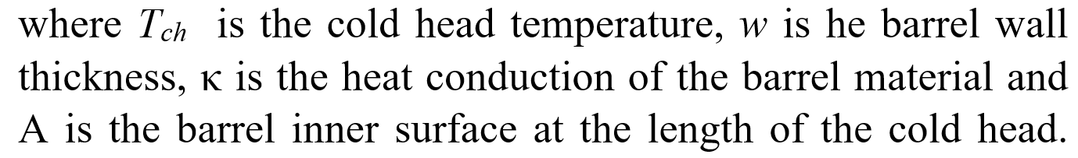
Calculating barrel surface temperature
Heat load on the barrel can be calculated from the measured Φ gas flow rate
The heat load is balanced by heat conduction through the barrel wall to the cold head:
From the two equations the barrel surface temperature can be calculated as a function of
gas flow rate.

Slide 23
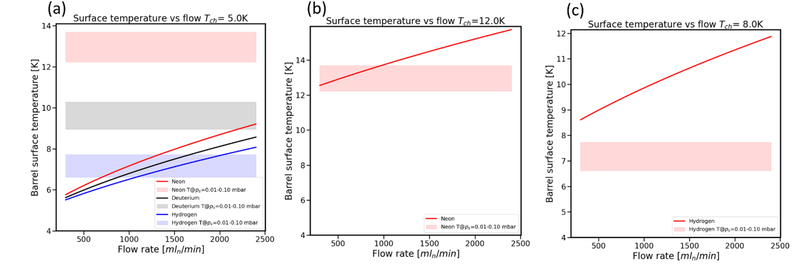
Conditions for snow formation explained
The barrel pressure at the early phase of pellet formation is measured to be 10⁻²...10⁻¹ mbar
The saturation temperature is indicated for this pressure range (1 – 10 Pascal)
H, D, Ne @ 5K
Snow may form when the barrel temperature is below the saturation temperature
Ne @ 12K
H @ 8 K
These plots are capable only to indicate trends, as the exact barrel pressure distribution is not known. The trends are explained:
H @ 5K : snow formation depends on local pressure
D, Ne @ 5K: always snow formation
Ne @ 12K: snow formation depends on local conditions
H @ 8K: No snow formation

Slide 24
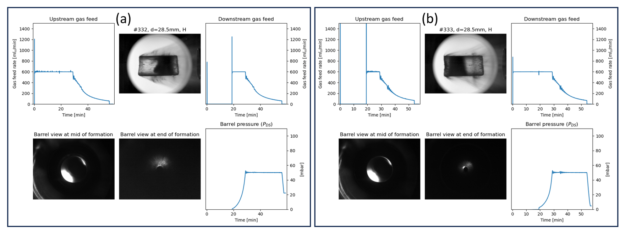
Snow formation for H pellet depends on local pressure
Pair of measurements with one-sided feeding at the start of pellet formation
Snow always forms on opposite side of gas feed

Slide 25
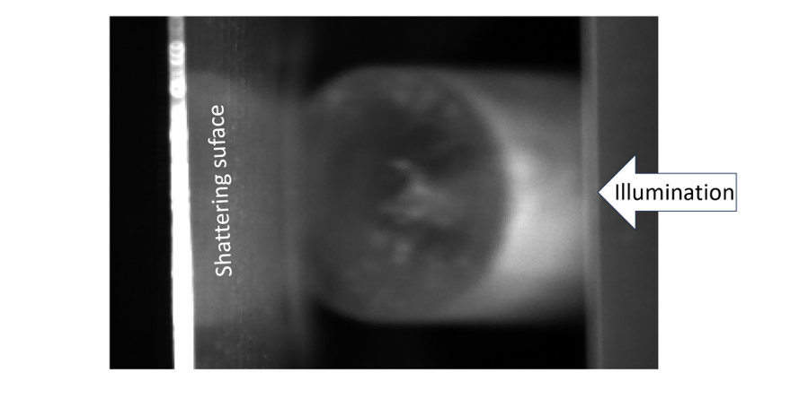
Snow (dark layer) is only on surface
Few images taken nearly opposite to pellet velocity
Image just before pellet hits shattering head
Dark layer is bright as
illumination
is coming from side
Dark axial stripe

Slide 26
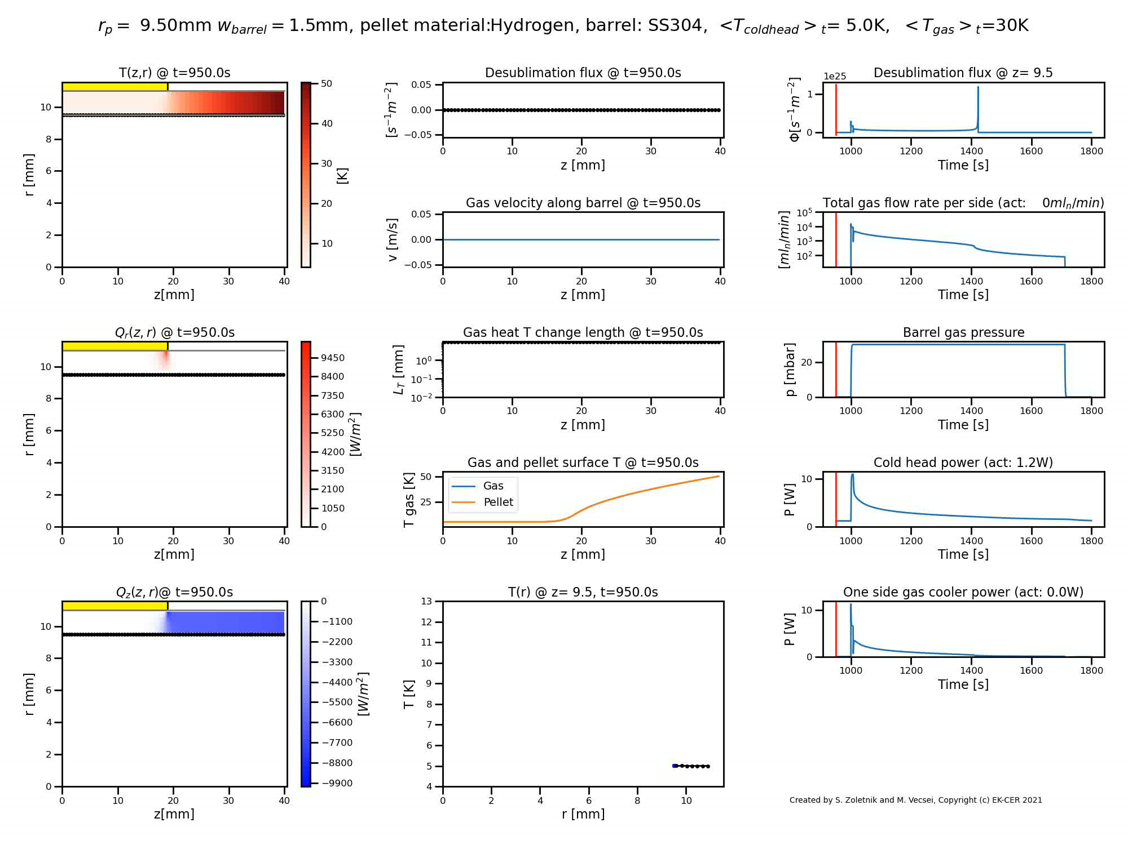
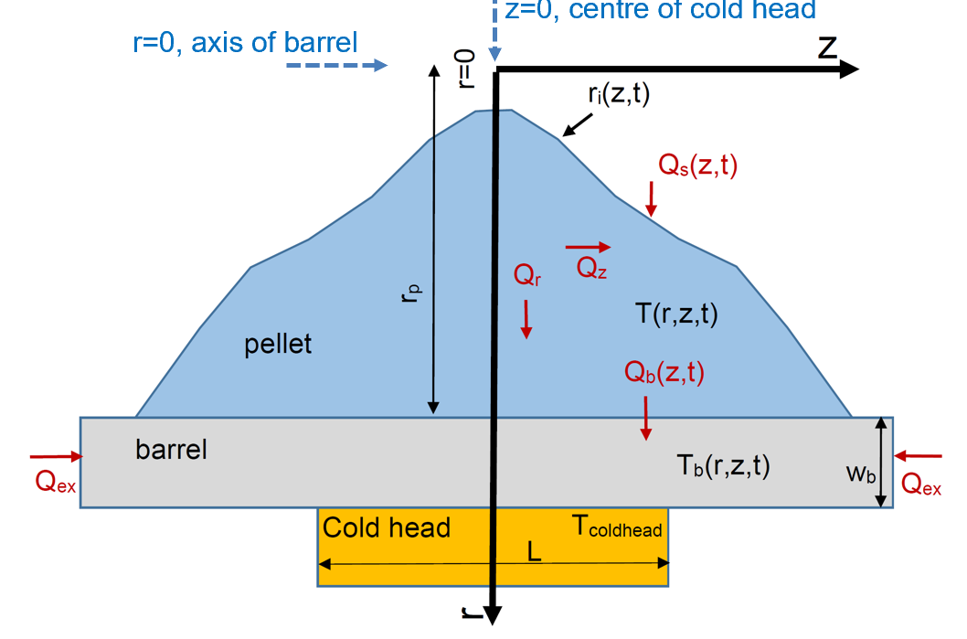
Pellet desublimation model
Pfreeze:
2D axially symmetric geometry
Heat transport in ice and barrel
Pellet material heat conduction from literature
Self-consistent calculation of desublimation,
gas heat conduction and surface temperature
Numerical mesh moving with pellet surface
Constant barrel gas pressure
→ gas flow, cold head power,... from model
Temperature in barrel wall and pellet
Gas flow rate
(log scale)
Temperature profile at Z=9.5 mm
S. Zoletnik, et al, EPS Plasma Conf. 2021 P2.1057

Slide 27
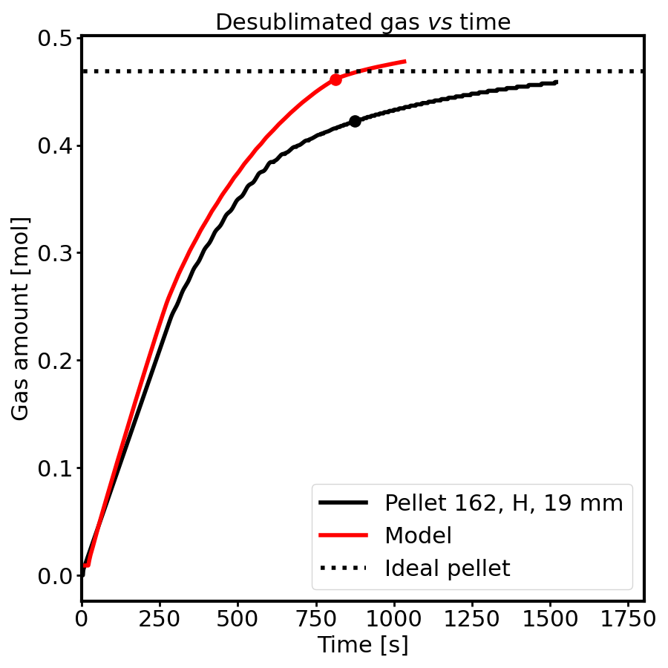
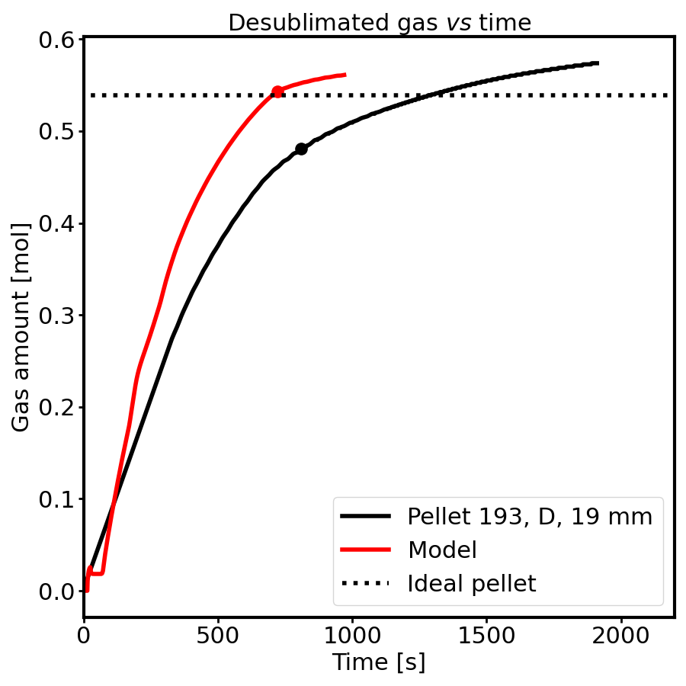
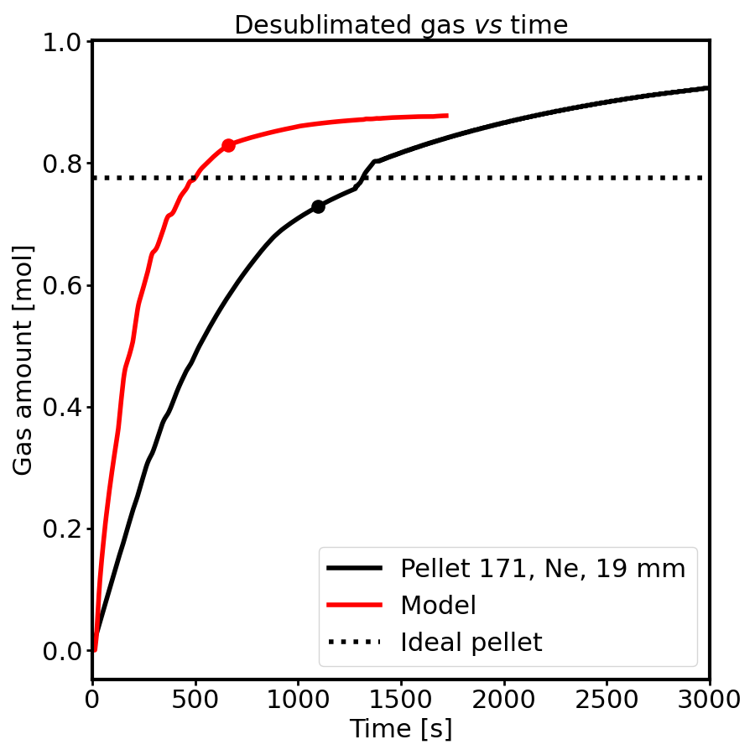



Comparison of modelling with experiment
Experimental barrel pressure is used in model → gas flow (desublimation rate) calculated
Hole
closure
Hydrogen
Deuterium
Neon
Experimental gas flow (desublimation rate) at start is systematically below modelled
Deviation is larger for dark pellets:
gas does not reach into core of pellet
→ uniform gas pressure in model not valid
→ would need coupled gas flow and desublimation model (under development)

Slide 28
Conclusions on pellet formation
19 and 28.5 mm diameter H, D, Ne and Ne-H pellets formed and launched in ITER DMS support lab
Pellet quality for 5 K cold head temperature depends on gas feed rate at start of formation
→ cryogenic snow formation
Snow formation tendency is explained by simple calculation
→ for details gas flow modelling is needed during pellet formation
Snow layer enables launching pellets intact
Observation of cryogenic snow formation might be interesting for other fields in physics

Slide 29
After launch
Fast shutter
(2 ms, optional)
Propellant suppressor
Injector
Shattering head
Flight tube
Close
Optical pellet diagnostic
(OPD)

Slide 30



OPD Concept
Direct imaging optics from the diagnostic chamber through the bioshield to the port cell
Shadowgraphy - back-illumination (diffusors are lit up from the front)
Combined detector system:
1. Scanning the pellet with Individual detector based ultrafast “camera”
Pellet is imaged into a fibre bundle – single fibres are connected to separate fast high-sensitivity detectors
Continuous illumination
2. High resolution imaging system (triggered by RT processing of detector signals)
Relatively simple CMOS cameras – three pieces – each camera one image
Pulsed light source – 100 ns time range – exposure time control
Shadowgraphy – two views
Pellet observation in the diagnostic chamber
Image of fibre-plate on direct view object plane

Slide 31



OPD concept demonstration in the DMS Support Laboratory
Reference:
ITER_D_82FFYW
Backend optics
Frontend optics
OPD system installed in DMS Support Laboratory
OPD Vacuum chamber
3D rendered design of DMS Support Laboratory system
Fibres to detectors (128)
APDCAM-10G camera
Pellet flight tube
Fibres for illumination
Installed in DMS Support Laboratory in early 2022
Integrated in the DMS Support Lab. control system
Continuously developed based on operation experience
Back illuminated fibre-plate

Slide 32



DMS Support Laboratory system – Example measurement
Pellet broken between gap1 and the OPD.

Slide 33



DMS Support Laboratory system – Example measurement
Example of broken pellet measured with APDCAM system but failed by CMOS cameras
Figure 14. Example of broken pellet measured with APDCAM system but failed by CMOS cameras.

Slide 34

Fast shutter
Fast shutter would prevent propellant gas to overtake pellet in the flight tube
Concept demonstrated by our team:
2 ms closing time
10 000 cycle test
Leakage below limit
Fast shutter is an optional device, in case
the propellant gas suppressor is insufficient.
It would be closed by OPD control behind the pellet

Slide 35

Pellet shattering in the support laboratory
Set-up
20-degree, open-concept shattering head
  → in fact shatter plate (not a tube)
Illumination from the side
  → 10,000 lm LED spot light
Observation from top
  → fast camera

Slide 36


Shatter view camera
Application for fragment analysis
Time of impact can be determined
150 us

Slide 37


Laser curtain diagnostic
Concept
Illuminate a thin plane (observable area: min. 40x40 cm)
Beam dump to prevent reflections
Fragments within plane scatter light, rest is dark
Observe with a fast camera
  Distance to camera is well defined → fragment size
Line laser sources
Fast camera

Slide 38


Evaluation: segmentation procedure
Fragment identification (python)
skimage.filters.threshold_local
+
ndimage.label
$$A=πr^{2}$$
$$r=\sqrt{A/π}$$
$$d_{avg}=2\sqrt{A/π}$$

Slide 39
Fragment size distribution measured
#435: H pellet, v = 584 m/s
#439: H pellet, v = 416 m/s

Slide 40
Fragment velocity distribution
#435: H pellet, v = 584 m/s
#439: H pellet, v = 416 m/s

Slide 41
Final conclusions
The ITER DMS Support Laboratory investigated processes and developed components for the ITER DMS system:
Pellet recipes
Propellant valve
Optical pellet diagnostic
Fast shutter
Shattering process
The development continues to ensure provision of a reliable fragment plume \into a disrupting ITER discharge.

Slide 42
BACKUP SLIDES

Slide 43
Desublimation model details

Slide 44



Model for pellet desublimation
Fixed temperature cold head
Axisymmetry, mirror symmetry around centre of cold head: r-z resolution
Pellet surface described as r_{i}(z) function → limitation on pellet surface shape
SS barrel with finite wall thickness, fixed heat flux along barrel at end of z domain
Constant gas pressure in barrel
2D heat conduction and temperature evolution calculated
in pellet and barrel
Surface heat load from gas and desublimation

Slide 45





Surface processes
Various processes are taken into account at gas-pellet interface:
Desublimation:
fraction of particles stick to the surface
(sticking coefficient)
Gas
Pellet
Balance of sublimation-desublimation is a function of pellet surface
temperature (T_{s}), gas surface temperature (T) and gas pressure (p):
T_{s}
T
Փ
α_{s}Փ
Desublimation
Sublimation
Heating:
Gas particles are reflected with different energy:
Heating:
Gas particles are reflected with different energy:
E-ΔE
Surface
heating
E
: energy accommodation coefficient
and are not very well known.

Slide 46

Determination of gas surface temperature
Sublimation-desublimation, pellet and gas surface temperature and heat flux in gas are handled consistently by considering 1D heat and gas flow in the gas perpendicular to the surface
Heat flux out from gas surface to pellet:
Gas
Pellet
T_{s}
T₀, p
T
v
Power by
desublimating particles
Power by sublimating
particles
gas heating
of pellet surface
Heat flux from gas volume to gas surface:
Q_{gas,surf}= Q_{gas,vol}
In steady-state the two heat fluxes are equal:
y
Desublimation flux:
From the two equations T can be calculated numerically if T_{s}, T₀ and p is known.

Slide 47



Surface conditions and heat transport
Heat load on pellet surface:
Heat load from balance of sublimation-desublimation
Heating by desublimated particles
Gas heating
Heat conduction through pellet ice and barrel sets the limit on Q
→ desublimation rate depends on ice thickness
At fixed barrel gas pressure small changes in surface temperature regulate the desublimation rate
Heat conduction
through barrel
Parameters at the pellet surface for thin pellet
layer as a function of surface temperature.
Hydrogen, d_{barrel}=28.5mm, w_{barrel}=2.6 mm

