Slide 1
NSTX citations over time J.W. Berkery, C. Ly (PPPL)

Slide 2
Examining the citations of NSTX papers can give both backward and forward looking insights
The NSTX website maintains a list of “NSTX papers”
Some of these are not primarily NSTX focused, but were written by people who were, at the time, “NSTX researchers”
I filtered those out manually
Plotting the citations of these papers by year can illustrate both:
What was the most impactful science produced by NSTX research?
What kind of papers, and what authors, tend to produce the most citations?

Slide 3
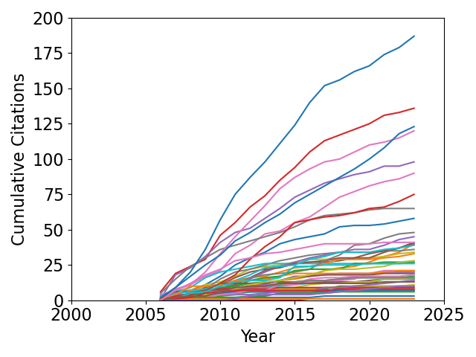
A single year example (2006) illustrates the process
Some metrics are automatically obtained
47 papers
9 NF, 11 POP, 5 PRL
Some metrics require a knowledgeable human to examine every single paper
How many of these are not primarily about NSTX?
What is the author’s PhD year (to sort by early/mid/late career)?
I started to think about doing this, but it seems way too hard
2006 All

Slide 4
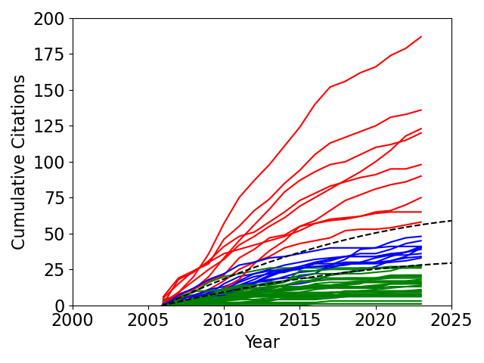
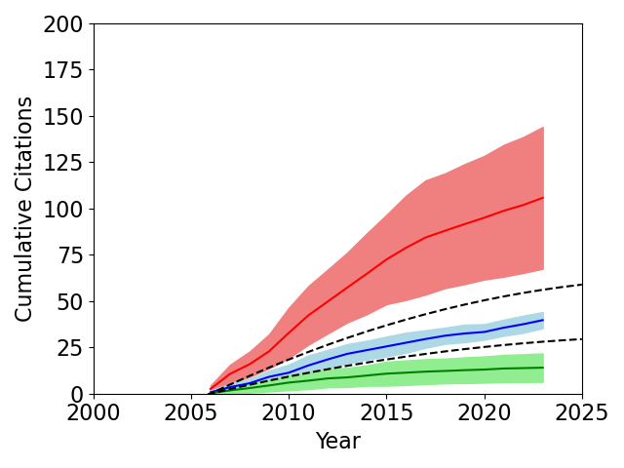
Citation rate separates high, medium, and lower impact papers
2006 All
2006 All
High: 9
Medium: 10
Lower: 28
High: 105.8 ± 38.3
Medium: 39.7 ± 4.4
Lower: 14.0 ± 7.7
High impact mostly evident within ~5 years
y = -0.10x²+5.0x
y = -0.05x²+2.5x (are there better choices)?

Slide 5
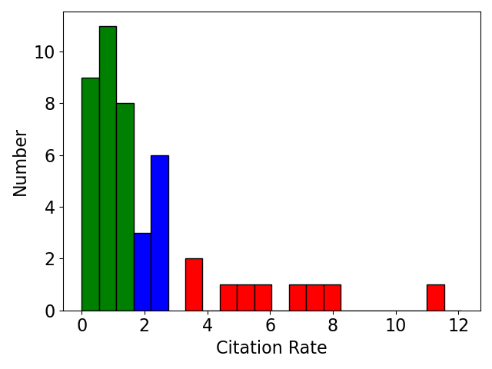
The high impact papers from 2006 really stand out
Zhu, PRL, “Toroidal-Momentum Dissipation by NTV” (187, 11.0)
Sabbagh, NF, “Resistive wall stabilized operation” (136, 8.0)
Myra, POP, “Blob birth and transport” (123, 7.24)
Sabbagh, PRL, “Active Stabilization of RWM” (120, 7.06)
Reimerdes, POP, “Cross-machine comparison of RFA and RWM” (98, 5.76)
Fredrickson, POP, “Collective fast ion instability-induced losses” (90, 5.29)
Menard, PRL, “Observation of Instability-Induced Current Redistribution” (75, 4.41)
Zweben, POP, “Structure and motion of edge turbulence” (65, 3.82)
Gates, NF, “Plasma shape control…using real-time equilibrium reconstruction” (58, 3.41)
2006 All
High: 9
Medium: 10
Lower: 28
(When comparing between years, will need to use rate of citation, not total)

Slide 6
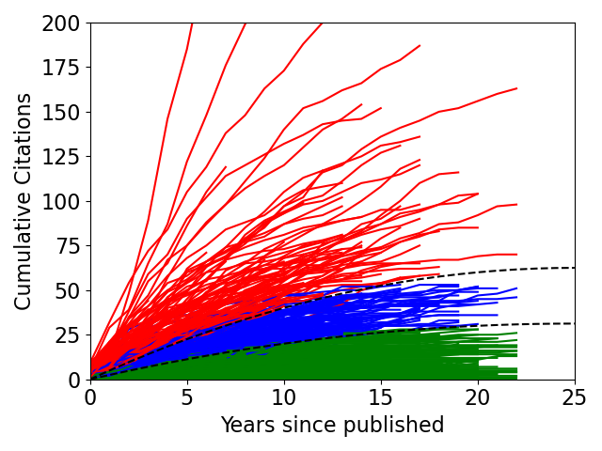
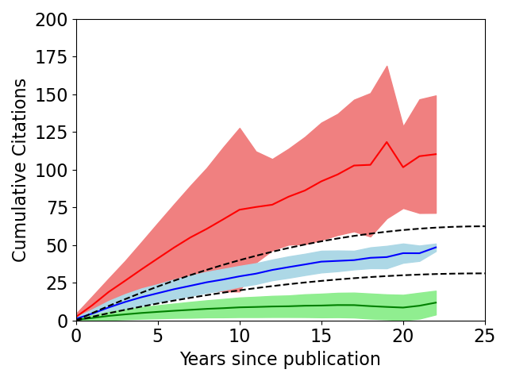
All papers, all years
All
All
High: 99
Medium: 172
Lower: 479

Slide 7
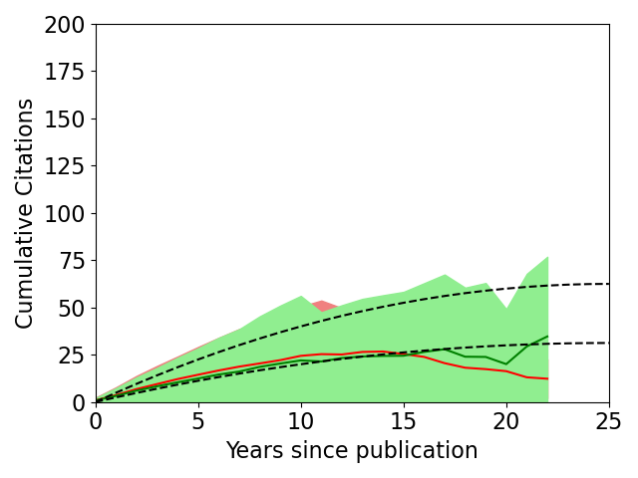
There is no discernable difference between PPPL and collaborators
All
PPPL first author
Other

Slide 8
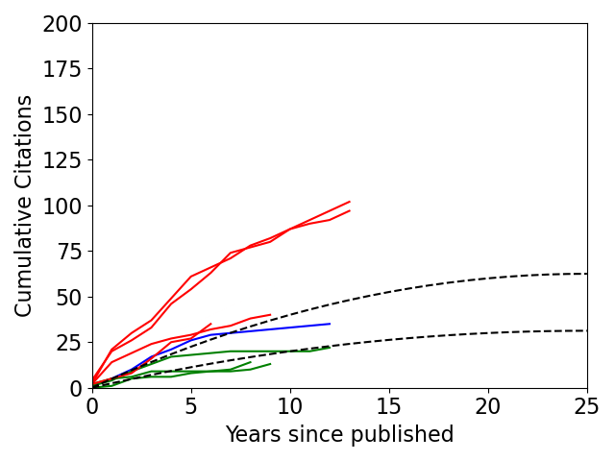
Can also look at the output from a single author (using myself as an example)
Berkery, (2010) POP, "The role of kinetic effects, …in resistive wall mode stability" (102, 7.85)
Berkery, (2010) PRL, "Resistive Wall Mode Instability at Intermediate Plasma Rotation" (97, 7.46)
Berkery, (2014) POP, "Benchmarking kinetic calculations of resistive wall mode stability" (40, 4.44)
Berkery, (2017) POP, "A reduced RWM kinetic stability model for disruption forecasting" (35, 5.83)
Berkery, (2011) PRL, "Effect of Collisionality on Kinetic Stability of the Resistive Wall Mode" (35, 2.92)
Berkery, (2011) POP, "Investigation of multiple roots of the RWM dispersion relation…" (22, 1.83)
Berkery, (2015) NF, "Modifications to ideal stability by kinetic effects in NSTX" (14, 1.75)
Berkery, (2014) POP, "Measured improvement of global MHD mode stability at high-beta…" (13, 1.44)
Berkery All (NSTX-related papers)
High: 4
Medium: 1
Lower: 3

Slide 9
The high impact papers can be categorized by physics topic
Fast ion instabilities / Alfven eigenmodes (13)
Lithium effects (12-13)
Gas puff imaging / blobs / edge turbulence (9)
Resistive wall mode (9)
Neoclassical toroidal viscosity / magnetic perturbations / error fields (7)
Turbulence (6)
Equilibrium / control / scenarios (5)
MHD / stability (non-RWM) (4)
Edge localized modes / pedestal (4)
High harmonic fast wave (4)
Other fast ion / neutral beam injection (4)
Divertor / Scrape off layer / heat flux (3-5)
Snowflake divertor (3)
Fast ion D-alpha (3)
Other Diagnostics (3)
IAEA Overview (3)
Transport (2)
Coaxial helicity injection (2)
Future devices (1)

Slide 10
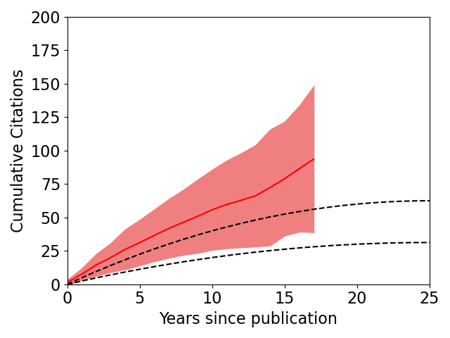
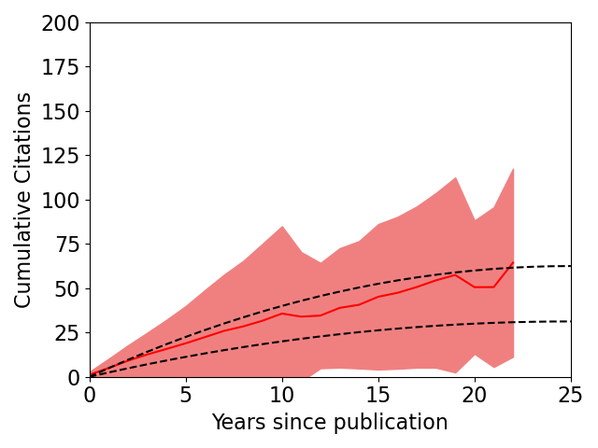
Journal comparison
PRL
Nucl. Fusion
Total: 31
Total: 186

Slide 11
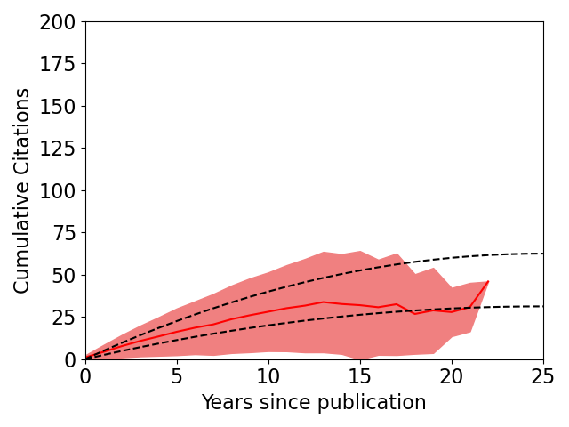
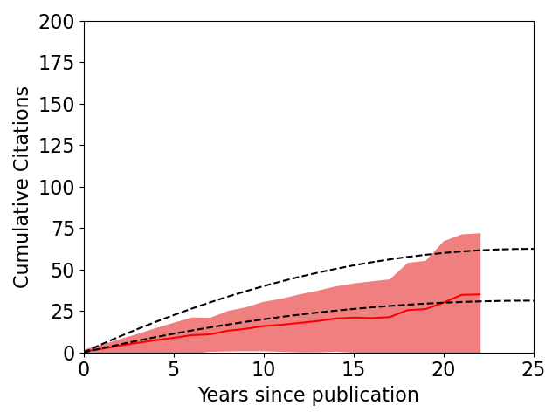
Journal comparison
Physics of Plasmas
Rev. Sci. Instrum.
Total: 139
Total: 116

Slide 12
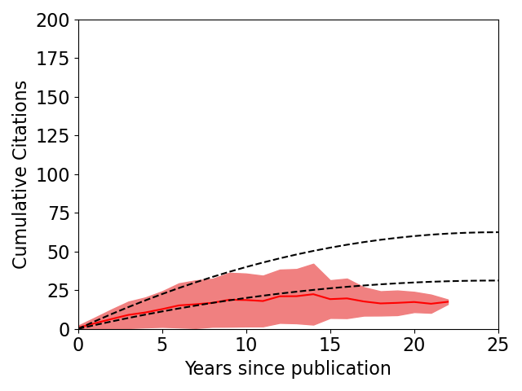
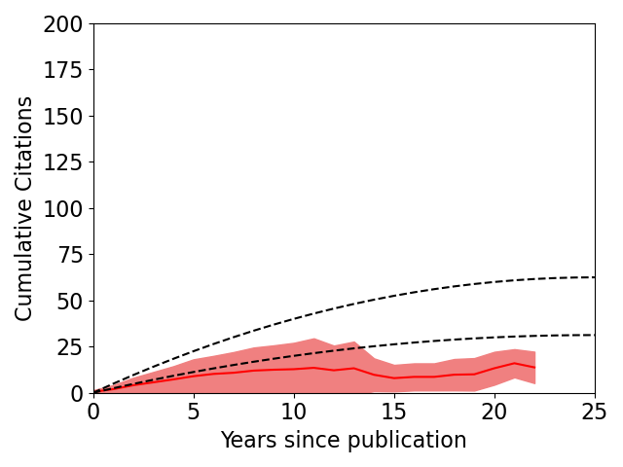
Journal comparison
PPCF
FED
Total: 62
Total: 44

Slide 13
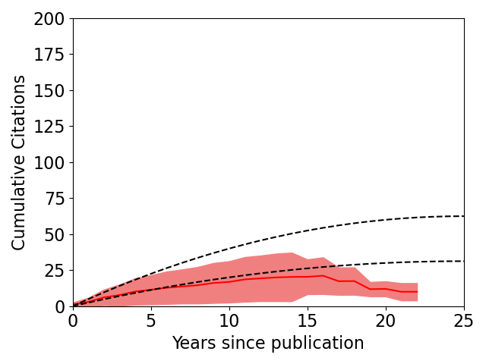
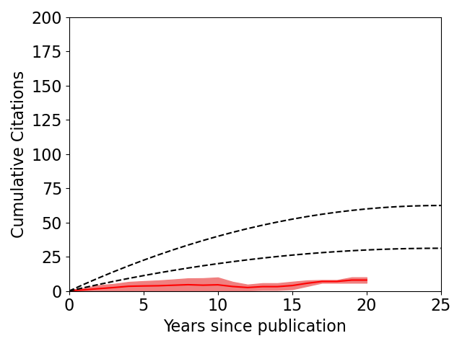
Journal comparison
J. Nucl. Mat.
Fusion Sci. Tech.
Total: 61
Total: 15

Slide 14
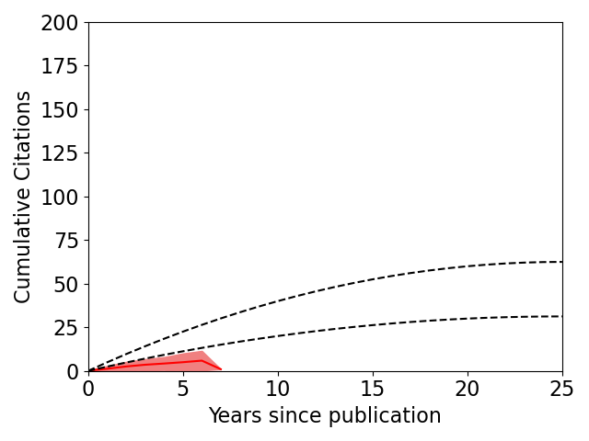
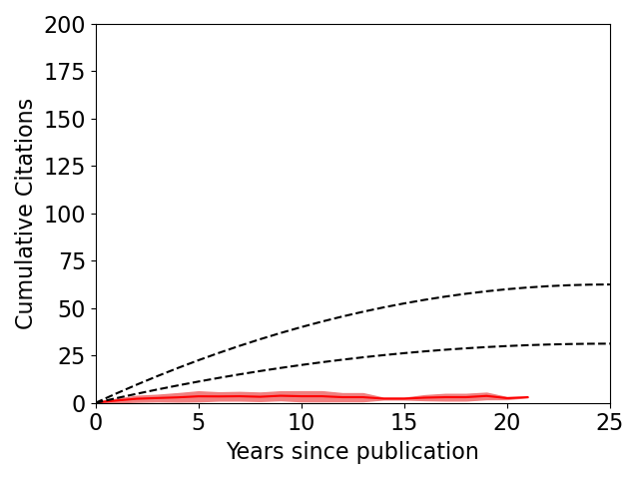
Journal comparison
Nucl. Mat. Energy
IEEE Trans.
Total: 13
Total: 18

Slide 15
Conclusions
NSTX papers can be separated into high, medium, and lower impact
And the category is mostly obvious after ~5 years
The high impact papers give clues about the most impactful science produced by NSTX
The statistics show that certain journals produce more citations than others
Theoretically one could also look at which authors produce more citations, but I didn’t get into that (except to conclude that PPPL and collaborators are equal)
(Detailed year-by-year stats in the backup slides)

Slide 16
Notes
Try doing early / mid / late career?
Difficult!
What else to look at?
Do something with impact factor?
Year by year stats follow…

Slide 17
Year by year results for high impact papers follows

Slide 18
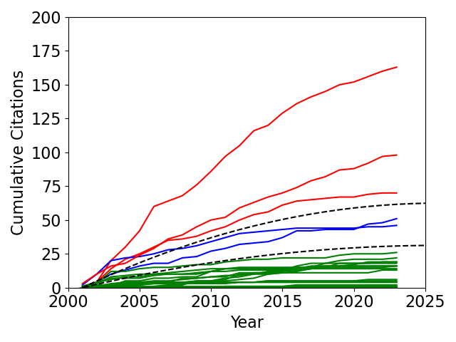
2001
Sabbagh, NF, “Equilibrium properties of spherical torus plasmas in NSTX” (163, 7.41)
Maqueda, RSI, “Edge turbulence measurements in NSTX by gas puff imaging” (98, 4.45)
Raman, NF, “Non-inductive current generation in NSTX using coaxial helicity injection” (70, 3.18)
2001 All
High: 3
Medium: 2
Lower: 17

Slide 19
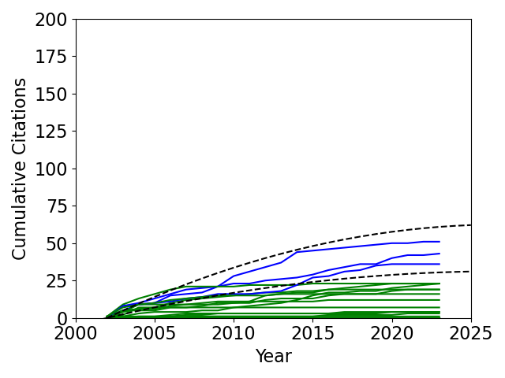
2002
None
2002 All
High: 0
Medium: 3
Lower: 19

Slide 20
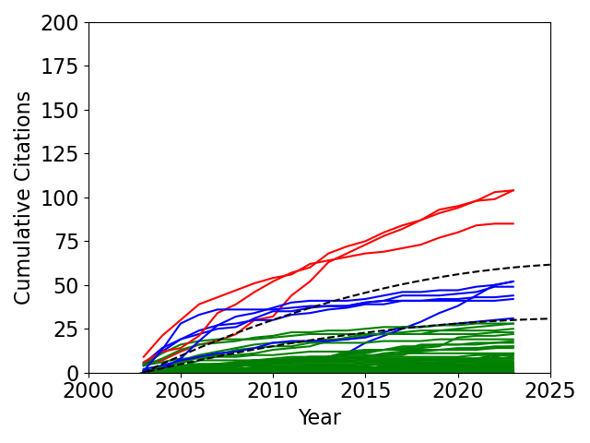
2003
LeBlanc, RSI, “Operation of the NSTX Thomson scattering system” (104, 5.2)
Maqueda, RSI, “Gas puff imaging of edge turbulence (invited)” (104, 5.2)
Menard, NF, “Limiting MHD instabilities in improved-performance NSTX spherical torus plasmas” (85, 4.25)
2003 All
High: 3
Medium: 6
Lower: 45

Slide 21
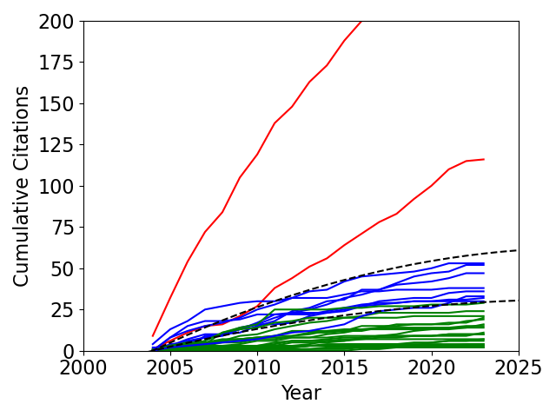
2004
Zweben, NF, “High-speed imaging of edge turbulence in NSTX” (237, 12.47)
Guazzotto, POP, “Numerical study of tokamak equilibria with arbitrary flow” (116, 6.11)
2004 All
High: 2
Medium: 8
Lower: 20

Slide 22
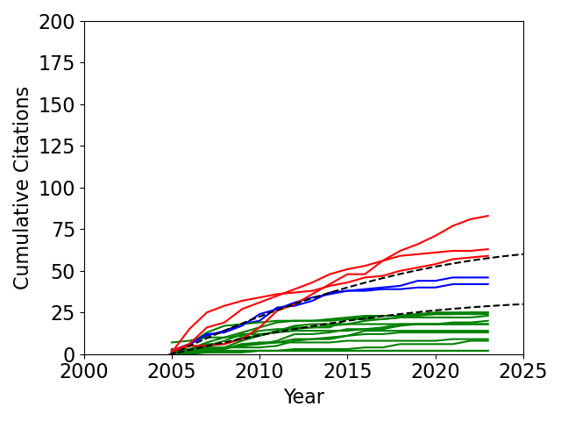
2005
Menard, NF, “Internal kink mode dynamics…” (83, 4.61)
Maingi, NF, “H-mode pedestal, ELM, and power threshold…” (63, 3.50)
Kaye, NF, “Progress towards high performance plasmas…” (59, 3.28)
2005 All
High: 3
Medium: 2
Lower: 13

Slide 23
2006
Zhu, PRL, “Toroidal-Momentum Dissipation by NTV” (187, 11.0)
Sabbagh, NF, “Resistive wall stabilized operation” (136, 8.0)
Myra, POP, “Blob birth and transport” (123, 7.24)
Sabbagh, PRL, “Active Stabilization of RWM” (120, 7.06)
Reimerdes, POP, “Cross-machine comparison of RFA and RWM” (98, 5.76)
Fredrickson, POP, “Collective fast ion instability-induced losses” (90, 5.29)
Menard, PRL, “Observation of Instability-Induced Current Redistribution” (75, 4.41)
Zweben, POP, “Structure and motion of edge turbulence” (65, 3.82)
Gates, NF, “Plasma shape control…using real-time equilibrium reconstruction” (58, 3.41)
2006 All
High: 9
Medium: 14
Lower: 24

Slide 24
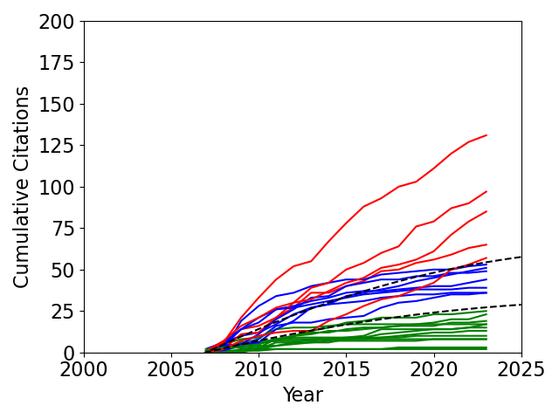
2007
Park, PRL, “Control of Asymmetric Magnetic Perturbations in Tokamaks” (131, 8.19)
Kaye, NF, “Confinement and local transport in the National Spherical Torus Experiment (NSTX)” (97, 6.06)
Gorelenkov, Physics Letters, “Predictions and observations of low-shear beta-induced shear Alfvén–acoustic eigenmodes in toroidal plasmas” (85, 5.31)
Kaye, PRL, “Scaling of Electron and Ion Transport in the High-Power Spherical Torus NSTX” (65, 4.06)
Gorelenkov, PPCF, “Predictions and observations of global beta-induced Alfvén—acoustic modes in JET and NSTX” (57, 3.56)
2007 All
High: 5
Medium: 7
Lower: 12

Slide 25
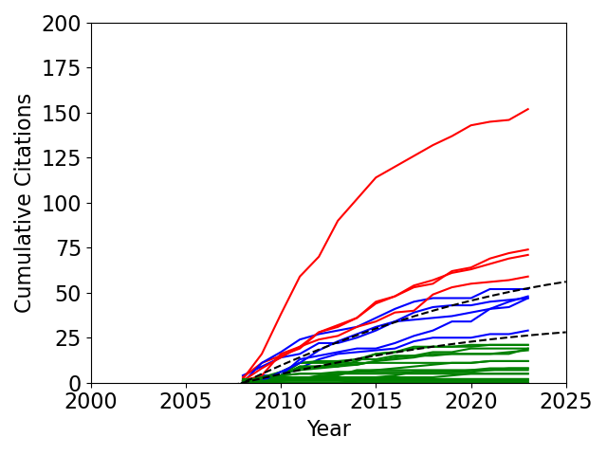
2008
H. Kugel, POP, “The effect of lithium surface coatings on plasma performance…” (152, 10.13)
E. Mazzucato, PRL, “Short-Scale Turbulent Fluctuations Driven by the Electron-Temperature Gradient…” (74, 4.93)
Hosea, POP, “High harmonic fast wave heating efficiency enhancement and current drive at longer wavelength…” (71, 4.73)
Podestá, RSI, “NSTX fast-ion D-alpha diagnostic” (59, 3.93)
2008 All
High: 4
Medium: 5
Lower: 17

Slide 26
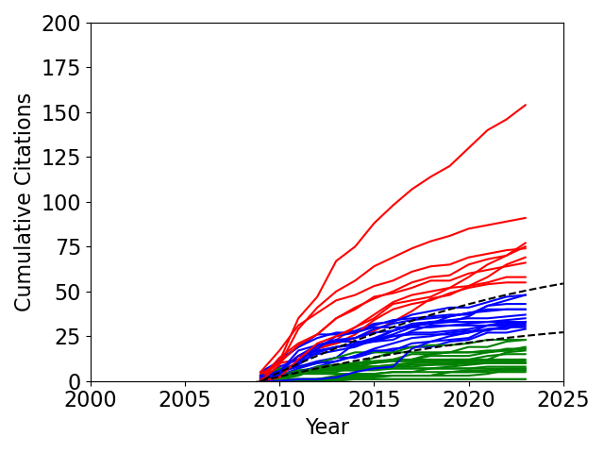
2009
Maingi, PRL, “Edge-Localized-Mode Suppression through Density-Profile Modification with Lithium-Wall Coatings in the National Spherical Torus Experiment” (154, 11.00)
Park, PRL, “Nonambipolar Transport by Trapped Particles in Tokamaks” (125 , 8.93)
Bell, PPCF, “Plasma response to lithium-coated plasma-facing components in the National Spherical Torus Experiment” (91, 6.50)
Gorelenkov, POP, “Beta-induced Alfvén-acoustic eigenmodes in National Spherical Torus Experiment and DIII-D driven by beam ions” (77, 5.50)
Park, POP, “Importance of plasma response to nonaxisymmetric perturbations in tokamaks” (75, 5.36)
Kugel, JNM, “Evaporated lithium surface coatings in NSTX” (74, 5.29)
Stutman, PRL, “Correlation between Electron Transport and Shear Alfvén Activity in the National Spherical Torus Experiment” (69, 4.93)
Manfield, JNM, “Transition to ELM-free improved H-mode by lithium deposition on NSTX graphite divertor surfaces” (66, 4.71)
Fredrickson, POP, “Modeling fast-ion transport during toroidal Alfvén eigenmode avalanches in National Spherical Torus Experiment” (58, 4.14)
Podesta, POP, “Experimental studies on fast-ion transport by Alfvén wave avalanches on the National Spherical Torus Experiment” (55, 3.93)
2009 All
High: 9
Medium: 15
Lower: 20

Slide 27
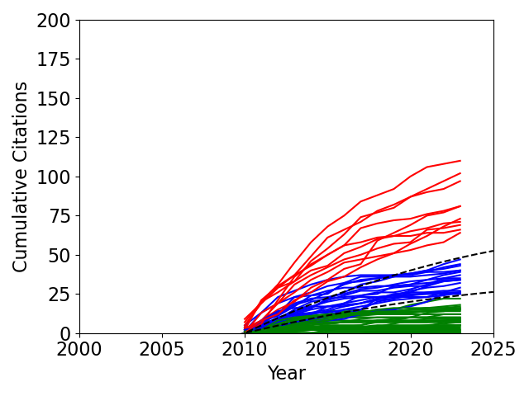
2010
Sabbagh, NF, "Advances in global MHD mode stabilization research on NSTX" (110, 8.46)
Berkery, POP, "The role of kinetic effects, including plasma rotation and energetic particles, in resistive wall mode stability" (102, 7.85)
Berkery, PRL, "Resistive Wall Mode Instability at Intermediate Plasma Rotation" (97, 7.46)
Zweben, POP, "Quiet periods in edge turbulence preceding the L-H transition in the National Spherical Torus Experiment" (81, 6.23)
Heidbrink, RSI, "Fast-ion Dα measurements of the fast-ion distribution (invited)" (81, 6.23)
Ménard, NF, "Progress in understanding error-field physics in NSTX spherical torus plasmas" (73, 5.62)
Solomon, POP, "Mechanisms for generating toroidal rotation in tokamaks without external momentum input" (71, 5.46)
Bell, POP, "Comparison of poloidal velocity measurements to neoclassical theory on the National Spherical Torus Experiment” (69, 5.31)
Canik, PRL, "On Demand Triggering of ELMs Using External Nonaxisymmetric Magnetic Perturbations in Toroidal Plasmas" (66, 5.08)
Mansfield, FED, "A simple apparatus for the injection of lithium aerosol into the scrape-off layer of fusion research devices" (64, 4.92)
2010 All
High: 10
Medium: 19
Lower: 33

Slide 28
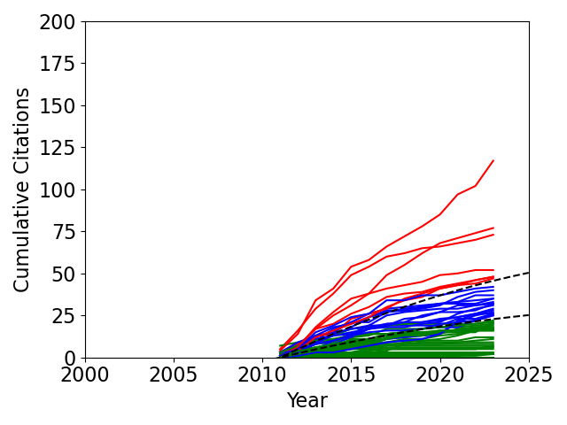
2011
Guttenfelder, PRL, "Electromagnetic Transport from Microtearing Mode Turbulence" (117, 9.75)
Maingi, PRL, "Continuous Improvement of H-Mode Discharge Performance with Progressively Increasing Lithium Coatings in the National Spherical Torus Experiment" (77, 6.42)
Soukhanovskii, NF, "Taming the plasma–material interface with the ‘snowflake’ divertor…" (73, 6.08)
Gray, JNM, "Dependence of divertor heat flux widths on heating power, flux expansion, and plasma current in the NSTX" (52, 4.33)
Crocker, PPCF, "High spatial sampling global mode structure measurements via multichannel reflectometry in NSTX" (48, 4.0)
Myra, POP, "Reduced model simulations of the scrape-off-layer heat-flux width and comparison with experiment" (48, 4.0)
Ren, PRL, "Density Gradient Stabilization of Electron Temperature Gradient Driven Turbulence in a Spherical Tokamak" (47, 3.92)
2011 All
High: 7
Medium: 16
Lower: 31

Slide 29
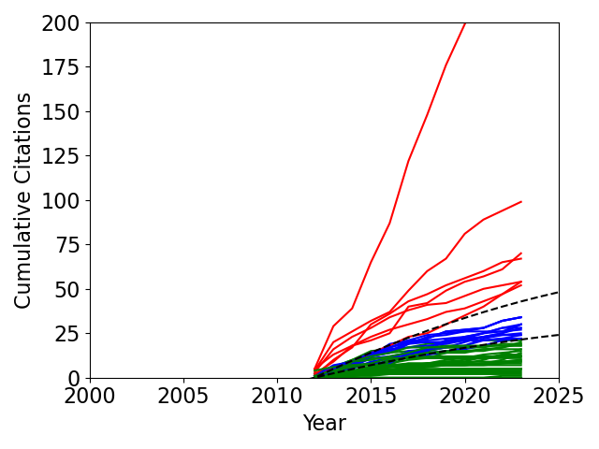
2012
Goldston, NF, "Heuristic drift-based model of the power scrape-off width in low-gas-puff H-mode tokamaks" (266, 24.18)
Maingi, NF, "The effect of progressively increasing lithium coatings on plasma discharge characteristics, transport, edge profiles and ELM stability in NSTX" (99, 9.0)
Kugel, FED, "NSTX plasma operation with a Liquid Lithium Divertor" (70, 6.36)
Soukhanovskii, POP, "Snowflake divertor configuration studies in National Spherical Torus Experiment" (67, 6.09)
Guttenfelder, POP, "Simulation of microtearing turbulence in national spherical torus experiment" (54, 4.91)
Perkins, PRL, "High-Harmonic Fast-Wave Power Flow along Magnetic Field Lines in the Scrape-Off Layer of NSTX" (54, 4.91)
Guttenfelder, POP, "Scaling of linear microtearing stability for a high collisionality NSTX discharge" (52, 4.73)
2012 All
High: 7
Medium: 14
Lower: 33

Slide 30
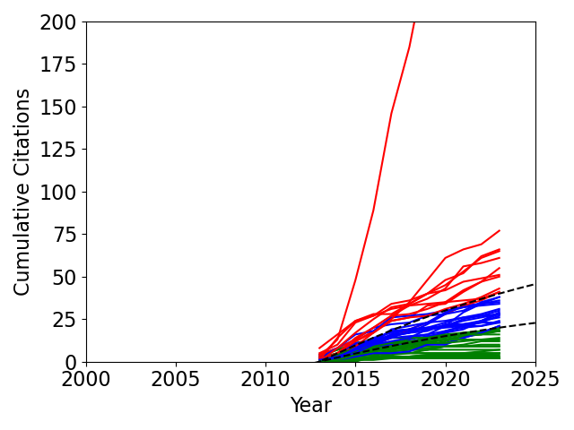
2013
Eich, NF, "Scaling of the tokamak near the scrape-off layer H-mode power width and implications for ITER" (442, 44.2)
Jaworski, NF, "Liquid lithium divertor characteristics and plasma–material interactions in NSTX high-performance plasmas" (77, 7.7)
Kramer, PPCF, "A description of the full-particle-orbit-following SPIRAL code for simulating fast-ion experiments in tokamaks" (66, 6.6)
Guttenfelder, NF, "Progress in simulating turbulent electron thermal transport in NSTX" (65, 6.5)
Groebner, NF, "Improved understanding of physics processes in pedestal structure, leading to improved predictive capability for ITER" (61, 6.1)
Mueller, POP, "The physics of tokamak start-up" (55, 5.5)
Sabbagh, NF, "Overview of physics results from the conclusive operation of the National Spherical Torus Experiment" (51, 5.1)
Canik, NF, "Edge microstability of NSTX plasmas without and with lithium-coated plasma-facing components" (50, 5.0)
Wang, POP, "Linear stability and nonlinear dynamics of the fishbone mode in spherical tokamaks" (43, 4.3)
Bortolon, PRL, "Mitigation of Alfvén Activity in a Tokamak by Externally Applied Static 3D Fields" (41, 4.1)
Skinner, JNM, "Plasma facing surface composition during NSTX Li experiments" (41, 4.1)
2013 All
High: 11
Medium: 19
Lower: 23

Slide 31
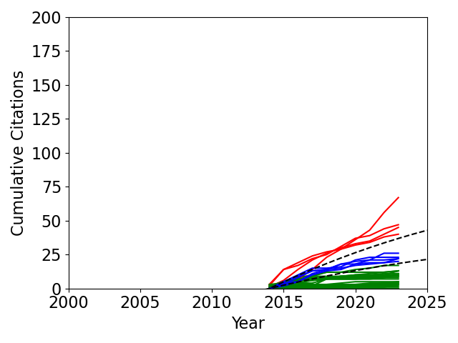
2014
Podestà, PPCF, "A reduced fast ion transport model for the tokamak transport code TRANSP" (67, 7.44)
Bertelli, NF, "Full wave simulations of fast wave heating losses in the scrape-off layer of NSTX and NSTX-U" (47, 5.22)
Boedo, POP, "Edge transport studies in the edge and scrape-off layer of the National Spherical Torus Experiment with Langmuir probes" (45, 5.0)
Berkery, POP, "Benchmarking kinetic calculations of resistive wall mode stability" (40, 4.44)
2014 All
High: 4
Medium: 5
Lower: 22

Slide 32
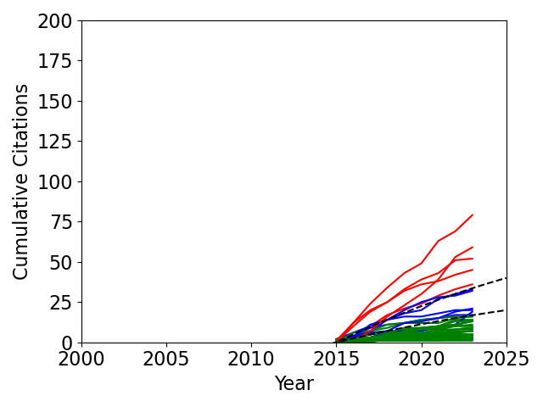
2015
Shaing, NF, "Neoclassical plasma viscosity and transport processes in non-axisymmetric tori" (79, 9.88)
Ryutov, POP, "The snowflake divertor" (59, 7.38)
Zweben, NF, "Edge and SOL turbulence and blob variations over a large database in NSTX" (52, 6.5)
Ebrahimi, PRL, "Plasmoids Formation During Simulations of Coaxial Helicity Injection in the National Spherical Torus Experiment" (45, 5.62)
Belova, PRL, "Coupling of Neutral-Beam-Driven Compressional Alfvén Eigenmodes to Kinetic Alfvén Waves in NSTX Tokamak and Energy Channeling" (36, 4.5)
2015 All
High: 5
Medium: 6
Lower: 27

Slide 33
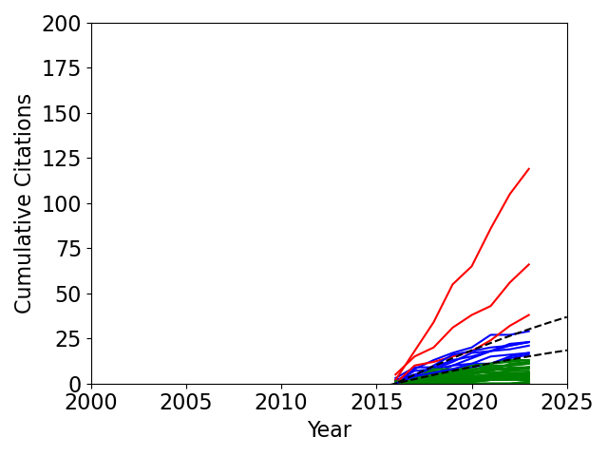
2016
Ménard, NF, "Fusion nuclear science facilities and pilot plants based on the spherical tokamak" (119, 17.0)
Zweben, PPCF, "Blob structure and motion in the edge and SOL of NSTX" (66, 9.43)
Petrov, PPCF, "A fully-neoclassical finite-orbit-width version of the CQL3D Fokker–Planck code" (38, 5.43)
2016 All
High: 3
Medium: 8
Lower: 37

Slide 34
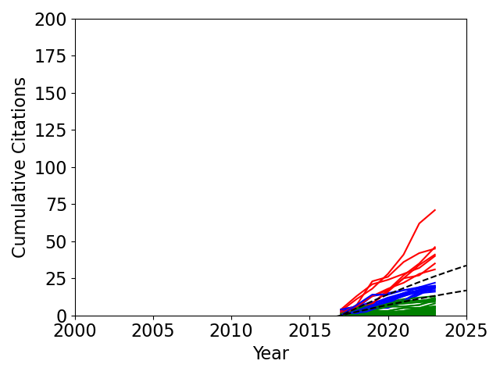
2017
Zweben, RSI, "Invited Review Article: Gas puff imaging diagnostics of edge plasma turbulence in magnetic fusion devices" (71, 11.83)
Soukhanovskii, PPCF, "A review of radiative detachment studies in tokamak advanced magnetic divertor configurations" (46, 7.67)
Ménard, NF, "Overview of NSTX Upgrade initial results and modelling highlights" (45, 7.5)
Podestà, PPCF, "Computation of Alfvèn eigenmode stability and saturation through a reduced fast ion transport model in the TRANSP tokamak transport code" (41, 6.83)
Duarte, NF, "Prediction of nonlinear evolution character of energetic-particle-driven instabilities" (40, 6.67)
Berkery, POP, "A reduced resistive wall mode kinetic stability model for disruption forecasting" (35, 5.83)
Fredrickson, PRL, "Suppression of Alfvén Modes on the National Spherical Torus Experiment Upgrade with Outboard Beam Injection" (31, 5.17)
2017 All
High: 7
Medium: 12
Lower: 28

Slide 35
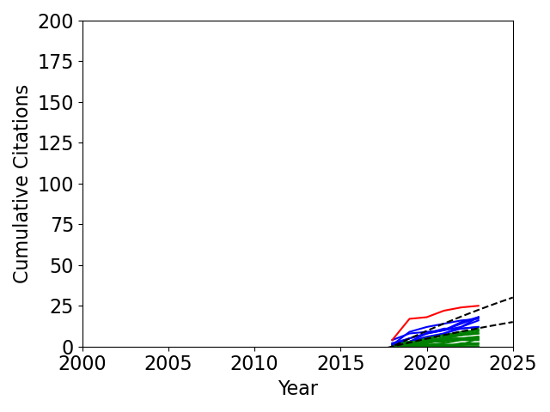
2018
Battaglia, NF, "Scenario development during commissioning operations on the National Spherical Torus Experiment Upgrade" (25, 5.0)
2018 All
High: 1
Medium: 7
Lower: 17

Slide 36
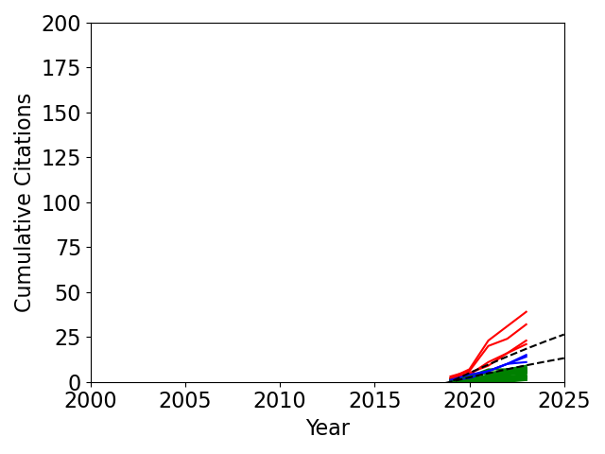
2019
Boyer, NF, "Real-time capable modeling of neutral beam injection on NSTX-U using neural networks" (39, 9.75)
Ferraro, NF, "3D two-temperature magnetohydrodynamic modeling of fast thermal quenches due to injected impurities in tokamaks" (32, 8.0)
Fredrickson, POP, "Emission in the ion cyclotron range of frequencies (ICE) on NSTX and NSTX-U" (23, 5.75)
Rindt, NF, "Power handling and vapor shielding of pre-filled lithium divertor targets in Magnum-PSI" (21, 5.25)
2019 All
High: 4
Medium: 3
Lower: 25

Slide 37
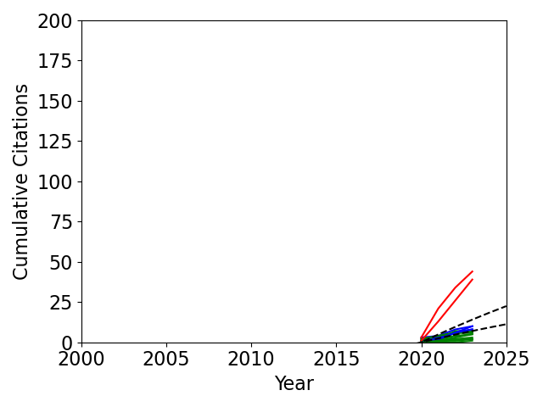
2020
Piccione, NF, "Physics-guided machine learning approaches to predict the ideal stability properties of fusion plasmas" (44, 14.67)
Geiger, PPCF, "Progress in modelling fast-ion D-alpha spectra and neutral particle analyzer fluxes using FIDASIM" (39, 13.0)
2020 All
High: 2
Medium: 5
Lower: 12

Slide 38
The top papers by total citations, and by citation rate
Eich, (2013) NF, "Scaling of the tokamak near the scrape-off layer H-mode power width …" (442, 44.2)
Goldston, (2012) NF, "Heuristic drift-based model of the power scrape-off width …" (266, 24.18)
Zweben, (2004) NF, “High-speed imaging of edge turbulence in NSTX” (237, 12.47)
Zhu, (2006) PRL, “Toroidal-Momentum Dissipation by NTV” (187, 11.0)
Sabbagh, (2001) NF, “Equilibrium properties of spherical torus plasmas in NSTX” (163, 7.41)
Maingi, (2009) PRL, “ELM Suppression … with Lithium-Wall Coatings in NSTX” (154, 11.00)
H. Kugel, (2008) POP, “The effect of lithium surface coatings on plasma performance…” (152, 10.13)
Sabbagh, (2006) NF, “Resistive wall stabilized operation” (136, 8.0)
Park, (2007) PRL, “Control of Asymmetric Magnetic Perturbations in Tokamaks” (131, 8.19)
Park, (2009) PRL, “Nonambipolar Transport by Trapped Particles in Tokamaks” (125 , 8.93)
Ménard, (2016) NF, "Fusion nuclear science facilities and pilot plants based on the spherical tokamak" (119, 17.0)
Piccione, (2020) NF, "Physics-guided machine learning approaches to predict the ideal stability …" (44, 14.67)
Geiger, (2020) PPCF, "Progress in modelling fast-ion D-alpha spectra … using FIDASIM" (39, 13.0)
Zweben, (2004) NF, “High-speed imaging of edge turbulence in NSTX” (237, 12.47)
Zhu, (2006) PRL, “Toroidal-Momentum Dissipation by NTV” (187, 11.0)
Maingi, (2009) PRL, “ELM Suppression … with Lithium-Wall Coatings in NSTX” (154, 11.00)
H. Kugel, (2008) POP, “The effect of lithium surface coatings on plasma performance…” (152, 10.13)
Shaing, (2015) NF, "Neoclassical plasma viscosity and transport processes in non-axisymmetric tori" (79, 9.88)
Boyer, (2019) NF, "Real-time capable modeling of NBI on NSTX-U using neural networks" (39, 9.75)
Guttenfelder, (2011) PRL, "Electromagnetic Transport from Microtearing Mode Turbulence" (117, 9.75)
Both of the top two are not really NSTX papers

Slide 39
Topics
Resistive wall mode
Sabbagh, (2006) NF, “Resistive wall stabilized operation” (136, 8.0)
Sabbagh, (2006) PRL, “Active Stabilization of RWM” (120, 7.06)
Reimerdes, (2006) POP, “Cross-machine comparison of RFA and RWM” (98, 5.76)
Sabbagh, (2010) NF, "Advances in global MHD mode stabilization research on NSTX" (110, 8.46)
Berkery, (2010) POP, "The role of kinetic effects, including plasma rotation and energetic particles, in RWM stability" (102, 7.85)
Berkery, (2010) PRL, "Resistive Wall Mode Instability at Intermediate Plasma Rotation" (97, 7.46)
Berkery, (2014) POP, "Benchmarking kinetic calculations of resistive wall mode stability" (40, 4.44)
Berkery, (2017) POP, "A reduced resistive wall mode kinetic stability model for disruption forecasting" (35, 5.83)
Piccione, (2020) NF, "Physics-guided machine learning approaches to predict the ideal stability properties …" (44, 14.67)
Neoclassical toroidal viscosity / magnetic perturbations / error fields
Zhu, (2006) PRL, “Toroidal-Momentum Dissipation by NTV” (187, 11.0)
Park, (2007) PRL, “Control of Asymmetric Magnetic Perturbations in Tokamaks” (131, 8.19)
Park, (2009) PRL, “Nonambipolar Transport by Trapped Particles in Tokamaks” (125 , 8.93)
Park, (2009) POP, “Importance of plasma response to nonaxisymmetric perturbations in tokamaks” (75, 5.36)
Ménard, (2010) NF, "Progress in understanding error-field physics in NSTX spherical torus plasmas" (73, 5.62)
Solomon, (2010) POP, "Mechanisms for generating toroidal rotation in tokamaks without external momentum input" (71, 5.46)
Shaing, (2015) NF, "Neoclassical plasma viscosity and transport processes in non-axisymmetric tori" (79, 9.88)

Slide 40
Topics
MHD / stability (non-RWM)
Menard, (2003) NF, “Limiting MHD instabilities in improved-performance NSTX spherical torus plasmas” (85, 4.25)
Menard, (2005) NF, “Internal kink mode dynamics…” (83, 4.61)
Menard, (2006) PRL, “Observation of Instability-Induced Current Redistribution” (75, 4.41)
Ferraro, (2019) NF, "3D two-temperature MHD modeling of fast thermal quenches due to injected impurities …" (32, 8.0)
Equilibrium / control / scenarios
Sabbagh, (2001) NF, “Equilibrium properties of spherical torus plasmas in NSTX” (163, 7.41)
Guazzotto, (2004) POP, “Numerical study of tokamak equilibria with arbitrary flow” (116, 6.11)
Gates, (2006) NF, “Plasma shape control…using real-time equilibrium reconstruction” (58, 3.41)
Mueller, (2013) POP, "The physics of tokamak start-up" (55, 5.5)
Battaglia, (2018) NF, "Scenario development during commissioning operations on NSTX-U" (25, 5.0)

Slide 41
Topics
Fast ion instabilities / Alfven eigenmodes
Fredrickson, (2006) POP, “Collective fast ion instability-induced losses” (90, 5.29)
Gorelenkov, (2007) Physics Letters, “Predictions and observations of … shear Alfvén–acoustic eigenmodes …” (85, 5.31)
Gorelenkov, (2007) PPCF, “Predictions and observations of global beta-induced Alfvén—acoustic modes …” (57, 3.56)
Gorelenkov, (2009) POP, “Beta-induced Alfvén-acoustic eigenmodes in NSTX and DIII-D driven by beam ions” (77, 5.50)
Stutman, (2009) PRL, “Correlation between Electron Transport and Shear Alfvén Activity in NSTX” (69, 4.93)
Fredrickson, (2009) POP, “Modeling fast-ion transport during toroidal Alfvén eigenmode avalanches in NSTX” (58, 4.14)
Podesta, (2009) POP, “Experimental studies on fast-ion transport by Alfvén wave avalanches on NSTX” (55, 3.93)
Wang, (2013) POP, "Linear stability and nonlinear dynamics of the fishbone mode in spherical tokamaks" (43, 4.3)
Belova, (2015) PRL, "Coupling of Neutral-Beam-Driven Compressional Alfvén Eigenmodes to Kinetic Alfvén Waves …" (36, 4.5)
Podestà, (2017) PPCF, "Computation of Alfvèn eigenmode stability … reduced fast ion transport model in TRANSP" (41, 6.83)
Duarte, (2017) NF, "Prediction of nonlinear evolution character of energetic-particle-driven instabilities" (40, 6.67)
Fredrickson, (2017) PRL, "Suppression of Alfvén Modes on NSTX-U with Outboard Beam Injection" (31, 5.17)
Fredrickson, (2019) POP, "Emission in the ion cyclotron range of frequencies (ICE) on NSTX and NSTX-U" (23, 5.75)
Other fast ion / neutral beam injection
Kramer, (2013) PPCF, "A description of the full-particle-orbit-following SPIRAL code …" (66, 6.6)
Bortolon, (2013) PRL, "Mitigation of Alfvén Activity in a Tokamak by Externally Applied Static 3D Fields" (41, 4.1)
Podestà, (2014) PPCF, "A reduced fast ion transport model for the tokamak transport code TRANSP" (67, 7.44)
Boyer, (2019) NF, "Real-time capable modeling of neutral beam injection on NSTX-U using neural networks" (39, 9.75)

Slide 42
Topics
Transport
Kaye, (2007) NF, “Confinement and local transport in the National Spherical Torus Experiment (NSTX)” (97, 6.06)
Kaye, (2007) PRL, “Scaling of Electron and Ion Transport in the High-Power Spherical Torus NSTX” (65, 4.06)
Turbulence
E. Mazzucato, (2008) PRL, “Short-Scale Turbulent Fluctuations Driven by the Electron-Temperature Gradient…” (74, 4.93)
Ren, (2011) PRL, "Density Gradient Stabilization of Electron Temperature Gradient Driven Turbulence in a ST" (47, 3.92)
Guttenfelder, (2011) PRL, "Electromagnetic Transport from Microtearing Mode Turbulence" (117, 9.75)
Guttenfelder, (2012) POP, "Simulation of microtearing turbulence in national spherical torus experiment" (54, 4.91)
Guttenfelder, (2012) POP, "Scaling of linear microtearing stability for a high collisionality NSTX discharge" (52, 4.73)
Guttenfelder, (2013) NF, "Progress in simulating turbulent electron thermal transport in NSTX" (65, 6.5)

Slide 43
Topics
Lithium effects
H. Kugel, (2008) POP, “The effect of lithium surface coatings on plasma performance…” (152, 10.13)
Maingi, (2009) PRL, “ELM Suppression through Density-Profile Modification with Lithium-Wall Coatings in NSTX” (154, 11.00)
Bell, (2009) PPCF, “Plasma response to lithium-coated plasma-facing components in NSTX” (91, 6.50)
Kugel, (2009) JNM, “Evaporated lithium surface coatings in NSTX” (74, 5.29)
Mansfield, (2009) JNM, “Transition to ELM-free improved H-mode by lithium deposition on NSTX graphite …” (66, 4.71)
Mansfield, (2010) FED, "A simple apparatus for the injection of lithium aerosol into the scrape-off layer …" (64, 4.92)
Maingi, (2011) PRL, "Continuous Improvement … with Progressively Increasing Lithium Coatings in NSTX" (77, 6.42)
Maingi, (2012) NF, "The effect of progressively increasing lithium coatings … in NSTX" (99, 9.0)
Kugel, (2012) FED, "NSTX plasma operation with a Liquid Lithium Divertor" (70, 6.36)
Jaworski, (2013) NF, "Liquid lithium divertor characteristics and plasma–material interactions in NSTX …" (77, 7.7)
Canik, (2013) NF, "Edge microstability of NSTX plasmas without and with lithium-coated plasma-facing components" (50, 5.0)
Skinner, (2013) JNM, "Plasma facing surface composition during NSTX Li experiments" (41, 4.1)
Rindt, (2019) NF, "Power handling and vapor shielding of pre-filled lithium divertor targets in Magnum-PSI" (21, 5.25)

Slide 44
Topics
Edge localized modes / pedestal
Maingi, (2005) NF, “H-mode pedestal, ELM, and power threshold…” (63, 3.50)
Canik, (2010) PRL, "On Demand Triggering of ELMs Using External Nonaxisymmetric Magnetic Perturbations …" (66, 5.08)
Groebner, (2013) NF, "Improved understanding of physics processes in pedestal structure, …" (61, 6.1)
Boedo, (2014) POP, "Edge transport studies in the edge and scrape-off layer of NSTX with Langmuir probes" (45, 5.0)
Divertor / Scrape off layer / heat flux
Gray, (2011) JNM, "Dependence of divertor heat flux widths on heating power, flux expansion, and plasma current …" (52, 4.33)
Myra, (2011) POP, "Reduced model simulations of the scrape-off-layer heat-flux width and comparison with exp." (48, 4.0)
Goldston, (2012) NF, "Heuristic drift-based model of the power scrape-off width in low-gas-puff H-mode tokamaks" (266, 24.18)
Eich, (2013) NF, "Scaling of the tokamak near the scrape-off layer H-mode power width and implications for ITER" (442, 44.2)
Soukhanovskii, (2017) PPCF, "A review of radiative detachment studies in … magnetic divertor configurations" (46, 7.67)
Snowflake divertor
Soukhanovskii, (2011) NF, "Taming the plasma–material interface with the ‘snowflake’ divertor…" (73, 6.08)
Soukhanovskii, (2012) POP, "Snowflake divertor configuration studies in National Spherical Torus Experiment" (67, 6.09)
Ryutov, (2015) POP, "The snowflake divertor" (59, 7.38)

Slide 45
Topics
Gas puff imaging / blobs / edge turbulence
Maqueda, (2001) RSI, “Edge turbulence measurements in NSTX by gas puff imaging” (98, 4.45)
Maqueda, (2003) RSI, “Gas puff imaging of edge turbulence (invited)” (104, 5.2)
Zweben, (2004) NF, “High-speed imaging of edge turbulence in NSTX” (237, 12.47)
Myra, (2006) POP, “Blob birth and transport” (123, 7.24)
Zweben, (2006) POP, “Structure and motion of edge turbulence” (65, 3.82)
Zweben, (2010) POP, "Quiet periods in edge turbulence preceding the L-H transition in NSTX" (81, 6.23)
Zweben, (2015) NF, "Edge and SOL turbulence and blob variations over a large database in NSTX" (52, 6.5)
Zweben, (2016) PPCF, "Blob structure and motion in the edge and SOL of NSTX" (66, 9.43)
Zweben, (2017) RSI, "Invited Review Article: Gas puff imaging diagnostics of edge plasma turbulence …" (71, 11.83)
Fast ion D-alpha
Podestá, (2008) RSI, “NSTX fast-ion D-alpha diagnostic” (59, 3.93)
Heidbrink, (2010) RSI, "Fast-ion Dα measurements of the fast-ion distribution (invited)" (81, 6.23)
Geiger, (2020) PPCF, "Progress in modelling fast-ion D-alpha … and neutral particle analyzer fluxes using FIDASIM" (39, 13.0)
Other Diagnostics
LeBlanc, (2003) RSI, “Operation of the NSTX Thomson scattering system” (104, 5.2)
Bell, (2010) POP, "Comparison of poloidal velocity measurements to neoclassical theory on NSTX” (69, 5.31)
Crocker, (2011) PPCF, "High spatial sampling global mode structure measurements via multichannel reflectometry …" (48, 4.0)

Slide 46
Topics
High harmonic fast wave
Hosea, (2008) POP, “HHFW heating efficiency enhancement and current drive at longer wavelength…” (71, 4.73)
Perkins, (2012) PRL, “HHFW Power Flow along Magnetic Field Lines in the Scrape-Off Layer of NSTX" (54, 4.91)
Bertelli, (2014) NF, "Full wave simulations of fast wave heating losses in the scrape-off layer of NSTX and NSTX-U" (47, 5.22)
Petrov, (2016) PPCF, "A fully-neoclassical finite-orbit-width version of the CQL3D Fokker–Planck code" (38, 5.43)
Coaxial helicity injection
Raman, (2001) NF, “Non-inductive current generation in NSTX using coaxial helicity injection” (70, 3.18)
Ebrahimi, (2015) PRL, "Plasmoids Formation During Simulations of Coaxial Helicity Injection in the NSTX" (45, 5.62)
Future devices
Ménard, (2016) NF, "Fusion nuclear science facilities and pilot plants based on the spherical tokamak" (119, 17.0)
IAEA Overview
Kaye, (2005) NF, “Progress towards high performance plasmas…” (59, 3.28)
Sabbagh, (2013) NF, "Overview of physics results from the conclusive operation of NSTX" (51, 5.1)
Ménard, (2017) NF, "Overview of NSTX Upgrade initial results and modelling highlights" (45, 7.5)

Slide 47
xxx
xxx
xxx
xxx

Slide 48
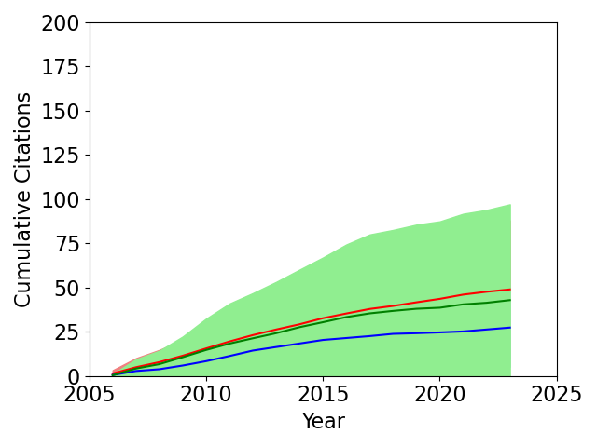
Early, mid, or late career splits needs work to make conclusions
2006 Early/Mid/Late Career
Late: 18, Mid: 11, Early: 10
Numbers for papers, not people
8 unknown or no PhD
Used: Early <= 5 years, Mid: 5-15, Late > 15. Better split???
Hard to distinguish right now
To do properly this might take a lot of work
Statistics by career will probably improve when using the full multi-year database
Late: 48.9 ± 39.0
Mid: 27.4 ± 22.1
Early: 42.9 ± 54.2
I made an attempt with what I knew / could find about the 2006 authors – not satisfied with this right now

