Slide 1
Heating and current drive options for a Spherical Tokamak Advanced Reactor
Jack Berkery (PPPL)
K. Shah, J. Menard, N. Bertelli, T. Brown, N. Gorelenkov, M. Gorelenkova, M. Ono, A. Pankin, A. Simonin (CEA)

Slide 2
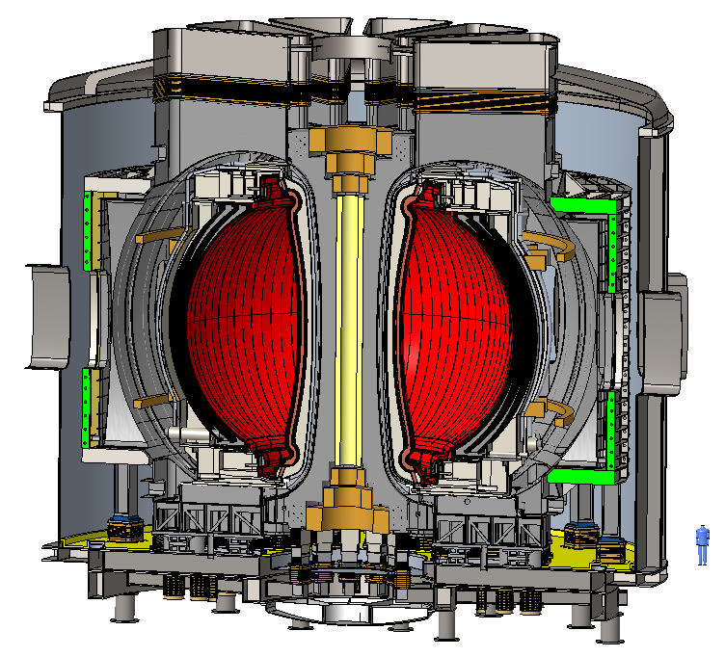
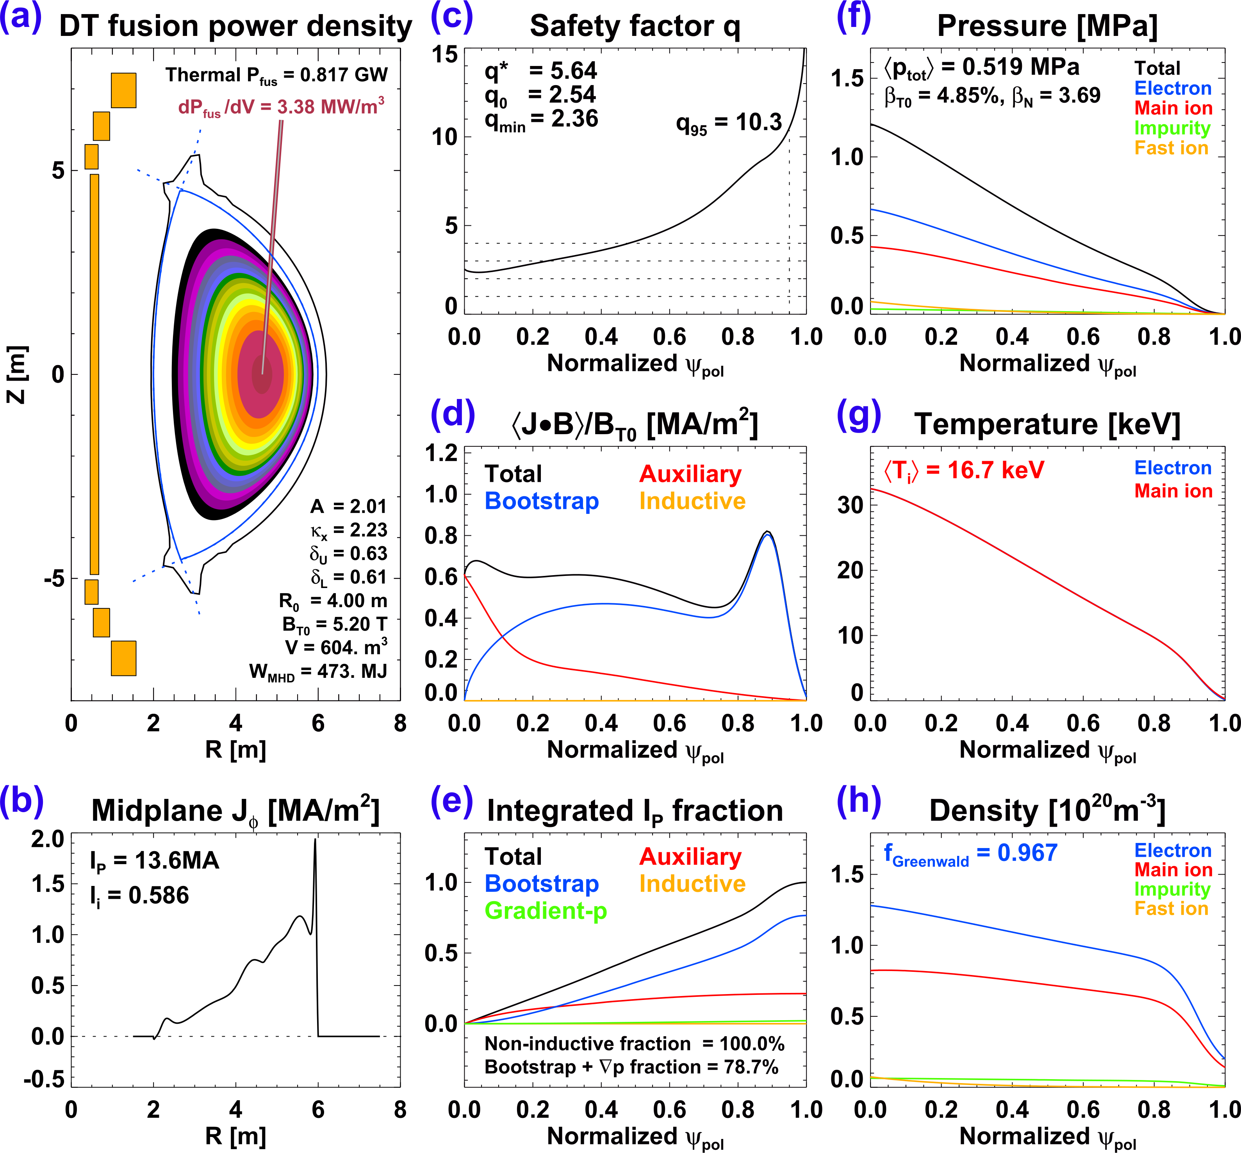
The Spherical Tokamak Advanced Reactor (STAR) design project
Developing high fidelity physics and eng. models of R = 4 m, A = 2, B_{T} = 5.2 T, κ = 2.2 configuration
P_{fus} = 0.5-1.5 GW, P_{net} = 100-500 MWe
Menard, Monday 1pm
Gupta + Khodak, Wednesday, 8am
[J. Menard et al., IAEA FEC (2023) P/8 2215]

Slide 3
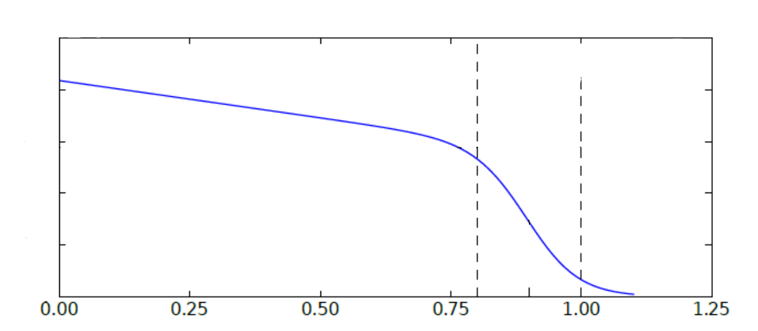
The design process for STAR involves integrating all parts of the plasma and machine requirements
First cut equilibrium
First cut engineering
H&CD systems
TORAY (standalone)
RT-4, TRAVIS
  Startup/rampup
Global stability
DCON
Radiation
PRAM
Pedestal
SOL
Iteration loop
Li vapor
Li solid
TRANSP
NUBEAM
TORAY
MMM
  For core transport (fixed pedestal)
Pedestal stability, height & width
BALOO
CGYRO
  KBM
M3D-C1
  PB modes
TRANSP
NUBEAM
TORAY
  For core transport (fixed pedestal)
Core
SOL width & heat flux
XGC
SOLPS
Solid PFCs & Machine
EP stability & transport
RBQ
HINST
  Alfvenic stability
New equilibrium that satisfies the integrated requirements

Slide 4
Outline
Is the designed STAR plasma stable?
Will ECCD/ECH be able to start-up and ramp-up the current and temperature of the STAR plasma?
Will ECCD or NBI be able to drive the necessary auxiliary current for non-inductive steady state operation?
Will ECH or NBI be able to sustain the plasma temperature in steady state, vs. thermal transport?
What rotation, and radiation might be expected?

Slide 5
STAR aims to operate just above the global ideal MHD n = 1 limit
The target equilibrium of β_{N}~3.68 is unstable to ideal MHD
  no-wall limit at β_{N}~3.2
Including a conformal wall stabilizes the global ideal MHD instability (converts to a resistive wall mode)
  RWM kinetic stability or active control TBD
  STEP is planning β_{N} > 5
r_{w}/a=0.3
no-wall
wall
no-wall
0.6
0.9
stable
1.2
unstable
target
equilibrium
r_{w}/a
=0.3
a)
4
5…
q = 3
no-wall displacements β_{N} ~ 3.7
(not all shown)
b)
5…
m = 3
with-wall (r_{w}/a=0.3) displacements

Slide 6
Outline
Is the designed STAR plasma stable?
  Maybe? (Hopefully!)
Will ECCD/ECH be able to start-up and ramp-up the current and temperature of the STAR plasma?
Will ECCD or NBI be able to drive the necessary auxiliary current for non-inductive steady state operation?
Will ECH or NBI be able to sustain the plasma temperature in steady state, vs. thermal transport?
What rotation, and radiation might be expected?

Slide 7
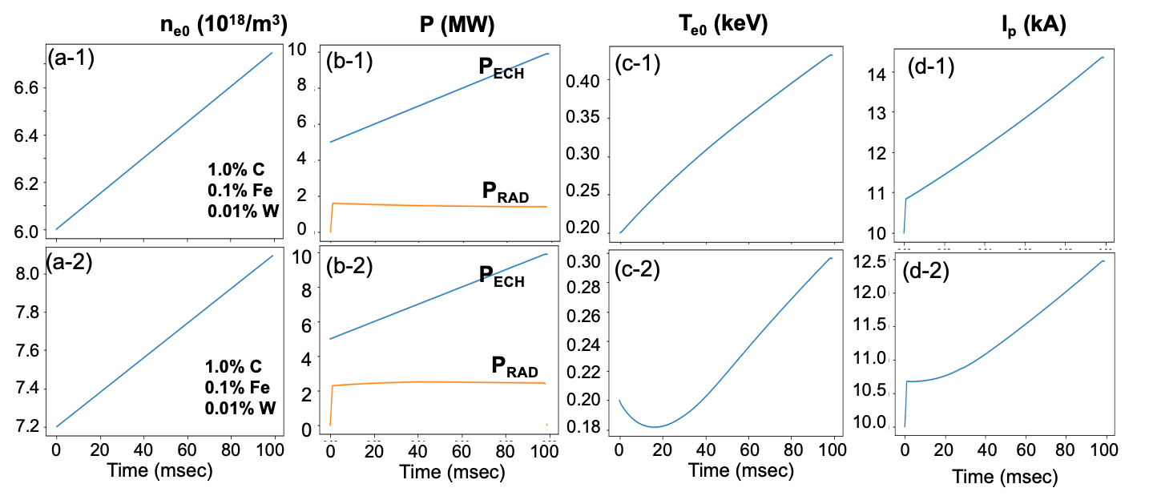
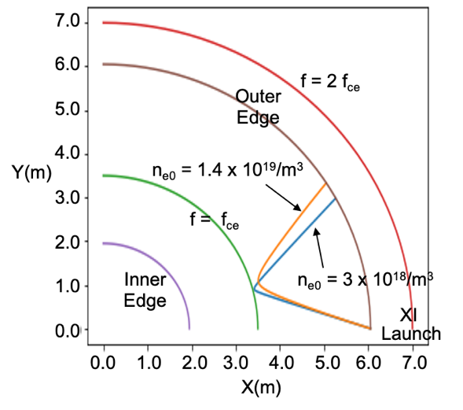
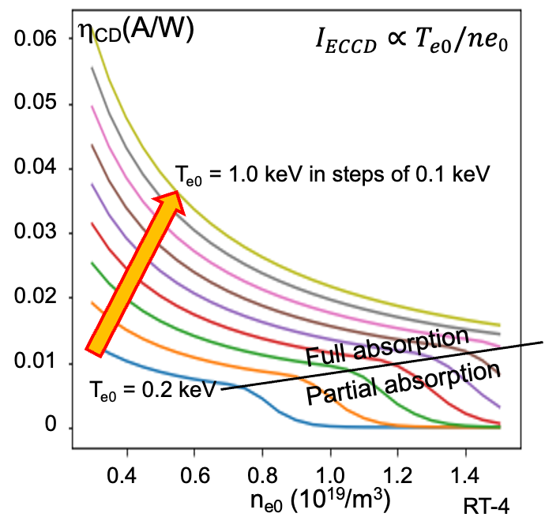
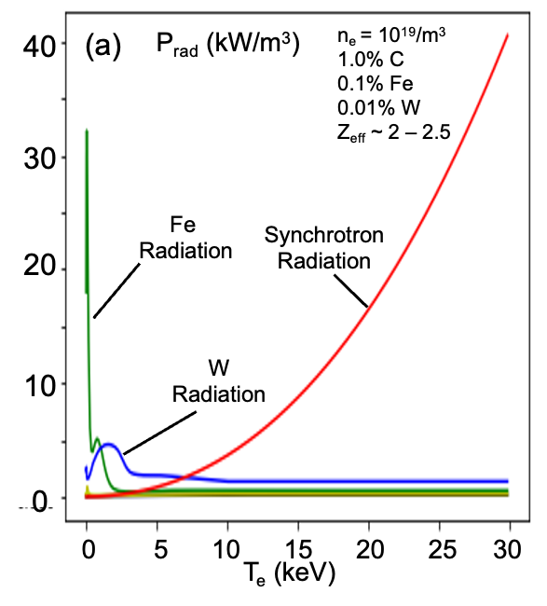
Time dependent modeling shows that start-up, burn-through, possible
Starting up: raise n, T, current
At low density, X-I EC absorption possible, even at low T_{e}
  At low density, rays approach closer to cyclotron resonance
Minimizing high Z impurities necessary to keep P_{rad} < P_{ECCD}
  Synchroton dominates at high T_{e}
[M. Ono et al., Nucl. Fusion 64 086021 (2024)]

Slide 8
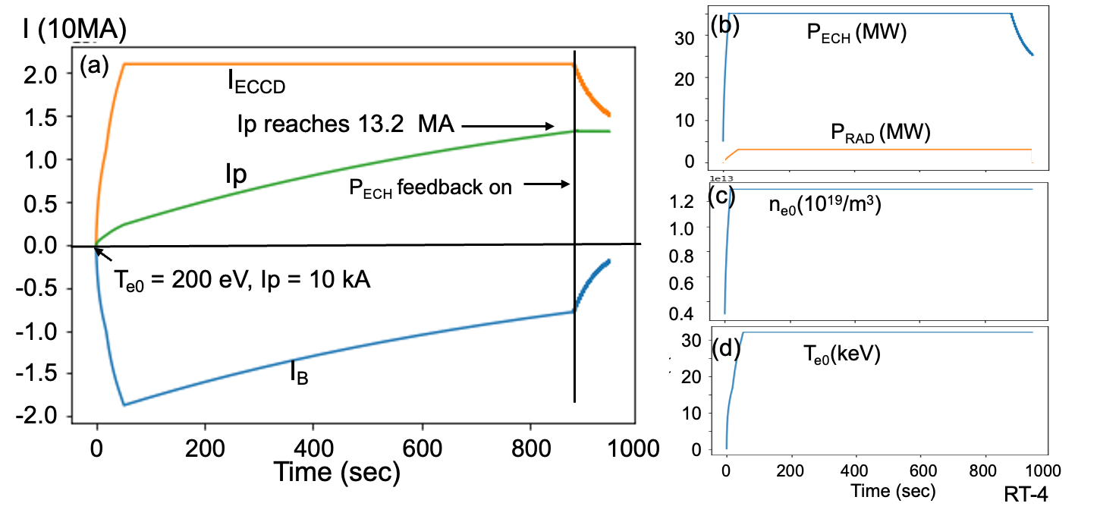
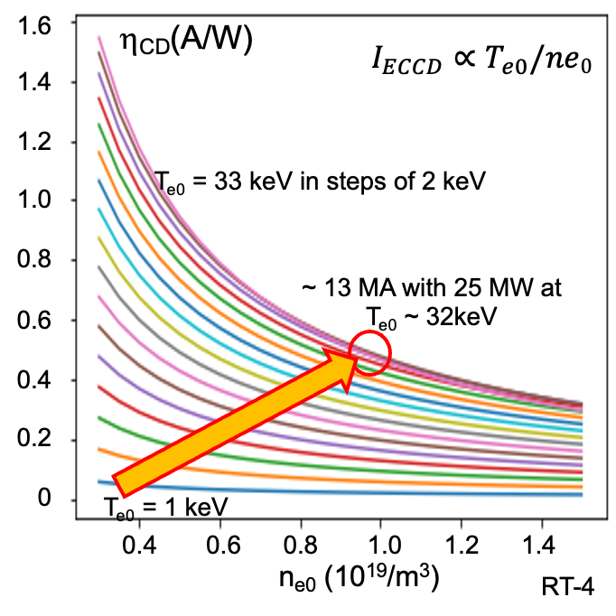
After start-up, the time dependent model determines a full ramp-up
Start-up to 1 keV at low n_{e}, ramp-up to 25 keV
Ramp-up of density and plasma shape is prescribed in the model
  Everything else calculated consistently for the evolving plasma: T_{e}, I_{ECCD}, I_{p}, P_{ECH}, and P_{rad}
Plasma current ramp-up takes much longer (~1000 s) because of decaying back EMF (I_{B})
Start-up
Ramp-up
[M. Ono et al., Nucl. Fusion 64 086021 (2024)]

Slide 9
Outline
Is the designed STAR plasma stable?
Will ECCD/ECH be able to start-up and ramp-up the current and temperature of the STAR plasma?
  Yes (if radiation is under control)
Will ECCD or NBI be able to drive the necessary auxiliary current for non-inductive steady state operation?
Will ECH or NBI be able to sustain the plasma temperature in steady state, vs. thermal transport?
What rotation, and radiation might be expected?

Slide 10
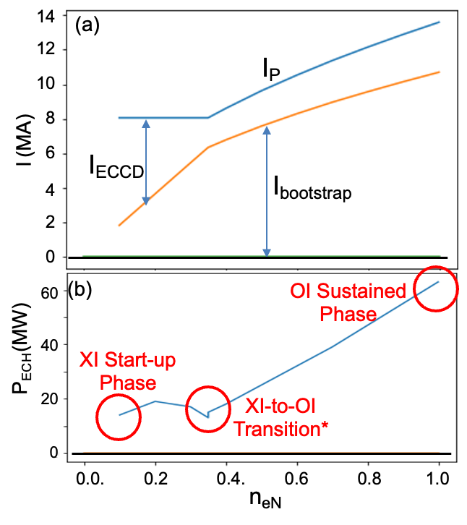
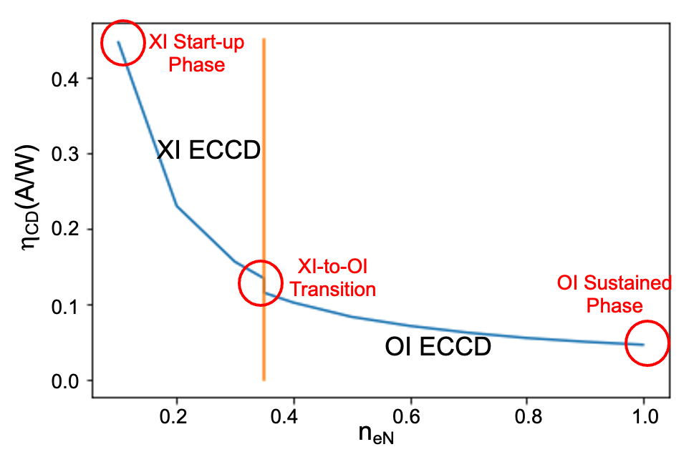
At the transition to the sustained phase, the needs for CD change
An auxiliary current profile was assumed to create the target equilibrium with high density and temperature
When density is increased to full level, envisioned to switch from X-I to O-I with a polarizer
  (Also now switching to TORAY/TRANSP calculations)
Or, switch to neutral beams
[M. Ono et al., Nucl. Fusion 64 086021 (2024)]

Slide 11
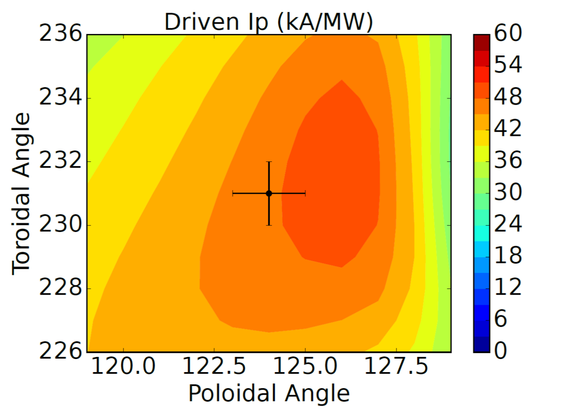
Systematic assessment of ECCD from varying launch locations shows that the necessary current profile can be achieved
TORAY scans of toroidal and poloidal launch angles finds optimal CD at six different launch locations
  All 170 GHz, fundamental O-mode
A combination of launchers gives good CD efficiency spread over the desired radial extent
(Poloidal. Toroidal not shown)
(Arrow lengths proportional to driven current)
[M. Ono et al., Nucl. Fusion 64 086021 (2024)]

Slide 12
NBI is also able to drive the necessary current, once beam energy is optimized
With higher enough beam energy, NBI can drive on-axis current
  0.5 MeV led to current shortfall, reversed q shear
  This has stability implications, and core heating, rotation…
NBI is a “blunter” instrument
  Matches CD generally, but not perfectly
0.5 MeV
0.7 MeV
a)
b)

Slide 13
Mention CIGALE beam?
Mention beam vs.ec pros and cons?

Slide 14
Outline
Is the designed STAR plasma stable?
Will ECCD/ECH be able to start-up and ramp-up the current and temperature of the STAR plasma?
Will ECCD or NBI be able to drive the necessary auxiliary current for non-inductive steady state operation?
  Yes!
Will ECH or NBI be able to sustain the plasma temperature in steady state, vs. thermal transport?
What rotation, and radiation might be expected?

Slide 15
Balance between heating and transport is being examined by TRANSP
Energy confinement time [s]
Implied TRANSP diffusivities for given heating and temperature profiles
H_{98y2}
= 2
Turbulent transport
The energy confinement time calculated by TRANSP is twice the ITER scaling, but in between Petty and NSTX scalings, as projected for A = 2
  With 50 MW ECH injected power plus ~150 MW of alpha heating
Implied diffusivities from interpretive TRANSP for the given temperature profile shows significant turbulent transport
  For NSTX, ions are typically close to neoclassical
[J. Menard et al., Phil. Trans. A 377, 20170440 (2018)]

Slide 16
The Multi-Mode Model currently predicts that turbulent transport of energy is too high to sustain the STAR temperature profile
Toroidal rotation profiles estimated for STAR using a simple momentum balance in TRANSP (not fully consistent calculation yet)
  These provide ExB shearing rates which are too low to influence turbulence
At present, it appears that MMM predicts turbulent thermal transport will lead to a lower temperature profile than desired
When NSTX-U returns to operations it will provide much-needed data in this gap

Slide 17
Outline
Is the designed STAR plasma stable?
Will ECCD/ECH be able to start-up and ramp-up the current and temperature of the STAR plasma?
Will ECCD or NBI be able to drive the necessary auxiliary current for non-inductive steady state operation?
Will ECH or NBI be able to sustain the plasma temperature in steady state, vs. thermal transport?
  Not looking good at the moment, but much work to be done
What rotation, and radiation might be expected?

Slide 18
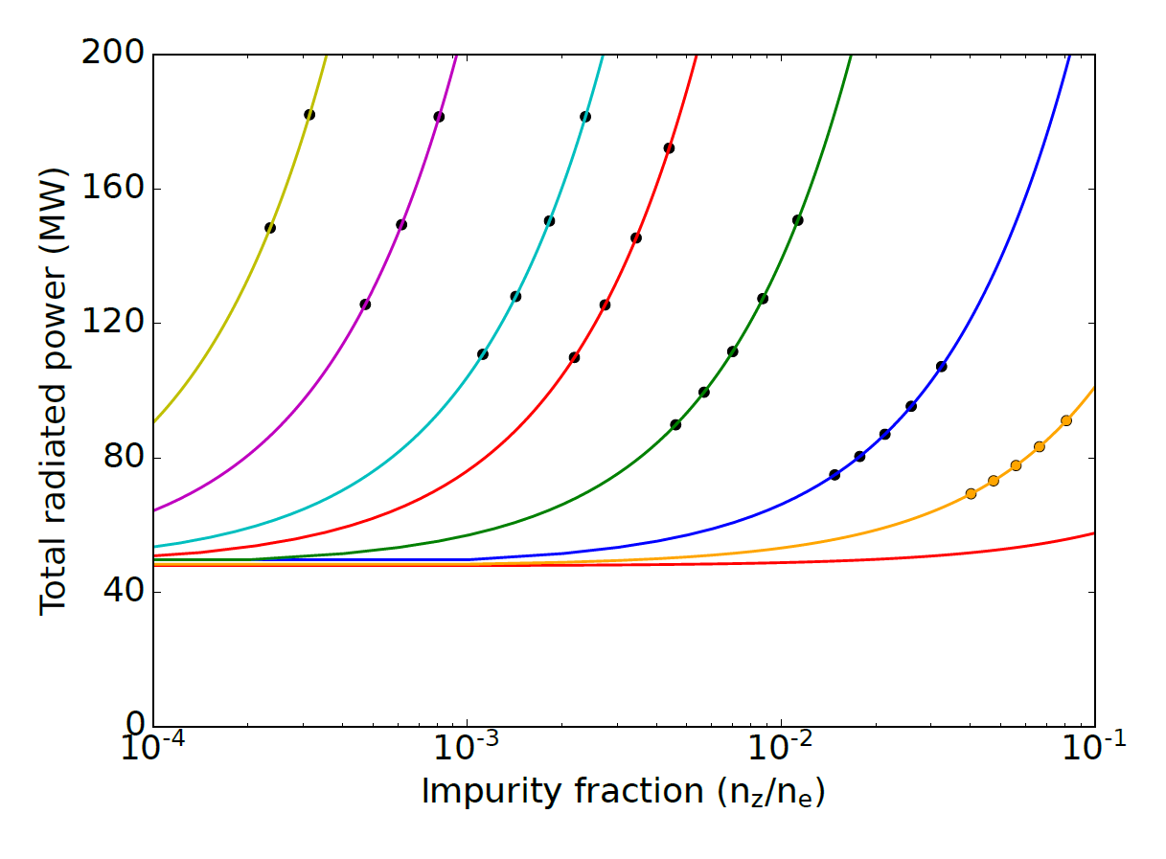
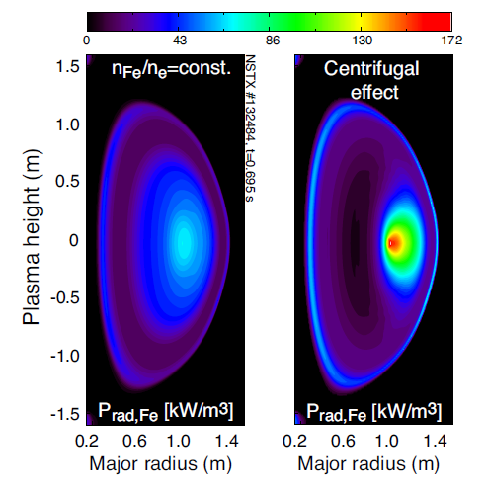
Radiated power may be desired (noble gases) or undesired (metals), and may not be symmetric due to rotation
STEP plans to radiate about 2/3 P_{heat} with Xenon
  For STAR, that would require ~0.05% Xe, but this might not be possible, based on depletion, alpha build-up…
Heavy metals in NSTX can be very asymmetric due to centrifugal force
  Due to lower rotation, however, W in STAR predicted to be only a few % asymmetric
NSTX Iron case: 132484 @ 0.695 s
STAR Tungsten case
W
Xe
Kr
Fe
Ar
Ne
1
2
3
C
τ_{He}/τ_{E}
~15% density depletion w.r.t outer midplane
4
5
P_{D} ~ 14 MW
Li
P_{synch} ~ 34 MW

Slide 19
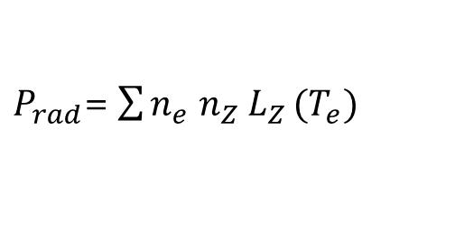
Some impurities radiate more at temperatures lower than STAR’s core, leading to off-axis radiation
edge
Cooling rate L_{Z} [Wm³]
STAR central temperature of 32 keV is past the peak of several cooling rates
  If this effect can overcome the ~n_{e}² factor, radiation peaks near the edge, not core
STAR
core
$P_{rad}$= $\sum{n_{e} n_{Z} L_{Z}}(T_{e})$
Xe 0.03 %
Kr 0.1%
The implications of this are not yet self-consistently worked out
  Could possibly be a good thing (keep core temperature high)
P_{rad, Xe} ~ 48 MW
P_{rad, Kr} ~56 MW

Slide 20
Conclusions
The STAR project is investigating a spherical tokamak advanced reactor
ECCD/ECH should be able to start-up and ramp-up the current and temperature of the STAR plasma
ECCD or NBI should be able to drive the necessary auxiliary current for non-inductive steady state operation
It remains to be seen whether ECH or NBI will be able to sustain the plasma temperature in steady state, vs. thermal transport
  Investigation with predictive TRANSP continues
The rotation level of STAR is not yet well known and this can affect the predicted transport, but shouldn’t lead to radiation asymmetries
Purposeful power radiation from noble gasses requires careful study to determine dilution and off-axis effects

Slide 21
Backup

Slide 22
Dimensionless efficiencies
4 m
TORAY
Position | ρ_{max} | n_{e} (ρ_{max}) [10²⁰ m⁻³] | T_{e} (ρ_{max}) [keV] | η_{CD} [kA/MW] | γ_{CD} | ζ_{CD}
A | 0.06 | 1.28 | 32.44 | 57 | 0.29 | 0.29
B | 0.09 | 1.28 | 32.32 | 56 | 0.29 | 0.29
C | 0.19 | 1.25 | 31.21 | 52 | 0.26 | 0.27
D | 0.34 | 1.18 | 27.29 | 47 | 0.22 | 0.27
E | 0.48 | 1.09 | 21.88 | 40 | 0.17 | 0.26
F | 0.56 | 1.04 | 18.44 | 32 | 0.13 | 0.24

Slide 23
Balance between heating and transport is being examined by TRANSP
Energy confinement time [s]
Implied TRANSP diffusivities for given heating and temperature profiles
H_{98y2}
= 2
Turbulent transport

Slide 24
Efficient electron cyclotron current drive is possible with X-I at high B_{T}
Non-inductive start-up/ramp-up is important for low-A STs
At B_{T} = 5.2 T, 170 GHz, low T_{e}, X-I efficiency >> X-II
  X-I ray always stays on the low-field-side of the cyclotron resonance, the Doppler interaction tends to occur for electrons moving in one direction
Launch phi = 200°
STAR B_{T} = 5.2 T
Launch theta = 90°
CQL3D: X-I, T_{e0} ~ 1 keV, n_{e0} = 10¹⁹/m³
[M. Ono et al., IAEA FEC (2023) P/1 2238]
[M. Ono et al., AIP Conf. Proc. 2984, 110002 (2023)]
[M. Ono et al., Phys. Rev. E 106, L023201 (2022)]

