Slide 1
Overview of D-T fuel cycles: the quest for tritium self-sufficiency and the growth of fusion energy
S. Meschini, R. Delaporte-Mathurin, G. Tynan, D. Whyte, S. Ferry
MIT PSFC

Slide 2
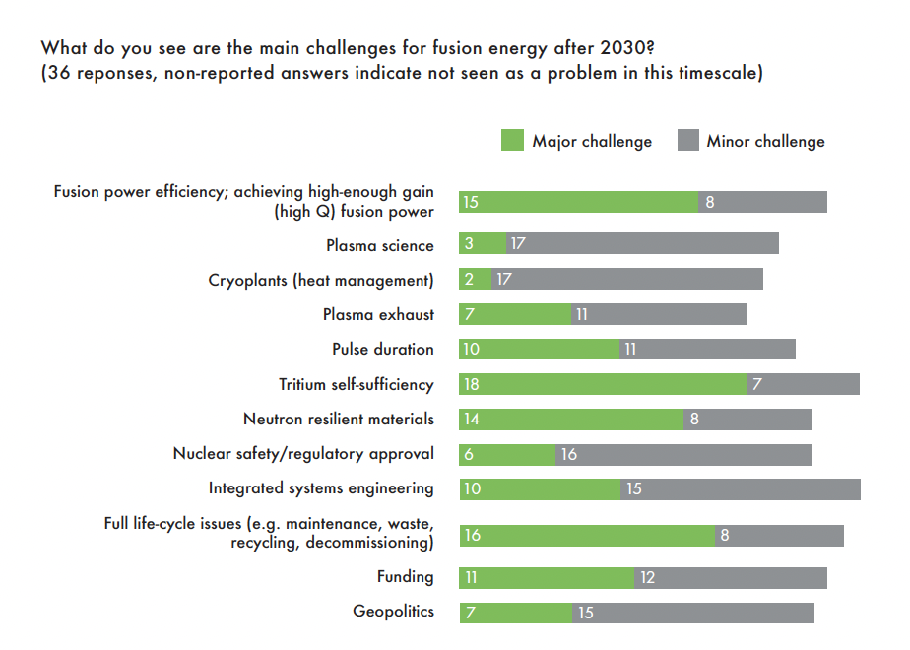
MOTIVATIONS

Slide 3
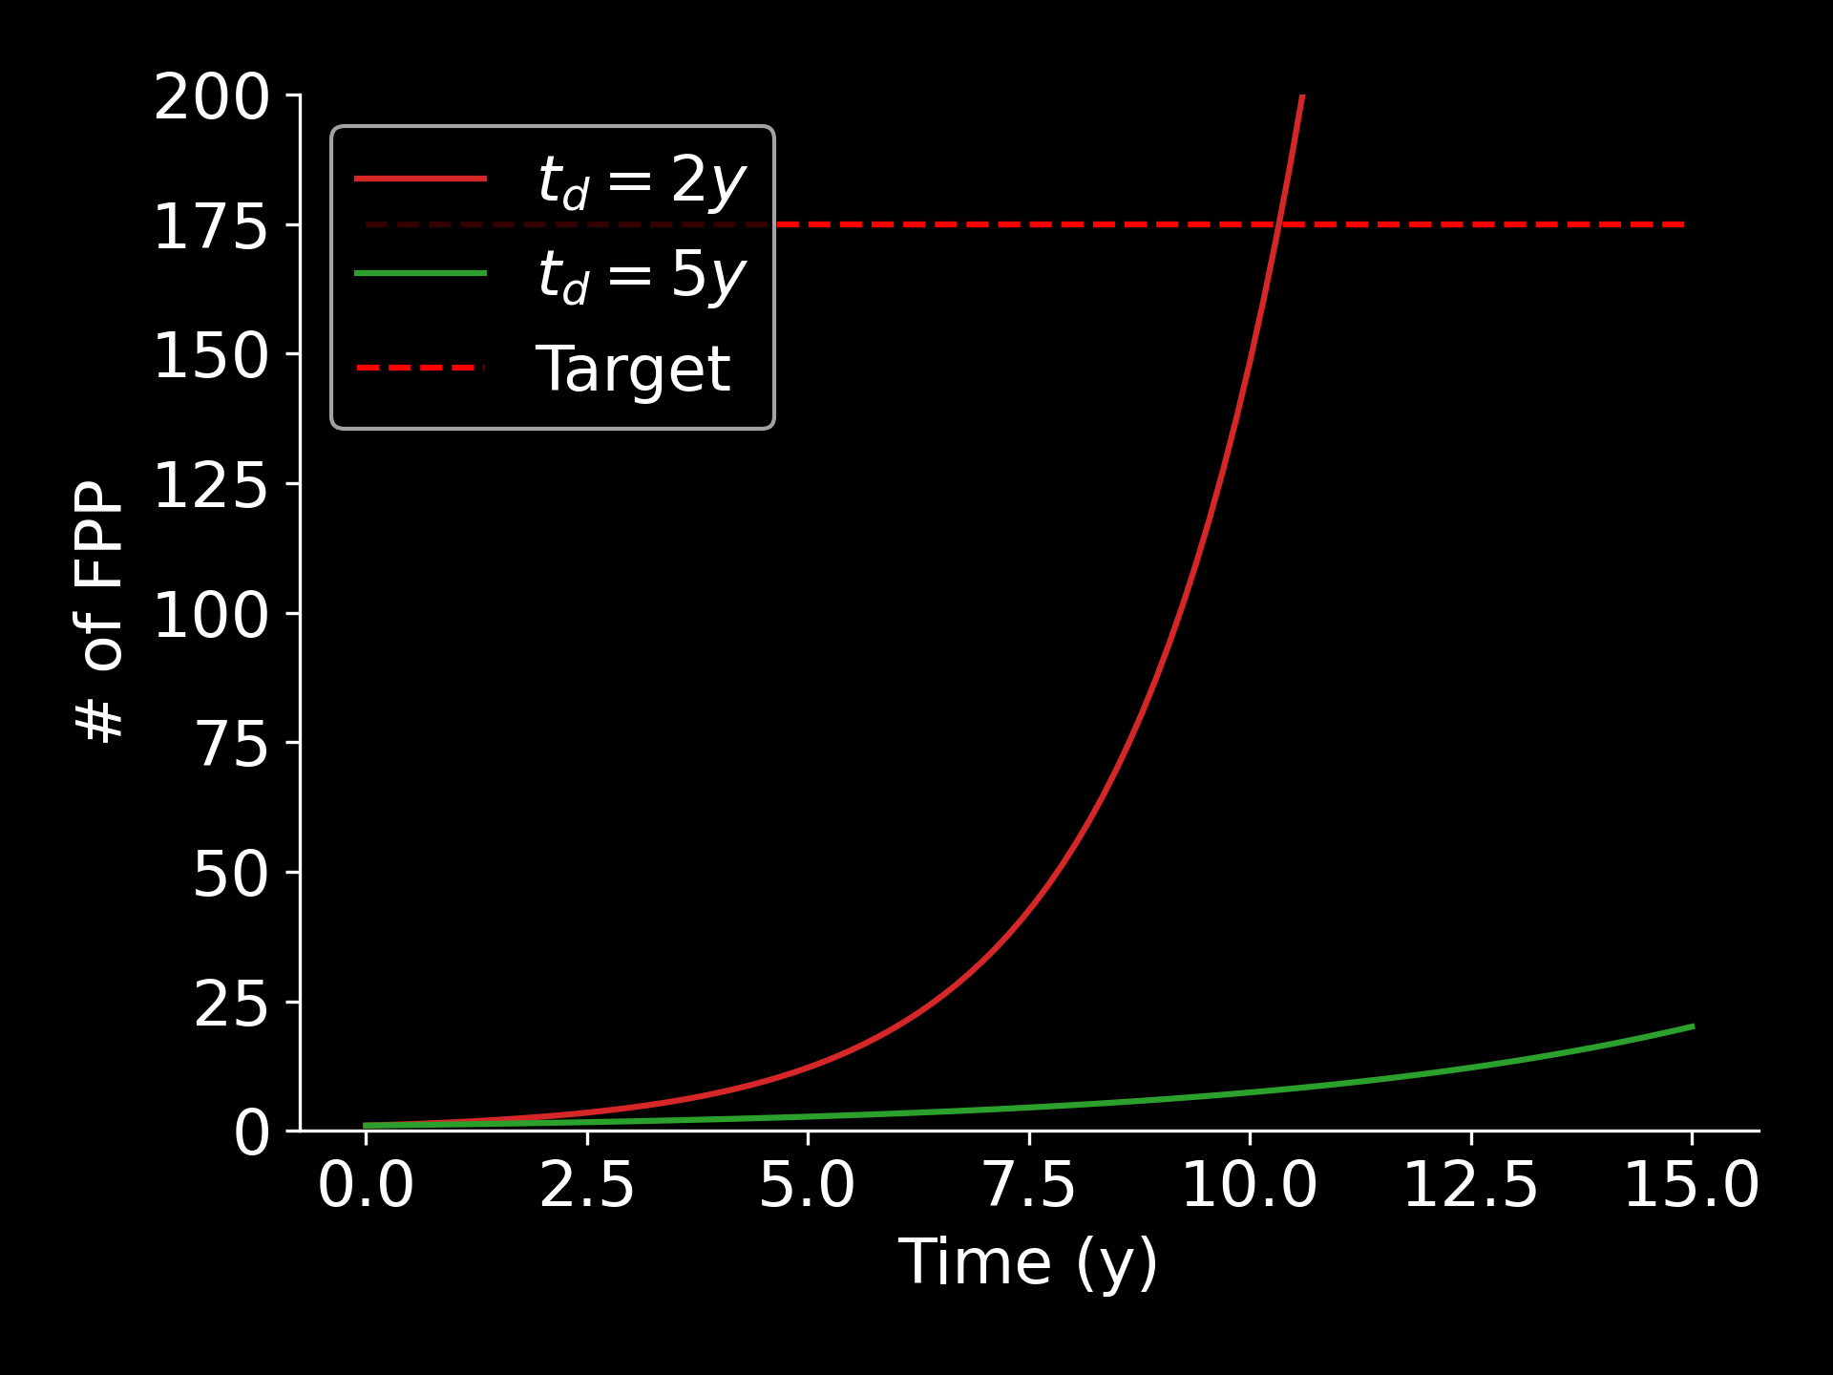
TRITIUM SELF-SUFFICIENCY (TSS)
Self-sufficient + produce net tritium
Startup inventory
FPP
Doubling time, $t_{d}$
FPP
TBRa > TBRr
Notes:
Figure of merit
We link these figure of merit with fuel cycle models

Slide 4
SYSTEM-LEVEL MODELING APPROACH
Tritium systems
1D or 0D + time models for each component
Residence time method
Non-radioactive tritium losses
Radioactive tritium losses
$$\frac{dI_{i}}{dt}= \sum_{j≠i}{{\left(\frac{I_{j}}{τ_{j}}\right)}_{i}}−\left(1+ε_{i}\right)\left(\frac{I_{i}}{τ_{i}}\right)−λI_{i}+S_{i}$$
FC
Startup inventory and FC dynamics
Inflow from j-th component
Mean residence time in the i-th component
Tritium generation
Abdou, M., et al., Nuclear fusion 61.1 (2020): 013001.
Meschini, S., et al., Nuclear Fusion 63.12 (2023): 126005.

Slide 5
TSS IS MULTI-SCALE PROBLEM
H – lattice interaction
Molecular dynamics
Density Functional theory
H transport
McNabb – Foster model (3D diffusion + trapping)
Tritium systems
1D or 0D models
Global market
Tritium reserves
Fusion energy penetration
$$t_{d}$$
Components
FC
FPP fleet
Phenomenology,
…
Defect evolution, trap energy and density
Startup inventory and FPP dynamics
Material selection, component design
Technology selection, system design, safety
Tritium management strategies, policies
Notes:
Add atomic scale the results do not produce very useful data, but allow to understand the phenomenology

Slide 6
OUTLINE
Fuel cycle
Fuel cycle dynamics
Fuel cycle layout
Main technologies
Macroscopic H transport
Tritium implantation and trapping
Impact of neutron irradiation and material damage on tritium self-sufficiency
Global market
Tritium reserves management
Fusion energy penetration
Notes:
Add atomic scale the results do not produce very useful data, but allow to understand the phenomenology

Slide 7
OUTLINE
Fuel cycle
Fuel cycle dynamics
Fuel cycle layout
Main technologies
Macroscopic H transport
Tritium implantation and trapping
Impact of neutron irradiation and material damage on tritium self-sufficiency
Global market
Tritium reserves management
Fusion energy penetration
Notes:
Add atomic scale the results do not produce very useful data, but allow to understand the phenomenology

Slide 8
A BASIC FUEL CYCLE MODEL
Storage & fueling
$$\frac{\dot{N}}{TBE}$$
$$τ_{IFC}$$
$$τ_{OFC}$$
Tritium processing
IFC
OFC
Tritium breeding and extraction
PLASMA
$$\dot{N}$$
$$\dot{N}\frac{1−TBE}{TBE}$$
$$\dot{N}∙TBR$$
$\dot{N}$: Tritium burn rate
TBE: Tritium Burn Efficiency
Outer fuel cycle (OFC)
Tritium flow
Inner fuel cycle (IFC)
Neutron flux

Slide 9
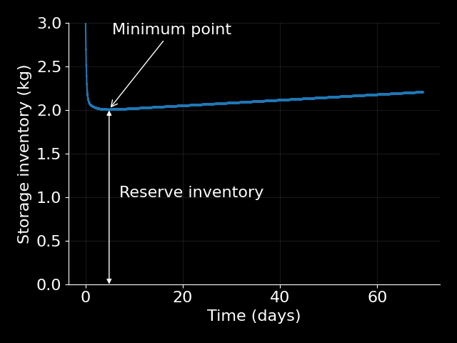
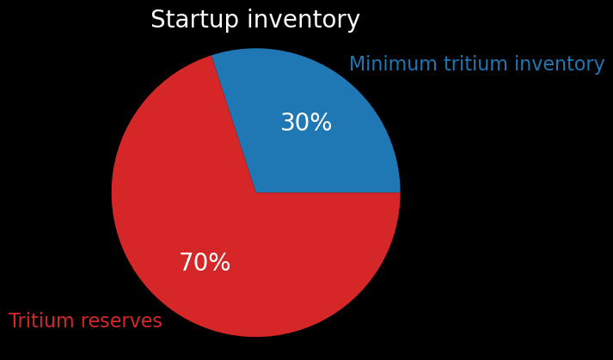
THE INITIAL TRANSIENT SETS THE STARTUP INVENTORY
For 24h tritium reserves
TBRa > TBRr

Slide 10
RISK REGIONS – REFERENCE VALUES
Required TBR
Doubling time (y)
Startup inventory (kg)
Risk
High
1.3
10
40
World reserves of tritium (non-military)
Medium
1.2
7
20
Medium-low
1.1
5
5
Low
1
2
1

Slide 11
Tritium fuel cycle of an ARC-class fusion power plant
T separation membrane
Isotope Separation System
Storage and Management
Fueling System
Blanket
DIR
Fuel Cleanup
Vacuum Pump
PLASMA
First Wall
TES
Detritiation System
Divertor
Heat exchanger
Meschini, S., et al., Nuclear Fusion 63.12 (2023): 126005.
Outer fuel cycle (OFC)
Tritium ion flux
Path may or may not be present, pending technology choices
Tritium flow
Inner fuel cycle (IFC)
Neutron flux

Slide 12
FUEL CLEANUP
T separation membrane
Isotope Separation System
Storage and Management
Fueling System
Blanket
GOAL
Separate fuel (D and T) from other gases
Different flavors of Pd membranes
DIR
Fuel Cleanup
Vacuum Pump
PLASMA
First Wall
TES
Detritiation System
Divertor
Heat exchanger

Slide 13
MOST CRITICAL COMPONENTS
T separation membrane
Isotope Separation System
Storage and Management
Fueling System
Blanket
!
DIR
!
Fuel Cleanup
Vacuum Pump
First Wall
TES
!
PLASMA
!
Detritiation System
Divertor
Heat exchanger
Outer fuel cycle (OFC)
Tritium ion flux
Path may or may not be present, pending technology choices
Tritium flow
Inner fuel cycle (IFC)
Neutron flux

Slide 14
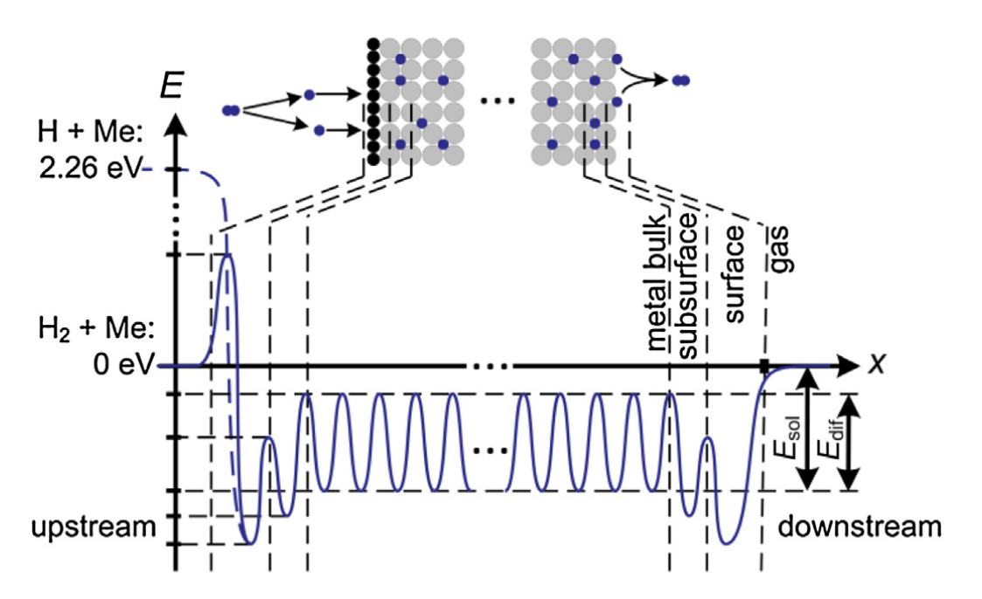
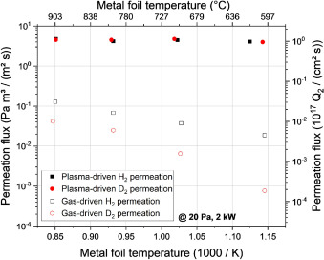
DIRECT INTERNAL RECYCLING
Metal Foil Pumps
GOALS
Provide effective pumping
Sharp H selectivity
SUPERPERMEATION
x10² – 10⁴
CLASSIC DIFFUSION
Peters, B.J, and Day, C., FED 124 (2017): 696-699.

Slide 15
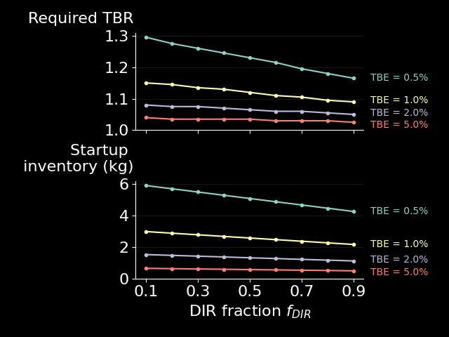
DIRECT INTERNAL RECYCLING
Metal Foil Pumps
FUNCTIONS:
Effective pumping
Sharp H selectivity
SUPERPERMEATION
x10² – 10⁴
CLASSIC DIFFUSION
Peters, B.J, and Day, C., FED 124 (2017): 696-699.

Slide 16
TRITIUM BURN EFFICIENCY
$$TBE=\frac{T burn rate}{T input rate}$$
Tritium removal is a collateral effect of He ash removal
Whyte, D. G., et al, Nuclear Fusion 63.12 (2023): 126019.
ITER TBE = 0.36%

Slide 17
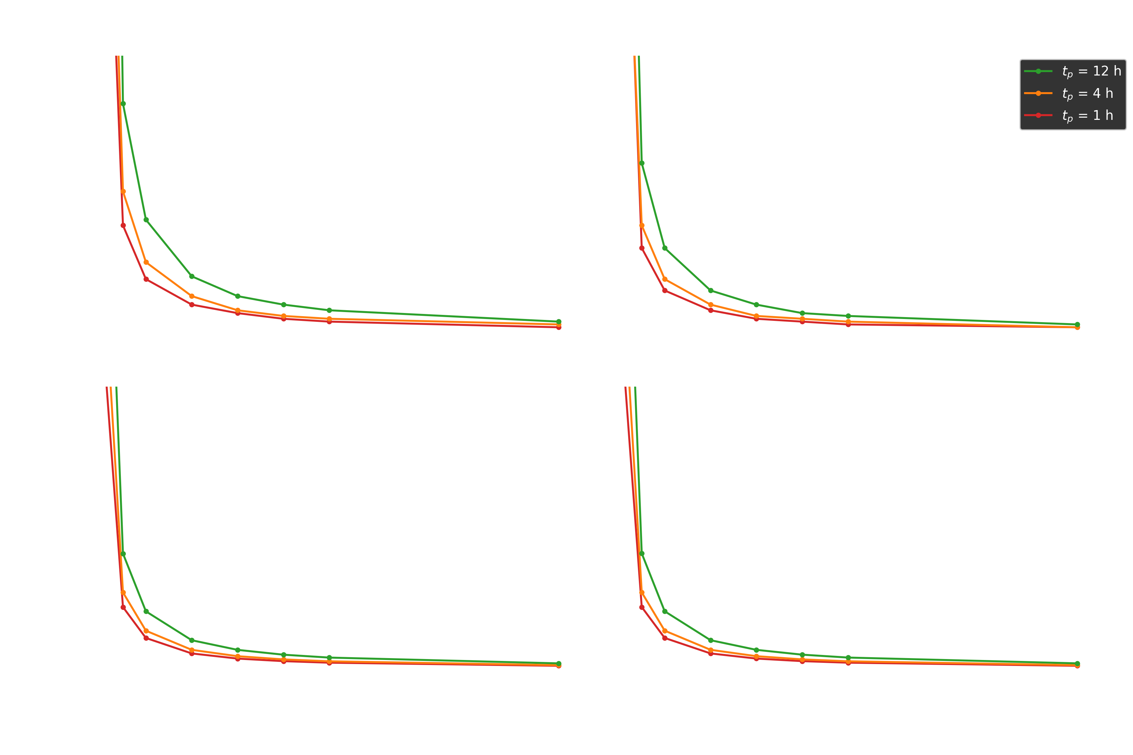
TBE and TSS
TSS is virtually impossible at low TBE
Meschini, S., et al., Nuclear Fusion 63.12 (2023): 126005.

Slide 18
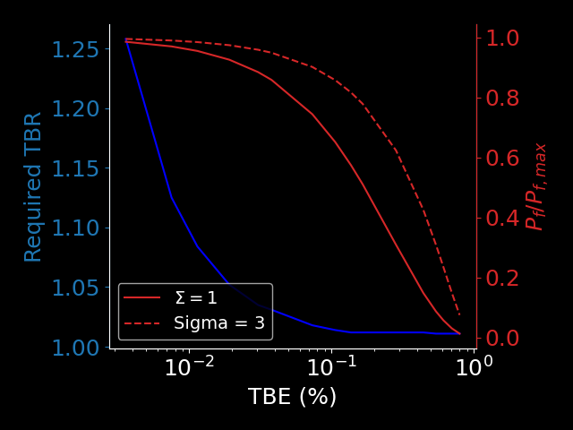
TBE and FUSION POWER
TBE can be improved by:
Increasing the He fraction in the divertor, $f_{He, div}$
Selective He pumping, $Σ$
Improving tritium self-sufficiency
Decreasing power production
Tritium self-sufficiency and power production are competing goals!
$$f_{He, div}$$
Meschini, S., et al., Nuclear Fusion 63.12 (2023): 126005.

Slide 19
TBE and FUSION POWER
Possible strategies to improve TBE and $P_{fus}$
Selective He pumping
Spin polarized fuels
Asymmetric transport
Improving tritium self-sufficiency
Decreasing power production
$$f_{He, div}$$
Meschini, S., et al., Nuclear Fusion 63.12 (2023): 126005.

Slide 20
OUTLINE
Fuel cycle
Fuel cycle dynamics
Fuel cycle layout
Main technologies
H transport
Tritium implantation and trapping
Impact of neutron irradiation and material damage on tritium self-sufficiency
Global market
Tritium reserves management
Fusion energy penetration

Slide 21
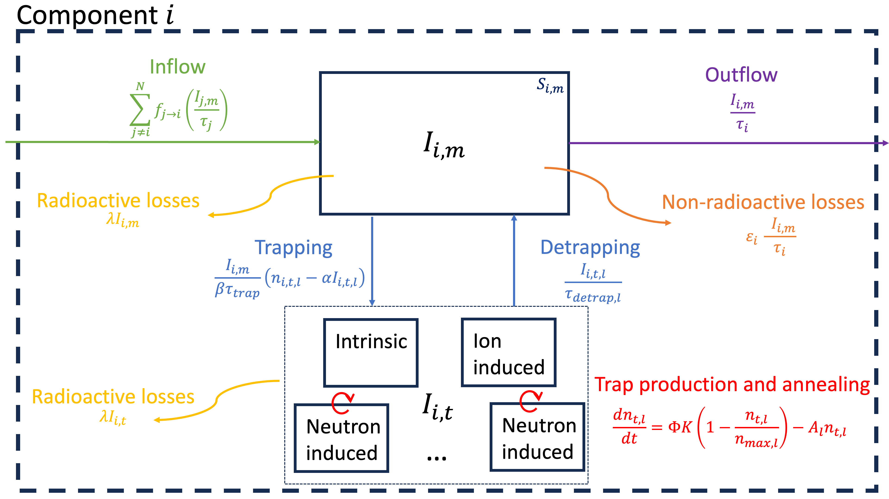
NEUTRON-INDUCED DAMAGE IN MATERIALS
Material damage and hydrogen trapping
n
H
Implantation
Radiation damage
n
T separation membrane
Trapping
Detrapping
Isotope Separation System
Storage and Management
Fueling System
Blanket
Diffusion
DIR
Fuel Cleanup
Vacuum Pump
PLASMA
First Wall
TES
Detritiation System
Divertor
Heat exchanger
+ COMPONENT REPLACEMENT

Slide 22
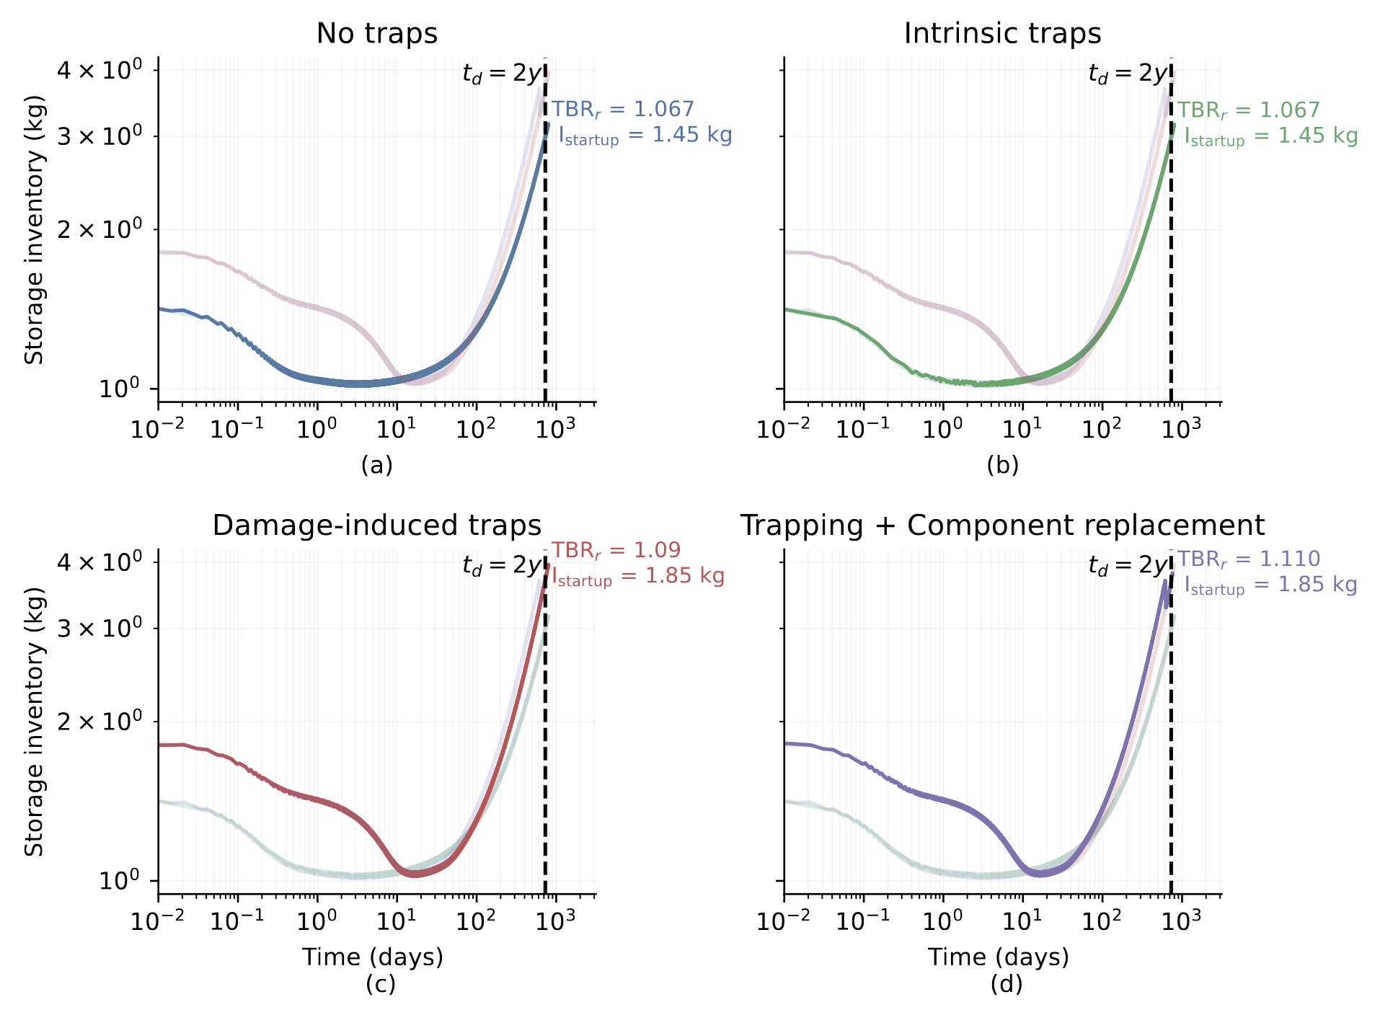
TRAPPING AND COMPONENT REPLACEMENT STRONGLY IMPACT TSS
No traps
As before
Intrinsic traps
Trapping energy negligible at blanket operating temperatures
Negligible (constant) trap density
Damage-induced traps
High trapping energy
Non-negligible, increasing trap density
+ 3% TBRr and + 20% startup inventory
Trapping + component replacement
Periodic tritium sink
Must recover trapped tritium before disposal
Meschini et al., Submitted to NF

Slide 23
DESIGN CONSIDERATIONS DUE TO TRAPPING
Tritium retention in tritium facing components (structural materials) dominates the reactor tritium inventory
Very high operating temperatures may worsen retention due to trapping

Slide 24
OUTLINE
Fuel cycle
Fuel cycle dynamics
Fuel cycle layout
Main technologies
Macroscopic H transport
Tritium implantation and trapping
Impact of neutron irradiation and material damage on tritium self-sufficiency
Global market
Tritium reserves management
Fusion energy penetration
Notes:
Add atomic scale the results do not produce very useful data, but allow to understand the phenomenology

Slide 25
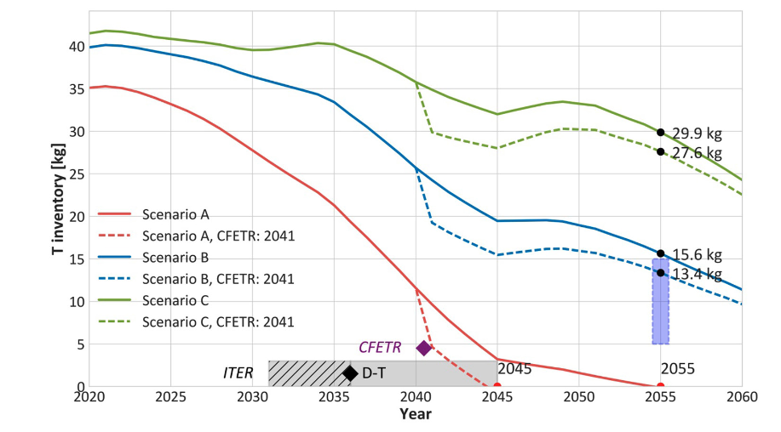
TRITIUM RESOURCES AVAILABLE
Private companies might deploy FPPs² even before ITER starts D-T operations (delayed to 2039¹)
Goal:
375 TWh of electricity production by 2050
$N_{FPP}=175$ with
$P_{fus}=1000 MW_{th}$
Kovari, M., et al. "Tritium resources available for fusion reactors." Nuclear Fusion 58.2 (2017): 026010.
See also: Pearson, R., et al., Fusion Engineering and Design 136 (2018): 1140-1148.
¹ https://www.iter.org/newsline/-/4056
² The global fusion industry in 2024, Fusion Companies Survey by the Fusion Industry Association

Slide 26
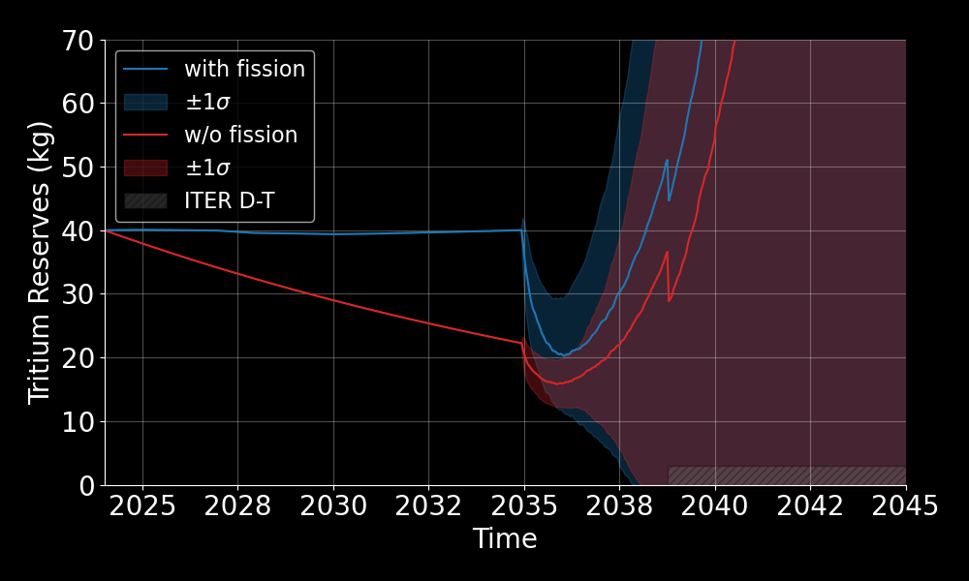
UNCERTAINTY IN FC DESIGN MAKES THE RESERVES EVOLUTION VERY UNCERTAIN
Multiple factors impact tritium reserve evolution:
TBR
Startup inventory
FPP construction time
FPP availability
…
First FFP operations start
First FPP construction starts
S. Meschini, TOFE 2024

Slide 27
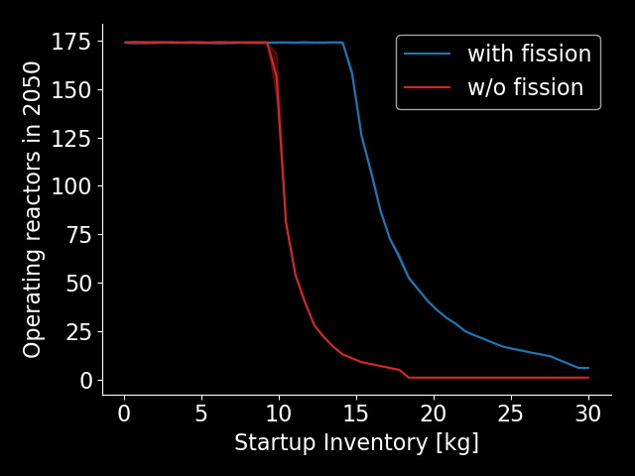
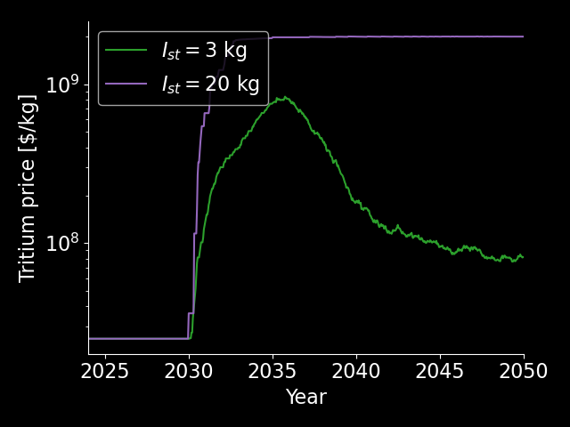
STARTUP INVENTORY DRIVES FUSION ENERGY GROWTH AND TRITIUM ECONOMY
Assuming a regulated market as for He3
Limit at $2 B\$/kg$
$25M\$/kg$ ¹
Tritium reserves chocked by too high, scattered demand
S. Meschini, TOFE 2024
¹ Kovari, M., et al. "Tritium resources available for fusion reactors." Nuclear Fusion 58.2 (2017): 026010.

Slide 28
CONCLUSIONS
Tritium self-sufficiency is a multiscale problem. Lack of coordination and experiments to connect the scales.
Technology development (DIR) and ‘tritium efficient’ plasma operations (TBE) can revolutionize fuel cycle designs
Tritium retention in tritium facing components (structural materials) dominates the reactor tritium inventory
Very high operating temperatures may worsen retention due to trapping

Slide 29
CONCLUSIONS
Tritium reserves might easily approach 0 for $I_{st}>5 kg$
Regulated or unregulated market?
If the operations of FPPs start between 2035 and 2040, ITER T consumption will be easily covered by surplus production from FPP
T price is likely to spike, then fall - might be a valuable revenue stream for 1st generation FPPs

Slide 30
BACKUP SLIDES

Slide 31
R&D H TRAPPING
Trap energy and density data is scarce and unreliable for structural materials (V alloys, Eurofer, HEA, Nikel superalloys)
Defect production and dynamics need deeper understanding, especially at high fluences and high neutron energies
Tungsten is assumed to be a good proxy for fusion neutrons (demonstrated for fission neutrons only). None of the available facilities can achieve FPP-relevant fluences (or dpa) with 14 MeV neutrons
Computational material science (DFT and MD) might be pivotal to speed up R&D in this field

Slide 32
RELATION BETWEEN TSS FIGURES OF MERIT
Uninformed approach
Informed approach
$$t_{d}$$
$$t_{d}$$
Informed by global scale constraints (economics, policies, T supply)
$$TBR$$
$$I_{startup}$$
$$TBR_{r}$$
$$I_{startup}$$
Set by FC design and reserves
Set by FC design and reserves
From blanket design
Design requirement for blankets

Slide 33
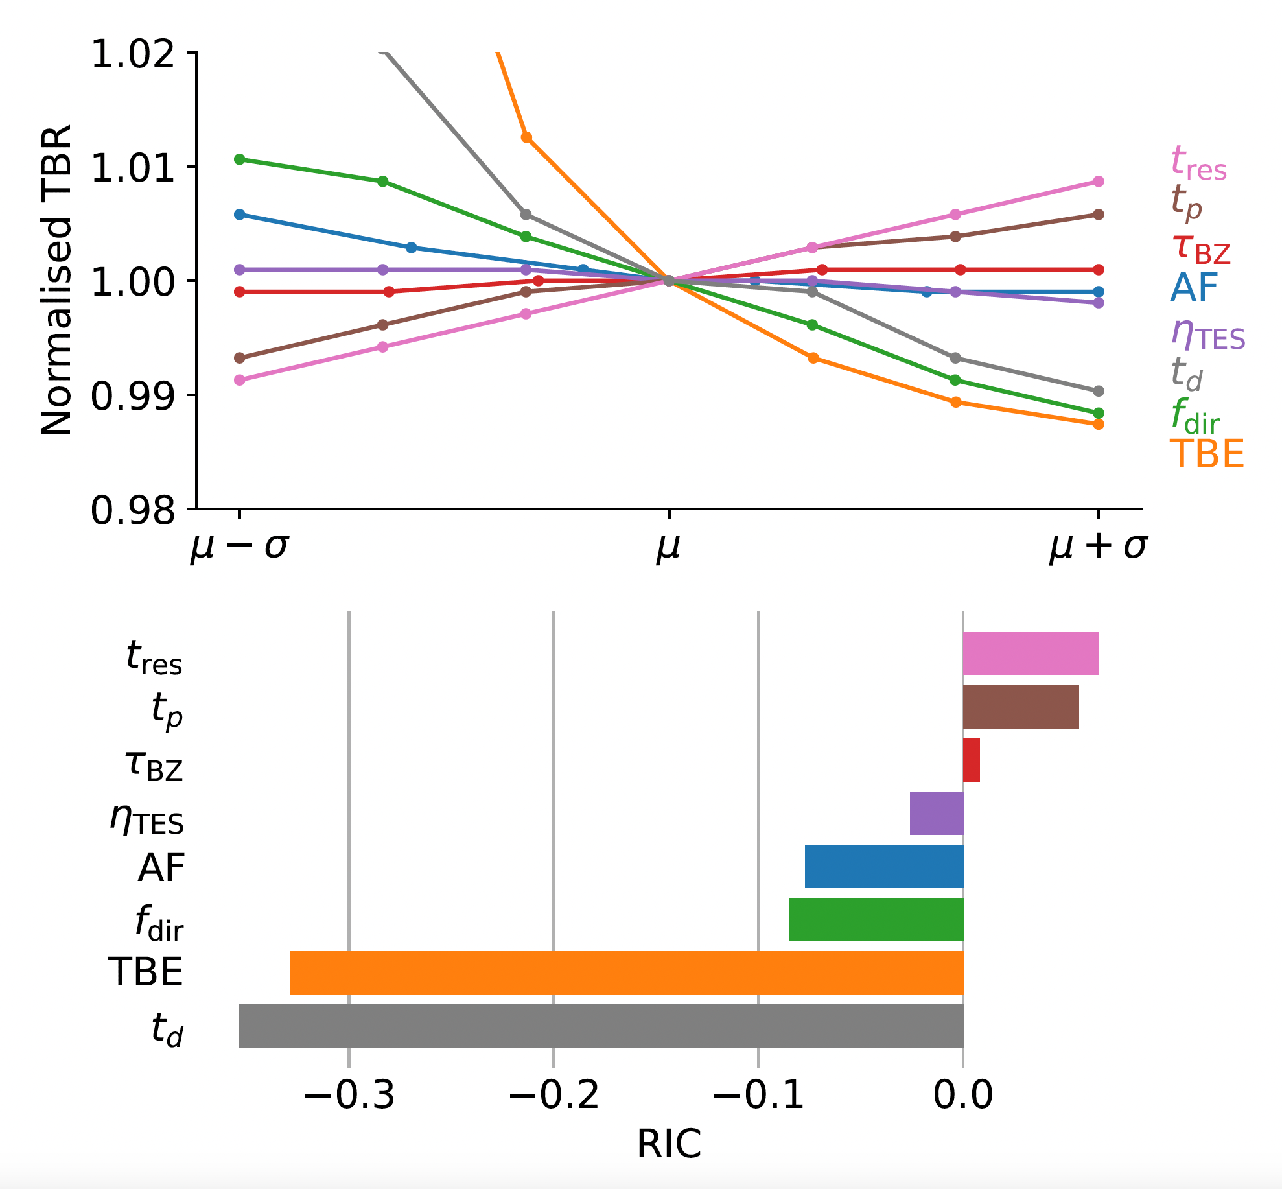
MAJOR DRIVERS ARE IFC RESIDENCE TIME AND TRITIUM BURN EFFICIENCY
Faster T processing time
Better fuel usage
Relative sensitivity index

Slide 34
BREEDING BLANKETS
T separation membrane
Isotope Separation System
Storage and Management
Fueling System
Blanket
GOAL
Breed tritium (+ heat extraction and shielding)
DIR
Fuel Cleanup
Vacuum Pump
PLASMA
First Wall
TES
TECHNOLOGIES
Liquid breeders:
Molten salts*
Li
PbLi
Solid breeders:
HCPB
Detritiation System
Divertor
Heat exchanger
*LIBRA experiment at MIT

Slide 35
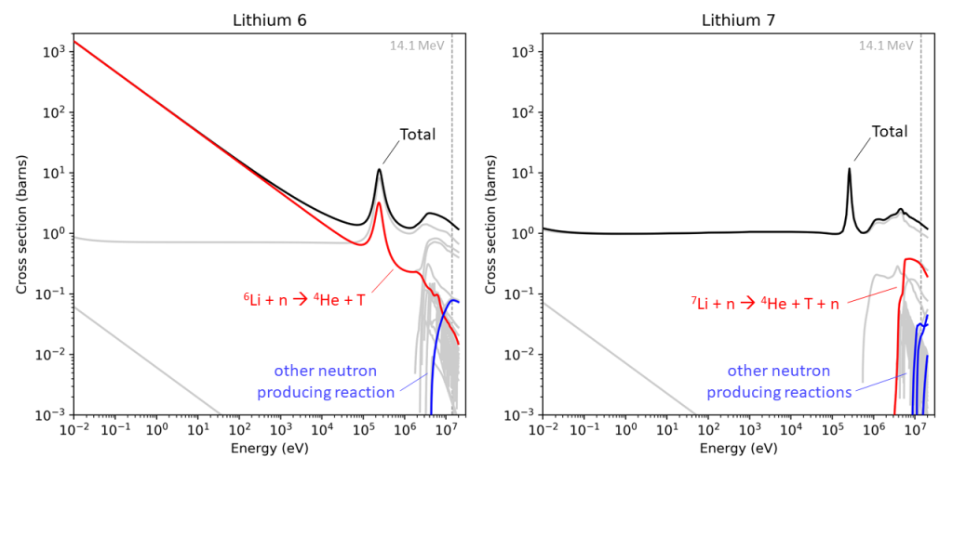
BREEDING BLANKETS
T separation membrane
Isotope Separation System
Storage and Management
Fueling System
Blanket
GOAL
Breed tritium (+ heat extraction and shielding) ^{1,2}
DIR
Fuel Cleanup
Vacuum Pump
PLASMA
First Wall
TES
TECHNOLOGIES
Liquid breeders:
Molten salts
Li
PbLi
Solid breeders:
HCPB
Detritiation System
Divertor
Heat exchanger
Shimwell, J., https://xsplot.com/
¹Di Giacomo, M., Master Thesis, PoliTo, 2024.
²Bae, Jin Whan, et al., Nuclear Fusion 64.5 (2024): 056013.

Slide 36
TRITIUM EXTRACTORS
T separation membrane
Isotope Separation System
Storage and Management
Fueling System
Blanket
GOAL
Extract tritium from a carrier
TECHNOLOGIES
Permeator against vacuum
Vacuum sieve tray
Gas-liquid contactor
DIR
Fuel Cleanup
Vacuum Pump
PLASMA
First Wall
TES
Detritiation System
Divertor
Heat exchanger

Slide 37
HEAT EXCHANGERS
T separation membrane
Isotope Separation System
Storage and Management
Fueling System
Blanket
GOAL
Heat transfer
Prevent contamination (if double function coolant/carrier)
DIR
Fuel Cleanup
Vacuum Pump
PLASMA
First Wall
TES
Detritiation System
Divertor
TECHNOLOGIES
Direct coupling with power cycle
Double wall heat exchanger
Indirect coupling
Intermediate loop (+storage)
Heat exchanger
Simultaneous extraction of heat and tritium?
Colliva, Francesco, et al., FED 201 (2024): 114261.

Slide 38
VACUUM PUMPS
T separation membrane
Isotope Separation System
Storage and Management
Fueling System
Blanket
GOAL
Remove He ash (plasma operations)
Pump down (dwell time)
TECHNOLOGIES
Kinetic
Turbomolecular
Vapor diffusion
Getter
Cryopump
DIR:
Metal foil pumps
Proton conducting pumps
Multistage cryopumps
DIR
Fuel Cleanup
Vacuum Pump
PLASMA
First Wall
TES
Detritiation System
Divertor
Heat exchanger

Slide 39
DESIGN CONSIDERATIONS DUE TO TRAPPING
Tritium retention in tritium facing components (structural materials) dominates the reactor tritium inventory
Tritium retention in plasma facing components still important but less relevant (compare an FPP vs experimental device)
Very high operating temperatures may worsen retention due to trapping
Frequent replacement of in-vessel components requires fast and efficient tritium removal techniques
Standard tritium removal techniques are not effective to remove tritium from high energy traps

