Slide 1


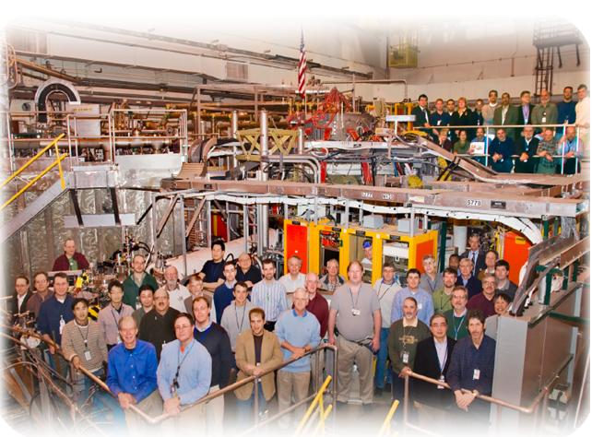
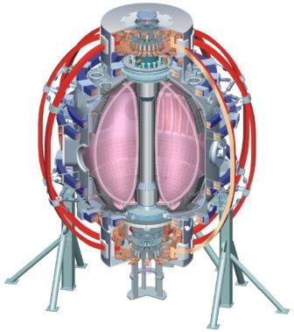
NSTX
Supported by
Is there any confinement degradation going to NSTX-Upgrade Elongation and Aspect Ratio
College W&M
Colorado Sch Mines
Columbia U
CompX
General Atomics
INL
Johns Hopkins U
LANL
LLNL
Lodestar
MIT
Nova Photonics
New York U
Old Dominion U
ORNL
PPPL
PSI
Princeton U
Purdue U
SNL
Think Tank, Inc.
UC Davis
UC Irvine
UCLA
UCSD
U Colorado
U Illinois
U Maryland
U Rochester
U Washington
U Wisconsin
Stefan Gerhardt
Culham Sci Ctr
U St. Andrews
York U
Chubu U
Fukui U
Hiroshima U
Hyogo U
Kyoto U
Kyushu U
Kyushu Tokai U
NIFS
Niigata U
U Tokyo
JAEA
Hebrew U
Ioffe Inst
RRC Kurchatov Inst
TRINITI
KBSI
KAIST
POSTECH
ASIPP
ENEA, Frascati
CEA, Cadarache
IPP, Jülich
IPP, Garching
ASCR, Czech Rep
U Quebec
NSTX 2011 & 12 Research Forum
ASC Breakout Session
Wed. March 16th, B318 PPPL

Slide 2
Big Picture Description
Aspect (A) ratio and elongation (κ) are the lowest order shape parameters in a tokamak…and their impact on the ST is the focus of R11-2.
NSTX has a large database of confinement with A<1.55 and κ<2.4.
  NSTX upgrade will run at larger values of both these parameters.
It is hard to scan these parameters independently in NSTX.
  Will be even harder in NSTX-U…this may be the last chance.
Propose to do three scans:
  A scan at fixed κ
    at constant I_{P}, and/or
    at constant q (this very interesting for possible/inevitable decreased tearing stability at higher A)
  κ scan at fixed A
    at constant I_{P}, and/or
    at constant q
  Push to very high A and κ
Goals:
  1: Confirm (or not) confinement and current drive assumptions used in Upgrade modeling.
  2: Study toroidal physics of confinement.
  3: Develop the shapes to be used in further XPs targeting R11-2, JRT, Upgrade support.

Slide 3
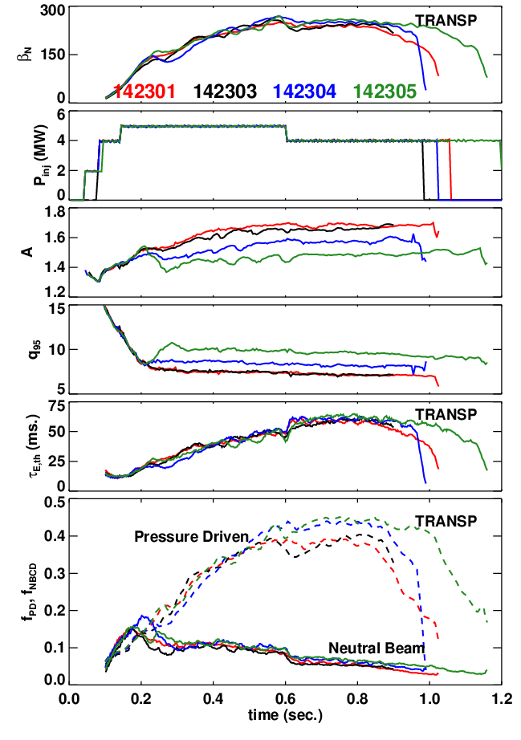
Limited Data Set Last Year Showed a Reduction in Normalized Confinement When A & κ Were Increased
I_{P}=900 kA, B_{T}=0.45 T
Some drop in β_{N} at higher A (for fixed P_{inj}).
Big hit in q₉₅. (10->7.5)
Confinement is degraded by ~10%.
  H from 1.02 to 0.85.
T_{e} is a bit lower, which hurts the NBCD.
Data collected at the end of the run, when machine performance was sub-optimal.

Slide 4
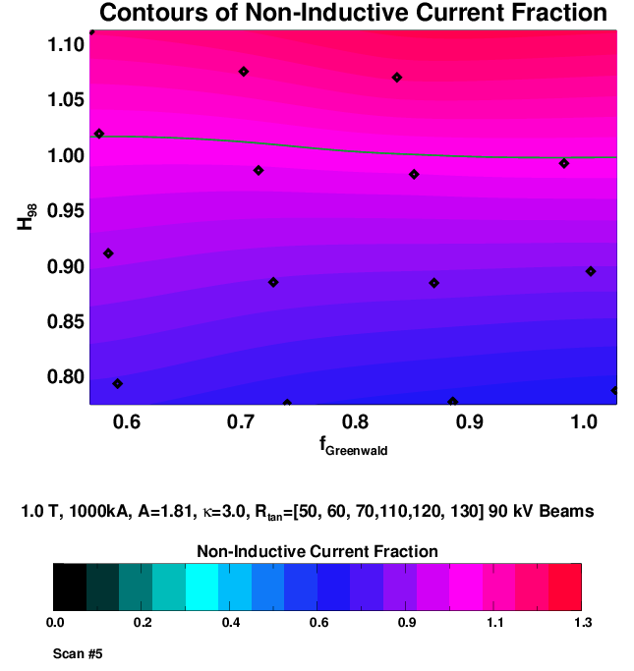
NSTX-U Scenarios Need H>1.0 to Meet
Non-Inductive Targets At High Current
Free-boundary TRANSP calculations
  Z_{eff}=2, D_{FI}=0.
Scale the T_{e} profile and use neoclassical ion transport.
Current profile is fully relaxed.
All six sources at 90 kV.
A=1.81, κ=2.9, gap_out=20 cm
  Large gap helps with off-axis NBCD.
Can be fully non-inductive at 1000 kA with H~1.0.
H=0.85 drops f_{NI} to ~70%.
Want to get new/better confinement data in these configurations.

Slide 5
In General, It is Hard to Scan A and κ Independently
Fundamental Issue: the inner gap is not an independently controlled quantity.

Slide 6
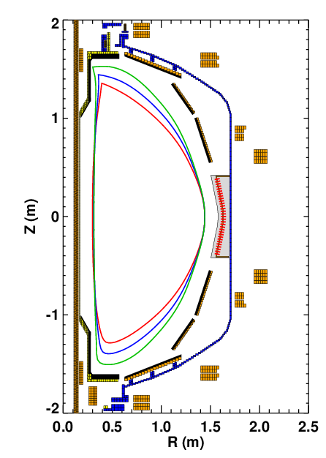
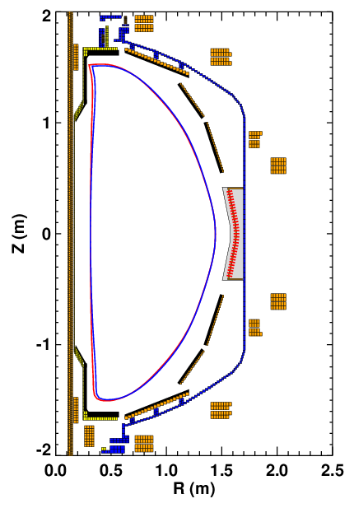
Scan of Kappa At Fixed A.
With Constant I_{P} or Constant q₉₅
Low elongation limit is set by current limit on the PF-1A coil.
  Otherwise the inner gap shrinks
  700 kA plasma need 19.6 kA of PF-1A
Scan of κ at fixed A and I_{P}
A | κ | I_{P} | q₉₅ | I_{PF-1A}
1.56 | 2.66 | 825 | 12.1 | 10.7
1.55 | 2.69 | 700 | 17.9 | 6.3
1.55 | 2.55 | 700 | 13.9 | 11.6
1.52 | 2.3 | 700 | 12.03 | 19.6

Slide 7
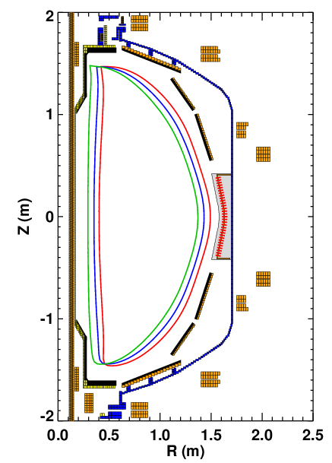
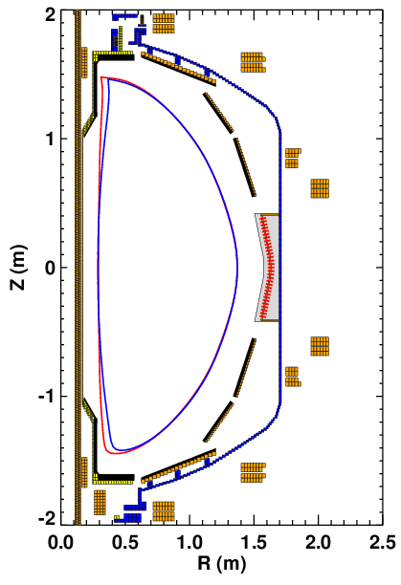
Scan of A at Fixed Kappa
With Constant I_{P} or Constant q₉₅
High aspect ratio limit set by the PF-1A coil current limit.
Scan of A at fixed κ and I_{P}
700 & 1000 kA
A | κ | I_{P} | q₉₅ | I_{PF-1A}
1.53 | 2.64 | 1000 | 9 | 18.9
1.54 | 2.7 | 700 | 18 | 7
1.65 | 2.69 | 700 | 12 | 13.3
1.74 | 2.67 | 700 | 9.5 | 19.6

Slide 8
XP Summary
Part 1: Aspect Ratio Scan at Fixed Kappa
  Base configuration: 700 kA, κ=2.7
  Scan of A at fixed I_{p} (6 shots)
  Scan of A at fixed q (6 shots)
Part 2: Kappa Scan at Fixed Aspect Ratio
  Scan of κ at fixed I_{p} (6 shots)
  Scan of κ at fixed q (6 shots)
Part 3: Go as close as possible to the A=1.8, κ=3 shape indicated earlier. (6 shots)
Questions:
  Fix 4 MW input power, or try to fix β? May not be important if β scaling is weak.
  Which of the turbulence diagnostics can handle the wide range of shapes?
  How much lithium? Pick the amount thought representative of Upgrade operations?
Analysis:
  TRANSP for global confinement and current drive trends.
  Turbulence measurements?
Run time request: 1 day, possibly broken into two sub-sections.

