Slide 1


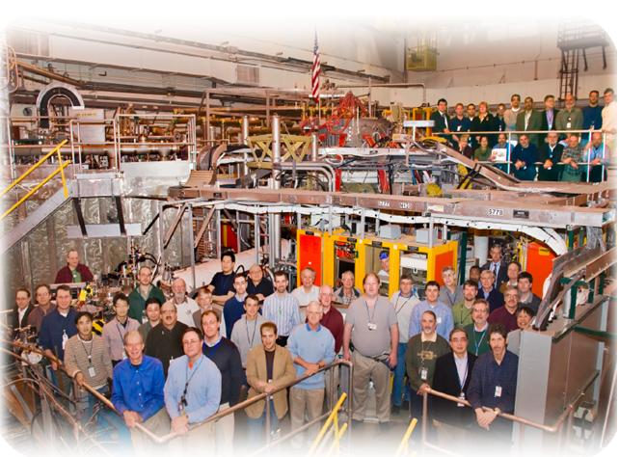
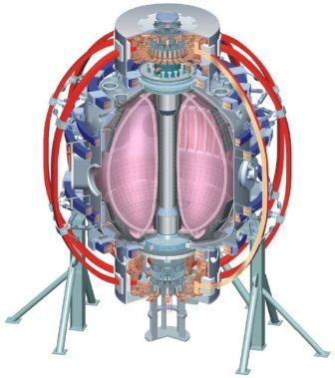
NSTX
Supported by
“Controlling” MHD During the Plasma Start-Up
College W&M
Colorado Sch Mines
Columbia U
CompX
General Atomics
INL
Johns Hopkins U
LANL
LLNL
Lodestar
MIT
Nova Photonics
New York U
Old Dominion U
ORNL
PPPL
PSI
Princeton U
Purdue U
SNL
Think Tank, Inc.
UC Davis
UC Irvine
UCLA
UCSD
U Colorado
U Illinois
U Maryland
U Rochester
U Washington
U Wisconsin
S.P. Gerhardt, Alessandro Bortolon, other victims
Culham Sci Ctr
U St. Andrews
York U
Chubu U
Fukui U
Hiroshima U
Hyogo U
Kyoto U
Kyushu U
Kyushu Tokai U
NIFS
Niigata U
U Tokyo
JAEA
Hebrew U
Ioffe Inst
RRC Kurchatov Inst
TRINITI
KBSI
KAIST
POSTECH
ASIPP
ENEA, Frascati
CEA, Cadarache
IPP, Jülich
IPP, Garching
ASCR, Czech Rep
U Quebec
2011 & 12 NSTX Research Forum
MS TSG Breakout Session

Slide 2
Overview
“Low-density startup” should include surviving the entrance of q=4,3, & 2 into the plasma…typically some few hundred msec. after SOFT.
Tearing/mhd associated with those surfaces often locks to the wall, leading to large β collapse or disruption.
I (we?) think that any of the current profile, plasma β, rotation, or rotation shear may impact the amplitude locking of these modes.
  Also all the early EPM/TAE activity.
Propose to optimize the discharge to ride through early modes:
  β: Feed forward or feedback control of NB heating.
  Current profile: heating timing, ramp rate.
  Rotation: H-mode timing.
Early EFC is not a focus of the XP, but will be used as available.

Slide 3
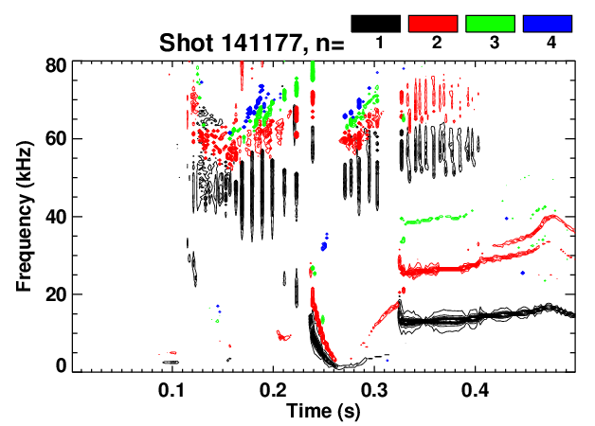
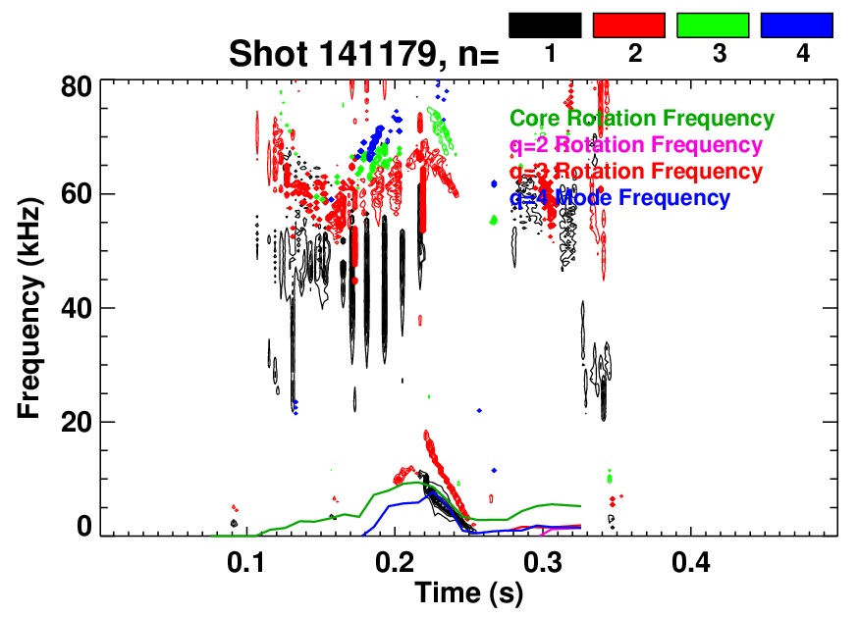
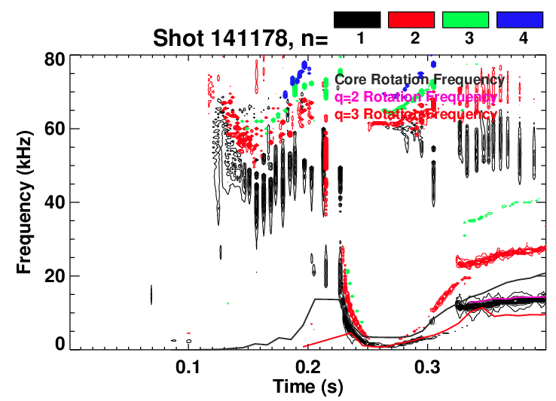
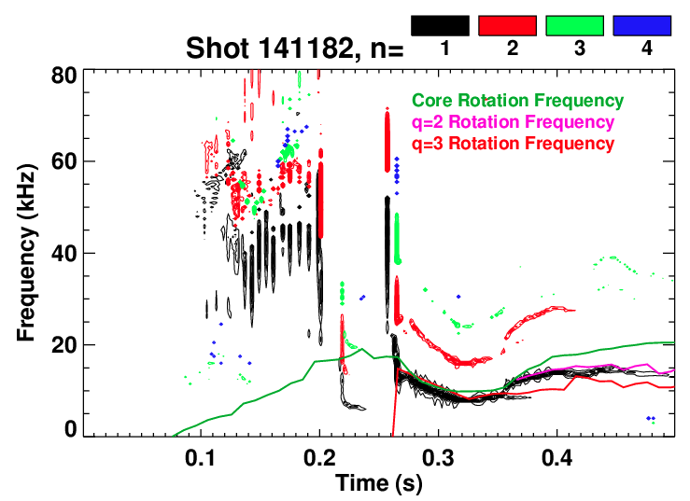
S. Sabbagh’s Low n_{e} Shots Failed When Rotating Modes Started to Lock
“Good Low
Density Shot”
“Bad Shot”
Mode at q=4 locks to wall
Chirping?
Chirping?
“Good Low Density Shot”
Fixed the gas.
Good high
density shot.

Slide 4
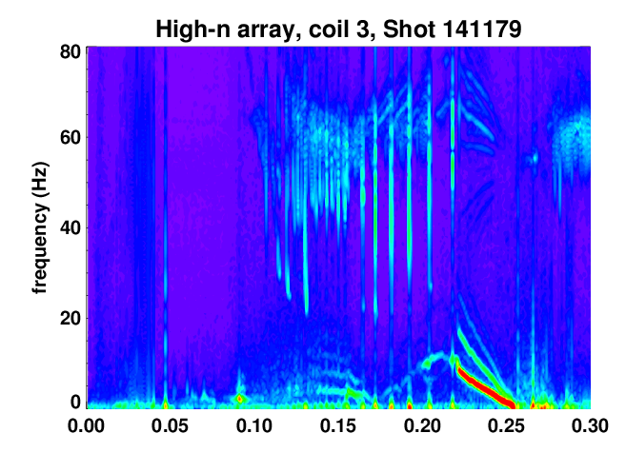
Appears that EPM May Have Triggered the Mode That Ultimately Locks
q=4 enters the plasma at ~0.19, but mode does not strike till 0.22.
Mode strike coincident with large EMP.
Does some triggering physics explain why previous shots didn’t have large q=4 modes?

Slide 5
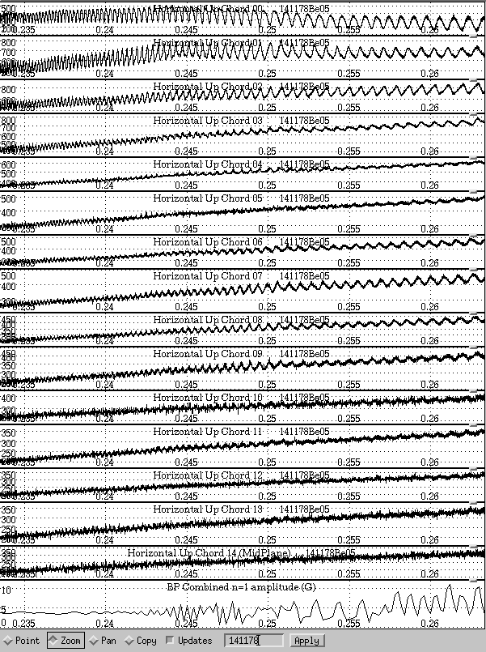
Chirping q=3 Mode Settles With Inversion Radius In the Outer Plasma
Mode chirps down.
Inversion layer develops in the outer plasma.
q=3 island?…need bit more analysis.
Core kink-like component as well?
ME-USXR may be quite useful analyzing this data.

Slide 6
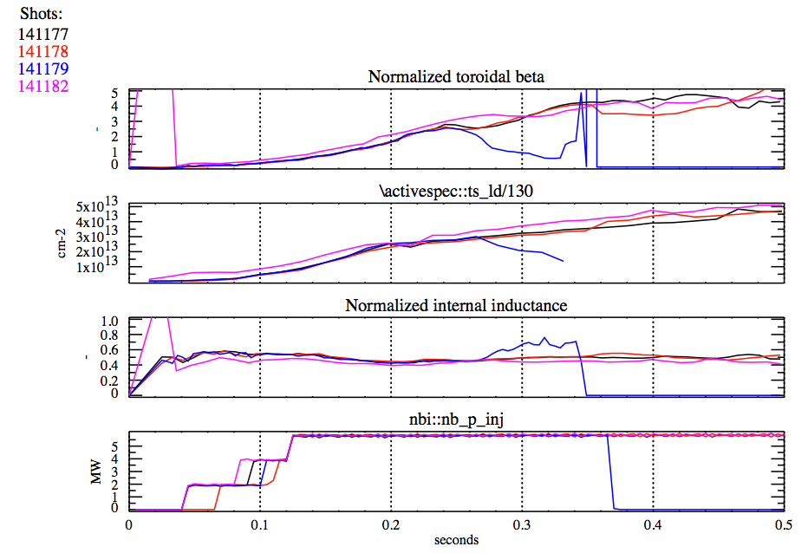
Not Easy To Find Difference Between Shots Using
0D Parameters
Long-Pulse Lower Density
Disrupting Lower Density
Long Pulse Higher Fuelling

Slide 7
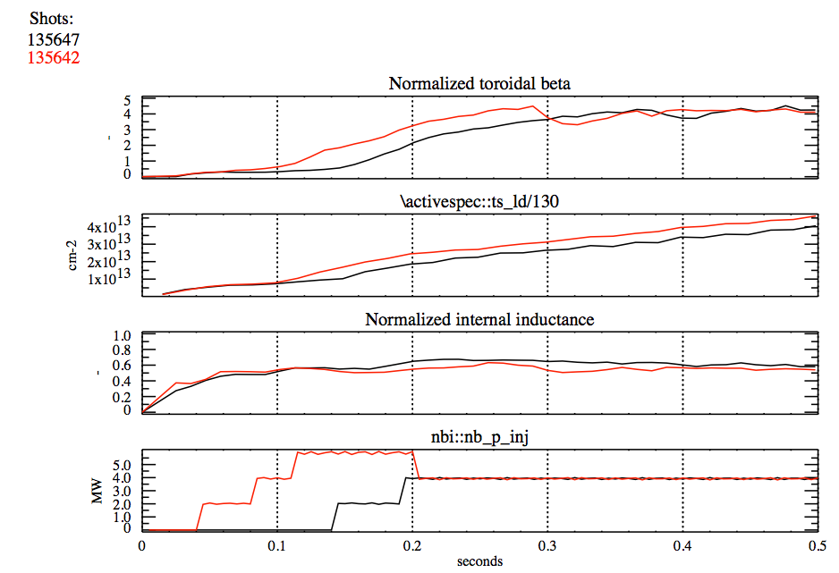
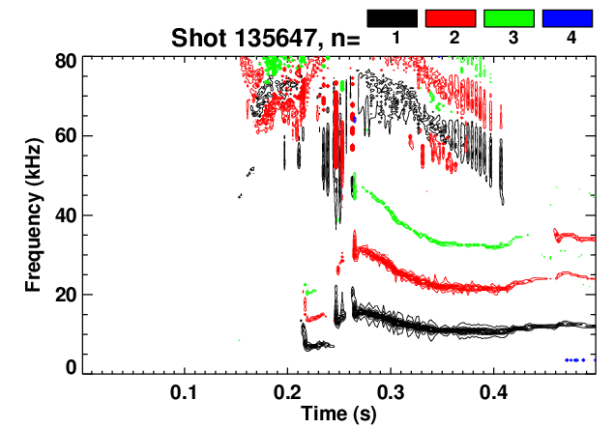
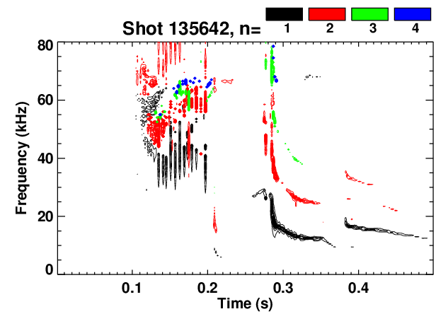
We Have Evidence That Changing the Heating Profile Can Impact the Evolution of These Modes.
Tried early and late heating.
  Delay of H-mode as well.
  Substantial changes in EP/TAE
Rotating n=1 mode amplitudes are modified.
  Need to look more carefully at m-number identification.
135642: Early P_{inj} 135647: Late P_{inj}

Slide 8
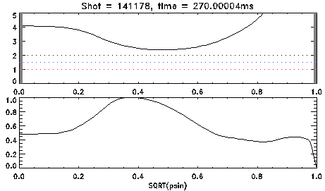
XP Plan: Needs refinement, but basics are…
Reload a scenario such as 141178 (S. Sabbagh’s reduced density target).
Study the space of rotation, β, and n_{e} vs. mode dynamics.
  Test low power early, delayed H-mode.
    Reduced β and density with single source will allow surfaces in quickly, should have strong rotation.
    Elimination of EPMs may be important…lower voltage pre-heating beam?
  Study timing of β (P_{inj}) ramp.
    When is the earliest time that we can ramp β without EPMs and large modes.
    Can we prevent too-rapid J evolution if we only heat strongly after q=2 enters?
  Vary the ramp rate:
    If we slow the ramp rate, can we prevent some unstable current profiles?
    And eliminate some irreproducibility of the modes?
    Target the q=2 & 3 surfaces entering just after the I_{OH} zero crossings?
  What is the impact of reduced input power?
    Onset of “IREs” will be unacceptable.
    Unsustainably high l_{i} will be unacceptable.
    Earlier onset of RWMs or the “late” rotating MHD is OK…
      not in scope of XP
Diagnostic considerations.
  Need source A for important MSE measurements.
    MSE-LIF might be OK…?
  Need USXR measurements, BES (?) for MHD identification.
Typical q and J|| profile during time of q=2 & 3 entering

