Slide 1


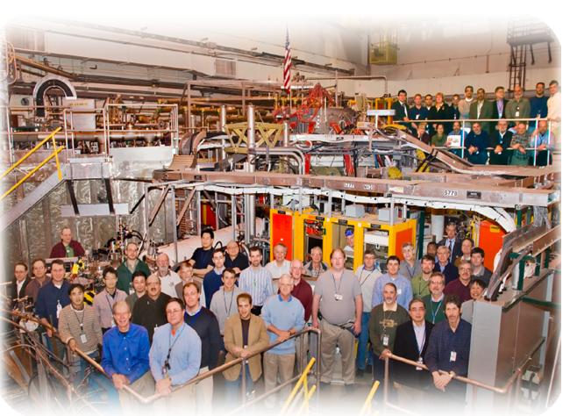
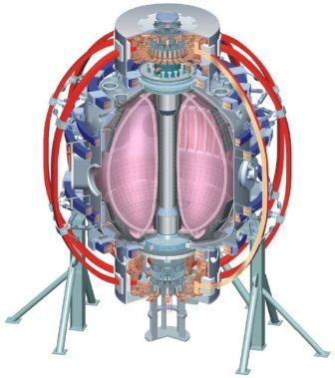
NSTX
Supported by
Commissioning The RWM Proportional Control Algorithms with Six Sub-Units
College W&M
Colorado Sch Mines
Columbia U
CompX
General Atomics
INL
Johns Hopkins U
LANL
LLNL
Lodestar
MIT
Nova Photonics
New York U
Old Dominion U
ORNL
PPPL
PSI
Princeton U
Purdue U
SNL
Think Tank, Inc.
UC Davis
UC Irvine
UCLA
UCSD
U Colorado
U Illinois
U Maryland
U Rochester
U Washington
U Wisconsin
Stefan Gerhardt
Culham Sci Ctr
U St. Andrews
York U
Chubu U
Fukui U
Hiroshima U
Hyogo U
Kyoto U
Kyushu U
Kyushu Tokai U
NIFS
Niigata U
U Tokyo
JAEA
Hebrew U
Ioffe Inst
RRC Kurchatov Inst
TRINITI
KBSI
KAIST
POSTECH
ASIPP
ENEA, Frascati
CEA, Cadarache
IPP, Jülich
IPP, Garching
ASCR, Czech Rep
U Quebec
2011-12 NSTX Research Forum, ASC Session
B318, PPPL
Wednesday, March 16th

Slide 2
Proportional RWM Control is Being Restored, and Expanded, in Two Steps
First restore simple pre-programmed SPA control from PCS.
  Call this the “ssp” algorithm, replacing “spa” algorithm.
  Will test and qualify the PCS to PSRTC communication process, train new programmers in PCS programming.
  This is being worked on right now.
  We can commission this during ISTP.
Add proportional control of both n=1 and n=0 modes.
  Call this the “tmf” algorithm, replacing “smf”.
  Will of course allow pre-programmed current in 6 separate coils.
  Restore proportional control of n=1 modes.
  Add code for feedback as I_{n=0}=Dd(I_{P}Z)/dt.
    Get measurement from improved dZ/dt estimator.
    Easy to add this capability now (even if never used), more difficult to add it later.
  Modify the OHxTF algorithm for 6 SPAs.
  Still need to assess the scope of required changes to mode-id code (SPG).
  Will do off-line debugging as much as possible, but need XMP (~1/3 day):
    XMP to develop new “standard” RWM control algorithm be be loaded into shots in 2011.
Upgraded state-space RWM controller calls “tmf”, adds additional current request.

