Slide 1


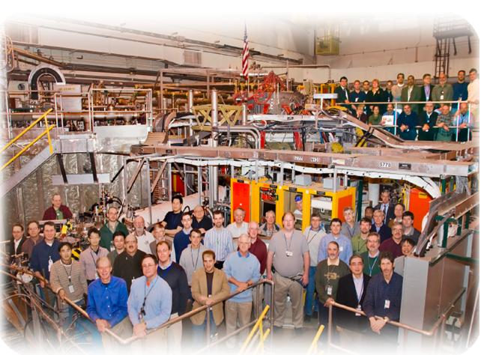
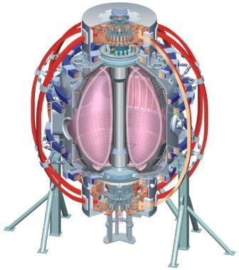
NSTX
Supported by
Viability of Passive Impurity Reduction Techniques for High-f_{NI} NSTX-U Scenarios
Stefan Gerhardt, others…
College W&M
Colorado Sch Mines
Columbia U
CompX
General Atomics
INL
Johns Hopkins U
LANL
LLNL
Lodestar
MIT
Nova Photonics
New York U
Old Dominion U
ORNL
PPPL
PSI
Princeton U
Purdue U
SNL
Think Tank, Inc.
UC Davis
UC Irvine
UCLA
UCSD
U Colorado
U Illinois
U Maryland
U Rochester
U Washington
U Wisconsin
Argument for passive techniques:
Unknown impact of high-A and κ scenarios on stability. (both n=0 and n=1)
Known intolerance of confinement reduction in high I_{P} & f_{NI} scenarios.
Culham Sci Ctr
U St. Andrews
York U
Chubu U
Fukui U
Hiroshima U
Hyogo U
Kyoto U
Kyushu U
Kyushu Tokai U
NIFS
Niigata U
U Tokyo
JAEA
Hebrew U
Ioffe Inst
RRC Kurchatov Inst
TRINITI
KBSI
KAIST
POSTECH
ASIPP
ENEA, Frascati
CEA, Cadarache
IPP, Jülich
IPP, Garching
ASCR, Czech Rep
U Quebec
ITER & CC Breakout Session
NSTX 2011&12 Research Forum
B-318, PPPL, Thursday, March 18th

Slide 2
Part 1: Study the dr_{sep} Variations in a High-A ELMing Regime with Reduced Li
Thesis: If a lot of lithium can totally pump a 1.4 sec. shot, then a smaller amount might do the same for a shorter shot.
Goal: Understand the scenario impact of ELMs on the transport, stability, and impurity characteristics of NSTX-U prototype discharges...and how dr_{sep} changes it.
  Can we validate the assumptions (Z_{eff}=2, H₉₈>1, κ>2.8, A>1.65) made for common NSTX-Upgrade simulations.
1: Develop ELMy scenario with moderate Li. (5-6 shots)
  Type-V ELMs may be best (small perturbations), but mixed Type I + V would be OK.
  DN, standard NSTX elongation and A (If DN ELMs are too big, then bias down slightly?)
    If DN ELMs are too big, then bias down slightly?
2: Increase aspect ratio and elongation to upgrade parameters. (4 shots)
  JRT support…Diallo type studies?
  If ELMs become less frequent, then reduce Li rate for comparison.
    I don’t expect this, given the destabilizing effect of higher-A.
3: Modify dr_{sep} over small range that preserves shaping.
  +/- 1cm, maybe a bit more when biased down.
  Make changes as early in the shot as possible.
4: Increase Li rate until ELMs are eliminated (8 shots).
  Quantify the performance effect of Li on these upgrade scenarios…including SOL widths!

Slide 3
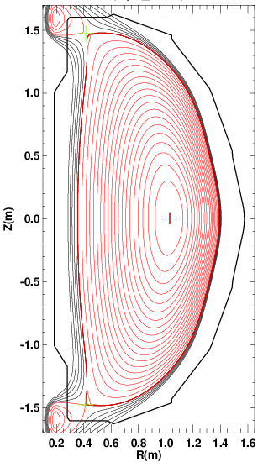
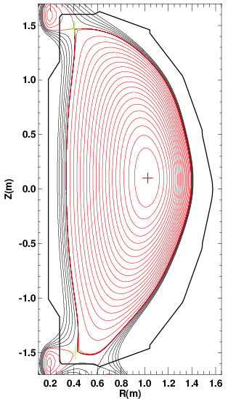
Part 2: Study Impact of Double and Triple Snowflake On Impurity Dynamics and Global Confinement
Goals…similar to previous slide:
  Achieve plasmas that reproduce the optimistic modeling assumptions.
  Study if the snowflake, and potentially associated ELMs, have a deleterious impact on n=0 stability (and potentially n=1 as well).
  Test the heat flux reduction with upper director participating…and heat flux widths in the upgrade scenarios.
Methodology
  Start with standard high-A, DN divertor scenario. Medium to strong Li conditioning.
    750-800 kA to keep in PF-1A coil current envelope.
  Introduce snowflake in lower divertor.
    Use PF-1B for stability.
  Scan PF-1A coil to divert strongly down to slightly up.
    Tricky: Must arrange so that the NET upper divertor “effect” is equal to that in the lower divertor.
      This is NOT easy.
      If controller is working, then consider it.
High-A DN and “DN SF” Configurations

Slide 4
BACKUP

Slide 5
Overview
NSTX-U high-f_{NI} scenarios will need impurity control & deuterium pumping w/o substantial confinement reduction or loss of shaping.
Many proposed impurity control techniques are “active”: ELM pacing, gas injection, vertical jogs.
  Higher-A plasmas may be more sensitive to n=0 & 1 perturbations than we like?
Propose testing two options for passive impurity control:
  Moderate Li evaporation w/ somewhat unbalanced DN.
    Test effect of small up-down bias
  “DN Snowflake” with heavier Li.

Slide 6
What conditions are required to achieve relaxed 1 MA fully non-inductive plasmas in NSTX-Upgrade?
For P_{inj}=12 MW, A=1.65, κ=2.7, Z_{eff}=2.
  f_{NI} & q_{min}>1 for H₉₈>1.1 and f_{GW}>0.7
If Z_{eff}=3
If

Slide 7
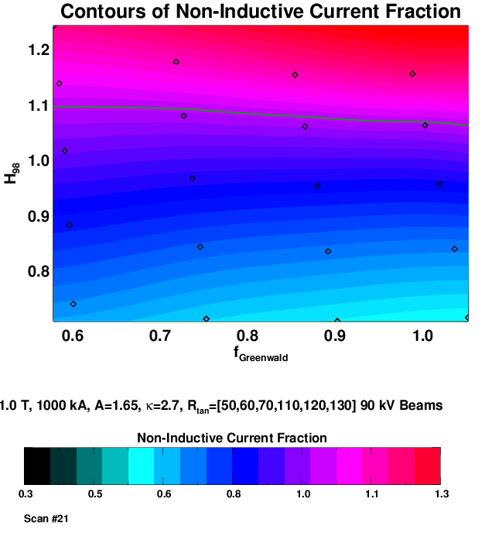
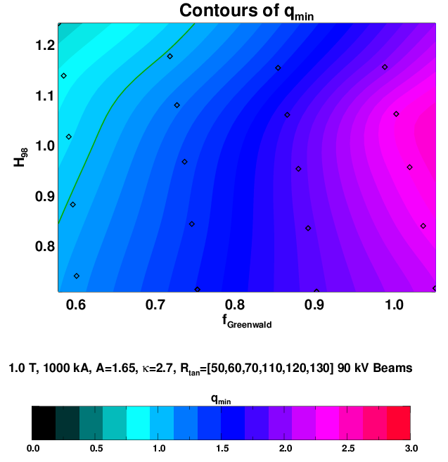
Important to Maintain Good Confinement For Upgrade Scenarios
κ=2.7, A=1.65, 1 MA, 1 T, 12 MW input power
H>1.1 : Fully non-inductive H<0.9: f_{NI}<80%

Slide 8
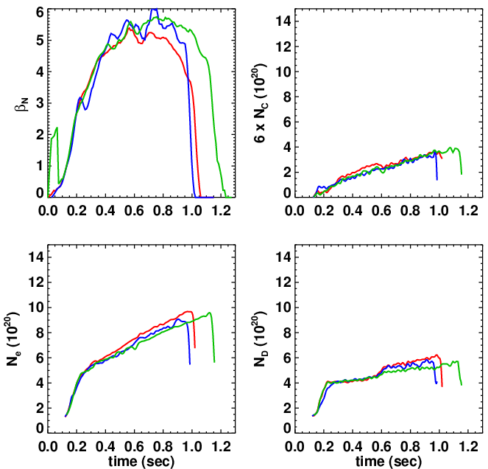
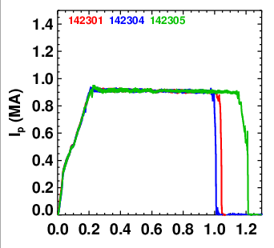
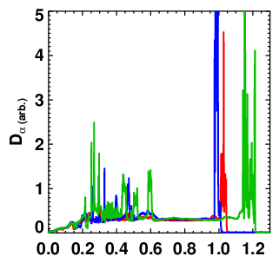
2010 High-A Shots Demonstrated Steady Carbon Accumulation
A= , κ=
A= , κ=
A= , κ=
Large Li evaporation in the AM, no between-shot conditioning

Slide 9
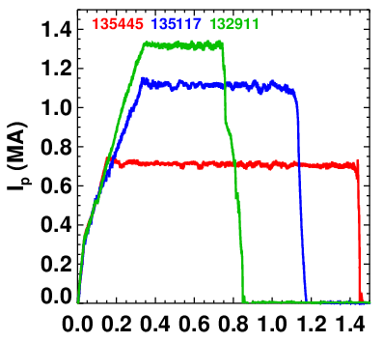
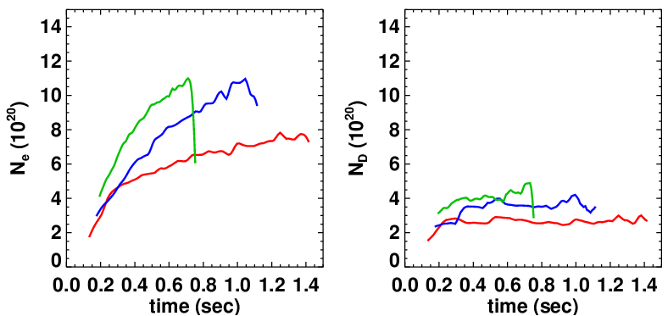
Heavy Lithium Evaporation Can Pump Long Pulse Shots
…How Much Can We Reduce the Lithium and Retain the Benefit?
Moderate aspect ratio examples designed for high performance…HFS fuelling.
Demonstrates deuterium density control in heavily (300 mg/shot) lithiated discharges
No real sign of deuterium inventory rising.
Suggestion for XP:
Go to higher aspect ratio (A=1.7, κ=2.9).
Use less lithium, so that the plasma is closer to the ELMing boundary
Higher-A may facilitate this!
Make small changes in the magnetic balance to impact particle confinement and ELMs.
  USN has reduced particle confinement?
  ELMs are bigger at double null? But maybe we want smaller ELMs when biased up?

Slide 10
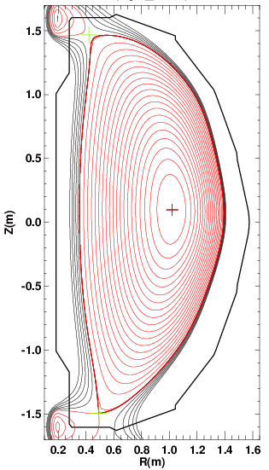
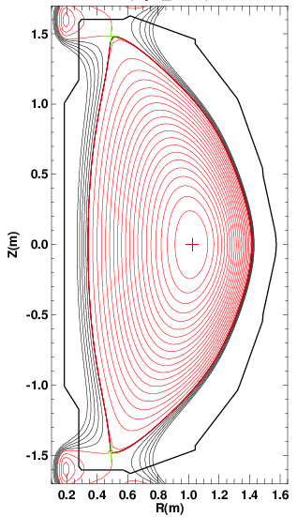
A Variety of Divertors Can be Produced at the Upgrade Aspect Ratio.
High-δ
LOSP on Moly.
UOSP On Graphite
w/ PF-1B
High-δ
LOSP on Moly.
Up-Down Symmetric
w/o PF-1B
Standard High-δ
PF-1A Only
High-δ, Lower Snowflake Minus
w/ PF-1B
Propose to focus on this comparison.
Must be careful to not exceed PF-1A coil current limit.
The upper PF-1A current must balance the “net” lower divertor coil currents

Slide 11
Proposed Experiment Has Two Complementary Steps
Test 1: Reduced lithium + unbalanced DN (USN vs. LSN scans)
  Begin with low(er) Li evaporation rate (30-50 mg/shot), double null near-fiducial, I_{p}=800 kA. Shot should have some ELMs.
  Increase the inner gap -> drives up κ and A. Go to κ~2.8, A~1.7.
  Once at target A, scan dr_{sep} +/-0.5, 1 cm. Make change in dr-sep at early in the shot as possible.
  If ELMs are not present or vanish, then reduce Li rate.
    Is there a benefit with He GDC in this case?
  Total: 15-20 shots
Test 2: DN snowflake.
  Start with standard high-A shot. Larger Li rate of ~200 mg/shot
  Add PF-2L, PF-1B to make the standard “snowflake –”
    Adjust PF-1AU to keep the upper X-point on the boundary.
  Reduce the PF-1AU to bias down.
  Total: 15 shots
Common questions and observational goals.
  Is the global carbon content reduced?
  Are the perturbations from ELMs large enough to drive VDEs. Do they trigger core kink/tearing modes?
  Are l_{i} or F_{P} different in the low-Lithium or snowflake case?
  How is confinement impacted by the changes?

