Slide 1
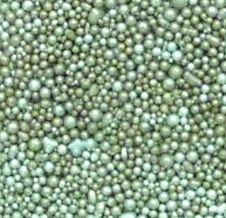
The Centrifugal Granule Injector Concept:
Can Injected Li Granules Trigger ELMs ?
6 inch
Independent Control:
Granule Size : 0.5 - 1 mm
(change between shots)
Injection Speed: 0 - 100m/s
(ramp during shots)
Pacing Frequency: 0 - 100 Hz
(ramp during shots)
Dropper
1 mm Scale
Li Granules
5.5 inch
Li Granules
8 inch
V = 0 - 100 m/s
Freq = 0 - 100 Hz
1

Slide 2
Calculated Pedestal Deposition for 1 mm Li Granules with Injection Speeds from 30 m/s to 100 m/s
Linear Temperature and Density
Profiles Assumed for Pedestal:
Te (r/a = 1) = 0
Te(r/a = 0.94) = 1 keV
ne(r/a = 1 ) = 0
ne(r/a = 0.94) = 5 x 10¹³ cm⁻³
Reasonable Approximation
to DIII-D Pedestal R = 1.67 m
a = 0.65 m
Neutral Gas Shielding Ablation
Model for Li Employed
Results Similar to D Pellet Ablation
Which Does Trigger ELMs on DIII-D
Deposited Li Density vs r/a
Top of Pedestal
Paul Parks, Wen Wu
7

Slide 3
The Granule Injector
8 Inches
Delivery Tube
from Dropper
Existing Laser
& Photodiode
(Freq. Monitor)
Existing Laser
& Photodiode
(Particle Counter)
Ferro Tec
Rotary Feed-thru
Flexible
Coupling
Air Driven
Micromotor
19

Slide 4
Granule Injection Run Plan
Systematic scan of granule size and velocity
  Do granules trigger ELMs?
  What kind of ELMs?
    Is the evaporated Li swept toward the LSN?
Systematic scan of pacing frequency
  Is Prad reduced?
1 day requested

Slide 5
Serving Double Duty to Inject Li Powder at the Midplane
(Li Swept by SOL Flow Toward LSN)
8 Inches
Delivery Guide
from Dropper
Existing Laser
& Photodiode
(Freq. Monitor)
Li Powder
Existing Laser
& Photodiode
(Particle Counter)
Ferro Tec
Rotary Feed-thru
Flexible
Coupling
Air Driven
Micromotor
20

Slide 6
Midplane Powder Injection Run Plan
Systematic scan of powder size and velocity
  Does midplane injection cause the evaporated Li to be swept toward the LSN?
Systematic scan of powder flux
  Signs of improved plasma performance
  Elms triggering?
1 day requested

Slide 7
Extra Slides

Slide 8






The Scheme: Redirecting a Regular Stream of
Falling Lithium Granules with a Rotating Impeller
Granule Reservoir
Pacing Frequency
Insertion Velocity
Free Fall Distance
Depth of Insertion
  Injection Velocity
Impeller Radius
Pacing Frequency
Rotor Period
Shaft Rotation Frequency
8

Slide 9
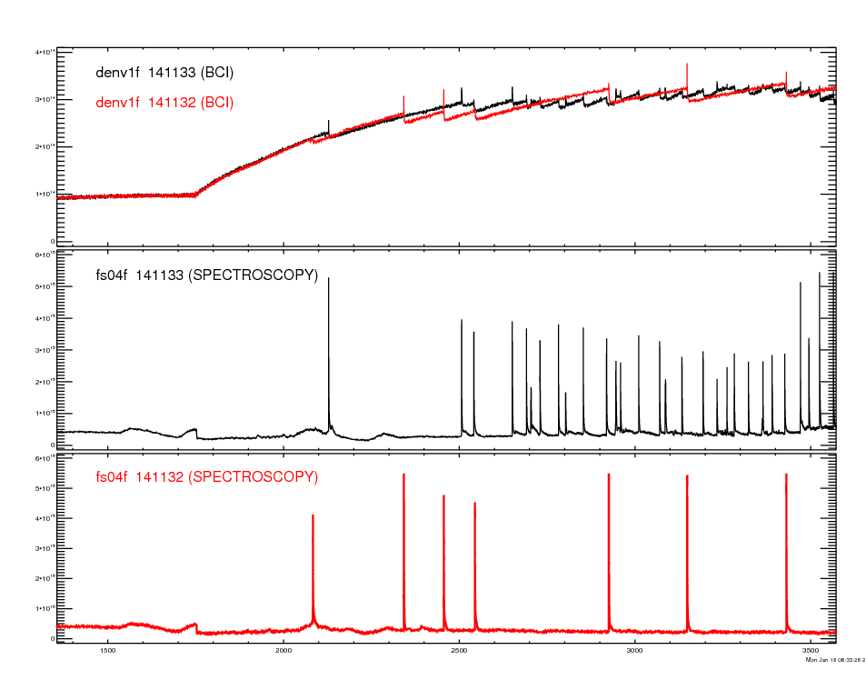
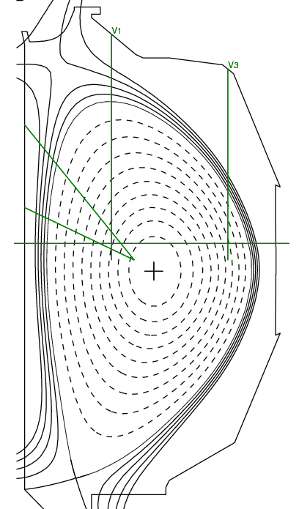
Demonstration of ELM Pacing by Deuterium Pellets with No Fueling on DIII-D
4.0
1.8 mm D₂ Pellets
100-150 m/s
3.0
(10¹⁴ cm⁻²)
Density
2.0
14 Hz Pellets
1.0
0.0
6
4
Div Dα
(a.u.)
Pellet
2
0
6
Div Dα
No Pellet Comparison
4
(a.u.)
ITER shape
β_{N} = 1.8
2
0
1.5
2.0
2.5
3.0
3.5
Time (s)
Larry Baylor
4

Slide 10
Lessons Learned from Successful ELM Pacing
Experiments on DIII-D using D Pellets
DIII-D results indicate thresholds of D pellet sizes and speeds exist for reliable ELM pacing.
A hypothetical curve is drawn by hand on the right indicating where a threshold boundary may exist. (shown in yellow)
A second hypothetical curve for Li granules is shown (in grey). This curve is meant to indicate that lower speeds and small sizes may be needed with Li granule injection.
The crossed lines indicate the chosen design parameters for the prototype Li.
ELM triggered
No ELM triggered
ELM triggered
No ELM triggered
?
Li ELM Triggering
Boundary ?
ELM Triggering
Boundary ?
Larry Baylor
5

Slide 11
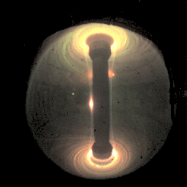
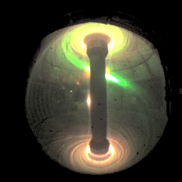
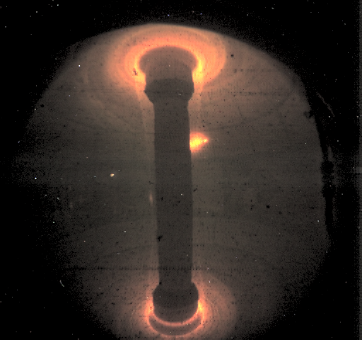
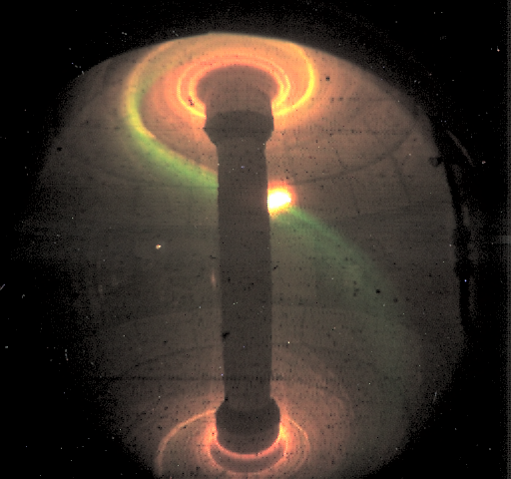
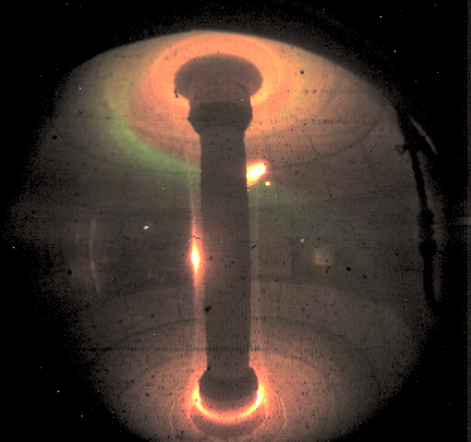
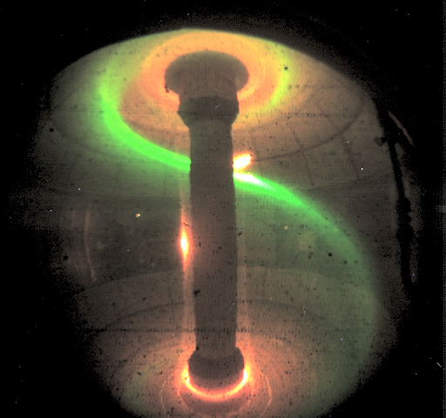
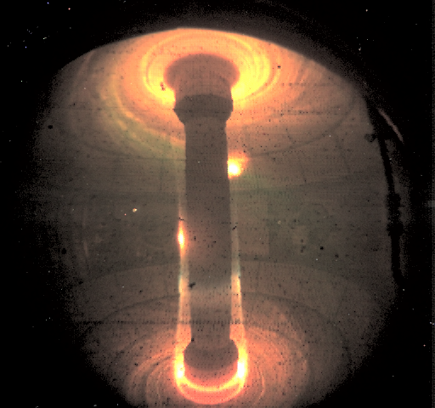
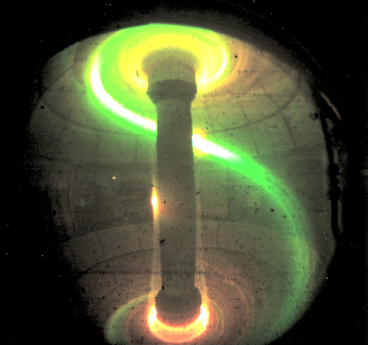
Examples of Edge Perturbations from Low-Velocity (~ 5m/s)
Lithium Clumps (~ 2mm) in Four Discharges (2008)
130364@ 272 ms
130364@ 280 ms
130389@ 353 ms
130389@ 356 ms
130387@ 191 ms
130387@ 197 ms
130385@ 393 ms
130385@ 400 ms
ELM
Triggered !
3

Slide 12
LiD is Another Interesting Candidate for ELM Pacing
Physical Properties of D, Li and LiD
 | Mass Density (gm/cm³) | Atomic Density (10²²/cm³) | Electron Density (10²²/cm³) | Melting Temp (°K) | Boiling Temp (°K)
D | 0.20 | 6.0 | 6.0 | 18.6 | 23.6
Li | 0.52 | 4.5 | 13.5 | 454 | 1615
LiD | 0.82 | 5.5 | 22 | 969 | N/A*
For the same size granule/pellet, Li (LiD) ablates 2.25 (3.66) times as many electrons as D.
* In vacuum, LiD dissociates before it boils

Slide 13
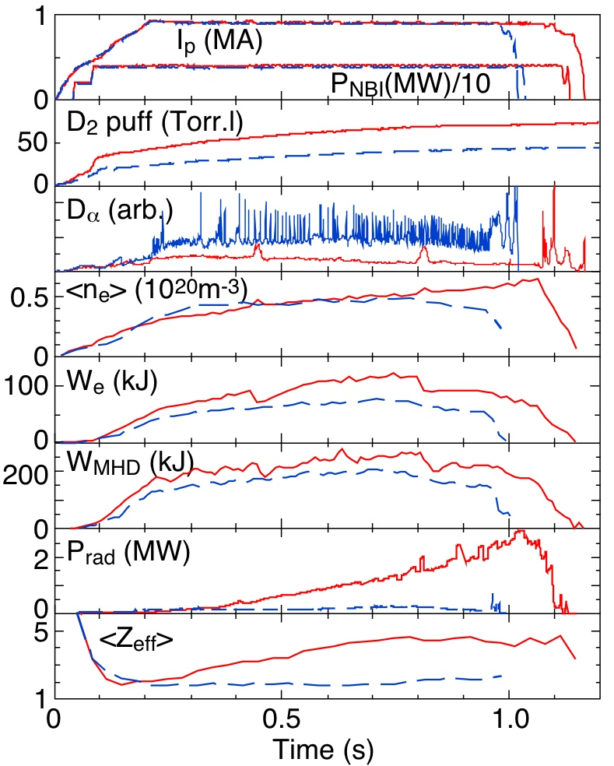
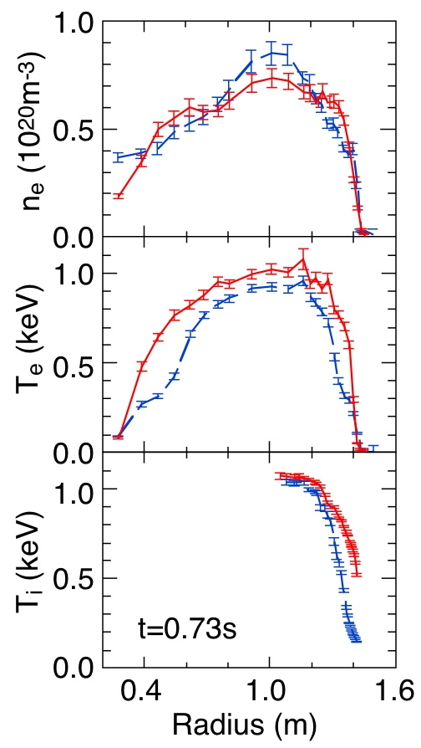
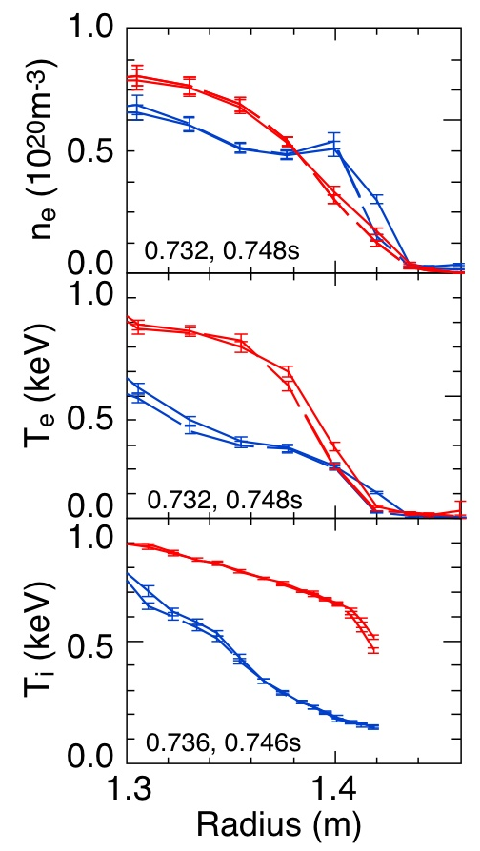
Lithium Coating Reduces Deuterium Recycling, Suppresses ELMs & Improves Confinement in NSTX
No lithium (129239); 260mg lithium (129245)
Without ELMs, impurity accumulation
increases radiated power and Z_{eff}
H. Kugel, B. LeBlanc, R.E. Bell, M. Bell

